Slide 1
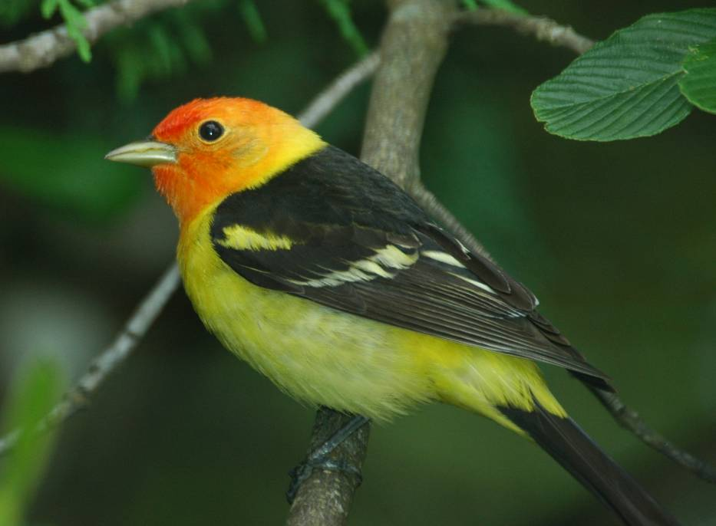
Young Stand Thinning & Diversity Study: Songbird Response
Joan Hagar
USGS – Forest & Rangeland Ecosystem Science Center

Slide 2
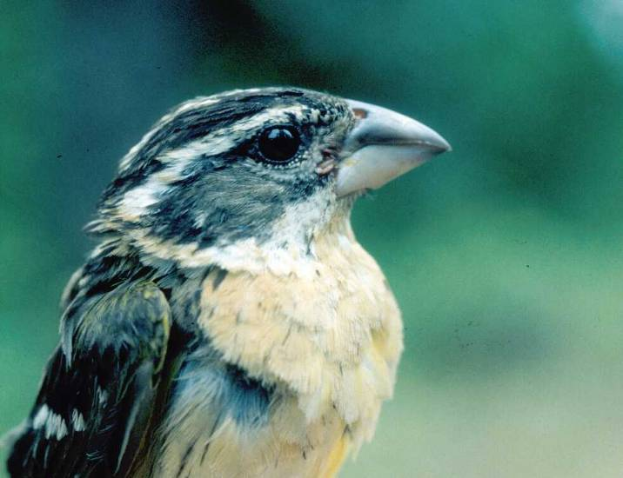
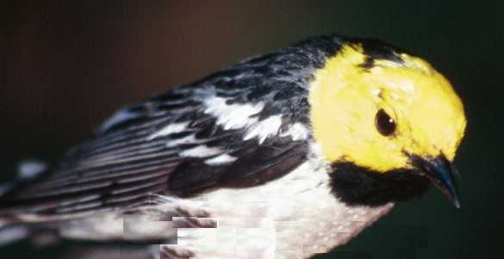
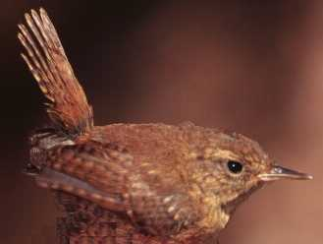
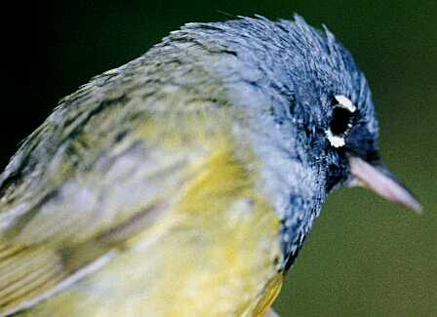
Deciduous Canopy
Conifer Canopy
Forest Floor
Shrubs

Slide 3
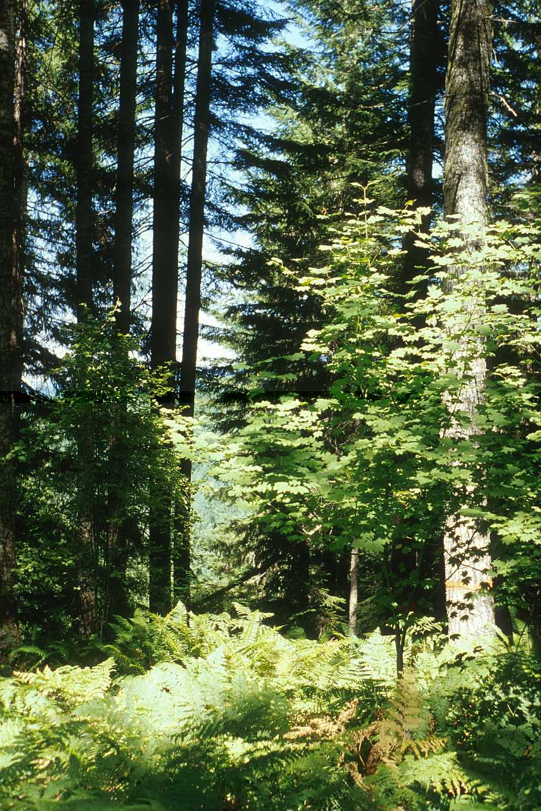
Structural Features of Songbird Habitat
Conifer foliage
Large trees
Deciduous shrubs and trees
Vertical diversity
Snags
Notes:
Structural Features of Songbird Habitat that may be influenced by thinning

Slide 4
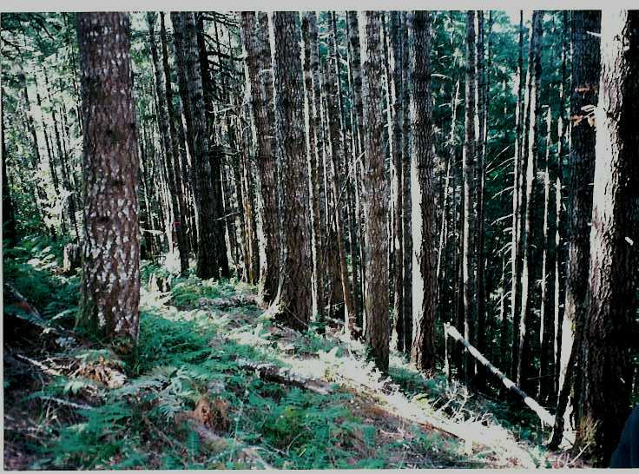
Notes:
Unthinned stand offers habitat for species associated with conifer foliage
Tree boles for bark foragers, but lacking complex architecture
Same size trees
Single canopy layer
Depauperate understory

Slide 5
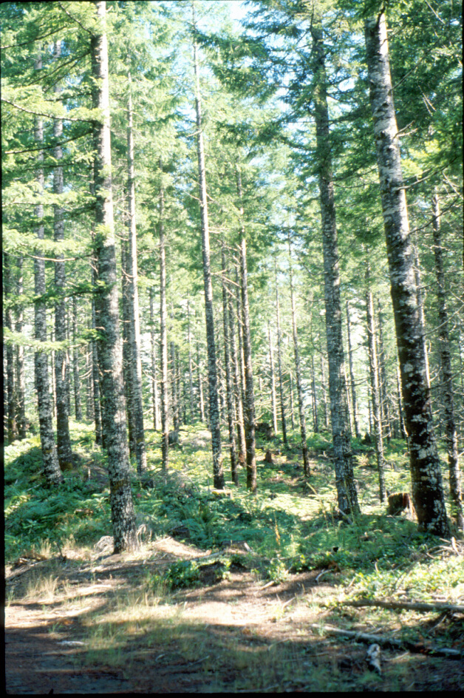
Expected Effects of Thinning
Short term:
Increase structural diversity
Long term:
Accelerate development of late-seral habitat
Maintain structural diversity

Slide 6
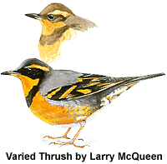
Questions of Interest
Short-term
What is the effect of thinning on songbird communities?
What is the effect of different patterns and intensities of thinning?
Long-term
Will response direction change over time?
How soon will thinned stands support old-forest assemblage?
Notes:
The immediate response of songbird assemblages to thinning in earlier sampling periods of this study and in other studies in western conifer forests generally has been increases in the density or abundance of species associated with open canopy conditions, decreases in those associated with dense, closed conifer canopy, but with an overall increase in species richness (Hagar et al. 1996, Haveri and Carey 2000, Hayes et al. 2003).
As vegetation develops over time after thinning, the responses of individual bird species to thinning is likely to change.

Slide 7
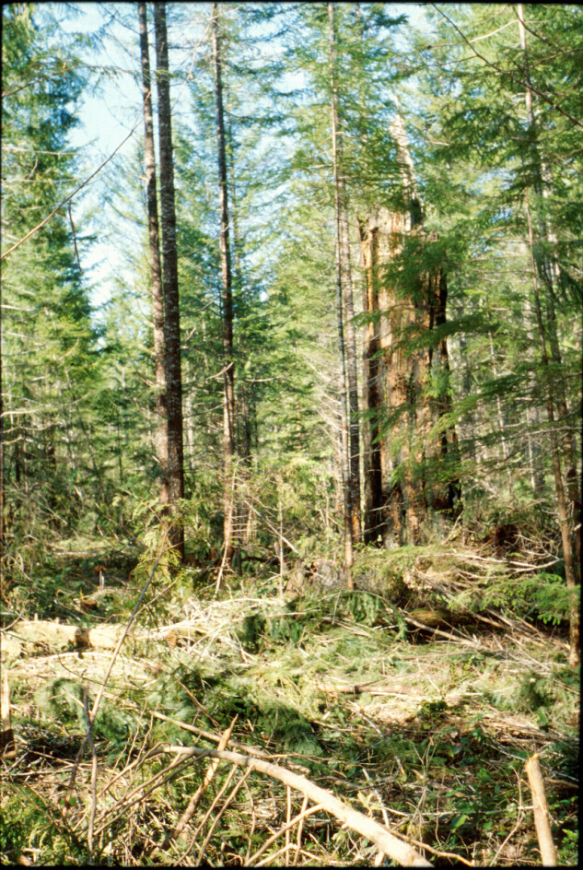
YSTDS: Replicated Study With Controls
4 replicates of each treatment
Data collected before and after harvest
Controls track baseline changes in bird density

Slide 8
Sampling Timeline for Songbirds
Pre-trt: 1992-1993
Thinning occurred: 1995 - 1997
Post 1: 1997-1998 (0 – 3 years post-treatment)
Post 2: 1999-2001 (2 – 6 years post)
Post 3: 2006-2007 (9 – 12 years post)

Slide 9
RESULTS

Slide 10
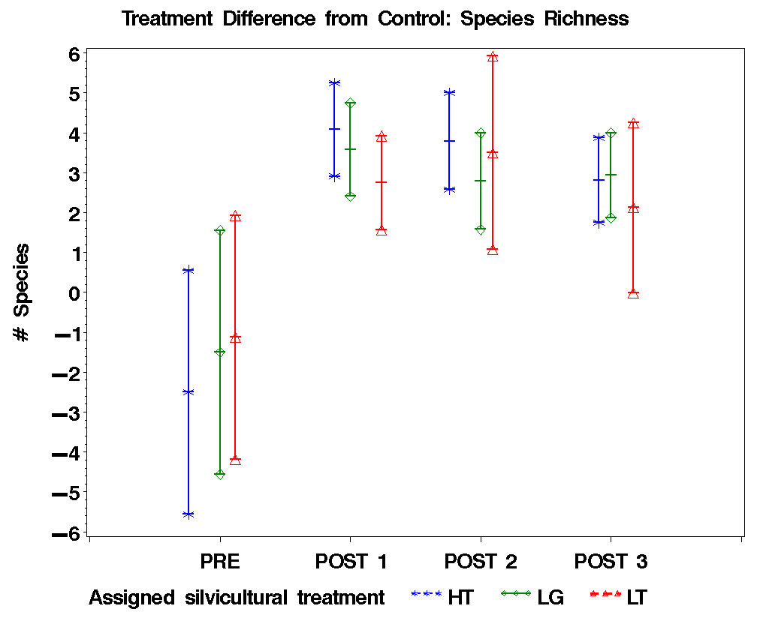
Notes:
Pre-trt: 1992-1993
Post 1: 1997-1998 (4 – 6 years post-trt)
Post 2: 1999-2001 (6 – 9 years post)
Post 3: 2006-2007 (13 – 15 years post)

Slide 11
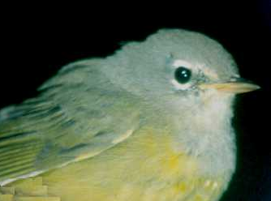
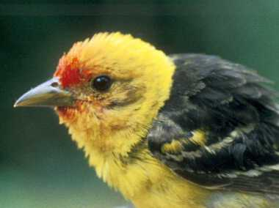
Positive Responses
Rufous Hummingbird
Hairy Woodpecker*
Red-breasted Sapsucker*
Hammond’s Flycatcher
Gray Jay
Townsend’s Solitaire*
American Robin
MacGillivray’s Warbler
Western Tanager
Dark-eyed Junco
Notes:
10 species that increased in density following thinning
‘*’ represents species that were virtually absent prior to harvest
Included: cavity-nesters, shrub associated species, canopy-associated species, early-seral species and mid-late associates
Discuss possible reasons for increases

Slide 12
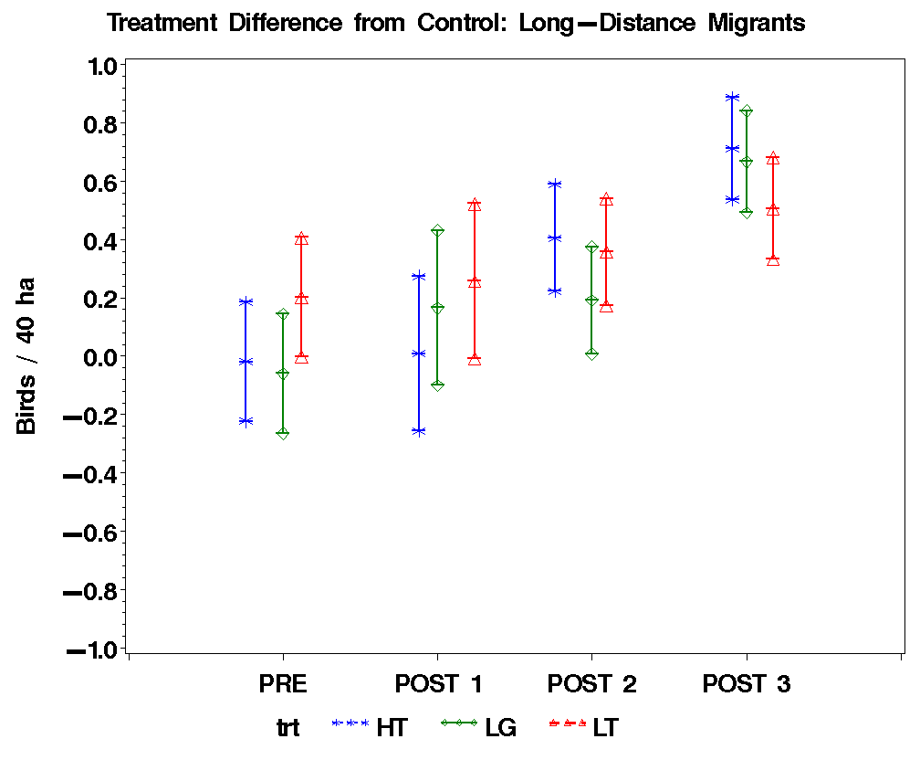

Slide 13
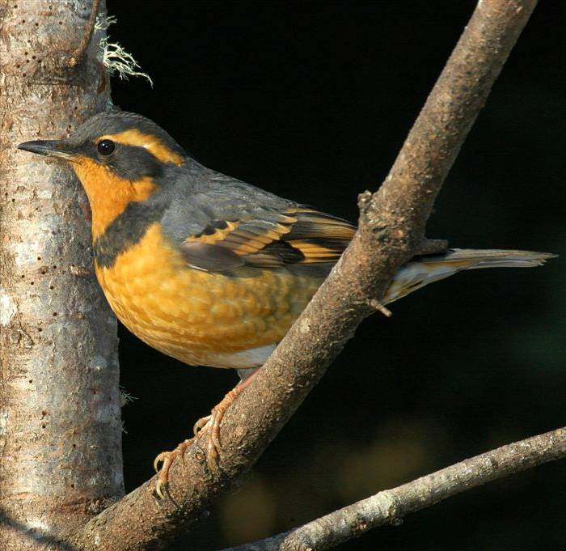
Negative Responses
Hermit Warbler
Golden-crowned Kinglet
Hermit Thrush
Varied Thrush
Winter Wren
Notes:
No species absent after harvest, but some species decreased in density
HEWA and HETH – long-distance migrants
Some sign of change in response trend…

Slide 14
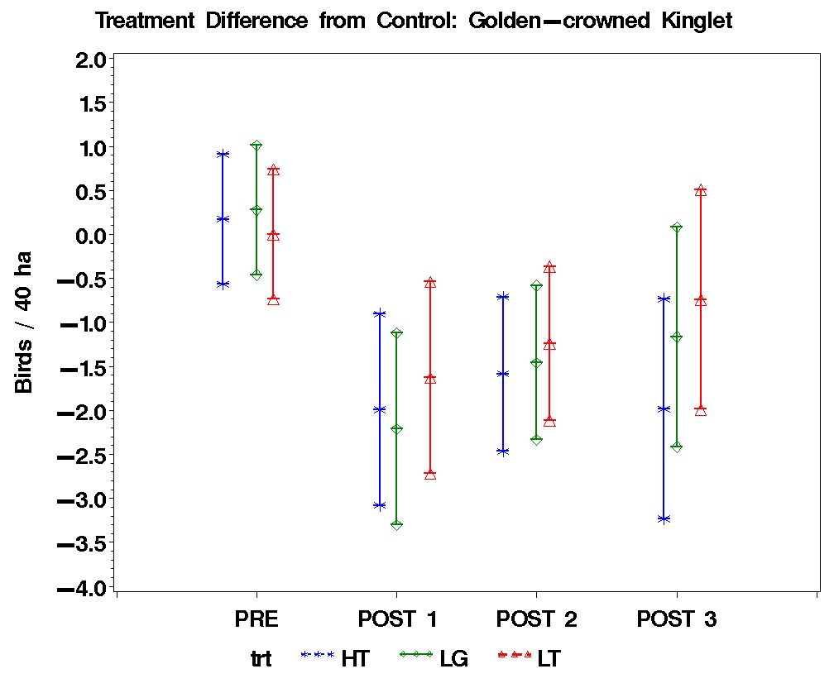
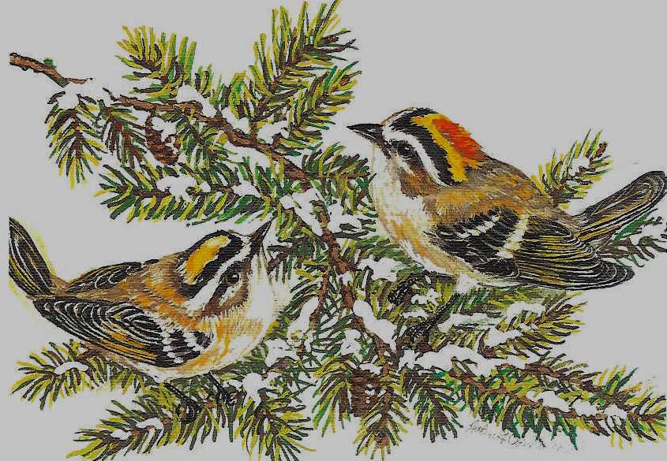
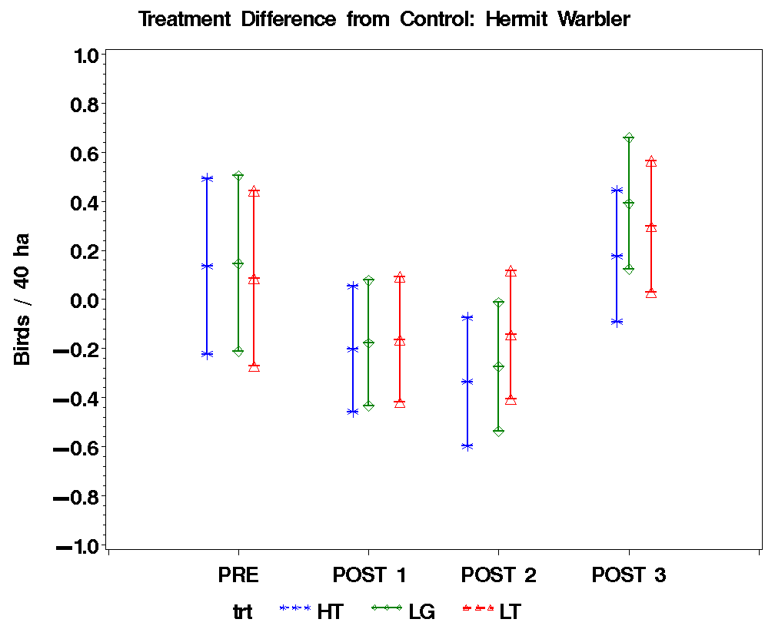
Notes:
Both strongly associated with conifer canopy

Slide 15
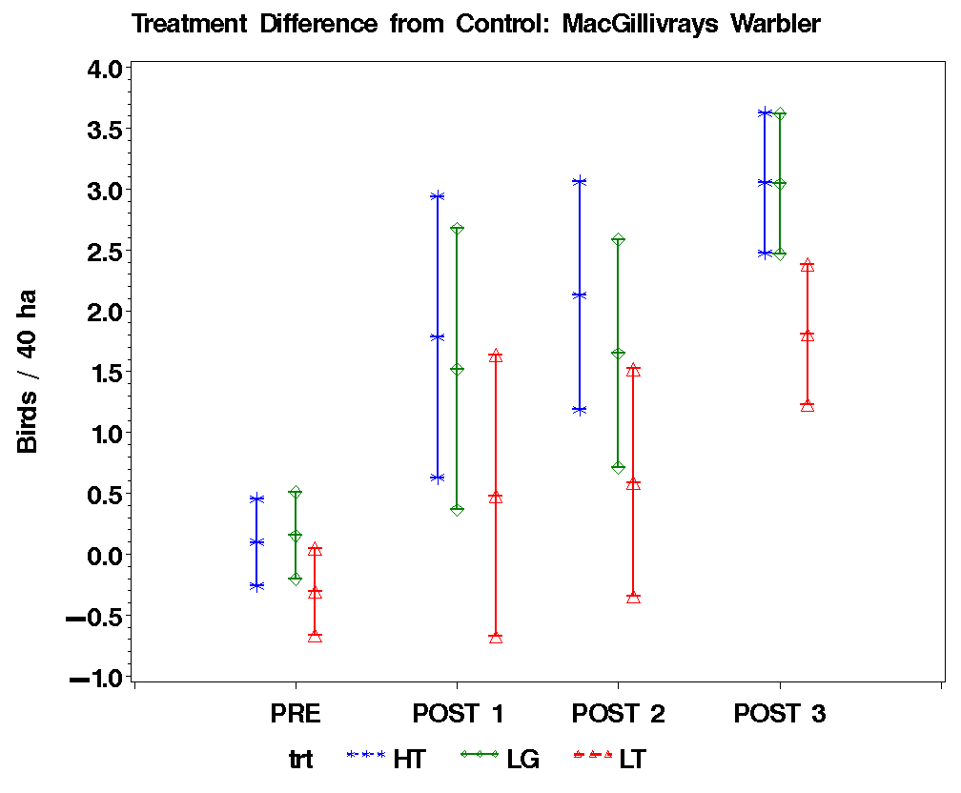
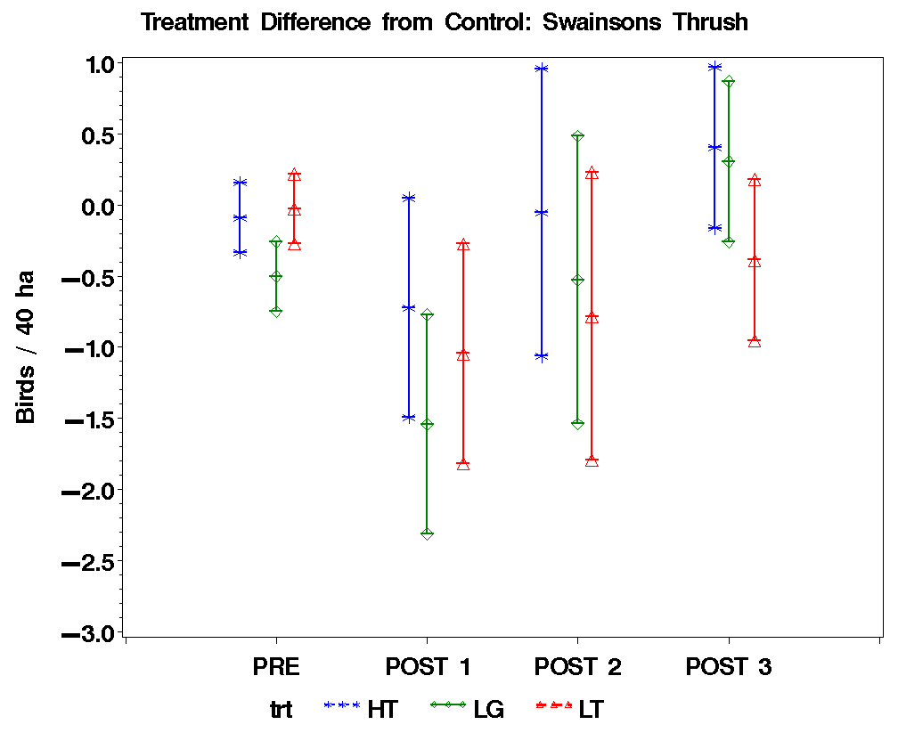
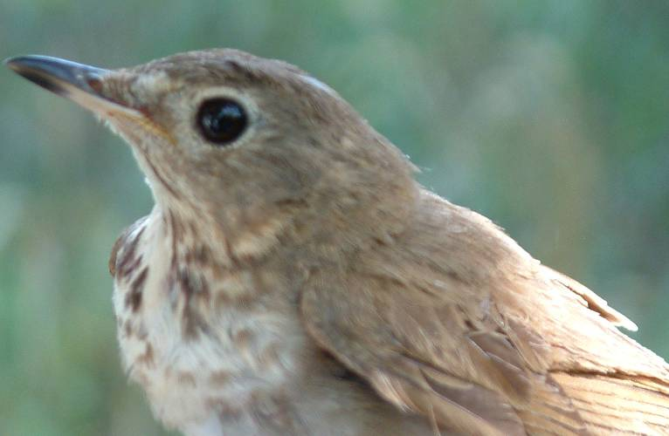
Notes:
Shrub associated species
MGWA – associated with low shrubs; immediate positive response; greatest magnitude in most intensive thinning treatments
SWTH – associated with tall shrubs; initial negative response;
most recent sampling showed no difference in abundance in thinned compared to controls
Least change over time in LT – probably related to pattern of tall shrub response

Slide 16
Frequency of Uncommon Species
 | Pre-thinning (1992-1993) | Post-Harvest (Phase I&II: 1997-1999, 2001; Phase III: 2006-2007)
 | All Stands (N*=32) | Controls (all Phases) (N=24) | Thinned Phase I & II (N=48) | Thinned Phase III (N = 32)
Common Nighthawk | 6% (3) | 4% (4) | 19% (17) | 9% (3)
Western Wood-pewee | 3% (1) | 0 | 21% (17) | 6% (2)
Olive-sided Flycatcher | 0 | 0 | 10% (13) | 25% (10)
Spotted Towhee | 0 | 0 | 17% (26) | 19% (15)
Notes:
Frequency of occurrence and (total number of observations) for uncommon species observed predominantly in thinned stands, Young Stand Study, Willamette National Forest.
N is the total number of stand x year combinations possible for each treatment and phase combination
A continued positive effect of thinning for two additional species that are generally uncommon on our study sites, Olive-sided Flycatcher and Spotted Towhee, was still evident more than 1 decade after harvest.
species were observed too infrequently to permit statistical analyses, but their occurrence only in thinned stands during the post-harvest phase, compared to their rarity during the pre-harvest phase of the study, suggests a response to thinning treatments.
For two other uncommon species, Common Nighthawk and Western Wood-pewee, the increase in the frequency of detection that was observed in thinned stands during the first post-harvest phase was no longer evident because they were rarely detected in 2006 and 2007 (Table 2).

Slide 17
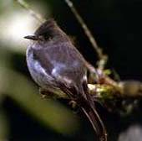
Summary: 15 Years Post-Thin
Species richness still greater in thinned than in unthinned stands
Initial positive response persisted for many species
Notes:
Many species that had initially responded positively to thinning still had higher density, and species richness was still greater, in thinned than in unthinned stands at one decade after thinning. For some, e.g., HAFL, effect of thinning beginning to diminish

Slide 18
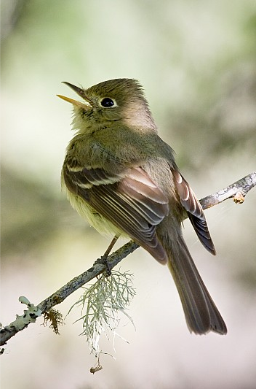
Summary: 15 Years Post-Thin (cont’d)
Negative effects of thinning no longer indicated for 3 species
Negative effects of thinning persisted for 3 species
Notes:
The densities of three species (HEWA, SWTH, GCKI) with an initial negative response to thinning increased in thinned stands to levels above or comparable to those in unthinned stands (i.e., negative effects of thinning no longer indicated).
Three species (WIWR, PSFL, HETH) with an initial negative response to thinning maintained lower densities in thinned than unthinned stands (i.e., negative effects of thinning persisted).

Slide 19
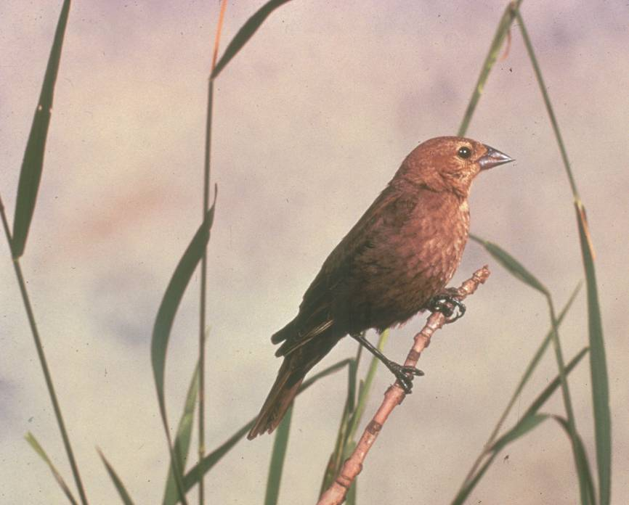
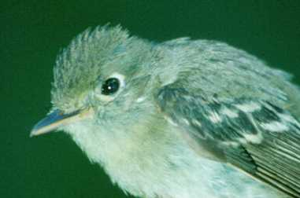
Precautions
Thinning adjacent to pasture land
Landscape-level considerations:
Cumulative negative effects
Refugia for dense forest species
Notes:
Cumulative effects: decrease in density at stand level could add up to population declines if thinning implemented everywhere in landscape.
HETH is example of dense forest associate that needs unthinned refugia

Slide 20
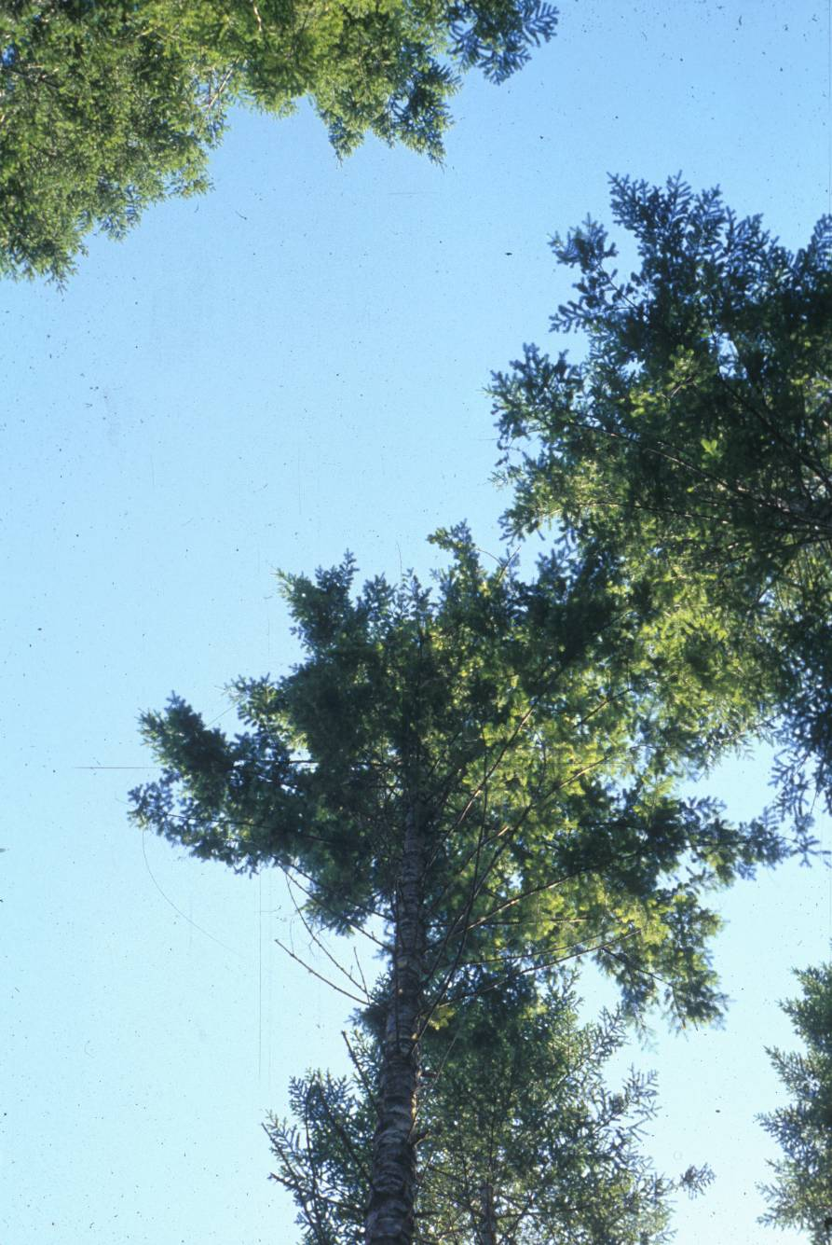
Conclusions
Long-term studies needed to capture interactions of time and thinning
Effects on forest structure were still evident at one decade after thinning
Importance of directly measuring wildlife response to management
Notes:
Our results indicate that the effects of thinning on forest structure were still evident at one decade after thinning, even if a difference in canopy closure between Light thin and unthinned treatments was no longer detectable. This highlights the importance of directly measuring wildlife response to management activities, rather than using habitat surrogates.

Slide 21
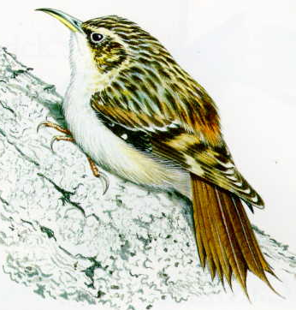

Wildlife Use of Created Snags in Young Conifer Stands
Joan Hagar - USGS-FRESC
Barry Schreiber – Fauna & Flora
Cheryl Friesen and Penny Harris – USFS Willamette NF
Notes:
Preliminary data

Slide 22
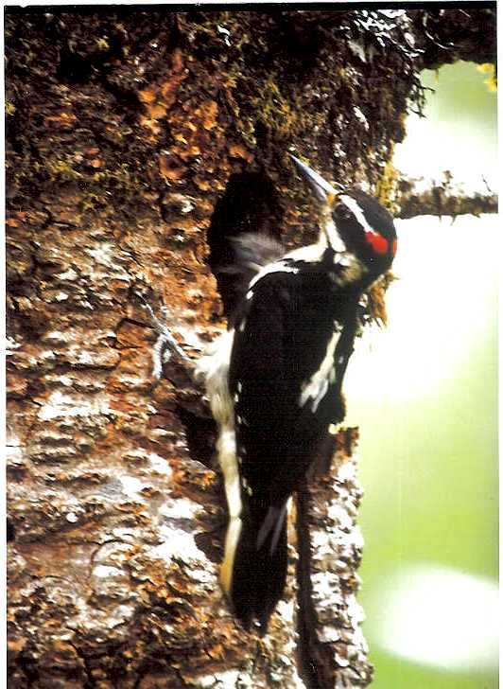
Cavity-Nesting Birds
Positive response to thinning
Inconsistent with decreased snag density

Slide 23
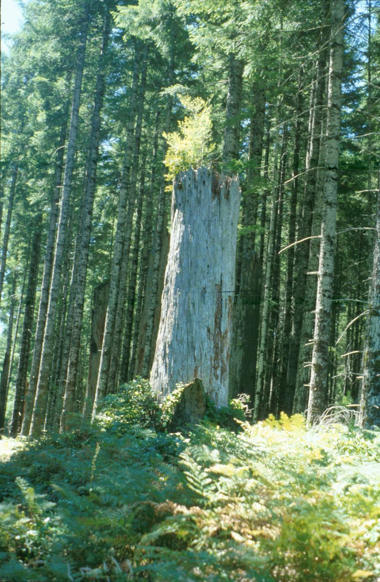
Snags
Rare in thinned stands
Decrease in density-dependent mortality

Slide 24
Thinning in Young Stands
Used for increasing structural diversity
But may decrease snag density
Create snags to make up for deficit?
Notes:
In the short term, thinning is unlikely to increase, and may actually decrease, the number of snags available as habitat for cavity-nesting species
Thinning will help accelerate growth to provide future large snags, but the current snag deficit calls for some immediate, stop-gap actions, such as creating snags from young trees.

Slide 25
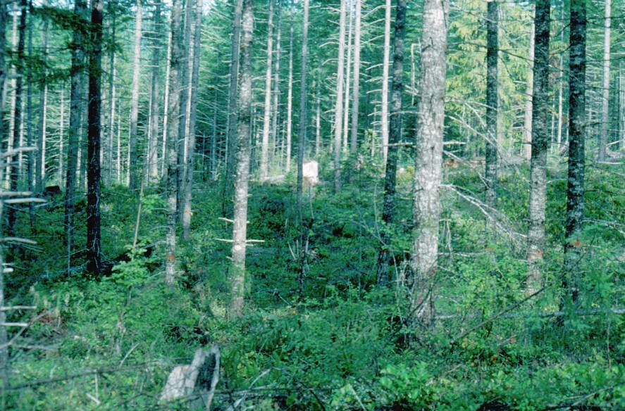
Do snags created from trees in young stands (14 to 18” dbh) provide habitat for wildlife?
Notes:
The question is…
Snags < 50 cm dbh are infrequently used as nest or roost sites by cavity-using wildlife in western Oregon (Mellen et al.: DecAID).
However, because the current snag deficit calls for testing methods to quickly create snags, the value as wildlife habitat of these relatively small diameter (i.e., <50 cm) trees warrants investigation.

Slide 26
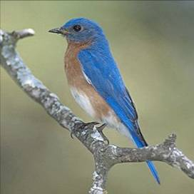
Goals and Objectives
Assess usefulness to CNB’s of snags created from trees in young stands
Compare occurrence of decay agents between 2 methods of snag creation
Compare the proportion of trees used for foraging and nesting between 2 methods of snag creation
Assess the interaction of thinning intensity and snag-creation method on use of snags by cavity-nesting species.
Long-term: how long do snags remain useful?
Notes:
Decay agents: fungus and insects
Insects as food for bark-foraging birds; fungus influences pattern of decay and therefore nest/roost suitability.

Slide 27
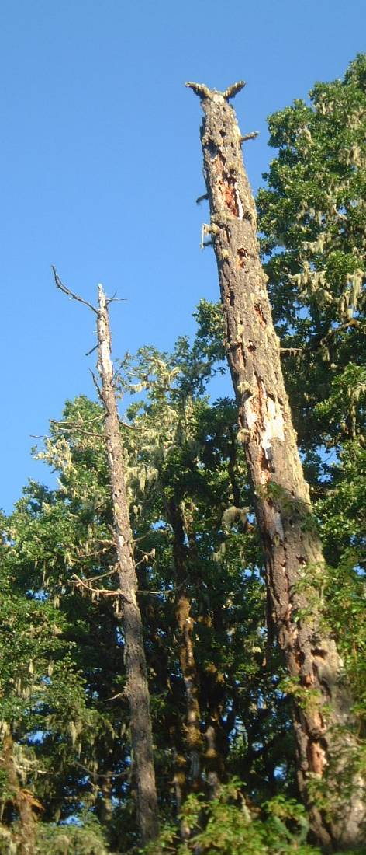
Snags in Young Stands: METHODS
YSS: 4 thinning treatments: Light thin, Heavy thin, Light with Gaps, Control
2 mortality treatments: Saw-Top and Saw-Top + Inoculation
Target density: 1 snag/acre
Trees treated winter 2001-2002
Surveyed for condition and wildlife use 2006-2007
Notes:
District Biologists felt that innoculation by itself would not kill trees in <5 years.

Slide 28
Results
Snag density increased approx. 50%
Notes:
More snags in control because of suppression mortality

Slide 29
RESULTS: Average snag DBH increased by approx. 5 inches
Notes:
Pre-trt ave = 12
Post-trt ave = 18
5” = 13 cm

Slide 30
% Created Snags with Decay Agents
No thin effect
Wood-boring beetles: 70% of trees; no treat. effects
Infrequently detected fungi:
Indian paint
Red heart
Red belt
Notes:
Trees killed by saw-topping plus inoculation had a higher frequency of use by Douglas-fir beetles (mean=84% of created snags) than trees that were saw-topped only (77%), regardless of thinning treatment (P = 0.02, ANOVA, 12 df)
Trees killed by saw-topping plus inoculation also had a higher frequency of pouch fungus (mean=39% of created snags) than trees that were saw-topped only (32.5%), regardless of thinning treatment (P=0.05, ANOVA).
The proportion of treated trees used by wood-boring beetles was not related to the tree-kill method nor to the thinning treatment (P = 0.13, ANOVA, 12 df): 69% of saw-topped trees and 71% of sawed and inoculated trees had wood-boring beetles.
Indian paint fungus (n=17 trees), red belt fungus (n=13 trees), and red heart fungus (n=8 trees) occurred too infrequently to assess the effects of tree-kill method and thinning treatment.

Slide 31
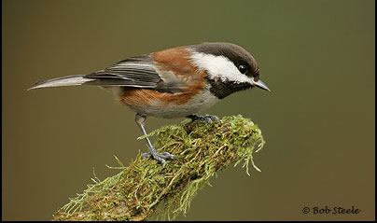
Results: Foraging and Nesting Use
43% of created snags were used for foraging
11% of created snags had nest cavities
Notes:
4-5 years after snag creation
45% of snags with sign of foraging were saw-topped; 55% were saw-topped and inoculated
The mean dbh of trees with nest cavities across all thinning treatments was 18.39”

Slide 32
Percent of used snags by mortality treatment
Notes:
The proportion of trees used for foraging by cavity-nesting birds was greater for trees killed by saw-topping plus inoculation (46%) than for trees that were saw-topped only (40%) (P < 0.01, ANOVA, 12 df).

Slide 33
Created snags with nest cavities by thinning treatment
Notes:
With nest cavities excavated by primary cavity-nesting birds
Mean proportion with 95% CI

Slide 34
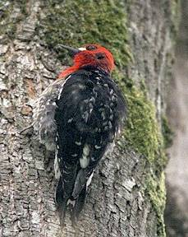
CNB Nest Surveys 2007 & 2008
9 active nests found
2 RBSA in 20” dbh created snag
1 CBCH in 23” dbh created snag
1 RBNU in 23” dbh created snag
2 RBSA in natural snag and 1 in live tree
2 CBCH in remnant snag/stump
Notes:
Most of the active nests found were in snags that exceeded the average diameter of created snags.
All in thinned stands

Slide 35
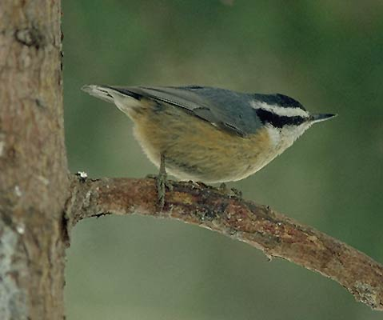
Conclusions
Created snags were used for foraging and nesting
More nest cavities in thinned stands
Snags < 20” dbh: marginal nesting habitat?
Notes:
Trees treated with saw-topping and saw-topping in combination with inoculation of heart-rot fungus were used for foraging and nesting by cavity-nesting birds.
More nesting cavities in natural (older) than created snags: use of created may increase in near future

Slide 36
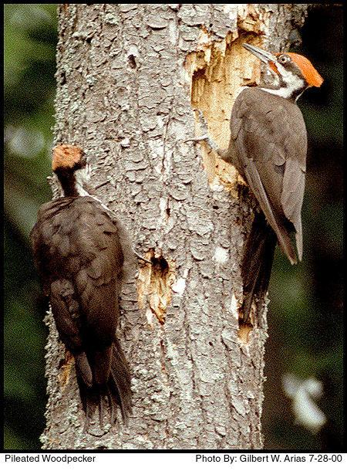
1º cavity excavators created more nest cavities than they used
Cover for small mammals
Winter roost habitat
Notes:
Primary cavity excavators created more nest cavities than they used, creating habitat for secondary cavity users.
Snags created from trees < 20” dbh may not provide suitable nesting habitat for many cavity-nesting species. However, cavities in created snags may be used as cover by small mammals, and may also provide winter roosting habitat for secondary cavity-users.
Cavity-using birds need multiple winter roosts/bird, so cavity availability may have an important influence on winter survival. More nest cavities in thinned stands – suggests that it may not be cost-effective to create in unthinned stands

Slide 37
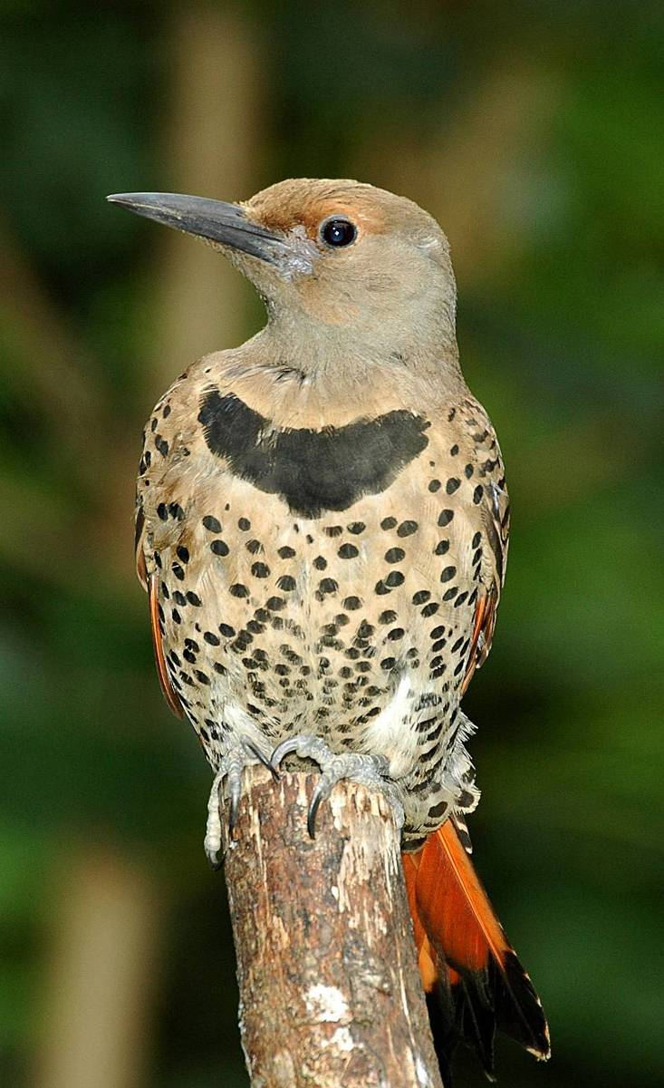
Matt Lee
Questions?
Notes:
Questions?

