Slide 1
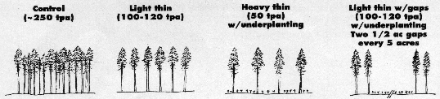
The Young Stand Thinning and Diversity Study
Stands not thinned (4 reps)
Some thinned to maximize timber volume (4 reps)
Some thinned to increase heterogeneity (4 reps)
Some thinned to accelerate tree growth (4 reps)

Slide 2
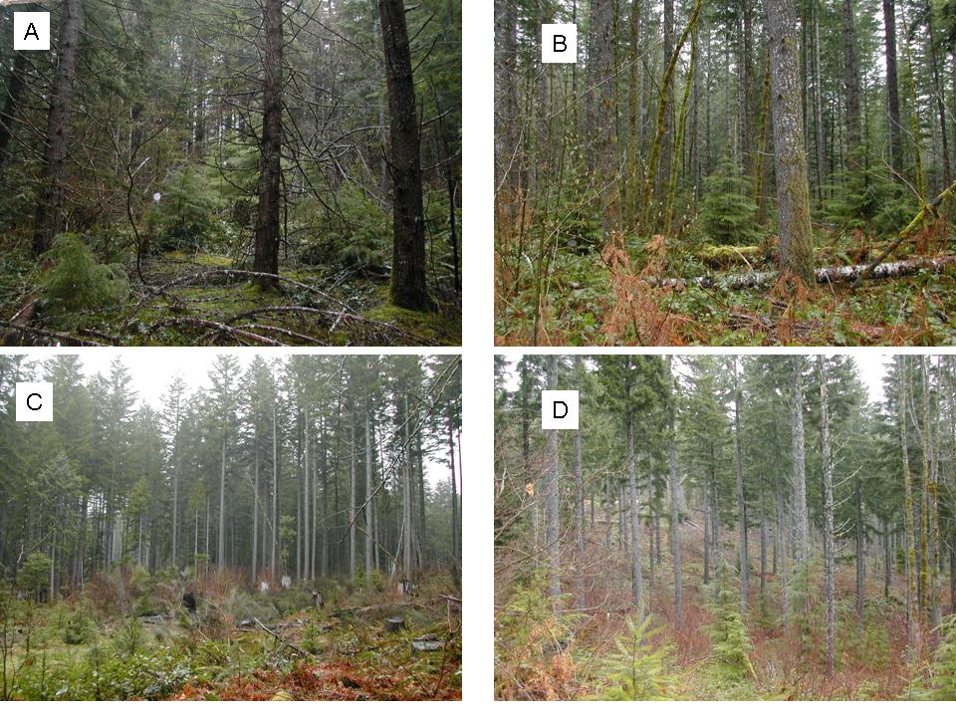

Slide 3
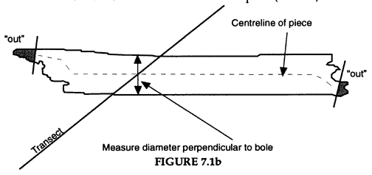
Sampling Dead Wood
Sampled dead wood in 1996/97 and 2006 using line intercept transect sampling at fixed plots.
1996/97 = pre-existing wood & recruited wood

Slide 4
TAC | Location | Treatment | # Transects / TAC
 |  |  | 1996/97 | 2006
1 | Cougar Reservoir | Control | 23 | 3
2 | Cougar Reservoir | Heavy | 13 | 3
3 | Cougar Reservoir | Light | 19 | 3
4 | Cougar Reservoir | Gaps | 30 | 6
5 | Mill Creek | Control | 25 | 3
6 | Mill Creek | Heavy | 18 | 3
7 | Mill Creek | Light | 26 | 3
8 | Mill Creek | Gaps | 33 | 6
9 | Christy Flats | Control | 23 | 3
10 | Christy Flats | Heavy | 15 | 3
11 | Christy Flats | Light | 24 | 3
12 | Christy Flats | Gaps | 30 | 6
13 | Sidewalk Creek | Control | 17 | 3
14 | Sidewalk Creek | Heavy | 10 | 3
15 | Sidewalk Creek | Light | 15 | 3
16 | Sidewalk Creek | Gaps | 30 | 6
Total number of transects: |  |  | 351 | 60

Slide 5
Thinning added 5-10% more dead wood volume, but the dead wood volume was dominated by pre-existing pieces
CWD Characteristic | Control | Light thin | Thin with gaps | Heavy thin | P
Pre-existing piece volume(m3/ha) | 425 (131) | 402.3 (131.8) | 380.6 (95.3) | 370.0 (54.4) | 0.8912
New piece volume | 4.8 (9.50)B | 28.5 (19.0)AB | 36.4 (10.6)A | 22.8 (7.0)AB | 0.0211
Total piece volume | 429.7 (133.3) | 430.8 (126.1) | 417.0 (84.8) | 392.8 (57.0) | 0.9507

Slide 6
How many samples are needed to estimate dead wood volume?

Slide 7
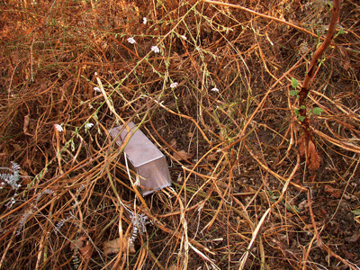

Small Mammals sampled during fall 2007 and 2008
50 Sherman live traps in variable-length transects, 20-m spacing
25 Tomahawk live traps set on the ground at alternating stations
25 Tomahawk live traps attached to tree boles at alternating stations

Slide 9
Trapping Protocols
Trapping at each site occurred over a 4-day period during mid September through mid November.
Traps were baited with rolled oats, peanut butter and sunflower seeds
Cotton batting was placed in all traps to provide thermal cover for captured mammals.
Two grids in each block were sampled simultaneously and the other two grids in the same block were sampled in the following week.
The order for sampling grids within blocks was random and blocks were sampled sequentially.

Slide 10
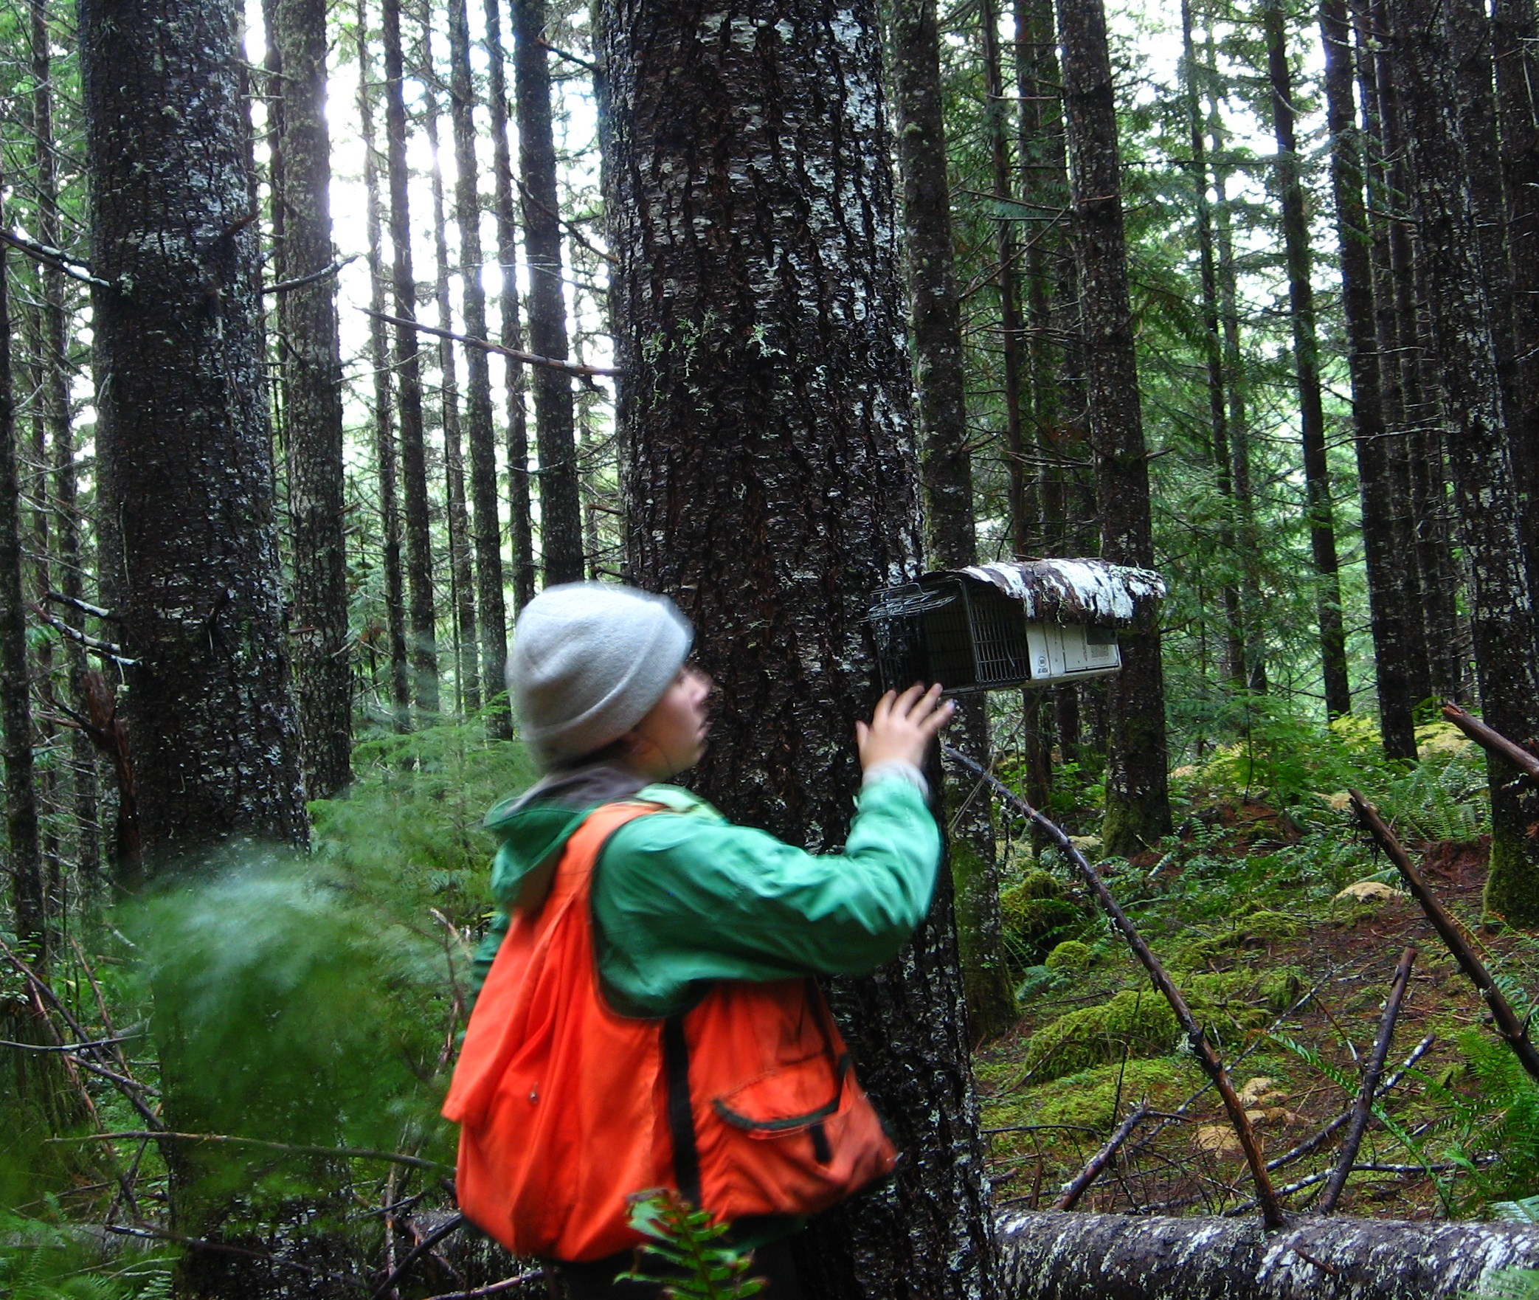
Traps were checked twice daily to reduce mortalities

Slide 11
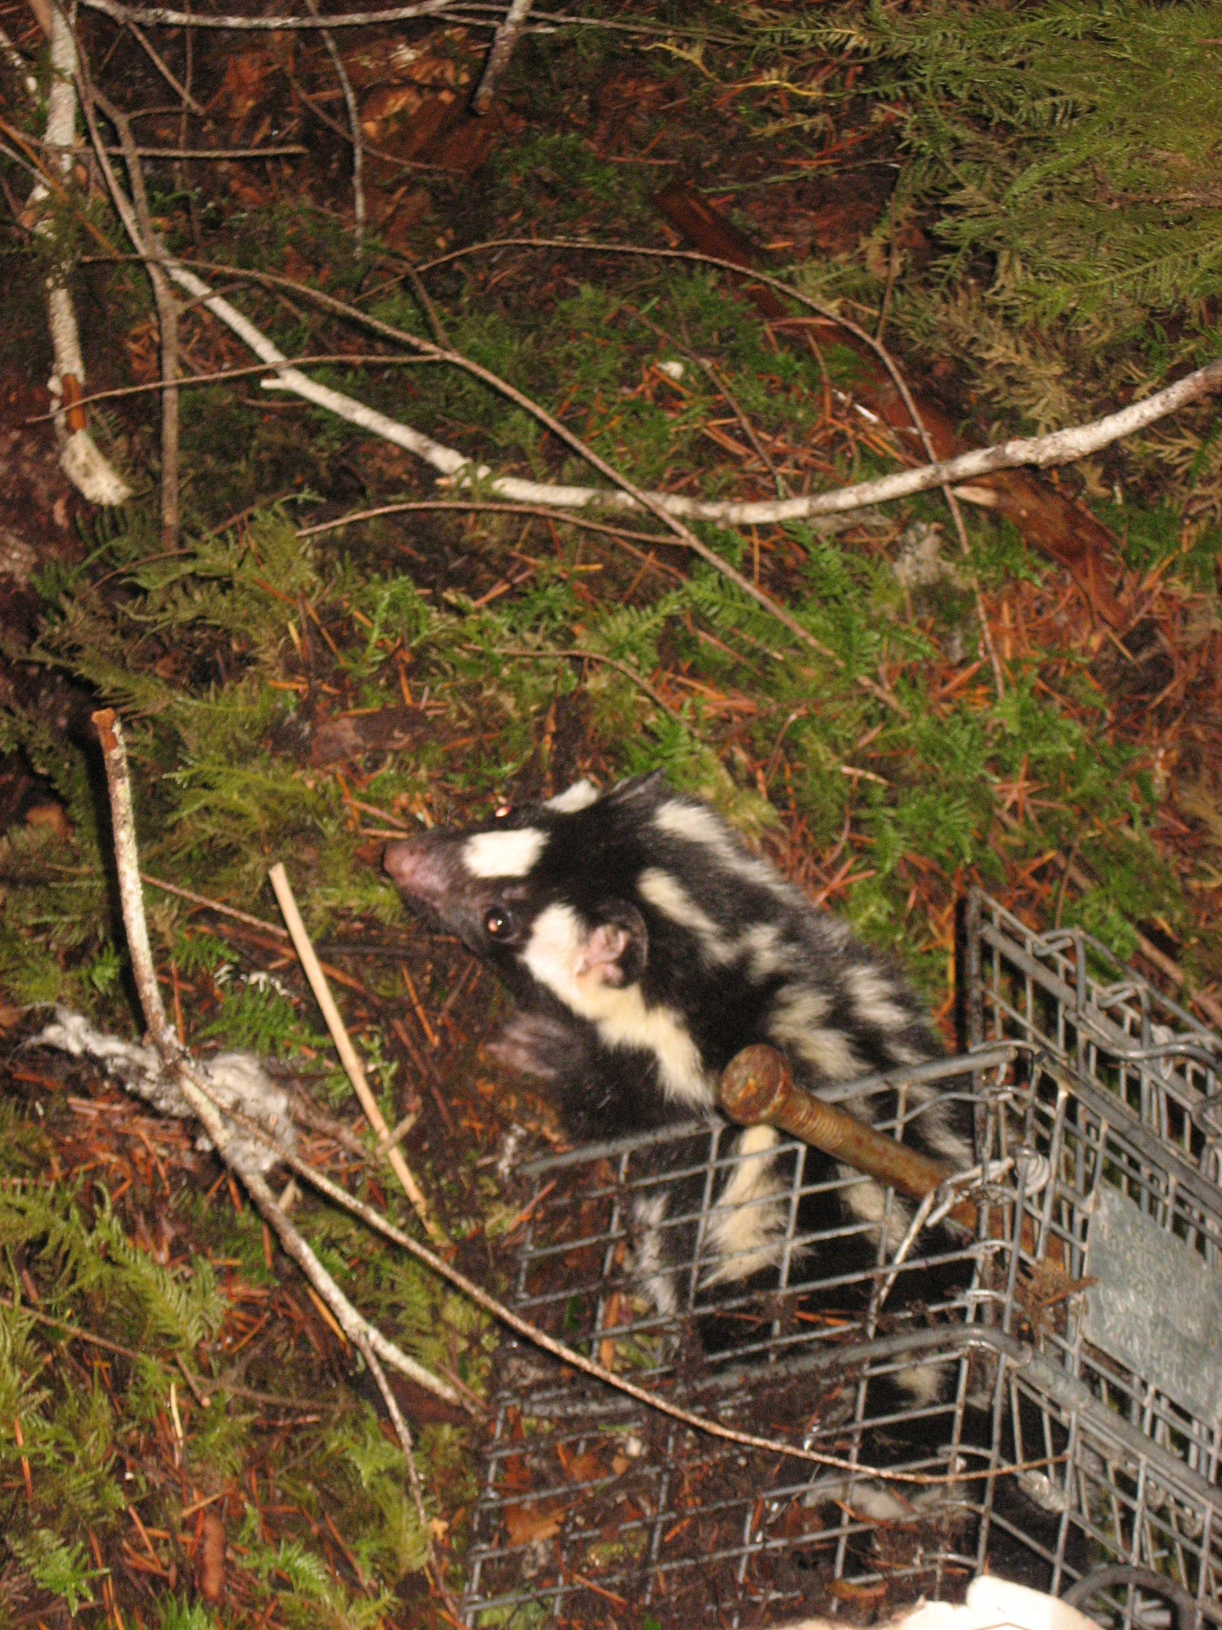

Slide 12
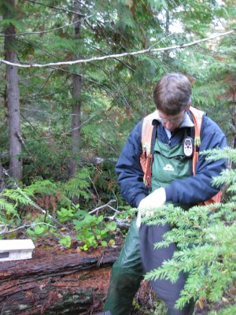
Animals were removed from the traps, and ear tagged

Slide 13
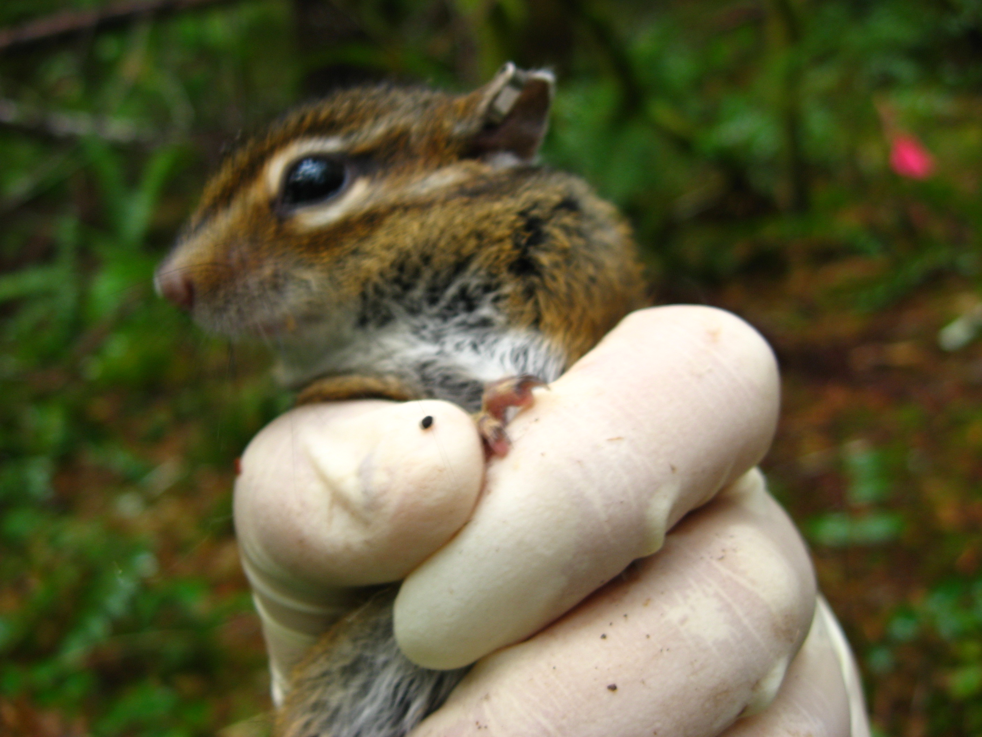

Slide 14
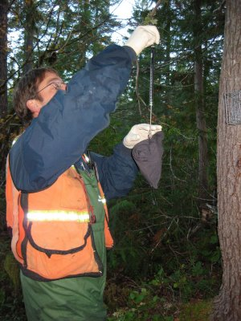
All animals were weighed and then released at the point of capture

Slide 15
Species | Control | Heavy | Light | Gaps | TOTAL
Deer mouse | 255 | 724 | 609 | 619 | 2207
Townsend's chipmunk | 444 | 774 | 811 | 803 | 2832
Trowbridge's shrew | 132 | 34 | 60 | 71 | 297
N. Flying squirrel | 202 | 22 | 78 | 45 | 347
Red-backed vole | 62 | 27 | 40 | 30 | 159
Creeping vole | 4 | 11 | 24 | 21 | 60
Pacific shrew | 46 | 6 | 22 | 16 | 90
W. spotted skunk | 16 | 2 | 3 | 3 | 24
Coast mole | 14 | 0 | 0 | 0 | 14
Vagrant shrew | 1 | 1 | 1 | 2 | 5
Douglas' squirrel | 1 | 5 | 11 | 6 | 23
Snowshoe hare | 2 | 0 | 0 | 0 | 2
California ground squirrel | 0 | 0 | 2 | 9 | 11
Ermine | 1 | 0 | 3 | 1 | 5
Shrew-mole | 4 | 0 | 0 | 1 | 5
Bushy-tailed woodrat | 0 | 4 | 3 | 0 | 7
Pacific Jumping Mouse | 0 | 2 | 0 | 0 | 2
Brush rabbit | 0 | 1 | 0 | 0 | 1
TOTAL CAPTURES | 1184 | 1613 | 1667 | 1627 | 6091
TOTAL SPECIES | 14 | 13 | 13 | 13 | 18

Slide 16
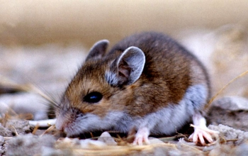
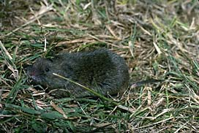

Slide 17
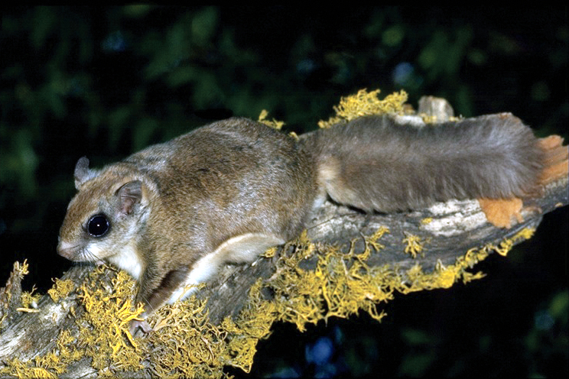
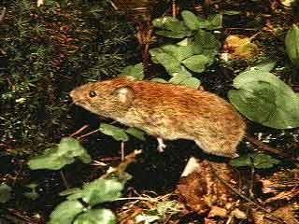
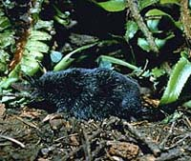

Slide 18
Correlations between estimated abundance using Program MARK and capture rates (per 1000 trap nights)
 | 2007 | 2008
Flying Squirrel | 0.96 | 0.97
Townsend's chipmunk | 0.85 | 0.92
Deer mouse | 0.81 | 0.95
Red-backed vole | 0.99 | 1.00

Slide 19
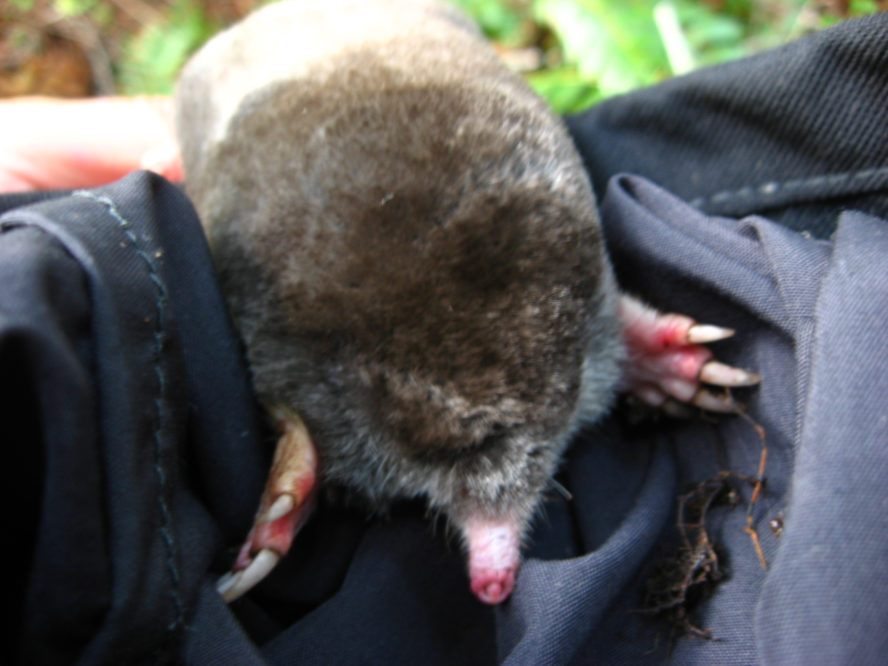
Many species had too few captures to analyze
Coast moles were only captured on control sites

Slide 20
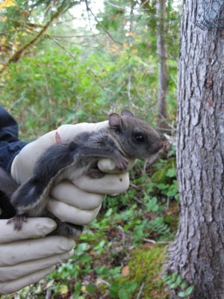

Slide 21
Associations with Dead Wood Volume
Flying squirrels were more strongly associated with thinning (-) than with dead wood volume (+)
Deer mice and creeping voles were more associated with sound dead wood (+) and thinning (+).
Townsend’s chipmunks and California red-backed voles were more associated with dead wood (+) than with thinning (+/-).

Slide 22
CONCLUSIONS
Thinning increased CWD volume by 5-10% in some treatments and increased areal cover of dead wood by nearly 20% following thinning.
Spatial distribution of wood is highly variable; need 50-70 plots to characterize means and variances.
The sampling CWD transects should be marked permanently to facilitate accurate tallies of CWD pieces in the future.

Slide 23
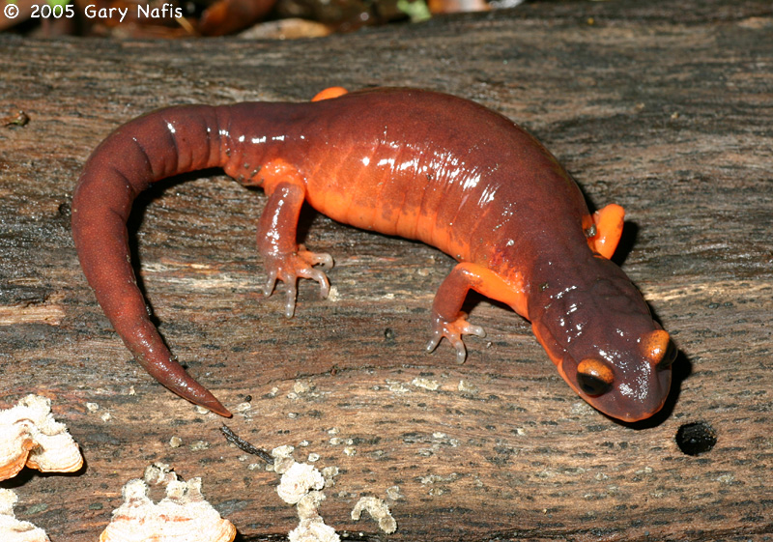
CONCLUSIONS

Slide 24
CONCLUSIONS
Townsend’s chipmunk and red-backed vole captures were associated with dead wood.
Other species were more associated with thinning or a combination of dead wood and thinning.
Change in the understory vegetation was probably more important than dead wood as a determinant of abundance for creeping voles and deer mice.

Slide 25
Recommendations
Recruited dead wood from thinning is small; larger pre-existing pieces are the most likely to be associated with small mammal abundance.
Care around pre-existing pieces is key to maintaining high levels of dead wood in these stands until large trees begin to die (or can be killed) decades into the future.

Slide 26
Recommendations
Monitoring of dead wood must be intensive, with 50-70 transects per sample area to capture means and variances in stands similar to the ones that we worked in.
New techniques should be explored to ensure that pieces measured at one time period can be accurately tracked into the future by different field crews.

Slide 27
Recommendations
Thinning had a marked and consistent negative effect on northern flying squirrels
NOTE: This is consistent with the Forest Ecosystems Studies findings.
Since this is a primary food source for northern spotted owls, thinned stands should be strategically placed within a matrix of unthinned stands.
We anticipate that flying squirrel populations will recover as the thinned stands close canopy and mature, unthinned stands will be an important bridge until that time.

Slide 28
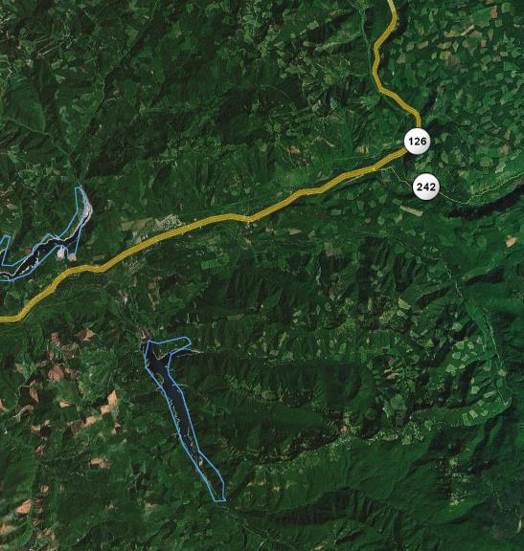

Slide 29
Recommendations
Monitoring of small mammals should continue on 10-year intervals to assess when populations of flying squirrels begin recovering in the thinned stands.
At the community level, it would be informative to know when, and if, the mammal community in these young stands approximates the community composition and structure in old-growth stands.

Slide 30
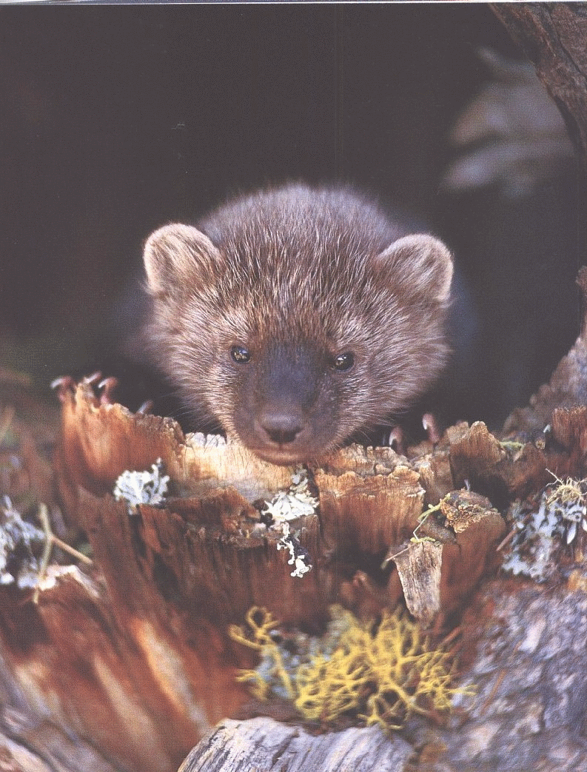
QUESTIONS?

