Slide 1
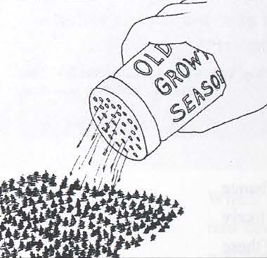
Thinning young stands – vegetation response
Klaus J. Puettmann
Adrian Ares
Duncan Wilson
Oregon State University

Slide 2
Background
Overstory response
Tree regeneration
Understory vegetation
  Gaps
Repeated thinnings
Resilience

Slide 3
CROWN LIFT
Astoria
20 year
5 year
Density effect on crown recession increases with age
Puettmann and Berger 2005

Slide 4
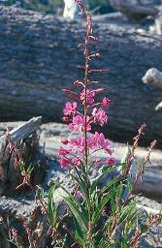
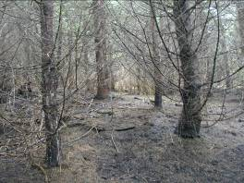
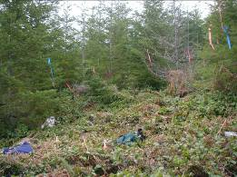
FORBS
Astoria
! no density*age interaction
Puettmann and Berger 2005

Slide 5
Species composition
Invasives*
Residuals*
* as defined by Halpern (1989)
Puettmann and Berger 2005
Notes:
Astoria district

Slide 6
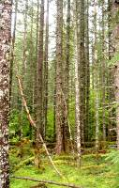
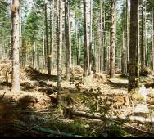
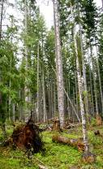
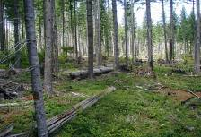
Thinning responses

Slide 7
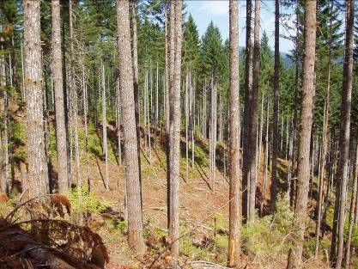
Overstory tree density
        1 3 5 10
Year
Mortality
- mostly density related (D-fir, chinkapin and
hardwoods in controls)
Minor mortality in thinning treatments
Ares et al., in prep.

Slide 8
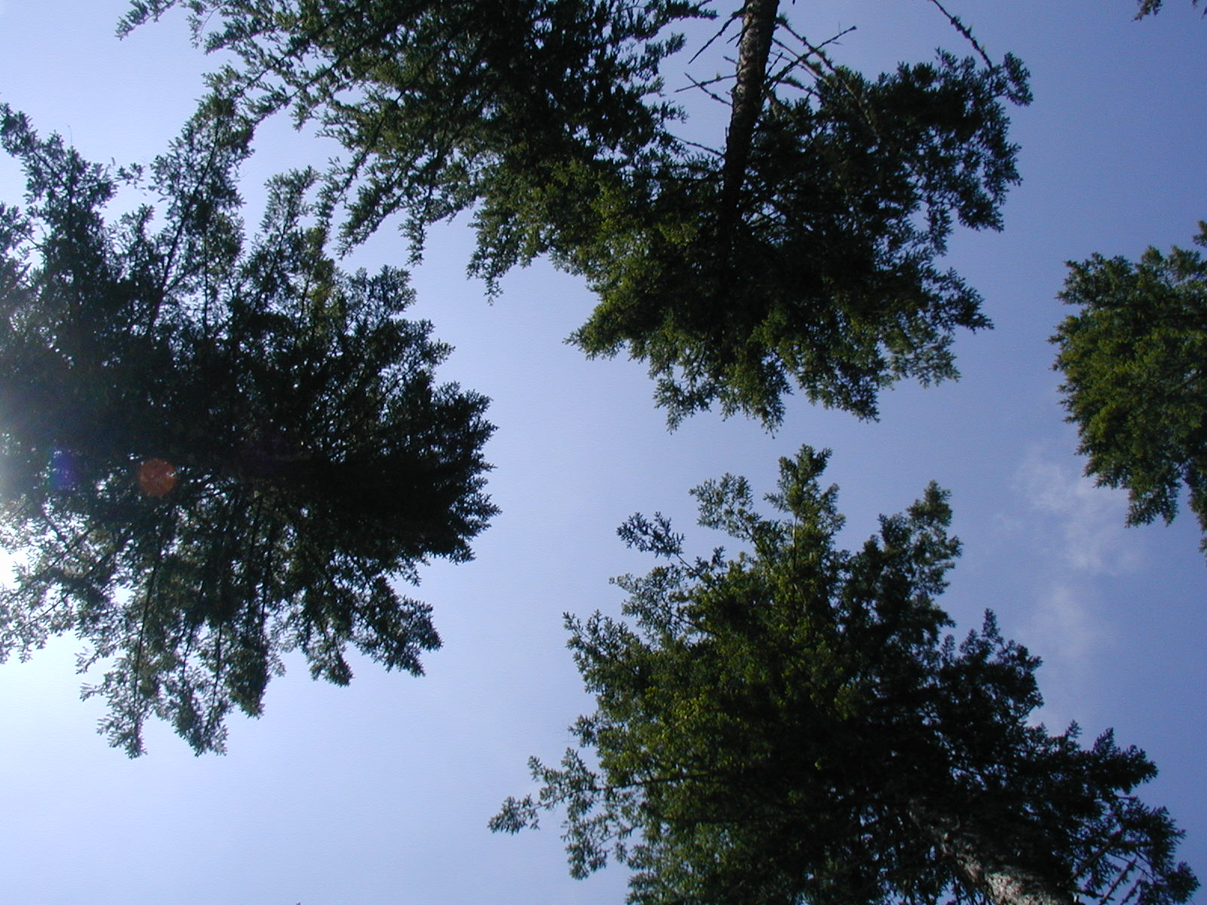
Overstory cover
~ 2% increase/year
Ares et al., in prep.

Slide 9
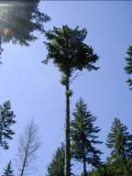
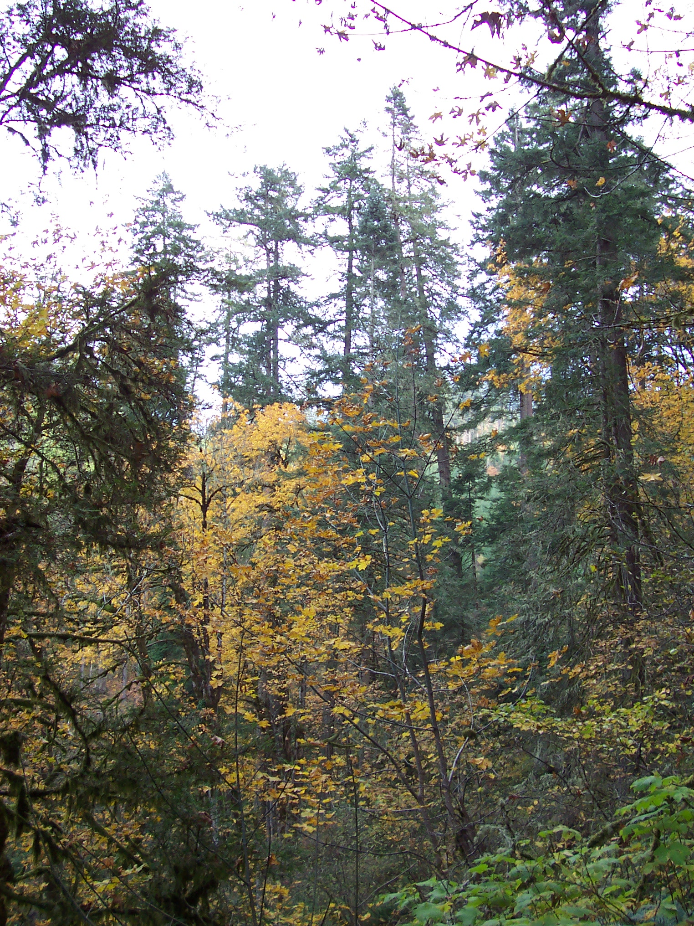
Canopy layer diversity
35 m
30 m
25 m
20 m
15 m
10 m
5 m
0 m
STAND 1
STAND 2
STAND 3
No short-term changes
Beggs 2005
Notes:
Implications for decision about high/low/proportional thinnings

Slide 10
Acceleration of “dominant old-growth” trees
(largest 6 tpa)
Growth (inch/yr)
Only heavy thinning led to
increased diameter growth
Beggs 2005
Notes:
Heavy greater than control, no difference between other thinnings
Same results for > 6tph, but no difference, if we just used largest 4 tpa

Slide 11
Regeneration density (tpa)
 | Control | Heavy Thin | Light Thin | Light thin w\ gap
intolerant | 68 | 483 | 444 | 637
tolerant | 643 | 1218 | 1590 | 708
total | 710 | 1701 | 2033 | 1345
“Plenty” of seedlings – on average
High variability within treatments
Kuehne and Puettmann, 2008
Notes:
species code2 # sites % plots # ha-1 # sites % plots # ha-1
shade-intolerant
Red alder Alnus rubra ALRU 7 5.0 (1-2) 35.2 (2-189) 2 1.9 (0-6) 14.5 (0-45)
Pacific madrone Arbutus menziesii ARME 2 6.5 (0-44) 45.1 (0-233) 2 1.6 (0-4) 28.3 (0-54)
Oregon ash Fraxinus latifolia FRLA 0 1 0.3 (0-1) 5.0 (0-17)
Western white pine Pinus monticola PIMO 0 4 5.8 (1-12) 15.1 (3-35)
Black cottonwood Populus balsamifera POBAT 0 2 1.4 (0-4) 14.5 (0-45)
Bitter cherry Prunus emerginata PREM 4 4.5 (0-25) 19.1 (0-106) 3 23.0 (0-61) 477.4 (0-1345)
Douglas fir Pseudotsuga menziesii PSME 7 41.2 (22-68) 232.7 (58-613) 4 49.6 (36-67) 479.9 (215-1005)
Willow Salix spec. SALIX 0 1 0.3 (0-1) 8.8 (0-43)
0
shade-tolerant
White fir Abies concolor ABCO 1 0.4 (0-3) 0.5 (0-3) 0
Grand fir Abies grandis ABGR 5 7.4 (0-42) 69.0 (0-463) 2 1.1 (0-3) 3.8 (0-11)
Bigleaf maple Acer macrophyllum ACMA 6 14.9 (0-29) 49.2 (0-99) 4 24.7 (2-65) 1078 (18-3377)
Incense cedar Calocedrus decurrens CADE 0 3 4.7 (0-9) 28.3 (0-43)
Giant chinquapin Chrysolepis chrysophylla CHCHC 6 8.9 (0-20) 30.6 (0-90) 3 14.2 (0-47) 258.2 (0-1048)
Pacific dogwood Cornus nutallii CONU 2 0.4 (0-1) 0.5 (0-2) 2 3.0 (0-7) 27.7 (0-71)
Cascara buckthorn Frangula purshiana FRPU 3 8.9 (0-33) 32.9 (0-136) 4 11.8 (1-35) 119.7 (6-380)
Pacific yew Taxus brevifolia TABR 2 0.4 (0-1) 0.9 (0-5) 4 10.4 (4-19) 61.7 (10-150)
Western redcedar Thuja plicata THPL 7 8.9 (3-26) 23.2 (3-95) 4 26.6 (11-56) 297.3 (73-818)
Western hemlock Tsuga heterophylla TSHE 7 43.6 (1-87) 1293 (3-5581) 4 54.8 (35-68) 623.5 (145-1066)
California laurel Umbellularia californica UMCA 1 1.1 (0-8) 1.6 (0-11) 0
1) without gap plots
2) abbreviations used in analyses

Slide 12
Species diversity of regeneration
(species/treatment)
 | Control | Heavy Thin | Light Thin | Light thin w\ gap
intolerant | 5.5 | 5.8 | 5.5 | 5.5
tolerant | 2 | 2.8 | 2.5 | 3.5
total | 7.5 | 8.5 | 8 | 9
Benefit of leaving “minority” species
Kuehne and Puettmann, 2008

Slide 13
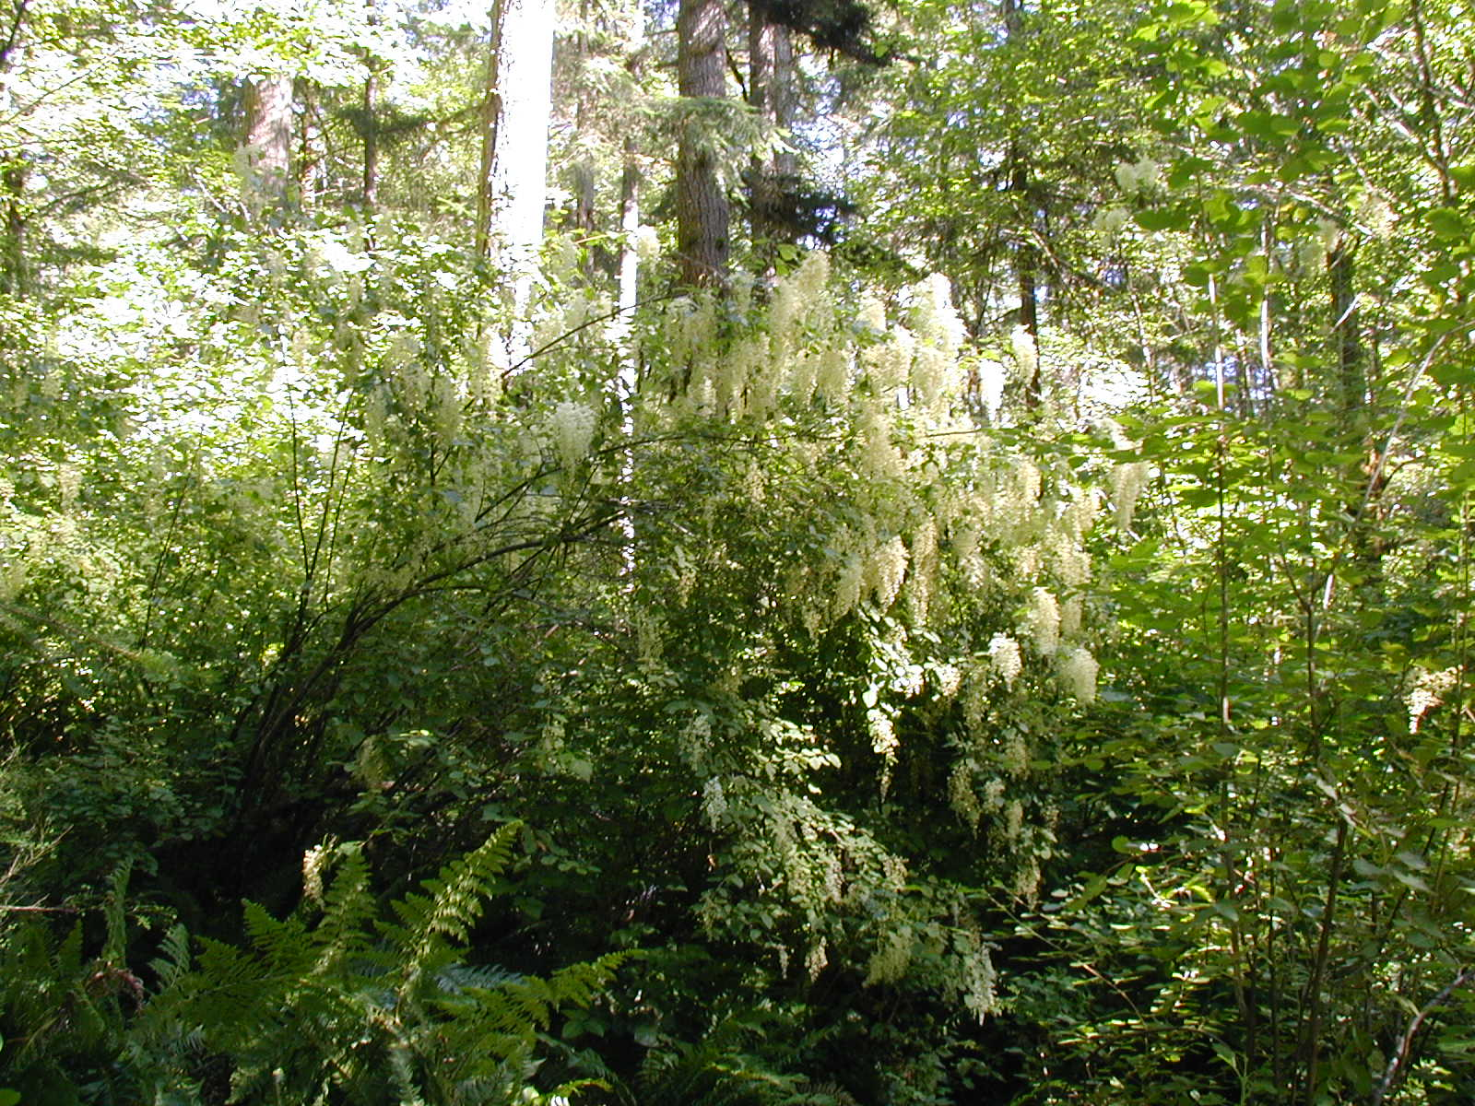
Tall shrubs
        1 3 5 10
Year
Initial decline = harvesting damage
Slow recovery
Ares et al., in prep.

Slide 14
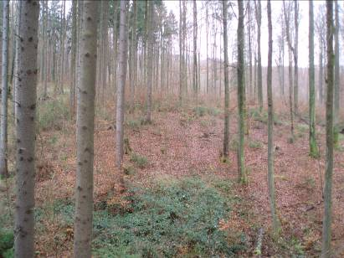
Low Shrubs
        1 3 5 10
Year
Recovery and higher cover
after initial decline
Ares et al., in prep.

Slide 15
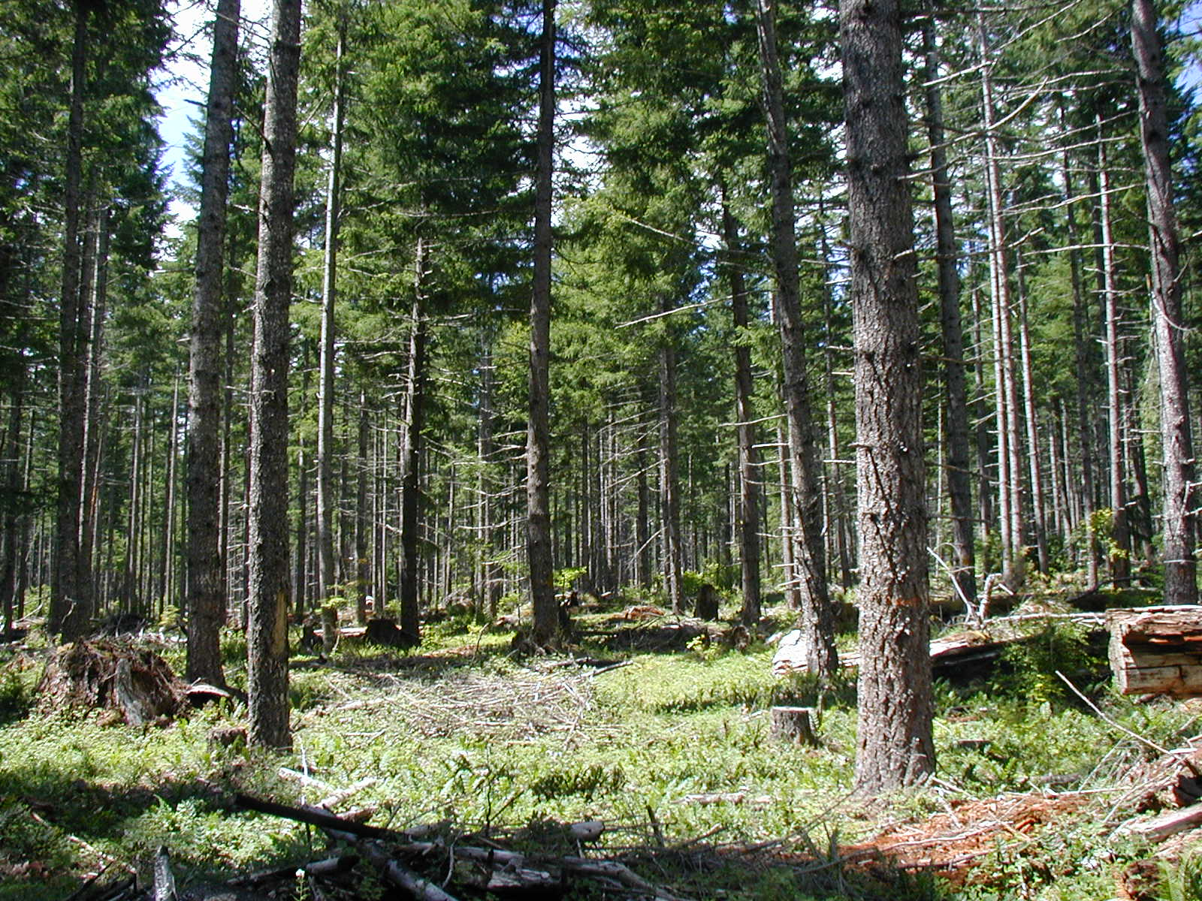
Herbs
        1 3 5 10
Year
Initial increases after thinning
Ares et al., in prep.

Slide 16
Bryophytes
1 3 5 10
Year
Initial differences after thinning disappear
Ares et al., in prep.

Slide 17
Impact on understory herb diversity
Lower higher
Plant interactions in change with overstory treatment
- high variability
- varied with thinning
Harvesting
damage?
Wilson and Puettmann, in prep.
Notes:
Sort out variabilty of interactions – relationship to species richness of herbs

Slide 18
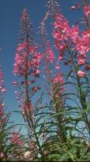
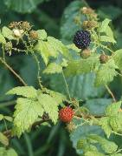
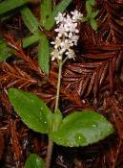
Understory Composition
C HD MD VD
Increase in richness mostly due to early seral species
Modified from Berryman, unpubl.
Notes:
Increase in vegetation/herbs = early seral – no simple acceleration of late-successional features (species composition)

Slide 19
Where does the higher species richness come from?
Gap impact hard to detect in stand level analysis
Ares et al. 2009

Slide 20
Thinned Forest Matrix
Thinned Forest Matrix
0.1 ha Gap
0.4 ha Gap
Fahey and Puettmann JoE 2007

Slide 21
t_{(4,56)} = 4.74, p = 0.0023
t_{(6,84)} = 5.47, p < 0.0001
Eearly successional spec.
Late successional spec.
Fahey and Puettmann JoE 2007

Slide 22
Gap Partitioning
ANOVA with NMS axis:
t_{(4,56)} = 4.82 , p = 0.0021
t_{(6,84)} = 4.13, p = 0.0011
Resource + environmental gradient
Ground disturbance
Pre-gap vegetation
Fahey and Puettmann JoE 2007
Notes:
Gaps are creating heterogeneity in understory vegetation communities – Are patterns similar for other life-forms?
Gap effect seems to be following physical gap extent not the more expansive light gap definition
Community patterns may differ by gap size

Slide 23
Competitor
Gap influence
limited to “gap”
  physical disturbance
Ruderal spec.
  competition for light (large gaps only)
Comp. spec.
  competition for light (large gaps only)
Ruderal
Stress tolerator
Fahey and Puettmann, 2008
Notes:
The competitor species group showed a symmetrical pattern in both gap sizes, whereas ruderal and stress-tolerator groups both showed a strong skew of the gap effect toward north sides of gaps regardless of gap size. Also, in both gap sizes, stress tolerator group was below reference forest levels on north, but not south, side of gaps (Fig. 2).
be attributable to high abundance of ruderal species and low abundance of stress-tolerator species. Factors, such as physical disturbance and propagule availability, have a significant influence on understory species composition (Collins and Pickett, 1988a, 1988b; Beatty, 2003). Ruderal species are dependent on disturbance and physical disturbances of existing vegetation are certainly partly responsible for observed gap response (Fahey and Puettmann 2007). However, the directional nature of the response suggests this is not the only factor at work. The northward skew of these group distributions suggests a light driven control on the occurrence of ruderal and stress-tolerator species at levels different from those achieved in the adjacent thinned forests. On north sides of larger gaps, ruderal species are more likely able to replace stress-tolerator species presumably because they can benefit from high levels of direct solar radiation (Fahey and Puettmann 2007), which acts as a secondary disturbance on stress-tolerator species. [k1]This may help explain why gap influence on surrounding forests was minimal even in large gaps. Physical disturbance of existing vegetation outside of gaps is minimal, therefore, gap influence is likely to occur only in places where stress-tolerator species are eliminated by this secondary disturbance and are then replaced by either ruderal or competitor species. [k1]not sure I understand, something does not fit

Slide 24
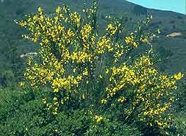
Exotic Species
Overall – low cover
Slight increase after thinning – still low
Local problems – seed source?
DMS data suggest decrease over time
Beggs 2005
Notes:
Cover generally very low
Localized occurrence, function of distance to seed source
Will monitor development (expansion/extirpation) of exotics

Slide 25
Repeated thinning
Overstory trees increased
- diameter growth
- live crown ratio
Understory vegetation
Berger and Puettmann, unpublshed

Slide 26
Repeated thinning
Average % cover, year 6
 | Once-thinned | Twice-thinned
Fern | 30 | 43
Herb | 15 | 21
Low shrub | 35 | 36
Tall shrub | 23 | 16
Graminoid | 2 | 3
Forest understory spp. | 95 | 95
Open-site spp. | 7 | 20
Exotic | 0.1 | 1
greater amounts of ferns
and early-successional
species
no effect on abundance of
tree regeneration
Berger and Puettmann, submitted

Slide 27
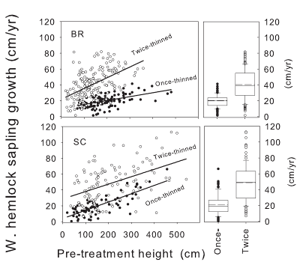
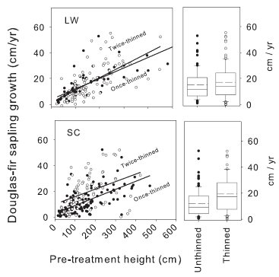
Rethinning – tree growth
Response a function of shade tolerance
Multiple thinnings necessary to establish
D-fir in the midstory
Shatford et al. 2009

Slide 28
Repeated thinning
Thinned twice
Thinned once
Unthinned
Strengthens desirable and undesirable trends

Slide 29
Regional assessment
  initial shrub cover
  < 30% thinning = +
  > 30% thinning = -
  no shrub/herb tradeoff
Wilson et al. in review

Slide 30
Future plans
Investigate vegetation dynamics, especially as related to wildlife habitat (w/ M. Betts)
Investigate tradeoffs between adaptability/resilience and productivity

Slide 31
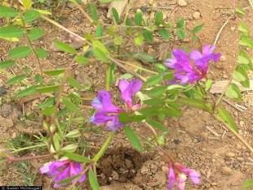
Resilience
S. McDougall
Increased redundancy in ecosystem functions:
N-fixation
C HD MD VD120 VD80 VD40
Notes:
Richness of understory N-fixing species increased in the thinning treatments compared to the control. Eight species of N-fixing were found in the study sites; they were mostly herbs (trefoil, American vetch, desert deervetch, vetch, pea, lupin). The invasive scotchbroom was found in some plots. N-fixing species were more common at OM Hubbard and almost absent at Keel Mountain.
Cover of understory N-fixing species was greater in VD200 than in the other thinning treatments and the control. It was also greater in MD200 and VD300 than in the control.
Red alder was present in two of the three sites with very low basal areas (average = 0.03 to 0.11 m2/ha)

Slide 32
N-fixing species by site
C HD MD VD120 VD80 VD40
Varies by
Site/initial conditions

Slide 33
Conclusions
Different components have different response patterns and/or dynamics
Spatial scale of interest is important
jImportance of initial conditions in determining responses
Repeated entries strengthen desirable and undesirable trends

Slide 34
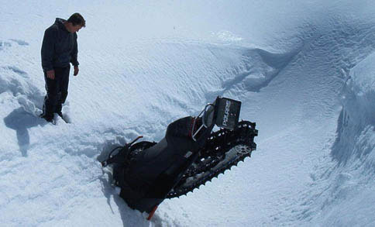
Thank you for your attention
Questions and comments ?
Thanks to all cooperators, site coordinators, field crews, and fellow researchers
Photocredit:
USFS, USDI, OHS, D. Coates, A. Blum

