Slide 1
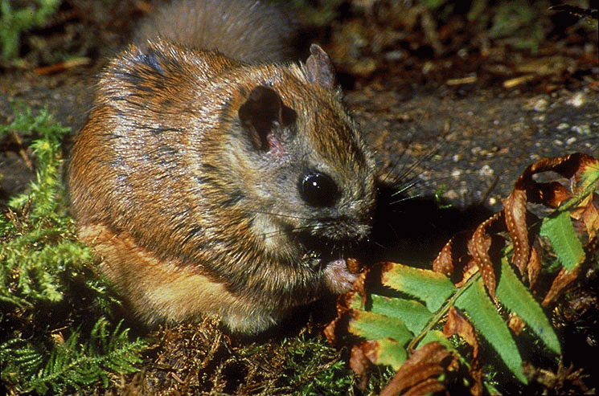
Habitat Use and Ecology of the Northern Flying Squirrel
Todd M. Wilson
USFS, PNW Research Station

Slide 2
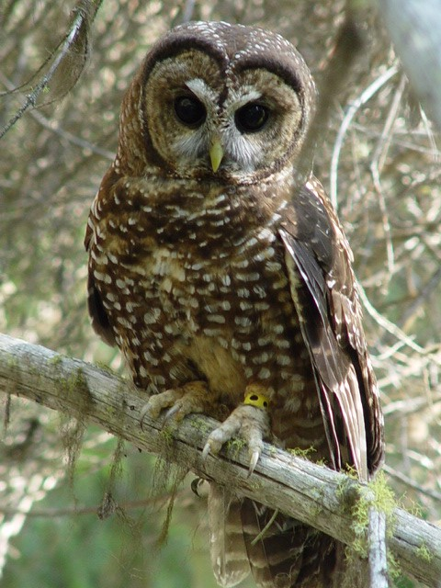
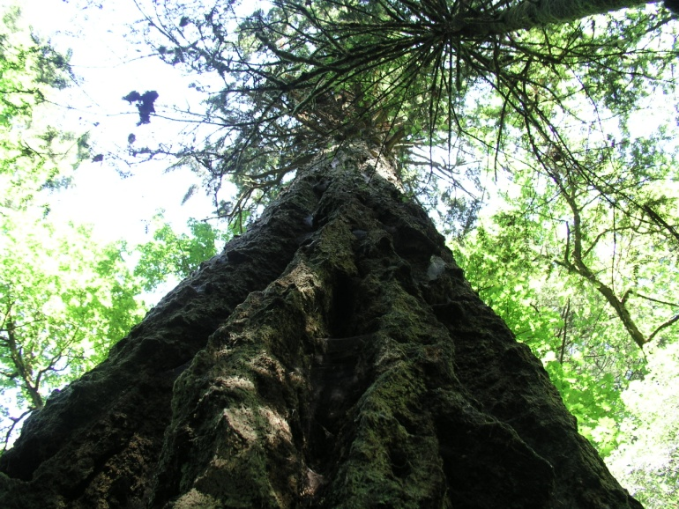
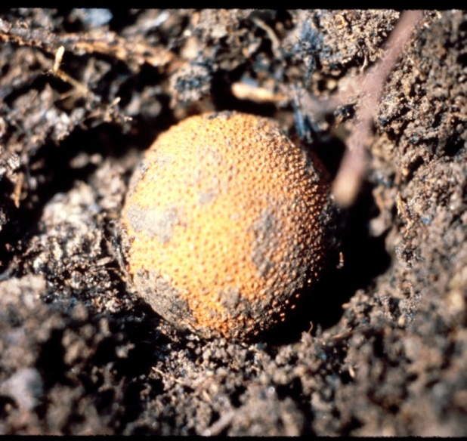
Pacific Northwest

Slide 3
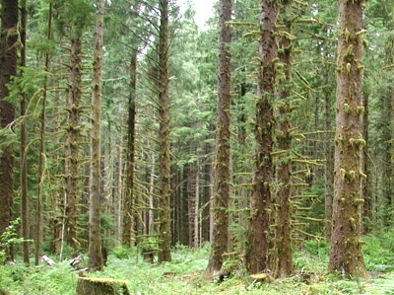
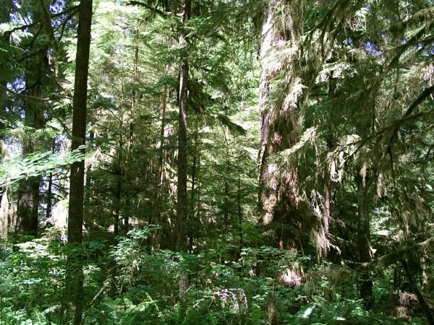
Simplified to Complex

Slide 4
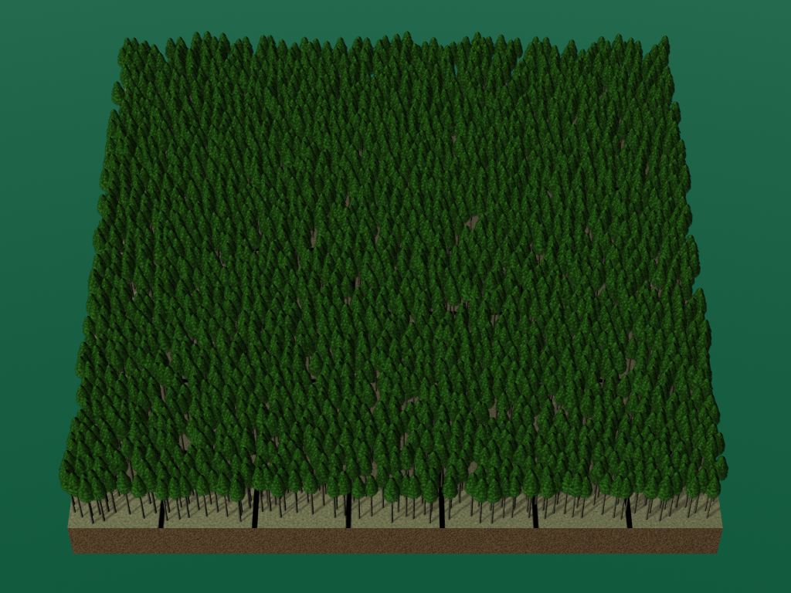
13 ha Stand (32 acres)

Slide 5
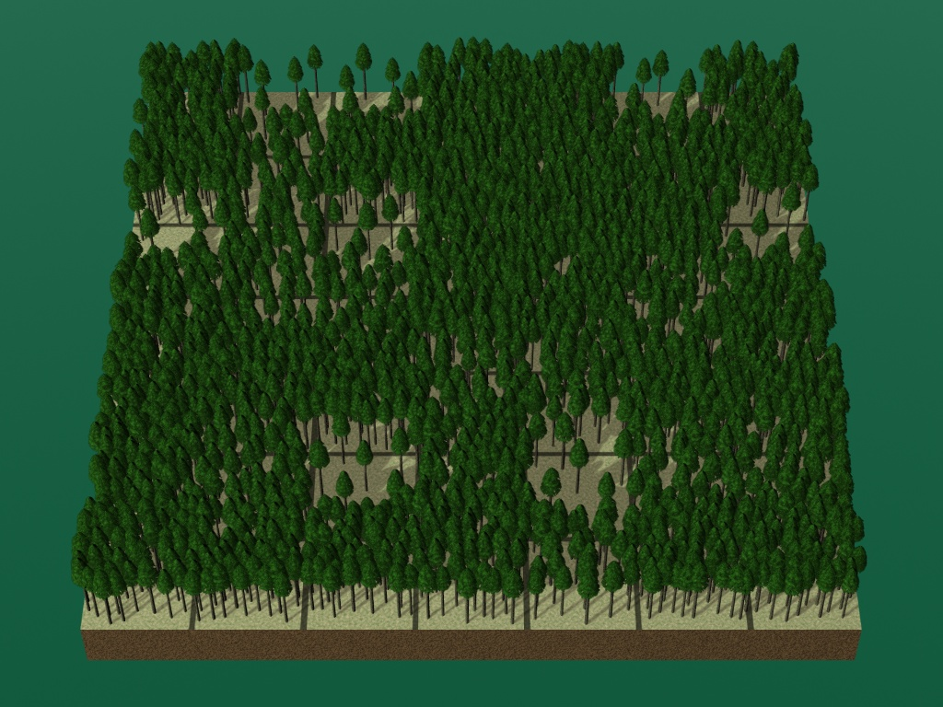
Variable-density Thinning

Slide 6
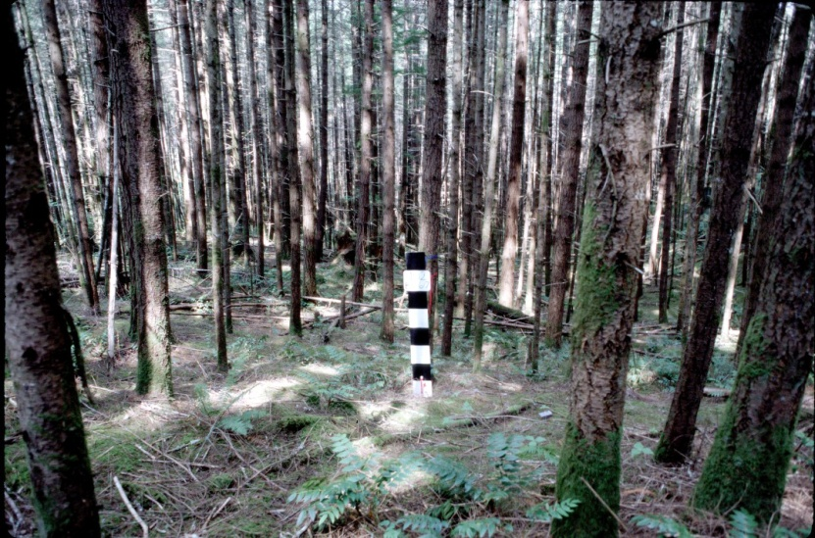
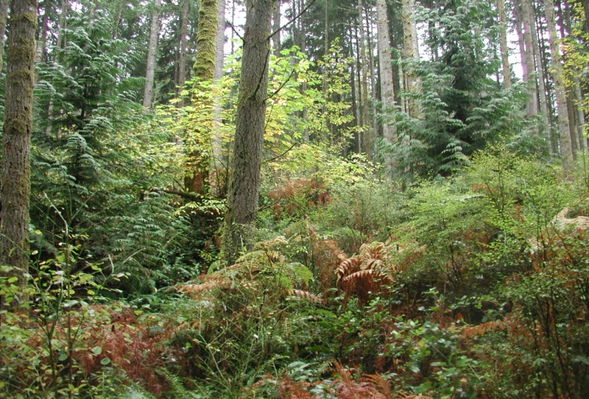
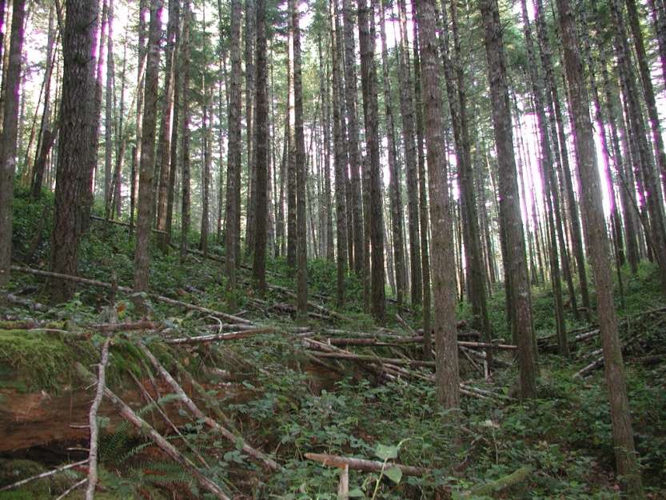
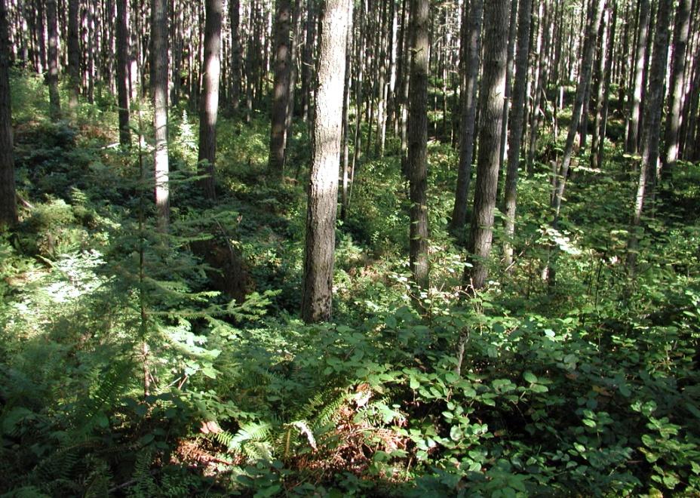
Legacy Forest
Pre-treatment
Open-Cut
Control
Light Thin

Slide 7
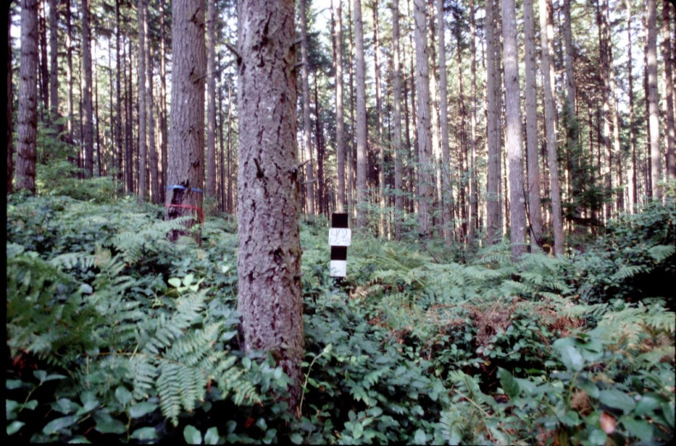
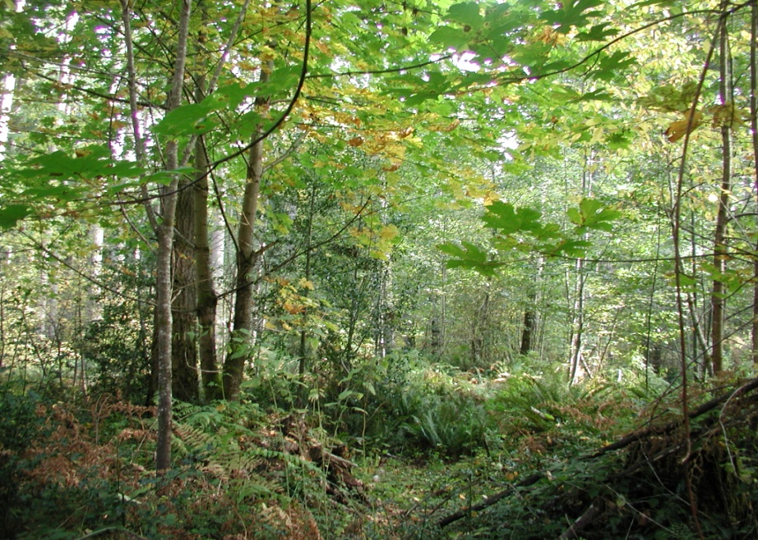
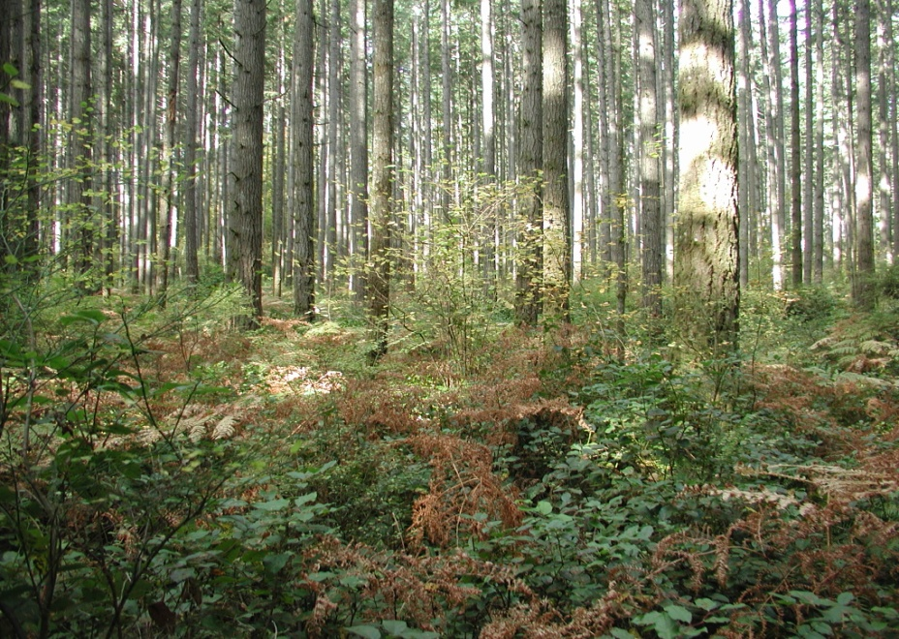
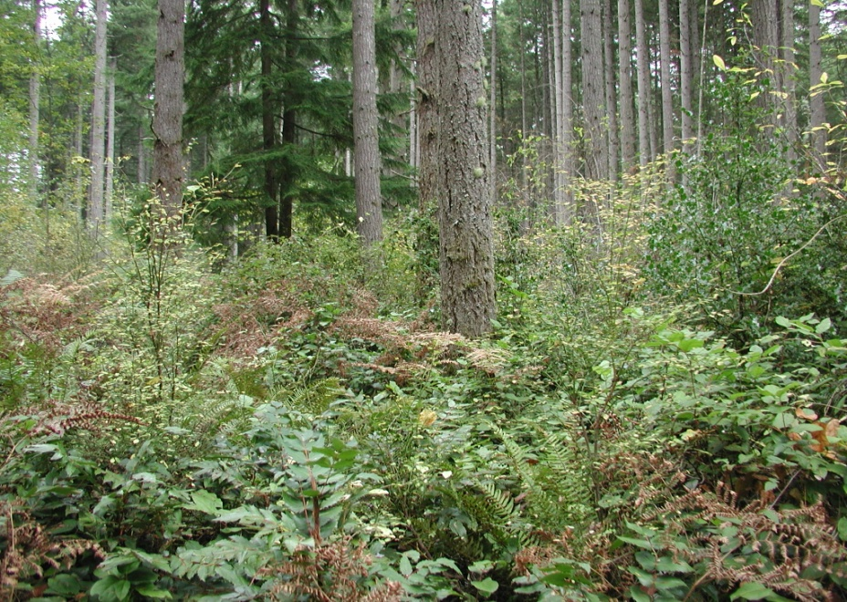
Timber Forest
Pre-treatment
Open-Cut
Control
Light Thin

Slide 8
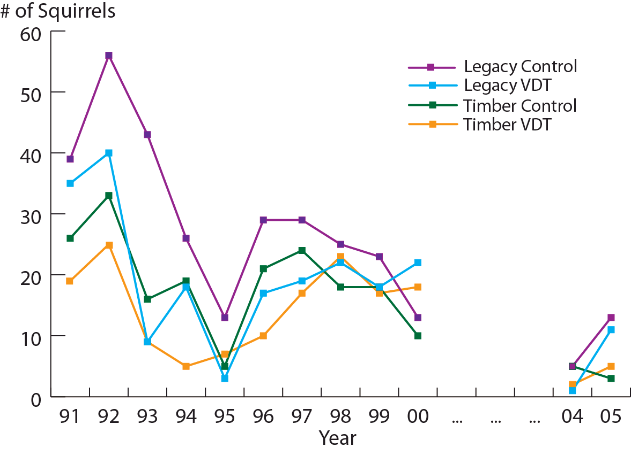
Thinning

Slide 9
Associations
High canopy cover
Patch-level changes
in vegetation
Understory cover
Large coarse
woody debris
Abundant
coarse woody debris
Nearness
to water
Large trees
Ericaceous
shrubs
Large snags
Stand Age
Availability of fungi
Increased litter depth
Nearness to conifers

Slide 10
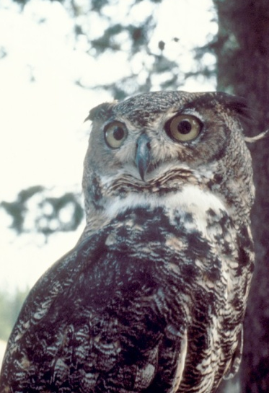
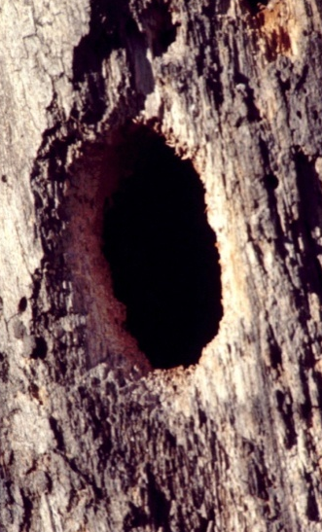
Hypothesized Limiting Factors
Food
Dens
Predation
Competition

Slide 11
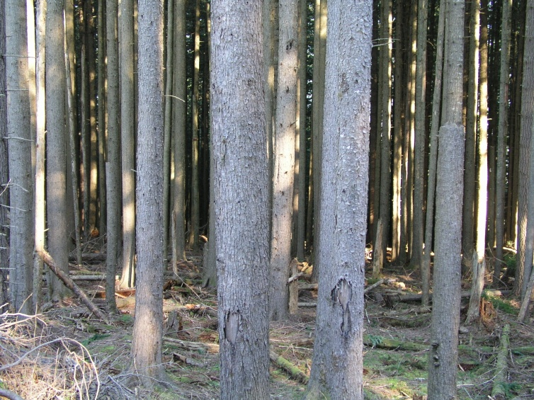
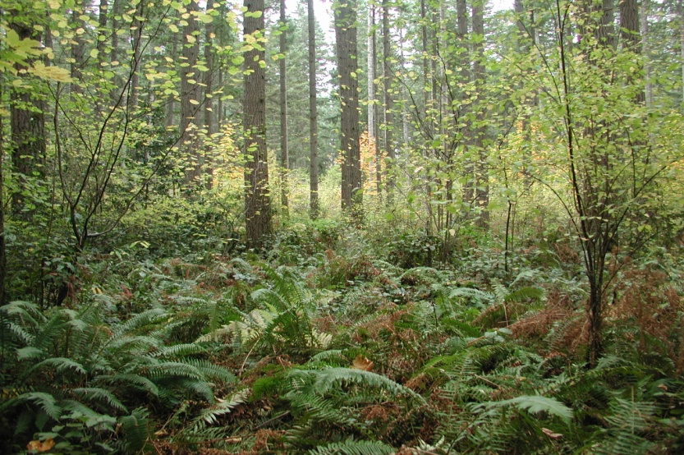
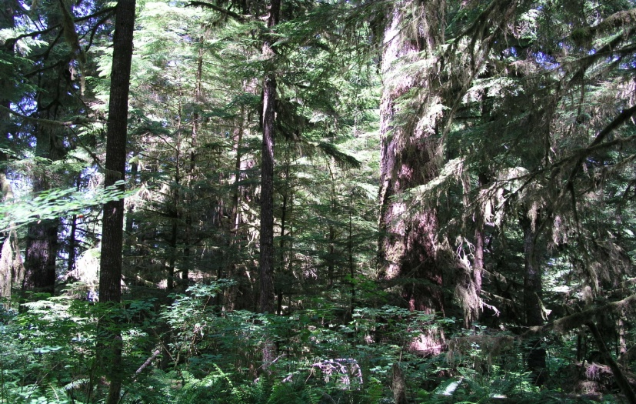
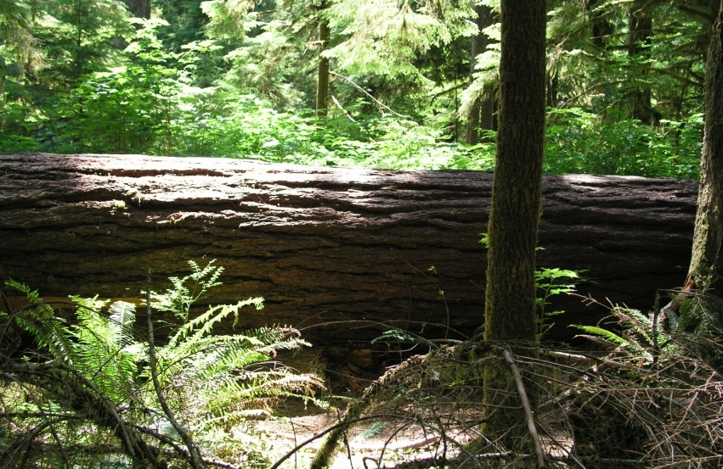
Forest Structuring Processes
Crown-class Differentiation
Understory Development
Canopy Stratification
Decadence

Slide 12
Classifying Stands as High or Low Abundances
Canopy
Gaps
10-m Intercept
Variance in
Live Tree d.b.h
Notes:
Model based alternative to discriminant analysis
Convergence can be tricky

Slide 13
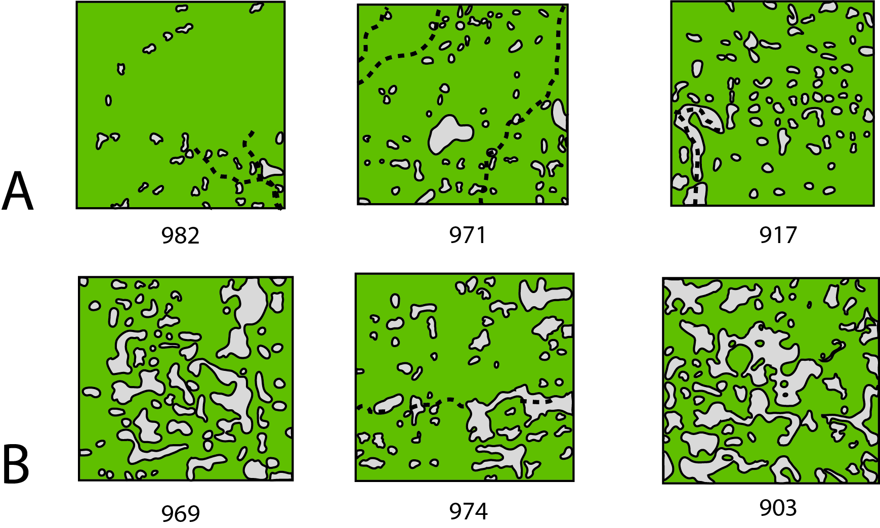
Olympic Peninsula
(smallest white patches ca. 10m x 10m gaps)

Slide 14
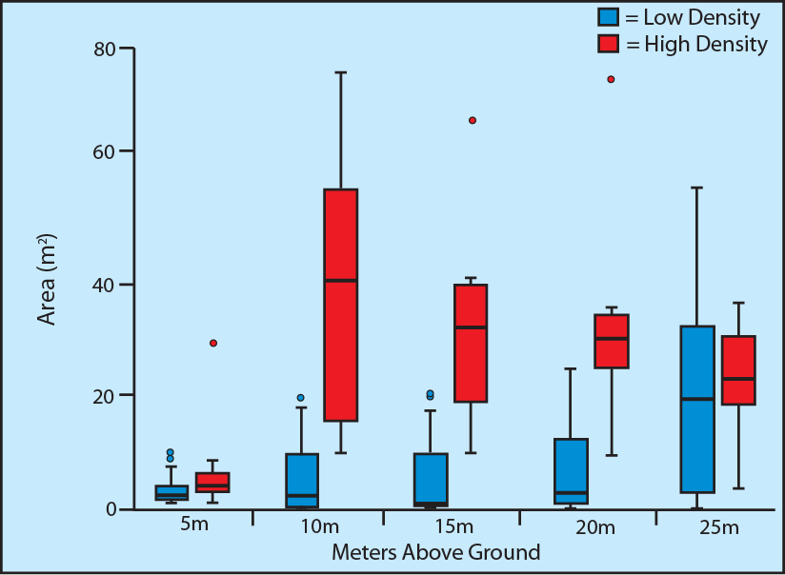
Vertical Layers
25
20
15
10
5

Slide 15
Structure-Predation Hypothesis
Forest Structure

Slide 16
Detection Risk (Visual/Aural/Scent)
OR
High
OR
Low

Slide 17
Attack Risk
Safe
Very Unsafe
Unsafe
Mixed

Slide 18
Squirrel Space Use
Den

Slide 19
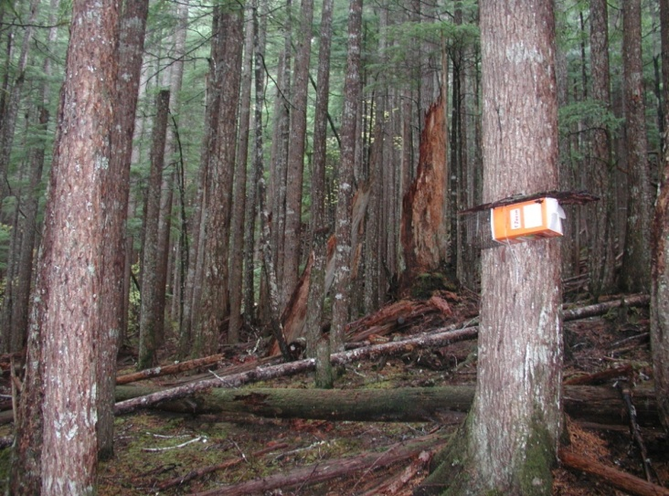
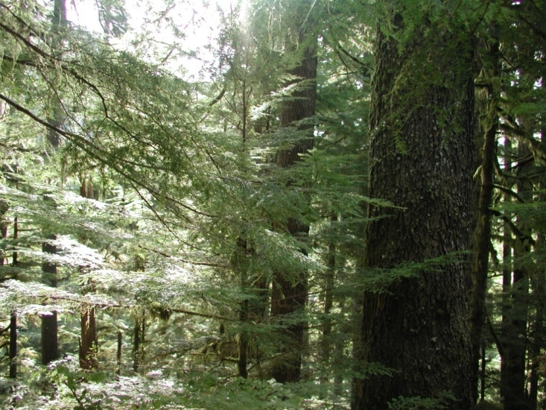
Where do we find lots of flying squirrels?

Slide 20
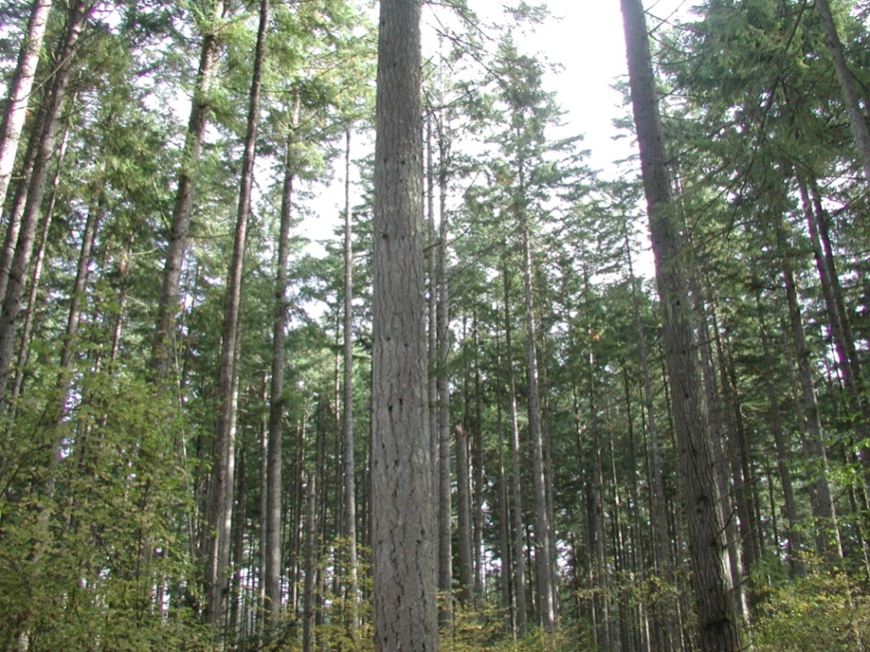
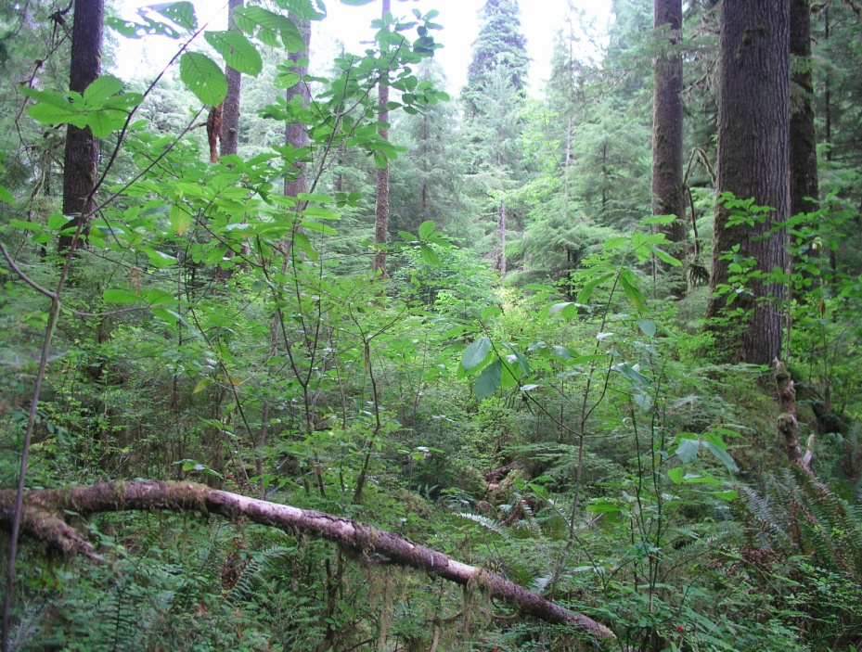
Where do we find few (if any) squirrels?
Notes:
Forests that have been thinned to where you can see long distances, and non-managed forests with large gaps

Slide 21
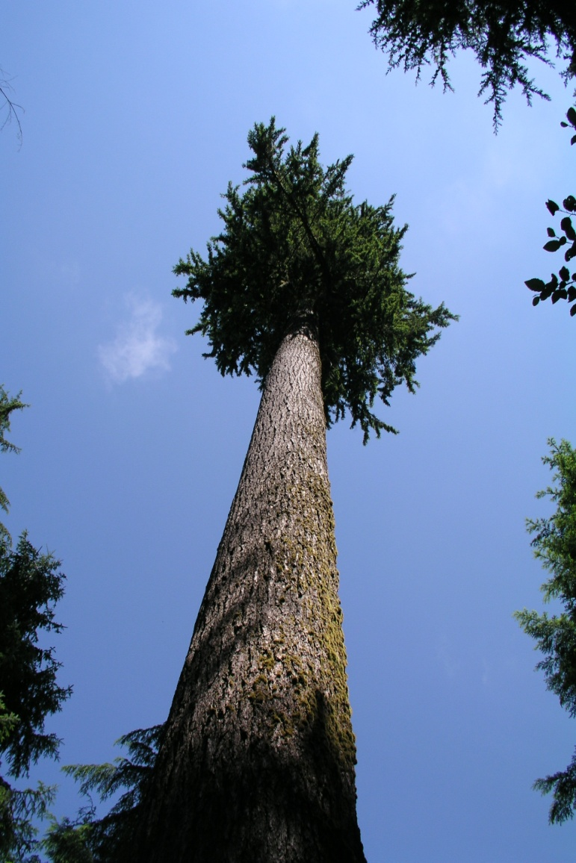
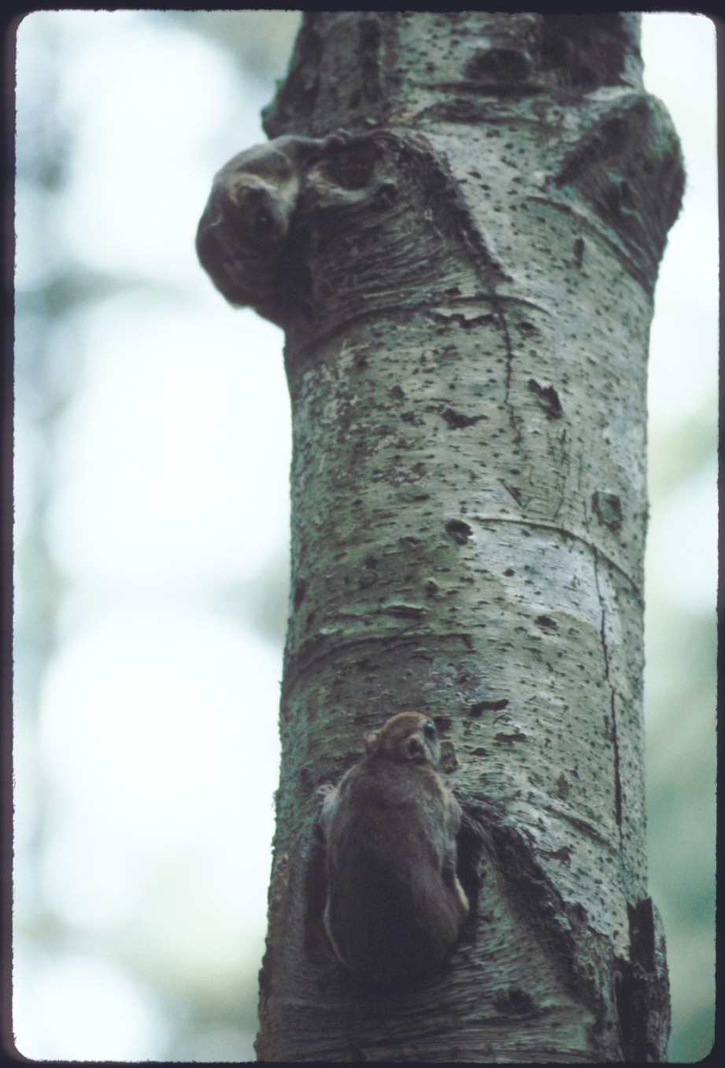
What about big trees, snags and CWD?
Notes:
They have been shown associated with high pops in ANOVA studies, but not when looking at a wide gradient of structural conditions. Lots of squirrels can be found in areas with little or no CWD or snags. 2/3 of den tree (of 600+ by Carey, Wilson, etc.) were in live trees. Presence of snags and CWD in stands supporting high squirrel abundances may reflect the ecological processes that lead to structural complexity

Slide 22
Stay tuned for
Part II
Notes:
Have to think spatially and temporally and in multiple dimensions. Now have some metrics that can be applied in thinning prescriptions. Continue expanding research and search for management partners.

