Slide 1
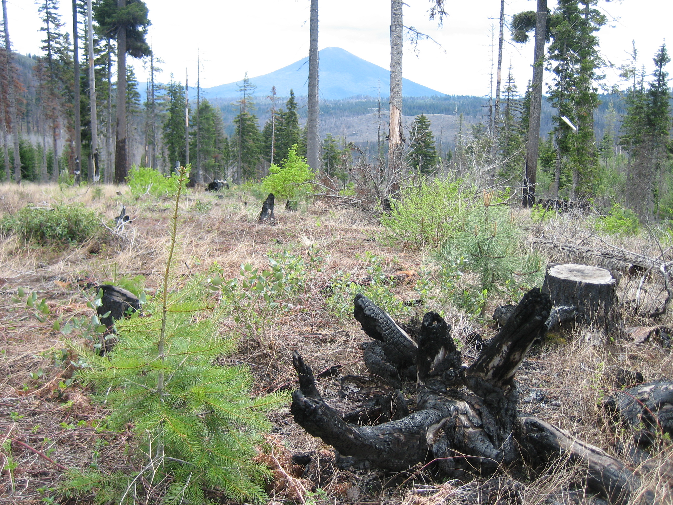

Dry-conifer Ecology and Silviculture in Western Oregon
John D. Bailey
Oregon State University
Notes:
Little experience in this part of the world recently – but I come from academia – draw on related ecosystems and general concepts; look forward to help synthesizing and getting some specific experience!

Slide 2
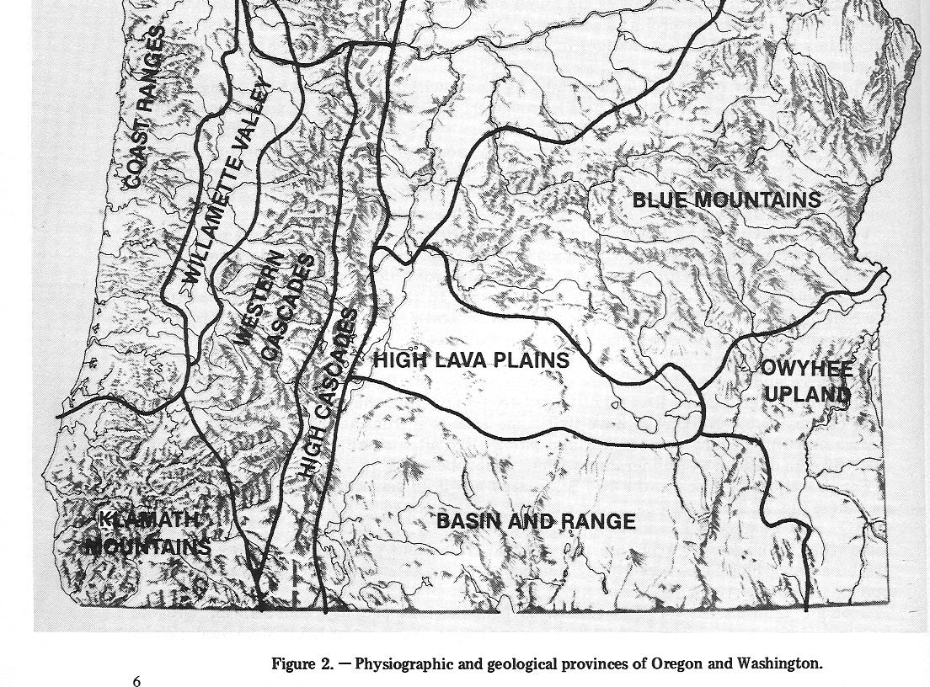
Two provinces but…
Rainfall
Temperature

Slide 3
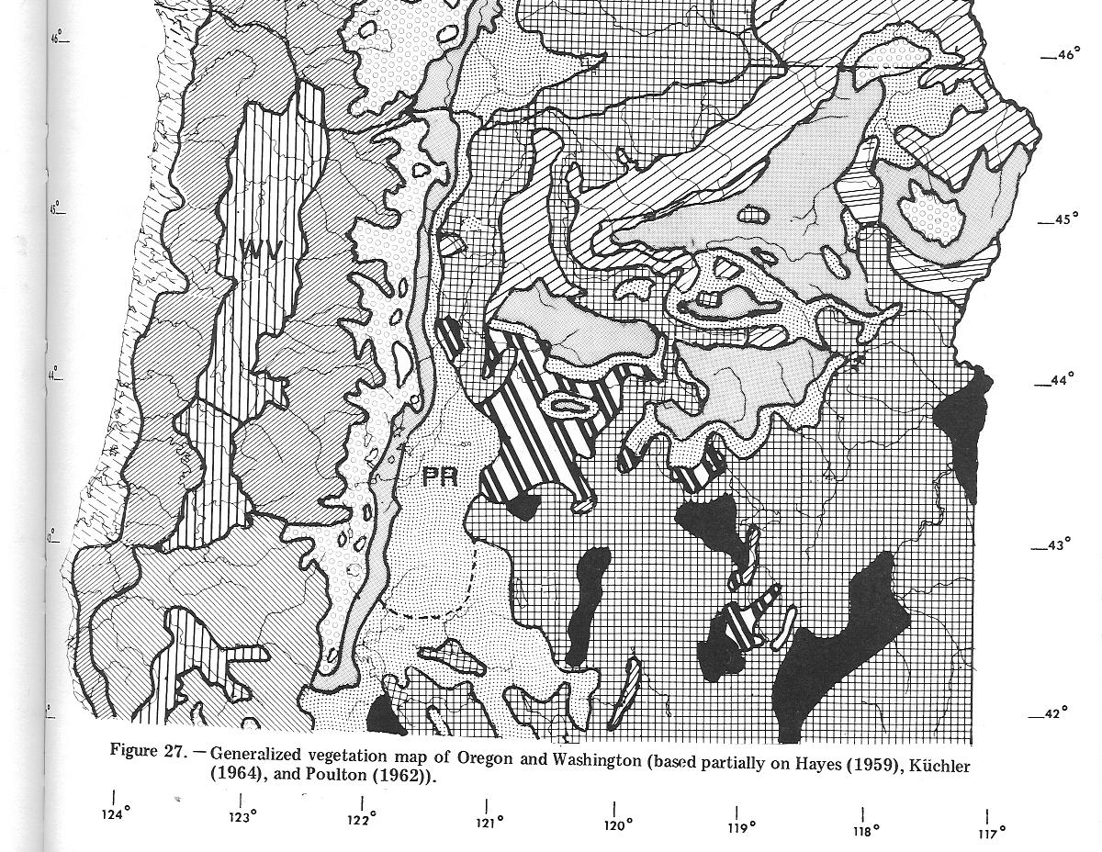
Forest Vegetation Formula:
Geology and Soils
Climate/microclimate
Disturbances - fire
Heterotrophs - humans

Slide 4
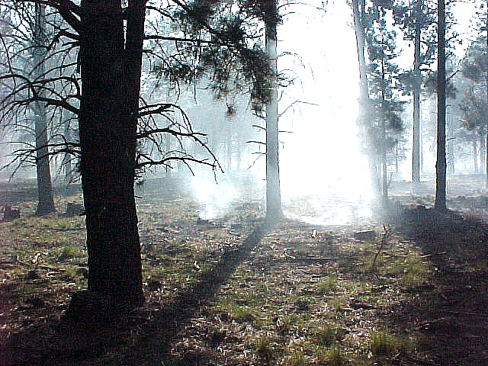
Ecology 101
Autecology (e.g., silvics)
Synecology (e.g., Douglas-fir infill)
Ecosystems – exchanges of mass and energy
Disturbance (no such thing as ‘balance’)
Douglas-fir (dominant)
Ponderosa and sugar pine
Incense-cedar
Oregon white oak
Forests and woodlands
Savannas
Grasslands/meadows

Slide 5
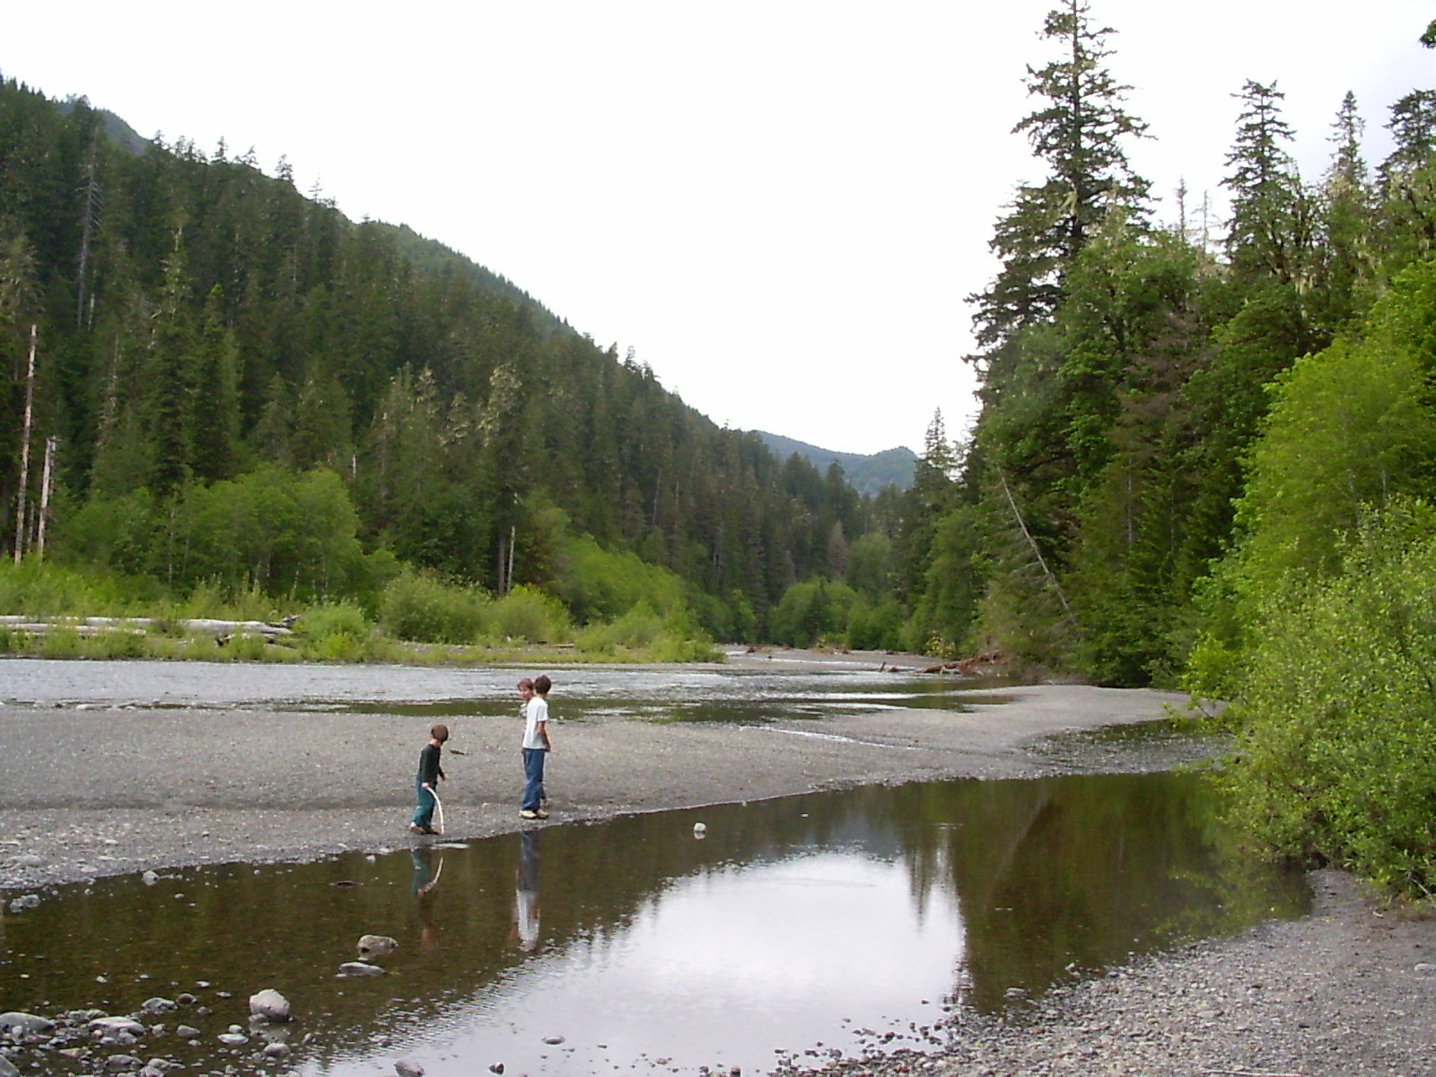
Stand Dynamics
Stand Initiation
Stem Exclusion
Understory Reinitiation
Old Growth
Seral stages (spatial and temporal patterns)
meadows?
fire-maintained woodlands
native peoples
young forest?

Slide 6
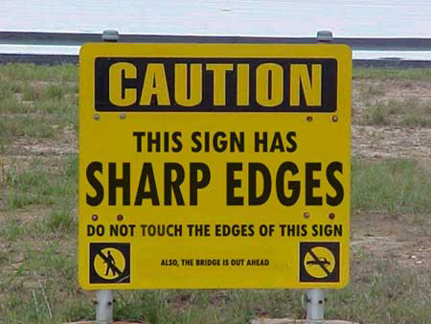
Historic vs. current conditions
“Axis of Evil”
settlement and land conversion
overgrazing
fire exclusion and suppression*
dewatering of drainages
scattered (often high-grade) logging*
ungulate proliferation
Fuel accumulation
Density
Age and size structure

Slide 7
Silviculture Mechanical Treatment (e.g., “thinning”) vs. Prescribed Burning
Advantages
Disadvantages

Slide 8
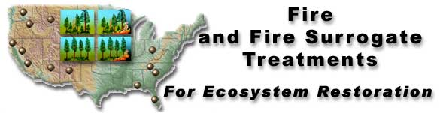
National Program
13 sites in the US
Two factors (mechanical and fire)
Basic Design and Monitoring
http://www.fs.fed.us/ffs/
Control Burn Only
Thin Only Thin & Burn

Slide 9
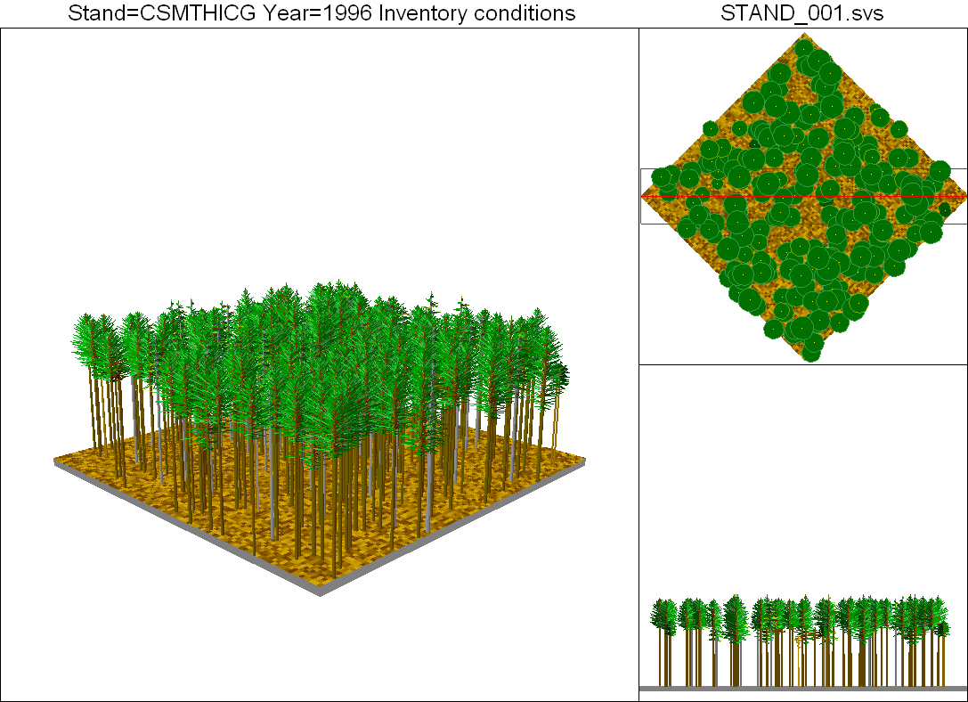
Standard Fuels Reduction Treatment – 2 million acres/year

Slide 10
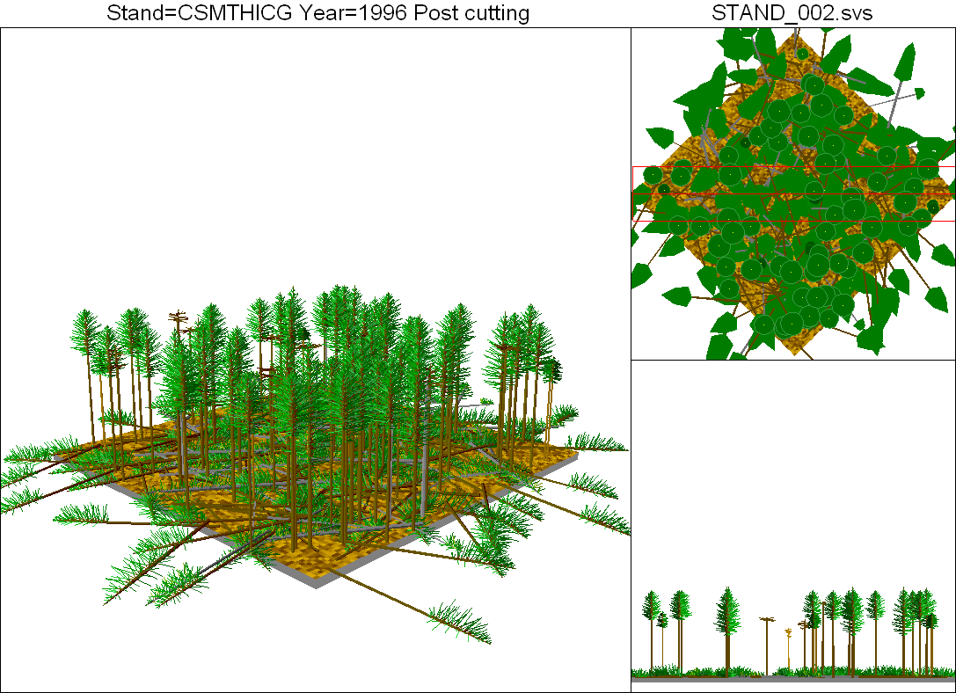
FFS 80/80 Treatment

Slide 11
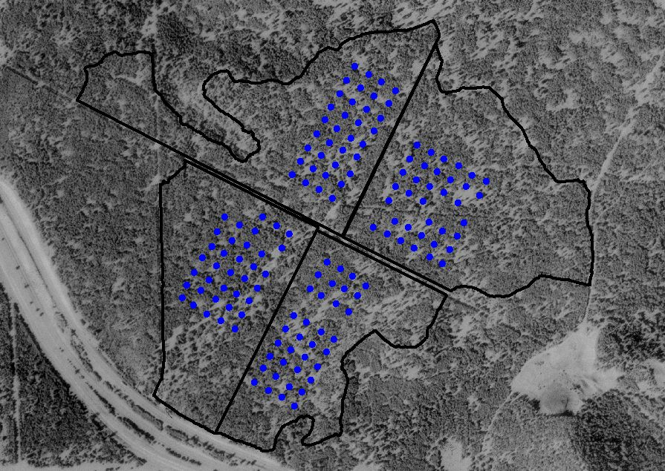
FUELS REDUCTION TREATMENTS
Silvicultural Effectiveness
n. Having the intended or expected effect; serving the management purpose over time and space
Structure
tree and stand
live and dead
Composition
Fuels levels
Stand Dynamics – DFD’s
restoration
ecosystem-based management
carbon
Sustainability

Slide 12
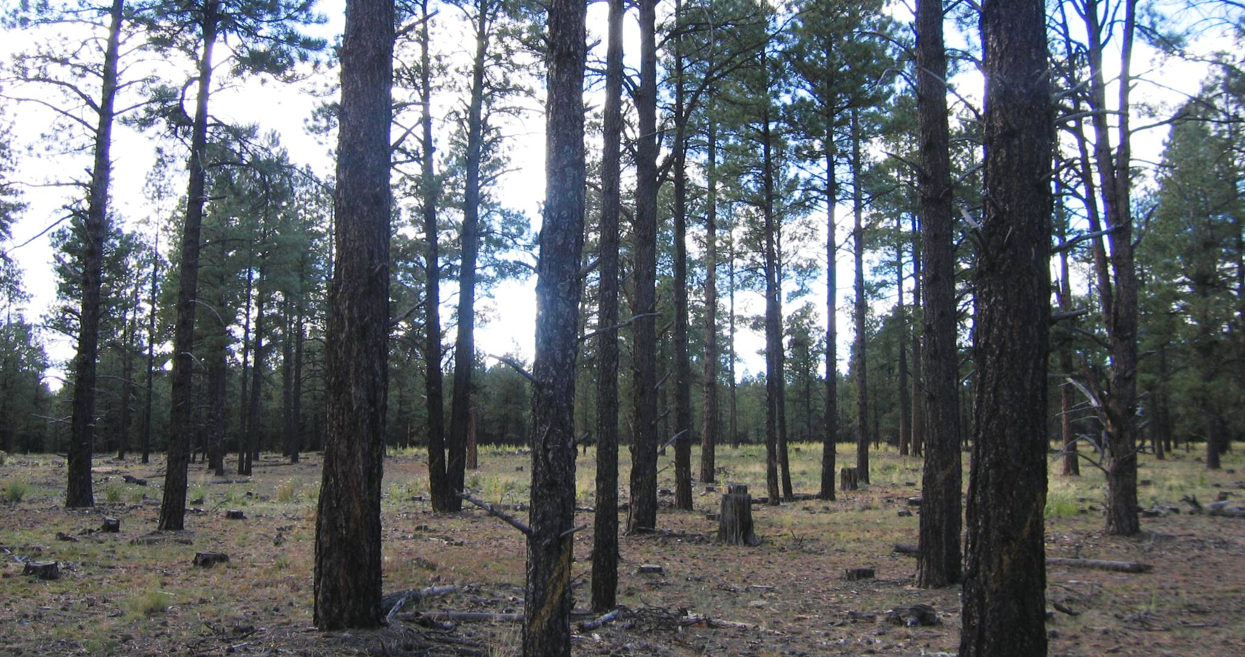
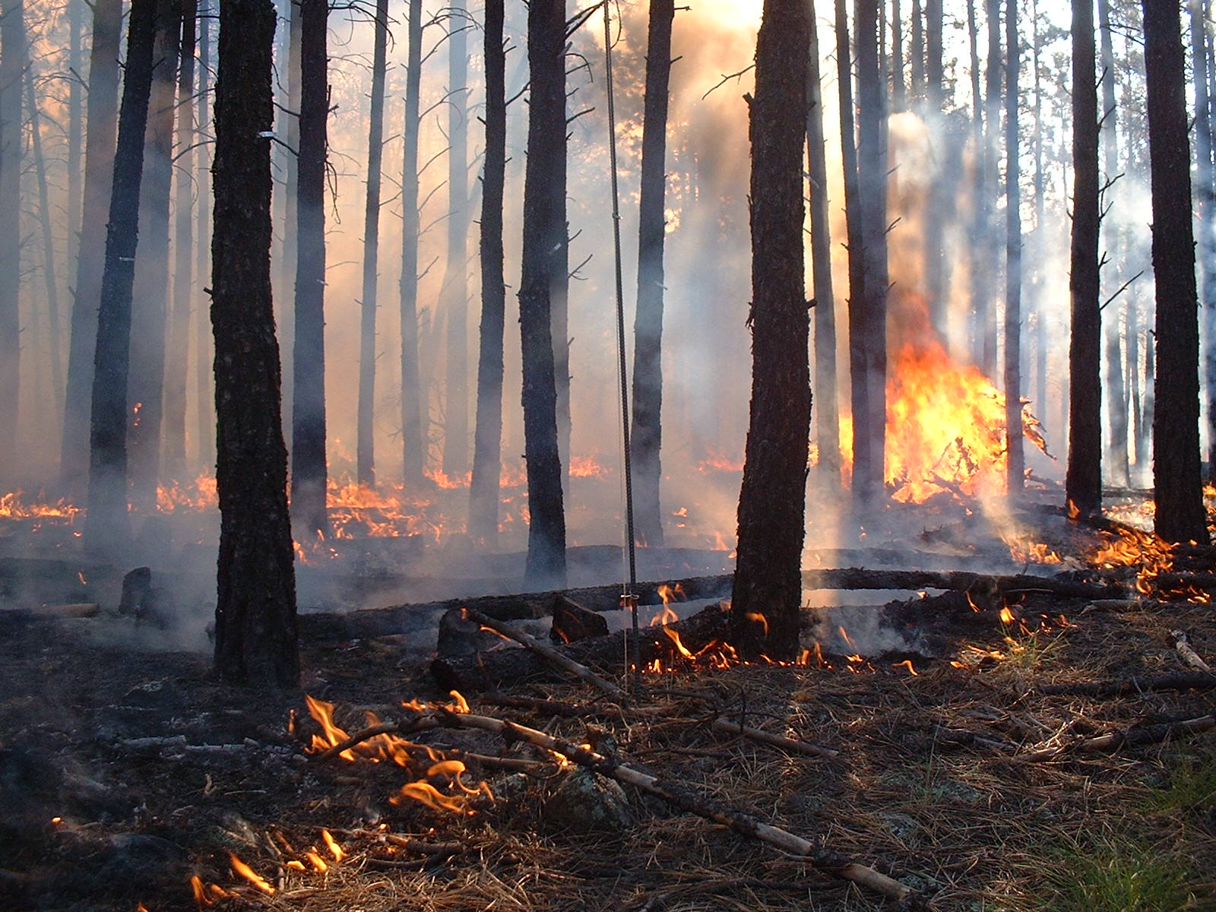
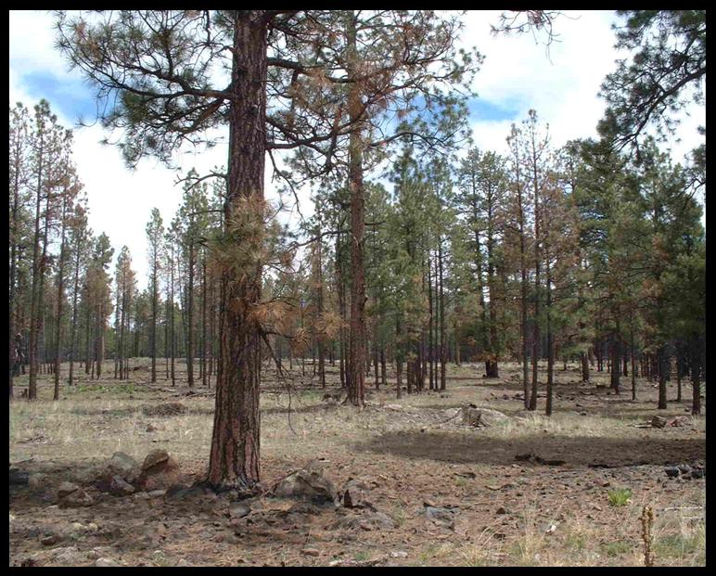
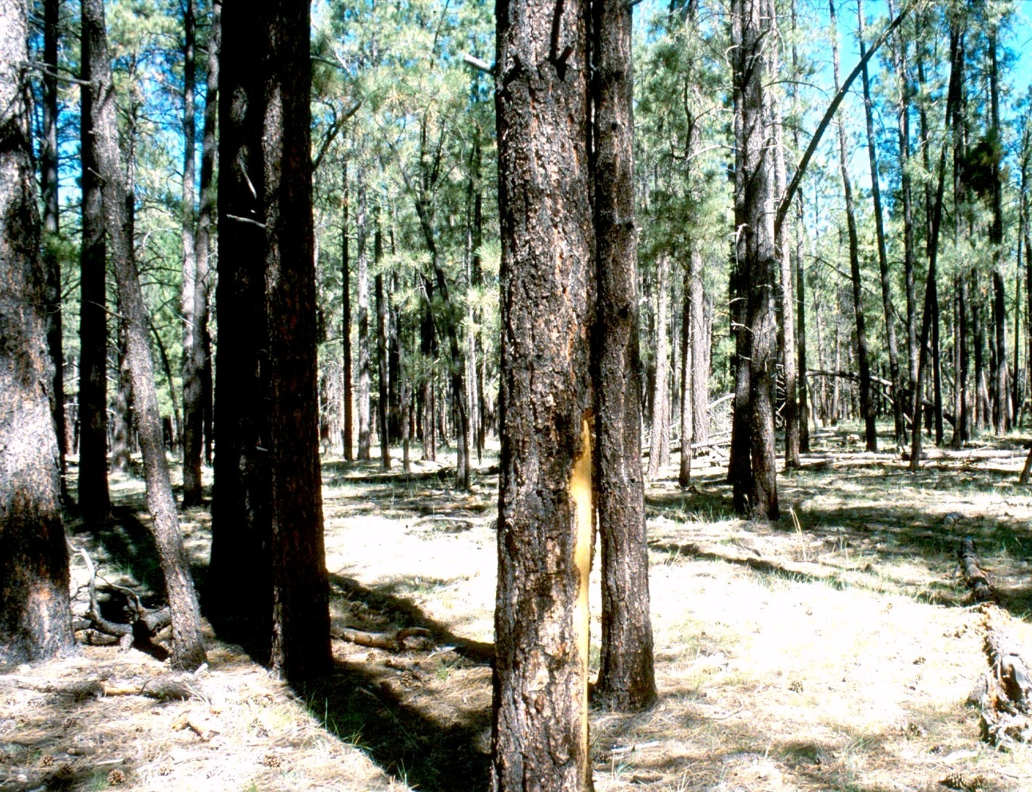
FFS Treatments – Southwest Plateau (northern Arizona)
Mechanical harvest only Prescribed fire only
Harvest followed by fire Control

Slide 13
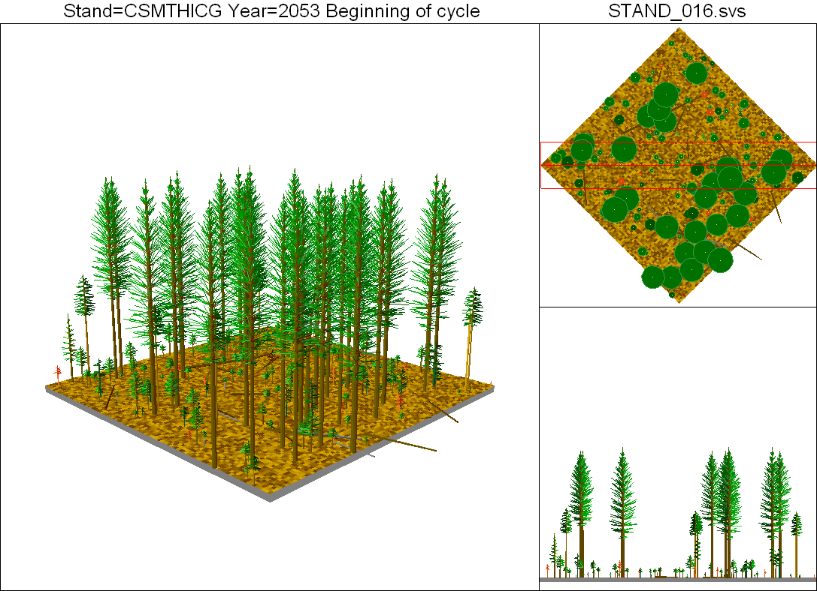
FFS Treatment – Future Structure and Dynamics…40 years later

Slide 14
Other Restoration Treatments
Silvicultural Effectiveness
n. Having the intended or expected effect; serving the management purpose over time and space
Meadow encroachment
Oak savanna infill
northern spotted owl habitat
defensible fuel breaks
MULTI-AGED MANAGEMENT
STANDS AND LANDSCAPES

