Slide 1
Briefing on Biooil/Biochar Study and DEMOs
05/28/2009
Gabe Dumm & Jim Archuleta
Umpquya National Forest
Notes:
Please forgive my absence, but I hope this automated PowerPoint will work for you.
I have included contact information for you at the end of this slideshow.

Slide 2
Study Name is
Sustainable forest bioenergy production using in-woods fast-pyrolysis conversion including bio-oil production and bio-char incorporation
Notes:
We spent more time putting together the study than getting a snappy name and it shows.

Slide 3
Umpqua Perspective
How did this Idea Start ?
Diamond Lake RD Wildlife Program
Desired to improve soil productivity
  Big Game Food Plots
Improvements via Terra Preta de indio
  Human created soil >1000yrs ago
  Developed in Amazon Basin
    Still nutrient stable
    Sold as bagged topsoil
Notes:
Diamond Lake RD’s nationally recognized Wildlife program wanted to maintain soil productivity within food plots.
Wildlife Biologist Jeff Bohler pushed for an exploration of Terra Preta.

Slide 4
Study Cooperators
Rocky Mountain Research Station
  Primary Investigator, Soil Nutrient Response
Renewable Oil International, LLC
  BioOil/BioChar Production
University of Idaho (Intermountain Forest Tree Nutrition Cooperative)
  Soil Nutrient Response
University of Montana
  Forest Operations (Economics) and Transportation
Umpqua NF
  Provides Site, Feedstock, and Grinding
Notes:
Cooperator list with area of responsibility
Also added are the NRCS and Oregon Dept of Forestry as collaborators on the Glide and Merlin Demos.

Slide 5
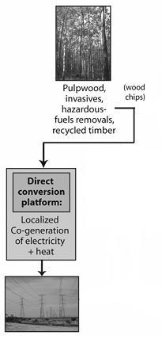
FS Most Prescribed Platform
Forest Service Fuels Reduction Projects
Output is cogeneration energy
  Often discounted if Biomass transport exceeds certain mileage
Notes:
Energy output is readily available, but problematic for storage.

Slide 6
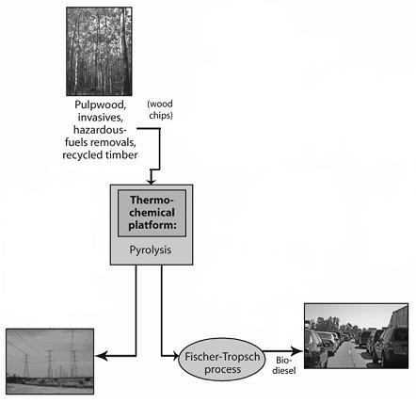
Platform Proposed by Bio-Oil/Bio-Char Study on the Umpqua NF
In-Woods BioOil
Production= Reduced
Transport cost
Notes:
Study is most interested in the ability to produce a raw product (Light Fuel Oil), therefore we are focusing on Fast Pyrolysis. Fast Pyrolysis has the highest volume of both energy product and Biochar. It is hoped that the results will show a cost comparison of In-woods process, from reduced transportation costs of energy taken from the woods.

Slide 7
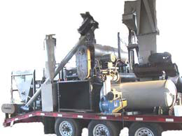
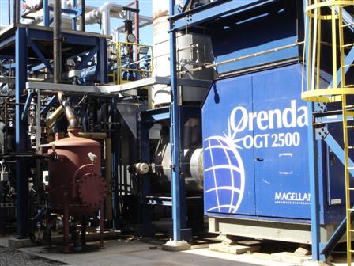
Study Objectives – Publish Comparison of Economic Feasibility:
In-Woods Mobile Biomass Pyrolysis Plant
Photo from
Renewable Oil Inc.
A Fixed Centralized
Pyrolysis Plant
Photo from
Dynamotive Energy Systems
Notes:
Native forest productivity creates 370 million dry tons of available biomass annually in the US (R. D. Perlack et al., “Biomass as feedstock for a bioenergy and bioproducts industry: The technical feasibility of a billion-ton annual supply” (Oak Ridge National Laboratory, 2005) ). The pictured equipment is hope to meet that need.

Slide 8
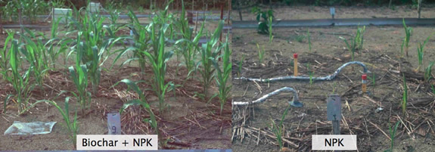
Study Objectives – Publish Impact of BioChar Amendments on Forest:
  Compare to biomass removal to fell-and-leave
  Photos from International Biochar Initiative website
Notes:
Photos from IBI website. We are hoping to replace these photos with trees, like the next slide.

Slide 9
Application of Biochar within LTSP
DL RD – Umpqua NF 04/2009
Notes:
Photos from IBI website. We are hoping to replace these photos with trees, like the next slide.

Slide 10
Pyrolysis Feedstock Requirements
Moisture Content ~10 Moisture
  Assumed Achievement – via Field Drying
    Currently practiced for Burning Slash Piles
    6 months to 1 year
    Demo will employ Dryer to ensure moisture content
Size
  Must be ground to 1/16th to 1/8th on one face after moisture requirement is met
Notes:
Self explanatory

Slide 11
Characteristics of Fast Pyrolysis
Rapid heating of the biomass
  1000º F per second
  Absence of Oxygen in a Closed System
Rapid condensation of the vapors into BioOil
Solid product of BioChar
Notes:
Self explanatory

Slide 12
BioOil Product Usage
BioOil Product is comparable with Bunker Fuel
  1 Ton of Slash = 120 Gallons of BioOil
BioOil - refinement possible to #2 Diesel
  Fischer-Tropsch Process or Blending
Biooil is heavier than water
  Spill clean up may be an issue in water
Notes:
Bunker Fuel is usually low-grade coal or heavy oil used to power a ship. Also called just bunker.
Fisher-Tropsch process was invented in petroleum-poor but coal-rich Germany in the 1920s, to produce liquid fuels.
While there are many benefits with Biooil, there is some tarnish to this silver bullet. We must be aware of issues with any application used in land management. However spill issues may not be a problem if it is on soil. Indications from the producer are that spills may be run through the equipment to recapture the oil and clean the soil. This will likely heat alter the soil so an organic amendment would likely be necessary.

Slide 13
BioChar Product Usage
Both a viable Soil Amendment and Avenue of Carbon Sequestration
  1 Ton of Slash = ¼ Ton of BioChar
    Literature indicates promotion of soil productivity
    Soil productivity may not be increased on all soil types
  Product may be comparable to Horticultural Charcoal
    Assumption of many
  Charcoal in the soil is a stable form of carbon
    Carbon sequestration in the soil is less susceptible to wildfire loss (Cornell Univ)
Notes:
Current uses of horticultural charcoal may show the application of Biochar when extrapolating to greater uses than potted plants.
Cornell University. "Simpler Way To Counter Global Warming Explained: Lock Up Carbon In Soil And Use Bioenergy Exhaust Gases For Energy." ScienceDaily 12 May 2007. 15 July 2008 <http://www.sciencedaily.com­ /releases/2007/05/070511211255.htm>.

Slide 14
Schedule of Study's Actions
Completed Activities
  Planning & Economic data collection
  Plan Field Studies
Pending Activities for 2009
  Spring/Summer
    Biochar Delivered
    Installed Field Study, with initial measurements taken
    Economic analysis continues
  Aug 18th 19th 22nd and 26th – Portable Pyrolysis demonstrations
    Outreach info on pyrolysis unit design and economics, annual accomplishment report
    Post-treatment Measurements
    Begin to prepare report, assure study design is archived for future research
Pending Activity for 2010
    Final report
Notes:
Self expanitory

Slide 15
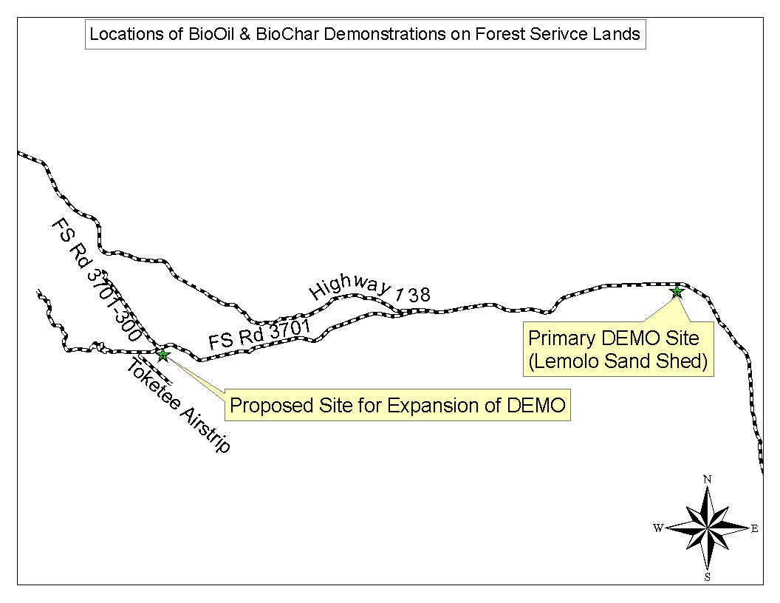
Site Locations
Notes:
Lemolo Site will be the only Public lands Demo, other dates are for Glide OR and Merlin OR. Map has not been updated to reflect all locations.

Slide 16
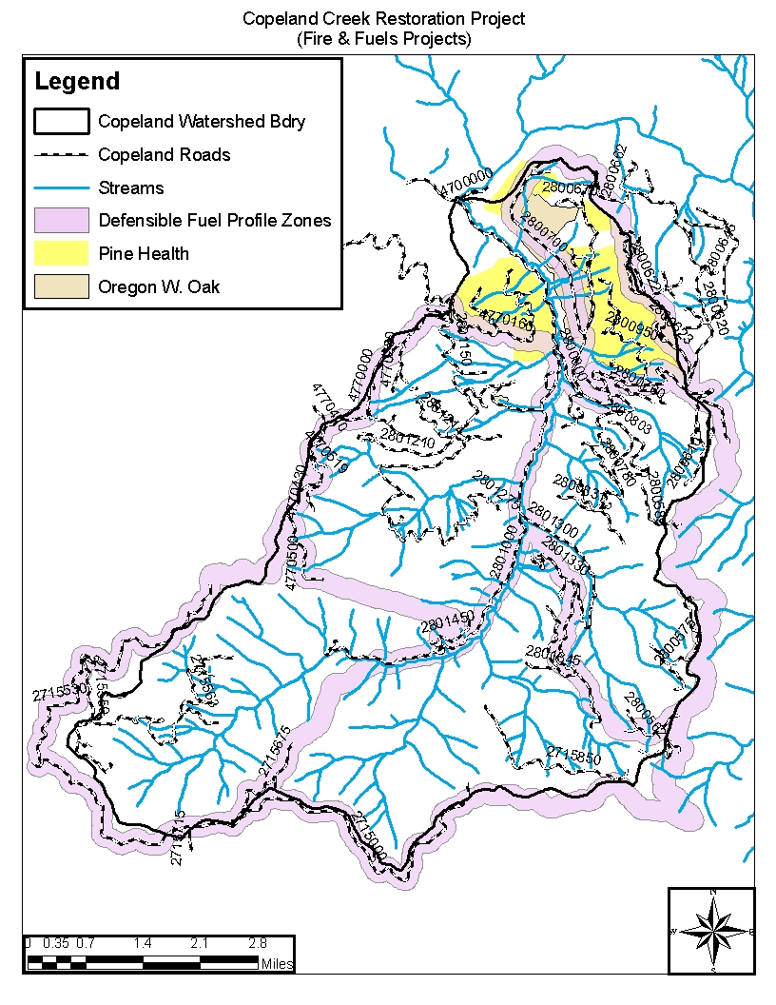
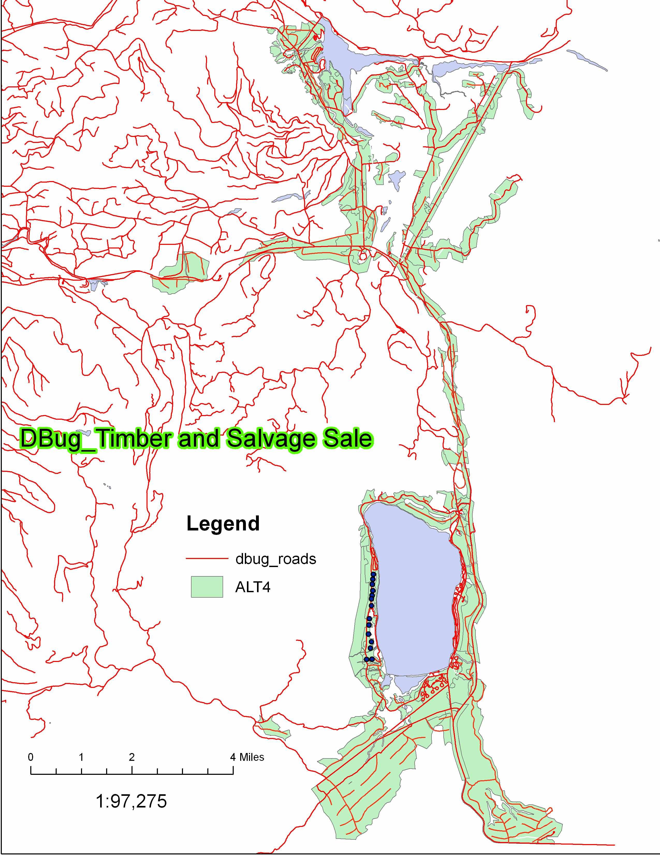
Implications of Fast Pyrolysis to Land Management
Landscape Scale Fuels projects are:
  Costly
  $1000/ac to Plan & Implement
D-Bug Planning Effort
  Un-merchantable acres
Copeland Creek Watershed Restoration
  Defensible Fuel Profile Zone (DFPZ)
  Pine & Oak Health
Notes:
The D-Bug Planning Effort Draft Environmental Impact Statement (DEIS) covers 9,000 ac: 7000 ac of commercial harvest and 2000 ac of Non-commercial fuels reductions.
Copeland Creek Watershed Restoration Plan uses the concept of Defensible Fuel Profile Zones (DFPZs) to reduce wildfire risk within a key watershed on the Diamond Lake Ranger District.
Both of these projects can produce copious amounts of Biomass for a Mobile Fast Pyrolysis Unit or units.
Using the Non-commercial acers within D-Bug as an example.
2000 ac with 9 dry tons of Biomass = 18,000 dry tons of Biomass
18,000 dry tons of biomass = 2,160,000 gal of Biooil and 4,500 tons of Biochar
Biooil value varies from $0.87/gal to $1.30/gal.
Biochar value varies from $600/ton to $1,300/ton.
You do the math! This is an option to make greater strides in fuels treatments on public lands.

Slide 17
Implications for this Adaptation
Forest Service may be able to enter a new revenue stream for:
  Funds to U.S. Treasury
    Off-set Wildfire costs or other Nat. Emergancy
  Receipts to Counties
    Off-set of Title II Payments to Counties
  Knutson-Vandenberg Act (KV)
    Sale Area Improvement Fund
Notes:
Self expanitory

Slide 18
What is needed to ensure Landscape Projects are viable?
Comparable products in the marketplace
  Bunker Fuel
  Horticultural Charcoal
  Others?
Develop BioOil/BioChar connections to products
  Is the comparison one to one?
Continue to follow developing science in Biomass and Soil Productivity
Ensure that local contracts are trained and equipped to do this work
Notes:
Comparable products, do these products have a 1 to 1 relationship in the value with established products currently in the marketplace.
Science is still evolving related to the uses of these products and their applications.

Slide 19
Questions
Gabe Dumm
gdumm@fs.fed.us
Cell 541-957-3446
Jim Archuleta
jgarchuleta@fs.fed.us
Office 541-498-2531
Notes:
Hope this was useful information to you.
Thank you for your time and feel free to contact us for more information.

