Slide 1
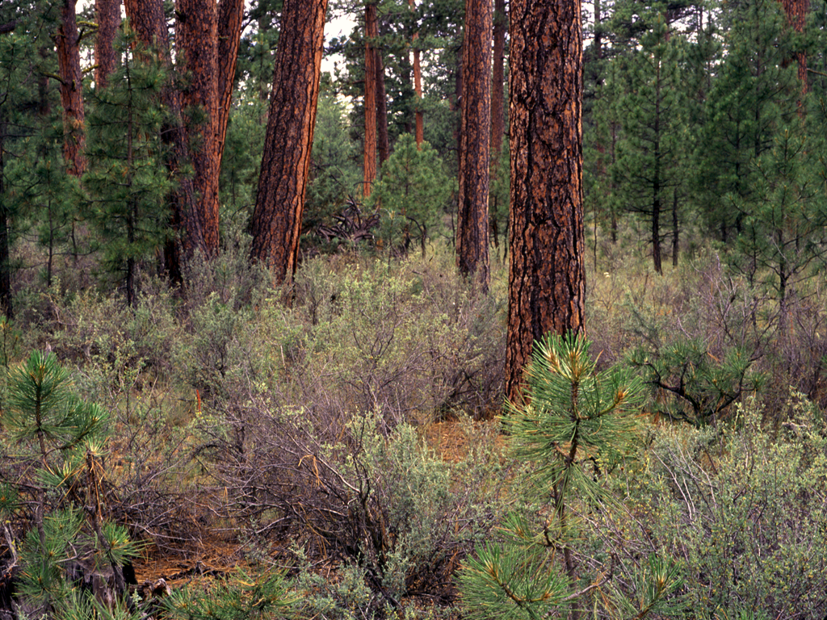
Integration of Multiple
Resource Values
A Critical Component of
Restoration in Dry Forests
Notes:
Presentation on ecoregions of the Pacific Northwest (Oregon and Washington).

Slide 2
There are more things in heaven and earth, Horatio, than are dreamt of in your philosophy.
--Hamlet I:v
Not only is nature more complex than we know, it is more complex than we can understand.
--attributed to Jack Ward Thomas

Slide 3
So how do we deal with complexity?
Notes:
A definition of “ecoregion.” At this broad scale, climate and geology are the drivers.

Slide 4
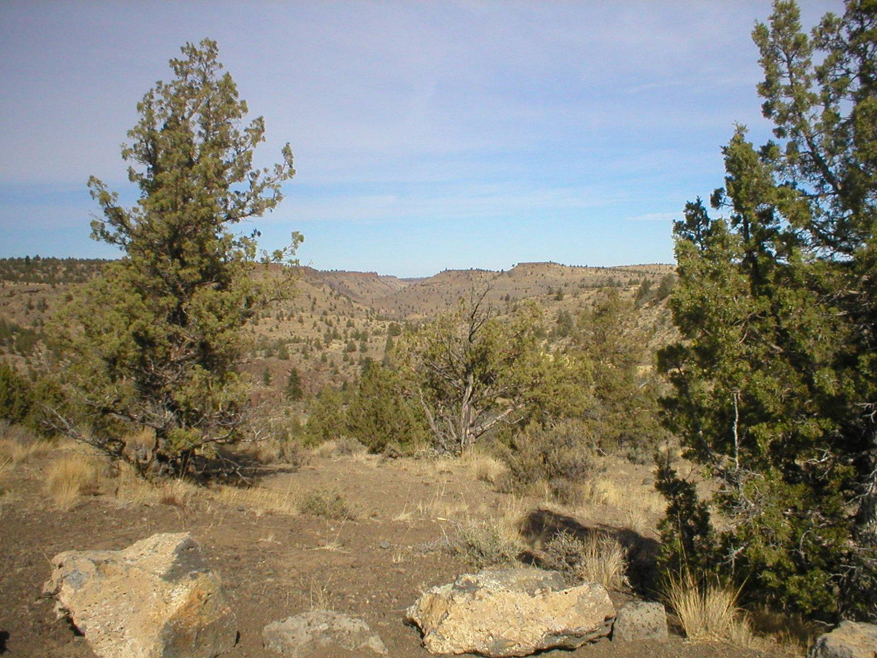
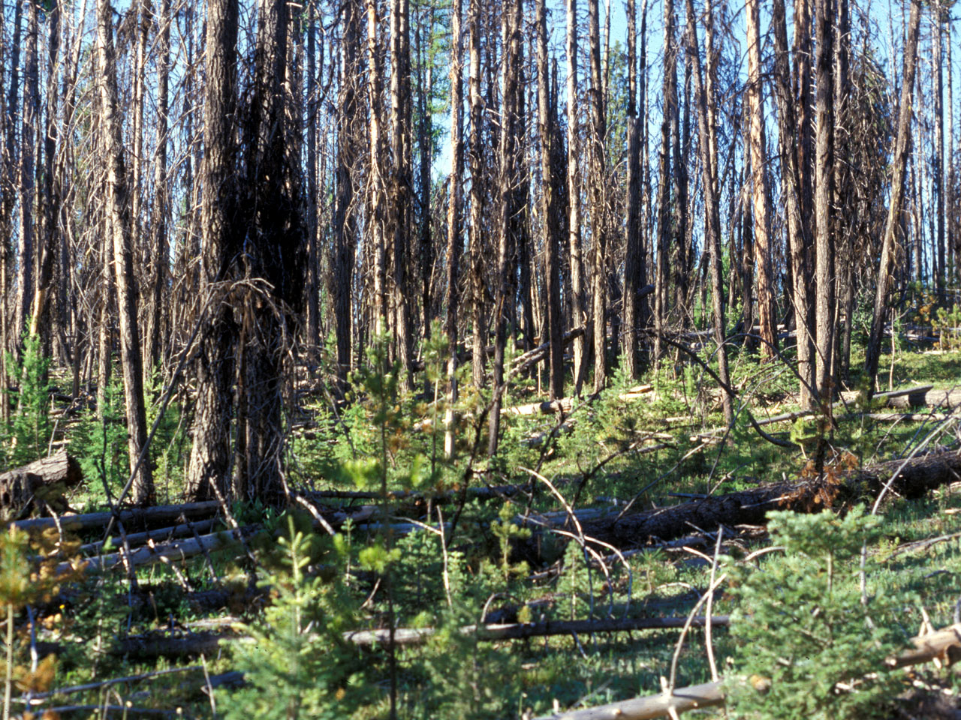
Ecology Basics
Ecology “unifying statement:”
We study the structure, function, and composition of ecosystems at multiple scales over time.
Notes:
The unifying statement for ecology is: We study the structure, function, and composition of ecosystems at multiple scales over time. This statement covers all the key features of landscape ecology and will be returned to again and again during the module. Incidentally, this is also an effective way to organize biodiversity into a manageable framework.

Slide 5
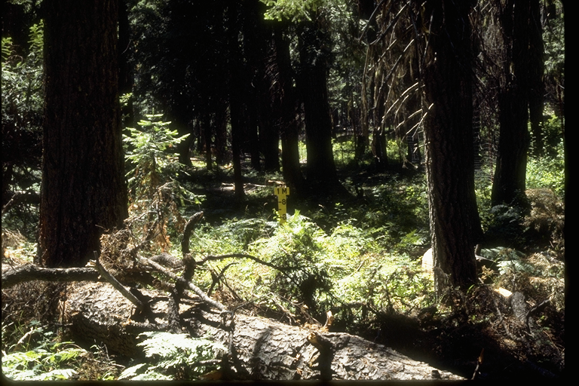
We study the structure, function, and composition of ecosystems at multiple scales over time.
Structure is the physical construction of the ecosystem
Notes:
Structure is the height, canopy layers, diameters, and downed wood of forest ecosystems. Structure is influenced by the limiting factors we discussed earlier—moisture, nutrients, temperature, etc. Ecosystems capable of producing more biomass will generally have more complex structure.

Slide 6
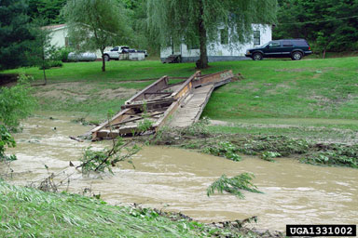
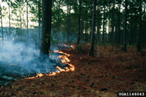
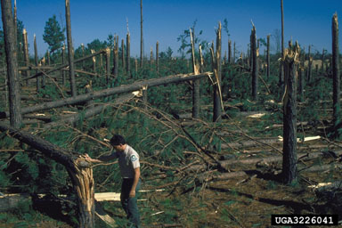
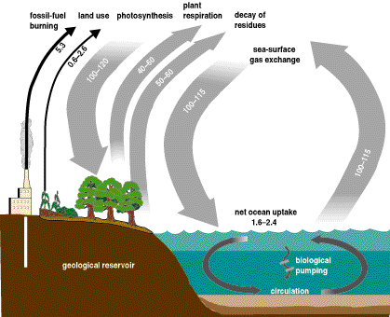
We study the structure, function, and composition of ecosystems at multiple scales over time.
Functions (processes) of ecosystems are probably their most important aspect, but also the most difficult to quantify
Notes:
Functions (processes) of ecosystems are probably their most important aspect, but also the most difficult to quantify. In recent years, we are more fully realizing the importance of process, as we better understand disturbance ecology.
Today we fully realize ecosystems are dynamic and continually affected by disturbance.

Slide 7
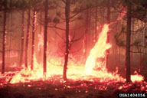
Ecosystem Processes: Disturbance
Modern ecology emphasizes disturbance and the continually transient nature of ecosystems
State and transition concepts
Notes:
Modern ecology emphasizes disturbance and the continually transient nature of ecosystems. Seral stages in ecosystems can take different pathways based on the nature of disturbance.
State and transition concepts are integral to our understanding of disturbance in grassland and shrubland ecosystems. They are based on succession, the topic of our next slide.

Slide 8
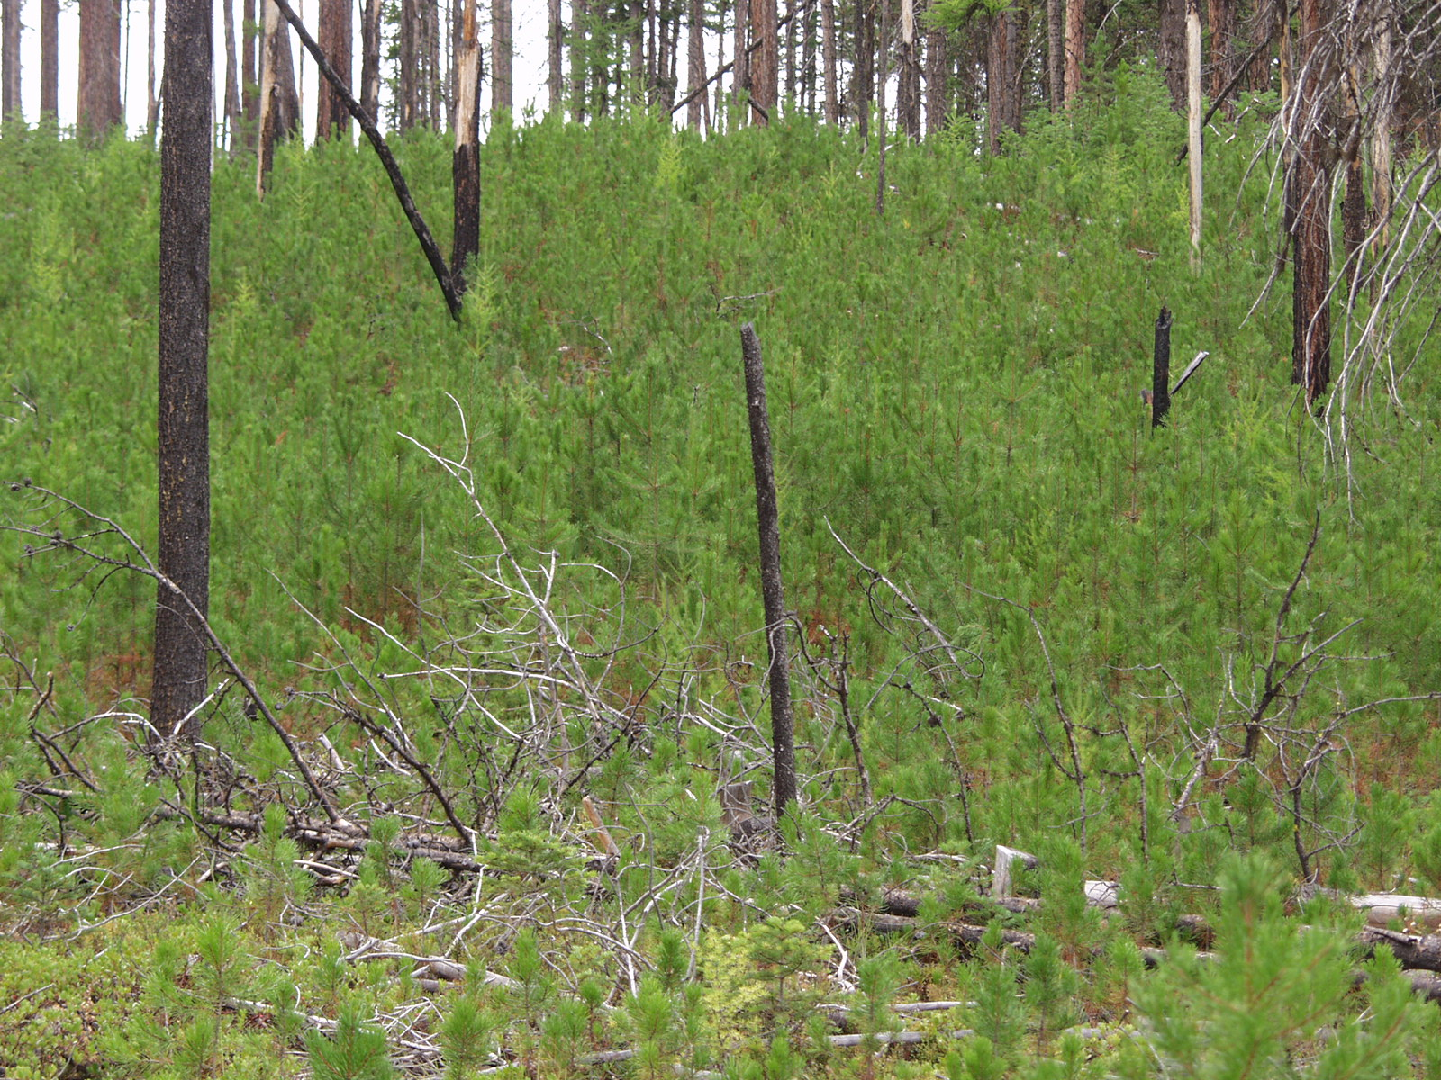
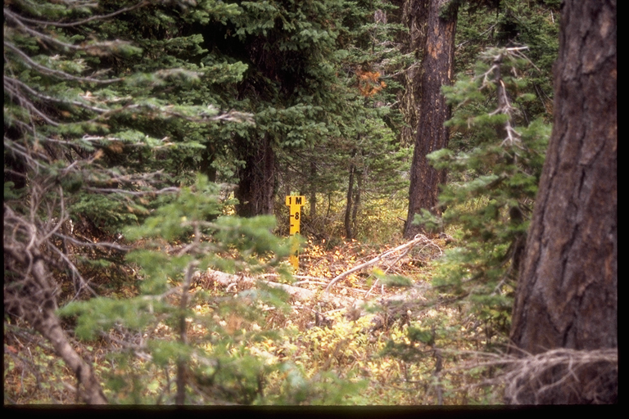
Ecosystem Processes: Succession
Notes:
Recently disturbed areas are colonized by plants and are re-vegetated. A series of plant communities then follows. This assemblage is called a sere, or a set of seral stages. This is a common process we all see every day within ecosystems.
State and transition models work as follows: the seral stages are the states, and the transitions are the pathways between these states. Some of these pathways can be quite complicated.
For more on state and transition models, see Stringham, T.K., W.C. Krueger and P.L. Shaver. 2002. State and transition modeling: An Ecological Process Approach. Invited Paper, J. Range Manage.

Slide 9
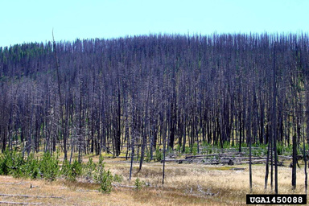
Ecosystem Scale: Space
Understanding scale is critical, because many processes have no meaning at the local scale.
Understanding scale is also critical because different disturbance regimes operate at different scales.
Notes:
Understanding scale is critical, because many processes have no meaning at the local scale. Understanding scale is also critical because different fire regimes operate at different scales. Fire frequency and severity have no meaning unless assessed over a landscape. We will illustrate this further in the next series of slides.

Slide 10
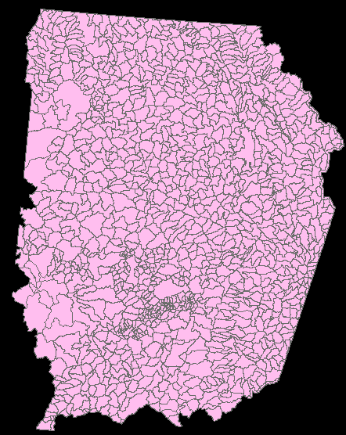
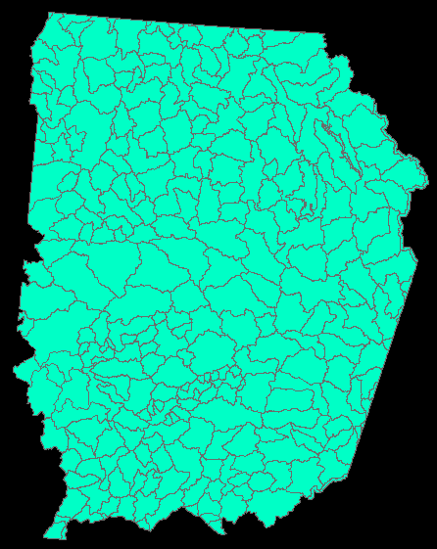
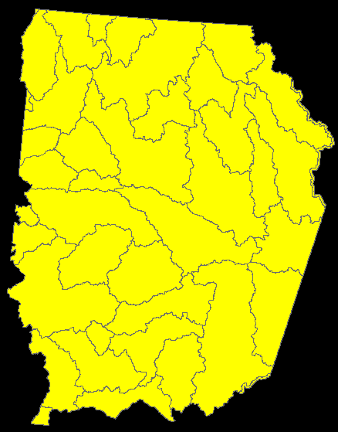
Landscapes can occur at different scales….
HUC 6
HUC 5
HUC 4
HUC6
HUC5
HUC4
Notes:
HUC=Hydrologic unit of capability=Watersheds. Note the lower the number the broader (larger) the landscape.

Slide 11
…because processes vary with environment and scale
Smaller, more frequent fires
Larger, less frequent fires
For example, fire frequency and severity
only have meaning in a landscape context.
HUC6
HUC5
HUC4
Notes:
Ecosystem processes change with scale. In landscape assessment, the proper scale for analysis should be carefully chosen. In regards to fire, the assessment area should be large enough to capture the range of fire sizes characteristic of that fire regime. Smaller, more frequent fires characteristic of fire regime I require a smaller area for assessment than areas with longer fire return intervals (regimes IV and V).

Slide 12
…because processes vary with environment and scale
Plant species that colonize rapidly following disturbance
Plant species that colonize slowly, by rhizomes and runners
HUC6
HUC5
HUC4
Notes:
Note how plants adapt to different disturbance regimes. Where disturbances like fire are frequent, plants that disperse seed easily are favored, since soil is frequently scarified and prepared for seeding.
Where fires are infrequent, plants expand into small gaps created by windthrow by means of vegetative propagation– runners, stolons, and rhizomes. They tend to colonize new areas more slowly.

Slide 13
…because processes vary with environment and scale
Wildlife less dependent on large intact areas
Wildlife more dependent on large intact areas
HUC6
HUC5
HUC4
Notes:
Animals also adapt to different disturbance regimes as well. In fact, this is currently a concern for the Northwest Forest Plan, which was written using a concept of reserve areas to protect the northern spotted owl and other late-successional dependent wildlife. The concept works well in relatively stable landscapes with infrequent fire, but less well in the drier portions of the planning area. These drier areas have accumulated late-successional structure because of fire exclusion. While providing owl habitat in the short run, in the long run they are unstable, with many areas likely to be affected by severe fire.

Slide 14

We study the structure, function, and composition of ecosystems at multiple scales over time.
Time also operates at multiple scales.
Concepts like fire frequency have no meaning without time.
Notes:
Time is just as important as space in understanding landscapes. Frequency and succession, some of our core concepts, have no meaning without time.

Slide 15
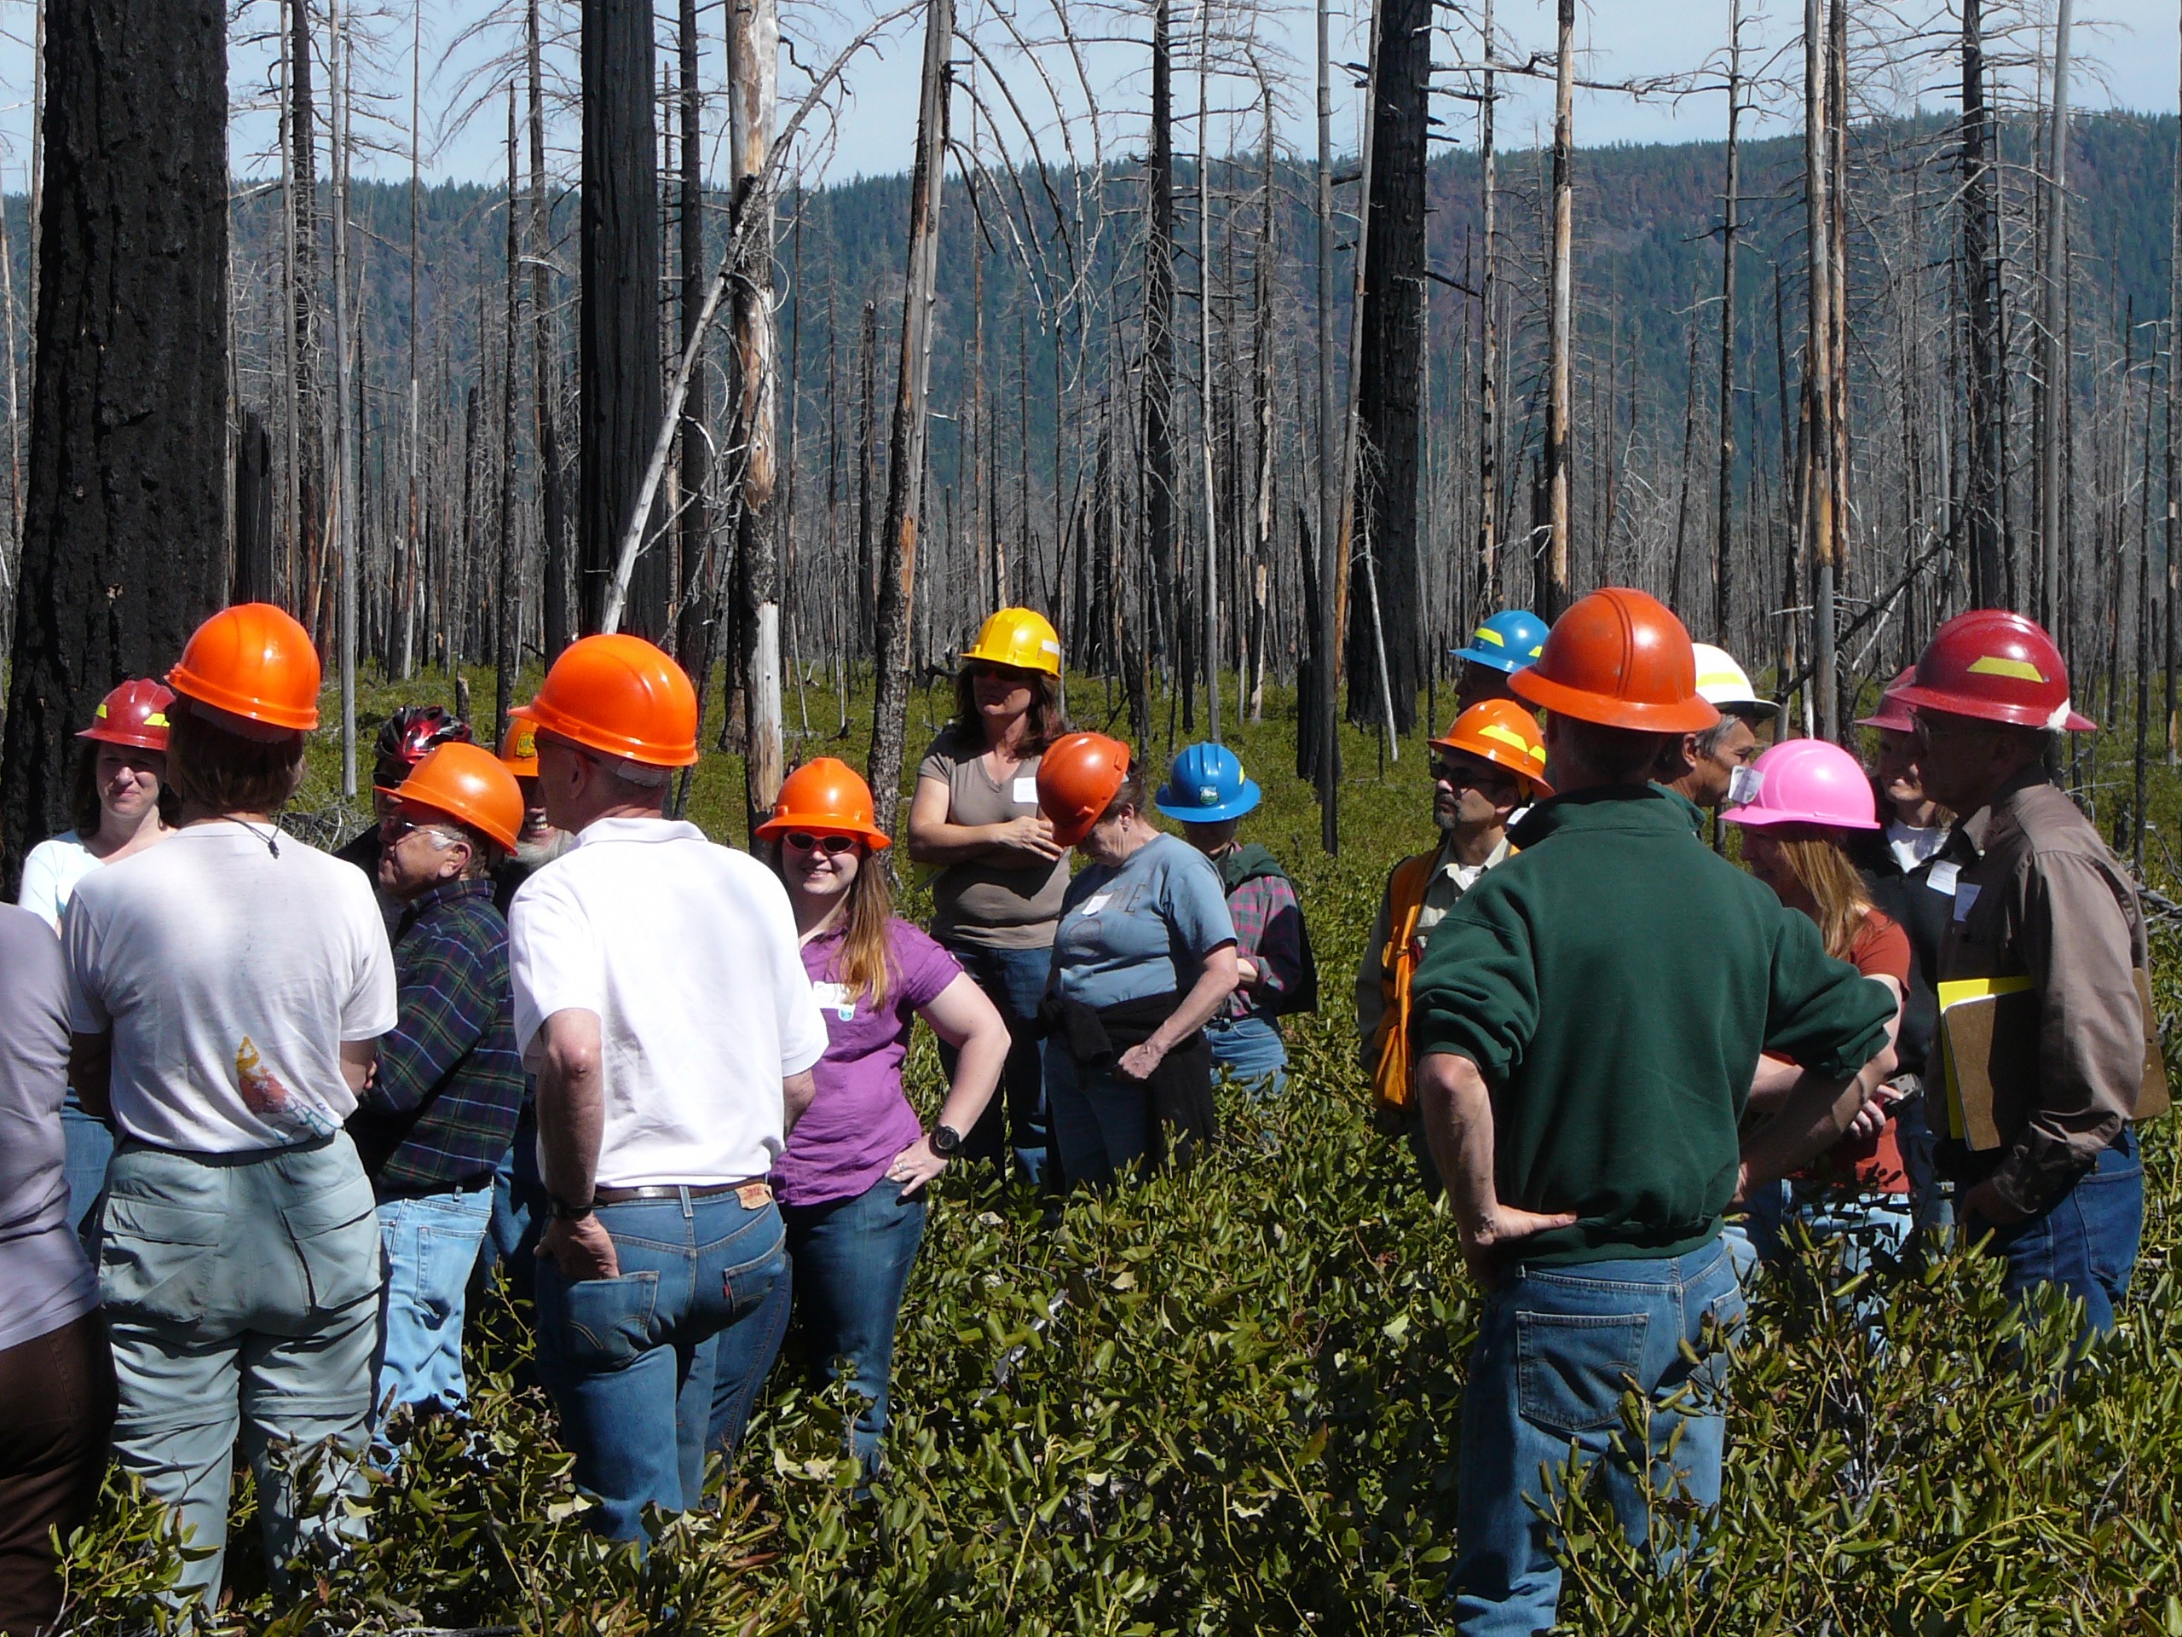
Well-integrated projects…
Are ecologically viable and sustainable
Can save time and money
Have more ownership
Are more defensible in a legal context

Slide 16
Single resource emphasis…
Risks failure from the unforeseen
Misses opportunities to save time and money
Can be vulnerable in a legal context

Slide 17
An example of a well-integrated project…

Slide 18
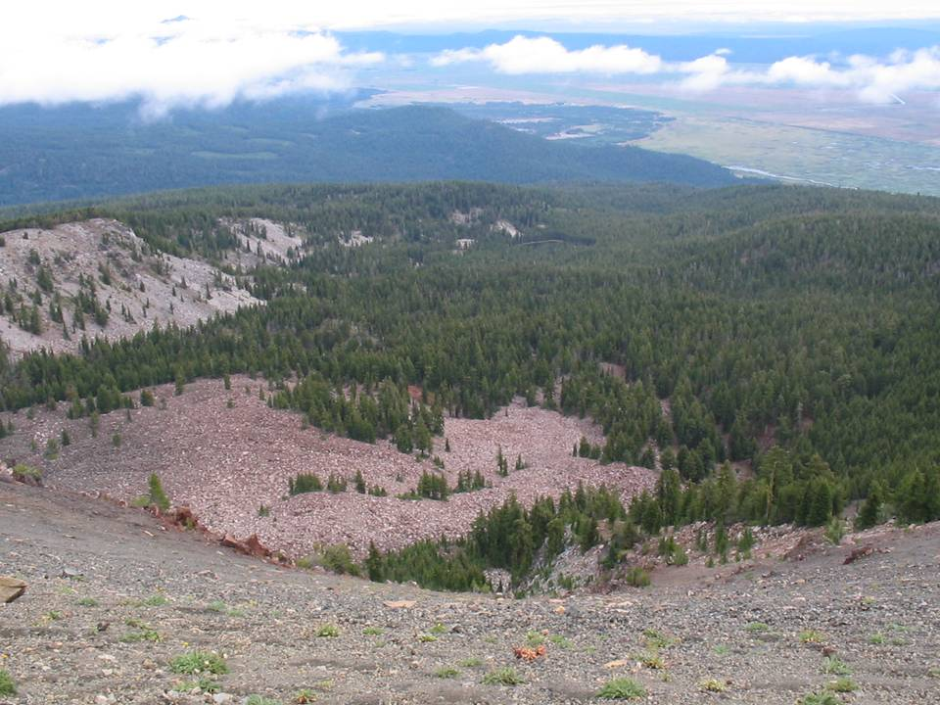
Landscape Treatment Prioritization to Reduce Northern Spotted Owl Habitat Loss from Wildfire: A Test Case Using Fire Regime and Condition Class on the Klamath RD
Dr. Gregg Riegel, Ecologist, Central Oregon Ecology Program, Deschutes NF
Co-authors: Jane Kertis, Fire Ecologist, USFS
Sarah Malaby, Fremont-Winema NF
John Foster, Fire Ecologist, TNC
Lois Shoemaker, Bio. Tech, Fremont-Winem, NF

Slide 19
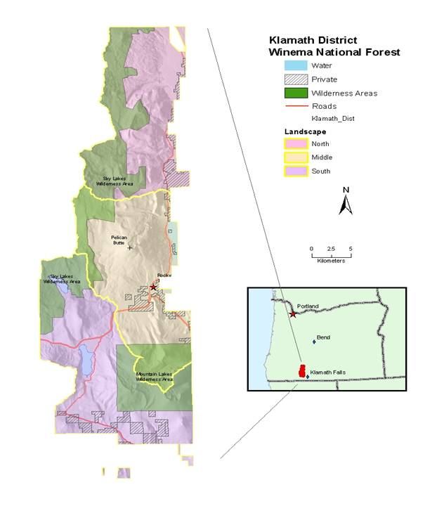

Slide 20
District Issues
Loss of bald eagle habitat
Threats of catastrophic fire to spotted owl habitat
Loss of variable stand and landscape composition and structure

Slide 21
Project Goals
Develop strategic plan to reduce fuels to improve landscape resiliency
Restore landscape to appropriate composition and structure to support owls and bald eagles

Slide 22
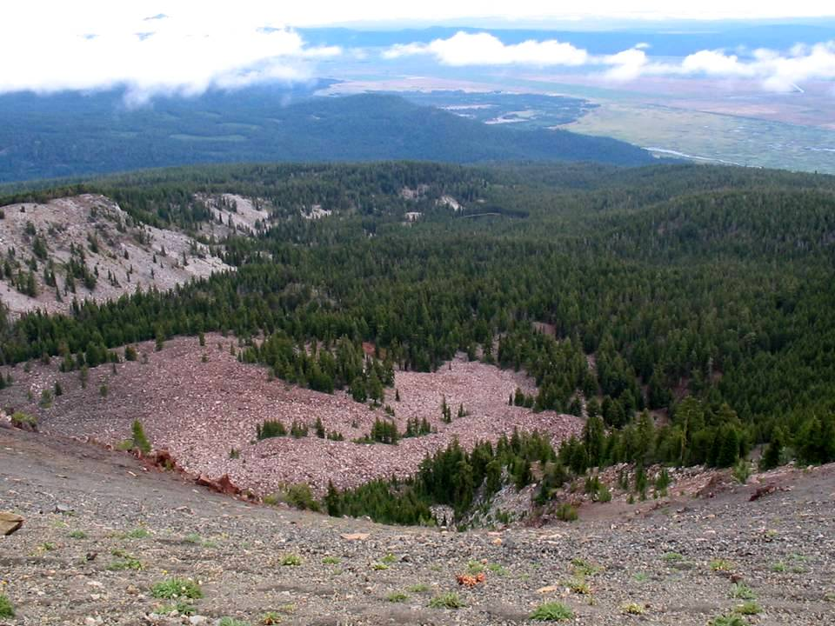
Process
Conduct FRCC mapping/analysis
Develop a current fire risk assessment
Identify other issues (WUI, nest site/key owl and bald eagle habitat, fish habitat)
Create priority areas
Recommend treatment types and timing

Slide 23
Condition Class
A categorical measure of departure:
Condition Class I =
within natural or historical range of variability (NRV or HRV)
Condition Class II =
moderate departure from HRV
Condition Class III =
extreme departure

Slide 24
Using FRCC Veg-Fuel Class Abundance as Treatment Guidance
 | North |  | Middle |  | South
Seral | MCON | RFIR | MCON | RFIR | MCON | RFIR
A | Over | Similar | Similar | Trace | Abundant | Similar
B | Over | Over | Over | Over | Over | Similar
C | Under | Abundant | Under | Over | Similar | Over
D | Trace | Trace | Trace | Trace | Trace | Trace
E | Abundant | Similar | Abundant | Over | Abundant | Over

Slide 25
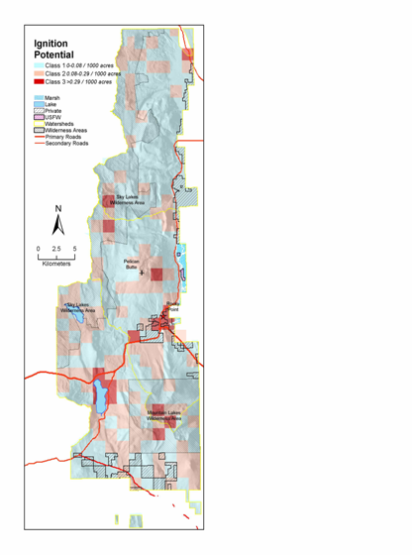
Current Fire Risk Assessment
3 Components:
Probability of ignition
Fire behavior potential
Composite fire risk

Slide 26
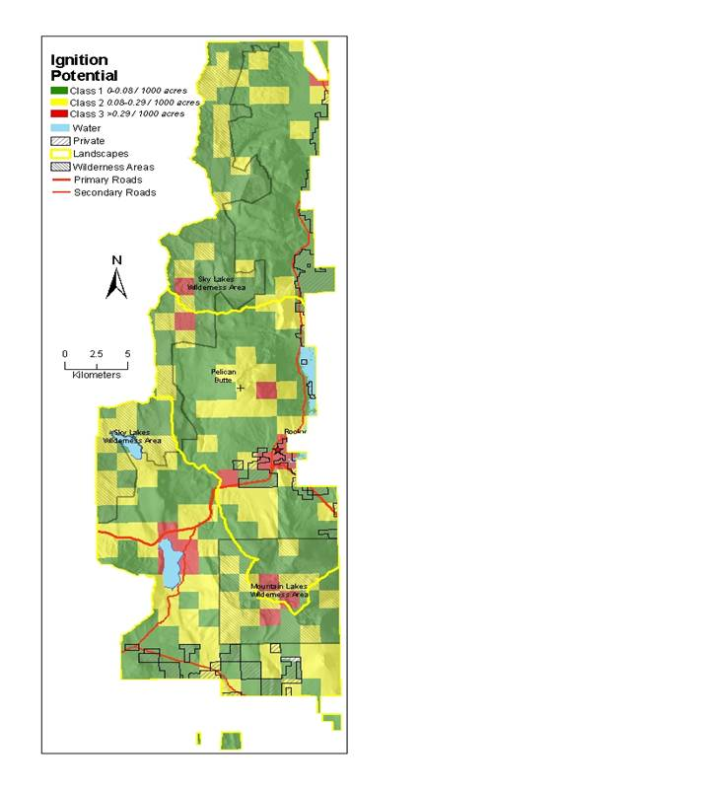

Slide 27
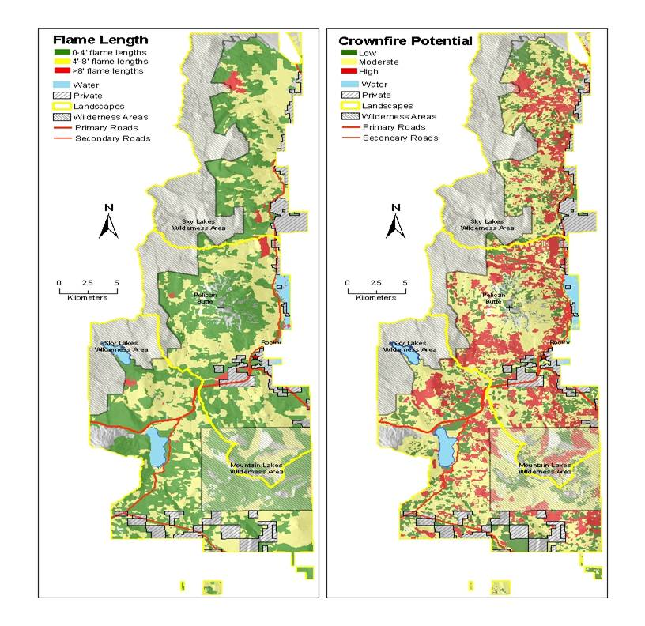

Slide 28
Other Issues
Wildland urban interface
Bald eagle land management unit
Spotted owl nests
Late successional reserves
Spotted owl core sites outside of LSRs
Fish (sucker and bull trout) habitat

Slide 29
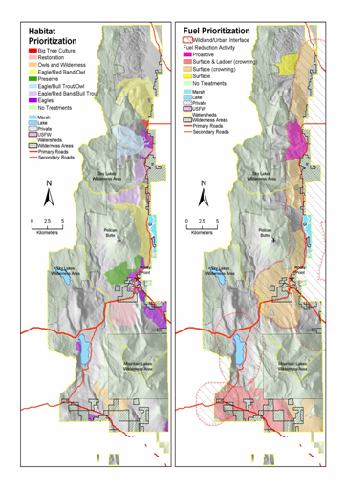
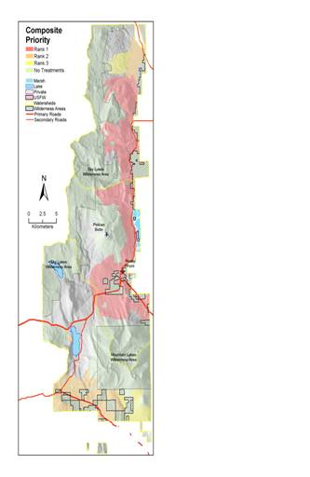
Create Priority Areas
Wildlife Fuels/fire
Multi-Resource

Slide 30
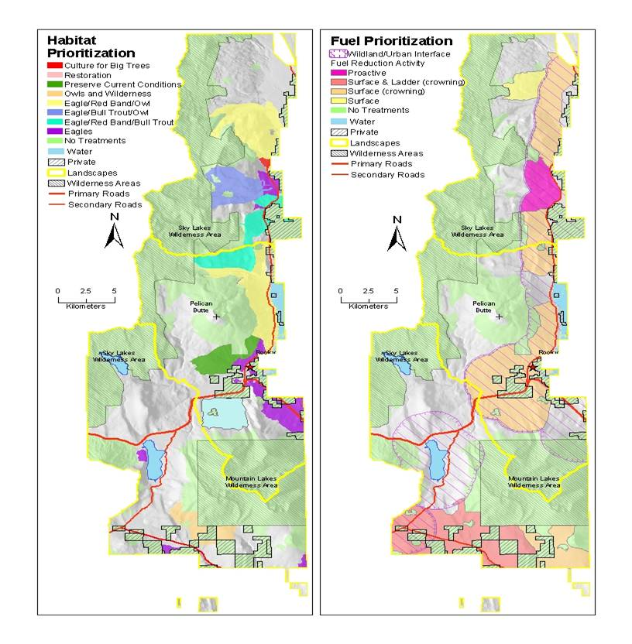

Slide 31
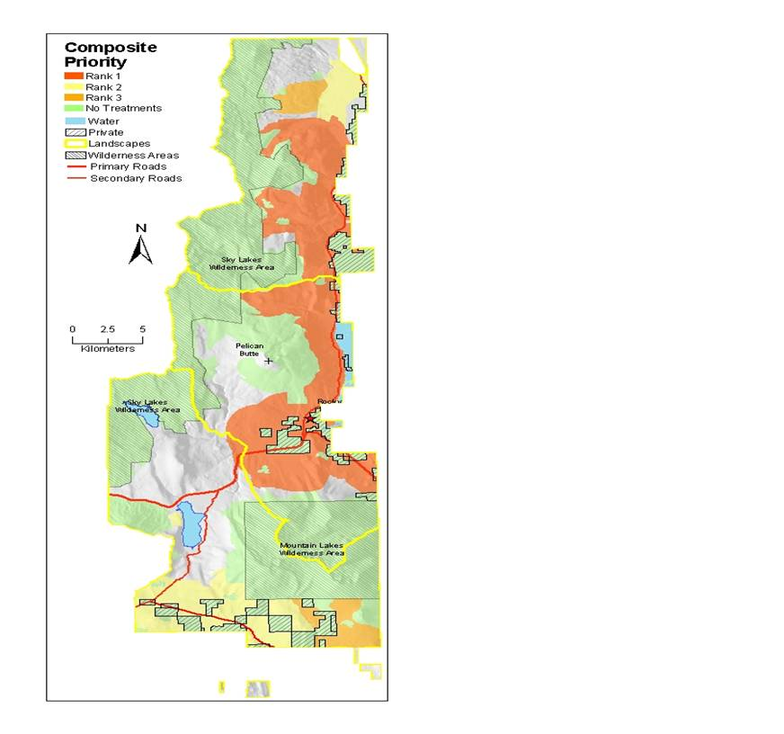

Slide 32
Next Steps
1. Determine schedule for treating high priority blocks
2. Begin NEPA process
Use information from FRCC to guide how much and what kinds of stands to treat
Run FARSITE/FLAMMAP to determine best placement of multi-resource treatments

Slide 33
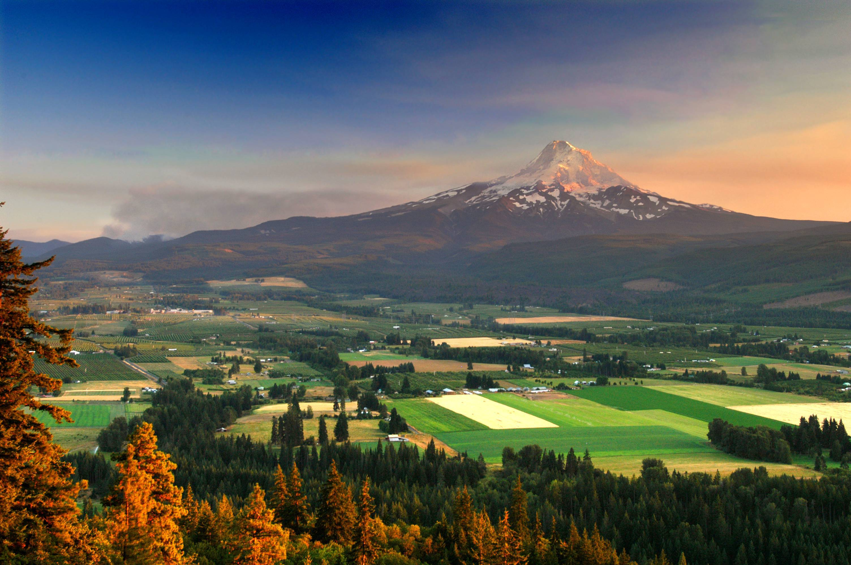
Towards better integration in the Pacific Northwest Region
Regional fuels-vegetation advisory team
Interdisciplinary and interagency
Leadership involvement

Slide 34
Towards better integration in the Pacific Northwest Region
Regional fuels monitoring standards
Field reviews
Plan to add a research member
Moving towards a goal of becoming a a clearinghouse for new applications and research

Slide 35
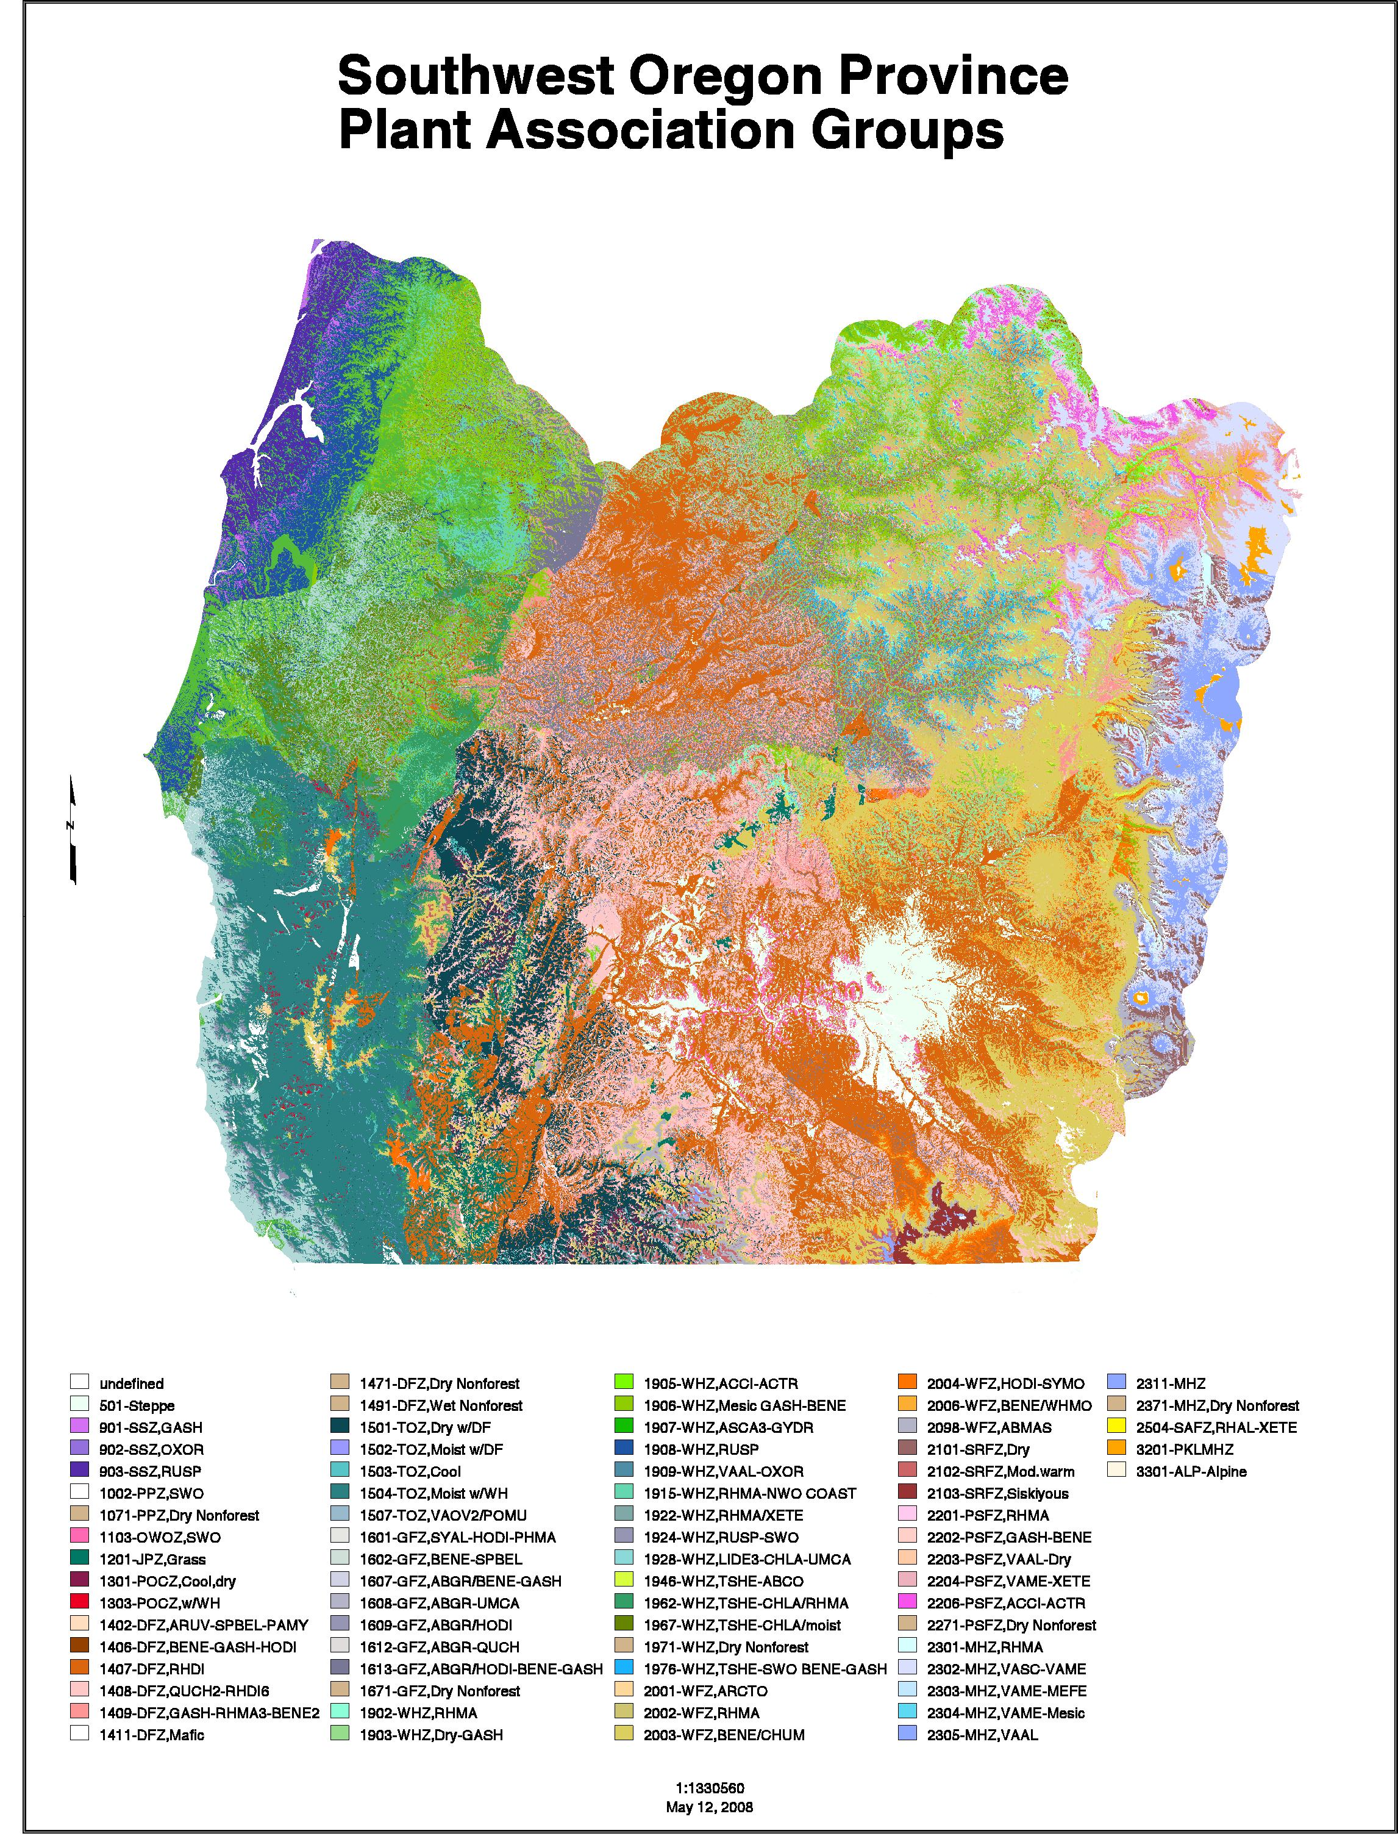
Visit ecoshare (www.reo.gov/ecoshare) for potential vegetation maps, guidebooks, data, and other resources
Links to Henderson model PNV maps
Link to IMAP existing vegetation mapping and modeling
Notes:
Potential vegetation defines land capability to produce ecosystem products and services, as well as the elements of biodiversity.

Slide 36
