Slide 1
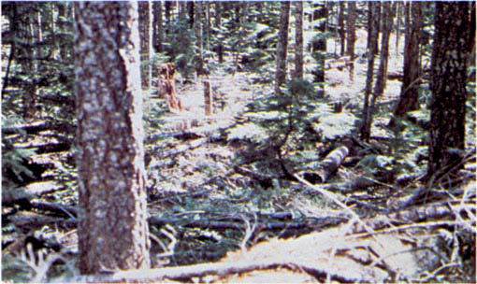
Managing Northern Spotted Owl Habitat in Dry Forest Ecosystems
Presented By
Cindy Donegan
U. S. Fish and Wildlife Service

Slide 2
Managing Northern Spotted Owl Habitat in Dry Forest Ecosystems

Slide 3
Managing Northern Spotted Owl Habitat in Dry Forest Ecosystems
WORKSHOPS
Managing Northern Spotted Owl Habitat in Dry Forest Ecosystems Bend, Oregon 2005
Silvicultural Practices Supporting Northern Spotted Owl Habitat in Dry Forest Ecosystems
Ashland, Oregon 2006
2005 Workshop - Recommendations
2006 Workshop - Priority Next Steps
No action is not an option; we must continue to move forward
Convene a recovery team to develop a spotted owl recovery plan
Establish interagency team with the role of setting a provincial context for where fuel reductions would facilitate maintenance and restoration of spotted owl habitat.
Take it on the road
Produce landscape prioritization maps. Senior Managers Group supported moving forward and established an interagency team to develop and distribute the maps
Action is needed. Federal agencies should work together, utilizing map product developed in #2 for project area ID.

Slide 4
Conceptual Model
Risk
Factors
Resource
Values
One to many
One to many
Composite
Risk Map
Composite
Values Map
Landscape Prioritization Map

Slide 5
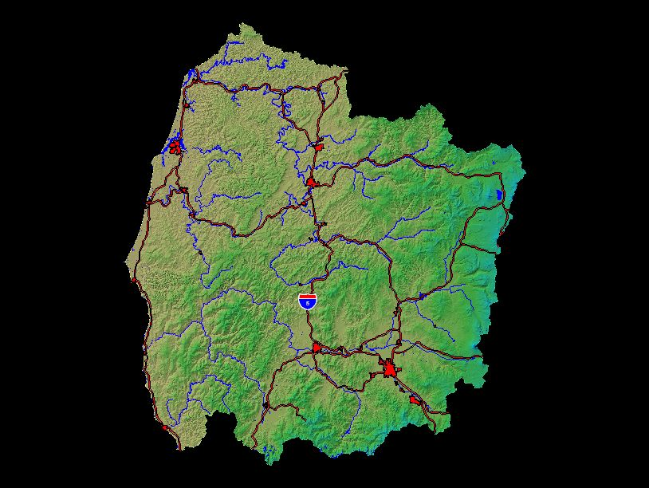
Managing Northern Spotted Owl Habitat
in Dry Forest Ecosystems
Coos Bay
Southern Oregon
Coastal Basin
( HUC 3 )
Roseburg
8.2 million total acres
41% Federal land
Grants Pass
Medford
Ashland

Slide 6
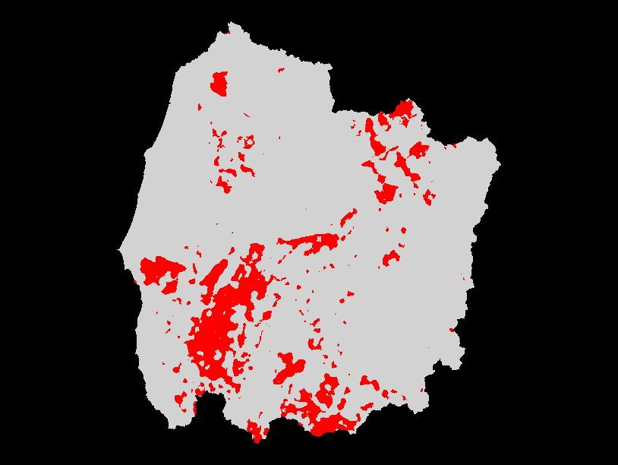
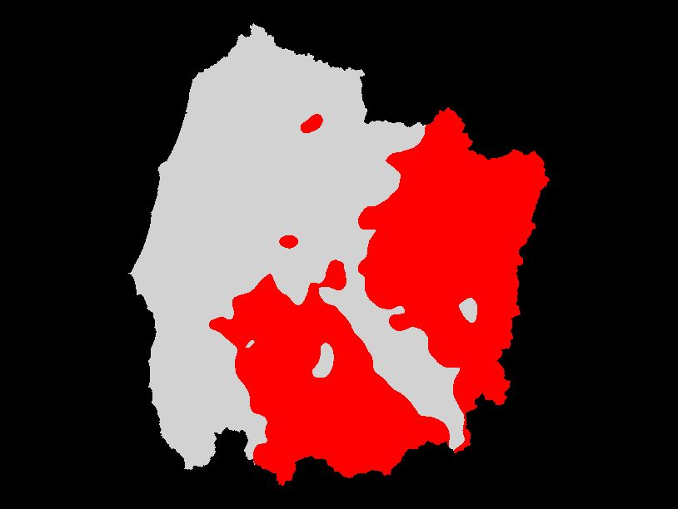
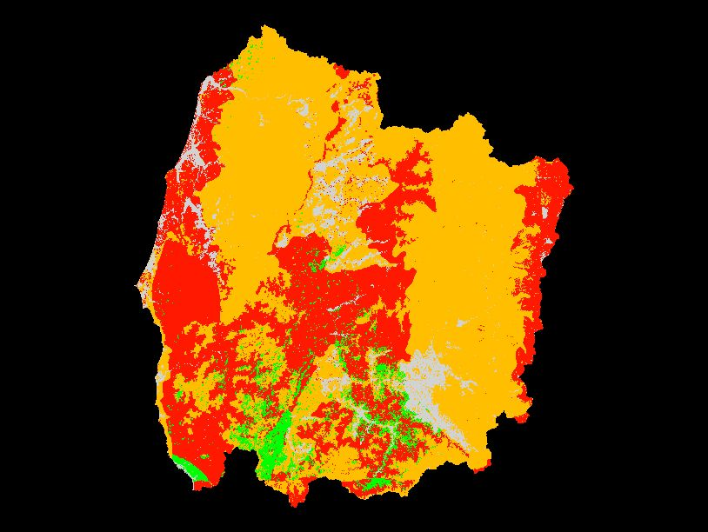
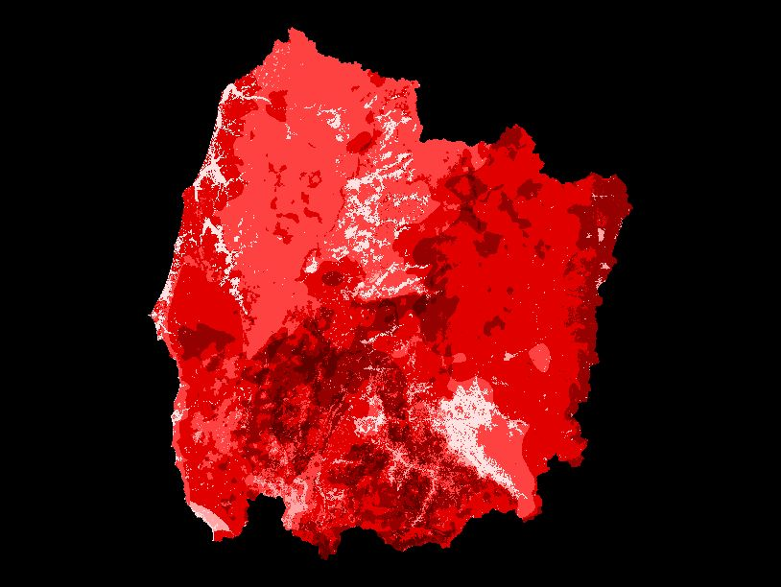
Crown Fire
Potential
Wildfire
Density
Condition
Class
Fire Risk
Composite Map

Slide 7
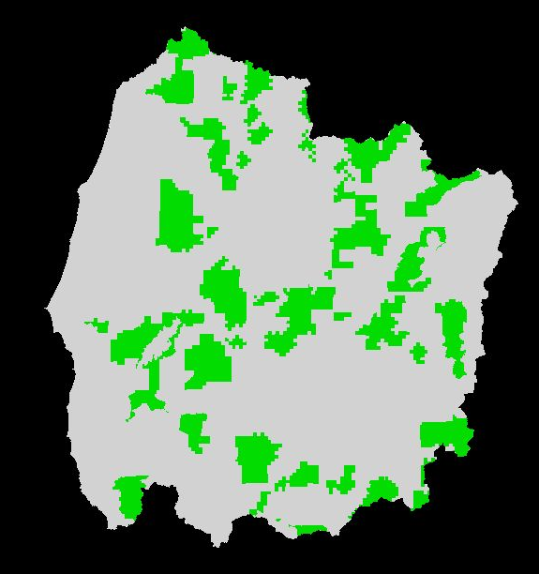
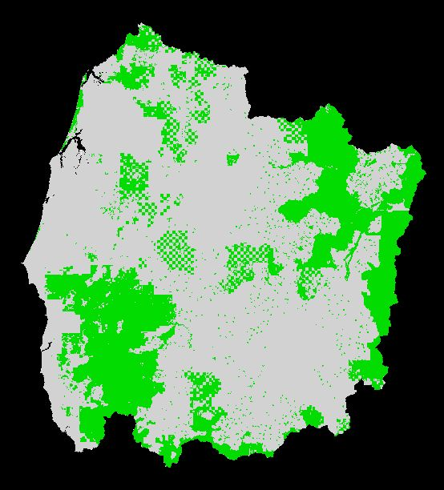
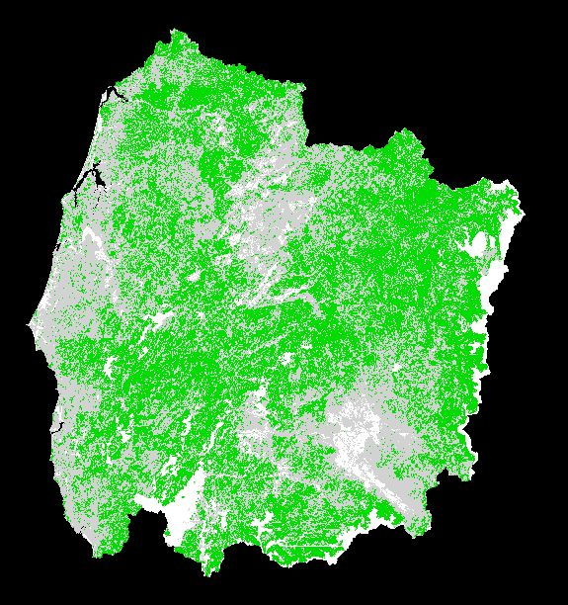
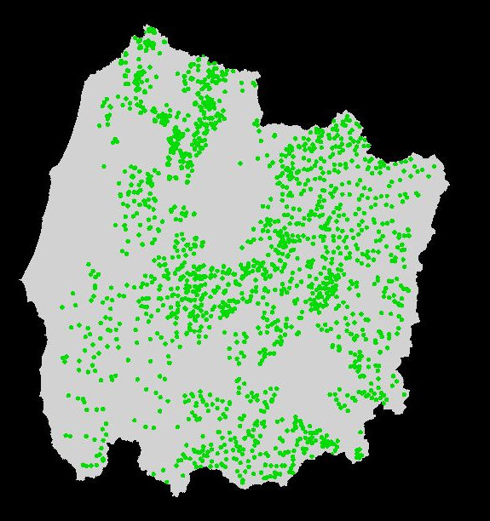
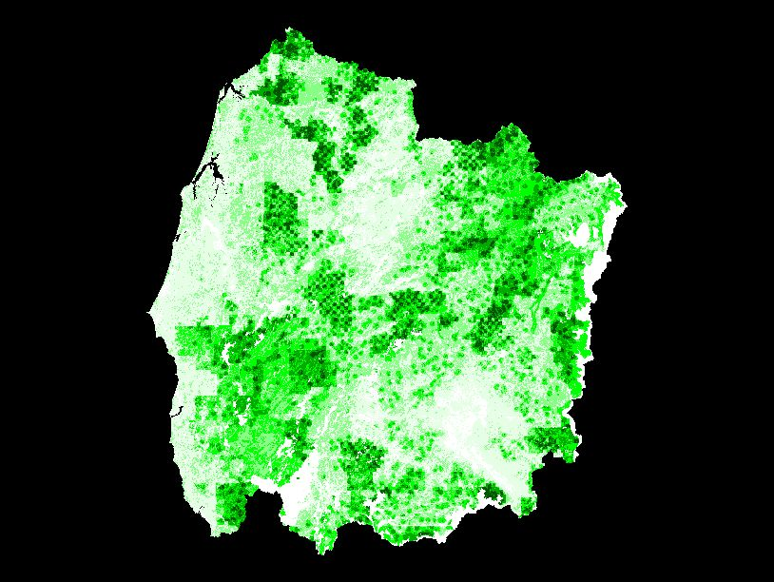
Critical
Habitat
Reserved
Habitat
Habitat
Connectivity
Owl
Presence
Habitat Value
Composite Map

Slide 8
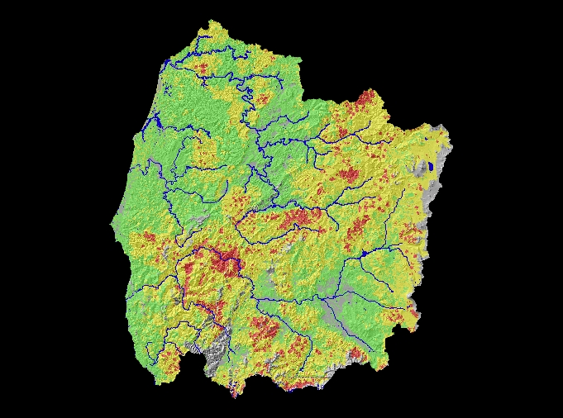
Combined Composite Map
Moderate Fire Risk &
Medium Habitat Value
High Fire Risk &
High Habitat Value
Lower Fire Risk &
Low Habitat Value
High
Priority
Protection
Lower
Priority
Protection

Slide 9
Amount of Treatment Acres
Within Analysis Area

Slide 10
Spectrum of Fire Danger
HIGH
MODERATE
VERY HIGH
LOW
EXTREME
FIRE DANGER LEVELS

Slide 11
Spectrum of Landscape Fire Risk
LESS LIKELY
MORE LIKELY
LARGE WILDFIRE RISK

Slide 12
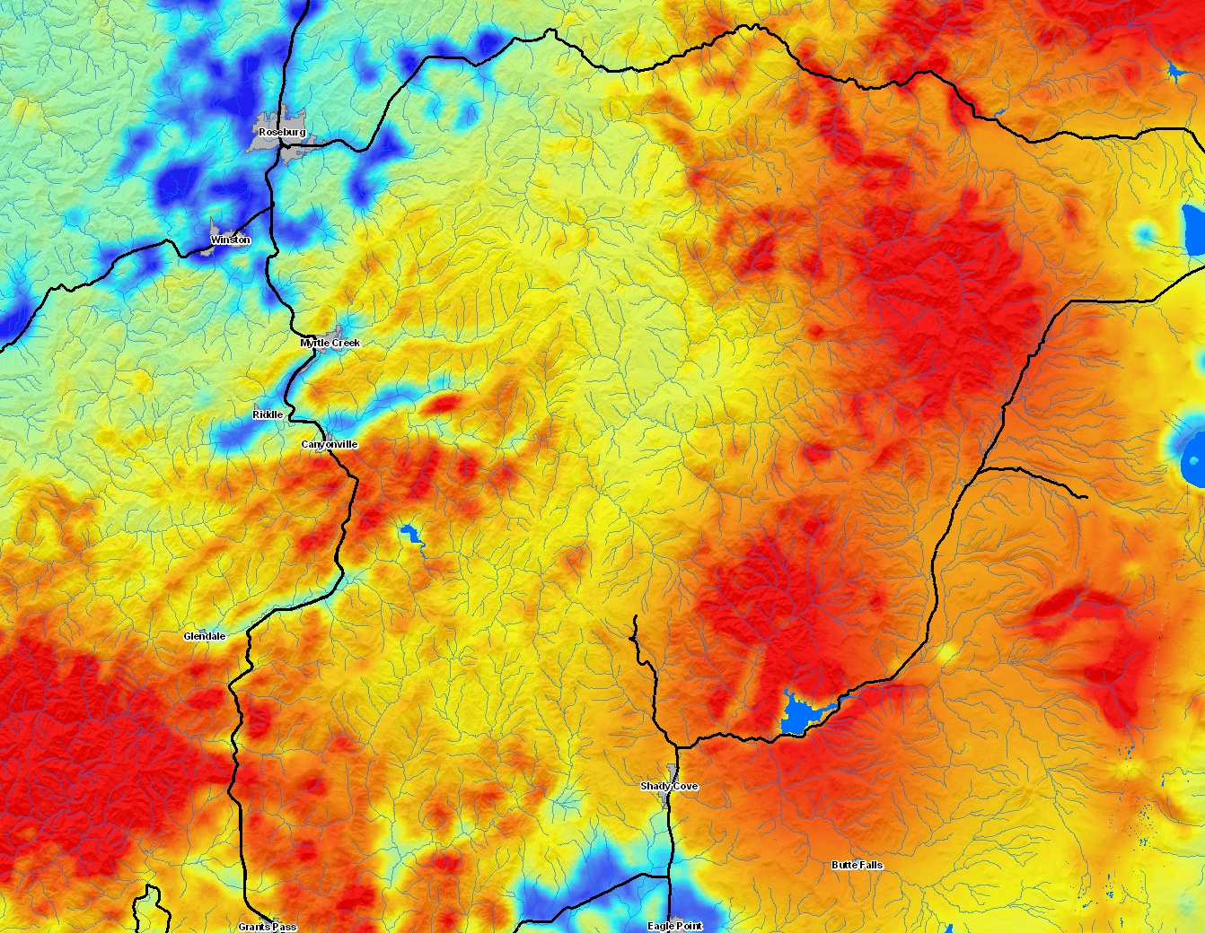

Slide 13
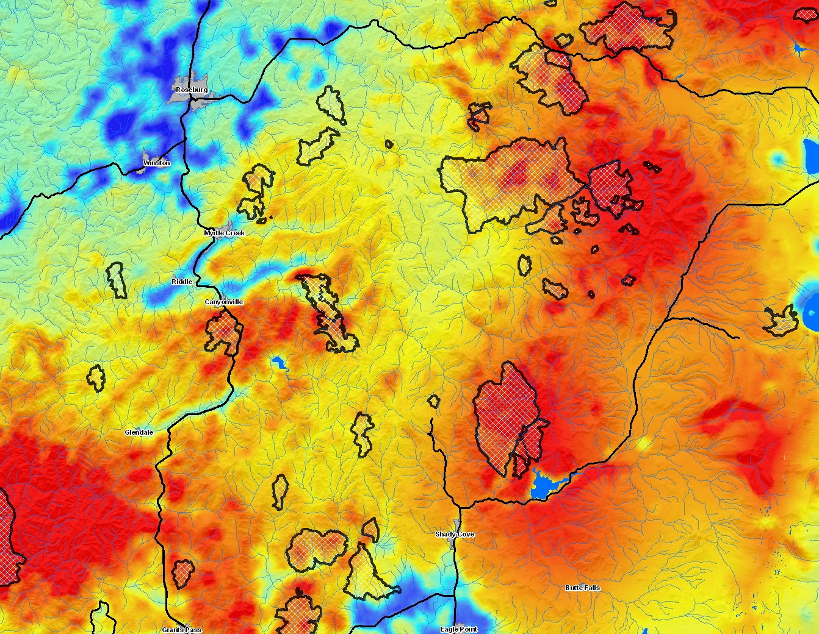

Slide 14
Where are the large fires happening?
area-adjusted frequency of fires >100-ac
spectrum of landscape fire risk (less to more likely)

Slide 15
FlamMap 3.0 (M. Finney)
A fire behavior mapping and analysis program that computes potential fire behavior characteristics (spread rate, flame length, fireline intensity, etc.) over a landscape under constant weather and fuel moisture conditions. Outputs are to be used for making fire and land management decisions.
GRIDS

Slide 16
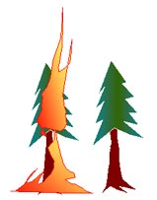
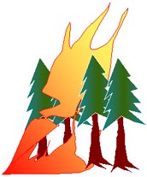
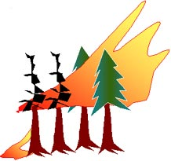
Crown Fire Activity Index
FlamMap output
0
Not applicable – non-forested lands
1
Surface - little or no tree torching will be expected
Passive - isolated torching of single or groups of trees will be observed and canopy runs limited to short distances.
2
Active - sustained runs through the canopy will be observed that may be independent of surface fire activity.
3

Slide 17
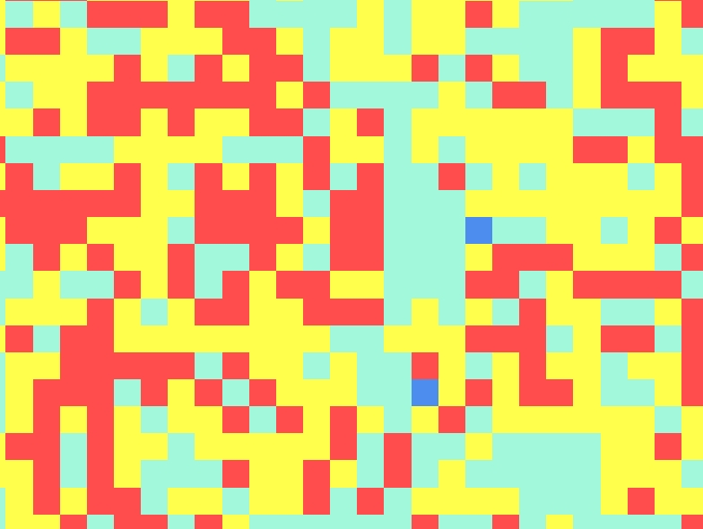
1000-ac circle
3
1
2
2
2
3
3
3
2
3
1
1
1
1
2
1
2
2
3
3
1
2
3
1
2
2
2
2
2
2
1
1
1
3
2
2
1
2
1
2
2
2
1
3
2
3
2
3
1
3
1
1
3
1
2
1
2
2
3
3
3
2
1
3
3
1
1
1
2
2
2
2
2
1
3
3
3
3
2
3
3
1
1
1
0
1
1
2
2
3
1
1
3
2
1
3
3
1
1
1
2
3
3
3
2
3
1
3
2
3
3
2
2
1
1
1
3
3
1
2
1
2
3
3
2
2
3
3
3
1
2
1
2
1
3
2
2
2
2
2
2
2
1
1
2
2
2
3
3
3
3
1
3
2
2
1
2
1
1
3
2
1
2
3
3
1
3
2
2
2
1
1
0
2
3
2
3
1
3
2
3
2
1
2
3
1
2
2
3
1
3
1

Slide 18
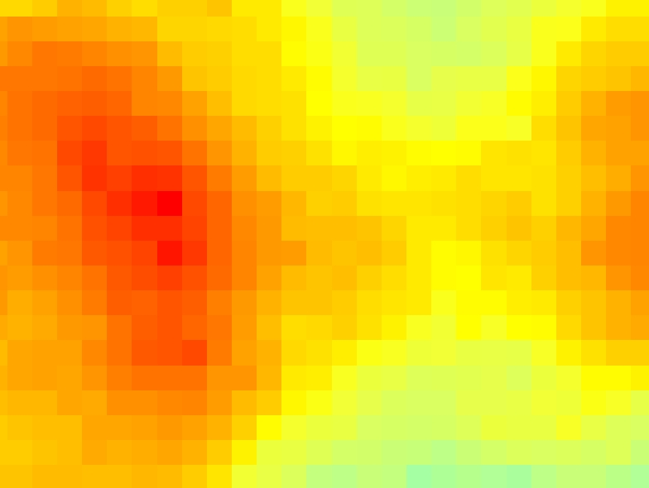
1000-ac circle
2.0

Slide 19
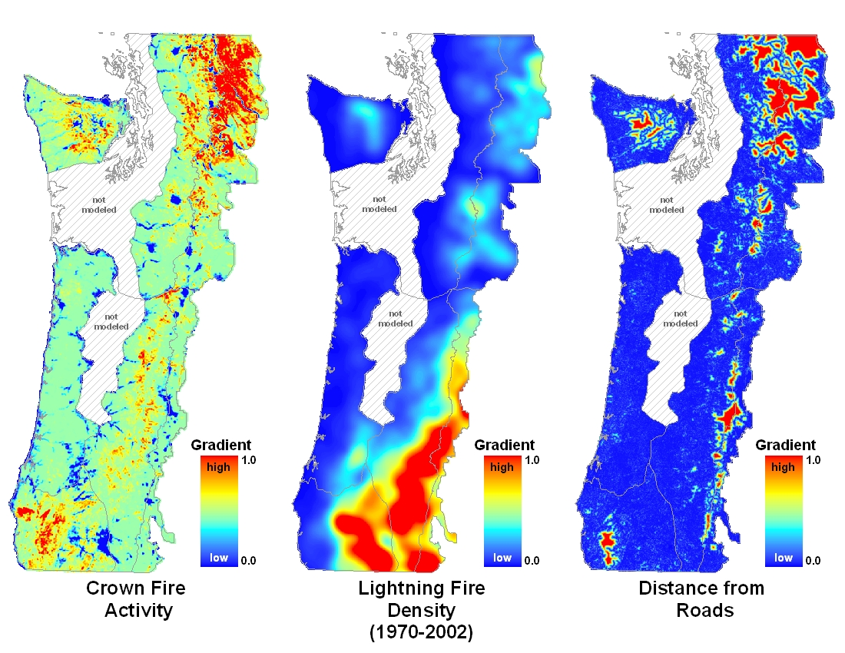
(FlamMap)
(Arc GIS)

Slide 20
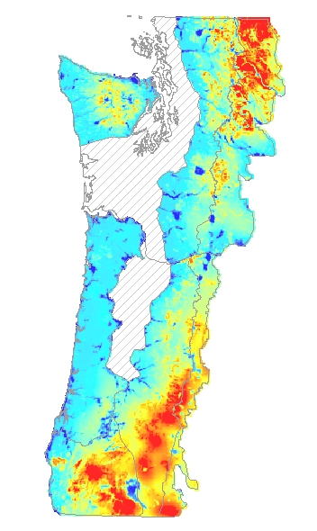
Composite landscape fire risk map
(2CF+LD+RD)

Slide 21
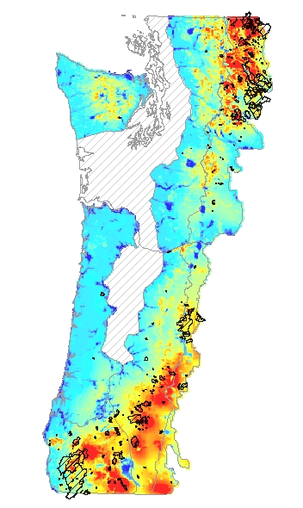
Composite landscape fire risk map
Fires >100-ac since 1970

Slide 22
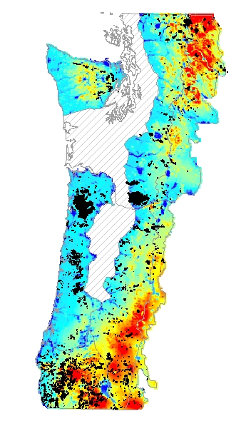
Composite landscape fire risk map
Fires >100-ac from 1936 map

Slide 23
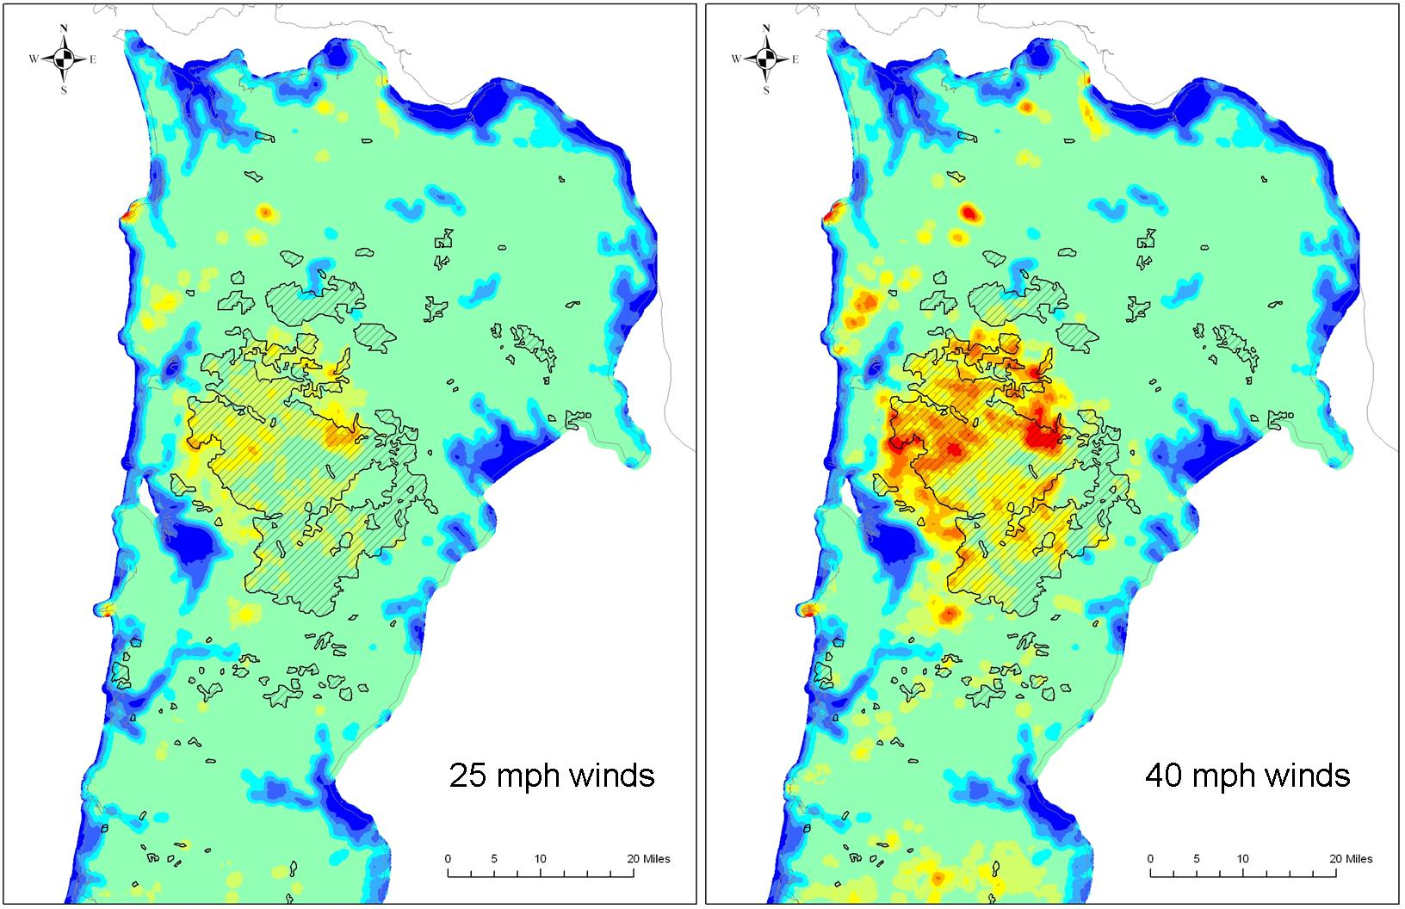
Adjusting weather parameters

Slide 24
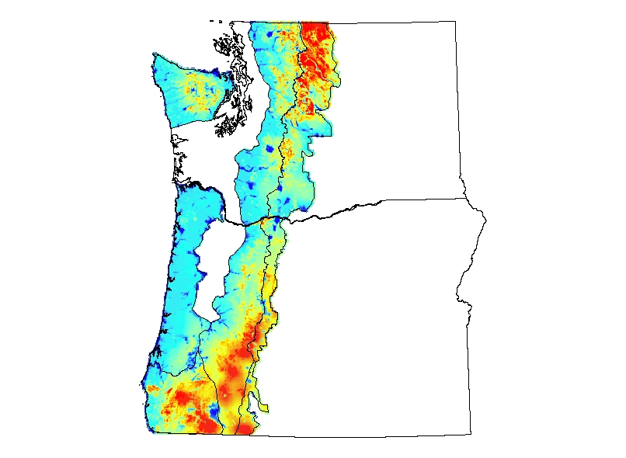
Scale of Use
Physiographic Province

Slide 25
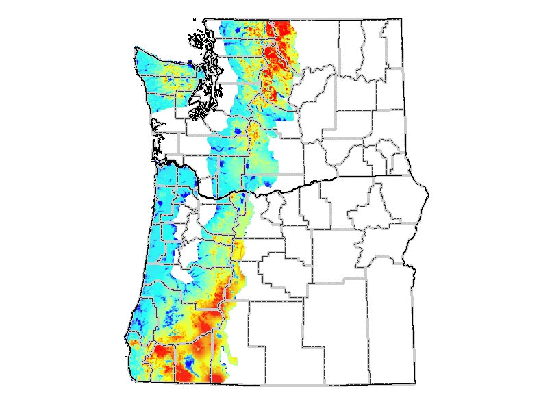
Scale of Use
State/County

Slide 26
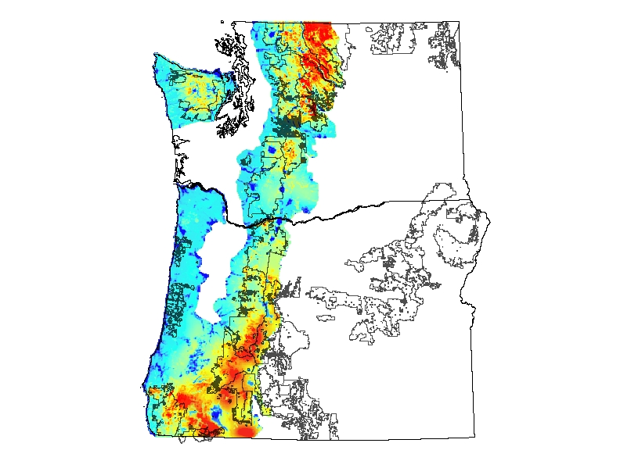
Scale of Use
Administrative Unit

Slide 27
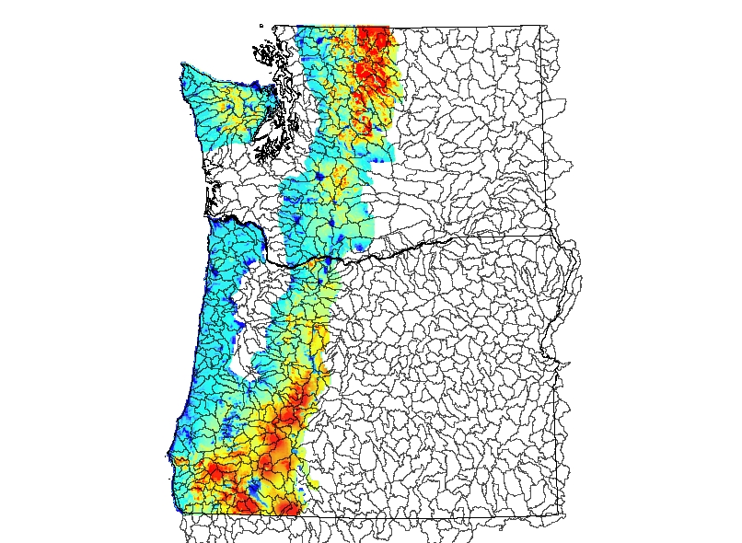
Scale of Use
HUC 5

Slide 28
Scale of Use
project level planning
need site-specific, refined modeling

Slide 29
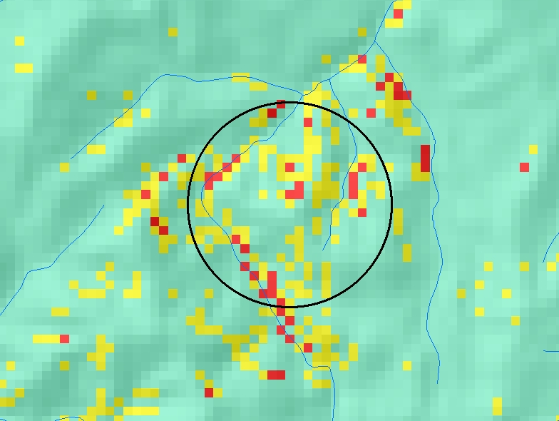
Example Application
Cow Creek Project – Umpqua National Forest

Slide 30
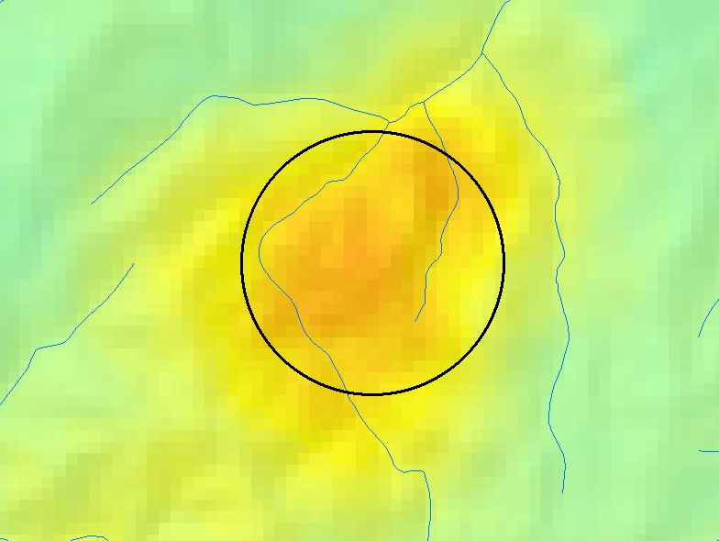
Example Application
Cow Creek Project – Umpqua National Forest

Slide 31
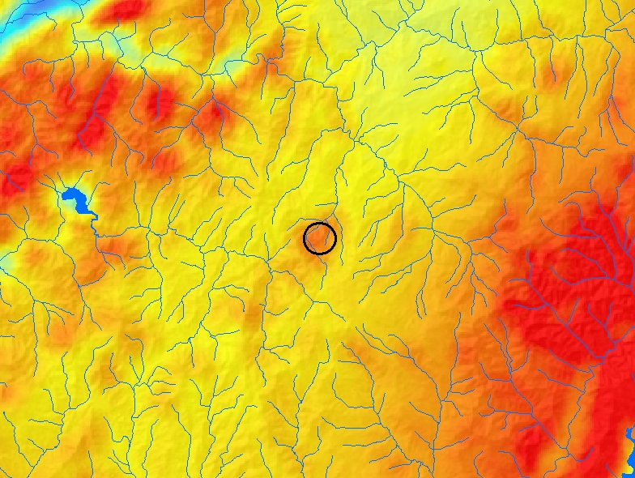
Example Application
Cow Creek Project – Umpqua National Forest

Slide 32
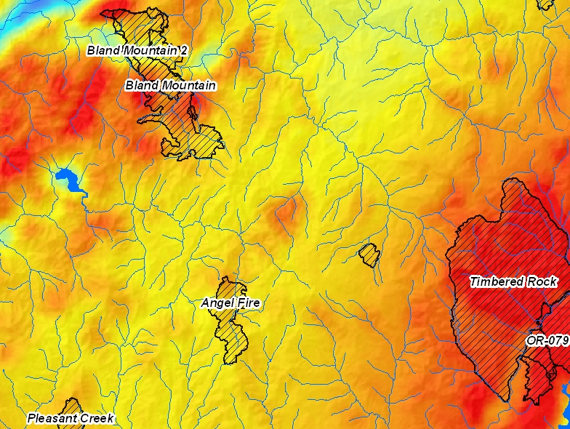
Example Application
Cow Creek Project – Umpqua National Forest

Slide 33
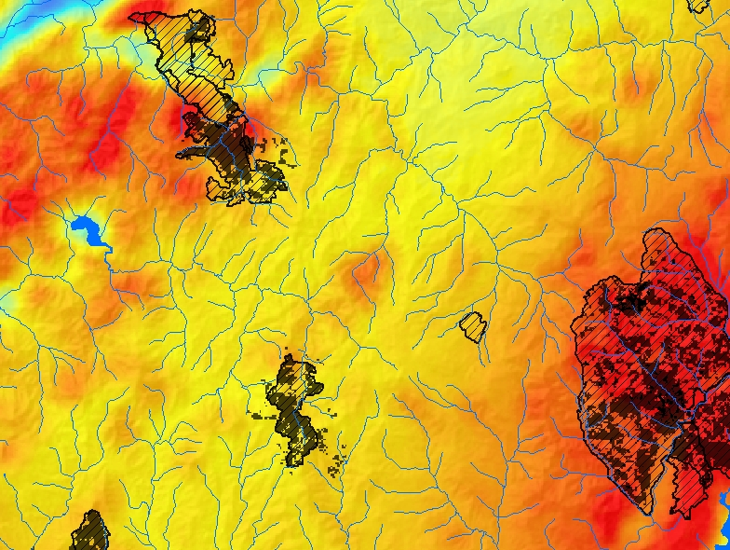
Example Application
Cow Creek Project – Umpqua National Forest

Slide 34
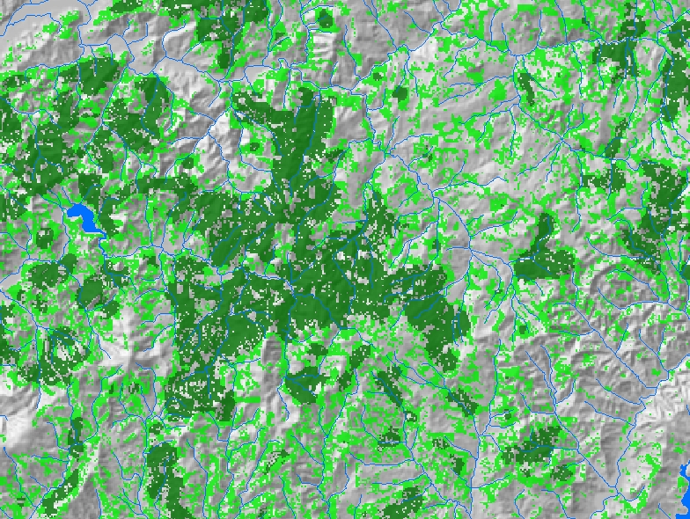
Example Application
Cow Creek Project – Umpqua National Forest
Owl habitat

Slide 35
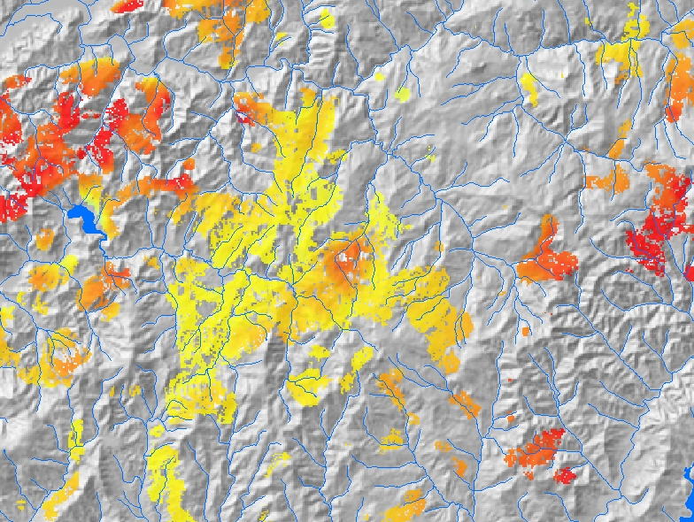
Example Application
Cow Creek Project – Umpqua National Forest
Owl habitat

Slide 36
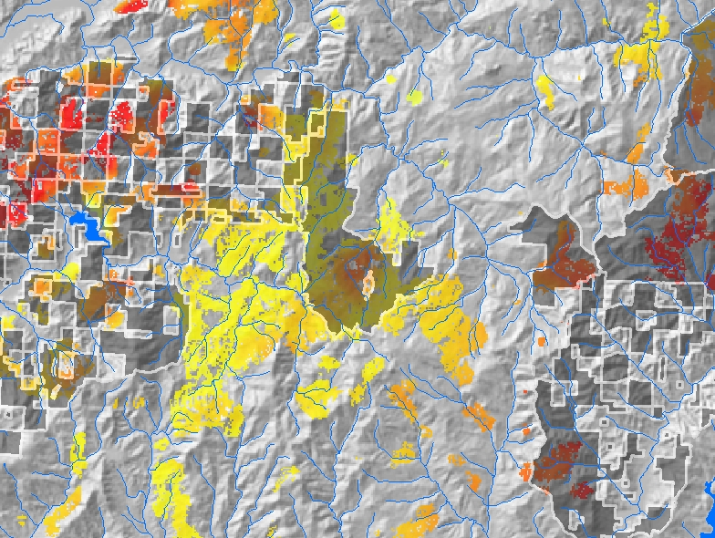
Example Application
Cow Creek Project – Umpqua National Forest
LSRs

Slide 37
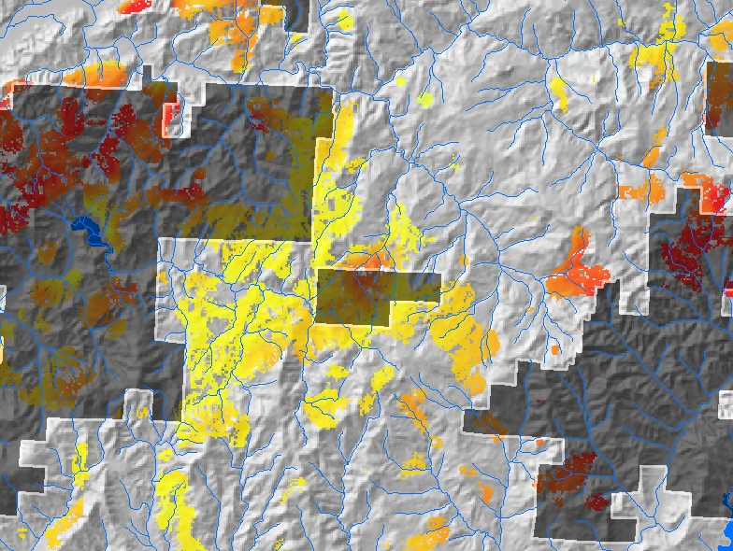
Example Application
Cow Creek Project – Umpqua National Forest
CHUs

Slide 38
Example Application
Cow Creek Project – Umpqua National Forest
site-specific
project planning
beginning
WUI

Slide 39
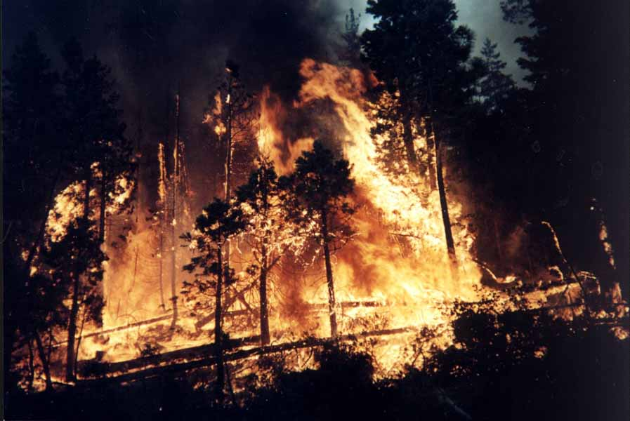
Questions ???

