Slide 1
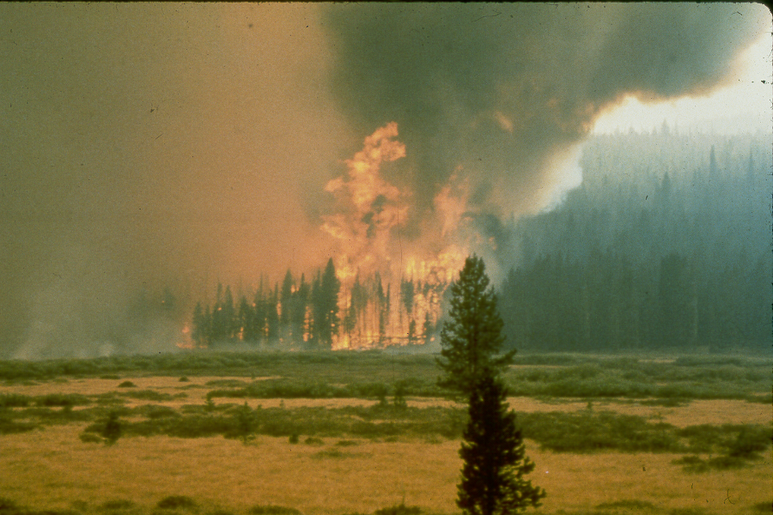
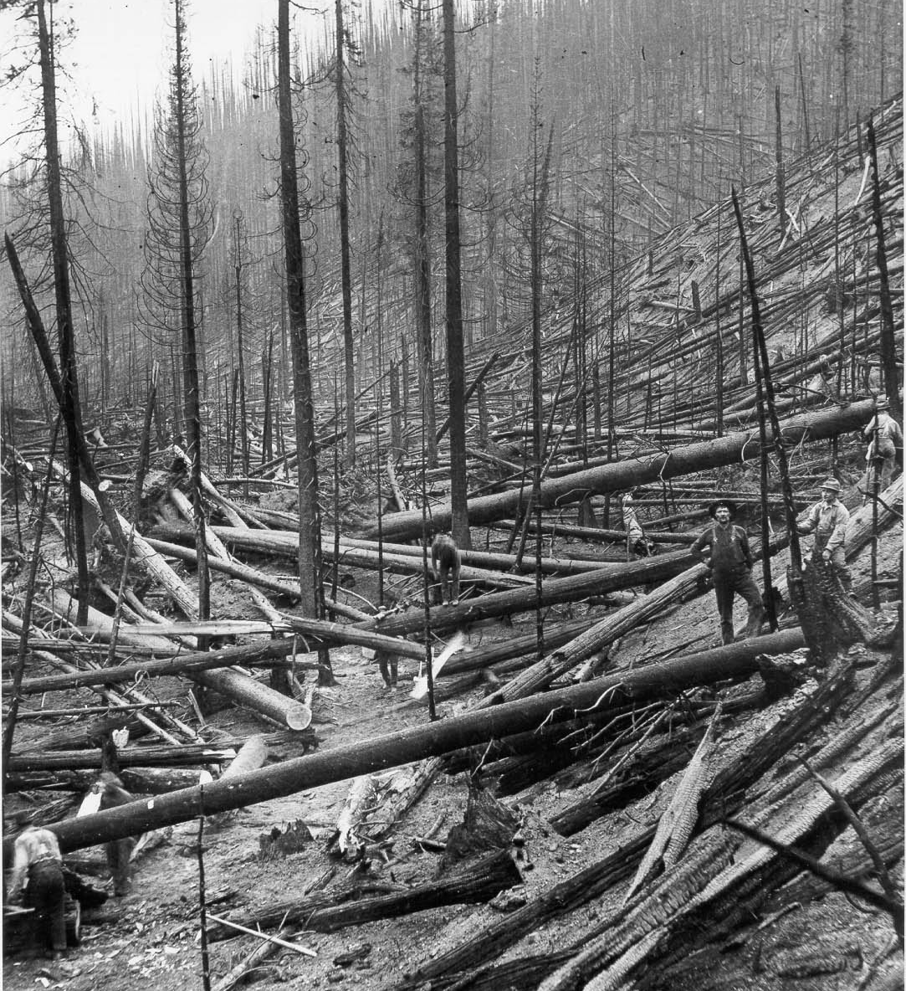

Slide 2
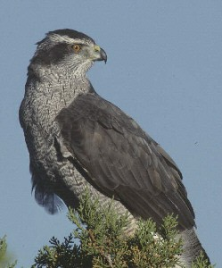
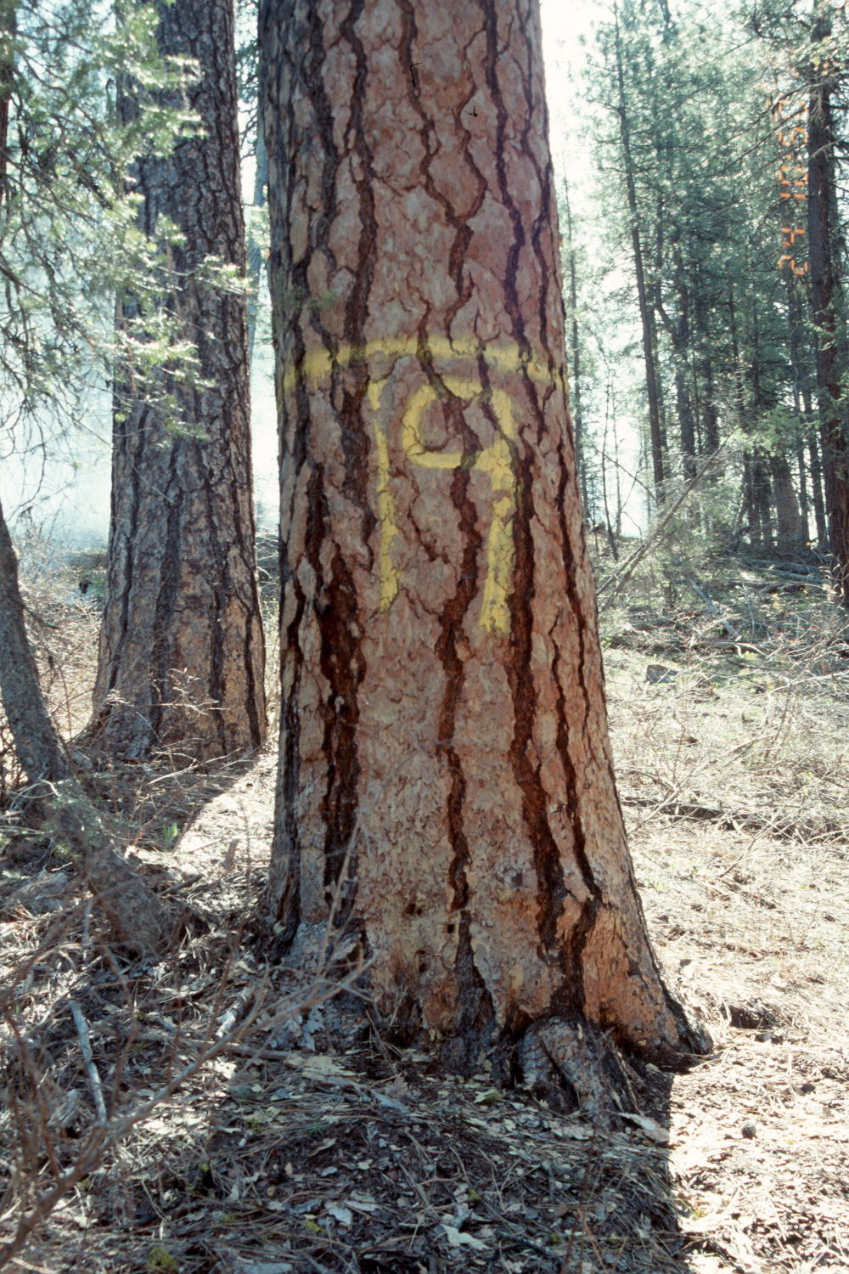
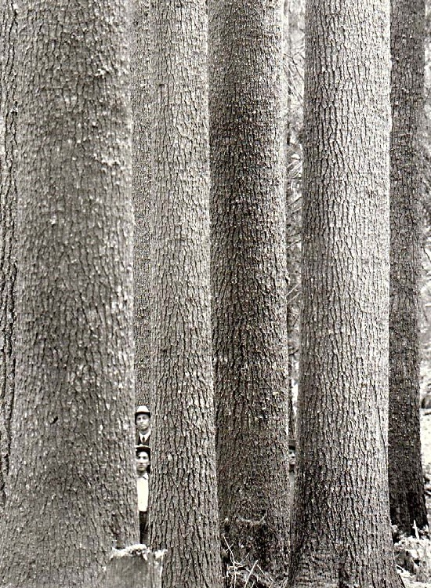
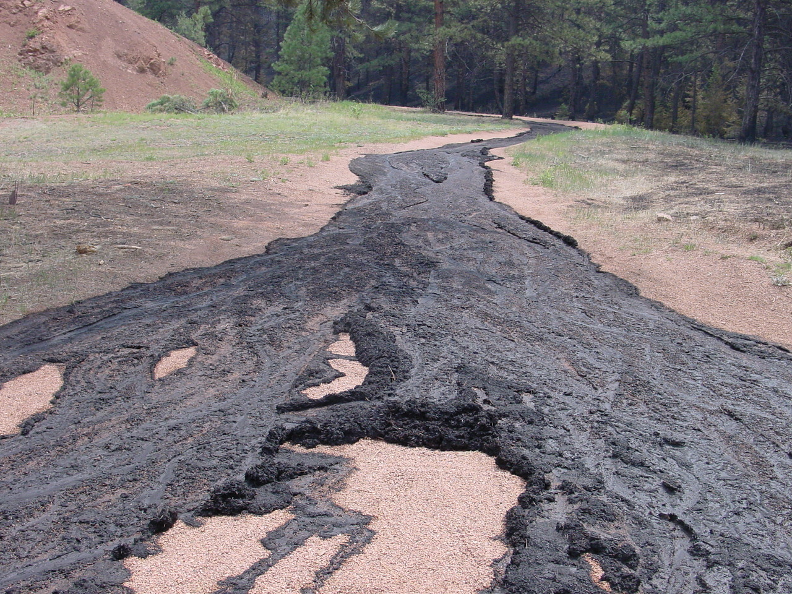
Integrated Forest Restoration
RMRS
Terrie Jain, Russ Graham, Ann Abbot (vegetation), Bill Elliot, Randy Foltz, Pete Robichaud (fire/erosion) John Squires, and Rich Reynolds (wildlife)
Collaborators
Han-Sup Han (forest products), Humboldt State University; Chris Keyes (silviculture), University of Montana
National Forests
Black Hills, Idaho Panhandle, Boise, Colville, Kootenai, Dixie
Stakeholders
Colville Coalition, Yaak Valley Council, Kootenai Coalition,
Coeur d’Alene Coalition

Slide 3
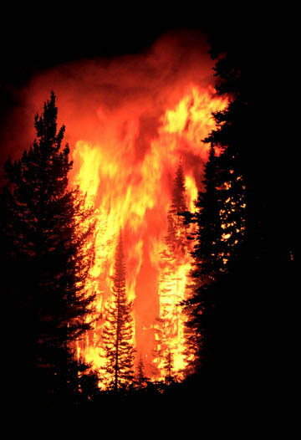
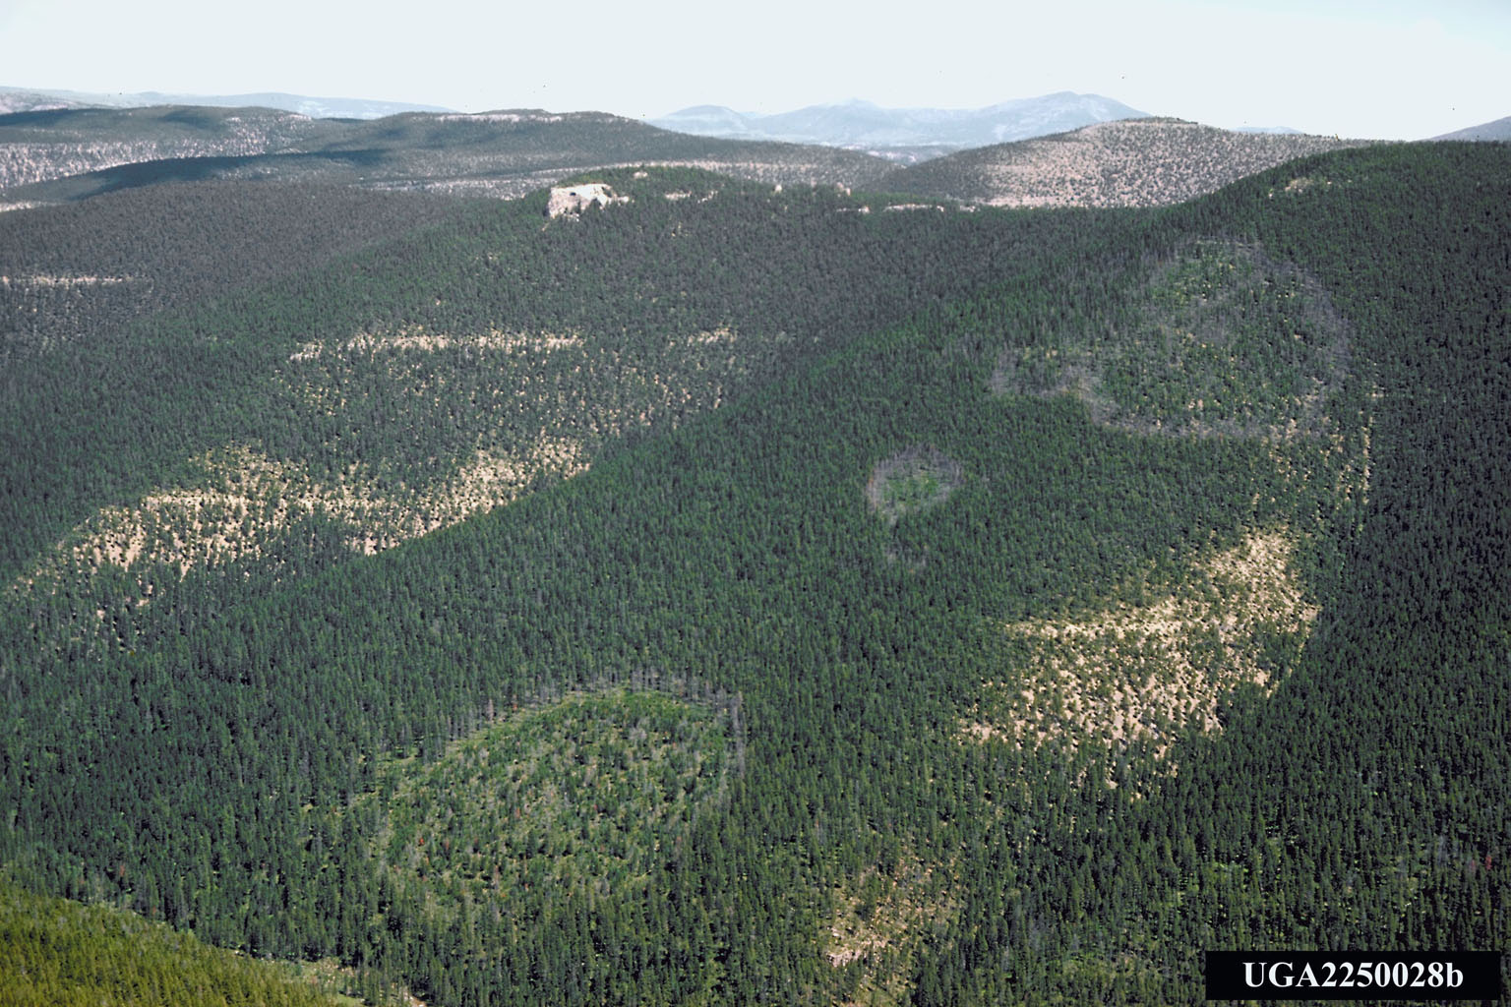
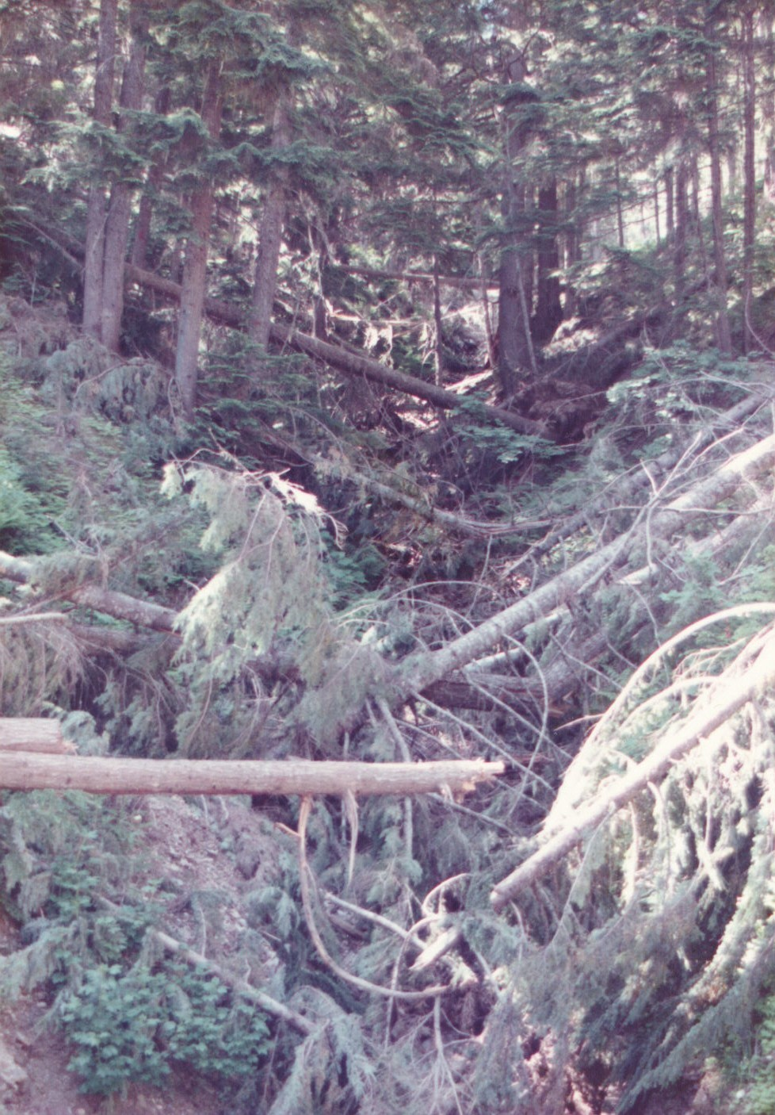
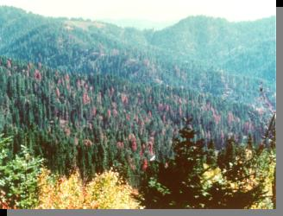
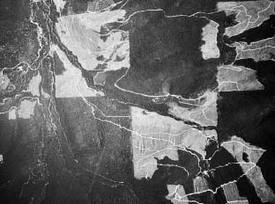
Why Restore? Forest Change
Fire
Diseases
Weather
Insects
Harvesting

Slide 4
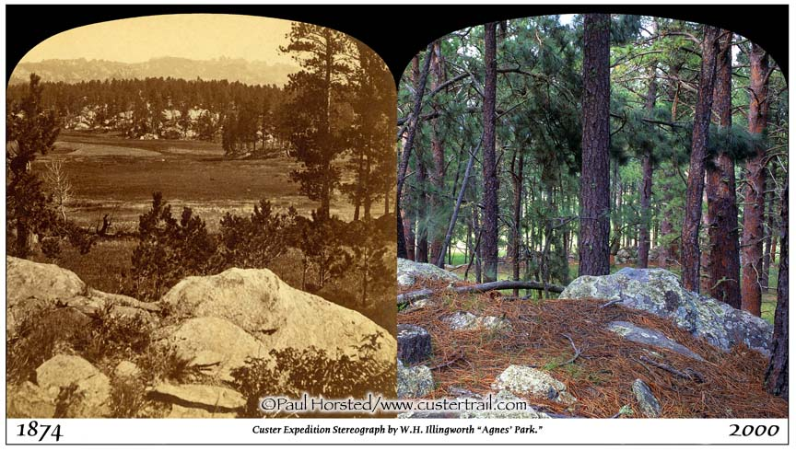
Nutrient/Organic Matter Compression Towards the Soil Surface
Crowns
Soil surface
Roots/myco/
nutrients

Slide 5
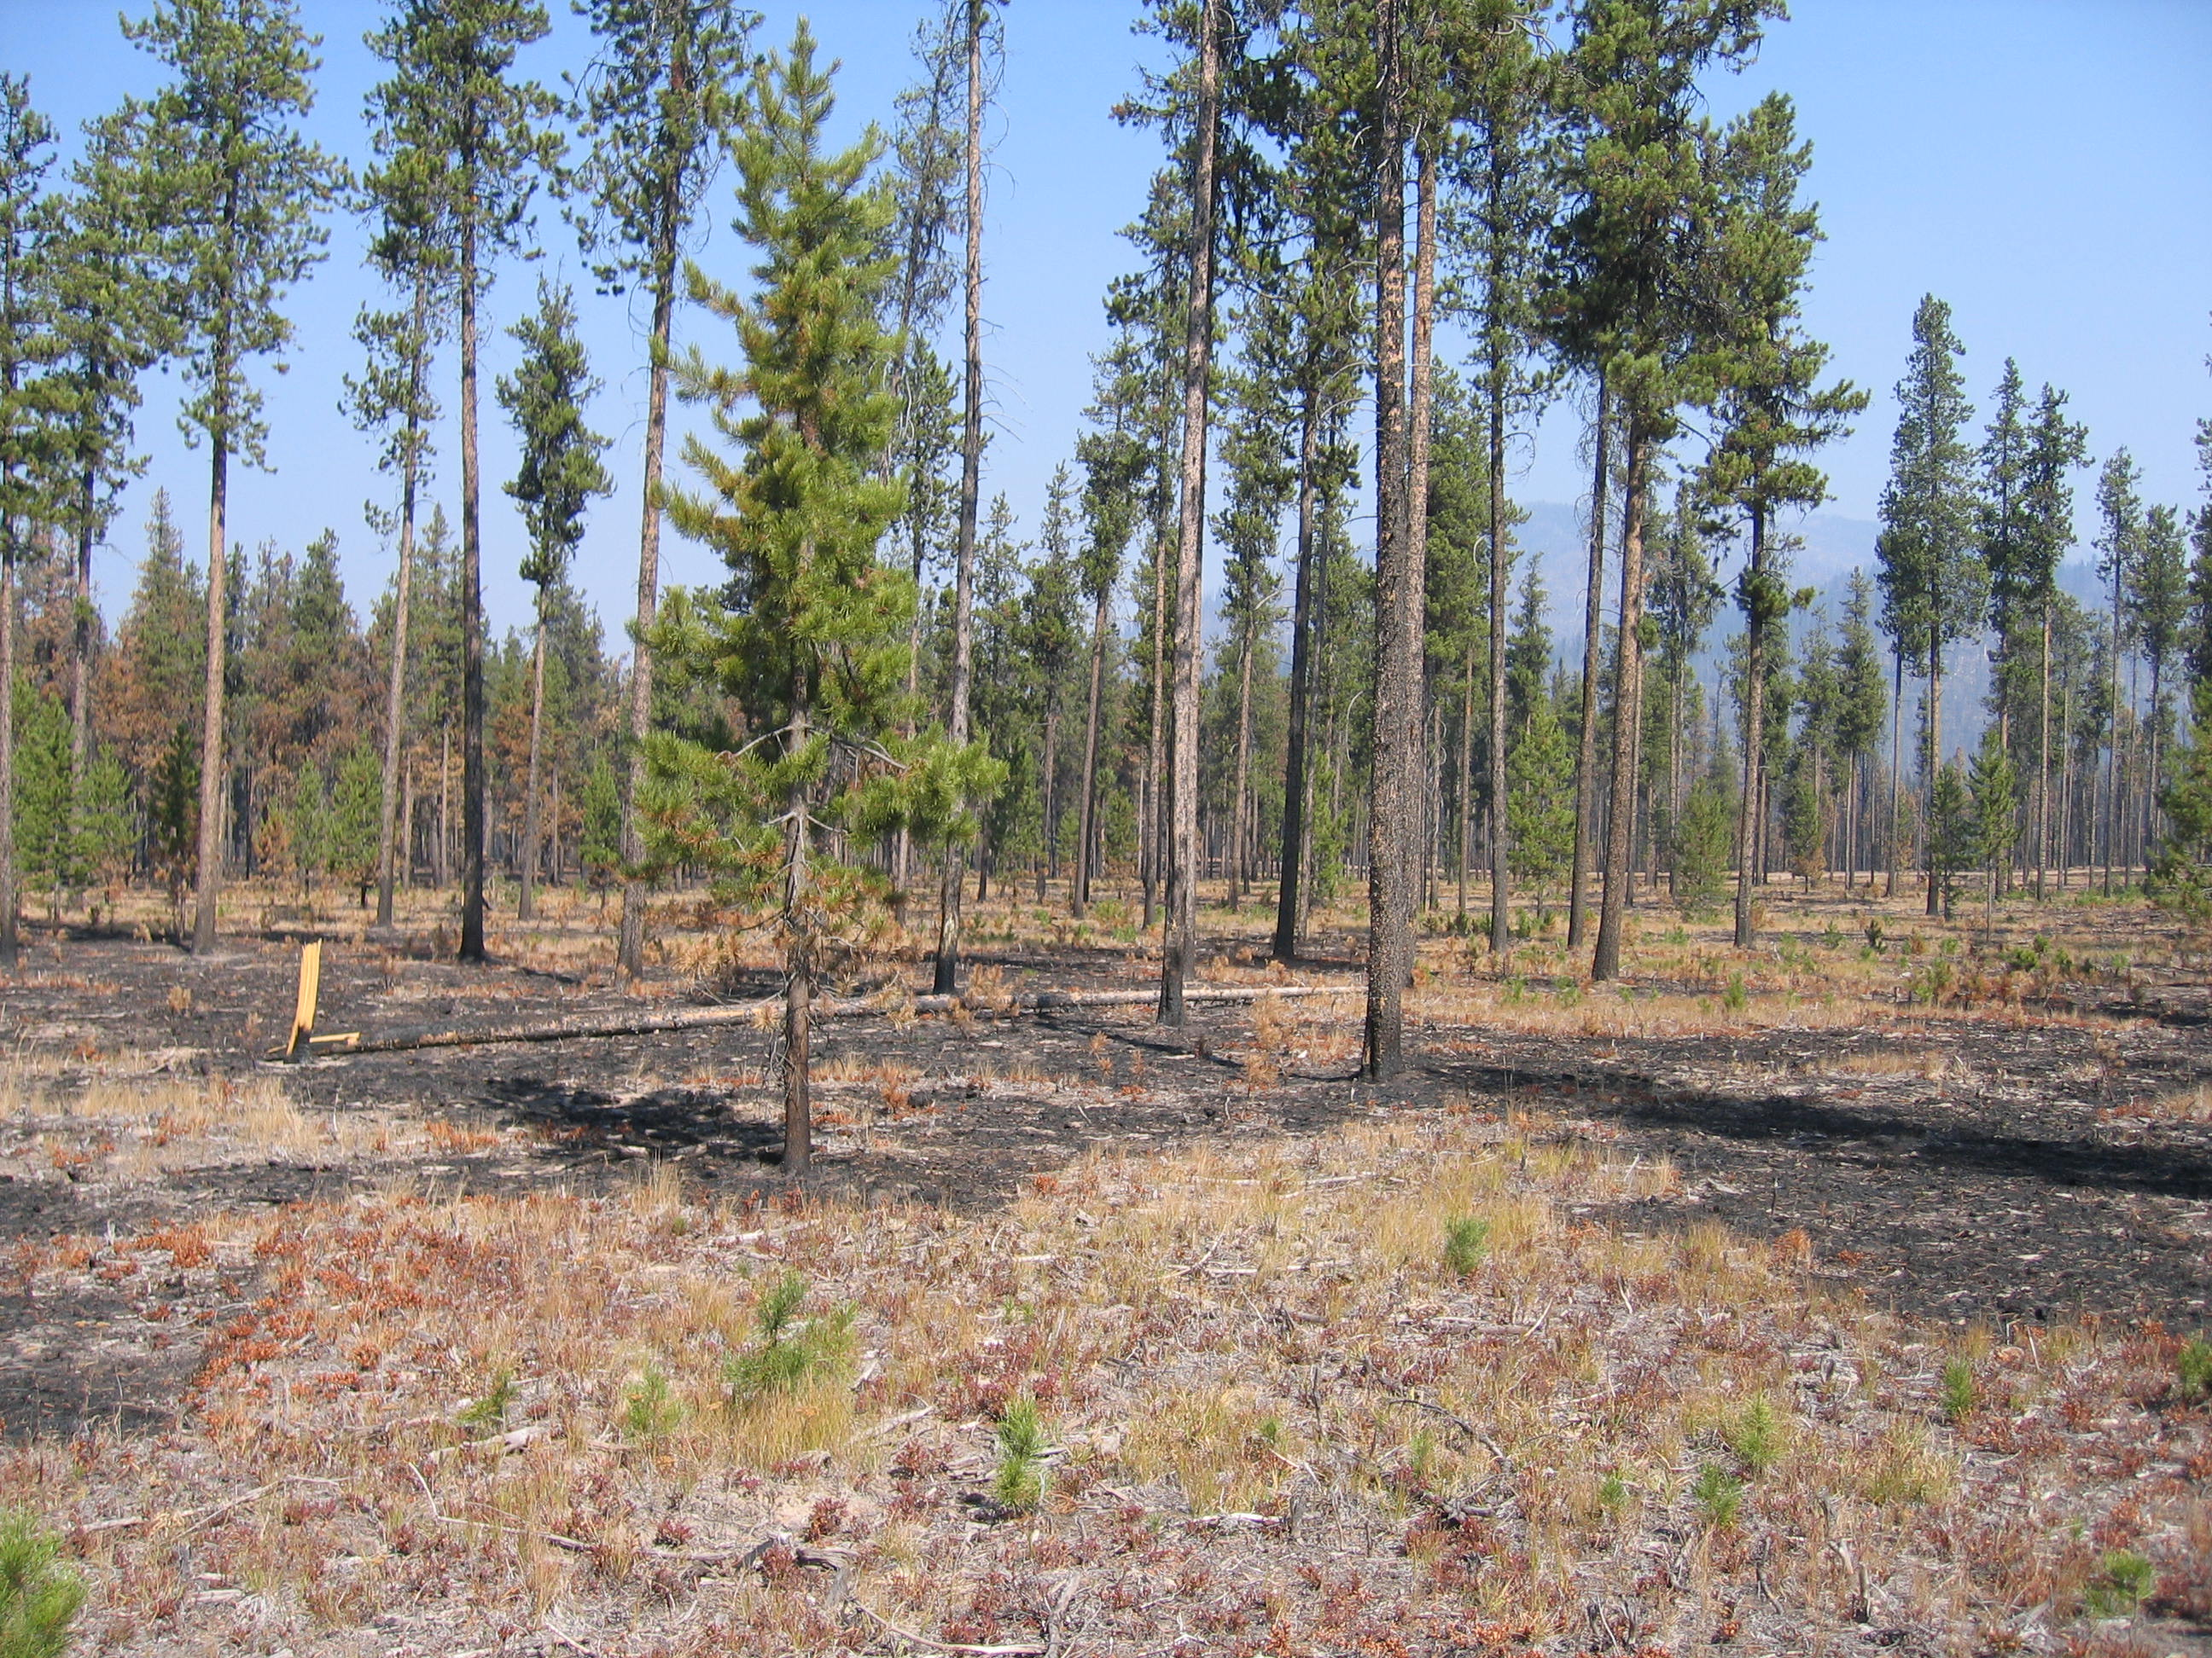
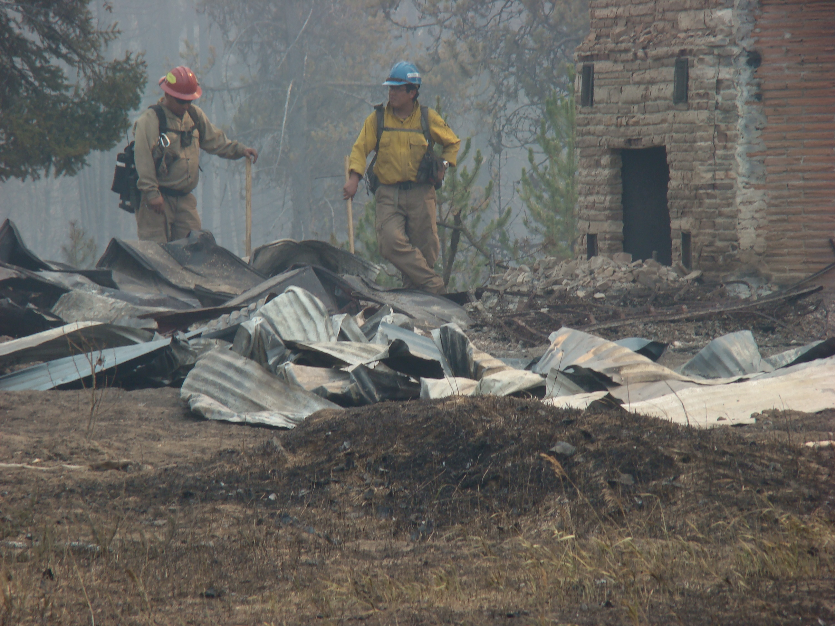
Restoration Elements Short-term (One Day) Benefits Success of Fuel Treatments
Fire fighter and citizen safety
Infrastructure protection
Homes, cabins, lodges
Power lines
Culverts, camp grounds
Alter fire behavior
Contain & suppress a fire
Point/area protection

Slide 6
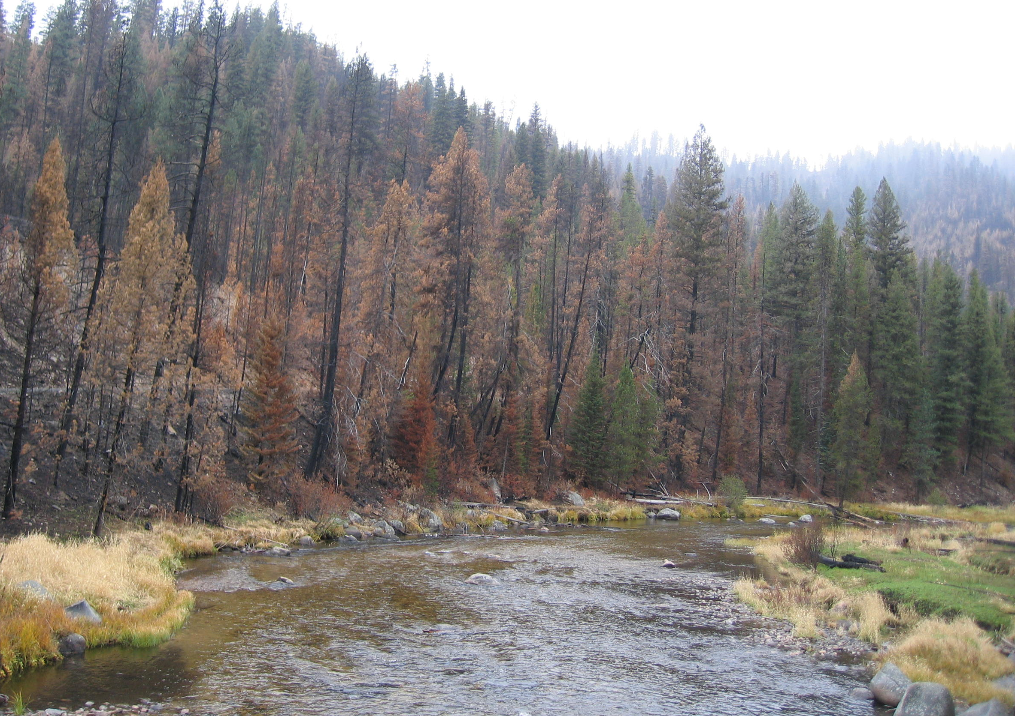
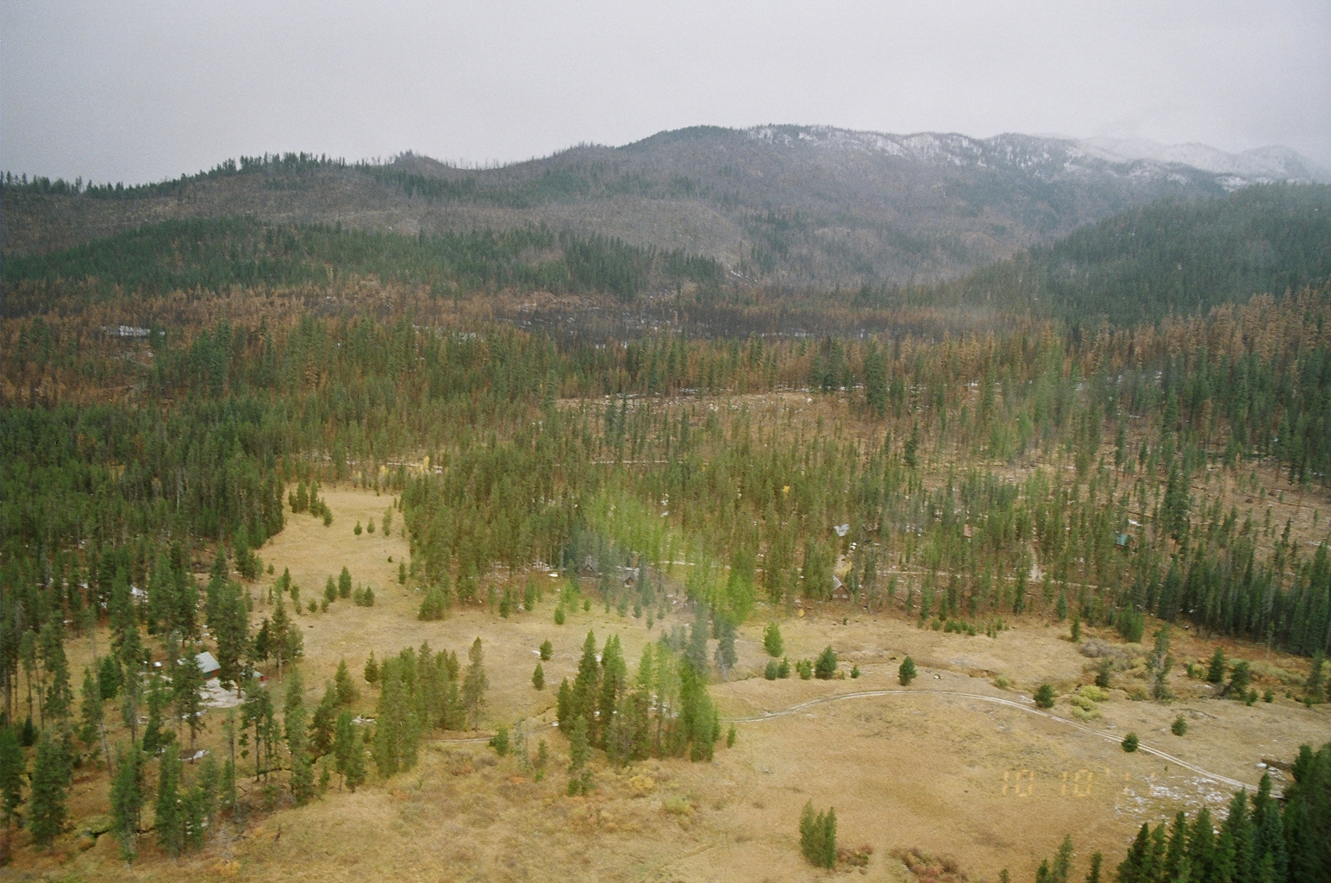
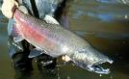
Long-term (Decades) Benefits of Fuel Treatments
What is left after a wildfire
Forest values
Sense-of-place
Wildlife & fish habitat
Clean air & water
Productive soils
Carbon cycling
Economics
Products
Tourism

Slide 7
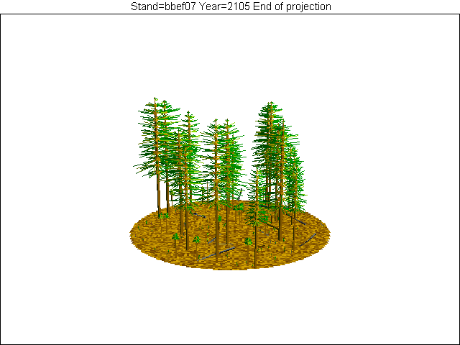
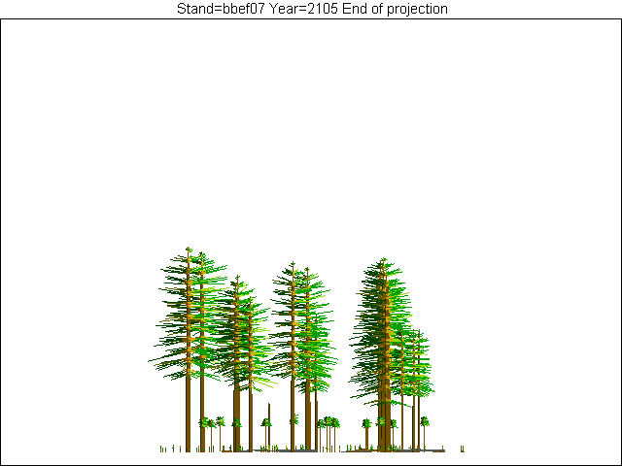
Wildlife Habitat For example: Goshawk Forest Conditions
Interlocking tree crowns – grouped trees
Small openings between tree groups
As much old forest as is sustainable
High interspersion of age classes

Slide 8
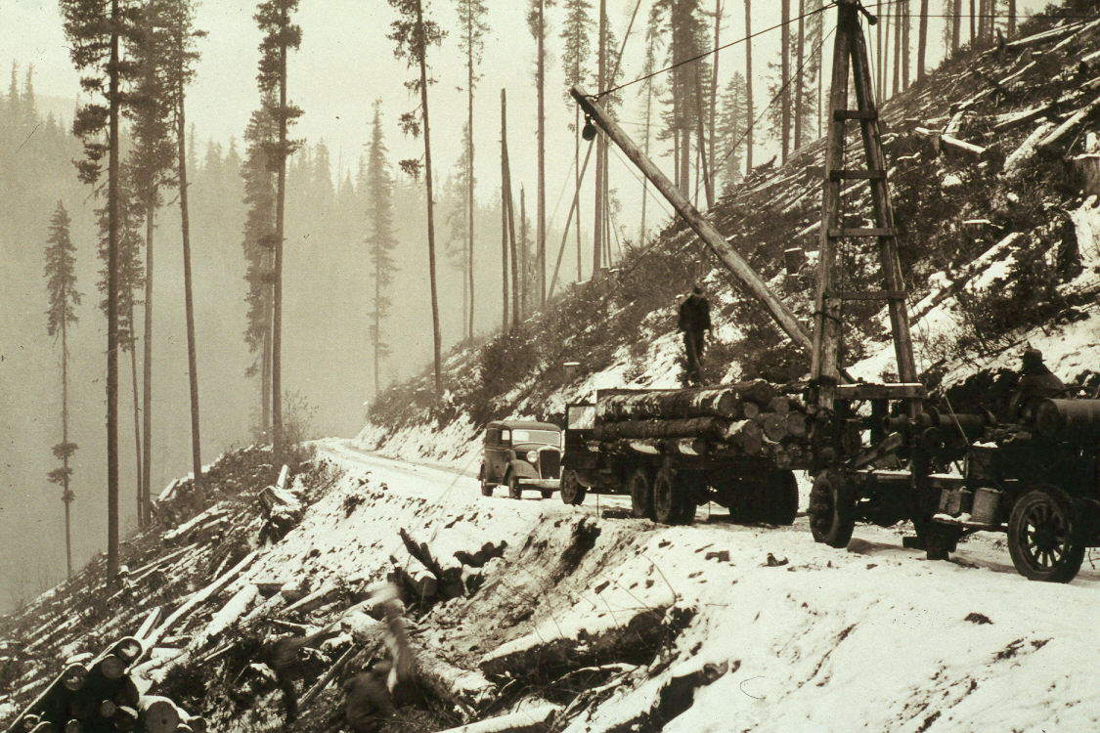
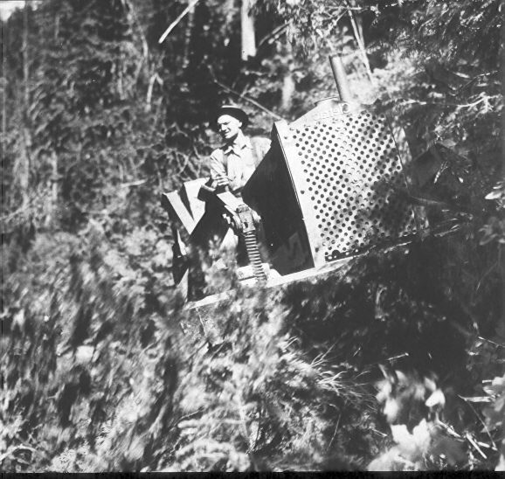
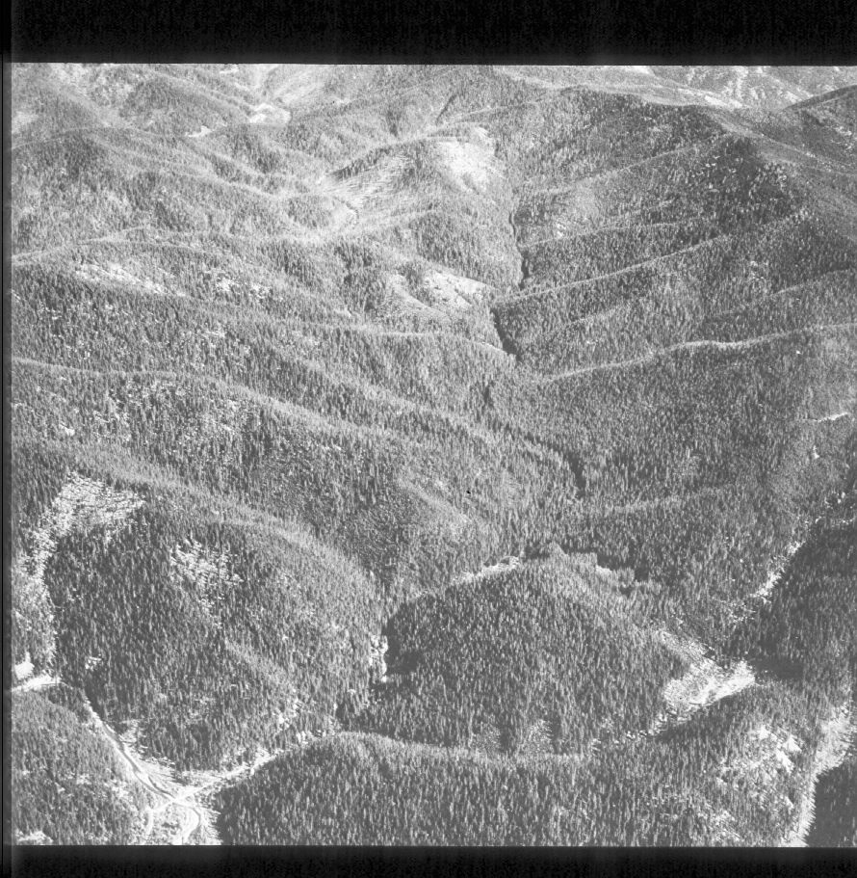
Watershed Health Roads Ecosystem services

Slide 9
Logic Paths for Approaching Restoration A Scientist’s Perspective.
Provide ecologically sound information
Management issues
Social values
Provide management alternatives
Ecologically sound
Socially acceptable
Economically viable
Integrate multiple management objectives
Science based
Provide examples

Slide 10
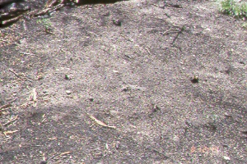
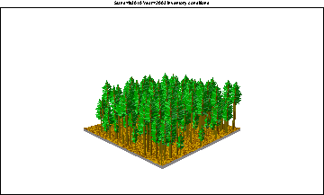
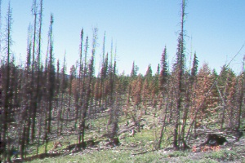
Relation Between Forest Structure and Burn Severity Wildfires in Moist, Cold, and Dry Forests
As a Function of Pre-Fire Forest Structure
Burn Severity

Slide 11
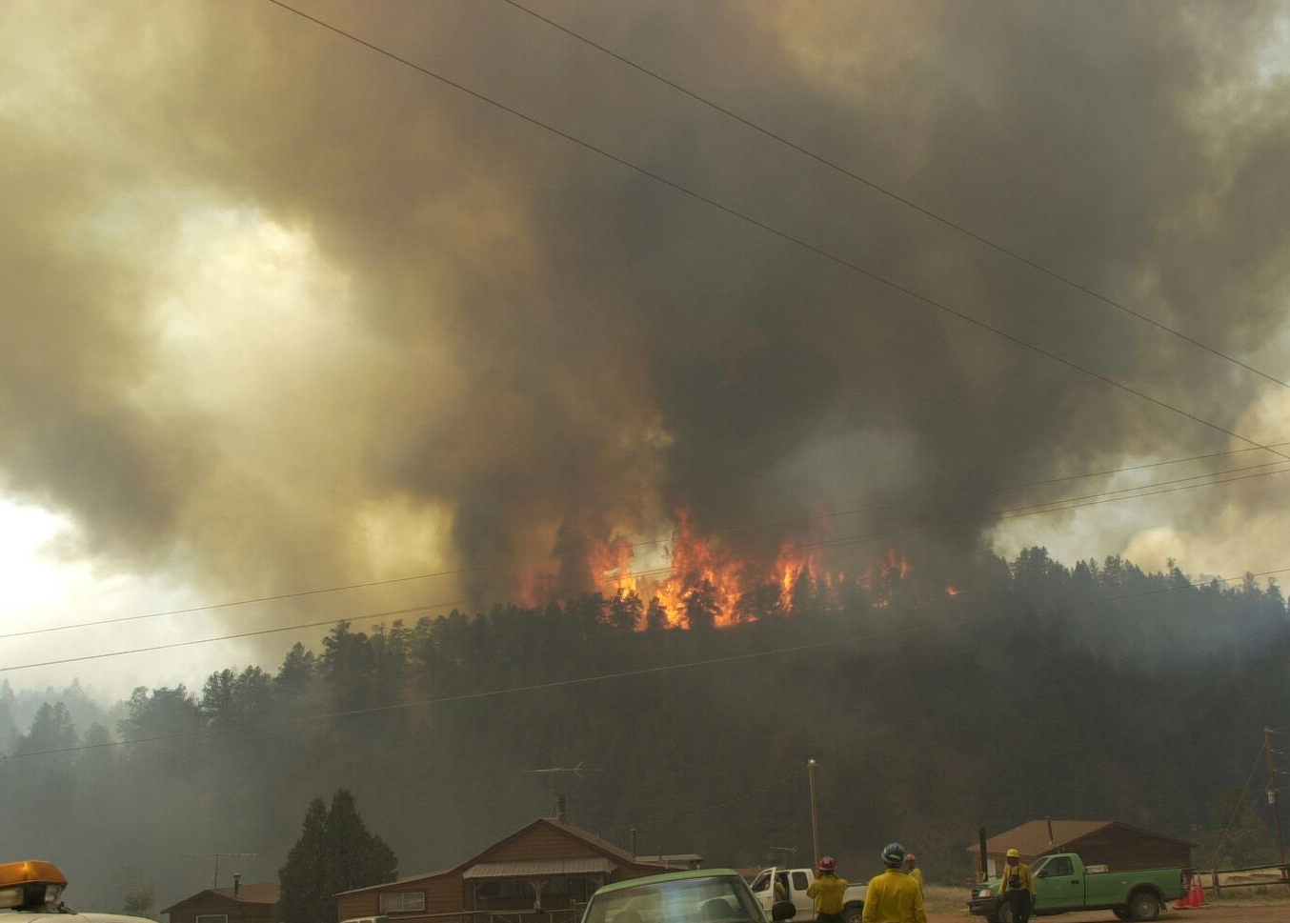
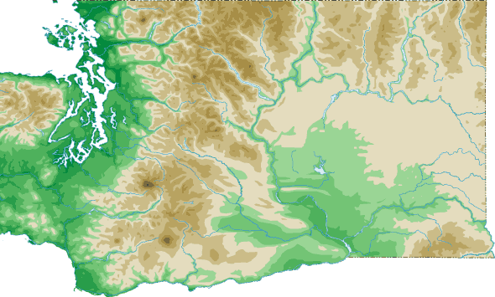
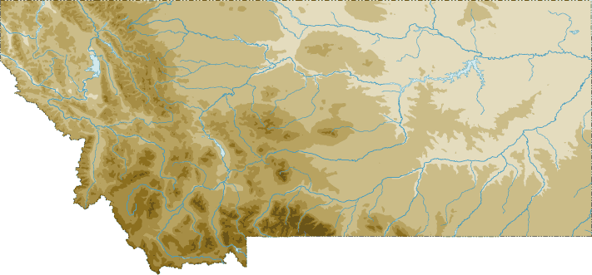
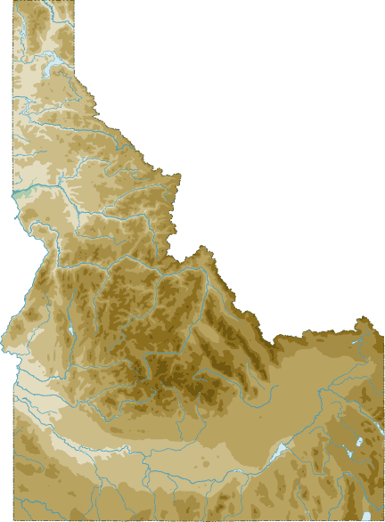
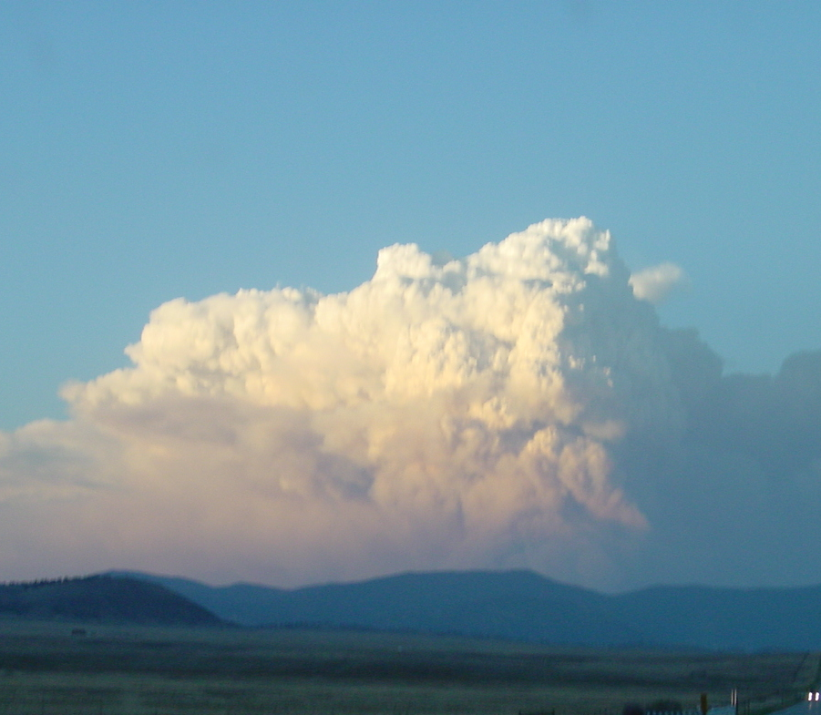
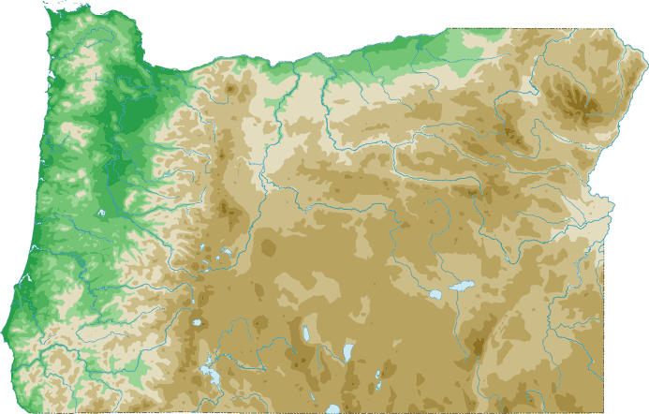
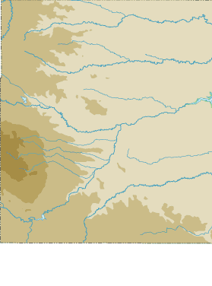
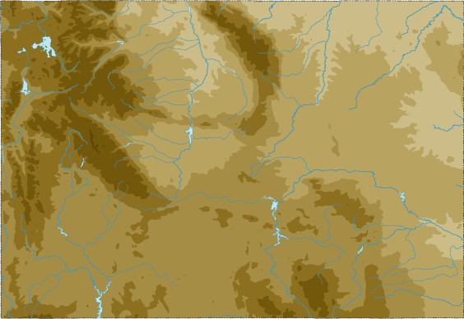
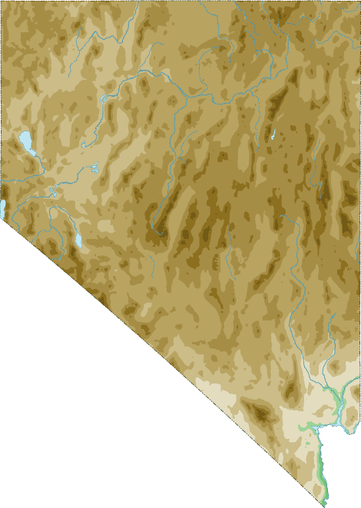
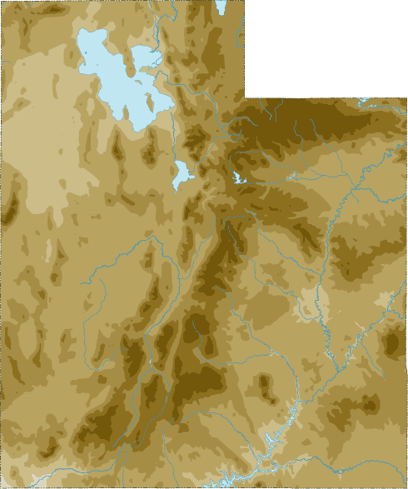
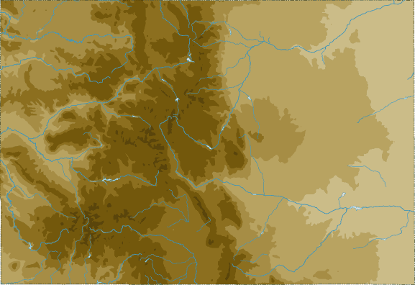
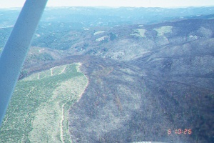
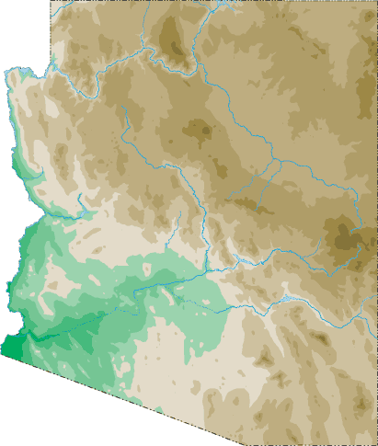
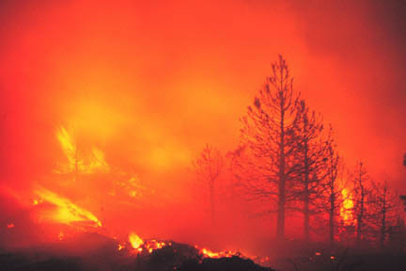
Visited 73 2001-2003 Wildfires
3
13
5
MT
4
12
6
2
WA
4
2
4
2
3
1
1
ID
1
1
1
OR
1
1
UT
1
1
CO
1
1
AZ
2

Slide 12
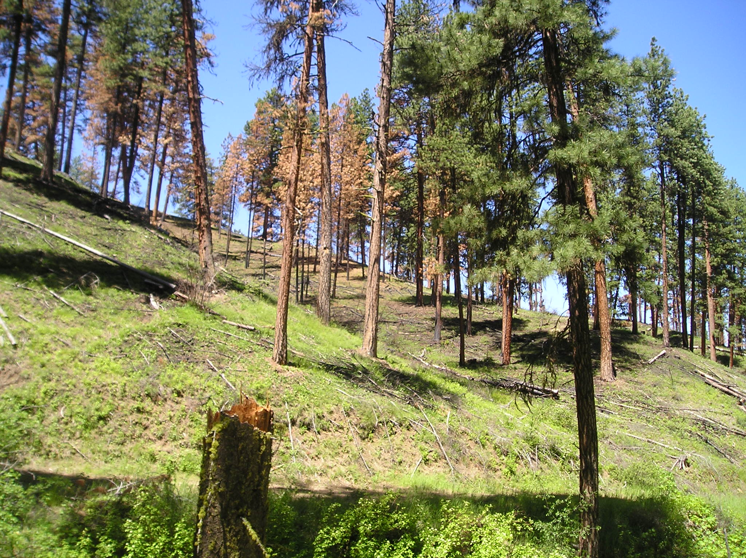
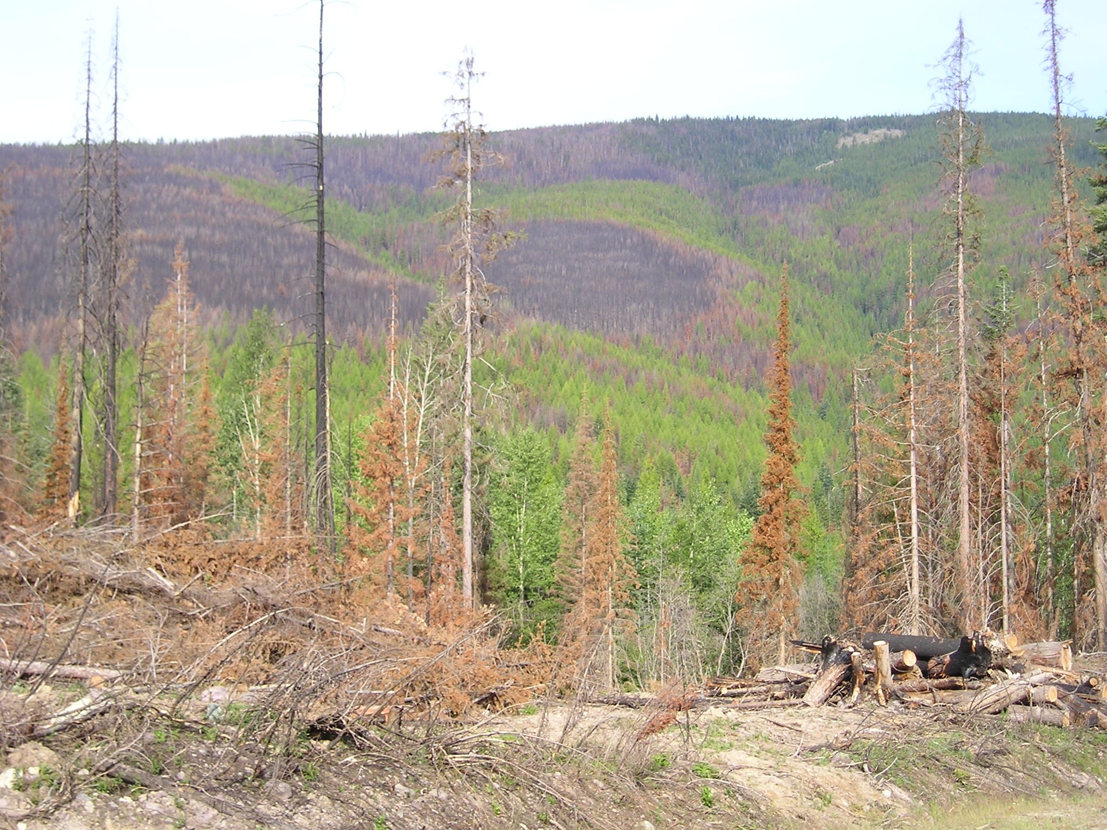
Tree Burn Severity
Vertical
Horizontal

Slide 13
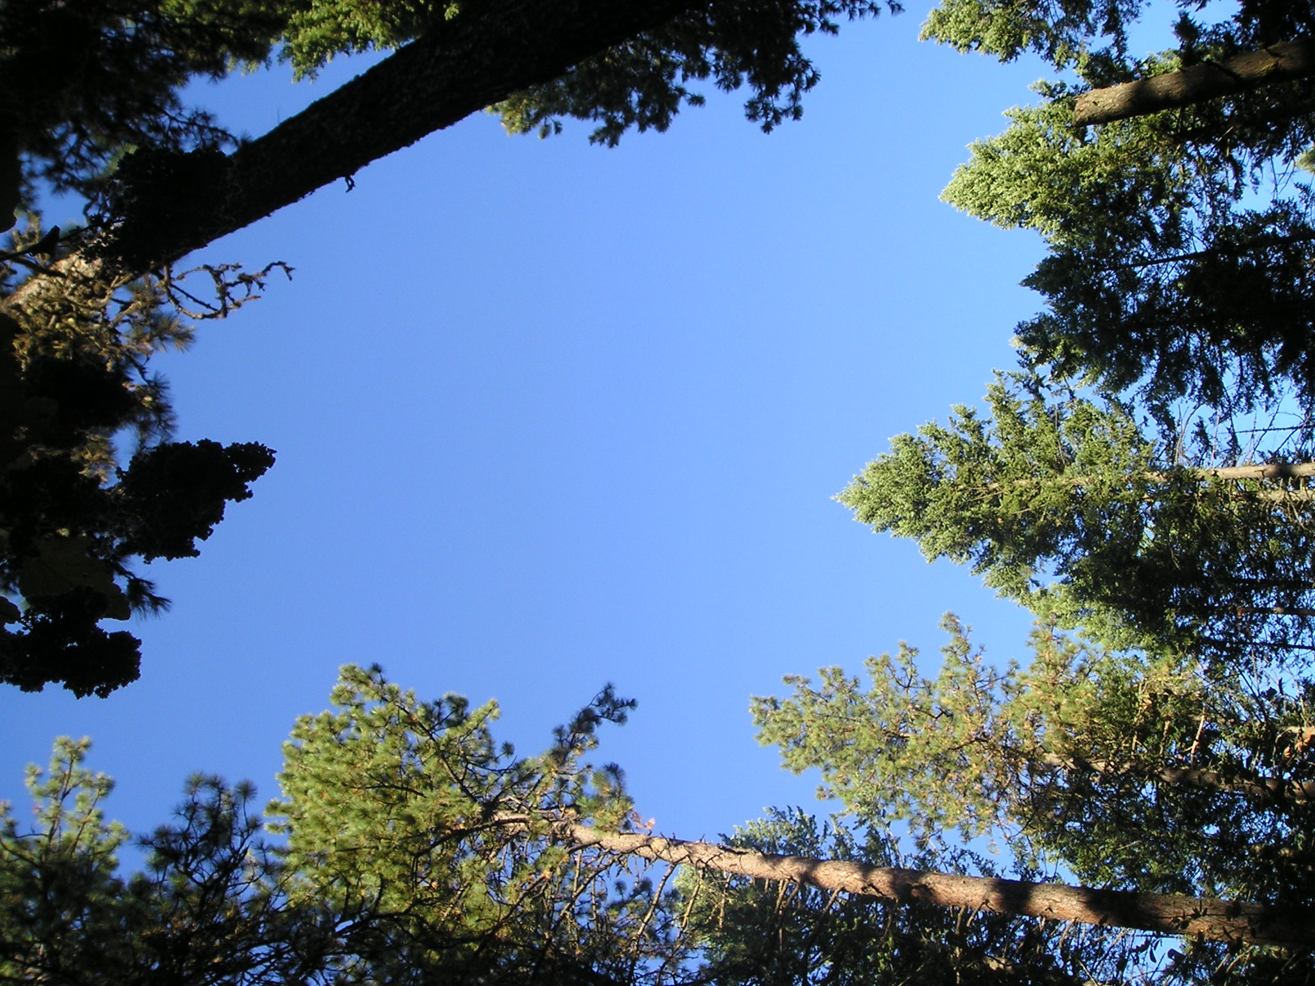
Low Overstory Tree Density

Slide 14
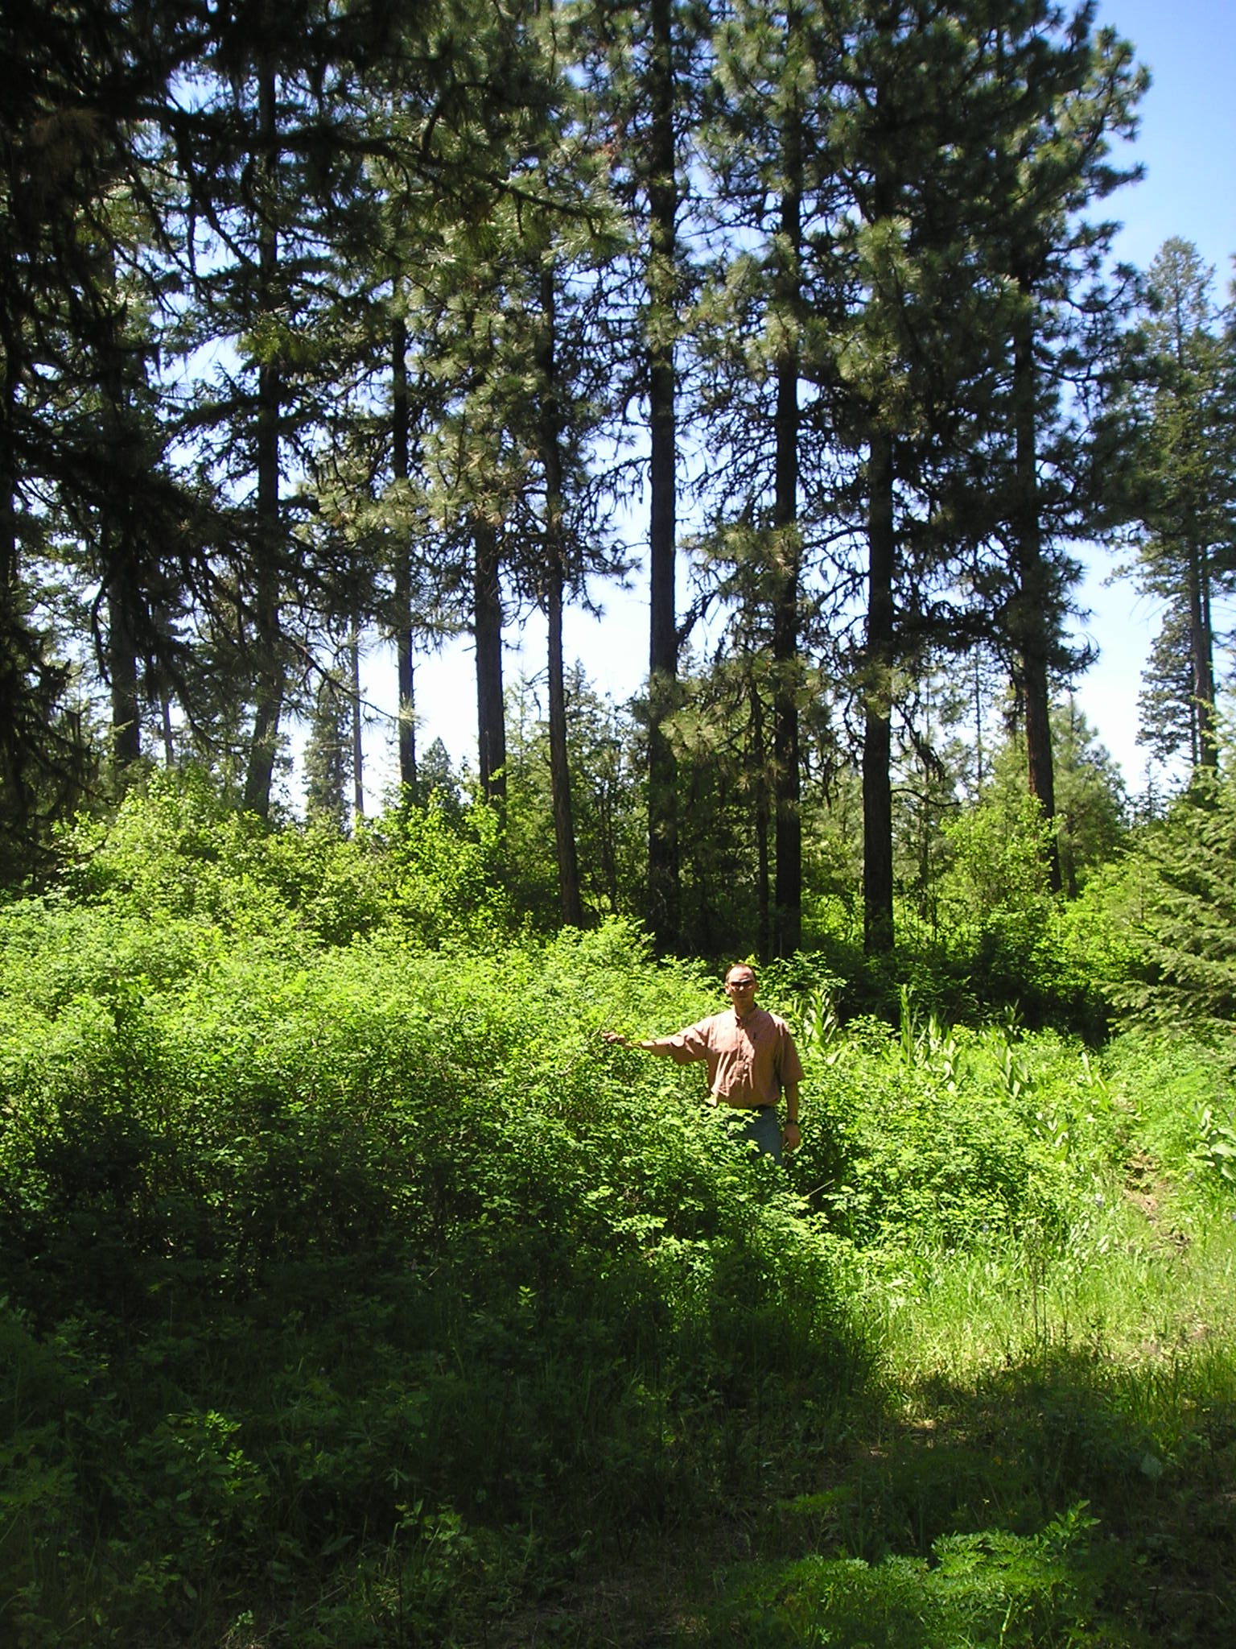
PP/Mixed Conifer Forests Tree Burn Severity
53% probability of brown trees (mixed brown and brown) from heat scorch –
23 obs. – 10 mixed brown, 1 brown, 5 black
Conditions:
Dry forest
Low canopy base height
Low cover (20%)
Surface fuels – produce high heat?
10 ft
5 ft
May be good for wildlife browse and cover

Slide 15
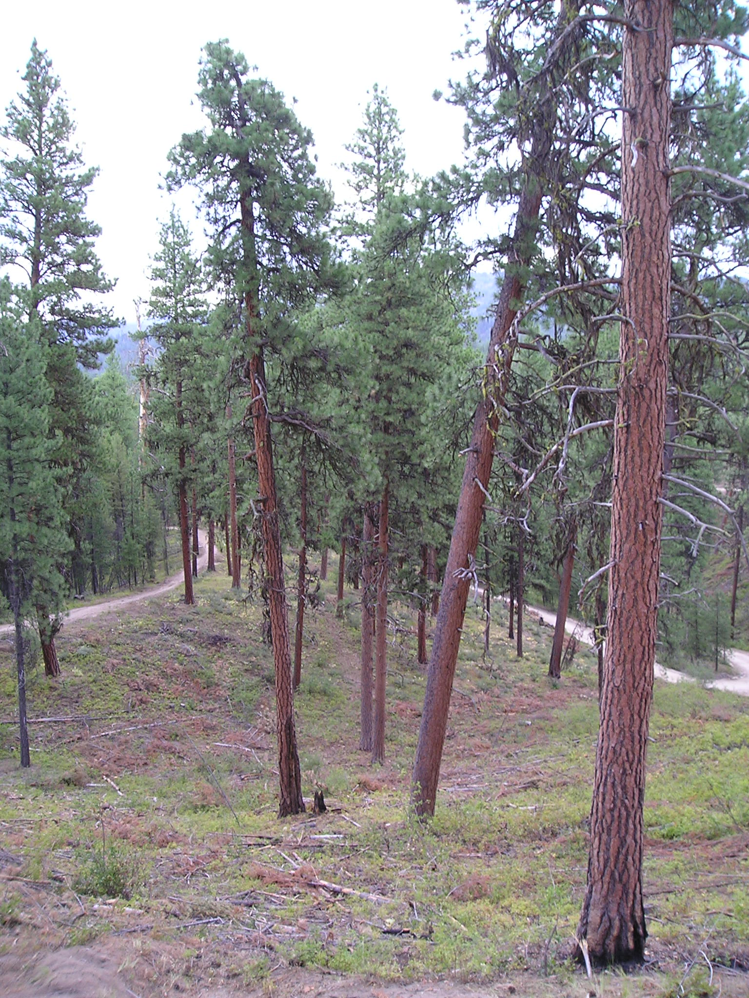
PP/Mixed Conifer Forests Tree Burn Severity
Tree size > 21”
70% probability of green trees
Surface fuels < 3 t/a
57% probability of green trees
Conditions:
1) Dry forest
2) Canopy base height (high)
3) Low surface fuels
30 ft

Slide 16
Take Home Message Low Overstory Density
Be aware of habitat type – vegetation type
A low overstory density does not always result in low soil or tree burn severity
Be aware how overstory density may influence understory vegetation – surface fuels
Key component that influenced the outcome – surface fuels

Slide 17
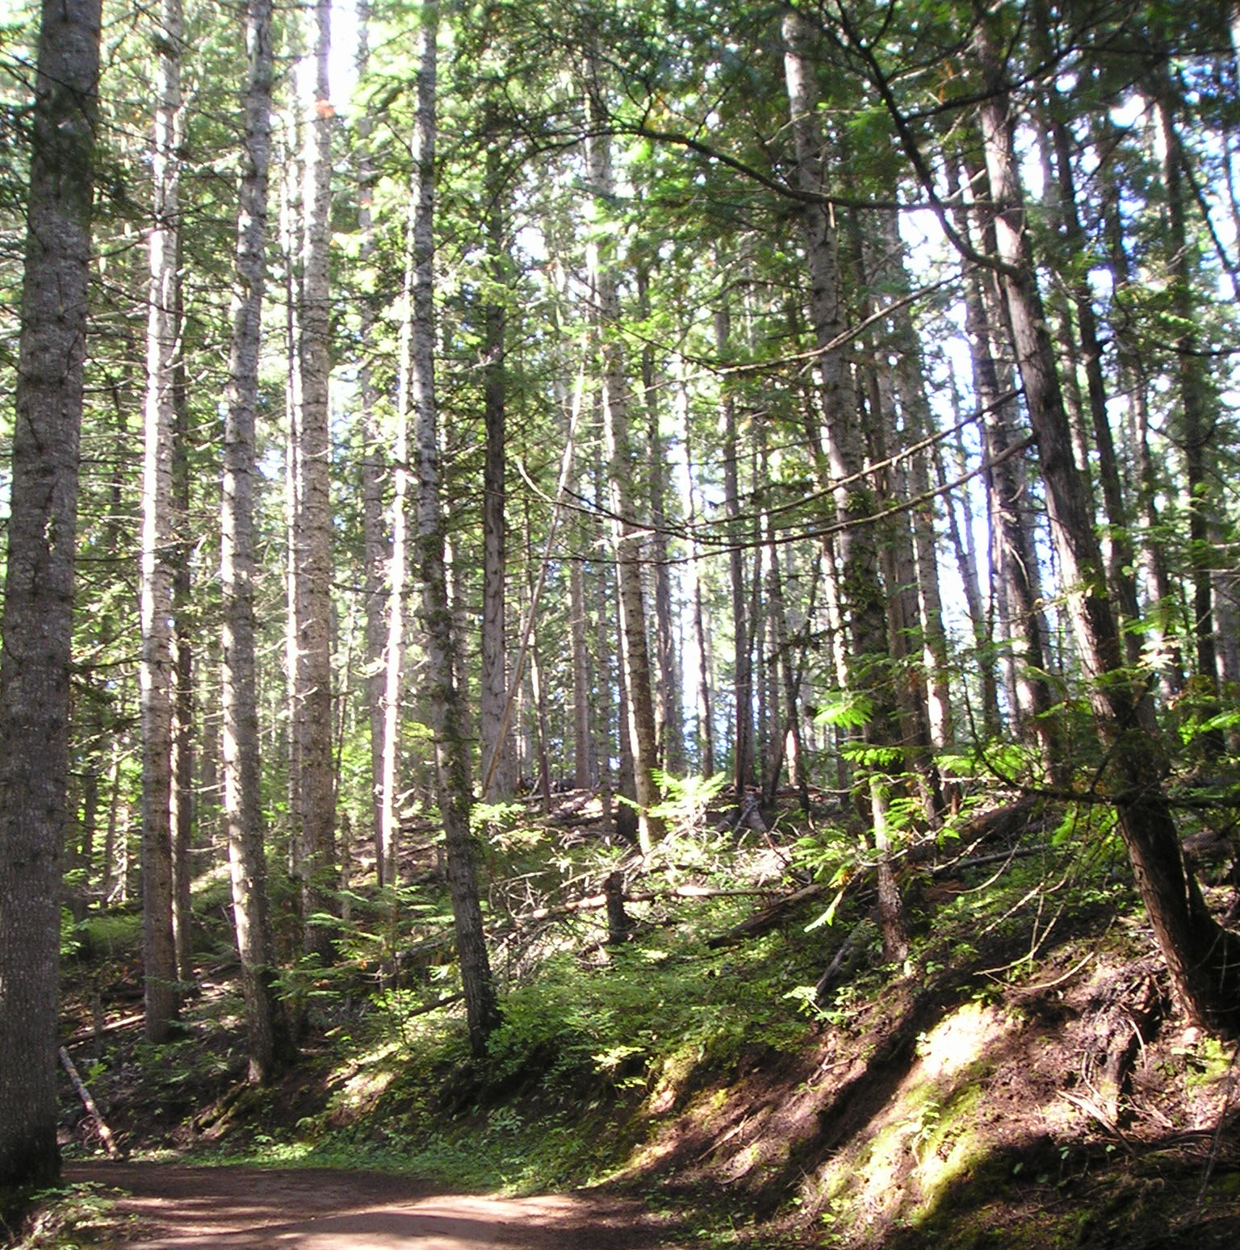
High Overstory Tree Density

Slide 18
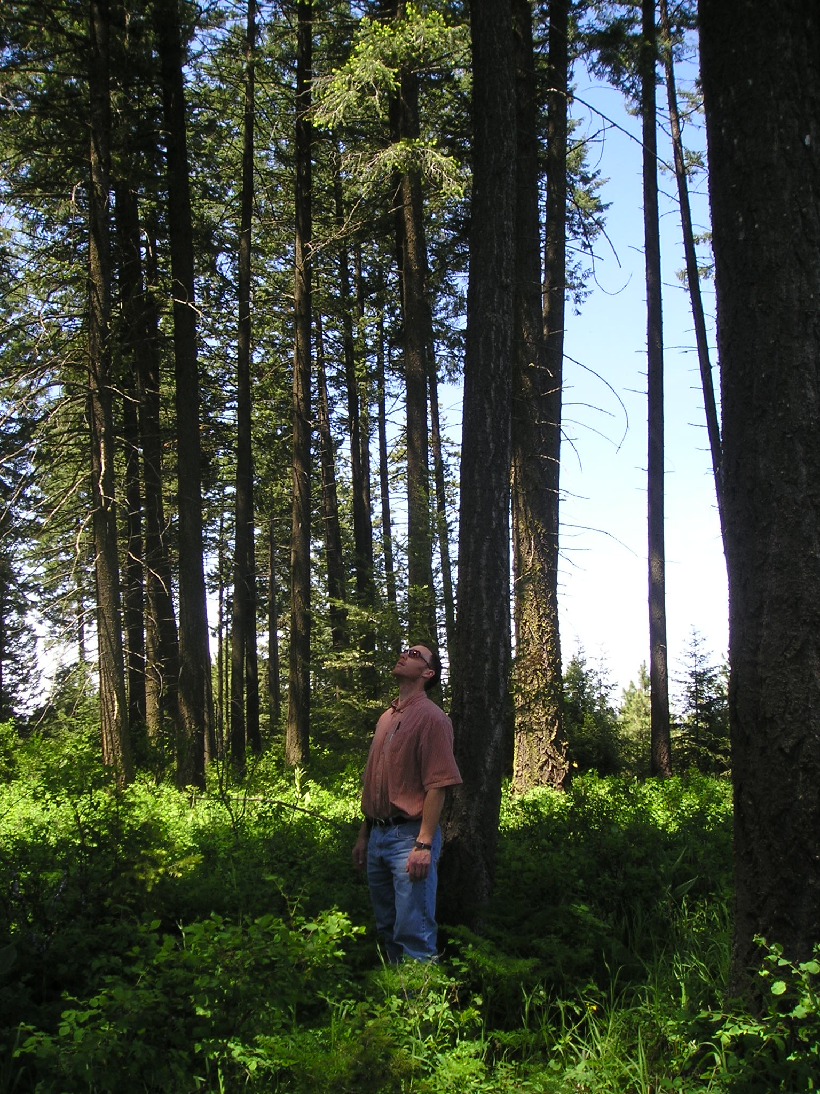
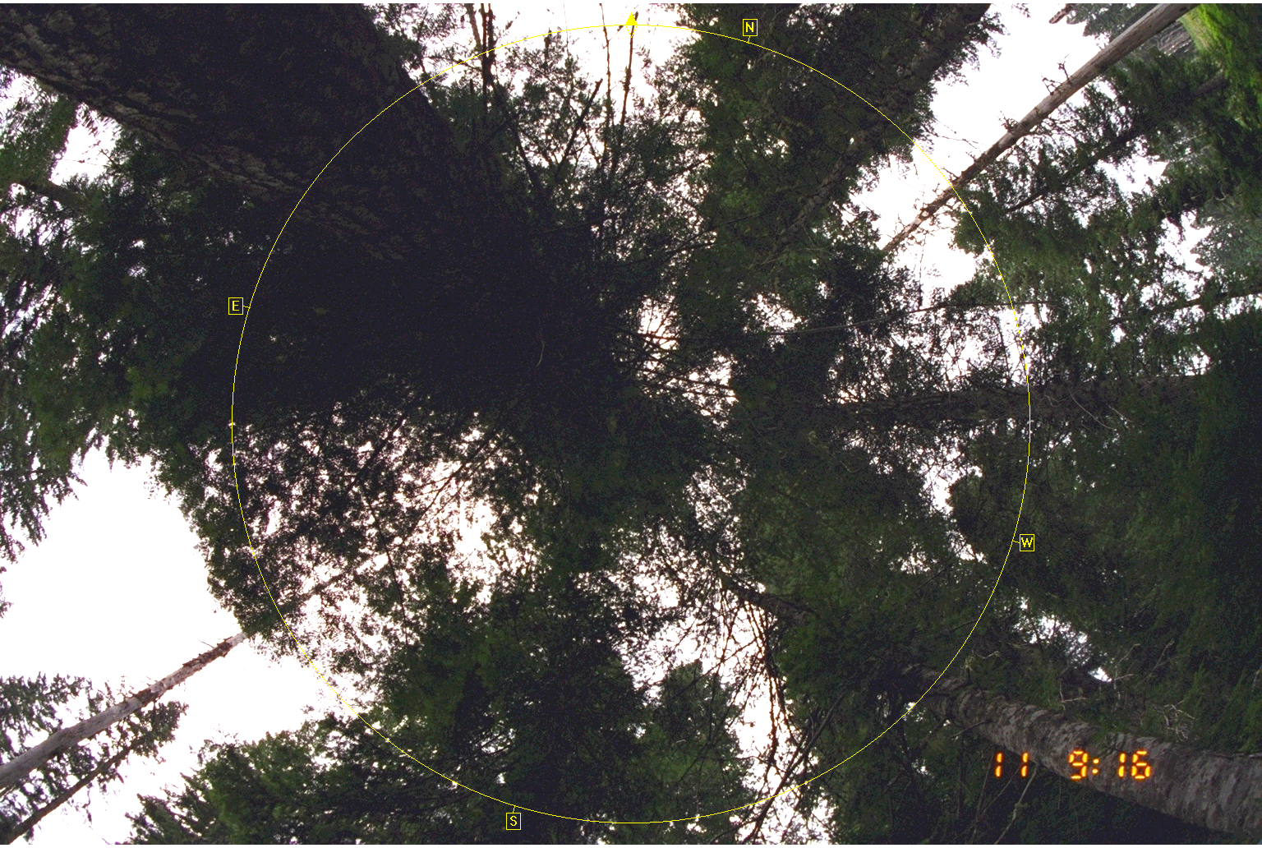
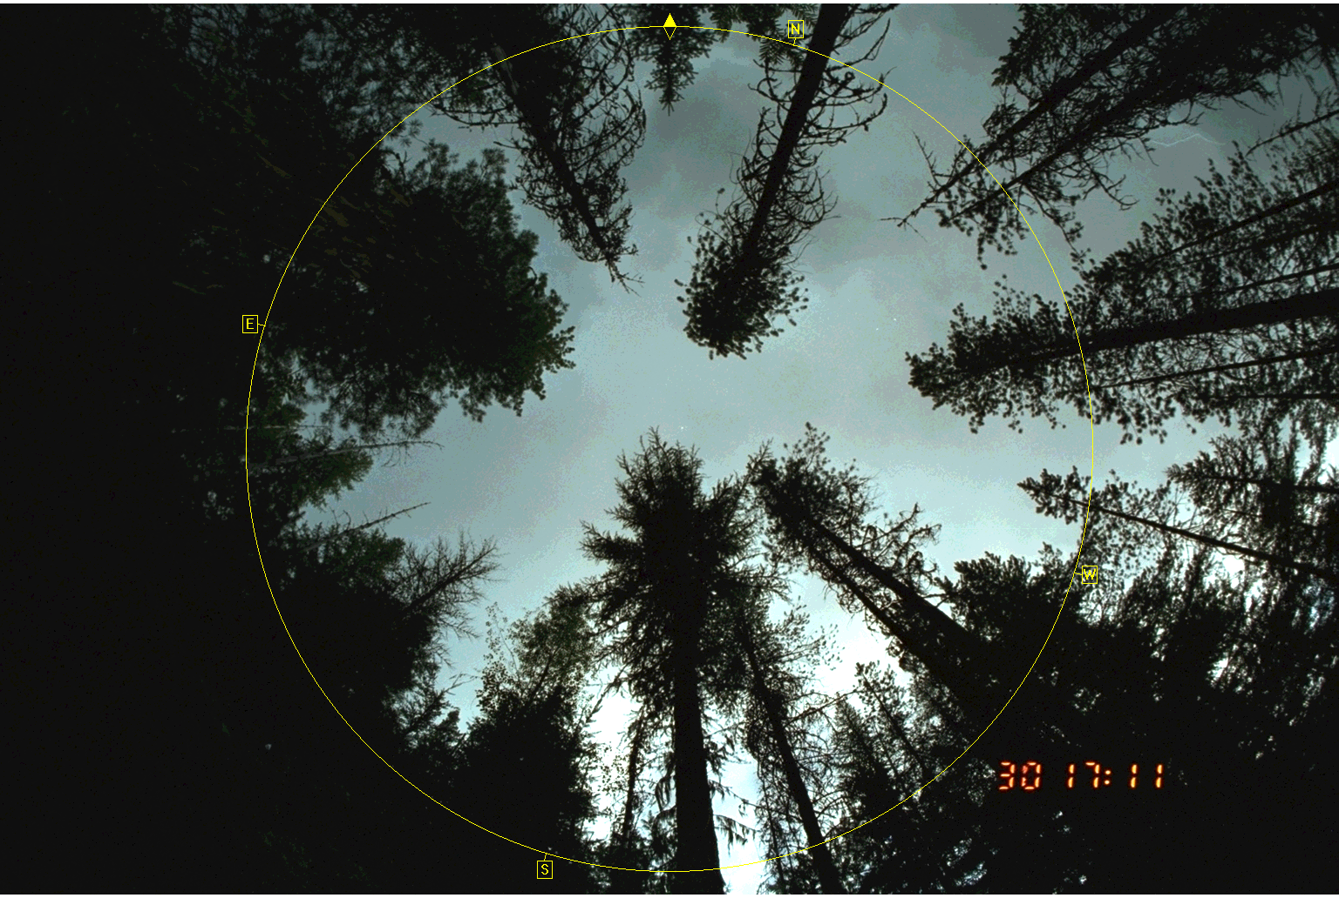
PP/Mixed to Moist Conifer Forests Tree Burn Severity
67% probability of green trees
Conditions: 13 observations
Top height: Dry=58; Moist=61
Canopy cover: 60 to 70%
Basal area: Dry=140; Moist=120
High canopy base heights:
Dry = 30; Moist = 12
Crown ratio: Dry=38; Moist=39
75 % cover
45 % cover
Notes:
Outcome 12 67 – 7 green, 3 mg, 3 black
42 mixed green:9 g, 34, mg, 1-mg, 5-b, 19 black

Slide 19
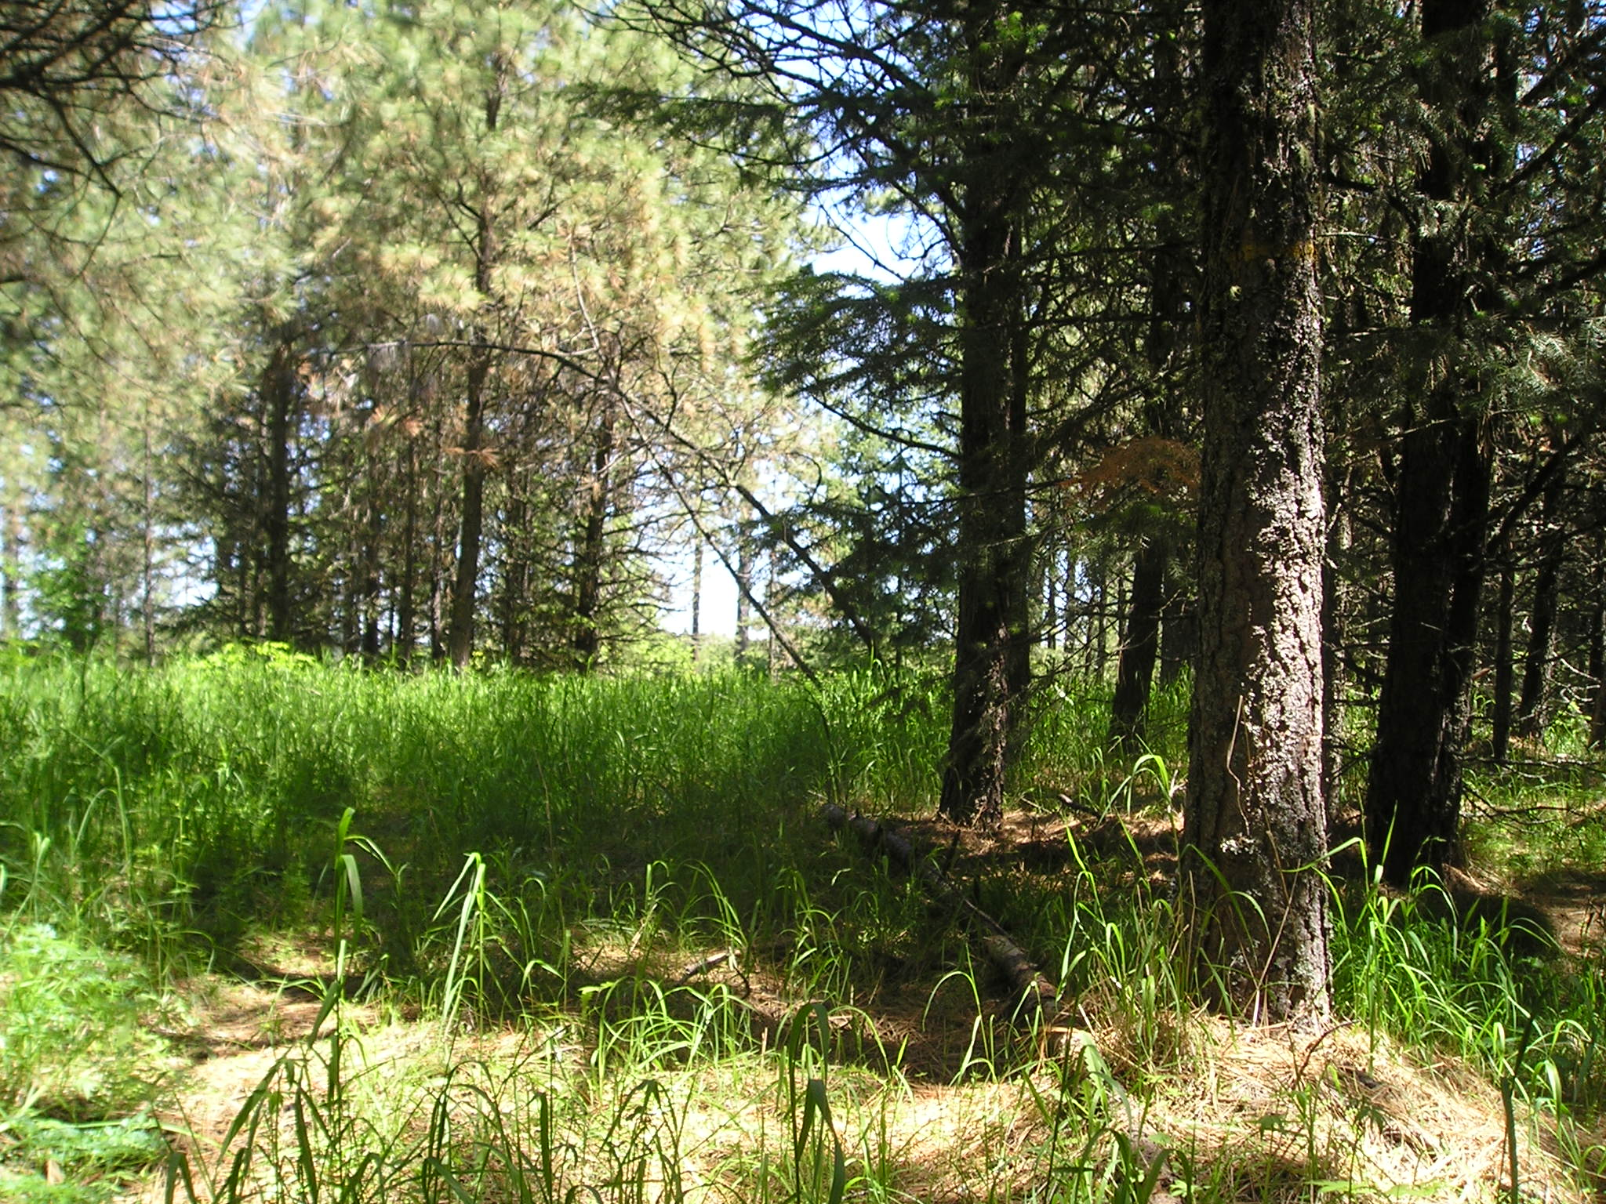
All forest types Tree Burn Severity
Conditions:
High overstory density
Needle understory
Higher canopy base height
52 % probability of mixed green
41 % probability of brown trees
Conditions:
Low overstory density
Grass understory
Low canopy base height

Slide 20
Take Home Message
High overstory density can be resilient
Distance between the surface and canopy base height
Type of surface fuel
When do high densities become a problem?
Continuous canopy – fire enters from adjacent stand
No distance between surface and canopy
Can you still kill trees?
Yes
Depends on species

Slide 21
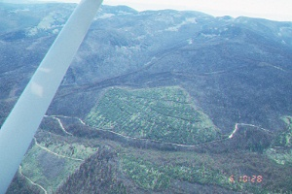


Moist and Cold Forests Tree burn severity
Conditions:
Dense stands of trees
Low canopy base heights
Herbaceous understory
Treated site after harvest
Young forests (< 50 years)
52 & 55% probability of green trees
Fuel moisture and live to dead fuel ratio

Slide 22



Fuel Treatment Effectiveness Wildfires
All treatments burn
Do not change fire size
Wildfire behavior changes quickly with changes in forest structure
Distance matters in changing severity
Irregular forests tend to burn irregularly

Slide 23



Slash Chunking

Slide 24



Surface Fuel Treatments Mastication
Enhance decomposition
Mastication w/wo burning
Prescribed fire - lower duff moisture

Slide 25
Grapple pile
And burn
Economic
Evaluation
Mastication
Prescribed
fire

Slide 26



Litter/humus/ fermentation (Duff) build-up
Notes:
Not only have we had a change in tree species, the soil surface has also changed and there is an increase in duff buildup.

Slide 27

Rationale
Issues
Fire not present for over 100 years
Increase biomass
Increase stress
Ecology
Fine roots and ectomycorrhizae in duff (humus)
Cyclic
Grow and become active > 40 degrees F in spring
Decrease temperature pulse into ground – high lower duff moistures
Spring
Fall
Winter
Notes:
Rationale behind study. Ecotomycorrhizae and roots are cyclic in that they increase in the spring and summer and decrease in the fall and winter. Therefore the objective is to change the surface duff layers when roots and ectomycorrhizae are the least active which is when the soil temperatures are less than 40 degrees F. The second objective is to slowly over time remove the deeper duff layers to accomplish this with fire we want the lower duff moistures to be very high (ideally > 100% lower duff moisture).

Slide 28

Burning Conditions and Consumption
¹ Standard Errors
Notes:
Lower duff moistures and temperatures at the time of the fires. As you noticed that the higher lower duff moistures limited the amount of litter and humus consumption. But as lower duff moisture decreased (97%) more of the surface organic layers were consumed (10 cm)

Slide 29




Snow well
Firewood/slash
Harvested
Pre-Fire Reintroduction
Notes:
The order of how we implemented the different fuel treatments (left to right, top to bottom).

Slide 30
Alternative Canopy Fuel Treatments
Priest River
Experimental Forest
Canyon Creek
Benton Creek

Slide 31



Irregular Selection

Slide 32












Resulting Forest Structure
50% of observations
< 10% cover
< 40 BA
10-22 TPA
WWP, WL, PP
11-65% cover
41-160 BA
23-340 TPA
WH, WRC, WWP
51 to 100% of observations

Slide 33



Logistics of Implementation
Slash treatments
Photograph guide and discussed our options
Not as easy as large units but can be done
Needed to dig fire line down middle of some units
Incorporate patience
Grapple piling
Mastication
Prescribed fire

Slide 34


Evaluate fire behavior using FARSITE modeling approach
5 to 10 ft.
11 to 15 ft.
> 15 ft.
Post-treatment
Stand location

Slide 35


