Slide 1
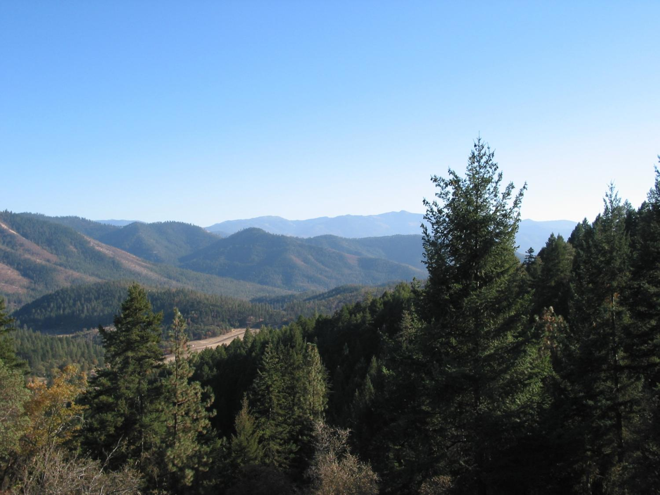
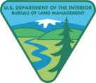
Planning at the Landscape Level
Ed Reilly – Medford BLM

Slide 2
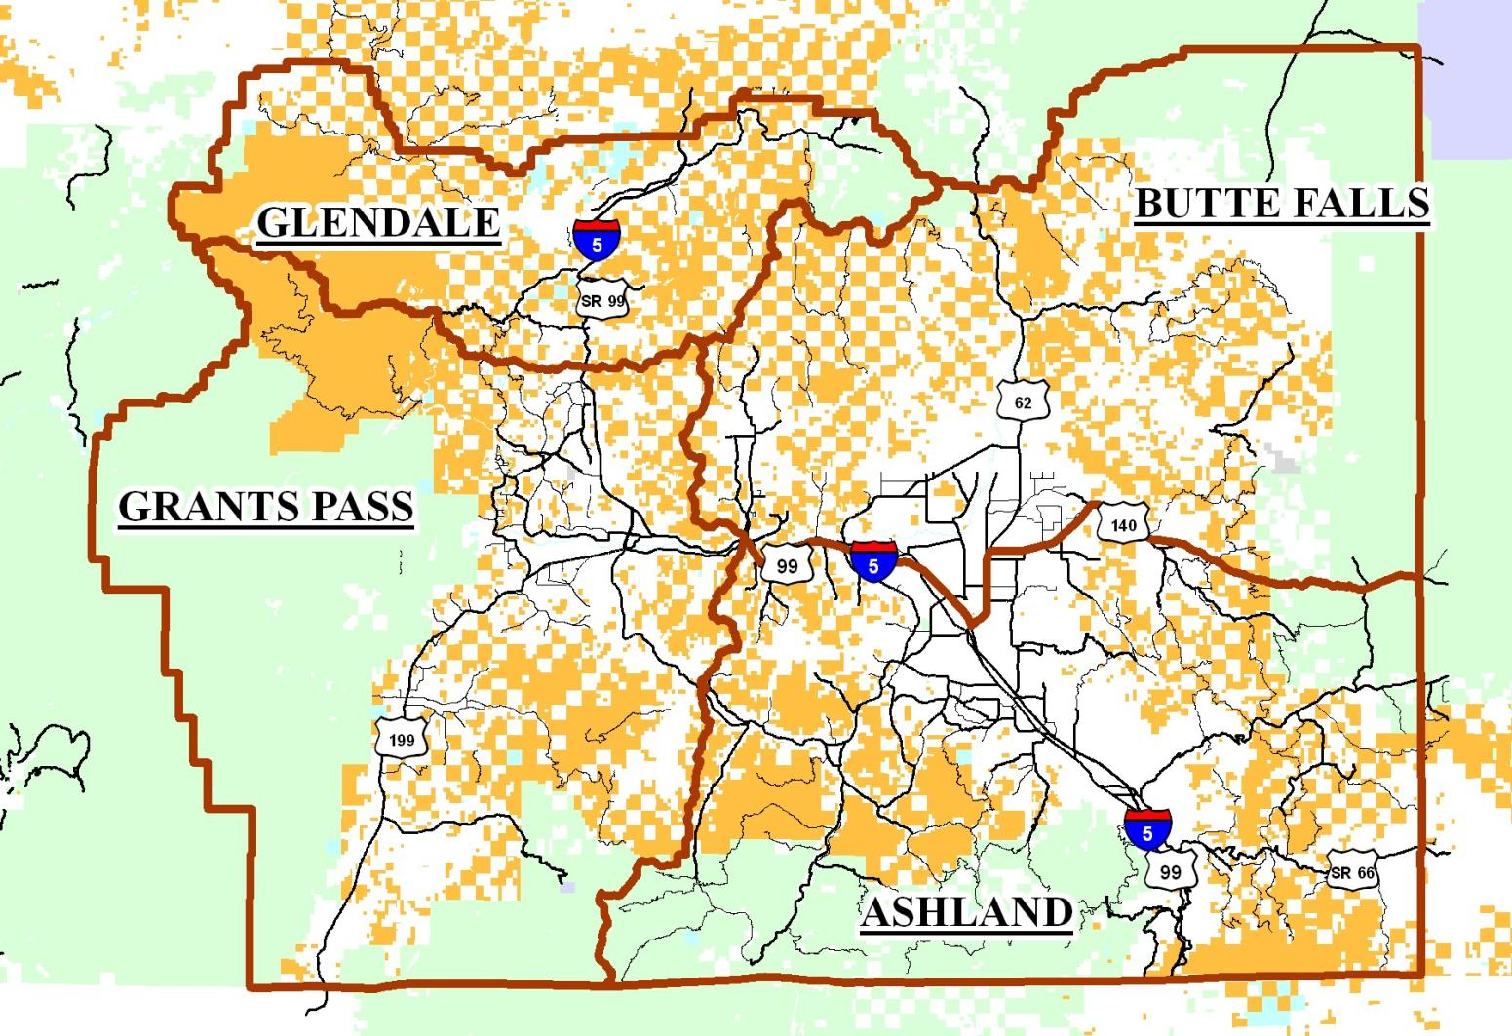

Slide 3
Understand Your Objectives
Fuels Reduction
Ecological Restoration
Long Term Transportation System Needs
Forest Products (saw logs, poles, fire wood)
Biomass Opportunities
Riparian System Restoration
Species Conservation
Special Habitat Protection

Slide 4
NEPA
Clear Purpose and Need
Too many and varied projects can cloud your NEPA Purpose and Need.
Consider one analysis effort with multiple NEPA documents

Slide 5
Scale
What scale are you planning for?
Look at processes at larger scales and smaller scales
Planning areas typically range from 6,000 to 12,000 acres ( Sixth Field Watershed)

Slide 6
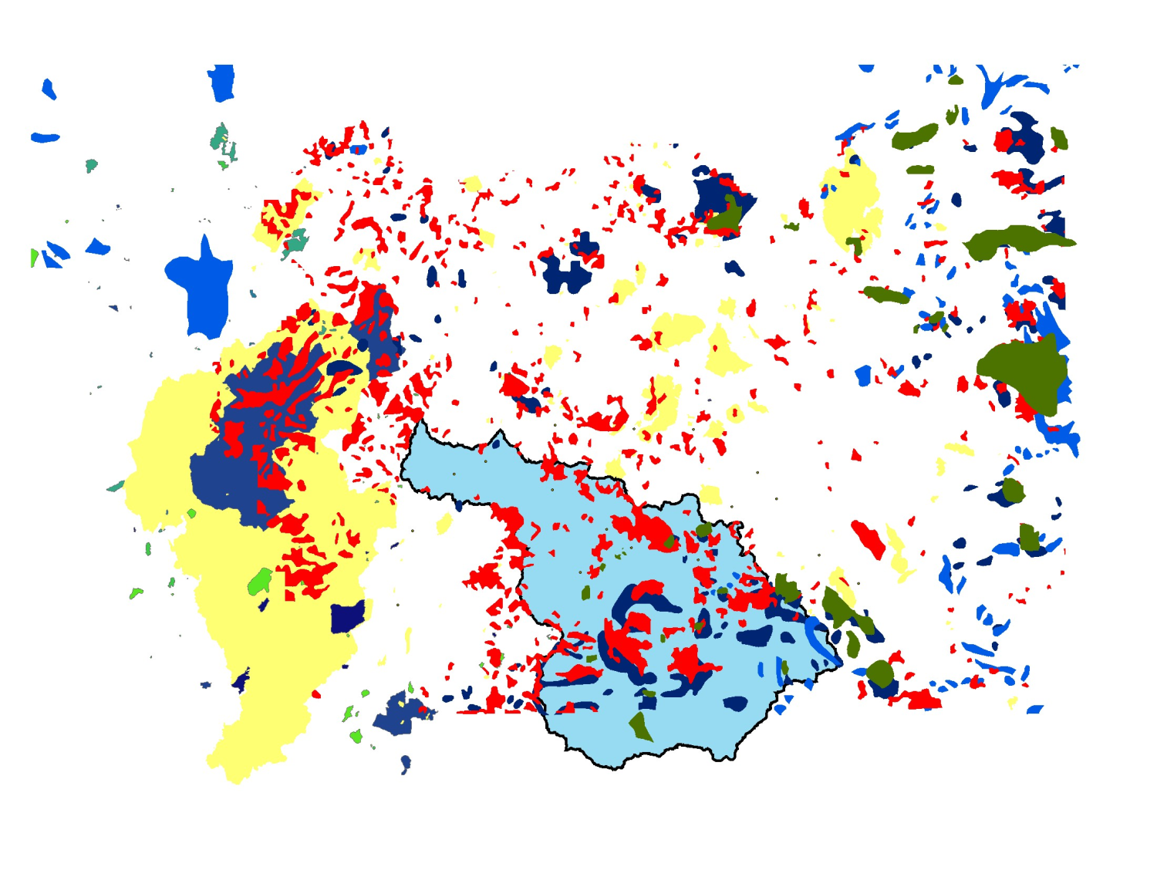
Large Fires 1900-2003

Slide 7
Knowledge of Ecosystem And Processes
Present Vegetation - Seral stage, distribution and species composition
Historical Vegetation – Seral stage, distribution and composition
Disturbance Agents - Fire, flood, insects, pathogens, wind

Slide 8
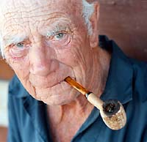
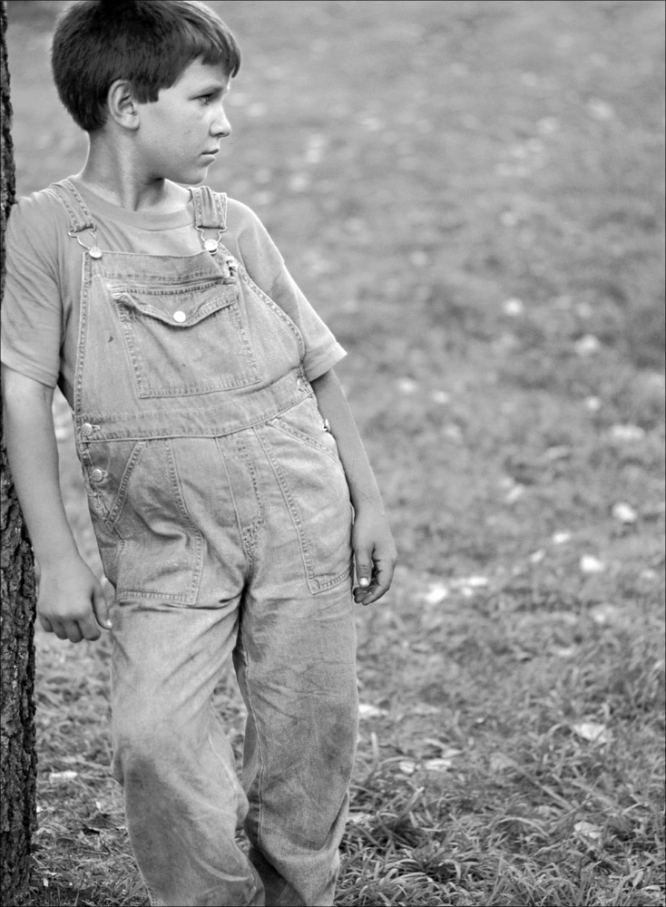
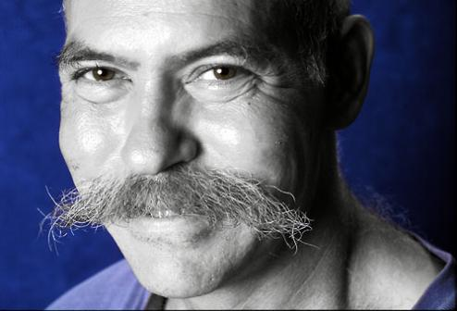
Think Long Term
Think about continued stand development and ecological processes 10 years, 50 years, 100 years in the future

Slide 9
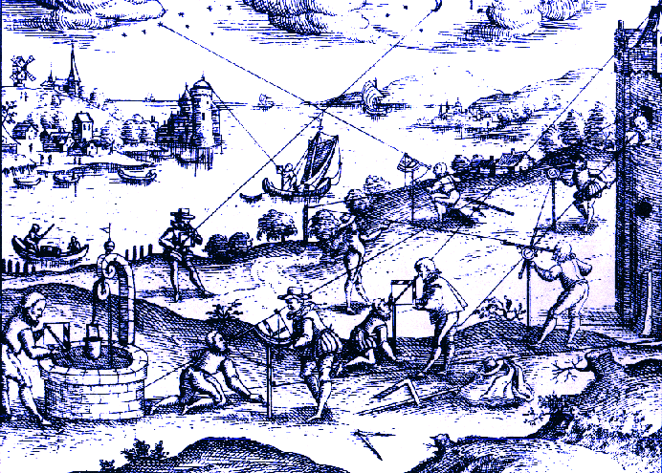
Establish historical context
Old survey records – General Land Office
Landfire Biophysical Setting Models

Slide 10
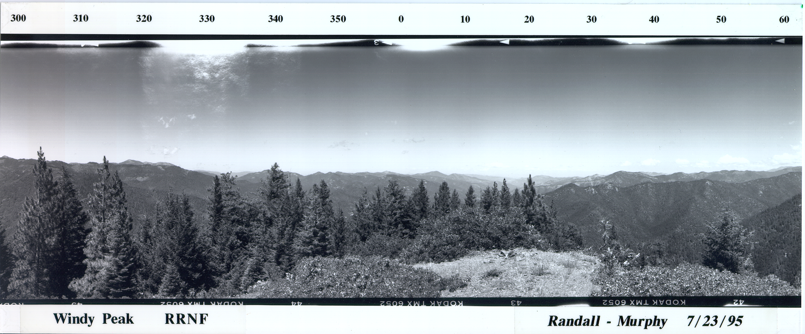
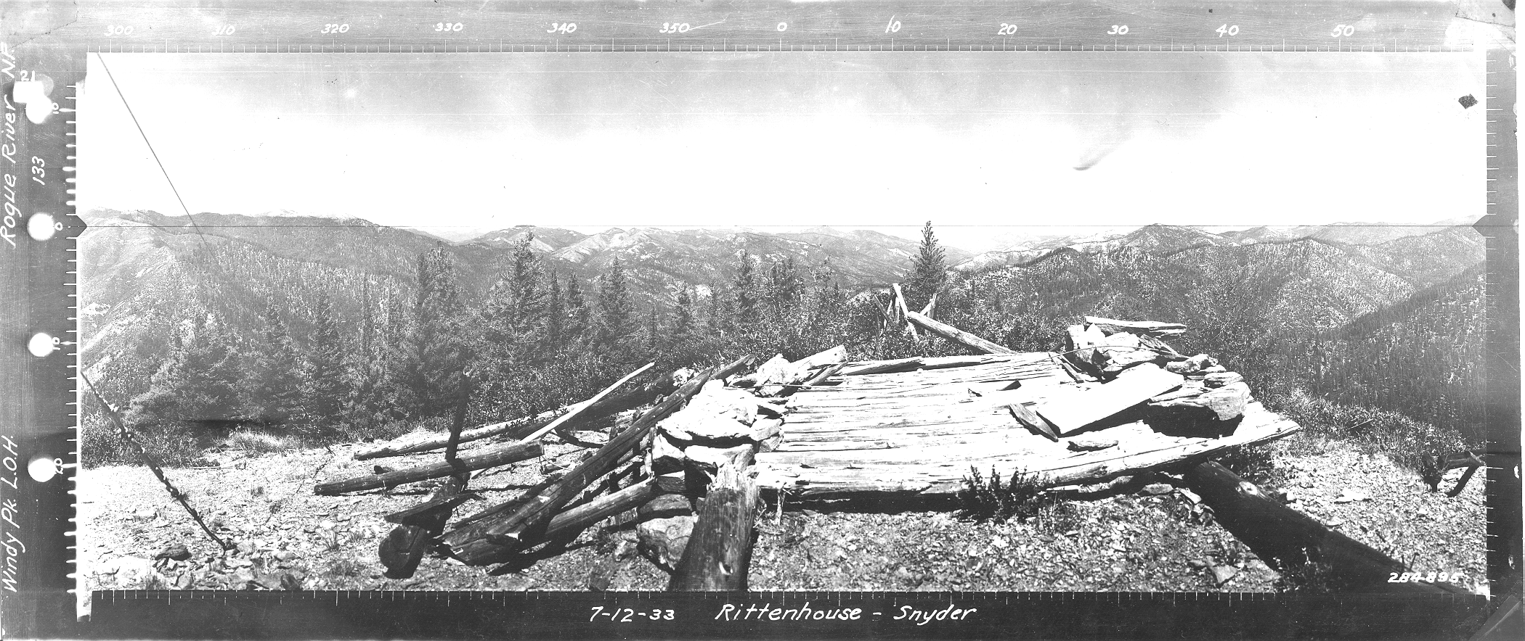
Establish historical context

Slide 11
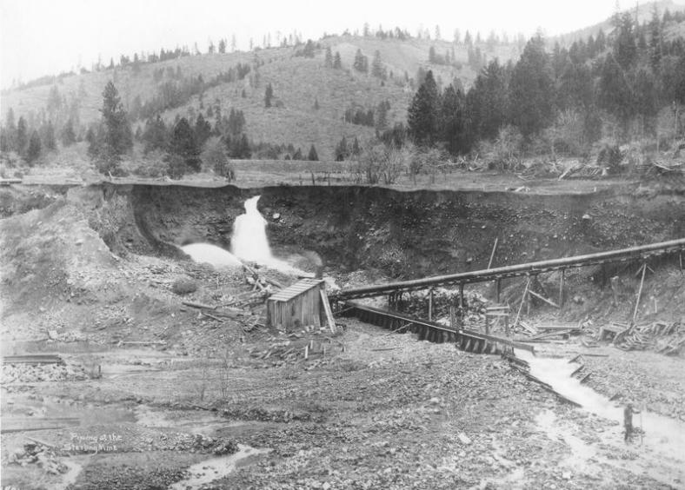
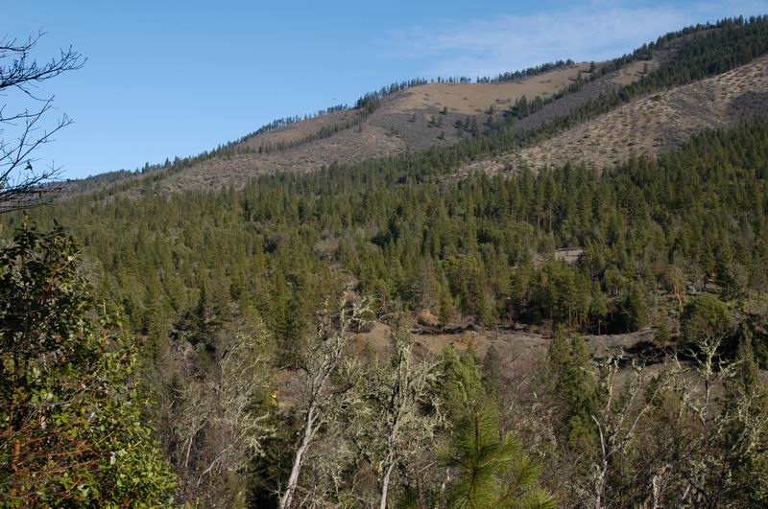
Establish historical context
Historic Photos

Slide 12
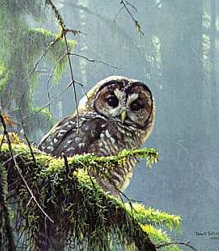
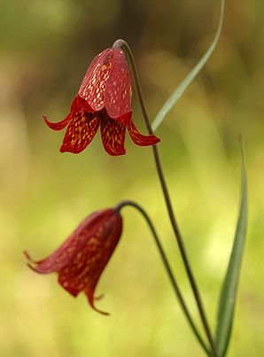
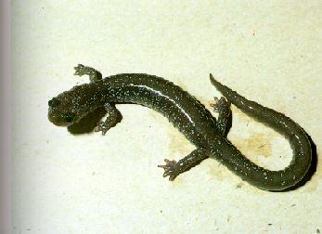
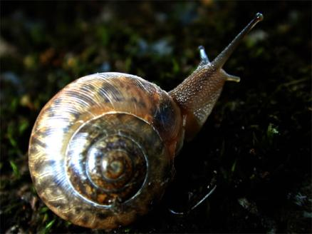
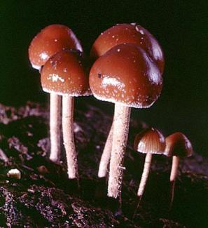
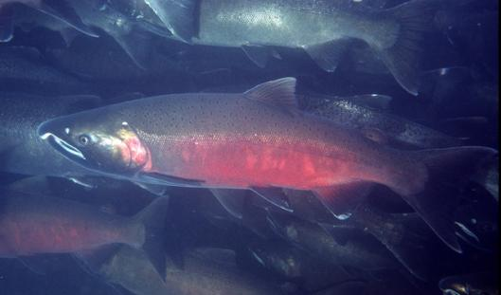
Inventories
Special status species

Slide 13
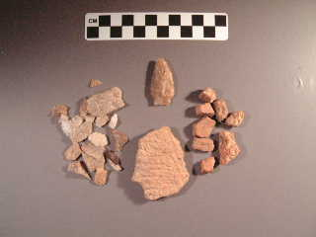
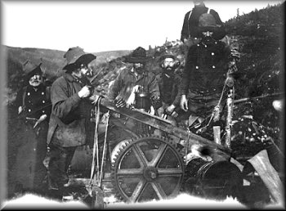
Inventories
Cultural Surveys

Slide 14
Surveys are expensive!
Pin down your proposed action first.
Screen for economics if needed.
Survey only the areas proposed for treatment.
Carefully consider areas that you may add on in the future and include in current survey package.

Slide 15
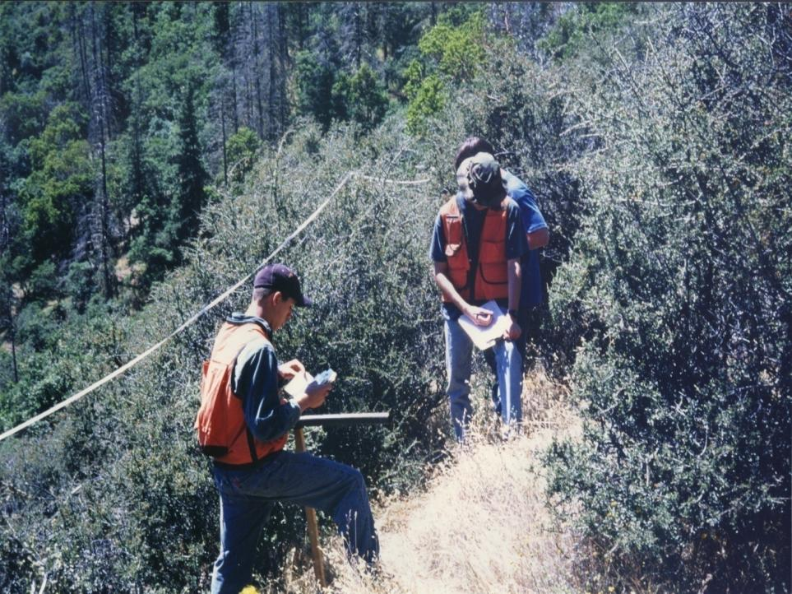
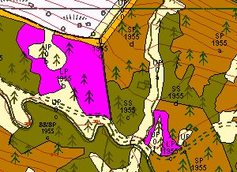
Inventories
Vegetation
Every stand in planning area reviewed

Slide 16
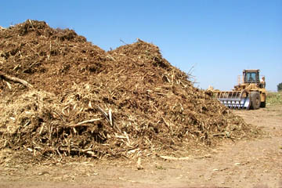
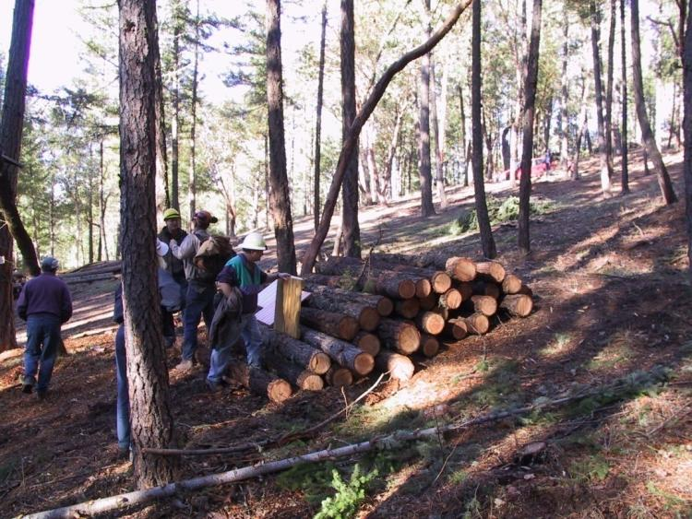
Biomass Opportunities

Slide 17
Vegetation Inventory
Silviculture out in front two years or so mapping veg
Then work with sub groups (timber prep, fuels, fish, road design) to come up with projects and work out details for a Proposed Action.

Slide 18
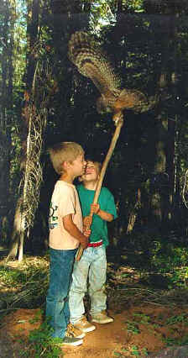
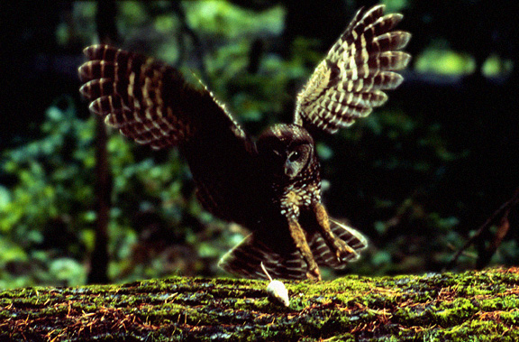
Assessments
Spotted Owl Late Seral Reserves
How will habitat be provided for long term?

Slide 19
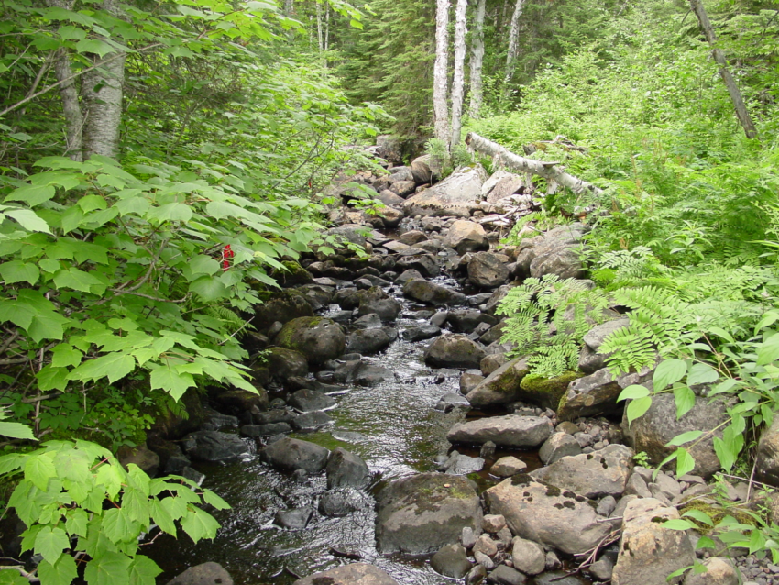
Assessments
Riparian Reserves
Where is the riparian system functioning well?
Where might intervention help?

Slide 20
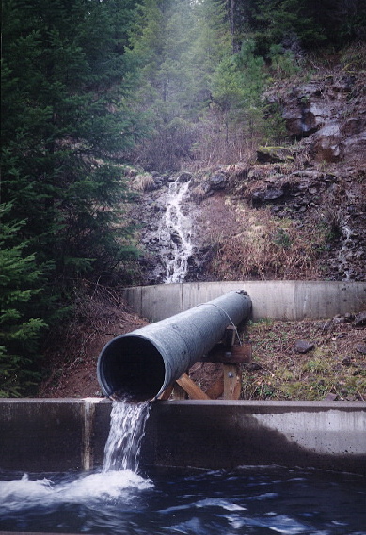
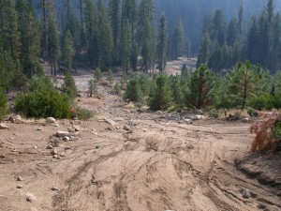
Assessments
Transportation system
Culverts & fish passage
New roads
Decommission roads

Slide 21
Sources of background information
Watershed Analysis
Fire Management Plans
Northwest Forest Plan
Local Forest Management Plans
LSR Assessment
Community Fire Plans
Other local Plans

Slide 22
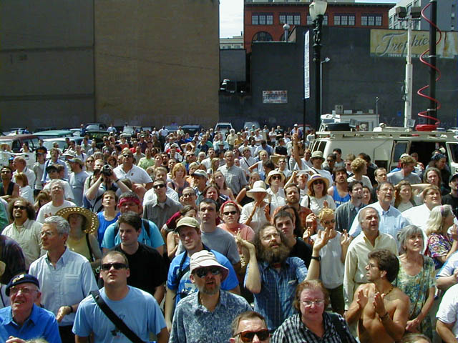
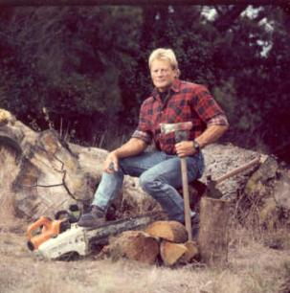
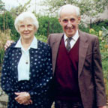
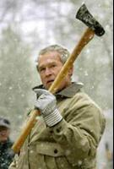
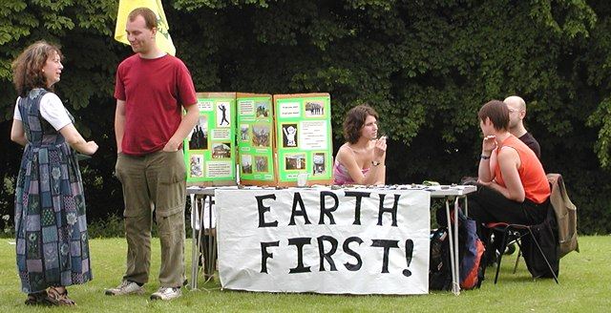

Collaboration / Public Outreach

Slide 23
Establish Desired Future Condition
Describe for landscape and stand level
Species composition
Densities
Distribution of plant communities
Distribution of seral stages

Slide 24
Landscape Level Goals
Density reduction of trees and shrubs by thinning and/or reintroducing fire into the ecosystem.
Protection and/or restoration of special habitats and areas designated important for connectivity, including riparian and late-successional habitat.
Moving forested landscapes toward dominance by larger, older trees.
Promoting, maintaining, and restoring shade intolerant species such as ponderosa pine trees on appropriate sites.

Slide 25
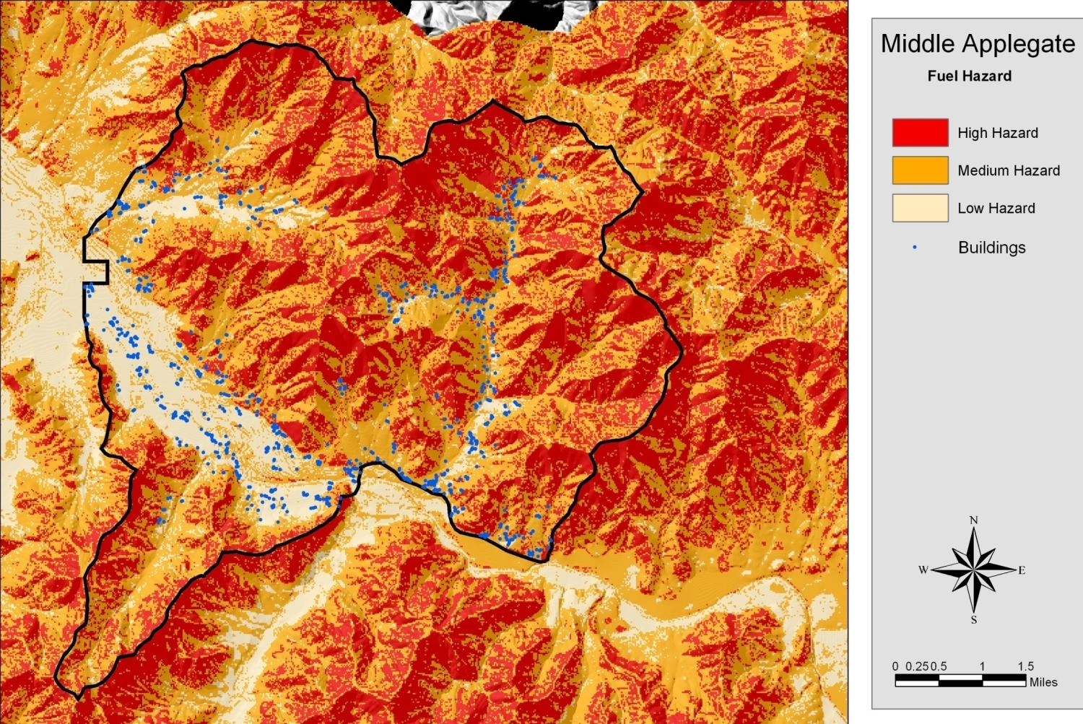

Slide 26
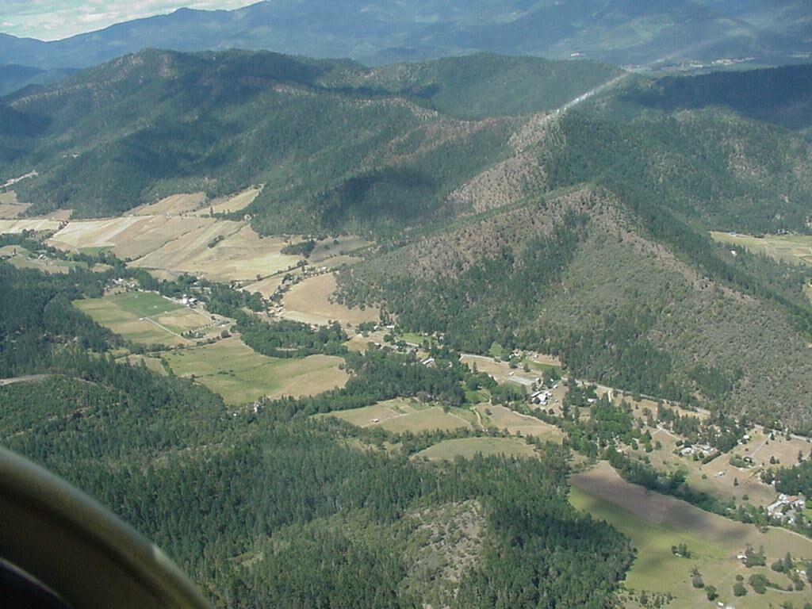
Landscape aerial
Conifer
Oak woodland

Slide 27
Build on Previous Work
Adjacent Private Lands Work
Adjacent Other Federal
Treat Large Blocks
Consider Future Maintenance
(underburning)

Slide 28
Variable Landscape Prescriptions
Suite of prescriptions for all forest types and situations encountered
Applied as stand characteristics change with aspect, soil or species composition
Allows for more flexibility and adaptation to subtle changes in stand conditions

Slide 29
Examples of variable prescriptions
Typically Based on Plant Associations
Dry Douglas-fir density management
Moist Douglas-fir density management
Ponderosa pine radial thin
Ponderosa pine regeneration
Disease Pockets
Old Growth Protection
Defensible Fuel Profile Zone

Slide 30
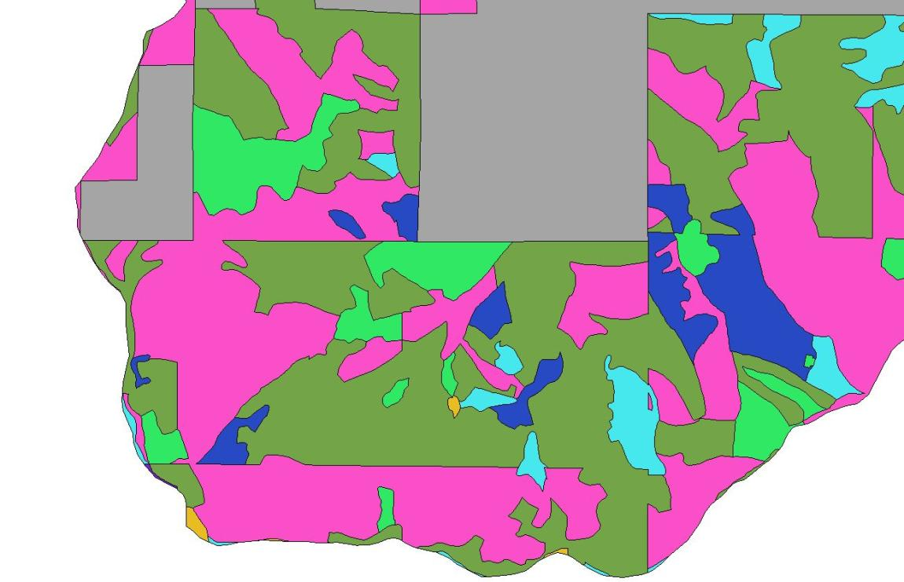
Standard Veg Mapping
3
Unit 3 – 458 Acres

Slide 31
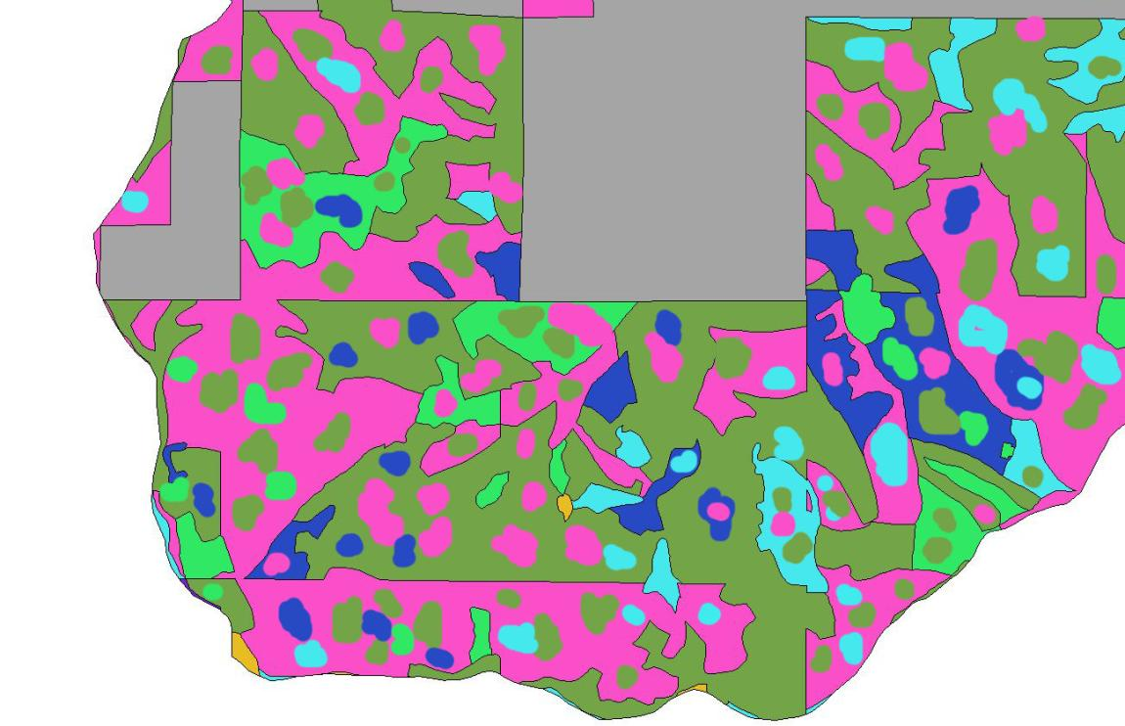
Variable Prescription Implementation

Slide 32
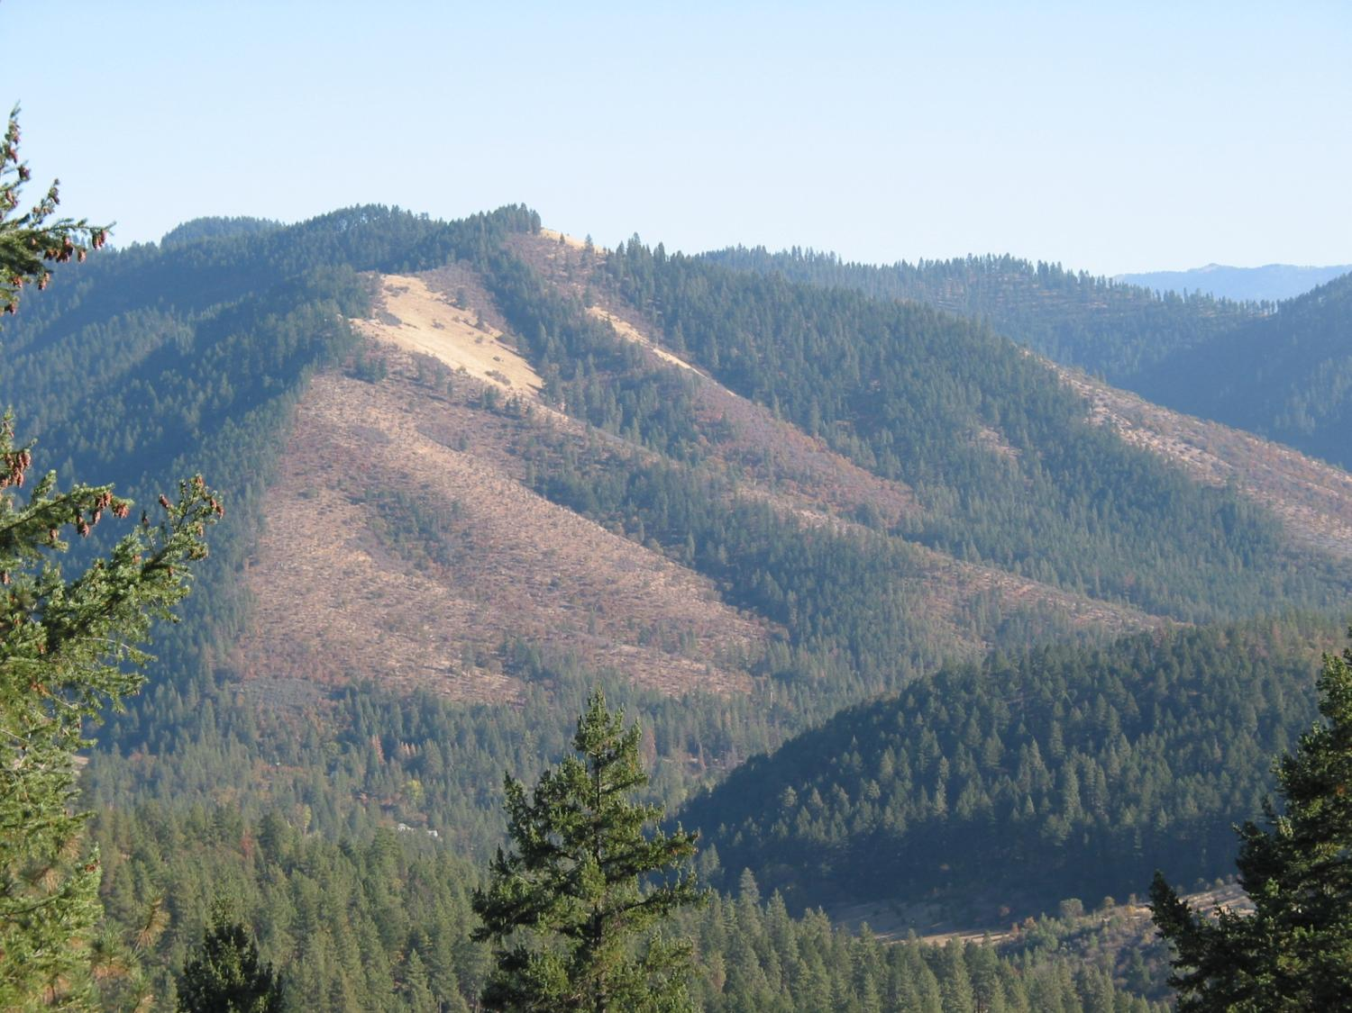

Slide 33
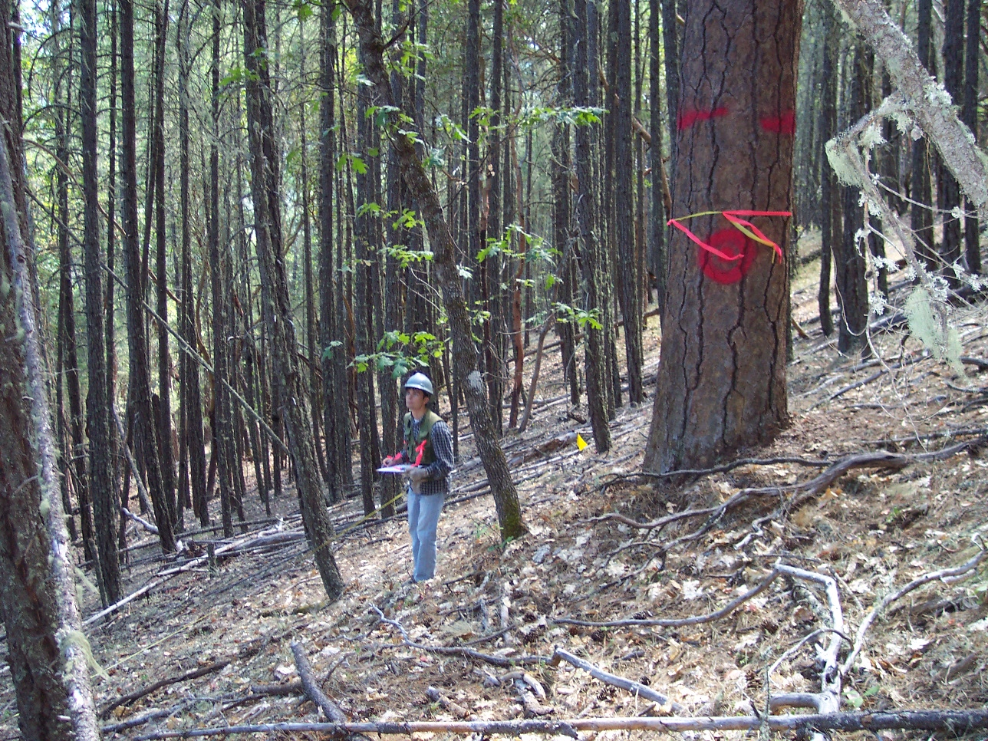

Slide 34

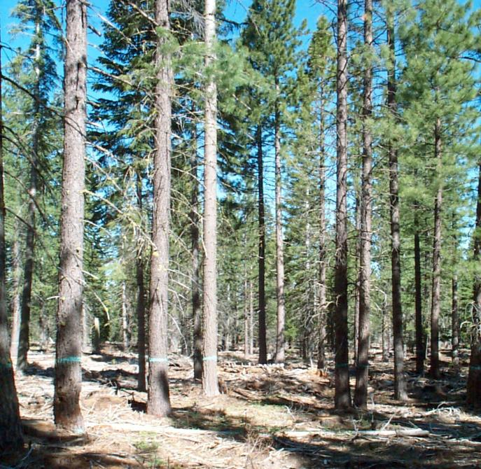
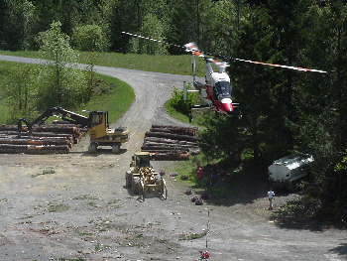
Flexibility in logging systems

Slide 35
Basic principles of forest fuel
reduction treatments
Reduce surface fuels
Increase height to live crown
Decrease crown density
Keep big trees of resistant species
James K. Agee, Carl N. Skinner

Slide 36
Multi Stage Treatments
Commercial Conifer Density Management
Thinning from below
Leaving the healthiest larger trees
Follow up fuels treatments
Removing smaller diameter noncommercial trees
Disposing of slash and ladder fuels
Under burning

Slide 37
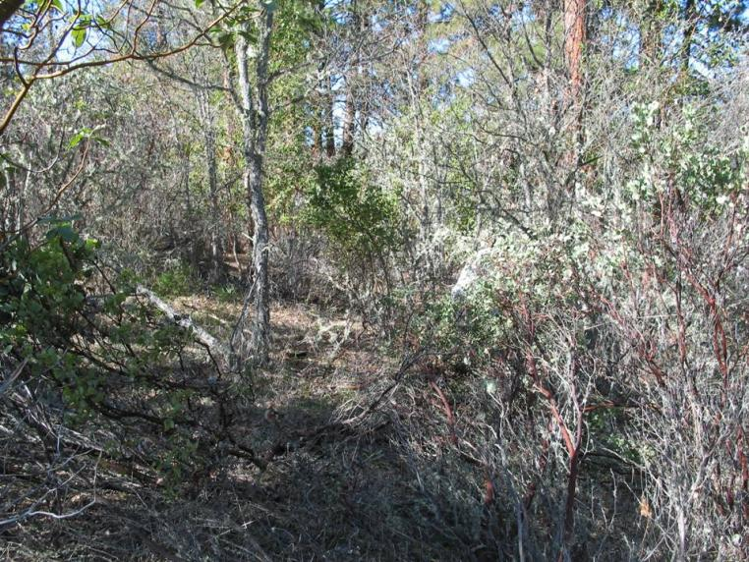
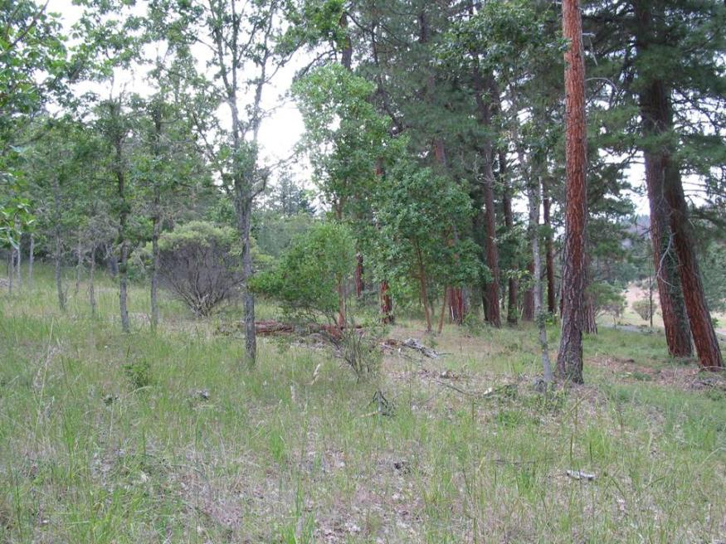
Fuels Reduction
Hand Treatment
Non-Commercial

Slide 38
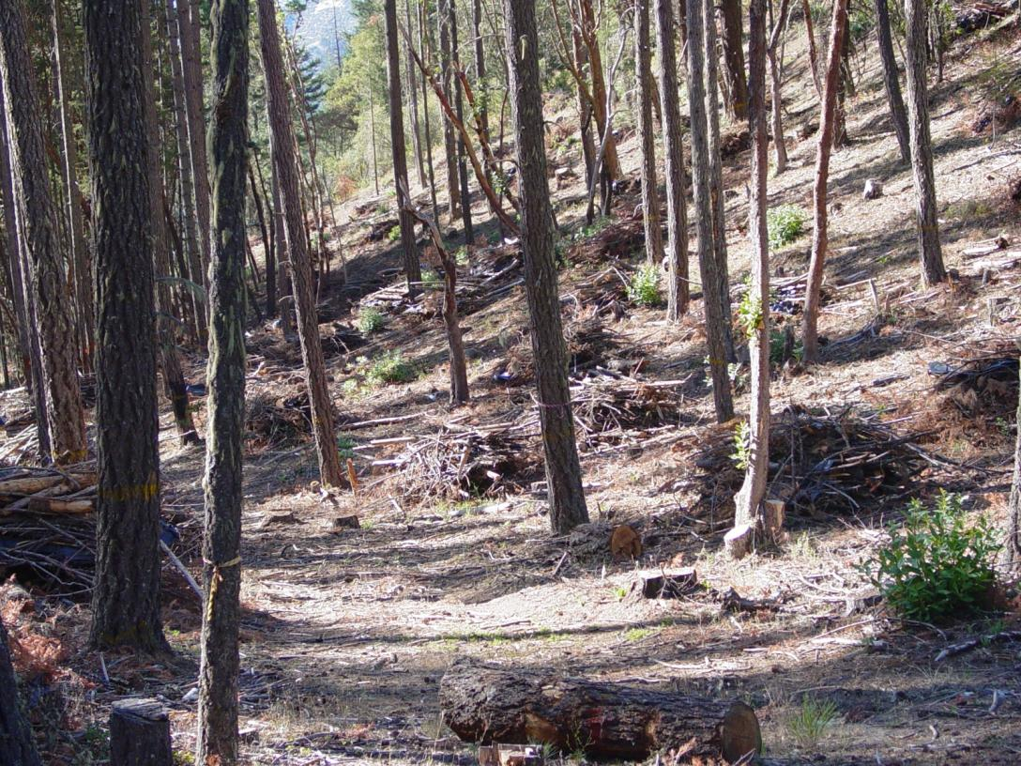
Disposal of activity slash and ladder fuels

Slide 39
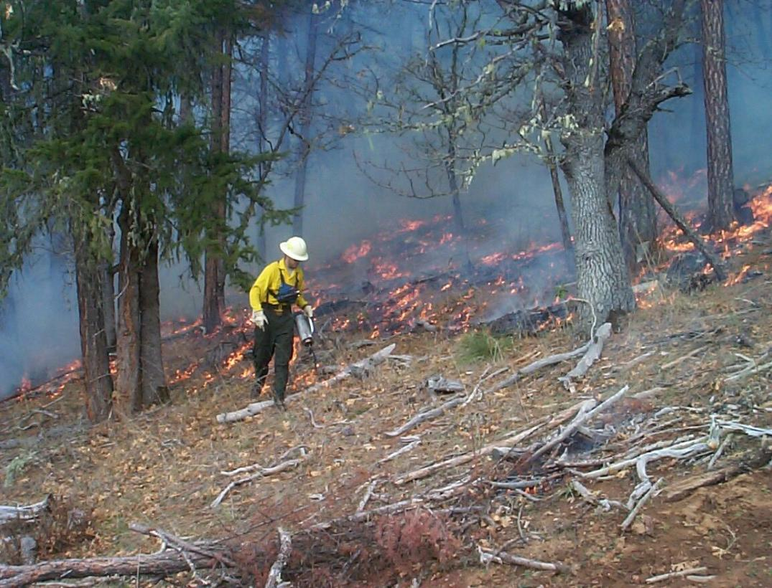
Under burning

Slide 40
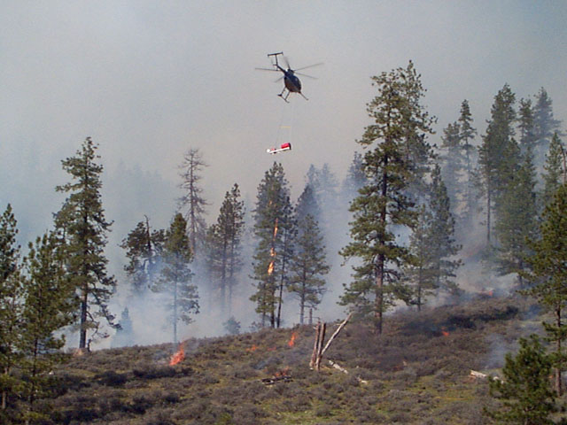
Helitorch pine
Ponderosa Pine Restoration
Broadcast Burning

Slide 41
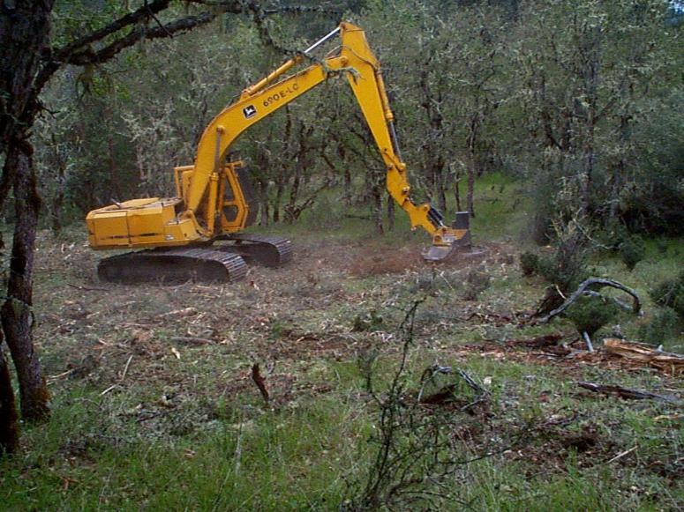
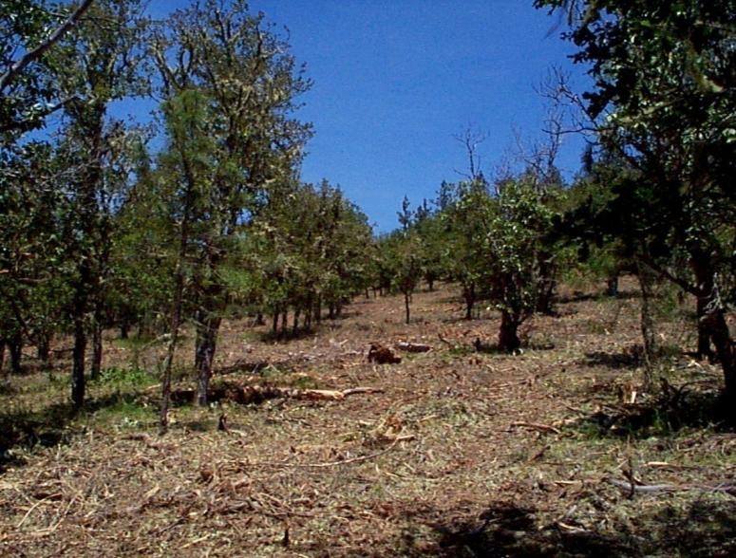
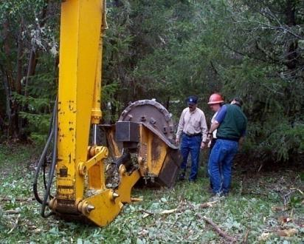
Slashbuster

Slide 42

Defensible Fuel Profile Zone

Slide 43
65% < 14”

Slide 44


Slide 45






Monitoring

Slide 46
Key Components of a Landscape Plan
Inventories
Assessments
Long term transportation and access
Variable prescriptions
Schedule for vegetation treatments
Expectation for maintenance treatments
Monitoring

Slide 47







Integrated Landscape Plan

Slide 48
 |  | Rate of Spread
Flame Length | CFA | (1) 0-1 | (2) 1-5 | (3) 5-10 | (4) 10-15 | (5) 15-20 | (6) 20-26 | (7) 26-32 | (8) 32+
(1) 0 | 0 | 1 | 1 | 1 | 1 | 1 | 1 | 1 | 1
 | 1 | 1 | 1 | 1 | 1 | 1 | 1 | 1 | 1
(2) 0-1 | 1 | 2 | 2 | 2 | 2 | 2 | 2 | 2 | 2
 | 2 | 3 | 3 | 3 | 3 | 3 | 3 | 3 | 3
(3) 1-3 | 1 | 3 | 3 | 3 | 3 | 4 | 4 | 4 | 4
 | 2 | 3 | 3 | 3 | 3 | 4 | 4 | 4 | 4
(4) 3-10 | 1 | 3 | 3 | 3 | 3 | 4 | 4 | 4 | 4
 | 2 | 4 | 4 | 4 | 4 | 4 | 4 | 4 | 4
 | 3 | 4 | 4 | 4 | 4 | 4 | 4 | 4 | 4
(5) 10-22 | 1 | 5 | 5 | 5 | 5 | 5 | 5 | 5 | 5
 | 2 | 5 | 5 | 5 | 5 | 6 | 6 | 6 | 6
 | 3 | 5 | 5 | 5 | 5 | 6 | 6 | 6 | 6
(6) 22-35 | 1 | 5 | 5 | 5 | 5 | 6 | 6 | 6 | 6
 | 2 | 5 | 5 | 5 | 5 | 6 | 6 | 6 | 6
 | 3 | 5 | 5 | 5 | 5 | 6 | 6 | 6 | 6
(7) 35-48 | 2 | 5 | 5 | 5 | 5 | 6 | 6 | 6 | 6
 | 3 | 5 | 5 | 5 | 5 | 6 | 6 | 6 | 6
(8) 48-66 | 2 | 7 | 7 | 7 | 7 | 7 | 7 | 7 | 7
 | 3 | 7 | 7 | 7 | 7 | 7 | 7 | 7 | 7
(9) 66+ | 2 | 7 | 7 | 7 | 7 | 8 | 8 | 8 | 8
 | 3 | 7 | 7 | 7 | 7 | 8 | 8 | 8 | 8

Slide 49

Composite - CFA – ROS - FL

Slide 50

Star Gulch Treatments

Slide 51
Conceptual model
VDDT & TELSA
Age
Fire
Age
Cover type
Transition type
Cover type
Structural stage
Management
Structural stage
Initial vegetation
Transition pathways
Potential vegetation

Slide 52





Slide 53


Slide 57
Small Diameter &
Biomass Opportunities
Existing dense/pole stands
Fire Regime Condition Class (FRCC)
(departure from ecological norm)
Social screens and economic screens help prioritize where to go

Slide 58
Economic Screens
Distance from roads (1000 feet)
Steepness of slope
(affects harvest system)
0-35% - tractor 35% + cable system

Slide 59
Social Screens
Within Wildland Urban Interface (WUI)
Communities at risk
County fire plan risk assessment
CWPP (Community Fire Plans)
Federal Agency land allocations

Slide 60


Slide 61

"All models are wrong. Some are useful."
George E. P. Box

