Slide 1
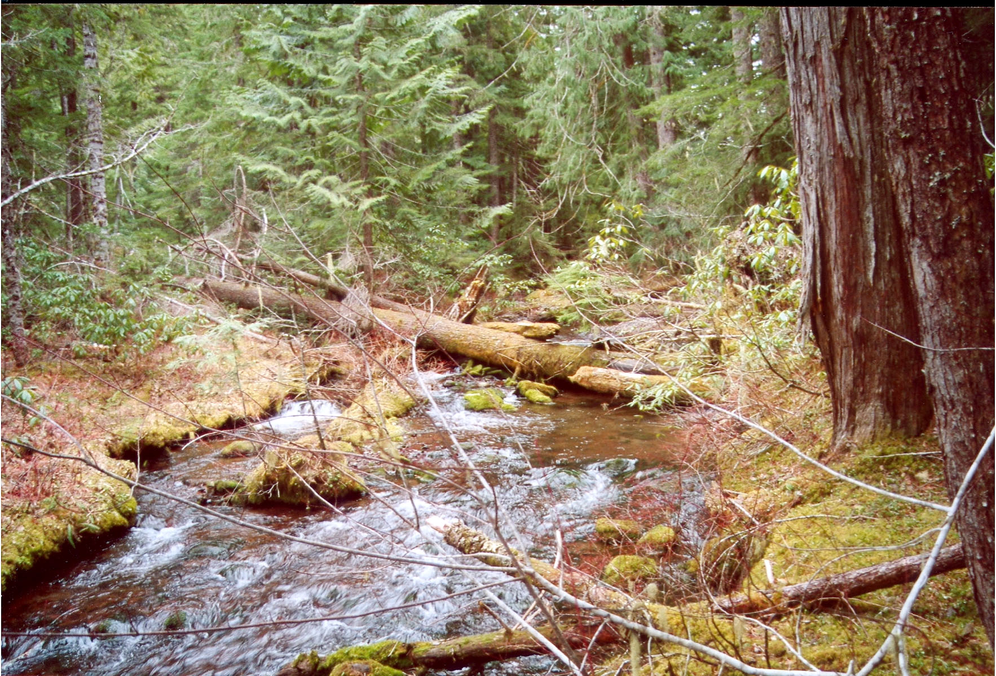
Topographic and Fire Regime Contexts for Riparian Areas of Western Oregon
Alan Tepley
Departments of Forest Science and Geosciences
Oregon State University

Slide 2
Riparian Fire Regimes
Major roles of riparian areas in relation to their local fire
regimes
Examples from recent fires
- fire severity in riparian vs. upland forests
Examples from historical reconstruction
- paired riparian/upland studies
fire frequency and severity in
riparian vs. upland forests
- broader landscape context

Slide 3
Roles of Riparian Areas in the Context of their Local Fire Regime
1. Refugia for old trees and fire-sensitive species
2. Similar fire regime to adjacent uplands
3. Prone to higher fire severity than adjacent
uplands
4. Fire Breaks
5. Chimneys or corridors for fire spread

Slide 4
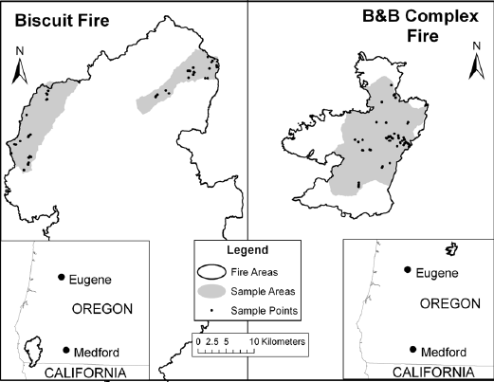
Riparian vs. Upland Fire Severity in the Biscuit and B&B Fires
Basal Area Mortality
100
Riparian
80
Upland
60
a
a
a
a
Percent
40
20
0
B & B
Fire
Biscuit
Fire
Halofsky 2007

Slide 5
Variation in Fire Severity within the Stream Network
Biscuit Fire
B & B Fire
100
100
80
80
a
b
b
60
60
b
Basal Area Mortality (%)
Basal Area Mortality (%)
b
40
40
a
20
20
0
0
Stream Type
Plant Association
Steady flow, fish-bearing
Ponderosa Pine
Moderate flow, fish-bearing
Dry Mixed Conifer
Low flow, few fish
Wet Mixed Conifer
Halofsky 2007

Slide 6
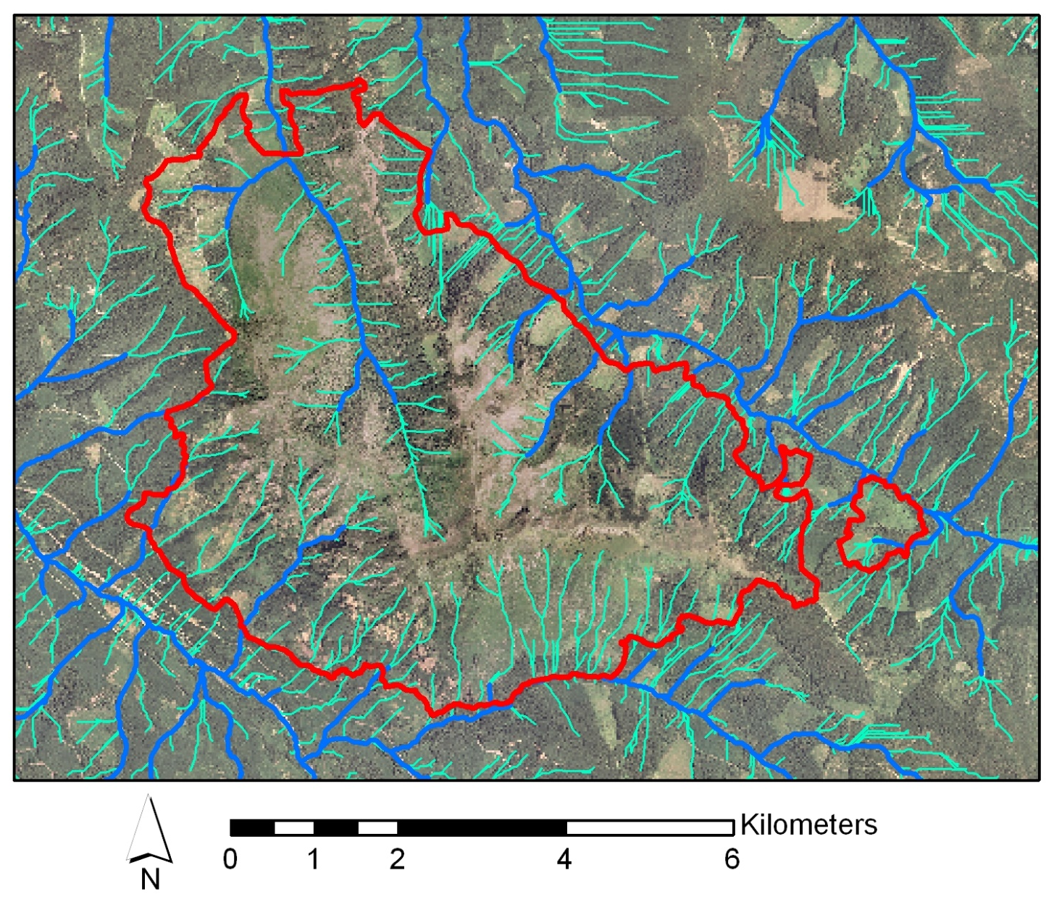
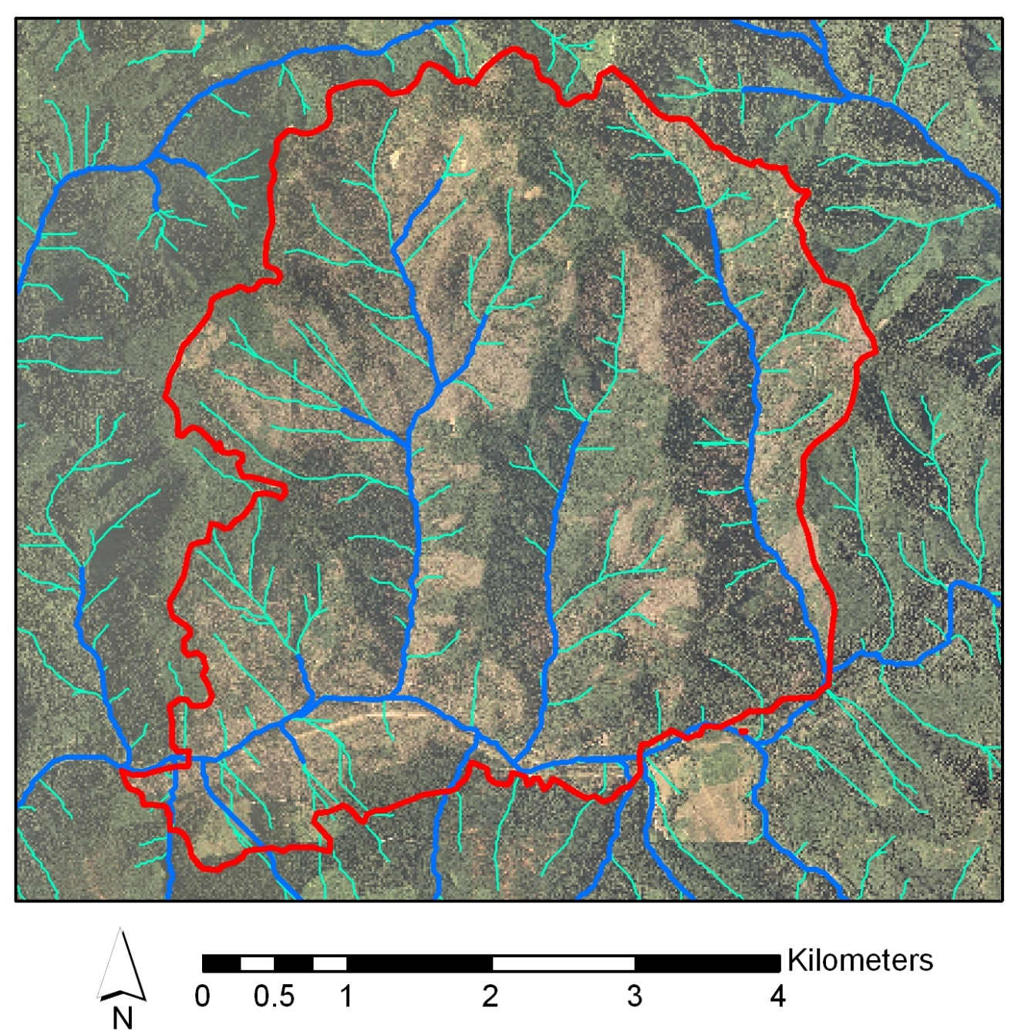
Insight from Recent Fires
in the Western Cascades
Warner Creek Fire (1991: 3,626 ha)
Clark Fire (2003: 1,997 ha)
Intermittent, 1st, and 2nd order streams
3rd and 4th order streams

Slide 7
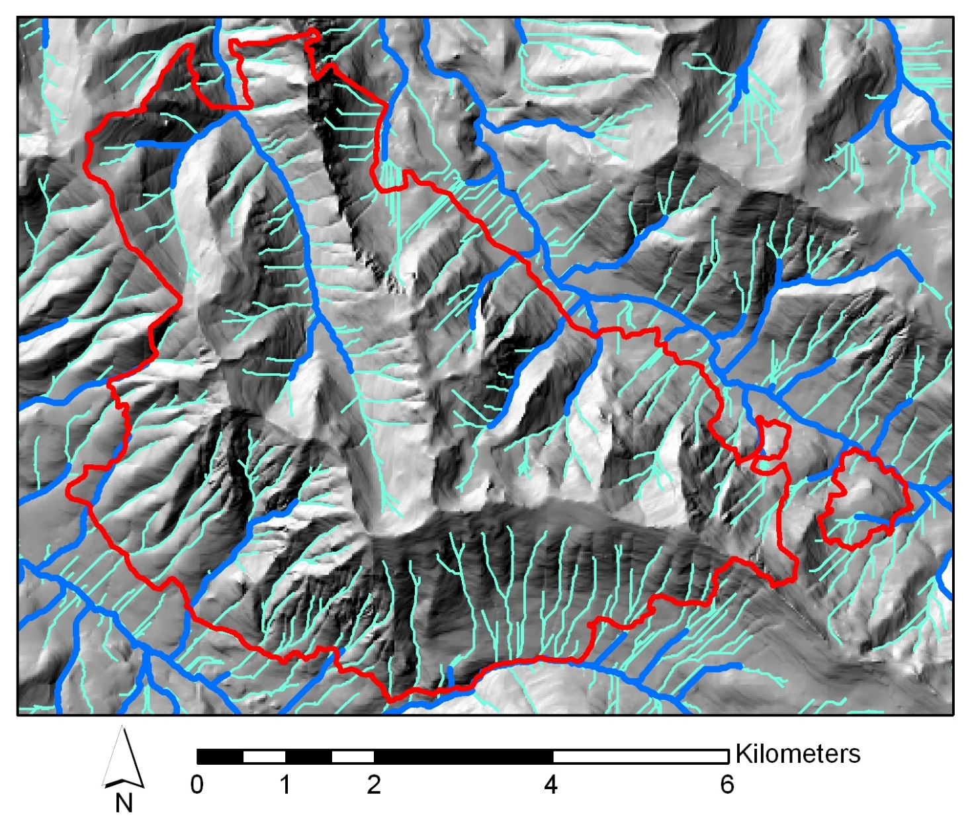
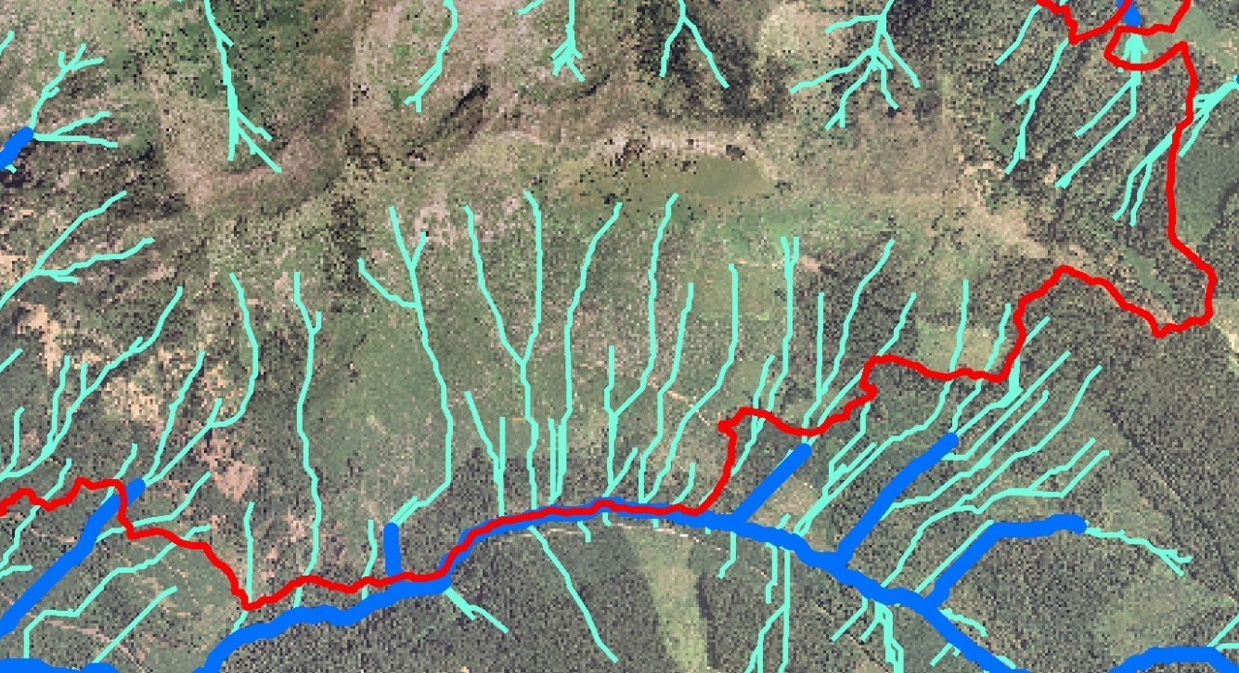
Fire Severity in Steep, Intermittent Stream Drainages
Warner Creek Fire
Riparian
Upslope
40
30
Live Canopy Cover (%)
20
10
0
West-Facing Slopes
East-Facing Slopes
Tollefson et al. 2004

Slide 8
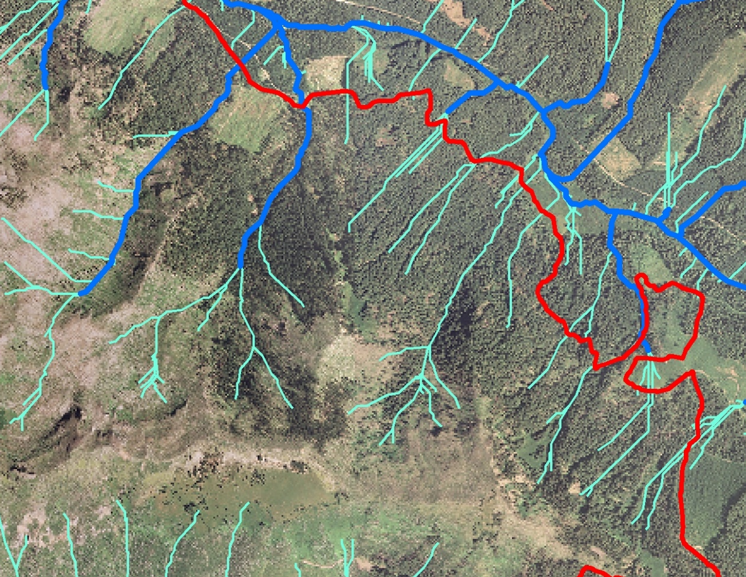
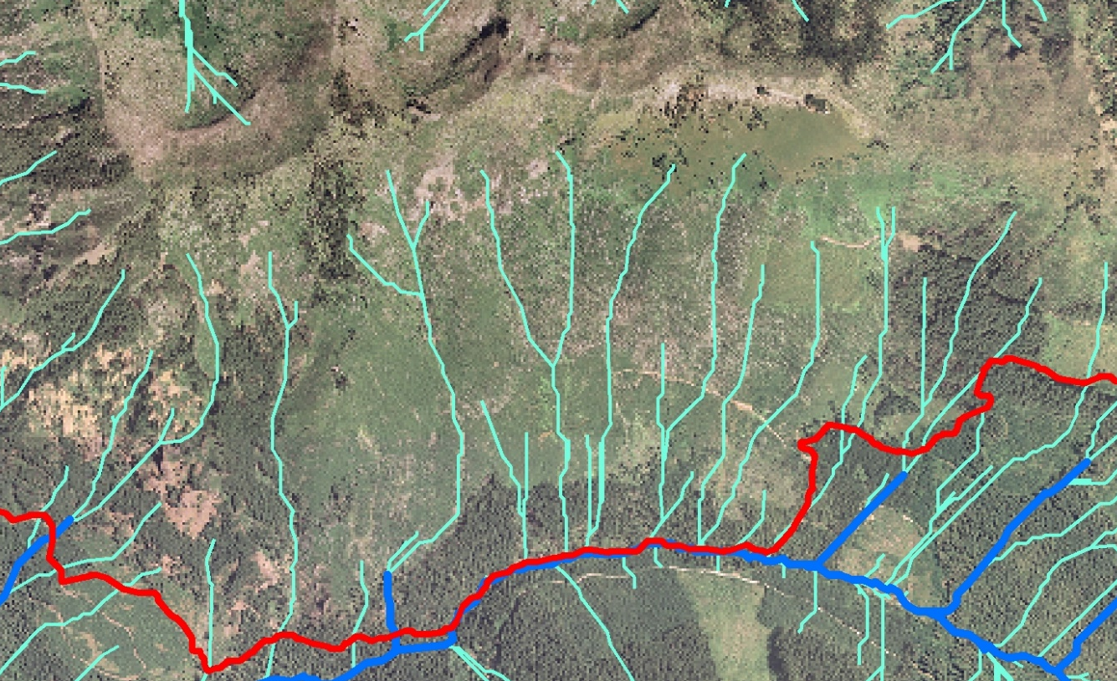
Fire Severity in other Parts of the Warner Creek Fire
Intermittent, 1st, and 2nd order streams
3rd and 4th order streams

Slide 9
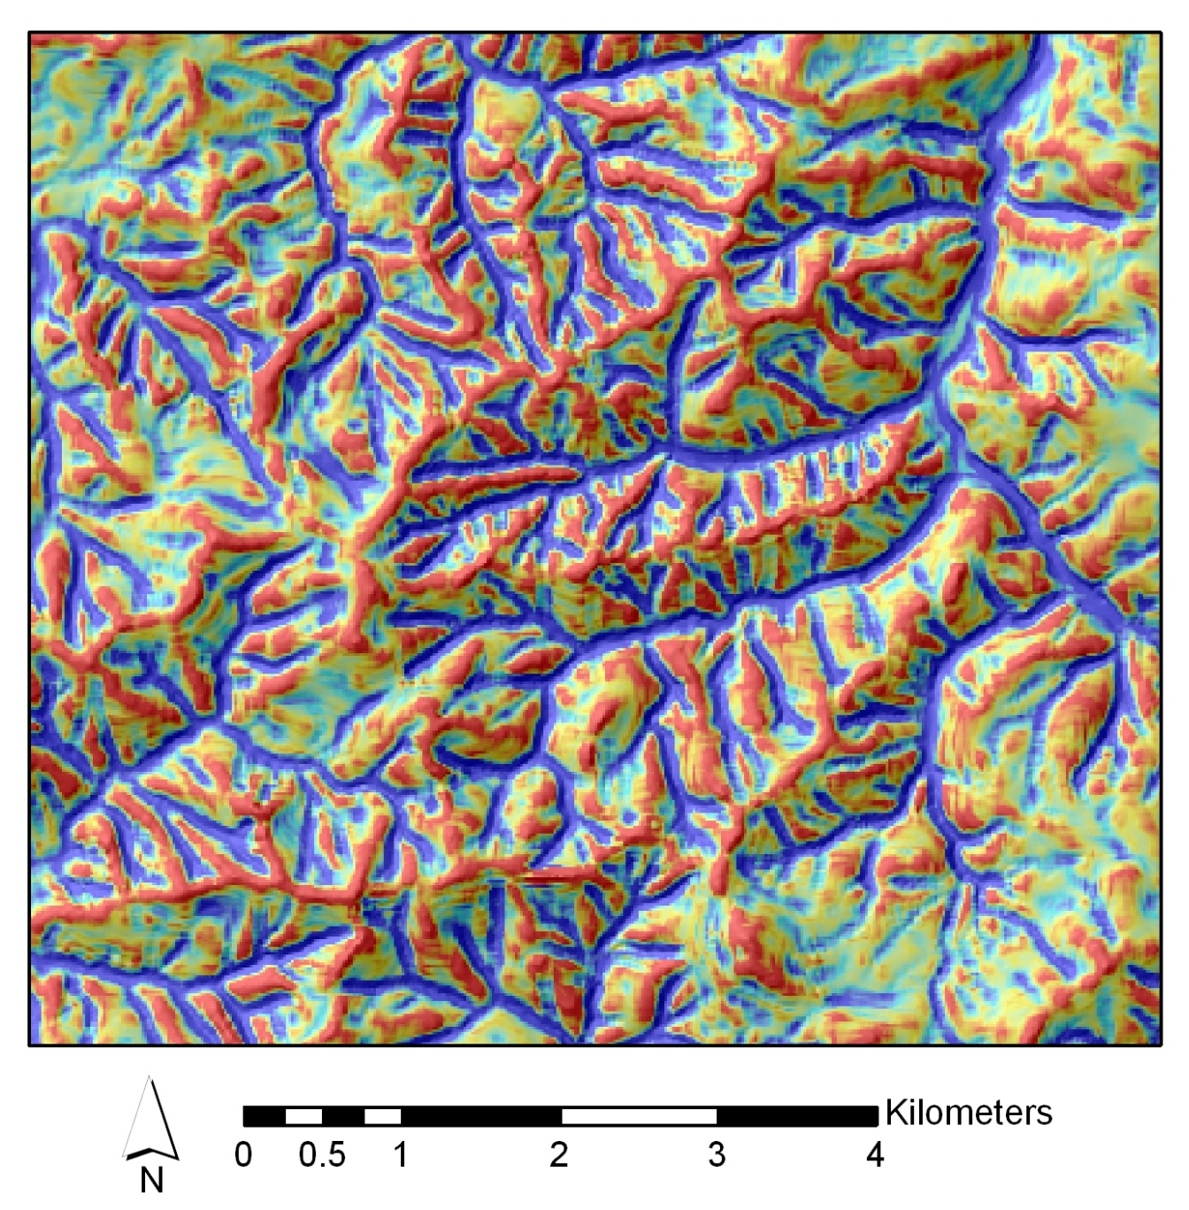
Riparian Areas as Refugia in the Western Cascades of Washington
Siouxon Creek
(fire ca. 1902)
Curvature
4
Divergent
Divergent
3
Convergent
Old-Growth Trees/ha
Convergent
2
1
0
Douglas-fir
Western
Hemlock
Western
Redcedar
8
Trapper Creek
(fire ca. 1875)
6
Divergent
Old-Growth Trees/ha
Convergent
4
2
0
Douglas-fir
Western
Hemlock
Western
Redcedar
Keeton and Franklin 2004

Slide 10
Riparian Forests as Refugia in a Variety of Landscapes
Eastern Cascades, Washington (Camp et al. 1997)
• Refugia occurrence most likely in areas with high soil and fuel moisture
– including stream confluences and valley bottoms
Mount Rainier (Hemstrom and Franklin 1982)
• “Nearly every major river valley contains a streamside old-growth corridor”
Klamath Mountains (Skinner 2003)
• Median fire intervals were approximately double in riparian areas
compared to upland sites
Southern Cascades (Olson and Agee 2005)
• Fire intervals for riparian forests were slightly longer, but not significantly
different from fire intervals in upslope forests

Slide 11
Higher Fire Severity for Riparian Areas on the East Slope of the Washington Cascades
20
16
Entiat
12
8
Riparian
4
Sideslope
0
Number of Cohorts
100
1600
1640
1680
1720
1760
1800
1840
1880
1920
1960
25
80
Okanogan
20
60
15
Percent of Recorded Fires
10
40
5
20
0
1600
1640
1680
1720
1760
1800
1840
1880
1920
1960
0
N
S
E
W
Year of Origin
CDG
HDSG
WDSH
Aspect
WMESH
PAG
Everett et al. 2003

Slide 12
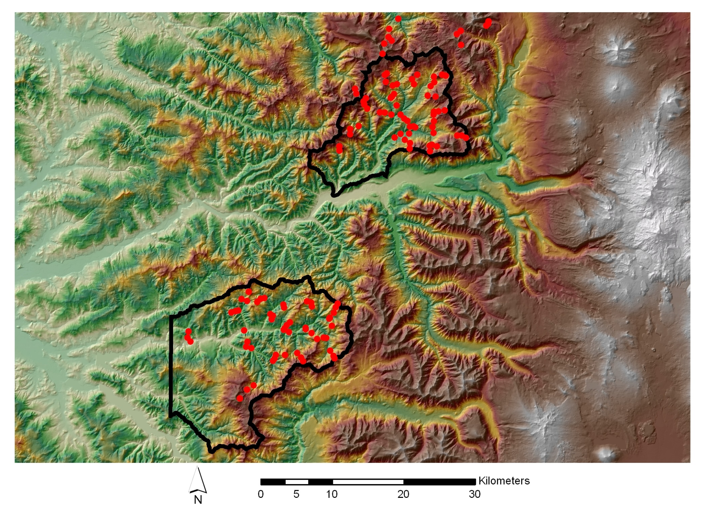
Study Area
Central Western Cascades
Blue River
Transect
Location
Elevation (m)
High : 3196
Low : 45
Fall Creek

Slide 13
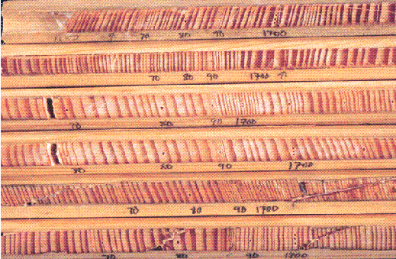
Transect Sampling Methods
Transect Length = 120 m
1
2
3
4
5
Slope
Direction
Plot size: 0.02 ha
Transect sample area: 0.1 ha
30 m between
plot centers
• 124 Transects
– 71 in Blue River area
– 53 at Fall Creek
• 3,452 tree cores collected
– avg. 28 per transect
– 76% of live trees

Slide 14
Relationship of Age Structure to Slope Position
Douglas-fir
Western Hemlock
Mountain Hemlock
Noble Fir
Pacific Silver Fir
Estimated Fire Date
30
Upper Slope
25
20
15
10
5
0
16
Mid Slope
12
Percent of Sampled Trees
8
4
0
8
Lower Slope
6
4
2
0
1200
1300
1400
1500
1600
1700
1800
1900
2000
Establishment Date

Slide 15
Topographic Influences on Fire Patterns and Age Structure (effects of elevation, slope relief, and aspect)
1,700
North Facing Slope
(Blue River Watershed)
1,500
1,300
North
1,100
Elevation (m)
900
South Facing Slope
(Fall Creek Watershed)
700
500
300
0
500
1,000
1,500
2,000
2,500
Distance (m)

Slide 16
Age Structure on a North Facing Slope with High Relief
Age Structure
5
4
Upper Slope
3
1778
1849
2,000
Upper Slope
2
1,800
N
1
Mid Slope
0
1,600
6
Mid Slope
Lower Slope
1477
1,400
4
Elevation (m)
Number of Trees
1,200
2
1,000
0
Lower Slope
3
800
2
600
1
0
500
1,000
1,500
2,000
2,500
Distance (m)
0
1500
1600
1700
1800
1900
2000
Douglas-fir
(> 200 yrs old)
Douglas-fir
(< 200 yrs old)
Western
hemlock
Establishment Date
Douglas-fir
Western
redcedar
Pacific
silver fir
Noble fir
Pacific
yew
Shade-Tolerant
Species

Slide 17
Age Structure on a South Facing Slope with Low Relief
Age Structure
6
Upper Slope
4
1919
1,000
1839
Upper Slope
S
2
900
Mid Slope
0
4
Mid Slope
Lower Slope
3
Elevation (m)
Number of Trees
700
2
1
500
0
6
Lower Slope
4
300
2
0
200
400
600
800
1,000
1,200
1,400
Distance (m)
0
1500
1600
1700
1800
1900
2000
Douglas-fir
(> 200 yrs old)
Douglas-fir
(< 200 yrs old)
Establishment Date
Douglas-fir
Golden
chinkapin
Western
hemlock
Western
redcedar
Shade-Tolerant
Species

Slide 18
Relief, Slope Position, Aspect, and
Fire Breaks in the Klamath Mountains
Thompson Ridge
• High Relief (650–1,600 m)
• Few perennial streams
Hayfork
• Lower Relief (640–1,360 m)
• Many perennial streams and
rocky outcrops
Fire Severity
Low
Moderate
High
• Forest age structure (fire severity) did
not vary with elevation, aspect, or
slope position
• Areas with similar patterns of fire
occurrence were separated from each
other by streams, riparian zones, sharp
changes in aspect, or changes in parent
material that act as impediments to fire
spread
N & E Aspects
S & W Aspects
100
80
60
Percent of Area
40
20
0
Lower
Mid
Upper
Lower
Mid
Upper
Slope Position
Taylor and Skinner 1998
Taylor and Skinner 2003

Slide 19
Likely Physiographic Settings for Fire Regime Roles of Riparian Areas
1. Refugia for old trees and fire-sensitive species
• Deeply dissected terrain with high relief
– Cold-air drainage may augment humidity and fuel
moisture differentiation from uplands
• Primarily north aspects
• Lower part of drainage network
• Gently sloping valley bottoms

Slide 20
Likely Physiographic Settings for Fire Regime Roles of Riparian Areas
2. Similar fire regime to adjacent uplands
• Little topographic or vegetative differentiation from uplands
– Lower part of drainage network in shallowly dissected
terrain with low local relief
– Upper part of drainage network in steep terrain with steep stream valleys
• Large fires burning under severe fire weather may overwhelm
the effects of local topography

Slide 21
Likely Physiographic Settings for Fire Regime Roles of Riparian Areas
3. Prone to higher fire severity than adjacent uplands
• Dry landscapes where frequent, low-intensity fires limit fuel
abundance
• Microclimate & moisture differentiation from uplands is
– high enough to accelerate stand development and fuel
accumulation in riparian forests
– but not high enough to buffer riparian forests from fire
during drought

Slide 22
Likely Physiographic Settings for Fire Regime Roles of Riparian Areas
4. Fire Breaks
• Perennial stream valleys
• Coupling/decoupling of riparian areas and uplands due to
upland fire regime
– Riparian areas of perennial streams may be effective
barriers to low-intensity fires
– Characteristics of the upland fire regime that influence fire intensity as it enters riparian areas influence the ability of riparian areas to function as fire breaks

Slide 23
Likely Physiographic Settings for Fire Regime Roles of Riparian Areas
5. Chimneys or corridors for fire spread
• Steep terrain with steep, narrow stream valleys
• Little vegetative difference from adjacent uplands
• Intermittent stream valleys
• Primarily south aspects
• Middle to upper part of drainage network

Slide 24
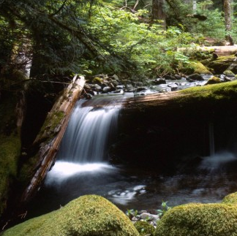
Conclusions
Riparian areas may assume at least 5 roles relative to local fire regimes
Topography and vegetation determine the most likely role
Major topographic variables
Local relief (effect on
cold-air drainage)
Aspect
Position in stream network
Stream valley gradient
relative to slope steepness
Major vegetation variables
Degree of vegetative
differentiation from uplands
Fuel abundance/continuity
in adjacent uplands
Rate of stand development/fuel
accumulation in upland vs.
riparian areas

Slide 27
Age Structure Patterns in Relation to Slope Relief and Aspect
High Relief, North Aspect
Low Relief, South Aspect
Douglas-fir
Shade-Tolerant Species
25
40
20
Upper Slope
Upper Slope
30
15
20
10
5
10
0
0
20
Mid Slope
30
Mid Slope
15
Percent of Sampled Trees
20
10
5
10
0
0
20
Lower Slope
30
Lower Slope
15
10
20
5
10
0
0
1200
1300
1400
1500
1600
1700
1800
1900
2000
1500
1600
1700
1800
1900
2000
Establishment Date
Establishment Date

Slide 28
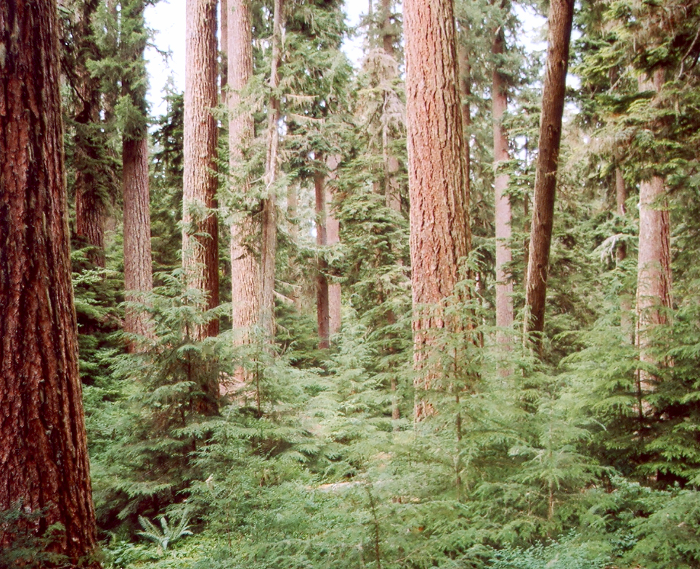
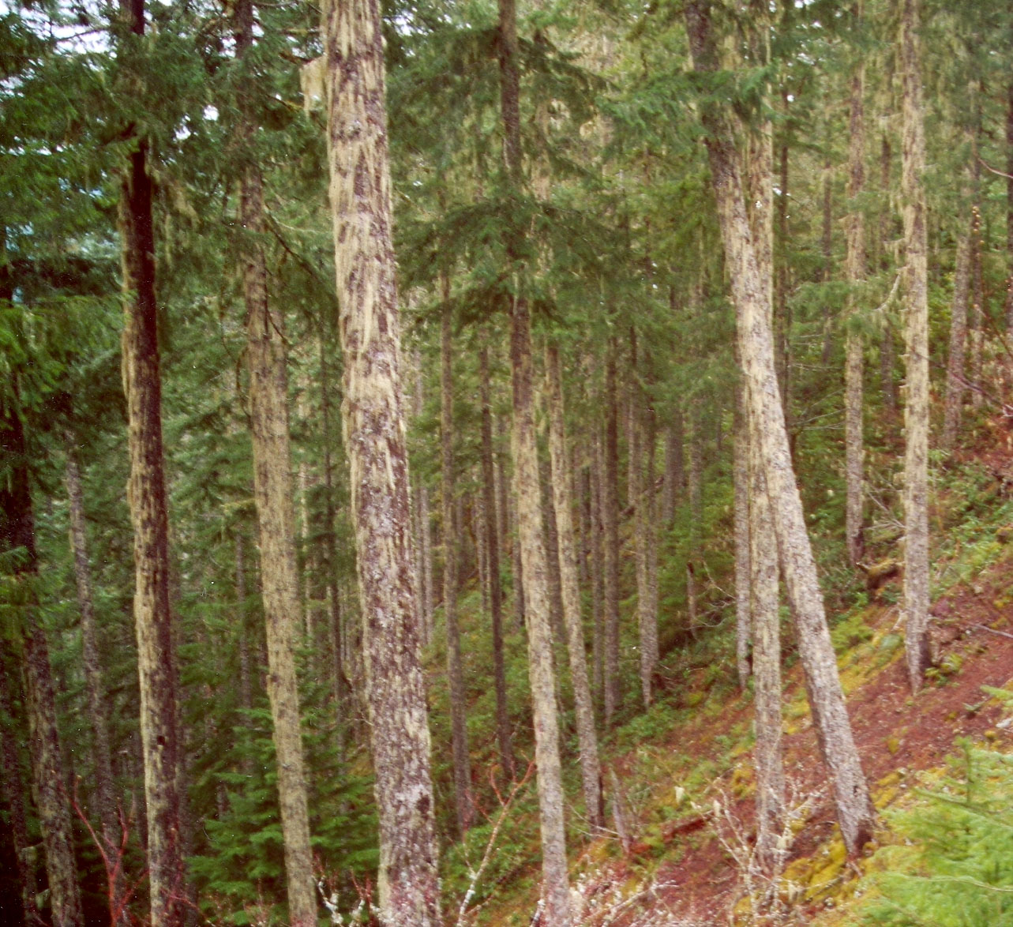
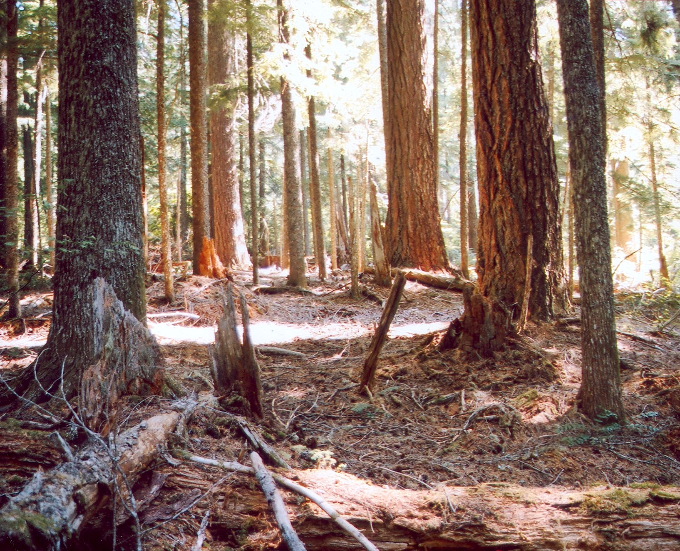
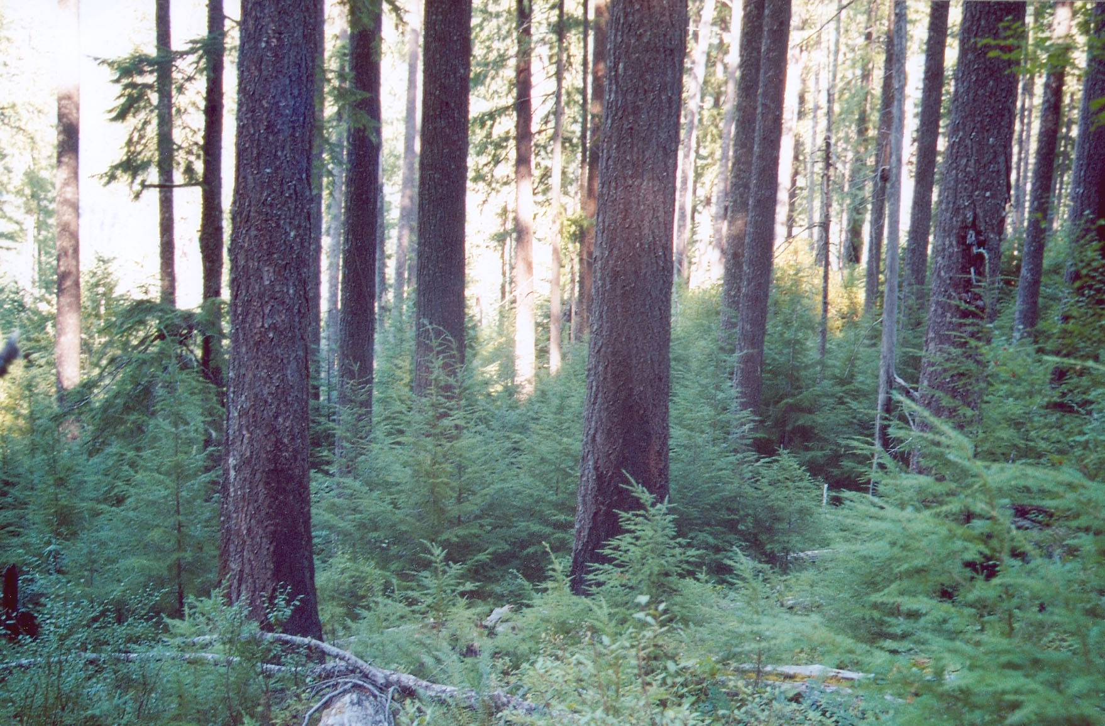
Relation to Successional Status of the Adjacent Upland Forest
Old Growth with Continuous Fuel
Mature Forest
Stand Development
without Fire
Old Growth with Fuel Discontinuity
Development of a Post-Fire Shade-Tolerant Cohort
ca. 150 yrs of Stand Development
Low- to Moderate-Severity Fire

