Slide 1
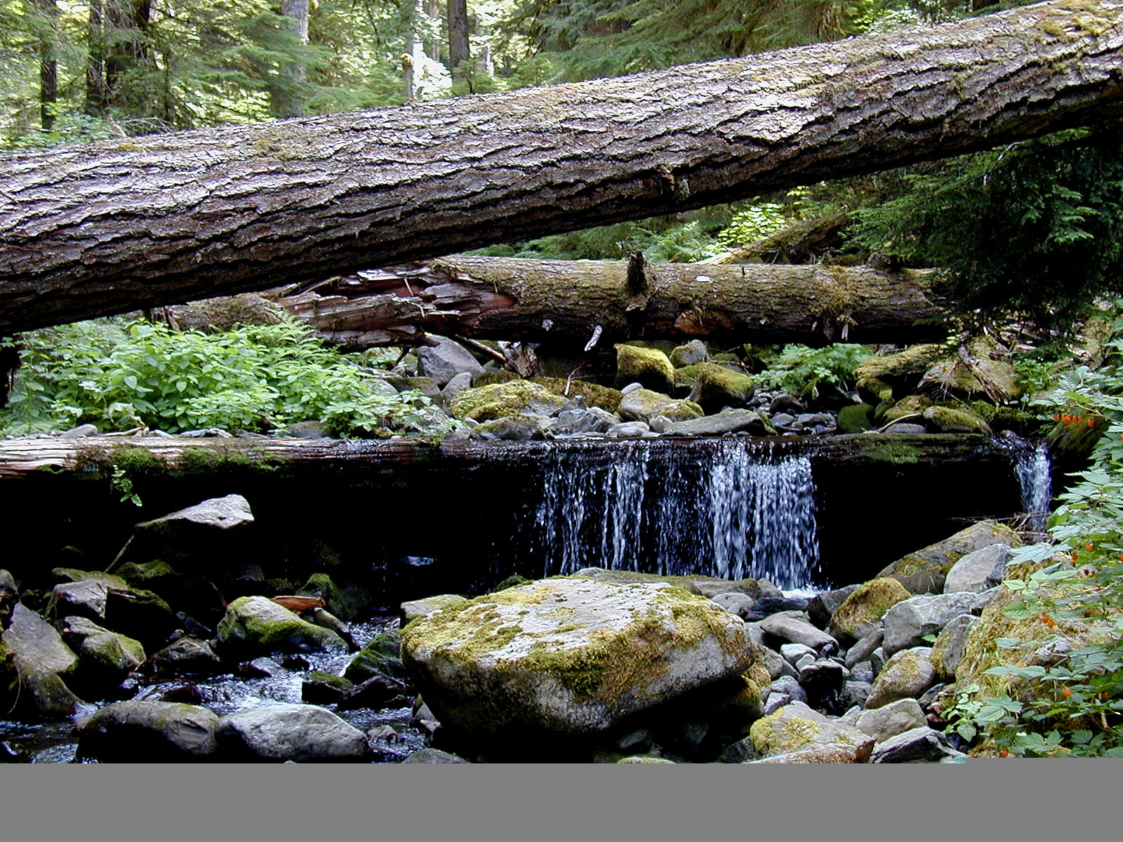
An Introduction to OSU StreamWood
Mark A. Meleason², Daniel J. Sobota¹, Stanley V. Gregory³
¹Washington State University, Vancouver Campus
²USDA Forest Service Pacific Northwest Research Station
³Department of Fisheries and Wildlife, Oregon State University
Notes:
Thanks Cheryl for having me. Today, I will give an introduction to a riparian forest model that was developed by my colleagues while I was OSU. Mark would be here, but his wife has a C-section scheduled today for their second child. But Mark wanted to let you all know that it was a tough choice for him. This material has primarily been developed by Mark and Stan. I’d like this to be interactive, so please stop if you have questions along the way.

Slide 2
Presentation Outline
Model Description
Types of Applications
Simulation Example
Notes:
To start, I’d like to go over the basic organization of this talk. I will start off by giving a descriptive over of the OSU streamwood. Next I will go over the types of applications it can currently perform. For the conclusion of the talk, I will work through a simulation example in the model.

Slide 3
I. Model Description
Model Overview
Model Components
Model Performance
Notes:
Okay, let’s begin with the model description. I’ll start with the basic model overview, discuss in more detail the forest and stream model components, and give some information on model performance, including sensitivity and accuracy

Slide 4
OSU StreamWood predicts…
STANDING STOCK of wood
(Breakage, movement, and decay)
MEANS and VARIANCE
(Individual–based Stochastic)
GENERAL trends
Scales: Time – ANNUAL
Space – MULTIPLE REACH
Notes:
Most wood models predict recruitment for a given time interval. SW differs in that in-channel dynamics are applied through time.
SW is run with a Monte Carlo procedure (random effects) so get a distribution of possible standing stocks for a given year.
A trade off: we did not want a model so specific that it could not easily be used at another site
GENERAL: representative of a regional trend (hypothetical) – outcomes for a given forest type and stream conditions
SW predicts standing stocks of wood at an annual time step and can be run for decades, centuries, or milenia
The model is broken up into multiple reaches so that, if desired, one can implement different management practices in different stream sections and examine how they influence wood dynamics downstream.

Slide 5
STREAMWOOD
Forest
Stream
Tree Recruitment
Log Recruitment
Tree Growth
Log Breakage
Tree Mortality
Log Movement
Forest Harvest
Decomposition
Notes:
Two models in 1: The output of the forest model is the input of the stream model
Emphases?: individual based – Monte Carlo

Slide 6
STREAMWOOD
Forest
Stream
Tree Recruitment
Log Recruitment
Tree Growth
Log Breakage
Tree Mortality
Log Movement
Forest Harvest
Decomposition
Notes:
First the forest model. Option to use a forest gap model within SW or import other results.

Slide 7
Forest Inputs
Forest Gap–Phase Model (w/I SW)
JABOWA (Botkin et al., 1972)
Individual-based, Monte Carlo
ORGANON and FVS (G&Y models)
User defined
Notes:
The Forest gap model based on the JABOWA family of models
Alternative, import he results of other FM or make up your own.

Slide 8
Riparian Zone
Harvest
Regime
forest
upland
partial cut
no cut
stream
Notes:
Can define regions of no-cut, partial cut, and upslope cutting/thinning.
Adding the ability to import FVS and ORGANON to obtain more sophisticated thinning regimes

Slide 9
STREAMWOOD
Forest
Stream
Tree Recruitment
Log Recruitment
Tree Growth
Log Breakage
Tree Mortality
Log Movement
Forest Harvest
Decomposition
Notes:
Stream model takes the trees that have died and determines which fall into the channel
For now, no snag dynamics – trees fall the year they die
Like the FM, the wood model is individual-based (each log is run through the 3 in-channel processes each year)

Slide 10
STREAMWOOD
Forest
Stream
Tree Recruitment
Log Recruitment
Tree Growth
Log Breakage
Tree Mortality
Log Movement
Forest Harvest
Decomposition
Notes:
Conversion of a tree to a log and includes entry breakage

Slide 11
Tree Fall Regime
forest
random
fall
or
random
fall
directional
fall
directional
fall
stream
Notes:
Can define regions of no-cut, partial cut, and upslope cutting/thinning.
Adding the ability to import FVS and ORGANON to obtain more sophisticated thinning regimes

Slide 12
STREAMWOOD
Forest
Stream
Tree Recruitment
Log Recruitment
Tree Growth
Log Breakage
Tree Mortality
Log Movement
Forest Harvest
Decomposition
Notes:
All logs break but data sparse – used first principles (broken stick model) and known distributions of length frequency distributions – e.g., reverse-j in OG forests

Slide 13
Tree Entry Breakage
Log lengths
A₁
A₂
B₂
B₁
C₃
Bankfull
Width
Notes:
Definition of a log – can be partially outside the channel. (e.g., C3 is outside the channel and would not be included)
Standing stock measures include:
1. and 2. total wood count and volume of all logs intercepting at least 1 bfw
3. Count of all completely within BFW
4. In-channel volume (m^3 / ha of stream bed)

Slide 14
In-channel Breakage
Does the log break?
residence time
top diameter
If so where?
Variations on broken stick model
Break location related to diameter
Notes:
Assumed that chance of breakage increases with residence time in the stream,
and that smaller log will have a greater chance of breakage than a larger log (all else being equal).

Slide 15
Predicted vs. Observed
Notes:
Example of model validation – comparison of frequency length distributions from observed (Mack Creek, OG) and simulated.

Slide 16
STREAMWOOD
Forest
Stream
Tree Recruitment
Log Recruitment
Tree Growth
Log Breakage
Tree Mortality
Log Movement
Forest Harvest
Decomposition
Notes:
Two questions: does the log move and is so, how far?

Slide 17
Chance of Log Movement
Does the log move?
Function of:
FLOW (peak annual flow)
Number of Key Pieces
Length outside of channel
Length to bankfull width
Notes:
Multiple logistic regression of a 12-yr tagged log data set – smoothed to make more “Ideal”

Slide 18
Chance of Movement: No Key Pieces, 100% Within Channel
Notes:
Response curve for chance of log movement for no key pieces and 100% in-channel. This is one example from a series - adjustable for “retentive” (e.g., large boulders) or non-retentive streams.

Slide 19
Distance of Log Movement
If it does move, then how far?
Single negative exponential model
k = average travel distance
(units of bank full width)
Assumed independent of piece size and channel characteristics

Slide 20
Distance Moved, Mack Creek
Notes:
Mack Data

Slide 21
STREAMWOOD
Forest
Stream
Tree Recruitment
Log Recruitment
Tree Growth
Log Breakage
Tree Mortality
Log Movement
Forest Harvest
Decomposition
Notes:
Final in-channel process is decay

Slide 22
Decomposition
Single negative exponential
Represents microbial decay and physical abrasion
Species-specific aquatic and terrestrial rates

Slide 23
The Value of Models
“Models of course, are never true, but fortunately it is only necessary that they be useful.”
“For it is usually needful only that they not be grossly wrong.”
Box, G. E. P. 1979. Some problems of statistics and everyday life. J. Am. Stat. Assoc. 74: 1-4
Notes:
Before launching into model applications, let’s state as clearly as possible the value of models:

Slide 24
Model Performance Evaluation “Truth is the intersection of independent lies” (Levins1970)
Absolute Tests difficult for most models
Using realistic input parameters:
Reasonable agreement with available data
And derived characteristics (e.g., log length frequency distribution)
Sensitivity Analysis: ID critical variables
Notes:
Difficult to prove a model – in fact, a model is either undergoing improvement (refinements based on discrepancies with real data or additional information about the system) or dead (not very useful). The refinement of a model is one area of usefulness.

Slide 25
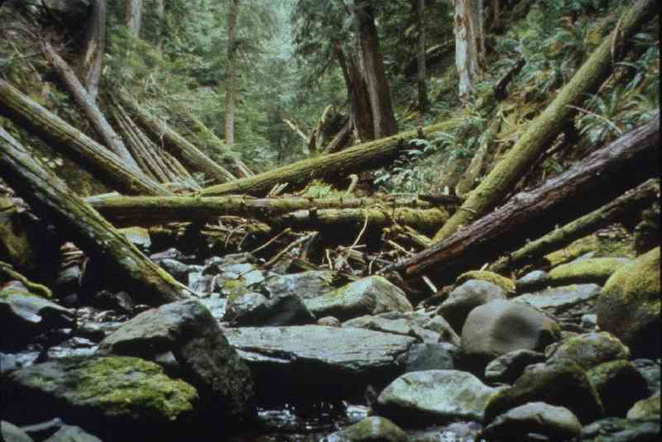
Notes:
Onward to some applications of this….

Slide 26
II. Sample Applications
Vary, riparian width, no-cut width, and upland rotation length
Characterizing variability of wood volume for a given forest type
Notes:
The first may be the most important to managers (e.g., mean response) but the variability of wood volume is also important in characterizing wood in streams through time.

Slide 27
Forest Basal Area: Standard Run
Notes:
Gap-phase model within StreamWood, western Cascades. Basal area of 3 main spp and total

Slide 28
Forest Plantation Basal Areas
Notes:
Simple clear cut to stream bank using 3 rotation ages.
Of course this is illegal, but this is a model! A test of the simplest case
Standard run is a 50-m wide native forest buffer without cutting (start from 0)

Slide 29
Volume From Plantation Forests
Notes:
See that the clearcuts achieve their levels prior to first cut

Slide 30
Plantation Forests: 6-m Buffer
Notes:
Now add a 6-m buffer and see that that the not wide enough to achieve site potential (120 yr old tree not tall enough to contribute much beyound 6 m.)

Slide 31
Plantation Forests: 10-m Buffer

Slide 32
Plantation Forests: 15-m Buffer

Slide 33
Total Volume by Buffer Width
Notes:
Simple function of buffer width – wider the no-cut buffer, more wood (but with diminishing returns)

Slide 34
Study Conclusions
6-m buffer: 32% of site potential
30-m buffer: 90% of site potential
Plantation forests: maximum 1st cut

Slide 35
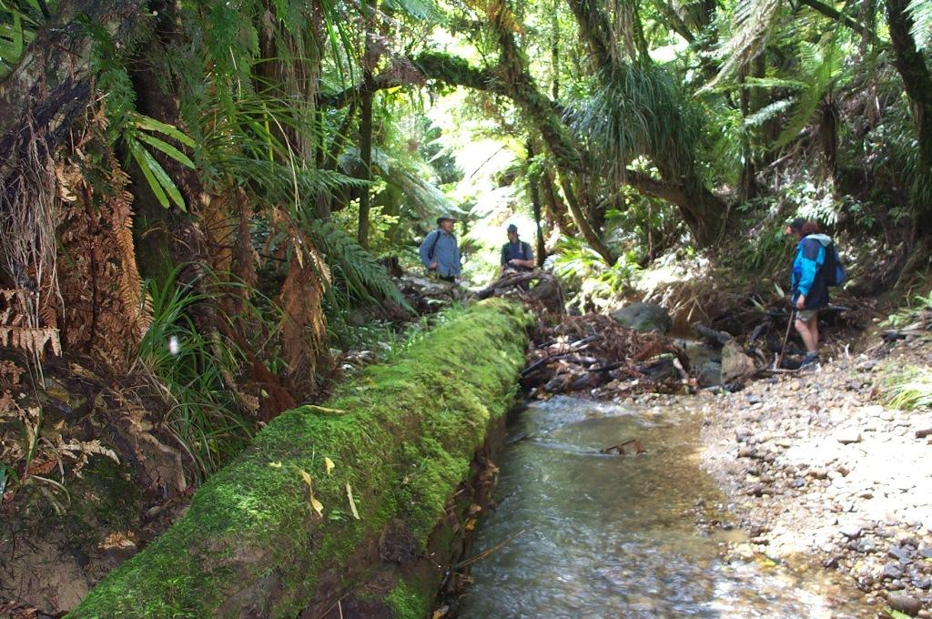
Notes:
Second case study. Characterizing wood variability for a forests of similar age and type for a give stream size.

Slide 36
Simulated Wood Volume Waihaha Basin, New Zealand
60
1800-yr
40
Volume (m³ 100 m⁻¹)
20
0
0
450
900
1350
1800
Time (year)
Notes:
Simulation of wood in a New Zealand Stream (used the forest-gap model LINKNZ).
Total wood volume / 200 m reach.
The bars are SD
Let’s look at the variation of the last year (1800) by each iteration
Since we ran it for 2000 iterations, n = 2000

Slide 37
Volume Frequency Distribution Year 1800, Waihaha, NZ
25
20
1800-yr
15
Relative Frequency
10
5
0
0
10
20
30
40
50
Wood Volume class ( m
3
/ 100 m)
Notes:
Relative frequency distribution of wood volume for year 1800. Note that the range is from 0-5 to >50 m3 / 100m)

Slide 38
Cumulative Frequency Volume Distribution Waihaha, NZ
Notes:
Now make is cumulative frequency by selected years.
Median wood volume (e.g., where 50% of the iterations [ n = 2000] aka reach estimates) for yr 400 were twice that of yr 200 – note also the longer tail
Also, the forest height is greatest in a mid-successional sere, thus yr 1800 is less than yr600.
Actually, the variability is also influence by the length of reach sampled – a longer sample reach will generally have a lower median but there is a finite limit to the length of a reach with “uniform” conditions (e.g., tributary junction etc.) so can base on standard protocol.
So, difficult to characterize as a “target” when a range of possible wood volumes are possible for a given forest type and stream width.

Slide 39
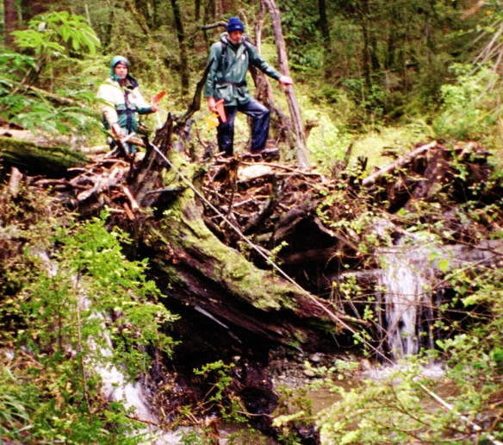

Slide 40
III. Simulation Example
4-reach system using the internal forest model (no harvest activity)
Bank full width = 10 m, length =200 m
Run for 200 years, 100 iterations
Notes:
A simple run

Slide 41
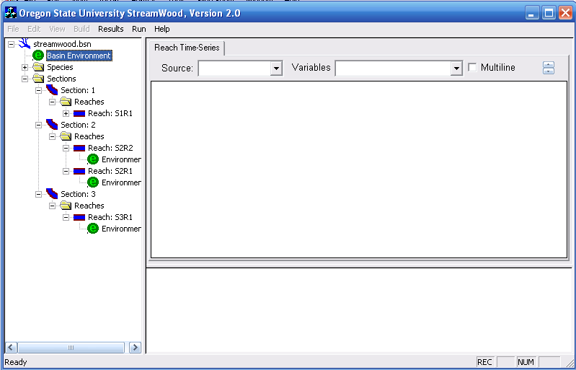
Notes:
The opening GUI with the reach tree expanded
Click on Basin Environment

Slide 42
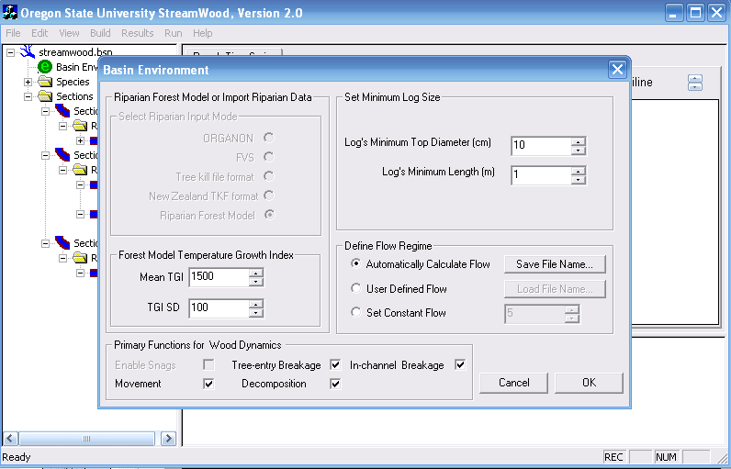
Notes:
These are variables set to the Basin level of the model – e.g., minimum log dimensions are 10 cm top d and 1 m length.
Note that the Riparian Forest Model or Import Riparian Data is greyed out.
This is because the type of forest input was defined by the use in basin file that defines the nature of the stream system (number of reaches, tree and log files to import, and species file to import)
Now click on the Reach environment

Slide 43
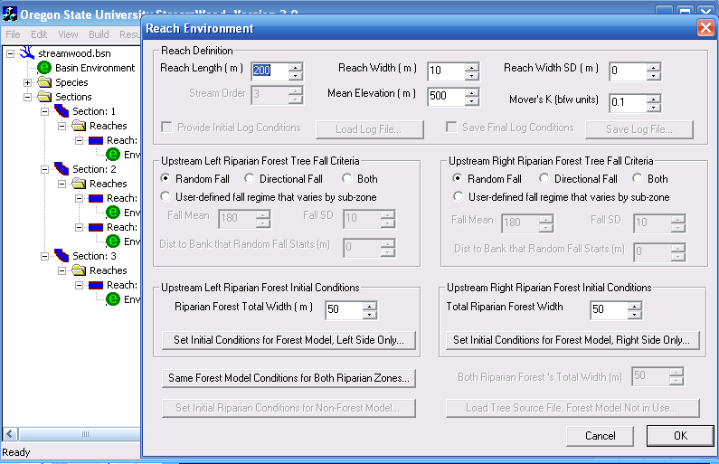
Notes:
This defines the characteristics of the reach – again, these values were stated in the basin file
Ok let’s do the run. Close this file and open Run

Slide 44
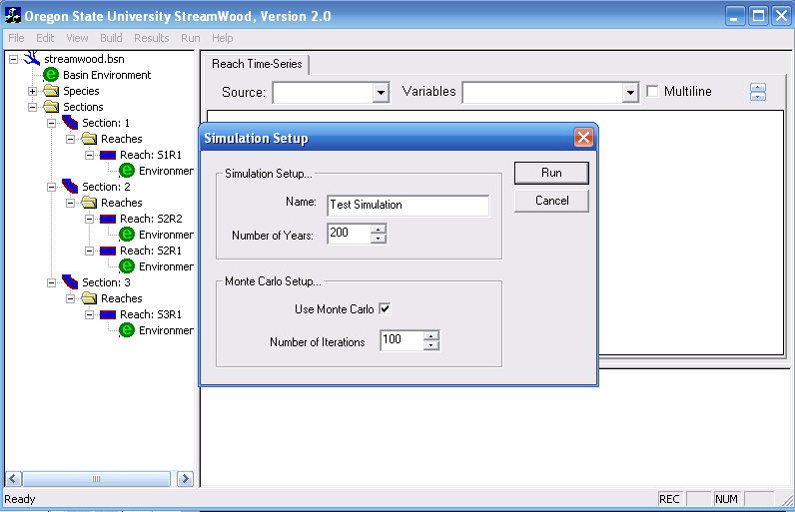
Notes:
Check use Monte Carlo and press run

Slide 45
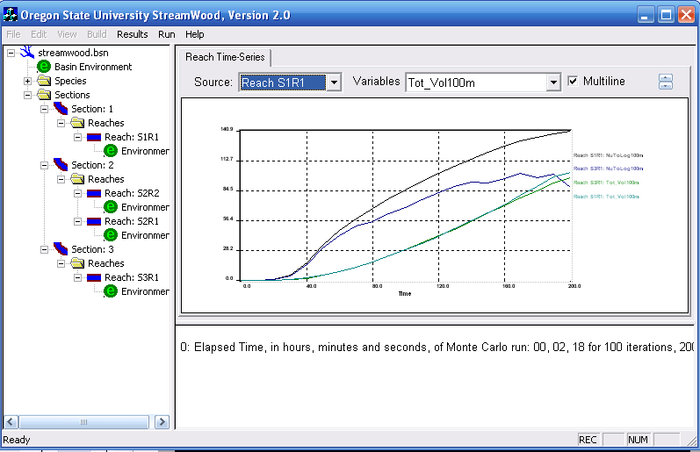
Notes:
Selected the top and bottom reach for total volume (lower 2 lines) and total count (top 2 lines). Volumes are very similar because larger pcs tend to be less mobile; count tend to increase as go downstream.

Slide 46
Final Thoughts
Designed to be flexible
Currently v2 is under construction
Includes “StreamLine” – a 1-reach system
Imports ORGANON and/or FVS dead tree files
Latest release version on HJA LTER website
http://www.fsl.orst.edu/lter/data/tools/models/
Developer: Mark Meleason (streamwoodv1@hotmail.com)

Slide 47
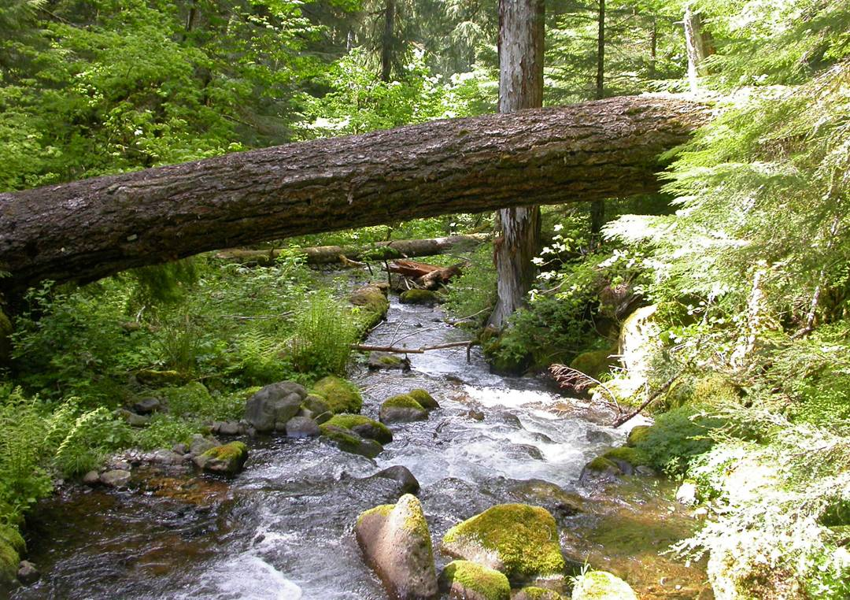
Questions?

