Slide 1
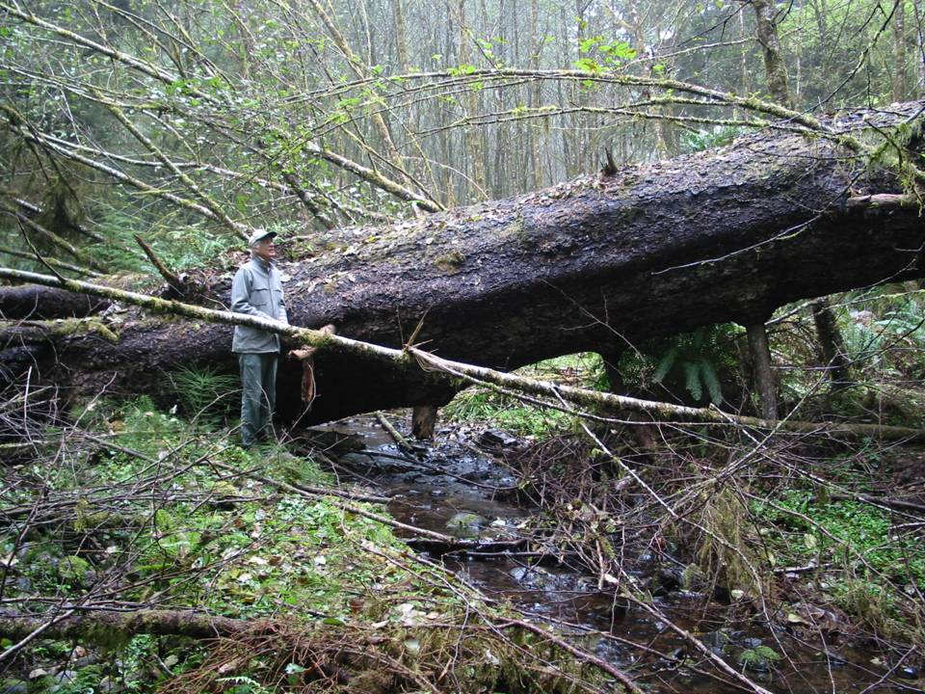
Riparian Thinning Logic
Jack Sleeper - Siuslaw National Forest
March 20, 2008

Slide 2
Talk Outline
Riparian Processes
Human Impacts to Riparian Areas
Siuslaw NF Thinning Design and Effects

Slide 3
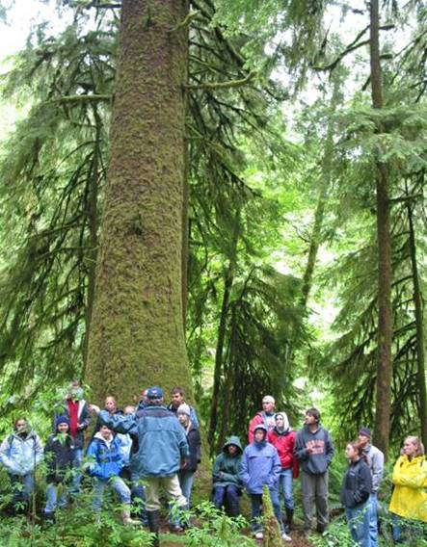
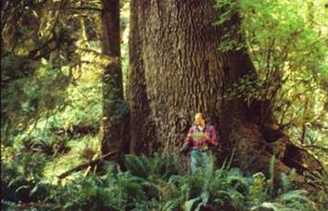
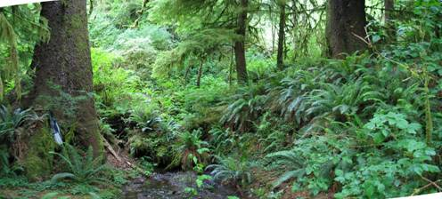
Large Trees

Slide 4
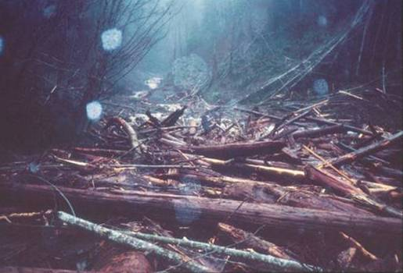
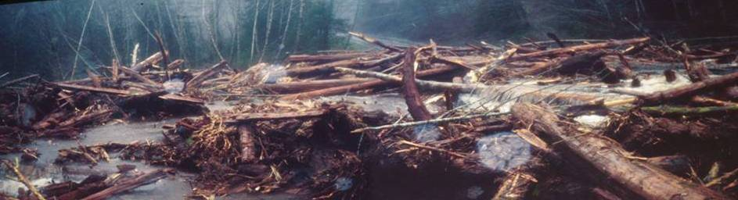
Debris Flows

Slide 5
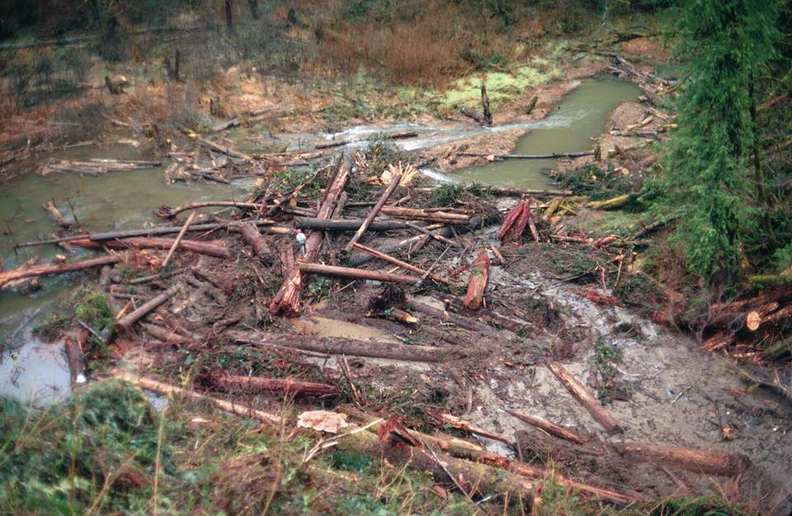
Wood & Sediment from Debris Flow

Slide 6
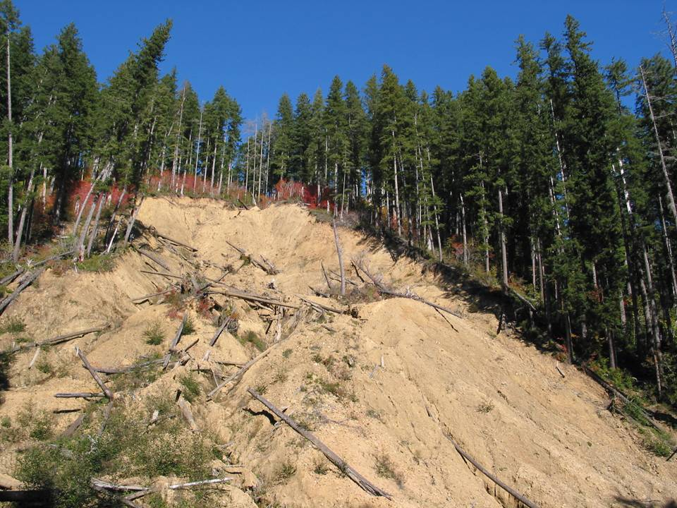
Upper Green River Landslide

Slide 7
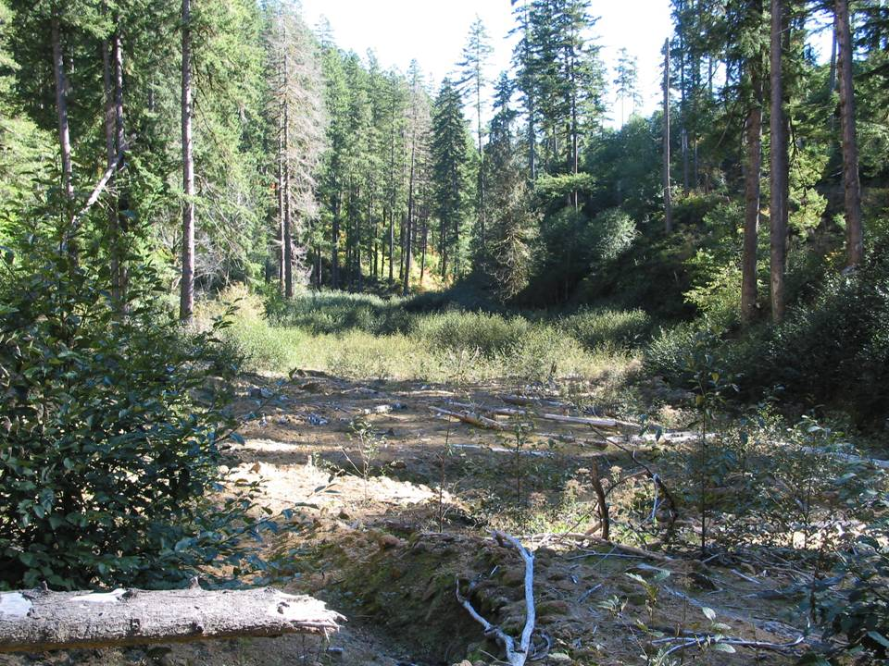
Valley Floor Buried with Landslide Deposit

Slide 8
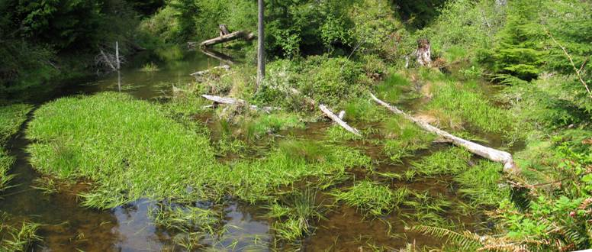
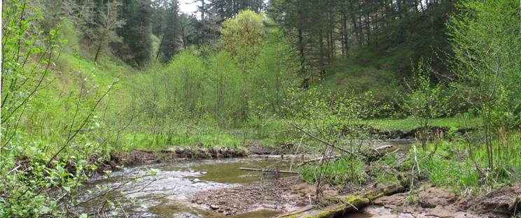
Beaver Ponds

Slide 9
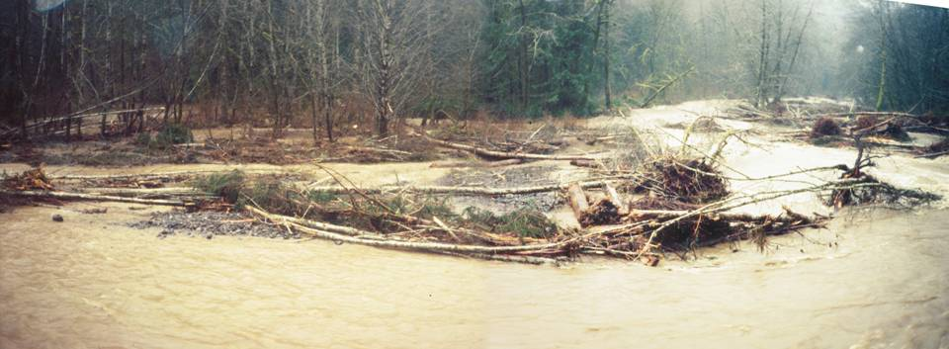
Floods

Slide 10
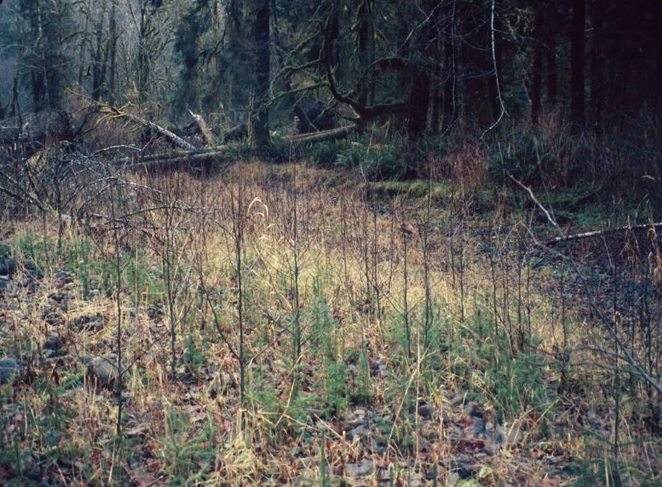
Spruce & Alder Seedlings

Slide 11
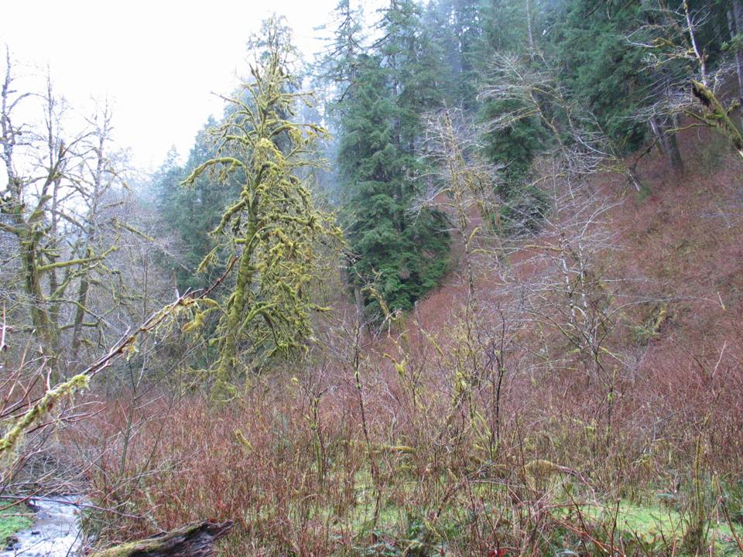
Notes:
Upper Yachats

Slide 12
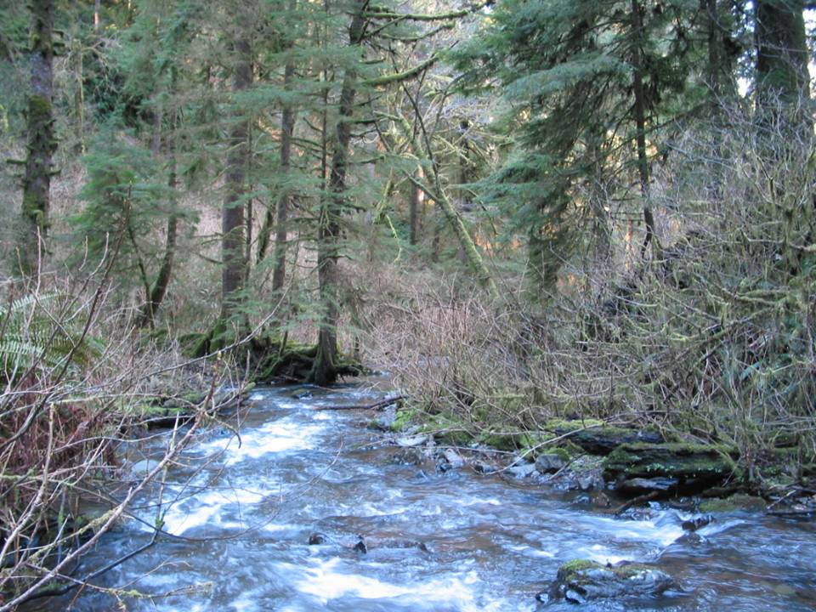

Slide 13
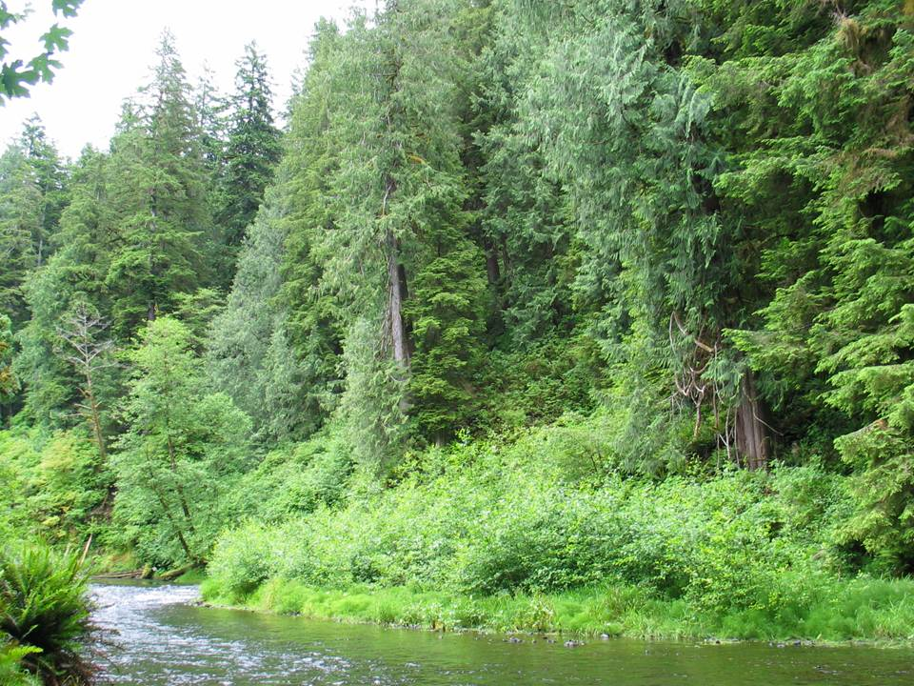
Notes:
Audubon Sanctuary on Tenmile Creek

Slide 14
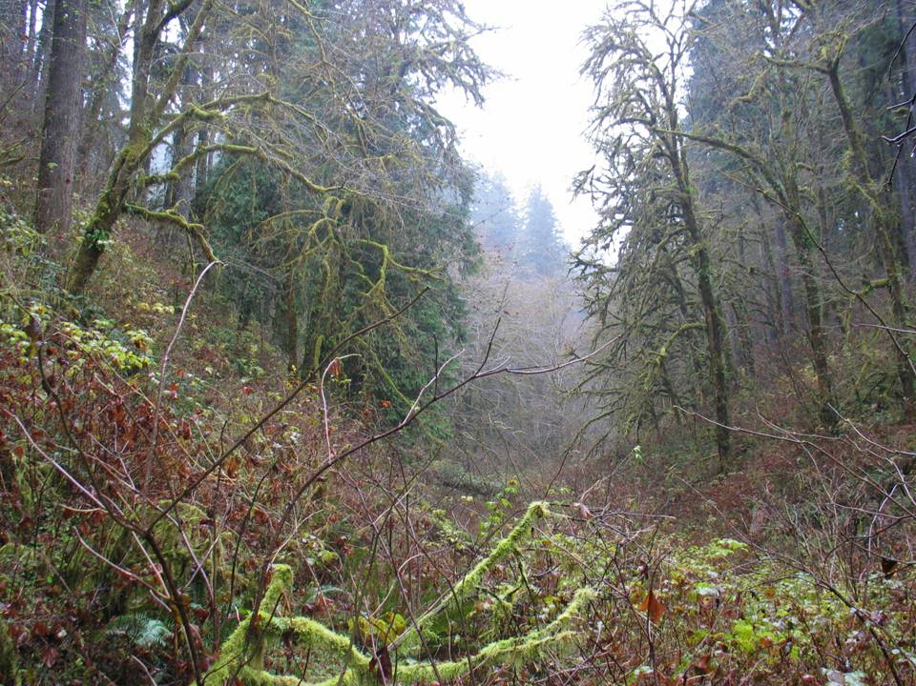
Notes:
Preacher Trib

Slide 15
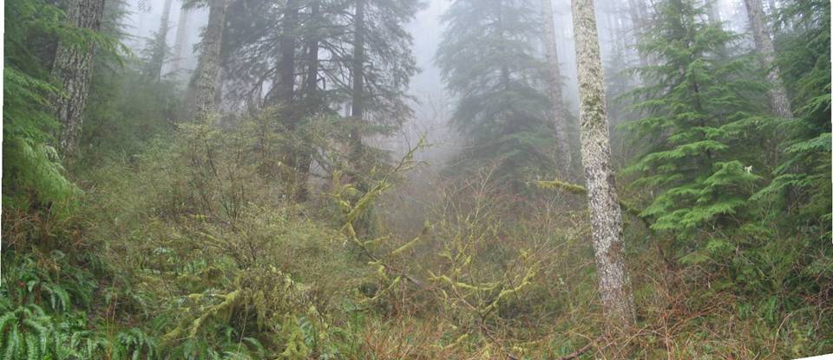

Slide 16
Natural Conifer Stands
Large diverse tree species
Disturbance & competition limit dense conifer stands near streams
Conifer stands mostly on toeslope and high terraces
Trees/Acre-lowest in riparian areas and increase upslope
Conifer stands have irregular riparian edges

Slide 17
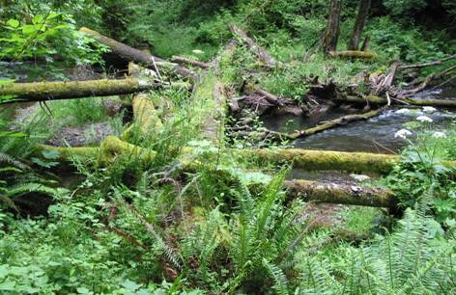
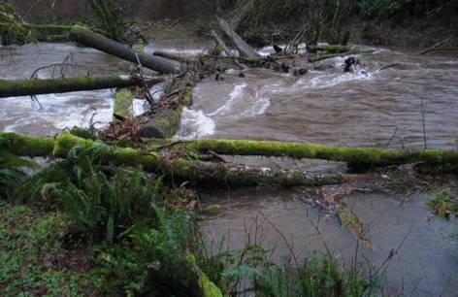
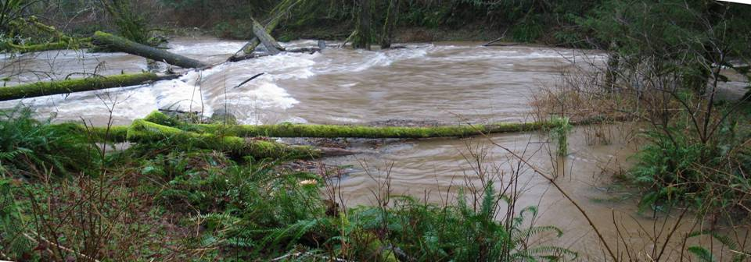
Large Wood in Streams

Slide 18
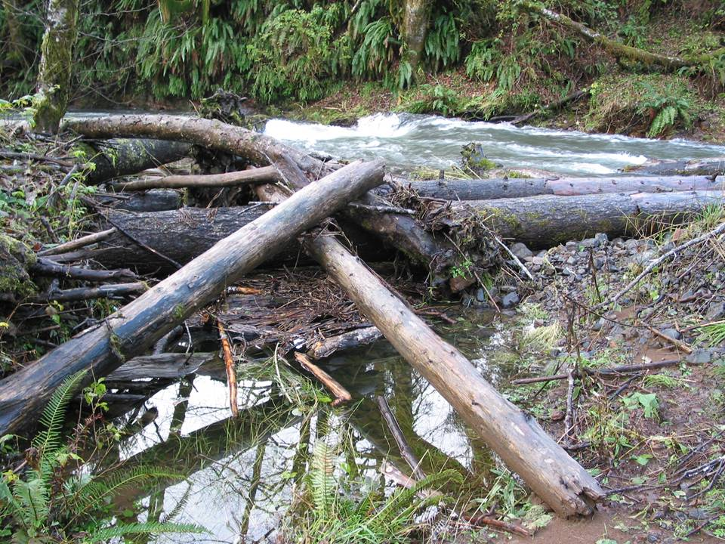

Slide 19
Riparian Impacts

Slide 20
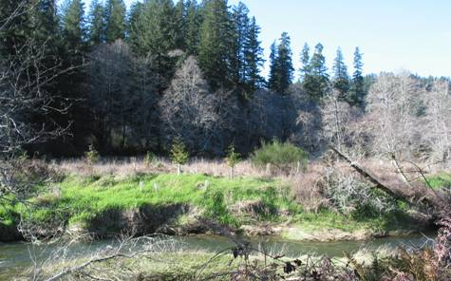
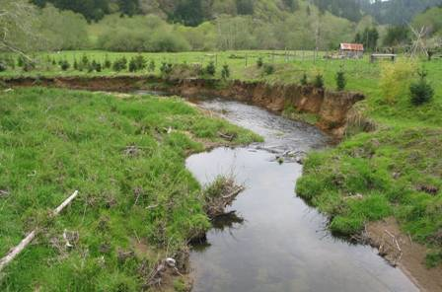
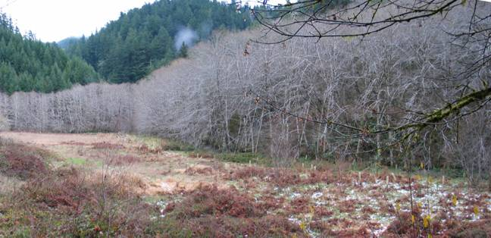
Settlement Reduced Large Trees in Riparian Areas

Slide 21
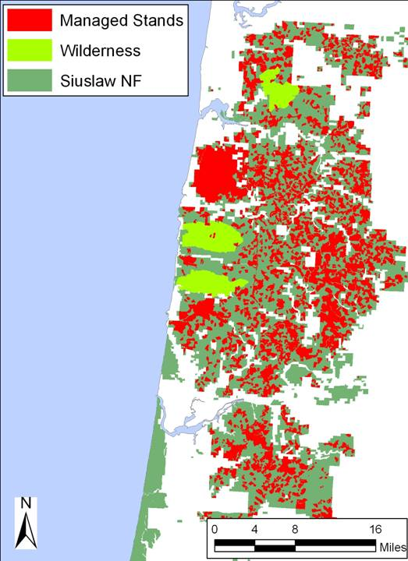
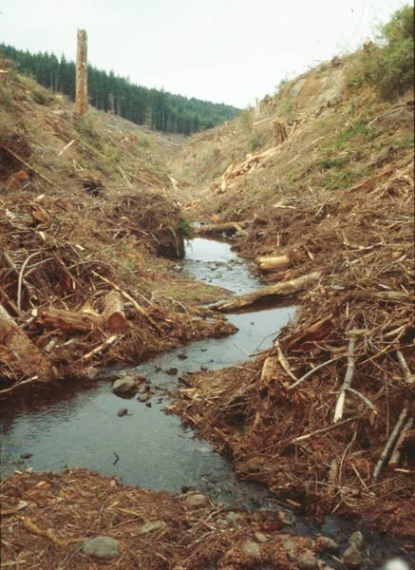
Large Trees Removed
Cape Perpetua
Florence

Slide 22
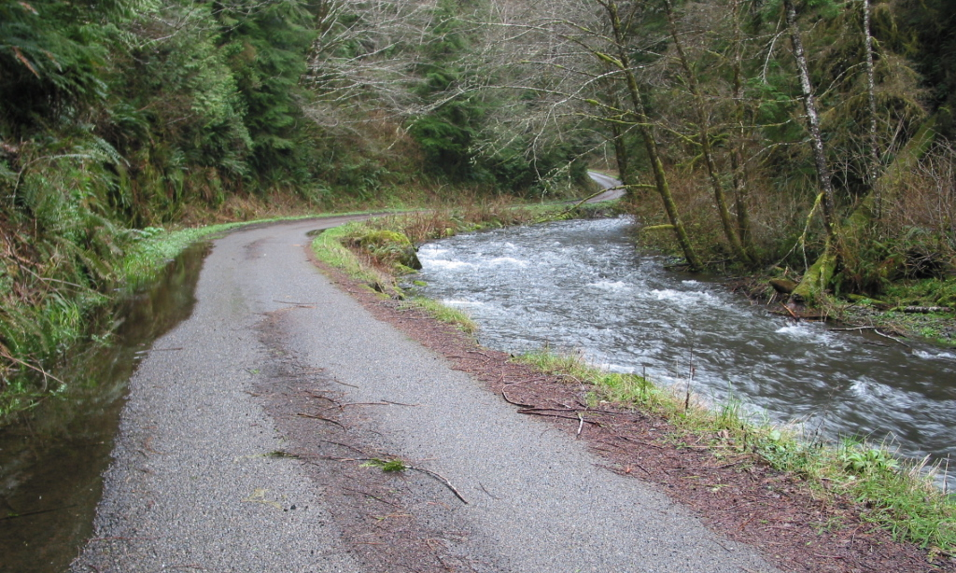
Roads Disconnect Riparian Area from Stream

Slide 23
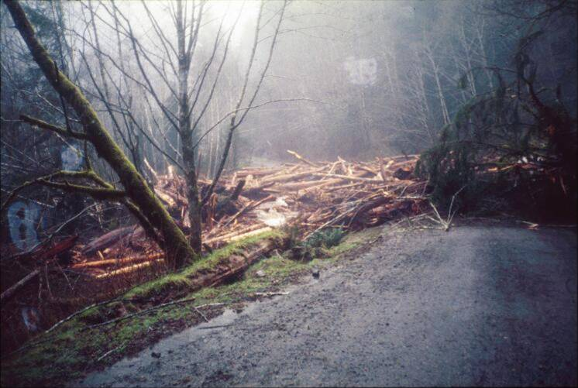
Debris Flow Intercepted by Road
Tenmile Creek

Slide 24
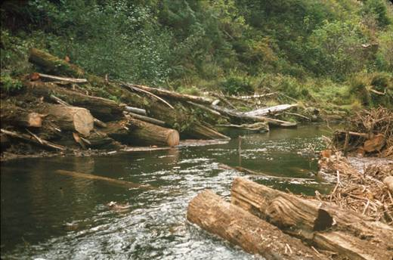
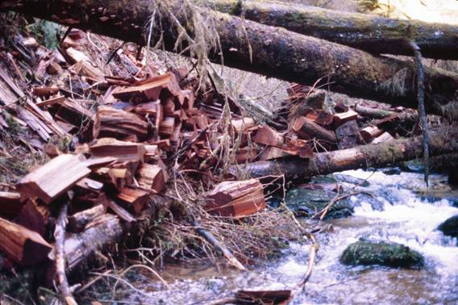
Stream Cleaning for -Transportation -Fish Passage -Cedar Shakes

Slide 25
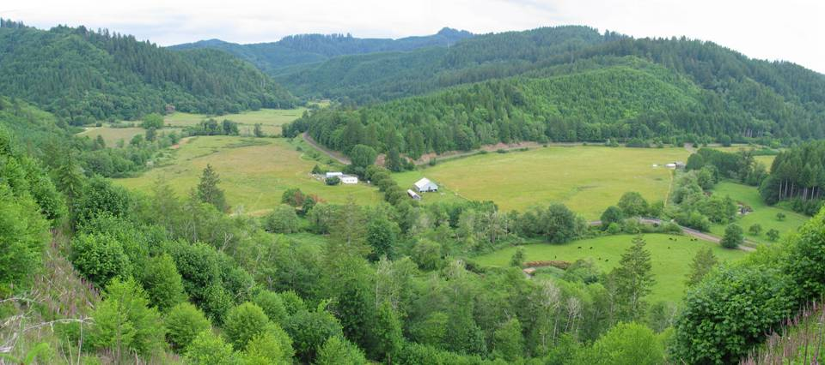

Slide 26
Natural & Managed Riparian Stands
Natural Stands
Large conifer with few trees/acre
Diverse species
Understory shrubs and trees present
Managed Stands
Small conifer with many trees/acre
Mostly Douglas-fir
Understory shrubs and trees absent

Slide 27
Why Thin Close To Streams?
Large wood has a major influence on aquatic processes and habitat
Large diameter conifers near streams have been reduced
Large wood in streams and on floodplains reduced
Thinning accelerates development of large diameter trees and diverse tree species
Northwest Forest Plan, Endangered Species Act, Essential Fish Habitat

Slide 28
Riparian Thinning Design and Effects

Slide 29
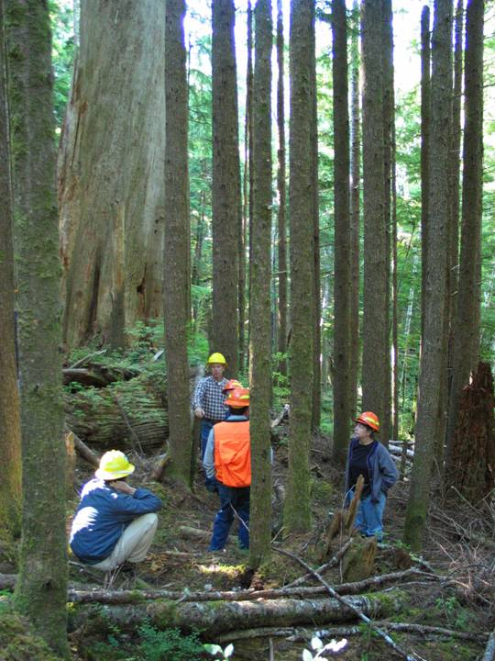
Interdisciplinary Team Plans Restoration Activities Including Thinning

Slide 30
Thinning Concerns
Stream Temperature
Stream Sedimentation
Wood Recruitment to Streams
Windthrow

Slide 31
Stream Buffer Design
Variable width
Based on site specific conditions
Follows edge of dense plantation
Protect Unstable Areas
Perennial Streams
First 2 rows of conifer near stream-no cut
Minimum 30 ft no cut buffer from floodplain
average 50-80 ft
Intermittent Streams
First row of conifer near stream-no cut
Minimum 15 ft no cut buffer

Slide 32
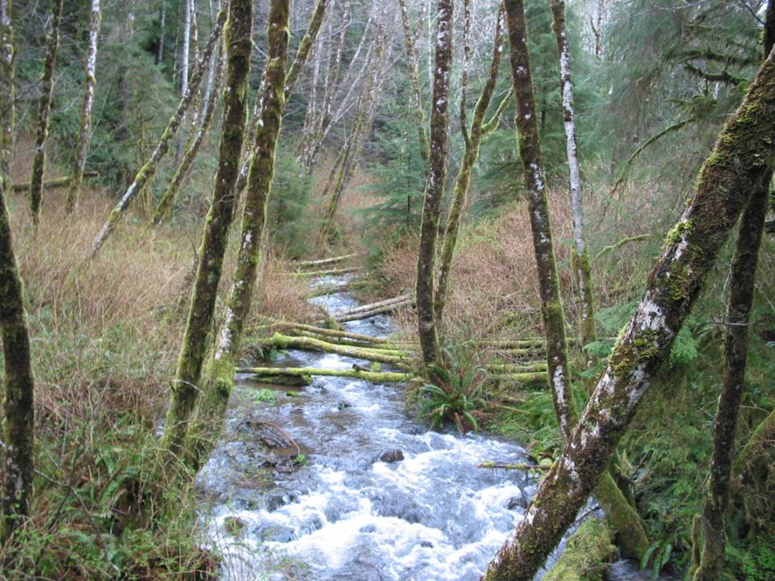

Slide 33
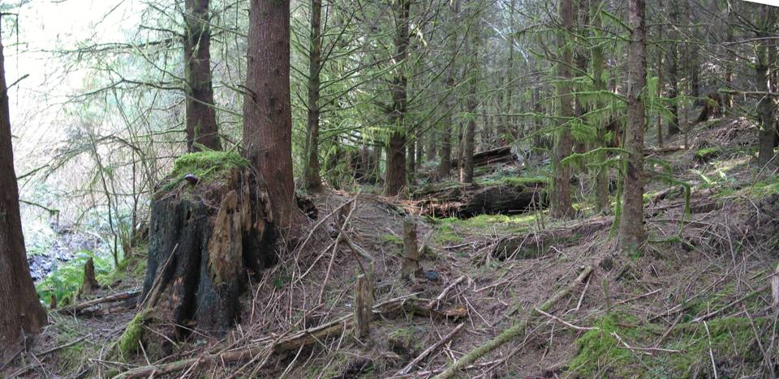
Stream
←No Cut | Thin→

Slide 34
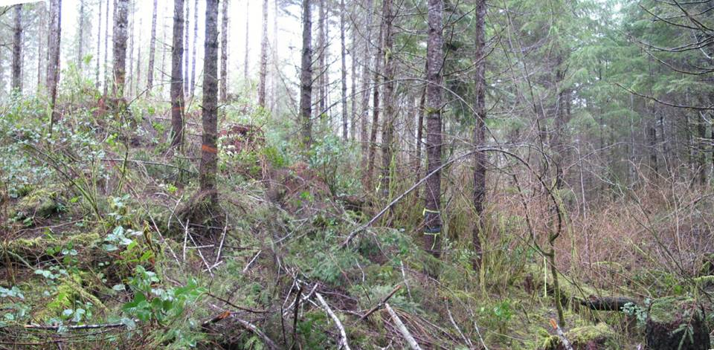
Thinned Unit No Cut Buffer

Slide 35
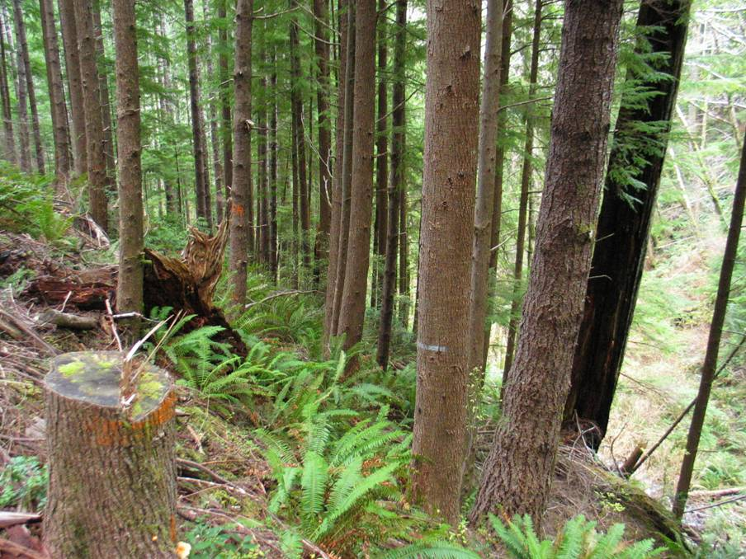

Slide 36
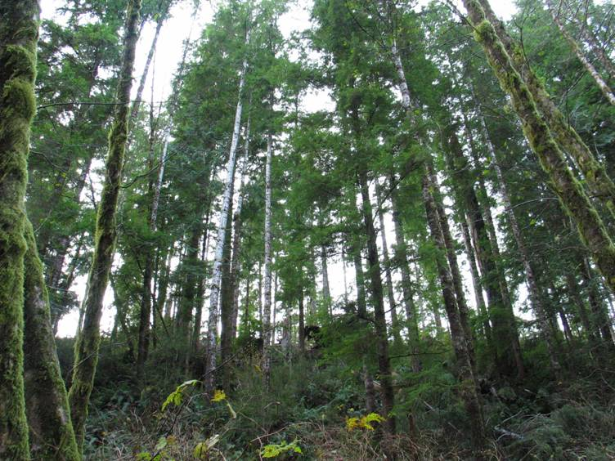
Stream Shade from No Cut Buffer

Slide 37
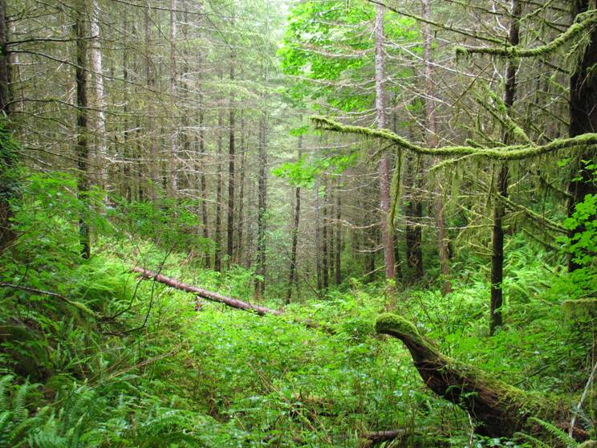
Dense Vegetation Shades Small Streams

Slide 38
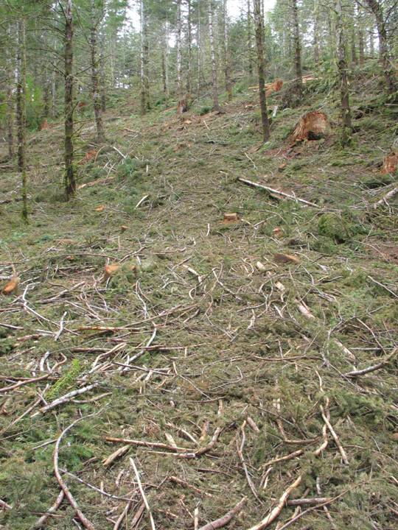
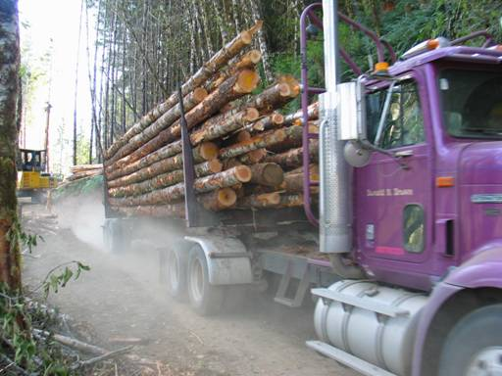
Sedimentation

Slide 39
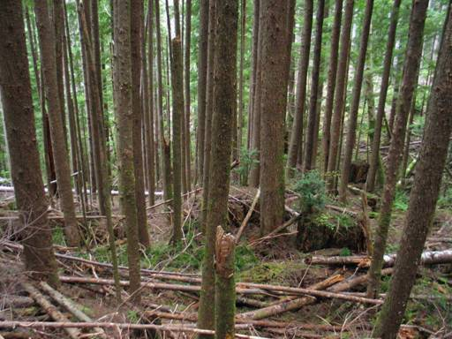
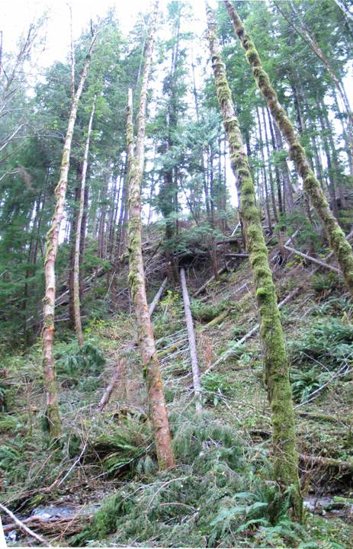
Wood Recruitment

Slide 40

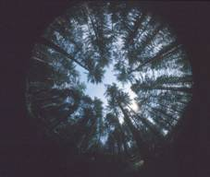
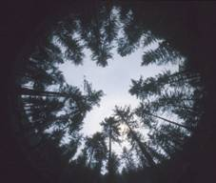
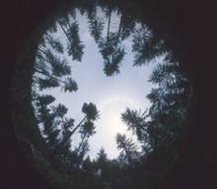
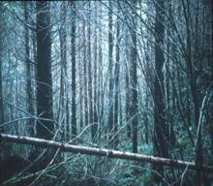
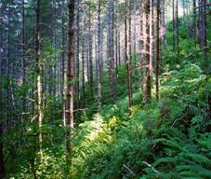
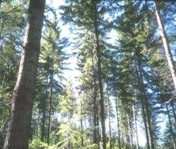
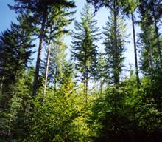




Douglas-fir Stand Development in Western Oregon
Seven Years After Thinning and Underplanting
Unthinned
100 Trees/Acre
60 Trees/Acre
30 Trees/Acre
Notes:
All treatments 7 years after thinning stands were underplanted with hemlock and Douglas-fir.
Point out Yachats treatments.

Slide 41
Uncertainty
Thin Density-trees/acre
Thin heavy or light?
Distribution across the landscape
Down Wood
Small pieces now or larger ones later?
Windthrow
How to contract & fund complex design?
Climate Change

Slide 42
Commercial Thinning Funds other Restoration Activities

Slide 43

Precommercial Thinning

Slide 44



Riparian Planting

Slide 45


Conifer Release

Slide 46



Add Large Wood to Streams & Floodplains

Slide 47


Road Decommission
2002
2003
2002
2003
2006
2006

Slide 48

Notes:
Yachats River near Beamer Creek

