Slide 1
Hartz Young Stand Management Project
How we got here!
(2005)

Slide 2
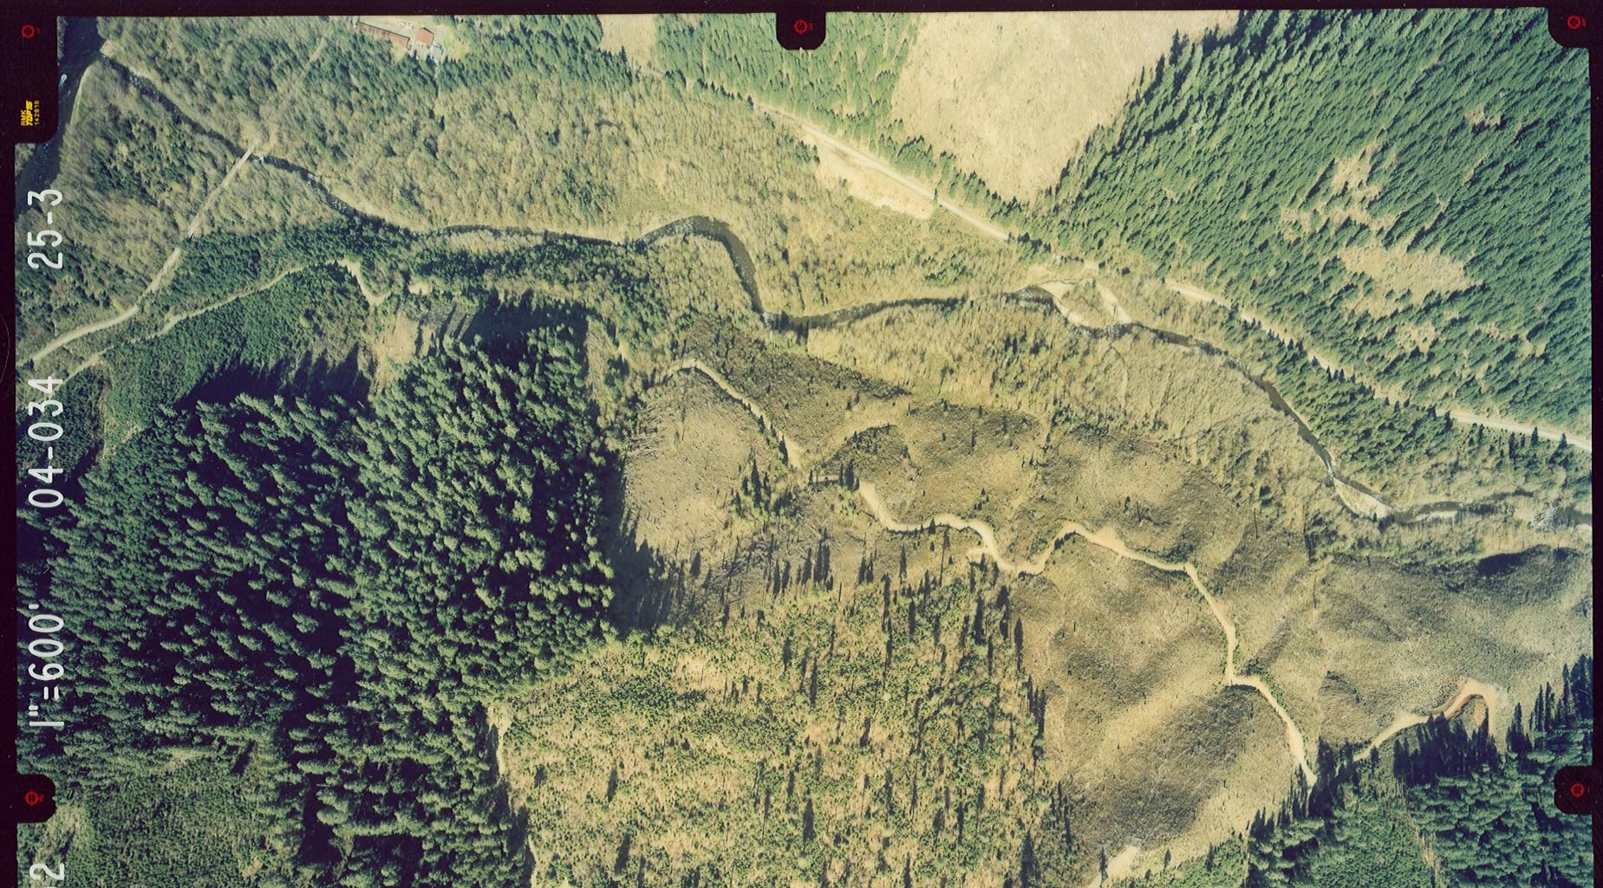
Downstream Conditions

Slide 3
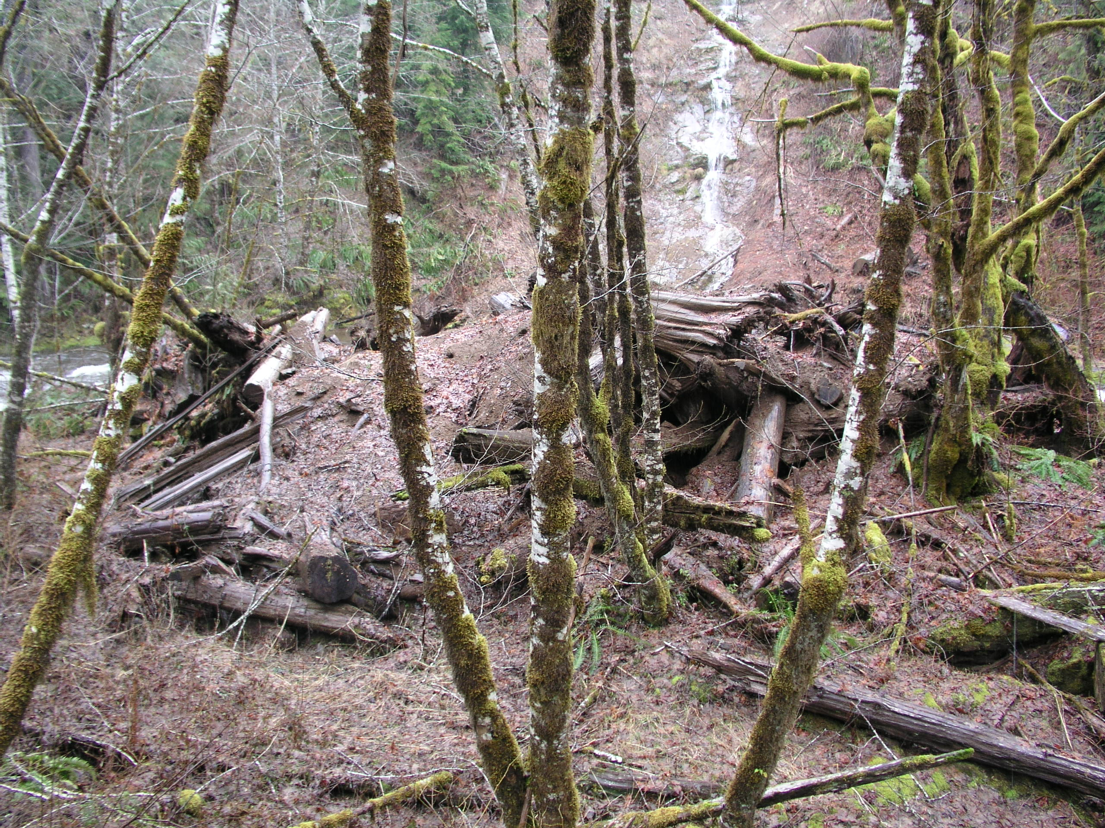
In-stream Salvage

Slide 4
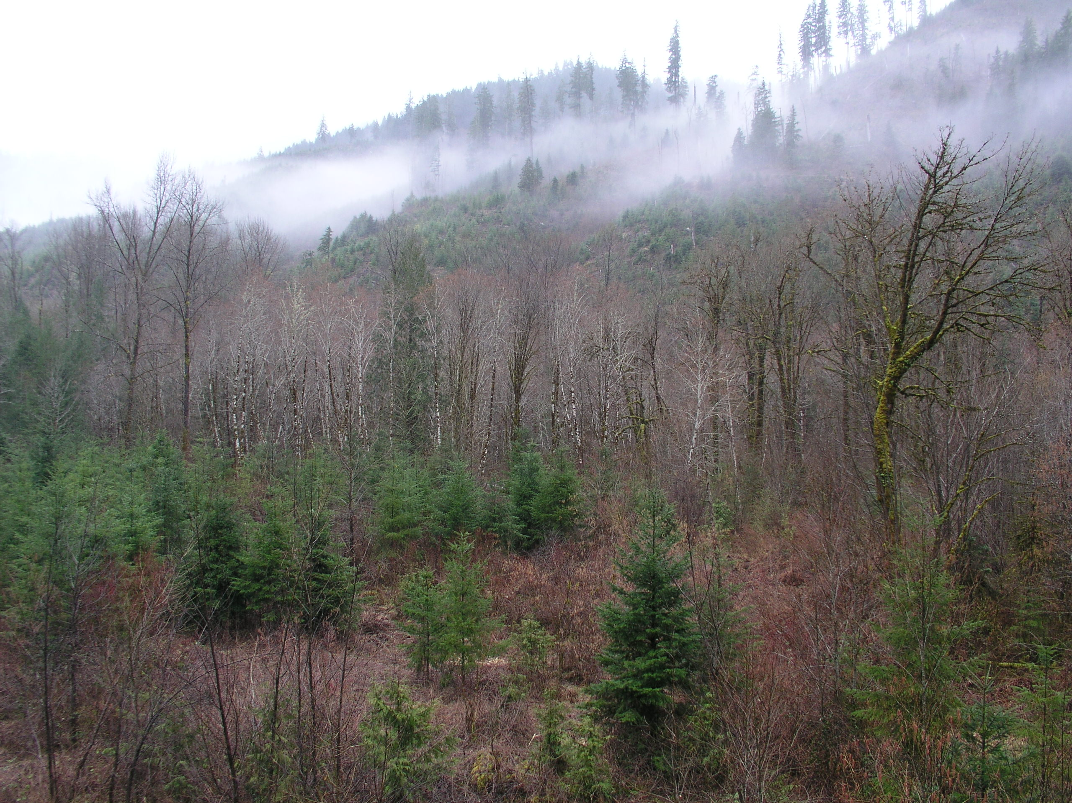
Hardwoods and Early Seral

Slide 5
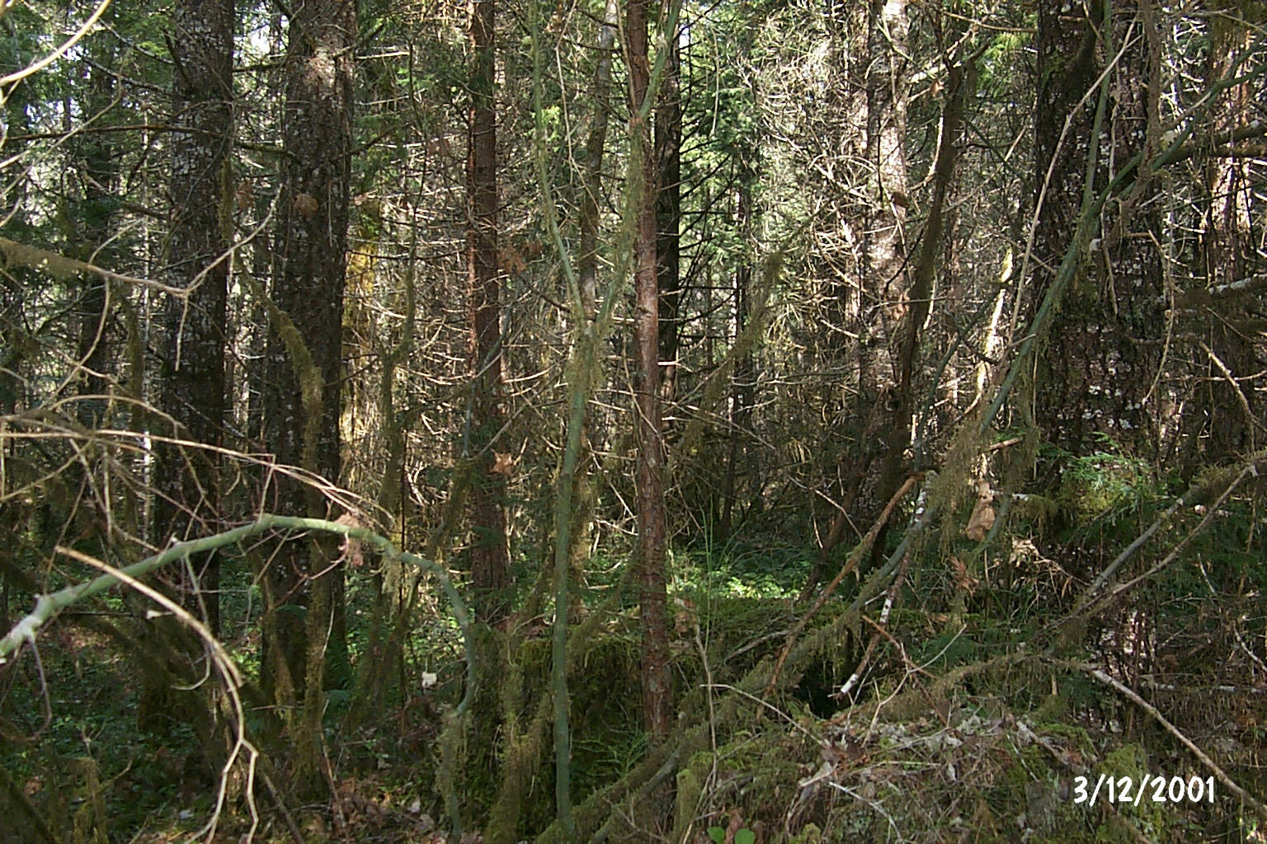
Stagnant Riparian Stands

Slide 6

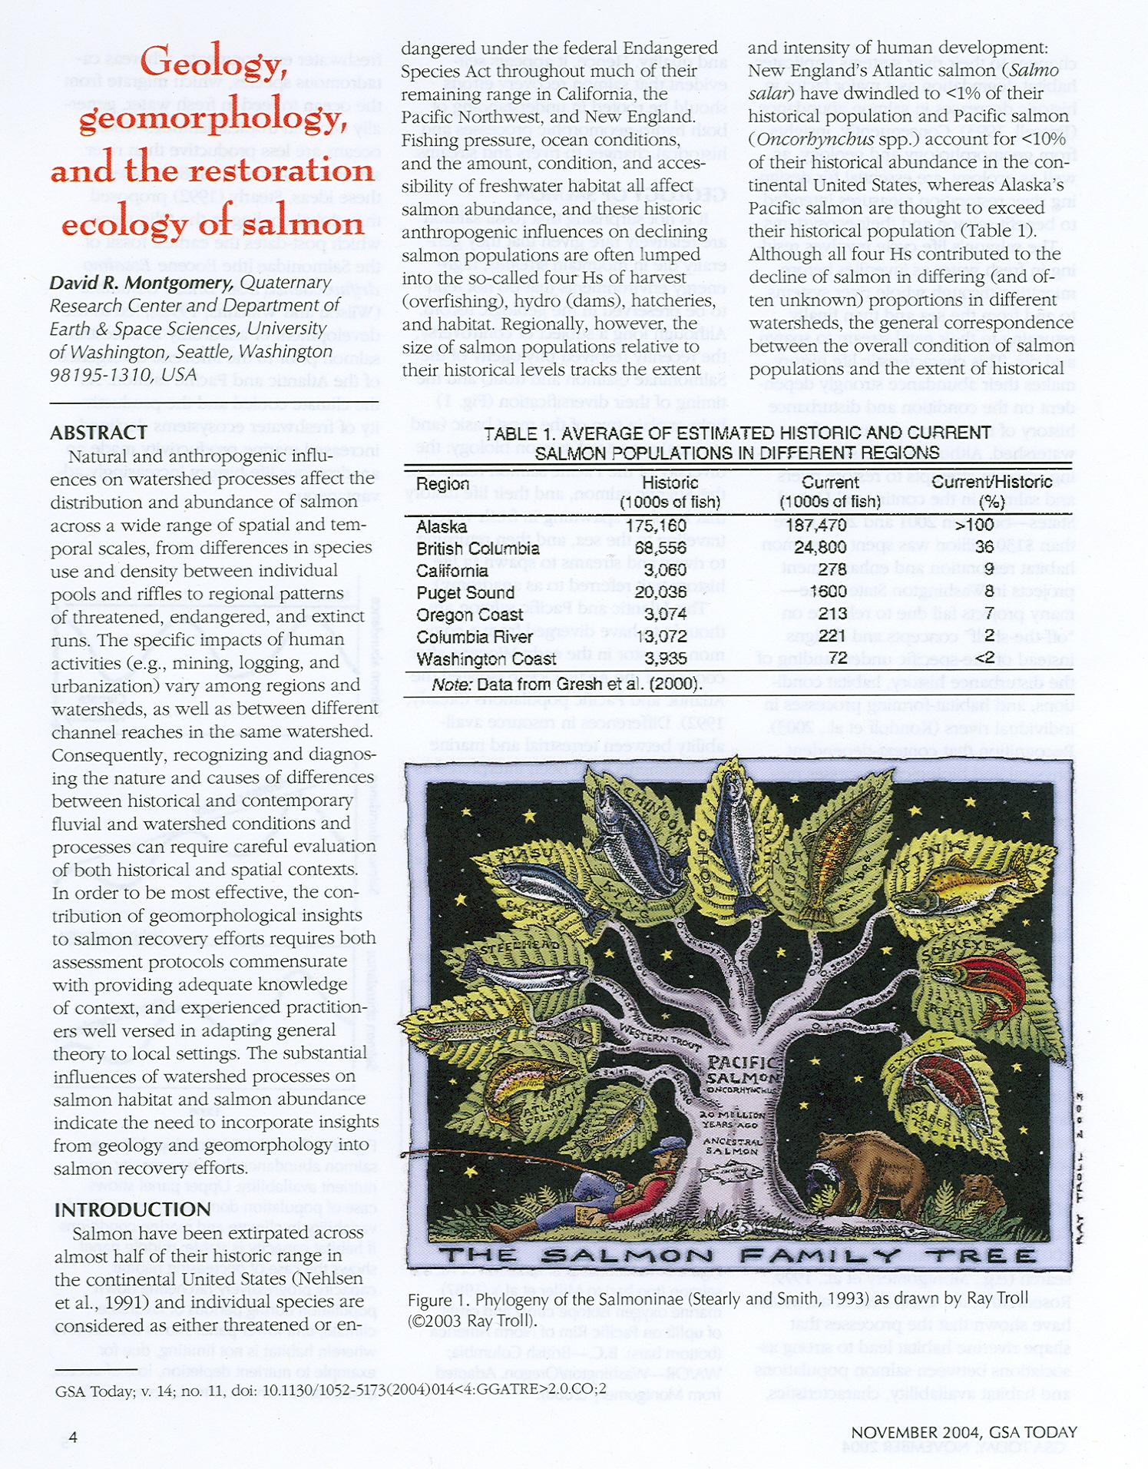
Influences

Slide 7
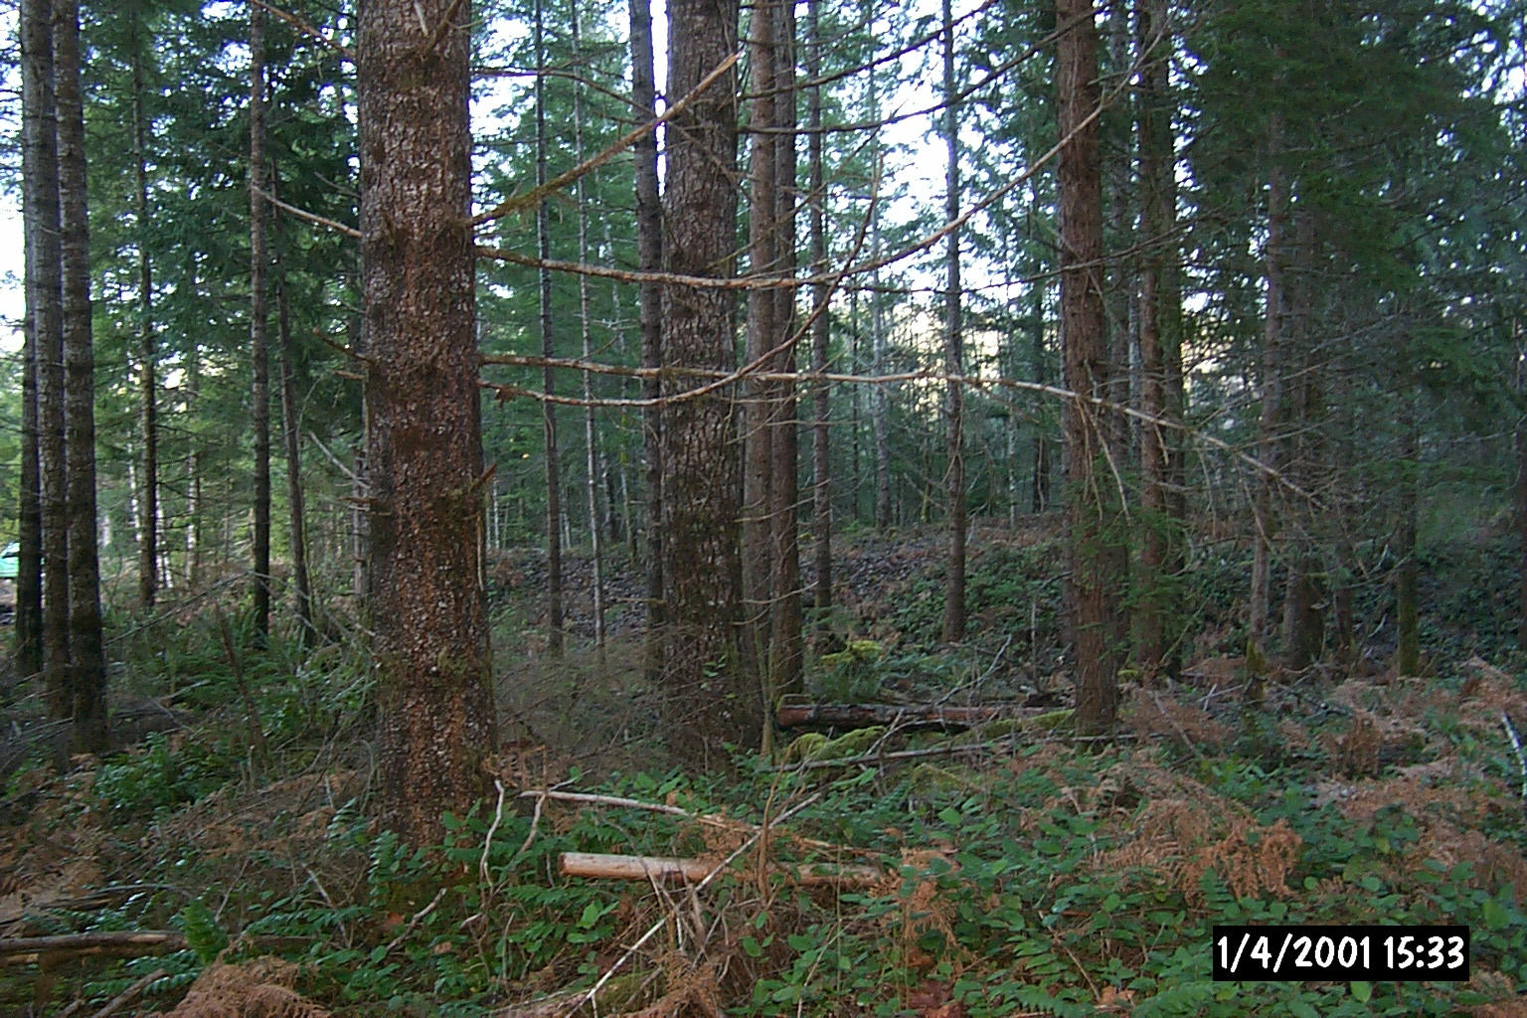
Desired Stand Outcomes

Slide 8
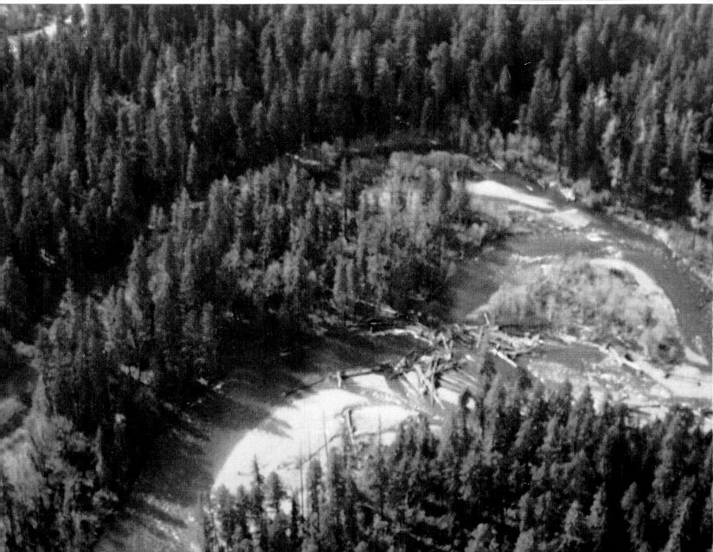
Desired Stream Outcomes

Slide 9
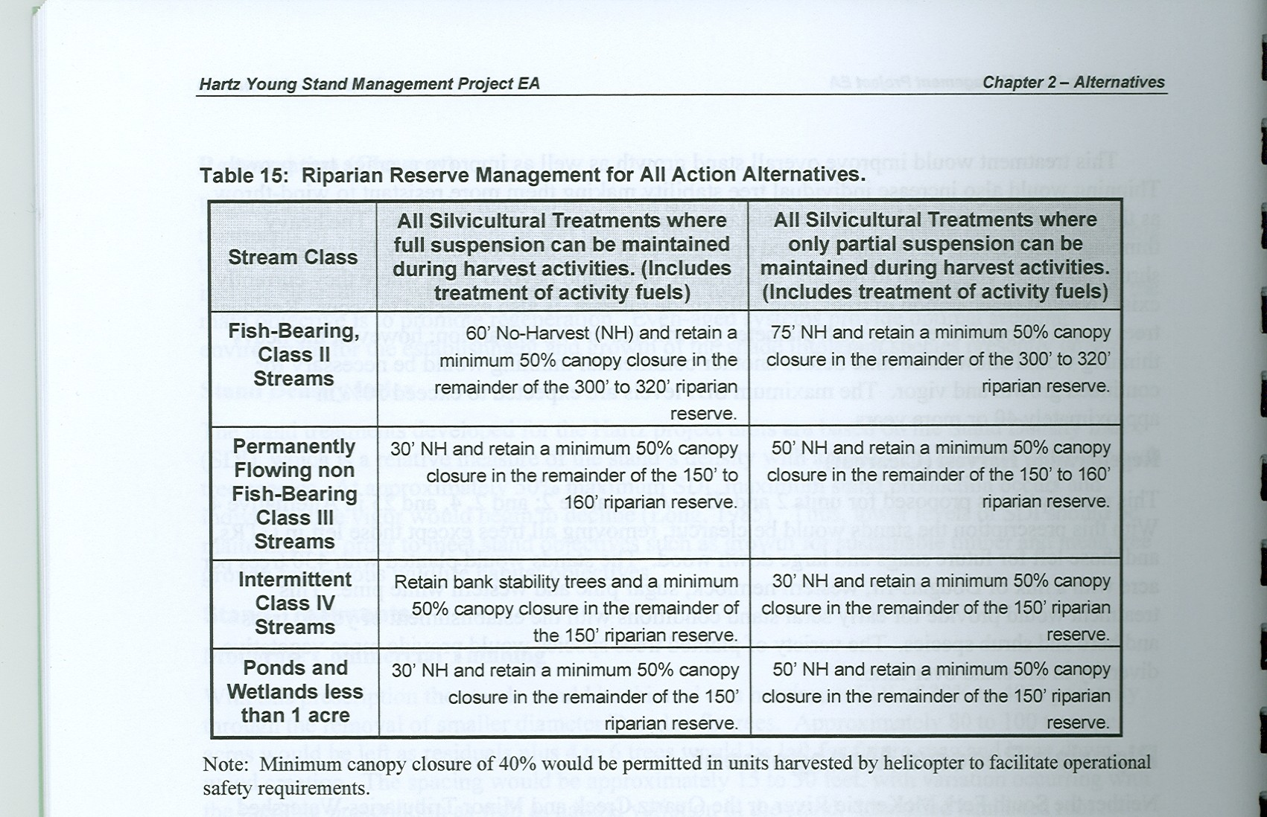
Our Design

Slide 10
What would we do differently?
More careful consideration of transport capability
More emphasis on gaps and patches and other diversity components such as variable density treatments
Better acknowledgement of the capability of modern harvest equipment and techniques
More balanced objectives

