Slide 1
Riparian Thinning:
Logic Paths for Silvicultural Prescriptions
Mt. Hood National Forest
Clackamas River Ranger District
Glenda Goodwyne, District Silviculturist
03/20/08

Slide 2
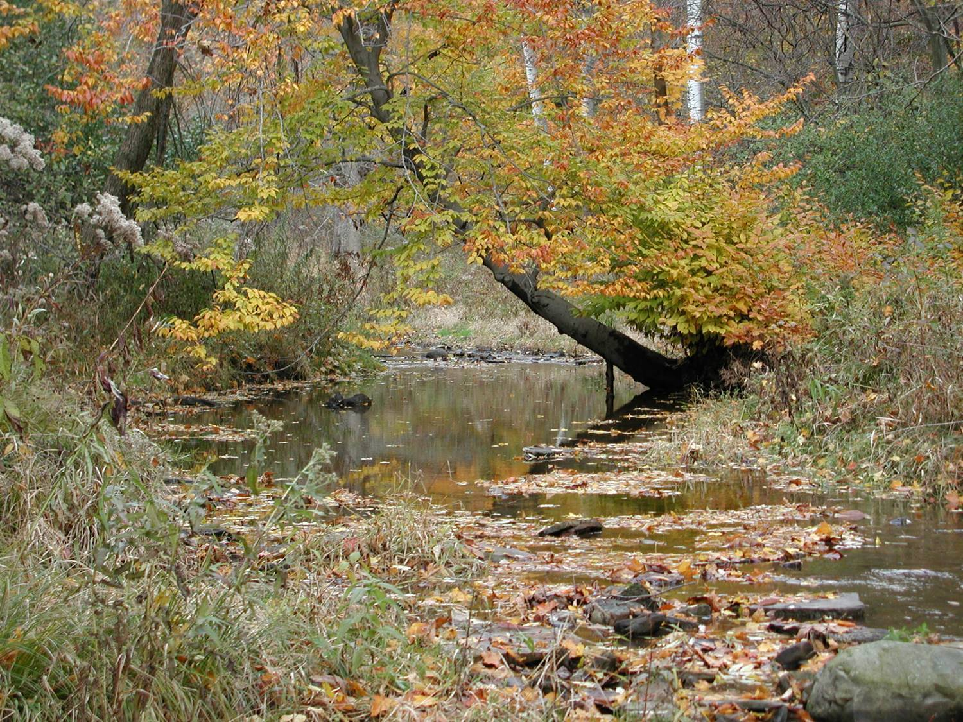
Riparian Condition Assessment
(project scale)
Bank stability
Pool: riffle ratios
Sediment levels
Presence/Absence of erosion
Stand density
Species/Size distribution
Stand health (overall)

Slide 3

Programmatic/Project
Goals and Objectives
Riparian/Silvicultural:
Improve habitat for aquatic & riparian-dependent species
Grow large trees, fast (for future large woody debris recruitment into channel and riparian environments)
Maintain/improve riparian health
Maintain stream temperatures
Enhance structural diversity and habitat complexity
Minimize soil and habitat disturbance
NLAA (Not Likely to Adversely Affect) Call
No deficit sales

Slide 4
Management and Guidance
Governing Bodies, Documentation, and Research:
Aquatic Conservation Strategy (ACS) Objectives
Forest Plan Standards & Guides
Clackamas Stewardship Partners (CSP)
NOAA Fisheries– Programmatic Biological Opinion (for low risk timber sales)
The Sufficiency Analysis for Stream Temperatures

Slide 5
Design Criteria Elements:
No-Cut Protection Buffers (along streams, ponds, seeps and wet areas considered skips)
No-Equipment Buffers
Variable Density Thinning (in-stand as well as between –stand diversity)
Gaps (created w/in RRs but outside protection buffers, 1/10 to ¼ acre in size)

Slide 6
Design Criteria Elements:
Minimum Stream Protection Buffer Widths by Type and Proximity to Listed Fish Habitat (LFH)
Adjacent to LFH habitat | Within 1 mile of LFH on Perennial and Intermittent Streams | > 1 mile upstream from LFH Perennial Streams | > 1 mile upstream from LFH Intermittent Streams
Maintain a minimum 100’ buffer | Maintain a minimum 50’ buffer | Maintain a minimum 50’ buffer | Maintain a minimum 50’ buffer
Primary and secondary shade zone protection, maintain 50 % canopy cover (CC) | Primary shade zone protection | Primary shade zone protection | Primary shade zone protection, normally 30’ buffer (CSP) 50’

Slide 7
Meeting the Objectives on the Ground
The Silvicultural Prescription:
Designed to increase stand growth, vigor and resiliency
Analyze Stand Data
Determine Residual Stand Characteristics
Determine the appropriate BA/RD
Use Designation by Description (DXD)

