Slide 1
Assumptions behind thinning young stands to create late successional riparian habitat
Characteristics of unmanaged riparian vegetation
Plantations in riparian zones
What does the NWFP say?
Perspectives on thinning in riparian zones

Slide 2
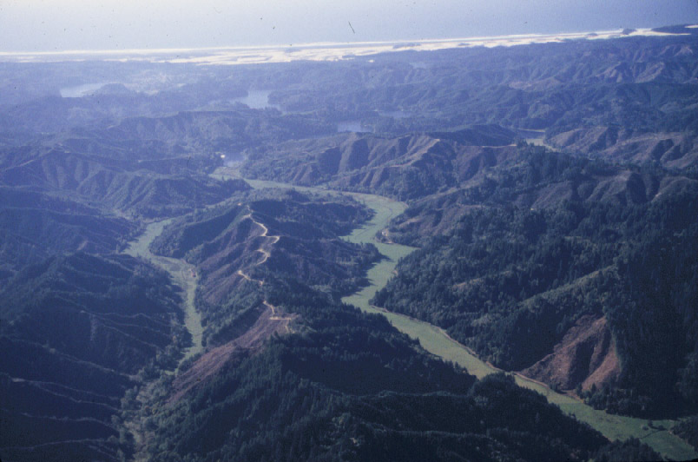

Slide 3
What do we know about Riparian Vegetation relative to uplands
Interactions with stream
Higher spatial heterogeneity
Greater proportion of deciduous cover
Edge dominated
More dynamic
Structured by geomorphic template

Slide 4
Riparian Zones:
Diverse vegetation on a variable and dynamic substrate

Slide 5
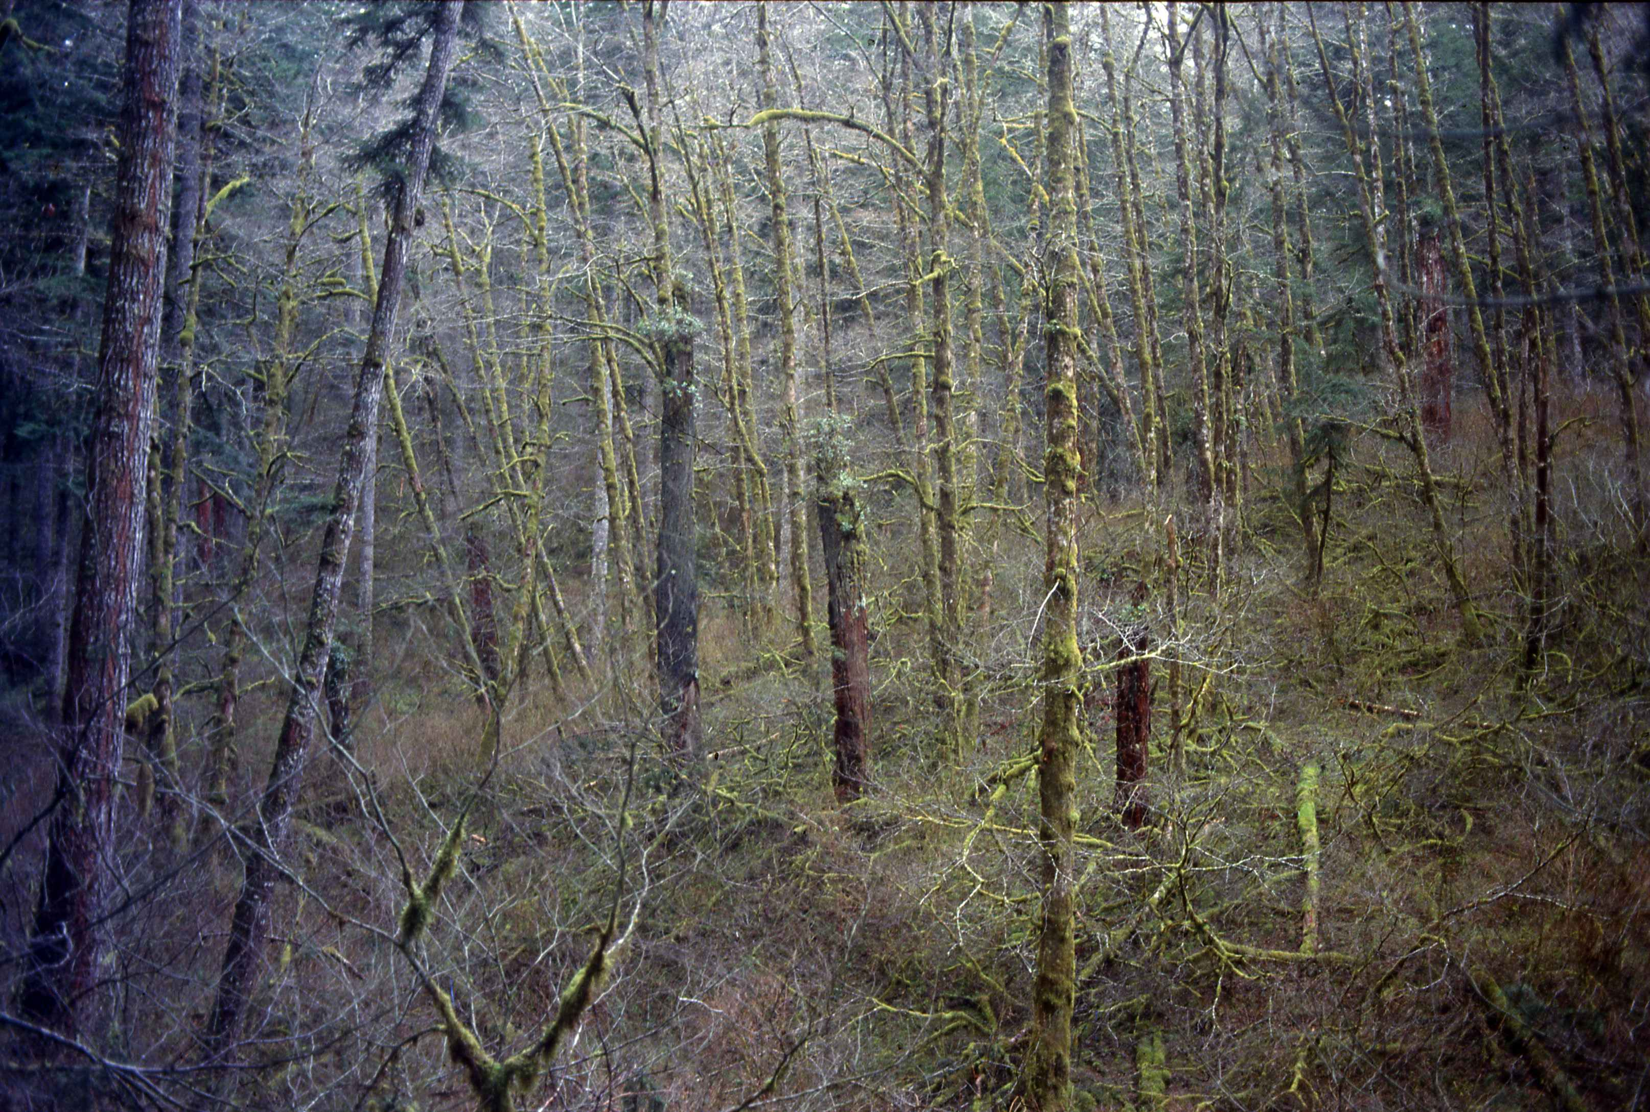
Mature Hardwood-Conifer Riparian Stand

Slide 6
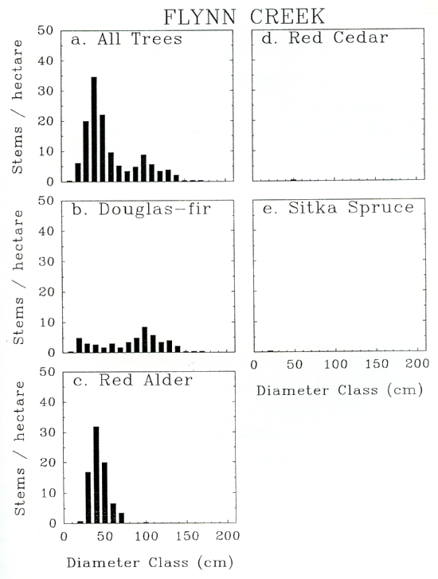
Range of size of trees
Reflects disturbance
history
Fires in 1850, 1868,
Mid 1880s

Slide 7
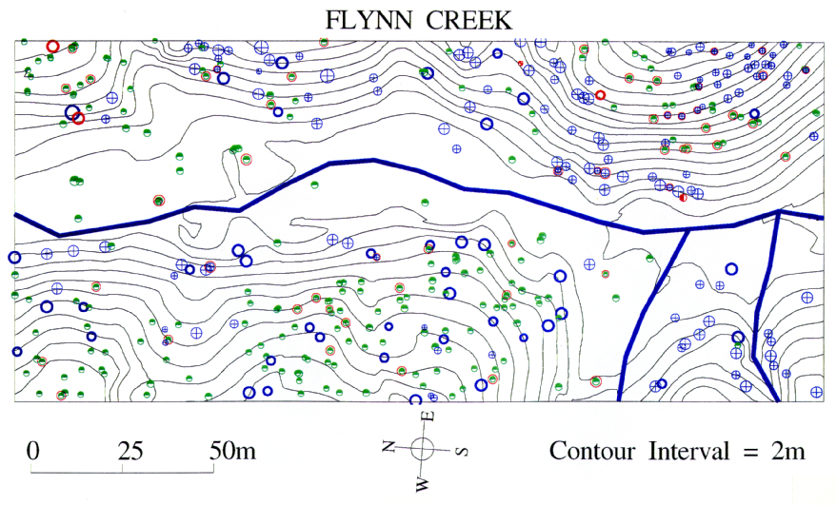
Spatial pattern a mature conifer hardwood riparian stand
THPL
PSME
ALRU

Slide 8
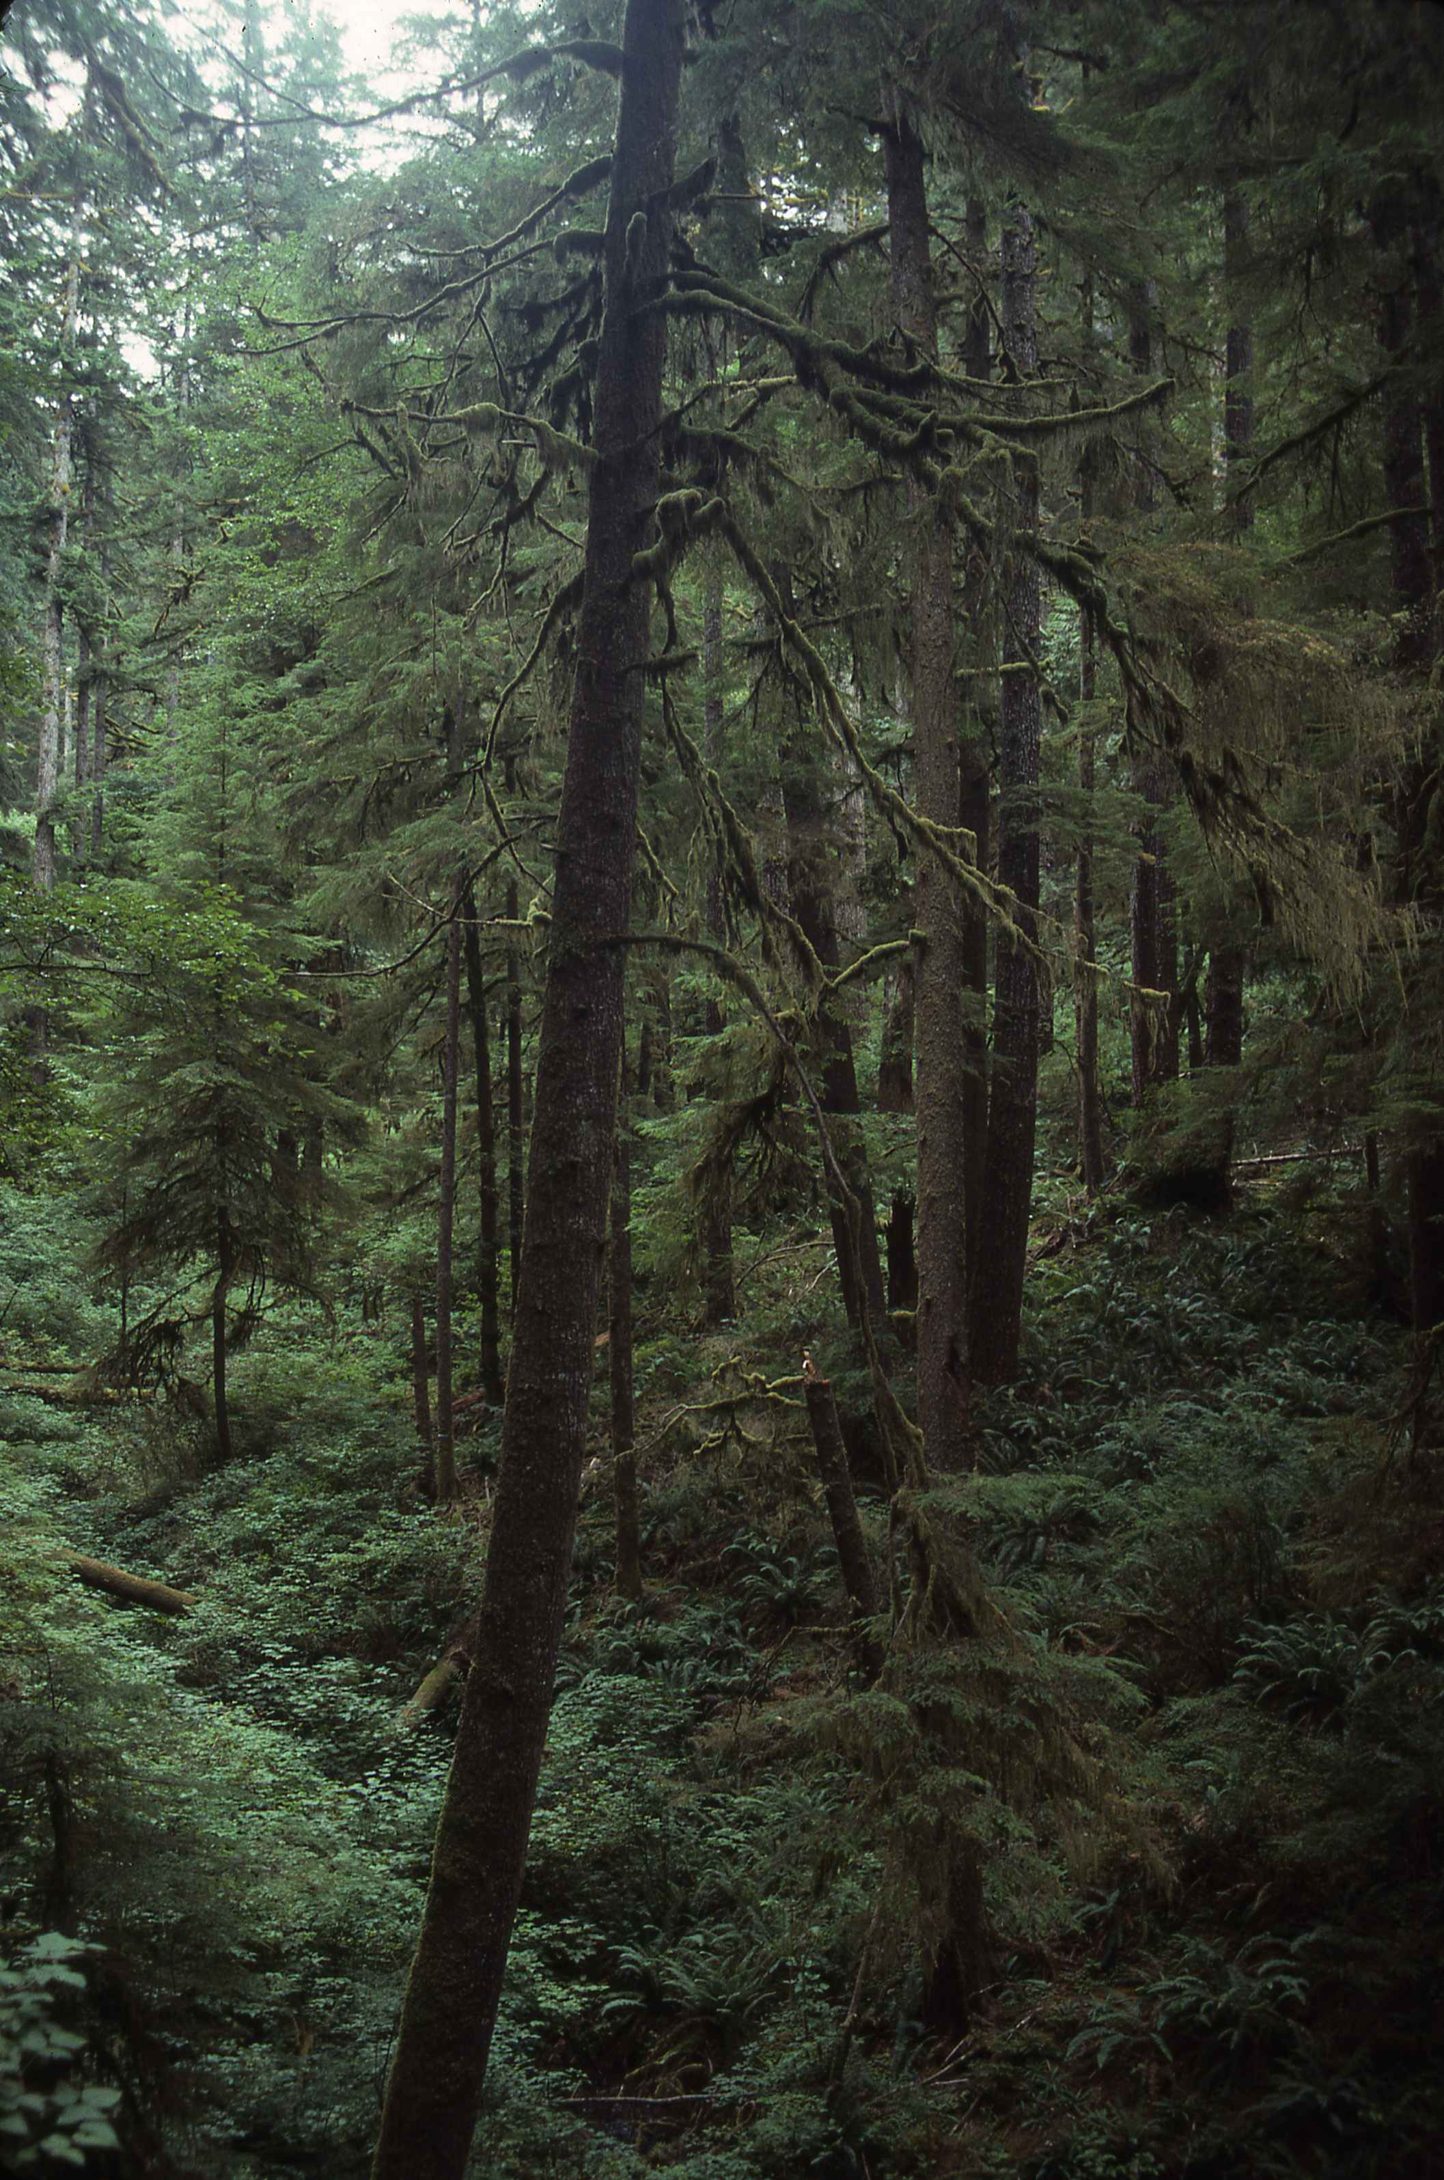
Mature/Old Growth Conifer
Riparian Stand

Slide 9
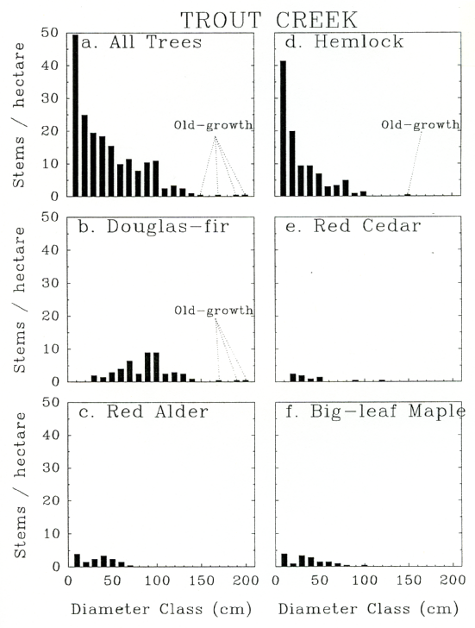
Old-growth remnants in a
Mature Stand

Slide 10
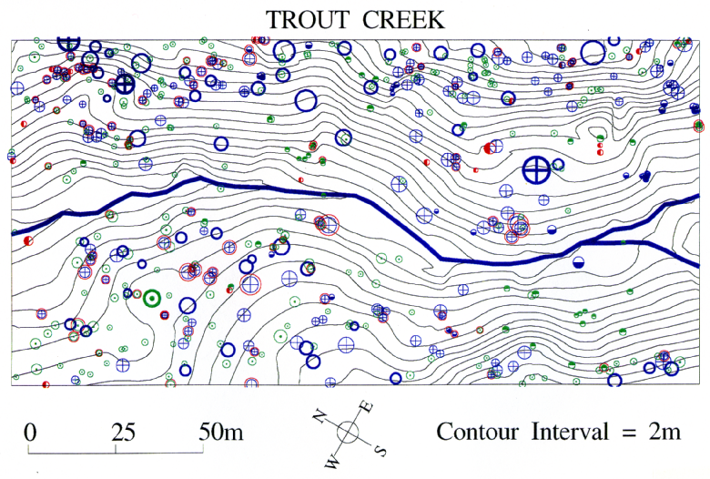
Spatial Pattern in a Mature/old Growth Riparian Stand
PSME
TSHE

Slide 11
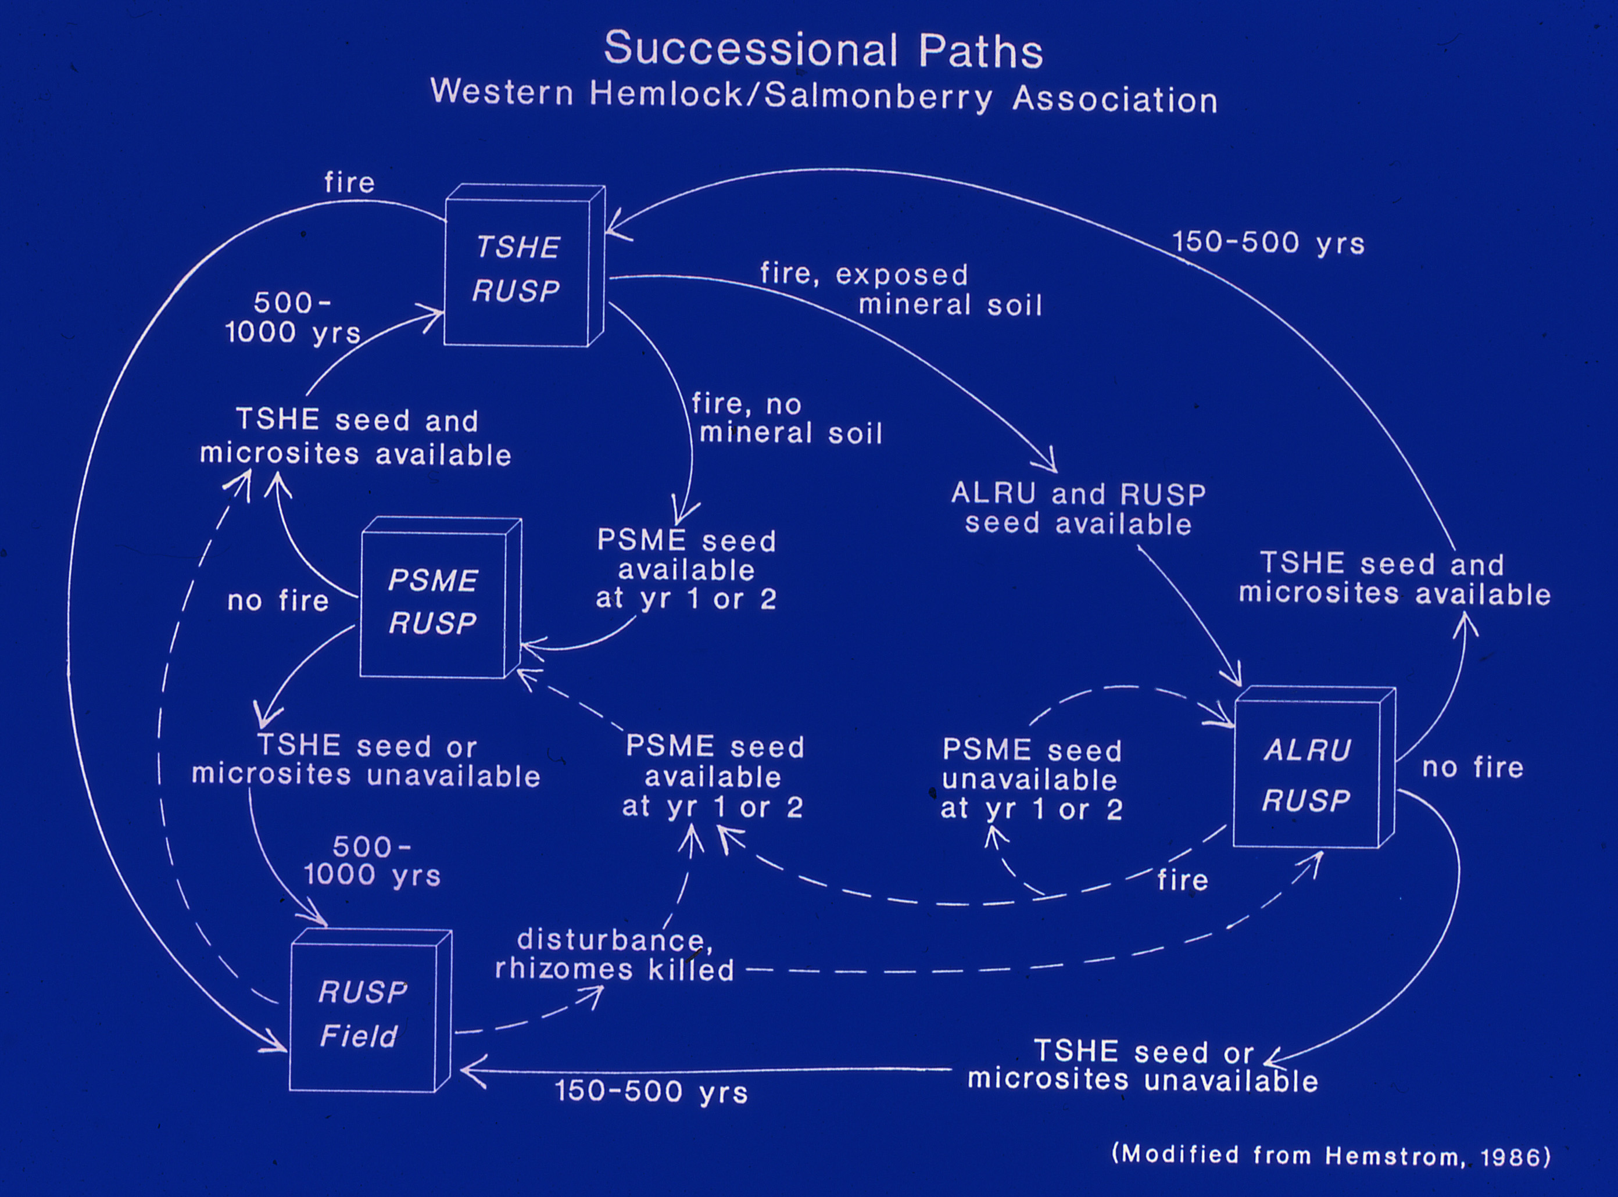
Successional Pathways in Riparian Zones in Coast Range

Slide 12
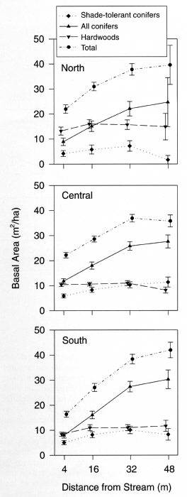
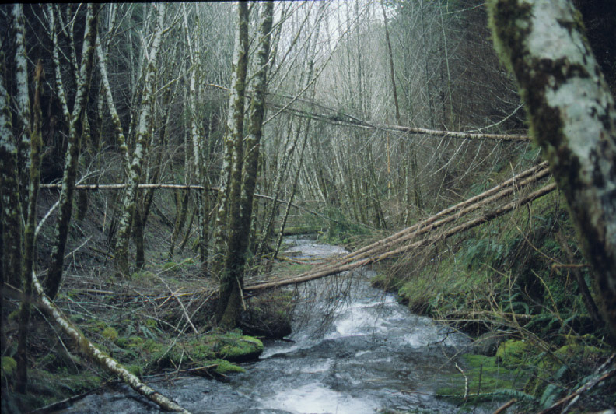
Conifer Basal Area Across Coast Range Increases with Distance from Streams

Slide 13
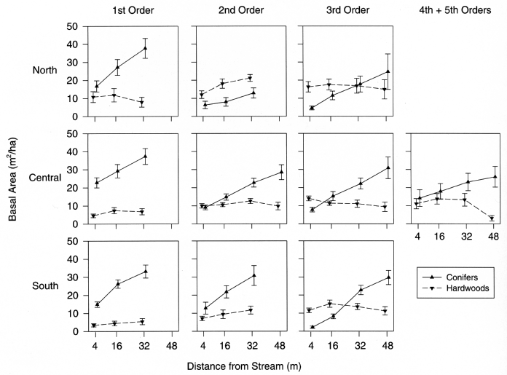
Conifer basal area is highest in low-order drainages

Slide 14
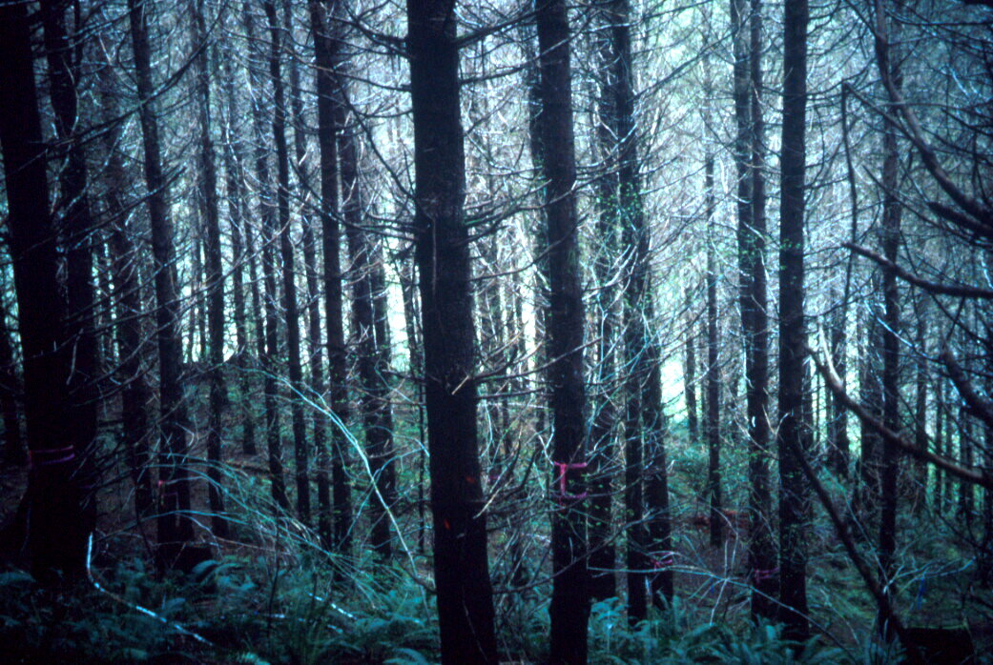
Plantations—What do we really know?

Slide 15
SIUSLAW MANAGED STANDS
35,000
Comm. thin
PCT
Stem exclusion stage, little understory veg
Canopy closure,begin crown recession
Small, open canopy
30,000
25,000
20,000
Acres
15,000
10,000
5,000
-
51 to yr
11 to 15yr
6 to 10yr
46 to 50yr
41 to 45yr
36 to 40yr
31 to 35yr
26 to 30yr
21 to 25yr
16 to 20yr

Slide 16
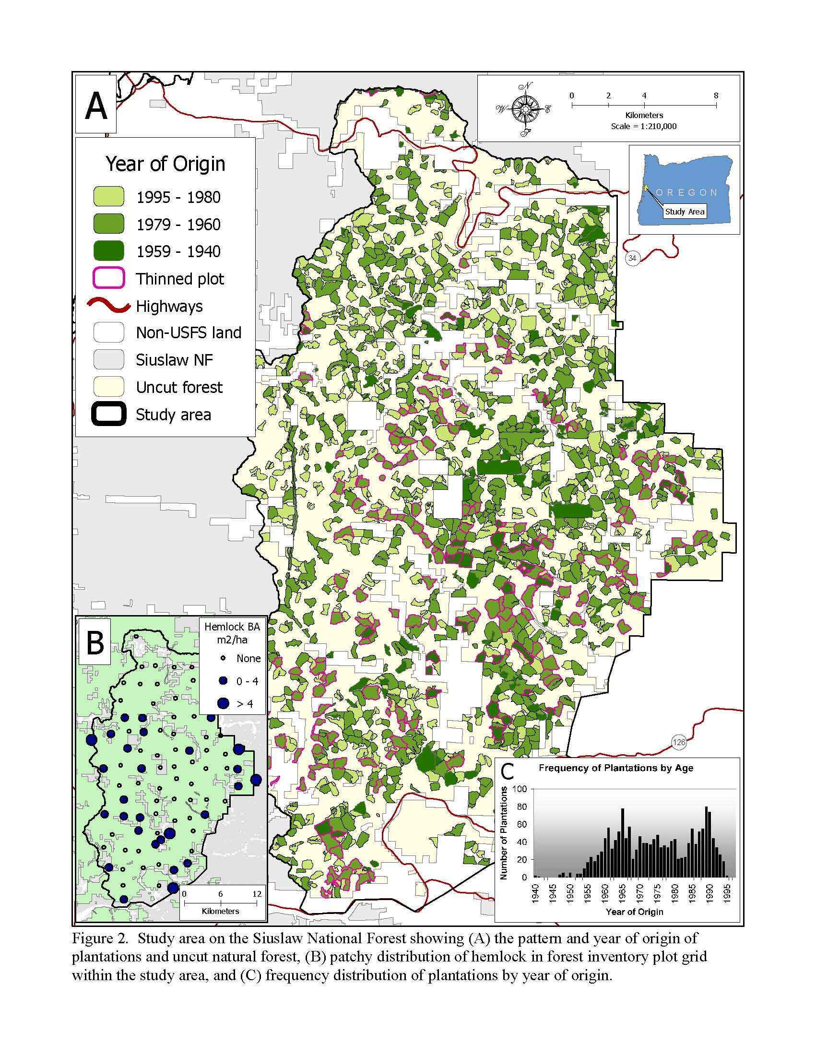
Distribution of Plantations
In a Late Successional
Reserve in Coastal Oregon

Slide 17
Hypothetical Range of Variation in Unmanaged
Riparian Vegetation and Conifer Plantations
Hardwood
Unmanaged
Riparian Vegetation
Canopy composition
Plantations <40 years old
Conifer
small
Canopy Tree Size
large

Slide 18
Average stand diameter vs age in old growth
and in plantations of different densities
100
80
Old Growth Stand
Low density
60
Plantations
Diameter (cm)
40
High density
20
0
0 20 40 60 80 100
Age (years)
Tappeiner et al. 1997

Slide 19
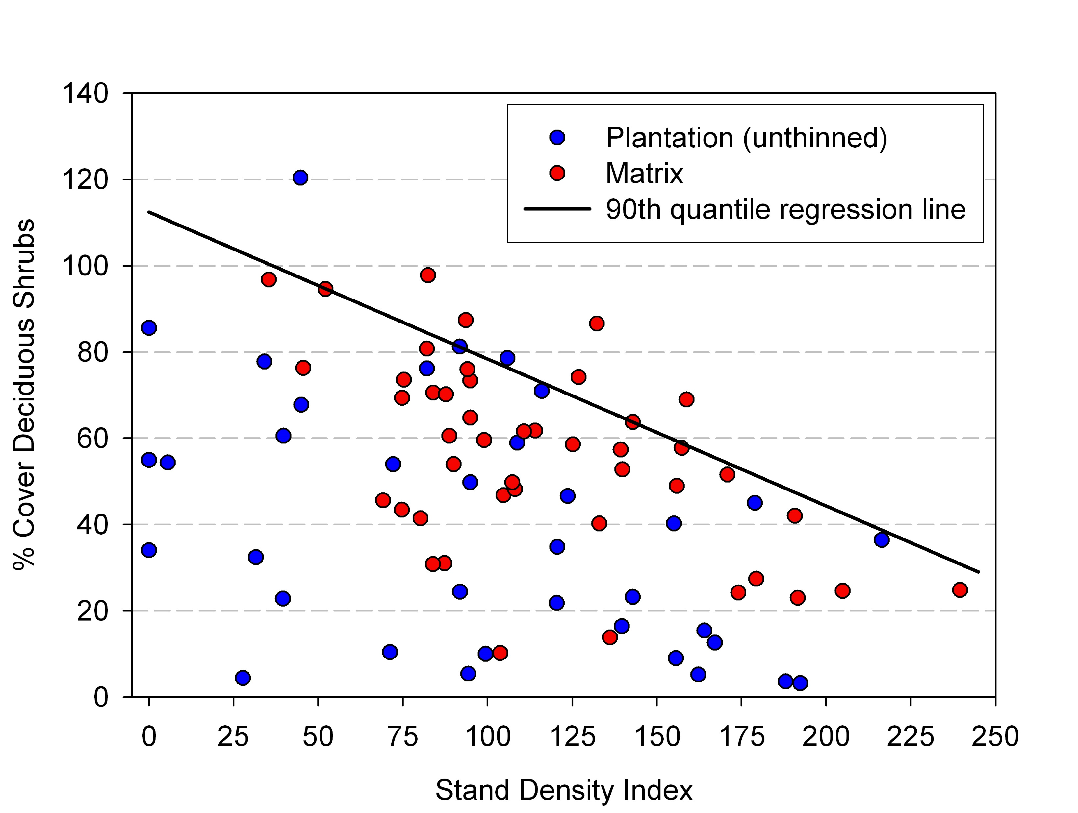
High Stand Densities Limit Deciduous Shrub Cover

Slide 20
What Does the NWFP Say About Riparian Reserves?
Maintain and restore species composition and structural diversity of plant communities
Functions
Habitat for riparian dependent communities
Thermal regulation
Erosion control
Wood debris inputs
Spatial and temporal connectivity within and between watersheds

Slide 21
Standards and Guides
Prohibit timber harvest, except as described below:
Allow salvage and fuelwood cutting if required to attain ACS objectives
Apply silvicultural practices for Riparian Reserves to control stocking, reestablish and manage stands, and acquire desired vegetation characteristics needed to attain ACS objectives

Slide 22
Why Thin in Riparian Areas?
Bigger trees both sooner and in the long run
Accelerate understory vegetation development
Deciduous shrubs
Shade tolerant regeneration
Increase greater spatial heterogeneity at stand level

Slide 23
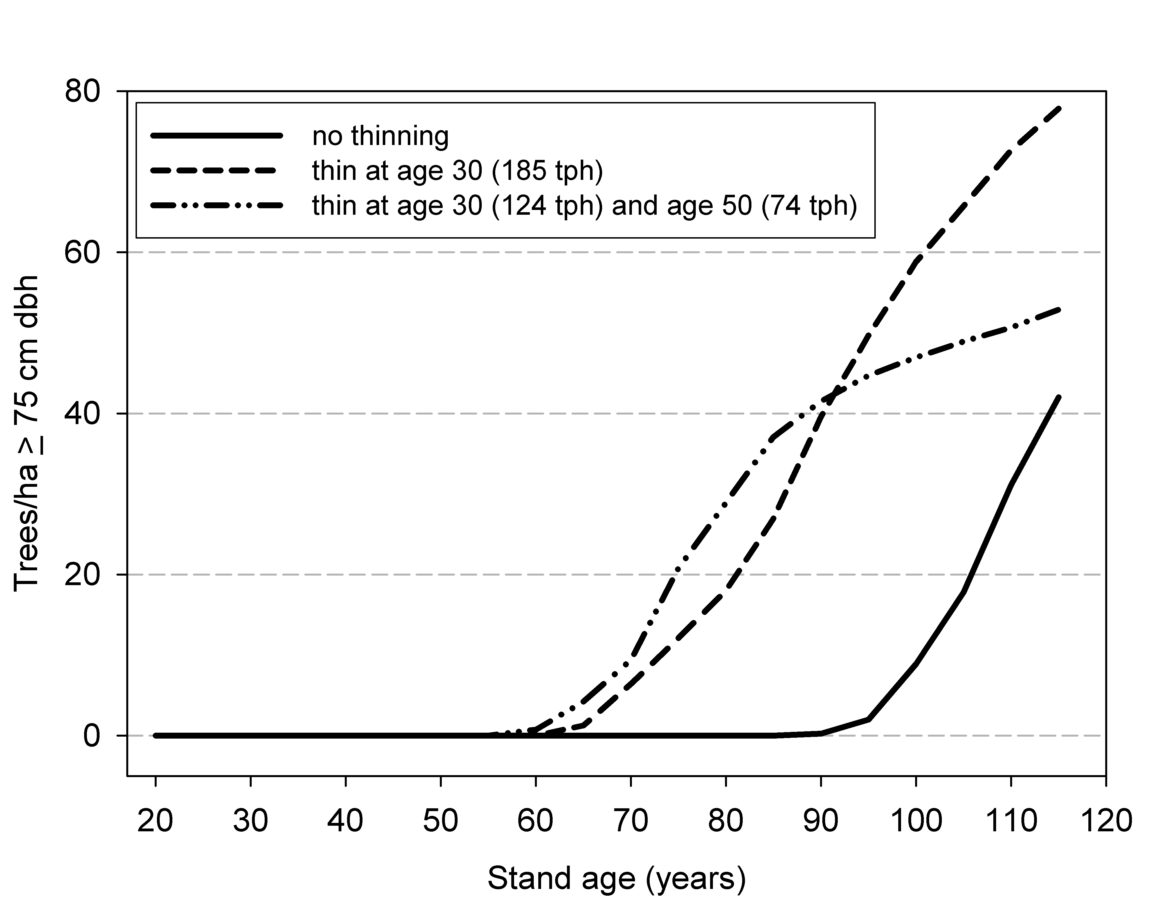
Simulated Effects of Thinning and No Thinning on
Density of Large Conifers

Slide 24
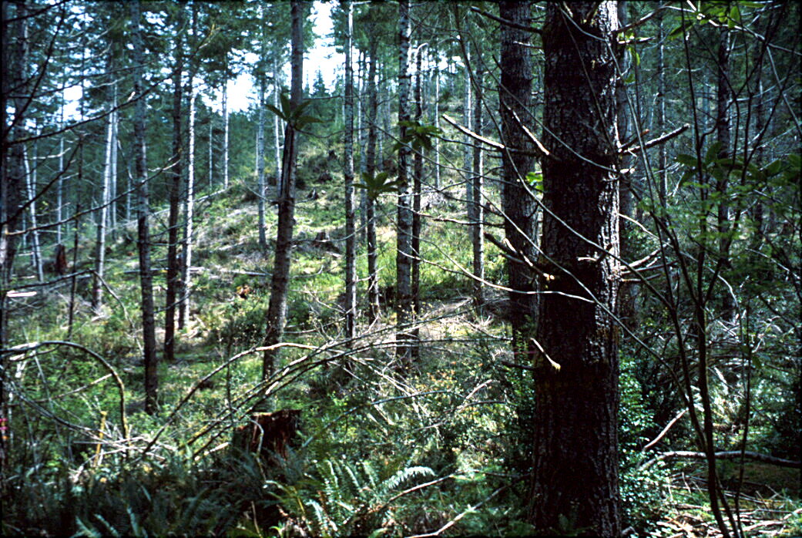
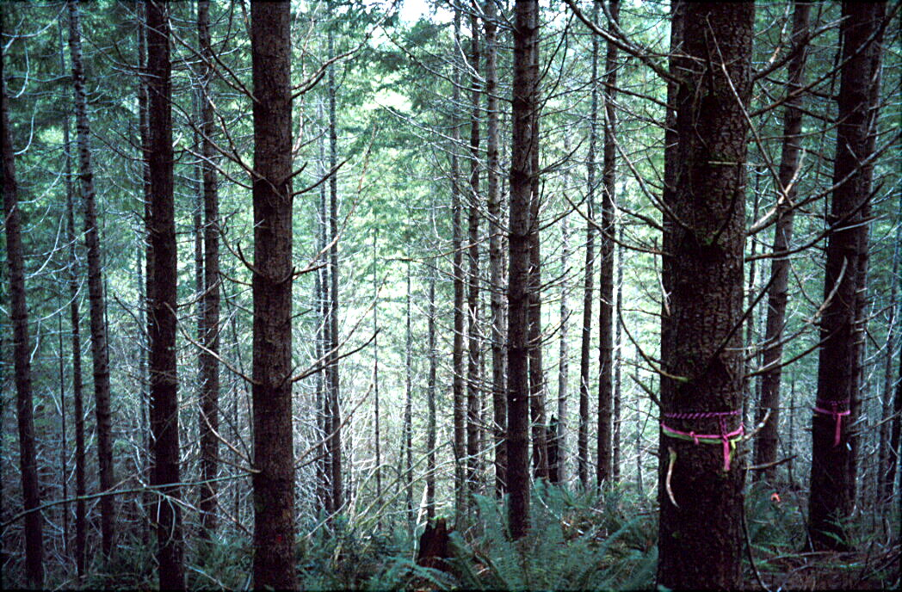
60 TPA
Variable Densities
100 TPA

Slide 25
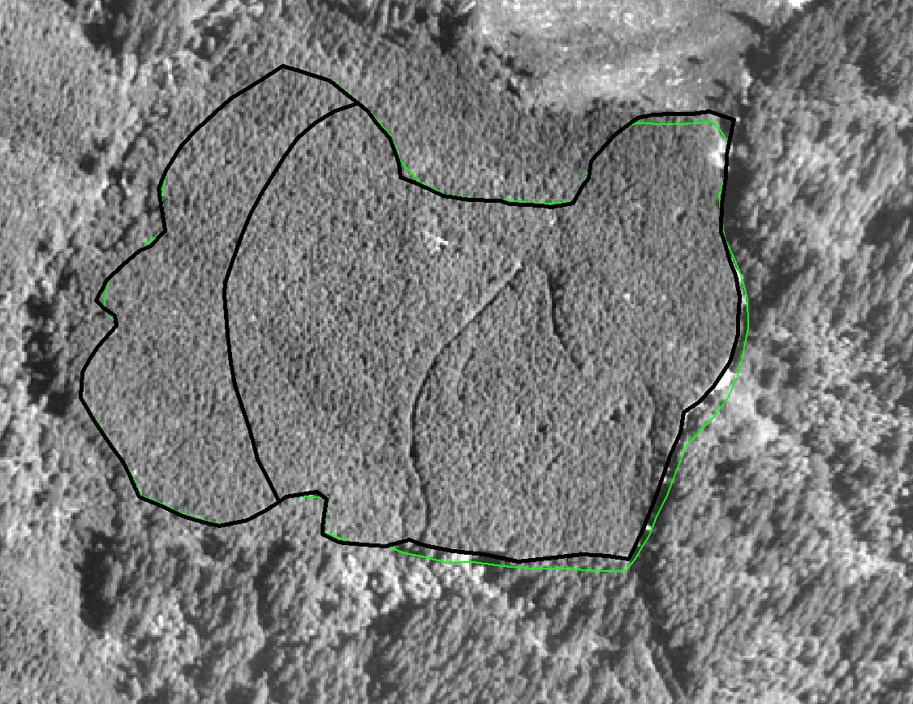
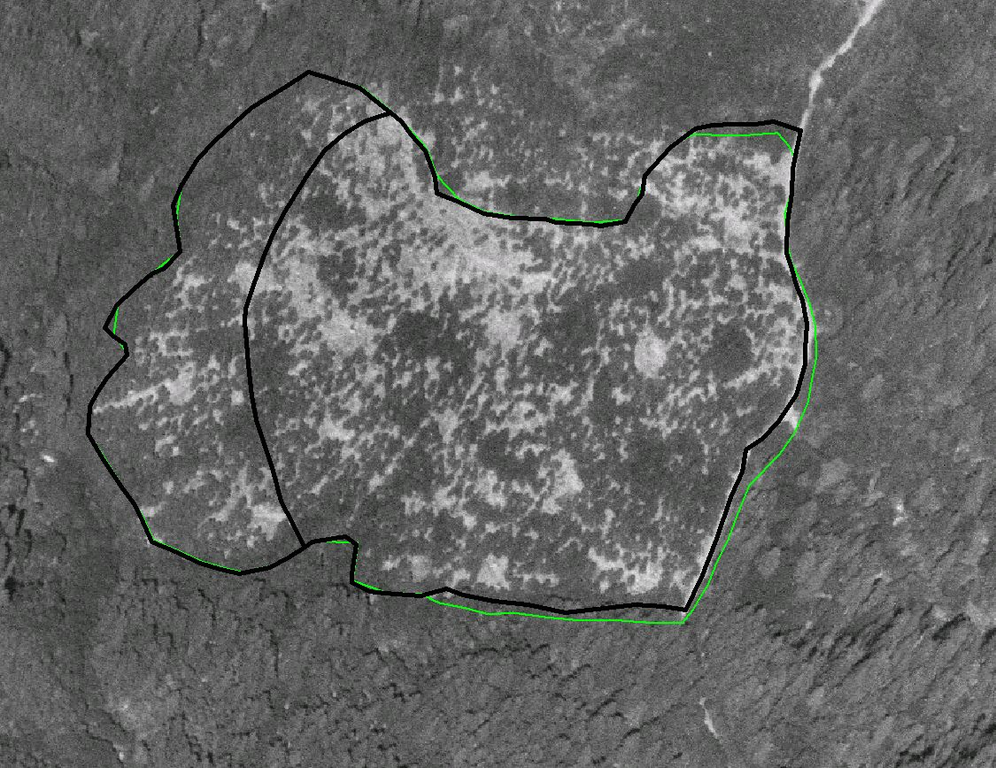
Diversification of young plantations using variable density
Thinning

Slide 26
Characterizing Objectives
Stand Level
Densities
Spatial patterns
Species composition
Short-term and longer term
Landscape level
Proportions of different types
Spatial patterns

Slide 27
Some guidelines
Increase spatial heterogeneity
Prioritize densest stands first (not all stands may need thinning)
Don’t thin uniformly
Use combination of heavy thin, moderate thin, light thin, no thin within same stand
Work with existing heterogeneity (e.g. hardwoods, shrubs)
Don’t use same approach on all stands

Slide 28
Conclusions
Unmanaged riparian vegetation differs from uplands in many ways
More hardwoods
Lower BA and stocking of conifers
More shrubs
More dynamic
More heterogeneous
Vary with size of stream

Slide 29
Conclusions
Plantations differ from unmanaged riparian vegetation
More uniform
More conifers
Smaller trees
Less shrubs and hardwoods
Less potential for big tree development
Plantations are not all the same

Slide 30
Conclusions
Thinning in riparian zones can accelerate big trees and shrub layer development
Use variable density approach
Not all plantations suitable for thinning
Prioritize based on stand and landscape level considerations
Need more monitoring

