Slide 1
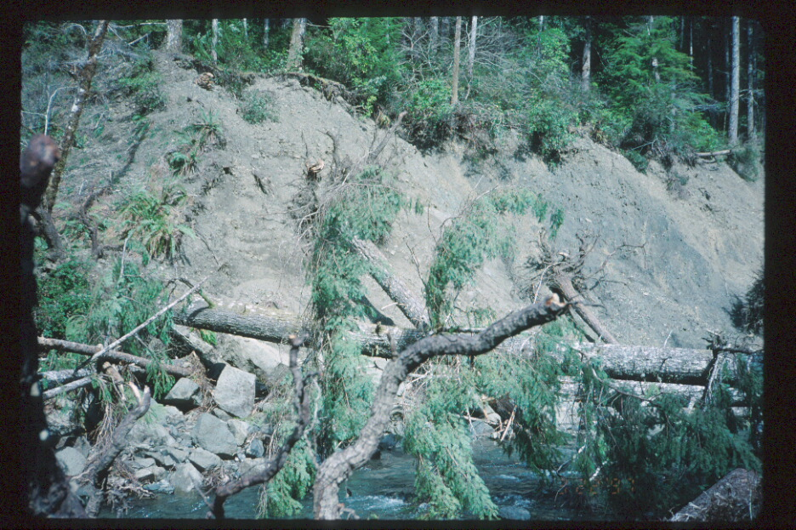

Slide 2
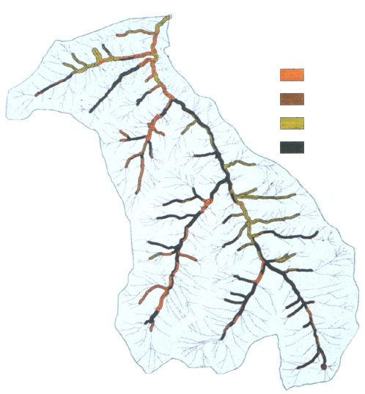
Pre-ACS
Buffers

Slide 3
“Sources” of Large Wood
Murphy & Koski | 1989 | AK
Robison & Beschta | 1990 | AK
McDade et al. | 1990 | OR
Lienkaemper & Swanson | 1987 | OR
Van Sickle & Gregory | 1990 | Model

Slide 4
Consideration of Upslope Sources of Large Wood
Murphy & Koski | 1989 | AK | 14% of total amount
Robison & Beschta | 1990 | AK | Not considered
McDade et al. | 1990 | OR | Not considered
Lienkaemper & Swanson | 1987 | OR | Not considered
Van Sickle & Gregory | 1990 | Model | Not considered

Slide 5
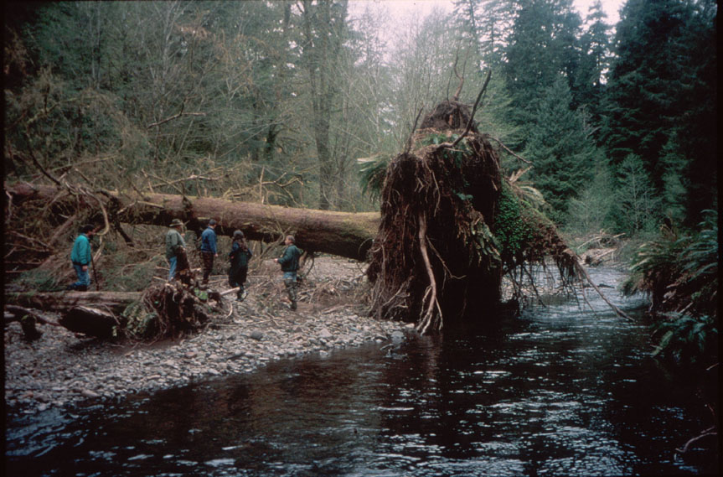

Slide 6
Dynamic Aspects of Aquatic Ecosystems in the ACS
“At the heart of this approach (the ACS) is the recognition that fish and other organisms evolved within a dynamic environment that has been constantly influenced and changed by geomorphic and ecologic disturbance.” p. V-29

Slide 7
Dynamic Aspects of Aquatic Ecosystems in the ACS
“To maintain community viability throughout a large drainage basin, it is necessary to maintain features of the natural disturbance regime (i.e., frequency, distribution, and magnitude.” p. V-13
“Wood enters streams inhabited by fish
either directly from the adjacent riparian zone or from tributaries that may or may not be inhabited by fish, or hillslopes.” p. V-13

Slide 8
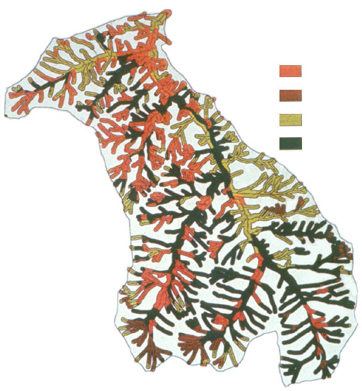
ACS Buffers

Slide 9
Science concerning small streams since NWFP
Sources of sediment: (e.g., Benda & Dunne 1997)
Sources of wood (e.g., Reeves et al. 2003; Benda et al. 2002,2003)
Sources of food/nutrients for fish-bearing streams (Kittrey et al. 2002; Wipfli & Gregorovich 2002; Gomi et al. 2002)
Amphibian biodiversity ‘hot spots’ (e.g., Kelsey & West 1998)

Slide 10
Science concerning small streams since NWFP
Sources of sediment: (e.g., Benda & Dunne 1997)
Sources of wood (e.g., Reeves et al. 2003; Benda et al. 2002, 2003)
Sources of food/nutrients for fish-bearing streams (Kittrey et al. 2002; Wipfli & Gregorovich 2002; Gomi et al. 2002)
Amphibian biodiversity ‘hot spots’ (e.g., Kelsey & West 1998)

Slide 11
Sources of Large Wood in Cummins Creek
Source | % of Total Volume
Stream Adjacent Riparian | 52
Upslope | 48

Slide 12
Percent of Wood Volume Delivered from Streamside and Upslope Sources in Different Sections of Cummins Creek, OR
100
Upslope
Streamside
80
60
% of Wood
Volume
40
20
0
KM
1
KM
2
KM
3
KM
4
KM
5
KM
6
KM
7
KM
8
KM
8.7
Section
From: Reeves et al. 2003. Sources of wood in a fourth order watershed in coastal Oregon. Canadian Journal of Forest Research..

Slide 13
Debris-flow Model for the Oregon Coast Range: Initiation, Runout, and Deposition
Initiation
Scour
Runout
Transport
Deposition
0 0.5km
Notes:
We developed an empirical model that estimates probabilities of debris-flow initiation, runout, and deposition for the Oregon Coast Range.

Slide 15
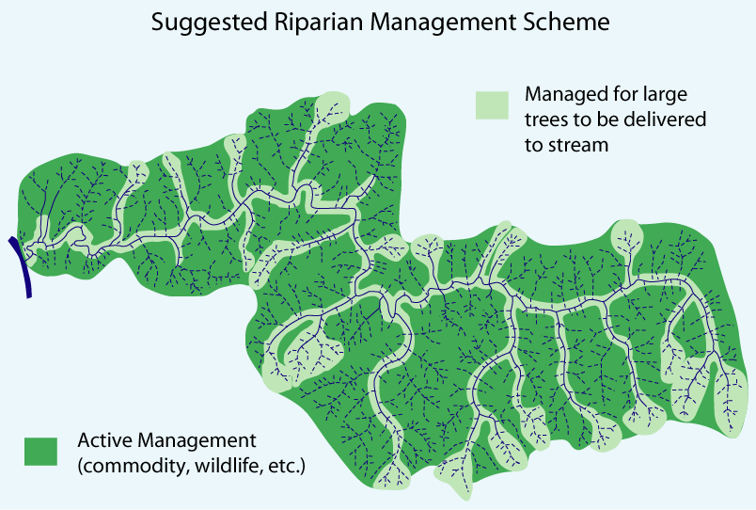

Slide 16
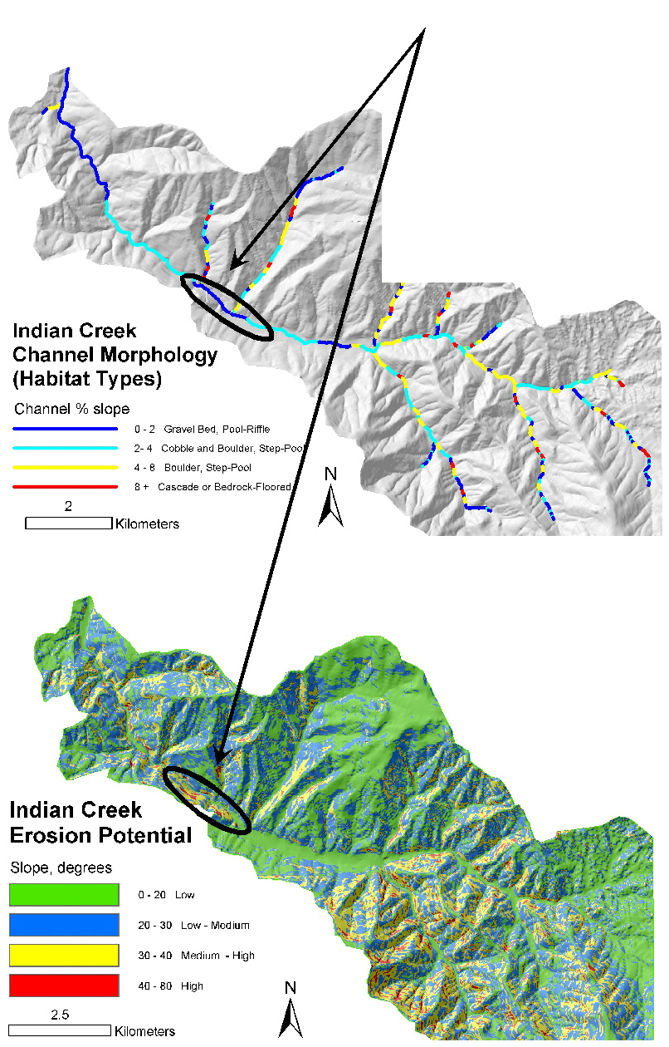
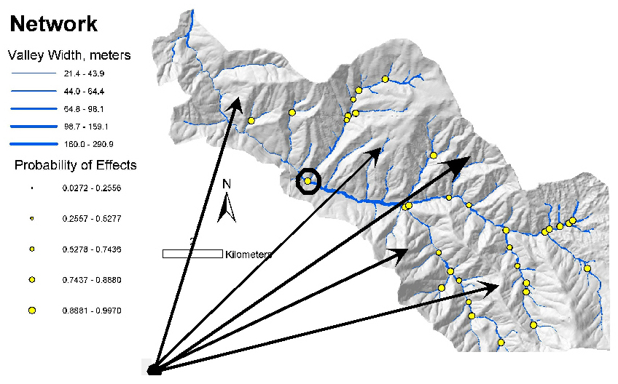
Timber Harvest Planning: Indian Creek Example
Less Intensive Forestry
Intersection of high-quality fish habitat (low-gradient channel, larger floodplains, junction effect and canyon transition), and steep, erosion-prone slopes adjacent to channel
More Intensive Forestry

Slide 17
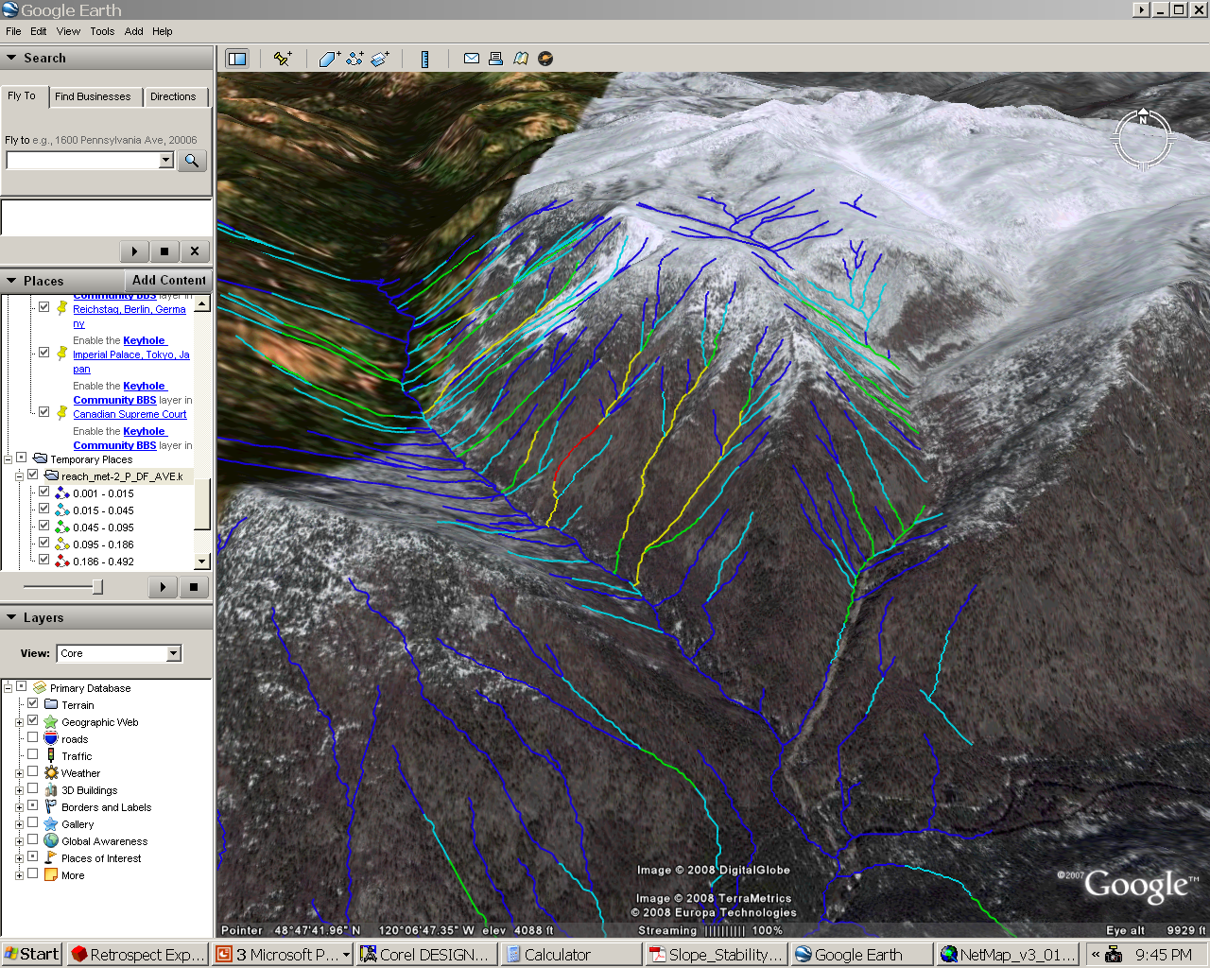

Slide 18
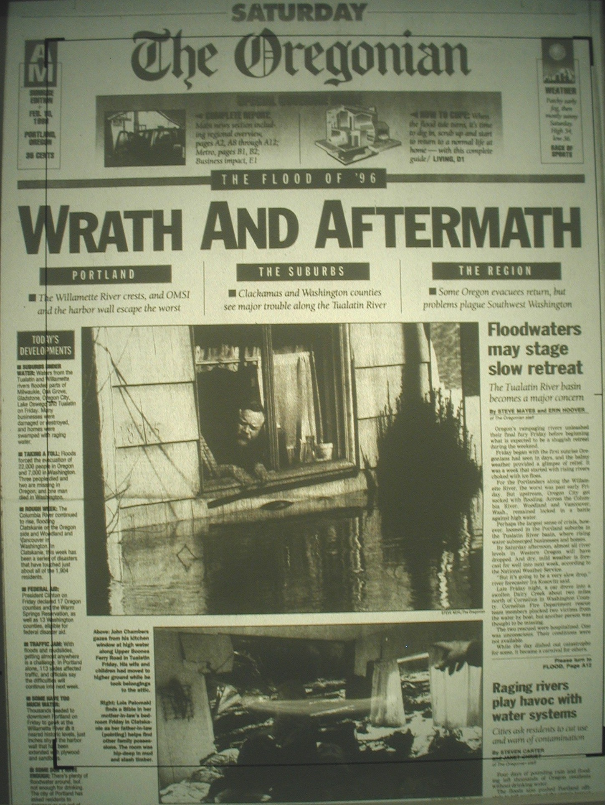
Sometimes High Intensity Trauma
Happens
L.M. Reid

Slide 19
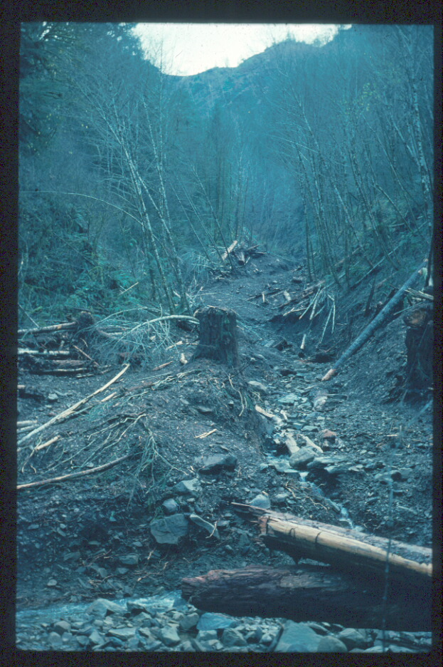
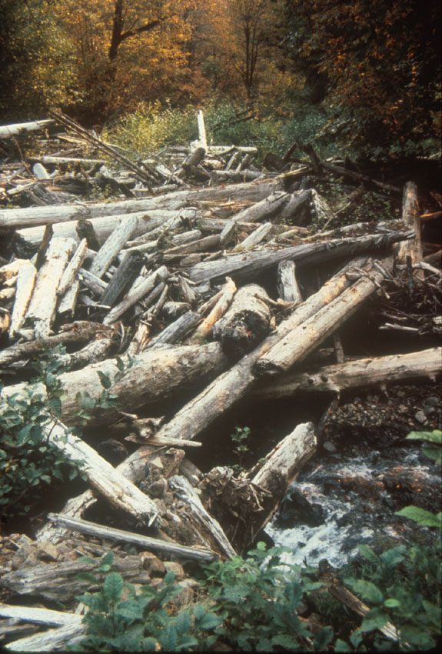

Slide 20
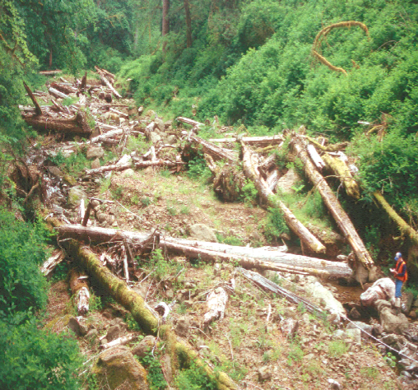
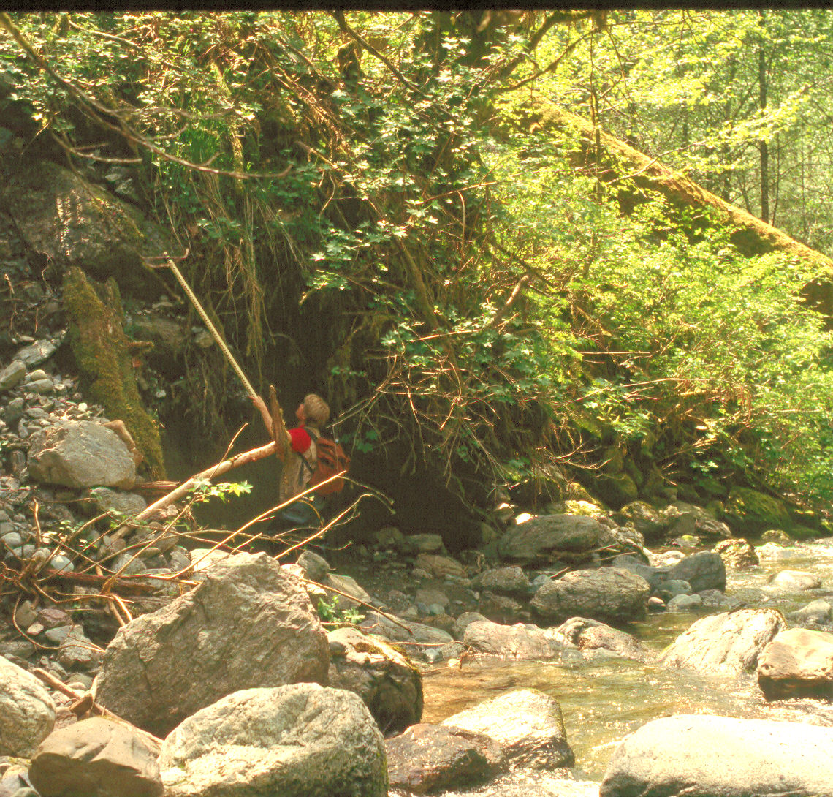
Effects on Larger Channels
Short-term Negative
Long-term Constructive

Slide 21
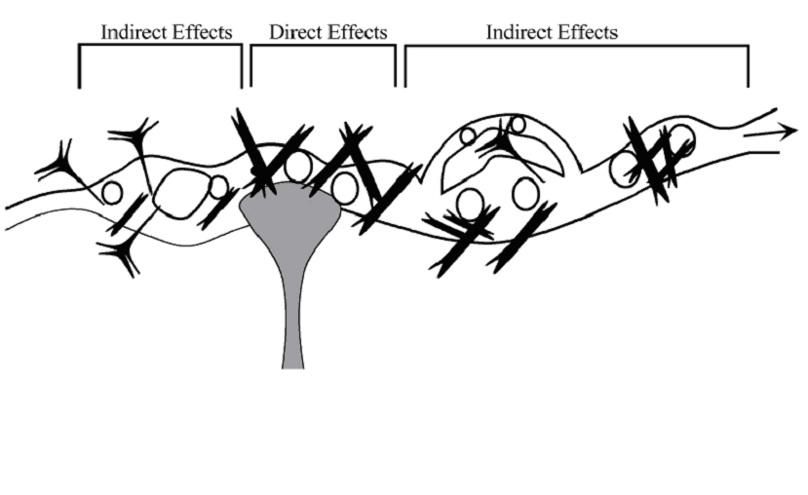
Direct and Indirect Effects
Debris
Fan
Upstream
Increased storage
of sediment and wood
Downstream
Increased transport
of sediment and wood
(Benda et al. GSA Bull. 2003)

Slide 22
Recruitment Flux of Large Woody Debris
FIRE
(500-yr cycle)
7
6
5
Large Woody Debris Flux
4
FIRES
(150-yr cycle)
3
2
1
0
0
100
200
300
400
500
600
700
800
Year
From: Benda and Sias 2003

Slide 23
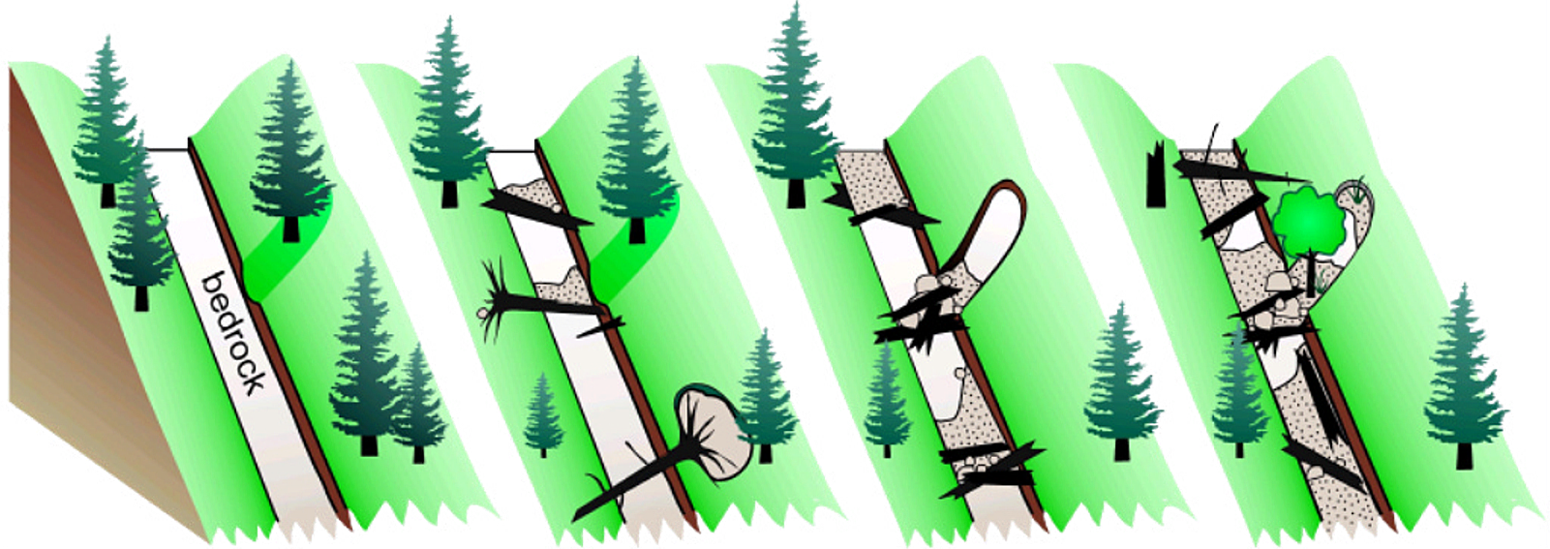
0 to 30 yrs
30 to 60 yrs
60 to 90 yrs
> 90 yrs
Time Since the Previous Debris Flow

Slide 24
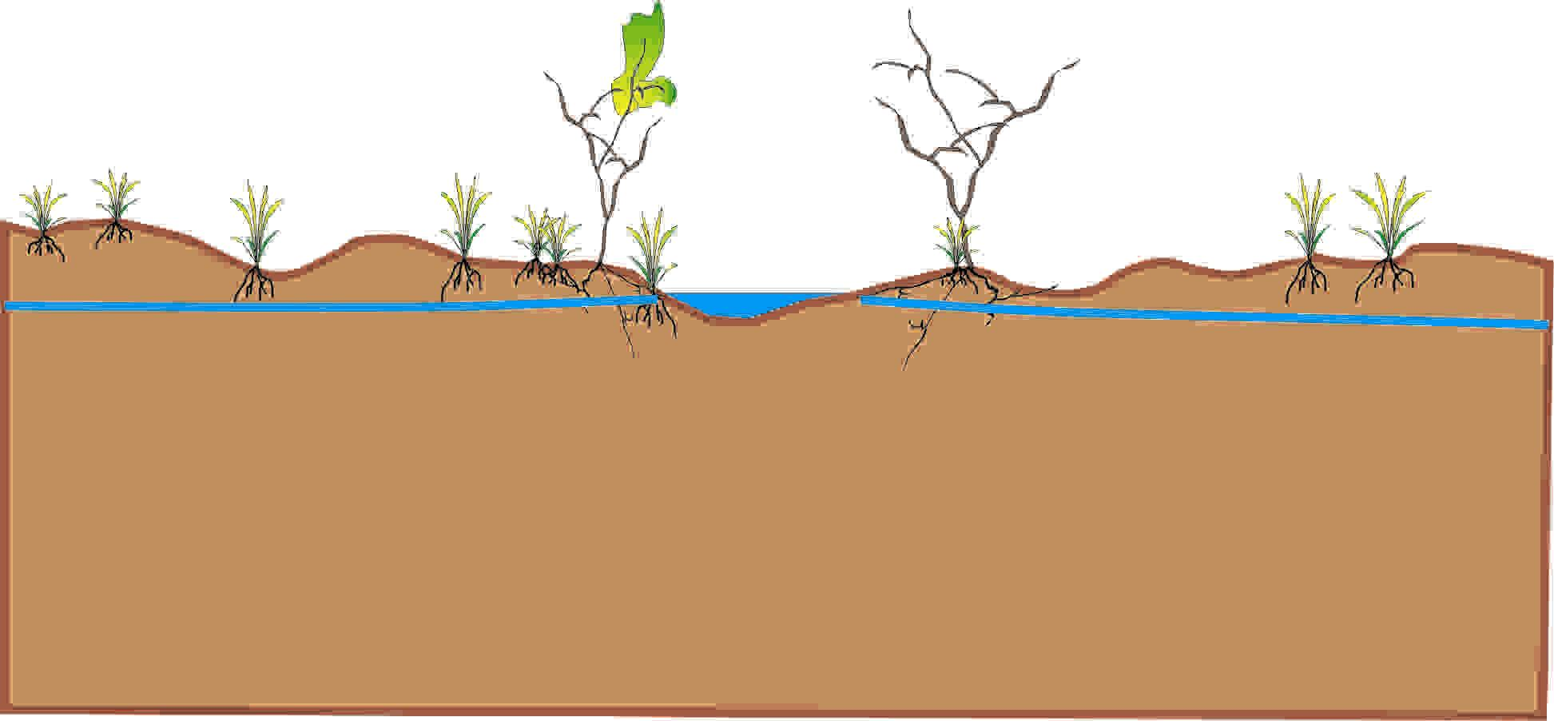
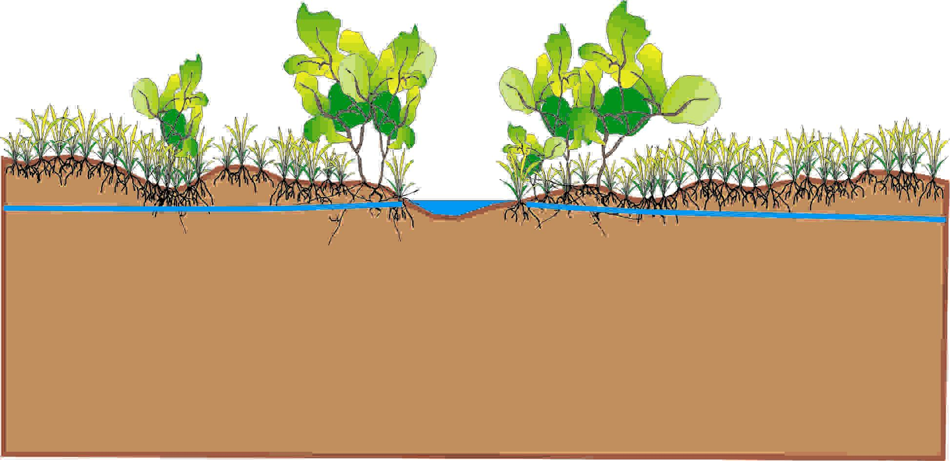
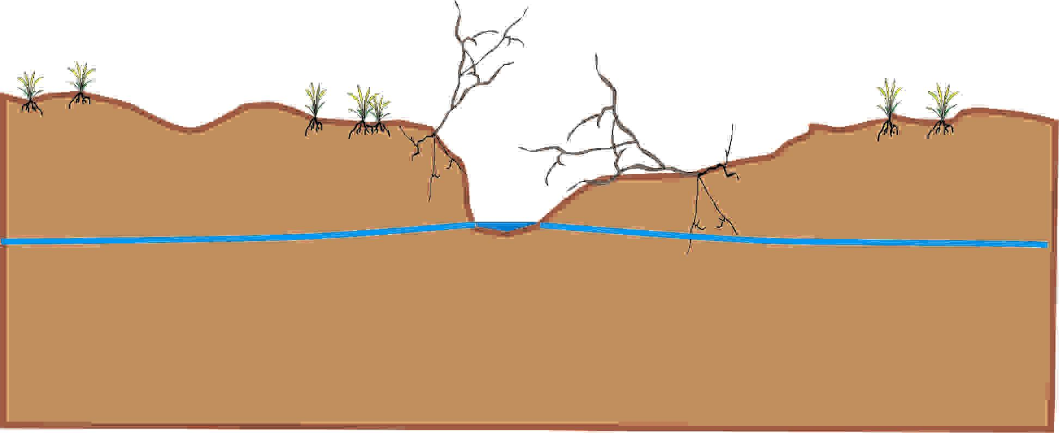
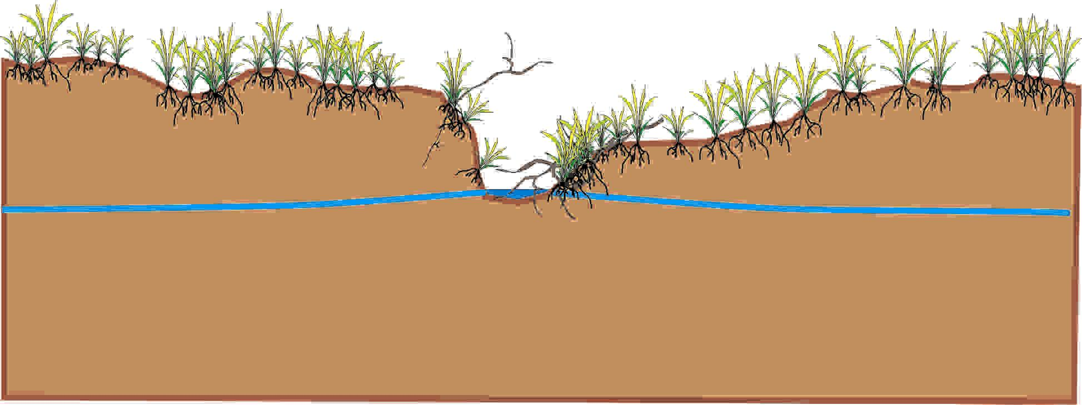
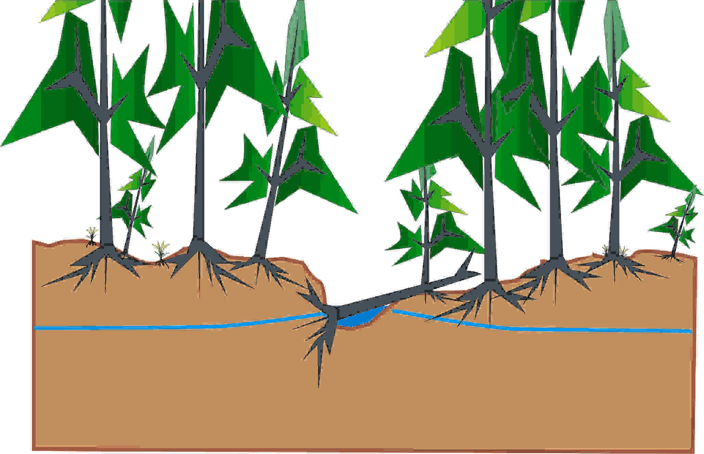
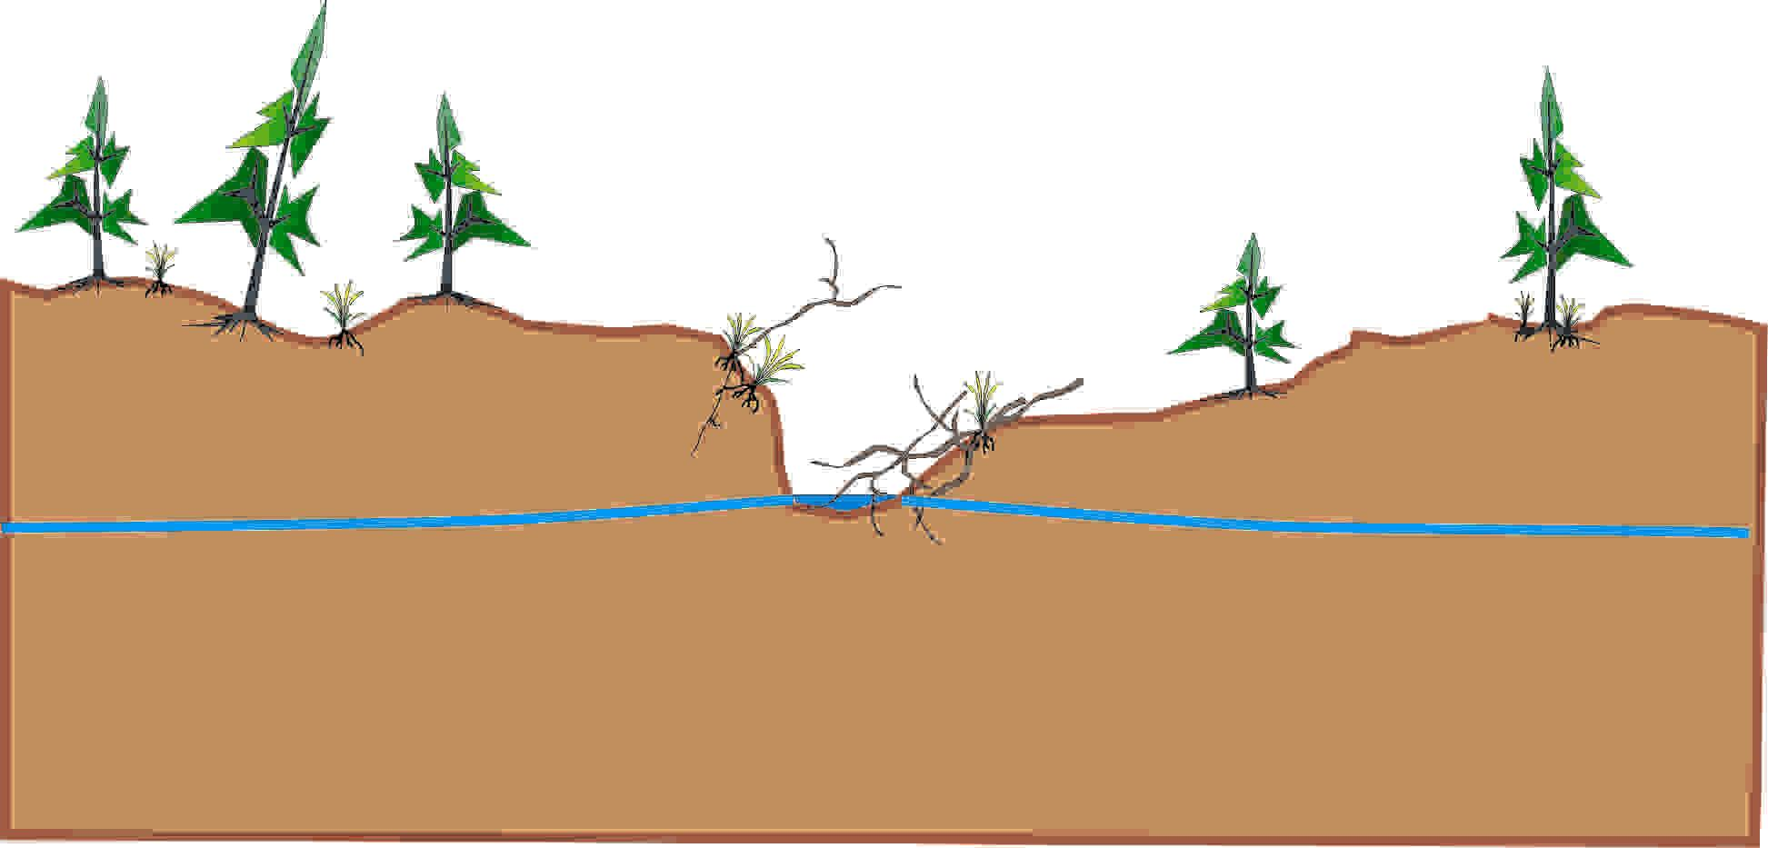
Hypothetical Effect of Fire on
Meadow Riparian Ecosystems
Pioneer Forb (High WT)
Climax Wet Meadow
Succession w/o Grazing
Major
Flood
Depositional Flood
Pioneer Forb
No Regen / No Grazing
Dry Meadow
Conifer
Regen
Fire
Conifer Initiation
Succession
Old Mixed Con Forest

Slide 25


Slide 26
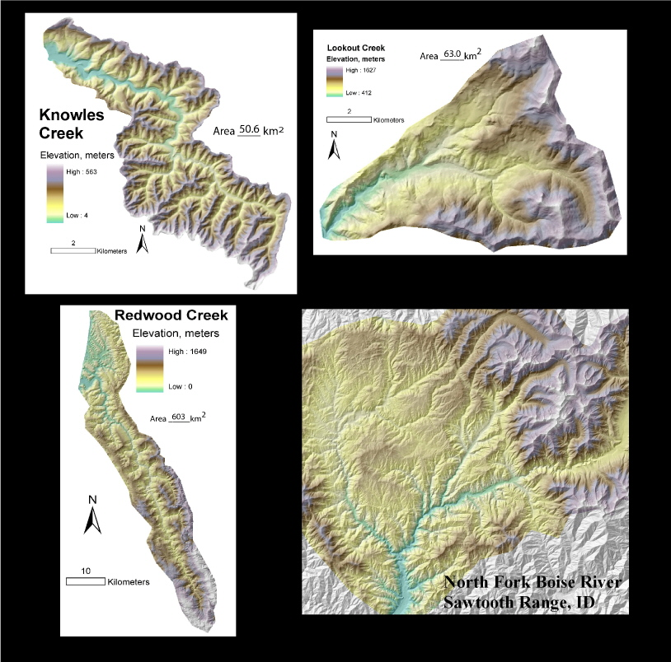
Relevance of Dynamic Events
Very important
(confluences & offsite)
Moderately important
(earthflows/slides)
Moderately important
(flash floods/confluences,
rare)
Little to Detrimental
(channel instability)

Slide 27
“The significant problems we face today cannot be solved with the same level of thinking that we were at when we created them.”
Albert Einstein

Slide 28
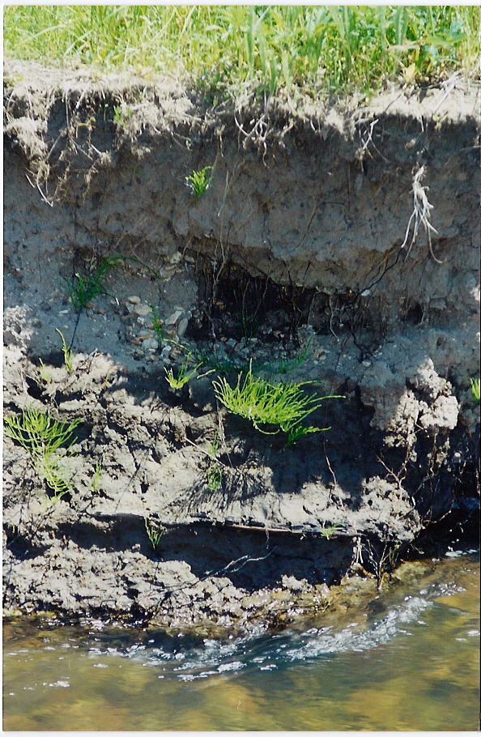
Fine overbank alluvium
Channel gravels
Coarse charcoal
Channel gravels
Limber Jim Creek,
Upper Grande Ronde River basin
From: W. Russell

Slide 29
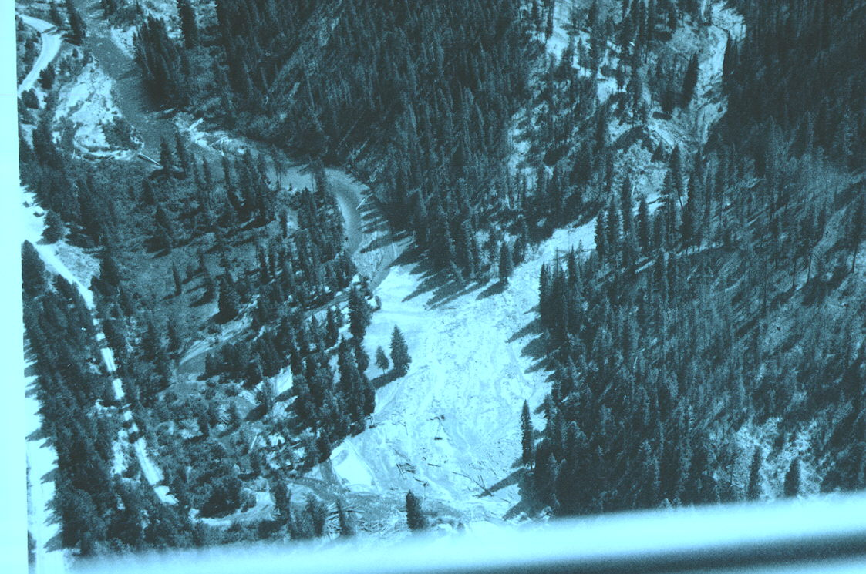
Wide Floodplains
Trapper Creek Basin
Fan

Slide 30
Adaptations to Dynamic Ecosystems
Persist throughout all ecological stages
Exist in refugia and move among patches

Slide 31
Adaptations of Anadromous Salmonids to Dynamic Environments
Straying of adults
High fecundity
Mobility of juveniles

Slide 32
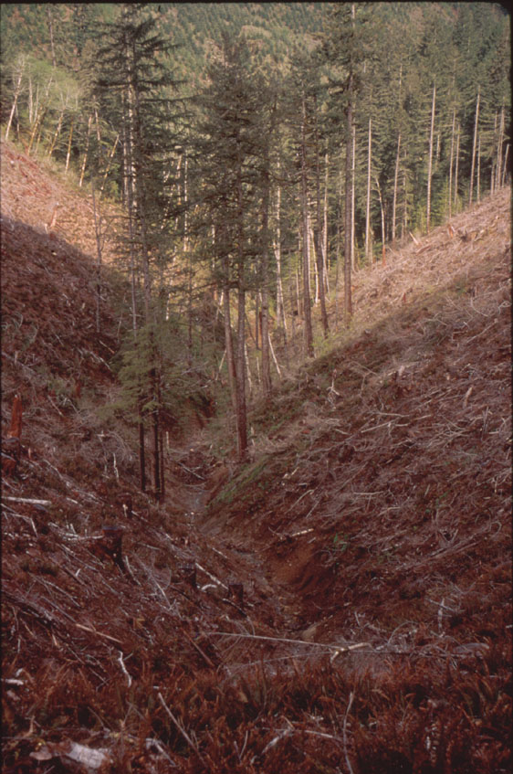

Slide 33
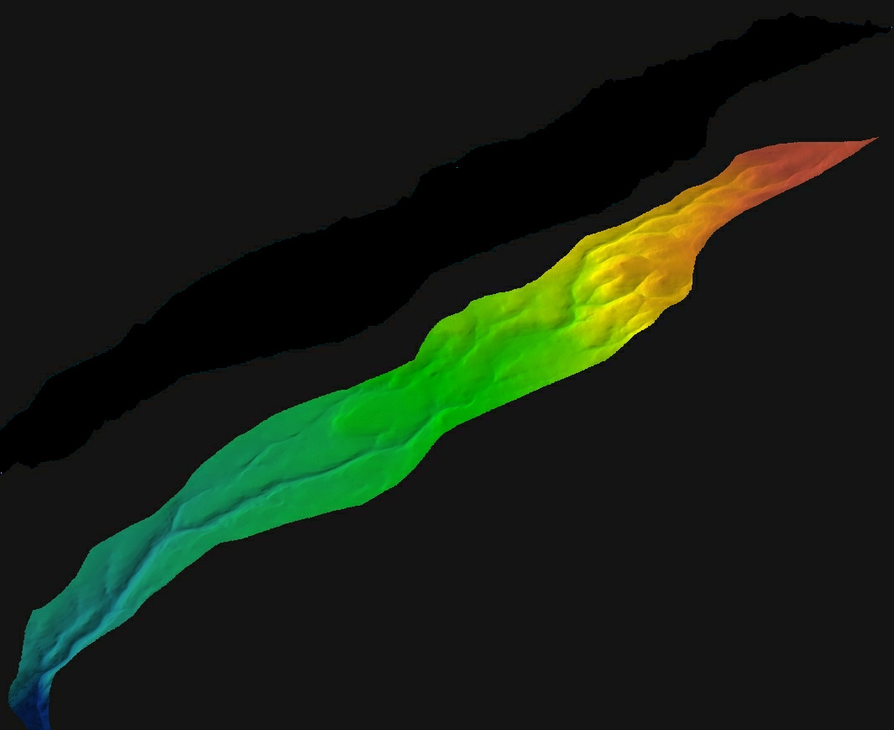
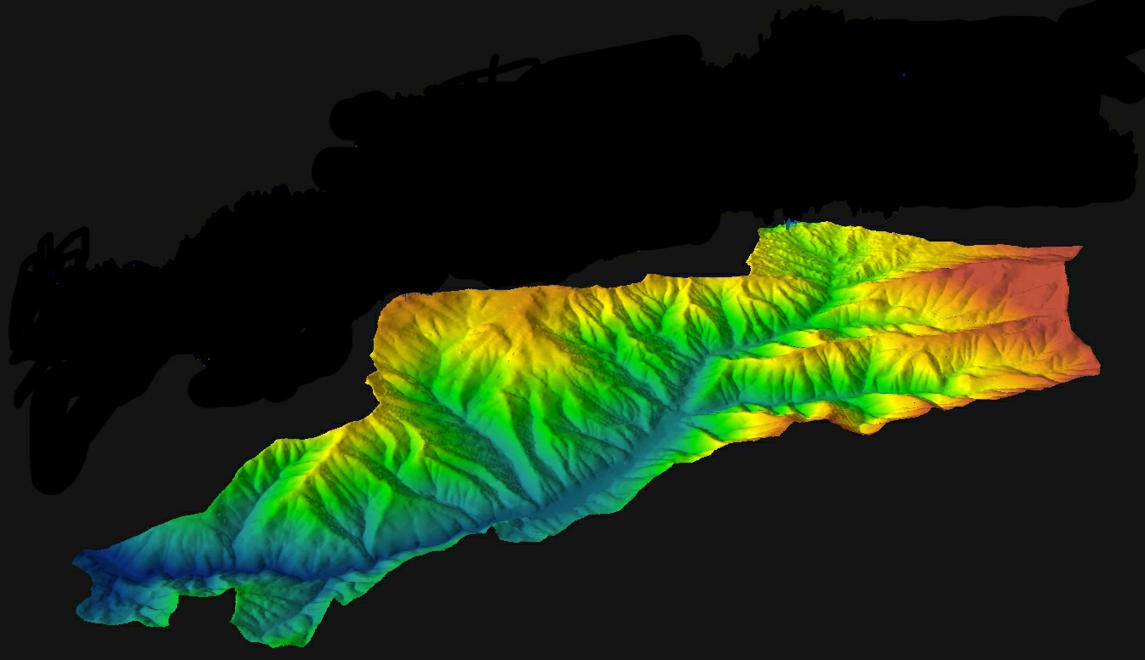
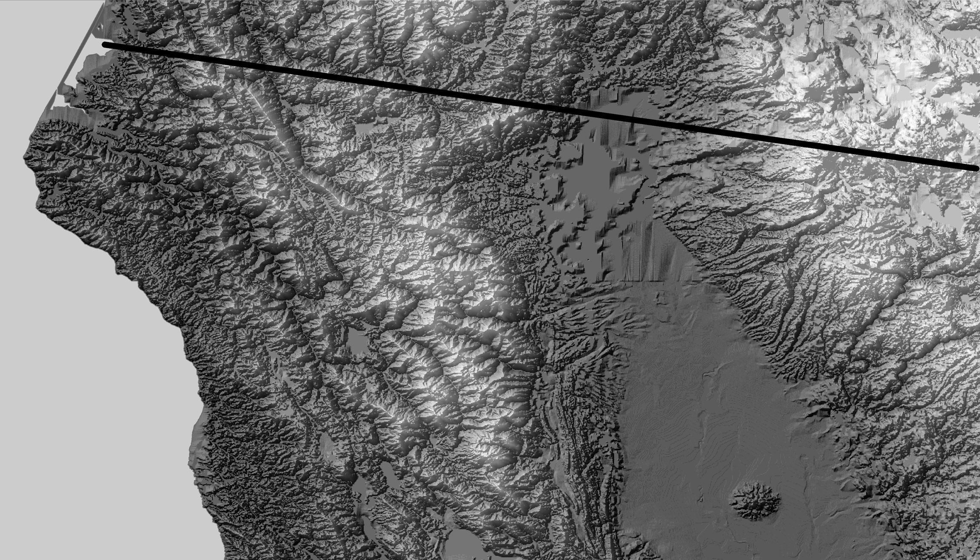
Landscape Organization of Environmental Variance
Gradients of
topographic
roughness
(i.e., variance in
erosion and topography)
Southern Cascades (Lassen area)
(lower variance)
Klamath Mts.
(higher variance)

