Slide 1
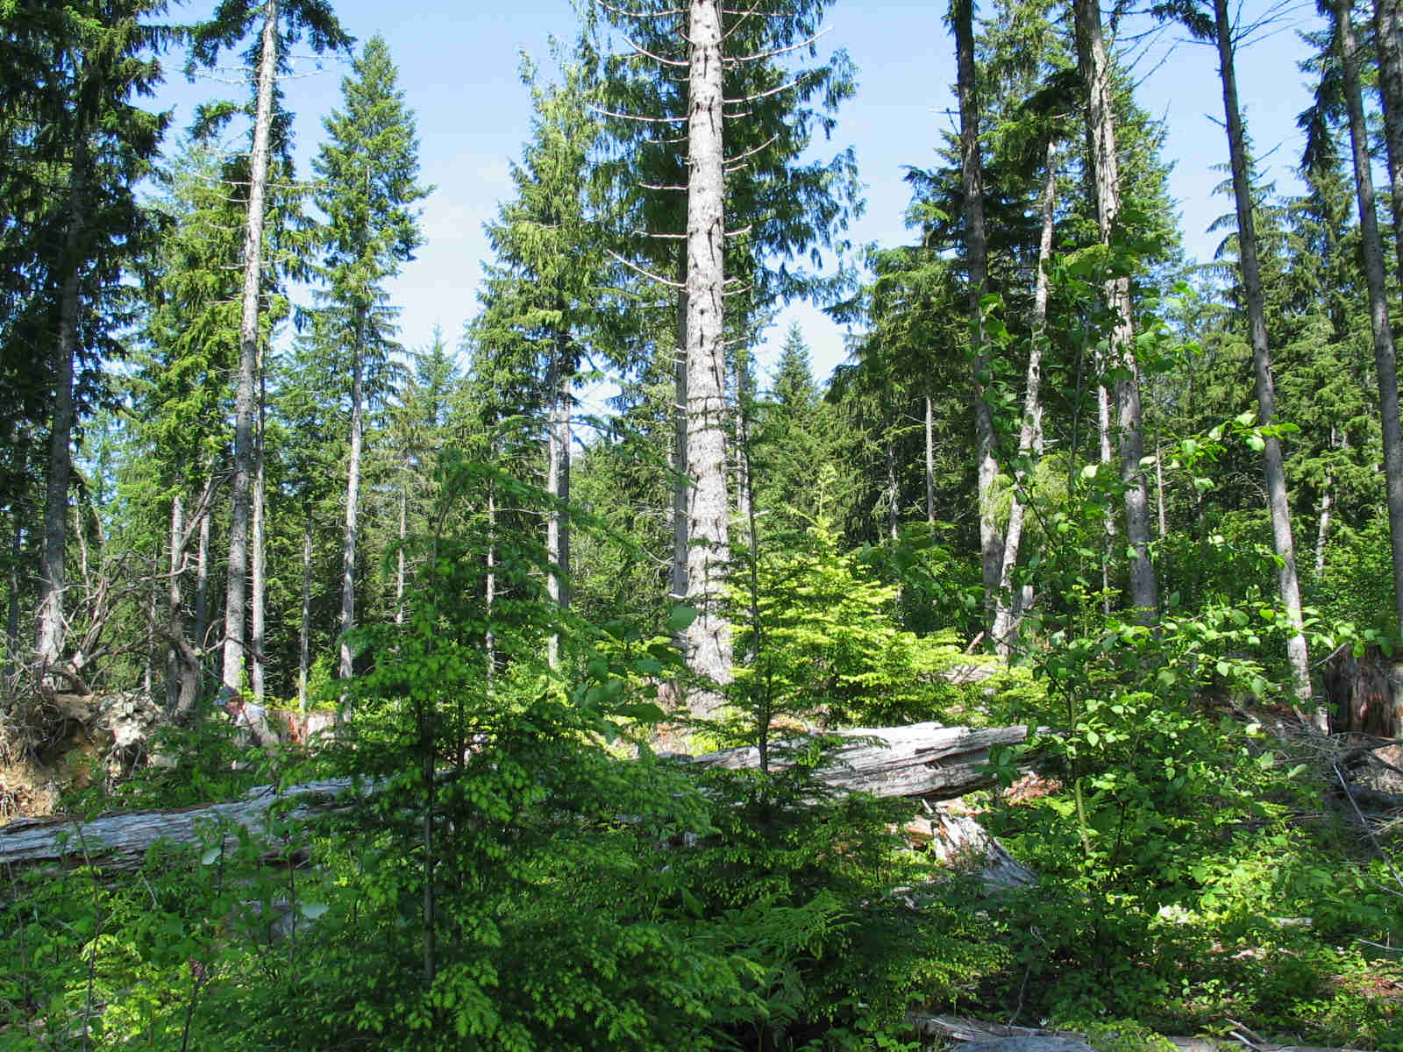
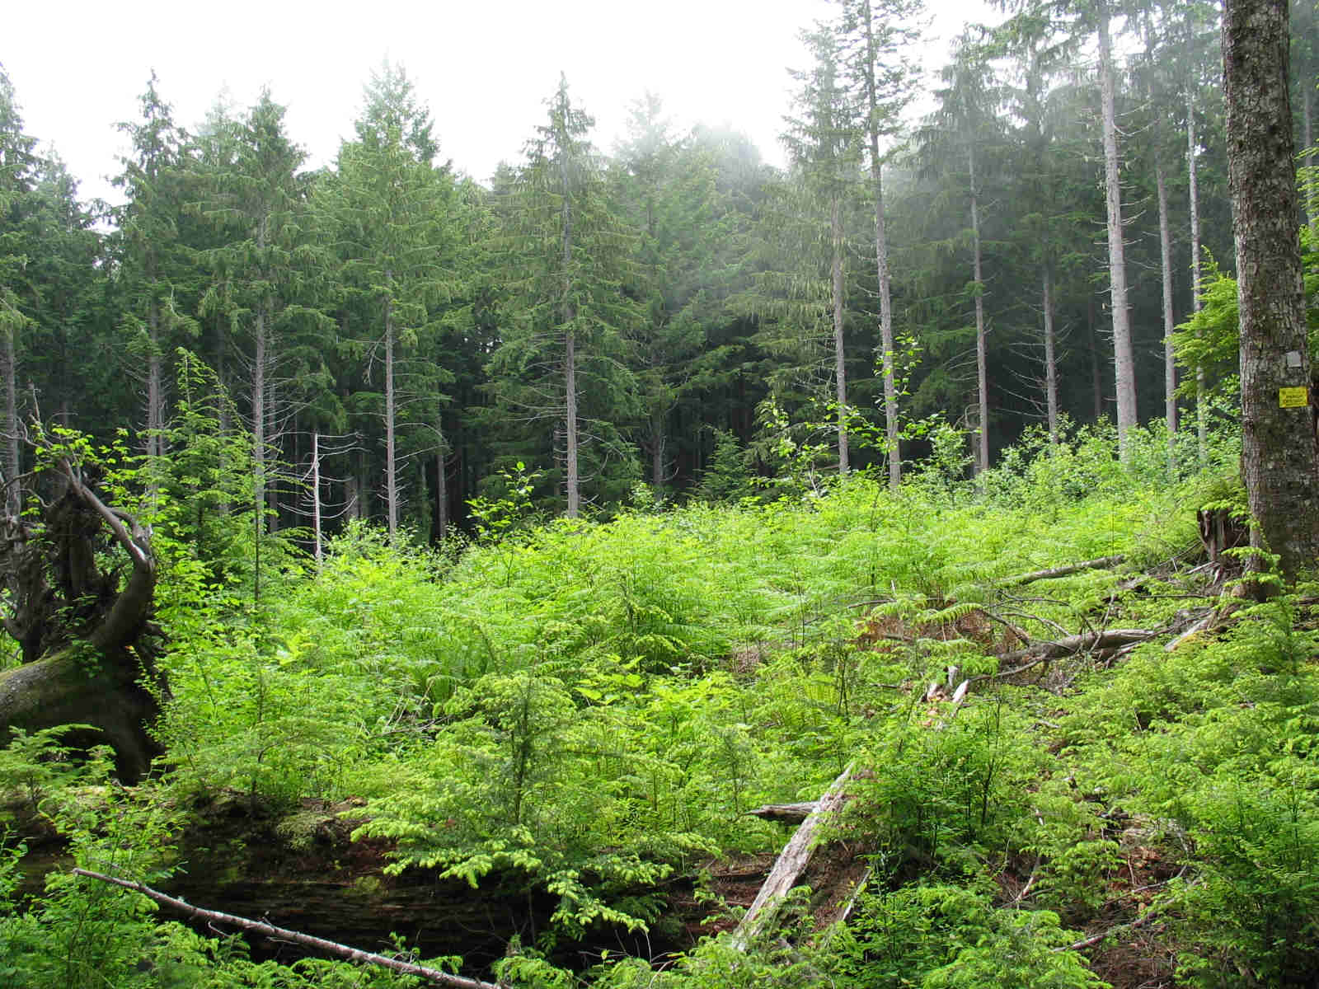
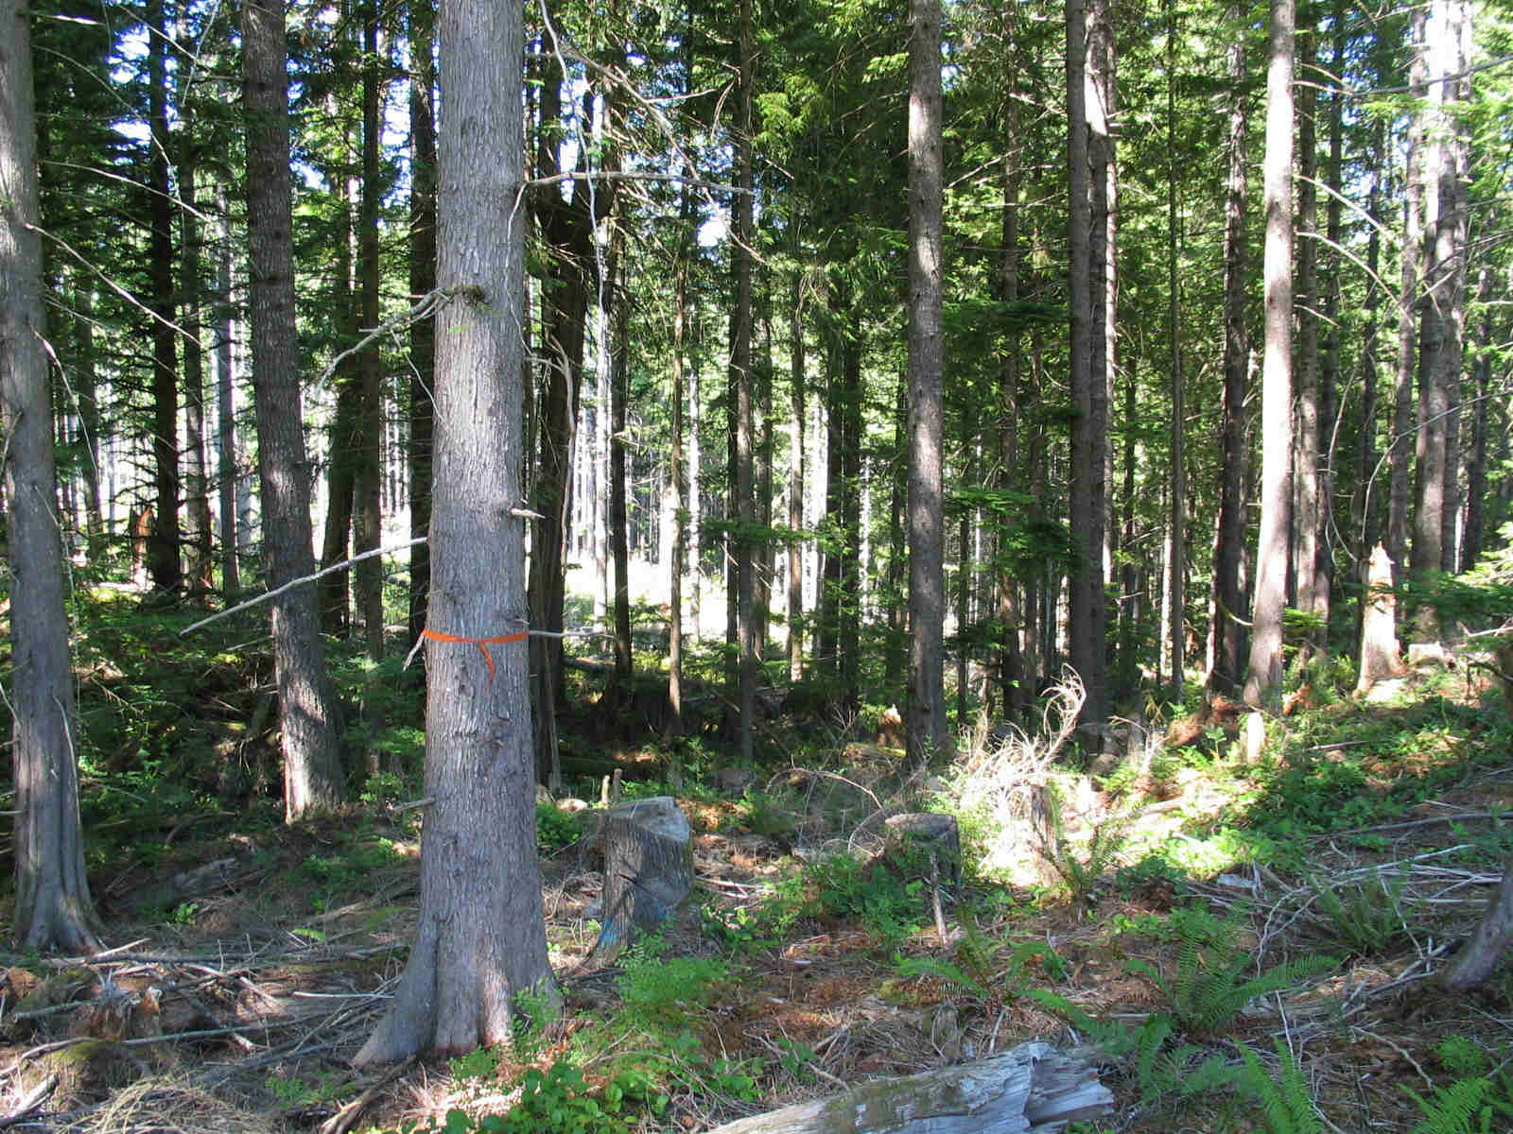
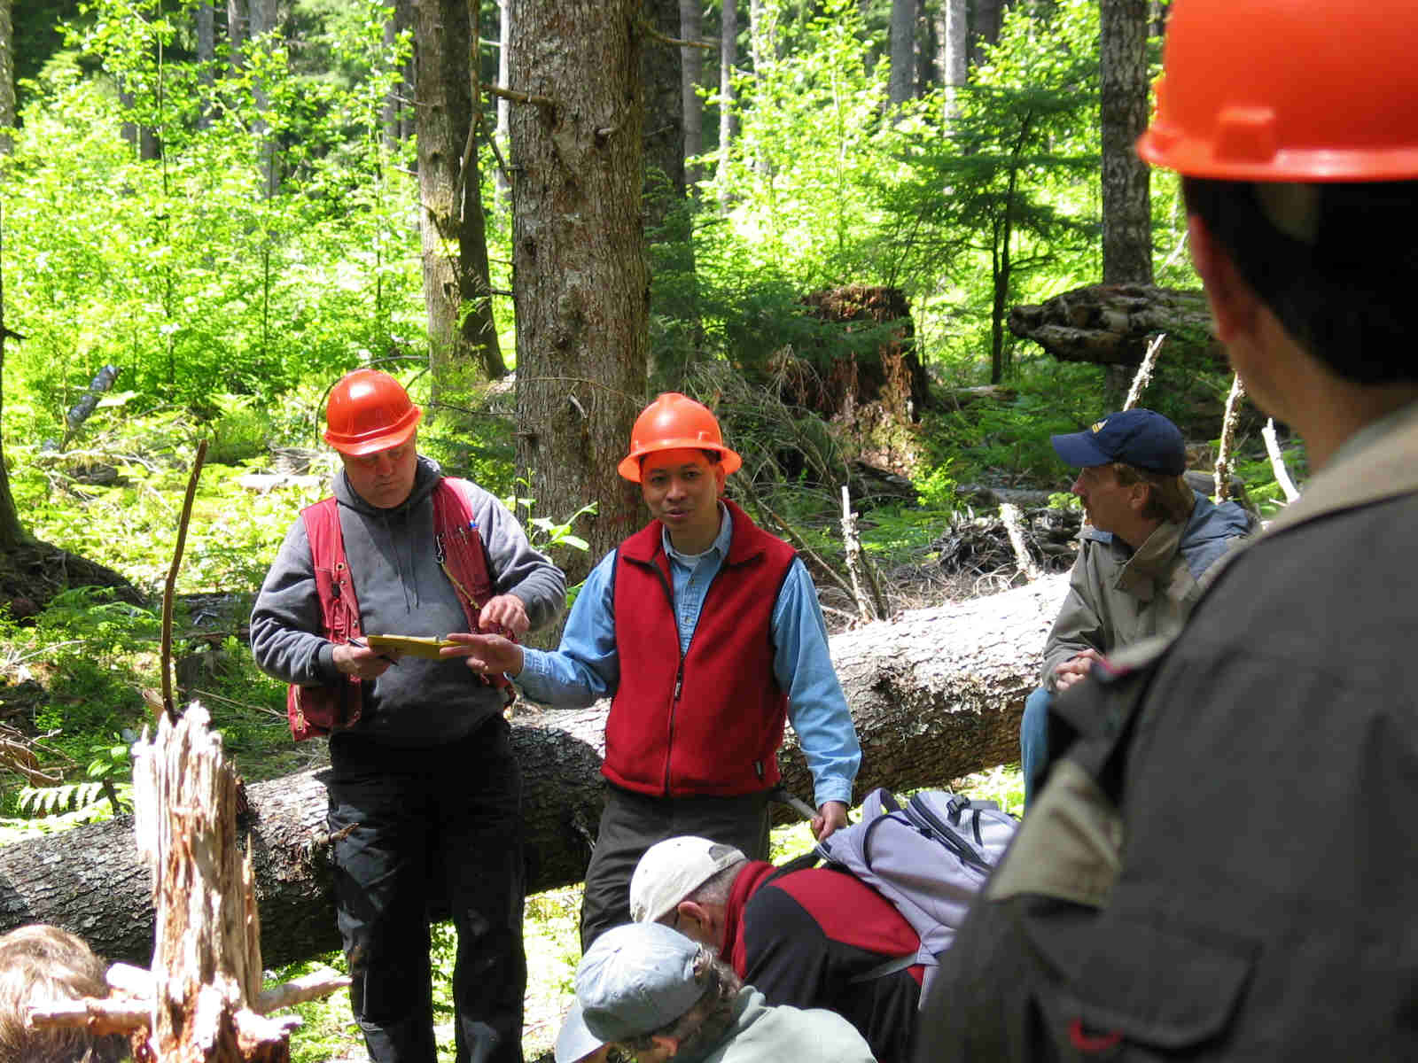
BLM Density Management Study:
Enhancing Structural and Biotic Diversity
Through Active Management

Slide 2
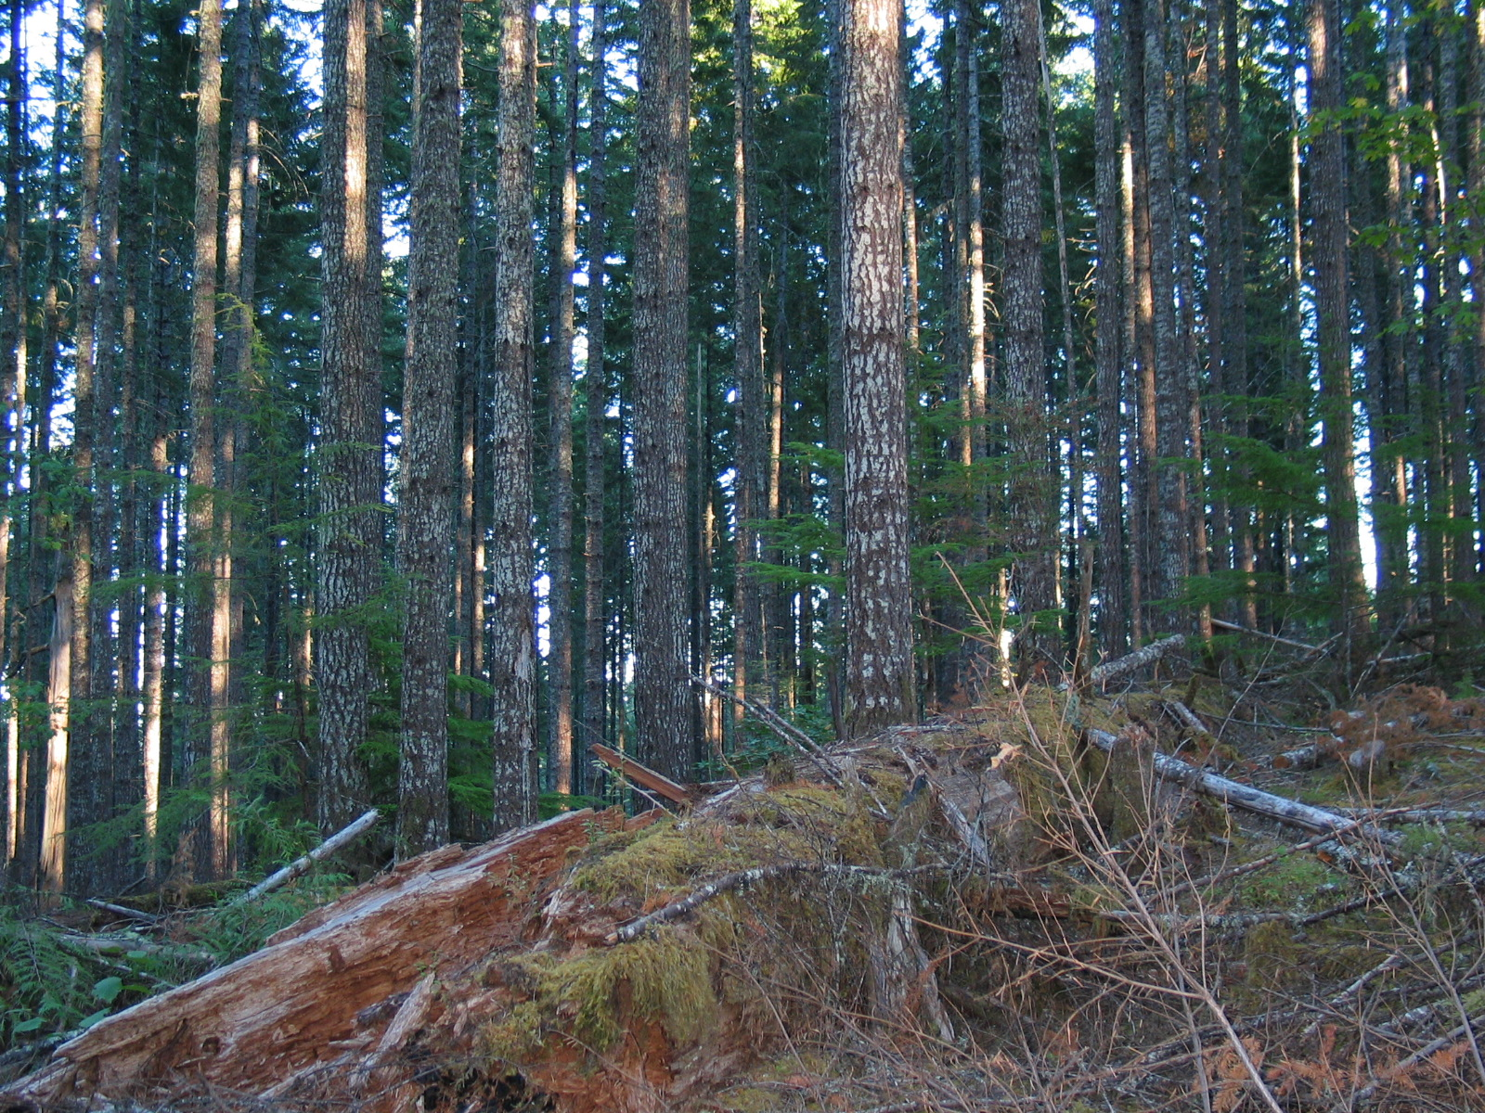
Enhancing Stand Structure Development in Young Douglas-fir Forests
Hundreds of thousands of acres in even-aged 40-70 year-old forests being managed under the Northwest Forest Plan
Preferred Northern Spotted Owl Habitat attributes
  vertical canopy layering
  tree height or diameter diversity
  canopy closure and volume
  large trees
  large snags

Slide 3
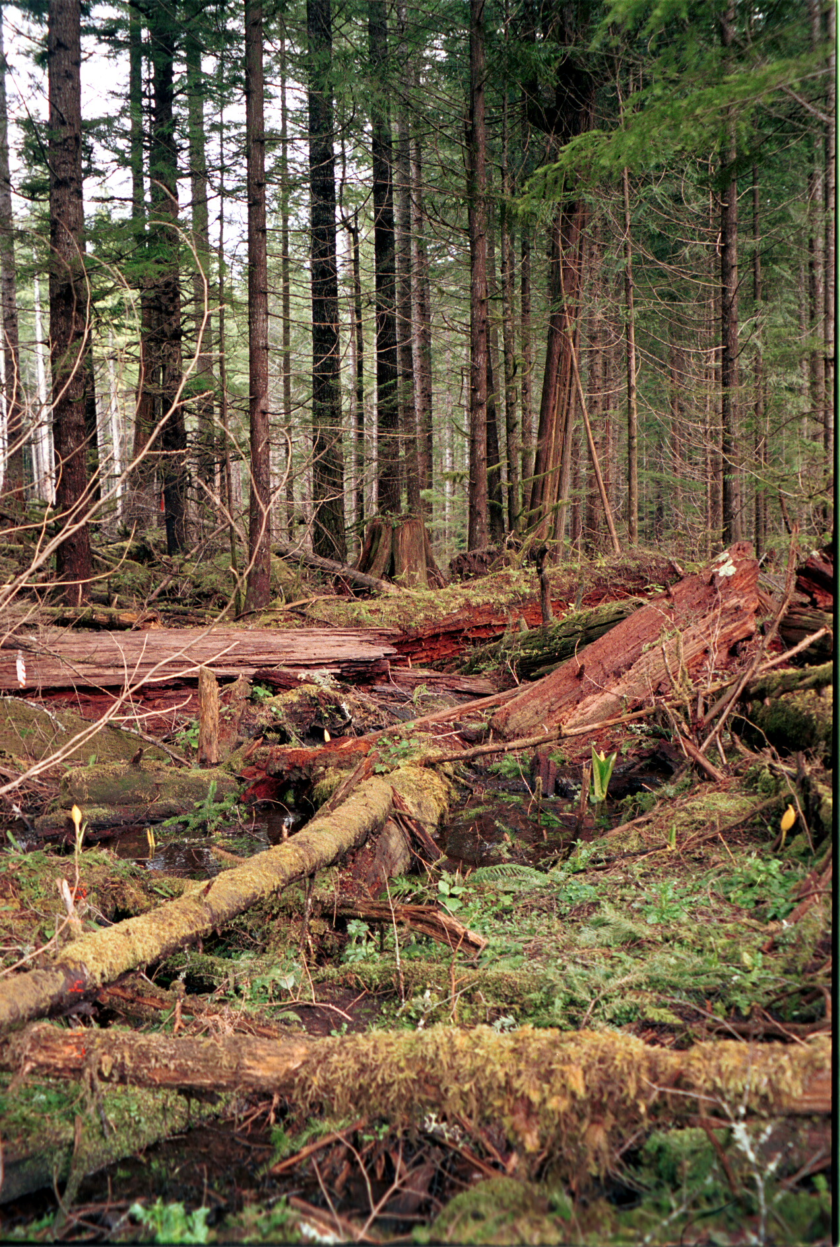
Thinning as a Tool for Riparian Habitat Restoration and the Compatible Production of Wood
Riparian Reserves
  Conserve diversity
  Maintain stream habitat and water quality
  Provide connectivity at watershed and landscape scales
Thinning strategies to promote diversity and the enhancement of riparian functions
  Modification of Overstory Canopy
  Altered Understory Environment
  Understory Vegetation and Structure Responses
  Enhanced Riparian Habitat and Function
Thinning
Buffer
Intermittent headwater stream
Notes:
Two approaches address different aspects
Riparian reserves

Slide 4
DMS Research Objectives
Evaluate effects of alternative density management treatments on important forest stand and habitat attributes
Determine treatment effects on selected plant and animal taxa (amphibians, arthropods, mollusks, nonvascular plants, and fungi)
Assess the combined effects of density management and alternative riparian buffer widths on aquatic and riparian ecosystems

Slide 5
DMS Desired Future Conditions
When treated stands reach 120-150 years of age:
  Large green conifer trees
    >8 Douglas-fir per acre >30 inches”
    2-6 TPA, diameter > 50 in.
    1 TPA, diameter > 50 in. with a broken top
  Enhanced species and structural diversity
    25-35 TPA, diameter 15-30 in., hardwoods and conifers
    100-200 TPA, diameter < 15 in., hardwoods and conifers
    Two or more species to include at least one shade tolerant species, and two or more age cohorts
  Snags
    8-12 snags/acre, 50% diameter 10-25 in., 50% diameter > 25 in.
    All decay classes present
  Downed logs
    900 linear feet/acre of well-dispersed logs
    1/3 of logs > 24 in. diameter
    2/3 of logs 10-24 in. diameter
    All decay classes present
Notes:
Target conditions for mature stands entering the understory re-initiation phase of development
Can we better provide for those future attributes through silvicultural manipulation in stands in the stem exclusion stage of development?

Slide 6
Density Management Treatments
Initial Thinning in 40-60 year-old Douglas-fir Stands
Treatment Units 30 – 60 ac
  Unthinned Control – 200-300 tpa
  High Density Retention – 120 tpa
  Moderate Density Retention – 80 tpa
  Variable Density Retention – 40 to 120 tpa
Fine-scale features
  0.25 to 1 ac Leave Islands
  0.25 to 1 ac Patch Openings
  Mixed-species planting of patch openings
  Snag and downed wood creation as needed

Slide 7
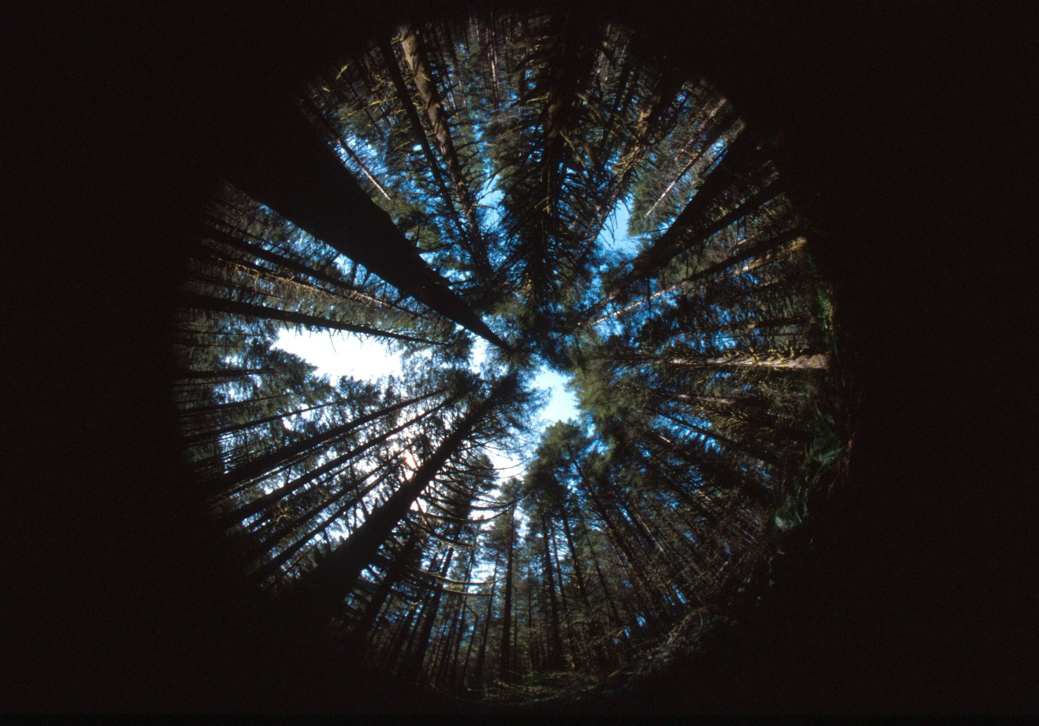
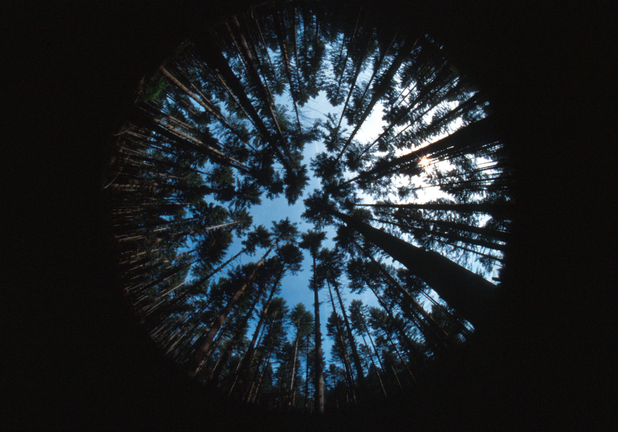
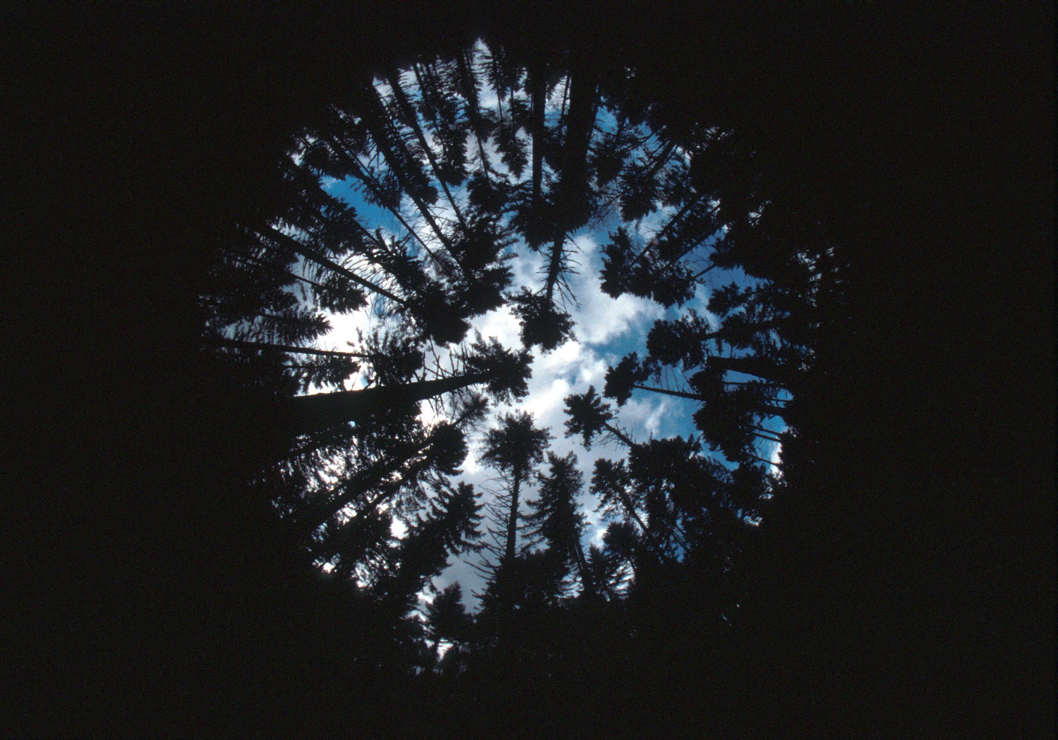
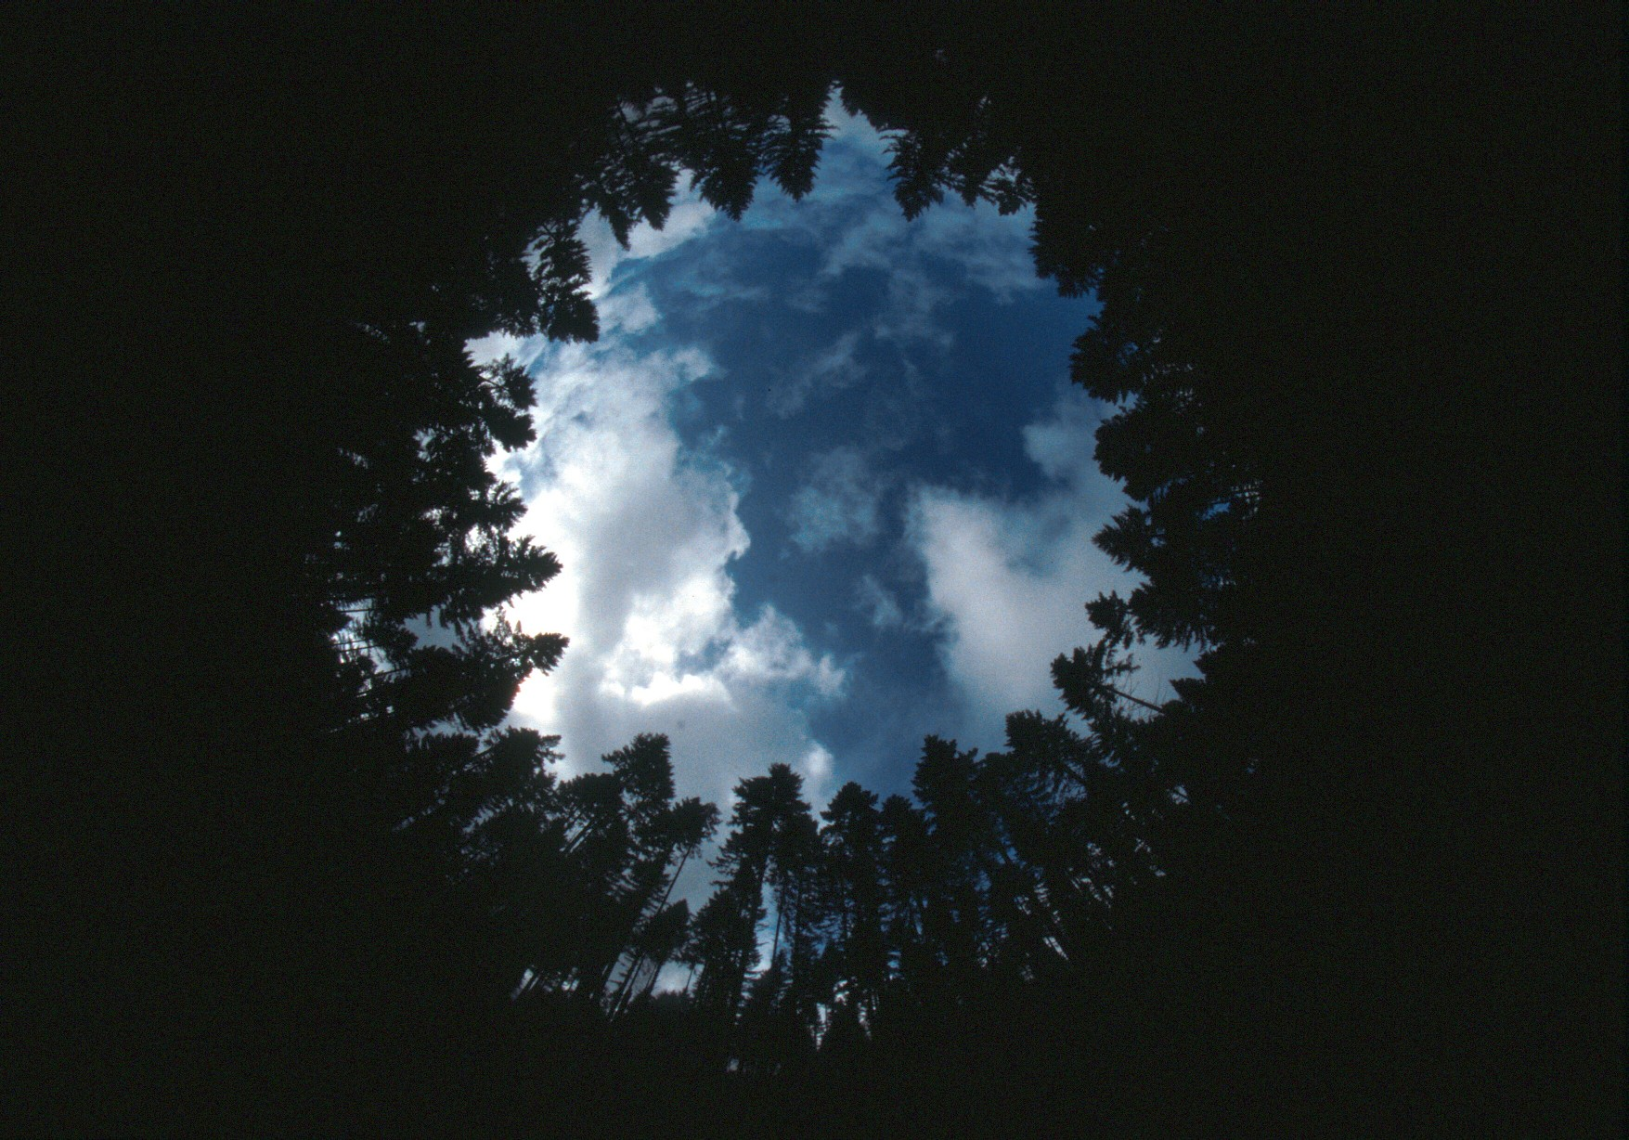
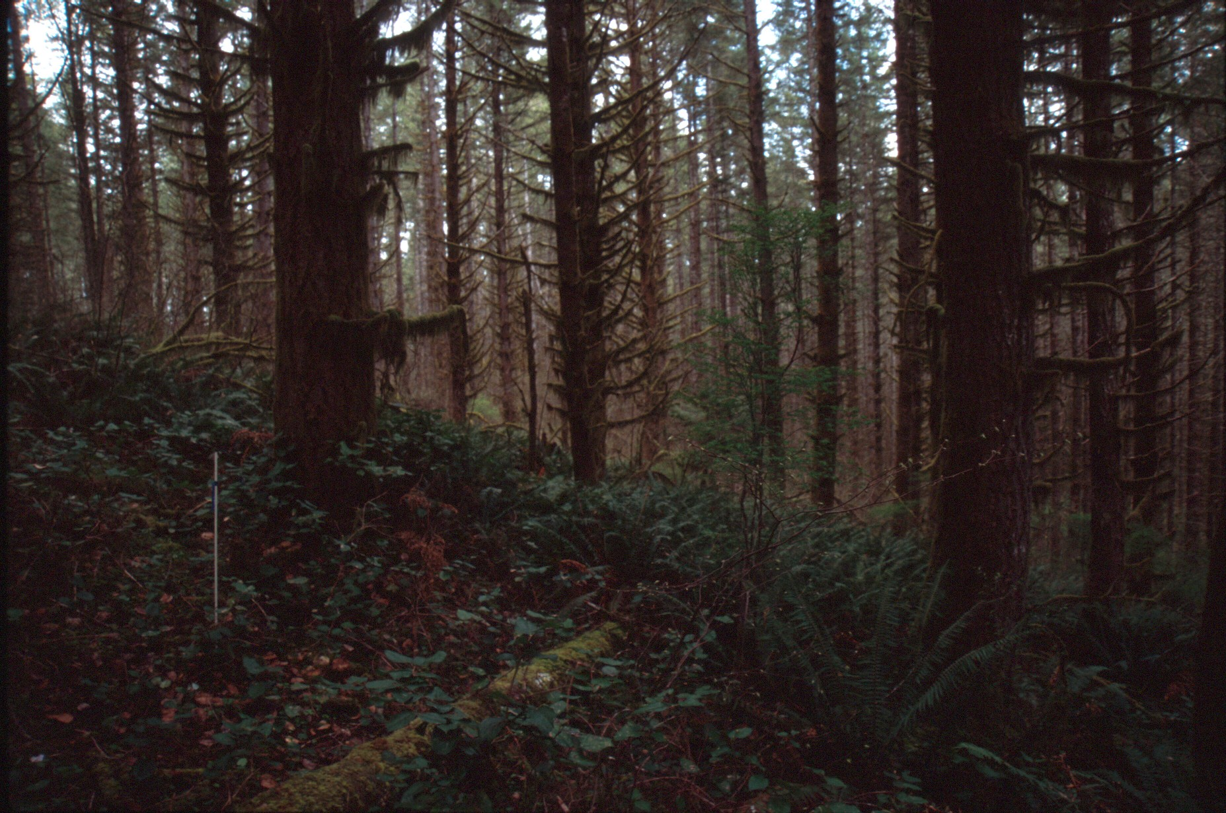
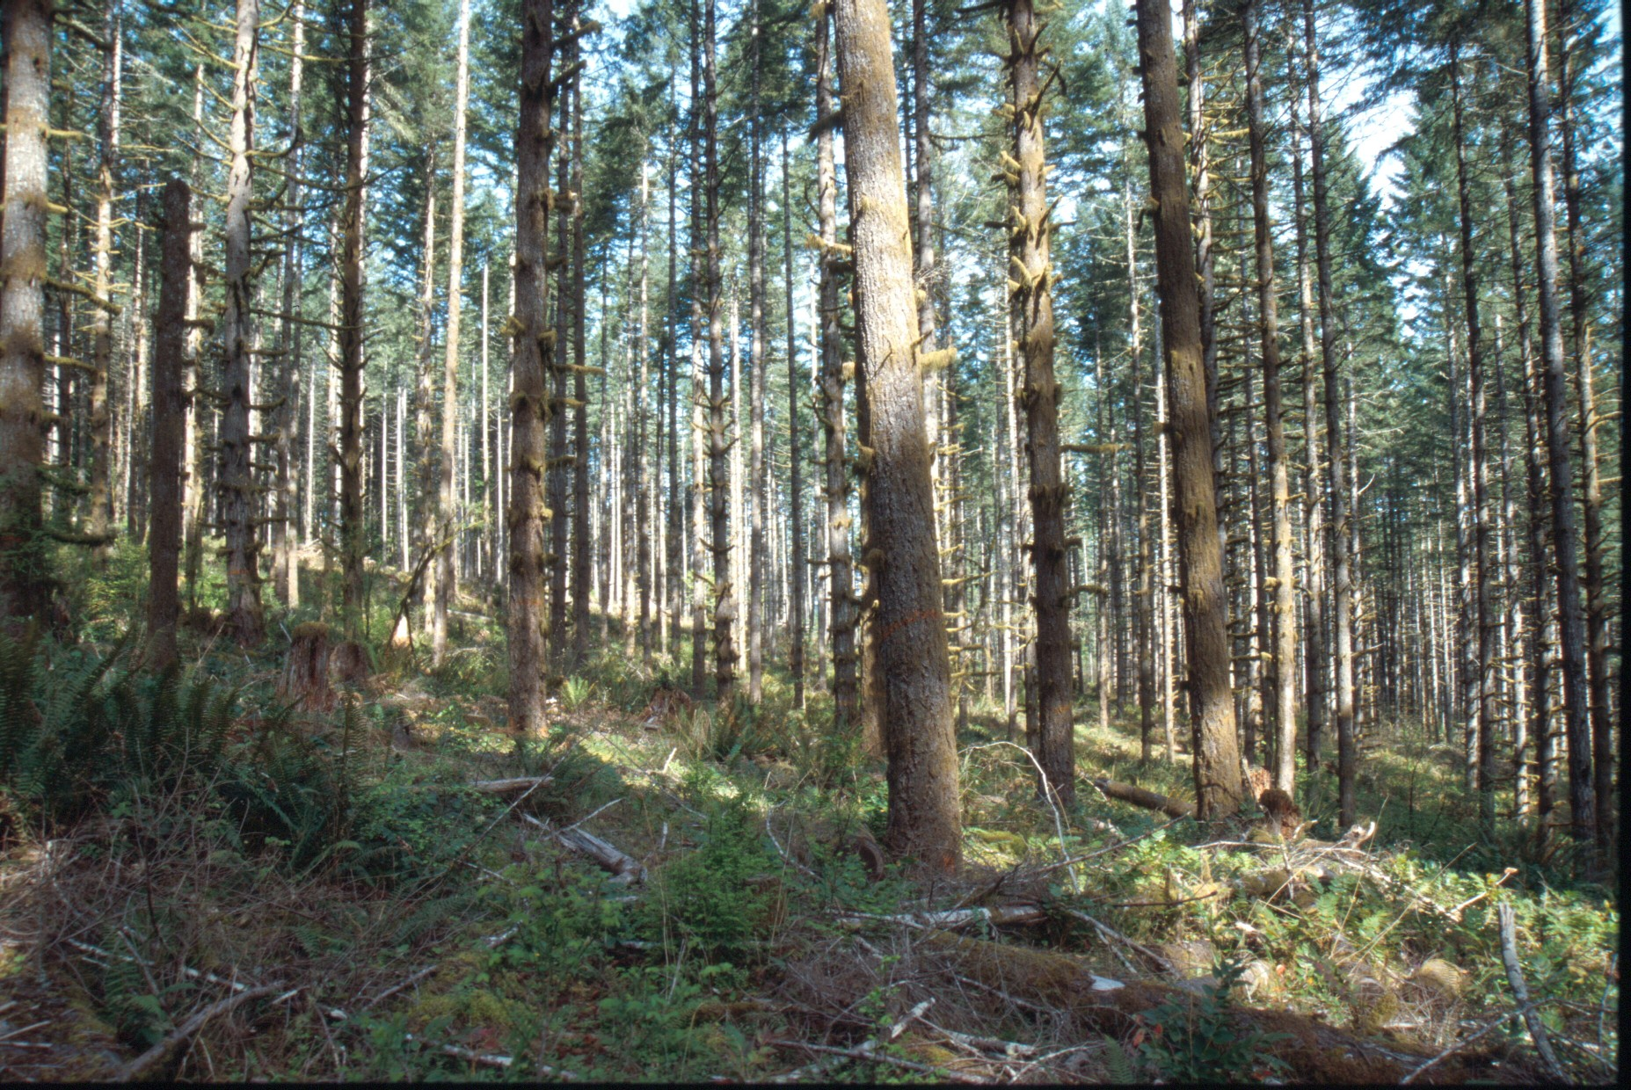
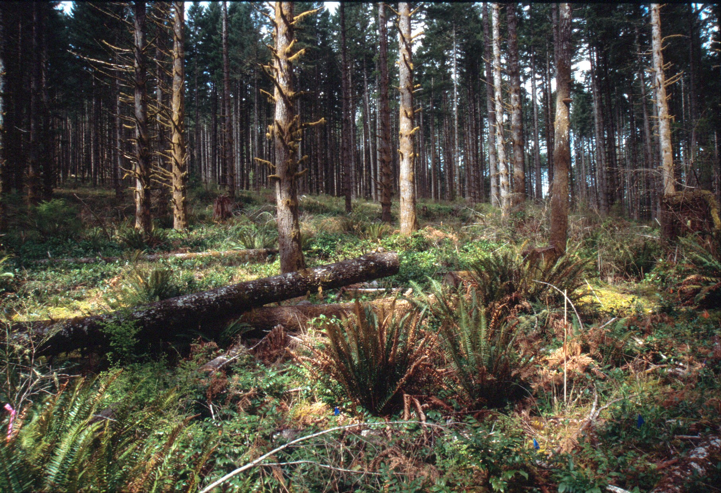
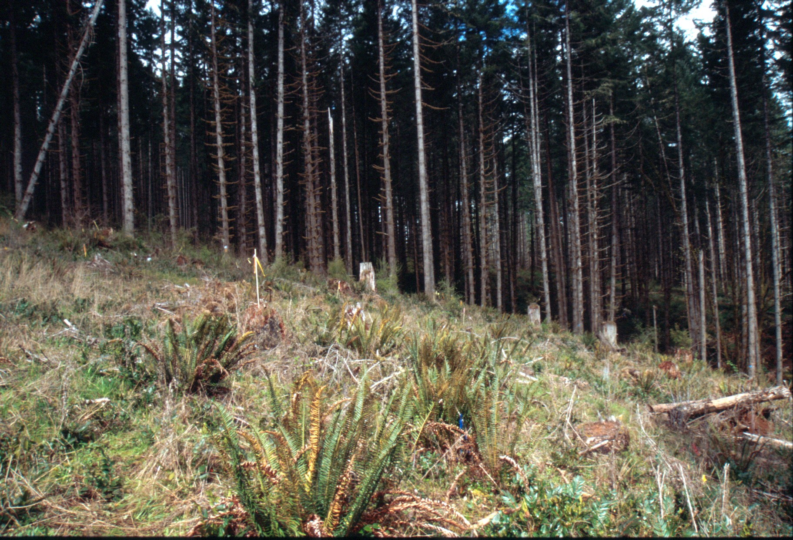
Typical Canopy and Stand Conditions
Three Years After Implementation
9%
28%
38%
61%
200-300 TPA
(Unthinned)
80 TPA
40 TPA
1 Acre Patch
Notes:
Types of thinning treatments applied.
Note that 80% removal of tree density only results in an increase of available light from 9 to 38%!

Slide 8
Riparian Buffer Treatments
Streamside Retention (SR)
  Only Trees With Canopy Providing Direct Cover to Stream (~ 25 ft)
Variable Width (VB)
  Topographic or Vegetation Breaks (~ 70 ft)
One Site-Potential Tree Height (1SPTH)
  Distance Equal to Potential Height of Dominant Tree (~220 ft)
Two Site-Potential Tree Heights (2SPTH)
  Distance Equal to Twice the Potential Height of Dominant Tree (~220 ft)

Slide 9
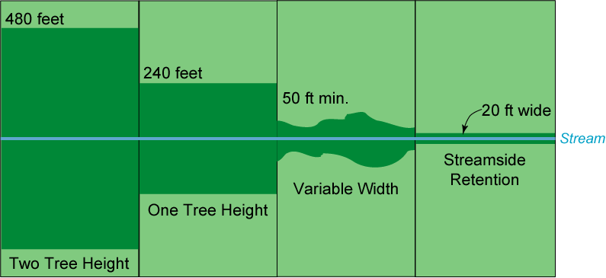
Riparian Buffer Alternatives
B2
B1
VB
SR

Slide 10
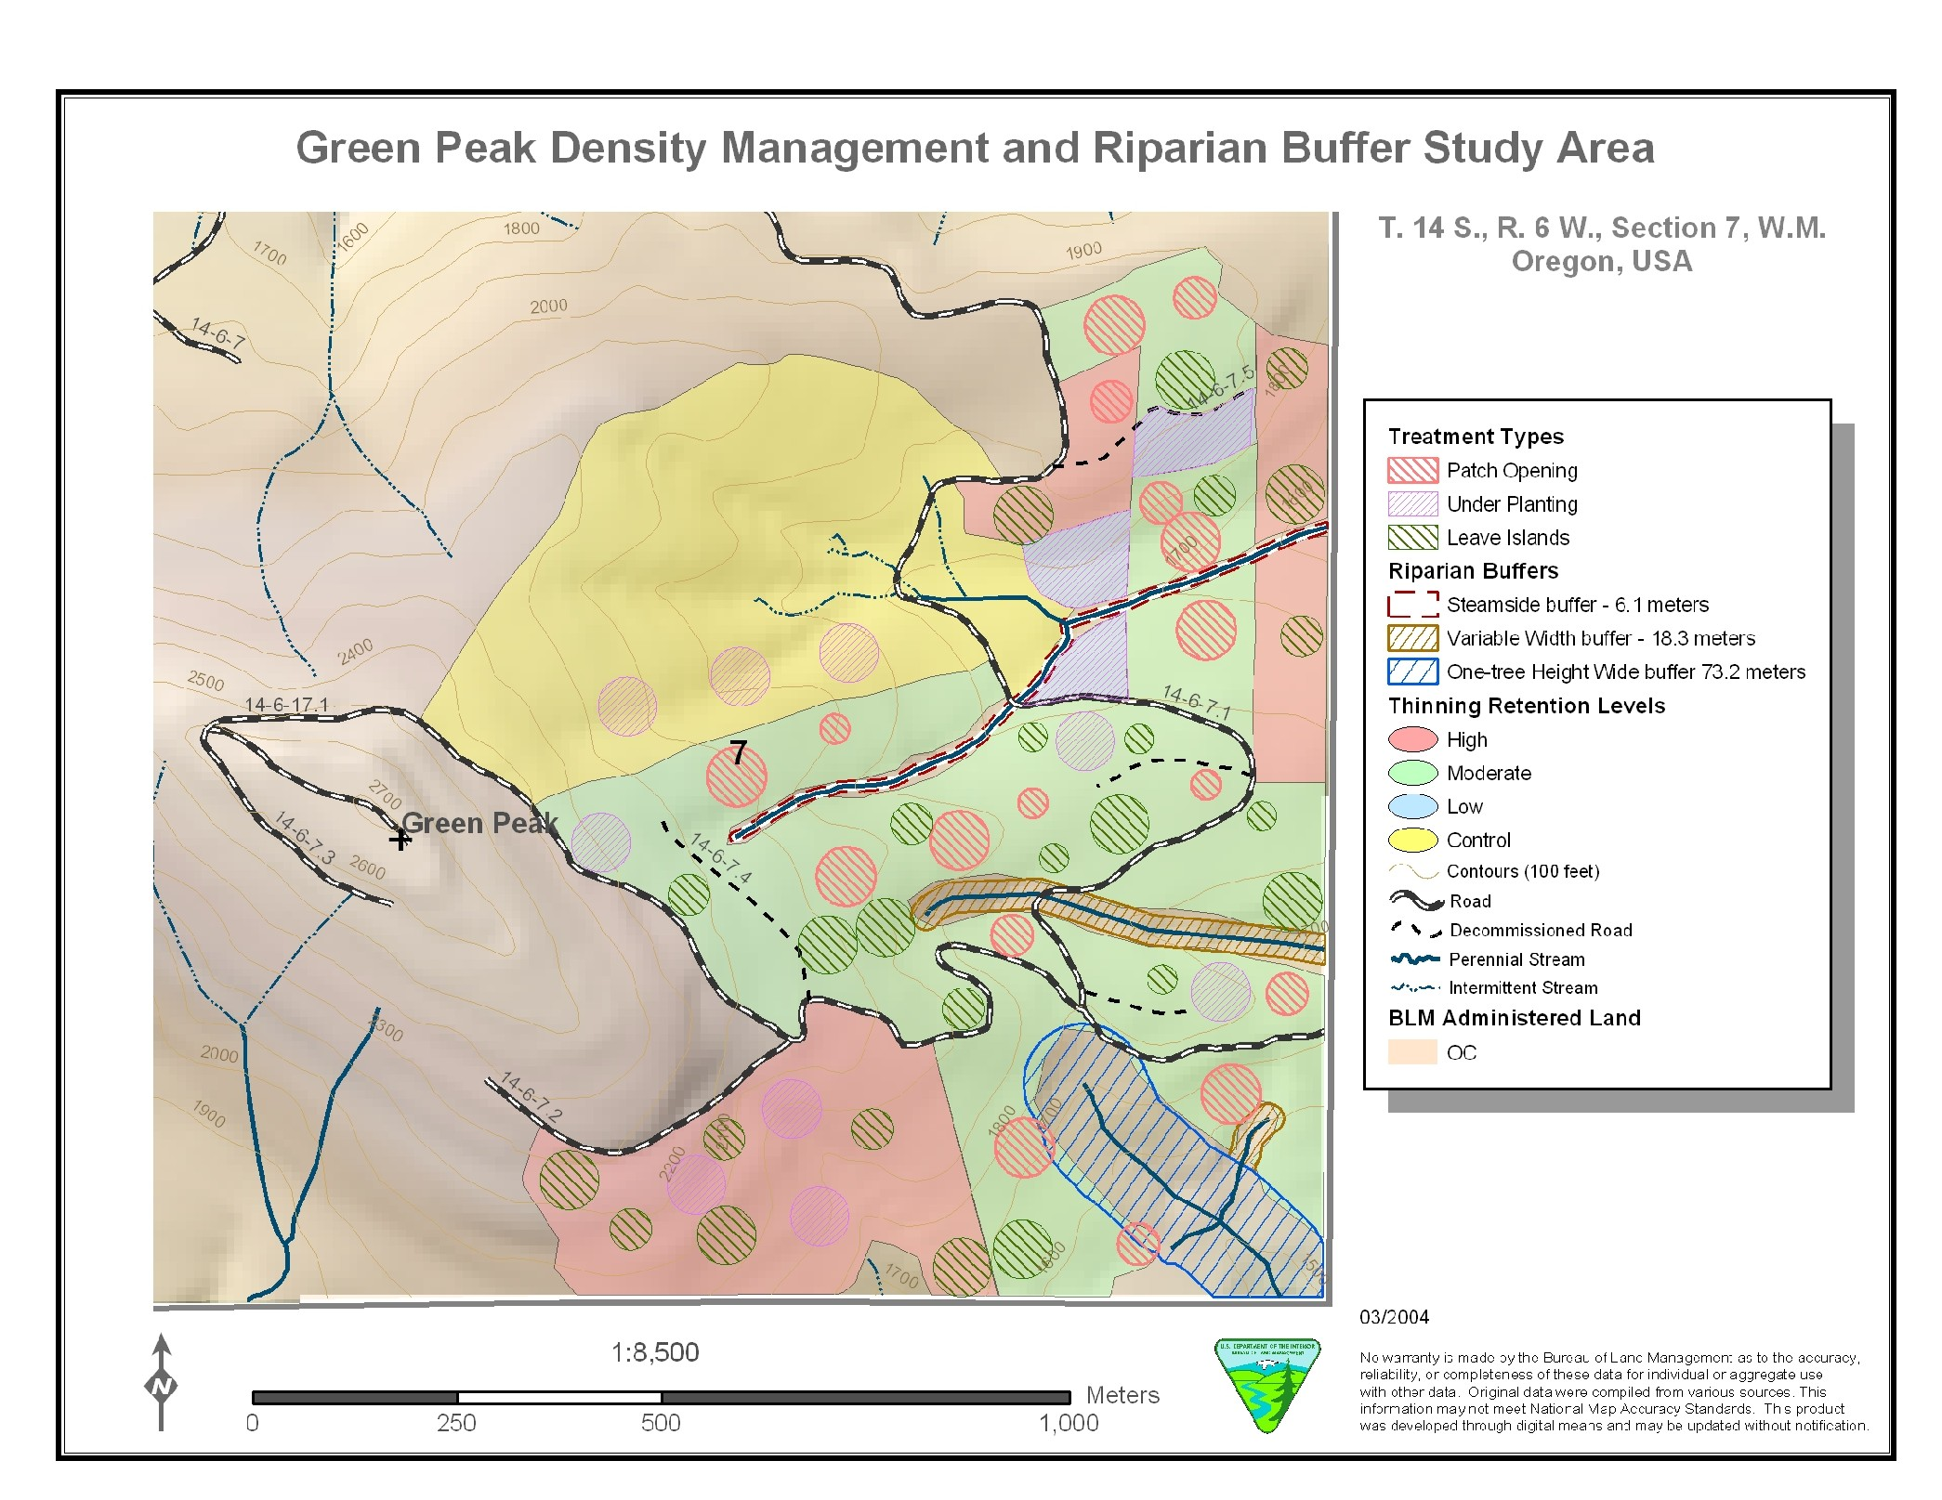
Density Management Study Installation:
Green Peak

Slide 11
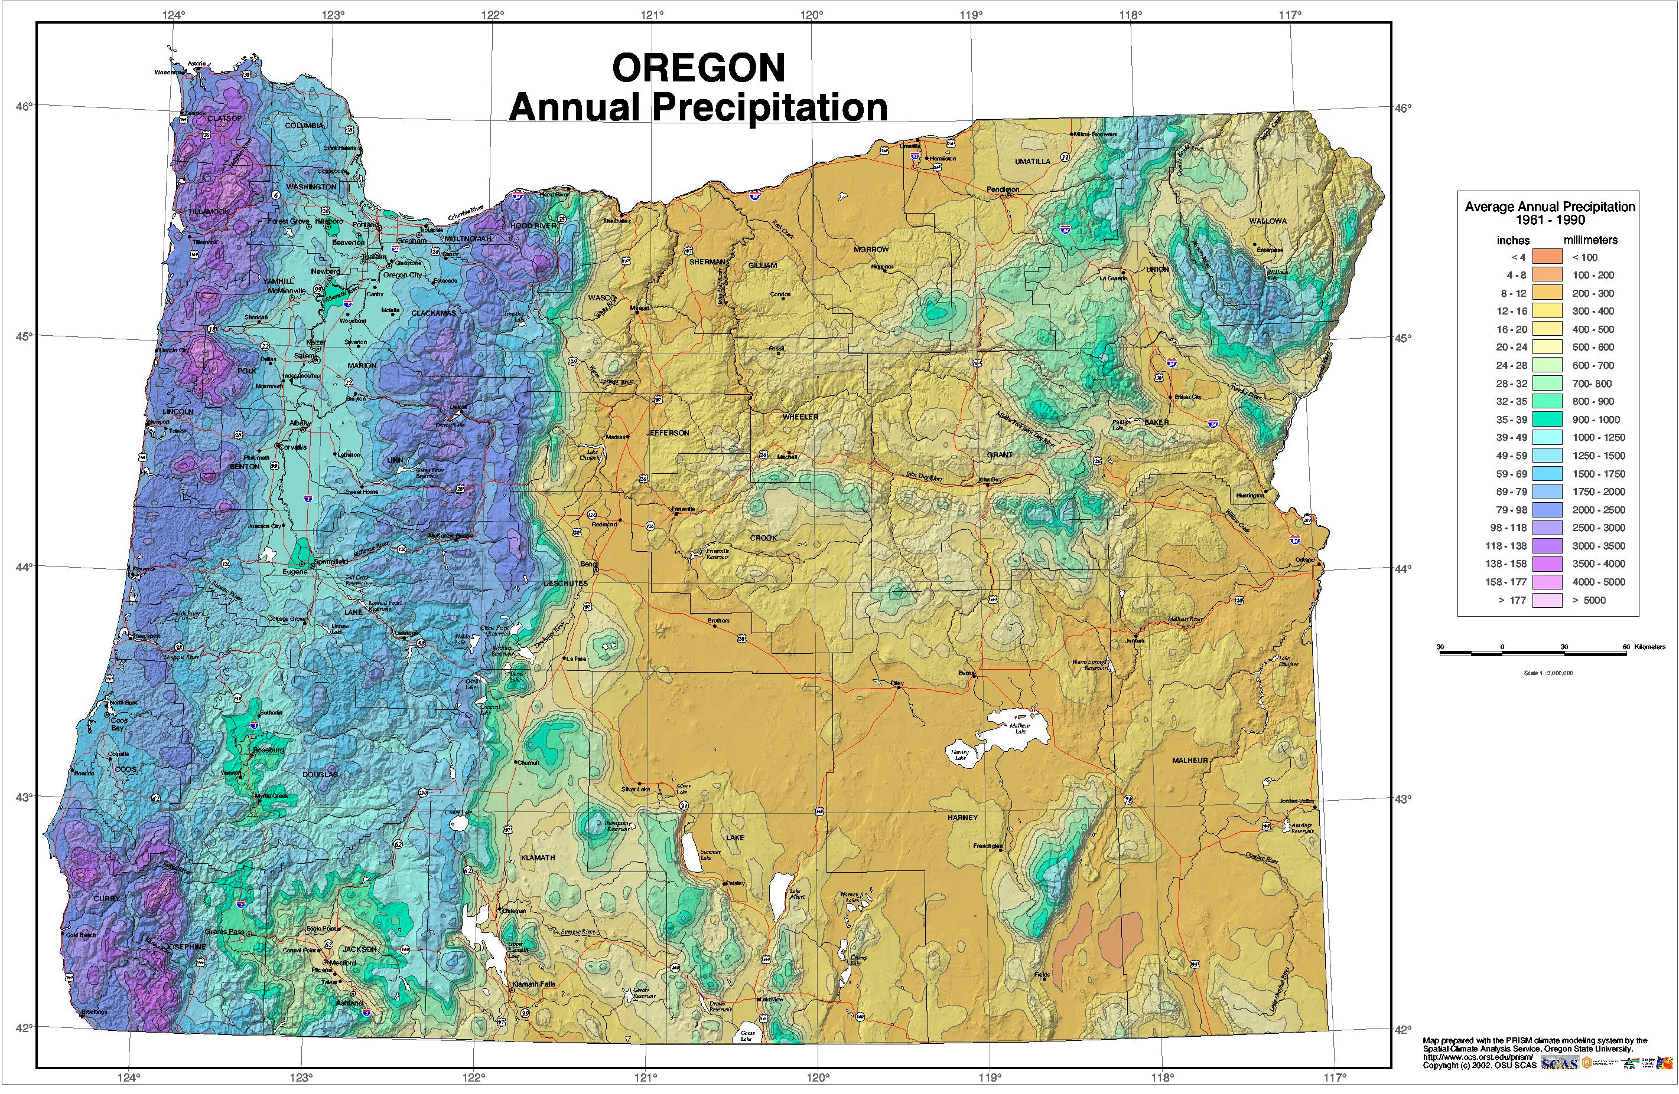
DMS Initial Thinning Study Sites
DMS Study Sites in Western Oregon

Slide 12
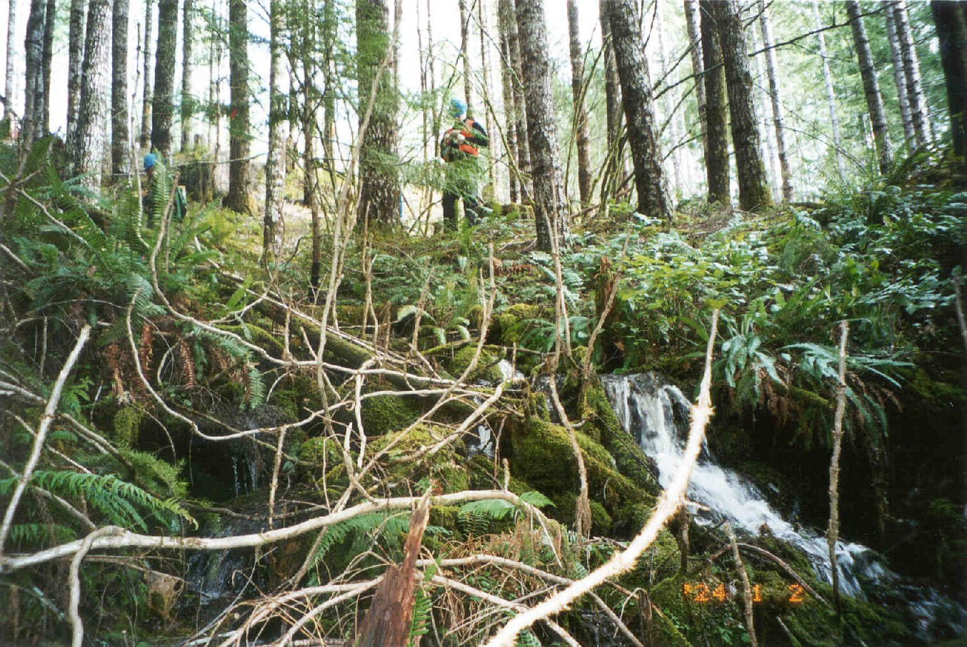


Density Management and Buffer Width Influences on Riparian Microclimate and Microsite
Paul D. Anderson
David J. Larson
Samuel S. Chan
Biology and Culture of Forest Plants Team
Pacific Northwest Research Station
USDA Forest Service
Notes:
Evaluation of alternative density management treatments intended to enhance the development of structural heterogeneity and biotic diversity in young, even-aged stands of Douglas-fir on BLM lands in western Oregon

Slide 13
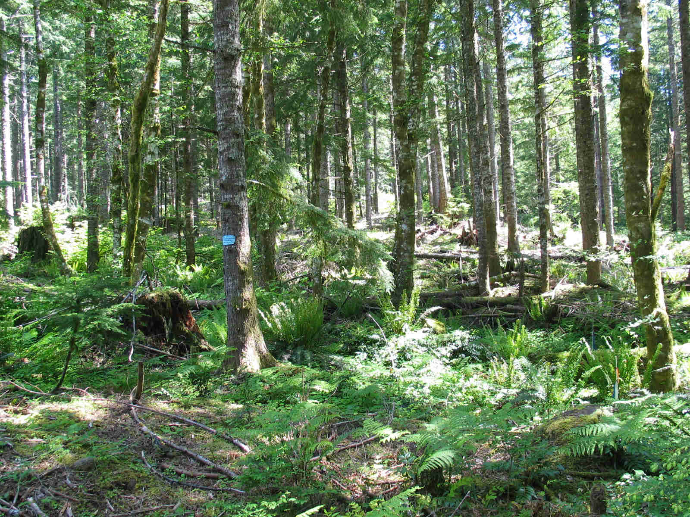
Objectives of the Riparian Buffer Microclimate/Microsite Study
Characterize spatial variation in microclimate
Determine effects of buffer widths and upland thinning treatments on microclimate
Quantify the relationship between canopy cover and understory light conditions
Characterize dynamics of tree canopy responses to thinning
Determine the influence of buffers and thinning treatments on understory vegetation

Slide 14
How Wide Should Buffers Be? Microclimatic Edge Effects
100
Soil Moisture
Radiation
Soil Temp
Air Temp
Wind Speed
Cumulative
Effectiveness (%)
Relative Humidity
0
0
0.5
1.0
2.0
3.0
Distance From Stand Edge into Forest
(tree height)
Redrawn From FEMAT (1994)
Notes:
Spatial variation with respect to edges created by the stream - riparian zone; and the buffer - upland thinning.
Depending on microclimate variable of concern, depth of edge effect varies

Slide 15
Factors influencing the effectiveness of buffers as a source of shade
Stand Structure
  Stand density
  Stand height
  Live crown length
  Foliage density
  Species composition
  Understory
  Down wood
Hydrophysiography
  Channel width
  Channel profile
  Stream orientation
  Stream depth
  Stream flow

Slide 16
Microclimate Gradients – Unthinned Stands
Summer Daily Extreme
Notes:
Temperature shows increase with distance from stream in uncut stands –
air temp gradient extending on average about 75 ft – similar distance as variable width buffers
soil temp gradient very sharp in first 15 ft – corresponds to hyporheic versus soil temperature (stream bed vs bank)
Relative humidity gradients extend for large distances upslope into uncut stands – gradients occur in absence of edge; - function of topographic relief and distance from open water surface or mesic riparian zone

Slide 17
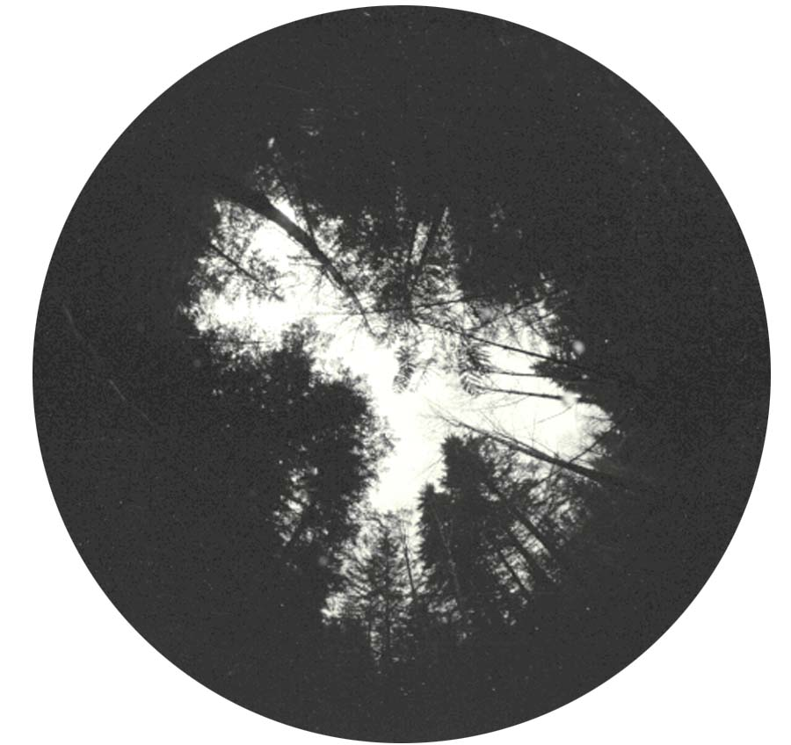
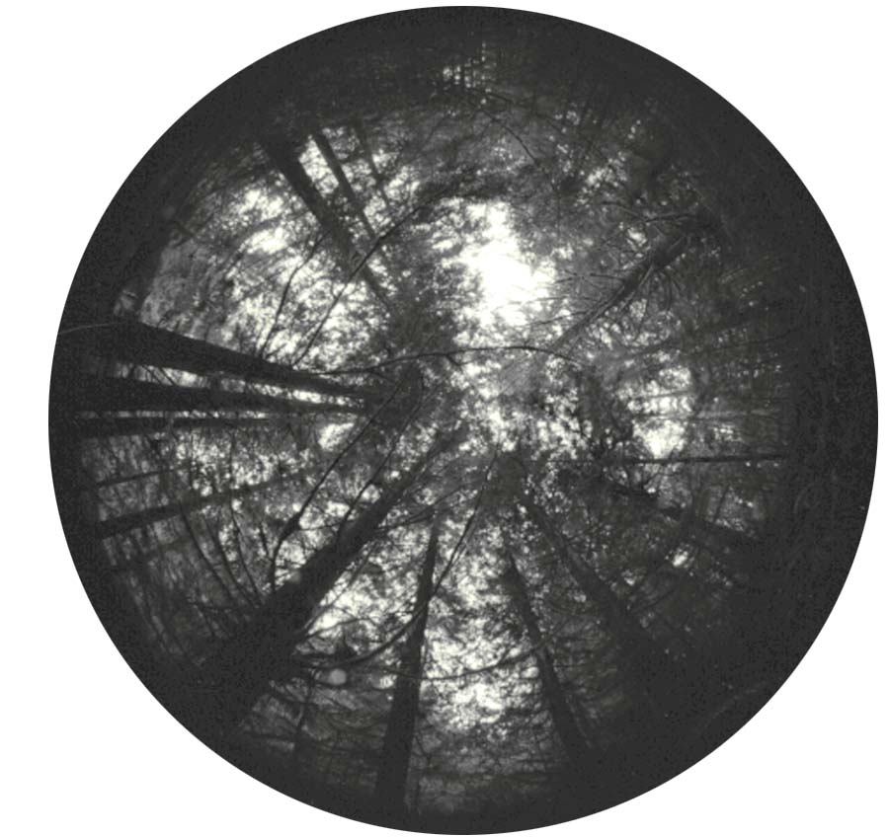
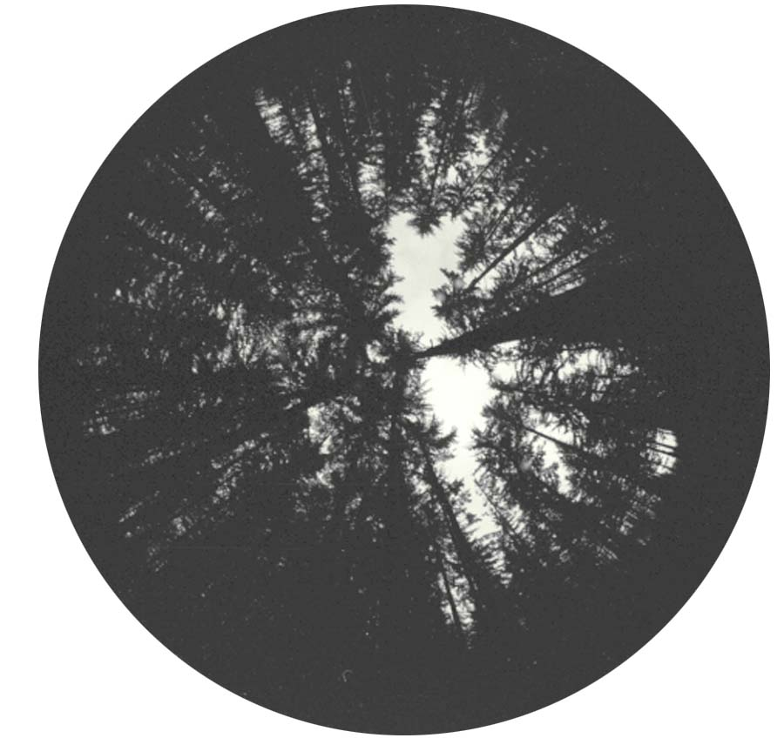
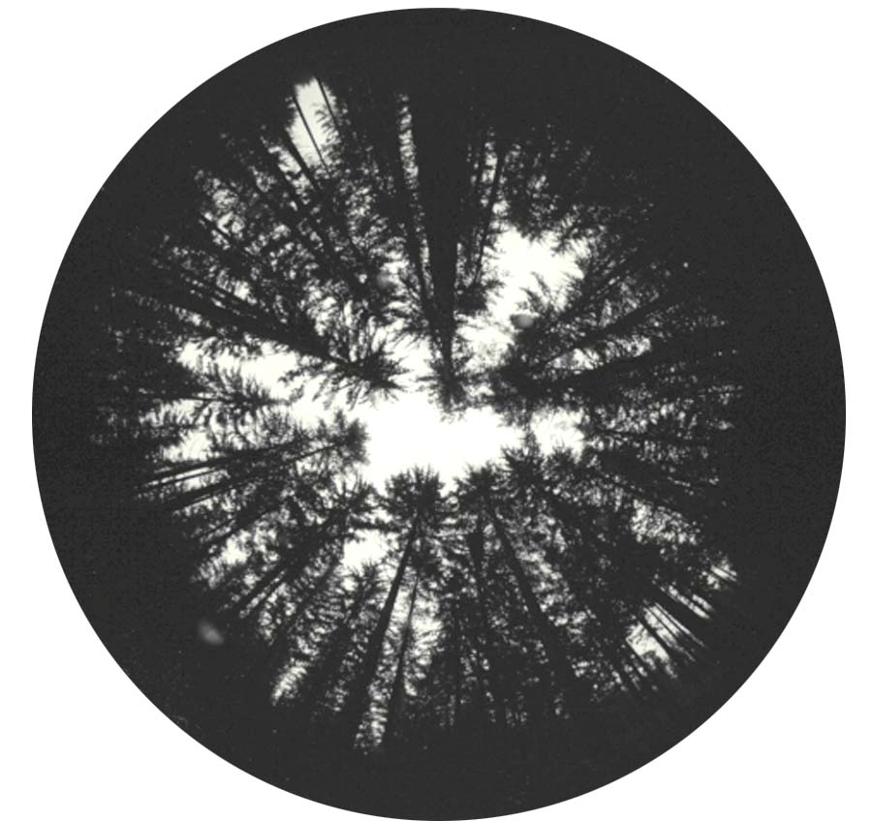
Canopy Transmittance Along “Typical” Transect:
A one-tree–height buffer into a moderate (80 tpa) thinning
Stream Center (0 ft) - 13%
Buffer (75 ft) - 5%
Buffer Edge / 80 TPA (255 ft) - 8%
80 TPA Thinning (375 ft) - 12%

Slide 18
Light Transmittance in Relation to Basal Area:
Observations Across Six DMS Sites
100
y = -9.332Ln(x) + 61.94
R² = 0.772
80
60
Visible Sky (%)
40
20
0
0
40
80
120
160
200
240
280
320
360
Basal Area (ft²)
Notes:
Percent visible sky does not change substantially with increases in basal area above approx 120 ft2/ac
Conversely, substantial increases in percent visible sky do not occur without thinning to residual basal areas less than 120 ft2/ac
Even with heavy thinning in 1-ac patch openings – only getting 30-80% visible sky – average about 58%
How low a basal area is needed to increase light levels for development of desired understory vegetation and habitat?

Slide 19
Basal Area – Light Relationships:
30-60 yr-old Douglas Fir
For each zone, circled means statistically differ from that of the unthinned control

Slide 20
Mean Daily Maximum Air Temperature by Zone
P=0.096
P=0.019
P=0.002
For each zone, circled means statistically differ from that of the unthinned control
Notes:
Significant treatment differences:
Stream - SRMD, VBPA tend to higher max temp than unthinned
Buffer – SRMD, VBPA, B1PA tend to have higher Tamax than unthinned
Upslsope – B1PA, VBPA higher Tamax than unthinned

Slide 21
Mean Daily Minimum Relative Humidity by Zone
P=0.167
P=0.075
P=0.019
For each zone, circled means statistically differ from that of the unthinned control
Notes:
Significant treatment differences:
Stream - None
Buffer – SRMD, B1PA tend to have lower Rhmin than unthinned
Upslsope – SRMD, B1PA, VBPA lower Rhmin than unthinned

Slide 22
Mean Daily Maximum Soil Temperature by Zone
P=0.602
P=0.057
P=0.021
For each zone, circled means statistically differ from that of the unthinned control
Notes:
Significant treatment differences:
Stream - none
Buffer –B1PA tended to have higher Tsmax than unthinned
Upslsope – B1PA tended to be higher Tsmax than unthinned

Slide 23
Microclimate Conclusions
Basal area in young Douglas-fir stands must be substantially reduced in order to achieve light levels that will potentially stimulate understory vegetation.
Differences in microclimate along transects with different buffer widths and upslope treatments tend to occur only during the warmest part of the day and in the upslope treated zone.
Microclimate is moderated within approximately 10m of the stream, regardless of upslope density treatment when buffered a minimum of 15-25 m.

Slide 24
Channel Orientation and Side Slope: Correlation with Microclimate
Microclimate Variable | Stream Width | Valley Width | Side Slope | Orientation
Temp Mean | -0.28 | -0.19 | 0.21 | -0.44
Temp Min | 0.04 | 0.06 | 0.52 | -0.64
Temp Max | -0.01 | 0.01 | 0.28 | -0.41
Temp Amp | 0.09 | 0.02 | 0.10 | -0.24
RH mean | -0.10 | 0.02 | -0.20 | 0.70
RH Min | -0.20 | -0.05 | -0.04 | 0.53
RH Max | -0.19 | 0.11 | -0.23 | 0.67
RH Amp | 0.09 | 0.05 | 0.01 | -0.49
Notes:
For headwater streams typical of the density Management Study
A variety of channel orientations and side slopes
Air temperature and Relative humidity above the stream were strongly correlated to stream orientation
Minimum daily air temperature was strongly correlated to side slope
Channels oriented in the general E-W direction experience less thermal stress than those oriented more N-S as topographic shading is more effective in the former

Slide 25
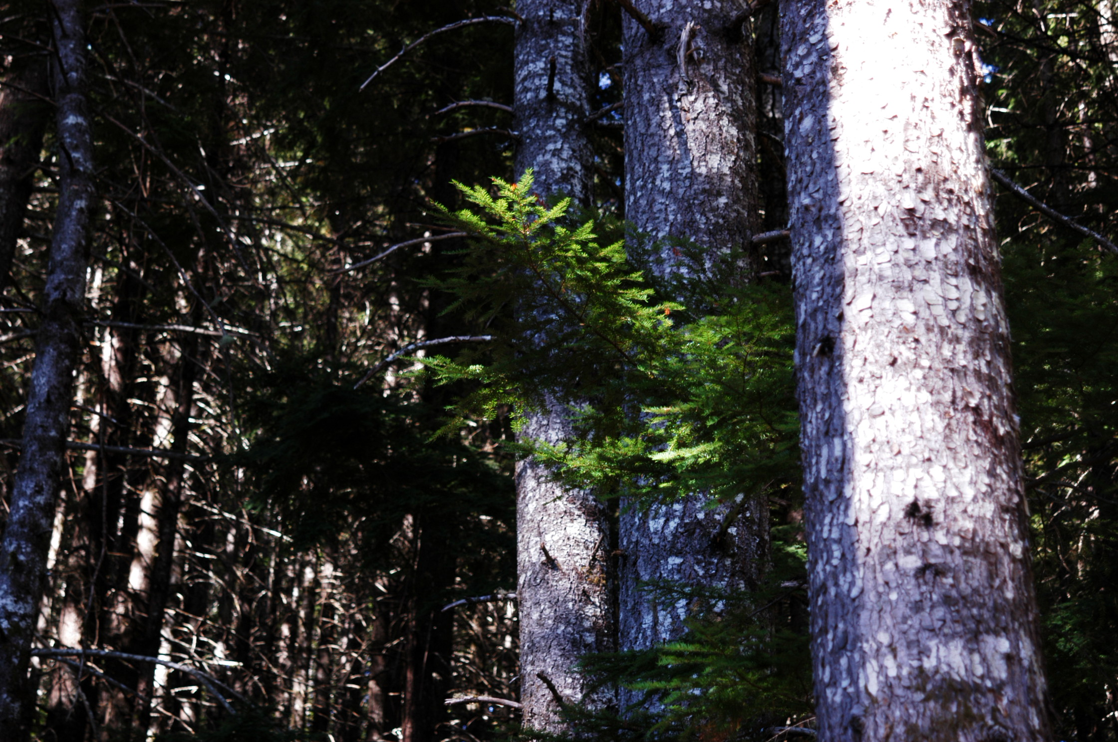
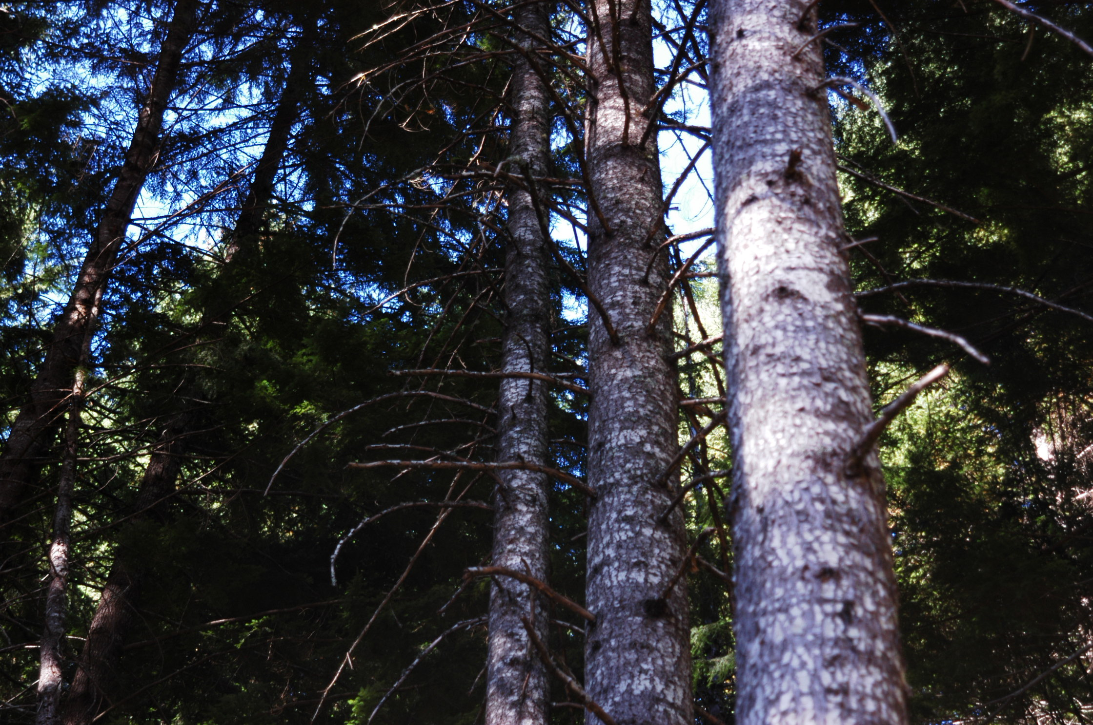
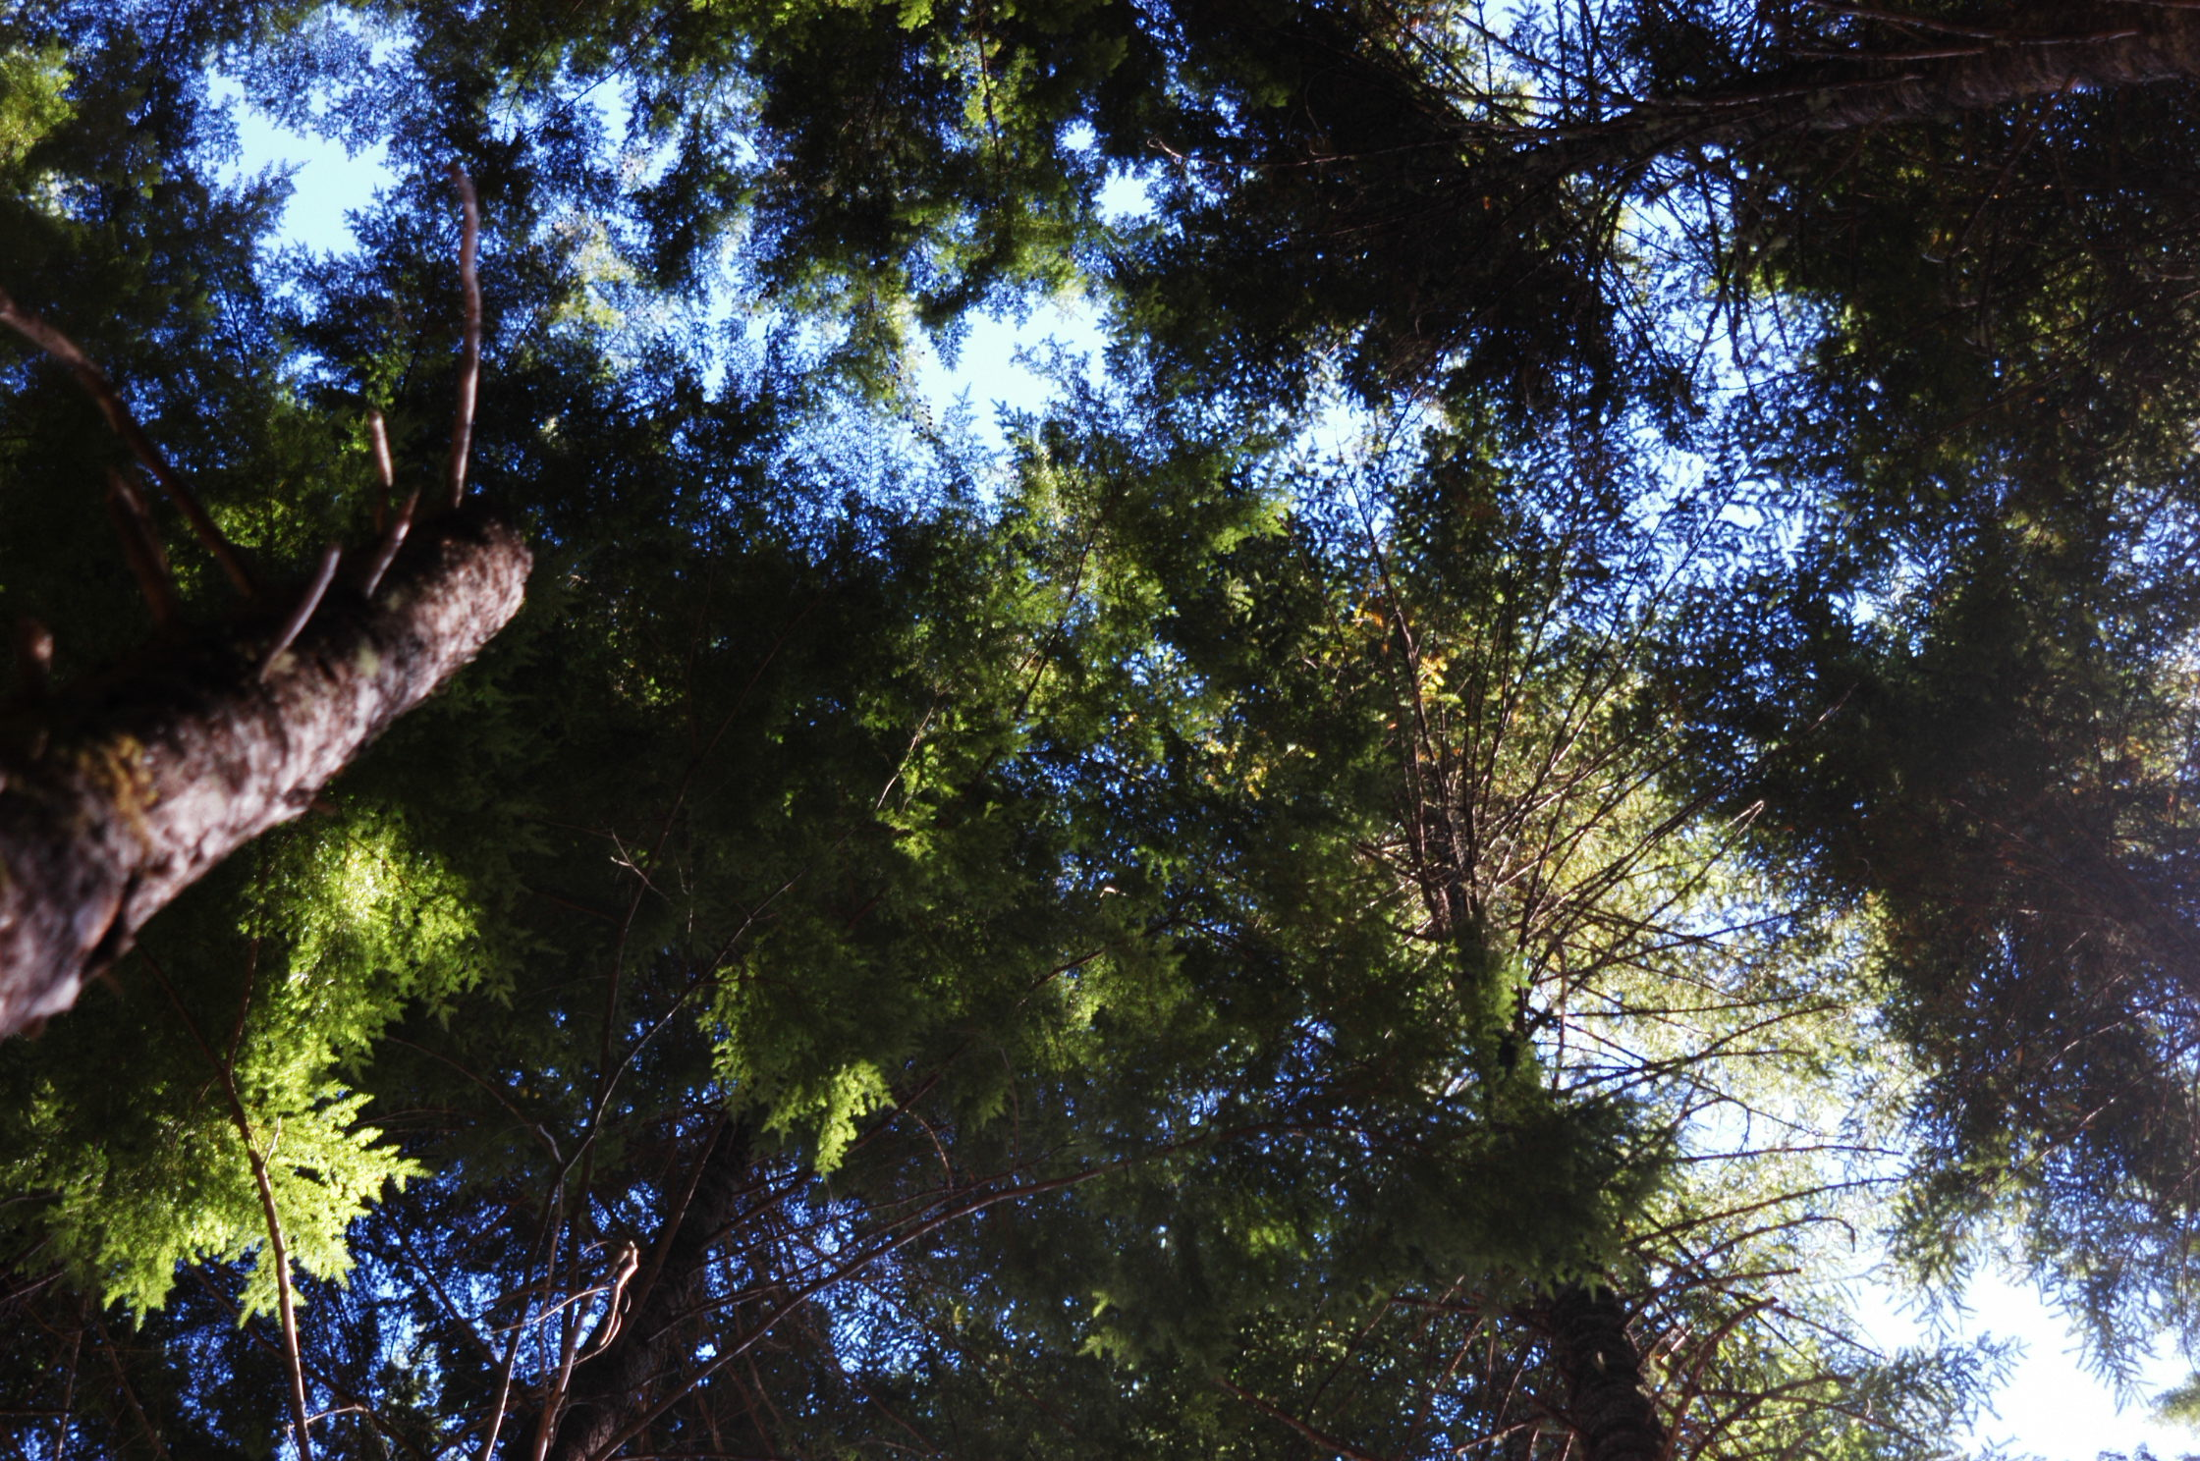
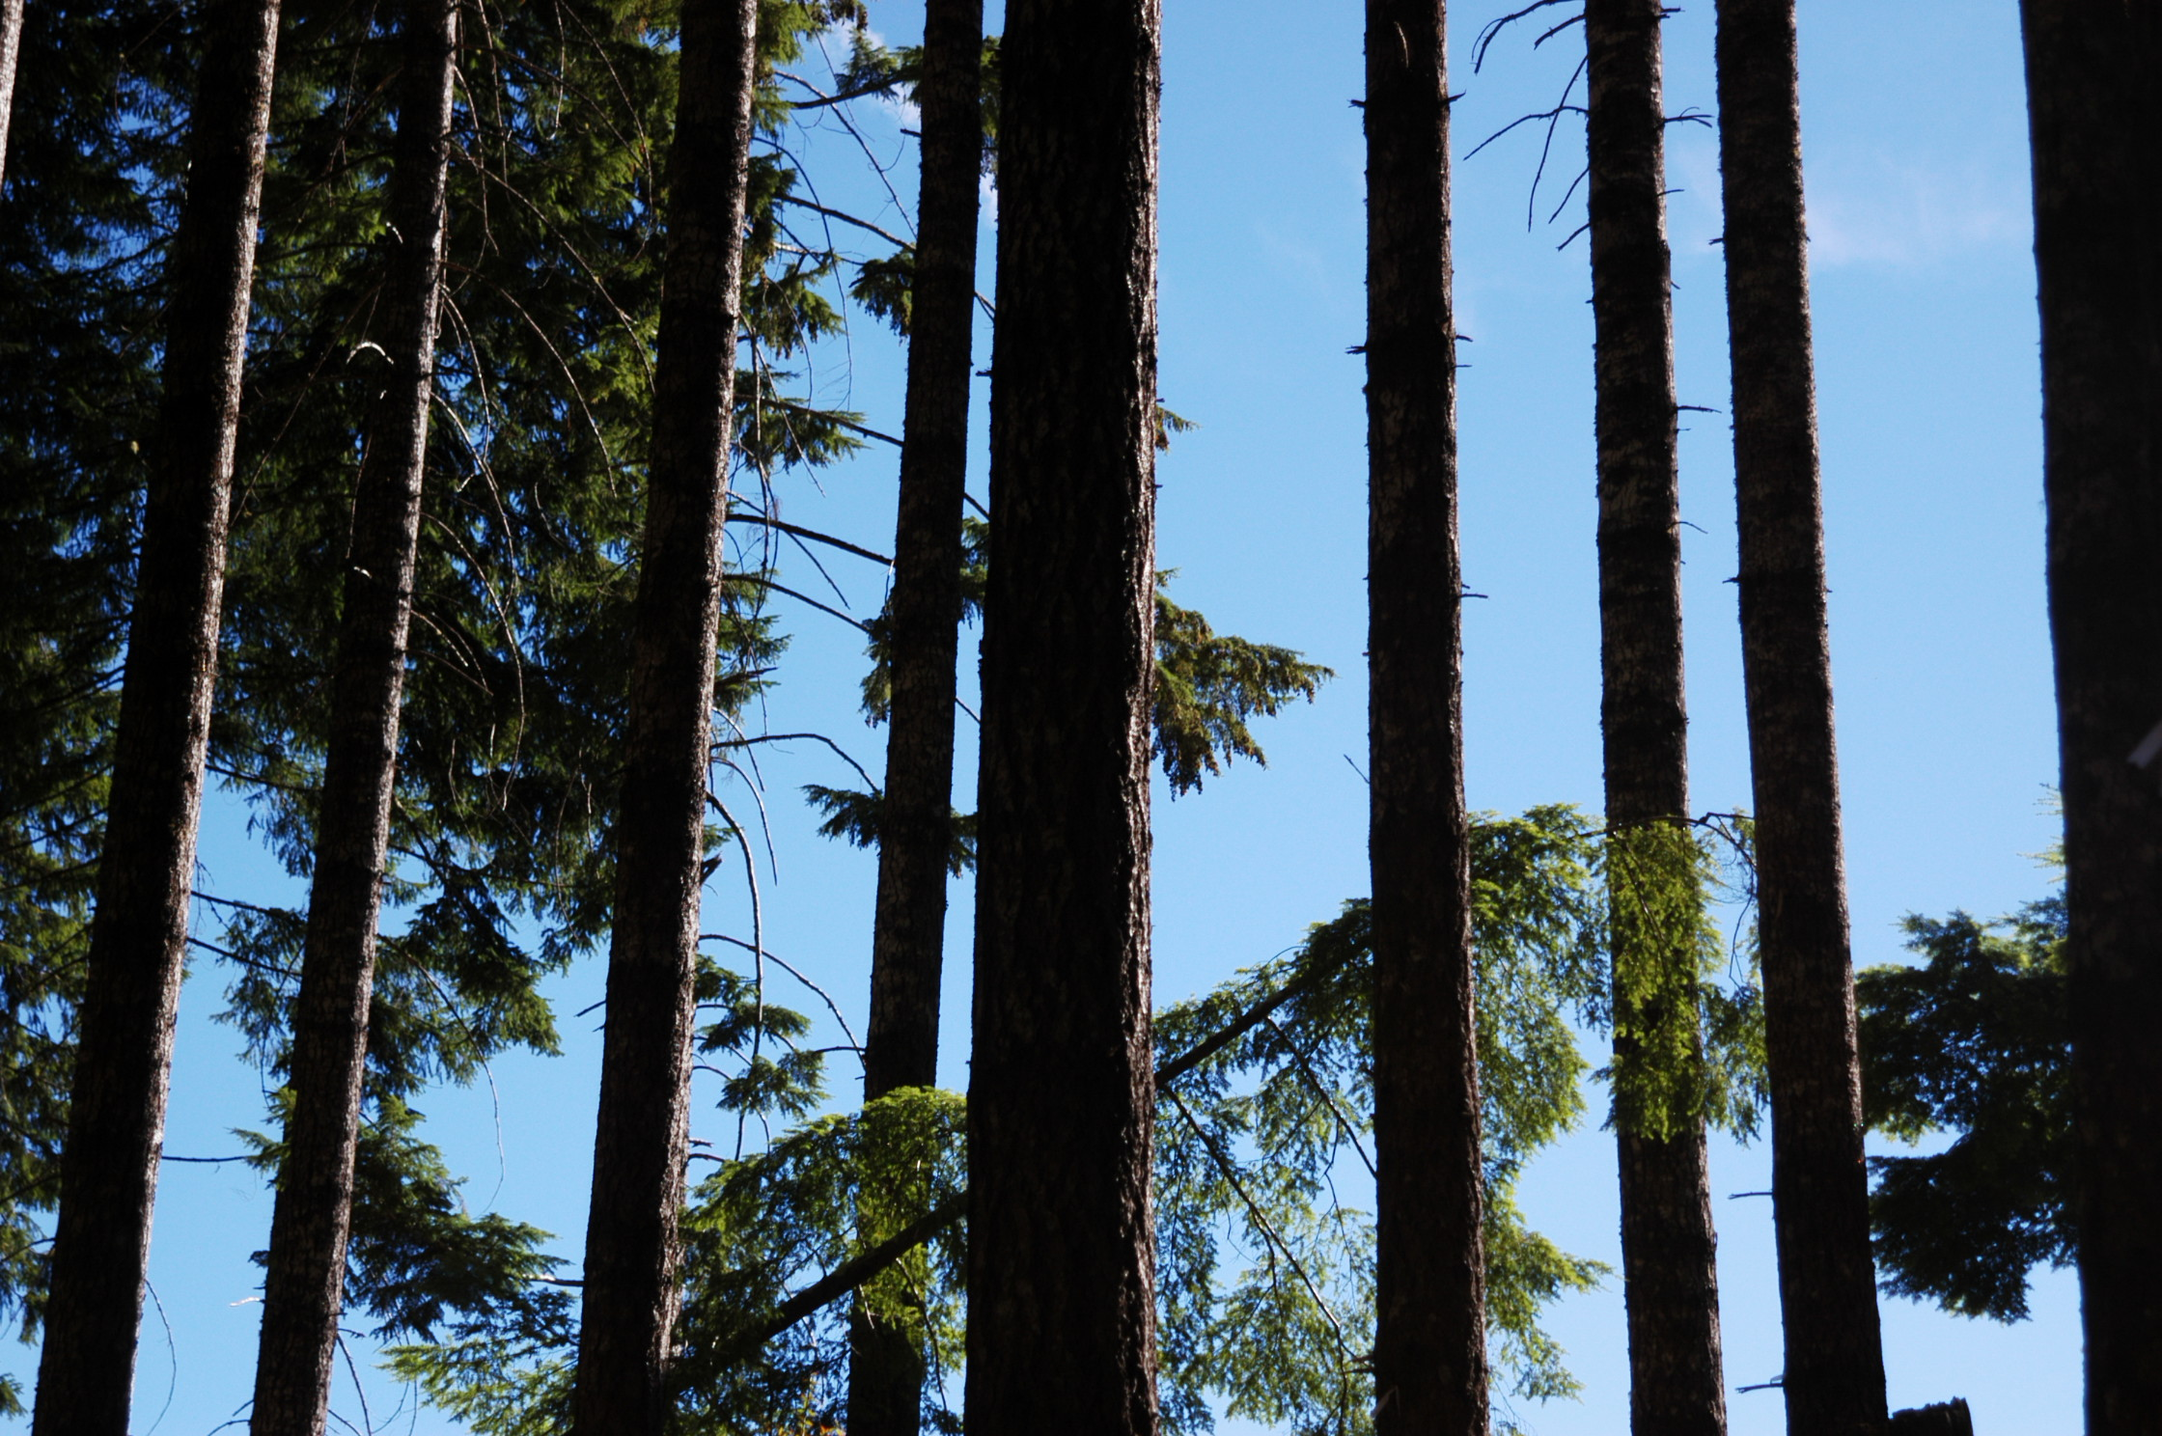
Canopy Density in the Shade Zones:
Correlation with Microclimate
Microclimate Variable | 6 am Secondary | 10 am Primary | 2 pm Primary | 6 pm Secondary | DIFN
Temp Mean | -0.28 | -0.19 | 0.21 | 0.32 | -0.44
Temp Min | 0.04 | 0.06 | 0.52 | 0.72 | -0.64
Temp Max | -0.01 | 0.01 | 0.28 | 0.22 | -0.41
Temp Amplitude | 0.09 | 0.02 | 0.10 | 0.09 | -0.24
RH Mean | -0.10 | 0.02 | -0.20 | -0.41 | 0.70
RH Min | -0.20 | -0.05 | -0.04 | -0.16 | 0.53
RH Max | -0.19 | 0.11 | -0.23 | -0.46 | 0.67
RH Amplitude | 0.09 | 0.05 | 0.01 | 0.17 | -0.49
6 am
10 am
2 pm
6 pm
Notes:
For DMS headwater streams associated with uniform, relatively dense canopies summer daily microclimate, full-leaf conditions ---
Angular canopy density is a metric describing the amount of visible sky blocked along the direct path of the sun to a point in forest – If you were to look directly at the sun, how much of the sky would be blocked from view by vegetation.
While an important variable in shade models – we generally observed low correlations between daily temperatures above the stream and canopy density
Greatest correlation occurred with low sun angle (afternoon secondnary shade zone).
In general there was greater correlation between microclimate and diffuse light
Angular canopy density may be more important where sites are flat, canopies are heterogeneous or sparse, and canopies do not extend fully across the stream channel

Slide 26
Preliminary Conclusions:
Shade Analysis for Headwater Streams
Topographic shading is an important element of stream shading in headwater streams.
Streams with a general east-west orientation tend to receive more topographic shading
Streams with steep side slopes tend to receive more topographic shading
Vegetation shading effectiveness increases with tree height and canopy density
The relative importance of topographic shading as compared to canopy shading is difficult to discern in areas of relatively dense, uniform canopy.

Slide 27
Buffers with Thinning:
Headwater Habitats and
Aquatic Vertebrates
Dede Olson
USDA Forest Service, PNW Research Station
Notes:
The Riparian Buffer Study is a component of the BLM Density Management Studies of Oregon. These studies are examining managed forest resources and effects of alternative forest management treatments to provide knowledge to better meet expected priorities of the western Oregon forest landscape in the next 20 years. In particular, the Aquatic Vertebrates and Habitats component of the Riparian Buffer Study is identifying biological values in headwater subdrainages. Biota in headwater subdrainages are not well-studied in the Pacific Northwest due to a prior focus on larger downstream reaches populated by anadromous salmonids. Basic characterization of headwater habitats and fauna will contribute to a better understanding of their ecological roles within the forested landscape. This is a critical information need to add specificity to Aquatic Conservation Strategy Objectives of the Northwest Forest Plan and to provide science support for local management decisions. This study also examines the effects of thinning upslope of 4 riparian buffer widths on instream vertebrates. These riparian management treatments include thinning both outside and within Northwest Forest Plan Interim Riparian Reserves, to within 20 ft of headwater streams. Year 1, 2, and 5 post-treatment sampling of in-channel habitats and vertebrates (12 sites) and upslope amphibians and mollusks (2 sites) is proceeding as planned. Post-treatment Year 2 sampling is now completed at 12 sites, and data management and analyses of treatment effects are ongoing. Our post-treatment results will help guide project to watershed scale management decisions relative to designating riparian protection in all land allocations. At a subset of study sites, our study also examines the effects of thinning on terrestrial ground-dwelling fauna such as amphibians and mollusks. Lastly, our study will result in recommendations for streamlined survey methodologies to contribute to cost-effective long-term monitoring programs.
The views of this presentation are those of the author and do not necessarily represent the views of the funding agency

Slide 28
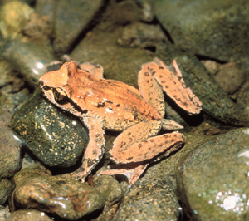
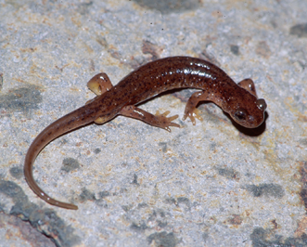
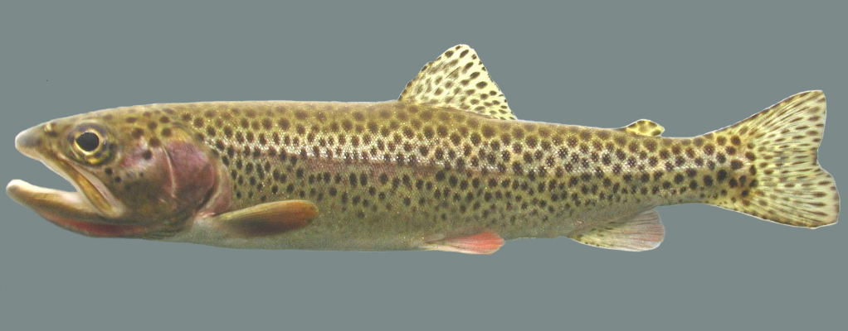
Objectives
Characterize aquatic habitats and vertebrates in headwaters
Examine effects of joint thinning and buffers on aquatic vertebrates and habitats

Slide 29
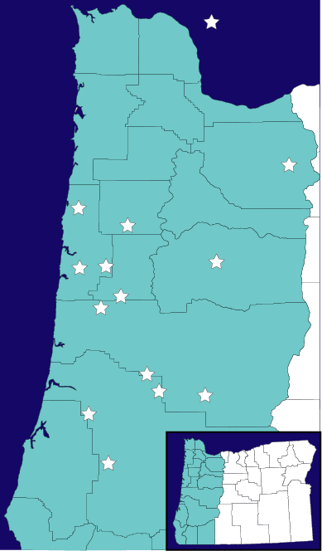
Density management and riparian buffer
study sites
Forest Service Site
Notes:
The Riparian Buffer Study was designed to be implemented at 13 sites in western Oregon, ranging from near Mount Hood to Coos Bay. Three sites occur on Forest Service lands, and 10 on BLM lands. The 3 Forest Service sites and 7 BLM sites are in young managed stands, ages 30-50 yrs, naturally regenerated. Three BLM sites are in an older age class, 70-80 years, two of which have been previously thinned and one not. These sites offer a forward look into possible riparian restoration treatments of older stands. For the purpose of analyses presented today, all sites are combined.

Slide 30
Characterizing Headwaters
Notes:
Of 13 sites, one site has not been implemented due to its occurrence in the Umpqua Cutthroat basin. One other site has a somewhat compromised layout, after implementation, due to buffers not being equally applied on both sides of all streams.
Hence:
Pre-treatment data analyses summarize findings at 13 sites.
Post-treatment data analyses summarize findings at 11 sites.
Methods:
Stream reaches were sampled for both instream and bank animals.
Instream: Hand searches were conducted when effective (not deep water).
Electroshocking was conducted in deep water.
Random stratified subsampling, following a modified Hankin-Reeves
design.
Bank: At instream units, each bank was searched for 5 min., area of search estimated.
Entire reaches were habitat typed: fast/slow units, unit size, substrate, wood.
Analyses:
Multivariate regression was used to explore species-habitat associations. Anova mixed procedure (SAS) was used to examine treatment effects. Pairwise comparisons of means were conducted with t-tests and Kruskal-Wallis tests.
Special thanks to Loretta Ellenburg for leading the collection of all data!
Special thanks to George Weaver for analyses of pretreatment data, and to Cindy Rugger for data management and analyses of instream and bank treatment effects.

Slide 31
Spatially Intermittent Streams Frequent
Type: 1 2 4 5 6 7
Perennial Summer Intermittent
Intermittent
Olson and Weaver (2007)
Notes:
Initially, there was no assumption about the definition of a stream channel in headwaters. Channels were surveyed in spring and summer, and subsequently classified as wet (perennial channel), intermittent (spatial intermittency, the water went subsurface), dry (no surface flow apparent but evidence of past scour and/or deposition), and above water (no evidence of scour or deposition). Consequently data were collected from a variety of channels that included some which never appeared to have running water (dry-dry, above water). Seven “hydrotypes” were seen in headwaters, as shown in this graph. The dominant stream channel (with water) hydrotype at our sites was Intermittent-Intermittent, which had sections of the reach running subsurface in both spring and summer.
Patterns of stream fauna were found with regard to hydrotype.

Slide 32
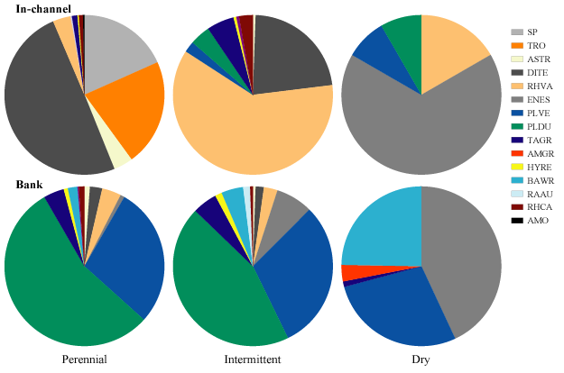
Characterizing Headwaters: Fauna
Fish
Torrent salamanders
Coastal giant salamanders
OR slender salamanders
Dunn’s salamanders
Ensatina
Western red-backed salamanders
Olson and Weaver (2007)
Distinct assemblages associated with hydrology, gradient, down wood and stream size
Headwaters species to assess : sculpins, tailed frogs, torrents
Notes:
The amphibian assemblages upslope of streams were examined at 2 sites. These assemblages were dominated by 2 species. At the Keel Mtn. site, they were Ensatina and Oregon Slender Salamander. At Green Peak, they were Ensatina and Western Redback Salamander. Their distributions along transects perpendicular to streams showed no riparian association.

Slide 33
Treatment Effects
Riparian Buffers
Leave Islands
Forest Thinning
Notes:
We examined the effects of stream buffers on the instream and bank species at 11 sites, and on upslope species at 2 sites.

Slide 34
Treatment Effects
Year 1:
Stream Habitat
Stream and Bank Animals
Upland Salamanders
Years 2-5:
Upland Salamanders (+ other spp)
Leave Islands
Years 5-6:
Stream and Bank Animals
Upland Salamanders
Down Wood Thermal Regimes
Notes:
We examined the effects of stream buffers on the instream and bank species at 11 sites, and on upslope species at 2 sites.

Slide 35
Treatment Effects
Years 1-2:
Stream Habitat
Stream and Bank Animals
Upland Salamanders
Years 1-5:
Upland Biota
Leave Islands
Microclimates
Years 5-6:
Stream and Bank Animals
Upland Salamanders
Down Wood Thermal Regimes
Olson & Rugger (2007): 11 sites
Rundio & Olson (2007): 2 sites
Wessell, Olson & Schmitz (in prep.): 4 sites
Olson, Rugger & Suzuki (in prep.): 11 sites
Kluber, Olson & Puettmann (submitted): 3 (1)
Notes:
We examined the effects of stream buffers on the instream and bank species at 11 sites, and on upslope species at 2 sites.

Slide 36
Treatment Effects
Years 1-2:
Stream Habitat
Stream and Bank Animals
Upland Salamanders
Years 1-5:
Upland Biota
Leave Islands
Microclimates
Years 5-6:
Stream and Bank Animals
Upland Salamanders
Down Wood Thermal Regimes
No Negative Treatment Effects
Mixed Treatment Effects: 1 site yes, 1 site no
Mixed Treatment Effects:
More amphibians in some leave islands and unthinned, More plants in thinned areas, LS plants in unthinned
1-acre islands have “interior” microclimates
One Treatment Effect: Fewer bank PLVE
No Treatment Effects
Some Distance-from-Stream Effects
Small and Large Diameter Wood and Substrates Retained Cool Temperatures
Notes:
We examined the effects of stream buffers on the instream and bank species at 11 sites, and on upslope species at 2 sites.

Slide 37
Caveats
Lack of consistent treatment effects may be due to…
Inference of findings restricted to…
Detectability issues
Power issues
Spatial scale issues
Study sites

Slide 38
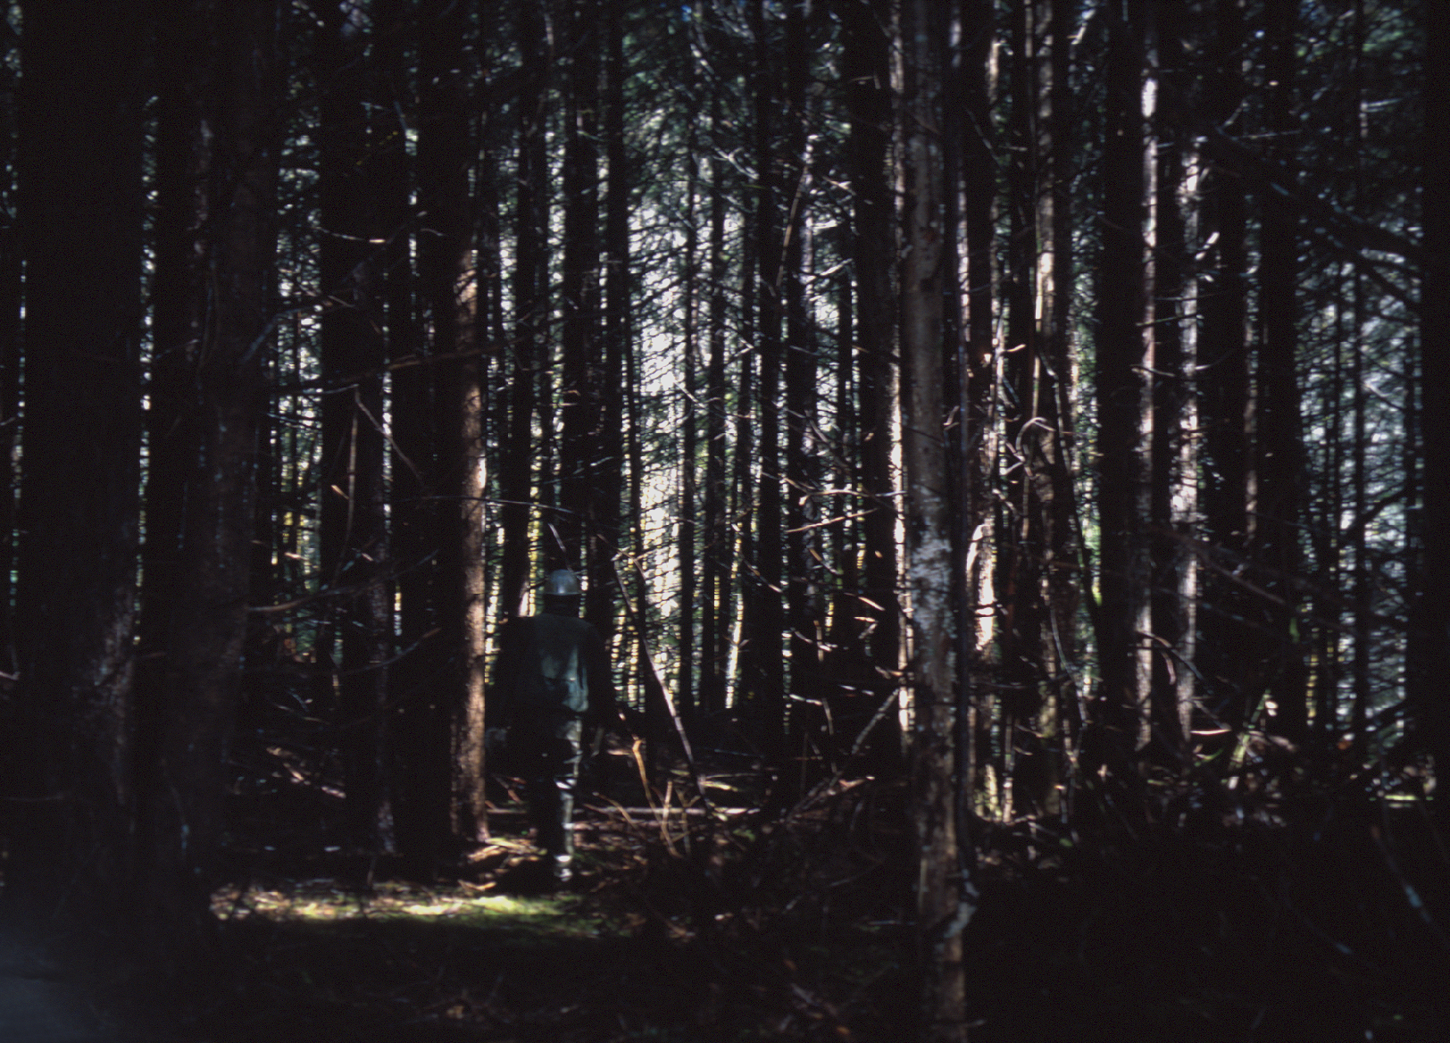
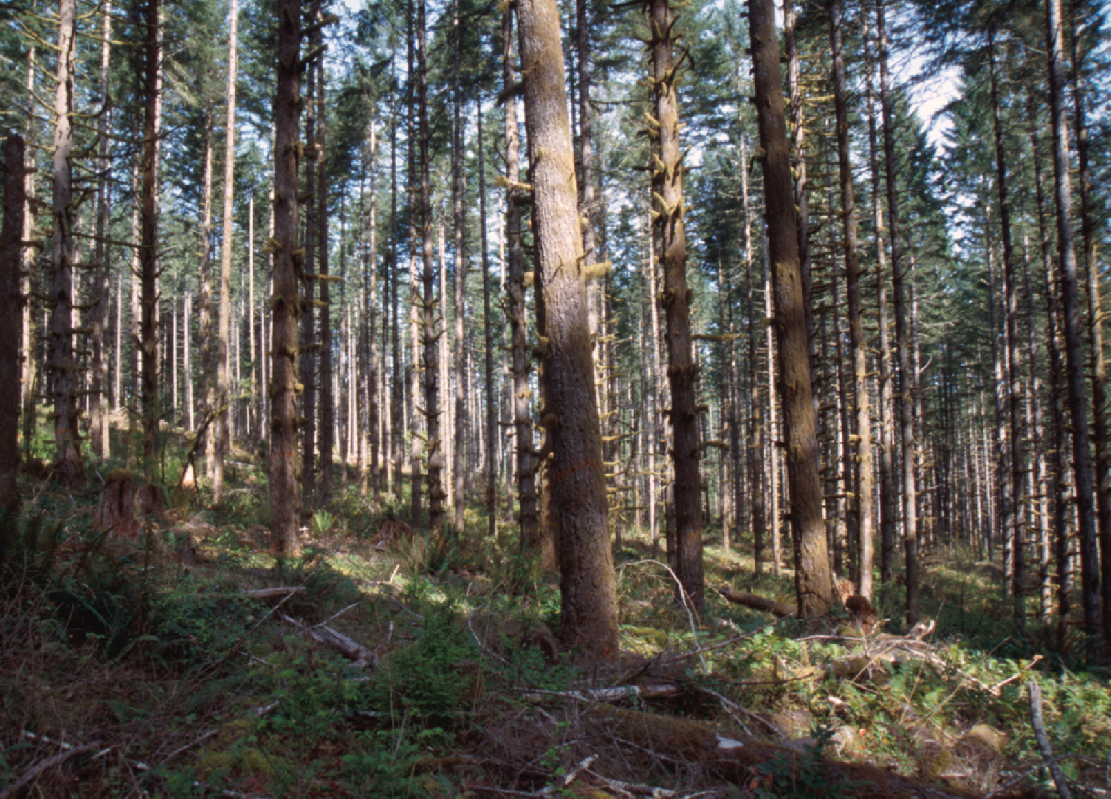
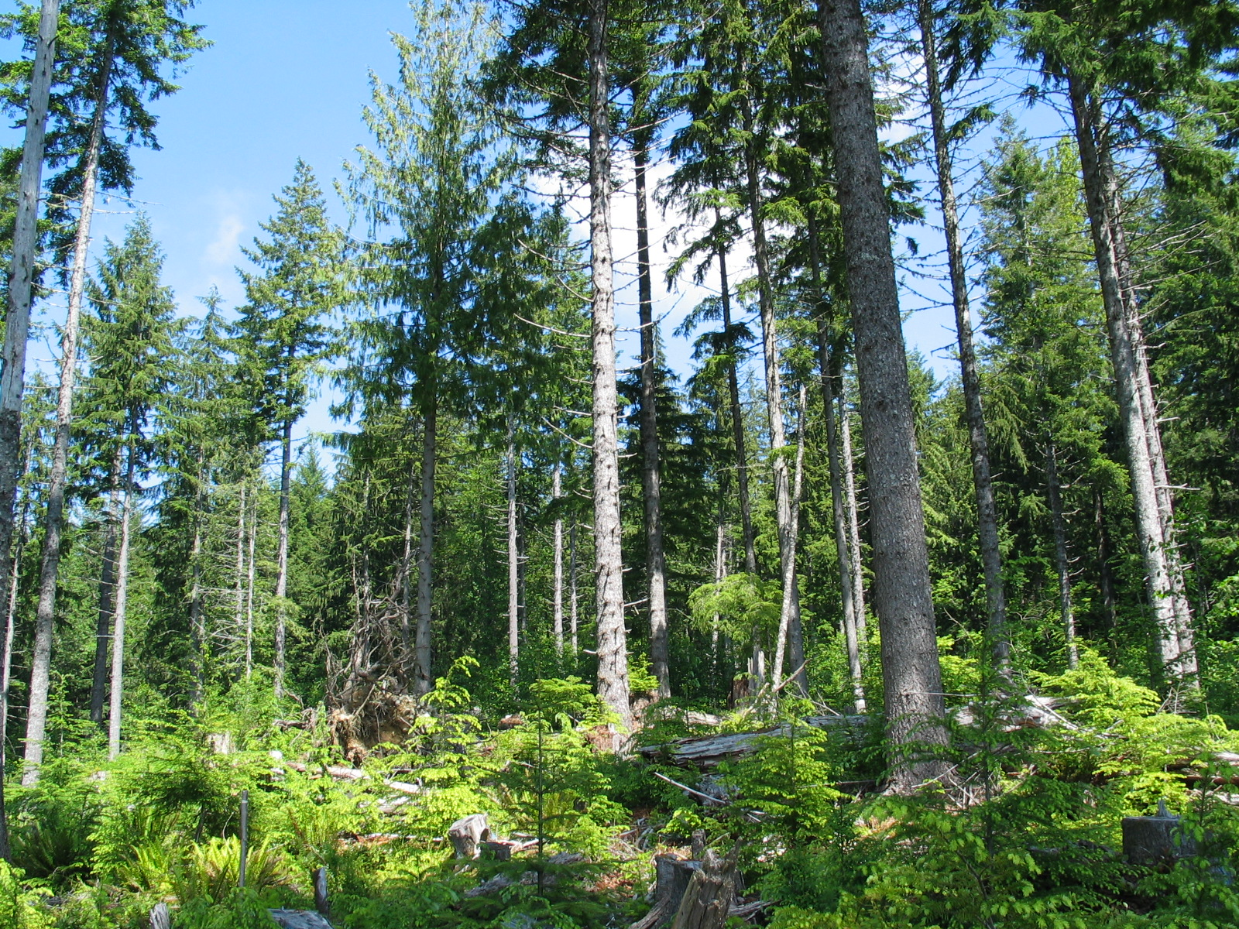
Oregon BLM Density Management Studies
PHASE 2
~240 TPA
80 TPA
~30TPA
Retained Buffers
N = 8 Sites
Thin-throughBuffer
N = 2 Sites
Notes:
Due to the study site sizes and geometry of streams in selected study sites, it was not possible to explore each of the 3 density management upslope treatments with the 4 riparian buffer widths. Hence, we chose to focus the riparian buffer study in one upslope treatment, the moderate thinning (80 TPA). As feasible at each study site, we attempted to fit as many buffer widths into the 80 TPA thinning treatment. At each site, stream reaches in control units also were included in the study.

Slide 39
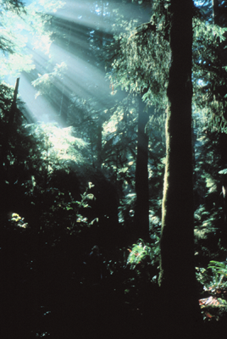

Overall Summary
Multiple headwater vertebrate assemblages
No dramatic thinning/ buffer effect, so far
Some patterns with bank/upland salamanders
Phase 2 beginning
Notes:
Our investigations have added knowledge to the complexity of amphibian assemblages in headwaters. Species have associations with intermittent streams and headmost areas of channels.
Preliminary results of the effects of thinning are emerging. Results are variable. No dramatic negative effect on abundance or stream occupancy have been seen across stream reaches, but some trends are being explored. Fish in 4 reaches disappeared, we are looking at why. Do fish have more of a mobile life history in headwaters? Six species of amphibians tended to occupy more reaches, however with incidental numbers, post-thin. Bank salamander abundances showed both positive and negative responses to treatment. Site-specific negative effects of thinning were seen for terrestrial salamanders.
Ongoing surveys of these reaches are occurring in year 5 post-thin.

Slide 40
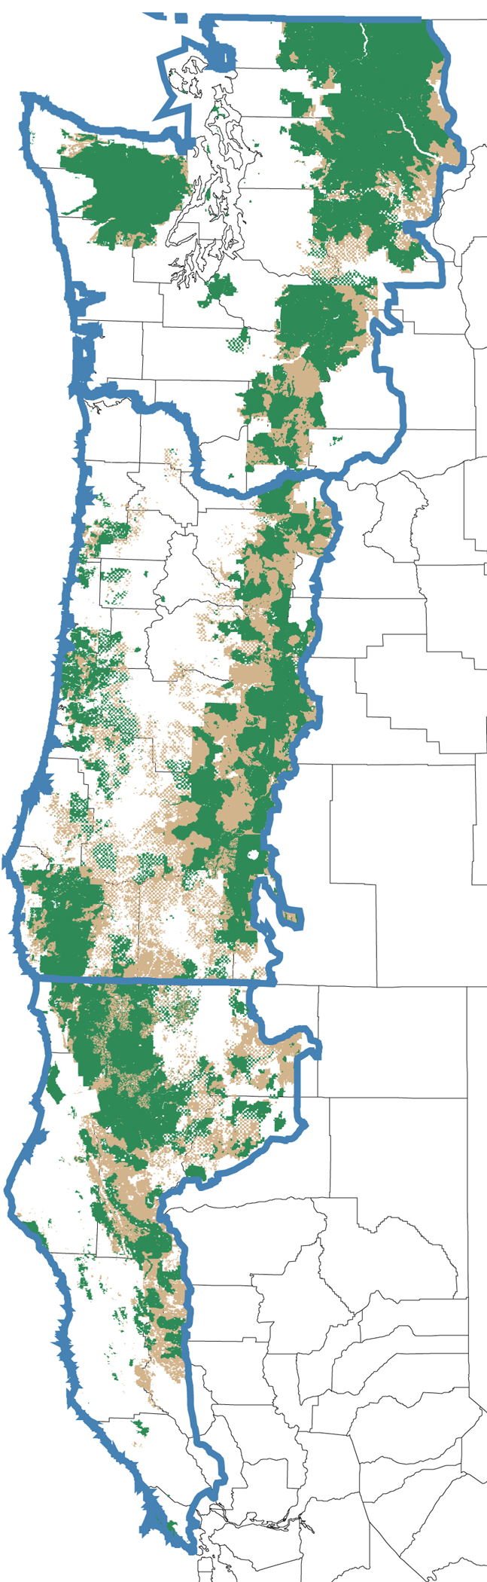
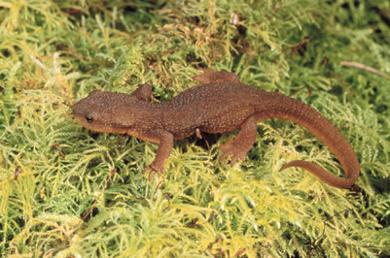
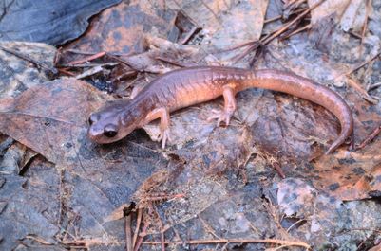
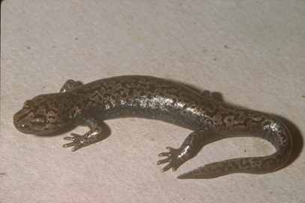
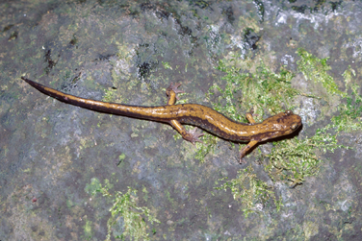
Reflection: While some taxa are protected at landscape scales as broad species distributions intersect protected lands …
…species persistence at smaller spatial scales is important for maintaining intact ecological systems.
Notes:
Map shows federal lands of the Northwest Forest Plan: green areas are reserved lands and brown areas are managed lands.

Slide 41
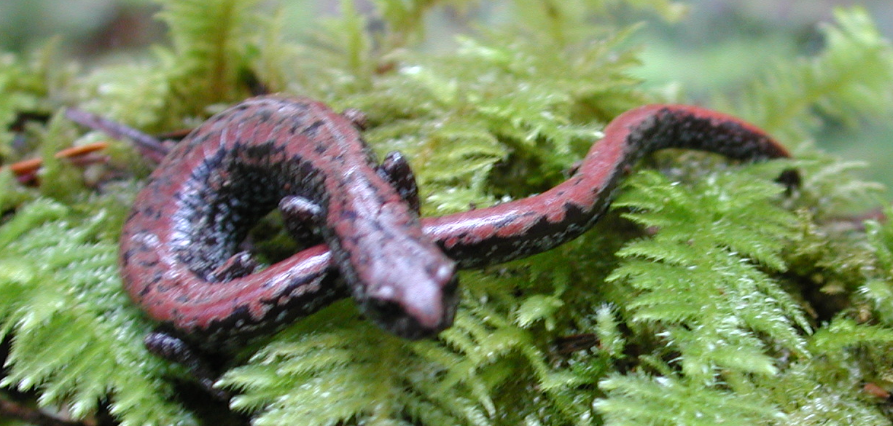
Rarer headwater-dependent species may require stand scale management
PATCHY DISTRIBUTIONS
DISPERSAL LIMITATIONS and RESTRICTED HABITAT
Notes:
Site-specific conditions may need to be taken into consideration for rare species. This may include stream density, stream occupancy by species, down wood, and talus.

Slide 42
Distances Detected from Streams
Species | Distance (m) | Reference
DITE, ASTR, PLDU, PLVE, ENES, ANFE, TAGR, RAAU | 400 | McComb et al. 1993a
ASTR, DITE, RHsp, PLDU, BAWR, PLVE, RAAU, TAGR | 200 | Gomez and Anthony 1996
DITE, ASTR, PLVE, ENES, TAGR, AMGR, RAAU | ~135 | McComb et al. 1993a
Notes:
Site-specific conditions may need to be taken into consideration for rare species. This may include stream density, stream occupancy by species, down wood, and talus.

Slide 43
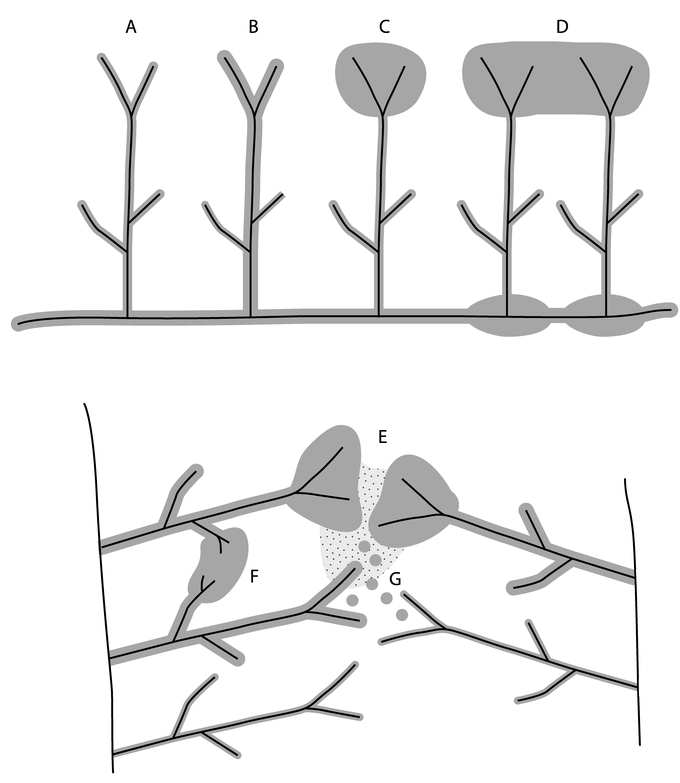
Designs to Integrate Stream and Upland Forest Management for Amphibians
Olson, Anderson et al. 2007
Notes:
Site-specific conditions may need to be taken into consideration for rare species. This may include stream density, stream occupancy by species, down wood, and talus.

