Slide 1
Curran Junetta Thin
Suzanne Schindler, Project Team Leader/Silviculturist
Cottage Grove RD, Umpqua NF
(541)767-5040, sschindler@fs.fed.us
Leslie Elliott, Silviculturist
Detroit and Sweet Home RD, Willamette NF
(541) 367-3961, ljelliott@fs.fed.us
Notes:
Introduction
Overview: will answer Questions 1-11 of Workshop Questionnaire
Flow of presentation –Big picture to Unit Prescription

Slide 2
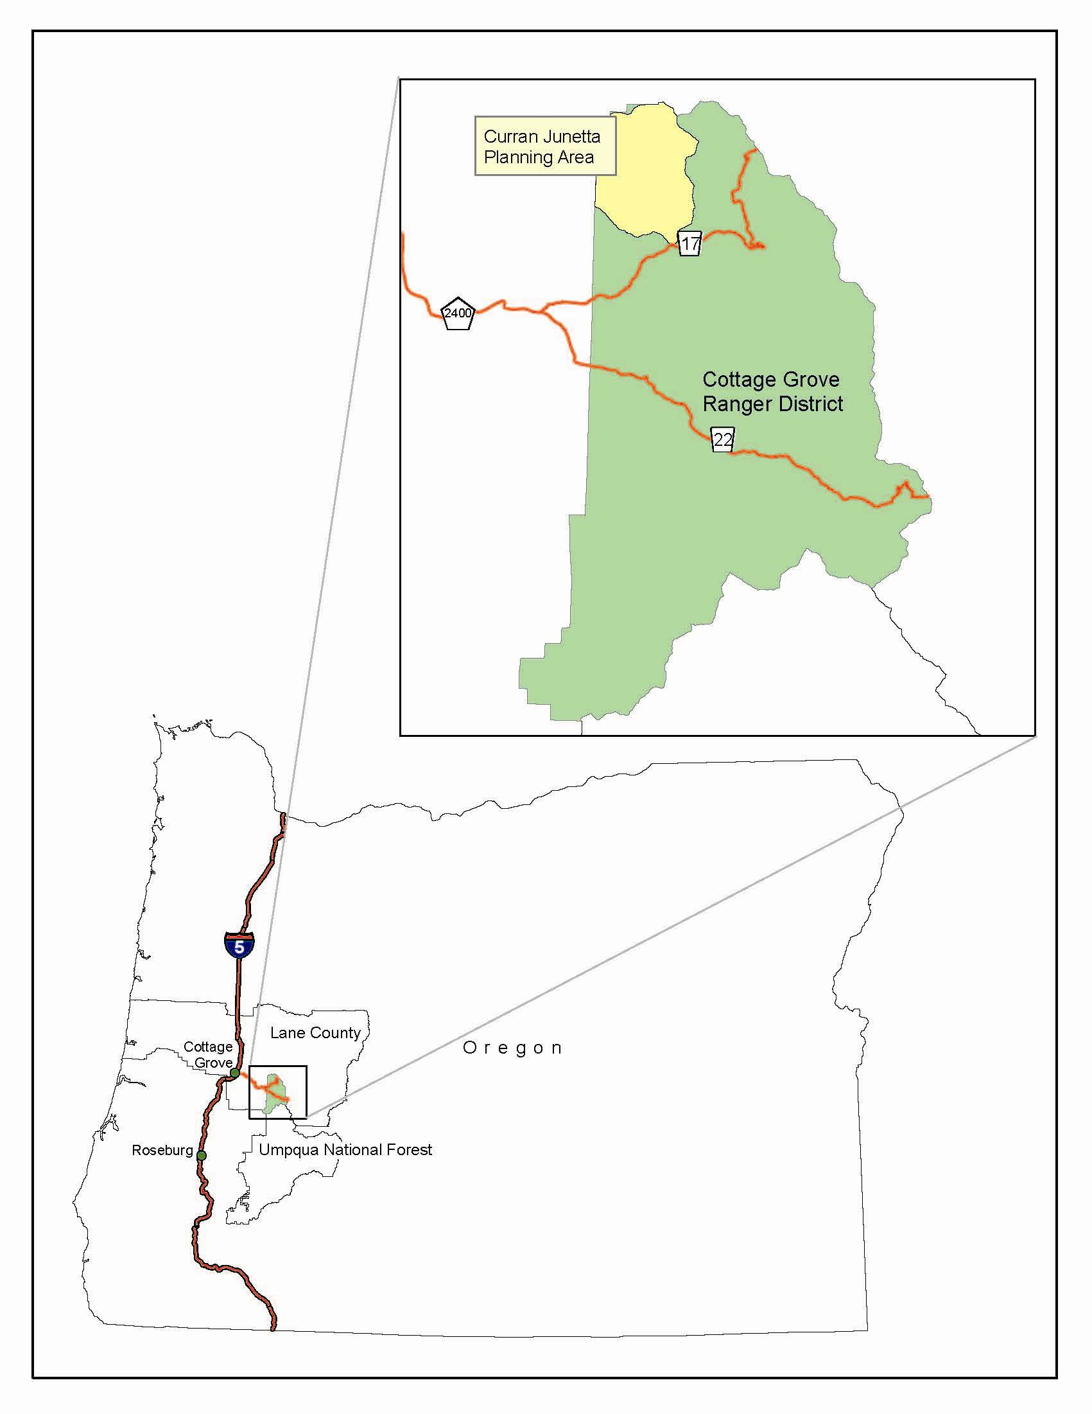

Slide 3
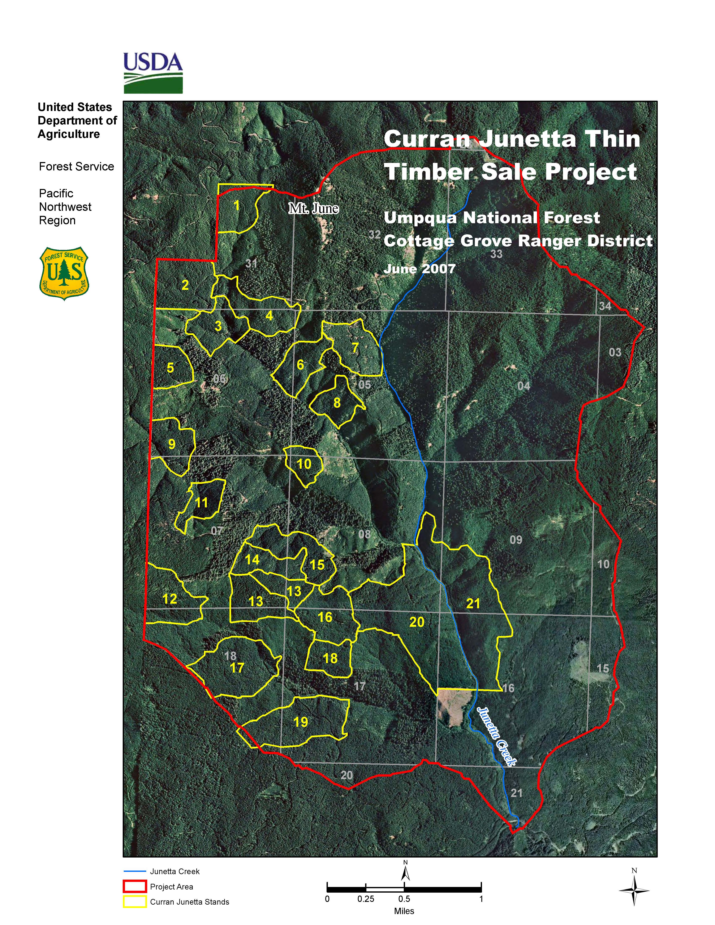
Notes:
Cover of EA, Umpqua web,… planning/ CG
7000 ac planning area
21 units totaling 1500 ac of 50 year old managed stands
½ section of cutover private land

Slide 4
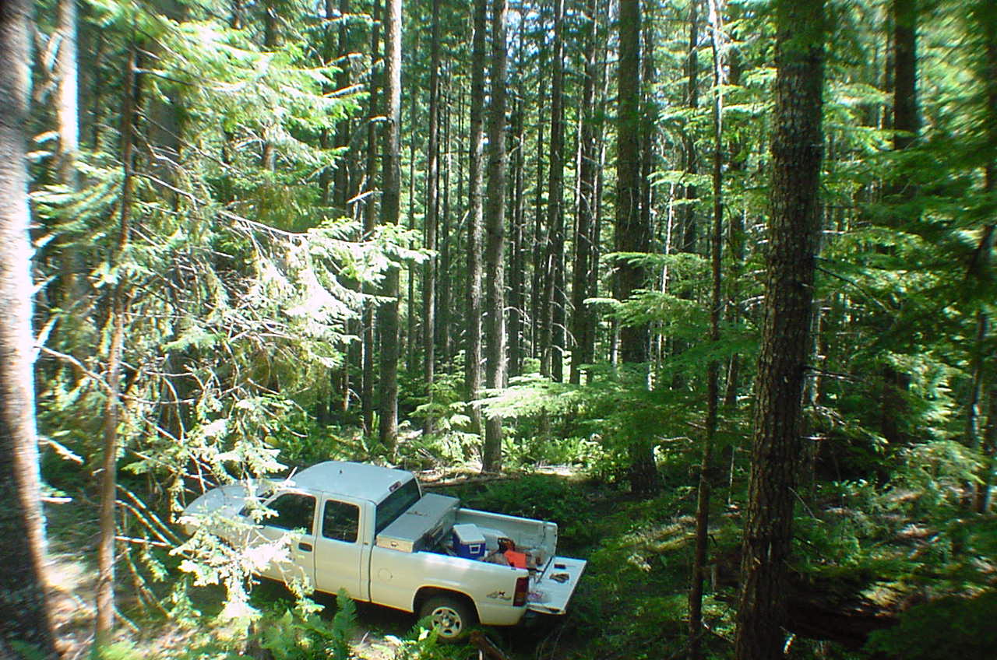
Question 3: Objectives The purpose of the project is to reduce tree density in second growth timber (stem exclusion stands) in order to restore species and structural diversity and improve condition class in the municipal watershed by improving stand fire resiliency, while providing wood products to the local community.

Slide 5
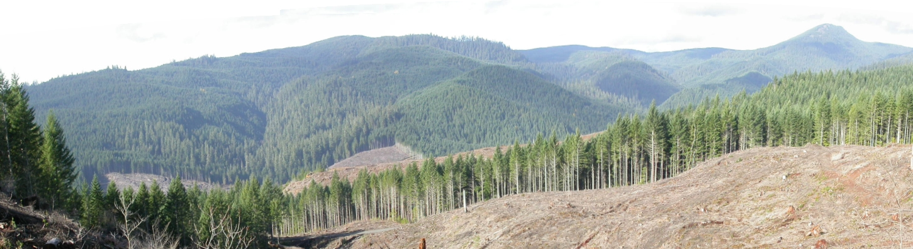
Notes:
Photo of CJ landscape taken from PVT land clearcut

Slide 6
Question 4: What district, forest or regional goals or directives were underlying the project?
Landscape variable thinning
Desired stand conditions would have lower, more variable densities that mimic the natural stand development processes of a moderate severity fire regime.
In the absence of wildfire, setting a course for stand development that leads to more the uneven structure characteristics of the historic late successional forest in Layng Creek would require thinning and gap creation.

Slide 7
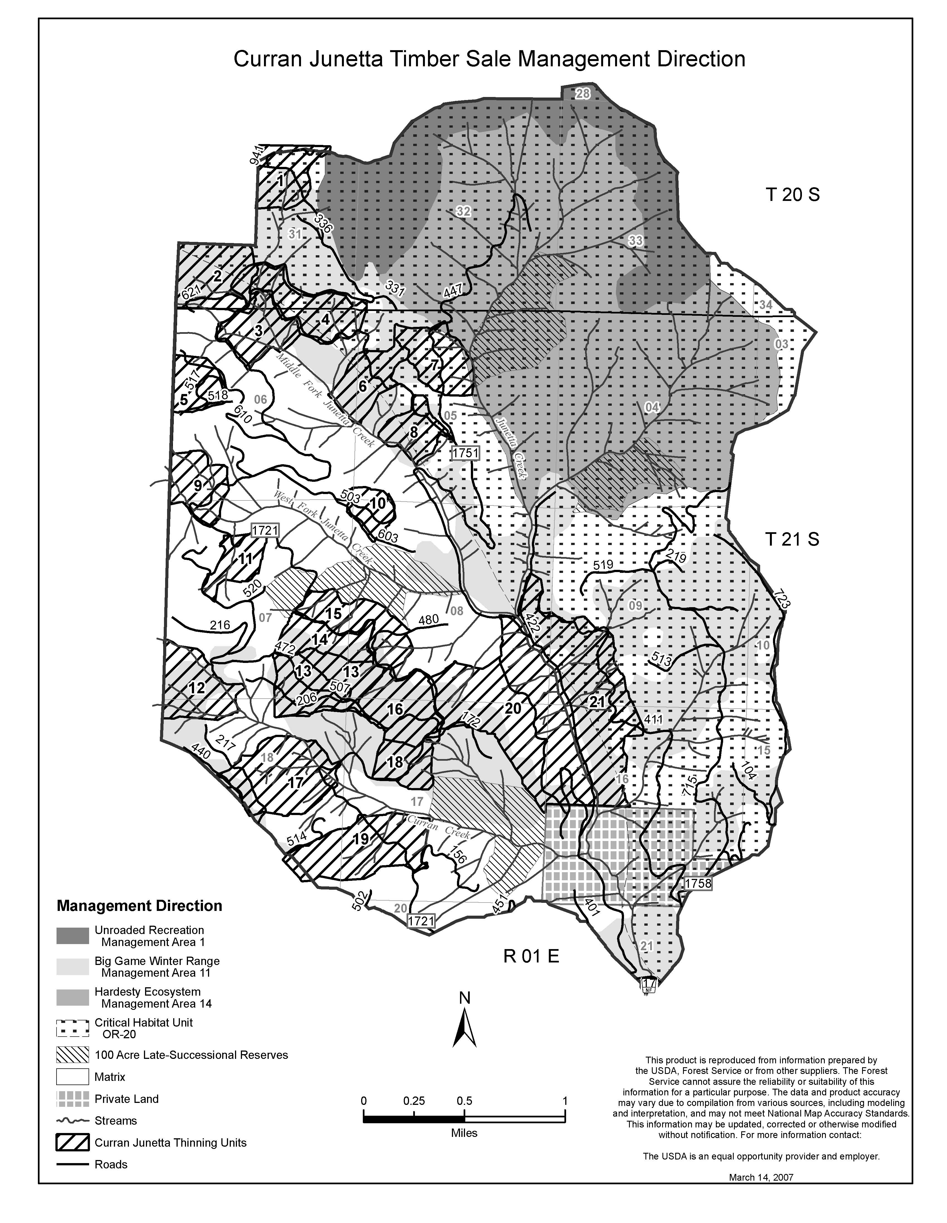
Question 4 cont.
NW Forest Plan: Matrix, RR,
NSO direction/CHU
Big Game Winter Range
Fire Resilient Stands

Slide 8
QUESTION 5: What was the condition of the forest stand pre-treatment? (DBH, TPA, Age, Etc)
 | Age | DBH (inches) | Height (feet) | TPA (≥7” dbh) | Total TPA | BA/ AC | Curtis RD | BF/AC | Total canopy closure
Ave. | 52 | 14 | 83 | 175 | 310 | 190 | 50 | 28,577 | 64%
Range | 41-59 | 11-17 | 50-106 | 120-299 | 155-505 | 156-305 | 42-73 | 21,253- 52,090 | 54-74%

Slide 9
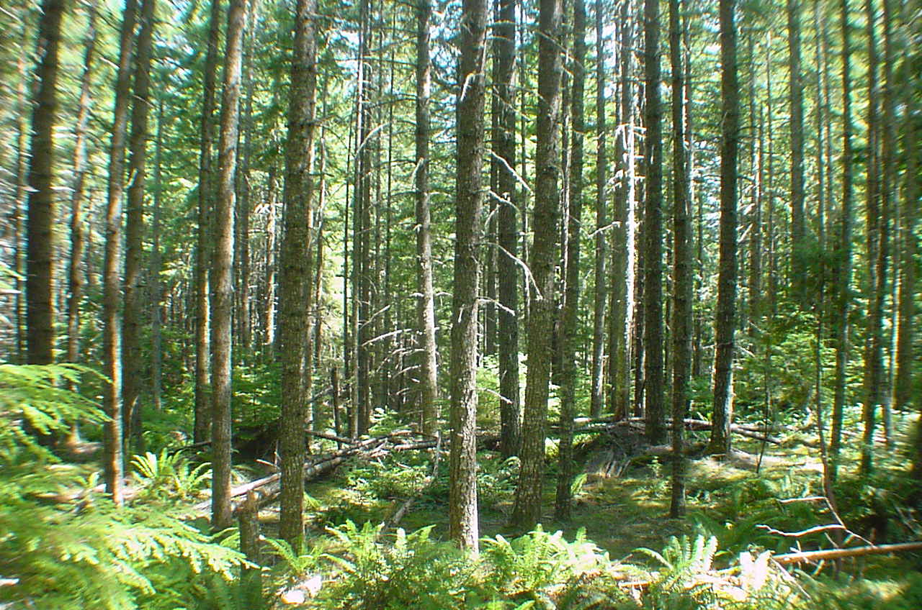

Slide 10
Question 6: Post Treatment Overview - Silvicultural Prescription Considerations
Landscape Areas
Disturbance Patterns
Aspect/Plant Associations
Desired Stand Conditions
Wildlife Considerations
Other Considerations

Slide 11
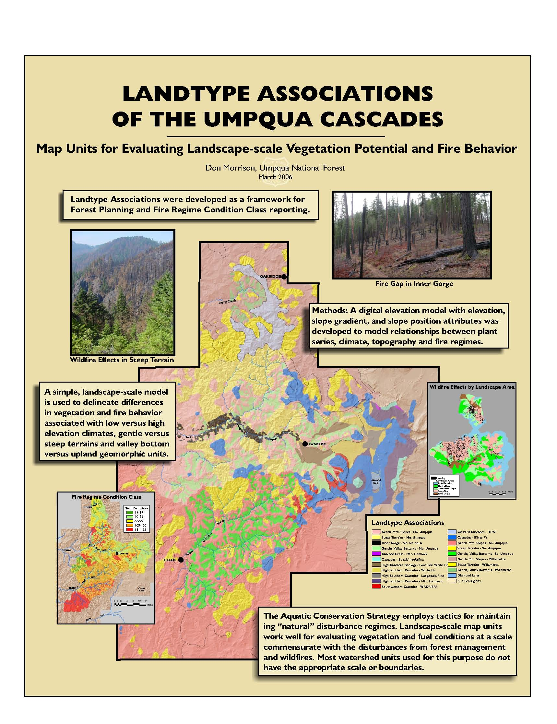
Notes:
Busy Slide – available handout
1)Forest Planning Team;
2)Broad landscape areas based on relationships between for.veg, climate & physigraphy – slope, aspect – CJ falls into 3, GVB, GMS & Steep landscapes;
3)modles differences in veg & fire behavior

Slide 12
Notes:
Explain Legend
Envision mountain – Top, mid-slope; toe of Mtn

Slide 13
Landscape Area | Aspect/Plant Association | Disturbance/Objective
Gentle Valley Bottom | North-facing Slopes (Units: 19, 20) South-facing Slopes* (Units: 2, 3, 4, 9, 17, 21) | -Refuge from fire, generally surface fires; disturbance from root rot pockets/snowdown -Accelerate stand development, restore species and structural diversity, by thinning and small gap creation
Gentle Mountain Slope | North-facing Slopes (Units: 5,11,12,13,14, 15, 16) South-facing Slopes* (Units:1,18) | -Dryer, fewer barriers to fire, larger patches of stand replacement -Apply thinning and canopy gap creation and underburning to restore structural & species diversity; larger gaps
Steep Terrain | North-facing Slopes (Unit: 7) South-facing Slopes* (Units: 6, 8,10) | -Steep slopes fire intensity greater & stand replacement fires more frequent -Improve resilience to fire, open canopies, even-aged management
*South facing slopes; tended to focus on heavy thin to promote fire resiliency
Notes:
Explain distruband and objective for each landscape area
Some units multiple landscapes Unit 15 and then further refine & delineate based on field checked plant association and aspect
TSHE/BENE/ Swordfern– moist; TSHE/BENE/ salal -dry

Slide 14
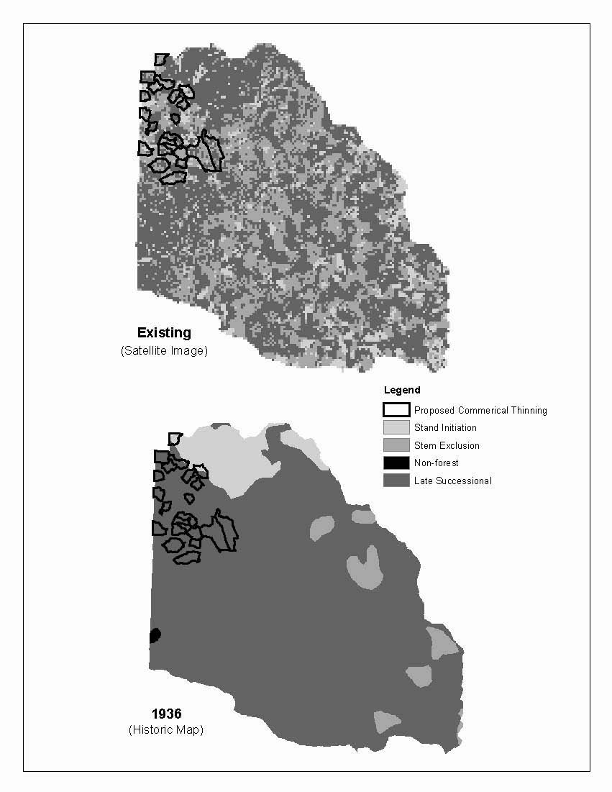
Desired Stand Conditions
The desired landscape condition would have larger patches in the different forest structure conditions compared to today’s pattern.
Desired patch sizes would approximate the infrequent historic fire events that covered thousands of acres.
The desired pattern of vegetation patches would be less fragmented, as was produced by moderate severity fire effects.
Notes:
Go to Legend & explain
Layng Creek 6th field watershed, about 42,000 ac

Slide 15
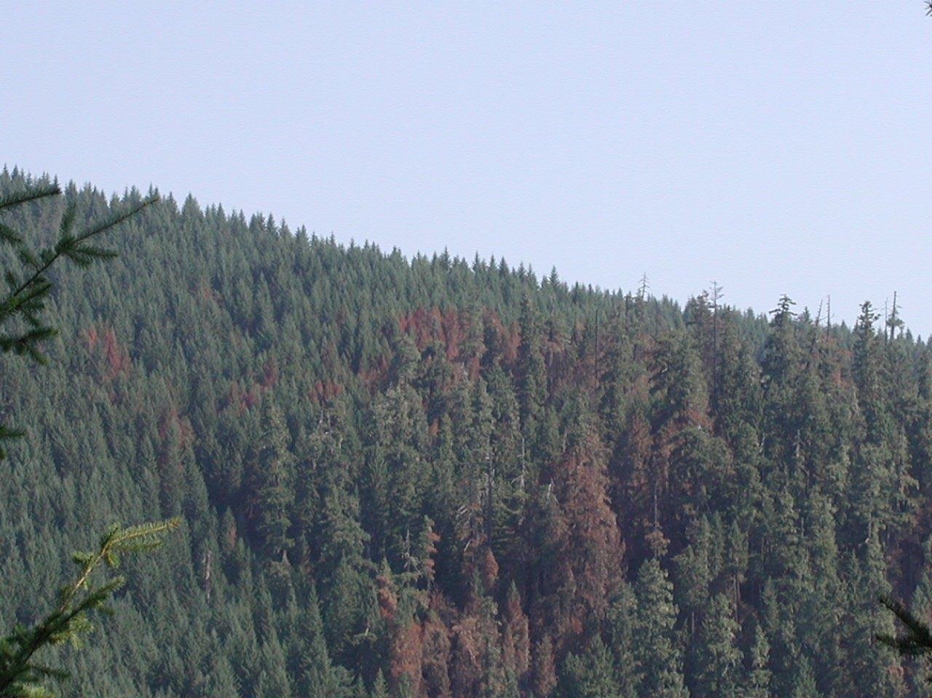
Notes:
Herman Fire August 2006
Also stratified by: plant association Dry vs wet and North vs South facing orientation.

Slide 16
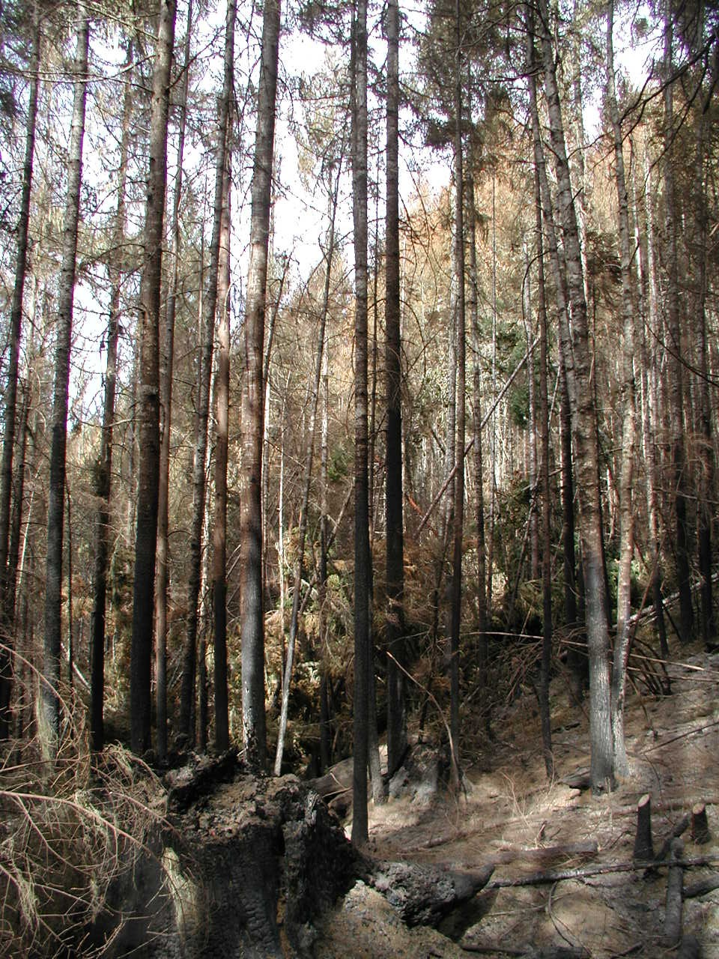
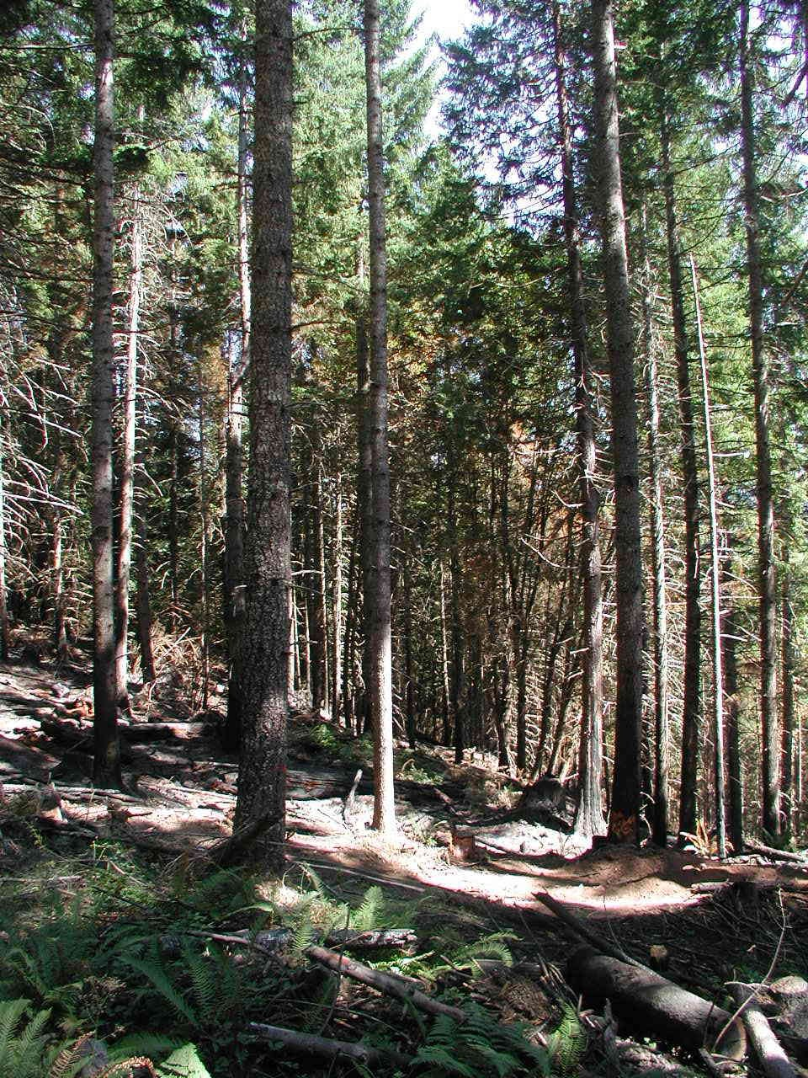
Fire Regime Condition Class
Notes:
Herman Fire wednt through recent commercial thin – objective was achieved
FRCC is the coarse scale measures of the degree of departure from the natural fire regime/reference conditions. At landscape scale
Steep and Gentle Mtn. Slopes in Condition Class 2 – moderate degrees of departure. No high – FRCC 3. Want – FRCC 1 – site specific scale.
Will maintain FRCC at Gentle Valley Bottoms at landscape scale. Herman Units directly adjacent to CJ planning area – fire burned trough untreated fuels vs. fire burning through treated fuels; 25% lower mortality in smaller trees, greater residual ground cover/CWD (CJ EA page 84).

Slide 17
Integrated Prescriptions
Wildlife Considerations
CHUs
Big game winter range
Owl Cores
Riparian
Protect primary shade zone on perennial Streams – 50’/60’ buffer
Protect unstable intermittent streams; Thin stable intermittents
Noxious Weeds

Slide 18
Integrated Prescriptions
Prescriptions | Units | Acres
40-60 TPA - no gaps | 13s, 11 | 64
40-60 TPA – 10 to 20% gaps | 1, 2, 4,6, 8, 13s, 21 | 410
70-90 TPA – no gaps | 3, 5, 7*, 13n, 15, 18 | 215
70-90 TPA – 10% gaps | 9, 10, 12, 14, 16, 17, 19, 20 | 547
 | Total | 1,236
Notes:
Meet P & N;
4 RXs mimics disturbance & natural variation;
DTR;
integrated- ex. Unit 7 steep should be heavy but near OC so RX Moderate

Slide 19
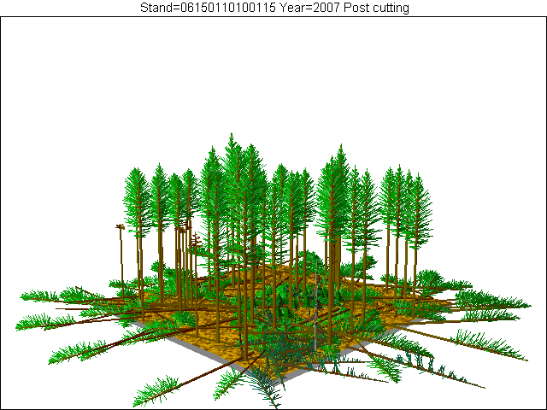
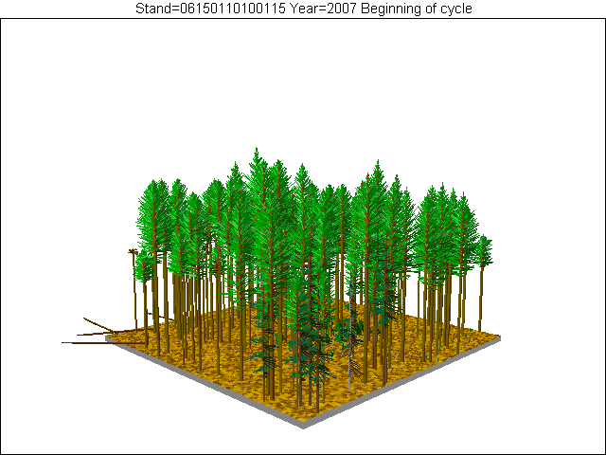
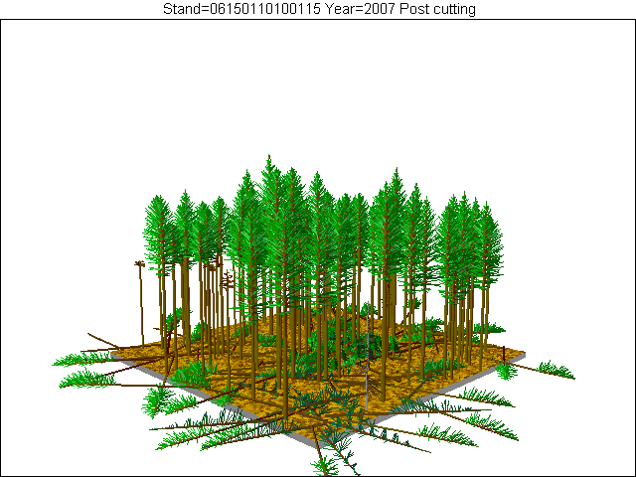
Thin to 40-60 tpa
Pre-treatment
Thin to 70-90 tpa
Notes:
Unit 9 – GVB, moderate thin, but South facing and BGWR; Thin to 70 TPA w/ ½ gaps

Slide 20
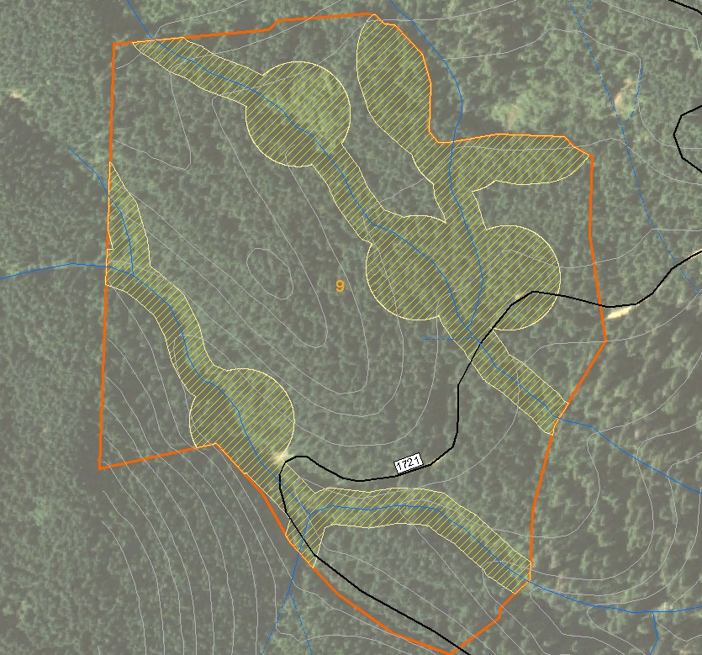
Unit 9
Gentle Valley Bottom
South/East Aspect
TSHE/BENE/GASH
Thin to 70 TPA w/gaps

Slide 21
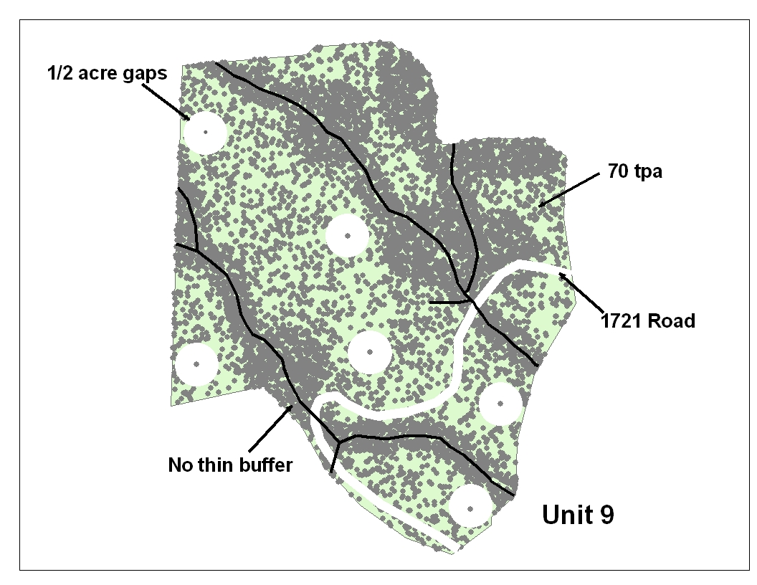
Unit 9 – Post Treatment Model
Stand Ave. 88 TPA
Overall 44% CC including gaps & no thin buffers
Notes:
Thin RX is to 70-90 TPA
50 ac unit; 17 ac no thin - 33 ac to thin to get variable thin go to 70 TPA RX

Slide 22
Unit 9 – Pre & Post Treatment Stand Attributes
Unit 9 | Age | DBH >7” | Canopy Closure | BA/ AC >7” | Curtis RD | BF/AC | DxD
Existing 171 TPA | 53 | 14.6 | 65% | 199 | 52 | 31,438
Thin to 70 TPA |  | 17 | 44% | 110 | 30 | Removed 13,169 (Thin & 3 ac of gaps) | 15
Notes:
Review attributes
DXD is Designate by Description and go to next slide…

Slide 23
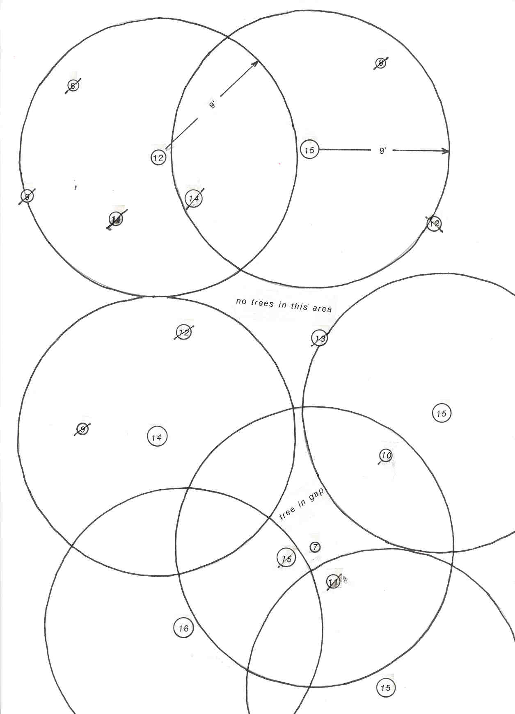
Designate by Description
C2.35# (Option 1) – Individual Tree Designation
Description of Included Timber:
Douglas-fir, Western hemlock, if within 15 feet of a live conifer tree with a larger D x D Diameter. All live trees with a larger D x D Diameter will remain standing after logging is complete.
Notes:
DxD is contractual method of marking guide to achieve RX

Slide 24
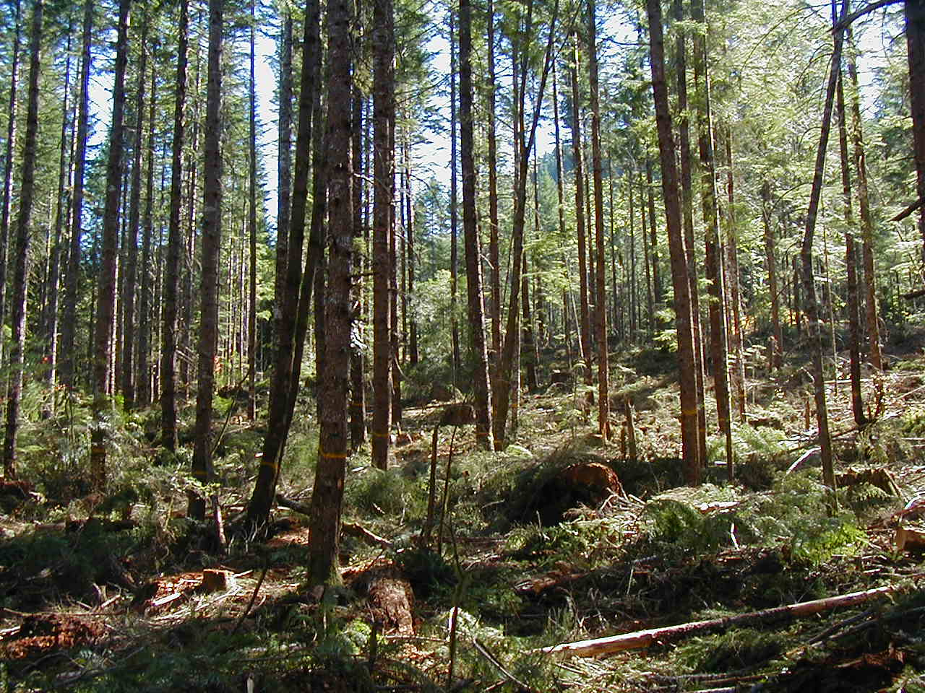
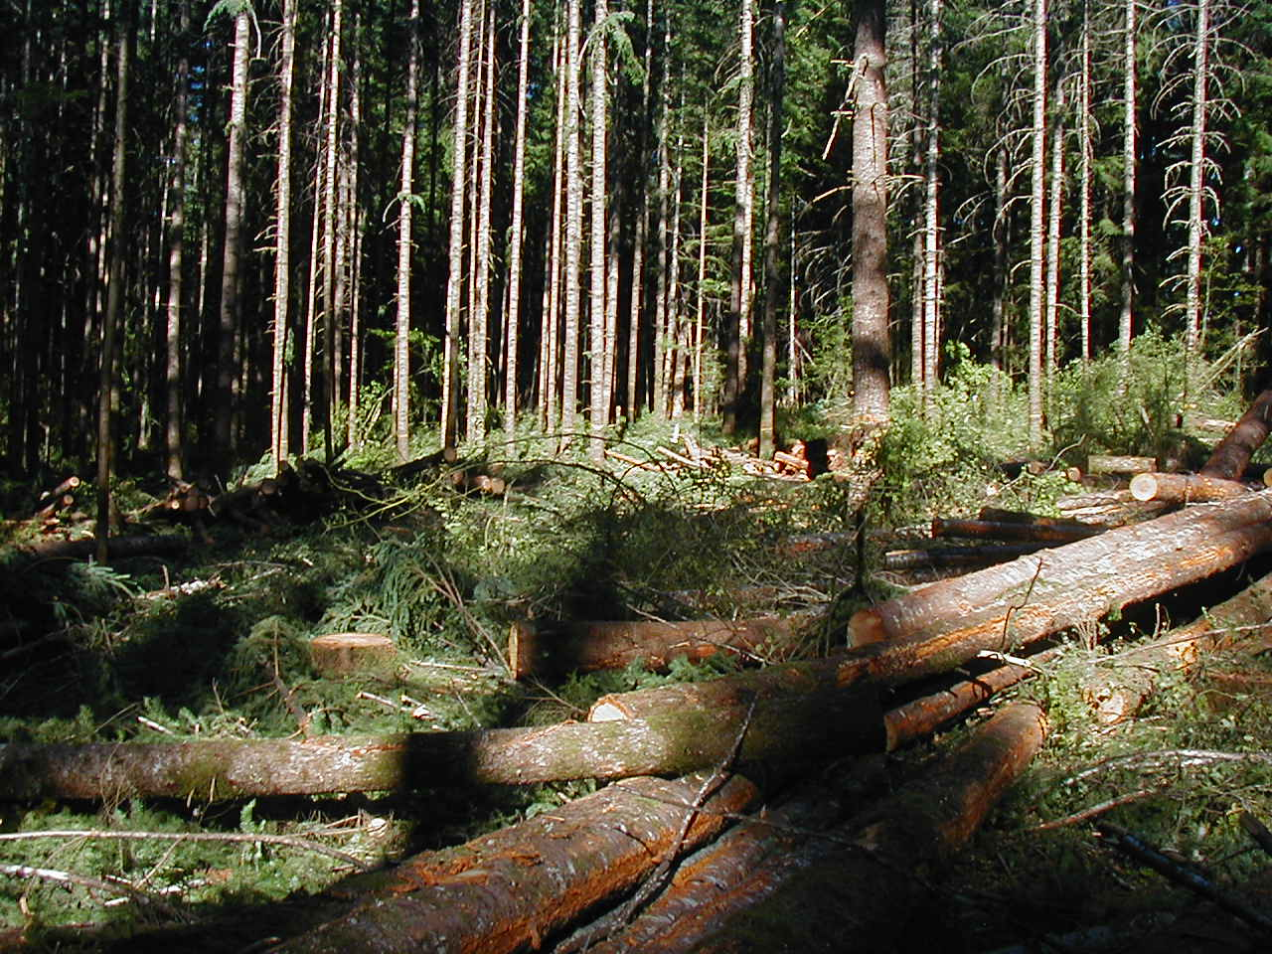
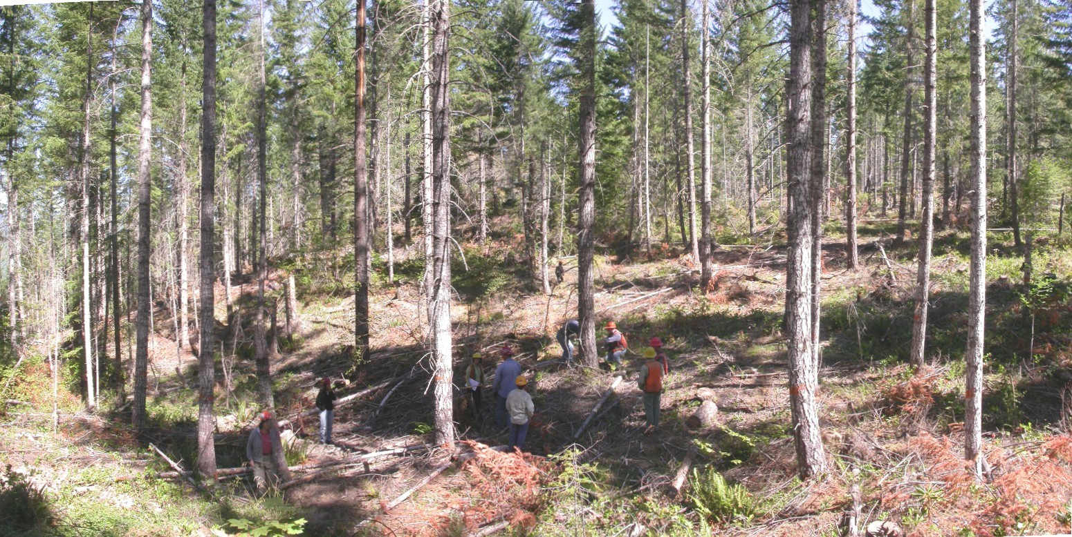
DxD Examples
Notes:
2006 DxD Top and right slide at Sweet Home RD Gordon thin to 90 TPA plus WL trees - DXD 13’
2006 Bottom left at Middle Fork RD thin to 40 TPA – DXD 18’

Slide 25
Questions 7-8:
QUESTION 7:
What tools and/or resources aided you in designing and implementing this project (e.g., growth models, contractual options, research or other publications)?
Chan S. et al. 2006; Zenner E.K. 2005; Franklin J.F. et al 1986; FVS, See Curran Junetta Thin EA references cited
QUESTION 8:
Were there any barriers that caused you to change your RX from what you preferred to do? i.e. contractual, legal, regulatory, etc.
To implement DxD need to keep prescriptions implementable. Geneally, one thinning RX per unit and if have gaps – only have one size/unit. Meet variable thinning objective across landscape. See spreadsheet for other considerations- Units 7 & 10 thinning lighter to retain > Canopy Closure for NS Owl cores.

Slide 26
Questions 9-11:
QUESTION 9:
What assumptions did you use to guide this prescription and what were the bases for making these assumptions -professional experience, scientific literature, simulation models, etc.?
All of the above
QUESTION 10:
What were the scientific uncertainties in this project?
Snag creation was estimated to be 5-10% mortality created by underburning if all goes right; from district FMO experience.
QUESTION 11:
In the context of your forest, would this project represent widely accepted current practices, or newly developed, novel practices?
Landscape stratification and design prescriptions to use of DxD. Propose ¼ acre dominant tree release and ½ ac gaps.

Slide 27
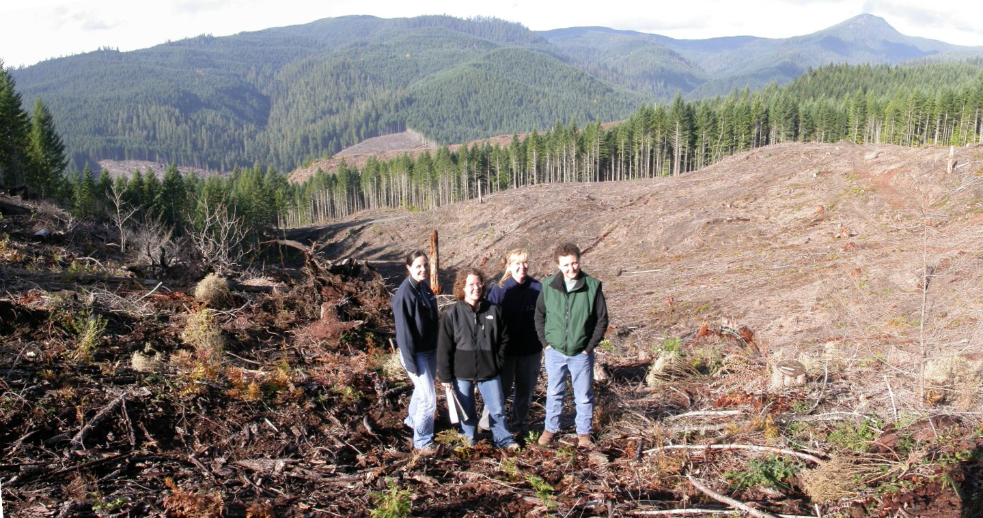
Thanks to all those involved!

