Slide 1
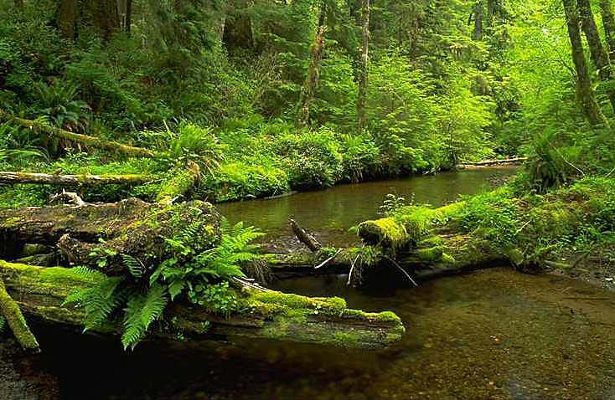

Large-scale forest restoration in the coastal Sitka spruce forest zone:
An experimental approach at Willapa Bay, Washington

Slide 2
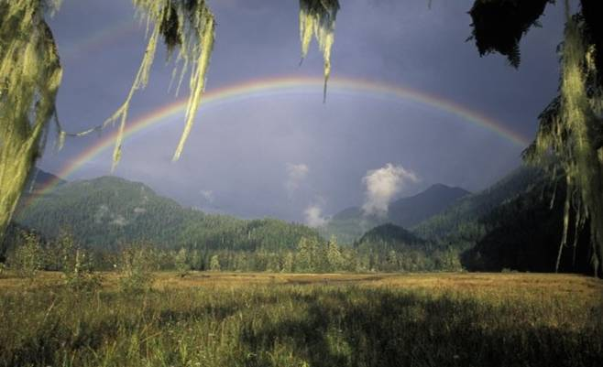
Mission Statement
The mission of The Nature Conservancy is to preserve the plants, animals and natural communities that represent the diversity of life on Earth by protecting the lands and waters they need to survive.
Notes:
Our vision is … a world where forests, grasslands, deserts, rivers and oceans are healthy; where the connection between natural systems and the quality of life is valued; and where the places that sustain all life endure for future generations

Slide 3
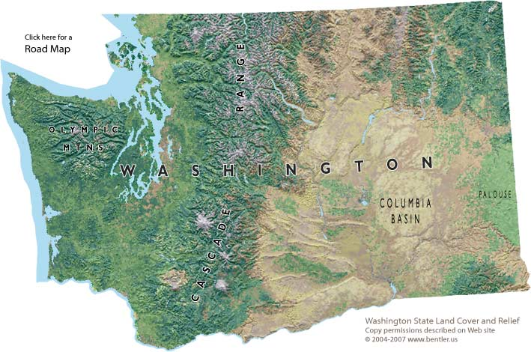
Notes:
6000 acre watershed

Slide 4
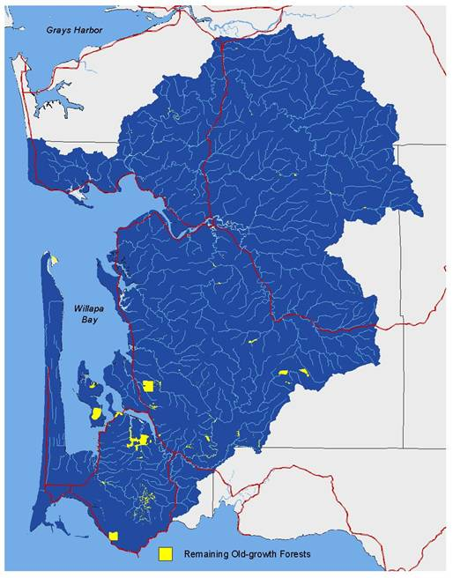
Remaining old-growth forest in southwest Washington as of 2001

Slide 5
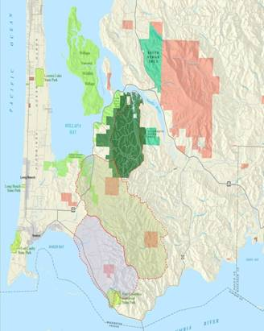
Notes:
6000 acre watershed

Slide 6
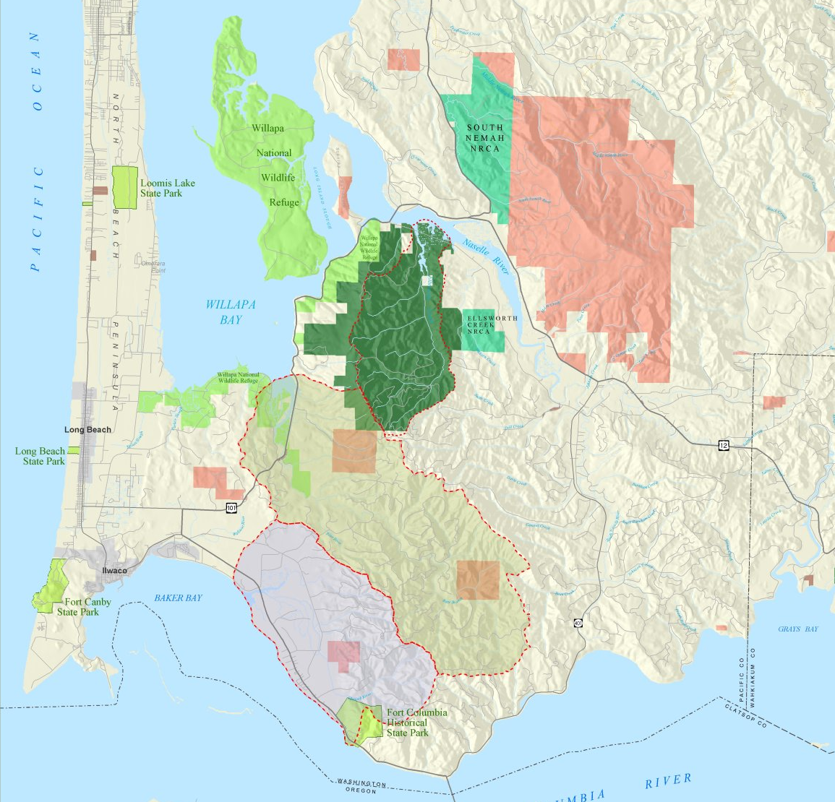

Slide 7
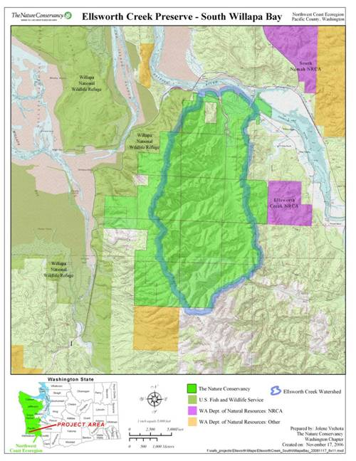
South Willapa
Bay - 2006
Ellsworth Creek Preserve
(approx. 7,436 acres)
Total cost approx. $19.5 million
Individuals 43%
Public 36%
Foundations 20%
Corporations 1%
Notes:
Stats

Slide 8
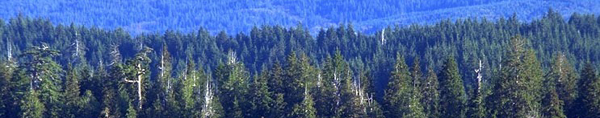
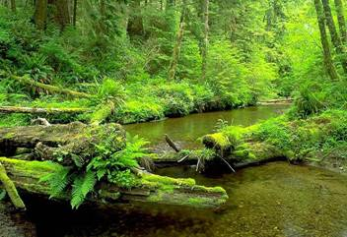
Primary Goal for the South Willapa Bay Conservation Area
“To restore ecologically functional estuarine, freshwater, and upland forest habitats that are capable of supporting species and ecological processes typically found within late-successional forest landscapes of the Pacific Northwest coast”

Slide 9
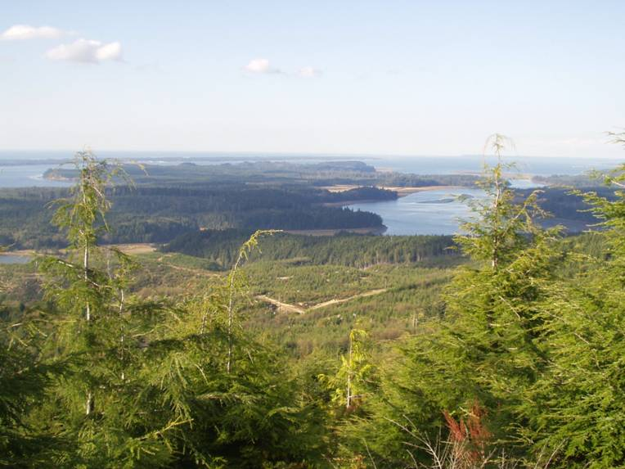
Notes:
Working together with the WNWR – MOU signed – creating a joint forest management plan to direct and coordinate management across joint ownerships

Slide 10
Desired Future Conditions
Ecosystem resistance and resilience
Wind disturbance
Climate change
Spatial and Temporal Variability across the landscape
Functional Landscape Linkages – Upland Forest …Freshwater
Habitat for Late-successional species – i.e. murrelets
Ultimately…Natural processes shape the landscape

Slide 11
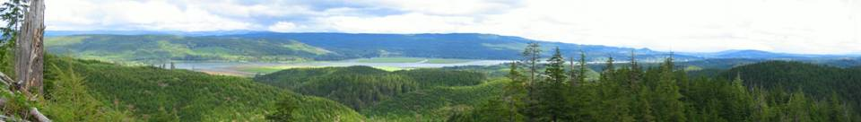
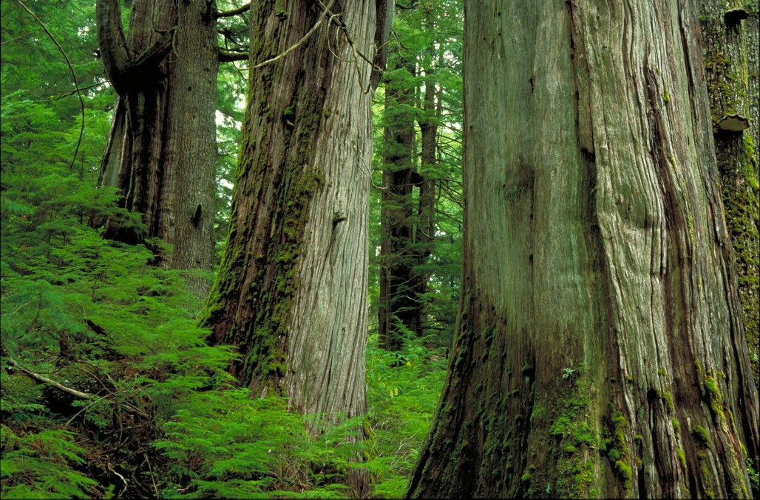
Outline
Adaptive management design
Forest Conditions & management direction
Treatment objectives
Challenges

Slide 12
Remaining old-growth forest in southwest Washington as of 2001

Slide 13
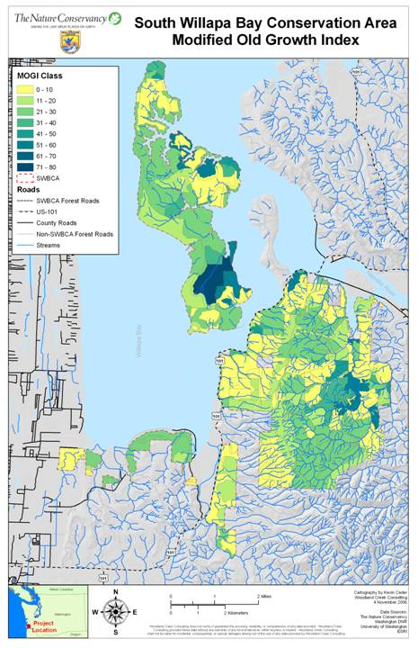
Remaining Old Growth
Large trees (number per acre > 100 cm dbh [40 inches])
Large snags (number per hectare > 50 cm dbh and > 15 m tall [20 inches dbh; 49 feet tall])
Volume of down woody debris (cubic meters per hectare)
Tree size diversity: (# of trees in the following 4 diameter classes: 2-9.9”, 10-19.9”, 20-39.9”, 40”+)

Slide 14
Science Review Panel
Dr. Timothy Beechie - NOAA, Northwest Fisheries Science Center
Dr. Robert Bilby - Weyerhaeuser Company
Dr. Michelle Marvier - Santa Clara University
Dr. Nalini Nadkarni - Evergreen State College & Int. Canopy Network
Dr. Nathan Poage - USFS Portland Forestry Sciences Laboratory
Dr. Martin Raphael - USFS Olympia Forestry Sciences Laboratory
Dr. Daniel Schindler - University of Washington
Dr. Thomas Spies - USFS Corvallis Forestry Sciences Laboratory
Notes:
Panel helped us do the work – helped us assess all viable restoration opportunities and identify what the key uncertainties were – where did the biggest questions lie and how could we design our restoration at Ellsworth Cr to answer some of these questions

Slide 15
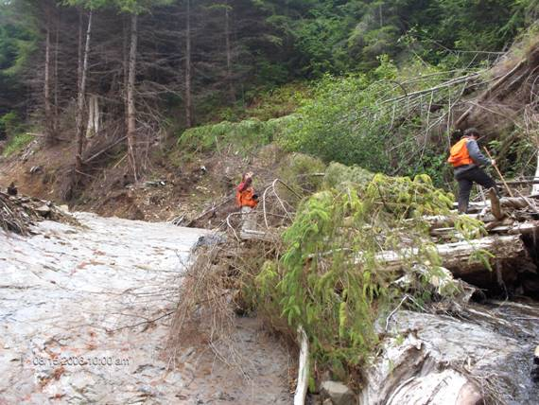
Acknowledging Uncertainties
Big questions about…
Ecology of Sitka-spruce forests and response to restoration activities
Effectiveness of restoration techniques, including thinning, and development of late-successional forest structure
Restoration at larger scales (e.g., multiple stands, watersheds)
Ecological interactions of freshwater and terrestrial systems
Cost

Slide 16
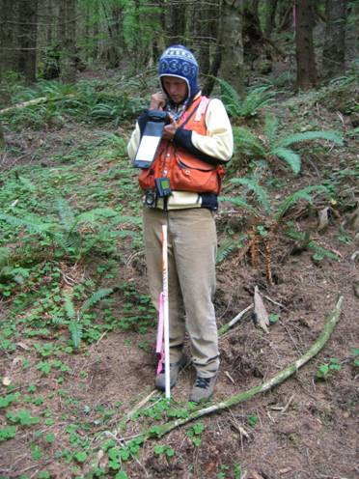
Key Study Questions
Can systems resembling natural late-successional landscapes be restored from plantation forests?
Can a management system be designed and implemented to accelerate ecosystem recovery?
How do you restore a landscape cost effectively?

Slide 17
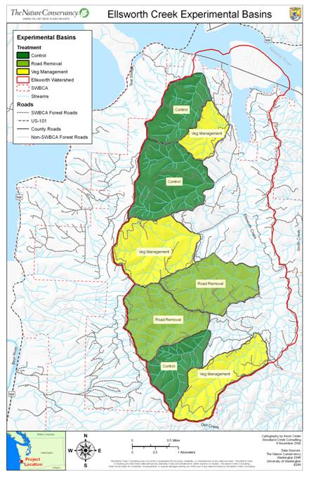
Experimental Design
Unbalanced Randomized Block Design
Eight experimental basins
Basin size 75 – 220 ha
Three blocks (N, C, S)
Three treatments
Control (3)
Thin (vegetation manipulation (3)
Road removal (2)

Slide 18
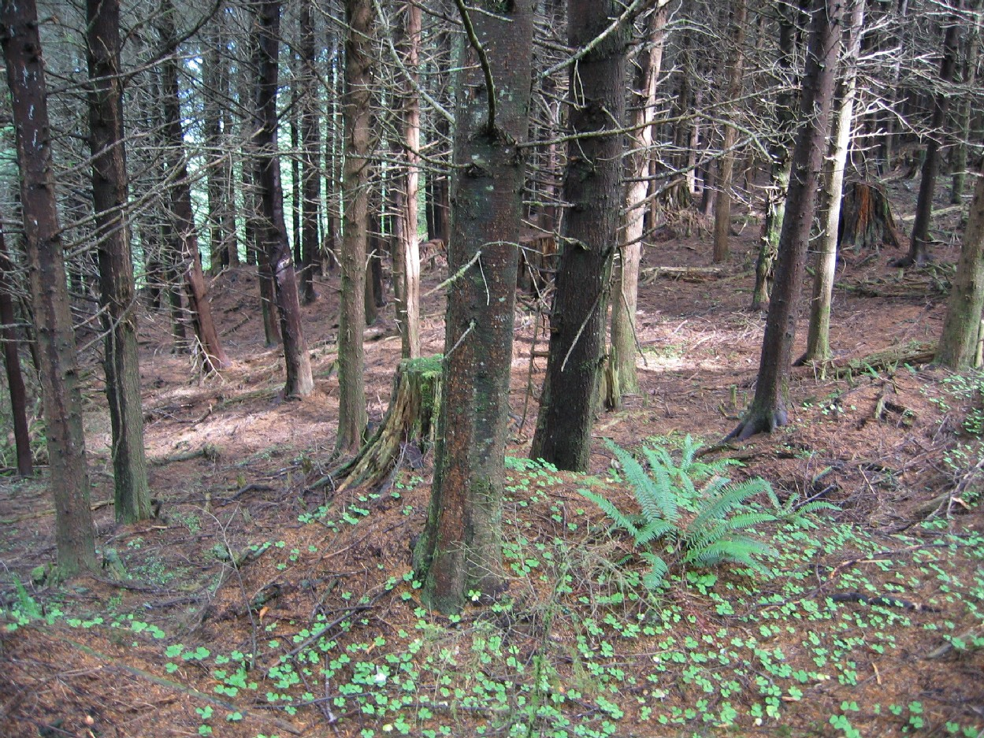
Restoration Pathways
CONTROL
Leave forests to develop without management intervention
Maintain an appropriate road system (adhere to legal and management objectives; permit future management without increasing threat of road related hazards)
Reevaluate treatment in 10 years in context of adaptive management strategy

Slide 19
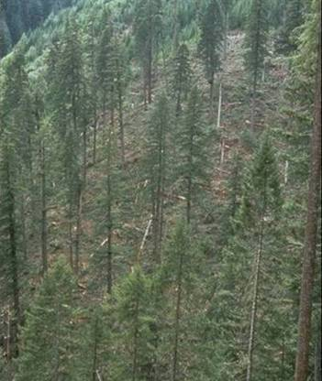
Restoration Pathways
THIN
(VEGETATION MANAGEMENT)
Actively thin forest stands to low residual stand densities (wide range of prescriptions)
Limited planting of trees/shrubs, not expected to be extensive
Maintain an appropriate road system (adhere to legal and management objectives; permit future management without increasing threat of road related hazards)

Slide 20
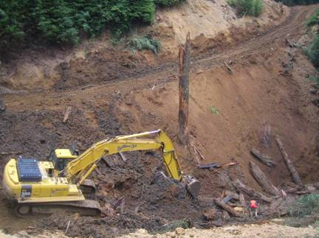
Restoration Pathways
ROAD REMOVAL
Retain only roads necessary for management or legal purposes
Remove and re-contour all other roads
Leave forests to develop without management intervention

Slide 21
Baseline Monitoring Variables
Habitat/Structure
Forest Vegetation – 224 permanent plots, LIDAR
Stream Reaches – 48 index reaches
Bio-indicators
Forest understory vegetation
Forest birds – variable circular plots (112)
Headwater stream amphibians - spotlight
Salmonids – spawning counts
Stream macroinvertebrates
Fish community – electrofish/snorkel survey
Ecological Processes
Natural disturbance (windthrow, disease, landslides) – LIDAR/aerial photos
Watershed hydrology – stream flow gauges, road connectedness
Cost
LIDAR data and model (USFS)
Notes:
Worked with tons of outside scientists on monitoring variables and protocols
Many of the methods replicate those used at other sites – allow for meta-analysis/comparisons
Highlight one variable and how it relates to treatment effect
Baseline data collection period (out to 2008)
LIDAR = Light detection and ranging

Slide 22
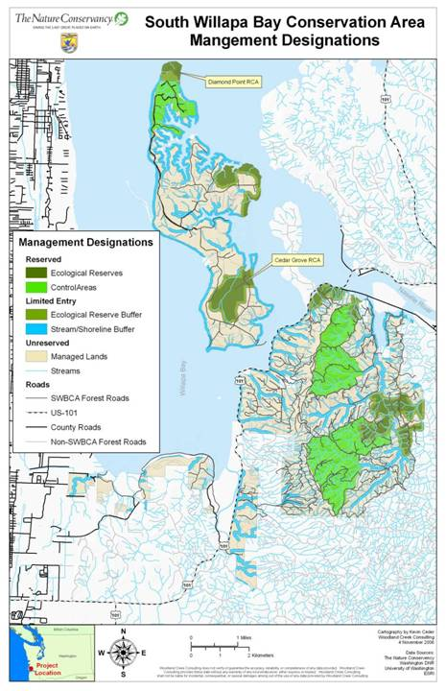
Management Zones
Ecological Reserves (965 ac.)
Control Areas (2,418 ac.)
Limited Entry Buffers (3,961 ac.)
Managed Lands (6,824 ac.)

Slide 23
Decision-making
Process

Slide 24
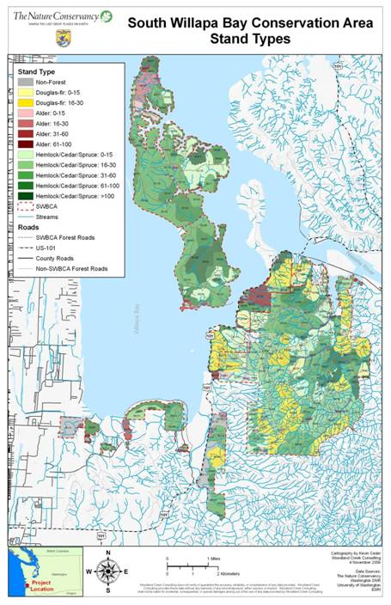
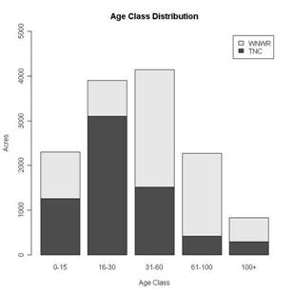
Stand Types

Slide 25
Desired Future Conditions
Ecosystem resistance and resilience
Wind disturbance
Climate change
Spatial and Temporal Variability across the landscape
Functional Landscape Linkages – Upland Forest …Freshwater
Habitat for Late-successional species – i.e. murrelets
Ultimately…Natural processes shape the landscape

Slide 26
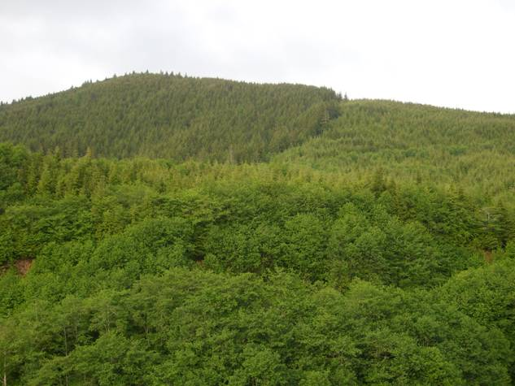

Slide 27
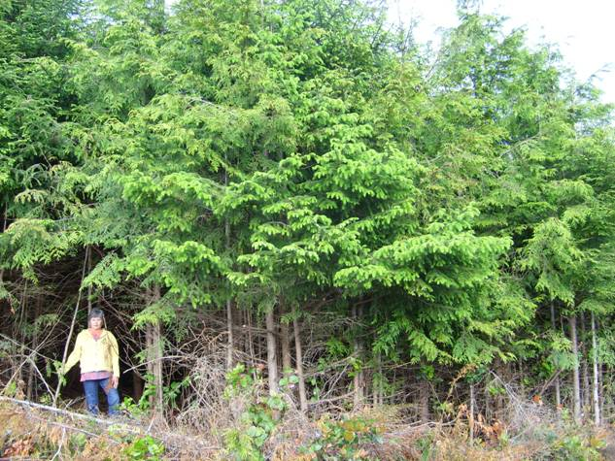

Slide 28
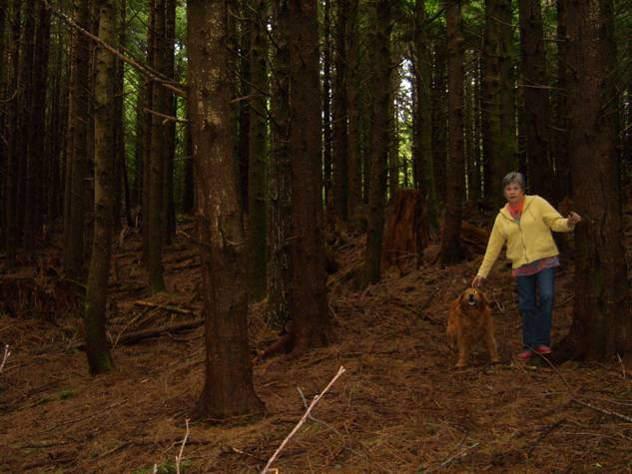

Slide 29
Application of Treatments
Increase forest stand resistance to wind disturbance
Promote western red cedar through selective thinning
Decrease height-diameter ratios
Develop late-successional habitat characteristics
Density management, promote growth of large trees
Maintain decadence (e.g., mistletoe brooms)
Enhance spatial heterogeneity
Variable-density thinning and uniform thinning
Restore landscape linkages
Thin in riparian areas and mass-wasting zones

Slide 30
Challenges
Cost Effectiveness and Transferability
Balancing ecological outcomes vs. financial returns
Feasible restoration model?
Different ownership management objectives (refuge, TNC)
Incorporating natural processes (wind, disease, insects) into restoration design.
Considering effects of climate change
When are we done? How many treatments?

Slide 31
Questions?

