Slide 1
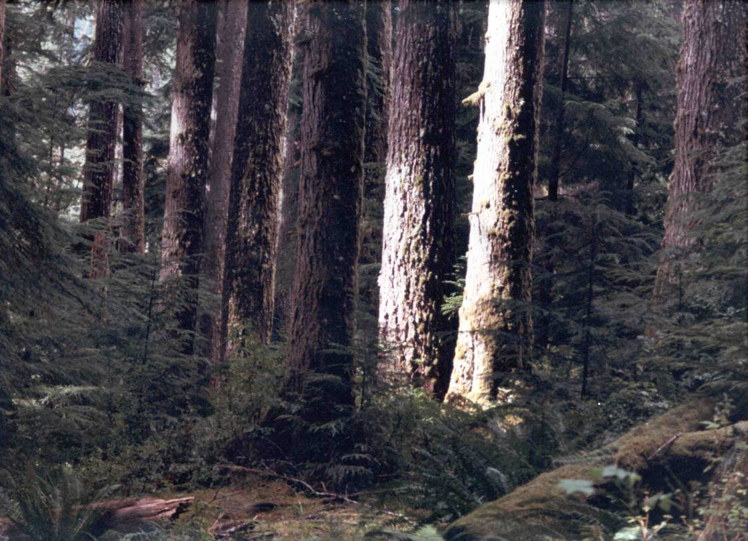


Railsiding Understory Thin
Non-commercial terrestrial habitat improvement
Sol Duc Valley, Olympic NF, Clallam County, WA
June, 2007
Verne Farrell, Silviculturist
Olympic National Forest
437 Tillicum Lane
Forks, WA 98331
360-374-1246
vfarrell@fs.fed.us

Slide 2
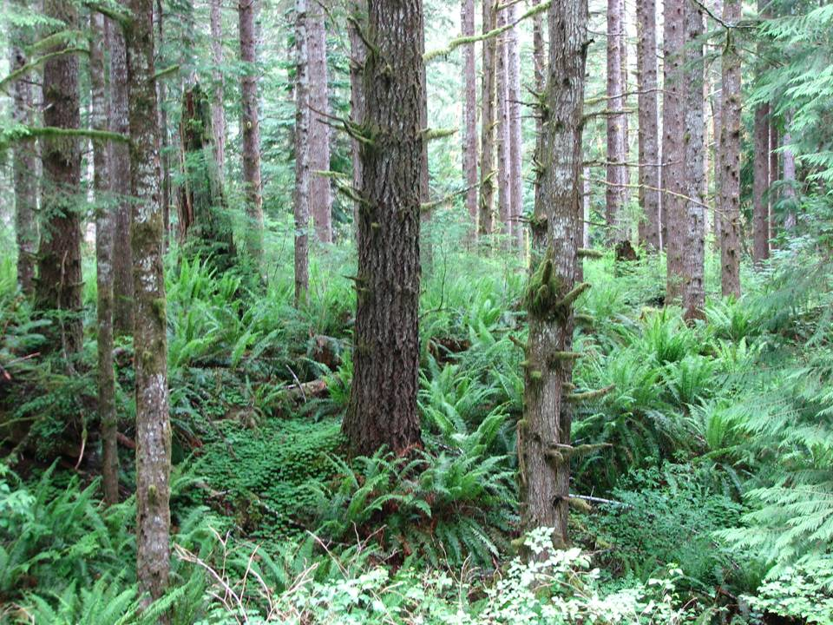
Notes:
Railsiding, 1998

Slide 3
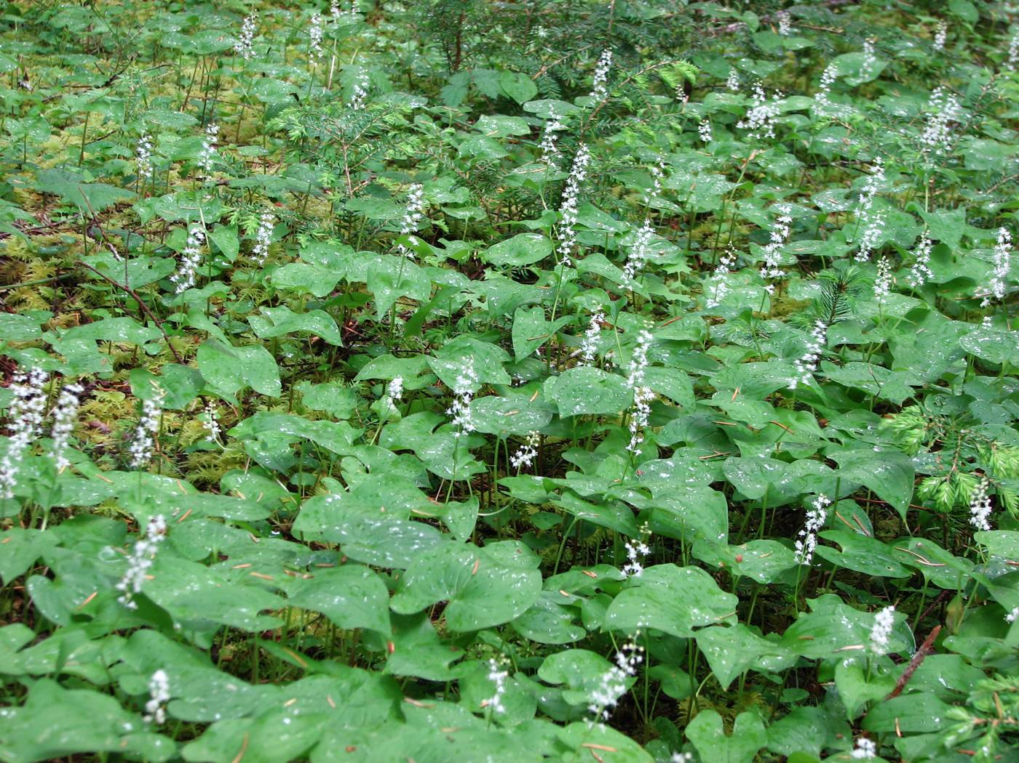

Slide 4
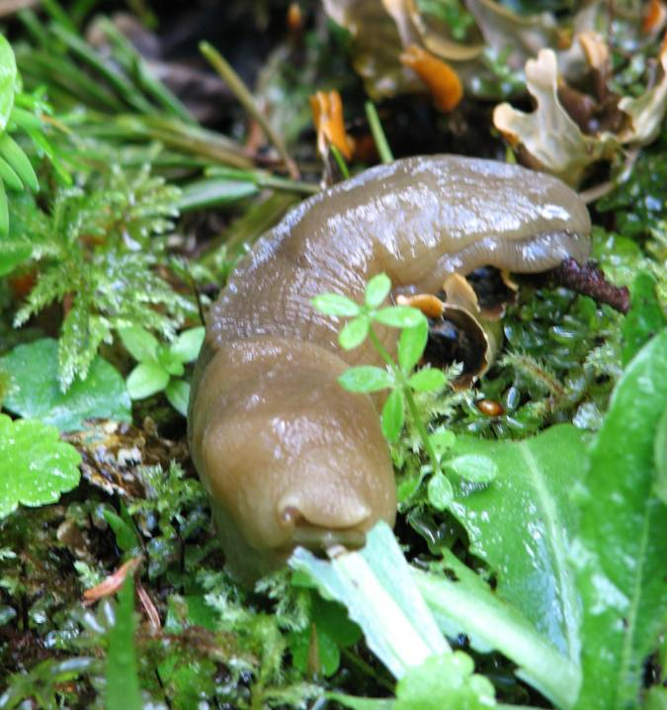

Slide 5
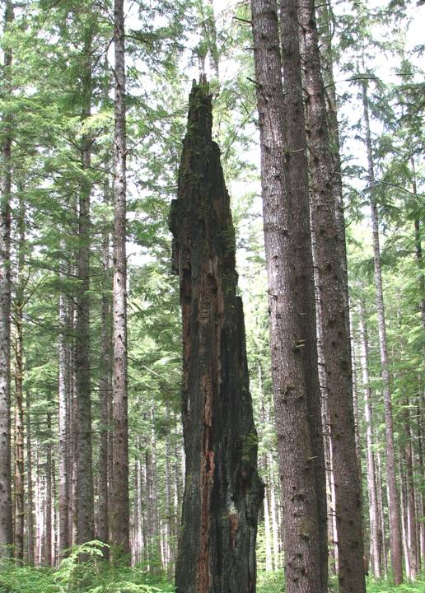
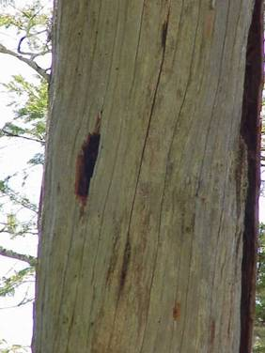

Slide 6
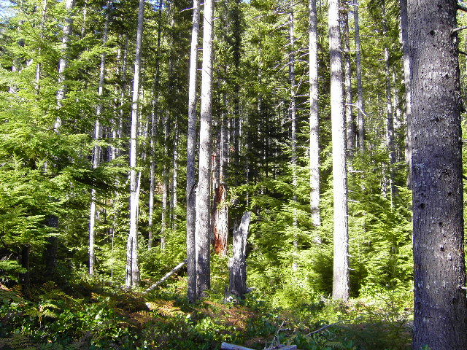
Notes:
Santo, 1992-3

Slide 7
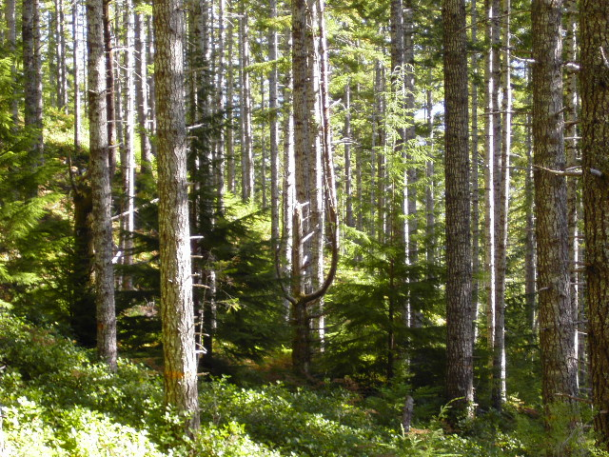

Slide 8
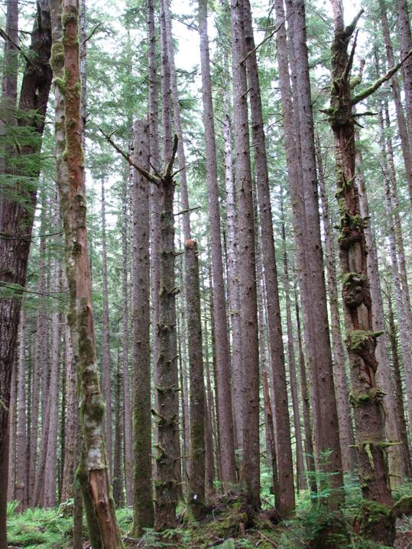
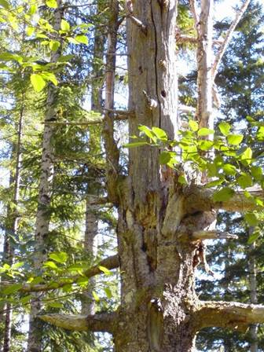
Notes:
Santo WL tree; Split (1999-2003) snag patch.

Slide 9
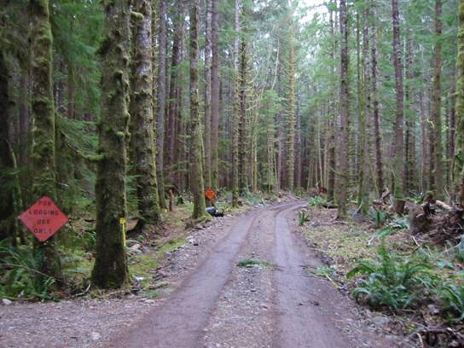
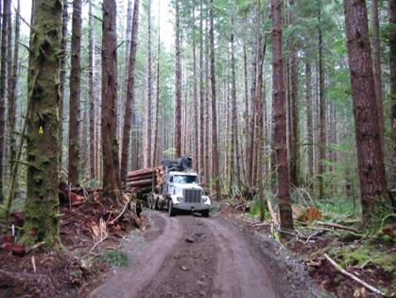
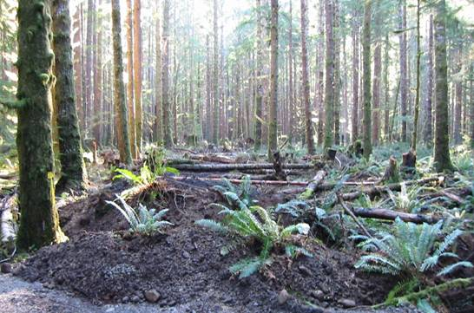

Slide 10
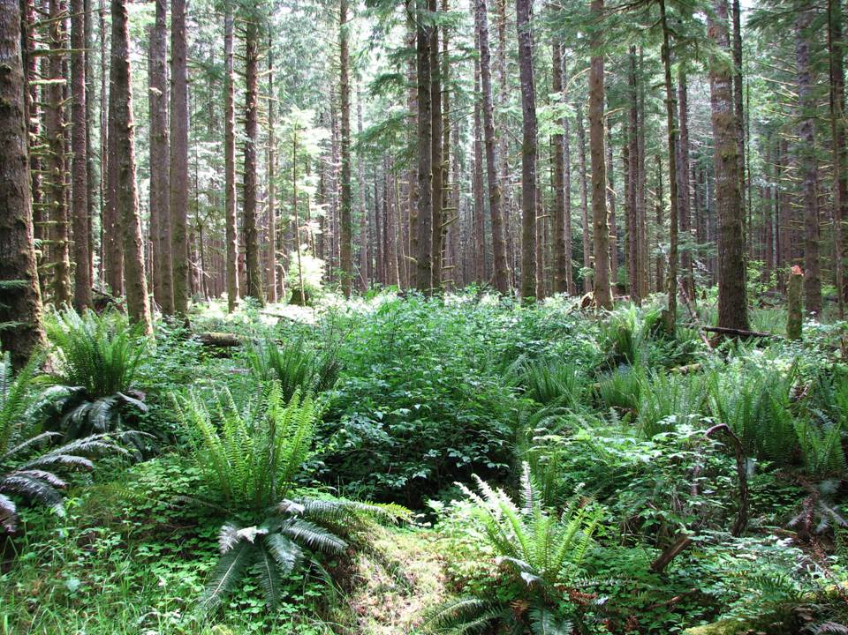

Slide 11
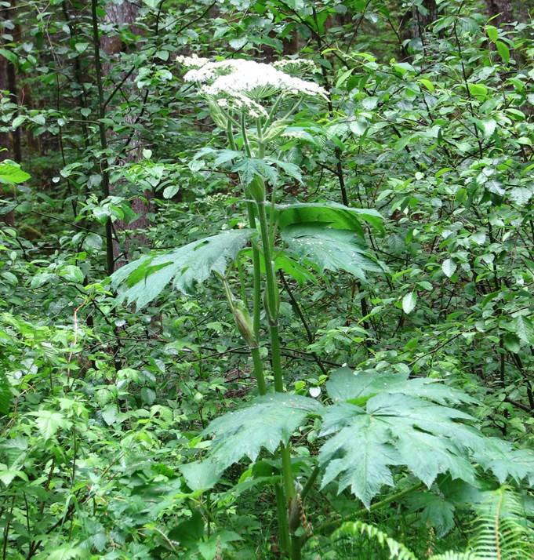

Slide 12
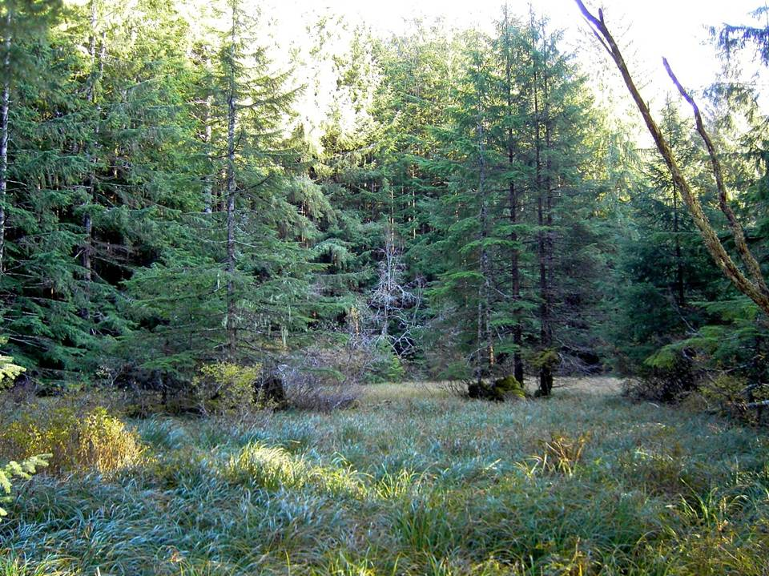

Slide 13
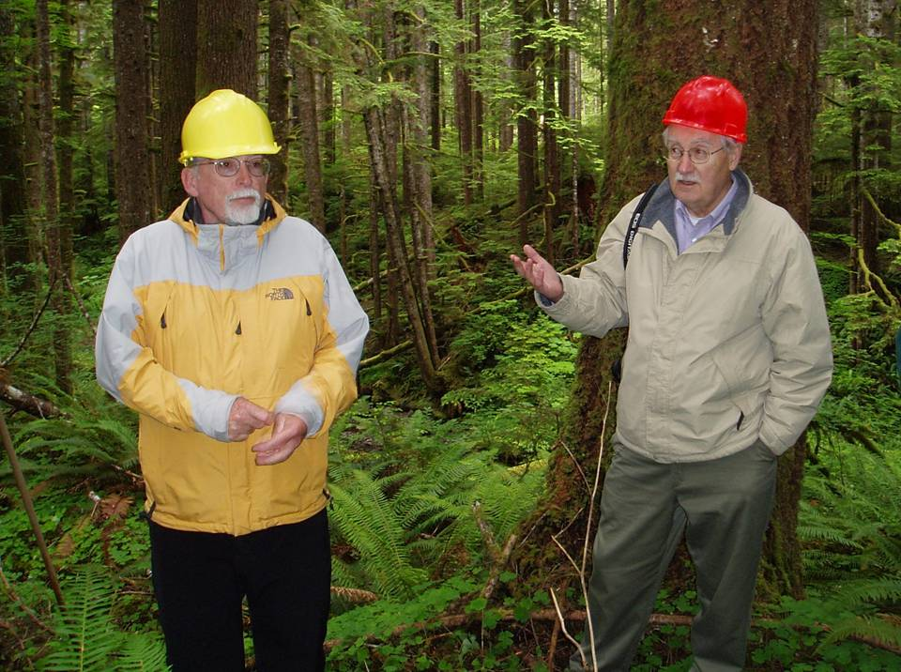
Notes:
Andy Carey and Jerry Franklin in Kugel Creek no-cut buffer (Kmark,2002)

Slide 14
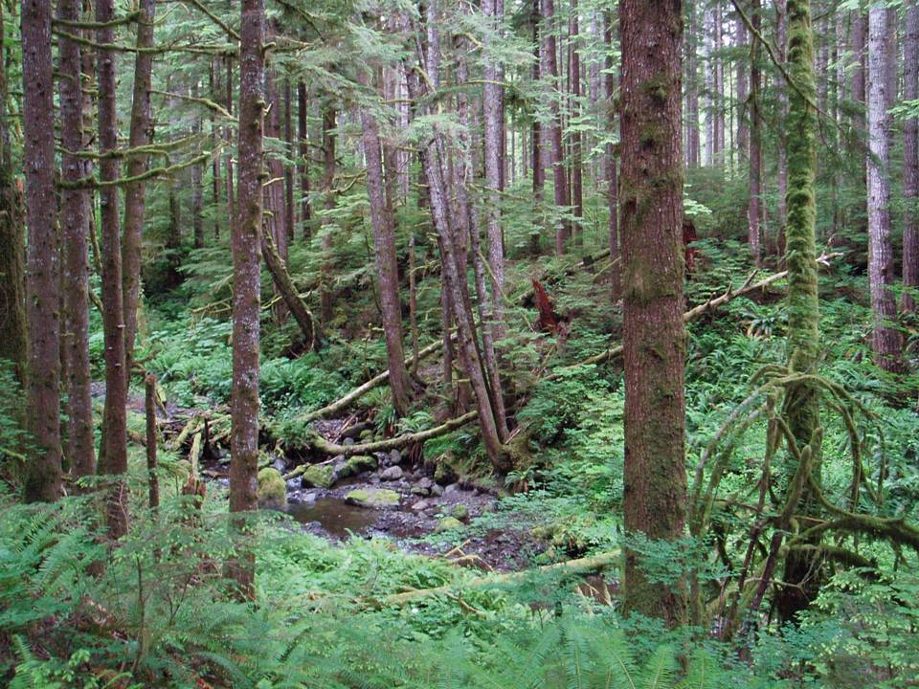
Notes:
Kugel Creek buffer

Slide 15
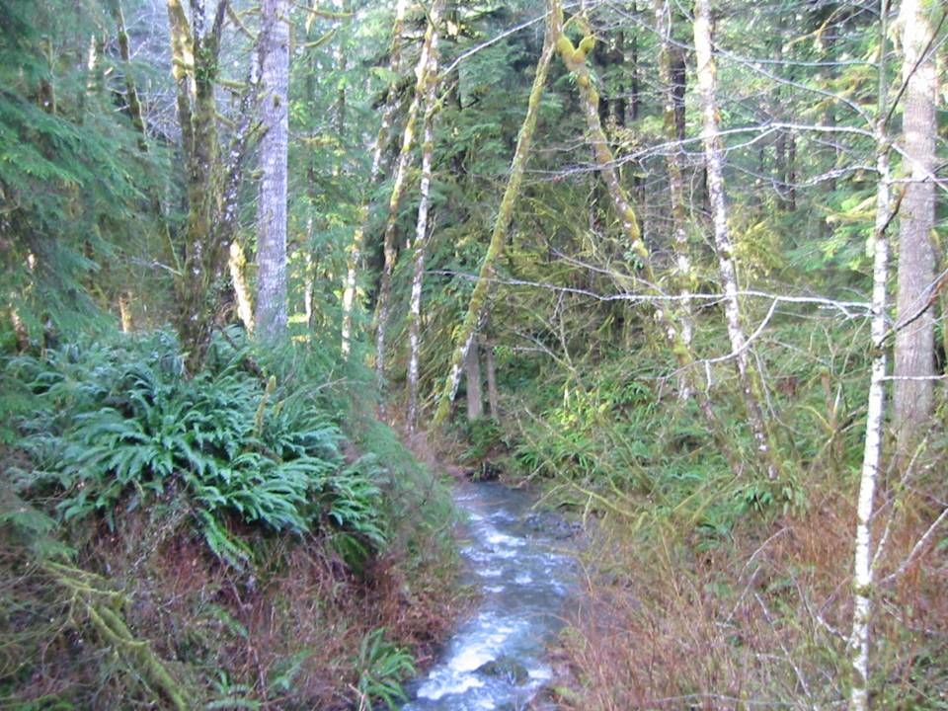
Notes:
Kugel Creek, Kmark, 2002

Slide 16
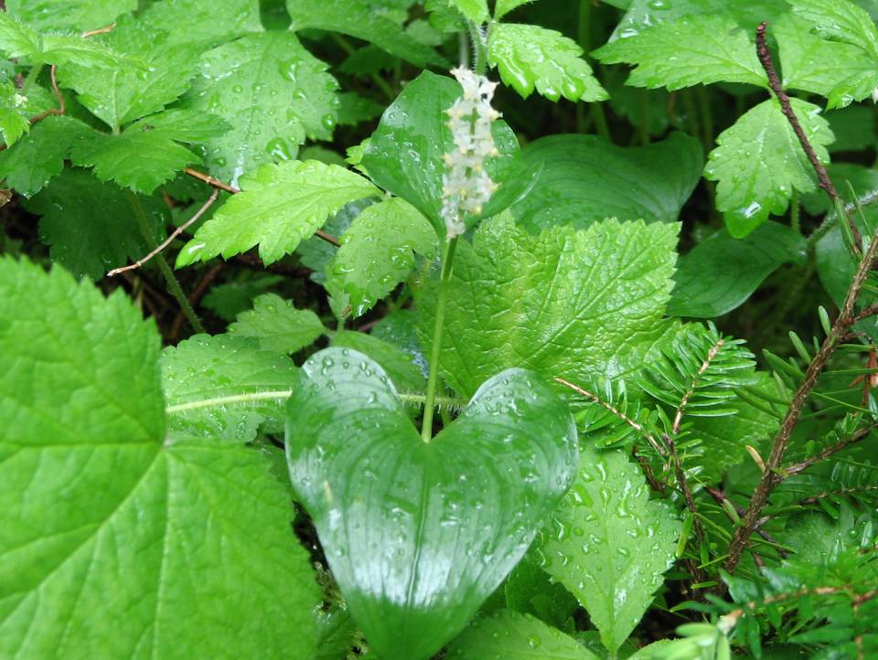

Slide 17
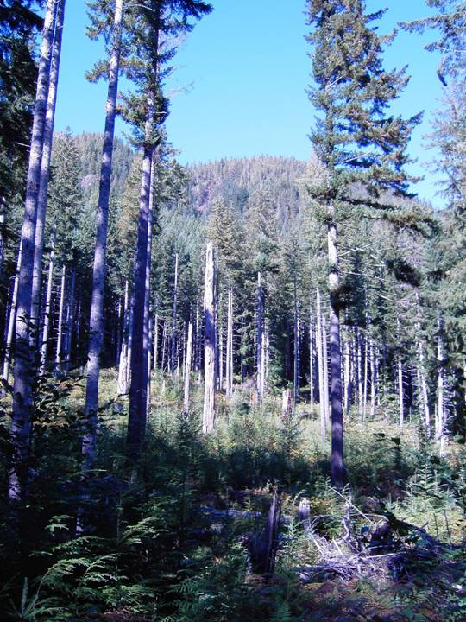
Notes:
Heckel, 1994-95

Slide 18
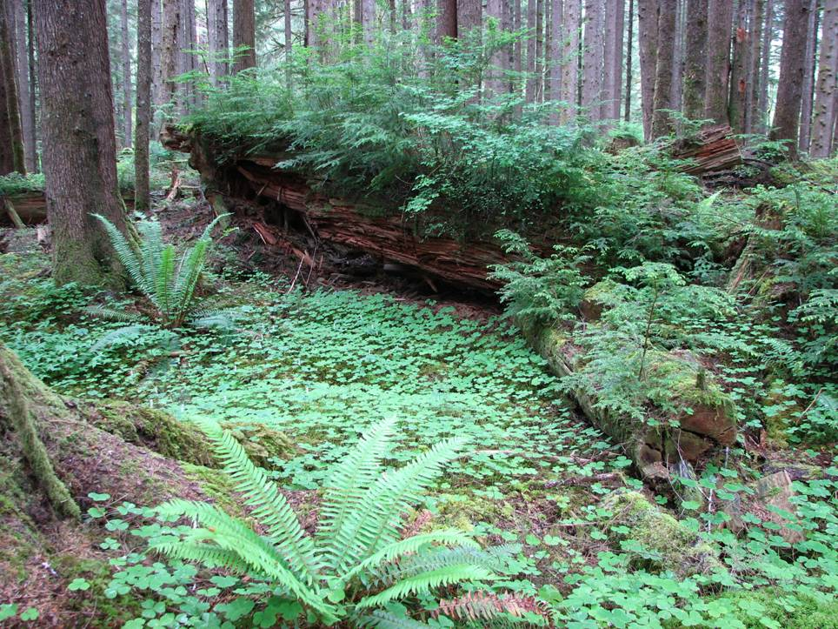

Slide 19
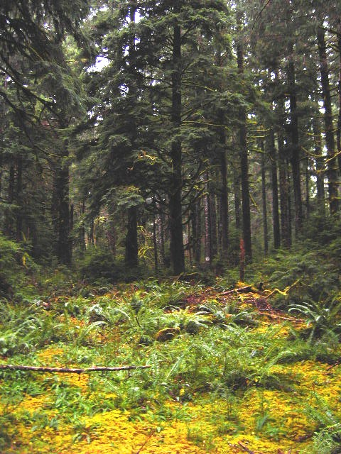

Slide 20
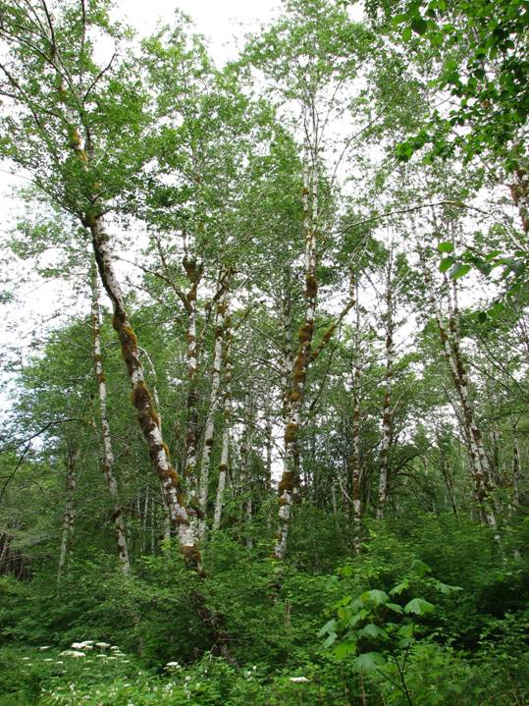
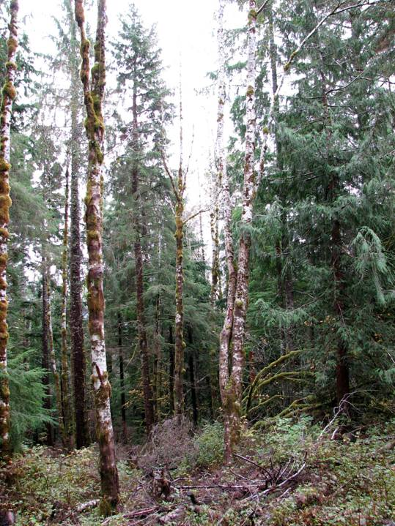
Notes:
Tie, 1998; Overpass alder thin, 2005-7

Slide 21
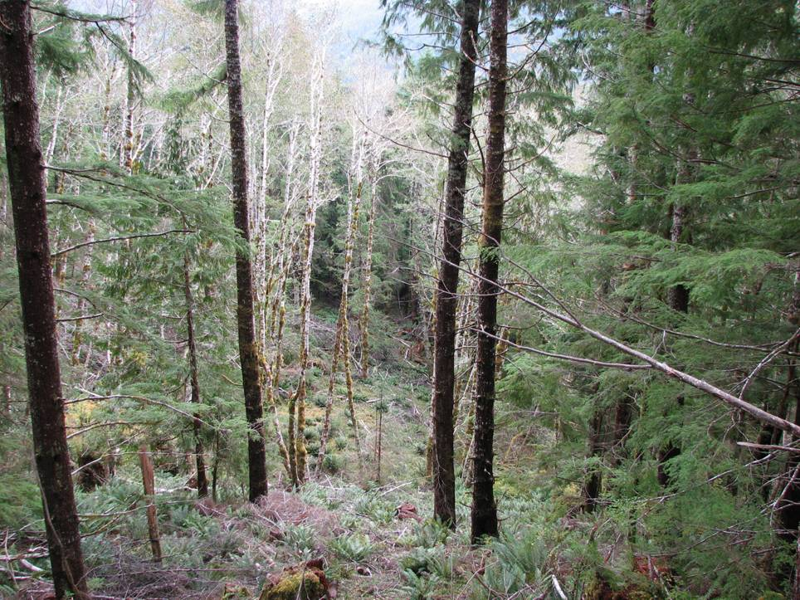
Notes:
Overpass alder thin, 2006

Slide 22
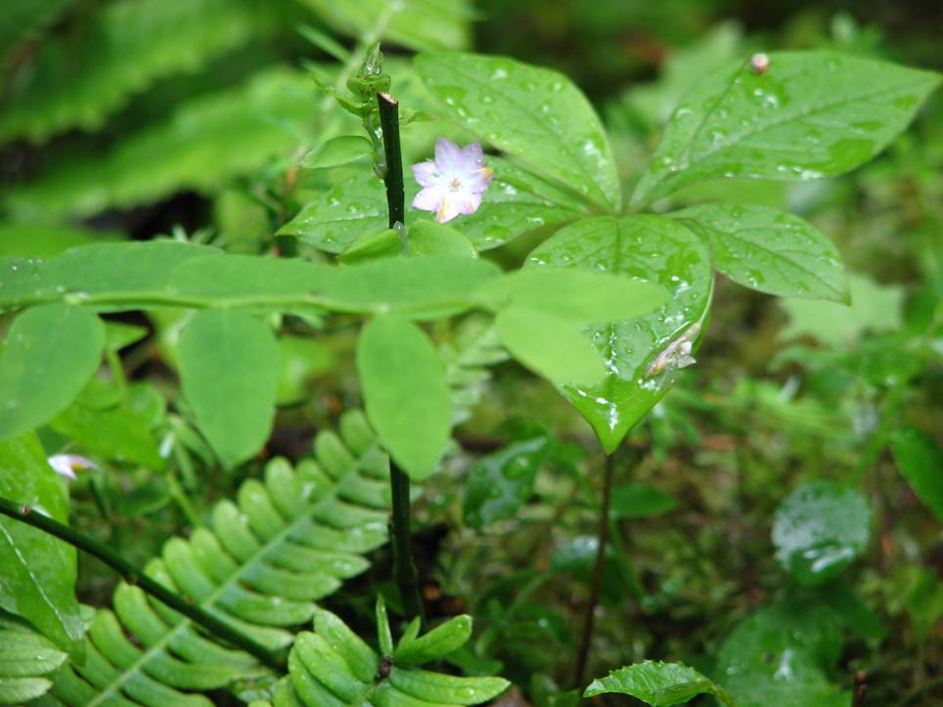
Notes:
Star flower

Slide 23
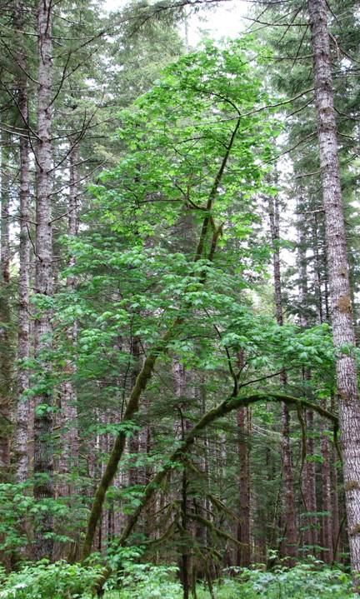
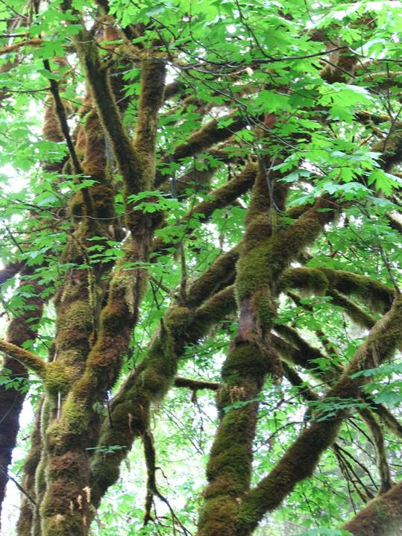
Notes:
Tie

Slide 24
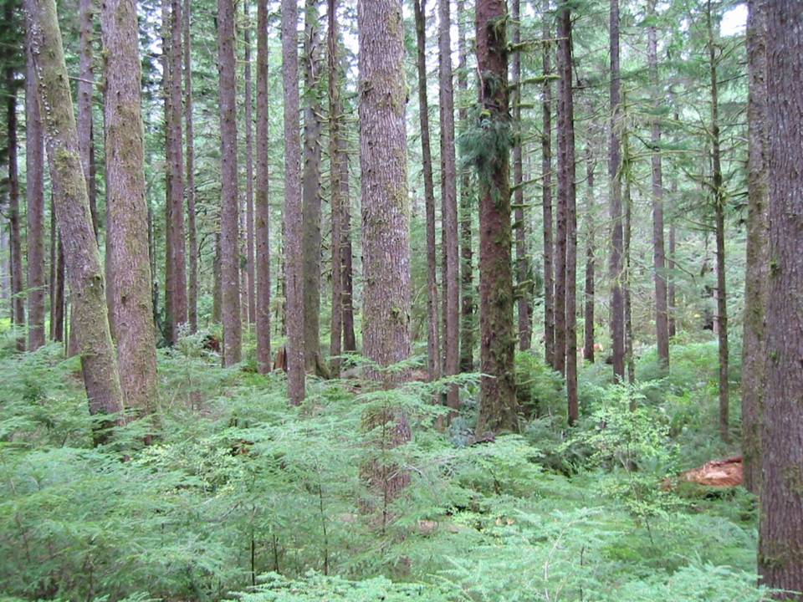
Notes:
Two Y, 2002-3

Slide 25
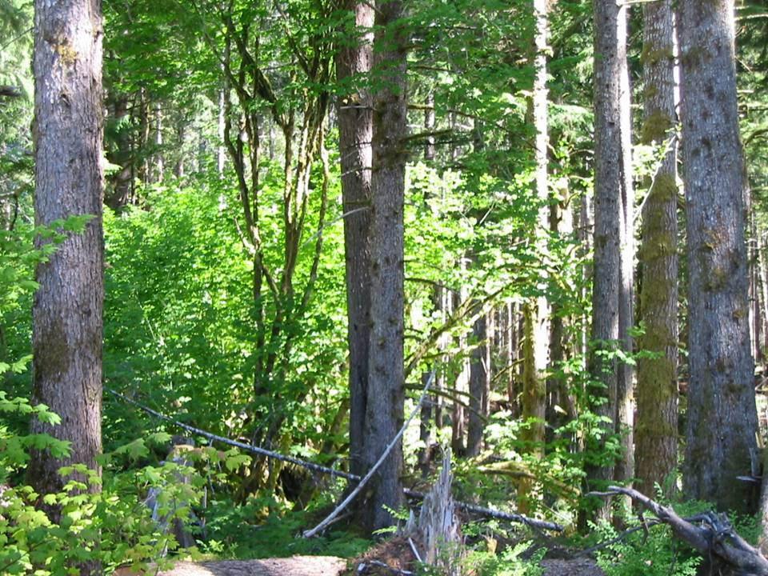
Notes:
Two Y, 2002-3

Slide 26
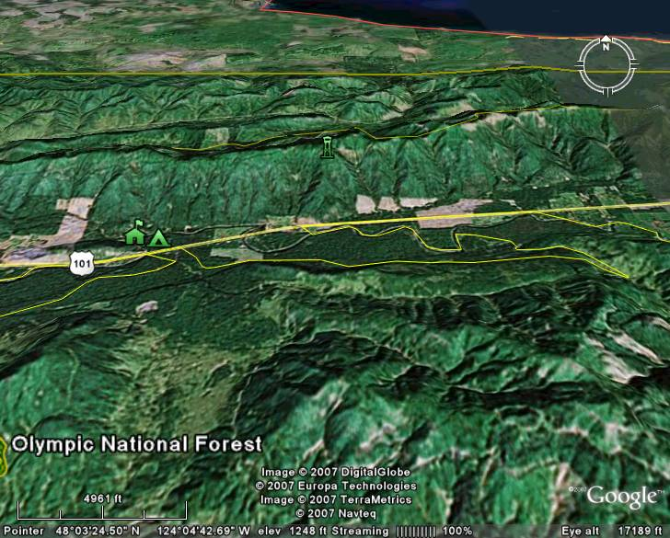
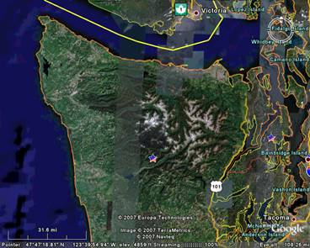
Strait of Juan de Fuca
Railsiding Understory Thin
Sol Duc River
Forks 18 miles
Sol Duc Valley
Olympic Peninsula, WA

Slide 27
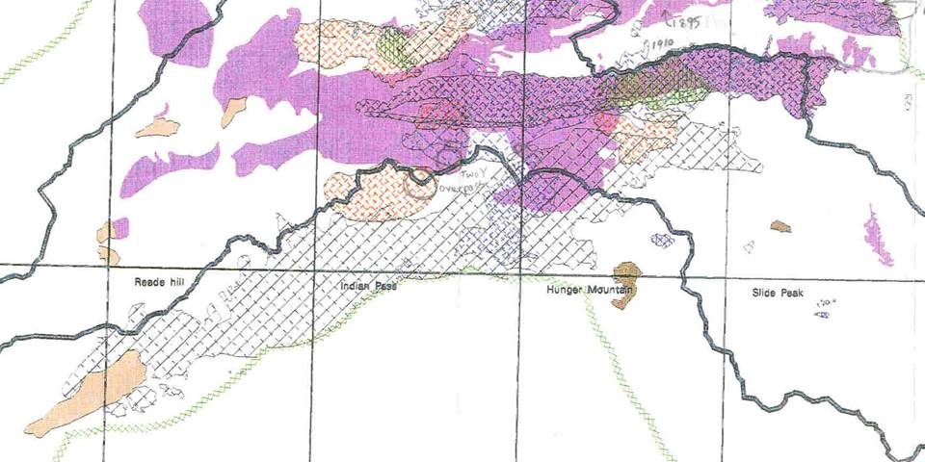
Sol Duc Area Fires, 1895 to Present
Snider Ridge
First Sol Duc Burn
Great Sol Duc Fire
Littleton Fire
Railsiding UST
Snider
Bigler Mt
Great Forks Fire of 1951
Forks Prairie
First Sol Duc Burn ca. 1895 27,300 Acres
Great Sol Duc Fire 1907 8,800
Sol Duc Fire 1914 6,500
Planting Fire 1919 1,000
Littleton Fire 1920 2,800
Notes:
The four fires that occurred subsequent to the First or Original Sol Duc Burn spread across Snider Ridge to varying extents, but generally burned from the valley bottom, where they started from land clearing fires, to the top of the ridge, where they stopped. They did not spread toward the city of Forks.
Contrast those with the Great Forks Fire of 1951, which started from railroad sparks along the Port Angeles West railroad track near Camp Creek in August 1951, was contained at 1600 acres by dozer lines and crews, and then flared up again on September 20 under east wind conditions. It jumped firelines, blazed over the side of Bonidu Peak and directly over Bigler Mountain, and then on down through the North Fork Calawah to the outskirts of Forks, covering some 25 miles and 31,000 acres in about 10 hours.

Slide 28
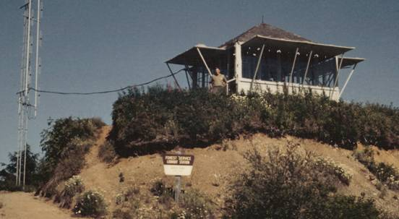
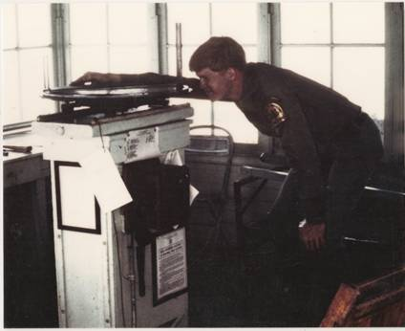
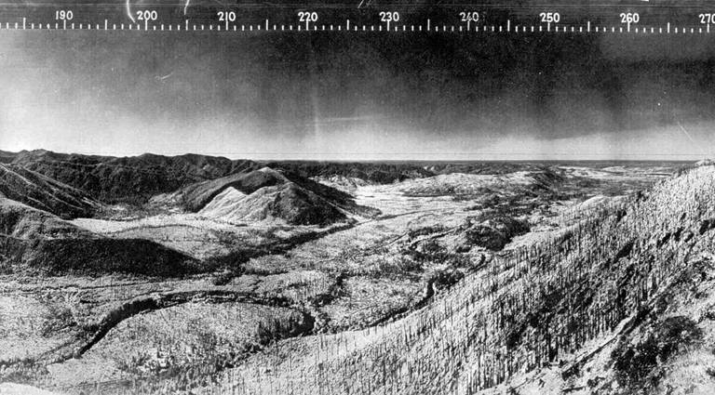
1935 Osborn photo of the west end of Snider Ridge, Bigler, and Sol Duc Valley from Kloshe Nanitch Lookout
Railsiding UST
Notes:
The 1935 Osborn photo shows the view to the southwest and west across the face of Snider Ridge most affected by the Douglas-fir dieback. Note that the city of Forks is situated to the southwest, down the North Fork Calawah drainage, the path of the Great Forks Fire of 1951. Note the recent cutting (recent in 1935) on what is now Green Crow land on the east face of Bigler Mountain (210 to 215 degrees), and that other lands now owned by RTOC on the other side of Bigler down the NF Calawah are also recent clearcuts in the photo.
Note also the numerous “legacy” snags in the old photographs, some of which (a significant number) still remain and provide cavity nester habitat into the 21st century.
Finally, take a look at the planting crew doing replanting work in 1936. The slope they’re working on is exactly in profile from the camera. The “rise” of the slope on the original photo is 3.6 inches, while the “run” is 4.5 inches, indicating a slope of 80%. Slopes of this steepness are common on Snider Ridge.

Slide 29
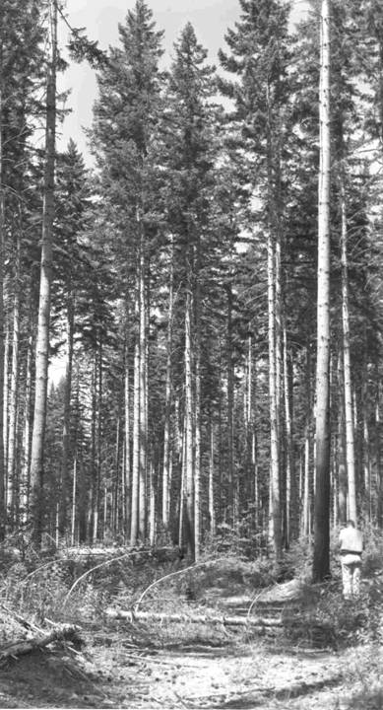
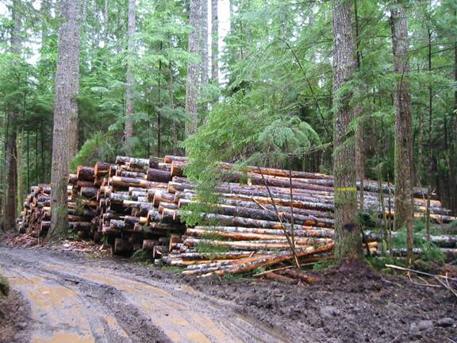
First commercial thin, 1972-74
Second commercial thin, 1998

Slide 30
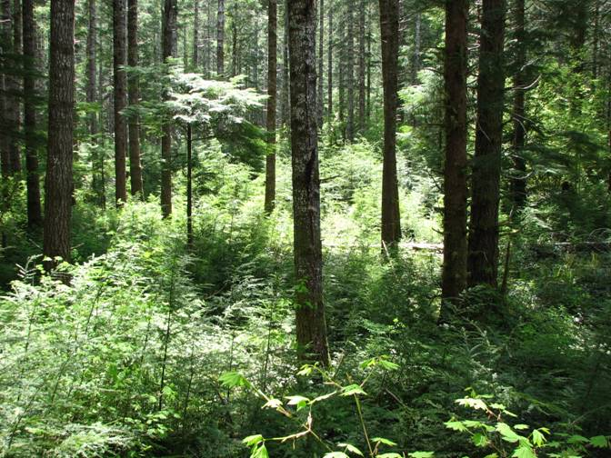
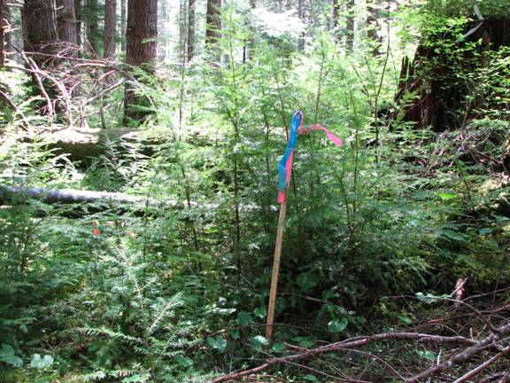
Objective: Develop terrestrial habitat in a twice-commercial-thinned stand of Douglas-fir and hemlock that had grown a dense “carpet” of hemlock saplings following its first commercial thinning in the 1970s.
Objective: Demonstrate management of hemlock “carpets”
Hemlock carpets?
Recalcitrant understories?

Slide 31
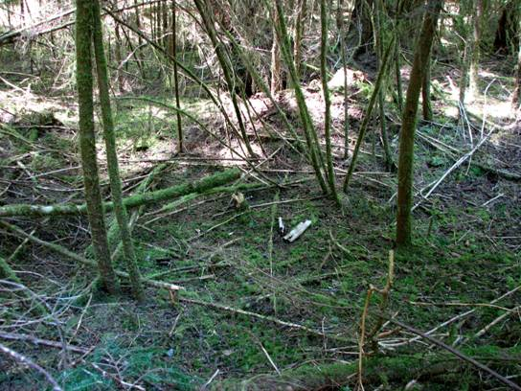
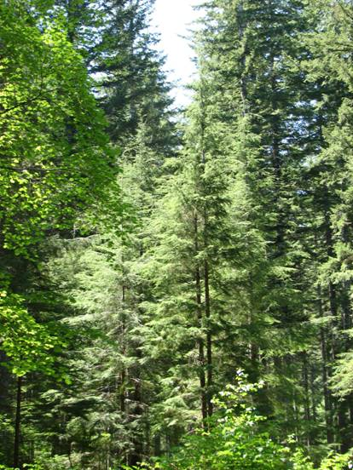
Objective: Allow retention of full crowns and encourage diameter growth of residual understory hemlock
Objective: Open the understory and reintroduce (or prevent exclusion of) herbs and shrubs to (or from) the forest floor by thinning the understory cohort of hemlock
Notes:
Need impoverished forest floor picture, and midstory hemlock here

Slide 32
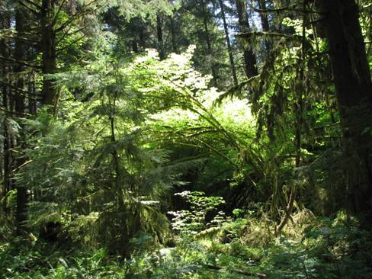
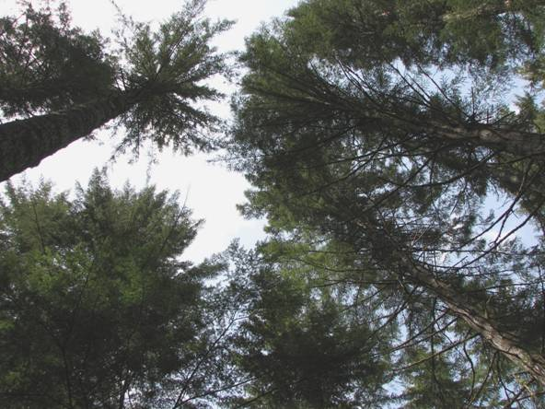
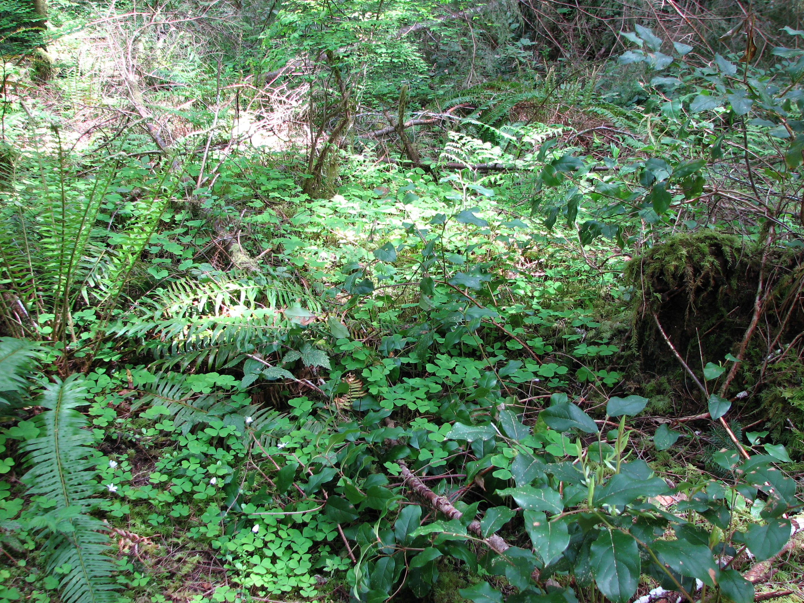
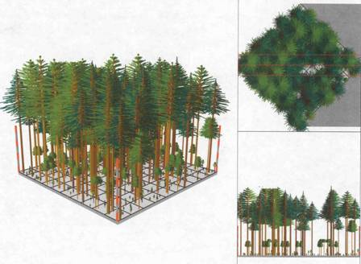
Objective: Develop a stand exhibiting three distinct canopy layers—the overstory DF and WH, the understory hemlock and vine maple, and the ground layer of herbs and shrubs including red huckleberry, salal, fools huckleberry, sword fern, oxalis, etc.

Slide 33
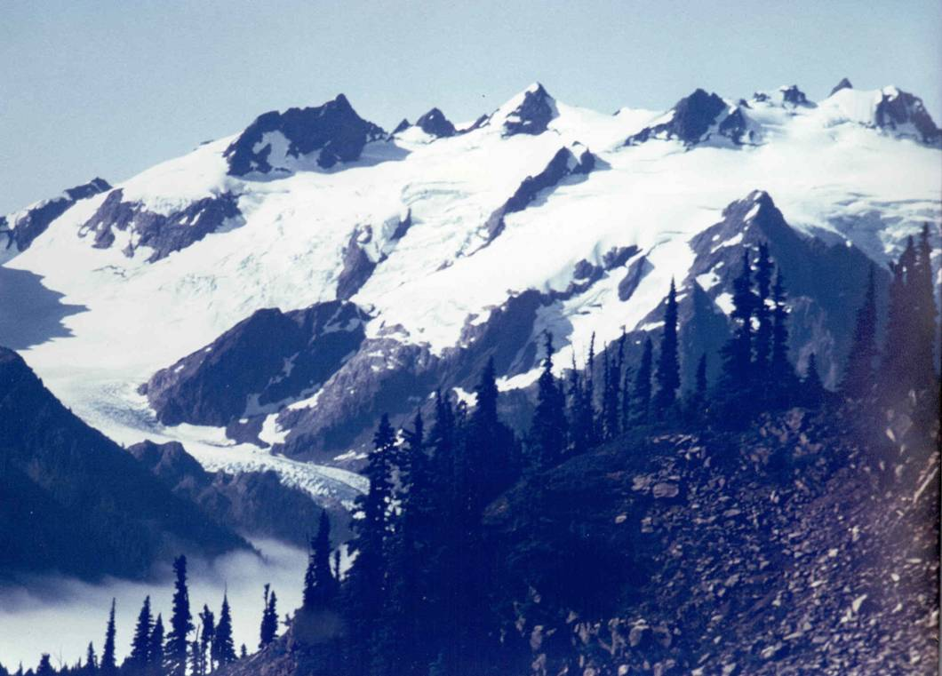
Forest/Regional Goals:
Implement the NW Forest Plan
Develop late successional habitat in AMA and LSR —
the Olympic is entirely AMA (20%) and LSR (80%)
Add diversity to simplified second-growth forests —
NWFP, Olympic AMA, D16

Slide 34
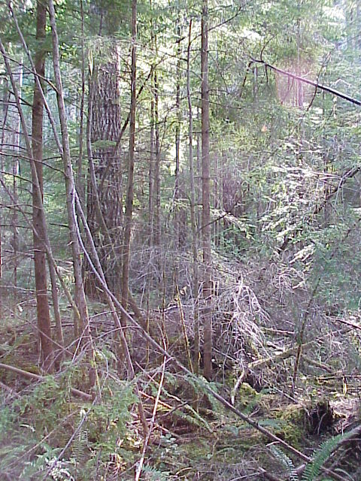
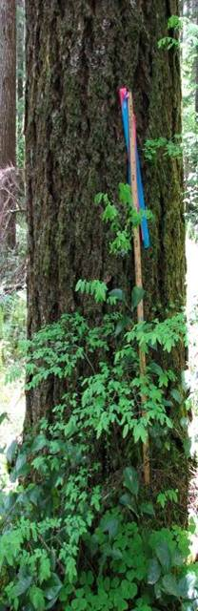
Pre-treatment Stand Conditions:
Overstory, post-commercial thinning (second CT 1998): Estimate 89% DF, 11% WH, 180 ft²/ac BA, 66 TPA, 22.5 in. QMD, RD_{Curtis} = 38, LCR 35-45%
Understory: Variably 5-20 thousand TPA, WH, 0-4” DBH, 4-18 feet tall that came in following the first commercial thin in the early to mid ‘70s.
Ground vegetation: Light to non-existent due to exclusion by the dense hemlock understory stand.

Slide 35

Intended post-treatment stand conditions:
A stand exhibiting three distinct canopy layers—the overstory DF and WH, approx. 150 feet tall, the understory hemlock (approx 170 TPA) and vine maple, approx 8-16 feet tall, and a ground layer of herbs and shrubs including red huckleberry, salal, fool’s huckleberry, sword fern, oxalis, etc.
Prescription:
Thinning was specified to an average spacing of 16x16 feet, from below, cutting and spacing only from trees 6 inches DBH and under—in particular, thinners were not to space off overstory trees.
Hemlock was the priority cut-tree.
Cedar, spruce, and hardwoods were priority leave-trees.
Shrubs of any kind were not to be cut.

Slide 36




Tools/Resources
NW Forest Plan, Olympic AMA (D16):
Add diversity to simplified second-
growth forests
PNW 447, old-growth definitions: Large
trees; shade-tolerant associates; deep,
multilayered canopy; snags; CWD
Dr. Joan Hagar: Deciduous shrub cover approaching 35% encourages neotropical migrant birds to inhabit conifer stands
Dr. Andrew Carey: Skips, gaps, CWD and Ericaceous shrubs are important for spotted owl prey species
Notes:
PNW 447, as updated by more recent publications emphasizing the importance of spatial heterogeneity, both vertical and horizontal, including “skips and gaps.”

Slide 37

Assumptions—basis:
(and uncertainties)
• Once the understory hemlock has developed a woody stem, it can be
thinned mechanically, the same as any plantation—experience.
• Two canopy layers, i.e., the overstory DF and WH, plus the residual
understory hemlock and vine maple, would prevent a second pulse of
hemlock regeneration from germinating under the thinned understory—
experience and positive or wishful thinking.
• The thinned understory hemlock would be able to grow and develop without
excessive wet-noodling—logic (wind should not be as great a factor in the
understory and fervent prayer (the H/D ratio of a 2-inch,16-foot tree is 96!)
• Herbs and shrubs would be able to persist and increase in biomass or
be re-introduced in the thinned understory—experience with post-PCT and
post-CT stands.

Slide 38


Railsiding Understory Thin
32 acres thinned November, 2001; 44 acres thinned March, 2004
Before Treatment, October 5, 2001
After Treatment, December 3, 2001
After 2002 Growing Season, September 23, 2002

Slide 39

A lot of stems were cut:
3-ft Biltmore stick
Notes:
This picture shows about 15 stems cut in approximately 10 square feet, representing 65,000 stems per acre at this point.

Slide 40


Potential problems:
Prescription not understood:
All understory trees removed
Shrubs inadvertently cut
Slash
Wet noodling/blowdown

Slide 41



Results: (3 and 5 growing seasons on)
Hemlock carpet eliminated
Developing midstory WH & vine maple
No new pulse of hemlock regen
A few wet-noodled understory trees
Much more ground vegetation

Slide 42



Results (continued):
Improved diameter growth of understory trees
59% increase in diameter growth
5-yr radial growth post-thin 0.35”
5 inch X 30 foot hemlock
UST 11/01
5-yr radial growth pre-thin 0.22”
UST 11/2001
2nd CT 1998
Notes:
Add small pic of tree with increment borer

Slide 43
Widely accepted, current? Newly developed, novel?
Well…

Slide 44

Questions?
This habitat don’t suck…
Answers $1
Answers requiring thought $10
Truthful and/or correct answers $100
(Questions and dumb looks are free)

Slide 45
Factors that may influence development of hemlock carpets in commercial thins:
Site moisture regime/plant association
Pre-thin ground vegetation cover, type and amount (reflecting stand density
and history)
Post-thin stand density, including losses due to blowdown
Stand species composition, i.e., relative dominance of DF vs. WH – may affect
height growth of hemlock carpet more than hemlock regeneration
Continuous, dense
Moist site
Hemlock carpet
Low post-thin stand density
Low veg cover
High pre-thin stand density
High post-thin stand density
High veg cover
Low pre-thin stand density
Dry site
Discontinuous, sparse

Slide 46
Other disturbances can generate hemlock carpets:
Post Christmas ice storm of 1996
Douglas-fir dieback on Snider Ridge
Low intensity fire along edge of Forks Burn, Bonidu Flat
Understory reinitiation stage forest, found in relatively undisturbed old
growth stands in Olympic National Park
1921 Blow (?) and other blowdown events

