Slide 1
Non Commercial Thinning In A Late Succesional Reserve - LSR 267
Rich Kelly Eugene BLM 541-683-6405 rkelly@blm.gov

Slide 2
Outline
EIS Background
EIS Prescriptions – non commercial thinning
Stand Assessments – young stands
Demonstration Stands
Conclusions

Slide 3
EIS - Upper Siuslaw LSR Restoration Plan
Forest and Aquatic Restoration Plan – purpose and need
protect and enhance late-successional and old growth forest ecosystems
foster the development of late successional forest structure and composition in plantations and young forests
Reconnect streams and reconnect stream channels to their riparian zones and upslope areas

Slide 4
Objectives
Reduce tree density and increase variability of tree spacing
Control noxious weeds
Decommission or improve roads
Increase stream structure with woody debris
Develop quantities of snags and coarse woody debris
Restore riparian conifer density
Develop understories of shade tolerant conifer species
Eliminate barriers to anadromous fish movements

Slide 5
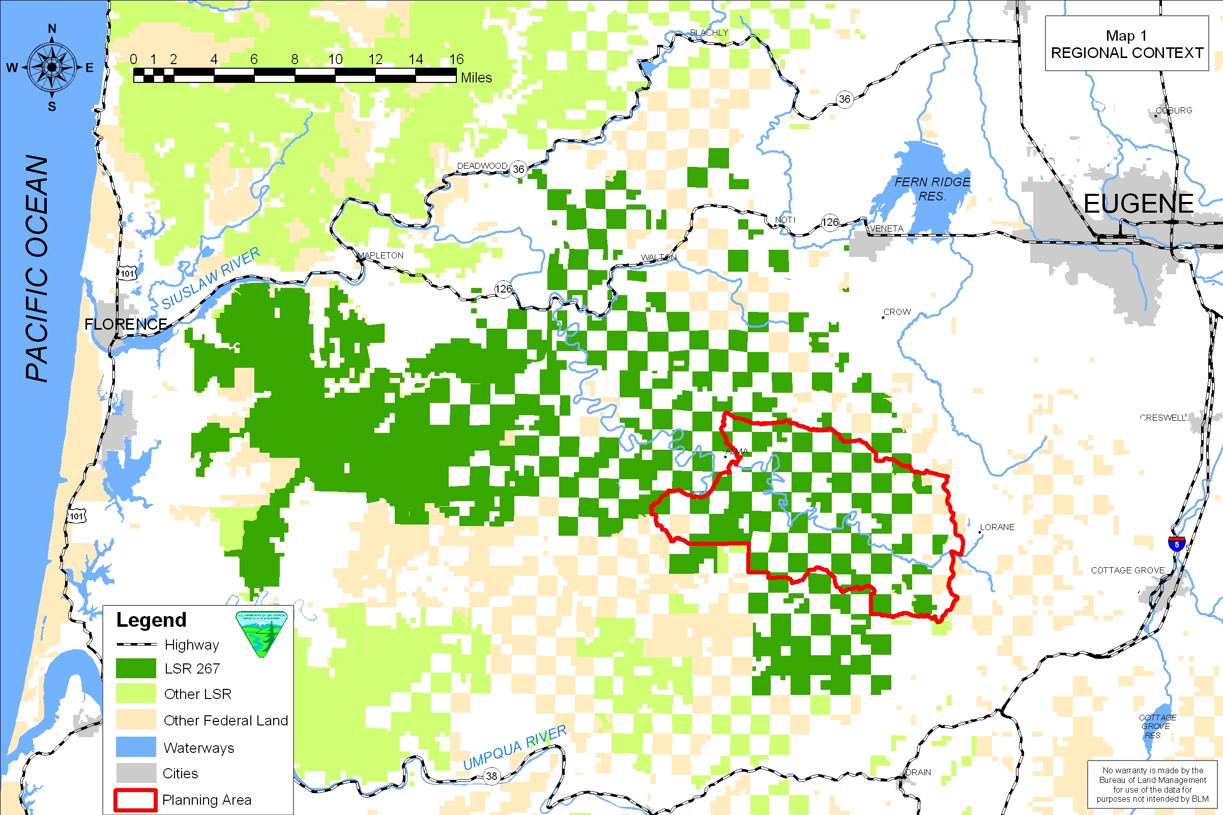
Planning Area

Slide 6
Credits EIS Team
Karin Baitis BLM Soil Scientist
Kathy Barry USFW Biologist
Alison Center BLM Biologist
Rick Colvin BLM Landscape Planner
Dave DeMoss BLM Forester
Richard Hardt BLM Forest Ecologist
Leo Poole BLM Biologist
Mark Stephen BLM Forester
Debra Wilson BLM Resource Technician
Bruce Hostetler USFS Entomologist
Darrel Ashcraft USFS Fuels Technician

Slide 7
LSR Restoration Plan
Innovative and creative approach to ecosystem mgt.
Not “traditional” silvicultural practices – young stand management
Not a philosophy “silviculture main function is the response to regeneration harvest” (i.e. rehab)
http://www.edo.or.blm.gov/planning/lsr/index.htm

Slide 8
ROD = Record Of Decision July 2004
Upper Siuslaw Late-Sucessional Reserve Restoration Plan - Upland Thinning Actions
Upper Siuslaw Late-Sucessional Reserve Restoration Plan - Watershed Restoration Actions
GOAL 1: Protect and enhance late-successional and old-growth forest ecosystems.
GOAL 2: Foster the development of late-successional forest structure and composition in plantations and young forests within LSR 267.
GOAL 3: Reconnect streams and reconnect stream channels to their riparian zones and upslope areas within LSR 267.

Slide 9
Format
Goal 1
Noxious weeds
Decommission roads
Goal 2
Reduce tree densities
Develop shade tolerant species
Develop snags and CWD
Goal 3
Reduce sedimentation from roads
Increase stream structures
Increase riparian conifer densities
Riparian hardwood conversion

Slide 10
Objectives and Actions
OBJECTIVE: Reduce tree density and increase variability of tree spacing in 75% (100% of stands; 75% of acres) of the 21-30-year age class, so that tree densities range from 40-110 TPA within 10 years.
ACTION: Among stands aged 21 to 30 years that were pre-commercially thinned, thin approximately 1/3 of stands in uplands (i.e., >100' from streams) to a treated stand average of 40-60 Douglas-fir trees per acre, with variable spacing.
ACTION: Among stands aged 21 to 30 years that were pre-commercially thinned, thin approximately 1/3 of stands in uplands (i.e., >100' from streams) to a treated stand average of 60-80 Douglas-fir trees per acre, with variable spacing.
ACTION: Among stands aged 21 to 30 years that were pre-commercially thinned, thin approximately 1/3 of stands in uplands (i.e., >100' from streams) to a treated stand average of 80-110 Douglas-fir trees per acre, with variable spacing.

Slide 11
Age Classes – Planning Area & LSR

Slide 12
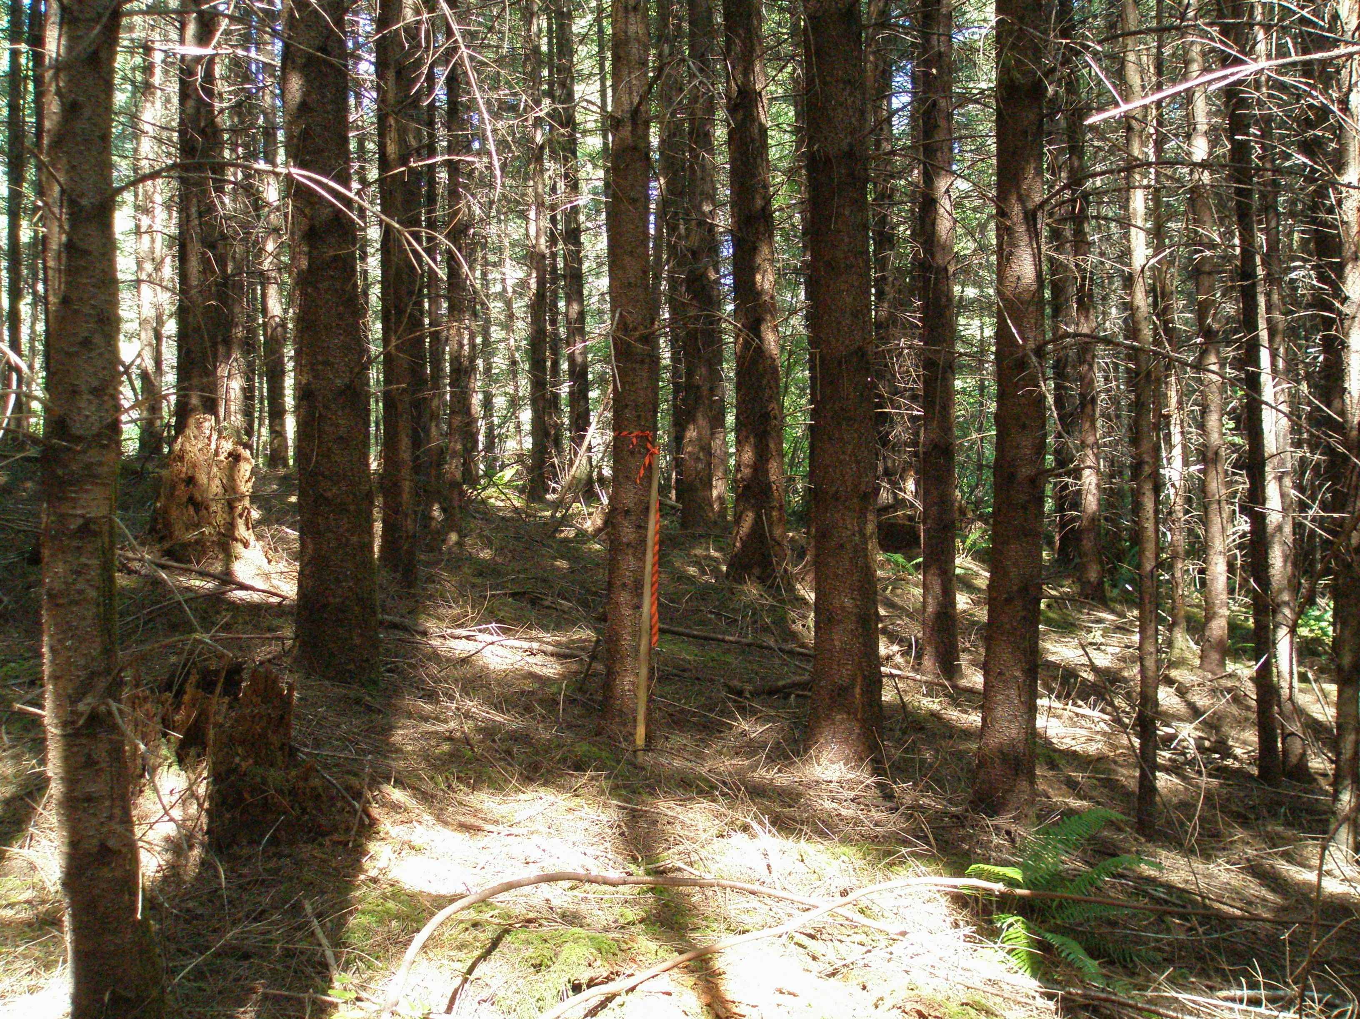
IMPLEMENTATION – Non Commercial Thinning

Slide 13
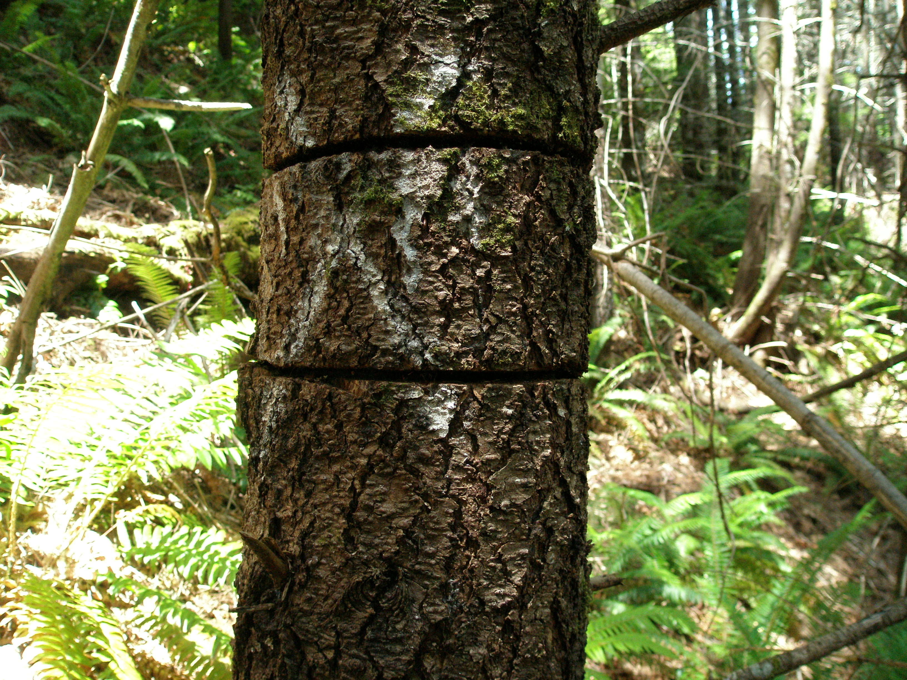
Tree Girdling – Veg. Mgt. Contract

Slide 14
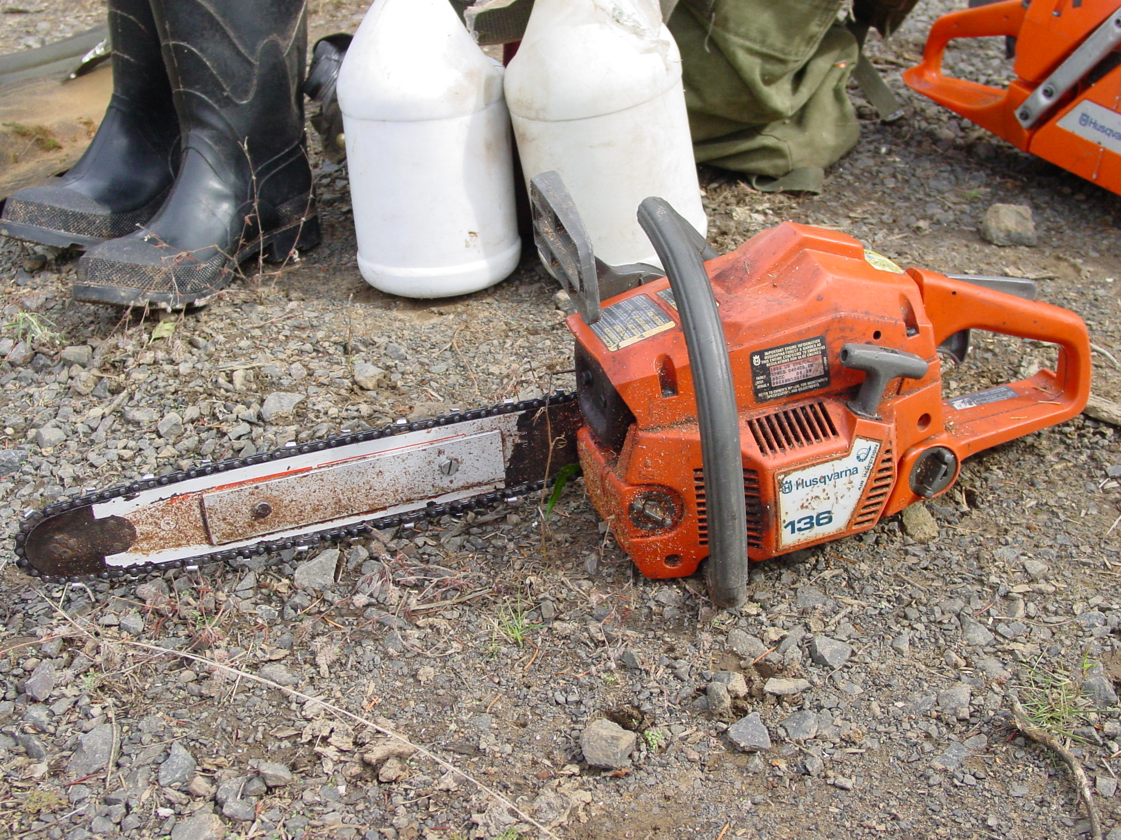
Equipment

Slide 15
Target Stands - Initial
Non PCTed Stands
Average Diameter 5-9 inches
High Relative Density - 300 TPA
Low Levels of CWD and Snags
Accomplishments:
2006 950 Acres
2007 400 Acres

Slide 16
Specifications Slide 1
1. The Contractor shall select leave trees and shall girdle take trees to achieve a variable width spacing of the Douglas fir trees across the entire project area.
2. The Contractor shall normally select the largest, healthiest, or best formed tree for the leave trees.
3. The Contractor shall not girdle/cut conifer trees which are:
Trees less than 6 inches DBH
Trees greater than 16 inches DBH
Non Douglas-fir tree species
Hardwood trees
Douglas fir trees with green limbs within 10 feet of the ground
Tree leaning at greater than 30 degrees from vertical
Trees with a broken top or missing terminal leader

Slide 17
Specifications Slide 2
4. The Contactor shall girdle trees for an average spacing of approximately 18 by 18 feet (average of 134 trees per acre). The contractor shall normally vary the spacing from 12 to 24 feet. The contractor shall rarely (less than 5% of the time) use 8 foot spacing between trees.
5. The Contractor shall not girdle conifer trees when the existing conifer spacing is equal to or greater than 25 feet (70 trees per acre).
6. The Contractor shall not girdle trees within a 25 foot wide leave strip along designated stand edges as identified on the project area maps.
7. The Contractor shall not girdle trees within a 50 foot wide primary shade zone along the side of perennial streams as identified on the project area maps.

Slide 18
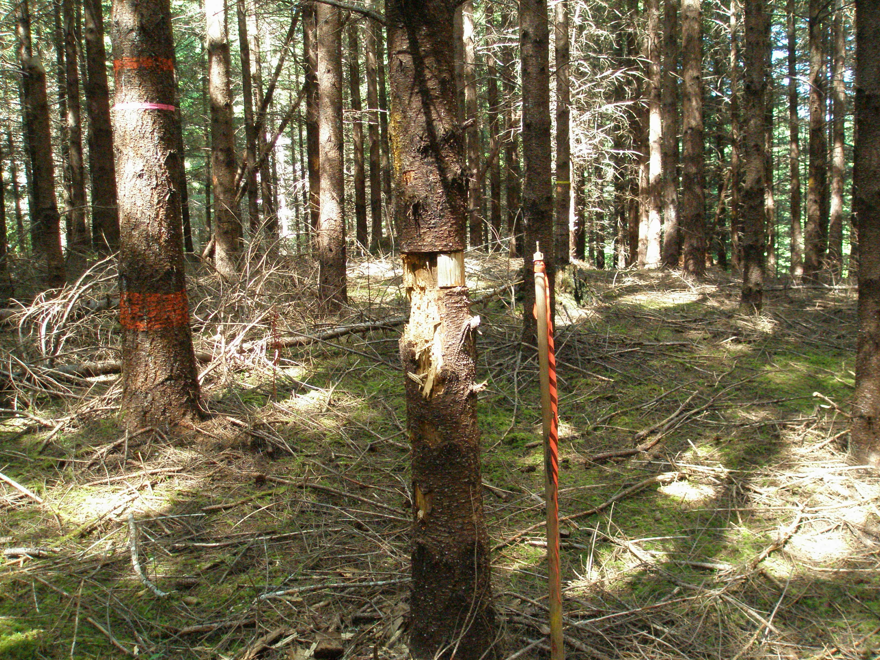
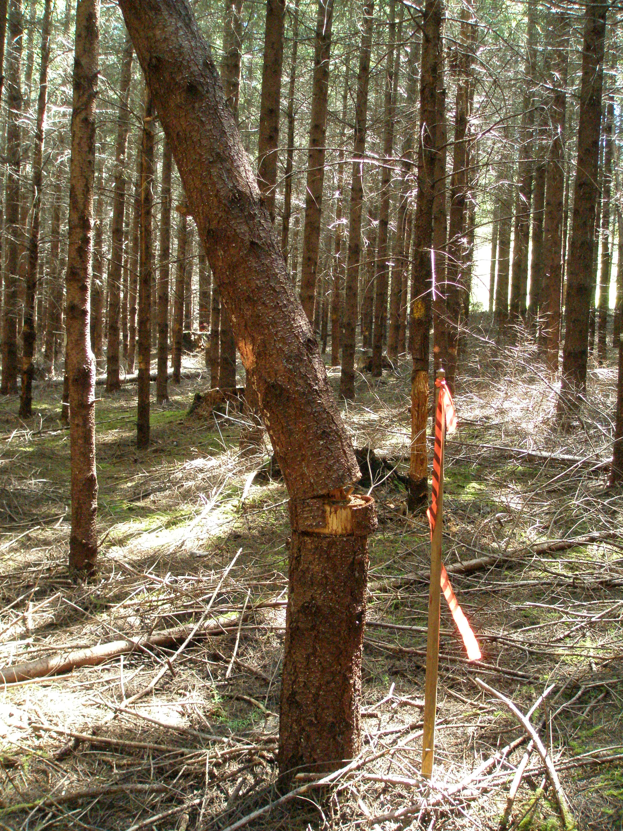
Tree Girdling – 1 to 2 years

Slide 19
Intended Conditions
Forest Stand Post-Treatment
PCTed stands 40-110 TPA
non PCTed stands 75-150 TPA
variable tree spacing - 8 feet to 30 feet
shade tolerant conifers 26-90 TPA by age 81
snags and coarse woody debris 1102-3794 cu ft. per acre
riparian conifers ≥ 13 TPA ≥ 24 inches DBH by age 80-131
stream structures (woody debris) 30-160 pieces per stream mile

Slide 22
Tools and Resources
Reforestation records database (Microstorms)
GIS maps
Aerial photos
Stand Assessments
multi year/multi agency vegetation management contract

Slide 23
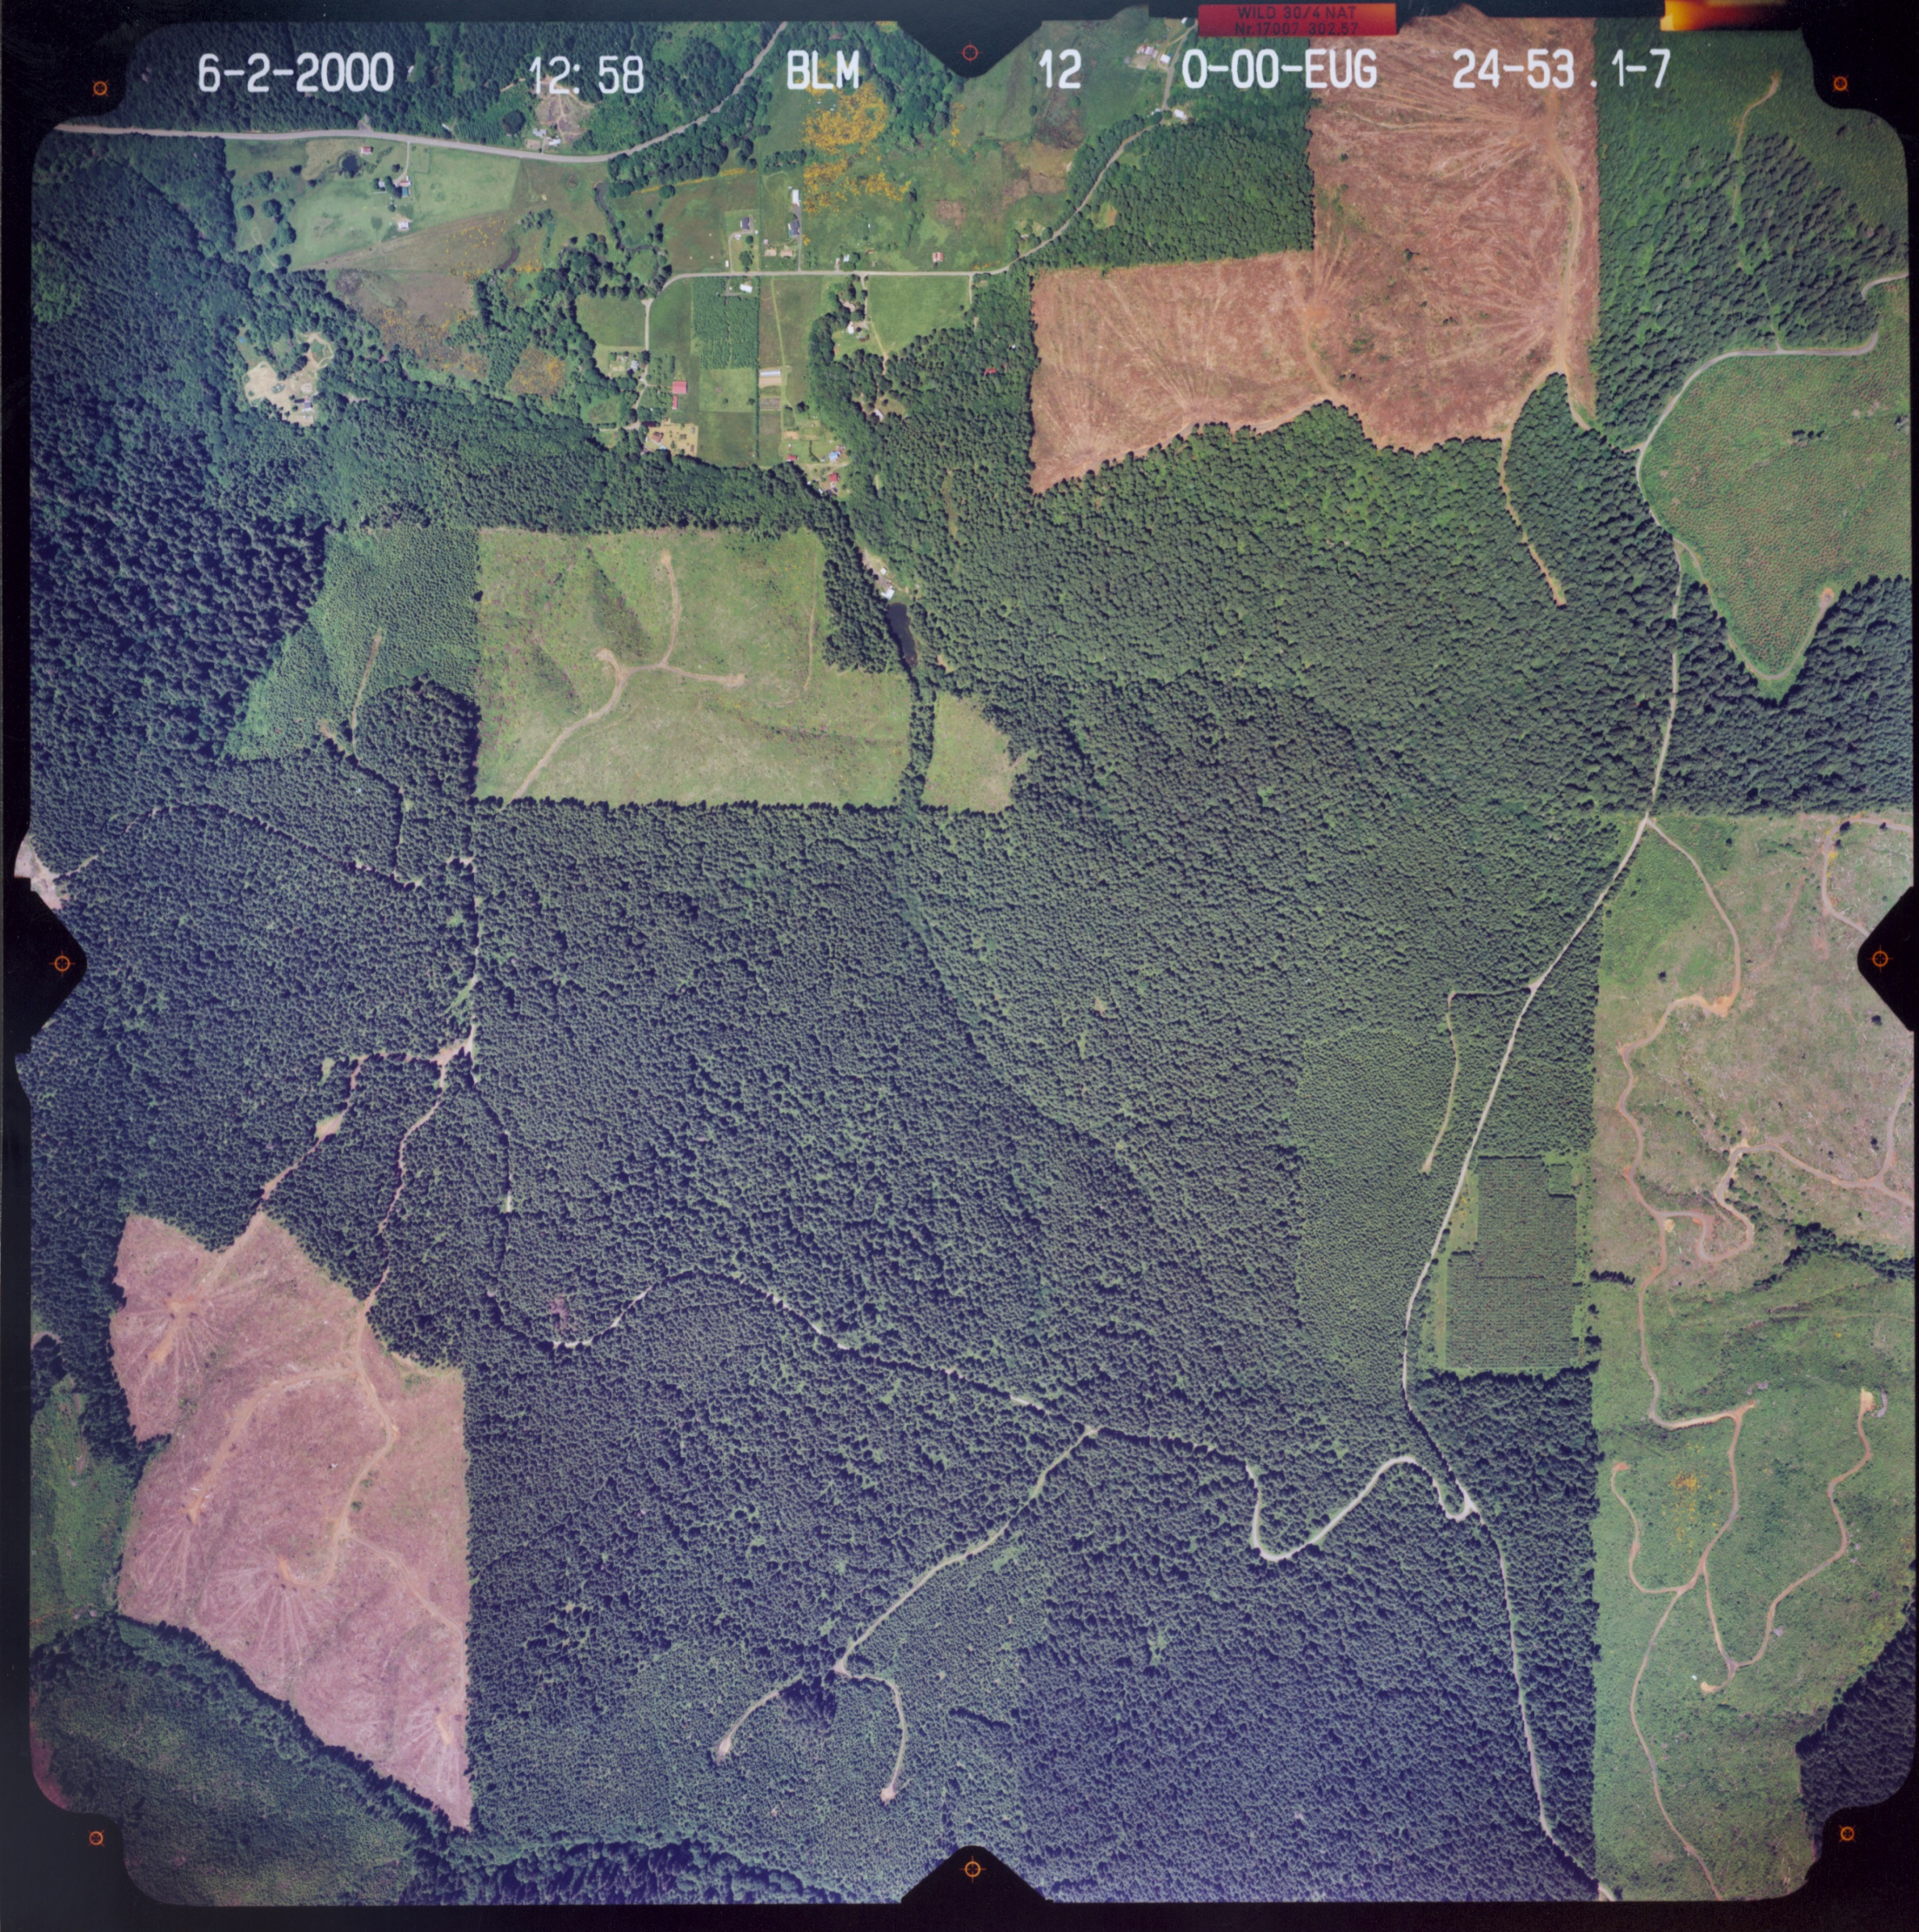
Stand Assessments
Stand Assessments versus Stand Exams

Slide 24
Recommended Treatment - Options
No Treatment
PCT
NCT
Habitat Circles
Understory Plant – Shade Tolerant Species
Stewardship Opportunity
Stand Exam
Commercial Thin
Density Reduction Treatment
Road Decommission
In Stream Debris and Structure
Riparian Conifer Release
Riparian Conversion

Slide 25
Demonstration - Stand Assessments
Indicators:
Average TPA
Average DBH
Maximum DBH
Relative Density
Ground Vegetation
Snags and CWD

Slide 26
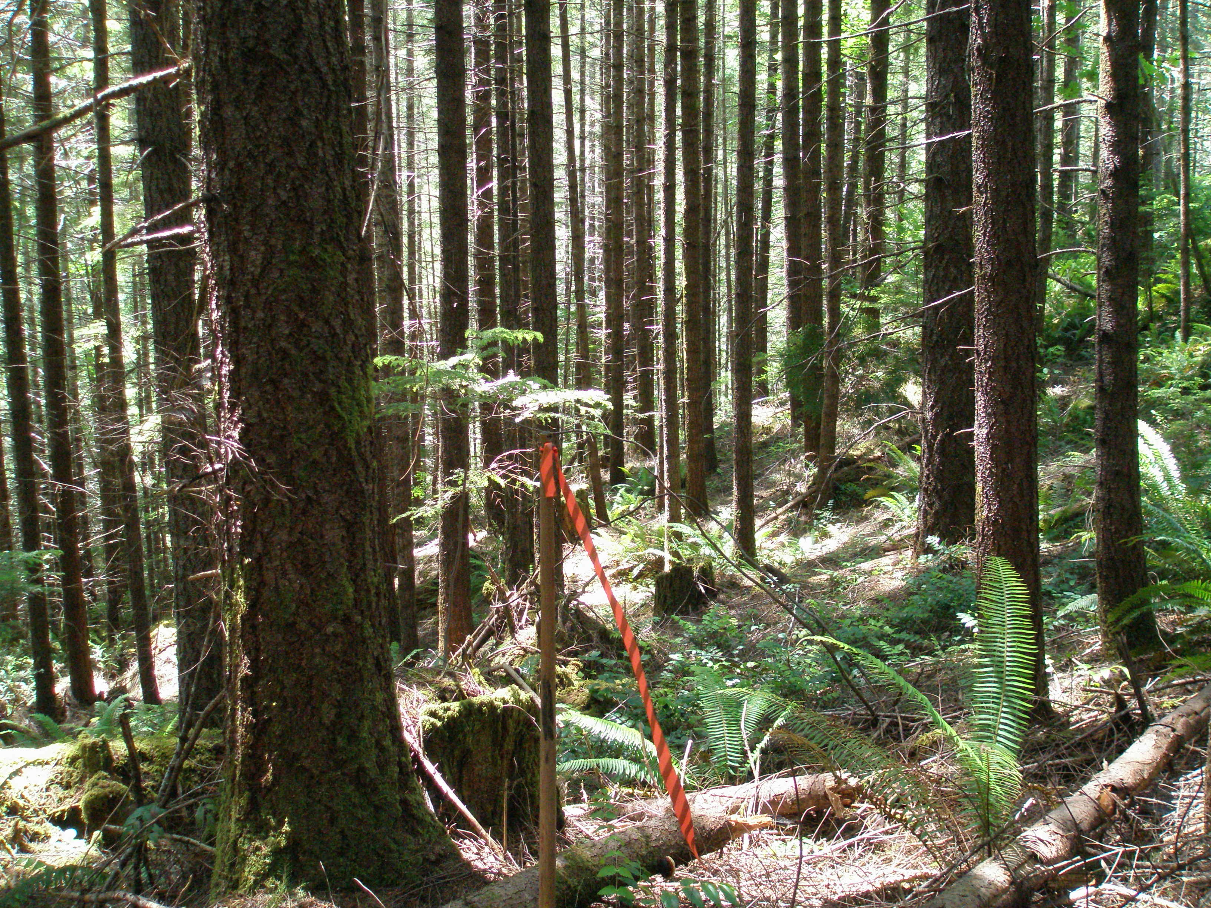
#1 Stand Conditions

Slide 27
# 1 Treatment ??
LSR Stand Assessment
 | 19-6-33
Average TPA | 260
Average DBH | 14
Maximum DBH | 21
Ground Vegetation | mostly brown
Snags & CWD | medium-logs
Relative Density | 75

Slide 28
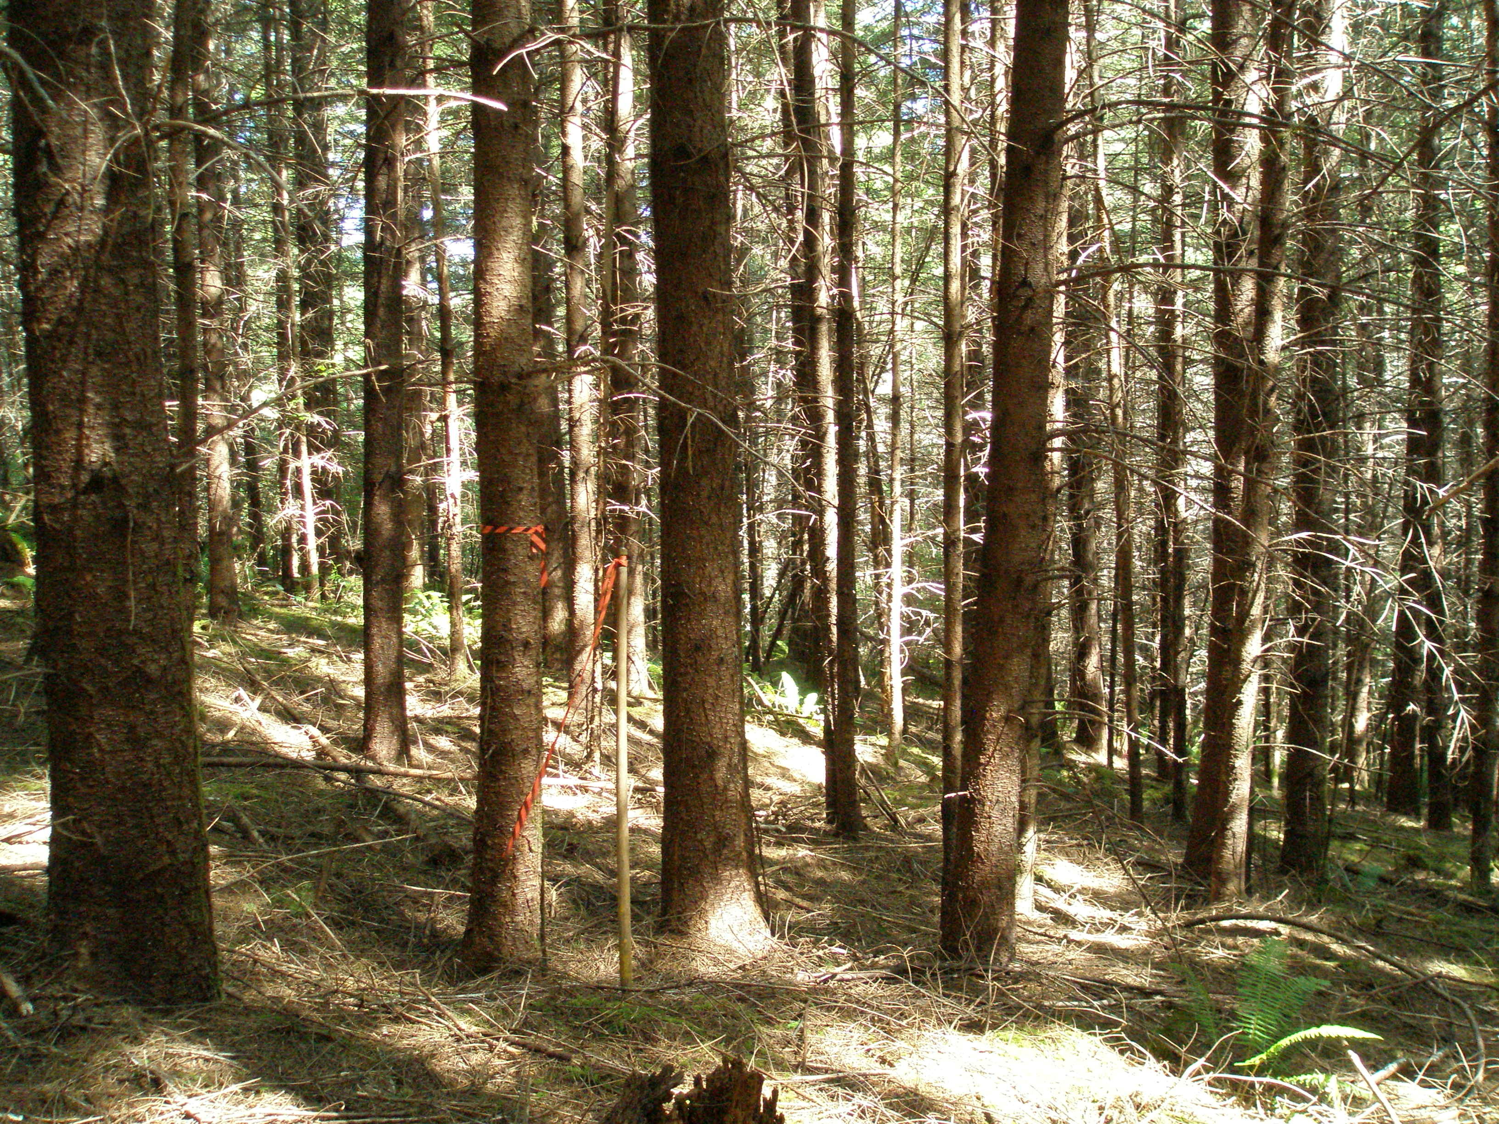
#2 Stand Conditions

Slide 29
# 2 Treatment ??
LSR Stand Assessment
 | 20-5-35
Average TPA | 600
Average DBH | 8
Maximum DBH | 13
Ground Vegetation | mostly brown
Snags & CWD | light- sup. mort
Relative Density | 82

Slide 30
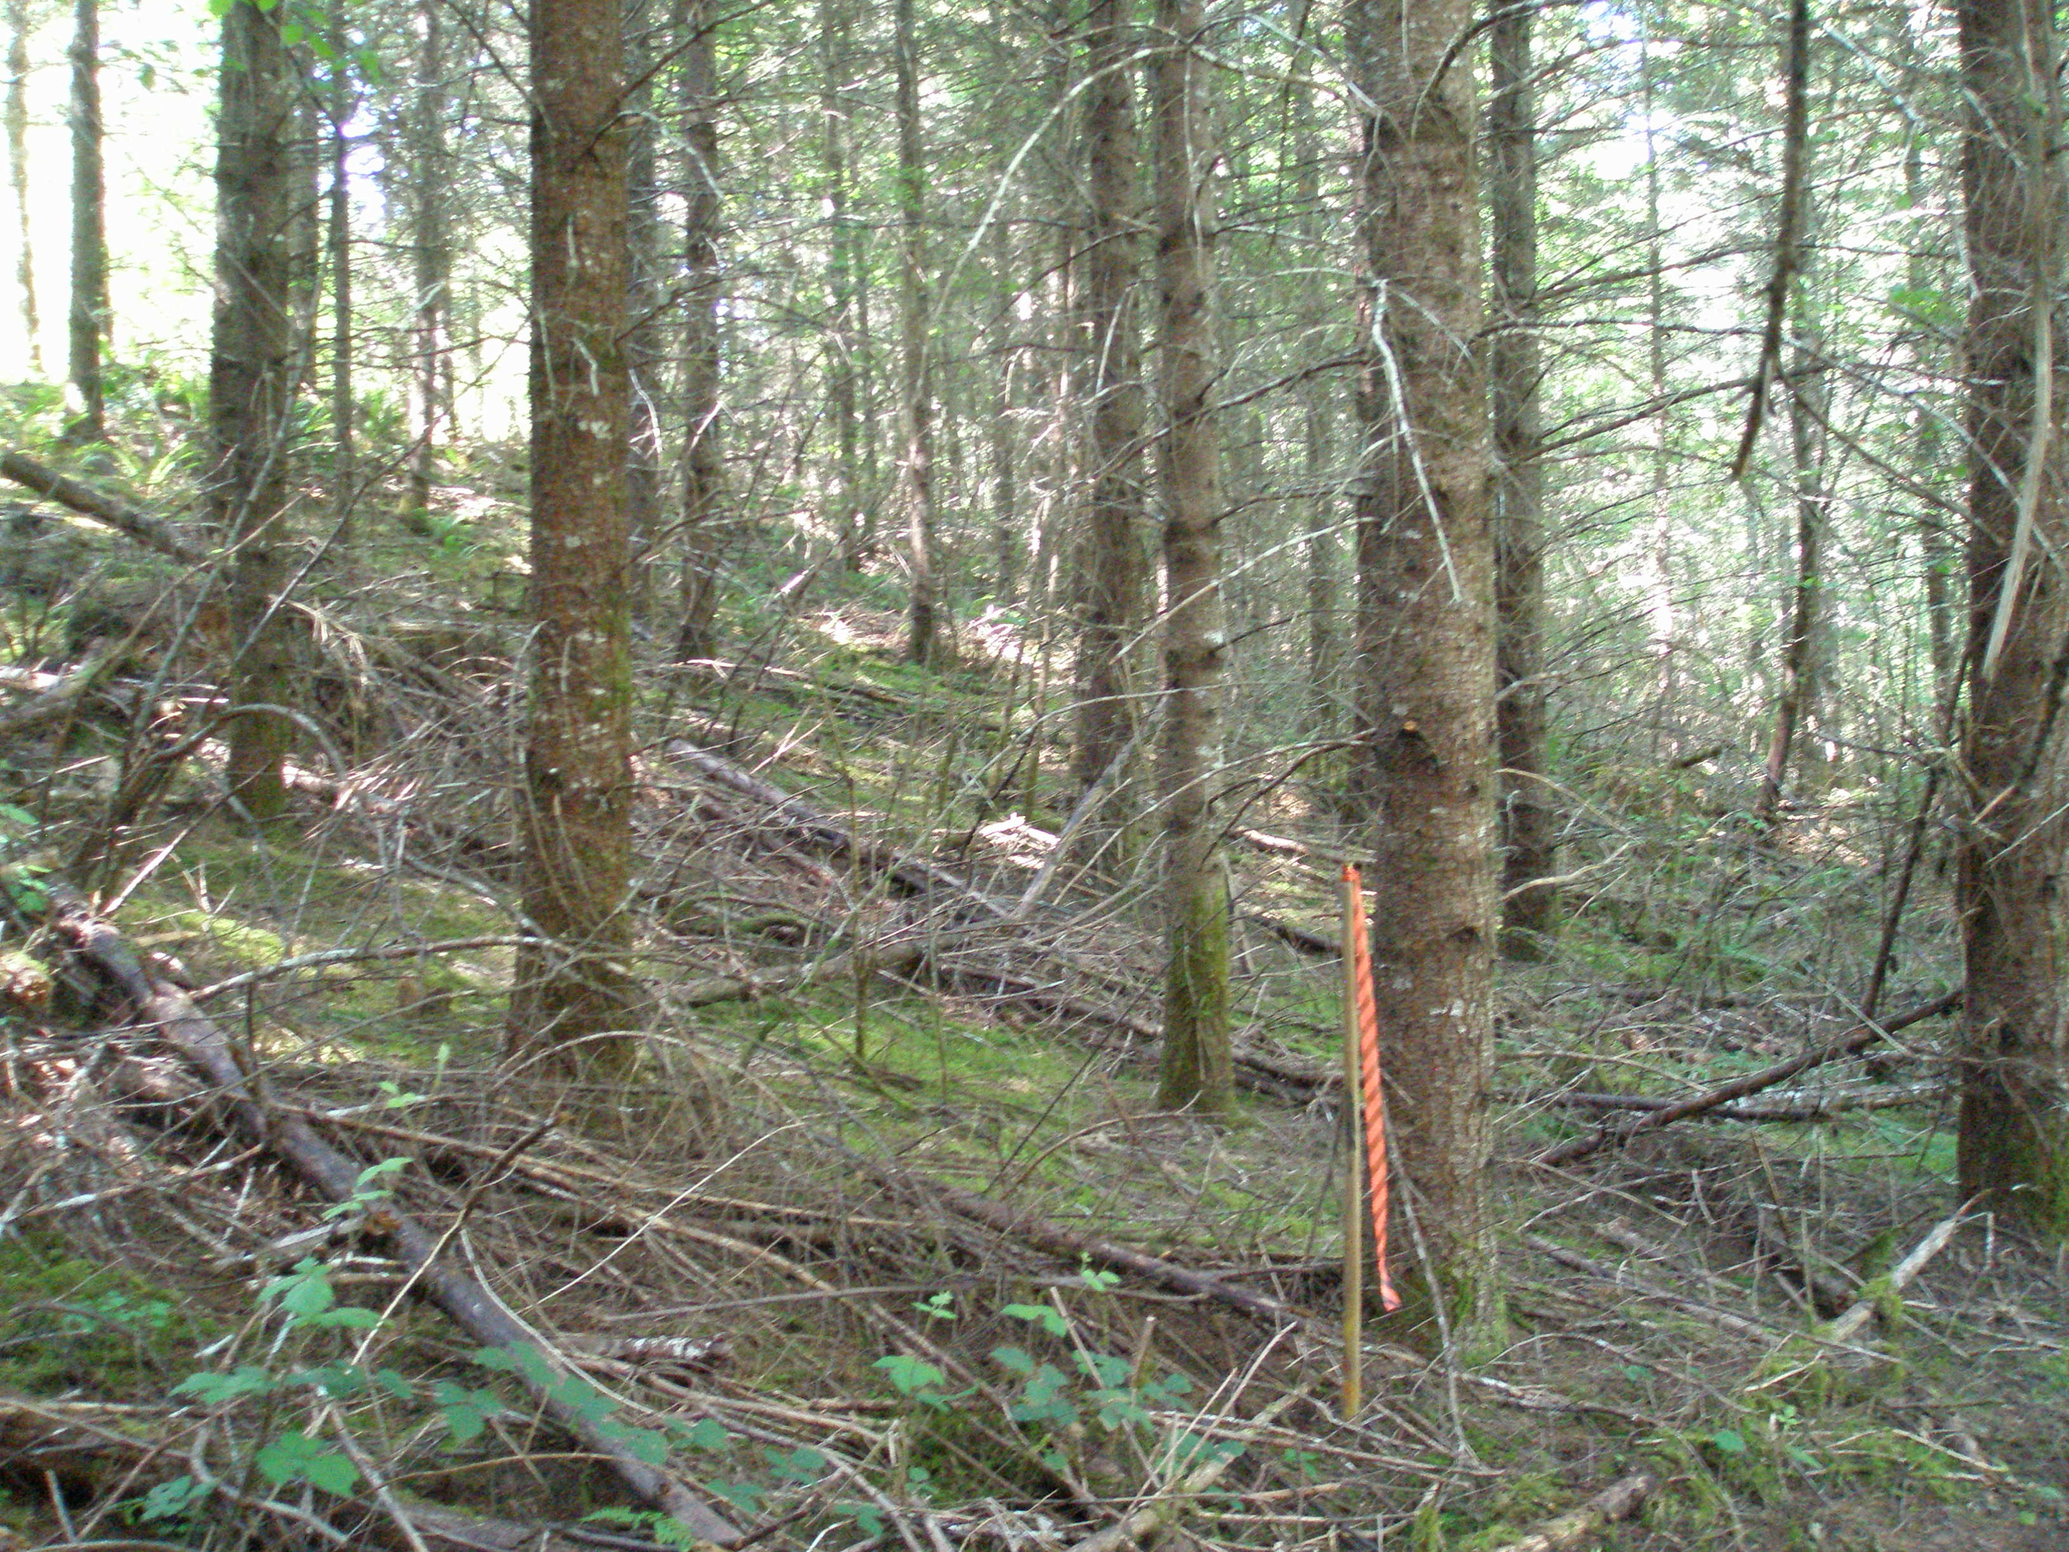
#3 Stand Conditions

Slide 31
# 3 Treatment ??
LSR Stand Assessment
 | 20-5-27
Average TPA | 290
Average DBH | 9
Maximum DBH | 12
Ground Vegetation | mostly brown
Snags & CWD | light-pct slash
Relative Density | 54

Slide 32
Barriers - Implementation??
Resistance to non traditional silvicultural treatments i.e. silviculture is “reforestation” not young stand management.
Conflicts with potential timber sale areas and PSQ targets

Slide 33
Discussions & Controversies
What is commercial and what is non commercial? What is the capability of the timber sale group?
Best Approach - multi entry versus single entry?
Timeframe - 10 Year plan versus long term development of the forest?
CWD – grow and “pulse” versus create it next 1-5 years

Slide 34
Thinning Capability ??

Slide 35
Science - Uncertainties
Wide window of silviculture – not trying to optimize or maximize. In the context of the “traditional forest management practices” this project represents newly developed and untested practices.
Prescribed level of snags and CWD?
Watershed Analysis = 1102-3750 cu ft. per acre
Longevity and function of CWD?

Slide 36
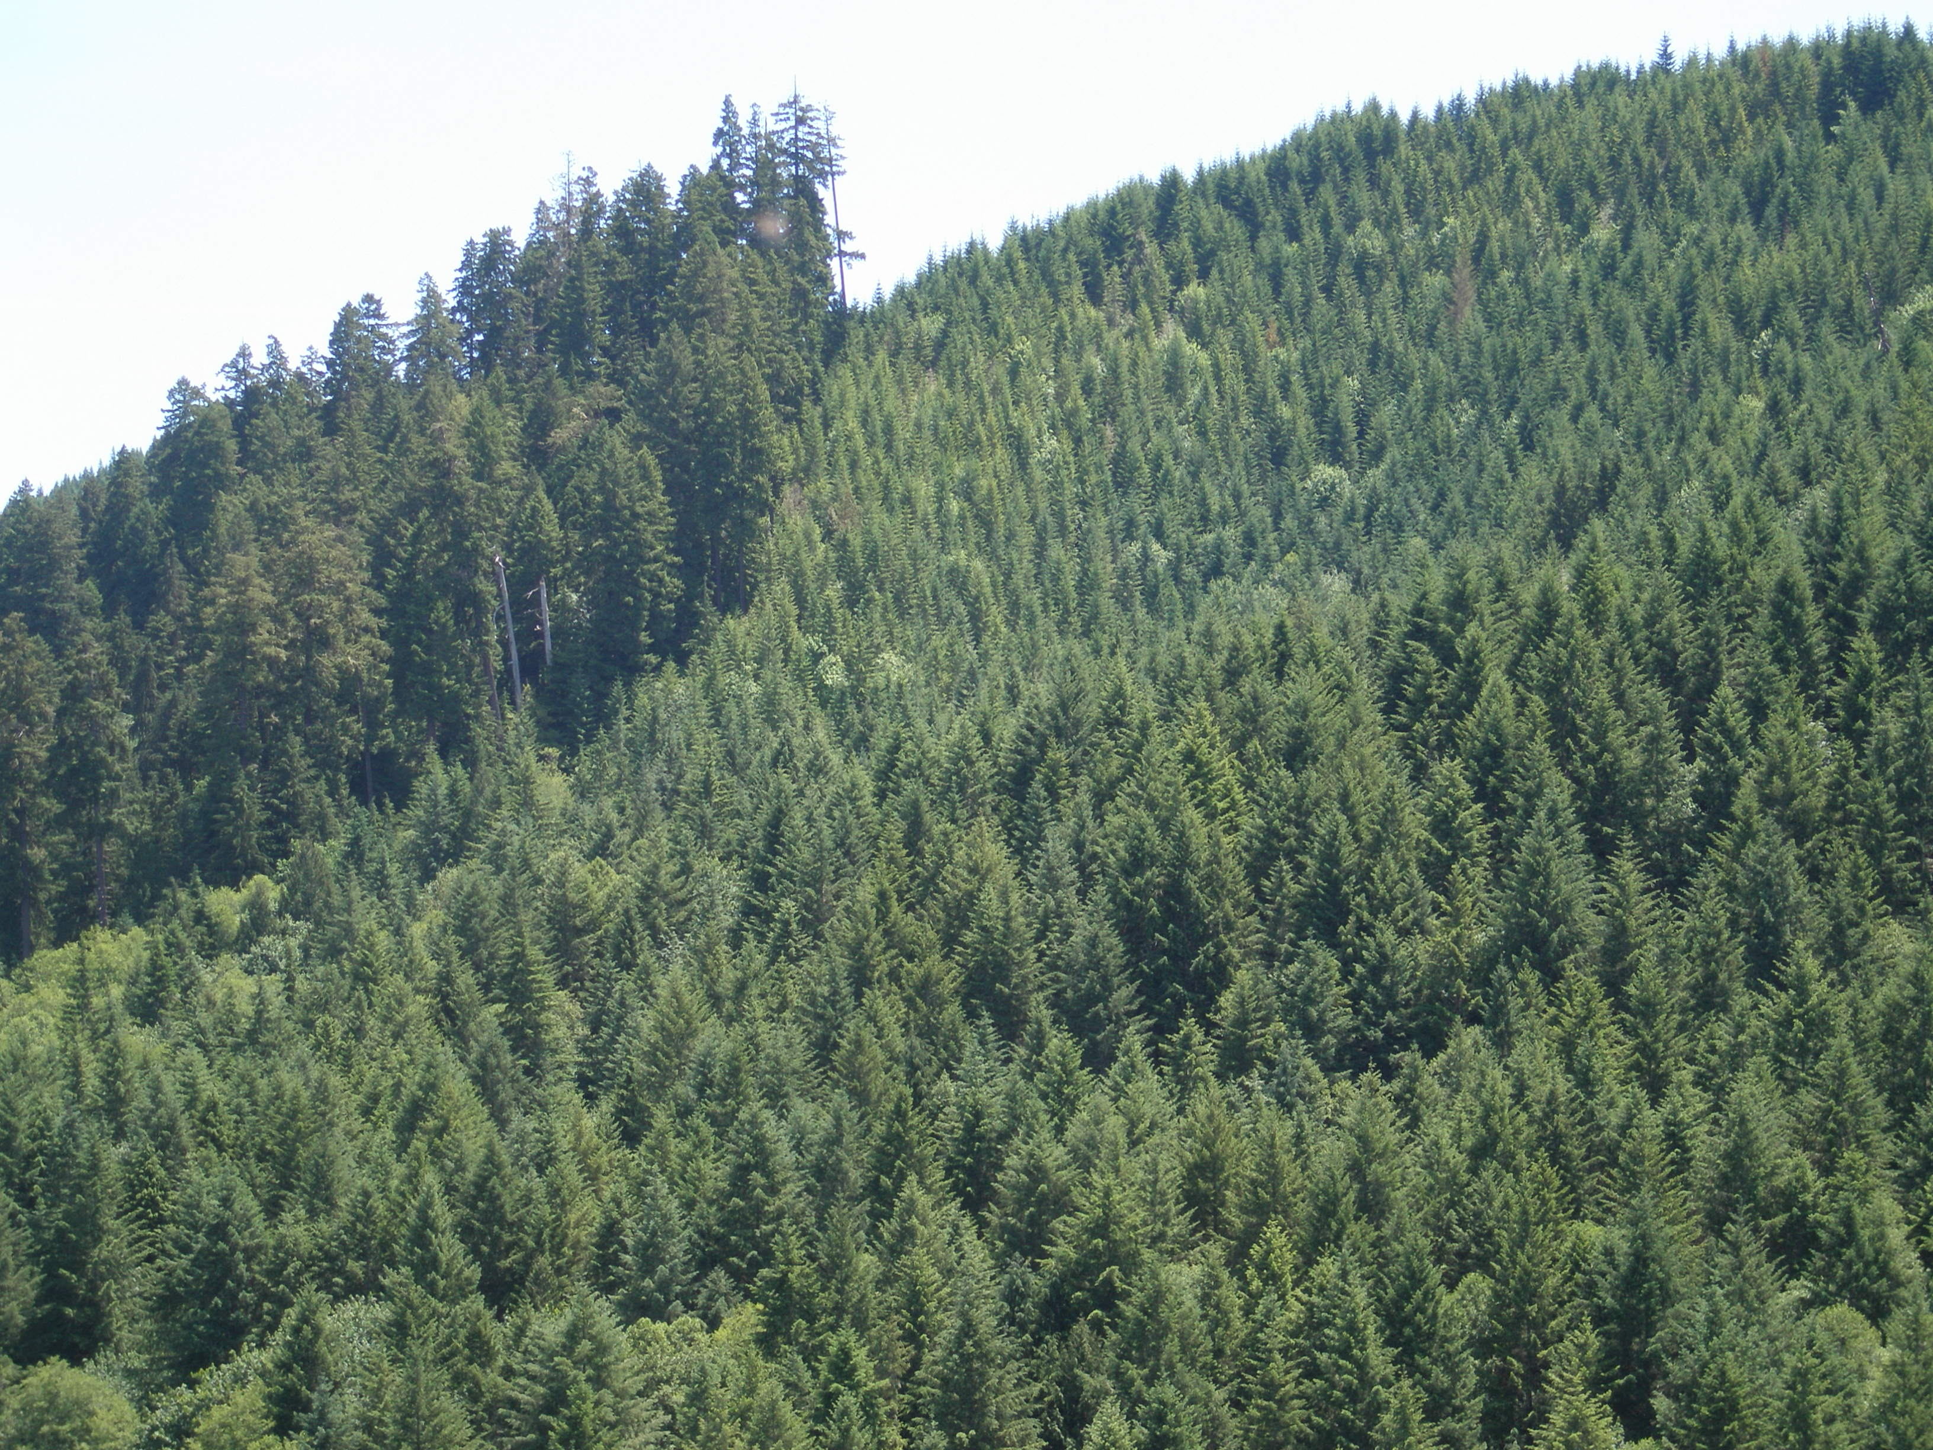

Slide 37
Development of the Forest

Slide 38
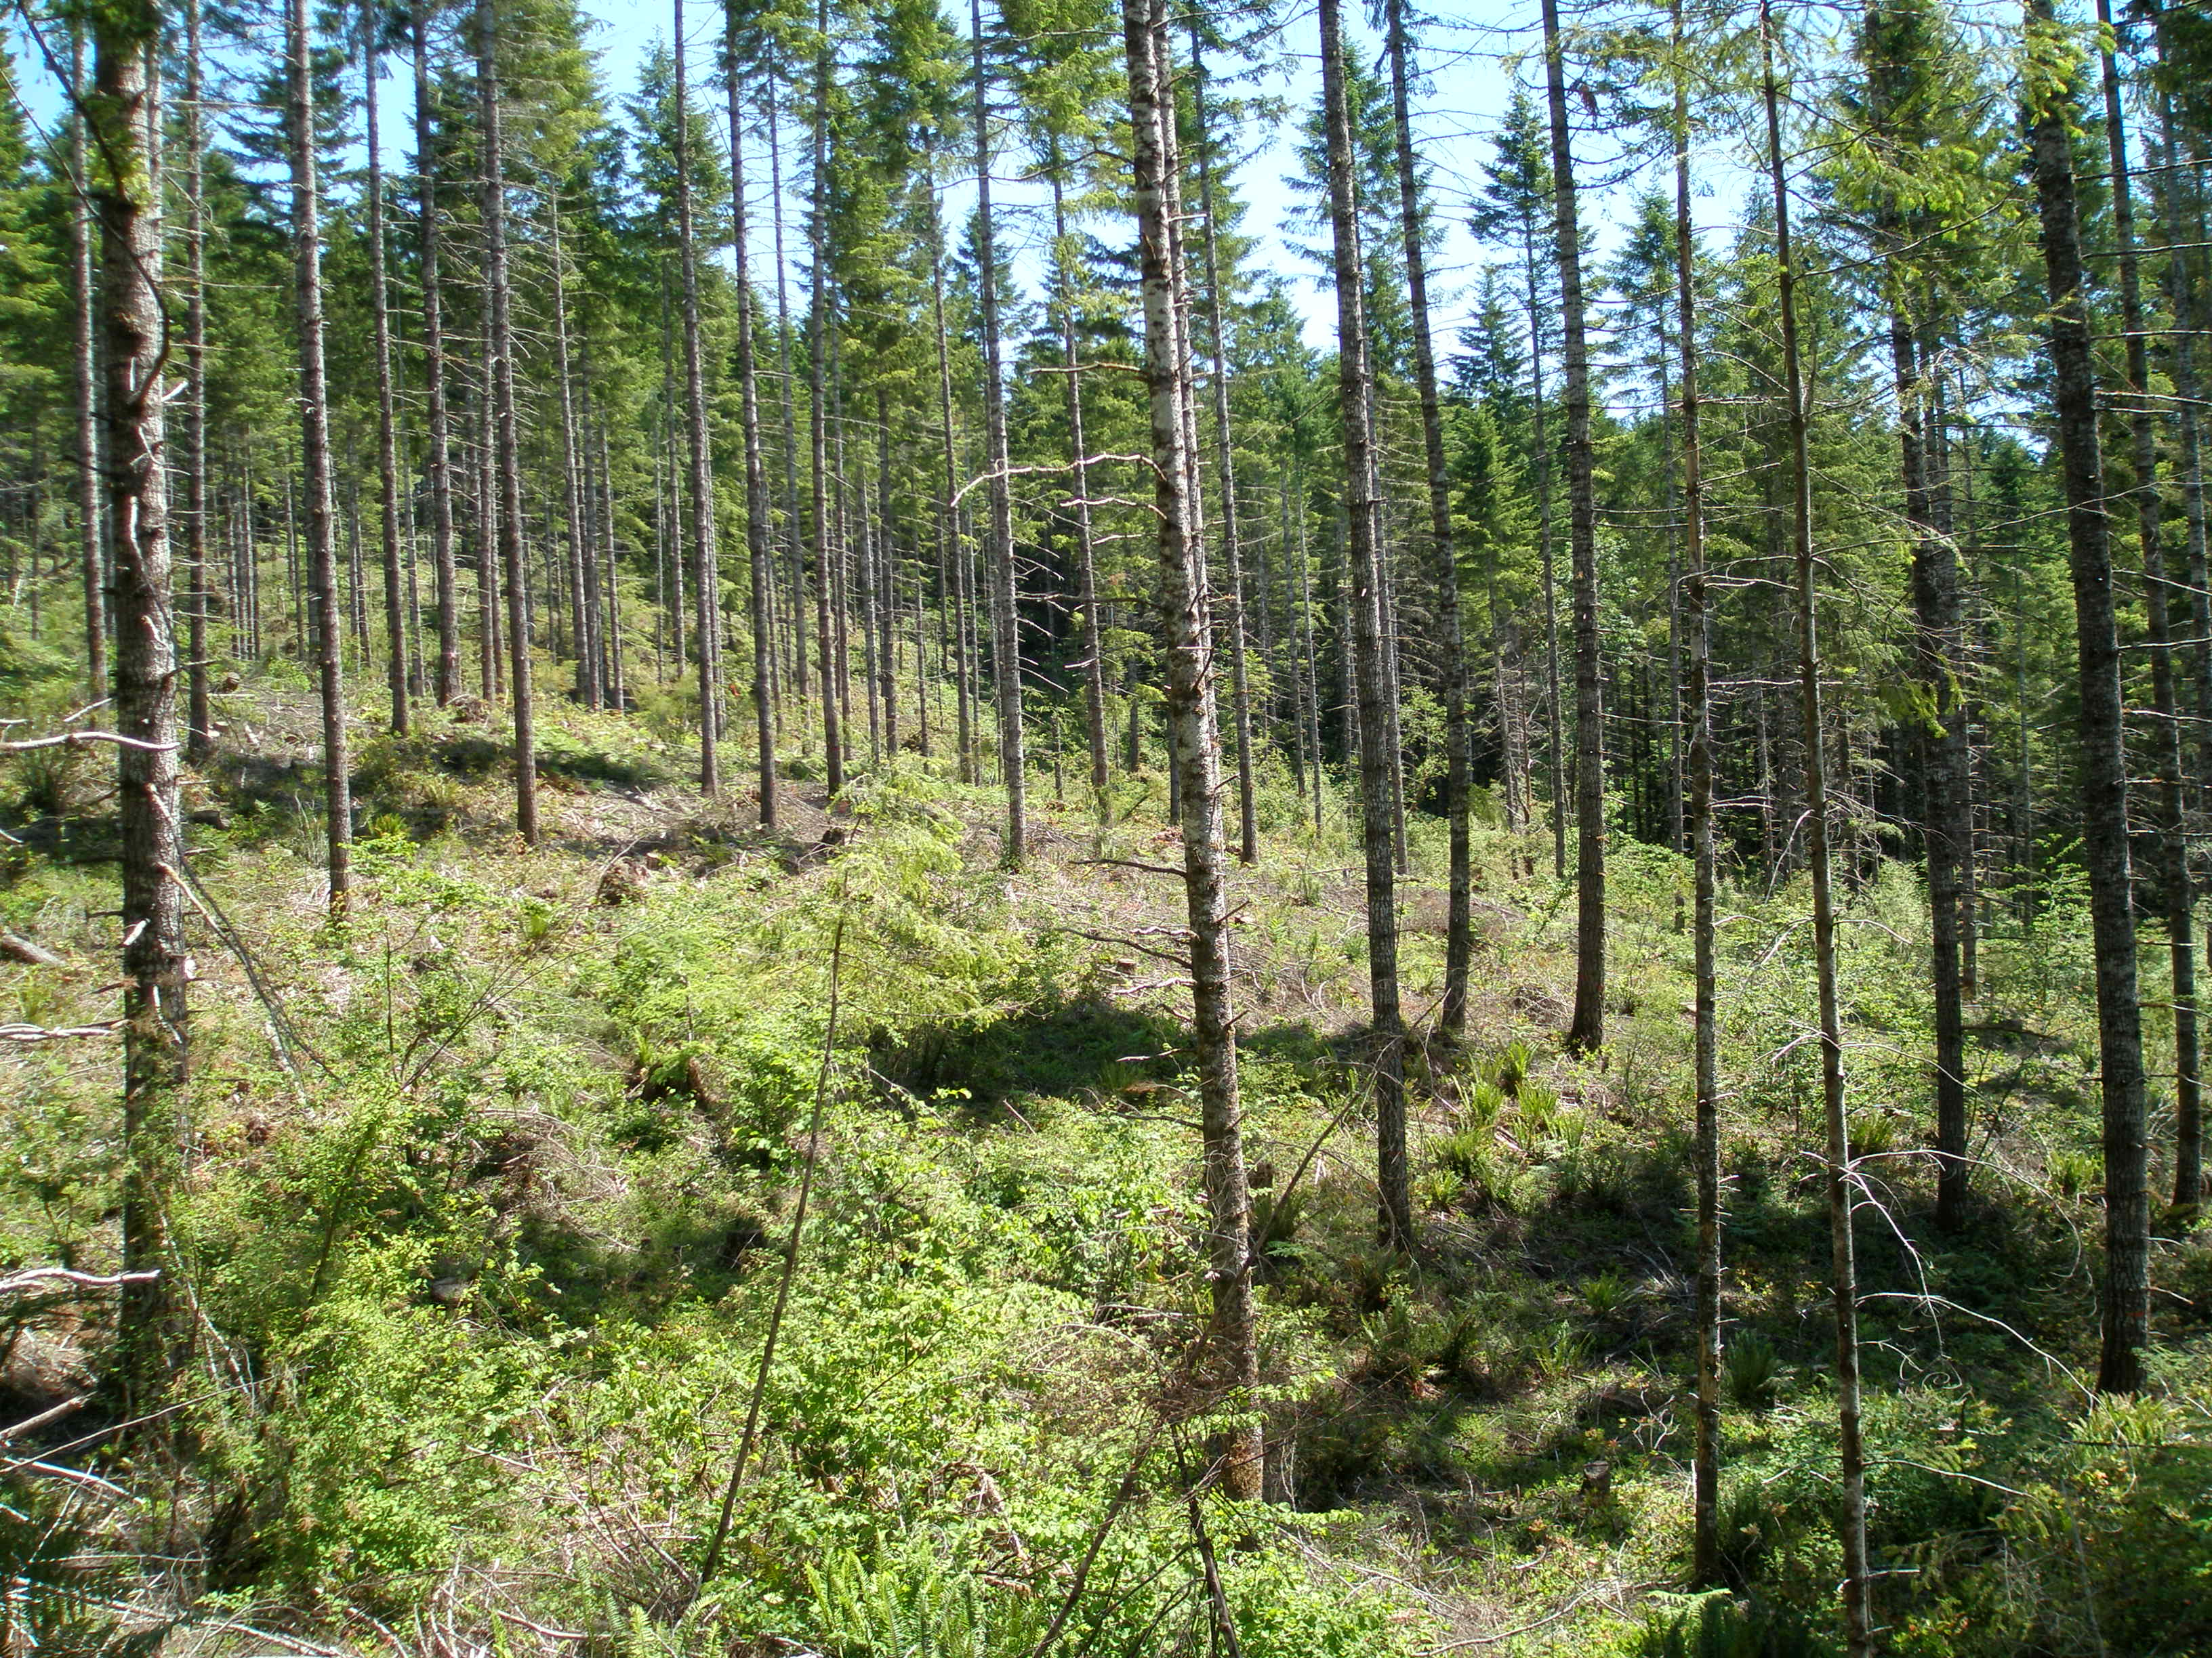
LSR Timber Sales

Slide 39
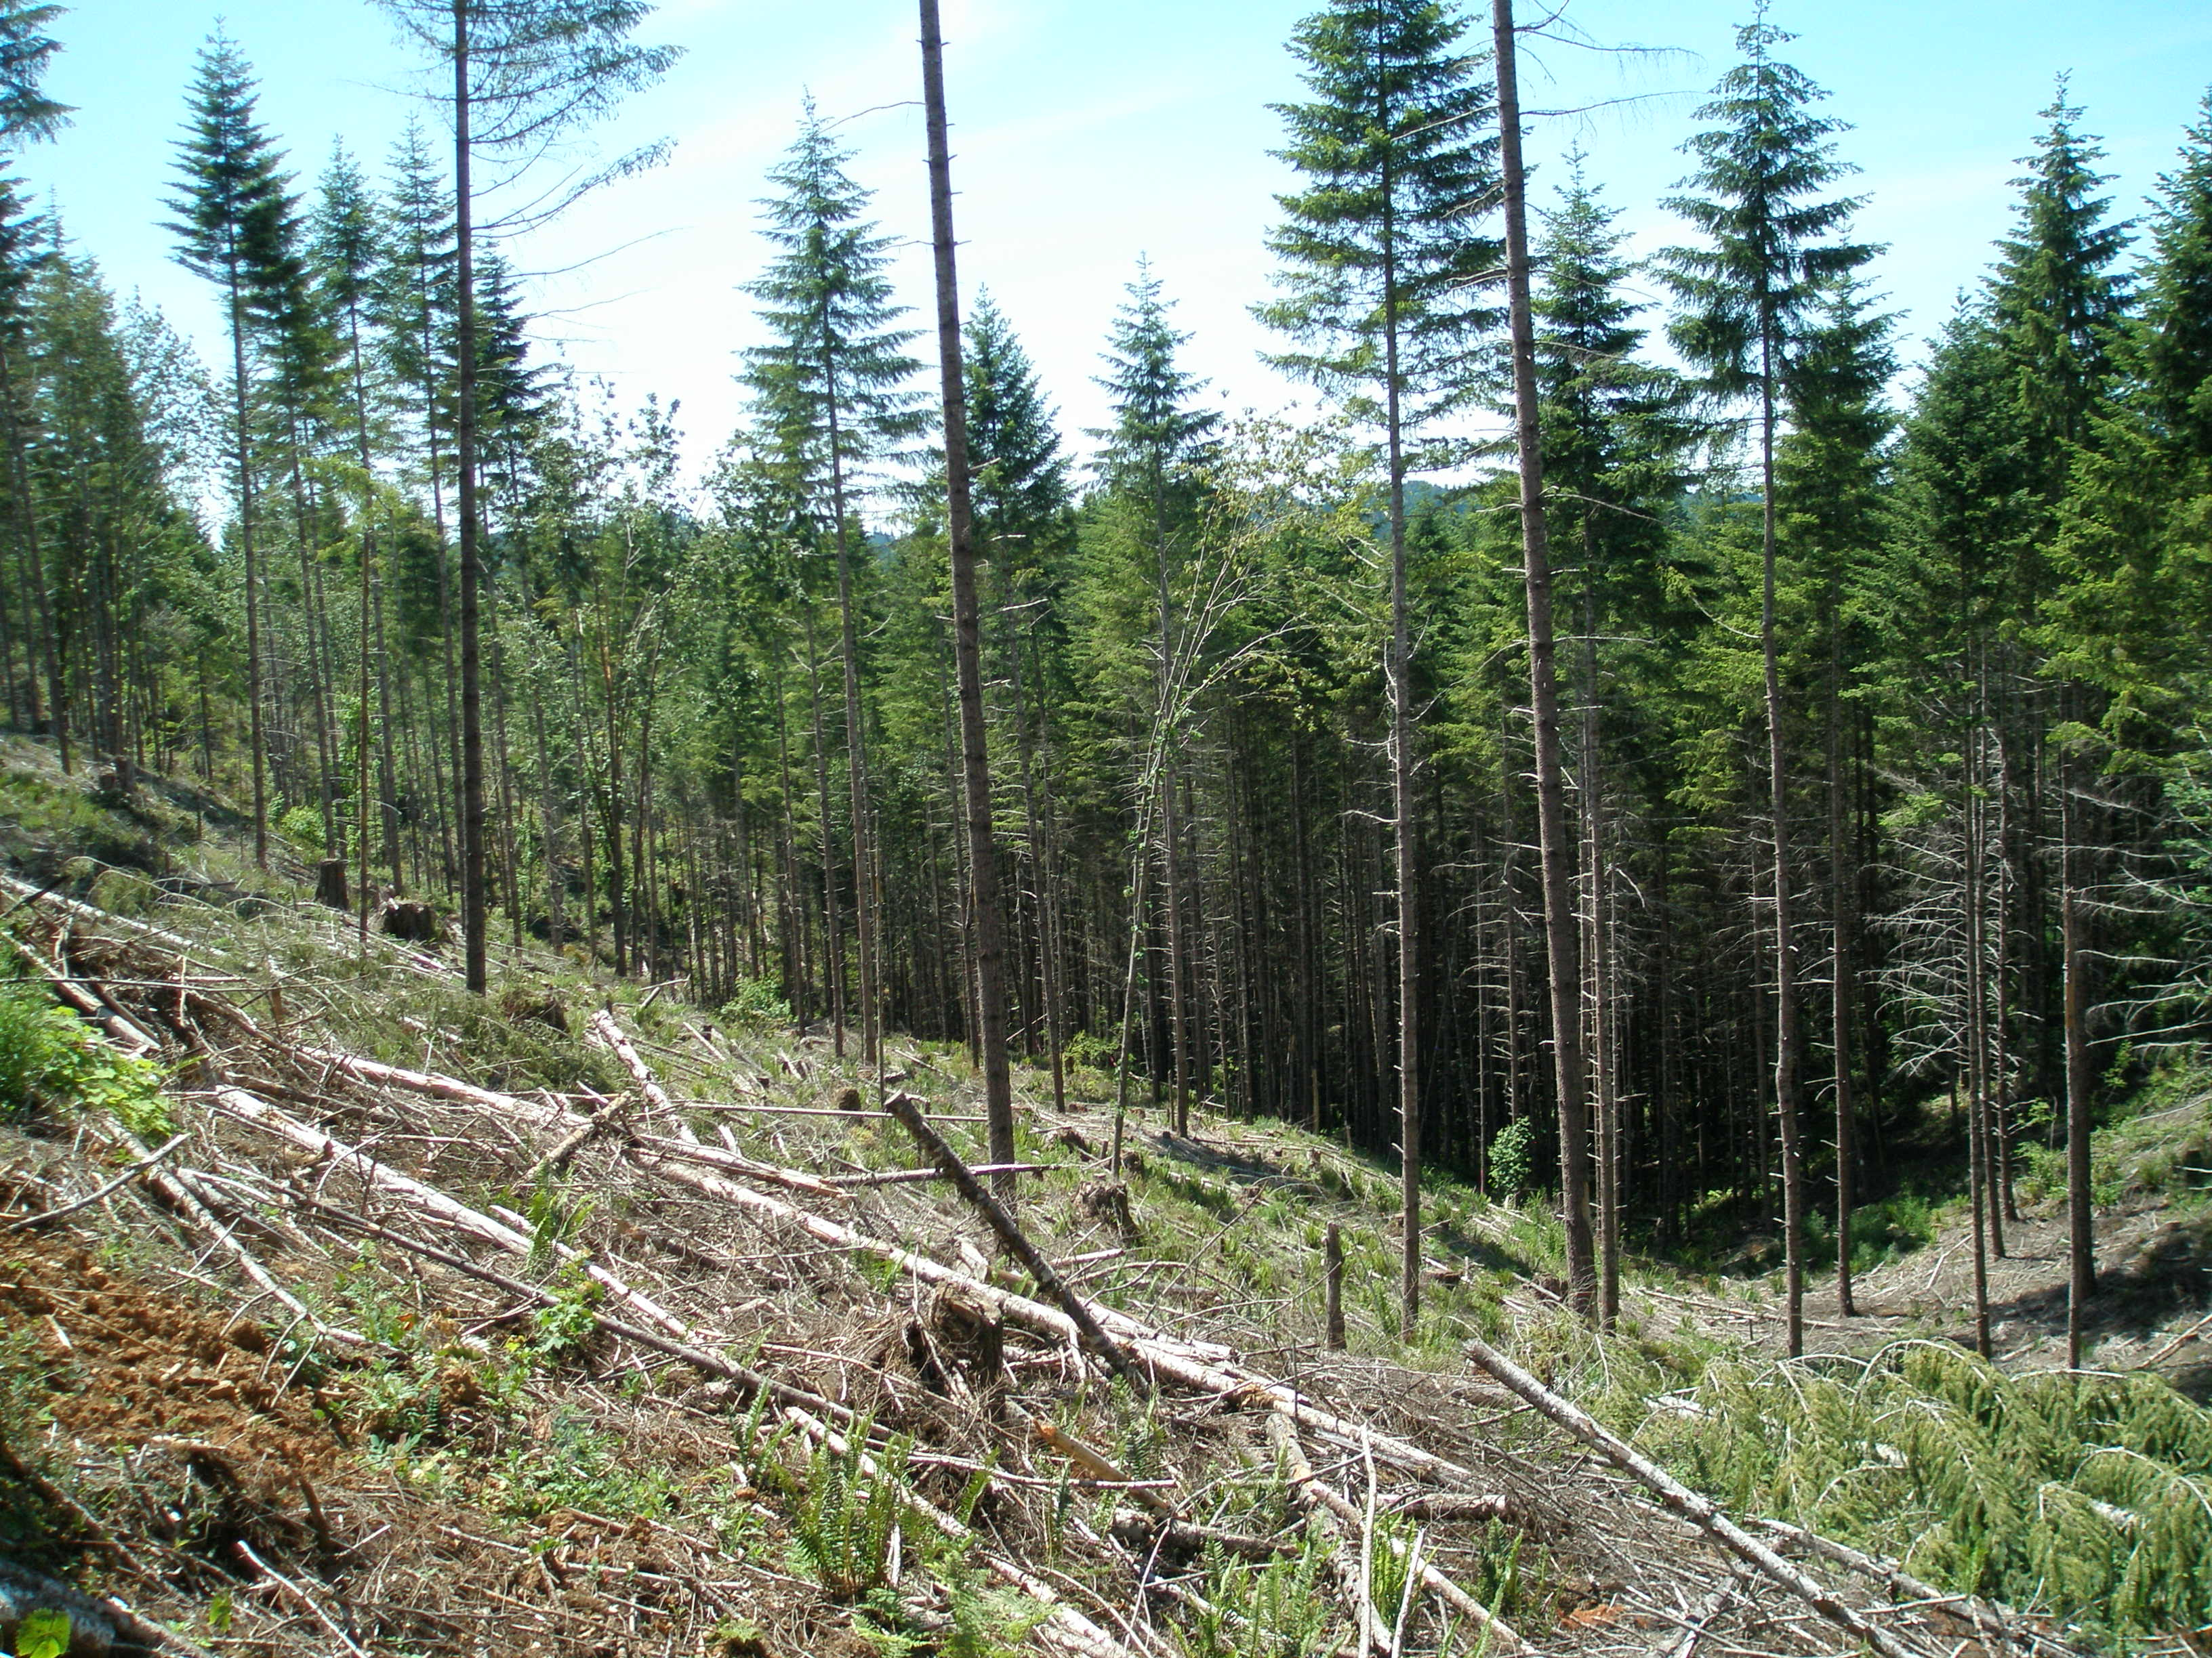
LSR Timber Sales

