Slide 1
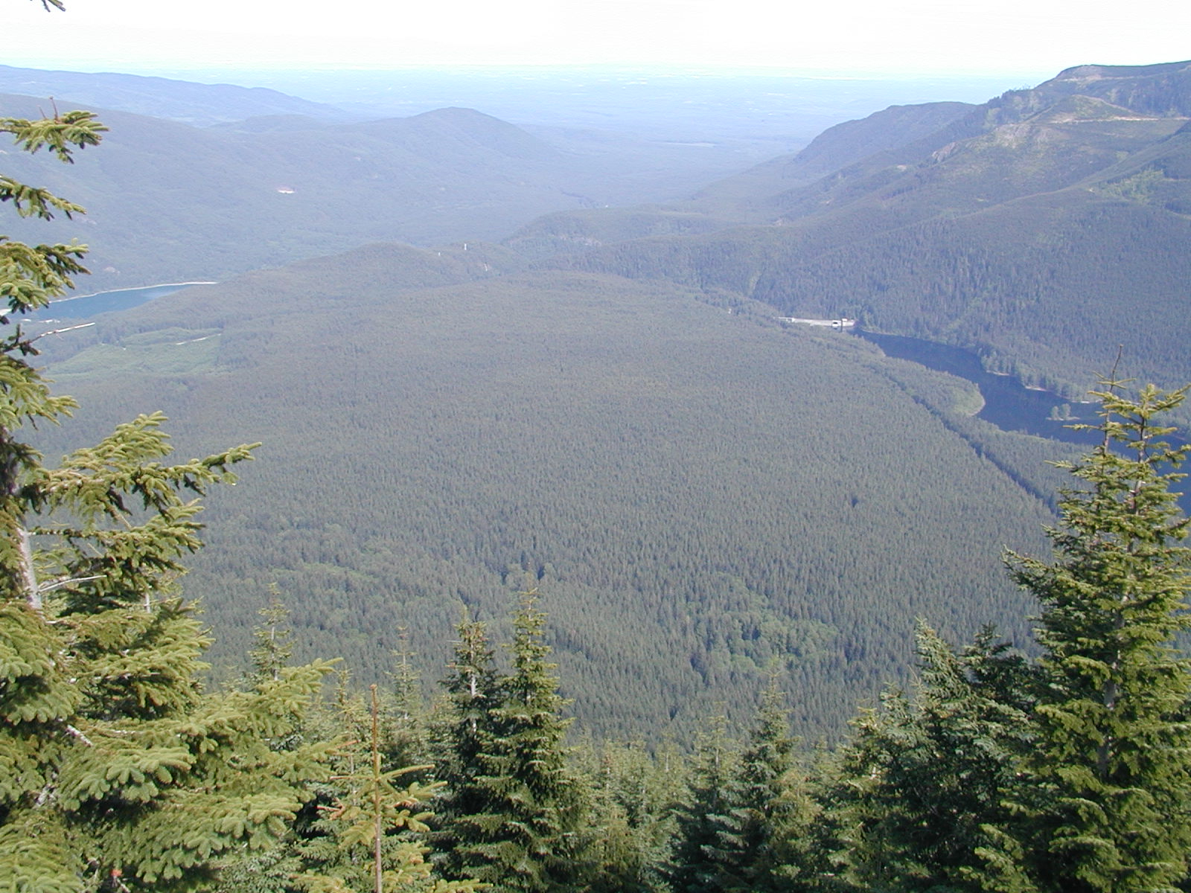

700 Road Ecological Thinning Project, Cedar River Watershed
Rolf Gersonde, Silviculturist
Cedar River Municipal Watershed

Slide 2
Seattle Public Utilities – Cedar and Tolt Municipal Watershed

Slide 3
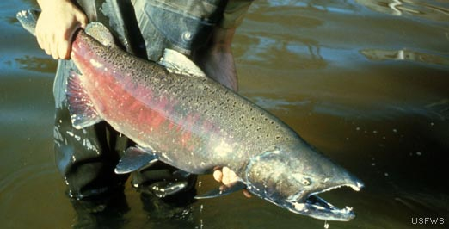
Key Features of SPU-HCP (2000)
Safe and secure water supply
50-year term
Ecological reserve
Restoration commitments
  Roads, streams, riparian and upland forests
Bull trout
Common loon
Chinook
Spotted owl

Slide 4
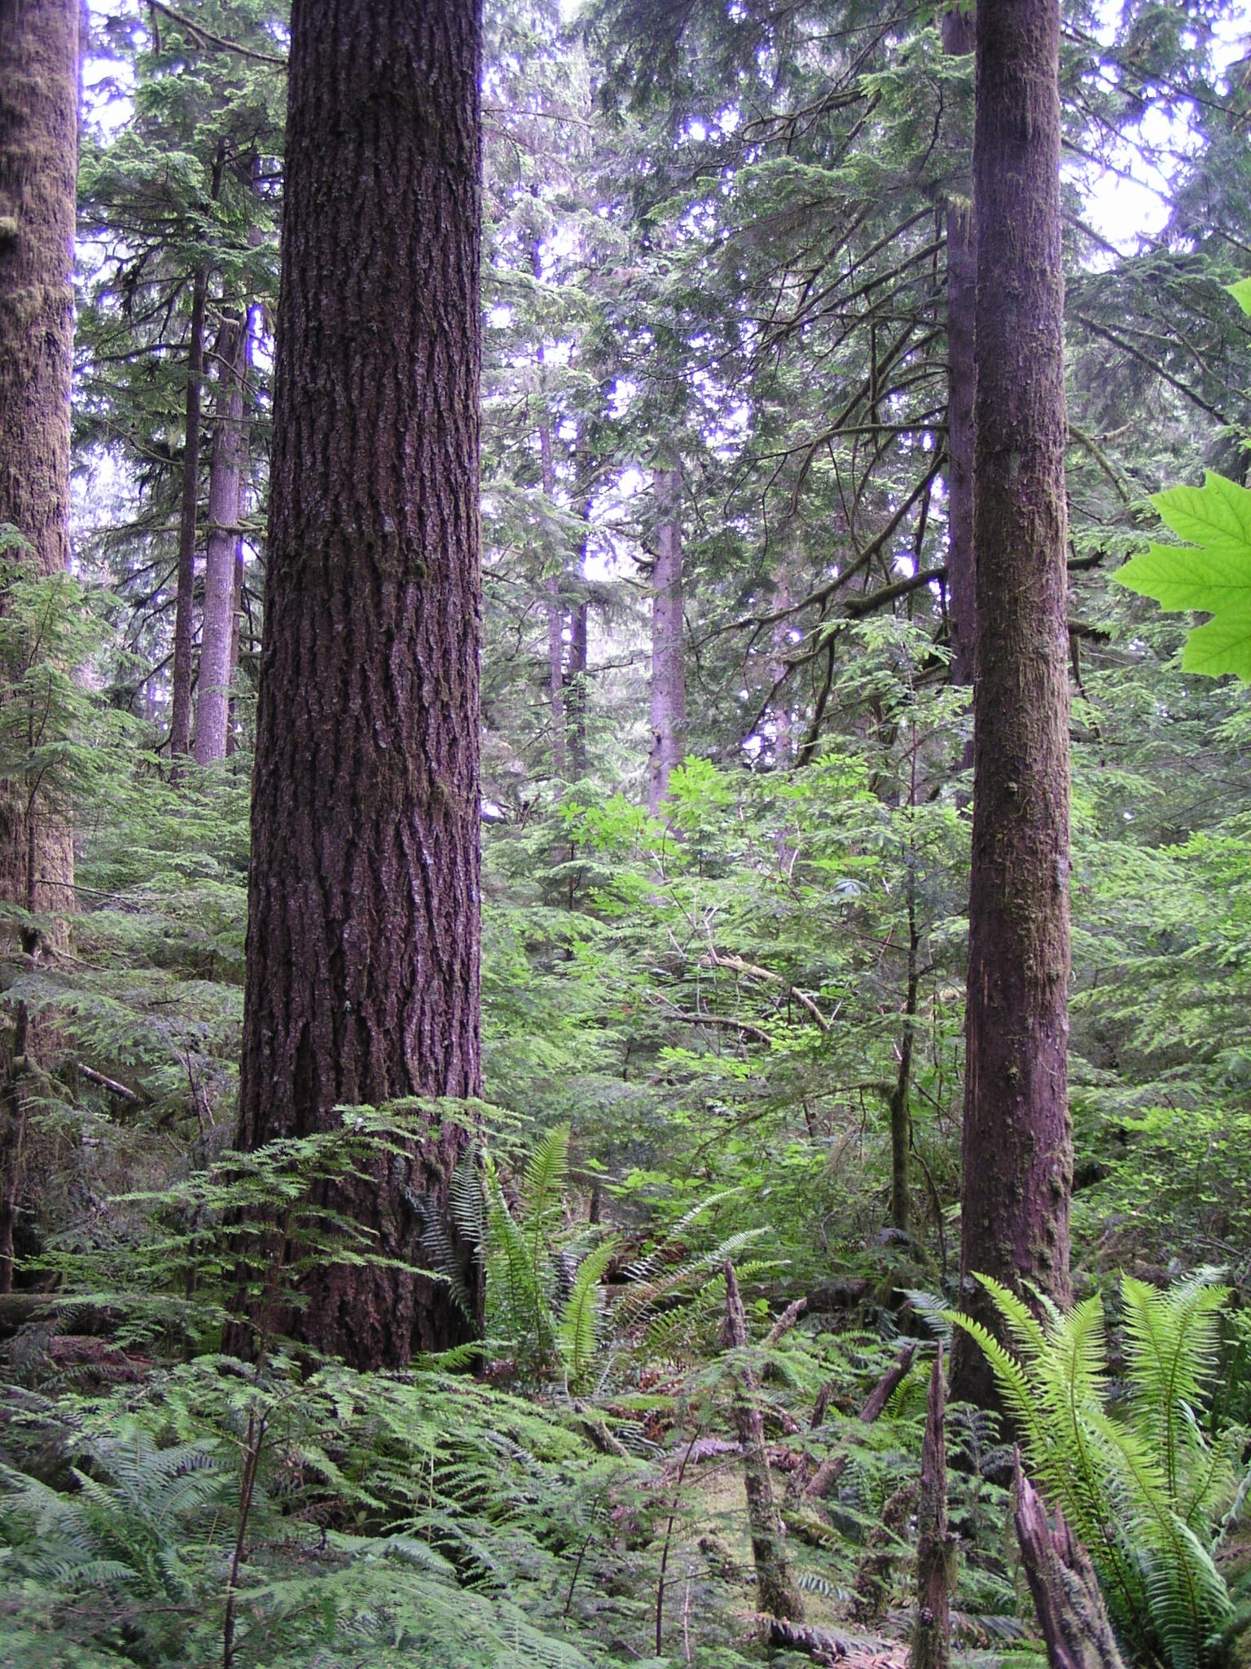
Forest Restoration Goals
LSF Conditions
  Tree size
  Spatially clumped
  Foliage height diversity
  Decadence
Ecosystem Functions
Biological Diversity
Ecosystem Resilience

Slide 5
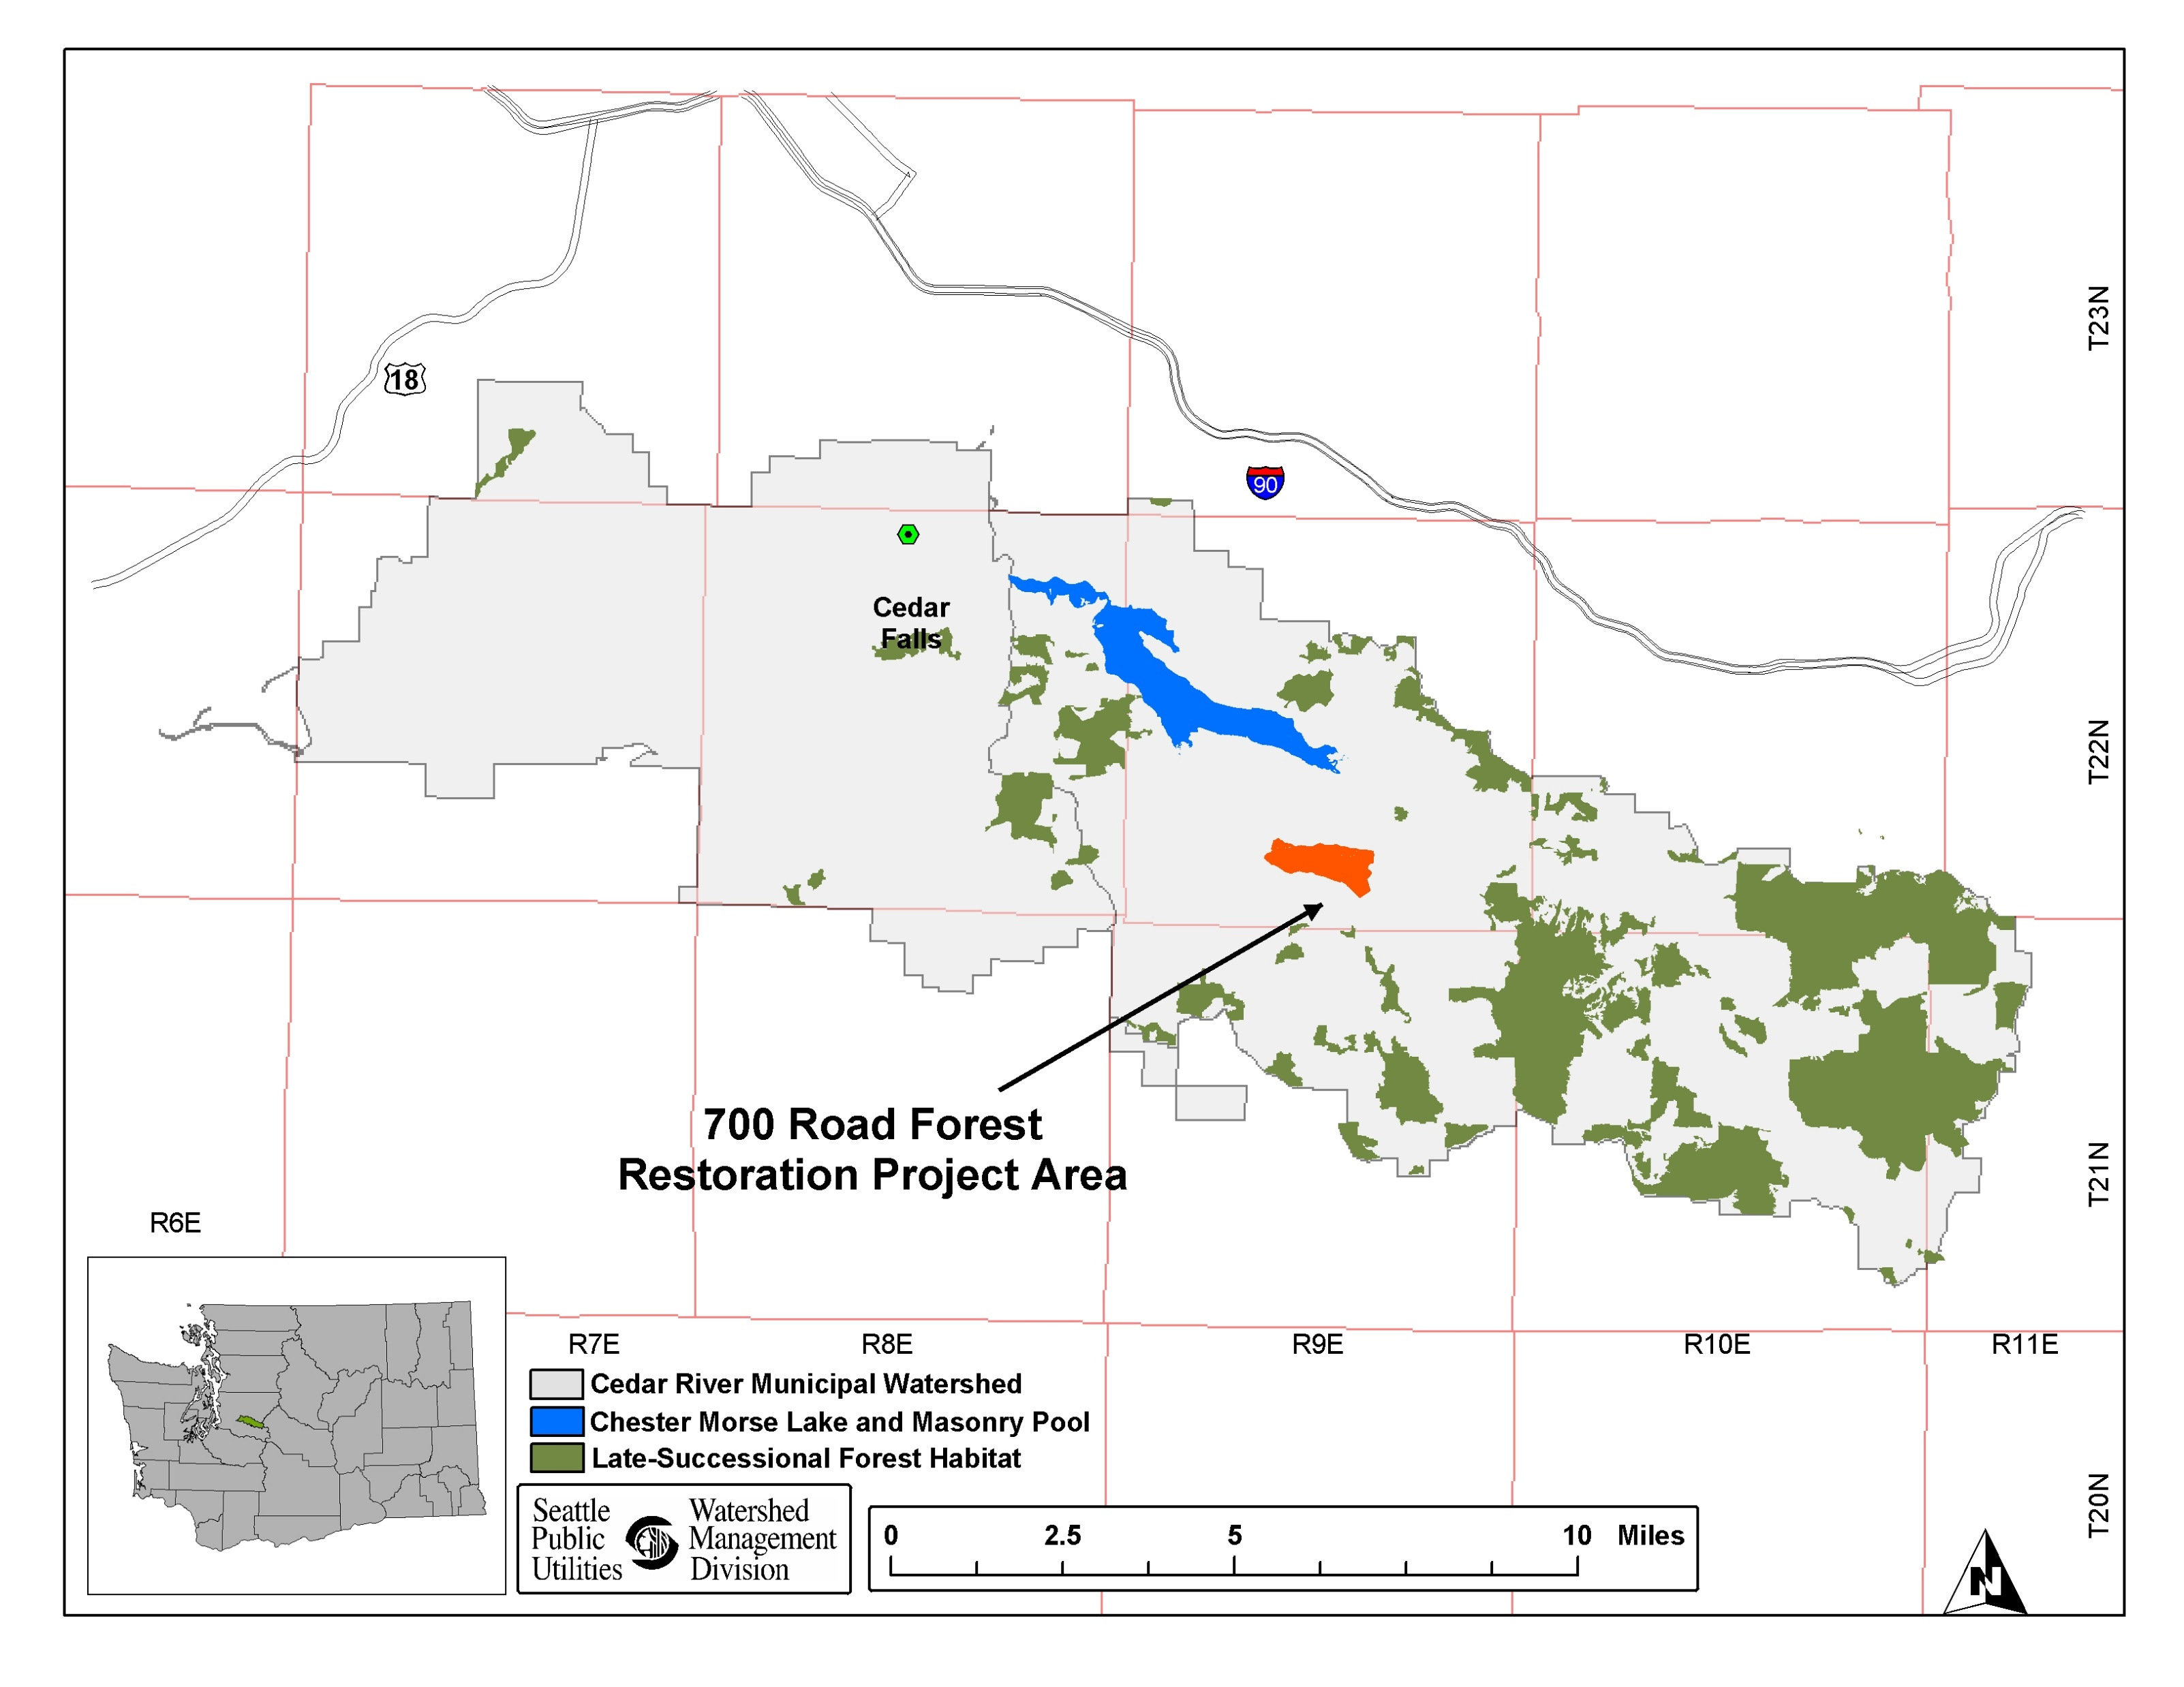
700 Rd Project Location in the CRW

Slide 6
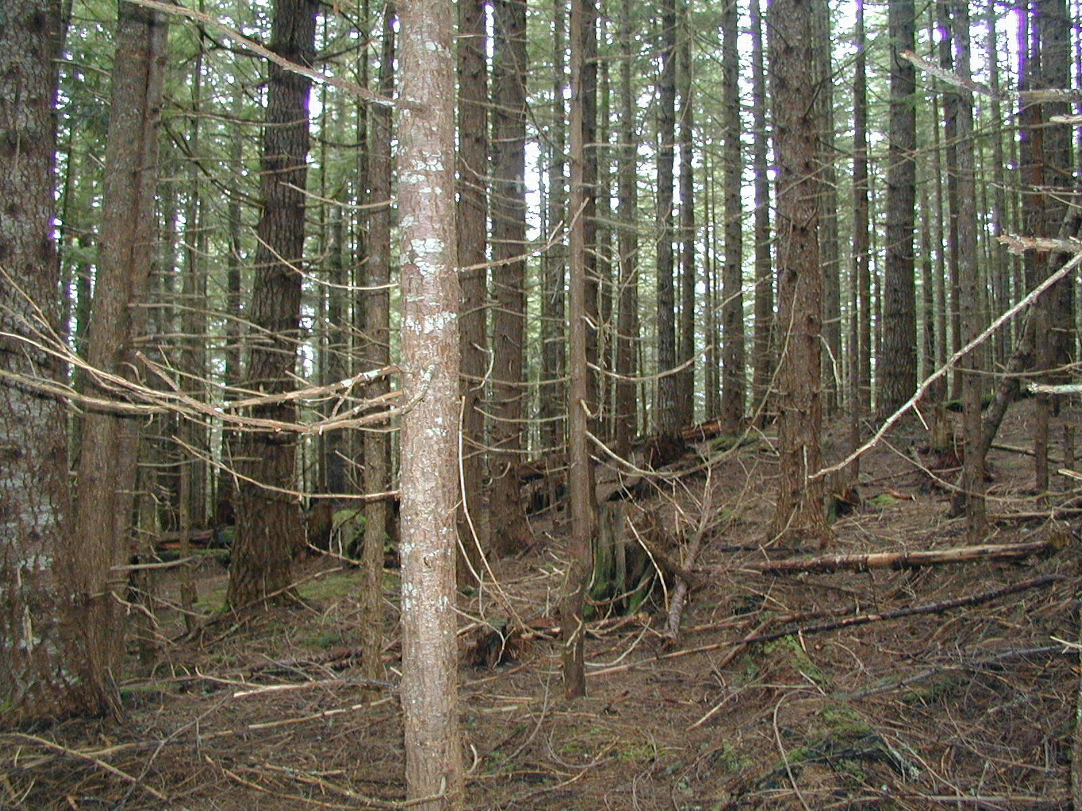
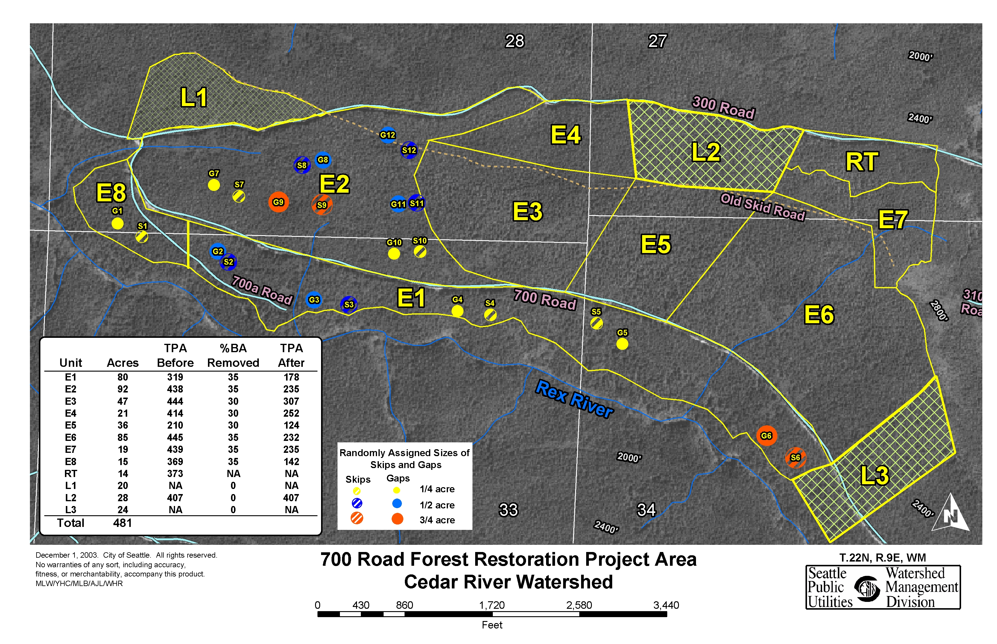
700 Road Ecological Thinning Project (2004)
Species:
WH, DF, RC, SF, RA
Structure:
65 year single cohort,
BA 210-360 sqft/ac
QMD 9.3” – 14.3”
SDI 400 - 620

Slide 7
Stakeholder involvement process
Comments at Ecological Thinning Workshop (7/18/2004)
Prescriptions are too conservative. You should experiment with thinning more heavily.
Prescriptions not conservative enough – they should be limited to never cutting any “big” trees.
You don’t need to experiment. You can learn from what other landowners have done.
Second-growth forests created from clearcutting are on “natural” trajectories and don’t need intervention.
There is more wildlife in my back yard than I have seen in the second growth in the watershed.
You need to create openings to provide habitat diversity and support wildlife.
We need to know exactly how any money made from sale of trees will be used.

Slide 8
Stakeholder involvement process
Summary of changes
Reduce area to be ecologically thinned
Reduce number of acres where trees will be yarded
Create numerous variably-shaped small gaps and skips
Create Unit E9 at the top of the ridge
Add variable sized skips around existing unique habitat features
Increase basal area targets
Lower diameter limit for cutting

Slide 9
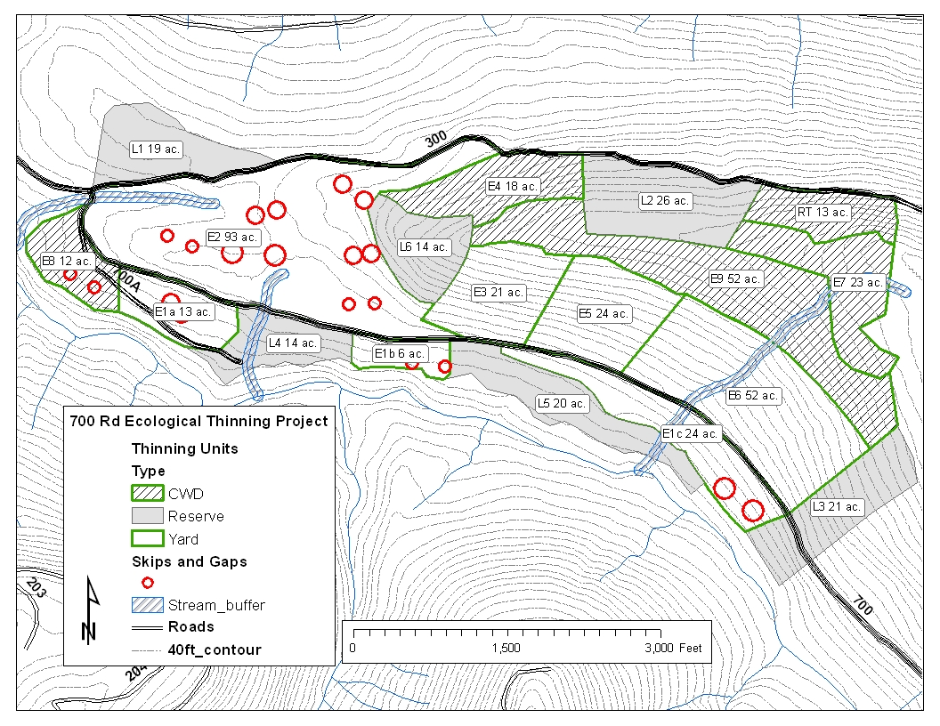
700 Road Ecological Thinning Project (2006)
Treatments:
230 ac. Thinning with
Skips and gaps
120 ac. Cut and Leave
Reserve areas

Slide 10
Structure type ratio by treatment unit

Slide 11
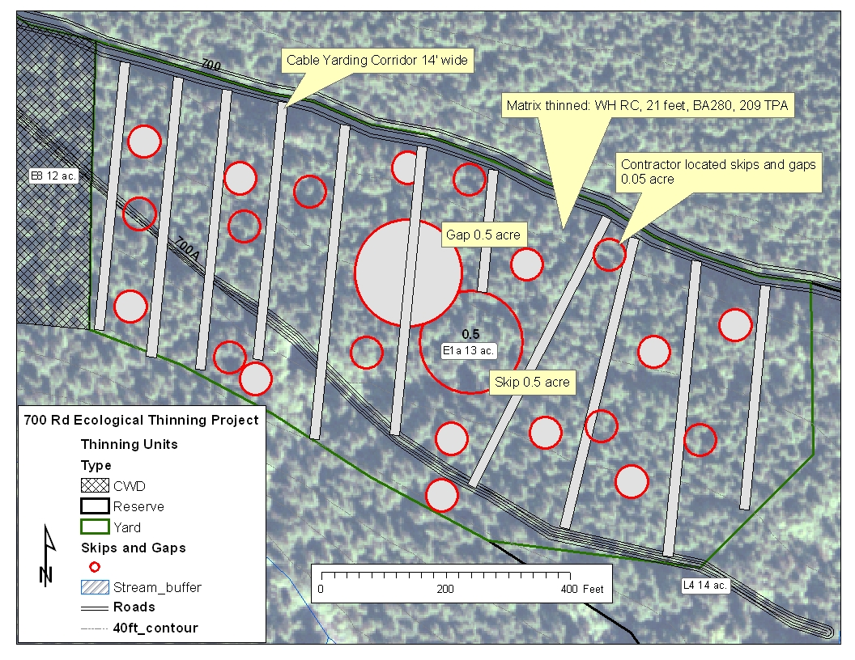
Scales of Variability
Thinning-pool spacing with skips and gaps 700 Rd
Unit E1a

Slide 12
Diameter distribution by species
Differentiation into crown and size classes
Thinning pool varies by species, create bimodal distribution

Slide 13
Example of thinning prescription (E1)

Slide 14
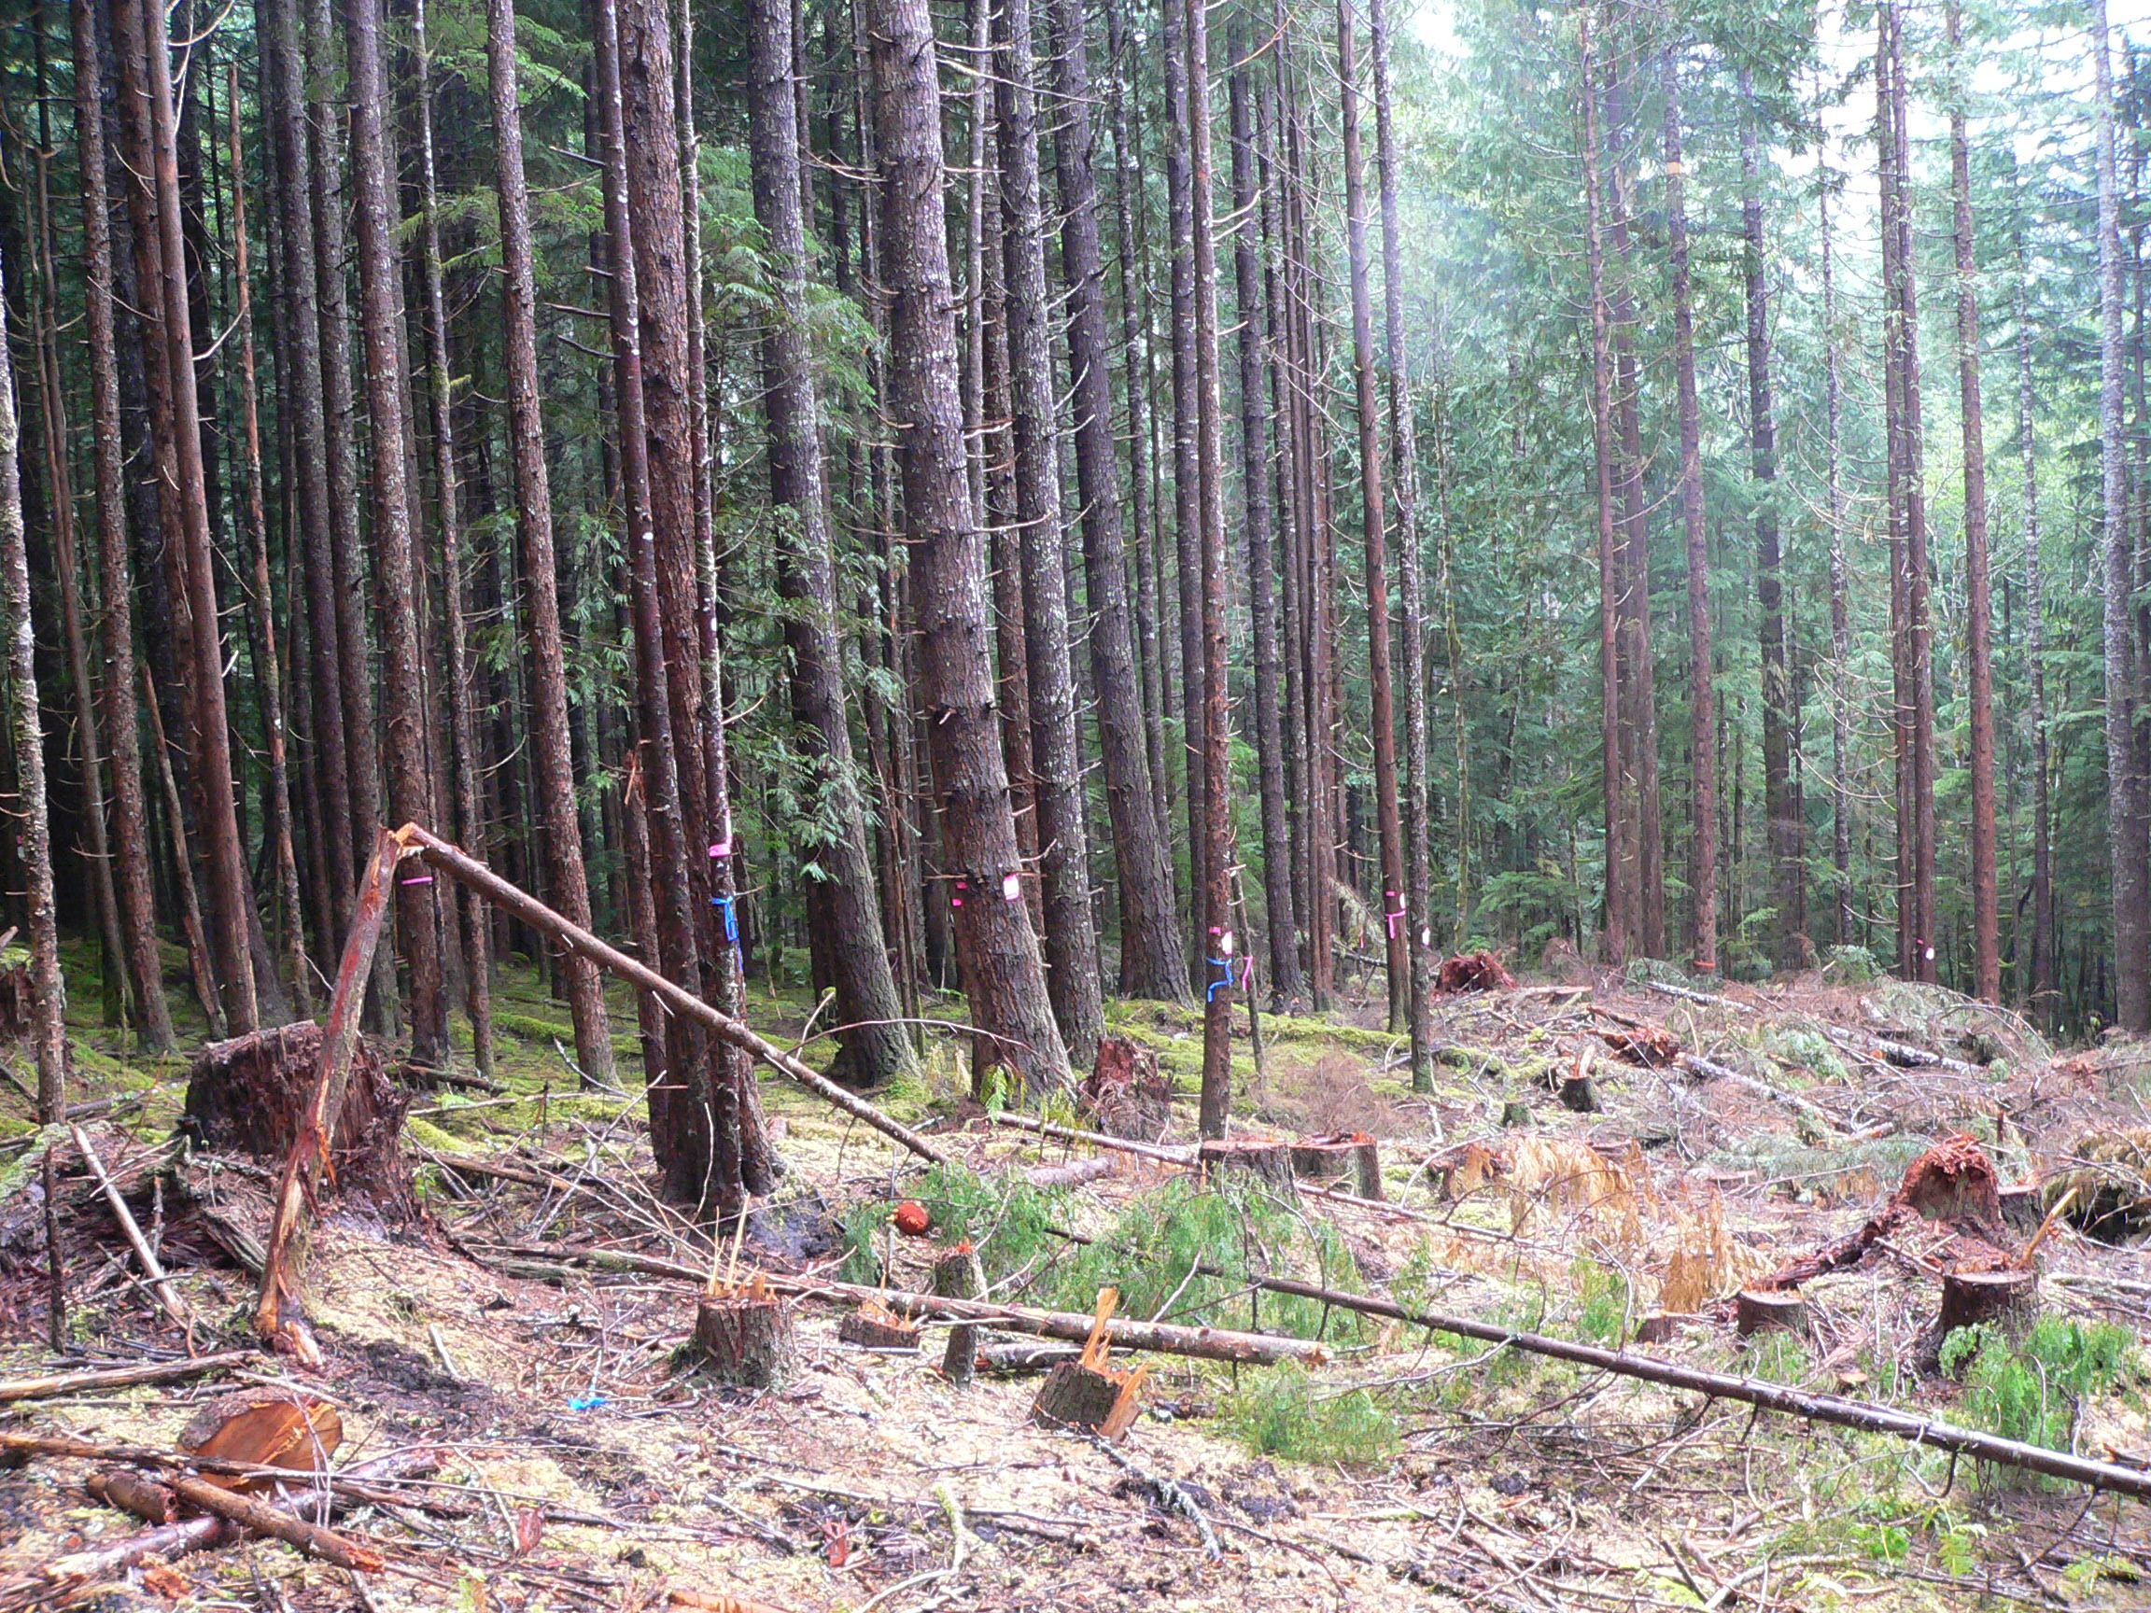
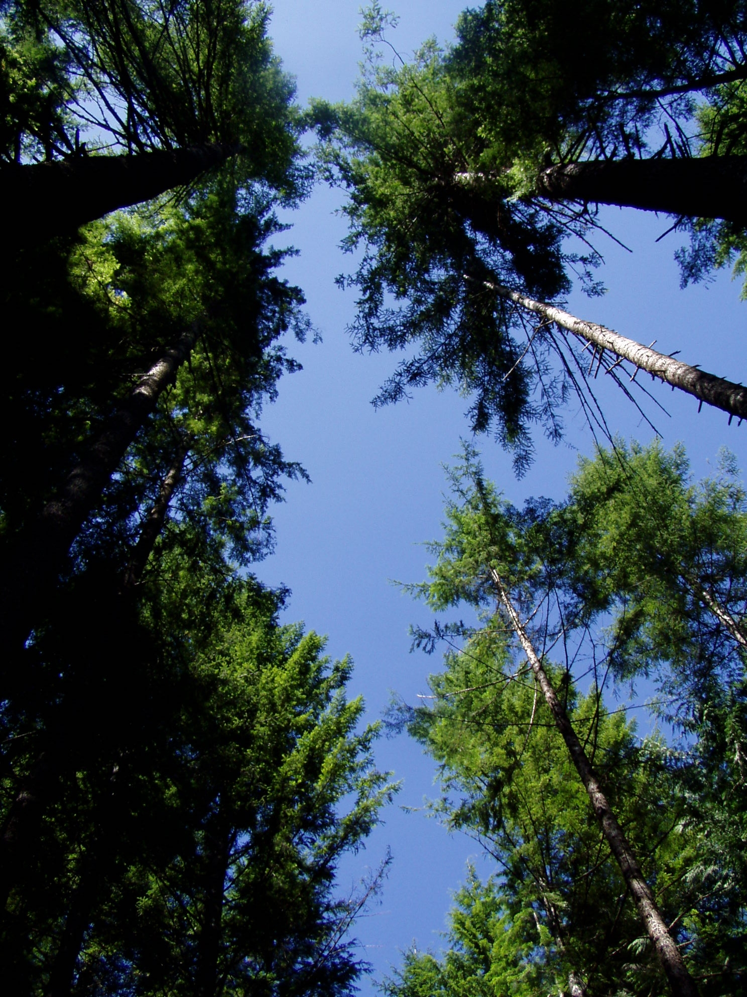
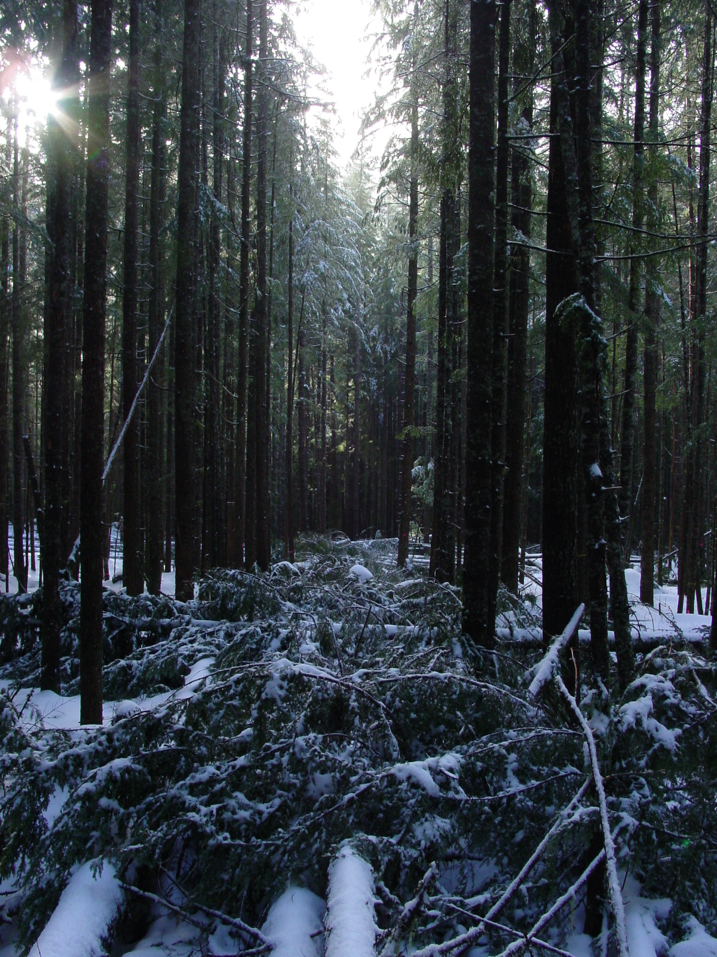
Structural Features
Large skip and gap Thinned matrix

Slide 15
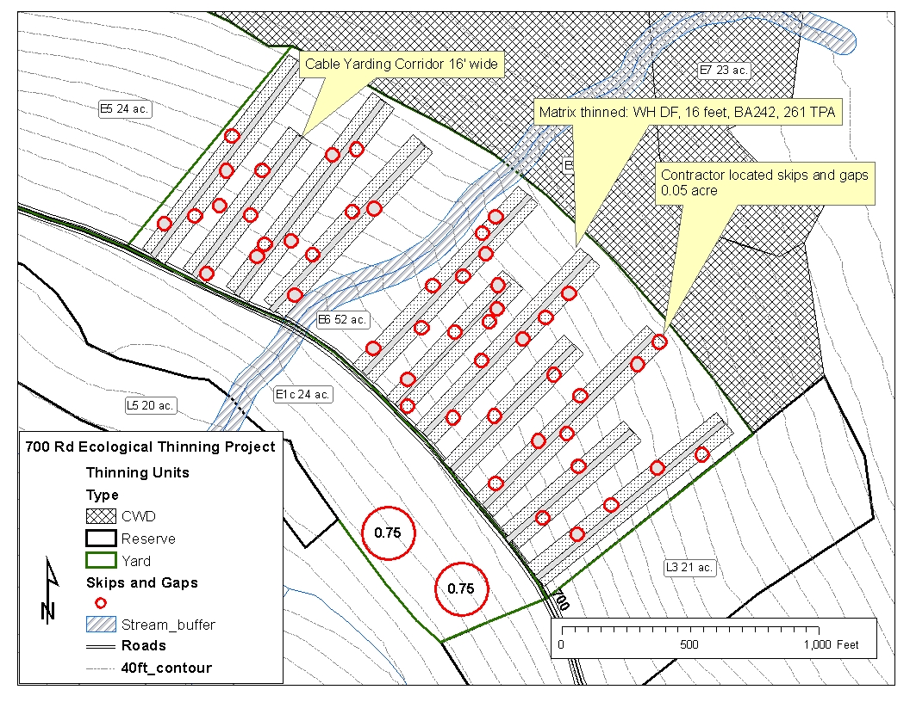
Conceptual layout of thinning Unit E6

Slide 16
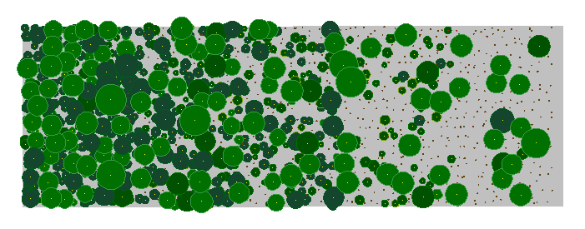
Effect of canopy density on understory light environment
Stand Visualization
System
tRAYci Light Model

Slide 17
Distribution of light intensity at different stand densities

Slide 18
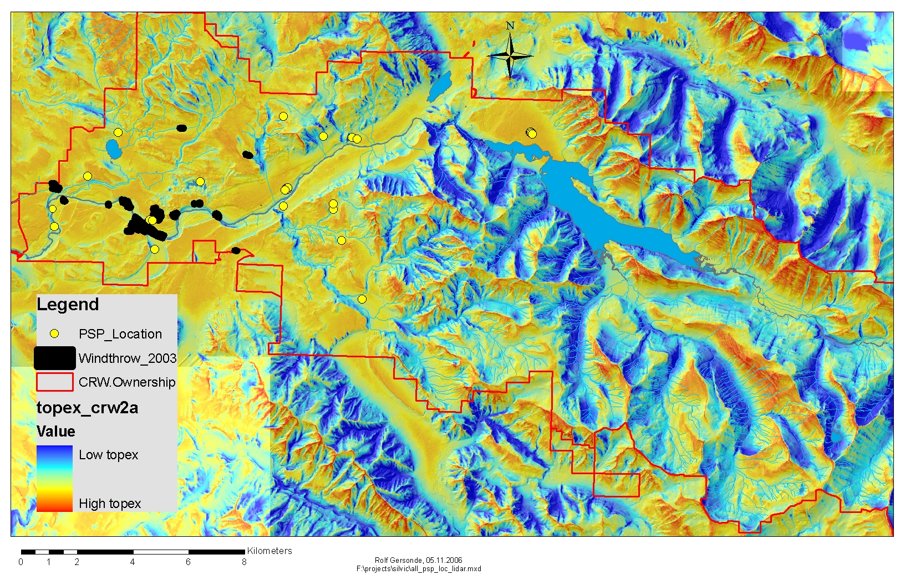
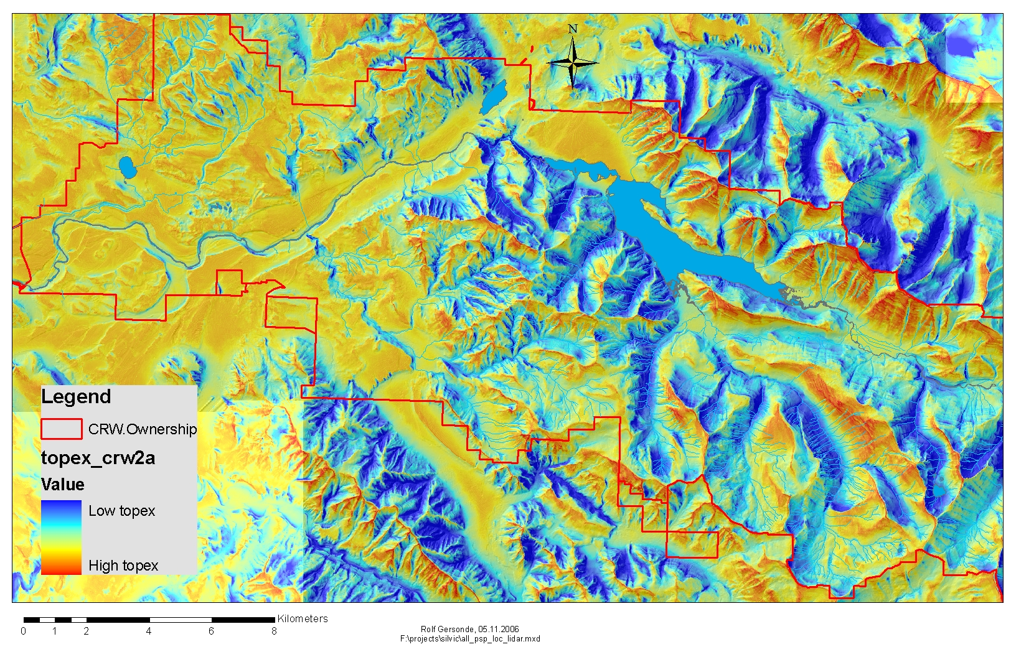
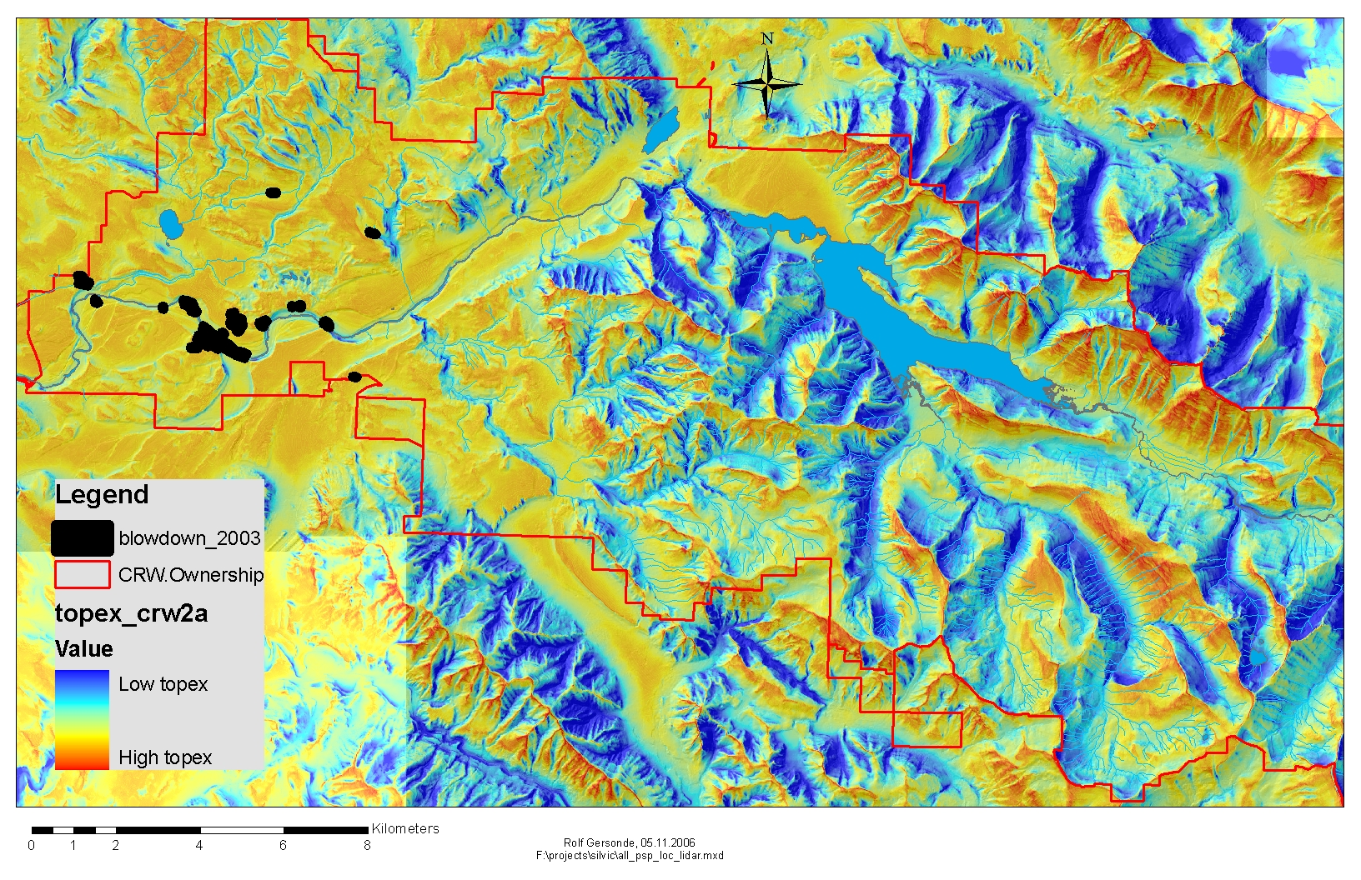
Wind Disturbance Regime
Topex: Jean-Claude Ruel, Steve Mitchell, and Naa Lanquaye-Opoku

Slide 19
Effect of tree position relative to gap edge
on diameter growth and average crown width
Graph shows median and quartiles, data are taken from mature
Douglas-fir stand at CRMW; diameter increments are
significantly different at p=0.032; average crown width are
significantly different at p=0.0004.

Slide 20
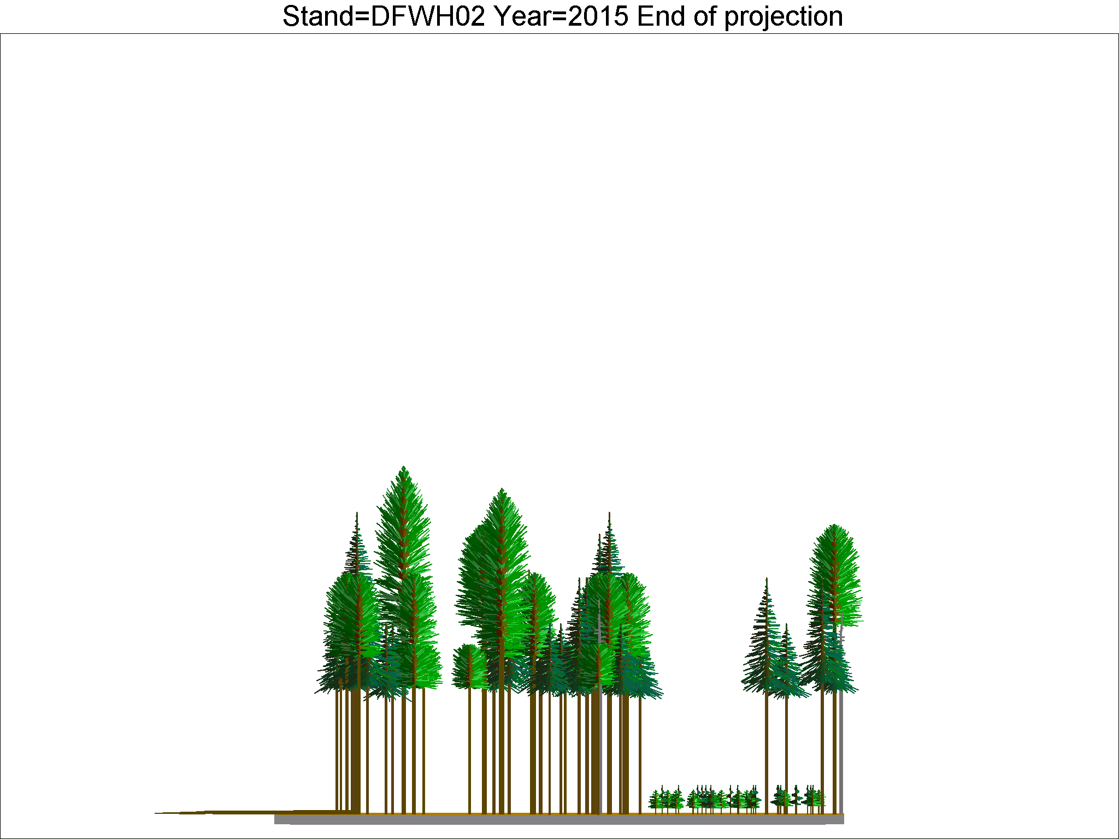
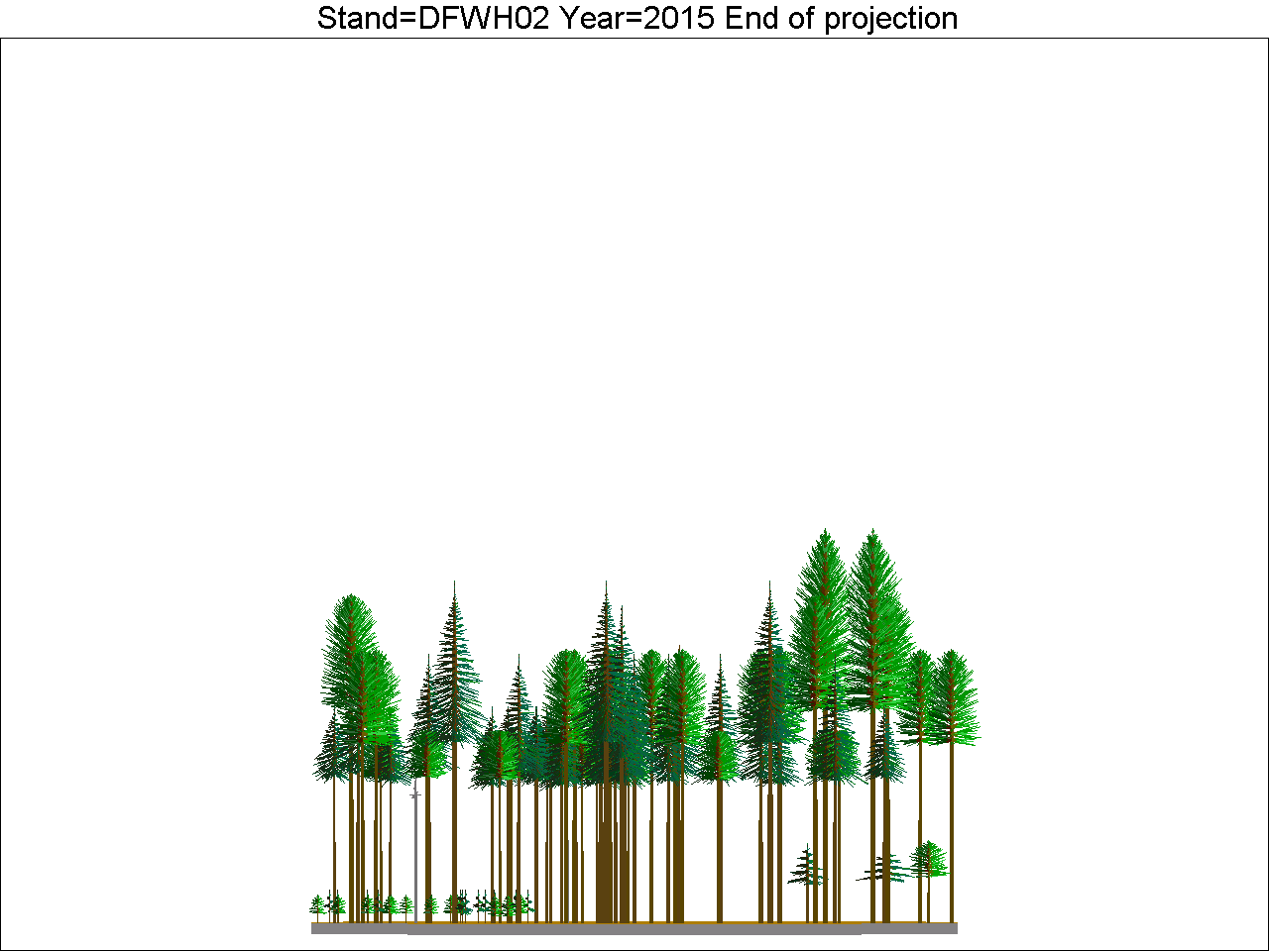
Disaggregated growth modeling in FVS

Slide 21
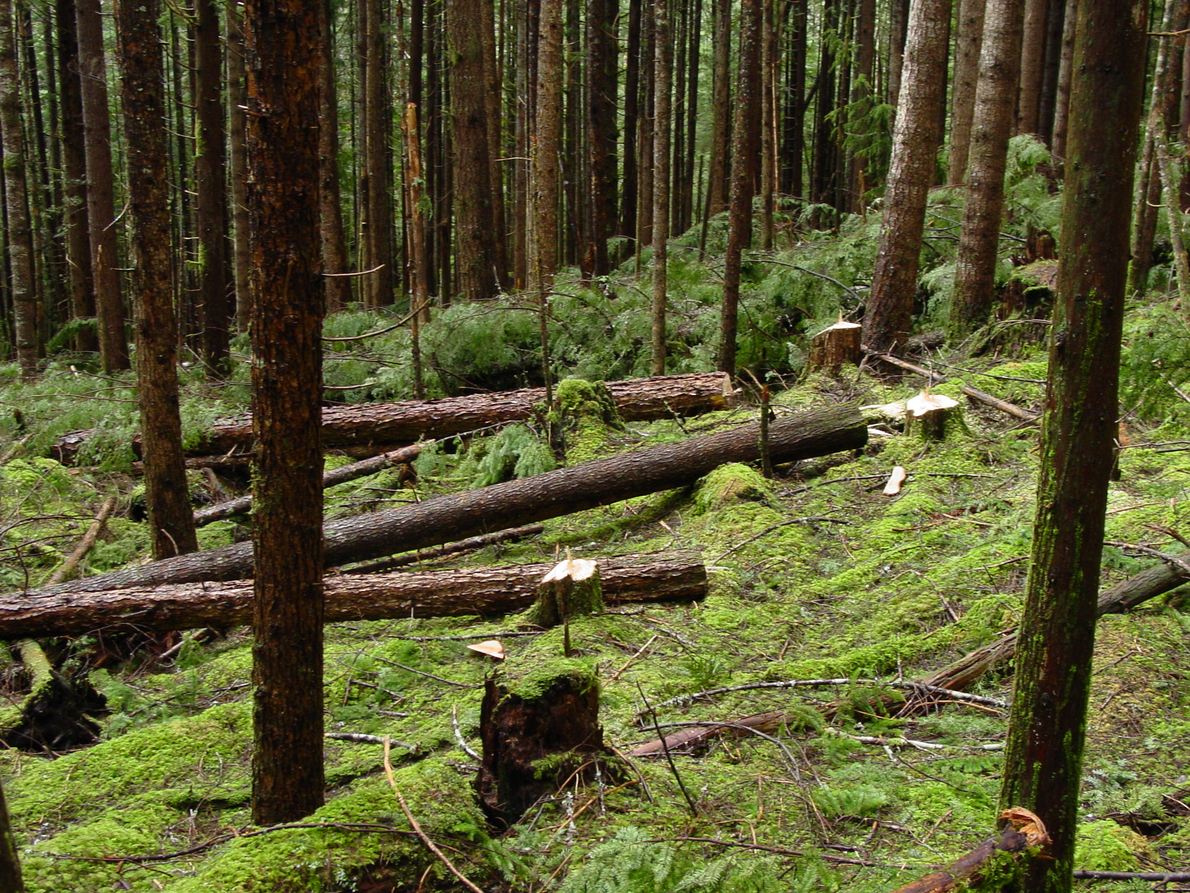
Down wood volumes:
11% ground cover, 45 tons or 6000 bf/ac on 120 acres
80% of average “westside conifer-hardwood” forests
(Ohmann and Waddell 2002)

Slide 22
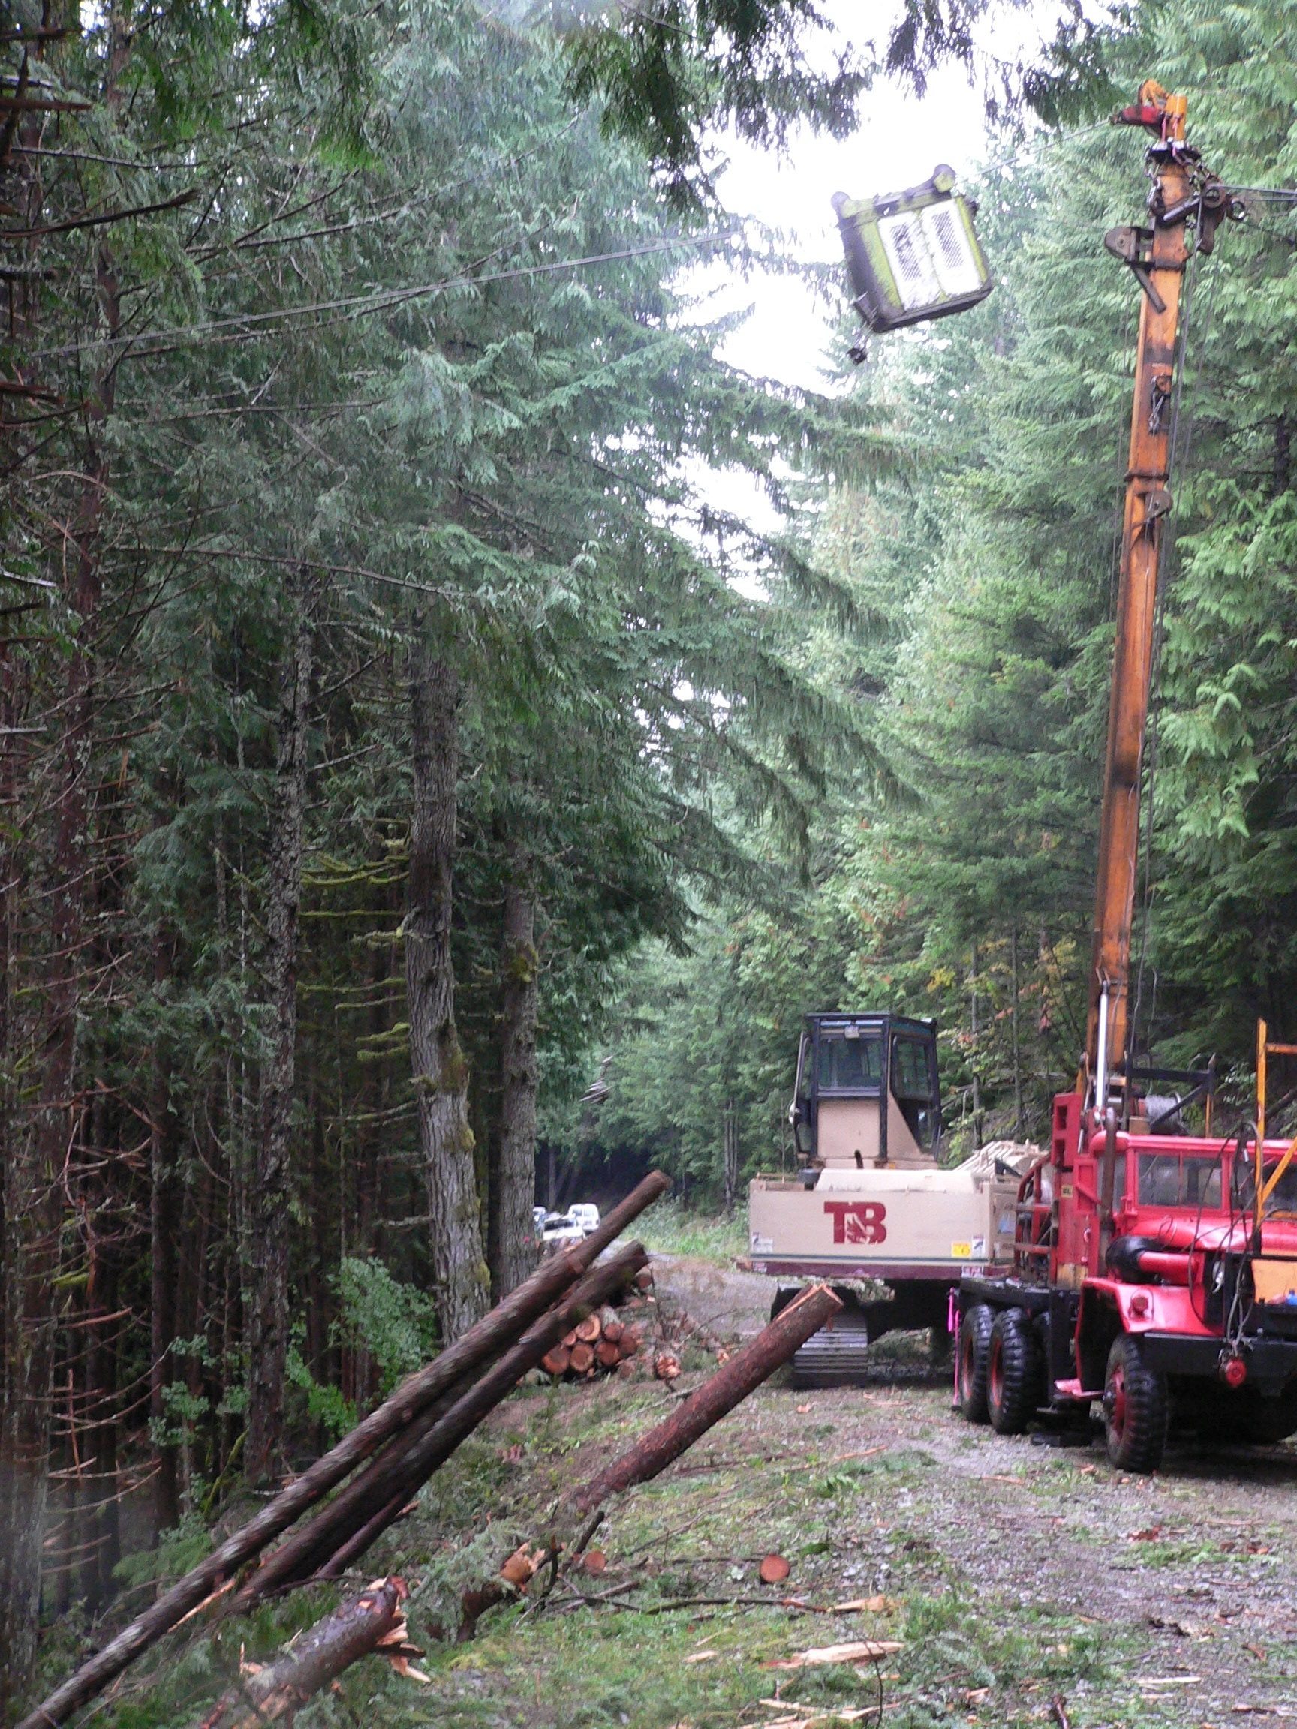
Contractual Issues
Surplus timber production
(2.5 mmbf) requires approval
from City Counsel (ordinance)
FSC Certification (2006)
Request for Proposal
Long-term relationship with
contractors
Operator Certification
A&R Cable Thinning

Slide 23
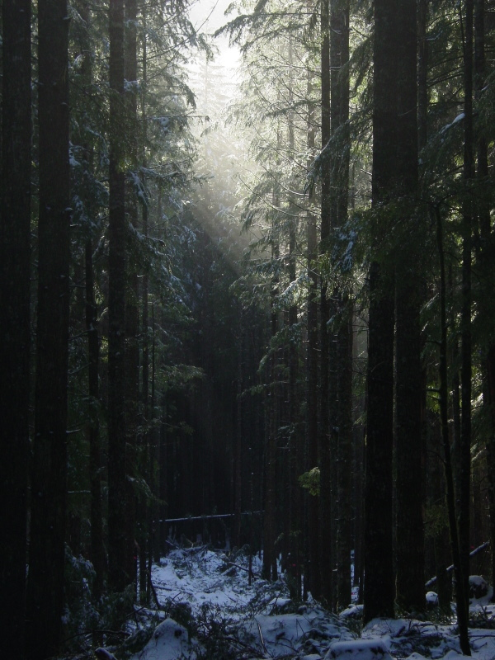
Forest Restoration Uncertainties
Understory response
Effect of CWD on understory developement
Proportion of structure types
Gap size/diversity
Maintaining growth rates
Disturbance interactions

