Slide 1
Policy implications from a recent study on Biscuit Fire effects (first)
Study findings as justification for these policy implications (second)
Policy implications: What should be considered in future NEPA documents covering post-wildfire management and fire-hazard abatement activities? Based on what we learned
Limits of inference to study findings: broad given previous absence of evidence of this quality, but here limited to mixed severity regimes

Slide 2
Policy implications
A.
We need to elevate our concern over the potential losses of soil productive potential resulting from intense wildfire for the following reasons:
1.
To meet the intent of MUSY to “maintain or enhance productivity of the land.”
2.
Potential losses in the forests future capacity to sequester carbon—this means subtrationality not additionality in C credit markets.
3.
Potential losses in capacity to produce biomass energy or wood products to replace fossil-fuel based building and other products.
Potential losses in jobs and the long-term economic foundation for forest-dependent communities.
4.
5.
Potential losses in acres capable of producing late-successional habitat, especially given losses from the fire.

Slide 3
Policy implications
B.
Consider major changes in post-fire mitigation strategies:
Given huge losses of soil N and C, consider planting or seeding N₂-fixing plants in intensely burned areas (BAER).
1.
Consider fertilizing seedlings of trees critical to reconstructing forest structure.
2.
Reduce the excessive focus on erosion control (especially as predicted by WEPP model)
3.
Value native invasives and sprouters to retain remaining nutrients and soil structure.
4.
Consider salvage logging (like in Biscuit) if it can pay for above mitigation efforts.
5.

Slide 4
Policy implications
C.
Consider major changes in pre-fire mitigation strategies.
1.
Without fuel reduction, thinning can lead to higher mortality than in untreated mature stands (80 to 100 years).
2.
Mid-story hardwoods dampened fire and reduced mortality of dominant conifers—consider leaving them when thinning.
Large woody debris added to canopy mortality (although less than fine fuels)—consider reducing woody debris targets.
3.
4.
Consider more than just fuels when reducing hazards.
Improve fire attack strategies, including early response, burnout preparation, and ridgetop roads and trails.
Find ways to pay for hazard reduction including flexibility in eastside screens, and especially fire-killed trees.

Slide 5
What’s the science behind:
A.
Elevating our concern over the potential losses of soil productivity?
B.
Considering major changes in post-fire mitigation strategies?
C.
Considering major changes in pre-fire mitigation strategies?

Slide 6
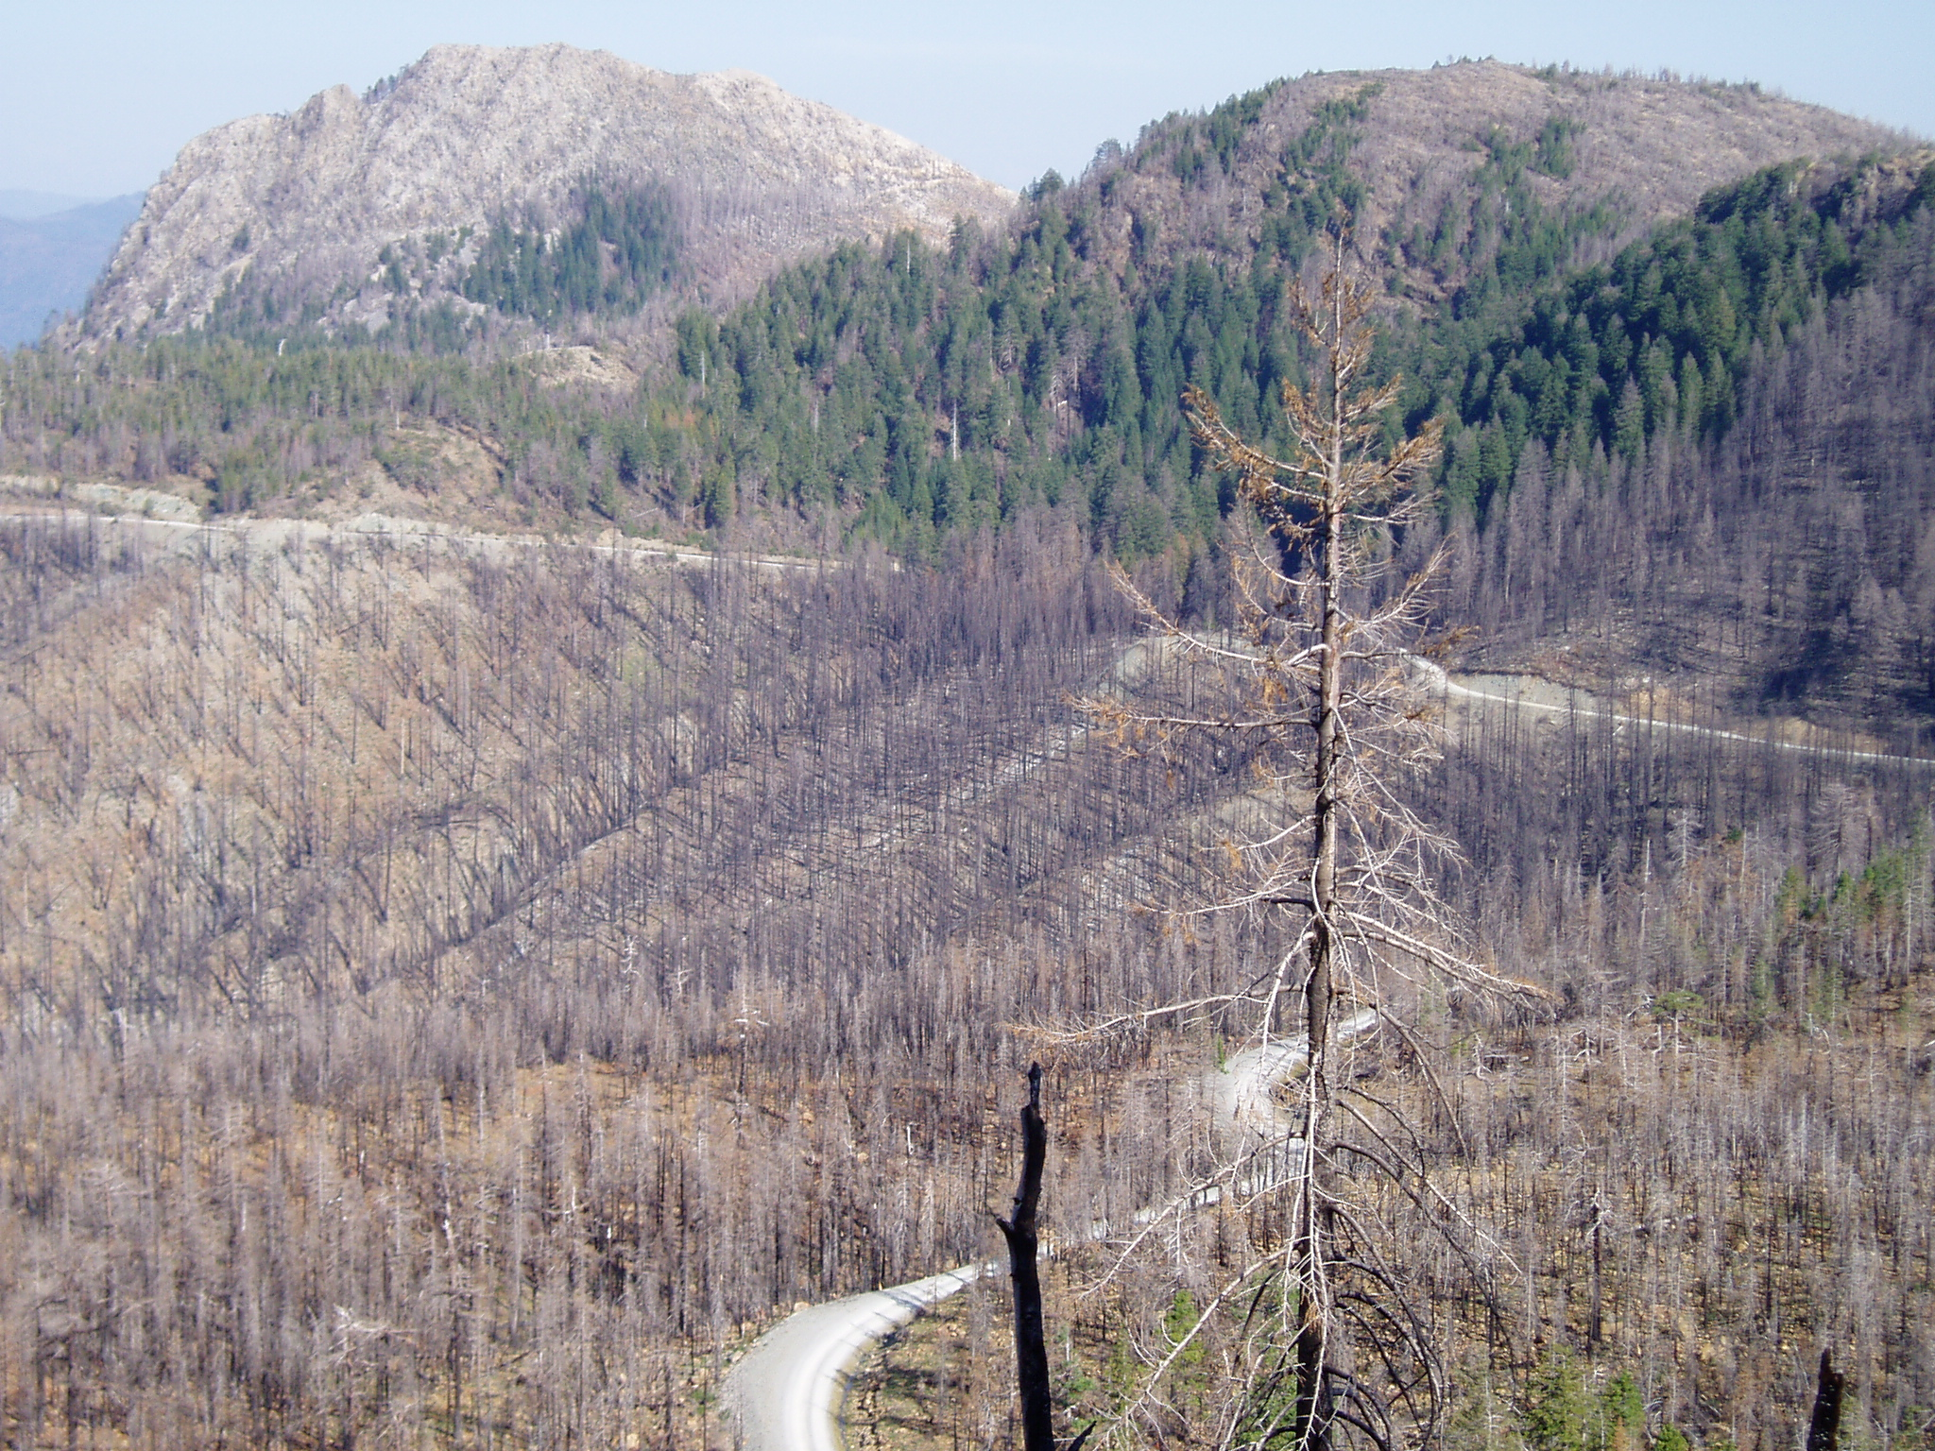

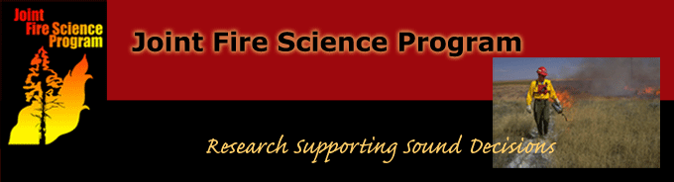
LTEP Biscuit Fire study
Long-Term Ecosystem Productivity

Slide 7
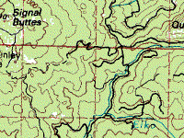
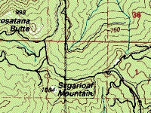
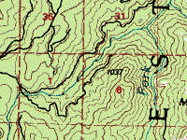
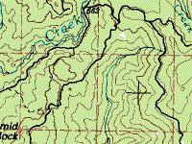
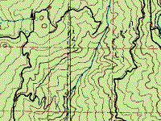
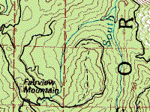
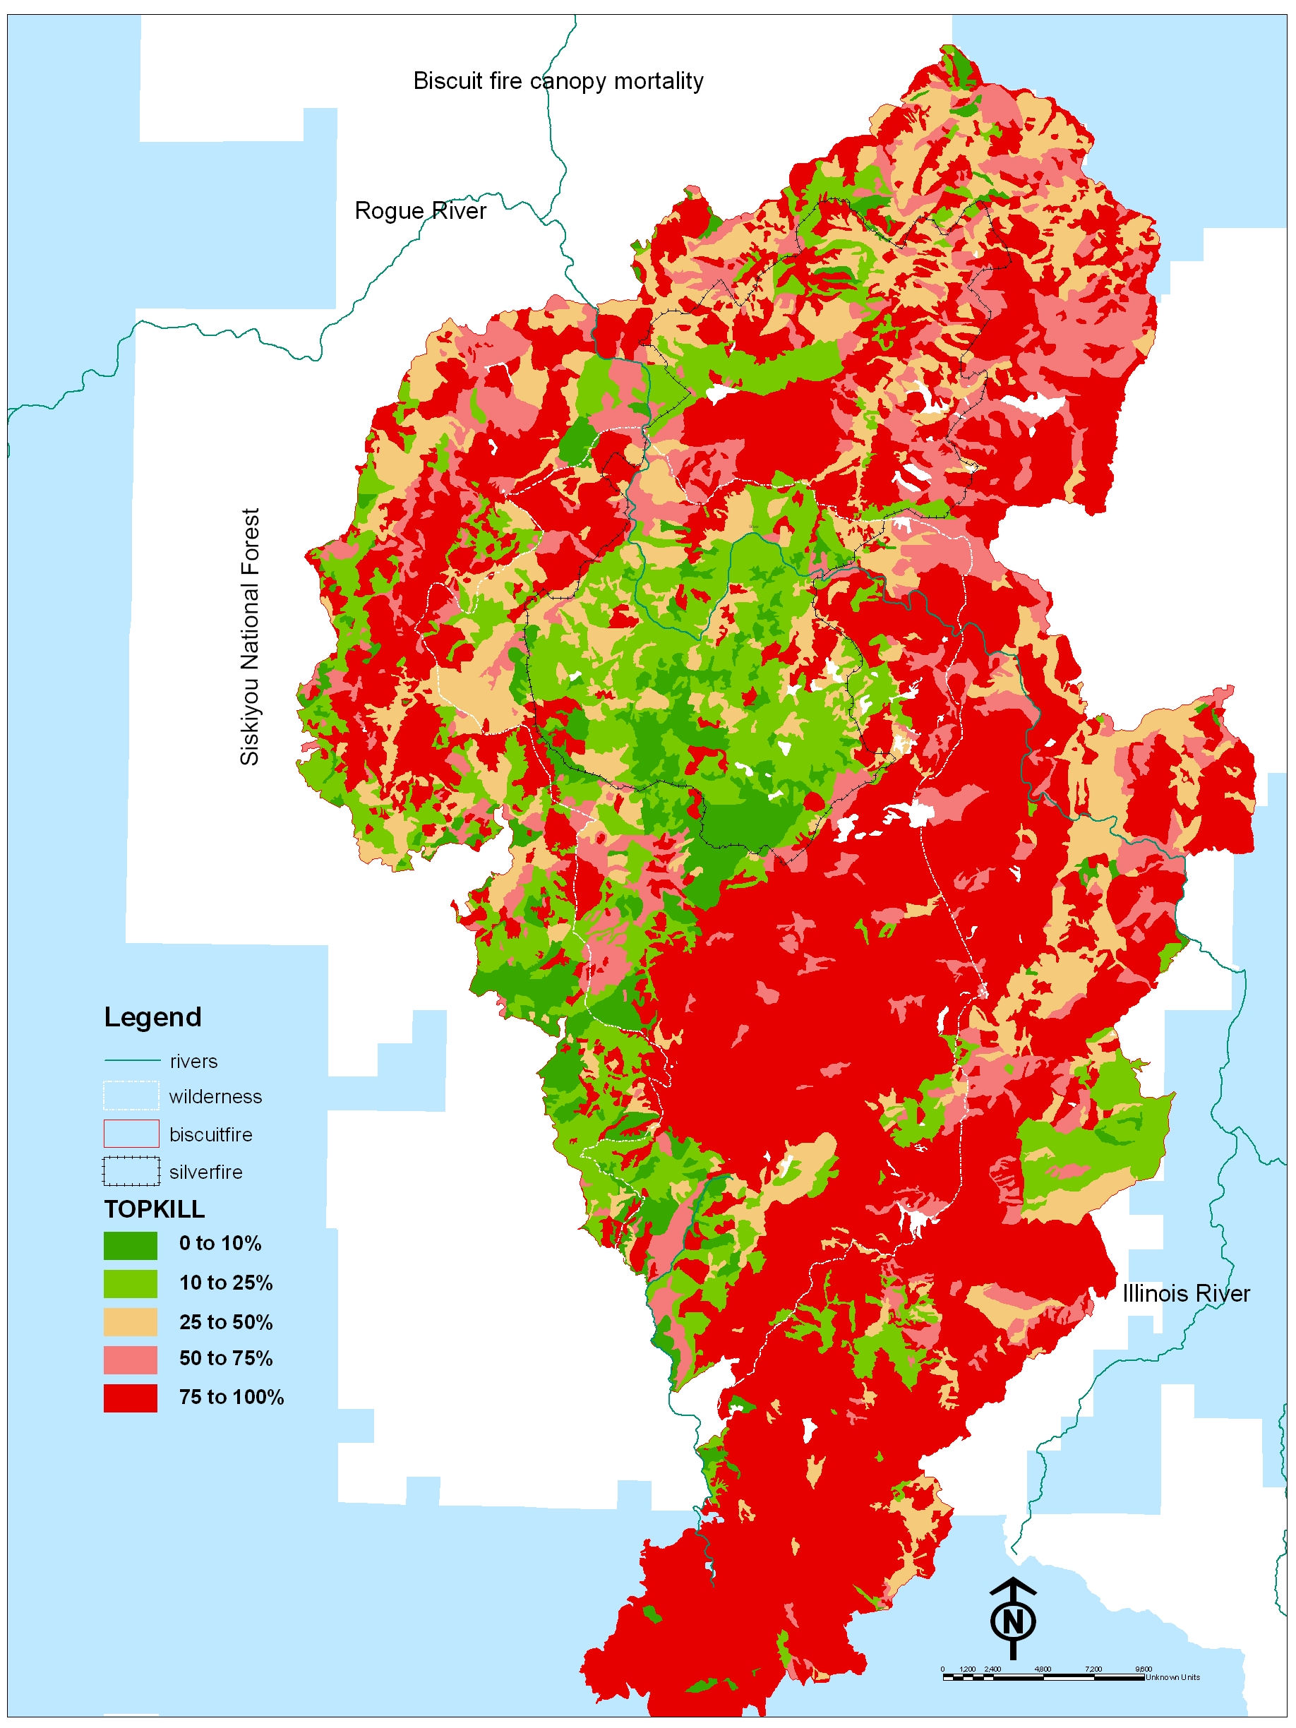
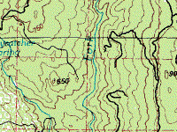
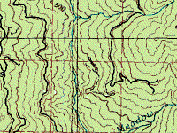
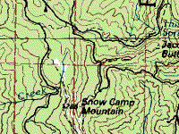
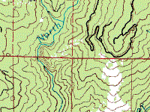
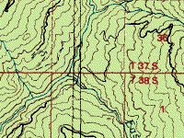
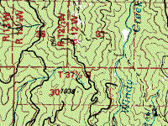
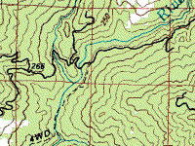
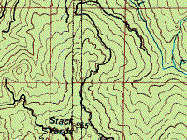
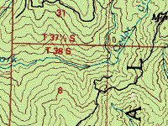
Introduction
The long-term ecosystem productivity program experiment near Gold Beach, OR, on the western flank of the Biscuit fire
Biscuit Fire area
The Biscuit Fire
2002
Sugarloaf burn study block
Grant’s Pass
Fairview Mountain block
Pistol River block
Snowcamp Lookout
Meadow Creek burn study block
Panther Lake block
Brookings
Unburned area
California
Various LTEP treatments

Slide 8
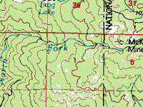
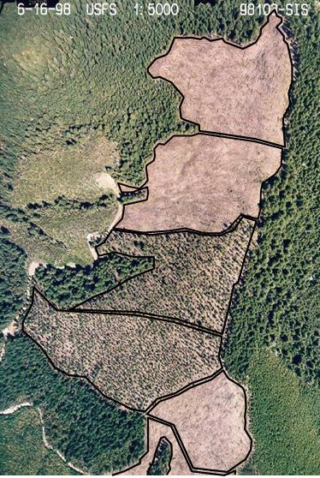
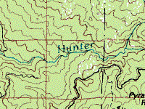
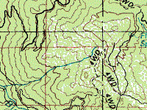
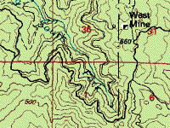
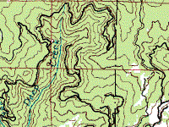
Intro 3
Background
Aerial view of the Panther Lake block in 1998 air photo.
Unburned area
Biscuit Fire area
Douglas-fir,
hi-wood
Douglas-fir,
lo-wood
Late- succession,
hi-wood
Snowcamp Lookout
Late- succession,
lo-wood
DF-hi
DF-lo
Panther Lake block
Pioneer,
hi-wood
Late-hi
Late-lo
Pioneer-hi
Control
Pioneer,
lo-wood
Control (not shown)
Pioneer-lo

Slide 9
Intro 4
Background: Eight burned LTEP treatments offer evidence on vegetation-fire interactions:
Conditions before the fire in 2002
Experimental treatments applied in 1996:
Control, no action
Leave untouched
Clearcut, plant Doug-fir +/- woody debris
Douglas-fir, hi-wood
Douglas-fir, lo-wood
Clearcut, plant pioneers, +/- woody debris
Pioneers, hi-wood
Pioneers, lo-wood
Thin, underplant leave +/- woody debris
Underburn in 2001
Thinned, hi-wood
Thinned, lo-wood
Thinned, underburned
Similar, 110-yr-old stands in 1995 before treatment

Slide 10
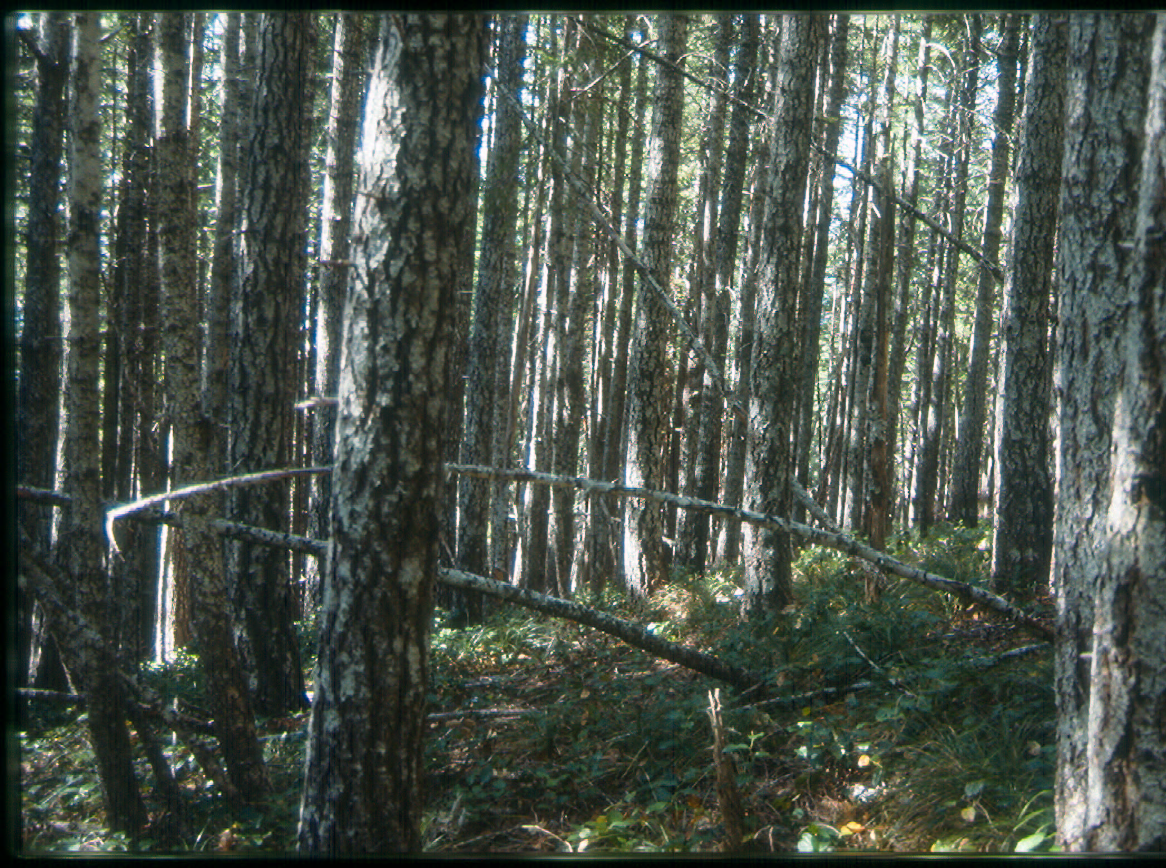
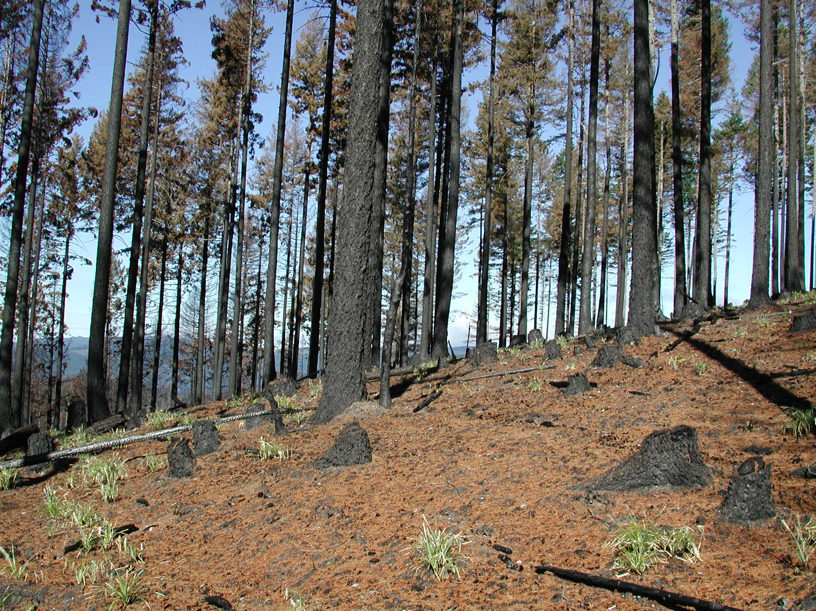
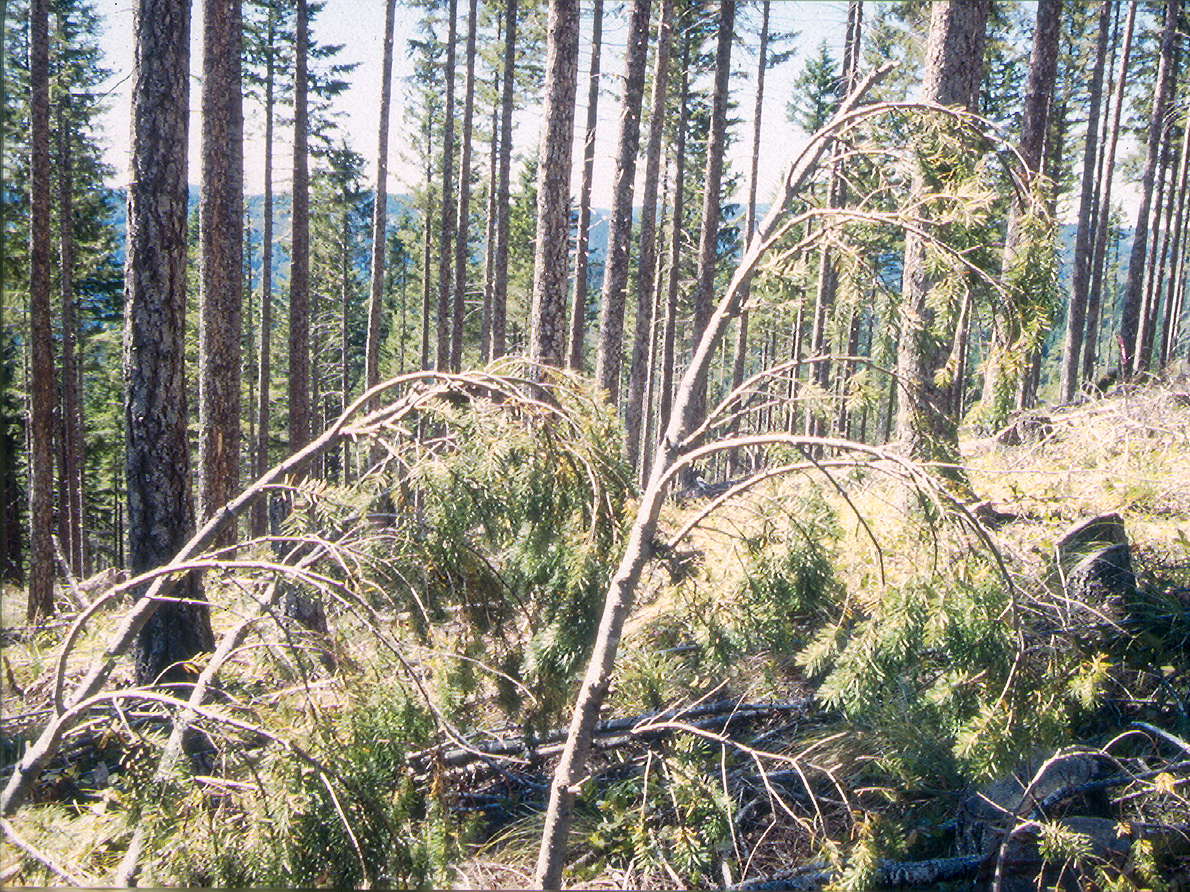
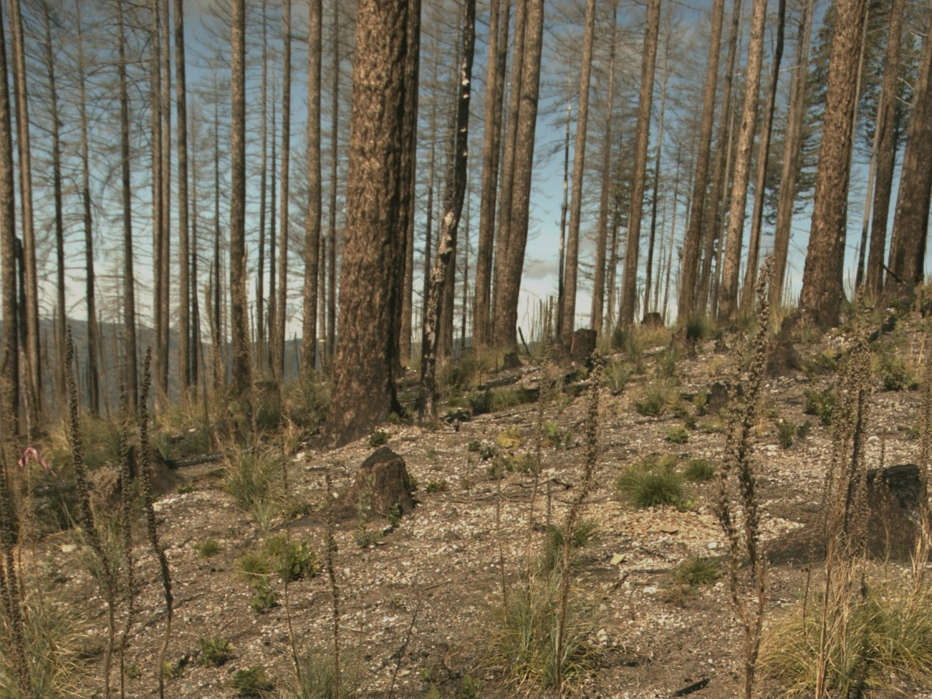
A1 photos
IL3
Thinned, hi-wood treatment
1993
2002
1998
2004

Slide 11
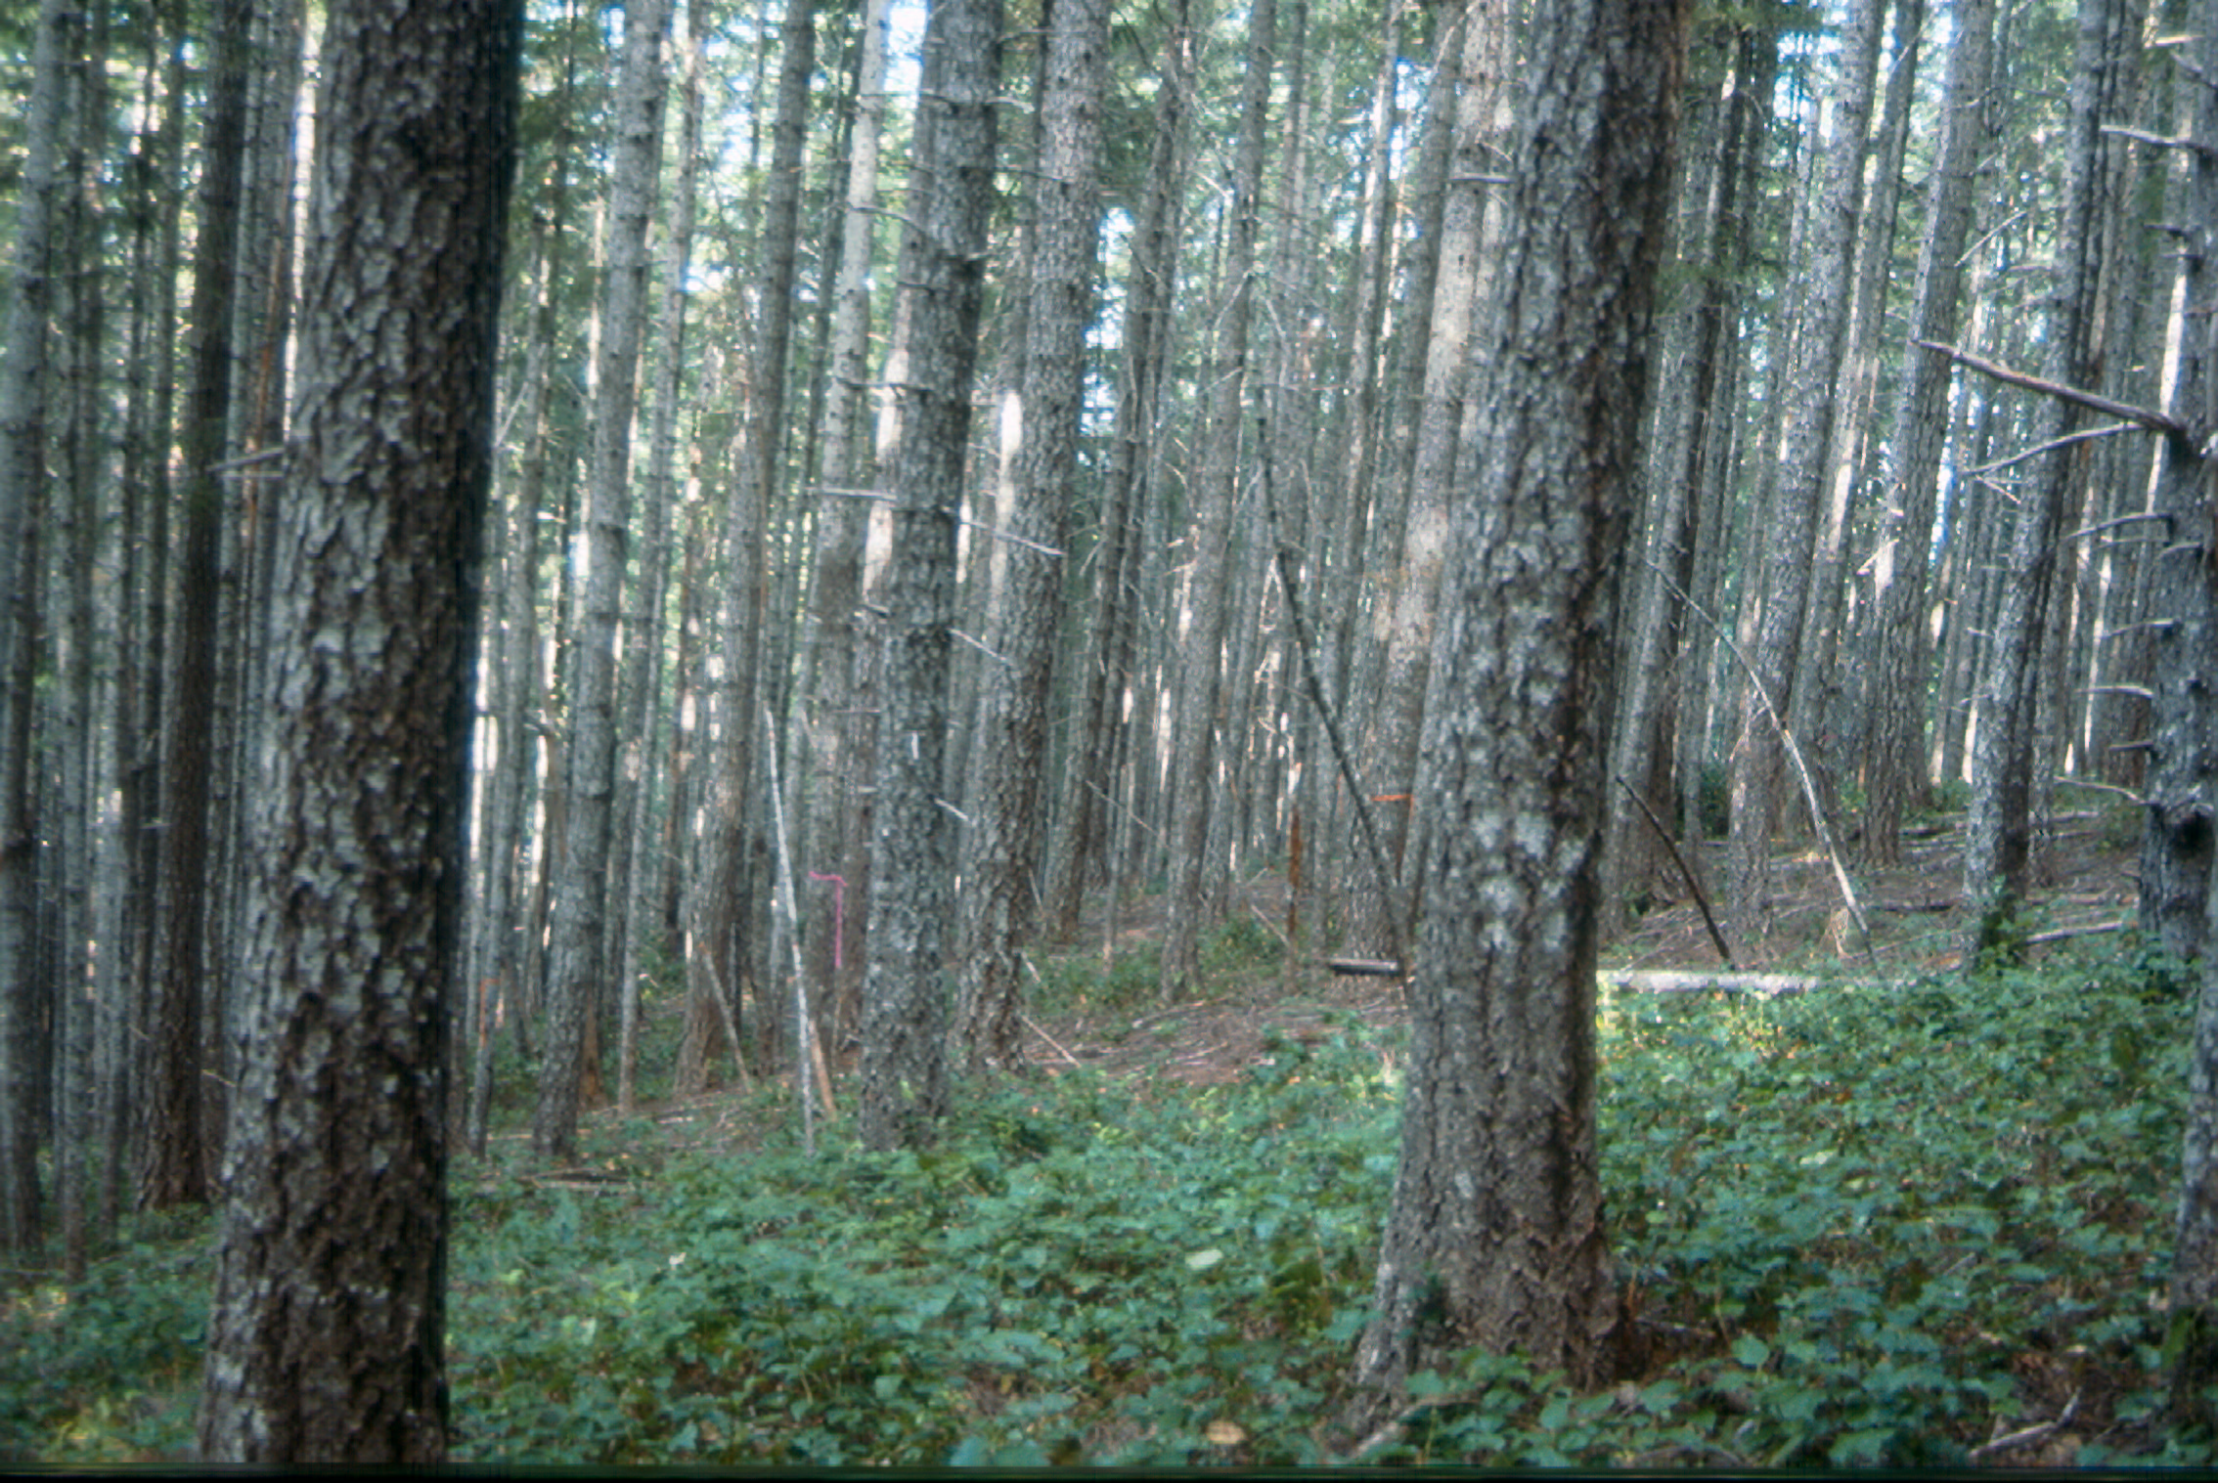
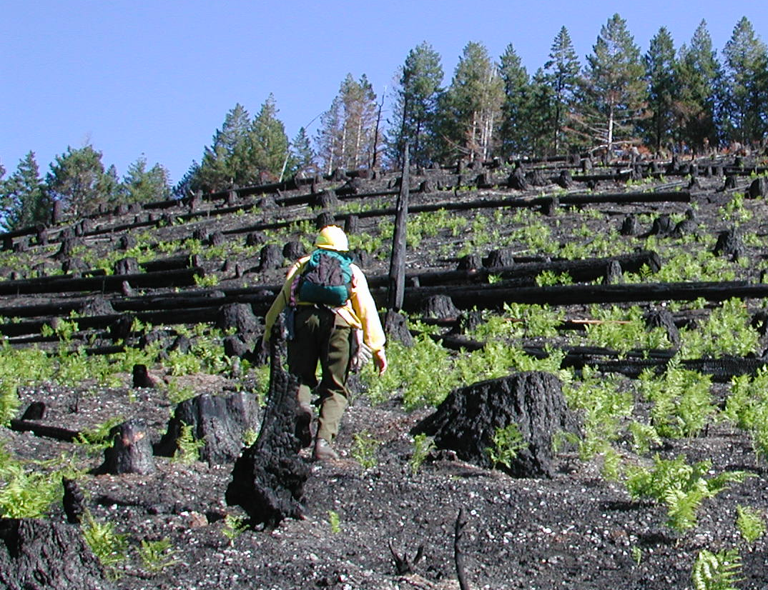
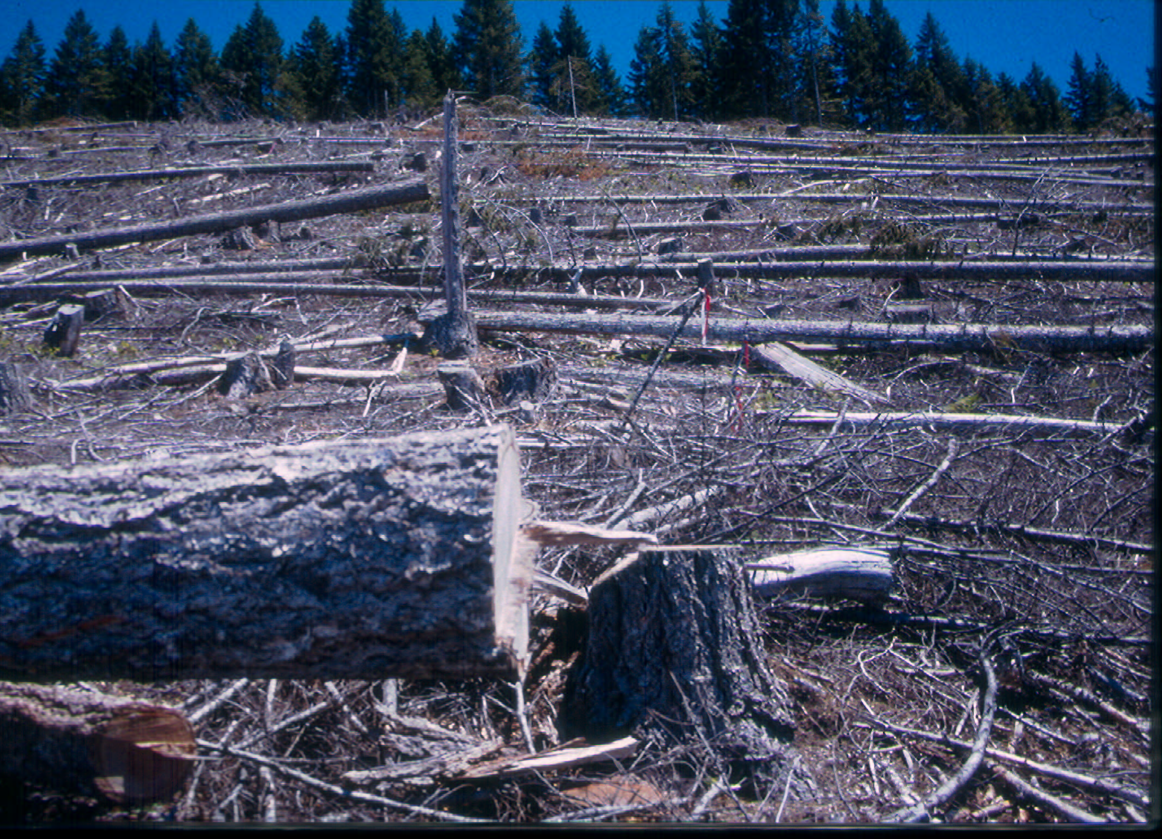
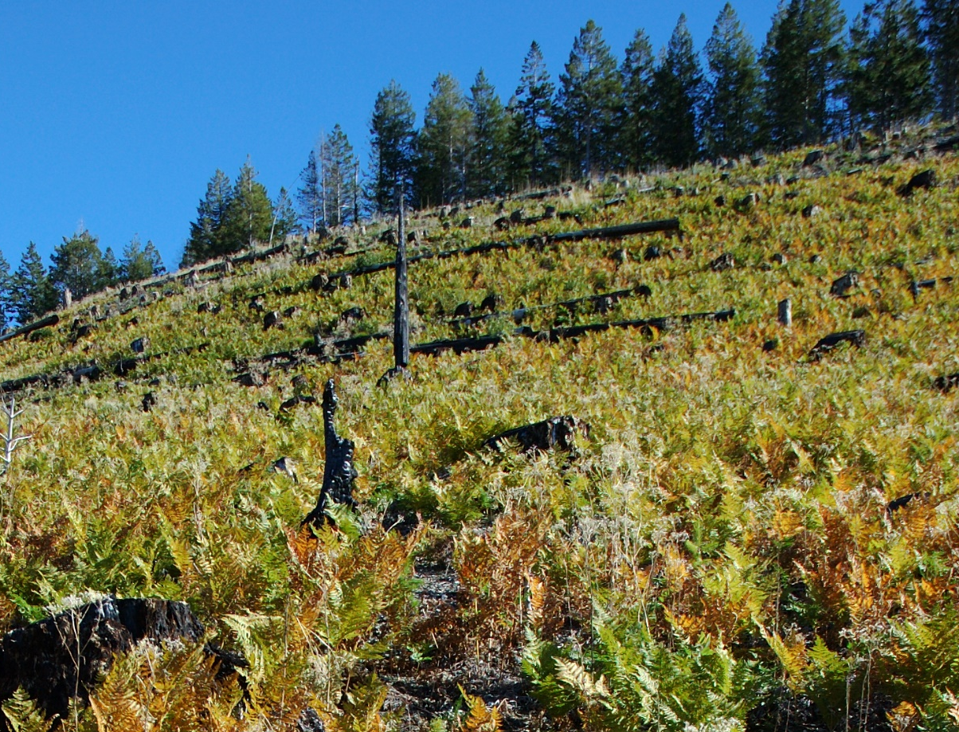
A2 photos
Douglas-fir, hi-wood
1993
2002
1998
2004

Slide 12
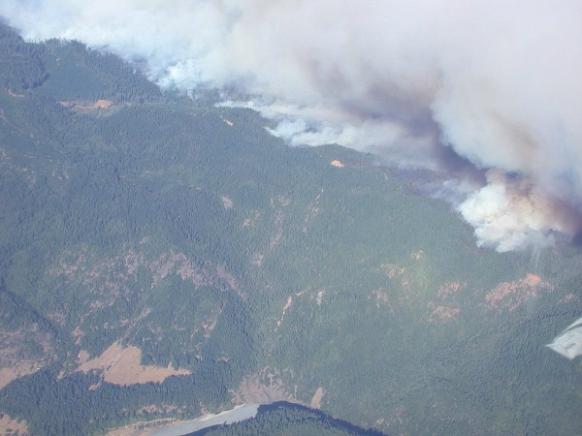
Initial Results
Interpreting fire effects on ecosystems can be misleading without before and after data, and without unburned controls
Data
“Theory”

Slide 13
Hypothesis A
Four LTEP treatments (two were replicated) offer evidence on thinning-fire interactions:
Because thinning reduces fuels, it also reduces fire movement and severity.”
A.
Because we know the conditions before the 2002 Biscuit Fire,
Experimental LTEP treatments applied in 1996:
Leave untouched
Control, no-action
Late-succession, underburned in 2001
Late-succession, +/- woody debris
Underburn in 2001
Thin, underplant +/- woody debris
Late, hi-wood
Late, lo wood
Late, underburned
Stands were similar in 1995 before the LTEP treatments
we can assess how the fire traveled through these four thinned and unthinned stand types

Slide 14
A1 evidence
Expected (theory)
Actual (data)
LTEP treatment
Control, no-action
Highest mortality
Late-succession, hi-wood
Medium mortality
Low mortality
Late-succession, lo-wood
Late-succession, underburned
Lowest mortality

Slide 15
Expected (theory)
Actual (data)
LTEP treatment
Control, no-action
(2 stands)
Highest mortality
Theory fails
30%
survival
70% mortality
Thinned, hi-wood
Medium mortality
Theory fails
100% mortality
Theory fails
Thinned, lo-wood
(2 stands)
Low mortality
92% mortality
Theory works
Lowest mortality
Thinned, underburned
64% survival
36% mortality

Slide 16
Why did controls burn less intensely than thinned stands as predicted by fire models?
Evidence to consider:
Controls had low fine woody fuels (30 and 9 Mg/ha) relative to 28 and 37 for thinned-lo, and 44 Mg/ha for thinned-hi stands.
Controls retained mid-story hardwoods (madrone, tanoak, chinkapin) and they did not act as fuel ladder as predicted, and rather appeared to dampen the fire (much lower char heights).
Still much to be learned about fire behavior.

Slide 17
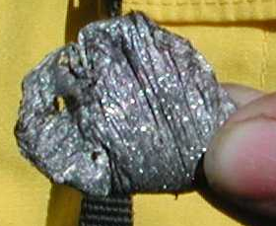
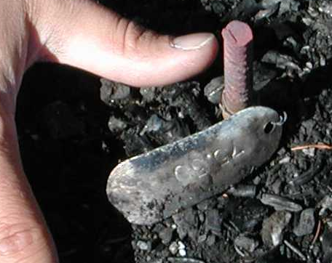
B1 evidence
Control, no-action
Thinned, under-burned
Thinned, hi-wood
Thinned, lo-wood
Douglas-fir, hi-wood
Douglas-fir, hi-wood
Pioneers, hi-wood
Pioneers, lo-wood
Panther block
Not burned
Not burned
Not burned
Not burned
Fairview block
Burn study block B
KEY
The temperature of the Biscuit Fire
Fire temperatures across the 6-acre measurement plots of the LTEP experiments as measured by the extent that aluminum tags melted that were attached to rebar marking our 25-m grid system.
Sustained above 700 °C
Moment above 700 °C
Below 700 °C
Result: Temperatures observed were enough to volatilize N, S, and possibly P and K. Further studies are needed to examine these potential losses.

Slide 18
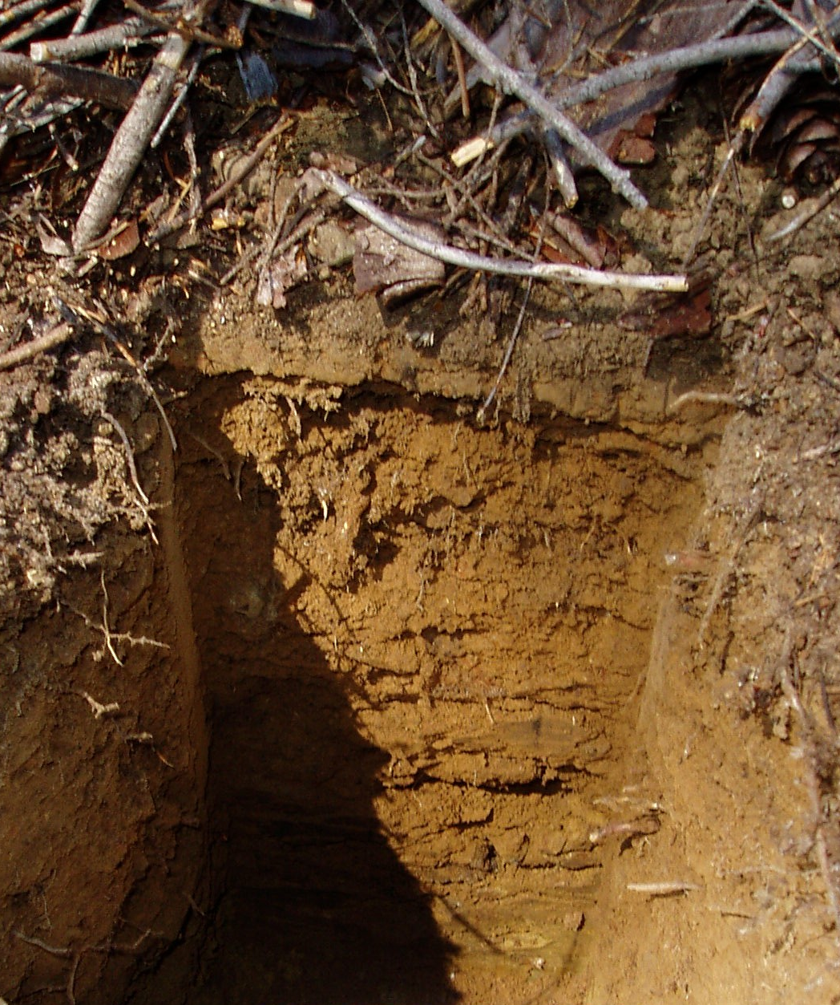
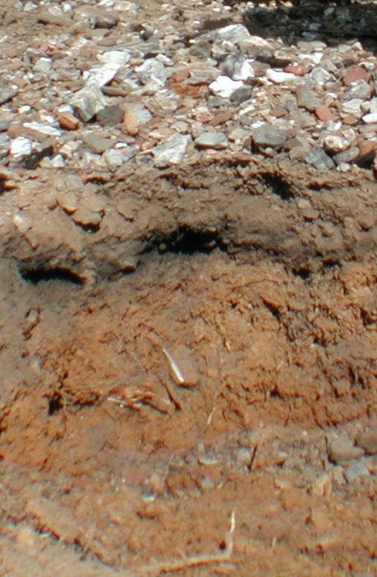
Issues with measuring soil change
Before Biscuit
After Biscuit
Post-fire surface rocks suggest fixed-depth methods can be highly inaccurate
Methods matter
Background changes suggest that pre-fire condition (1992) does not reflect condition just before the fire (2002)

Slide 19
Effects of intense wildfire: direct evidence for substantial losses from mineral-soil horizons
Carbon
Nitrogen
25
1600
Baird 1700
23
1400
20
1200
15
Mineral (60% of 23)
Baird 16
1000
Soil-C loss (Mg ha⁻¹)
Murphy 12
Soil-N loss (kg ha⁻¹)
Grier 855
800
690
10
600
Dyrness 7
Mineral 393 (57% of 690)
Murphy 490
O-horizon (40% of 23)
5
400
200
O-horizon 297 (43% of 690)
Dyrness -8
0
6 hotly burned LTEP stands
Literature range
6 hotly burned LTEP stands
Literature range
In the case of intense fire, losses of soil C are far from minimal as widely assumed

Slide 20
Effects of intense wildfire: indirect evidence for losses in long-term site productivity and C sequestration
Carbon
Nitrogen
Short-term negatives
1000
Reduced
25
Total C and N
SOM and mineral soil
Infiltration
Water-holding capacity
Cation-exchange capacity
Energy supply for microbes
23
800
20
690
Soil-C loss (Mg ha⁻¹)
600
Mineral
Soil-N loss (kg ha⁻¹)
15
Mineral
Increased
400
Bulk density
10
5
O-horizon
200
O-horizon
0
0
Profile C = 74
Profile N = 3000
Lost soil C = 31%
Lost soil N = 23%

Slide 21
Effects of intense wildfire: indirect evidence for losses in long-term site productivity and C sequestration
Carbon
Nitrogen
Short-term negatives
1000
Reduced
25
Total C and N
SOM and mineral soil
Infiltration
Water-holding capacity
Cation-exchange capacity
Energy supply for microbes
23
800
20
690
Soil-C loss (Mg ha⁻¹)
600
Mineral
Soil-N loss (kg ha⁻¹)
15
Mineral
Increased
400
Thinned
10
Bulk density
5
O-horizon
200
Homann et al. 2004
O-horizon
0
0
Profile C = 74
Profile N = 3000
Lost C = 31%
Lost N = 23%
Does a 23 Mg/ha loss equal a 20% decline in productive capacity?

Slide 22
Effects of intense wildfire: indirect evidence for losses in long-term site productivity and C sequestration
Carbon
Nitrogen
Short-term negatives
1000
Reduced
25
Total C and N
SOM and mineral soil
Infiltration
Water-holding capacity
Cation-exchange capacity
Energy supply for microbes
23
800
20
Soil-N loss (kg ha⁻¹)
690
Soil-C loss (Mg ha⁻¹)
600
15
Mineral
Mineral
Increased
400
Bulk density
10
5
O-horizon
200
Short-term positives
O-horizon
Increased
0
0
Nutrient availability?
Cations in ash
Mineral surfaces stripped of organic coatings
Reduced
Pathogens
Competition (for sprouting plants)

Slide 23
Effects of intense wildfire: indirect evidence for losses in long-term site productivity and C sequestration
Carbon
Nitrogen
Longer-term probabilities
1000
Losses of mineral-soil C that were recalcitrant to decomposition (product of previous microbial attacks), will take many decades to rebuild.
25
23
800
20
Soil-N loss (kg ha⁻¹)
690
Soil-C loss (Mg ha⁻¹)
600
15
Mineral
Mineral
Losses of soil N will take >300 years to be replaced without N₂-fixers?
400
10
5
O-horizon
200
Other nutrient losses at temps observed (>780 °C):
N: 200 °C
P and K: 774 °C
Ca and Mg: 1000 °C
O-horizon
0
0
Nonetheless, resiliency processes are poorly understood—and we need to follow actual responses.
If collective plant growth (trees and shrubs) is reduced, CO₂ uptake, return of C and N to soil, and weathering will slow?

Slide 24
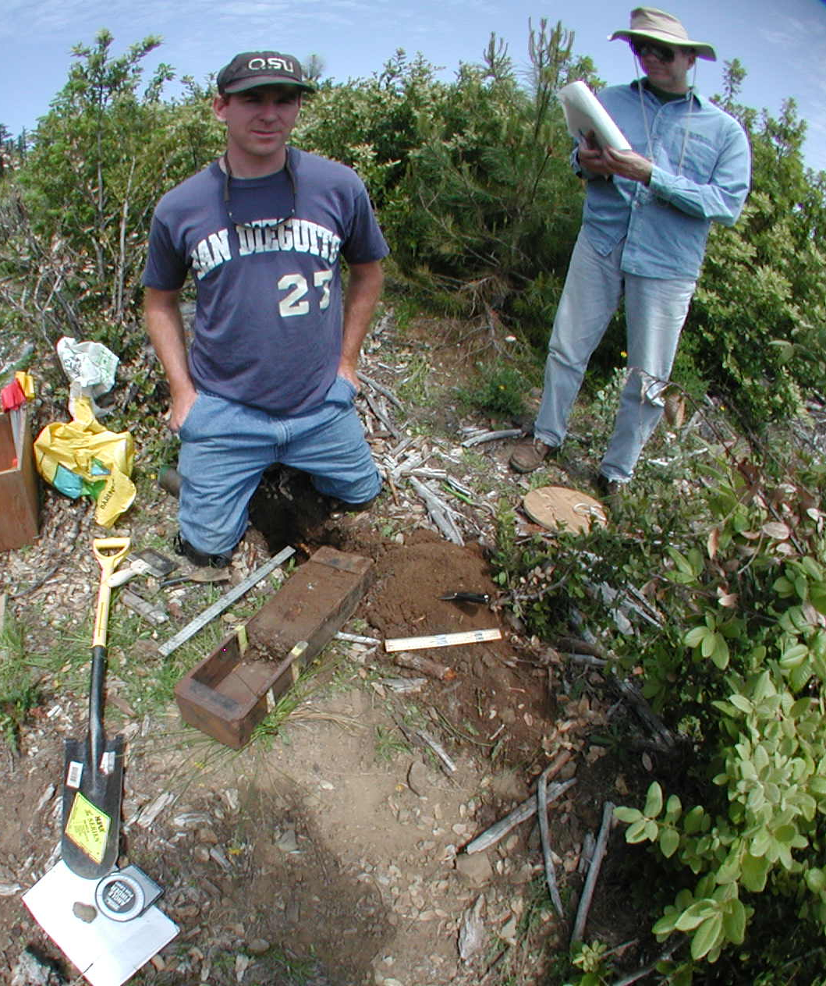
Overview on sampling methods
7-ha LTEP treatment “stand”
25-m gridpoint
Soil samples
1992
2003
1.5-ha “measurement plot”
23 LTEP stands,
12-16 samples per stand,
4 horizons to 30 cm depth,
1992 and 2003:
Total of ~2500 layer samples

Slide 25
Rock (>4 mm) concentration (% total inorganic matter)
burned
Unburned
Hotly burned stands
Unburned stands
0
20
40
60
80
0
20
40
60
0
5
10
Sampled depth mid-point (cm)
15
20
1992
2003
25
Huge rock gains near surface after fire
No detectable background changes

Slide 26
Effects of intense wildfire: common methods for assessing soil change need revisiting
Loss of surface fines—both organic and inorganic—leaves a layer of surface rocks, a decrease in volume, and a drop in surface elevation.
A
B
The fixed-depth surface layer underestimates fire-induced losses because it ignores particle losses and post-fire measurement is exaggerated by starting and ending at a lower elevation (with lower C & N).
Missing volume and fine soil
Post-fire comparable-layers approach
Pre-fire soil
Post-fire fixed-depth approach
Original surface
A
Post-fire surface
Comparable
surface layer
Fixed-depth
surface layer
Comparable
subsurface layer
Fixed-depth
subsurface layer
Original bottom
B
Post-fire bottom
Comparable-layers method accounts for loss of volume and surface fines by using rock and fine-inorganic mass as references.

Slide 27
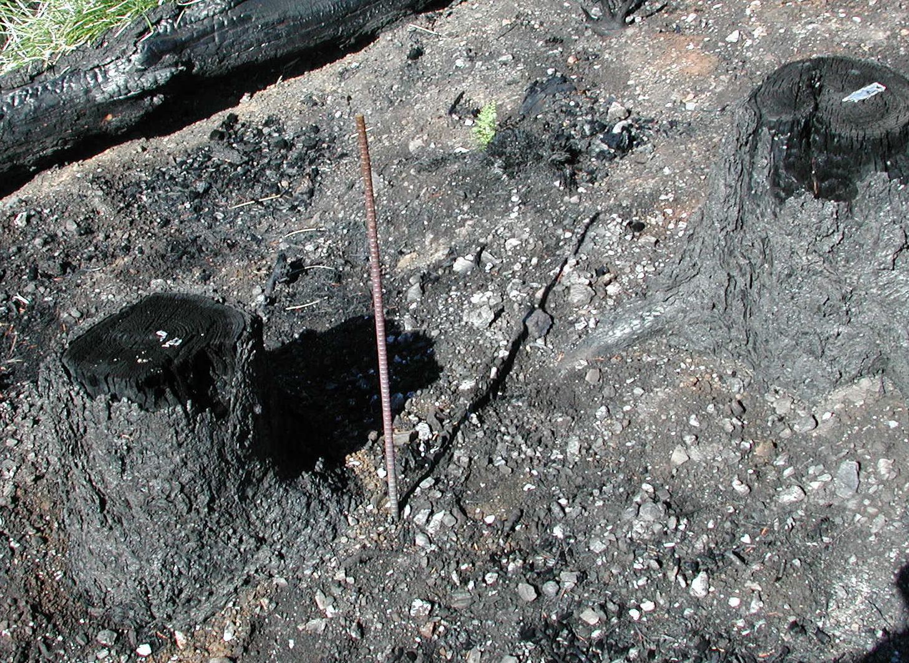
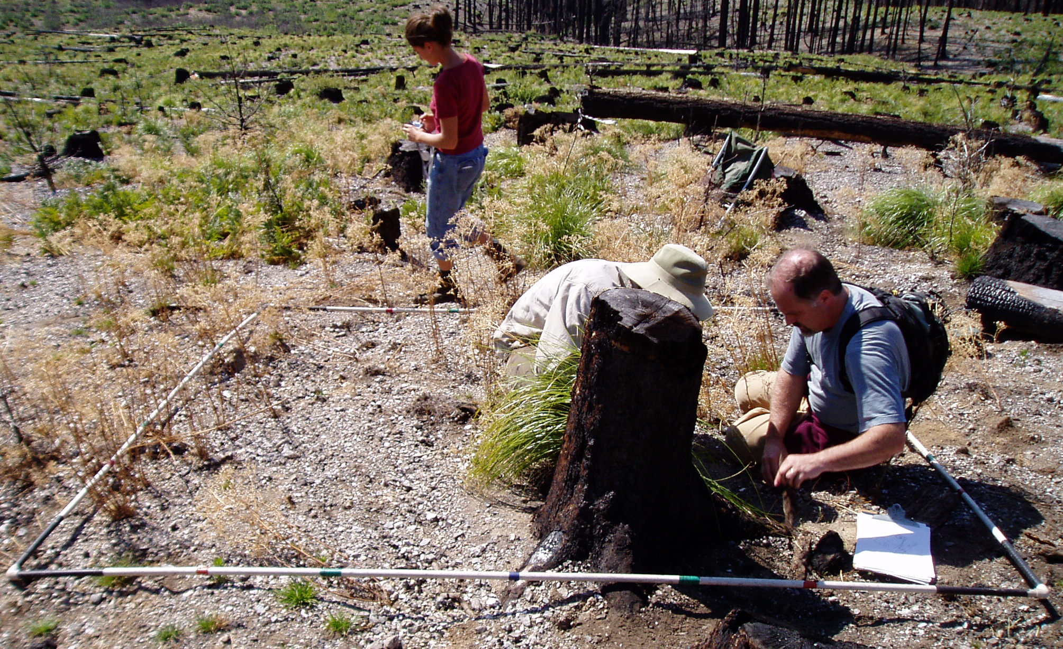
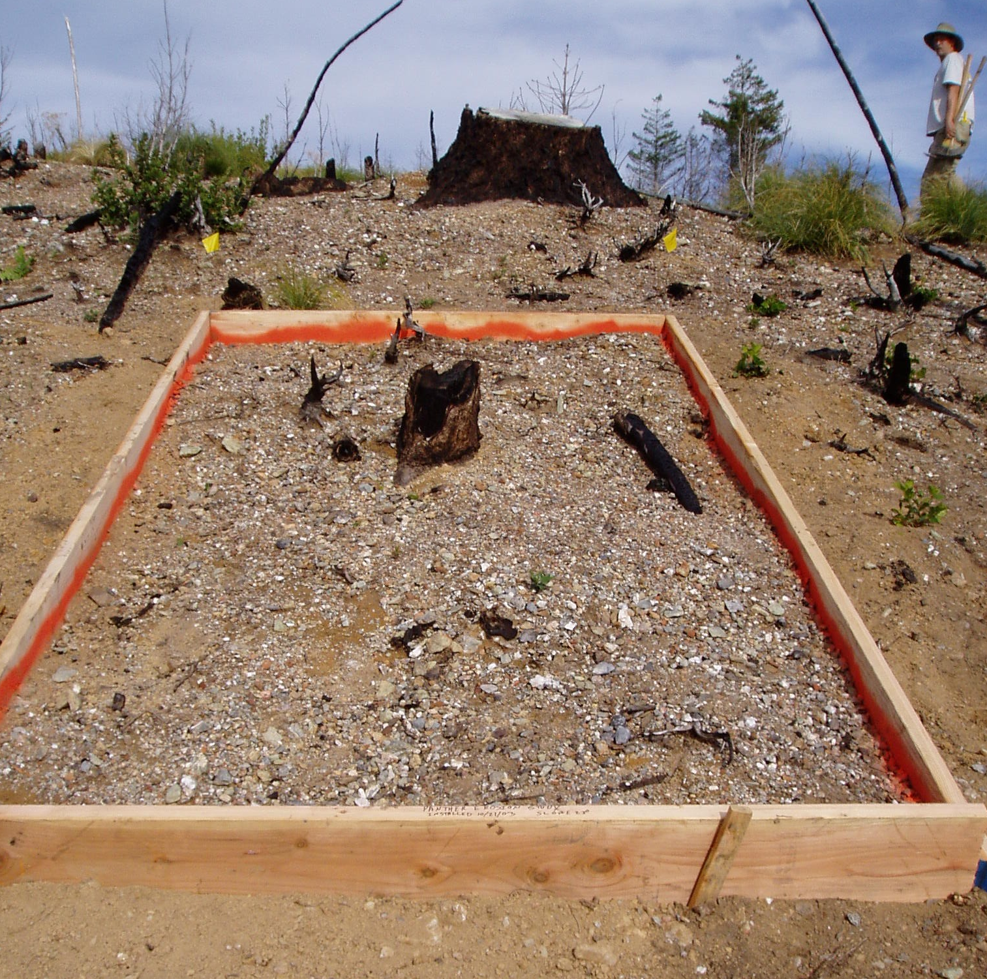
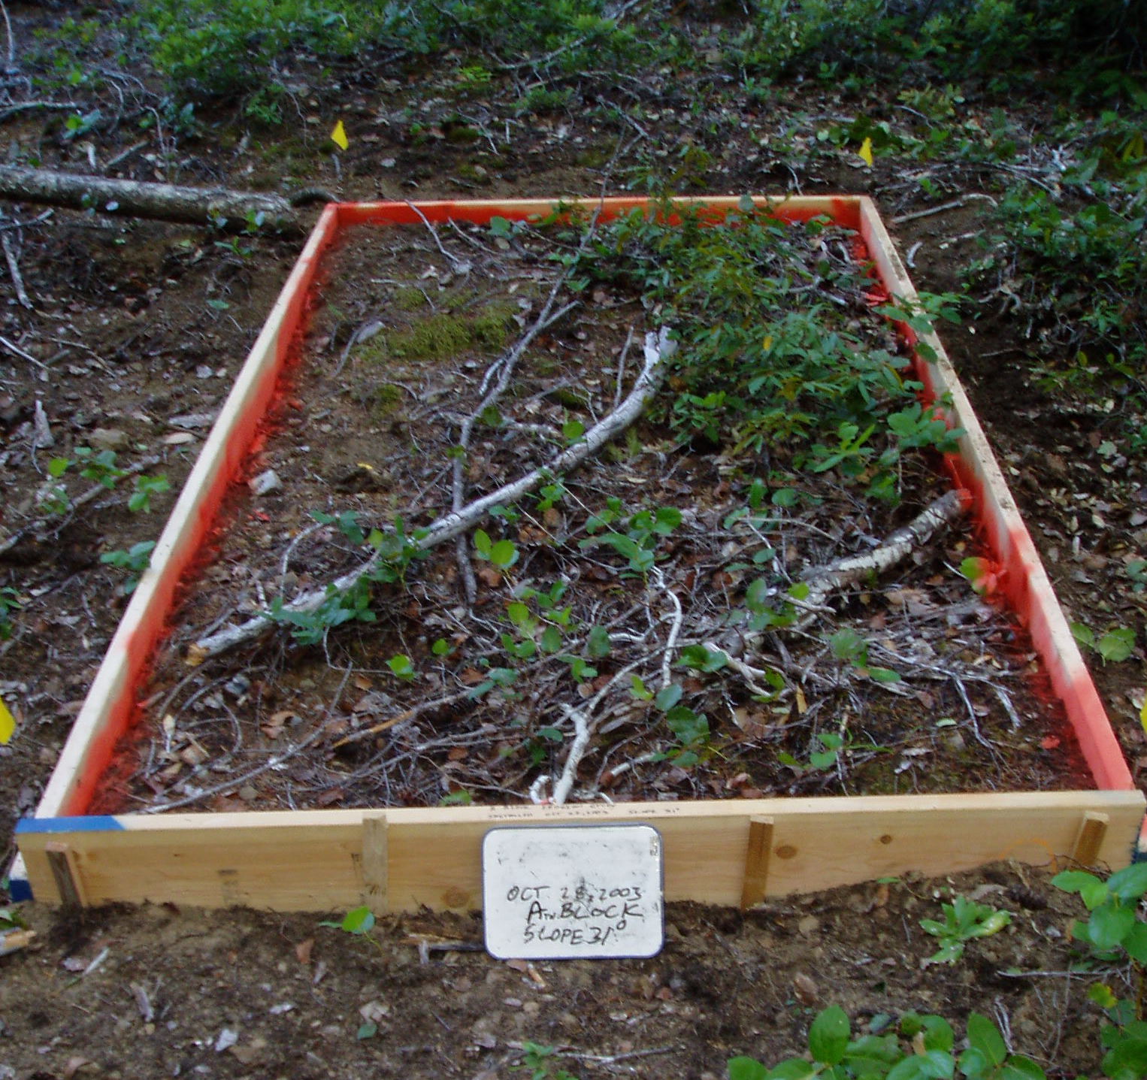
B4 photos
Microtopography plots
Erosion pins
Erosion boxes

Slide 28
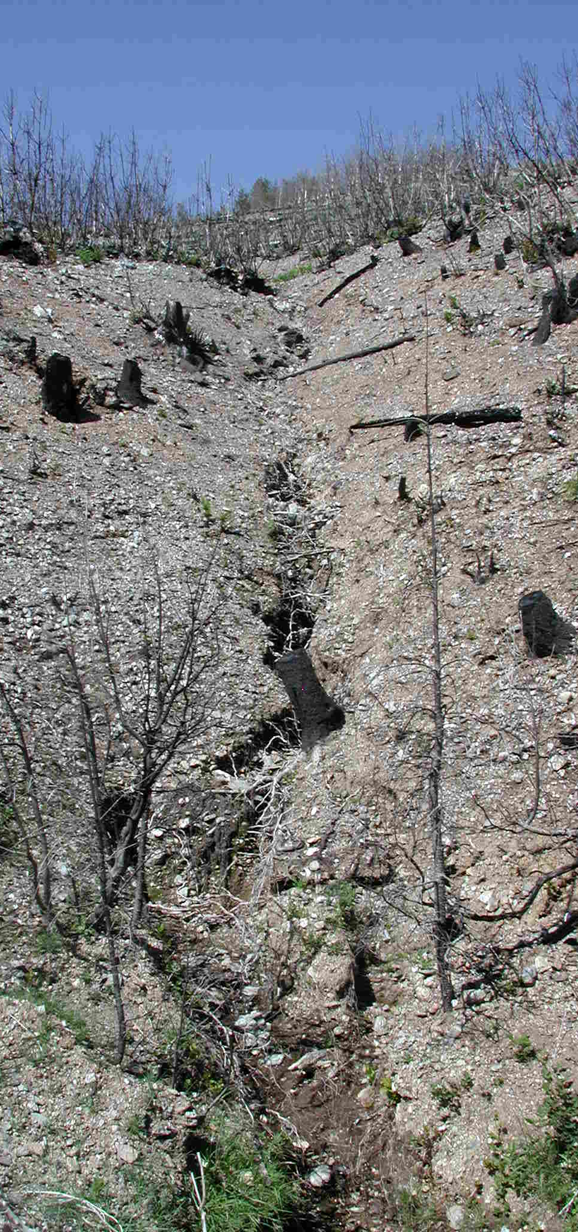
B10 evidence
Erosion measured as changes in erosion boxes in 2nd year after fire
Burned
Unburned
80
R²=0.3
40
Dumptruck loads per 15 acres
0
0
10
20
30
40
Slope (%)
Large water-driven soil movement was observed in erosion boxes on steeper, burned slopes.
Little accumulation downslope at stand scale (see photo, at left, of the stream at the base of a 30-acre hotly burned area just above a road).

Slide 29
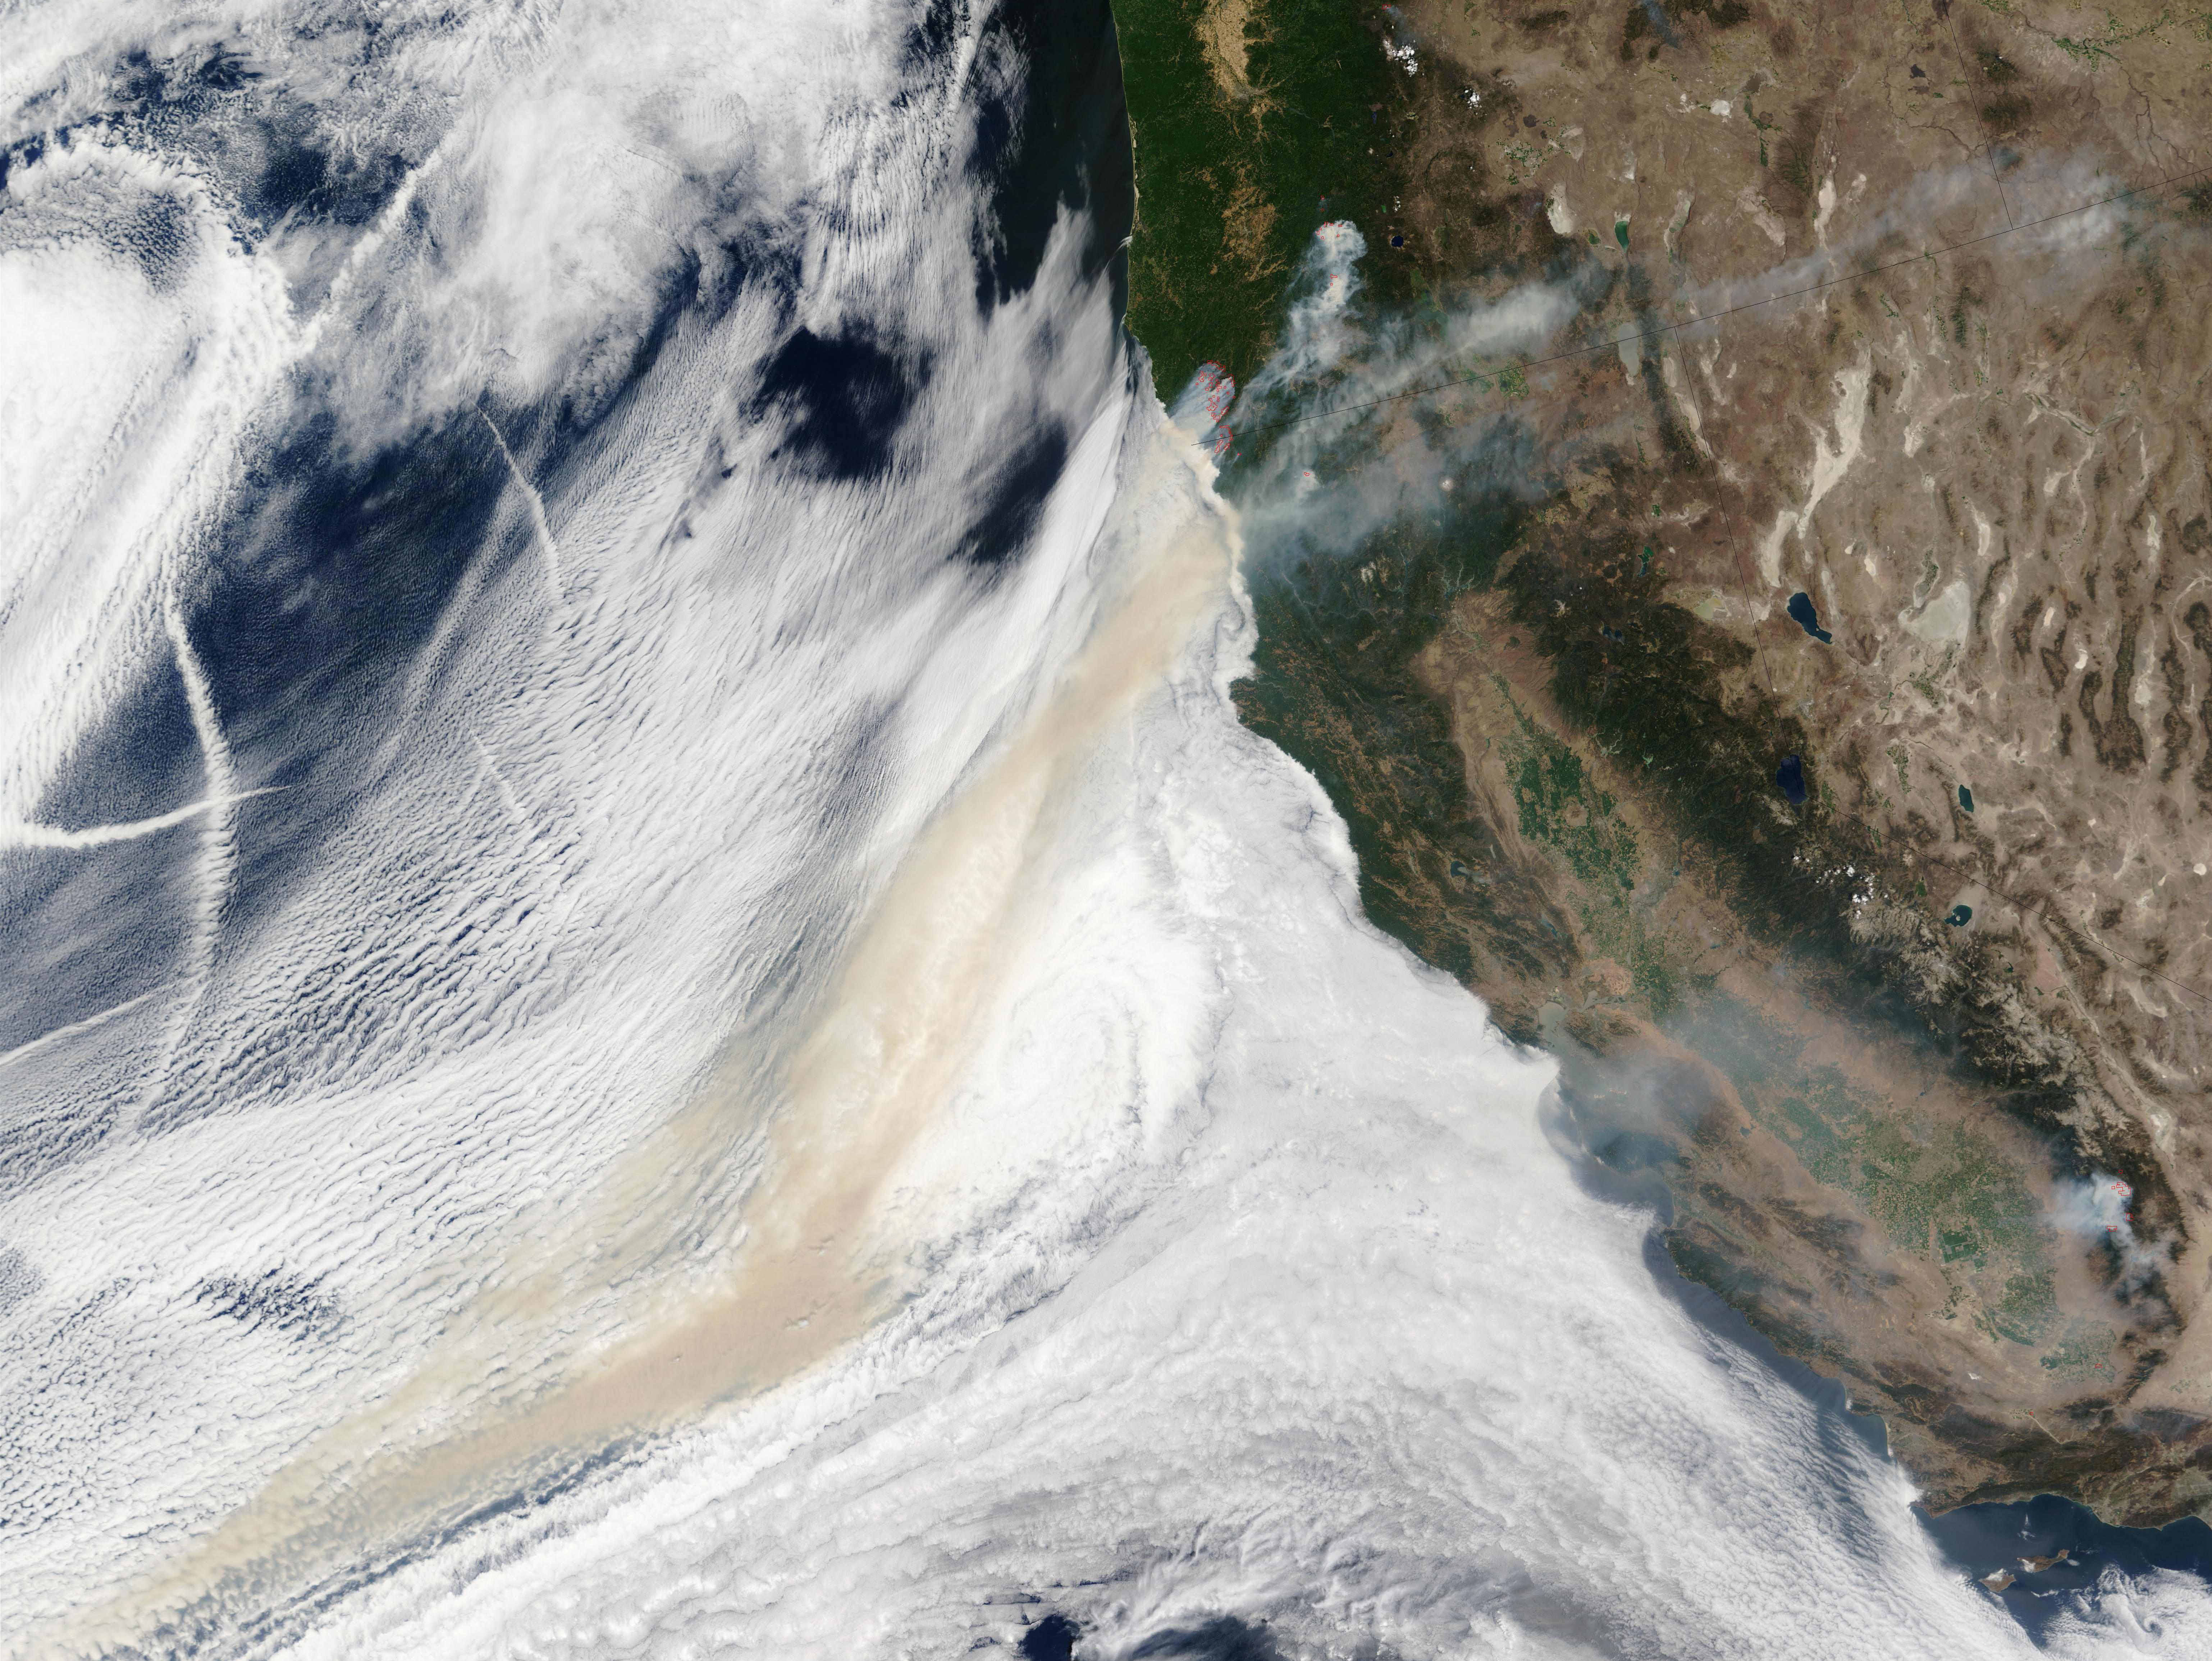
The Biscuit Fire
Oregon
Nevada
California

Slide 30
120
Ecosystem C budgets
Intact logs
Results:
Losses of soil C (23 Mg/ha) were about the same as losses from fine and coarse woody fuel C (22 Mg/ha)
Combustion was nearly complete for decayed logs, fine fuels, and the O horizon.
Intact (less decayed) woody debris C was 38% combusted while mineral soil C was 22% combusted.
100
Down 38%
Decayed logs
80
Down 100%
60
Fine fuels
Down 89%
Carbon (Mg/ha)
40
O-horizon
Down 100%
20
Which sources of combustion killed the trees is an unanswered question.
Slight evidence of more mortality in hi-wood treatments.
Mineral soil
Down 22%
0
Before
After

Slide 31
120
Ecosystem C budgets
Intact logs
100
Down 38%
300
Live trees
Down 100%
Decayed logs
Snags
80
Down 100%
200
60
Fine fuels
New snags become the biggest C pool.
Lots of implications that are poorly understood.
Down 89%
Carbon (Mg/ha)
Carbon (Mg/ha)
40
O-horizon
100
Down 100%
20
Mineral soil
Down 22%
0
0
Before
After
Before
After

