Slide 1

Early Seral Forest:
A Conservation Conundrum
Cheryl Ann Friesen
Science Liaison
USFS

Slide 2

For the last several decades, the big issue has been the protection and/or development of old growth forest
.
But many species rely on conditions provided in post-disturbance, younger forests.

Slide 3
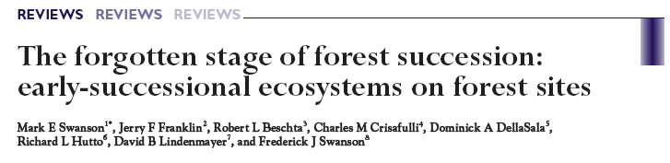
“Structurally and compositionally diverse early seral forest habitats are now the scarcest habitat in the region”
(Thomas et al. 2006 – Cons. Biol.)

Slide 4
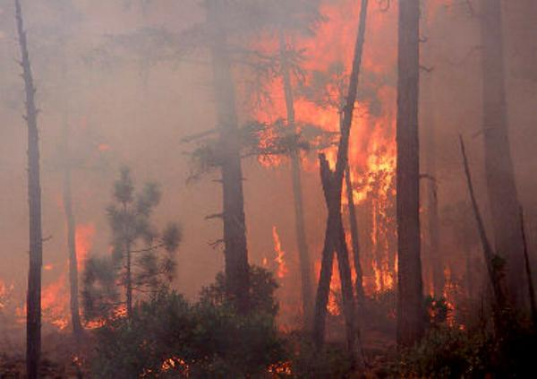
Early seral habitat comes from forests being:
Burned down

Slide 5
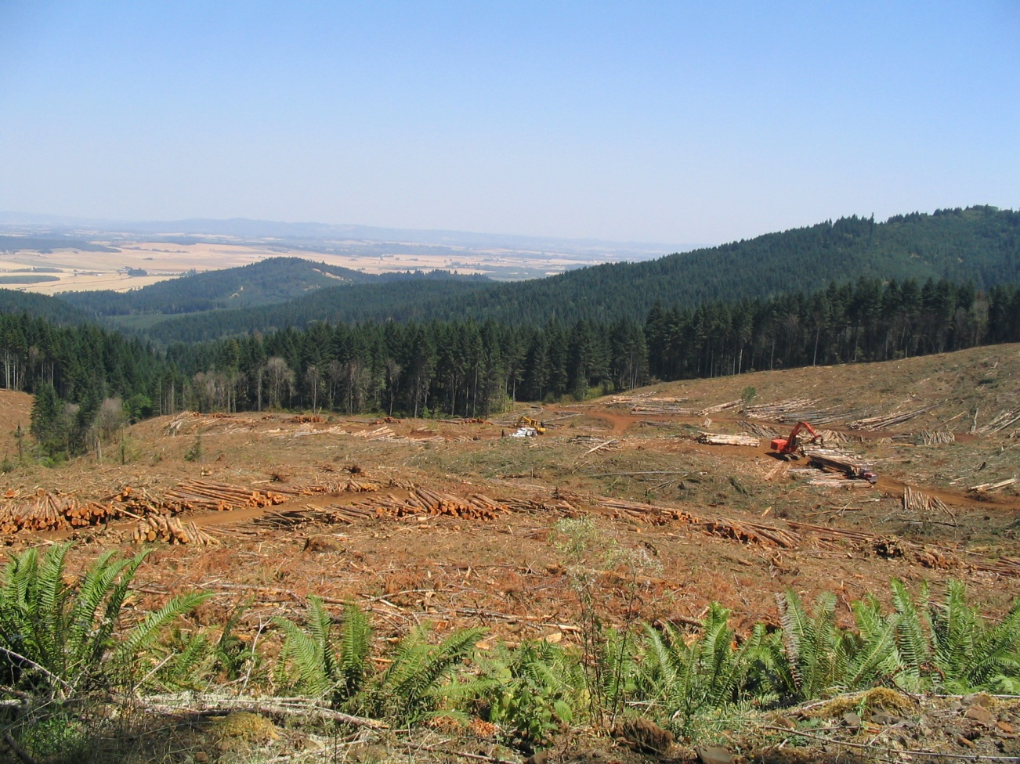
Early seral habitat comes from forests being:
Cut Down

Slide 6
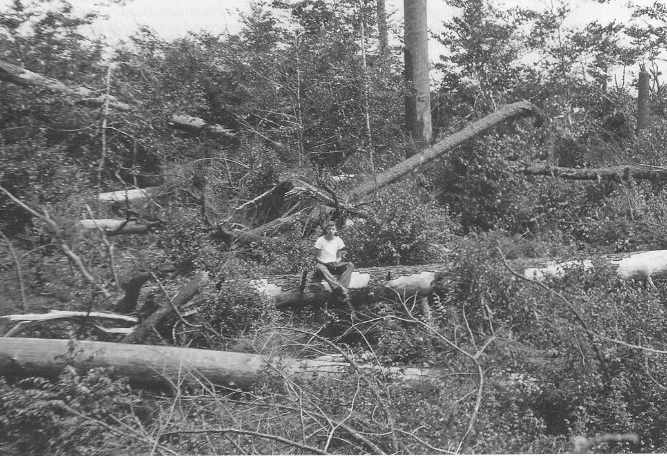
Early seral habitat comes from forests being:
Blown Down

Slide 7
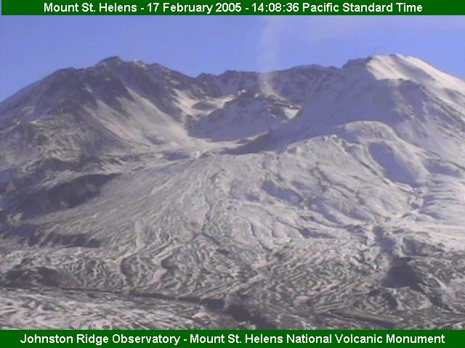
Early seral habitat comes from forests being:
Really “Blown” down

Slide 8
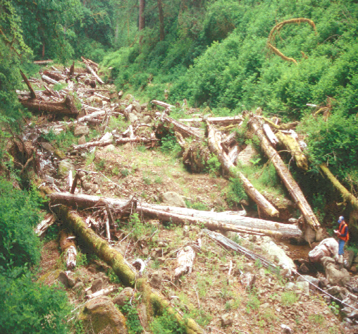
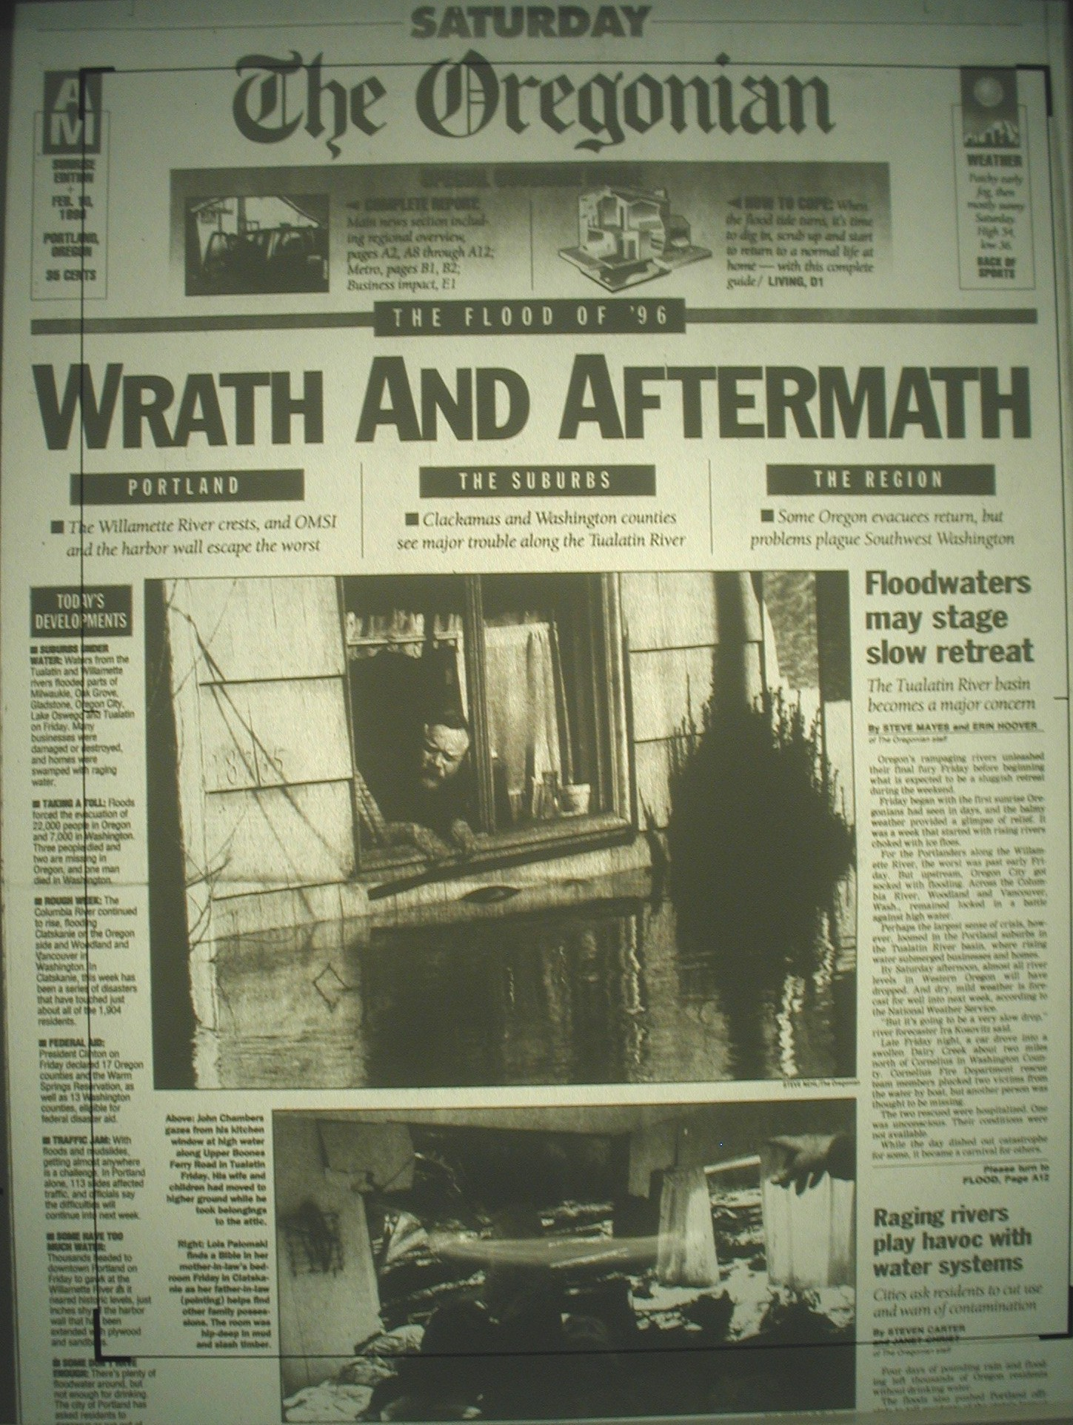
Early seral habitat comes from forests being:
Pushed Down by Floods

Slide 9
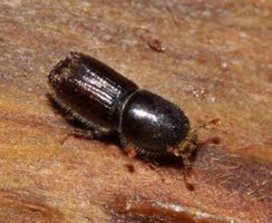
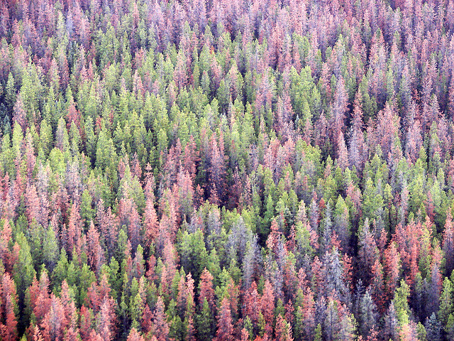
Early seral habitat comes from forests being:
Munched

Slide 10
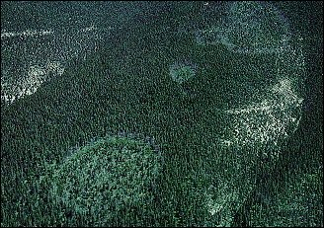
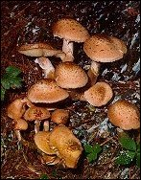
Early seral habitat comes from forests being:
Rotted
:

Slide 11
…a condition created from diseases, disaster, disturbance

Slide 12
Is there such a thing as a 'Good' Forest Opening?
How do you convince anyone to care about the value of a habitat created from “disturbance?”

Slide 13
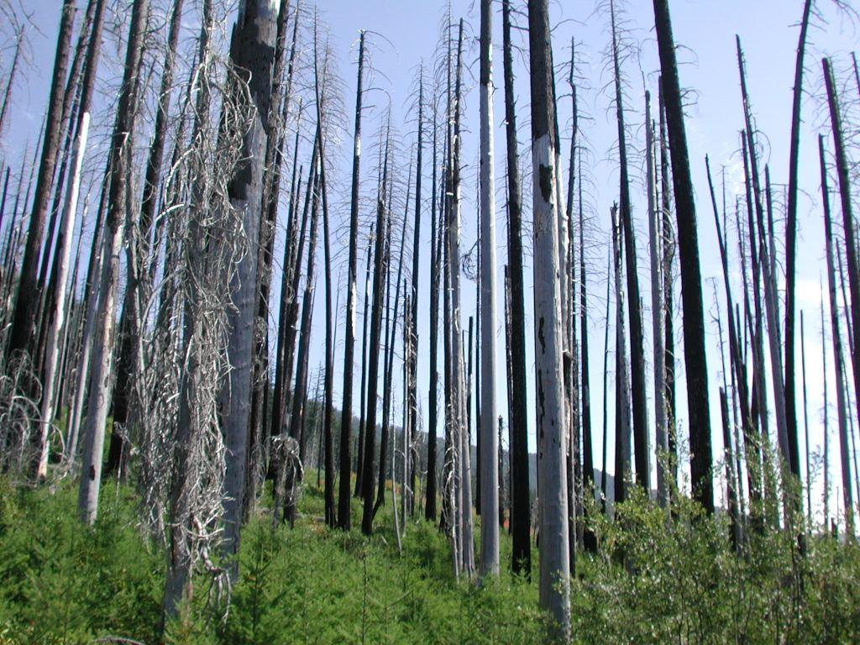

Slide 14
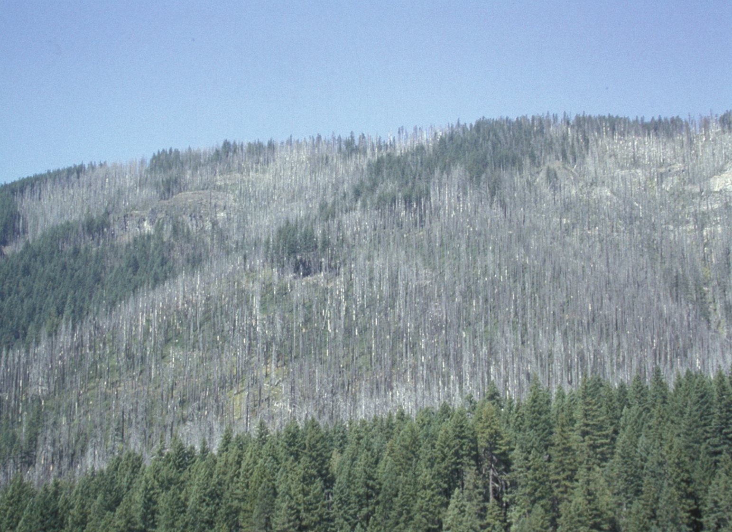

Slide 15
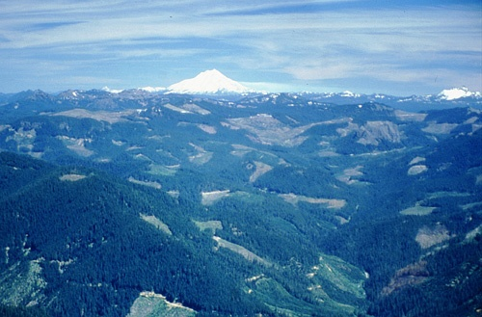
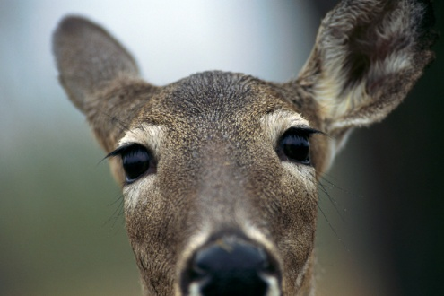


Slide 16
Uncover the Story…
…a work in progress…

Slide 17
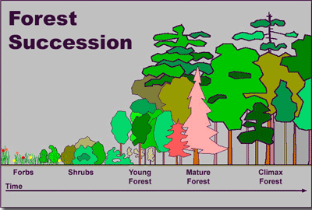
The world view of forestry…

Slide 18
A shift in focus…
Conventional wisdom: get through forb/shrub stage as quick as possible!

Slide 19
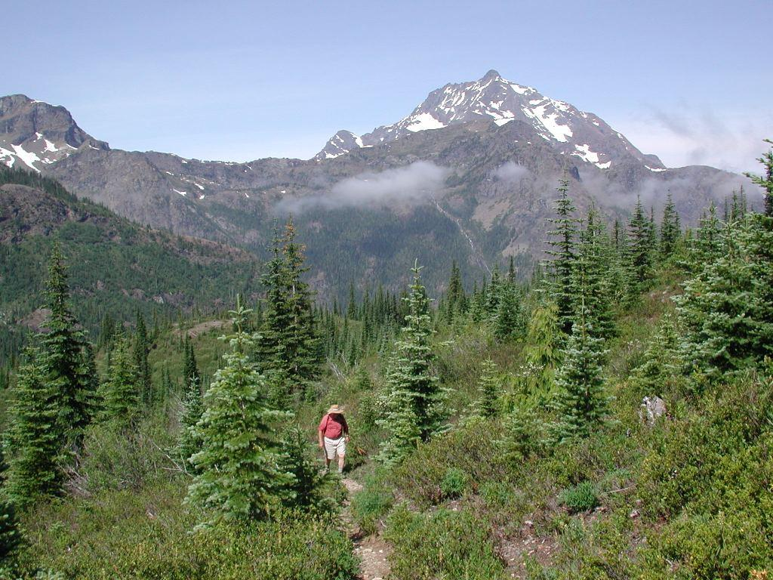
Early seral forest = truly a rich community!
What’s the rush?

Slide 20
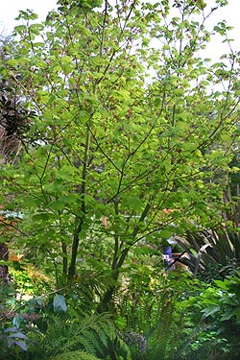
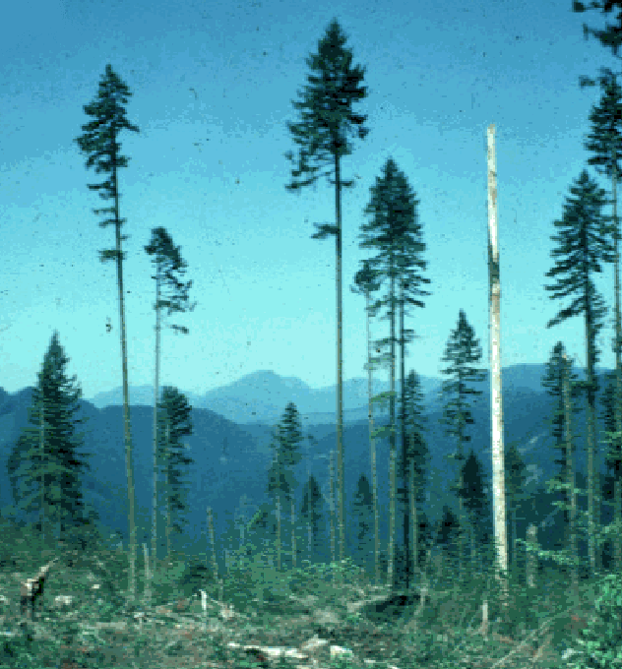

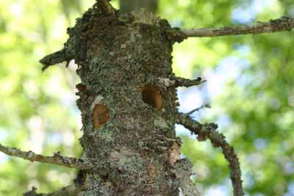
Not all early seral forest is the same
Snags
Large trees
Shrubs
Down logs
Tree Seedlings
Hardwoods
      CRANK UP THE VALUE!!

Slide 21
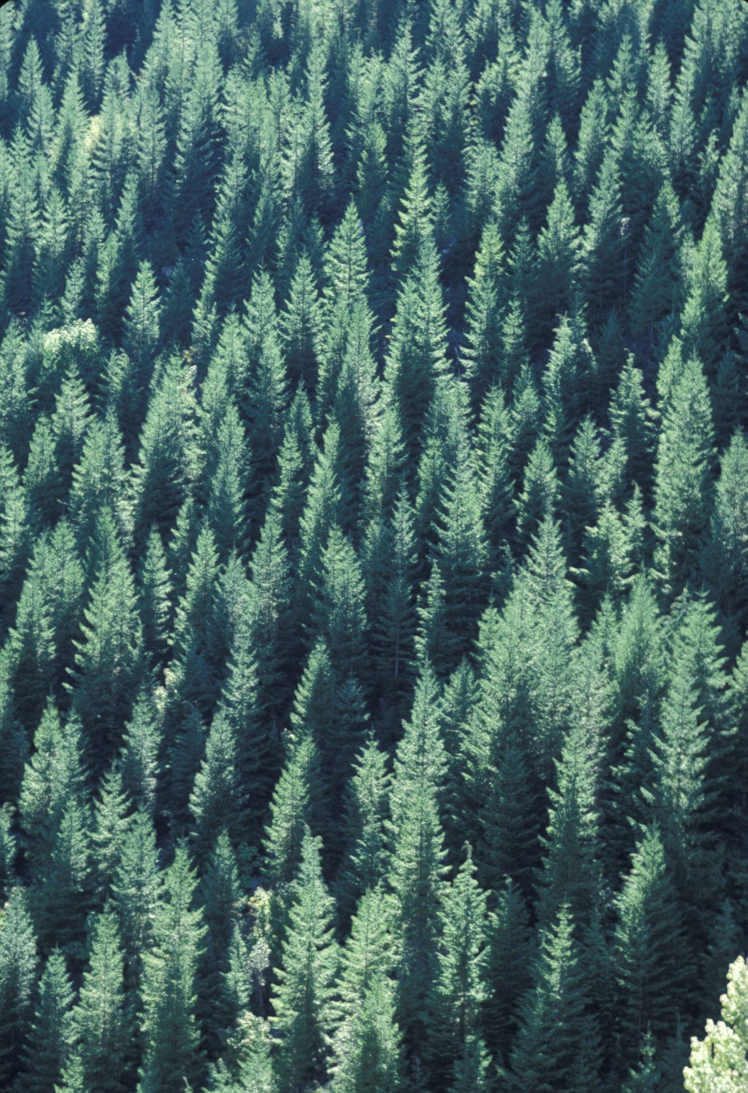
It’s a habitat of gradients with increasing value as you add components.
Conifer dominated? LOW Quality

Slide 22
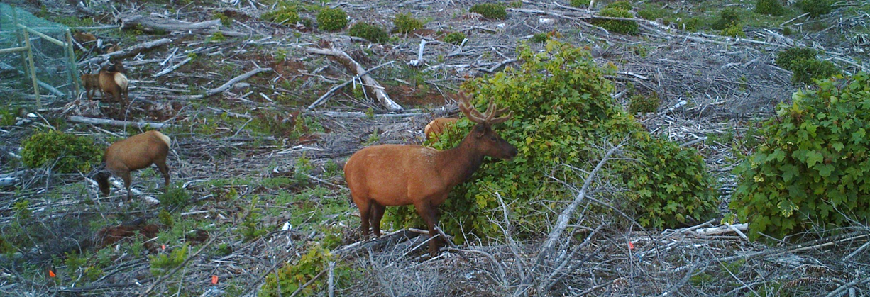
Shrubs and forbs only,
no structure:
Deer and elk okay

Slide 23
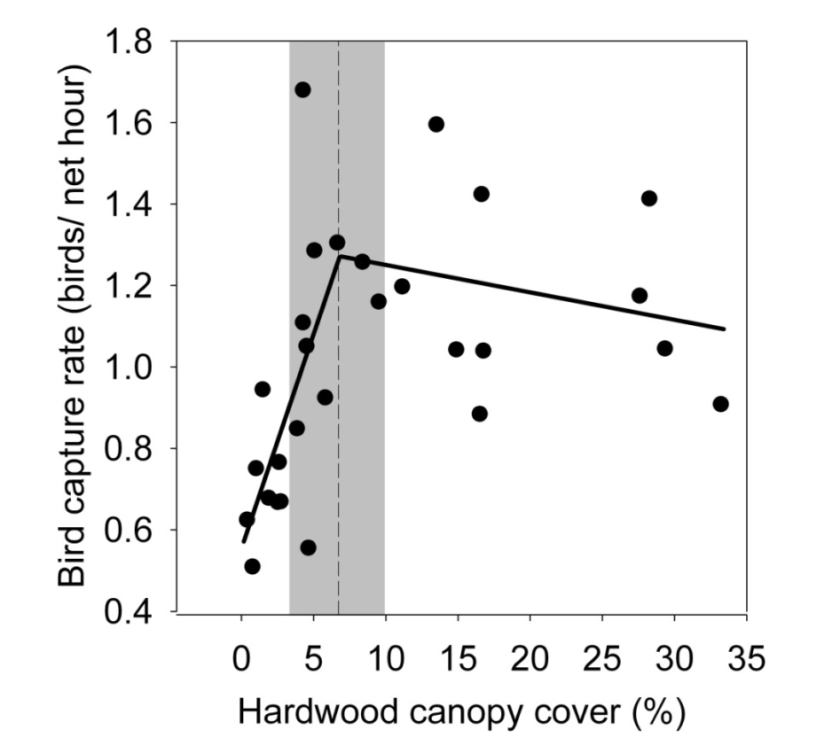
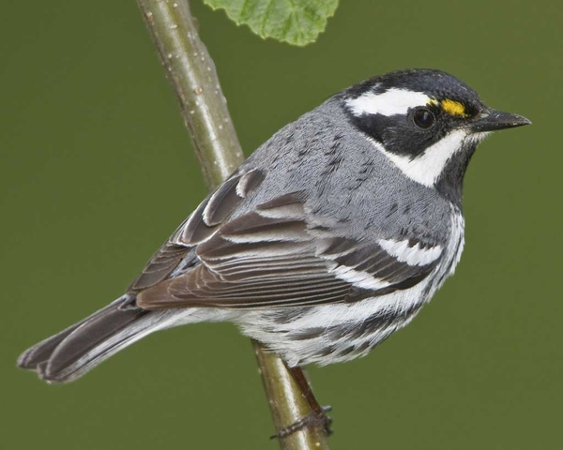
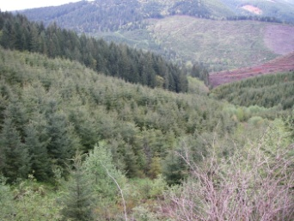
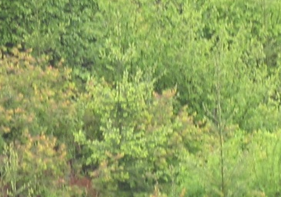
Foliage gleaners okay
Hardwood threshold at 6.7 % (SE=1.6)
Ellis & Betts 2011 For. Ecol. & Management

Slide 24
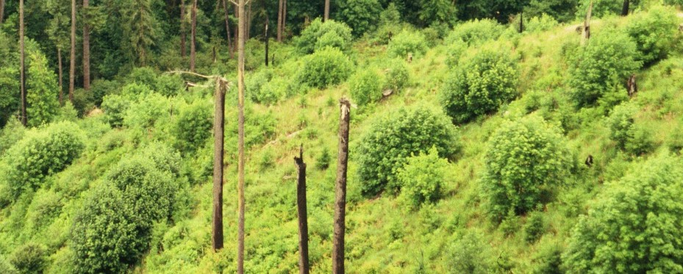
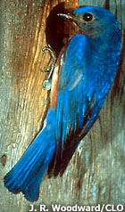
Add Snags…+++

Slide 25
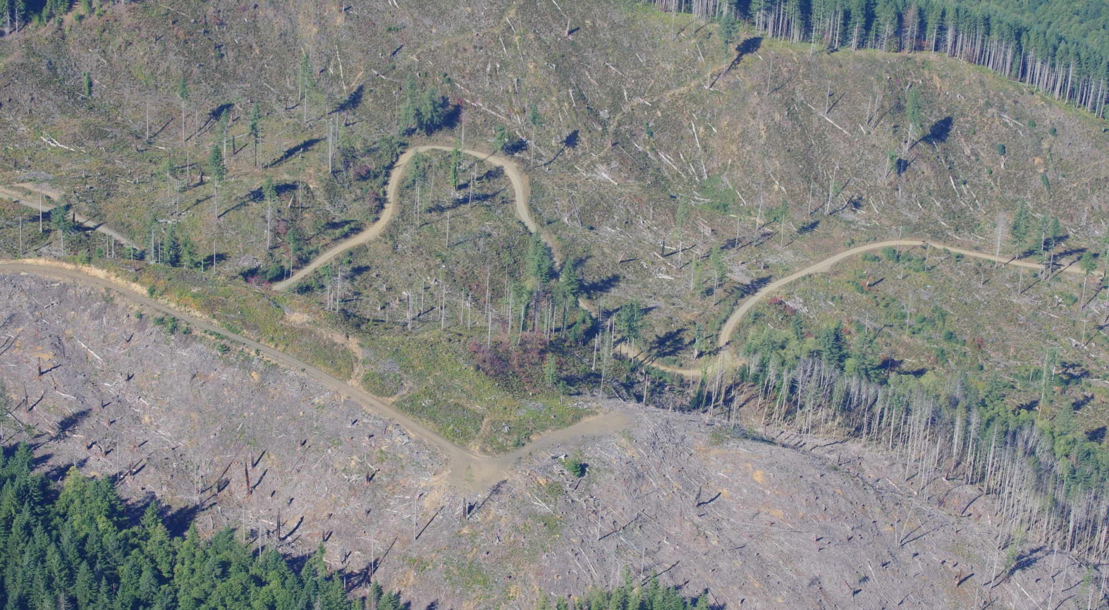
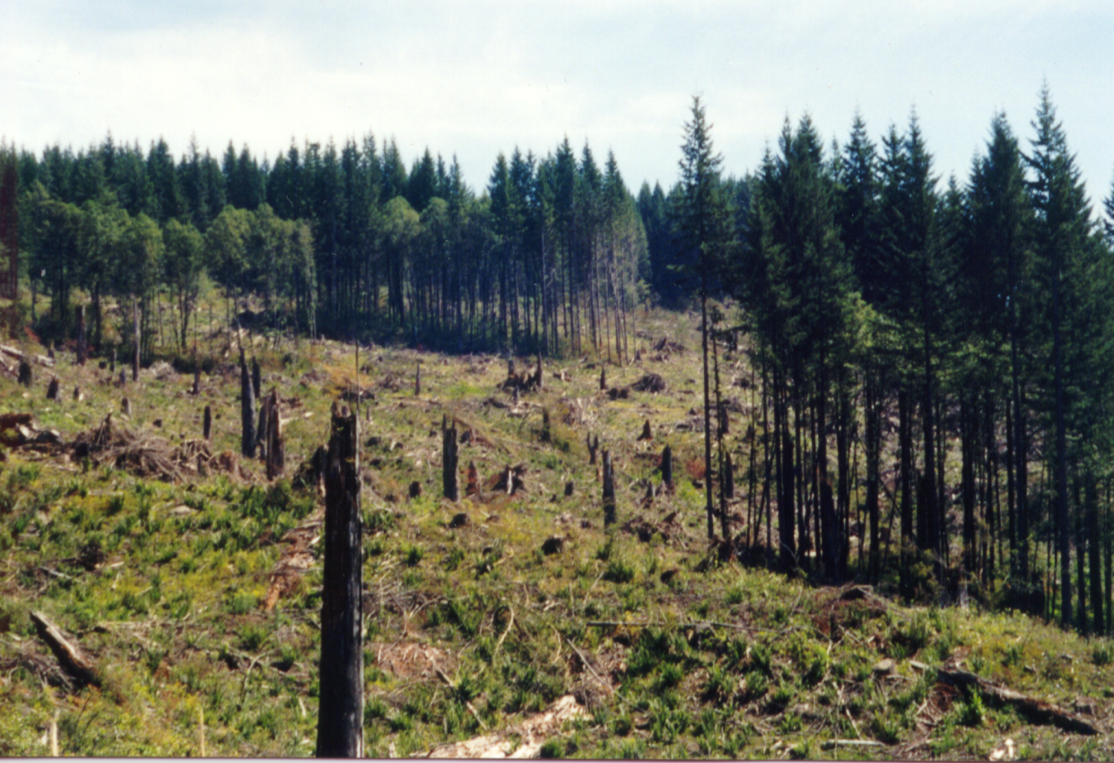
Is it here?

Slide 26
At 40% canopy closure, early seral understory species obviously suppressed.
Halpern et. al. 2013

Slide 27
This habitat is more popular than you might have thought….
WNF Vertebrates:
  14 species tied specifically to old growth
  0 species tied specifically to mid seral
  116 species generalists….use all stages
  71 species tied specifically to early seral forests
  and edges

Slide 28
All of the early seral or generalist species require one or more of the structural components listed previously…
  For example,
    85% need dead wood at some life stage

Slide 29
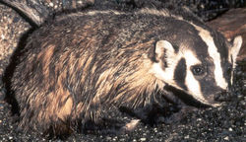


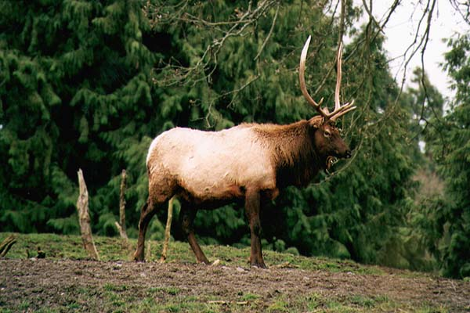
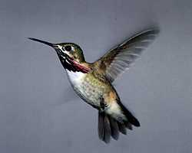
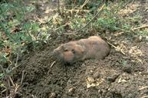
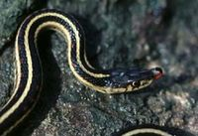
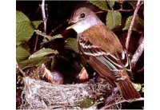
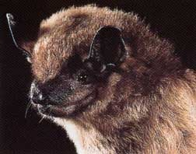

Slide 30
Why Are They There?

Slide 31

Sunshine = nuts nectar fruits bugs leafy plants warmth

Slide 32
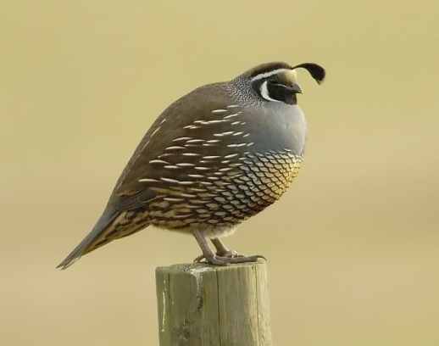
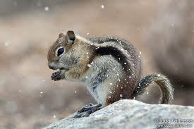
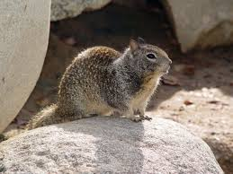
Nuts/Grass Seeds
CA Quail
Golden mantled ground squirrel
CA Ground Squirrel

Slide 33
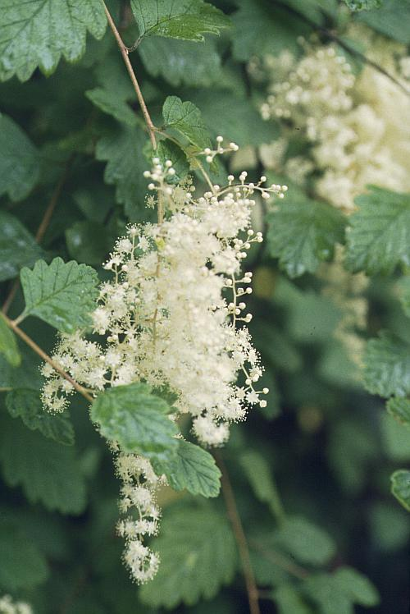
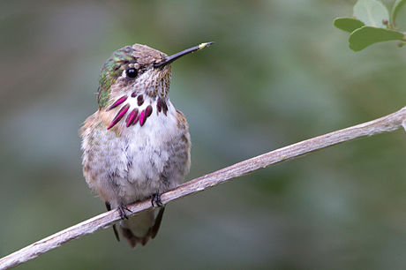
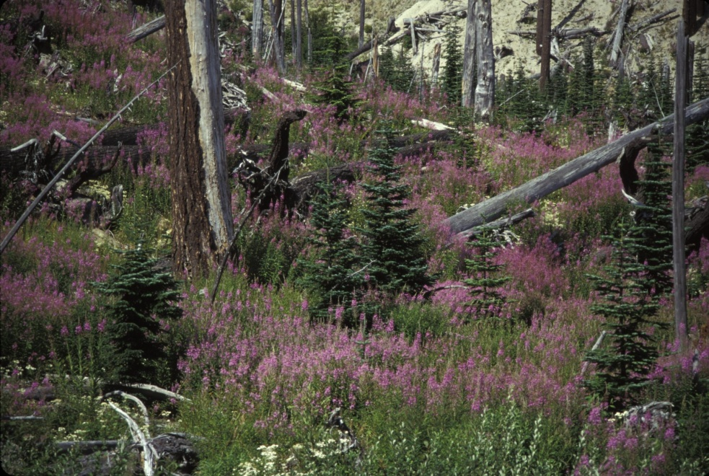
Nectar/flowering plants
Calliope Hummingbird
Rufous Hummingbird

Slide 34
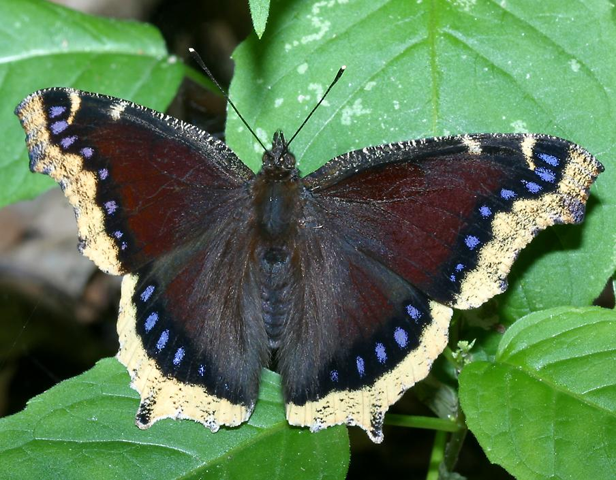
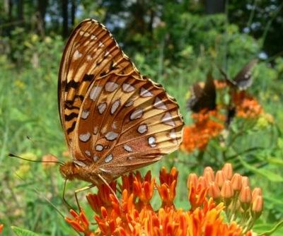

Butterflies

Slide 35
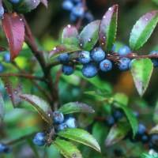
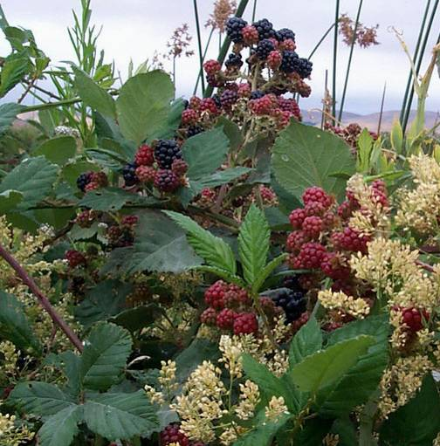
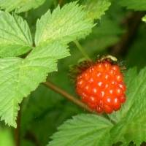
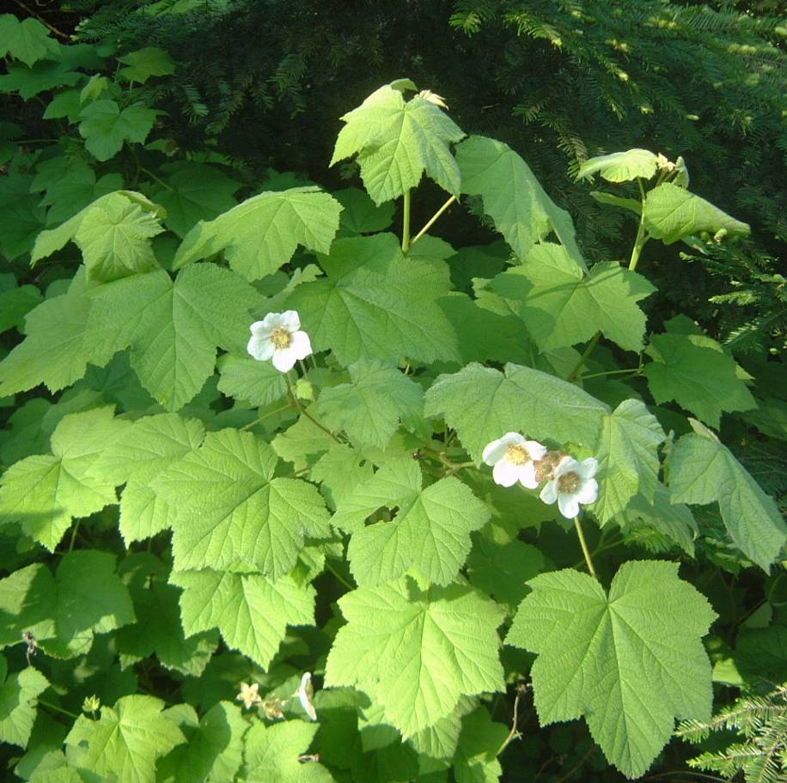
Fruits

Slide 36
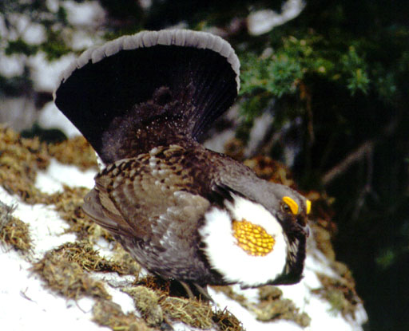


Black-headed grosbeak
Blue (sooty) Grouse
Black Bear

Slide 37

Invertebrates
Increase plant diversity = increased insect diversity
Leafy species support more insects
About 50% of arthropods at HJA are restricted to the open canopy conditions of early seal forest.

Slide 38







  Wolf-spiders
  Herbivorous caterpillars dominate!
  Jumping spiders
ants

Slide 39


Bumble Bees
Flying Midges
    Thermoregulation – easier to locomote in open-canopy environment
    Visibility – easier to find mate in open-canopy environment
    Food -- easier to find

Slide 40


Leafy Plants – Foliage Gleeners
Yellow-breasted chat
MacGillvray’s Warbler
Black-throated Gray Warbler

Slide 41



Orange crowned warbler
Shrubs + Structure
Olive-sided flycatcher
Pallid bat

Slide 42


Lots of insectivorous predators on the ground…
Townsend’s mole
Vagrant Shrew

Slide 43
Leafy Plants For Herbivores
  Herbivores prefer sunny conditions
    More broadleafed plants
    More photosynthesis
    More young leaves
    Higher calories
    Lower % poisonous secondary compound

Slide 44



Roosevelt elk
Pocket gopher
Heather vole
Mountain beaver

Slide 45



Residual
trees
and snags
Three- toed
Black-backed
Mtn. Bluebird

Slide 46







Dead Wood/
Brush piles
Deer mouse
Bewick’s
Wren

Slide 47


Basking and eating…
D. Vesely

Slide 48

So What’s the problem?
“clearcut harvest” essentially halted on W. OR forests in last 20 years.
8 fires per year suppressed in last 40 years in S. Fork McKenzie Watershed

Slide 49


CLAMS Projected 100-Year Change Under Current Policies
1996 2096
1996
(GNN)
2096 projected
(base policy)

Slide 50

Is this just a PNW Issue?
nope
Golden-winged warbler

Slide 51


Golden-winged
warbler
USGS

Slide 52


Endangered brush rabbit

Slide 53

Approximate return
interval of damaging
(F2) hurricanes in
New England.
>380 yr
380 yr
150 yr
85 yr
Boose et al. (2001)

Slide 54

Need to highlight the consequences as part of the story…
MacGillivray’s Warbler

Slide 55



BBS Population trends for Oregon
Orange-crowned warbler
Rufous hummingbird

Slide 56
Black-throated Gray Warbler

Slide 57

Dark-eyed Junco

Slide 58

American Goldfinch
All in decline in PNW

Slide 59


Slide 60

Who will be added to the endangered species list next?

Slide 61
Food For Thought
It is more complicated than we thought.
Can it be “man made?”
Can we “allow it” naturally?
Is there a proxy?
How much
How big
Where
When
How

Slide 62

Early Seral through Ecological Forestry Techniques?

Slide 63

Historical Range of Variability
Oregon Coast Range
% of Landscape
Early Seral:
10-25%
Old Growth:
35-60%
Probability
% of Landscape

Slide 64
Significant fires on the McKenzie River RD
8 fires per year suppressed in last 40 years in S. Fork McKenzie Watershed

Slide 65

Why Here, Why Now?
More fire prone areas to potentially treat to reduce fuels to reduce risk of habitat loss current Spotted Owl habitat from future wildfires

Slide 66
Perhaps early seral forest has a “face” that only mother nature could love…

Slide 67
Intelligent tinkering saves all the pieces…

Slide 68

QUESTIONS?

