Slide 1

Visual Silvicultural Prescription Library
Version 1.0 2015
Additional information for each stand can be found in the companion document: Prescription Library Supplemental.doc
Contact Cheryl Friesen for updates to this library (cfriesen@fs.fed.us) or visit the CCAMP Website at
http://ecoshare.info/projects/central-cascade-adaptive-management-partnership/

Slide 2
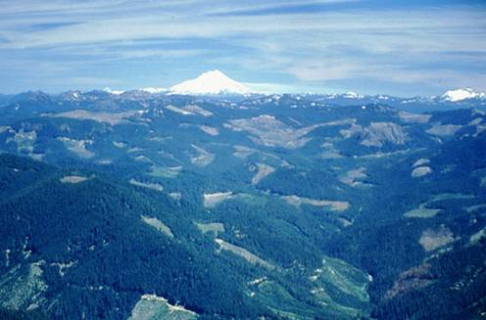
These are existing silviculture prescriptions implemented on the Willamette National Forest, Oregon. Planar imagery was taken from Google Earth, 2013 data. Photo points/street views were obtained in the field using a digital camera.
Each planar view is followed by 1-2 oblique views.
All information herein is available for public use
without additional permissions.

Slide 3
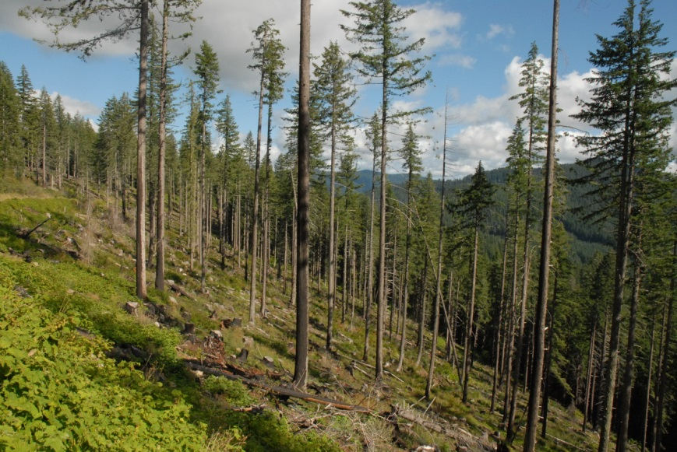
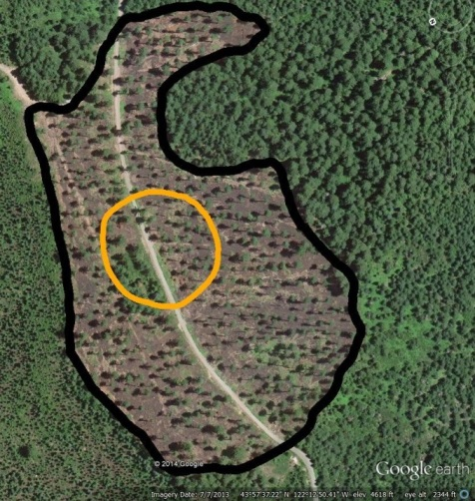

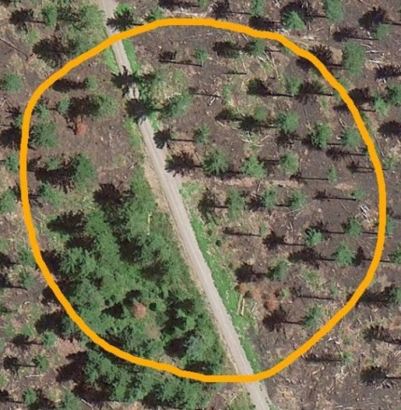
-- Key to Slides --
N
Planar/Street View of Stand
Planar (aerial) Google Earth view of stand. Gold circle reproduced (below) to show close-up view of stand. White dotted arrow references location of close up. True -North : solid white arrow.
Gold arrow shows location of on-ground photo point, w/ direction photo taken
Notes:
See Stand #8000094 in Word Document for Information about Stand.

Slide 4
SHELTERWOOD

Slide 5


Shelterwood
Harvested: 2004
Harvest Age: 100 - 400 Years
Acres: 48 TPA: 20
Stand# 8000094
N
N
Notes:
See Stand #8000094 in Word Document for Information about Stand.

Slide 6


PHOTO POINTS - Shelterwood Stand# 8000094
Photo: Gary Rost, USFS, 2014
Notes:
Photo Point Location: 43 57’ 38.1” N 122 12’ 58.2” W Direction of Photo: 110 degrees

Slide 7
Variable Density Thinning

Slide 8
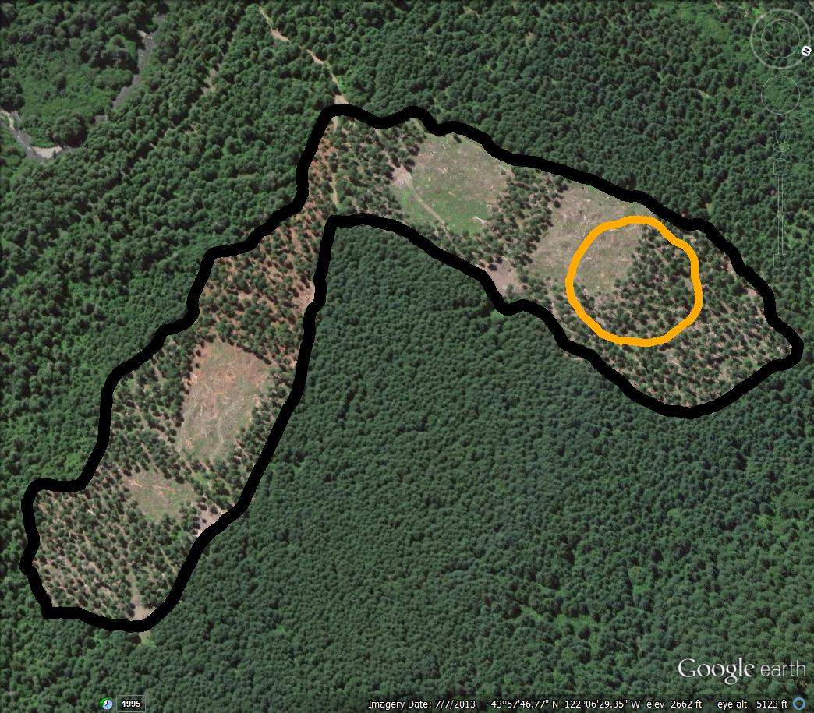
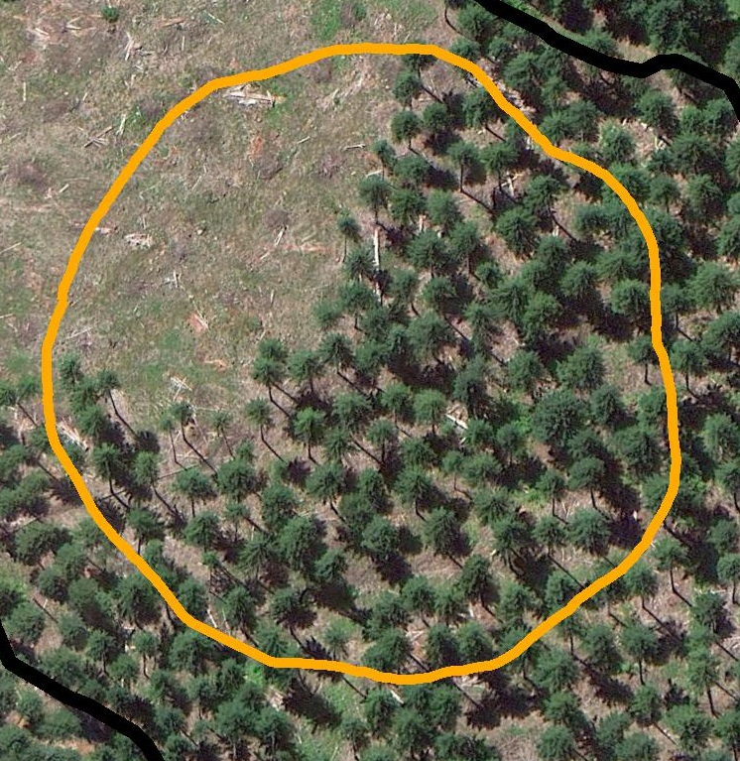
Variable Density Thinning
Harvested: 2013
Harvest Age: 59 Acres: 39 TPA: 57
C. Closure: 66 %
Stand# 1002889
N
The 4 square “gaps” total 8 acres
Notes:
See Stand #1002889 in Word Document for Information about Stand.

Slide 9
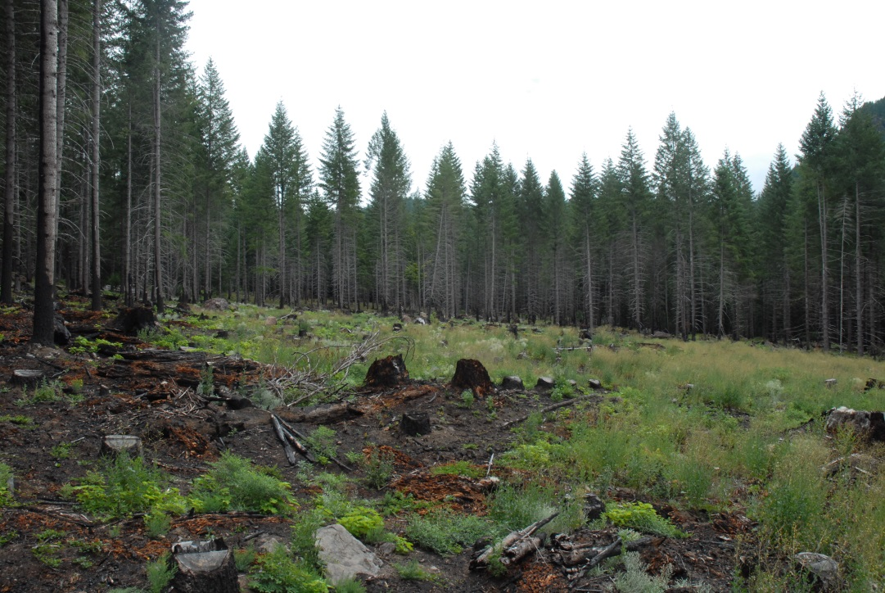
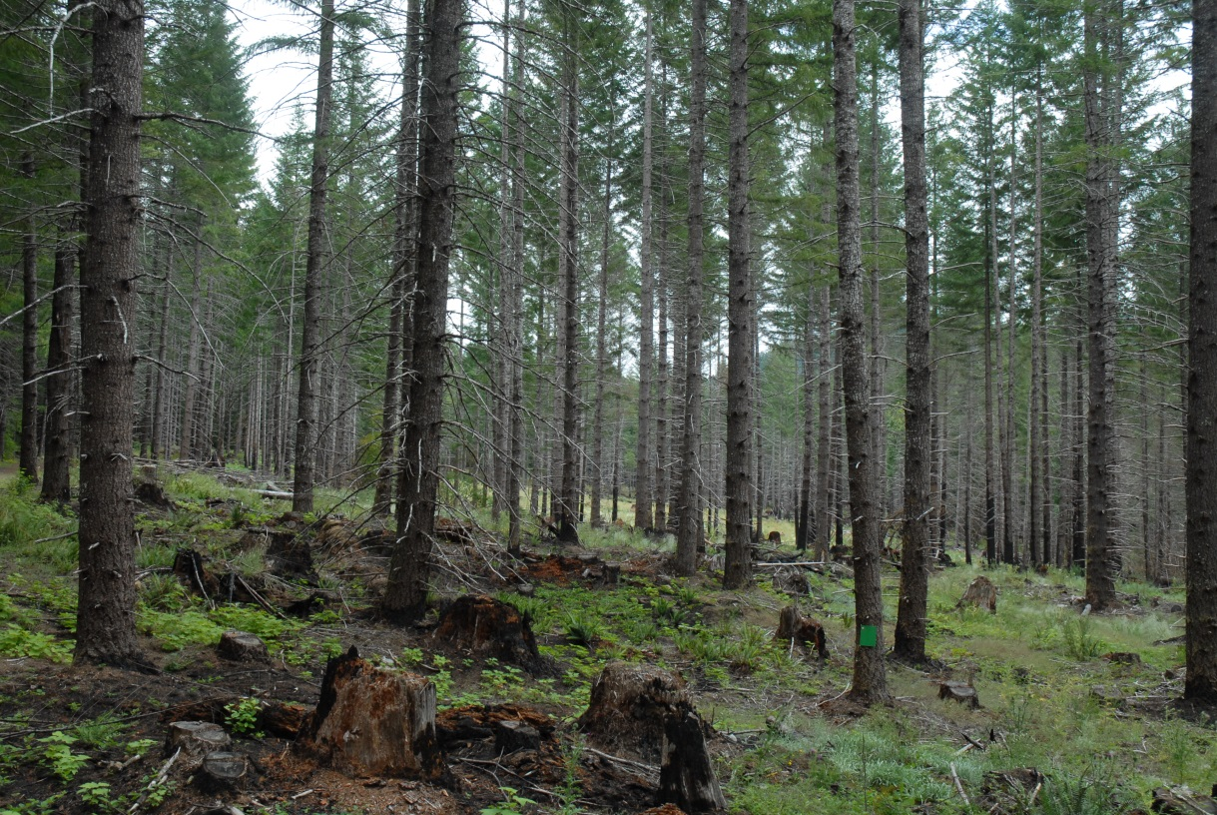
PHOTO POINTS – Variable Density Thinning Stand# 1002889
A
B
A
B
N
PP2
B
Large opening
w/stand trees to sides and in background
Photos: Gary Rost, USFS, 2014
Note: Light vegetation area in background-center of photo A. is opening shown in Photo B.
A
Notes:
Photo Point A Location: 43° 57’ 42.1” N 122° 06’ 33.1” W Direction of Photo: 110 degrees Green card on tree is 8.5 x 11 inches.
Photo Point B Location: 43° 57’ 42.5” N 122° 06’ 25.4” W Direction of Photo: 150 degrees

Slide 10
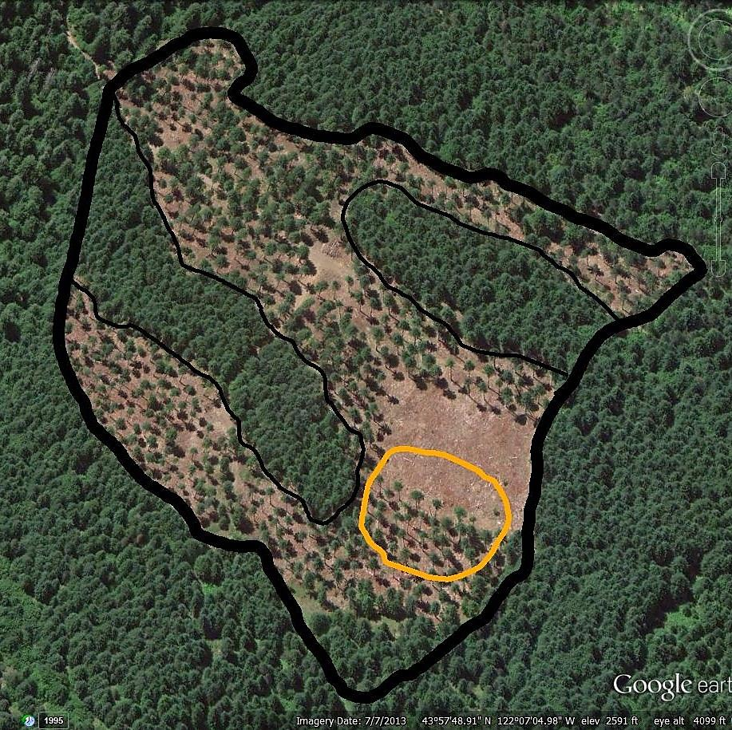
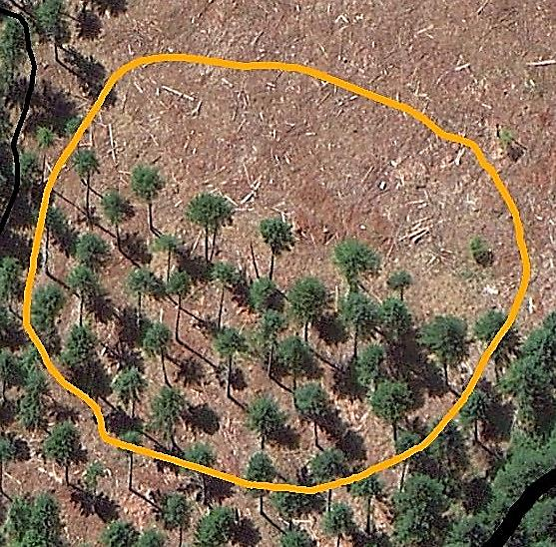
Variable Density Thinning
Harvested: 2013
Harvest Age: 56
Acres: 30 TPA: 44
C. Closure: 66 %
Stand# 1002894
N
N
2 riparian reserves
2 acres of gaps
Notes:
See Stand #1002894 in Word Document for Information about Stand.

Slide 11
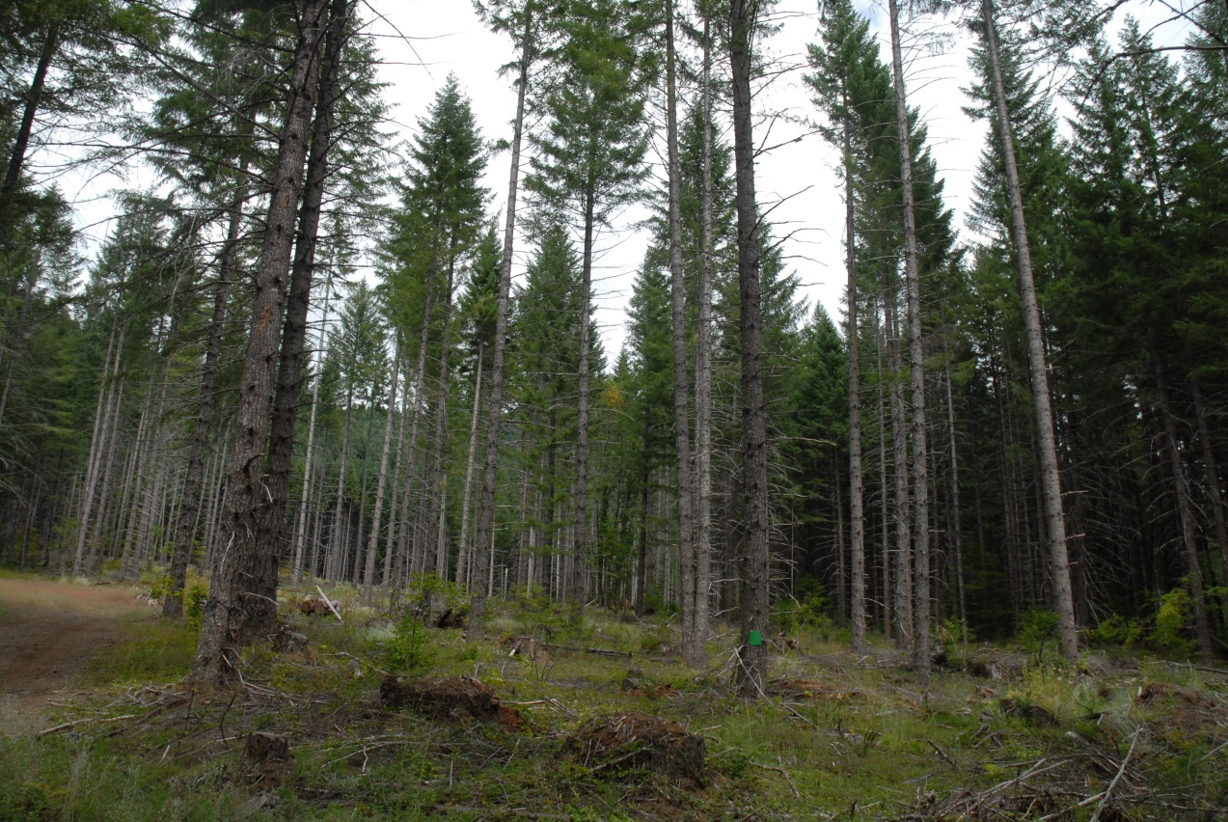

PHOTO POINTS – Variable Density Thinning
Stand# 1002894
Photo: Gary Rost, USFS, 2014
Notes:
Photo Point Location: 43° 57’ 45.6” N 122° 07’ 08.0” W Direction of Photo: 20 degrees. Green card on tree is 8.5 x 11 inches.

Slide 12
Commercial Thin

Slide 13
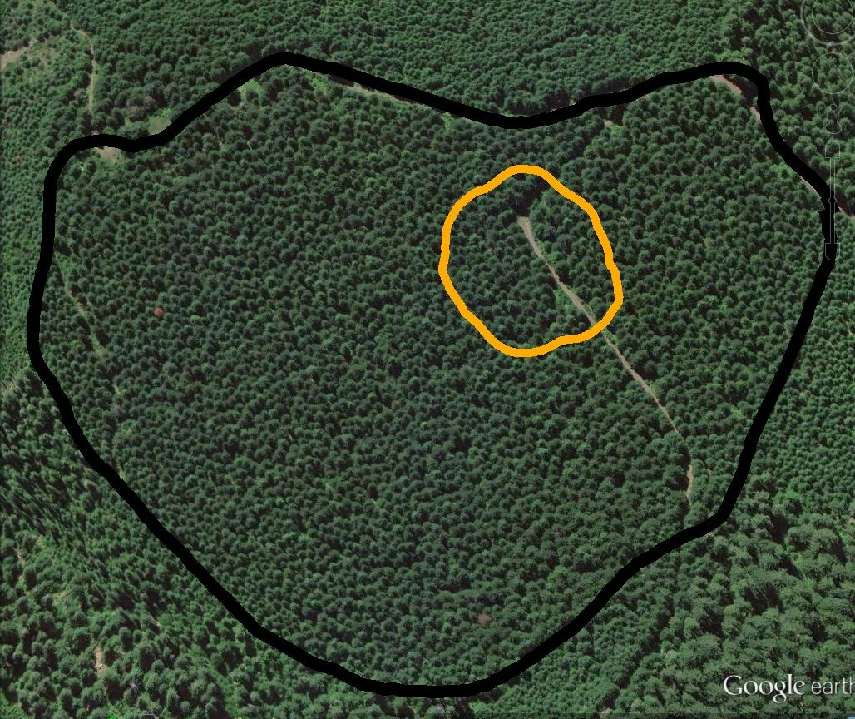
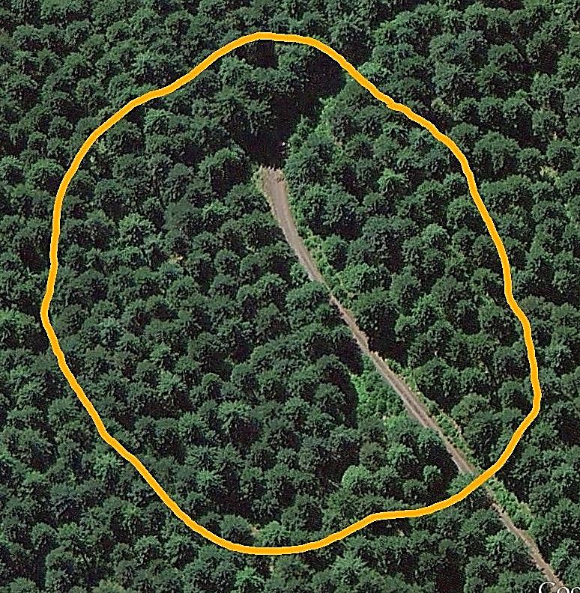
Commercial Thin
Harvested: 1990
Harvest Age: 39 Acres: 63 TPA: 74
Stand# 8002582
N
Notes:
See Stand #8002582 in Word Document for Information about Stand.

Slide 14
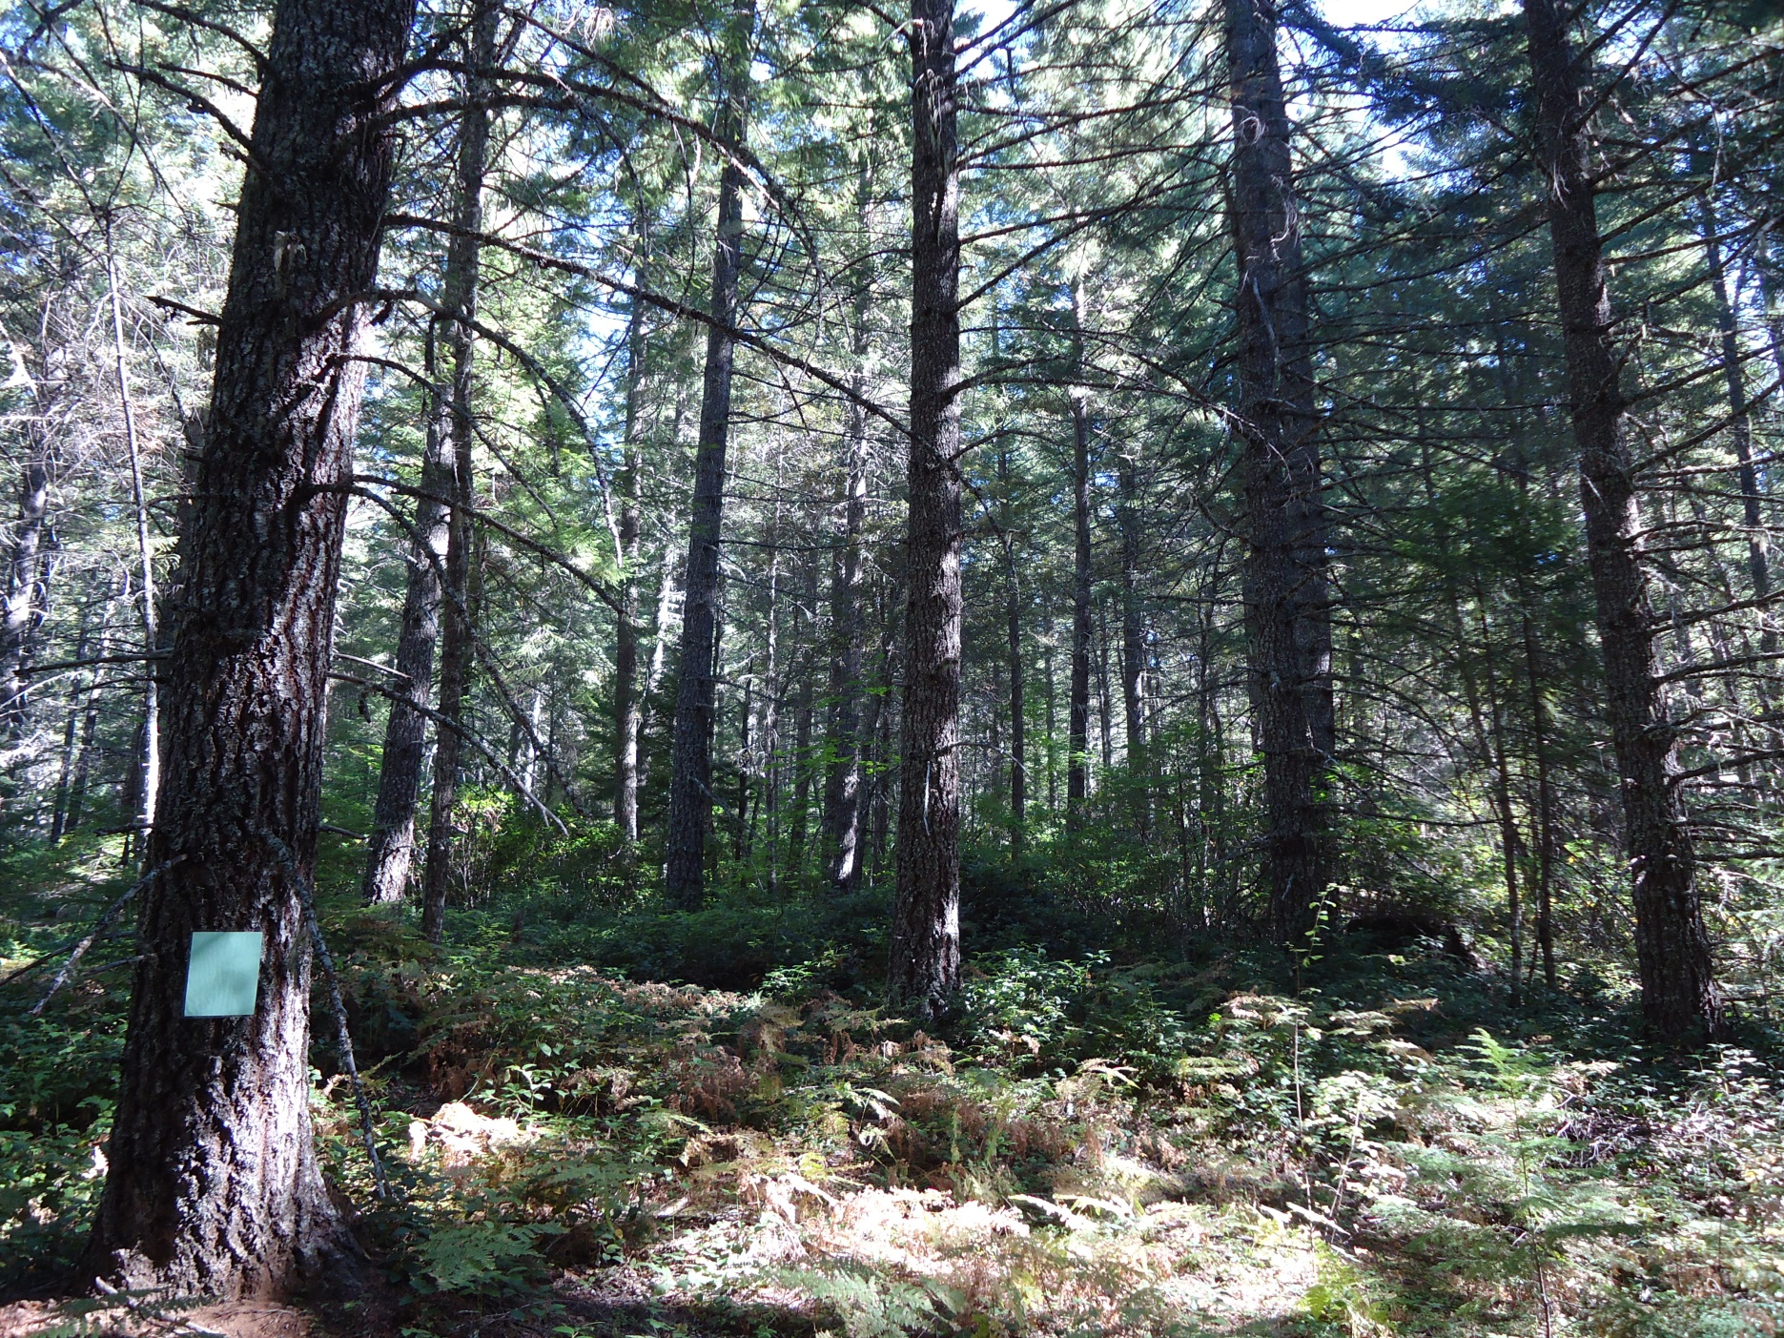

PHOTO POINTS – Commercial Thin Stand# 8002582
Photo: Tim Fox, USFS, 2014
Notes:
No GPS information available for Photo Point location. Green card on tree is 8.5 x 11 inches.

Slide 15
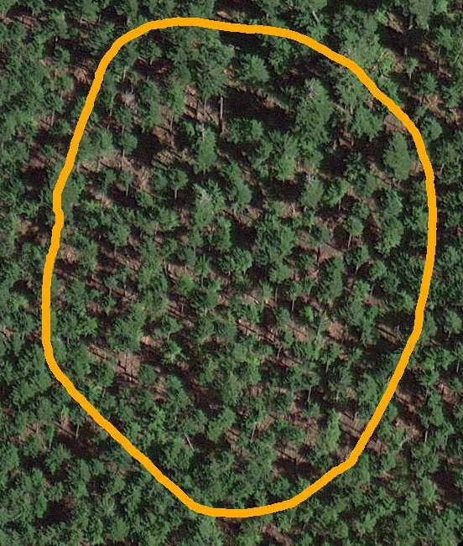
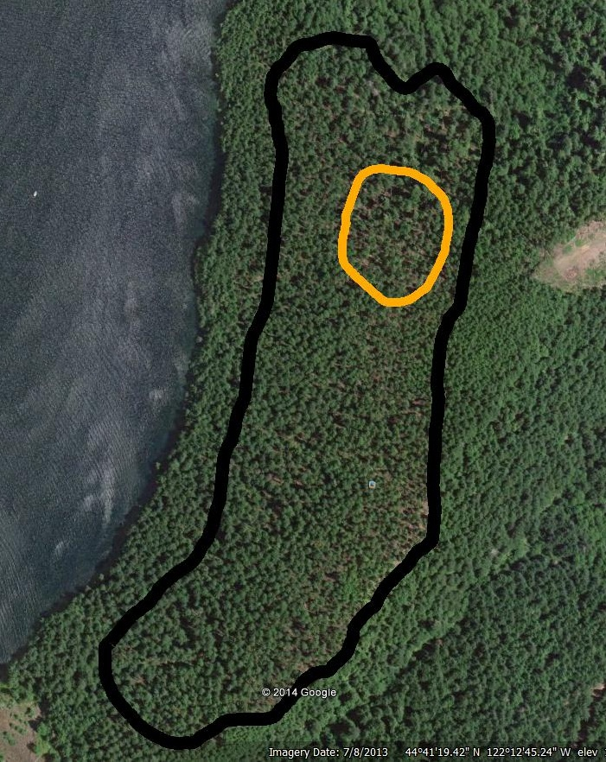
Commercial Thin
Harvested: 2005
Harvest Age: 80
Acres: 40 TPA: 85
Stand# 4026462
N
N
Notes:
See Stand #4026462 in Word Document for Information about Stand.

Slide 16
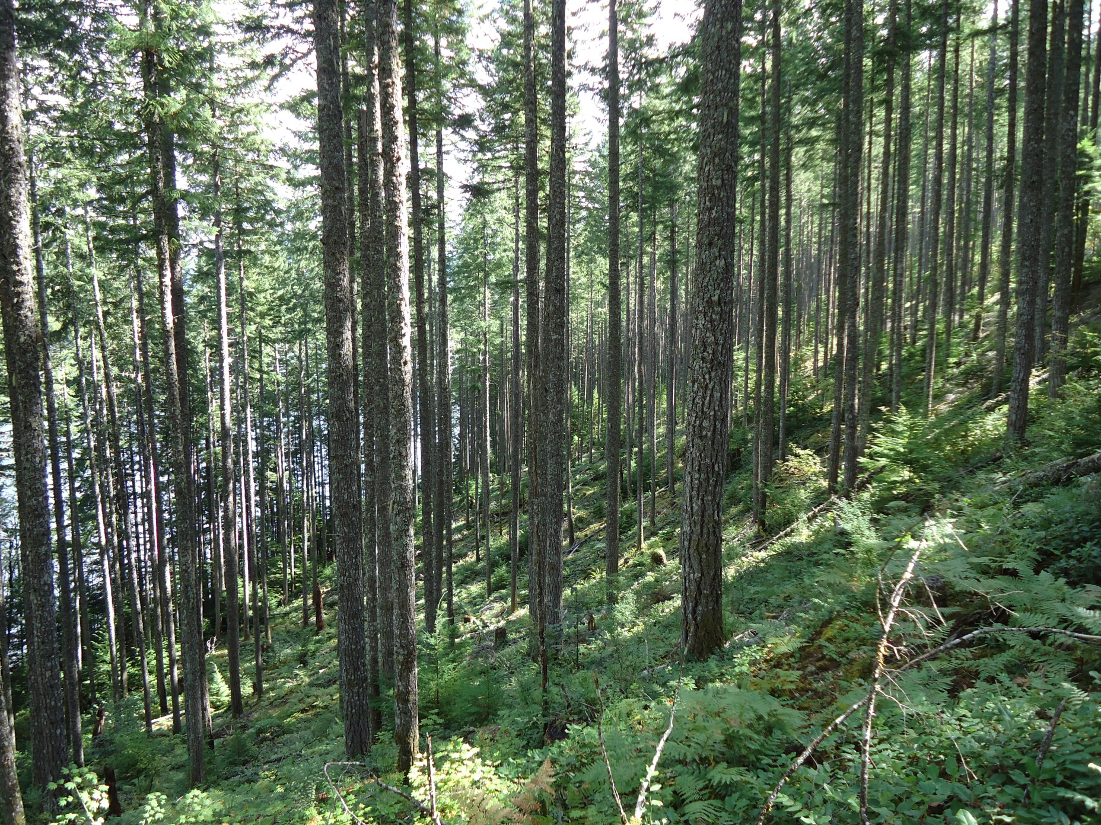

PHOTO POINTS – Commercial Thin Stand# 4026462
Photo: Tim Fox, USFS, 2014
Notes:
No GPS information available for Photo Point location.

Slide 17
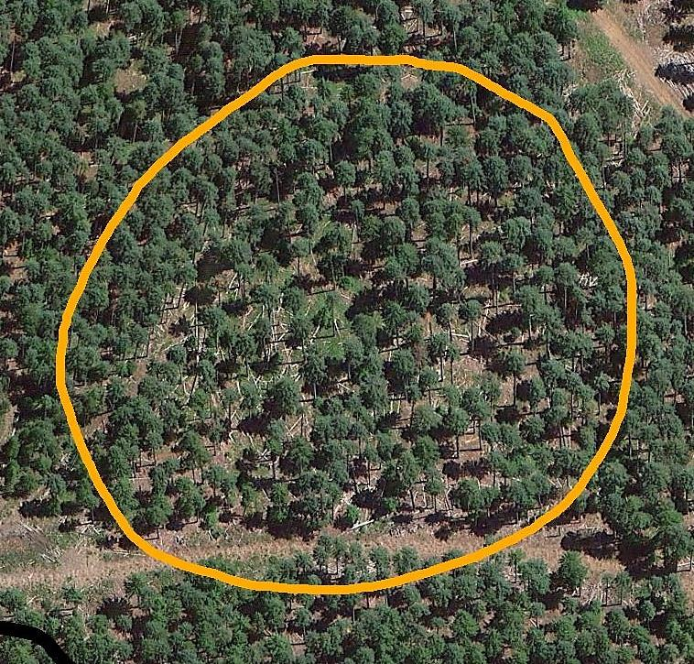
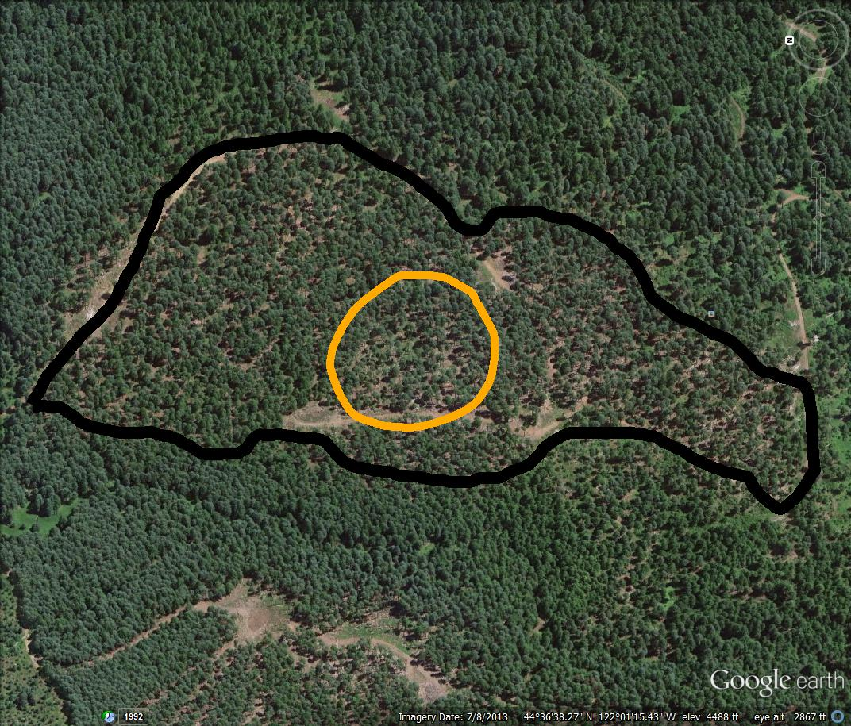
Commercial Thin
Harvested: 2005
Harvest Age: 90
Acres: 51 TPA: 97
Stand# 4025610
N
Notes:
See Stand #4025610 in Word Document for Information about Stand.

Slide 18
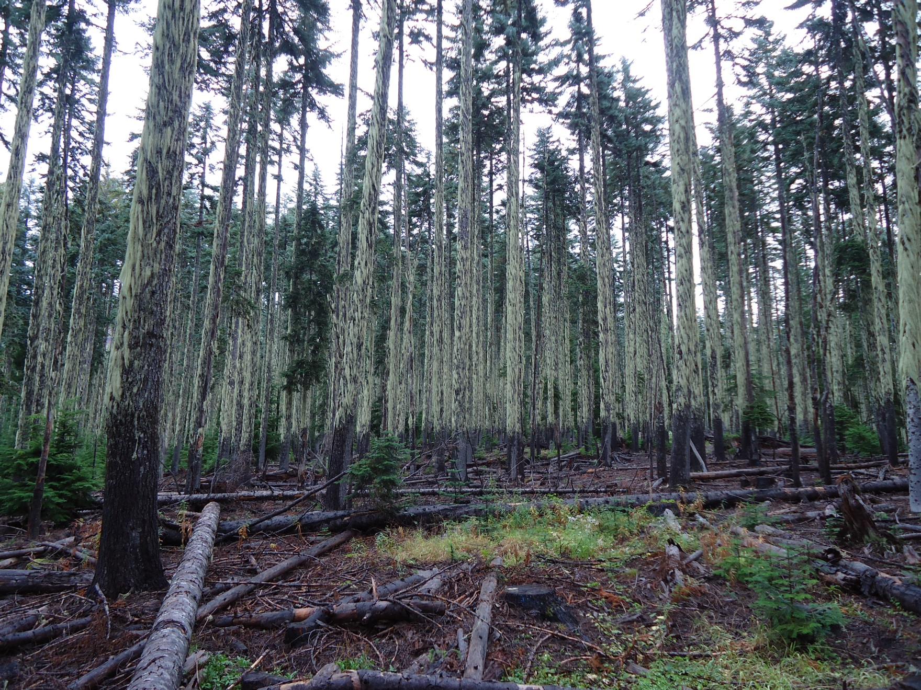

PHOTO POINTS – Commercial Thin Stand# 4025610
Photo: Tim Fox, USFS, 2014
Notes:
No GPS information available for Photo Point location. Believe the light/dark line on tree boles is result of snowpack and effect it has on moss-cover on the tree bole. –G.Rost

Slide 19
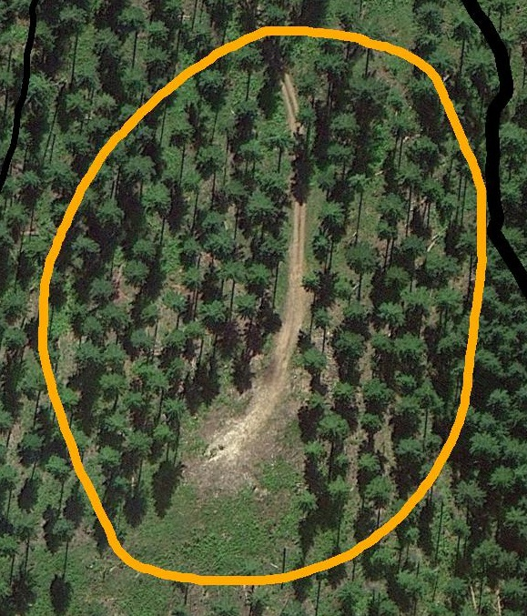
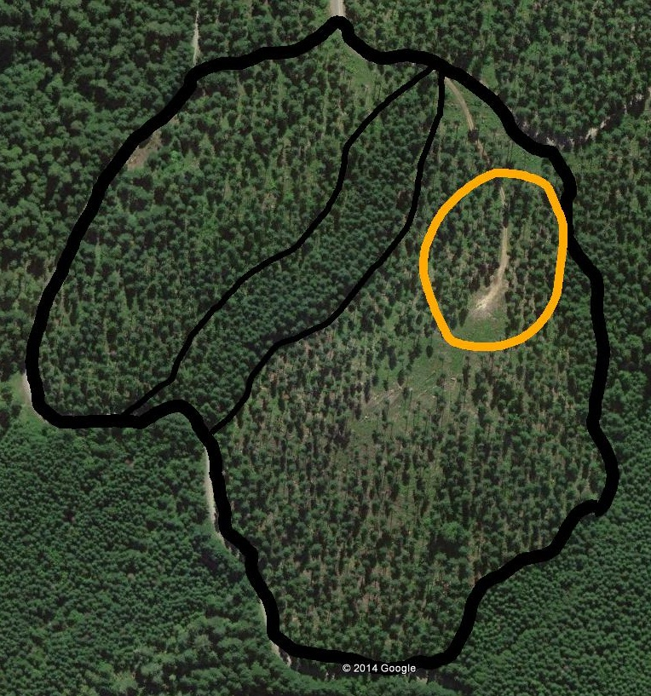
Commercial Thin
Harvested: 2006
Harvest Age: 45 Acres: 62 TPA: 50
Stand# 8002502
N
1 riparian reserve
Notes:
See Stand #8002502 in Word Document for Information about Stand.

Slide 20
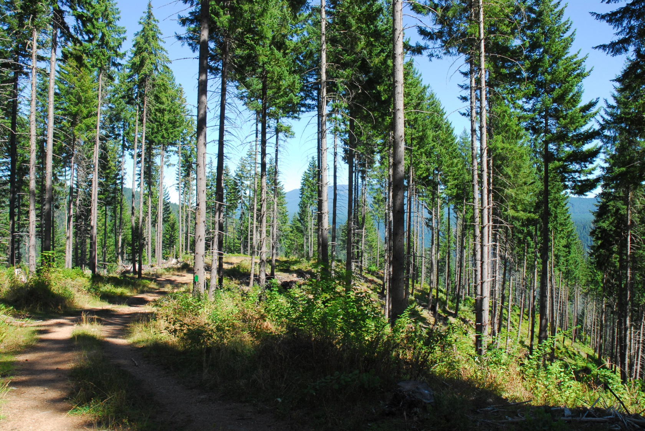

PHOTO POINTS – Commercial Thin Stand# 8002502
Photo: Gary Rost, USFS, 2014
Notes:
Photo Point Location: 43° 48’ 06.8” N 122° 27’ 45.7” W Direction of Photo: 66 degrees. Green card on tree is 8.5 x 11 inches.

Slide 21
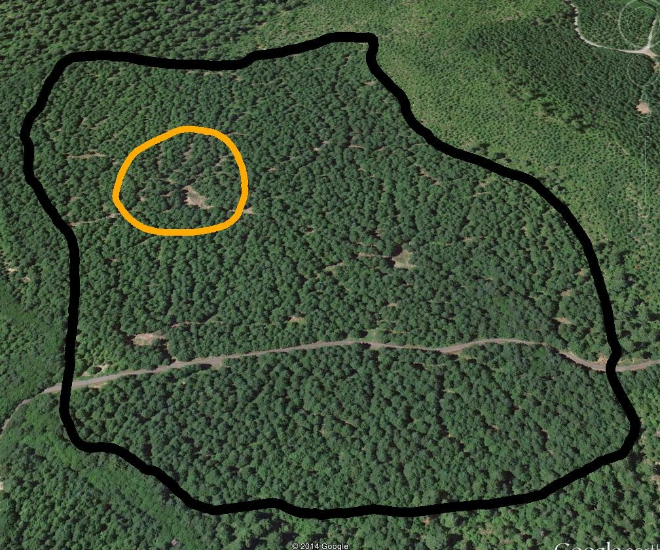
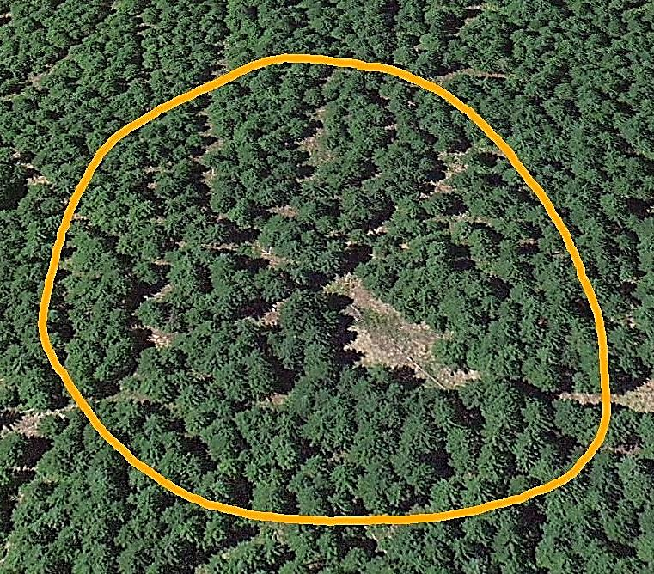
Commercial Thin
Harvested: 2001
Harvest Age: 40 Acres: 62 TPA: 139
C. Closure: 70 %
Stand# 4026186
N
Notes:
See Stand #4026186 in Word Document for Information about Stand.

Slide 22
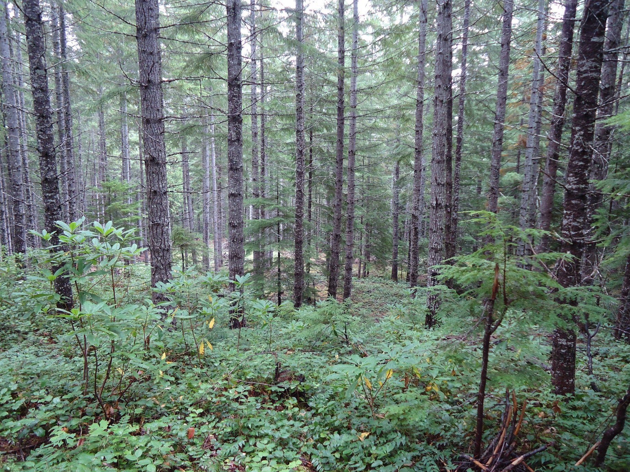
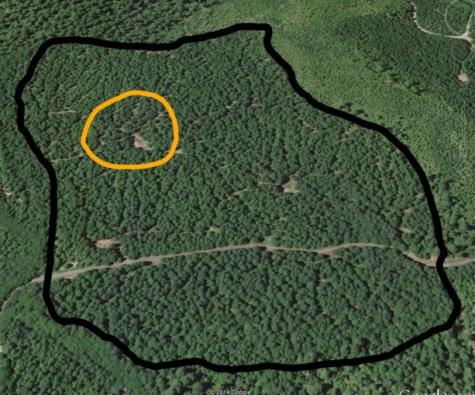
PHOTO POINTS – Commercial Thin Stand# 4026186
Photo: Tim Fox, USFS, 2014
Notes:
No GPS information available for Photo Point location. Green card on tree is 8.5 x 11 inches.

Slide 23
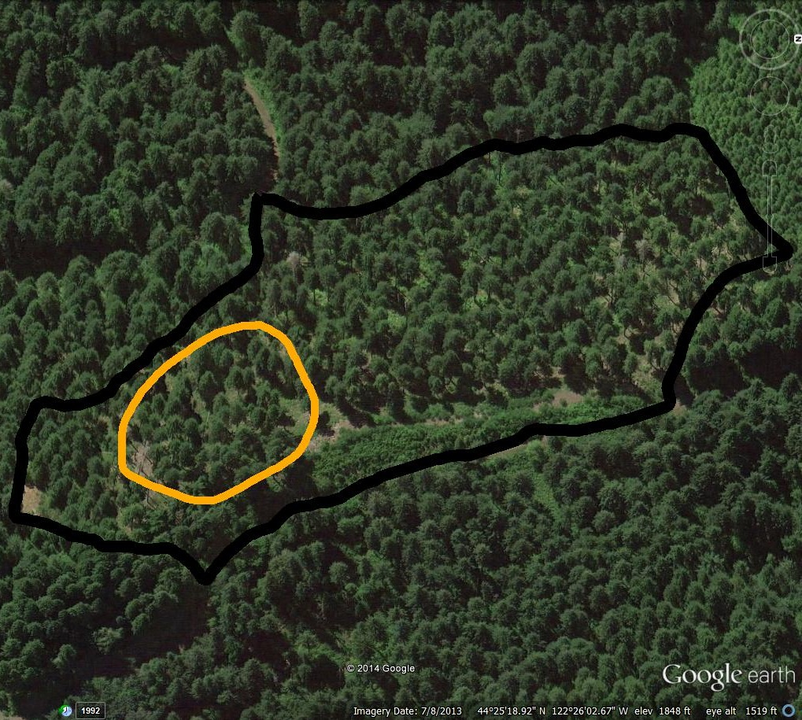
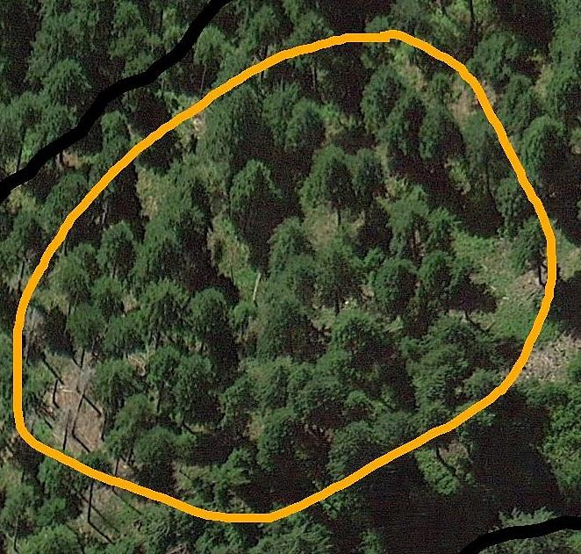
Commercial Thin
Harvested: 2007
Harvest Age: 107 Acres: 12 TPA: 42
C. Closure: 40 %
Stand# 3007719
N
Notes:
See Stand #3007719 in Word Document for Information about Stand.

Slide 24
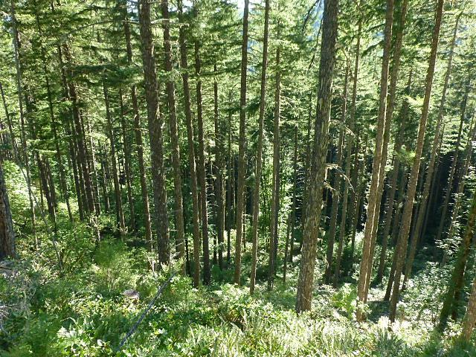
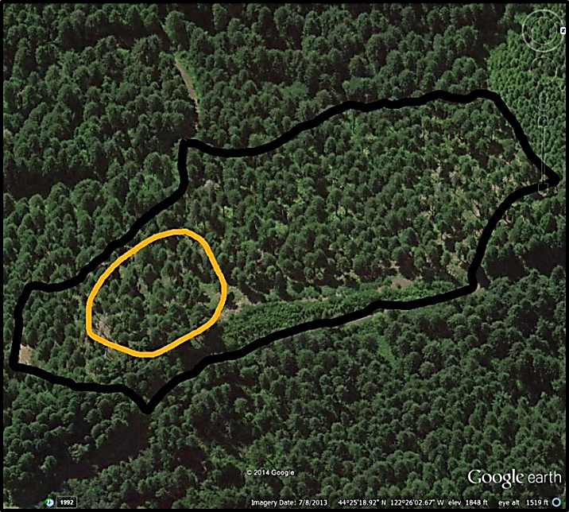
PHOTO POINTS – Commercial Thin Stand# 3007719
Photo: Gary Rost, USFS, 2014
Notes:
Photo Point Location: 44° 25’ 23.5” N 122° 26’ 02.5” W Direction of Photo: 250 degrees

Slide 25
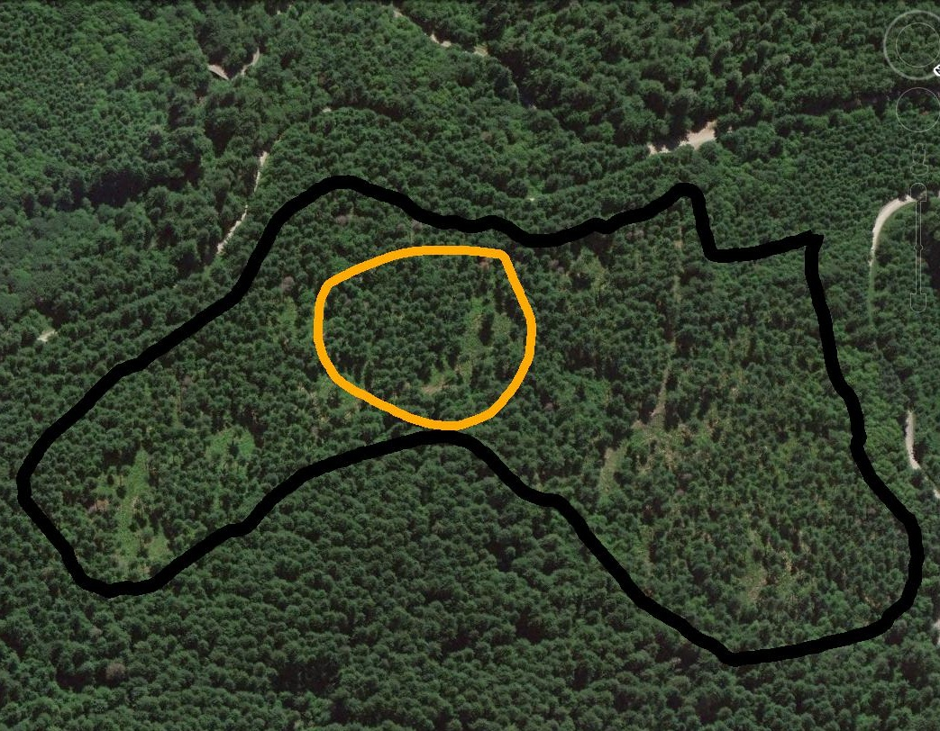
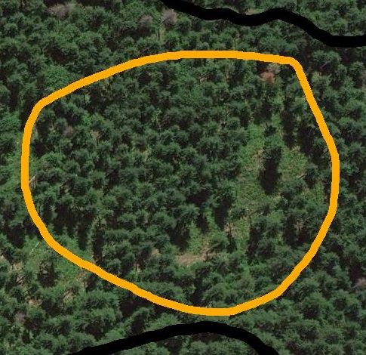
Commercial Thin
Harvested: 2006
Harvest Age: 47
Acres: 65 TPA: 71
C. Closure: 50 %
Stand# 3002588
N
N
Notes:
See Stand #3002588 in Word Document for Information about Stand.

Slide 26
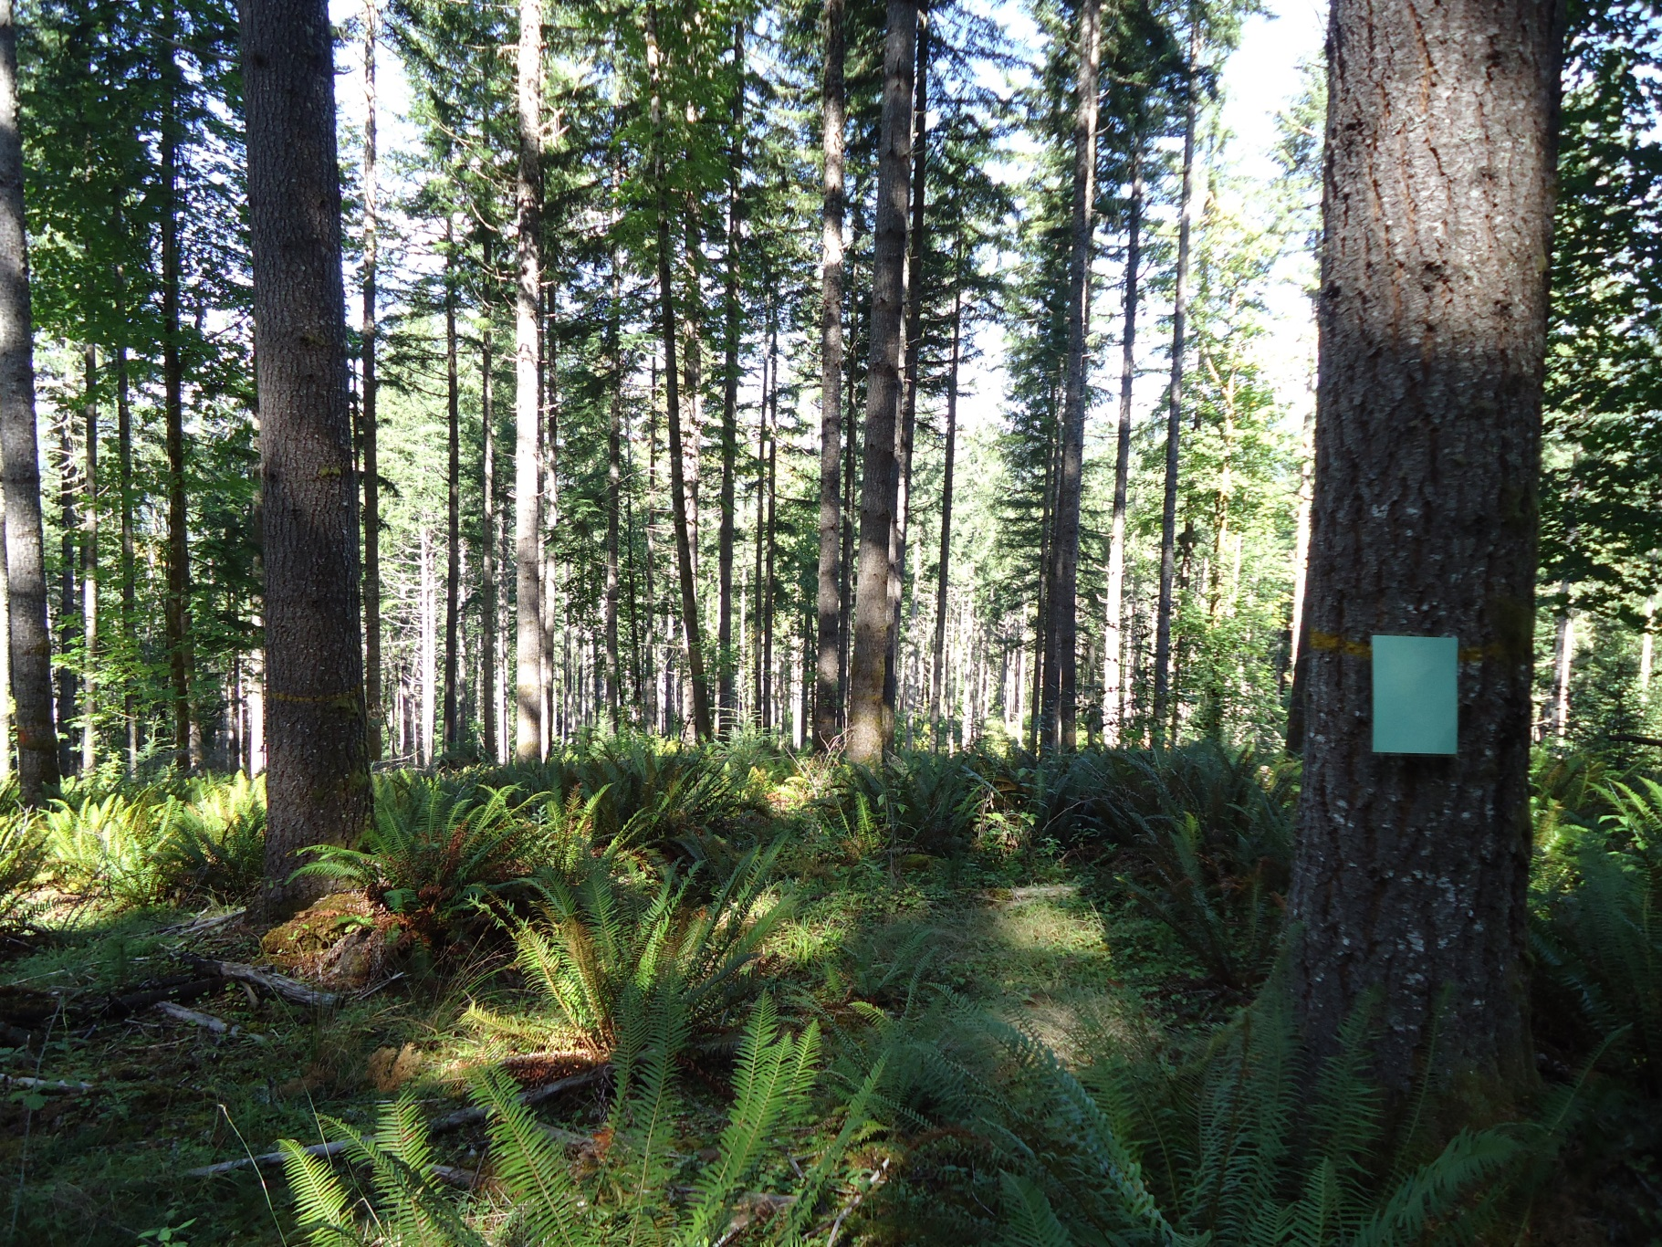
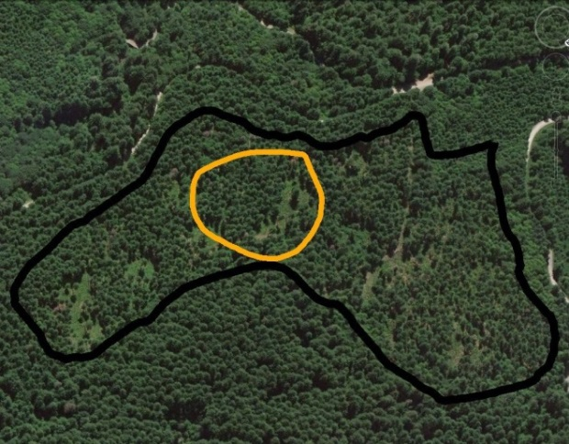
PHOTO POINTS – Commercial Thin Stand# 3002588
Photo: Tim Fox, USFS, 2014
Notes:
No GPS information available for Photo Point location. Green card on tree is 8.5 x 11 inches.

Slide 27
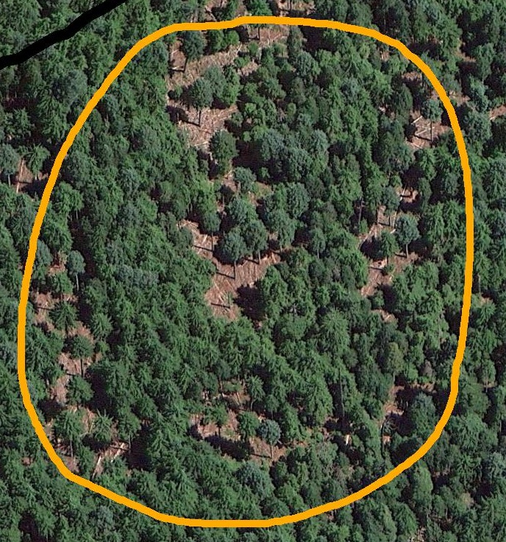
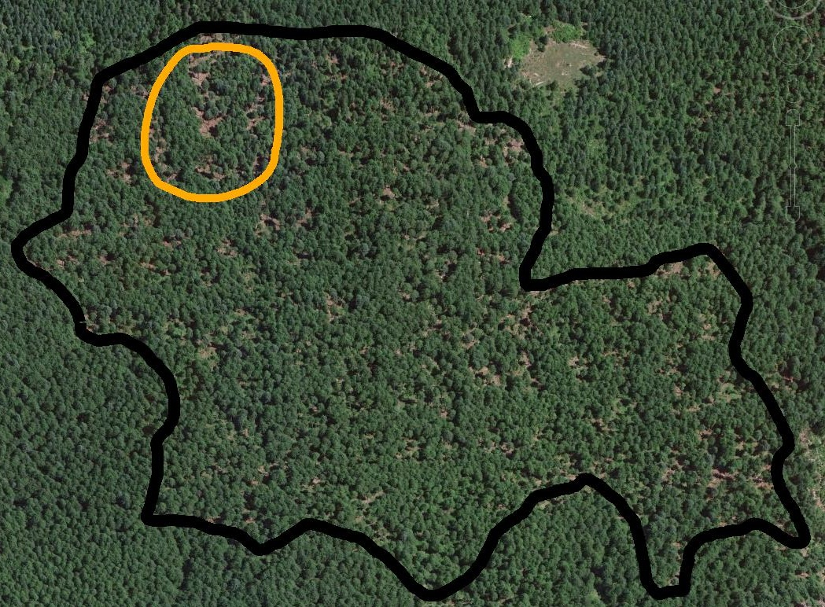
Commercial Thin
Harvested: 2003
Harvest Age: 90 Acres: 73 TPA: 147 Group DTR- 40’ spacing
Stand# 3007140
N
Notes:
See Stand #3007140 in Word Document for Information about Stand. Group DTR-40 ft. spacing from a group of 5 trees to create a ½ acre affected area, 1 group DTR per every 2 acres. Idea: to promote horizontal and vertical structural diversity in LSR.

Slide 28
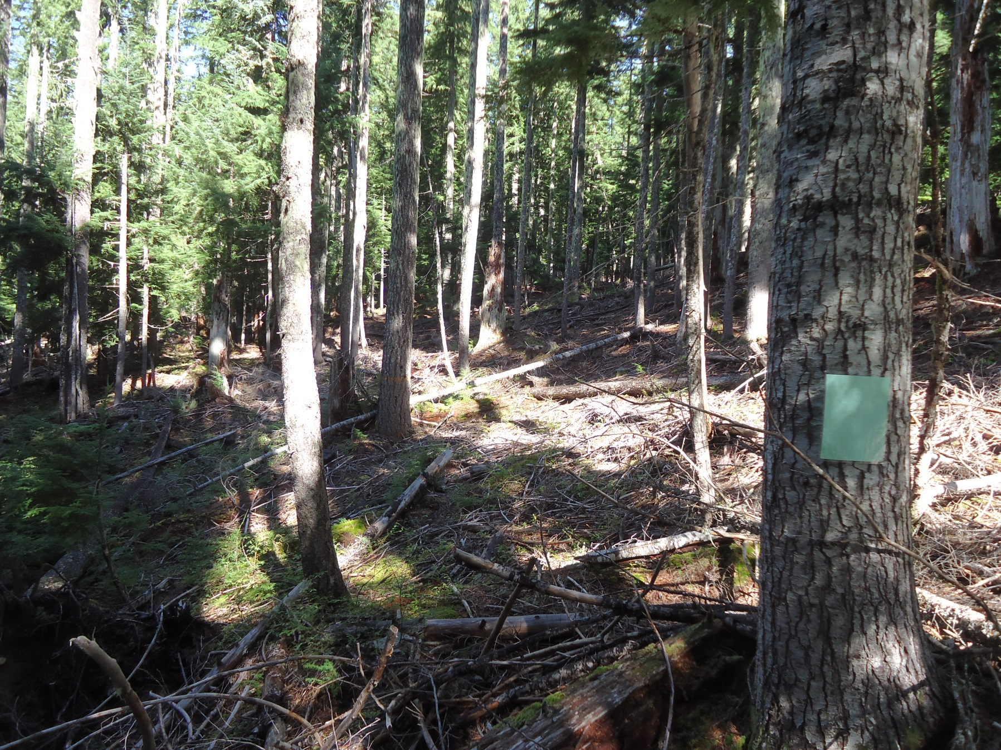

PHOTO POINTS – Variable Density Thinning
Stand# 3007140
Photo: Tim Fox, USFS, 2014
Notes:
No GPS information available for Photo Point location. Green card on tree is 8.5 x 11 inches.

Slide 29
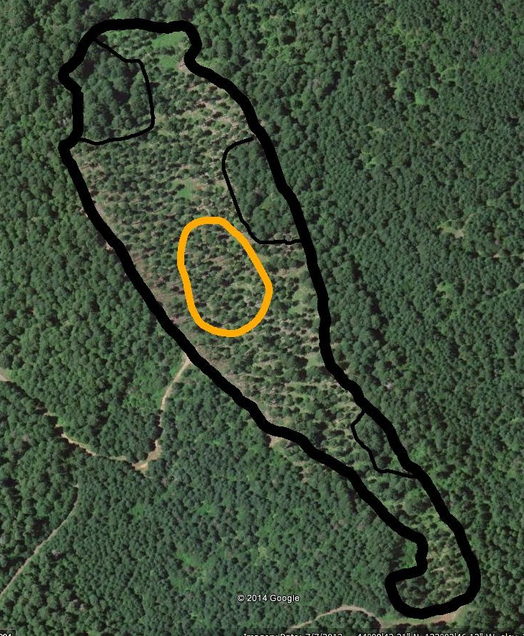
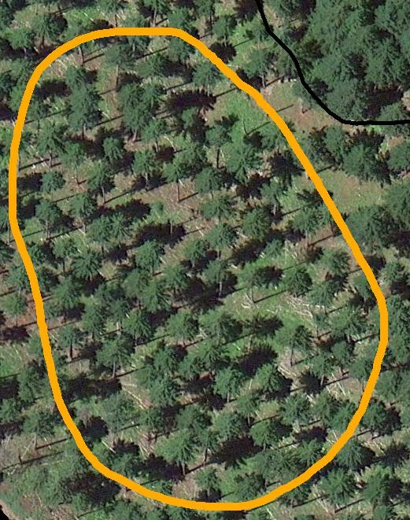
Commercial Thin
Harvested: 2008
Harvest Age: 60 Acres: 24 TPA: 31
C. Closure: 50-60 %
Stand# 7007446
N
Notes:
See Stand #7007446 in Word Document for Information about Stand. NOTE: Three small exclusions outlined in stand (delineated with lighter black boundaries) are No-Harvest, Retention areas-created for wildlife tree retention. Desired outcome: Retain approximately 240 lineal ft/acre of LWD (20”dbh, >20’ long). Retain 15% of stand in scattered, no-harvest retention areas w/variety of patch sizes.” (Delineated in photo)

Slide 30
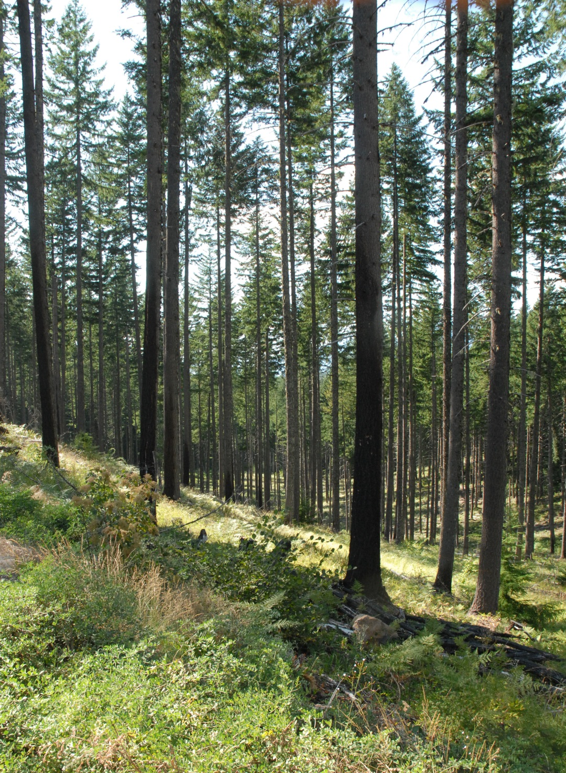

PHOTO POINTS
Commercial Thin
Stand# 7007446
Photo: Gary Rost, USFS, 2014
Notes:
Photo Point Location: 44° 09’ 38.5” N 122° 02’ 53.58” W Direction of Photo: 300 degrees. Green card on tree is 8.5 x 11 inches.

Slide 31
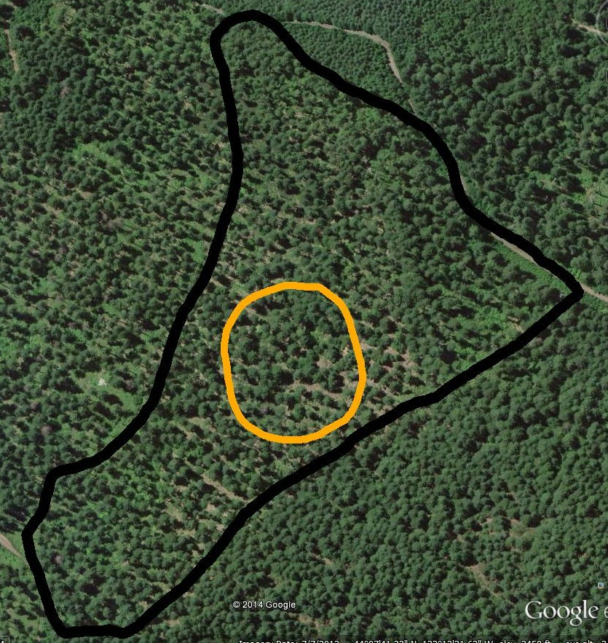
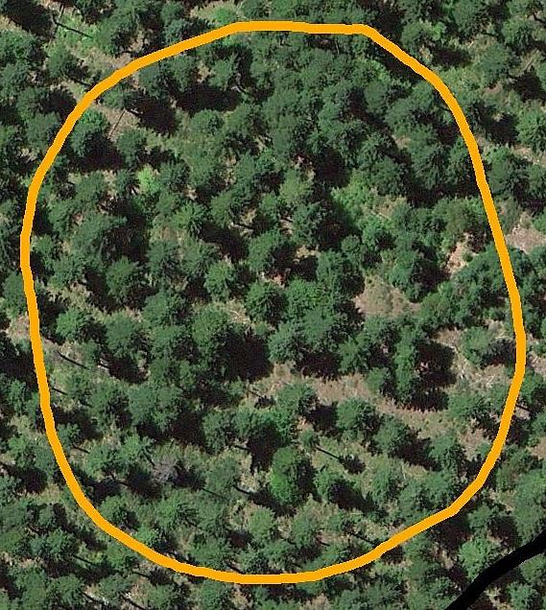
Commercial Thin
Harvested: 1998
Harvest Age: 72 Acres: 31 TPA: 37
C. Closure: 30 %
Stand# 1006055
N
Notes:
See Stand #1006055 in Word Document for Information about Stand.

Slide 32
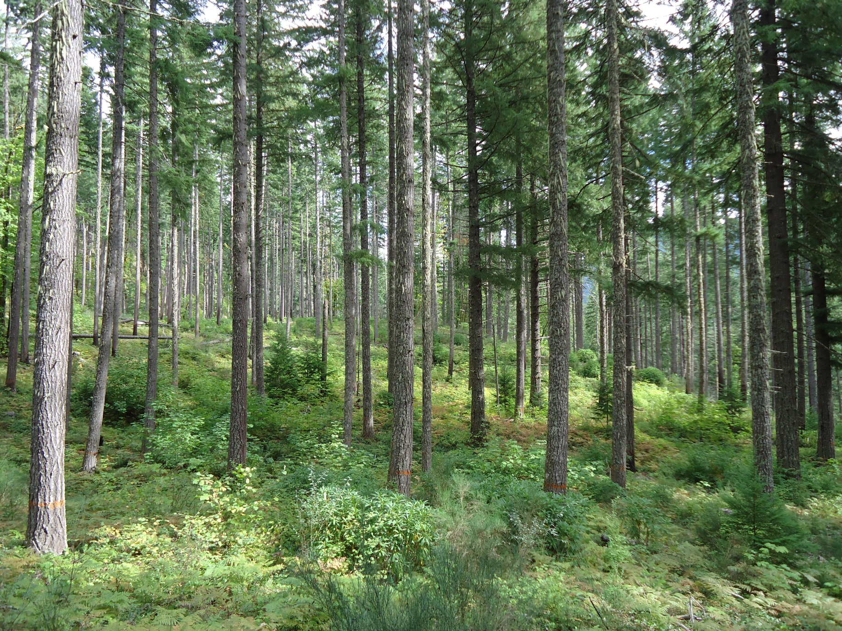

PHOTO POINTS – Commercial Thin
Stand# 1006055
Photo: Tim Fox, USFS, 2014
Notes:
No GPS information available for Photo Point location. Green card on tree is 8.5 x 11 inches.

Slide 33
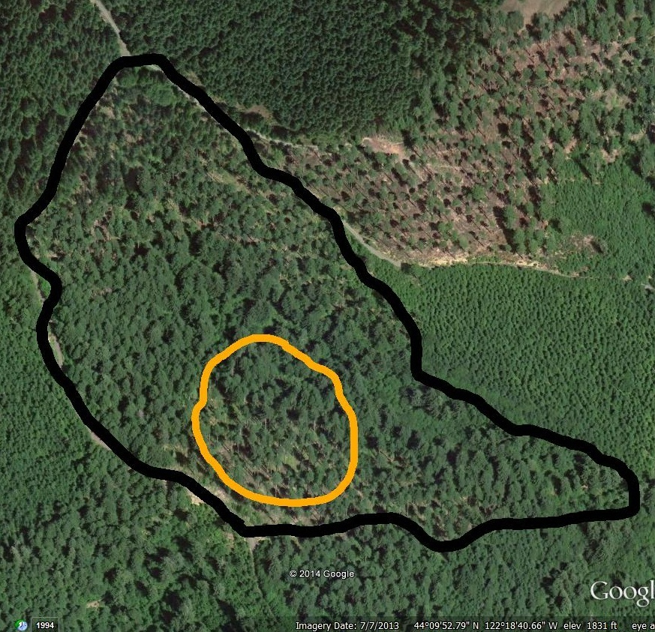
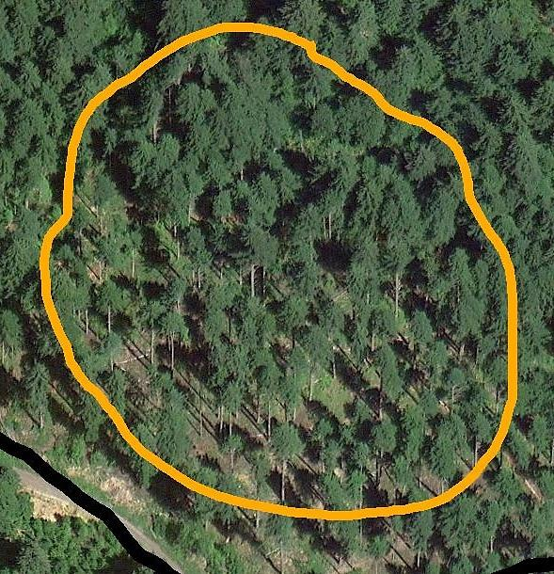
Commercial Thin
Harvested: 1998
Harvest Age: 101 Acres: 35 TPA: 59
C. Closure: 40 %
Stand# 1007241
N
Notes:
See Stand #1007241 in Word Document for Information about Stand.

Slide 34
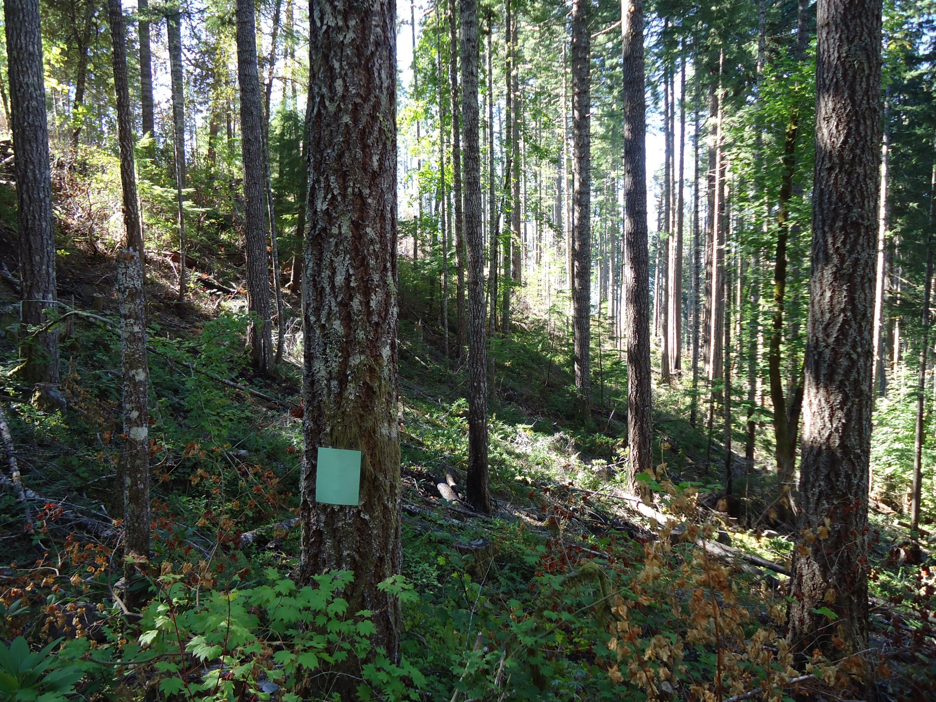

PHOTO POINTS – Commercial Thin
Stand# 1007241
Photo: Tim Fox, USFS, 2014
Notes:
No GPS information available for Photo Point location. Green card on tree is 8.5 x 11 inches.

Slide 35
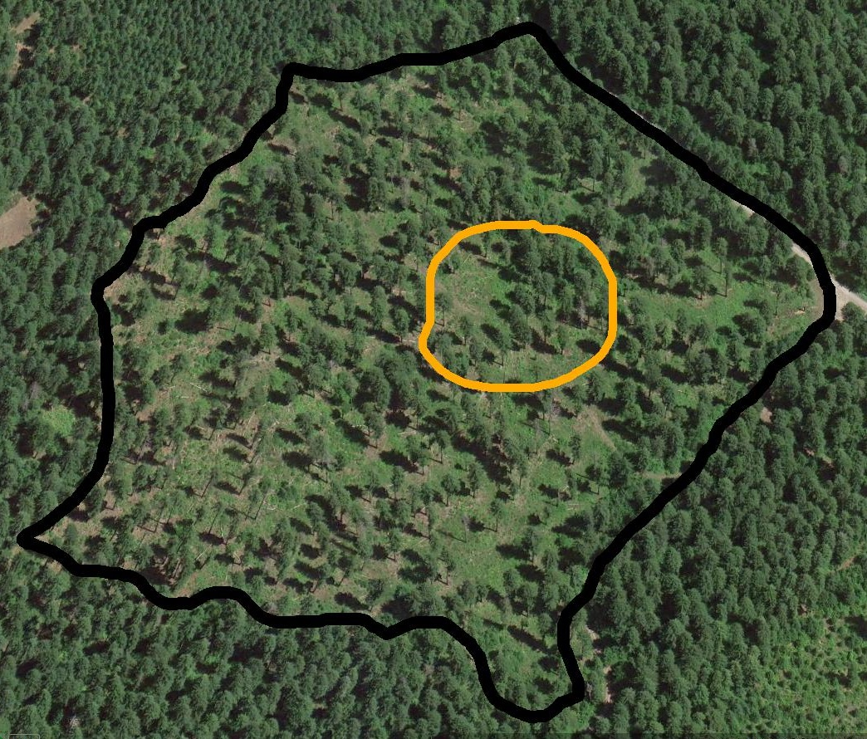
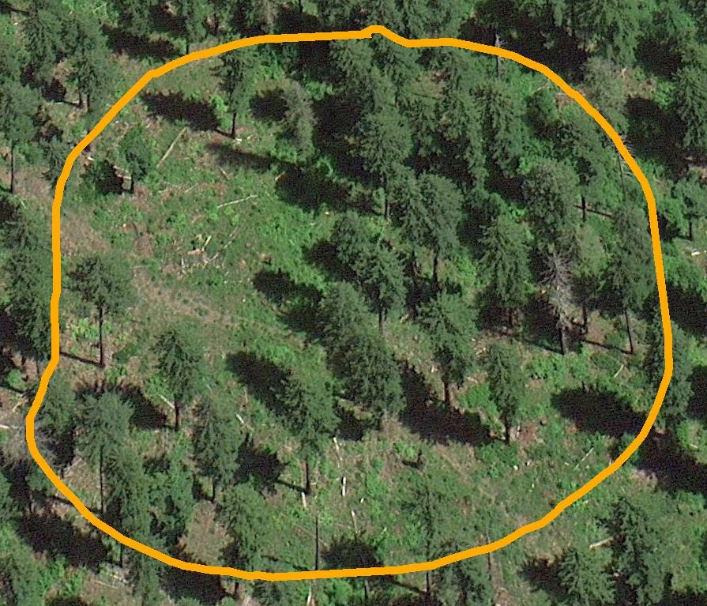
Commercial Thin
Harvested: 2002
Harvest Age: ~ 150
Acres: 50 TPA: 62
C. Closure: 30 %
Blue River Landscape Study
BRF - 4A Stand# 1005964
N
Notes:
See Stand #1005964 in Word Document for Information about Stand.

Slide 36

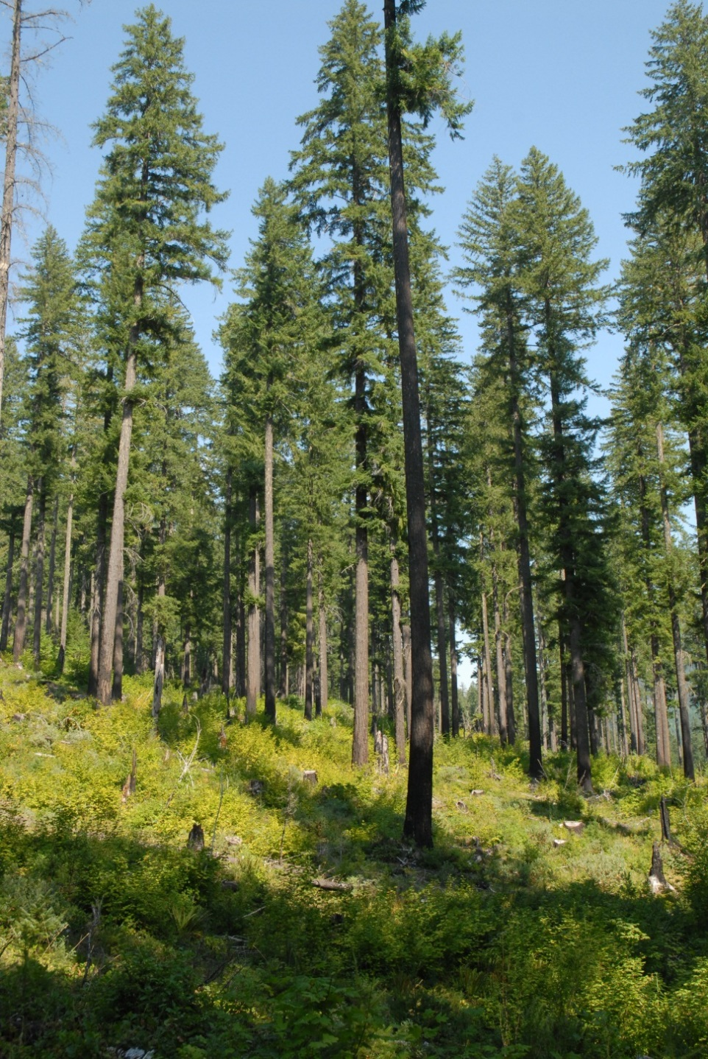

PHOTO POINTS – Commercial Thin
Blue River Landscape Study BRF - 4A
B
A
Photos: Gary Rost, USFS, 2012
A
B
Notes:
No GPS information available for Photo Point location.

Slide 37


Commercial Thin
Harvested: 2002
Harvest Age: ~ 150
Acres: 50 TPA: 23
C. Closure: 30 %
Blue River Landscape Study
BRF - 5B Stand# 1005968
N
Notes:
See Stand #1007241 in Word Document for Information about Stand.

Slide 38


PHOTO POINTS- Commercial Thin
Blue River Landscape Study
BRF - 5B Stand# 1005968
Photo: Gary Rost, USFS, 2012
Notes:
No GPS information available for Photo Point location.

Slide 39


Commercial Thin
Harvested: 2000
Harvest Age: ~ 100
Acres: 50 TPA: 26
C. Closure: 50 %
Blue River Landscape Study
NFQ - 9 Stand# 1005989
N
Notes:
See Stand #1005989 in Word Document for Information about Stand.

Slide 40



PHOTO POINTS - Commercial Thin
Blue River Landscape Study NFQ - 9
Stand# 1005989
N
B
A
Photo: Betsy Gabriel, USFS, 2011
Photo: Betsy Gabriel, USFS, 2011
A
B
Notes:
No GPS information available for Photo Point location.

Slide 41


Commercial Thin
Uneven Aged Management Project (UAMP)
Stand# 1005997
Harvested: 1997
Harvest Age: 45
Acres: 23 TPA: 92
N
Notes:
See Stand# 1005997 in Word Document for Information about Stand.

Slide 42


PHOTO POINTS - Commercial Thin
Uneven Aged Management Project (UAMP)
Stand# 1005997
Photo: Tim Fox, USFS, 2014
Notes:
No GPS information available for Photo Point location. Green card on tree is 8.5 x 11 inches.

Slide 43


Commercial Thin
Uneven Aged Management Project (UAMP)
Stand# 1006000
Harvested: 2000
Harvest Age: 40
Acres: 27 TPA: 67
N
Notes:
See Stand # 1006000 in Word Document for Information about Stand.

Slide 44


PHOTO POINTS - Commercial Thin
Uneven Aged Management Project (UAMP)
Stand# 1006000
Photo: Tim Fox, USFS, 2014
Notes:
No GPS information available for Photo Point location. Green card on tree is 8.5 x 11 inches.

Slide 45


Commercial Thin
Harvested: 1997
Harvest Age: 42
Acres: 86 TPA: 73
Young Stand Thinning &
Diversity Study (YSTDS)
Stand# 1001100
N
Notes:
See Stand #1001100 in Word Document for Information about Stand.

Slide 46


PHOTO POINTS - Commercial Thin
Young Stand Thinning & Diversity Study
Stand# 1001100
Photo: Tim Fox, USFS, 2014
Notes:
No GPS information available for Photo Point location. Green card on tree is 8.5 x 11 inches.

Slide 47


Commercial Thin
Harvested: 1996
Harvest Age: 43
Acres: 92 TPA: 121
Young Stand Thinning &
Diversity Study (YSTDS)
Stand# 7002137
N
Notes:
See Stand #7002137 in Word Document for Information about Stand.

Slide 48


PHOTO POINTS - Commercial Thin
Young Stand Thinning & Diversity Study
Stand# 7002137
Photo: Tim Fox, USFS, 2014
Notes:
No GPS information available for Photo Point location. Green card on tree is 8.5 x 11 inches.

Slide 49


Commercial Thin
Harvested: 1996
Harvest Age: 42
Acres: 49 TPA: 99
Young Stand Thinning & Diversity Study (YSTDS) Gap Stand # 7002306
N
Notes:
See Stand # 7002306 in Word Document for Information about Stand. Commercial Thin with Gaps treatment, leaving approximately 110 trees/acre, w/additional 20% of stand area harvested to leave 0.5 acre gaps, and underplanted with native conifer seedlings.

Slide 50


PHOTO POINTS - Commercial Thin
Young Stand Thinning & Diversity Study
Gap Stand# 7002306
Photo: Tim Fox, USFS, 2014
Notes:
No GPS information available for Photo Point location. Green card on tree is 8.5 x 11 inches.

Slide 51
Group selection

Slide 52


Group Selection
Harvested: 1987
Harvest Age: 150-200 Acres: 227 TPA: 120
Stand# 8003706
¼ acre gaps
N
N
Notes:
See Stand #8003706 in Word Document for Information about Stand. Post treatment: Approximately 15% of the stand in quarter acre openings with natural regeneration. Desired outcome: volume production with natural regeneration-groups were intended to emulate root rot pockets.

Slide 53


PHOTO POINTS – Group Selection Stand# 8003706
Photo: Gary Rost, USFS, 2014
Notes:
Photo Point photograph above shows one of the multiple openings in the aerial photograph. Road to right in photo above is the skid road connecting the openings. Photo Point Location: 43° 43’ 27.1” N 122° 08’ 26.8” W Direction of Photo: 147 degrees.

Slide 54


Group Selection
Harvested: 1996
Harvest Age: 140
Acres: 3 TPA: 9 (Overstory)
Stand# 5006712
N
Notes:
See Stand #5006712 in Word Document for Information about Stand. Scattered stand of old pine with mostly ponderosa pine regeneration, and a developing herbaceous/grassy ground vegetation.

Slide 55


PHOTO POINTS – Group Selection Stand# 5006712
Photo: Tim Fox, USFS, 2014
Notes:
No GPS information available for Photo Point location. Green card on stump is 8.5 x 11 inches.

Slide 56


Group Selection
Uneven Aged Management Project (UAMP)
Stand# 1005992
Harvested: 1996
Harvest Age: 46
Acres: 24 TPA: 88
N
Notes:
See Stand #1005992 in Word Document for Information about Stand.

Slide 57


PHOTO POINTS - Group Selection
Uneven Aged Management Project (UAMP) Stand# 10005992
Photo: Tim Fox, USFS, 2014
Notes:
No GPS information available for Photo Point location. Green card on tree is 8.5 x 11 inches.

Slide 58
Regeneration

Slide 59


Regeneration
Harvested: 1988
Harvest Age: 200
Acres: 14 TPA: 25 (Overstory)
Stand# 8004360
N
Notes:
See Stand #8004360 in Word Document for Information about Stand.

Slide 60


PHOTO POINTS – Regeneration Stand# 8004360
Photo: Tim Fox, USFS, 2014
Notes:
No GPS information available for Photo Point location. Green card on tree is 8.5 x 11 inches.

Slide 61


Regeneration
Harvested: 1999 (Seed Tree Cut) Harvest Age: 99
Acres: 41 TPA: 6 (Largest trees)
Stand# 3006709
N
Notes:
See Stand #3006709 in Word Document for Information about Stand. Retention trees retained for wildlife purposes.

Slide 62



PHOTO POINTS – Regeneration Stand# 3006709
Photo: Gary Rost, USFS, 2014
B
B
A
A
Notes:
Photo Point A Location: 44° 24’ 38.2” N 122° 24’ 01.8” W Direction of Photo: 66 degrees
Photo Point B Location: 44° 24’ 39.6” N 122° 23’ 55.7” W Direction of Photo: 200 degrees

Slide 63


Regeneration
Age: Unknown
Acres: Unknown TPA: Unknown
Private Land - #1 - Highway 126
N
Notes:
See Stand #’Private Regeneration.1’ in Word Document for Information about Stand.

Slide 64


Regeneration
Age: Unknown
Acres: Unknown TPA: Unknown
Private Land - #2 - Highway 126
N
Notes:
See Stand # ’Private Regeneration.2’ in Word Document for Information about Stand.

Slide 65
Restoration

Slide 66


Savanna Restoration
Harvested: 2011 (Shelterwood) Harvest Age: 110 ( w/ 250 – 400 year old remnants)
Acres: 414 TPA: 20
Stand# 5009288
N
Notes:
See Stand #5009288 in Word Document for Information about Stand.

Slide 67


PHOTO POINTS – Restoration Stand# 5009288
Photo: Gary Rost, USFS, 2014
Notes:
See Stand #5009288 in Word Document for Information about Stand.
Photo Point Location: 43° 30’ 45.0” N 122° 25’ 27.7” W Direction of Photo: 310 degrees Green card on tree is 8.5 x 11 inches.

Slide 68
http://ecoshare.info/projects/central-cascade-adaptive-management-partnership/

