Slide 1
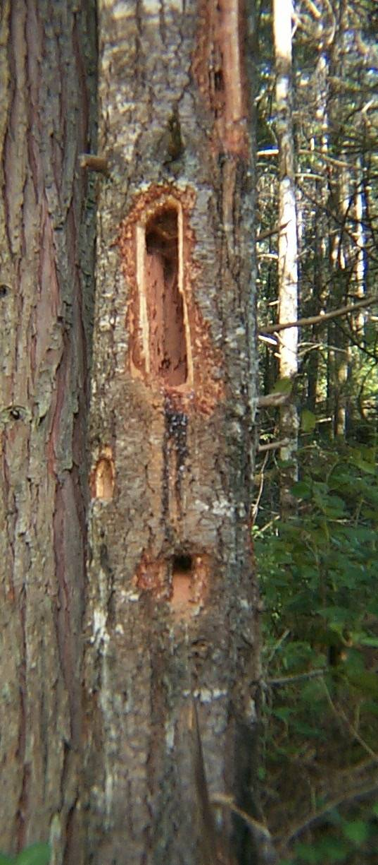
WLTDB: Analysis and Future Directions
Travis J. Woolley
Dave Shaw
Joan Hagar

Slide 2
Outline
Database QA/QC
Uncertainties in data
Where we might be headed…possibilities
Trends in the Data
Group Discussion

Slide 3
Database QA/QC
Original database - 1823 trees
  Dropped Thinned Units (780 trees)
  Species other than Douglas-fir (~40 trees)
  Diameter, tree condition, and other critical data missing
  (~50 trees)
Analysis - 951 trees (1-15 years post-treatment)
  Treatments
    Blasted – 170 trees
    Girdled – 249 trees
    Saw-topped – 120 trees
    Inoculated – 270 trees
    Girdled + Inoculated – 53 trees
    Saw + Inoculated – 89 trees

Slide 4
Variables removed……… and why
Decay class – not always recorded/not consistent with % bark loss

Slide 5
Variables removed……… and why
Decay class – not always recorded/not consistent with % bark loss
Snag Distribution – missing values

Slide 6
Variables removed……… and why
Decay class – not always recorded/not consistent with % bark loss
Snag Distribution – missing values
Distance to edge – missing values, recorded improperly

Slide 7
Variables removed……… and why
Decay class – not always recorded/not consistent with % bark loss
Snag Distribution – missing values
Distance to edge – missing values, recorded improperly
% canopy cover – difficult to interpret as collected

Slide 8
Variables removed……… and why
Decay class – not always recorded/not consistent with % bark loss
Snag Distribution – missing values
Distance to edge – missing values, recorded improperly
% canopy cover – difficult to interpret as collected
Treatment Height – missing values/recorded as greater than

Slide 9
Variables removed……… and why
Decay class – not always recorded/not consistent with % bark loss
Snag Distribution – missing values
Distance to edge – missing values, recorded improperly
% canopy cover – difficult to interpret as collected
Treatment Height – missing values/recorded as greater than
# of branches – missing values/recorded as % or #

Slide 10
Variables removed……… and why
Decay class – not always recorded/not consistent with % bark loss
Snag Distribution – missing values
Distance to edge – missing values, recorded improperly
% canopy cover – difficult to interpret as collected
Treatment Height – missing values/recorded as greater than
# of branches – missing values/recorded as % or #
Elevation – missing values
  Replaced as stand level elevation using GIS

Slide 11
Variables removed……… and why
Decay class – not always recorded/not consistent with % bark loss
Snag Distribution – missing values
Distance to edge – missing values, recorded improperly
% canopy cover – difficult to interpret as collected
Treatment Height – missing values/recorded as greater than
# of branches – missing values/recorded as % or #
Elevation – missing values
  Replaced as stand level elevation using GIS
Variables Added (GIS)
  Vegetation Zone
  Plant Association Group

Slide 12
Variables removed……… and why
Decay class – not always recorded/not consistent with % bark loss
Snag Distribution – missing values
Distance to edge – missing values, recorded improperly
% canopy cover – difficult to interpret as collected
Treatment Height – missing values/recorded as greater than
# of branches – missing values/recorded as % or #
Elevation – missing values
  Replaced as stand level elevation using GIS
Variables Added (GIS)
  Vegetation Zone
  Plant Association Group
Variables Remaining
  Tend to be all stand level variables…..

Slide 13
Sampling Design Implications

Slide 14
Created Wildlife Tree Sampling
KV funds for monitoring created wildlife trees in harvested stands
Tried to monitor 80% (sometimes only 50%) of created wildlife trees within a given stand
Trees were chosen by the ability of contractor to locate them

Slide 15
What does the data represent????

Slide 16
What does the data represent????
Dependent on Sampling Design

Slide 17

Proportions of use (e.g., bird use)
Landing

Slide 18
Landing

Slide 19
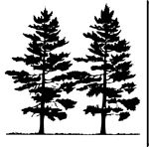
Landing

Slide 20
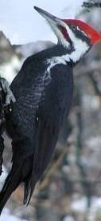
Landing

Slide 21
8 of 20 in the population had bird use= 40%
4 of 16 sampled had bird use = 25%
Landing

Slide 22
Landing

Slide 23
8 of 20 in the population had bird use= 40%
8 of 16 sampled had bird use = 50%
Landing

Slide 24
8 of 20 in the population had bird use= 40%
6 of 16 sampled had bird use = 38%
Landing

Slide 25
Random Sampling Approach
Landing

Slide 26
8 of 20 in the population had bird use= 40%
6 of 16 sampled had bird use = 38%
Landing

Slide 27
Inconsistencies in #’s of fallen snags
Literature
  Snag age 0 – 10
    ~90% still standing*
  * Wilhere 2003; Raphael and Morrison 1983 and 1987

Slide 28
Inconsistencies in #’s of fallen snags
Literature
  Snag age 0 – 10
    ~90% still standing*
  Snag age 11-20
    ~75-80% still standing*
  * Wilhere 2003; Raphael and Morrison 1983 and 1987

Slide 29
Inconsistencies in #’s of fallen snags
Literature
  Snag age 0 – 10
    ~90% still standing*
  Snag age 11-20
    ~75-80% still standing*
MRRD WLTDB
  Snag age 0 – 10
    99.5% still standing
  Snag age 11-15
    98% still standing
  * Wilhere 2003; Raphael and Morrison 1983 and 1987

Slide 30
Uncertainties

Slide 31
Uncertainties
Possible bias in sampling
  Bird use and mortality…… (fallen trees more decayed???)
  Unable to answer Questions of Snag Longevity…..

Slide 32
Uncertainties
What do the results, and conclusions we draw from those, represent?
Are they right or wrong?

Slide 33
Uncertainties
What do the results, and conclusions we draw from those, represent?
Are they right or wrong?
We don’t know…….

Slide 34
No Scope of Inference!!!
Results/Conclusions only represent the trees monitored….

Slide 35
No Scope of Inference!!!
Results/Conclusions only represent the trees monitored….
Can we faithfully present results and conclusions without other managers extrapolating results further?????

Slide 36
No Scope of Inference!!!
Results/Conclusions only represent the trees monitored….
Can we faithfully present results and conclusions without other managers extrapolating results further?????
Take Home message is…….

Slide 37
Where to go from here????

Slide 38
Where to go from here????
ALL IS NOT LOST!!!

Slide 39
Report to district
  Descriptive results (mortality, bird use, etc.)
    Assumptions and scope of inference
  Recommendations for future monitoring and analysis of created wildlife trees
  Example Outline

Slide 40
WLTDB Report Outline
1. Trends in Monitoring Data
Assumptions and LIMITED Scope of Inference
Mortality
Bird Use
  Foraging
  Nesting
2. Recommendations
Data Collection
  Quality Control
  Variable Formation (e.g., canopy closure)
    Continuous vs. categorical
Database formatting and data entry
  Quality control
  Formatting
Future sampling and analysis
  Sampling
    Stands or Individuals
    Random selection
  Statistical analysis for binary response variables
    Logistic Regression
3. Relevant Literature

Slide 41
Report to district
  Descriptive results (mortality, bird use, etc.)
    Assumptions and extrapolation
  Recommendations for future monitoring and analysis of created wildlife trees
  Example Outline
Publication???????????????
  Descriptive Results

Slide 42
Report to district
  Descriptive results (mortality, bird use, etc.)
    Assumptions and extrapolation
  Recommendations for future monitoring and analysis of created wildlife trees
  Example Outline
Publication???????????????
  Descriptive Results
  Use this case study as an example of how we can improve monitoring of operational methods to answer valuable questions.

Slide 43
Re-sampling Approach
  Redesign sampling of created wildlife trees with redefined questions….focusing on……
    Stand-level attributes vs. Individual tree attributes
    OR Both
  Sample less trees…..maybe even less stands
  FUNDS?????

Slide 44
Trends

Slide 45
Mortality by Treatment Over Time

Slide 46
Mortality by Treatment Over Time

Slide 47
Bird Use over Time

Slide 48
Bird Use over Time
**Interactions of Treatment, tree size, elevation, etc.

Slide 49
Bird Use over Time
**Interactions of Treatment, tree size, elevation, etc.

Slide 50
Bird Use over Time

Slide 51
Bird Use over Time

Slide 52
Bird Use and Tree Size

Slide 53
Bird Use and Tree Size

Slide 54
Bird Use and Tree Size

Slide 55
Bird Use and Tree Size

Slide 56
Discussion

Slide 57
Questions and Hypotheses…

Slide 58
Questions and Hypotheses…
Do we want to know about individual tree responses, or responses of trees at the stand level????
  Individual Tree Responses
    Mortality rates by treatment (treatment at stand level??)
    Bird use by tree size, age, decay class, etc…
    Inoculation treatment effects

Slide 59
Questions and Hypotheses…
Do we want to know about individual tree responses, or responses of trees at the stand level????
  Individual Tree Responses
    Mortality rates by treatment (treatment at stand level??)
    Bird use by tree size, age, decay class, etc…
    Inoculation treatment effects
  Stand-level responses
    Mortality/Bird use across Elevation
    Harvest type
    Stand Area

