Slide 1

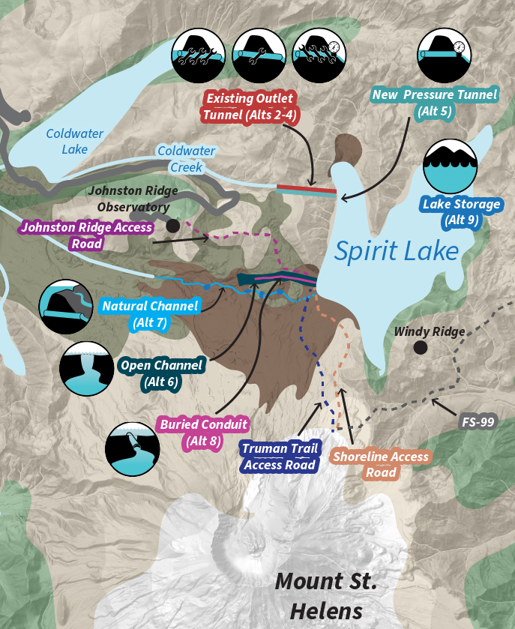
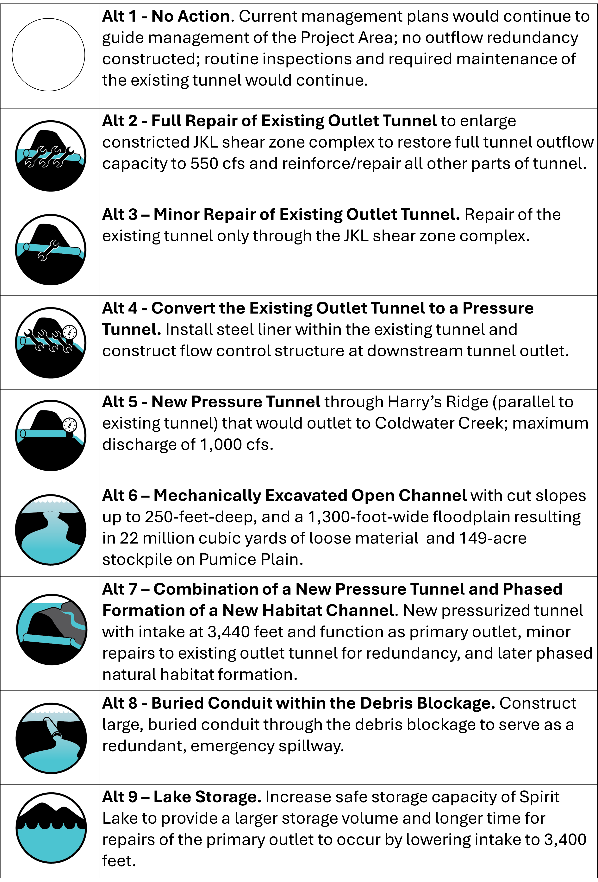



Spirit Lake Outflow Safety Improvement Project
Gifford Pinchot National Forest
Purpose of the Project The purpose of the Project is to provide for the safety of downstream communities by reducing the risk of flooding and mudflows from a failure of the Spirit Lake debris blockage.
Following the 1980 eruption of Mount St. Helens, Spirit Lake’s natural outlet to the Toutle River system was blocked by the landslide and debris flow from the eruption. The Spirit Lake tunnel was constructed under emergency conditions to address the imminent public safety threat posed by rising water levels in Spirit Lake. The tunnel is in an area of volcanic, geologic, hydrologic, and seismic hazards.
The geological pressures on the tunnel have caused rock heave, compression, cracking and support failures, necessitating periodic repairs. A failure of the tunnel would result in rising lake levels that could exceed the maximum safe operating level, at which point pressure from rising water levels could force the breaching of the natural debris blockage, putting the downstream population of approximately 50,000 people at risk of catastrophic flooding and mudflows.
Alternatives Evaluated in the Draft EIS
Comments on the Draft EIS must be received by October 30, 2025.
Send written comments via U.S. Mail to:
Kelsey Jolley, Spirit Lake NEPA Coordinator
987 McClellan Road
Vancouver, WA 98661
Comments may also be submitted electronically through the Comment and Analysis Response Application (CARA) at: https://cara.fs2c.usda.gov/Public//CommentInput?Project=66482
Scan the QR code to visit the Project Website for more information.

Slide 2
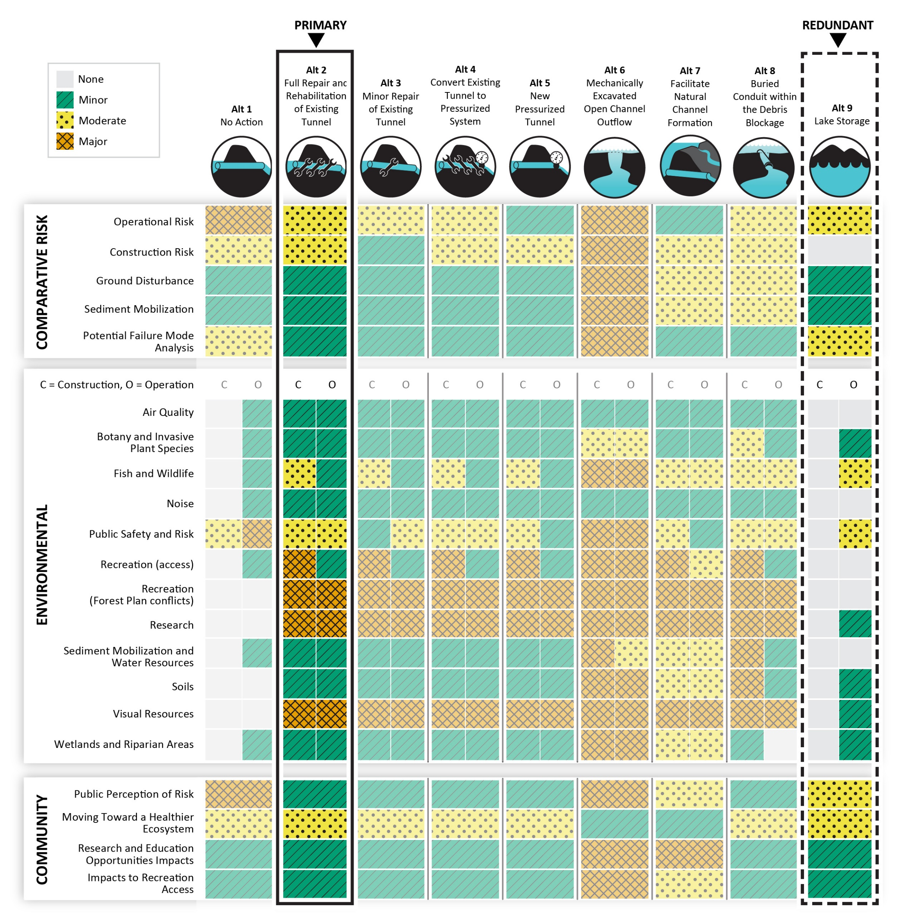
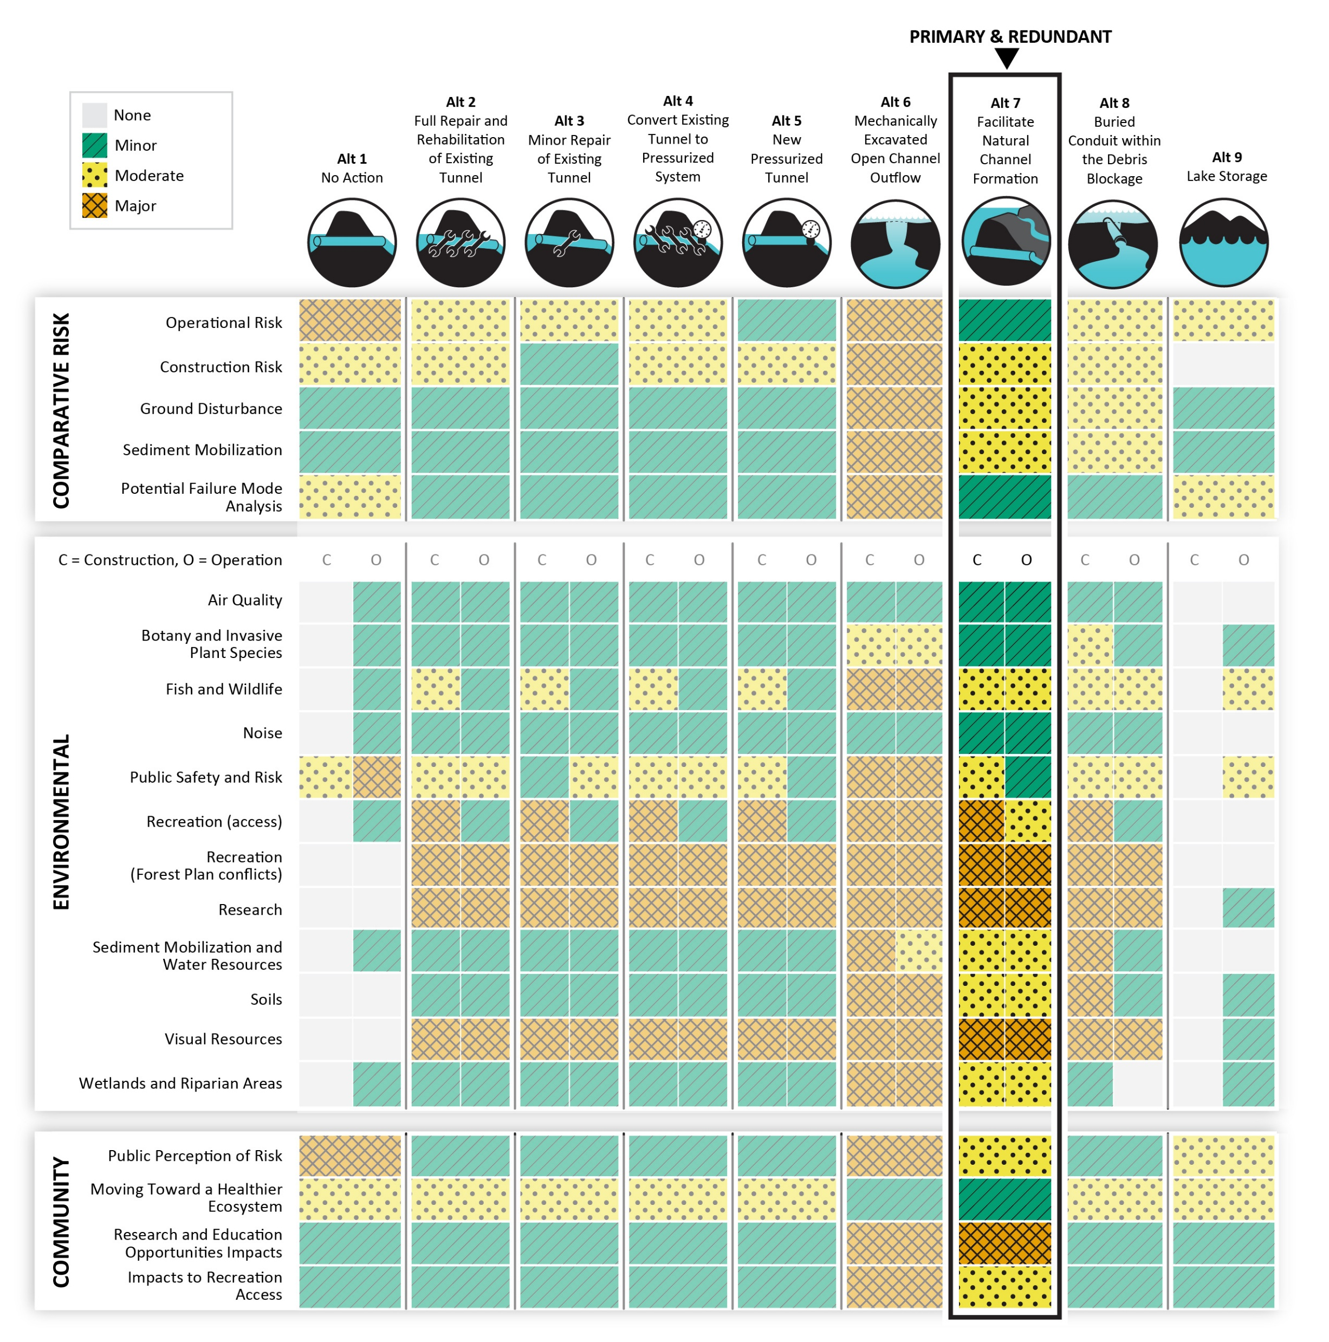
Summary of Two Preferred Alternatives
Multi-criteria Decision Analysis Tool For Preferred Alternative 2 + 9
Multi-criteria Decision Analysis Tool For Preferred Alternative 7
Puts most weight on minimizing adverse environmental consequences
Not responsive to community value of healthy ecosystems (potential future fish passage)
Minor impacts to recreation access
Uses path of existing temporary Truman Trail Access Road so limits loss of long-term research plots, vegetation, fish and wildlife
Puts most weight on community layer: offers enhanced ecosystem health (potential future fish passage)
Among the safest alternatives operationally
Impacts some research plots
Uses path of existing temporary Truman Trail Access Road so limits loss of long-term research plots, vegetation, fish and wildlife
NEPA Process
Milestone | Description | Anticipated Schedule
Notice of Intent (NOI) to Prepare an EIS | The public involvement phase begins when the NOI is published in the Federal Register | Sept 30, 2024
Scoping Period and Meeting(s) | Involves the public in identifying the environmental issues to be addressed in the EIS | Sept 30 - Nov 15, 2024
Notice of Availability of Draft EIS | Announces publication of the Draft EIS; begins public involvement phase | Aug 1, 2025
Public Comment Period | Provides 90 days for the public to comment on the analysis presented in the Draft EIS | Aug 1 – Oct 30, 2025
Final EIS/Draft Record of Decision (ROD) | Updates the Draft EIS and includes responses to all public comments received during the public comment period | April 2026
Objection Filing Period | Those that have filed substantive comments during scoping or DEIS comment period may file objections | April – June 2026
Objection Resolution Period | Forest Service reviews and resolves objections | June – Sept 2026
Final ROD | Forest Service publishes final decision on the Project | Sept 2026

