Slide 1


Forest Plan Revision
Hoosier National Forest Land and Resource Management Plan

Slide 2
Primary Decisions Made
Goals and Objectives
Management Requirements
Management area direction
Lands suited and not suited for resource use
Monitoring requirements
Recommendations to Congress (if any)
Notes:
A plan is a zoning document, we zoned the forest into 10 management areas. The desired conditions, suitability, and direction varies by management area. For example, we do not allow the use mechanical equipment within the Charles C. Deam wilderness to maintain trails whereas in other management areas chain saws and motorized equipment are allowed to maintain trails.
We have 6 goals: One is provide a useable landbase. To support that goal we have an objective to acquire lands in backcountry areas, especially those surrounded by NFS lands based on availability and a willing seller.
There are various kinds of suitability, for instance we decided that the Hoosier NF was not suitable for oil and gas leasing.
Recommendations to Congress could be such things as a roadless area being recommended for wilderness

Slide 3
Overview of Revision Process
August 1999, USDA FS mailed potential need for change items to public.
Fall 1999 we had: open houses, focus group meetings; trail group meeting, management indicator species meeting, and an interagency meeting.
In August 2002 we released a draft NOI with public meetings.
We published notice of intent November 2002 with public meetings December 2002.
Notes:
We began the forest plan revision process in August, 1999, we had many opportunities for participation. We published the notice of intent in November 2002.

Slide 4
Overview (continued)
In 2002, Alternatives are developed
In 2003 Draft Environmental Impact Statement (DEIS) and Proposed Plan to be published
In 2004, Final Environmental Impact Statement (FEIS), revised Forest Plan, and Record of Decision to be published.
Notes:
We should have the Draft Environmental Impact Statement and Proposed Plan available for comment next year.
We should have the final environmental impact statement and revised plan published in 2004.

Slide 5
Why Roadless?
We identified evaluation of roadless areas as a topic because of code of federal regulation (CFR) requirements at 36 CFR 219.17 and USDA Forest Service Regional policy.
Notes:
Roadless inventory and evaluation is a required step of plan revision.
Notes for reference ( optional discussion on other revision topics if needed)
Watershed Health
Unified Federal Policy guidance
Identify relative watershed health
Establish reference watersheds
Identify criteria for prioritizing watershed protection and restoration
Improve riparian area guidance
Define desired future condition of riparian areas
Ecosystem Sustainability
Viable Populations
Management Areas
Vegetation Management
Management Indicator Species
Research Natural Areas
Viable Populations
Maintain viable populations when possible
Contribute to viability of populations that exist outside of boundary
Maintain an array of habitats
Population Viability Assessment undertaken
Management Indicator Species
Revise list of MIS to reflect ecosystem community-oriented MIS for:
Dry forest
Mesic forest
Openland/brushland
Streams and Impoundments
Recreation Management
Social Assessment underway
Forest niche
Forest Plan Guidance
3 Plan Amendments
Off-road vehicle use
Trail Guidance

Slide 6
Roadless Inventory
We are looking at 14 areas.
We focused on backcountry areas—areas that have opportunity for solitude and a feeling of closeness to nature.
Notes:
This is the kind of topic where we think it is better for people to actually do the exercise, using the criteria, instead of us doing it and announcing the results.
Backcountry includes: MA 6.2, MA 6.4, Deckard Ridge, and Tincher Hollow. Backcountry areas usually have the best federal ownership pattern. We also included Sams Creek because of a suggestion by The Indiana Public Lands Coalition.
After we have further explained the process, we will ask you all to fill out evaluation forms on each area you are interested in and to let us know if we have missed any information about area that we need to include.
We provide the criteria and all of the resource information by area for you to use at the tables. We mapped most of the information; the maps represent the information that is easily displayed. The maps are not perfect, I’m sure that people in this audience have better information; that is one of the primary reasons we are having the workshop.
Hopefully we will have lots of chances for interaction as we begin to get analysis results and share that with you all.

Slide 7
What’s next?
Details on roadless area characteristics

Slide 8
Roadless Area Characteristics
Hoosier National Forest
USDA Forest Service
June 29, 2002

Slide 9
Purpose of Roadless Area Inventory
Reviewing inventoried roadless areas is a topic of the forest plan revision.
To determine whether previously designated roadless areas still meet roadless characteristics.
To identify new areas that may have roadless characteristics.

Slide 10
Purpose of Today’s Workshop
To help Hoosier National Forest update the forest roadless inventory.
To determine whether any existing backcountry areas qualify for roadless inventory.
  If an area does qualify, it will later be evaluated for wilderness.
  If an area does not qualify, it will continue to be managed as a backcountry area.

Slide 11
Understanding Definitions
Definitions for understanding roadless characteristics
  Backcountry
  Roads
    Classified
    Unclassified
    Improved
    Unimproved

Slide 12
Understanding Definitions
Backcountry area
  At least 1,000 acres of contiguous forest land that is not divided by “permanent linear structures,” including roads, power lines, pipelines, private land, etc.
  Is managed to be an undisturbed, forested environment influenced mainly by natural processes.

Slide 13
Understanding Definitions
What is a Road?
  A motor vehicle travelway over 50 inches wide, except those designated and maintained as a trail (USDA 2000).

Slide 14
Understanding Definitions
Classified Road
  Road needed for managing the National Forest
    Pond access, recreation access, openings access, etc.

Slide 15
Understanding Definitions
Unclassified Road
  Road not needed for managing the National Forest

Slide 16
Understanding Definitions
Improved Road
  A constructed feature
  Can be driven by a two-wheel drive vehicle under dry conditions
  50 inches in width or greater
  May include structures for surface runoff

Slide 17
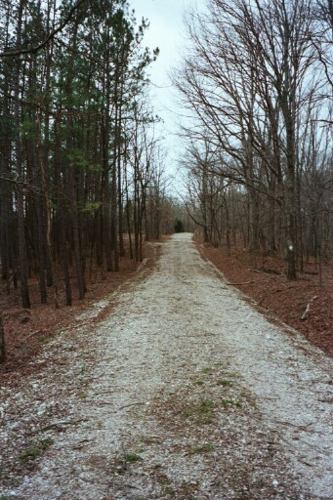
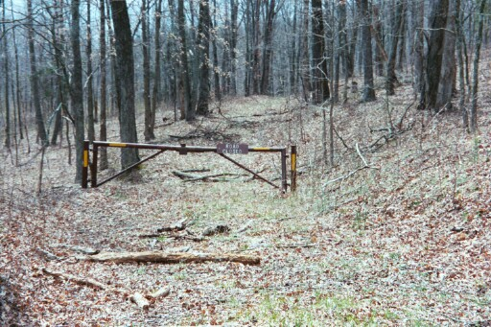
Understanding Definitions
Improved Roads

Slide 18
Understanding Definitions
Unimproved Road
  Little or no recent maintenance
  May be overgrown
  Cannot be driven by a two-wheel drive vehicle under dry conditions

Slide 19
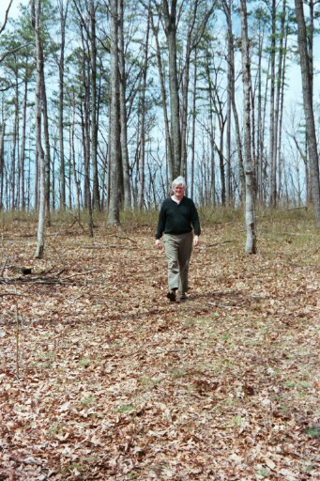
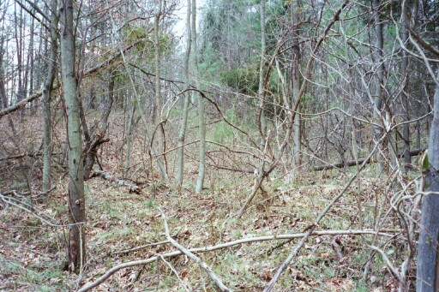
Understanding Definitions
Unimproved Roads

Slide 20
Roadless Characteristics
Forest Service Handbook 1909.12
1) The area contains less than a half mile of improved roads per 1,000 acres. (Applies to NFS only)
2) Less than 15% of the area is non-native vegetation. (Applies to NFS only)
3) Less than 20% of the area has been harvested within the past 10 years. (Applies to NFS only)
4) The area contains few private dwellings.
(Applies to entire area)

Slide 21
Roadless Characteristics (cont’d) Forest Service Handbook 1909.12
5) Land is regaining a natural appearance.
(Applies to entire area)
6) Changes to the land are natural, disappearing, or muted. (Applies to entire area)
7) Contiguous National Forest System ownership patterns (Applies to entire area)
8) The location maintains wilderness qualities. (Applies to entire area)

Slide 22
Areas Under Evaluation
Deckard Ridge – Brown County
Mt. Nebo Church – Brown County
Nebo Ridge – Brown County
Porter Hollow – Brown County

Slide 23
Areas Under Evaluation
Danner Creek – Orange County
Felknor Hollow – Orange County
Lick Creek – Orange County
Sam’s Creek – Orange and Martin Counties

Slide 24
Areas Under Evaluation
Happy Hollow – Perry County
Middle Deer Creek – Perry County
Mogan Ridge – Perry County
Mt. Pleasant – Perry County

Slide 25
Areas Under Evaluation
Hickory Ridge – Jackson County
Tincher Hollow – Lawrence County

Slide 26
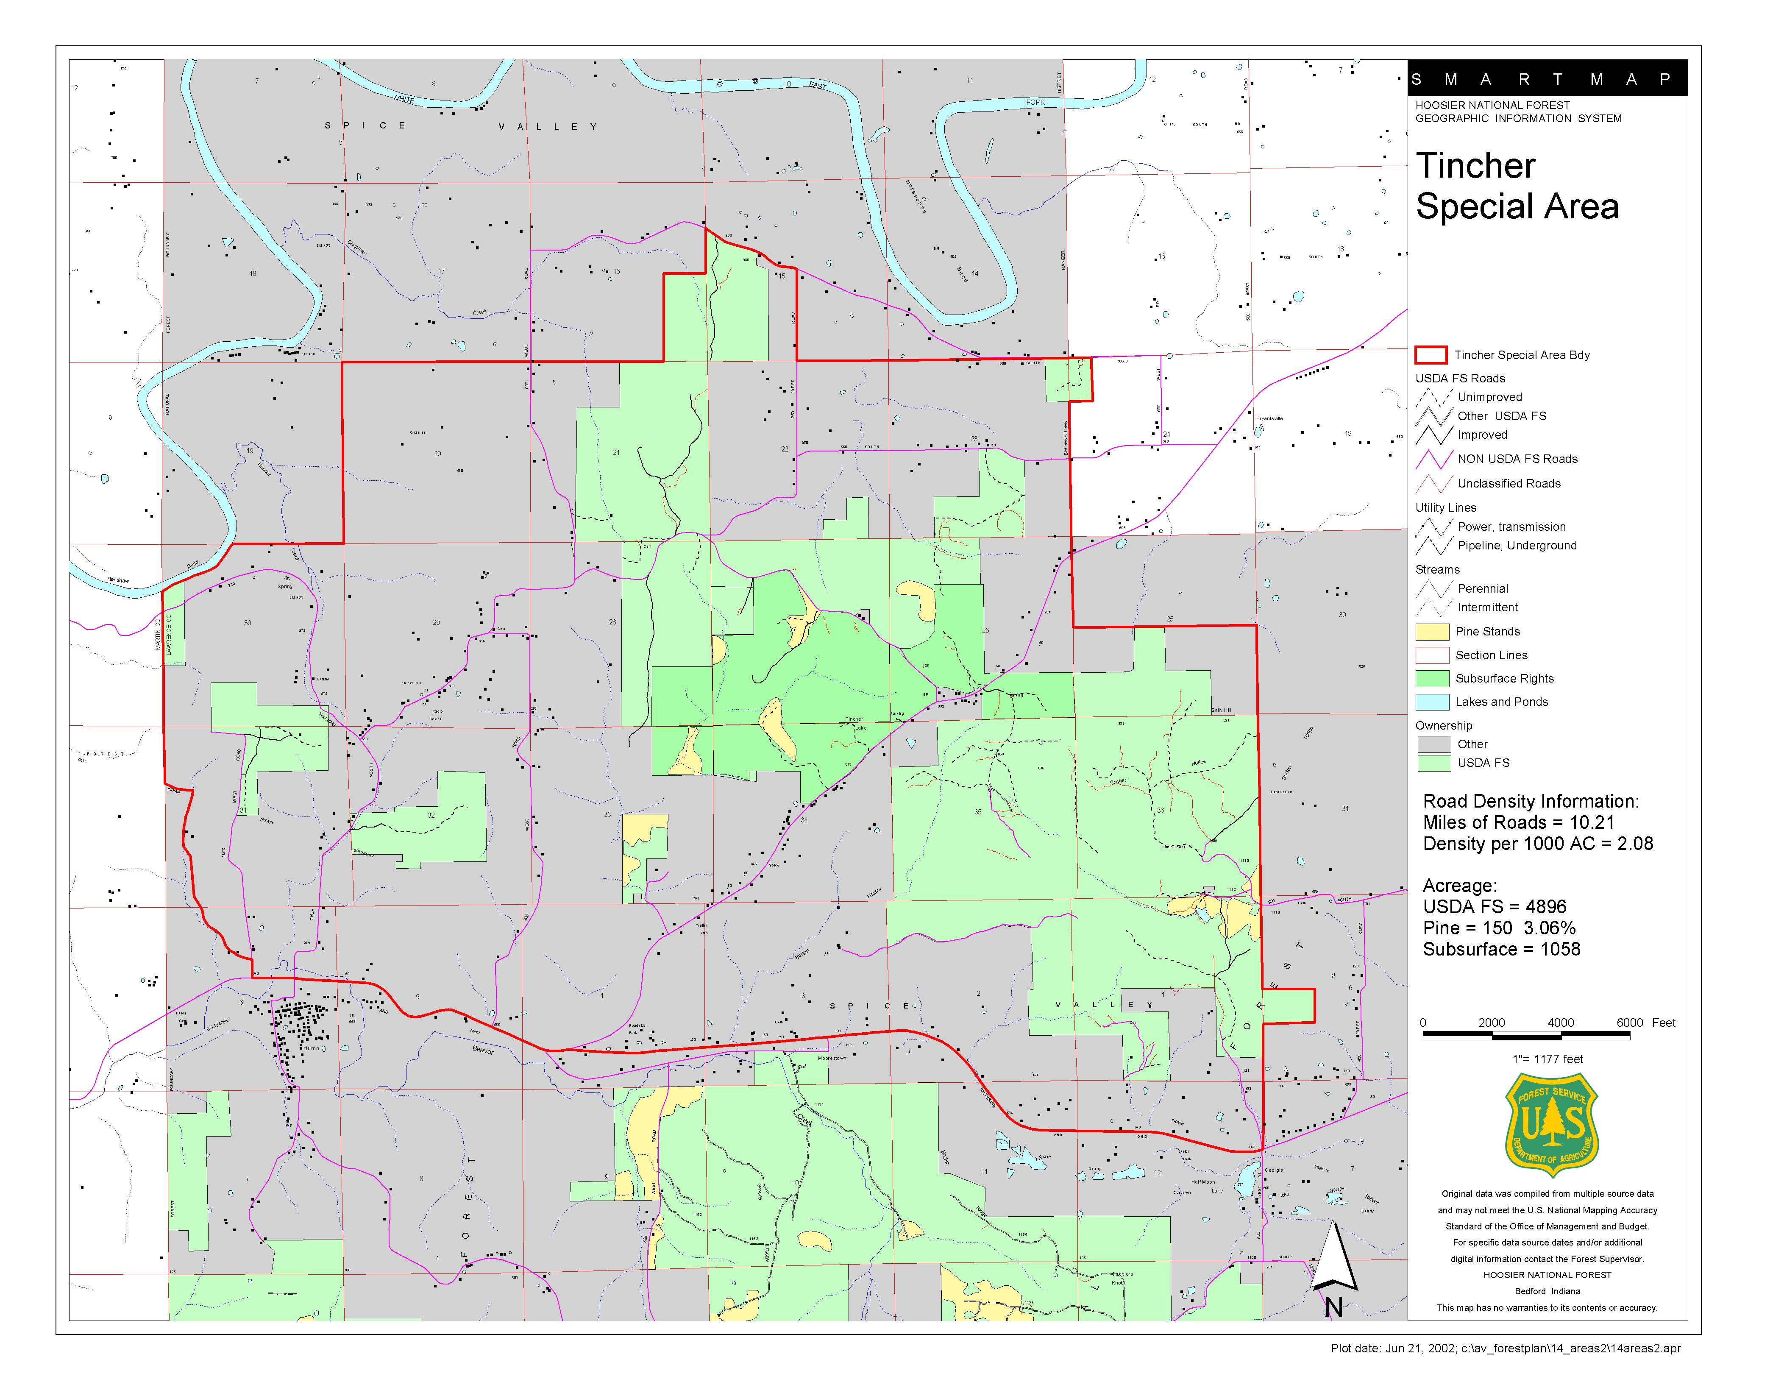
Map Example

Slide 27
How to Evaluate Each Area
An Example Using Mt. Nebo Church

Slide 28
Evaluate Each Criteria on the Evaluation Form
Criteria 1: The area contains less than a half mile of improved road for each 1,000 acres, and the road is under Forest Service jurisdiction.

Slide 29
Evaluate Each Criteria on the Evaluation Form
Mt. Nebo Church has 2.32 miles of improved roads per 1,000 acres.
It does not meet
Criteria 1.

Slide 30
Evaluate Each Criteria on the Evaluation Form
Criteria 2: Less than 15 percent of the area is non-native, planted vegetation.

Slide 31
Evaluate Each Criteria on the Evaluation Form
Mt. Nebo Church is 6.41 percent non-native, planted vegetation.
This area meets Criteria 2.

Slide 32
Evaluate Each Criteria on the Evaluation Form
Criteria 3: Less than 20 percent of the area has been harvested within the past 10 years.

Slide 33
Evaluate Each Criteria on the Evaluation Form
None of Mt. Nebo Church has been harvested within the past 10 years.
This area meets Criteria 3.

Slide 34
Evaluate Each Criteria on the Evaluation Form
Criteria 4: The area contains a few dwellings on private lands and the location of these dwellings and their access needs insulate their effects on the natural conditions of Federal lands.

Slide 35
Evaluate Each Criteria on the Evaluation Form
Mt. Nebo Church does not meet Criteria 4 due to “spotty” ownership patterns.

Slide 36
Evaluate Each Criteria on the Evaluation Form
Criteria 5: The land is regaining a natural, untrammeled appearance.

Slide 37
Evaluate Each Criteria on the Evaluation Form
Does Mt. Nebo Church meet Criteria 5?
  A pipeline bisects the area.
  Major county roads provide access to private property within the area.
  Presence of private property and houses, especially in the middle of the area.

Slide 38
Evaluate Each Criteria on the Evaluation Form
Criteria 6: Improvements existing in the area are being affected by the forces of nature rather than humans and are disappearing or muted.

Slide 39
Evaluate Each Criteria on the Evaluation Form
Does Mt. Nebo Church meet Criteria 6?
  A pipeline bisects the area.
  Major county roads provide access to private property within the area.
  Presence of private property and houses, especially in the middle of the area.

Slide 40
Evaluate Each Criteria on the Evaluation Form
Criteria 7: The area has existing or attainable National Forest System ownership patterns, both surface and subsurface, that could ensure perpetuation of identified wilderness values.

Slide 41
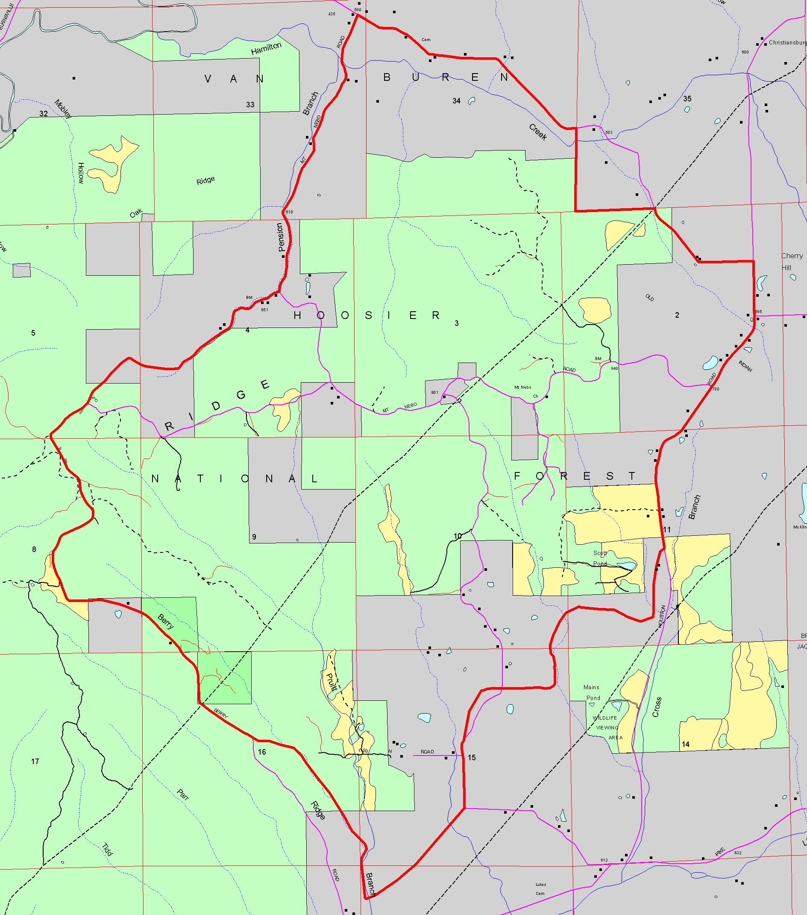
Evaluate Each Criteria on the Evaluation Form
Mt. Nebo Church has
70 acres of outstanding
oil and gas rights.
Mt. Nebo Church has
“spotty” ownership
patterns.

Slide 42
Evaluate Each Criteria on the Evaluation Form
Criteria 8: The location of the area is conducive to the perpetuation of wilderness values.

Slide 43
Evaluate Each Criteria on the Evaluation Form
Mt. Nebo Church is 2,763 acres.
This area meets the 2,500 acre “coarse” screen for perpetuation of wilderness values.

Slide 44
Conclusion from the Evaluation of Mt. Nebo Church
Does Mt. Nebo Church meet all eight roadless characteristics?
  If yes, it will be included as an inventoried roadless area.
  If no, it will continue to be managed as a backcountry area.

Slide 45
Questions?

