Slide 1
Forest Farming
An agroforestry practice
This presentation was developed by the USDA National Agroforestry Center
Notes:
Welcome. This presentation will cover one of the five recognized agroforestry practices currently being adopted and used in the US and its territories – forest farming.

Slide 2
Presentation Objectives
Define agroforestry
Define forest farming
Describe the benefits and concerns associated with forest farming
Identify potential opportunities, crops and products
Notes:
The presentation will define agroforestry; define forest farming; describe the benefits and concerns associated with forest farming; and identify potential forest farming opportunities, crops and products.

Slide 3
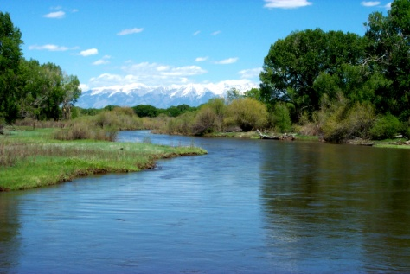
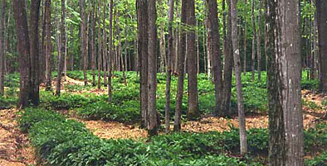
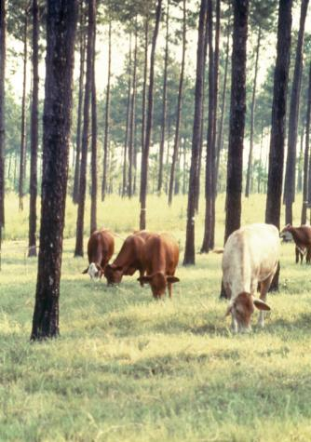
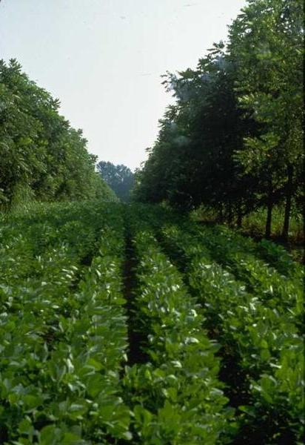
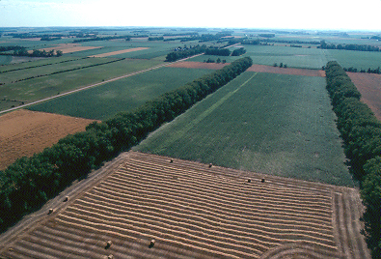
What is Agroforestry?
…the intentional combining of agriculture and working trees to create sustainable farming systems.
Riparian buffer
Forest farming
Silvopasture
Alley cropping
Windbreaks
Notes:
Forest farming is an agroforestry practice. But what is agroforestry? Although there are many definitions on agroforestry one of the simplest definitions is the intentional combining of agriculture and working trees and shrubs to create sustainable farming systems. In agroforestry systems, trees or shrubs and their products are intentionally used within agricultural systems, livestock, or forests and are cultured with woody plants (e.g. trees and shrubs). Knowledge, careful selection of species, and good management of trees and crops are needed to optimize the production and positive effects within the system and to minimize negative competitive effects. Agroforestry systems can be advantageous over conventional agricultural and forest production methods through increased productivity, improved economic benefits and social outcomes and the enhanced ecological goods and services provided. Forest farming is in use world-wide today.

Slide 4
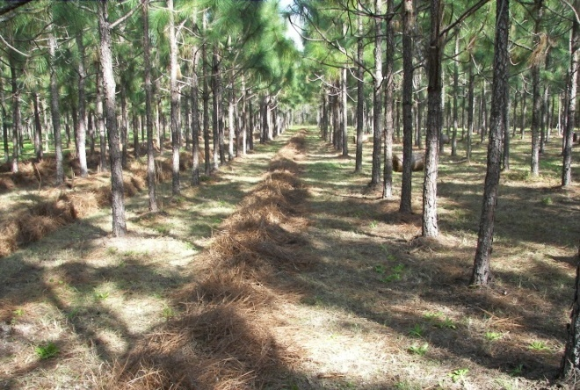
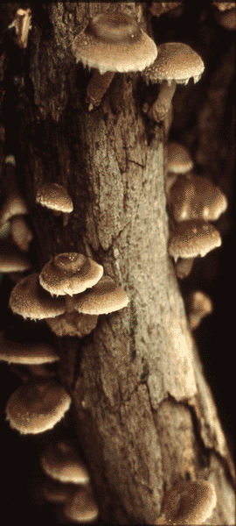
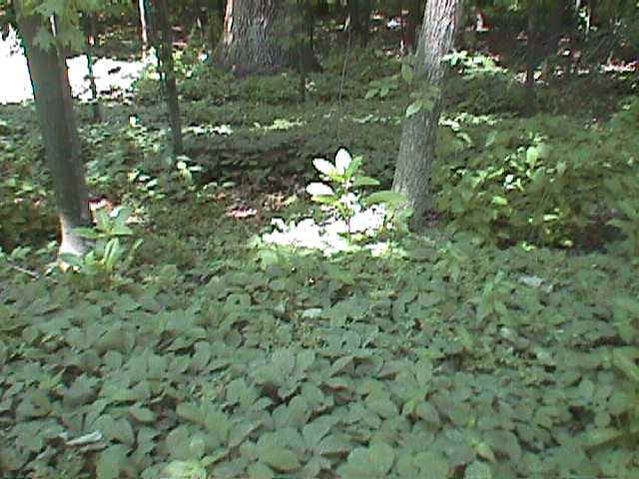
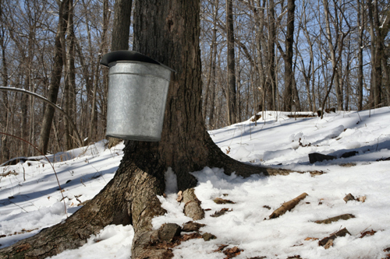
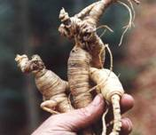
Forest Farming
The intentional manipulation, integration, and intensive management of woodlands that capitalize on specific plant interactions to produce non-timber products.
Notes:
Forest farming, sometimes referred to as multi-story cropping, is an agroforestry practice that is suitable for many of the forested areas of the United States. Forest farming is the intentional manipulation, integration, and intensive management of woodlands that capitalize on specific plant interactions to produce non-timber products. Many high-value specialty crops are now being cultivated under the protection of a forest canopy that has been modified to provide the appropriate microclimate and light conditions. To support this practice timber stand improvement activities are carried out to develop the appropriate understory conditions. Shade tolerant crops like ginseng, shiitake mushrooms, and decorative ferns are being grown and sold for medicinal, culinary, or ornamental uses. Other specialty crops include pine straw, coffee, and sugar maple syrup. Forest farming activities modify the forest ecosystem but do not significantly interfere with its crucial contributions of water capture and filtering, soil erosion control, microclimate moderation, and wildlife habitat.

Slide 5
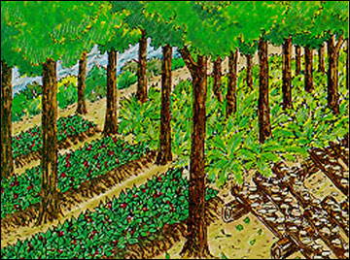
Forest Farming
Multi-storied cropping
Woodland gardening
Farming the forest
Home gardens (tropical)
Intentional and deliberate
Notes:
So, is forest farming new?? People have been doing forest farming for generations both here and abroad. In developing countries, there is a greater tradition of farming the forest. Forest farming is called many things – multistoried cropping, woodland gardening, farming the forest, home gardens. What ever its local name, forest farming is intentional and deliberate. The science of forest farming is relatively young, undeveloped, and full of questions.

Slide 6
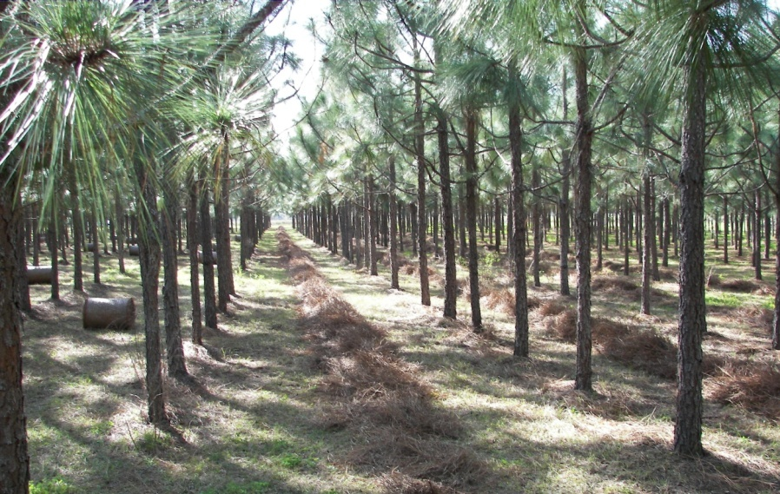
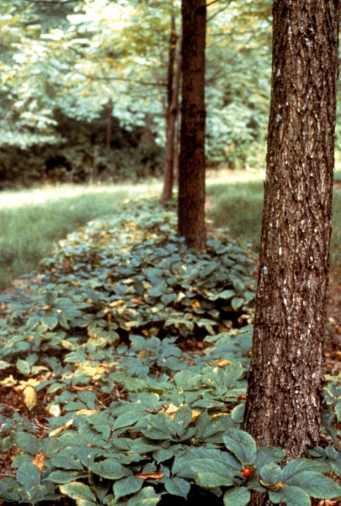
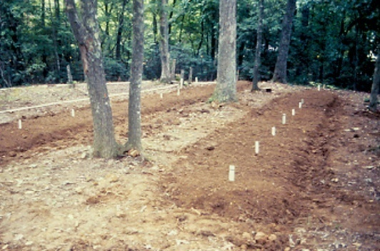
Forest Farming Methods
Woods cultivated
higher costs
farming in the forest
Wild simulated
mimics nature
lower cost
less inputs
Notes:
There are two basic levels or methods of forest farming – woods cultivated and wild simulated. Woods cultivated involves a more intensive development of the forest farming crops or products while wild simulated focuses on mimicking nature and generally results in lower costs and less inputs.
6

Slide 7
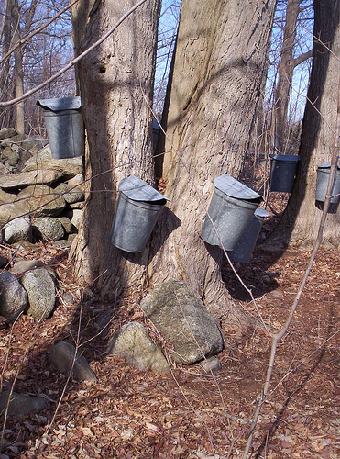
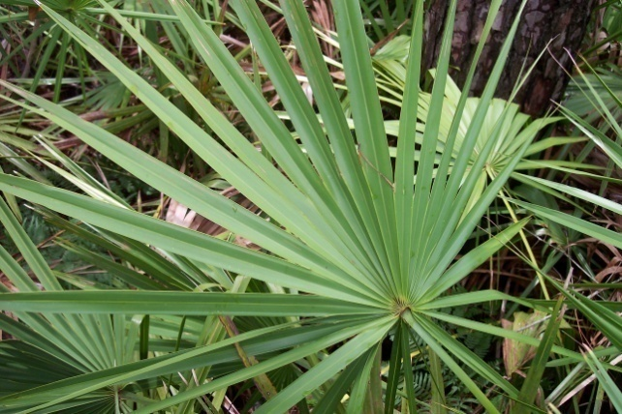
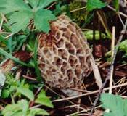
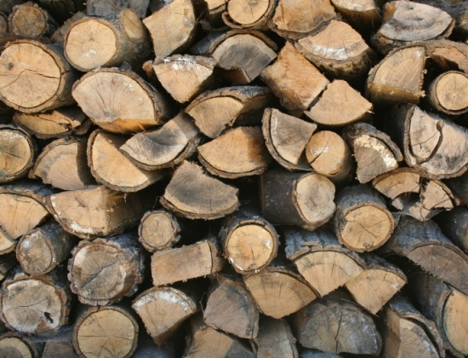
Forest Farming Benefits
Improve value and diversity of existing forests
Diversify income
Increase cash flow
Cultural/social connotations
Notes:
Why do forest farming? Let’s look at some of the reasons. Forest farming benefits include improved value of existing forests, diversification of income, and increased cash flow. No single special forest product has the potential to change the face of American farms, ranches and forests. However, a number do have sufficient market potential to be grown widely on a regional or national level. These will be the exception though, rather than the rule. Most forest farming markets are local to regional in nature. Finally, forest farming can have important cultural and social values, whether it’s the type of crop or the actual activity of forest farming.

Slide 8
Forest Farming Concerns
More intensive management, more skills
Markets remain fluid/poorly understood
Task of learning new concepts may be challenging
Considerable capital investments may be needed
Some plants may be endangered or subject to exploitation.
Notes:
There are a number of issues and concerns associated with forest farming. Forest farming may require more intensive management and more skills; many markets remain fluid and enigmatic or poorly defined; the task of learning new concepts may be challenging; considerable capital investments may be needed; and finally, some plants may be endangered or subject to exploitation, limiting the availability and harvesting of certain crops.

Slide 9
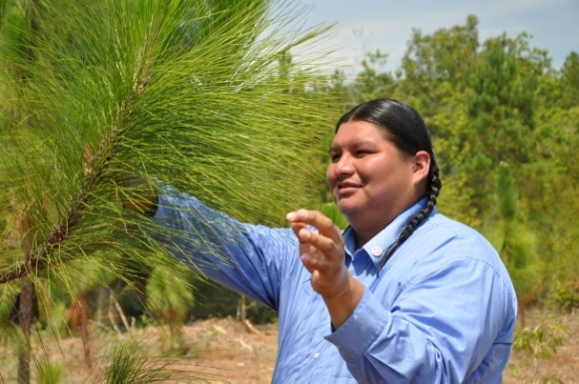
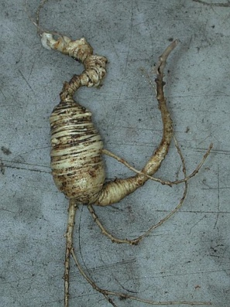
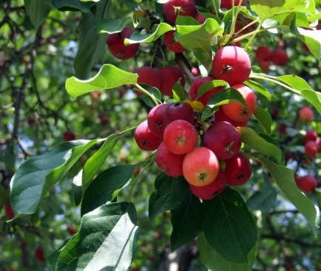
What to Grow???
Economic value with ready market
Associated with the understory – ground cover, herbs, shrubs, trees
Easy to grow or cultivate
Native
Traditional use
Under-utilized/novelty
Cultural or social interest
Notes:
What are some basic guidelines for deciding on a particular forest product? Things to consider include: does it have an economic value with a ready market; is it naturally associated with the understory – ground cover, herbs, shrubs, trees; is it easy to grow or cultivate; is it native; does it have a traditional use; is it an under-utilized or novelty crop or product; and is there a cultural or social interest that might create demand.

Slide 10
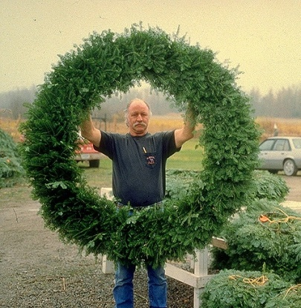
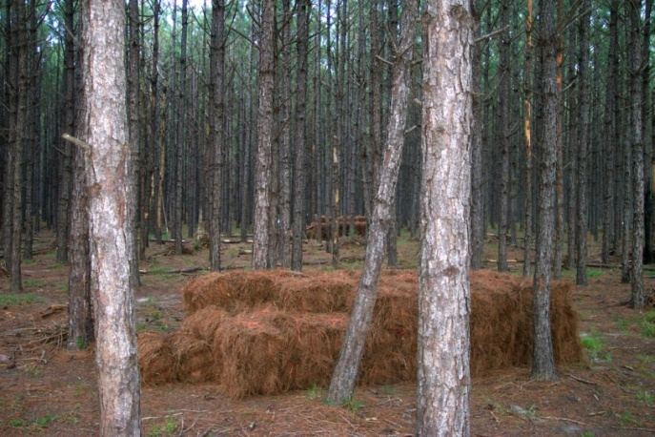
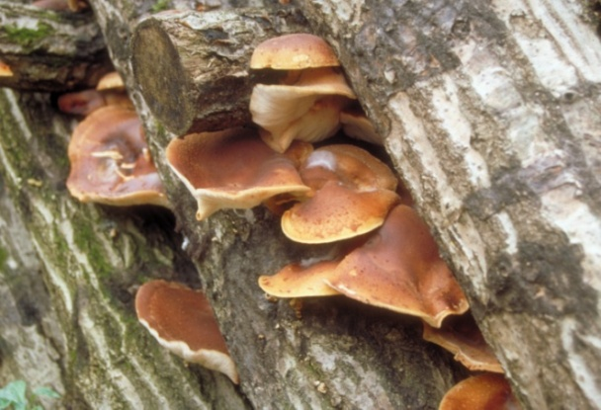
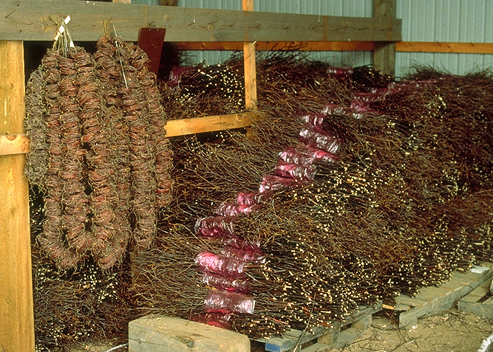
Potential Forest Farming Products
Mushrooms
Florals
Greenery
Fruits
Herbs/vegetables
Landscaping
Crafts
Botanicals/medicinals
Nuts
Pollen
Notes:
The list of potential forest farming products is almost endless and will vary by region. Some of the more common products include: Mushrooms, Florals, Greenery, Fruits , Herbs/vegetables, Landscaping, Crafts , Botanicals/medicinals, Nuts, and Pollen.

Slide 11
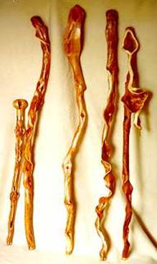
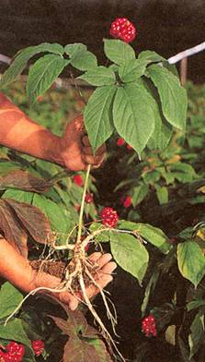
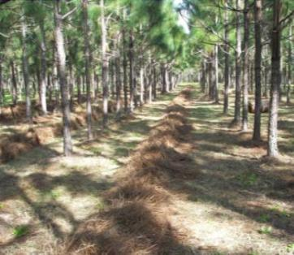
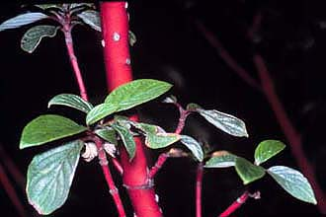
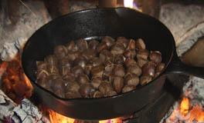
Product Categories
Medicinals
Food Products
Decoratives
Handicrafts
Notes:
Forest farming products can generally be placed in four categories. These include medicinals, food products, decoratives, and handicrafts. Many special forest products will be produced for niche markets at local or regional levels. With many of them, the true value of the plant will not be realized by producers unless they are willing to invest time, and perhaps money, into post-harvest processing and marketing of the product. Value generally increases when the plant (root, foliage, branch, or fruit) is transformed into a finished product that meets a consumer demand.

Slide 12
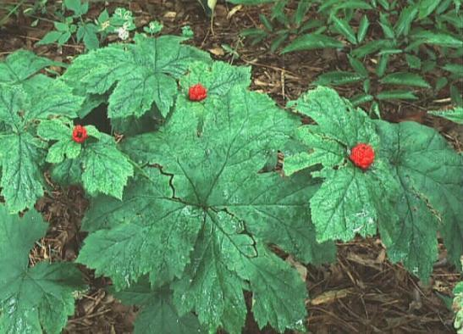
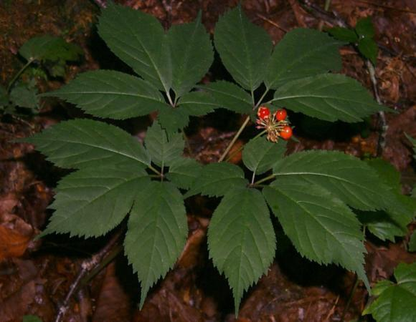
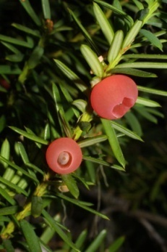
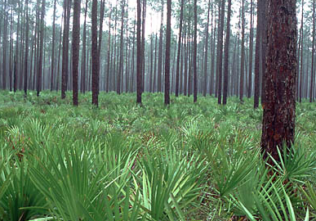
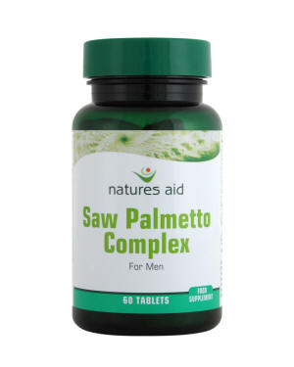
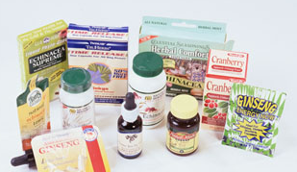
*Inclusion of this slide does not imply USDA endorsement of the health value of these products for humans Medicinals*
Dietary supplements
Herbal medicines
Ethnobotanicals
Examples:
Black cohosh
Ginseng
Goldenseal
May apple
Witch-hazel
Bloodroot
Pacific yew
Saw palmetto
Notes:
12
The use of plants for healing is not something new and fall into three main categories; Dietary supplements, Herbal medicines, and Ethnobotanicals. The foundation for much of the herbal medicinal industry in the US is based on knowledge gained from native Americans. Herbal medicinal plants are by far the largest segment of the forest farming industry in terms of value. Total U.S. market exceeds $4 billion. What portion of that is actually collected from forests is unknown.

Slide 13
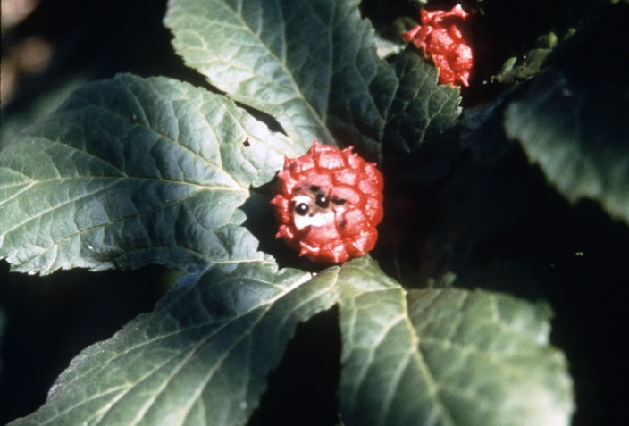
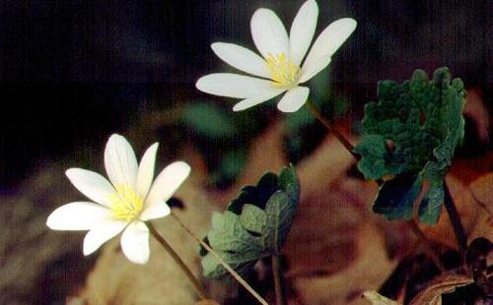
Opportunities
Popular/ in vogue
High demand
High value
International and US markets
Notes:
What are some of the opportunities with medicinals? They are popular and in vogue right now. There is a high demand and high value associated with the products. And there are international and US markets which also helps keep demand and prices high.

Slide 14
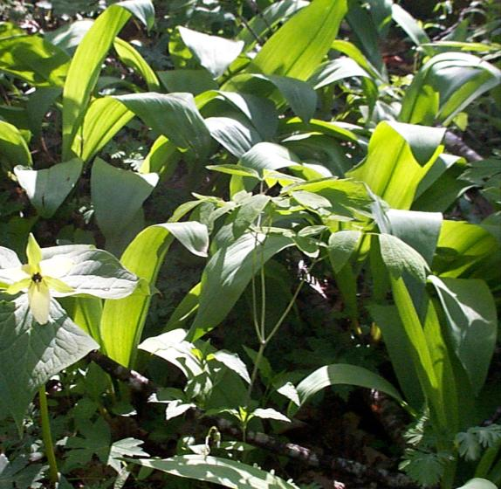
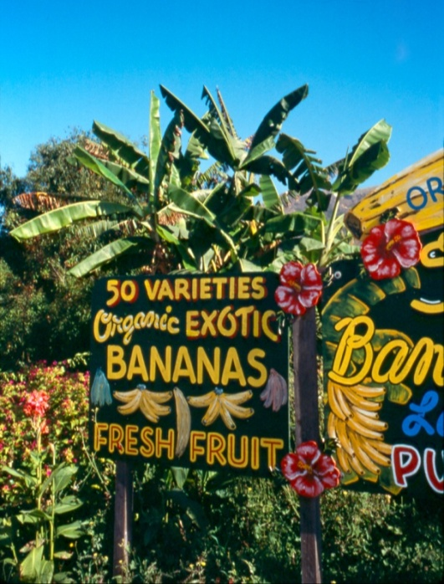
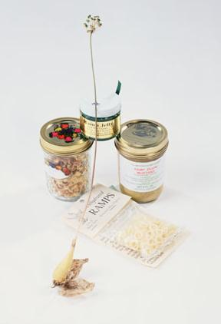
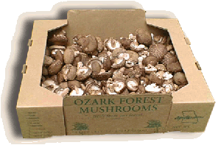
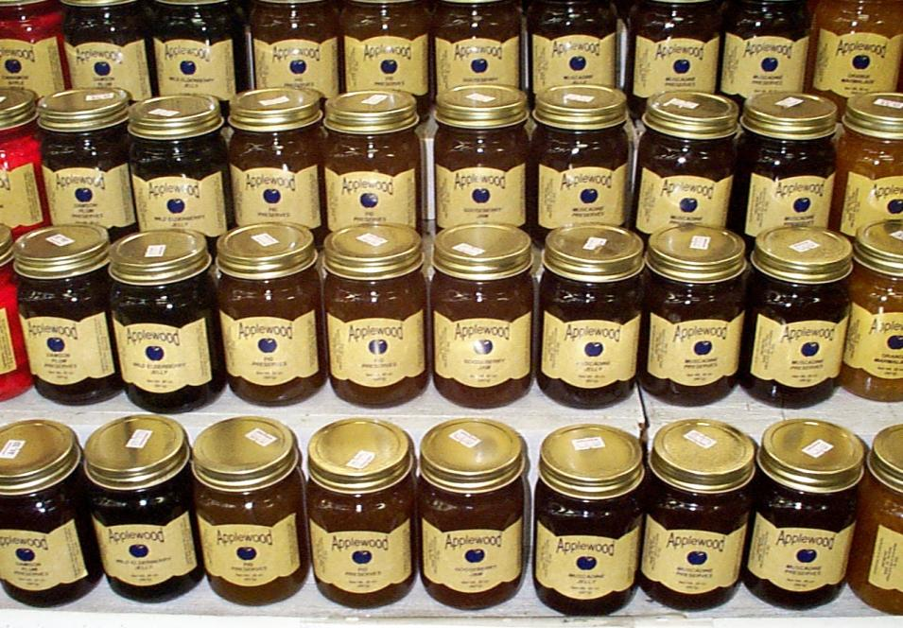
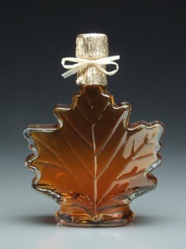
Foods
Fruits
Syrups
Mushrooms
Nuts
Vegetables
Honeys
Forest Farming
Notes:
The production and use of food from the forest has become much more than a family outing in the woods to pick berries. The array of potential food products is almost endless – from mushrooms to nuts, from to leeks to honey and syrup to fruits. If it tastes good to someone – you have a potential product and a market!

Slide 15
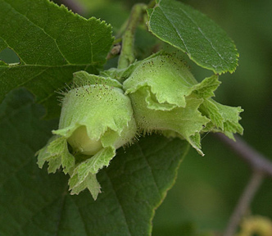
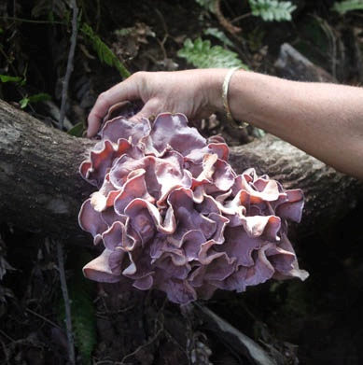
Opportunities
People love (and need) food
Native plants = natural (and wholesome)
Local food markets
Processing increases value
Organic possibilities
Notes:
15
What are some of the opportunities with foods? First of all, people love (and need) food. Most of the high value food products are from native plants. In today’s environment, natural means wholesome and good for you. Most if not all food products can be marketed through local food markets which simplifies travel and lowers costs. Processing the food products increases value beyond the raw product. In addition, organic opportunities are possible and profitable.

Slide 16
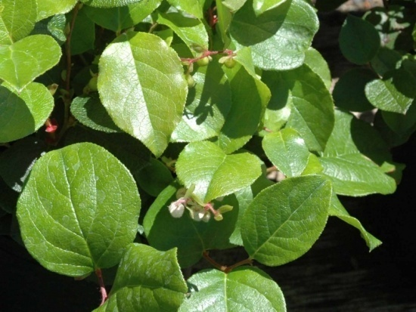
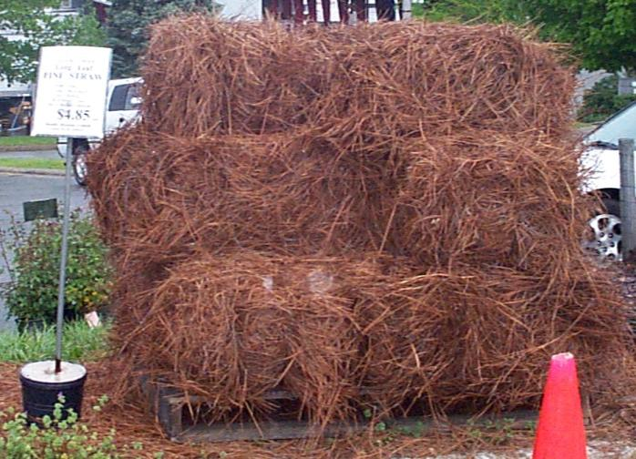
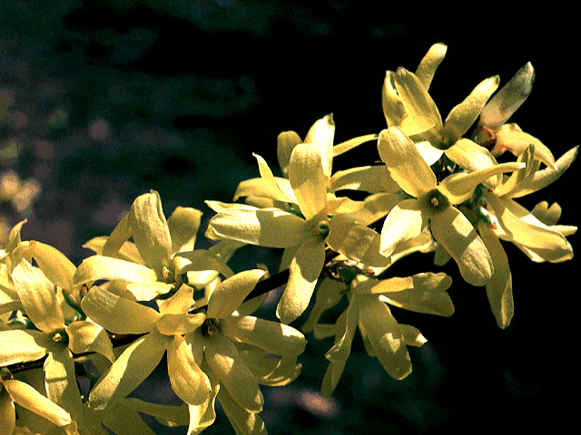
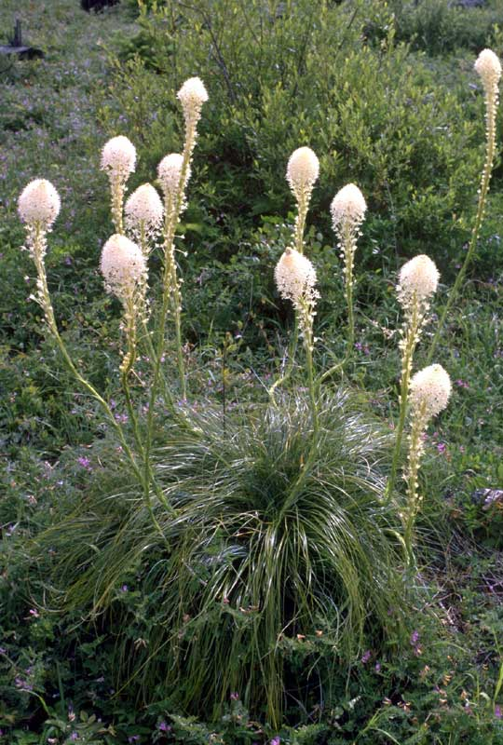
Decoratives
Landscaping
Florals
Examples:
Bittersweet
Red-twig dogwood
Forsythia
Sword fern
Pine straw
Pine cones
Galax
Moss
Boughs
Salal
Notes:
16
The decoratives market includes plants and plant parts for landscaping and floral arrangements. Because of the growth nature of plants used for Decoratives, many are seasonal and have limited periods of utility. Decorative markets range from local to international. One company in Wisconsin ships more than 300,000 pounds of Lycopodium to Germany each year.

Slide 17
Opportunities
Popular
Local and regional markets
Ready markets
Seasonal
Forest Farming
Notes:
What are some of the opportunities with decoratives? Decoratives are certainly popular especially for local and regional markets. Because of this popularity, there are ready markets for any of the products. While many decoratives are seasonal, this allows producers to focus their time and efforts into a defined time period and allows for the integration of other jobs or businesses.

Slide 18
Crafts
Derived from:
Vines
Branches
Cones
Foliage
Bark
Roots
Burls
Culls
Notes:
18
Interestingly, less is known about specialty wood, handi-craft products than any of the other forest farming products. Since any material from the forest can be used for handicraft products, the craft products are almost limitless. Many of the typical craft products are derived from Vines, Branches, Cones, Foliage, Bark, Roots, Burls, and Culls.

Slide 19
Opportunities
Open to the imagination
Making ‘silk out of a sow’s ear’
Local and regional markets
High value possibilities
Notes:
What are some of the opportunities with crafts? This one is truly open to the imagination. One of advantages of forest farming crafts is that an individual and take a totally secondary material and literally as the saying goes, make ‘silk out of a sow’s ear’. Craft products lend well to local and regional markets and depending on the demand and craftsmanship can create high value possibilities. However, growing craft materials and having the knowledge, skills, and artistic abilities to make value-added crafts are very different sets of skills.
19

Slide 20
For Additional Information
A number of web sites are available to provide more detailed information on forest farming. Here are a few:
USDA National Agroforestry Center https://www.fs.usda.gov/nac/practices/forestfarming.php
The Center for Agroforestry http://www.centerforagroforestry.org/practices/ff.php
Association for Temperate Agroforestry http://www.aftaweb.org/
Notes:
Where is there more information on forest farming? A number of web sites are available to provide more detailed information on forest farming systems. Here are a few: USDA National Agroforestry Center, The Center for Agroforestry, Association for Temperate Agroforestry, and Non-timber forest products.

Slide 21
Summary – Forest Farming
Multi-storied agriculture with trees
Enhanced economic diversification
Improved value and diversity of existing woodlands
Increased cash flow through a variety of non-timber products
Cultural/social connotations
Notes:
The woodlands and forests of the US contain a vast storehouse of products that are not timber-based. Forest farming provides opportunities to generate short-term and long term income from existing woodlots, many times with minimum capital investment. Especially on small family farms, this can contribute significantly to rural economic development and diversification and meet local cultural and social needs. The strength of today’s forest farming practice is its ability to meet multiple objectives, improving farm and forest sustainability, increasing and diversifying income while conserving and protecting our natural resources and creating a new way to the future.

Slide 22
Acknowledgements
This presentation was developed by the USDA National Agroforestry Center (NAC), Lincoln NE.
NAC is a USDA partnership between the U.S. Forest Service and the Natural Resources Conservation Service.
National Agroforestry Center
"The U.S. Department of Agriculture (USDA) prohibits discrimination in all its programs and activities on the basis of race, color, national origin, age, disability, and where applicable, sex, marital status, familial status, parental status, religion, sexual orientation, genetic information, political beliefs, reprisal, or because all or part of an individual’s income is derived from any public assistance. (Not all prohibited bases apply to all programs.) Persons with disabilities who require alternative means for communication of program information (Braille, large print, audiotape, etc.) should contact USDA’s TARGET Center at 202-720-2600 (voice and TDD).
To file a complaint of discrimination, write USDA, Director, Office of Civil Rights, Room 326-W, Whitten Building, 1400 Independence Avenue, SW, Washington, D.C. 20250-9410 or call (202) 720-5964 (voice and TDD). USDA is an equal opportunity provider and employer."
Notes:
This presentation was developed by the USDA National Agroforestry Center (NAC), Lincoln NE. NAC is a USDA partnership between the U.S. Forest Service and the Natural Resources Conservation Service.

