Slide 1
Windbreaks
An agroforestry practice
This presentation was developed by the USDA National Agroforestry Center
Notes:
Welcome. This presentation will cover one of the five recognized agroforestry practices currently being adopted and used in the US and its territories – windbreaks.

Slide 2
Presentation Objectives
Define windbreaks
Describe the benefits and types
Recognize basic design considerations
Windbreaks
Notes:
This presentation will Define a windbreak, Describe the benefits and types, and Recognize basic design considerations that influence the placement and type of windbreak that is needed.

Slide 3
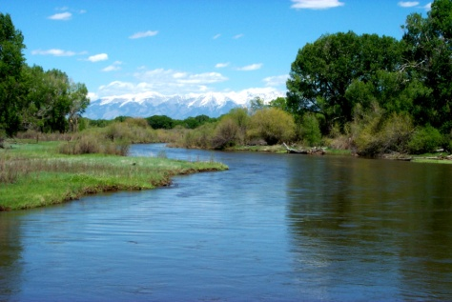
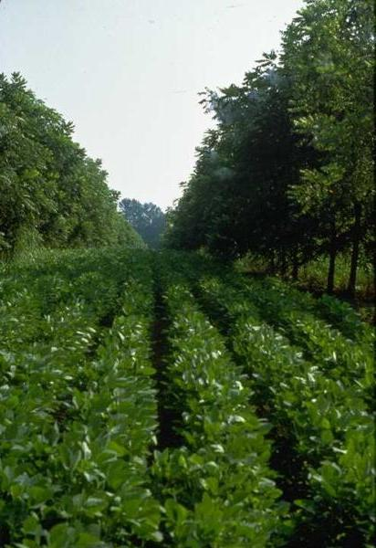
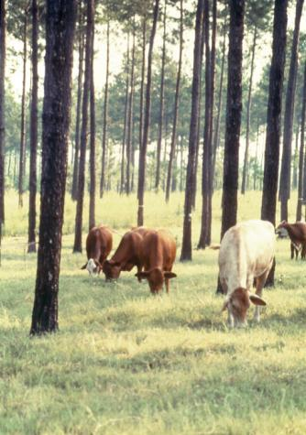
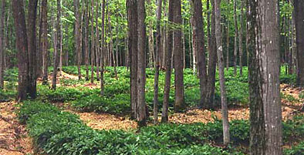
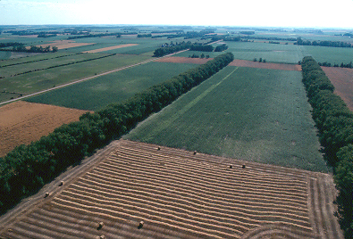
What is Agroforestry?
…the intentional combining of agriculture and working trees to create sustainable farming systems.
Riparian buffer
Forest farming
Silvopasture
Alley cropping
Windbreaks
Windbreaks
Notes:
A windbreak is an agroforestry practice. But what is agroforestry? Although there are many definitions on agroforestry one of the simplest definitions is the intentional combining of agriculture and working trees to create sustainable farming systems. In agroforestry systems, trees or shrubs and their products are intentionally used within agricultural systems, livestock, or forests and are cultured with woody plants (e.g. trees and shrubs). Knowledge, careful selection of species, and good management of trees and crops are needed to optimize the production and positive effects within the system and to minimize negative competitive effects. Agroforestry systems can be advantageous over conventional agricultural and forest production methods through increased productivity, improved economic benefits and social outcomes and the enhanced ecological goods and services provided. Agroforestry systems are used world-wide today.

Slide 4
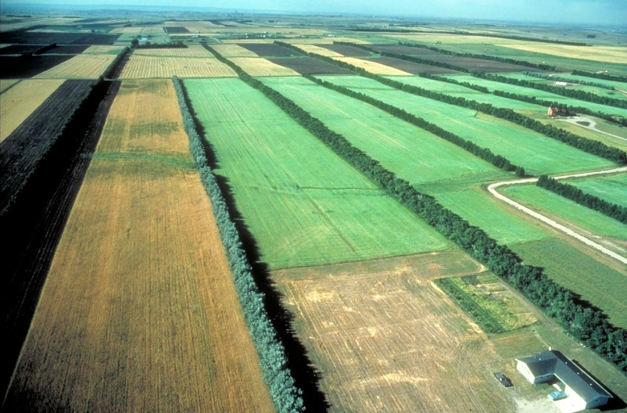
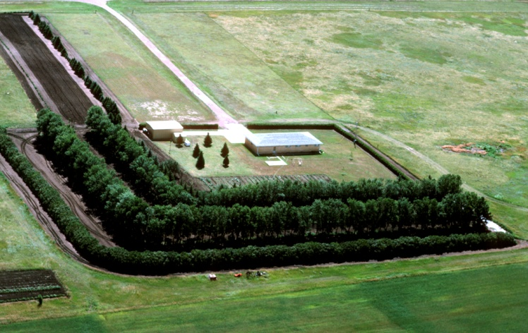
What is a windbreak?
Plantings of single or multiple rows of vegetation (trees, shrubs, grass) that are established for one or more environmental and economic purposes.
Windbreaks
Notes:
What is a windbreak? Windbreaks are a familiar agroforestry practice and applied in many areas of the country. They are also referred to as “shelterbelts” and have been used extensively in the United States since the “dust bowl” era of the 1930’s. A windbreak’s major function is to mitigate wind speed. Therefore, a windbreak can be defined as any living barrier that reduces troublesome winds by creating a wind shadow to the leeward (downwind) side. An agroforestry windbreak is one that utilizes single or multiple rows of trees and/or shrubs that are integrated into crop, livestock, or human activities for environmental and economic purposes.

Slide 5
What are the benefits?
Reduce soil erosion
Protect plants
Enhance plant growth
Manage snow
Provide shelter
Reduce energy needs
Improve wildlife habitat
Enhance aesthetics
Moderate noise
Screen views
Reduce airborne chemical drift
Improve irrigation efficiency
Increase carbon storage
Mitigate odors
Windbreaks
Notes:
What benefits do windbreaks provide? The first pane lists some of the more traditional and recognized benefits and purposes. The second pane lists some of the new emerging uses for windbreaks. Windbreaks offer a multitude of benefits – from reducing energy costs to sequestering carbon. Its important to remember that not all benefits can be achieved from all windbreaks. Different farm, ranch and community needs require different windbreak designs which provide varying types and levels of benefits. A good windbreak design, however, will create multiple benefits and mitigate multiple concerns.

Slide 6
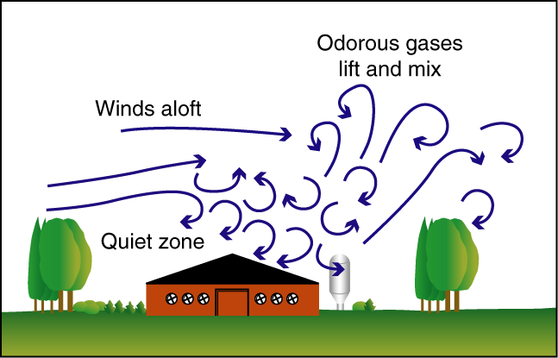
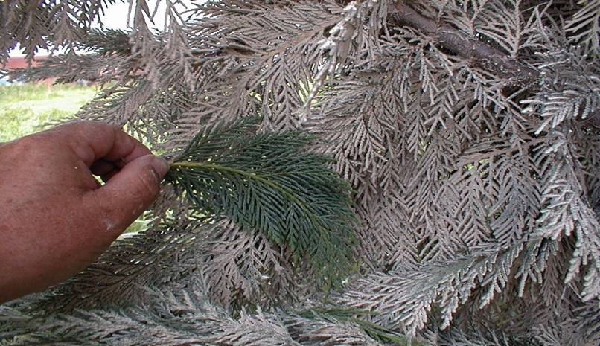
How does a windbreak work?
Modify:
Air flow
Sound waves
Odor plumes
Microclimate dynamics
Trap/filter air borne:
Sediment
Snow
Nutrients
Pesticides
Pathogens
VOCs
Windbreaks
Notes:
How does a windbreak work? Windbreaks work in two ways – modifying air currents that change air flows, sound waves, odor plumes, and microclimates and trapping or filtering air borne contaminants such as sediment, snow, nutrients, pesticides, pathogens, and volatile organic compounds (VOCs). These two activities make windbreaks an exceptional environmental tool for conservation planning.

Slide 7
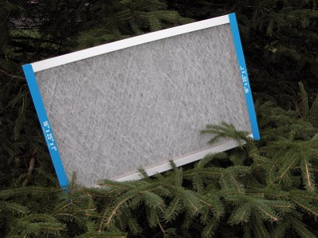
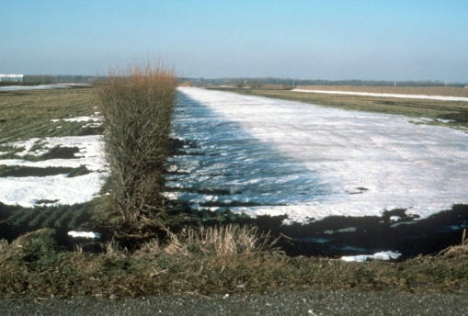
What are the effects?
Windbreaks:
lower wind velocity causing
air-borne material to be deposited
physically trap air-borne material
adsorb some of the chemicals
attached to air-borne material
alter the microclimate on the downwind side of the windbreak
Windbreaks
Notes:
What are the effects on the wind when a windbreak is placed on the landscape? Windbreak air flow modifications have a number of effects on air-borne material or particulate matter carried by the wind. Windbreaks lower wind velocity causing air-borne material such as snow to be deposited; physically trap air-borne material such as dust; adsorb some of the chemicals attached to air-borne material; and alter the microclimate on the downwind side of the windbreak that adds to increased crop yields. Air-borne material can come in almost any shape or size, and can be solid particles or liquid droplets. Air-borne material or particulate matter can include smoke, dirt and dust from factories, farming, and roads or organic compounds and chemicals or snow, mold, spores, and pollen.

Slide 8
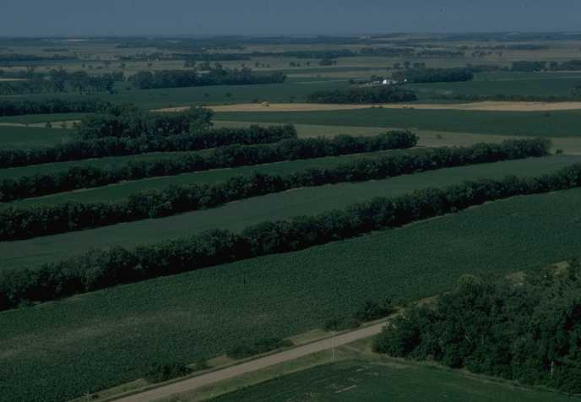
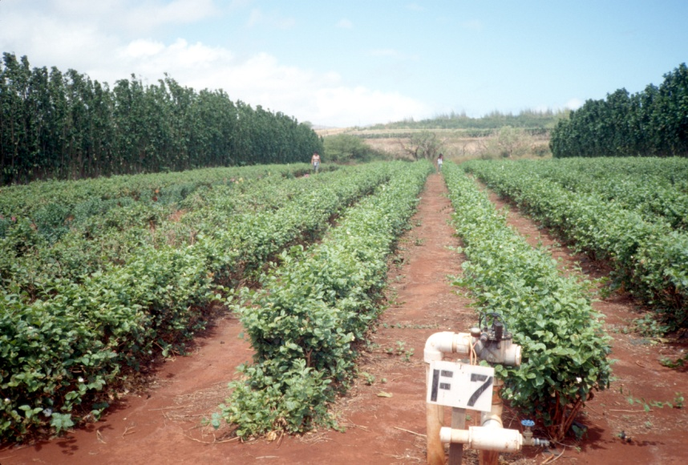
How can air flow patterns be modified?
Modification of the wind depends upon six key windbreak features:
  Height
  Density
  Orientation
  Length
  Width
  Continuity
Windbreaks
Notes:
How can air flow patterns be modified? Modification of air flow depends upon six key windbreak features: Height, Density, Orientation, Length, Width, and Continuity. Each one of these features has its place to play in a windbreak and directly influences the effectiveness of any windbreak. Lets take a look at each of these features in more detail.

Slide 9
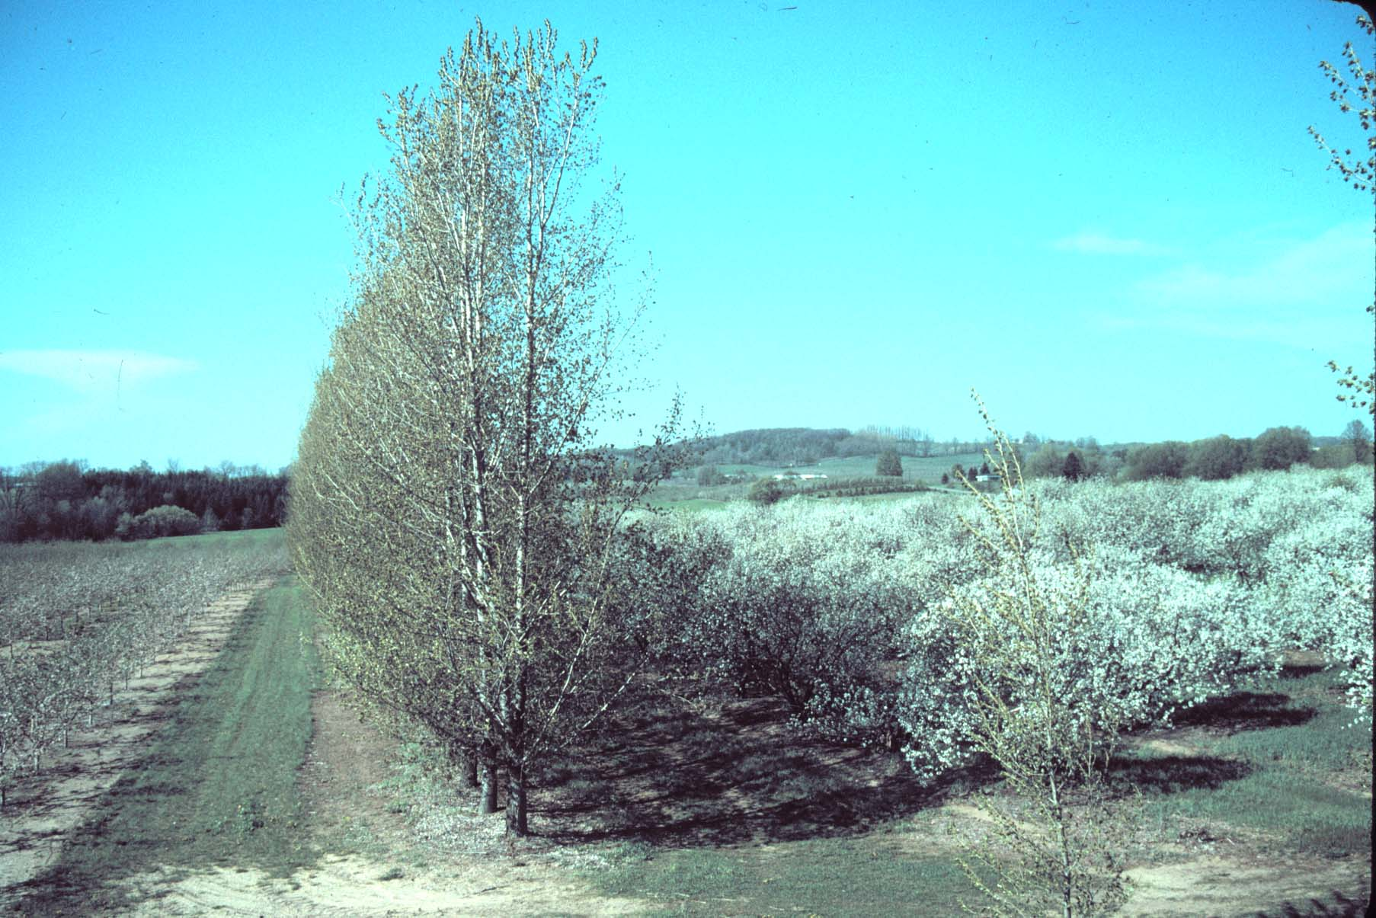
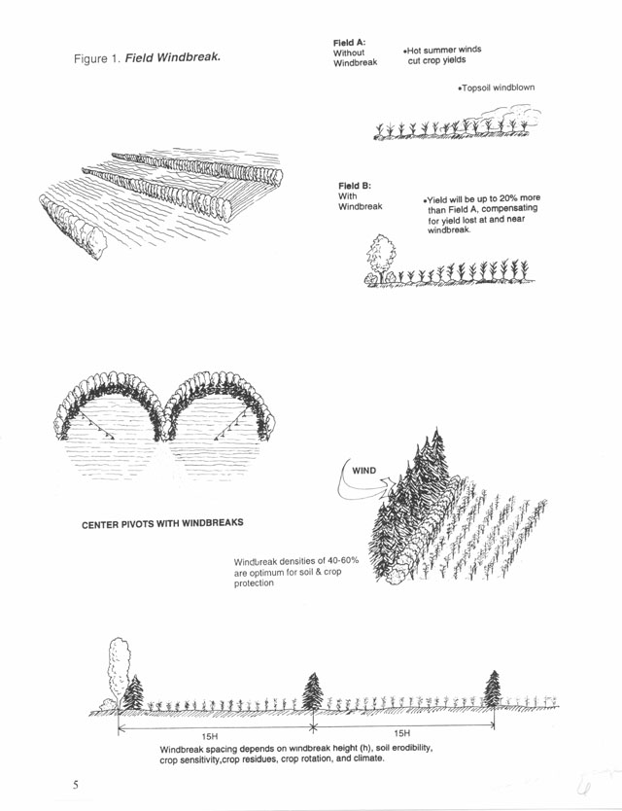
Why is height important?
H = Effective height of the windbreak
The height determines the distance of the downwind sheltered (protection) zone
H
10H to 15H
10H to 15H
Windbreaks
Notes:
Windbreak height (referred to as ‘H’) is the most important factor determining the downwind area of protection. The windbreak ‘H’ is the height of the tallest row of plants in the windbreak. The windbreak will reduce wind speed for 2 to 5 times the height of the windbreak (2H to 5H) on the upwind side and up to 30H on the downwind side of the barrier. The area protected is directly proportional to the height, i.e. a 20 foot windbreak will have a 40% reduction at 4H or 80 feet downwind and a 60 foot windbreak will have a 40% reduction at 4H or 240 feet downwind.

Slide 10
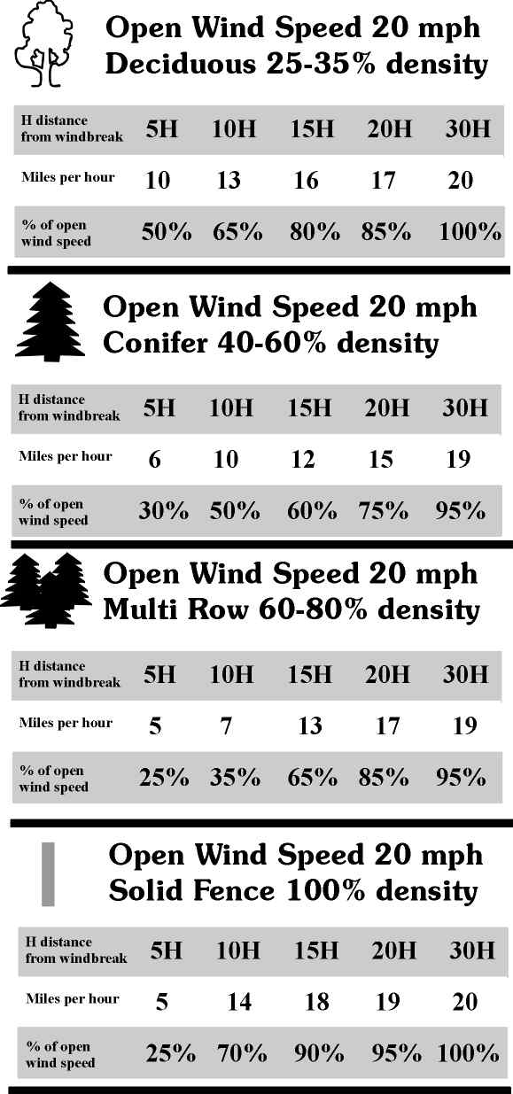
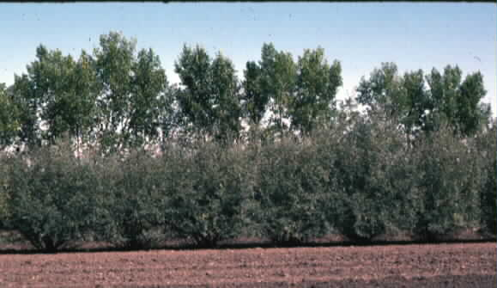
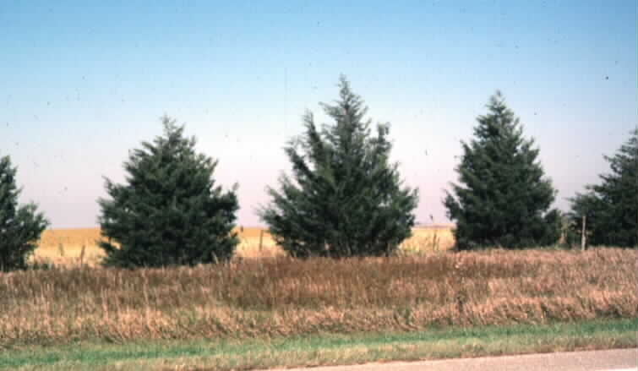
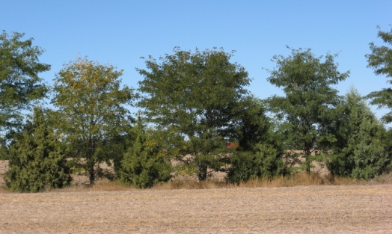
Why is density important?
Dense: maximum wind reduction but short wind shadow
Moderately dense: less wind reduction but longer wind shadow
Windbreaks
Notes:
Density is the ratio of the solid portion of the barrier to the total area of the barrier. Wind flows through the open portions of a windbreak, thus the more solid the windbreak, the less wind passes through. By adjusting windbreak density different wind flow patterns and areas of protection can be established. The density level is manipulated by the choice of plant materials (e.g. deciduous trees versus conifers) and the way the plants are arranged in the windbreak. Dense windbreaks have maximum wind reduction but short wind shadows or areas of protection while a less dense windbreak will have less wind reduction but a longer wind shadow or area of protection.

Slide 11
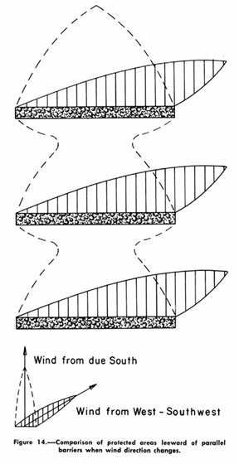
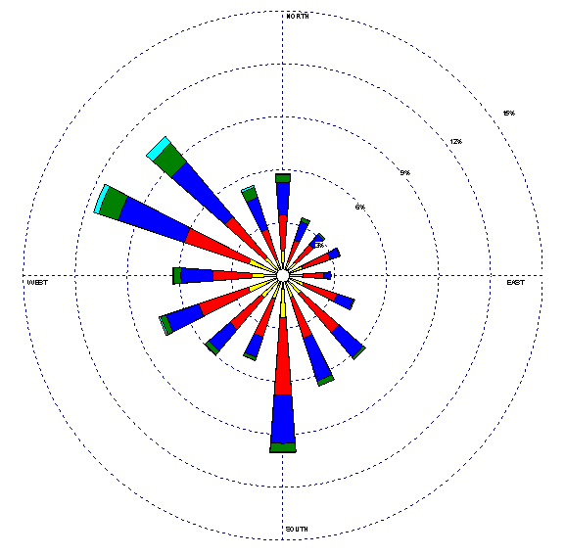
Why is orientation important?
Location or layout:
Directly influences area protected
Effects vary with critical weather periods and wind directions
Wind Rose
Windbreaks
Notes:
Why is orientation important? Windbreaks are most effective when oriented at right angles to prevailing or troublesome winds. The best orientation for each windbreak depends on the objectives for the windbreak. A key point to remember is that although the troublesome wind may occur primarily from one direction, it rarely blows exclusively from that direction. As the wind changes direction and is no longer blowing directly against the windbreak, the protected area decreases. Identification of damaging winds is a critical step. Data from local weather stations, climate data bases and landowner observations are all information sources. Wind roses are effective tools for determining prevailing wind directions. Wind roses are a graph of both frequency and velocity of winds during a specified period of time, usually a month or during a single day.

Slide 12

Why is length important?
For full protection, the windbreak needs to extend the entire length of the area needing protection to account for changing wind directions.
Doubling the length of a windbreak will generally increase the area protected by 4 times
Windbreak
protected area
Windbreaks
Notes:
Why is length important? Although the height of the windbreak determines the extent of the protected area downwind, the length of a windbreak determines the amount of total area receiving protection. For full protection, the windbreak needs to extend past the width of the area needing protection to account for changing wind directions. Doubling the length of a windbreak will generally increase the area protected by 4 times.

Slide 13
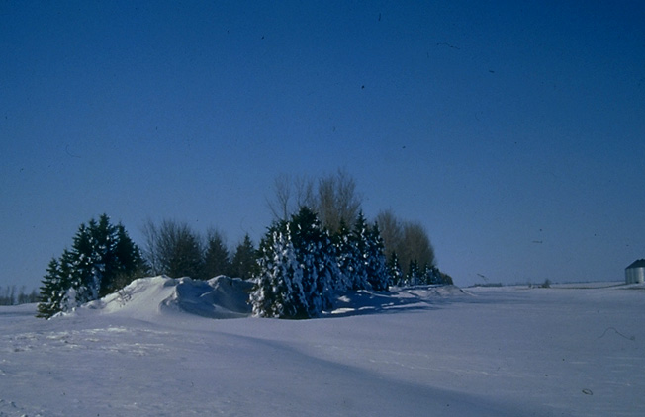
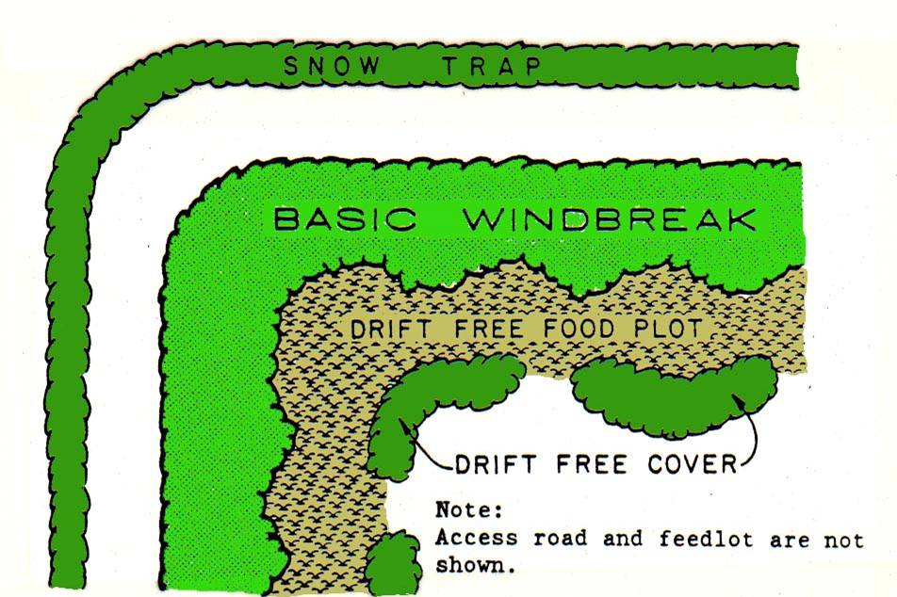
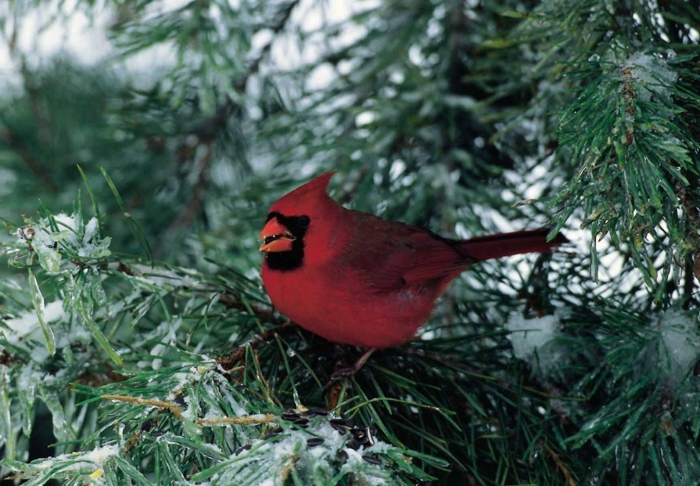
Why is width important?
Width influences:
Density
Wildlife values
Trapping capacity and efficiency
Windbreaks
Notes:
Why is width important? Width influences windbreak effectiveness through its influence on density, wildlife values such as increased food, cover and protection, and trapping efficiency. As the windbreak width increases density, wildlife value, and trapping efficiency all increase. Wider windbreaks allow the use of more types of plant species thus increasing site diversity and creating possible additional benefits such as income or food sources.

Slide 14
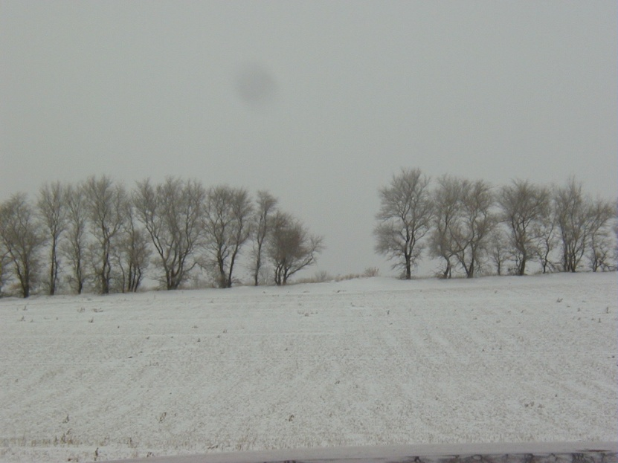
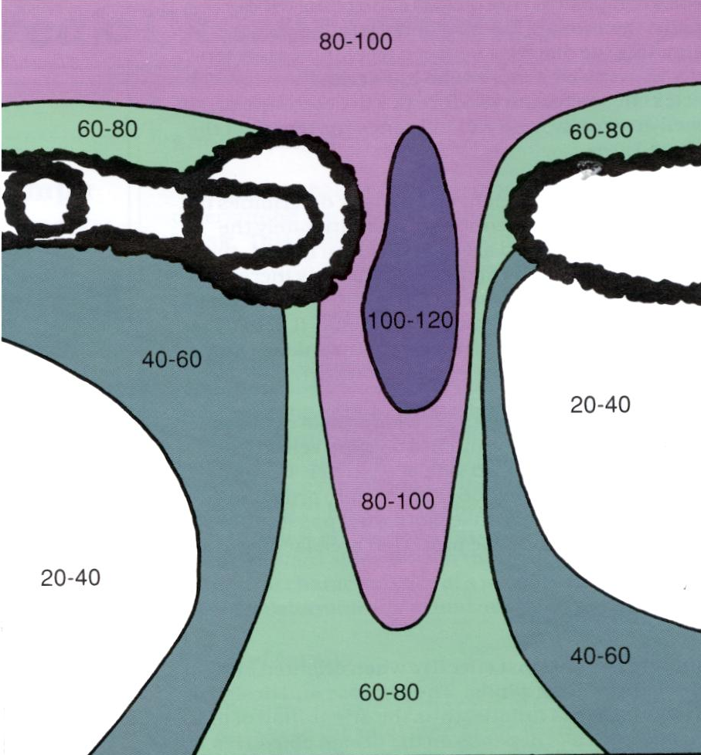
Why is continuity important?
Wind speed increases in a gap
Gaps in the windbreak can result in damage or complications downwind
(% of open wind speed)
Windbreaks
Notes:
Why is continuity important? It is critical that the wind barriers do not have any gaps. Essentially, a gap creates an “end effect” that generates higher winds, in the windbreak, dramatically reducing its effectiveness. The wind velocity through a gap can actually accelerate to 120% of open wind velocity resulting in crop damage or snow drift problems.

Slide 15
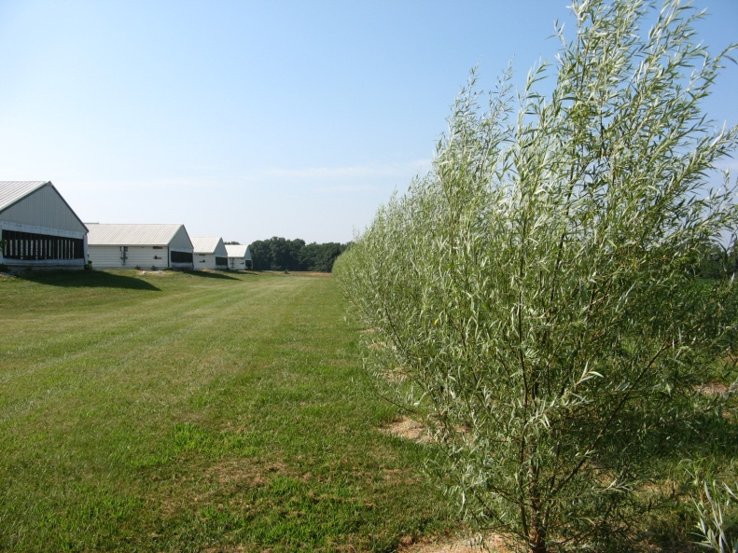
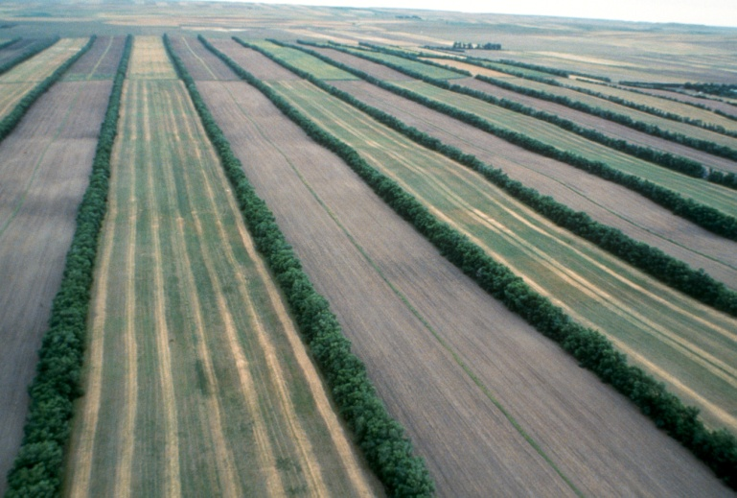
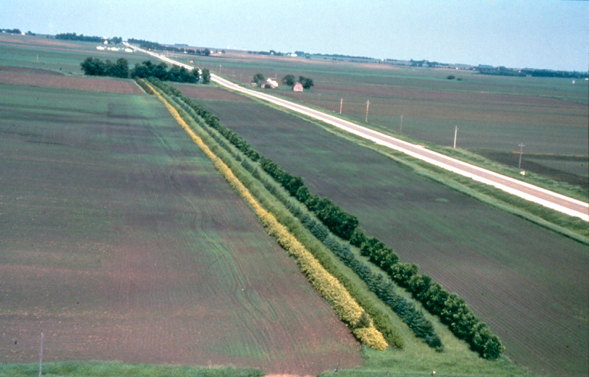
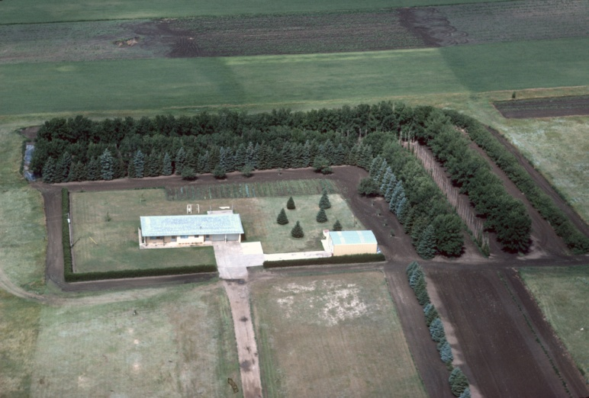
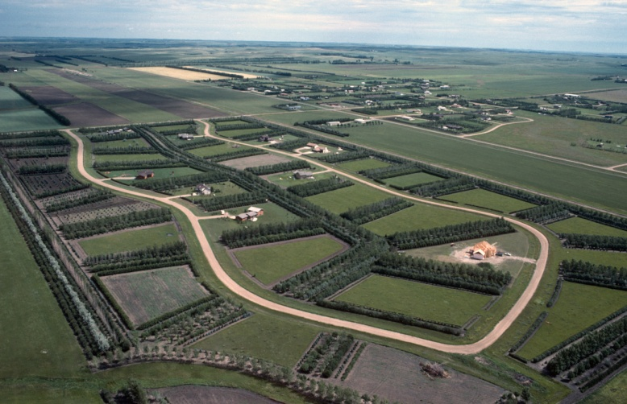
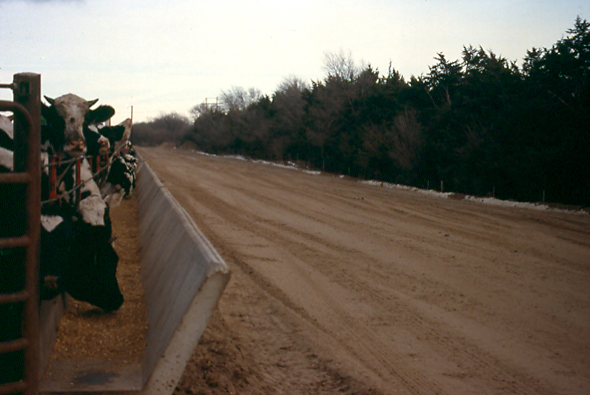
Types of windbreaks
Windbreaks
Notes:
There are an increasingly expanding array of issues that windbreaks are being asked to address. Early efforts concentrated on the use of windbreaks to prevent soil erosion, protect crops from drying winds, and deflect blowing snow from roadways. Today, windbreaks are being used for a variety of purposes to increase yields of agricultural fields, reduce energy needs around farmsteads and livestock, control dust and odors, and provide environmental services for rural communities. To meet these needs windbreaks are generally placed into four categories of windbreaks – field, farmstead, livestock, and specialty.

Slide 16
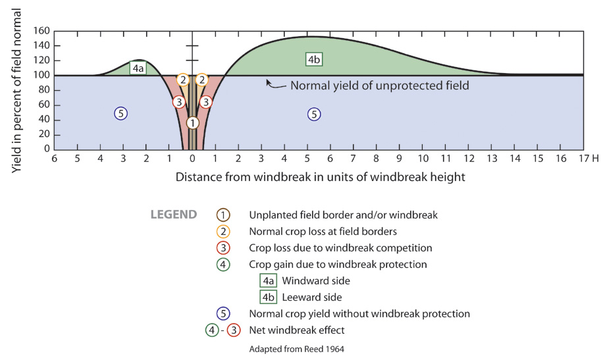
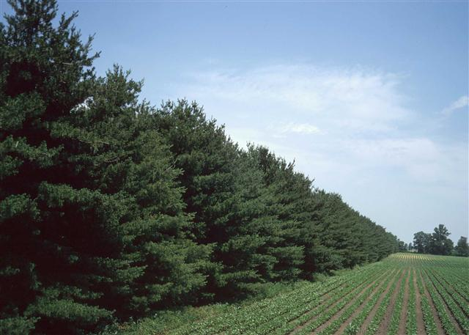
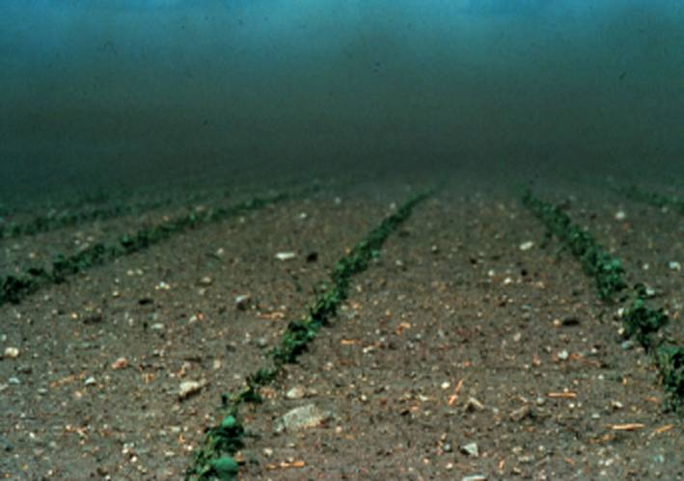
Types of windbreaks: field
Windbreaks
Notes:
Field windbreaks were one of the earliest types of windbreaks planted in the US. As in the past, field windbreaks are planted today to control wind erosion and protect crops. In these sheltered areas soil temperatures tend to be higher, evaporation lower, and humidity increased. Overall crop growth conditions are improved, reducing plant stress and improving net crop yields from 5 to 45%. In many areas where moisture is limiting, field windbreaks can also help capture snow and distribute it across the field. In the future, field windbreaks may be the key in helping agriculture cope with our changing climate.

Slide 17
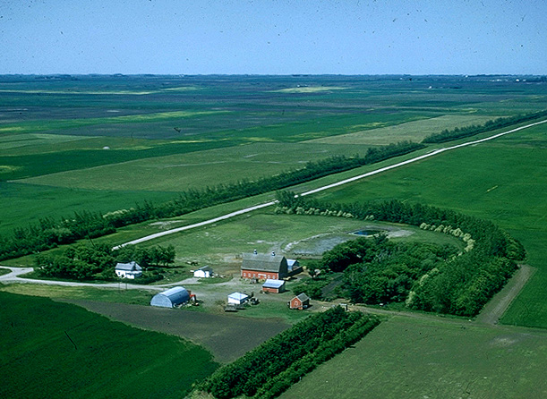
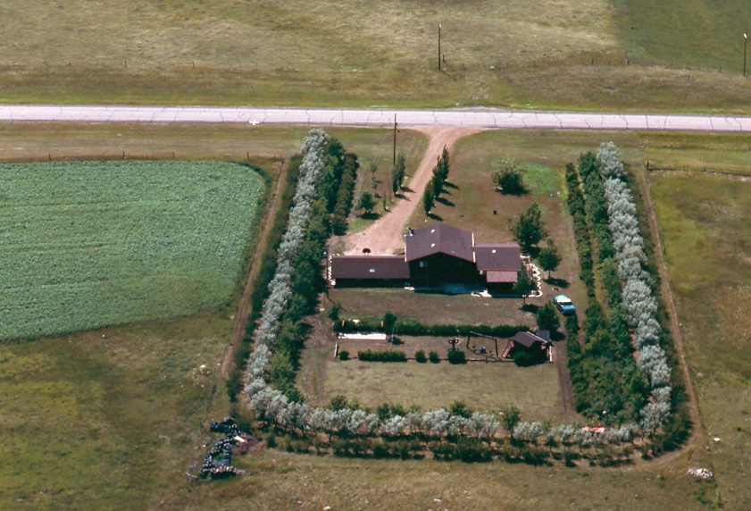
Types of windbreaks: farmstead
Windbreaks
Notes:
In many parts of the US, the constant force of wind exaggerates daily weather conditions and can make living in these areas seem difficult. A well designed windbreak around the home, ranch or farmstead slows the wind, improves the overall environment, and can reduce heating costs as much as 40 percent. Farmstead windbreaks conserve energy, provide snow control, improve working conditions and provide visual screening and dust control. Traditionally the most extensive use of farmstead windbreaks has been to protect rural homes in the northern regions of the US. However, windbreaks use for privacy screens, dust control and noise reduction as well as wind protection are important throughout the country.

Slide 18
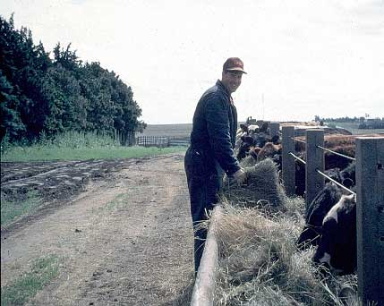
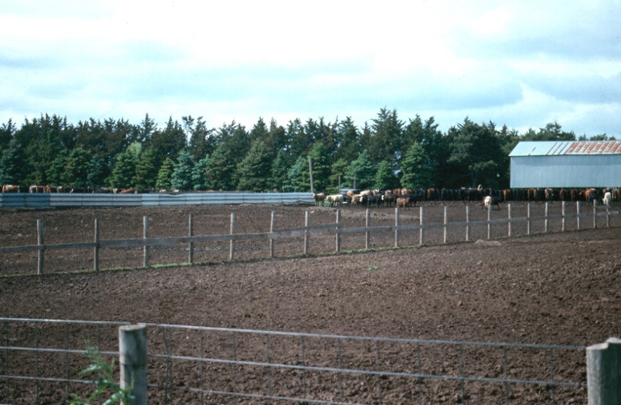
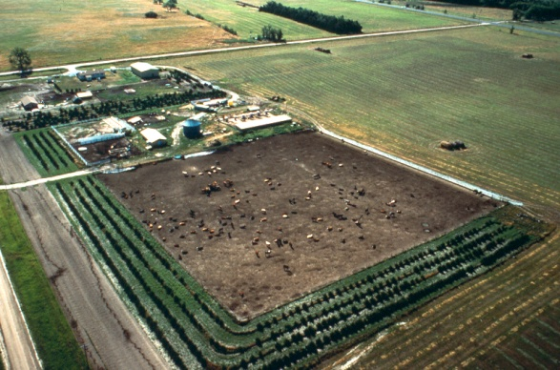
Types of windbreaks: livestock
Windbreaks
Notes:
Windbreaks can play an important role in the protection of livestock. Properly placed windbreaks can provide benefits to feedlots, pastures and calving areas. Reducing wind speed in winter lowers animal stress, improves animal health and increases feeding efficiency. A well, though out and properly cared for windbreak will protect livestock in both the winter and summer and will provide economic benefits over the long term.

Slide 19
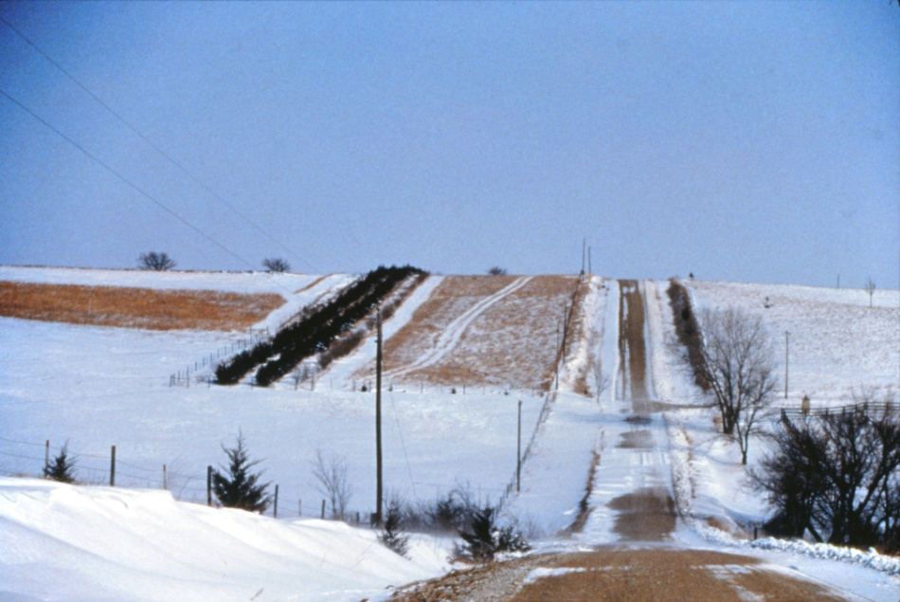
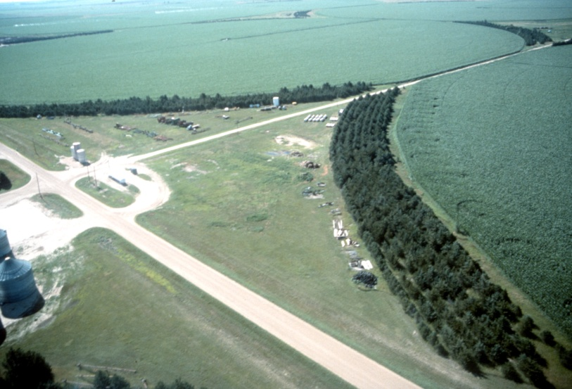
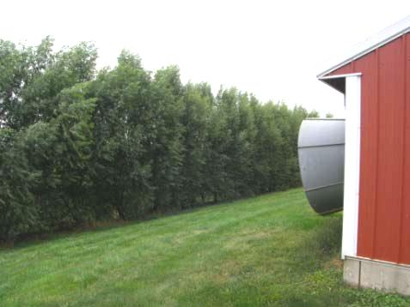
Types of windbreaks: specialty
Living Snow Fence
Irrigation efficiency
Dust
Odor
Windbreaks
Notes:
As mentioned earlier, new emerging uses for windbreaks include moderating noise, screening unsightly views, reducing airborne chemical drift, improving irrigation efficiency, increasing carbon storage, and mitigating livestock odors and dust as well as using specialized windbreaks called living snow fences to keep roads clear of snow.

Slide 20
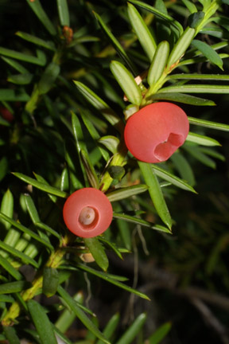
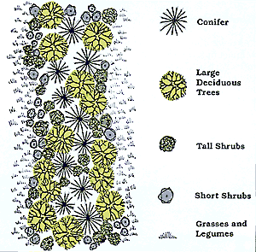
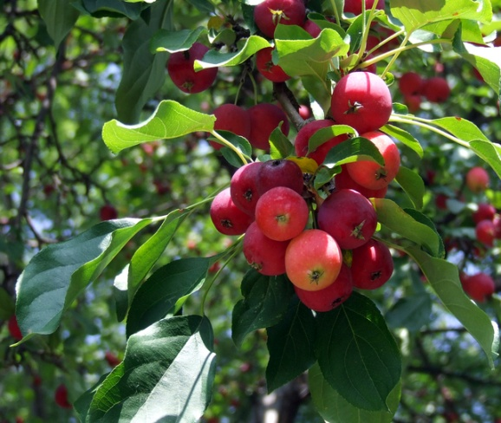
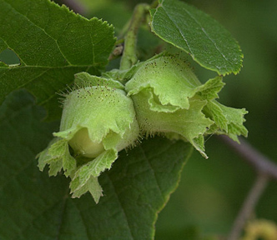
Multi-purpose windbreaks
Bio-energy feedstock
Food security
Wildlife
Income products
Notes:
While each of the previous types of windbreaks mentioned have a primary or key purpose, incorporating additional functions or benefits can be done with any type of windbreak. For example, a multi-row windbreak can be designed to function as a windbreak and allow woody bio-mass harvesting for energy needs and products. In this case, additional rows need to be incorporated into the design to allow rotational harvesting while maintaining the design integrity of the windbreak. Windbreaks can support wildlife that add beauty and pleasure to our lives. They also sustain birds that eat insect pests, improve hunting opportunities, and provide a focal point for family outdoor activities. You can add wildlife benefits to windbreak plantings whether your main goal is to shelter crops, livestock, roads, or a home or farmstead. In addition, windbreaks can be designed and managed to be an on-farm food source or to be a basis of income through the sale of products grown or produced from the windbreak.

Slide 21
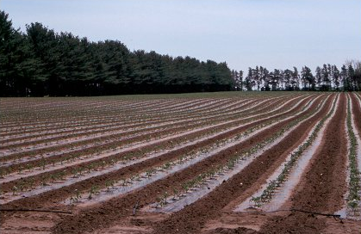
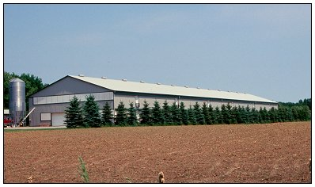
Summary
Windbreaks are an agroforestry practice
Windbreaks provide multi-functional benefits
Windbreaks can be designed to meet site needs and land owner objectives
Windbreaks
Notes:
In summary windbreaks are an old established agroforestry practice that even more today has relevancy and need. Properly designed windbreaks can be multi-functional to meet the needs and objectives of any landowner throughout the US.

Slide 22
For Additional Information
A number of web sites are available to provide more detailed information on windbreaks. Here are a few:
USDA National Agroforestry Center https://www.fs.usda.gov/nac/practices/windbreaks.php
The Center for Agroforestry http://www.centerforagroforestry.org/practices/wb.php
Association for Temperate Agroforestry http://www.aftaweb.org/
USDA Natural Resources Conservation Service
https://www.nrcs.usda.gov/wps/portal/nrcs/site/national/home/
Notes:
Where is there more information on windbreaks? A number of web sites are available to provide more detailed information on windbreak systems. Here are a few: USDA National Agroforestry Center, The Center for Agroforestry, Association for Temperate Agroforestry, and the Natural Resources Conservation Service.

Slide 23
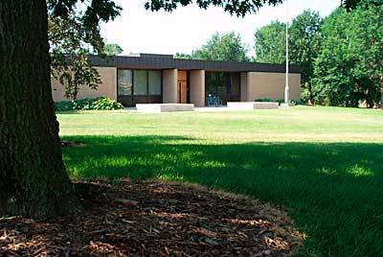

Acknowledgements
This presentation was developed by the USDA National Agroforestry Center (NAC), Lincoln NE.
NAC is a USDA partnership between the U.S. Forest Service and the Natural Resources Conservation Service.
National
Agroforestry
Center
"The U.S. Department of Agriculture (USDA) prohibits discrimination in all its programs and activities on the basis of race, color, national origin, age, disability, and where applicable, sex, marital status, familial status, parental status, religion, sexual orientation, genetic information, political beliefs, reprisal, or because all or part of an individual’s income is derived from any public assistance. (Not all prohibited bases apply to all programs.) Persons with disabilities who require alternative means for communication of program information (Braille, large print, audiotape, etc.) should contact USDA’s TARGET Center at 202-720-2600 (voice and TDD).
To file a complaint of discrimination, write USDA, Director, Office of Civil Rights, Room 326-W, Whitten Building, 1400 Independence Avenue, SW, Washington, D.C. 20250-9410 or call (202) 720-5964 (voice and TDD). USDA is an equal opportunity provider and employer."
Notes:
This presentation was developed by the USDA National Agroforestry Center (NAC), Lincoln NE. NAC is a USDA partnership between the U.S. Forest Service and the Natural Resources Conservation Service.

