Slide 1
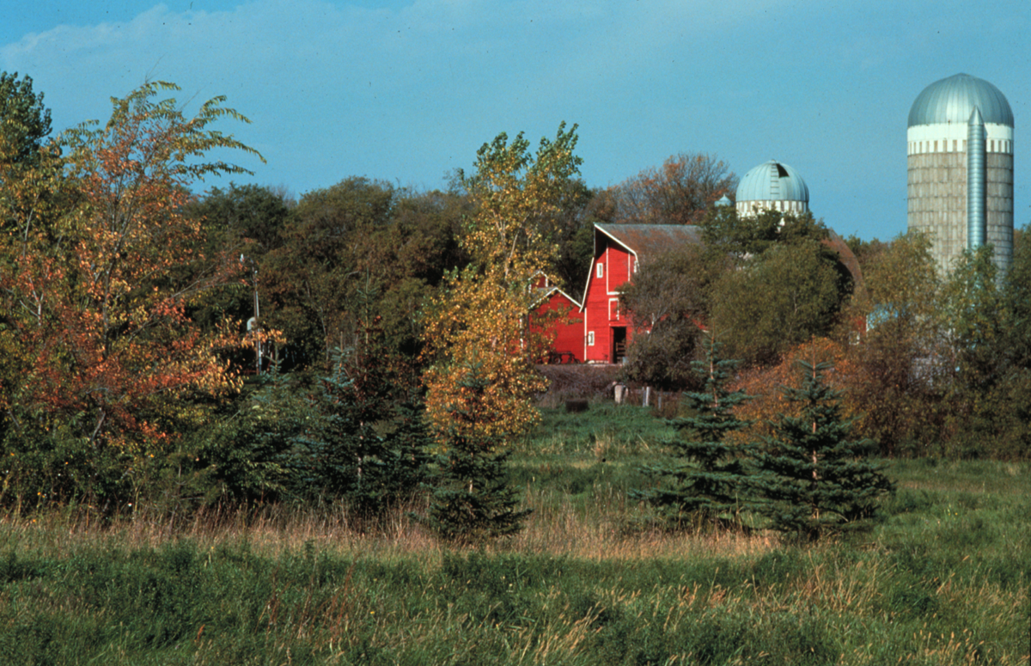
Windbreaks for Structures and Sites
Notes:
Windbreaks are “Working Trees” that provide multiple benefits in protecting or enhancing the soil, air, plants, animals and people.

Slide 2
What kind of structural sites are affected by high winds?
A. Residential sites
B. Industrial sites
C. Farm and ranch headquarters
D. Transportation systems
1. Highways and roads
2. Railroads
E. Livestock facilities
F. Irrigation systems (especially sprinkler systems)
G. Recreation sites

Slide 3
Resource Needs
Protect structures, outside work and play areas
Energy
Snow
Wind damage
Dust
Reduce noise
Screen unsightly areas
Enhance aesthetics
Provide wildlife habitat
Notes:
Windbreaks reduce wind speed and alter the microclimate in the sheltered areas. Field windbreaks reduce wind erosion and the damage to crops caused by wind-blown soil. They improve water use efficiency, reduce risks associated with drought, and manage blowing snow. In addition, field windbreaks provide opportunities to enhance natural controls of insects, provide valuable wildlife habitats, and add permanence and biological diversity to our agricultural systems. Some new research work is being done to examine the impact of windbreaks in reducing pesticide drifting and modify odors from livestock facilities and other sources. Since windbreaks are adding trees and shrubs to agricultural landscapes that normally did not have any trees previously, there is an opportunity for these new tree and shrub plantings to sequester carbon.

Slide 4
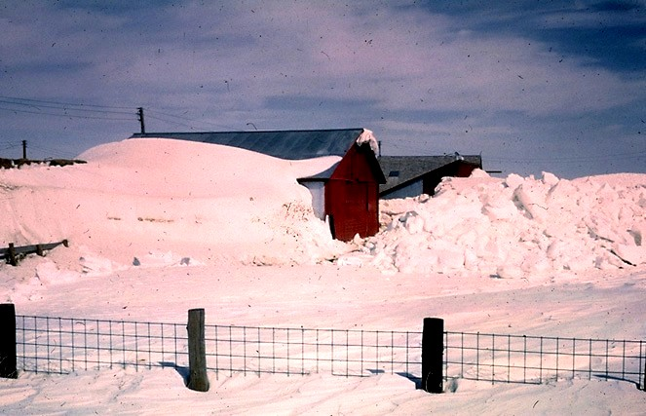
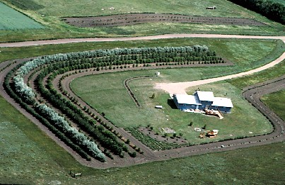
Saving Energy
Two-thirds of residential energy use is for heating (53%) and cooling (12%).
Windbreaks can save from 3 to 26% (average 10-15%) in heating.

Slide 5
Energy Gains & Losses
Warm Air Escapes
Cold Air Infiltrates
In the winter, up to 50% of the heat loss from a building is due to infiltration.
Notes:
Air exchange is passage of air into and out of a home through cracks around windows and doors, porous materials, open doors and windows and other openings. Air exchange is the heat-transfer most affected by winds.

Slide 6
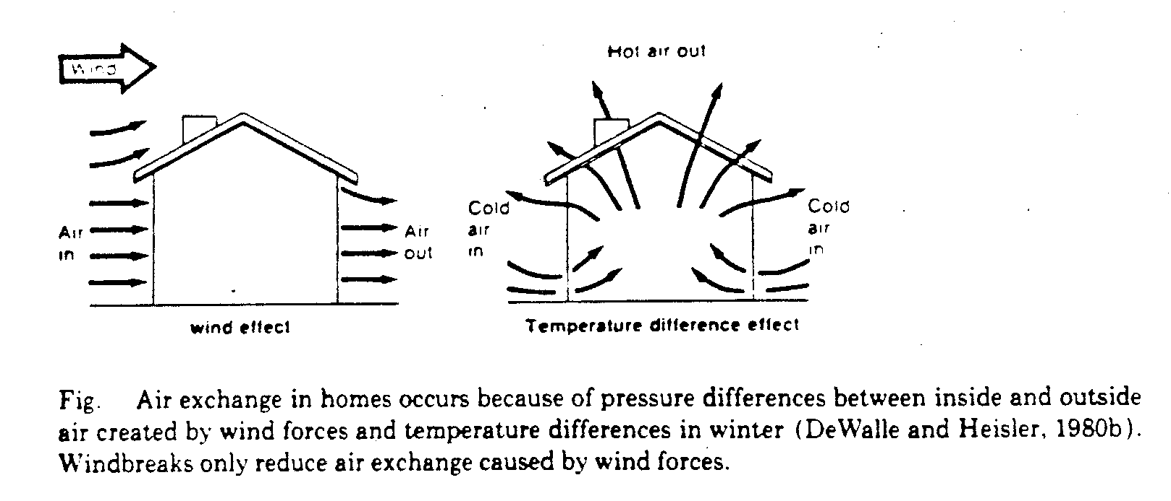
Energy Gains & Losses
Notes:
Air exchange typically represents 1/3 the heat loss from homes. Even in hot environments with lots of wind, the air exchange can blow out the cold air and let in the warm air. Windbreaks also impact solar radiation transmission through windows and heat conduction through exterior walls. For instance, windbreaks shading a house wall in the winter may be counter productive since they reduce solar heat gain.
DeWalle and Heisler showed in 1983 that ¼ the energy savings from windbreaks upwind of a mobile home were attrubted to reduced conduction/convection. (Reduced windspeed reduces the amount of thin warm air next to the exterior walls that is blown away. Some of the heat loss not affected by windbreaks is the chimney effect (hot air rises).
If the house is oriented so that large openings are facing prevailing winter winds, then windbreaks are more effective than the inverse.
Trees to the south should be far enough away so that winter sun can still reach the house (setback distance = mature height x (sin of the winter solstice sun angle).
Generally for the northern latitudes trees planted close on the south side of a structure provide less shade and cooling than close planted trees on the west. Summer sun angle is high so trees on south need to almost hang over the house. Afternoon sun, with the lower sun angle is still hot and shade trees to the west can help cool the structure.
Generally trees for shading a house will have to be much closer than minimum windbreak setback distances. Deciduous trees generally make best shade trees.

Slide 7
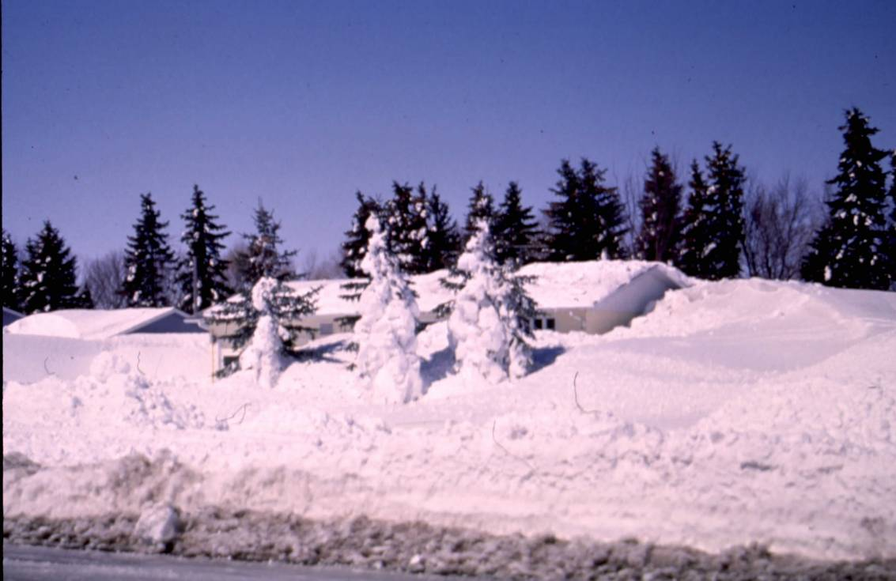
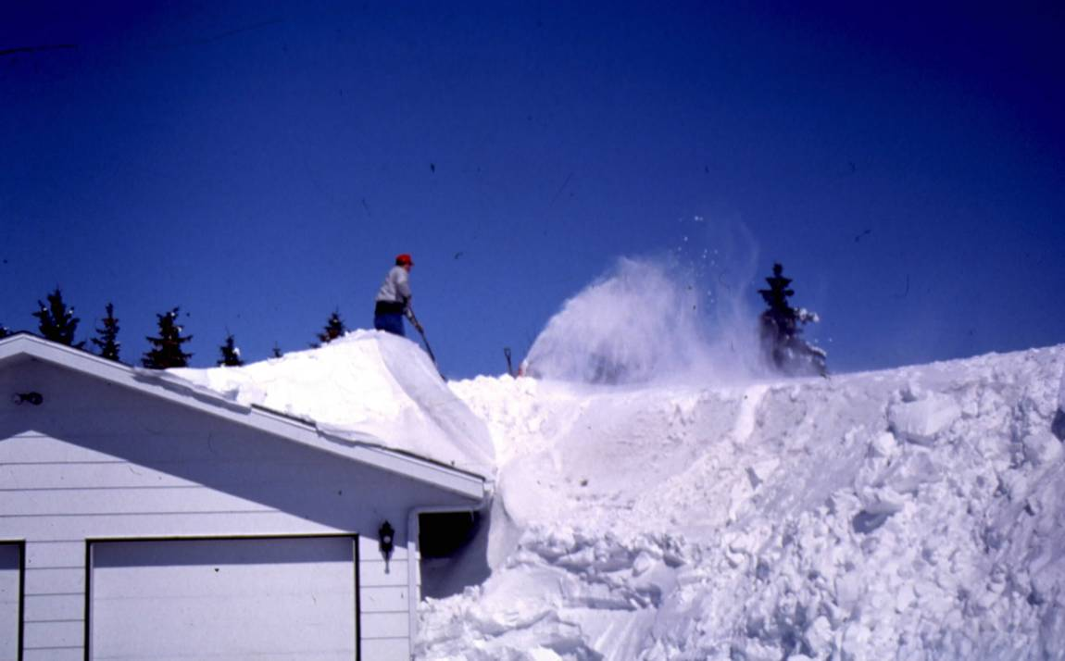
Removing Snow Costs!!
Landowners have estimated that snow removal costs can run about $200 per year.
Notes:
Though access is compromised, the home should be as warm as an igloo.

Slide 8
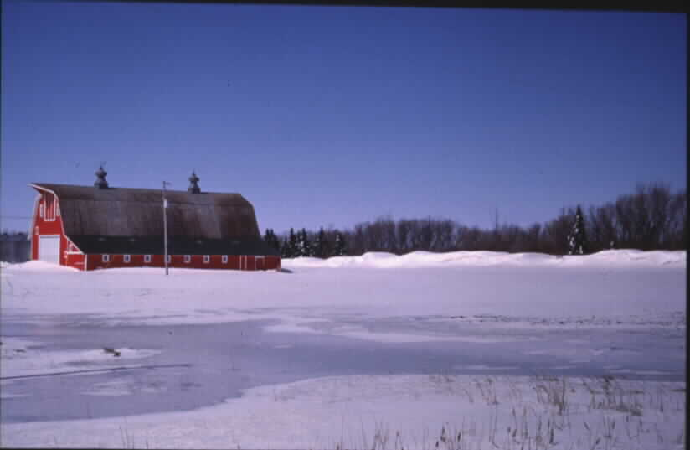
Windbreaks Reduce Snow Removal Costs
Note drift position and open areas
Notes:
Proper windbreak placement can keep a site protected from winter winds, clear of snow, and leave room for expansion. Wrong placement can bury the building site. There is a reason there are setback distances.

Slide 9
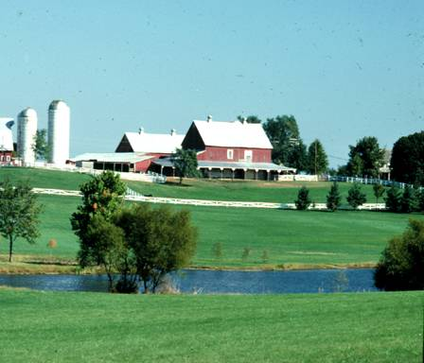
Reducing Physical Wind Damage
1. Roofs (wind)
2. Paint (blowing soil)
3. Doors and windows (wind)
4. Yards and gardens (wind)
5. Road surfaces (due to removal of windblown snow and wind deposited snow)
Notes:
As a little girl said the first time she was outside after moving to North Dakota, “Mom, Dad, come outside. It’s really nice. You don’t have to lean.” For many parts of the country, wind is a constant. Slowing the wind can protect building site features as described above.

Slide 10
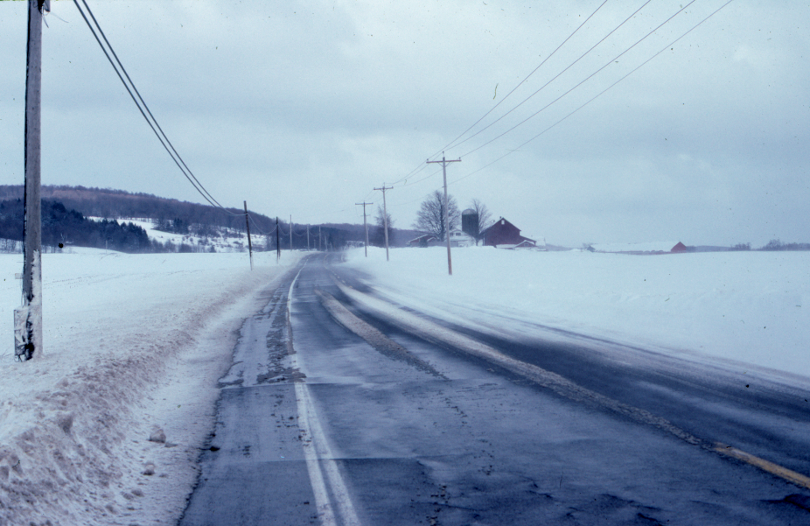
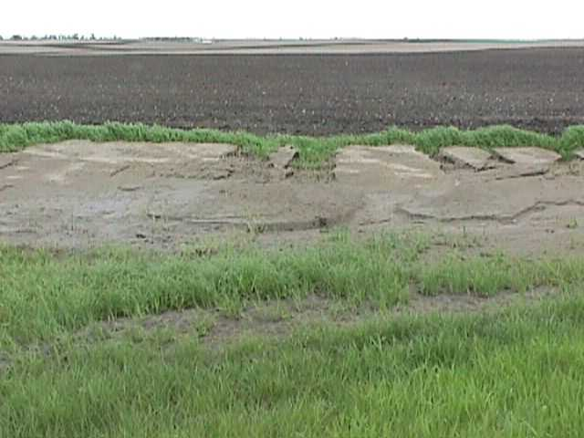
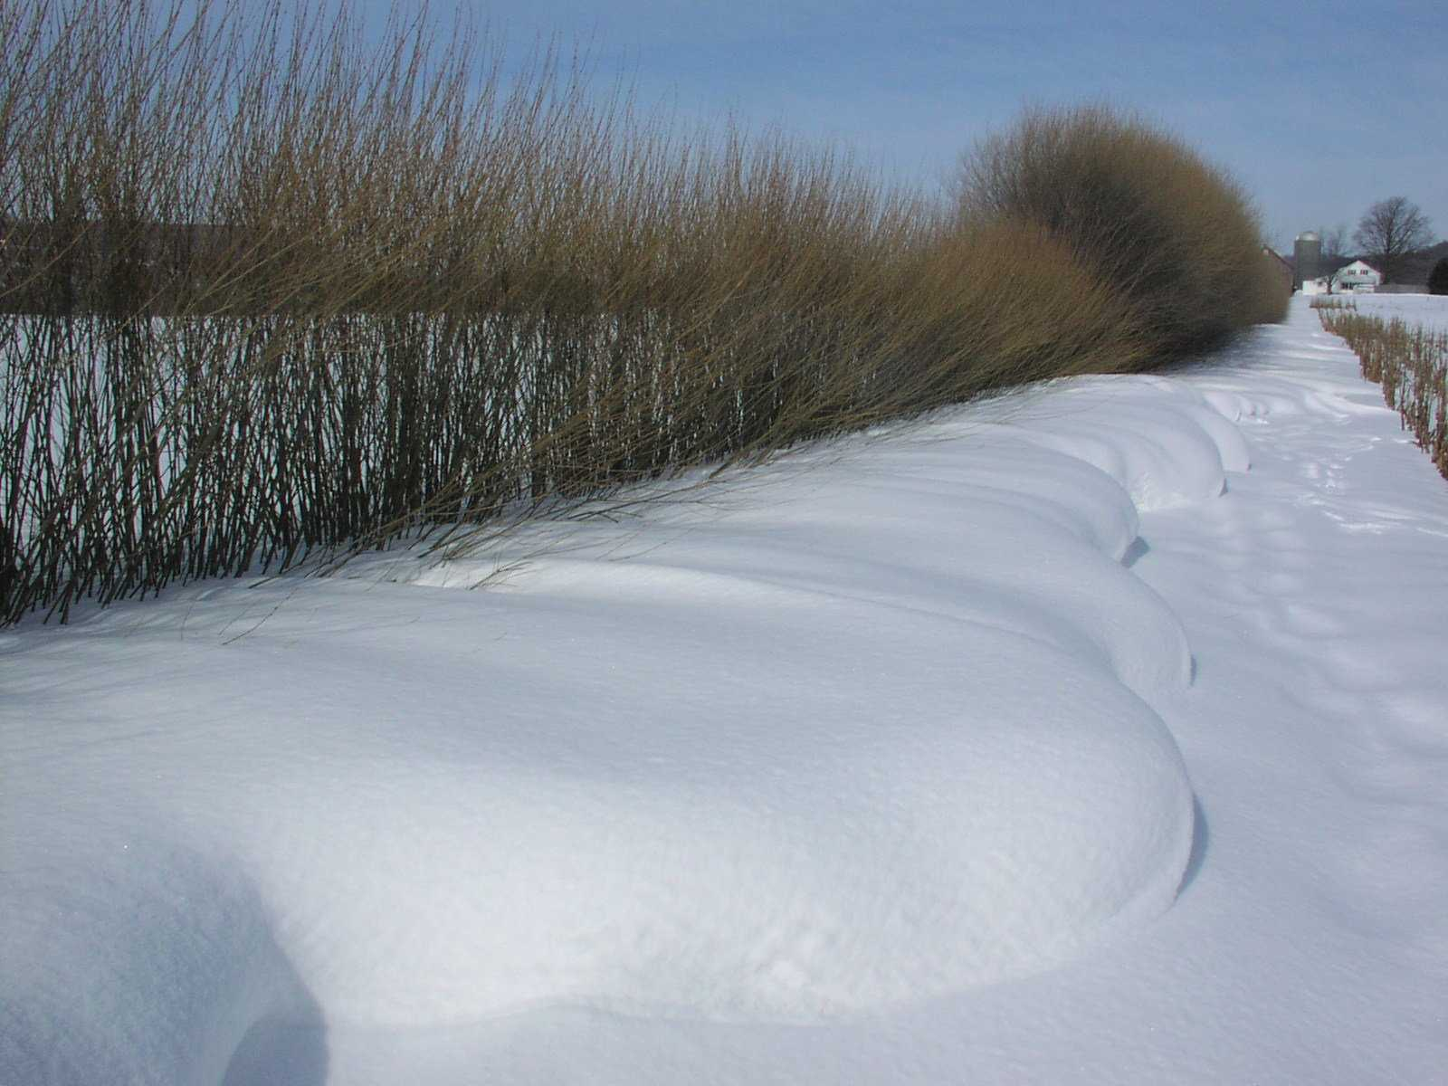
Resource Needs – Roads
Reduction in energy used to remove soil and snow from rights-of-way (fuel and equipment savings)
Washington
Notes:
Costs of removing snow from roads. Cost of removing soil from drainage ditches and road ditches. As mentioned in the snow section. One producer in Iowa used 100 gallons of diesel on each of two consecutive weekends to blow out the farmstead so that he could move around with a grinder-mixer to fill hog feeders. 200 gallons of diesel in two weeks is a pretty big cost, not counting wear and tear on equipment.

Slide 11
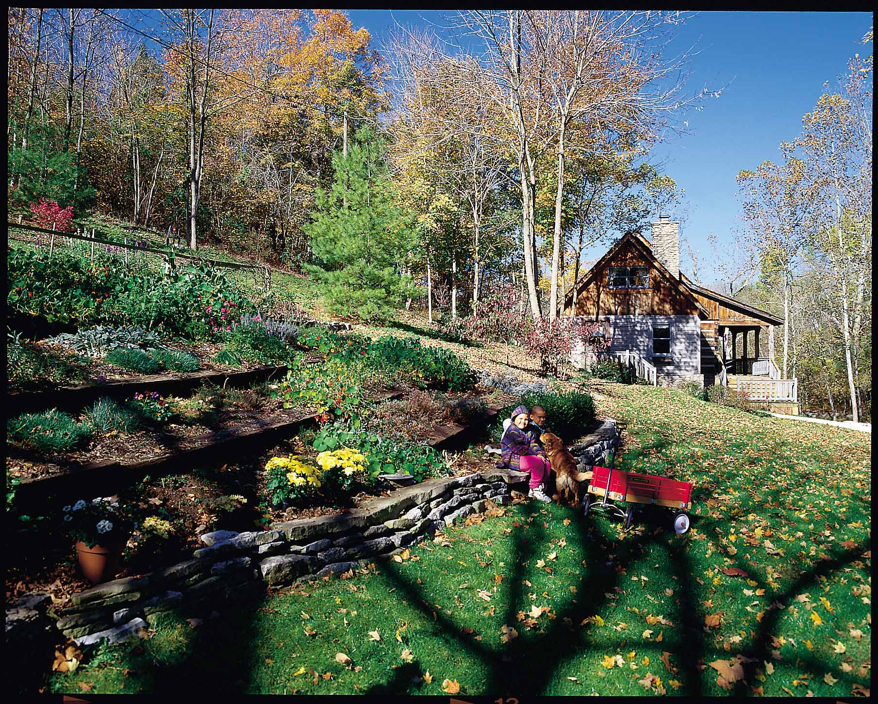
Aesthetics
Notes:
Besides reducing wind damage to buildings and stress on people, windbreak orientation, shapes, and species can be chosen that are particularly pleasing. Remember that aesthetics is in the eye of the beholder. Some folks obsess over the perfect weed free blue grass yard while others just use the grass to hold soil in place and to walk on while getting to the windbreak.

Slide 12
Aesthetic Attributes
WHAT
Noise reduction
Visual screens
Glare reduction
Visual character
Dust control
Odor control
Food supply
Windchill
HOW
Barriers and filter
Barriers
Barriers
Diversity
Barrier and Sink
Barrier
Edible species
Barrier
Notes:
Aesthetics involves all of our senses – sight, smell, taste, touch and hearing
Buffers Improve Aesthetics by providing
Barrier to noise, views, glare, dust, odor
visual character,
food consumption – no reason why we can’t eat our windbreak
dust control (safety, nuisance)
Recreation – hard to play badmitten in 30 mph winds
Wildlife viewing, hunting, trails,
Microclimate modification
Wind chill, enhance crop growth(economic)

Slide 13
Reduce Undesirable Noise
What properties does a buffer need to block noise?
Notes:
What properties does a buffer need to do this? Density
Also needs to be located close to the source of the noise.
Are trees better than grass? Need height so sound does not go over top.

Slide 14
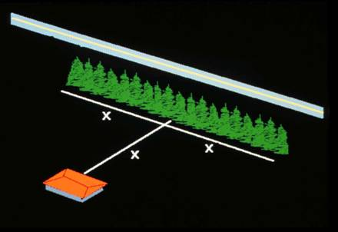
Reduce Undesirable Noise
What properties does a buffer need to block noise?
Length:
One to five rows wide; Two times the distance from the noise source when practical; Sufficient length to block the view
Notes:
What properties does a buffer need to do this? Density
Also needs to be located close to the source of the noise. But need to be alert to snow deposition issues
Keep in mind the differnce between winter and summer densities of the barrier.
Are trees better than grass? Need to be tall to intercept sound and reduce the amount of sound that may “return” to earth

Slide 15
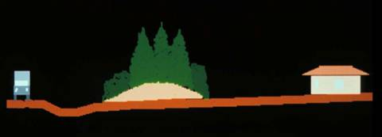
Reduce Undesirable Noise
What properties does a buffer need to block noise?
Limitations
Most noise reduction occurs when combined with earth mound or wall; Results may be seasonally variable due to changes in foliage.
Notes:
What properties does a buffer need to do this? Density
Also needs to be located close to the source of the noise.
The soil mound or a hard barrier is effective at deflecting noise away from an area. The veg material absorbs noise and reduces the amount of noise bounced to another area.
Are trees better than grass? Yes, But grass is better than a hard surface. Vegetation immediately adjacent to a hard barrier, or on the barrier such as vines would “soften” the deflected noise.

Slide 16
Design
Form follows function
Aesthetics may be the primary function
Noise barrier, visual screens, dust control
Beauty
Integrate into design
Alignment, edge,
Plant composition, layout
Form, color, texture
My need to ‘Overbuild’ to add visual interest
Notes:
The buffer design first needs to meet requirements of the intended functions, then aesthetics can be integrated into the design. The form of a buffer is dependent upon what functions it is trying to achieve. The height, width, composition and layout may be critical to achieve certain functions. However, some functions, like wildlife habitat, don’t care if the trees are in rows or are uniform in density. Remember aesthetics can be the primary purpose of the buffer- visual screen, noise barrier, dust control,
When possible integrate aesthetics into the design – don’t make it an after thought.
In many situations you can go beyond the minimum requirements of the design to meet the function to add aesthetic value. This over building usually involves working with the edges of buffers, which are the most visual part of a buffer. Or it might be as simple as a species change, ex: instead of Siberian elm as an inside row, perhaps use lilac, or crabapple, or magnolia, etc for aesthetic appeal and functionallity. But remember, a windbreak must still, moderate or deflect wind. If the main purpose is aesthetics or wildlife only, then perhaps a landscaper should do the yard design or a wildlife standard could be used for the wildlife design.

Slide 17
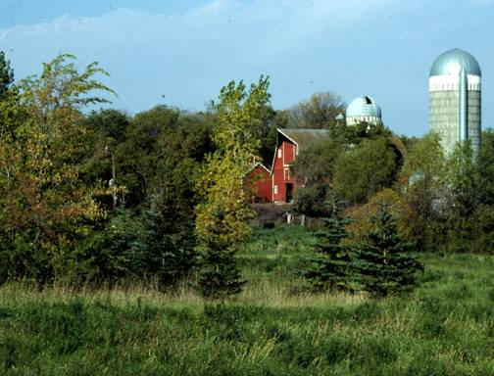
Landowner Objectives
Well maintained character
Natural character
Notes:
When dealing with visual quality, landowners usually have a preference and buffers can be designed to meet the landowners objectives. Again, if the practice is a windbreak, then it should moderate or deflect wind. Lots of different ways that can be done, each with a different look. Windbreaks do not have to be in straight lines. Not all spacings have to be uniformly the same. You do not have to have just one species in each rows. You do not even need rows! With proper location and alignment, may not even need to be contiguous.

Slide 18
The Dilemma:
Good Stewards – taking care of the land
Aesthetically pleasing
Natural Areas or managing for wildlife may be perceived as not taking care of the land.
Messy or trashy looking
Notes:
The dilemma- in most agricultural communities the visual aesthetic is based on the appearance that the land is being cared for – this idea of stewardship implies that the land is being managed – such as mowing, orderly planting, weed control, etc. –
We need to try and change this perception-
There are ways to maintain the “cared for” look without laser straight rows oriented on cardinal compass directions. In fact a windbreak with curved rows is considerably more aesthetically pleasing to many folks. For others, that concept is too radical to accept. Match design and aesthetics to resource needs, site conditions and landowner objectives.

Slide 19
Design Principles
Visual compatibility
Harmony, balance, order, unity, rhythm
Visual Variety
Interest, diversity, complexity, contrast
Notes:
When a landowner doesn’t express a strong opinion, there are some general principles that can be followed.
Visual compatibility means that the design should fit with the surrounding character.
However, if an area is visually undesirable then we don’t want to be compatible with it.
Visual variety deals with adding diversity to add visual interest, however too much can be chaotic and undesirable.
Still, remember, do not lose the function of a windbreak by being “artsey”

Slide 20
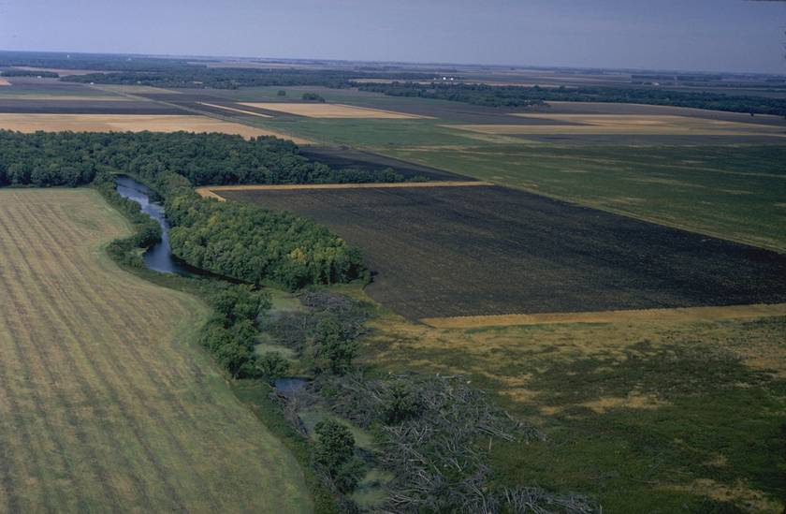
Visual Compatibility
Fit in with the surroundings
Notes:
The state or quality of orderly and harmonious visual elements-
In this flat agricultural landscape ….The irregularity of the riparian forest edge adds lots of structure and diversity, but managing adjacent fields is difficult and may force the landowner to remove the trees to make farming easier.

Slide 21
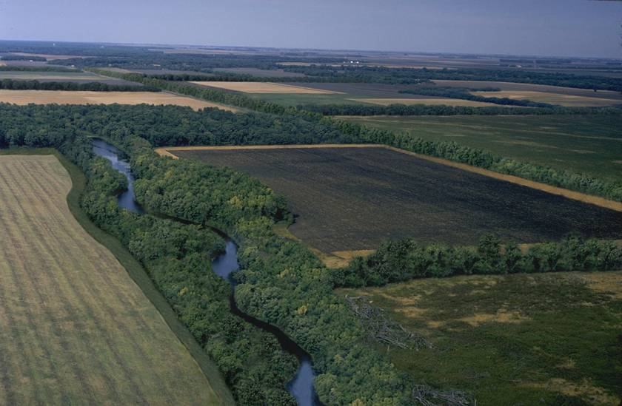
Visual Compatibility
Fit in with the surroundings
Notes:
Following field edges and creating straight lines are compatible. Making the edge of the riparian forest buffer as parallel as possible to the field edge means; cropping is easier, generally the buffer is wider in the areas where overland flow enters the creek. More of the immediate flood plain is in the buffer so there is less cropland to be cleaned up after floods. These benefits due only to a different way of designing a buffer might be all that is necessary to sell a producer on the buffe concept.

Slide 22
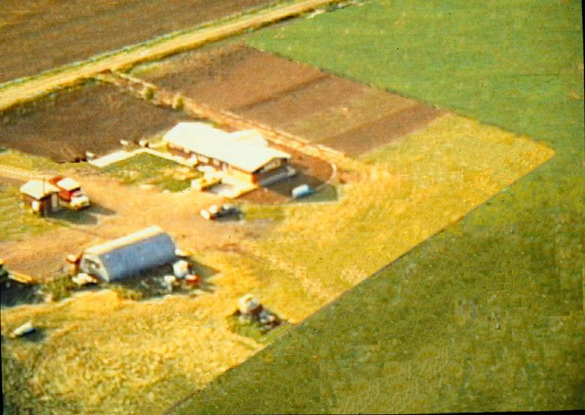
Visual Variety – Needs Something
Notes:
Individual buffer design can also be enhanced to add visual variety. This site needs some protection.

Slide 23
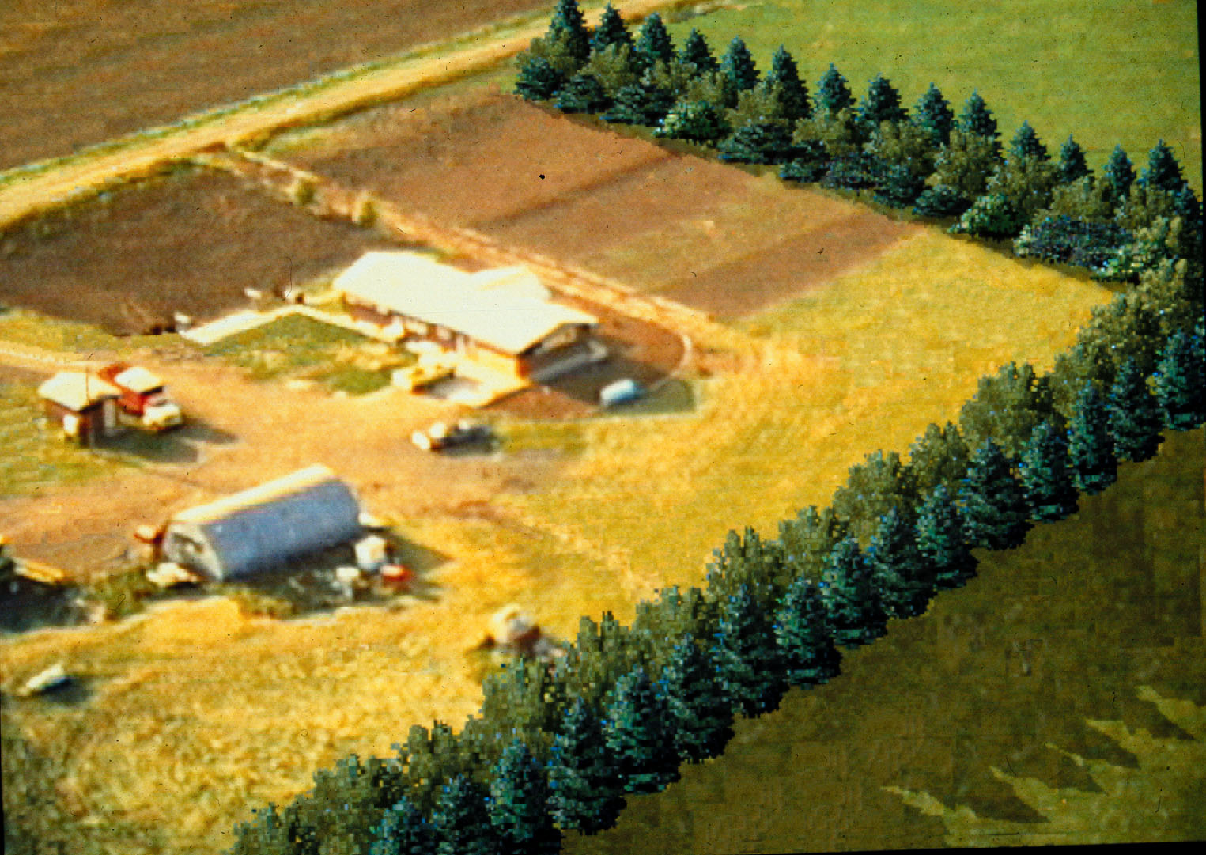
Visual Variety - Traditional
Alignment
Notes:
The alignment of farmstead windbreaks don’t have to be so rigid—This is the traditional way and it DOES work, but there are other alternatives

Slide 24
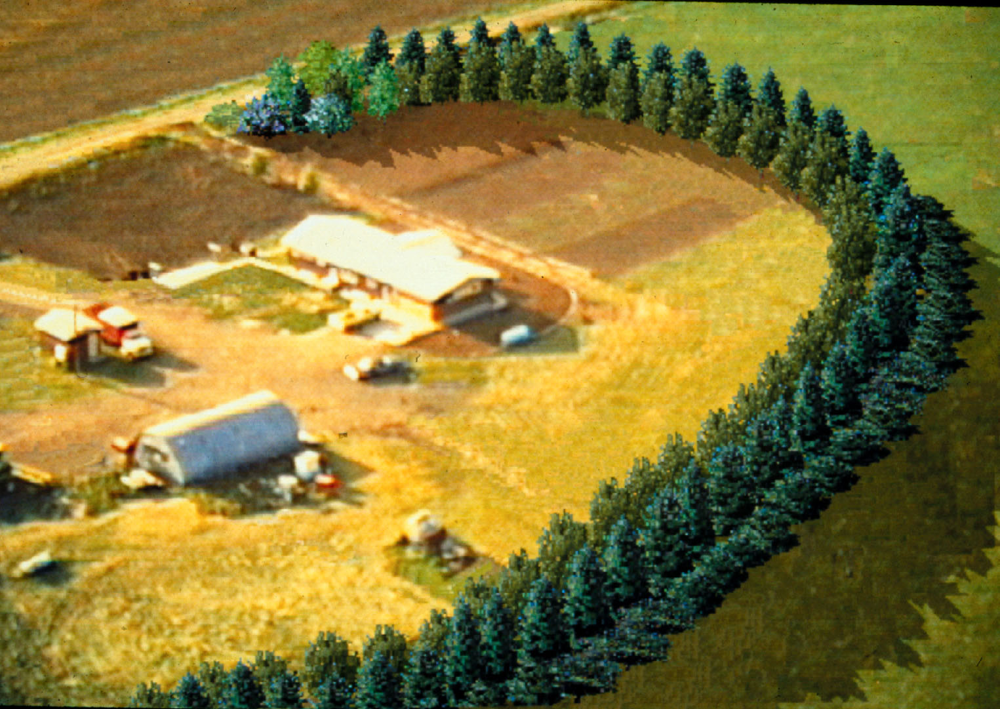
Visual Variety – a simple curve
Alignment
Notes:
Broad curves could be used. In this example I would plant out the corners in short curved windbreak rows to retain atraight field edges. Remember, if at all possible, minimize disruptions to farming caused by the installation of a conservation practice.

Slide 25
Visual Variety -Traditonal
Edge Treatment
Notes:
The edges of windbreaks can also….

Slide 26
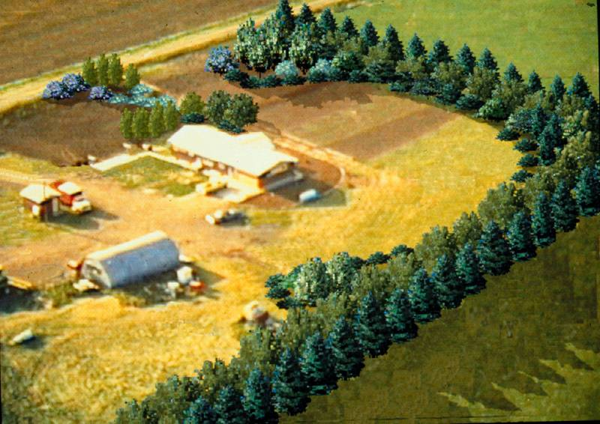
Visual Variety – Accent Plantings
Edge Treatment
Notes:
- Adds variety in color and geometry even to a straight row planting. Still functional. May increase windbreak and yard maintenance a bit.

Slide 27
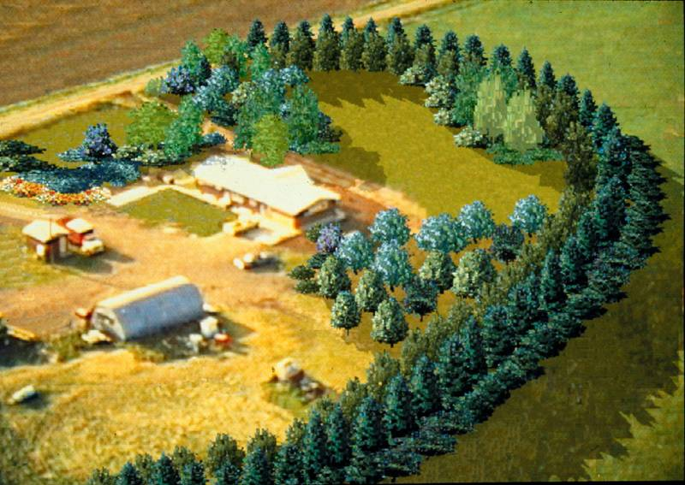
Visual Variety
Edge Treatment
Notes:
The core of the windbreak can provide an excellent background to place accent plants of varying color and texture.- The plants to the inside do not have to be just “pretty”. Depending upon the site and the owner, the “accent” plants could be fruit and nut trees, a wide assortment of fruiting shrubs, trees and shrubs for woody florals,

Slide 28
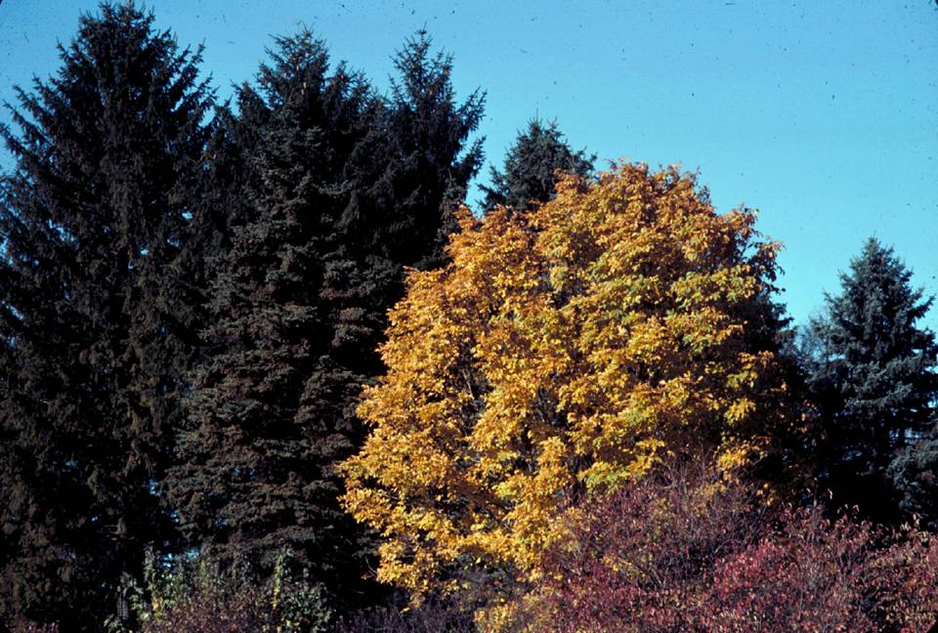
Color
26
Notes:
Adding a single or small group of plants on the edge can be effective. To assist for many of the windbreak design consideration addressed in this presentation, one should have access to a document describing the attributes of the trees and shrubs appropriate for the area such as North Dakota’s “Tree and Shrub Characteristics” discussed earlier. Documents like this along with plant pictures are quite helpful in the planning phases of the design. In ND one of the most common questions in wiindbreak design is, “What species will have red foliage in the fall?” That is because the vast majority of our plants have brown fall colors with a few having yellow fall colors (primarily elm and ash, so we know how much longer they will be around)

Slide 29
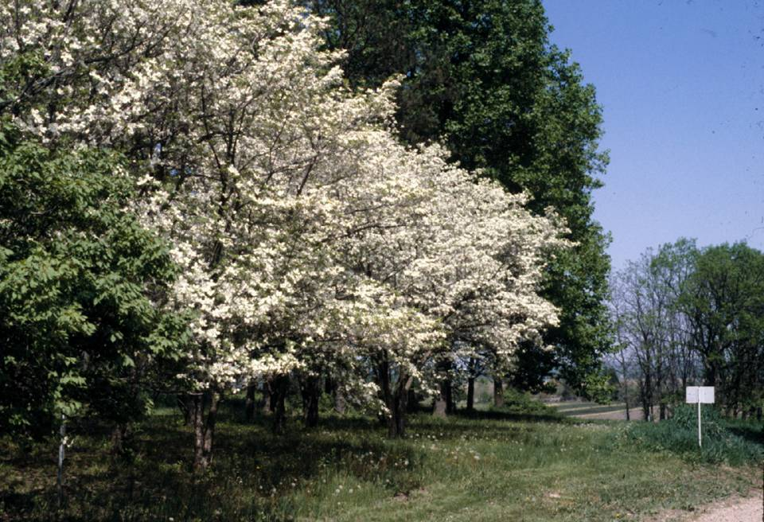
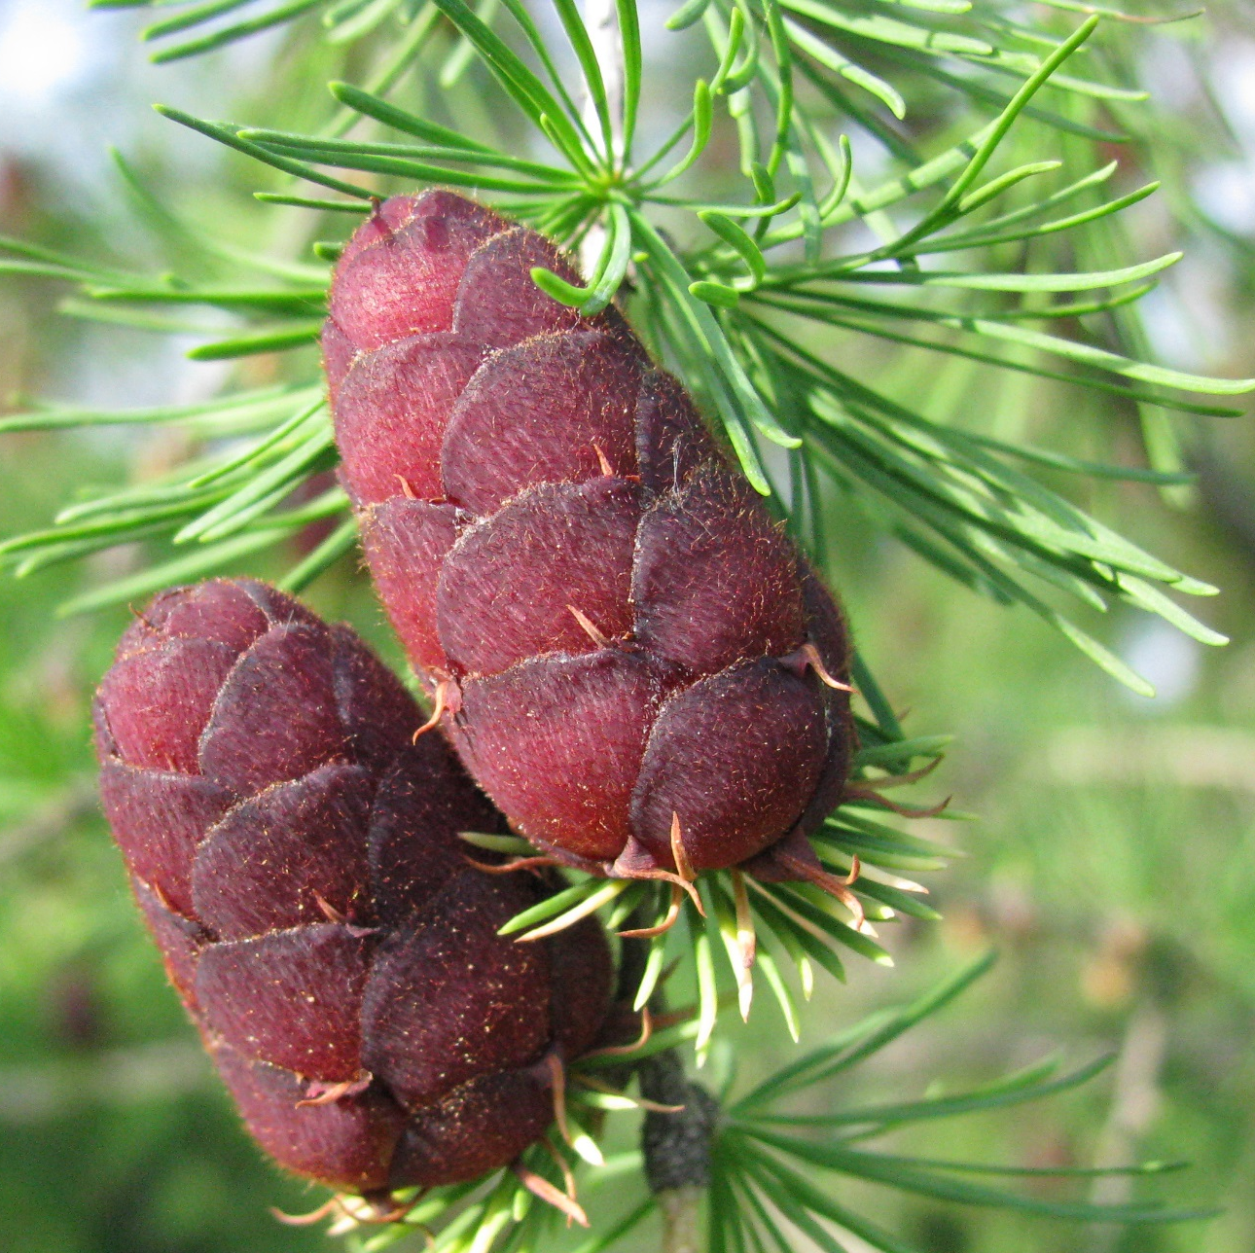
Color
27
Notes:
Color is not just a fall concept. Blossoms on fruiting varieties, even early cone development such as on larch can be pretty impressive.

Slide 30
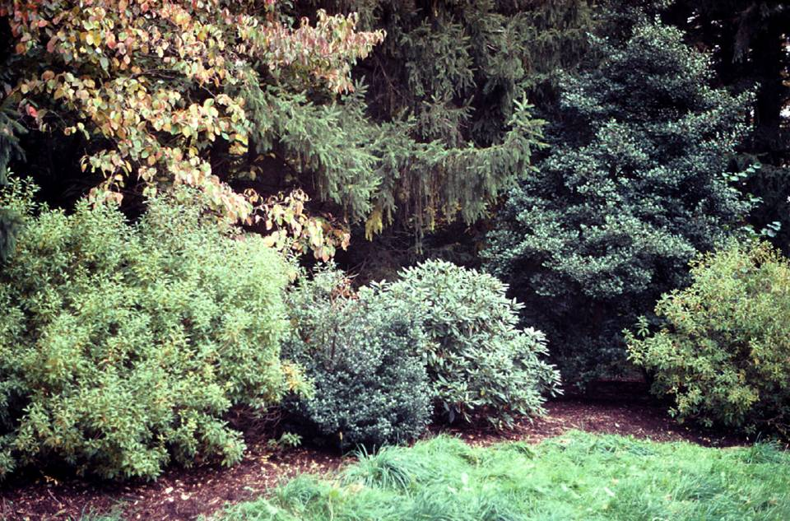
Texture
28
Notes:
The leaves and branches can create a variety of textures that add visual interest. This variety of species and their inherent textures add resilency to the windbreak and often improve effectiveness. They also increase the value of the windbreak for wildlife ranging from deer to ground dwelling bees.

Slide 31
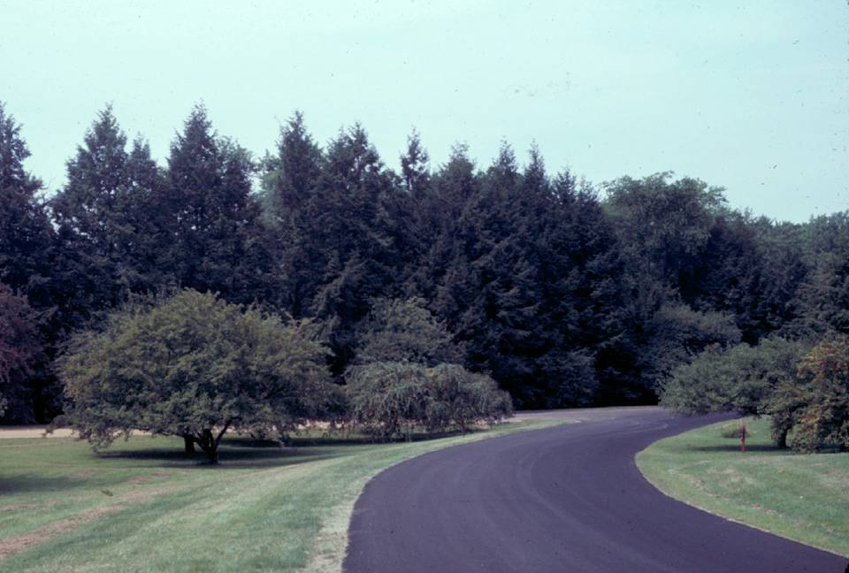
Form
29
Notes:
Consider varying the plant forms. The different shapes are fairly obvious but with the right species selection the deciduous trees in the foreground could also be food-producing fruit trees.

Slide 32
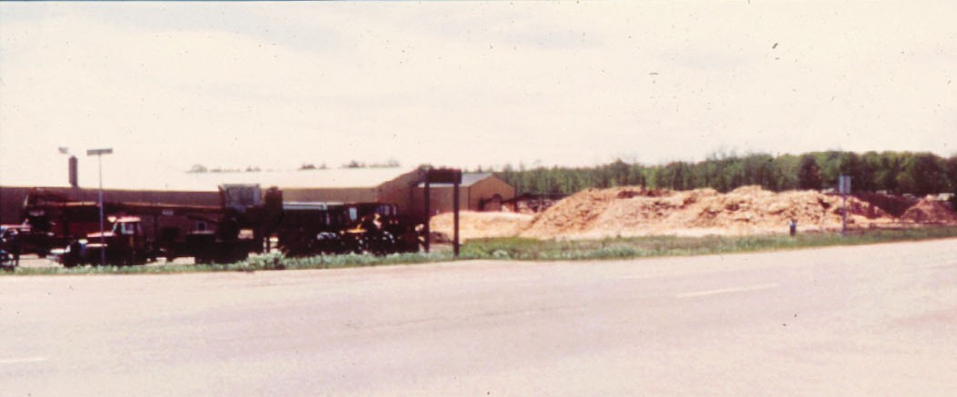
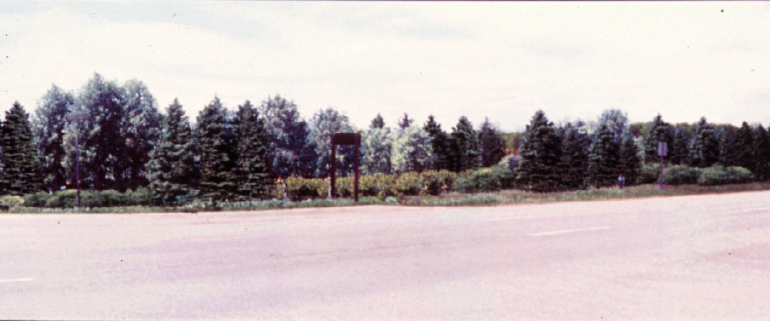
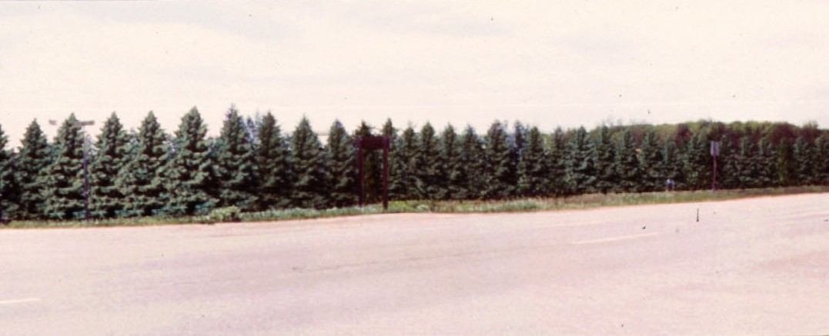
Notes:
Plants can be varied in the rows to break up the strong linear appearance. Nowhere is it written that each windbreak row can consist of only one species. Mixing up species within the row to compensate for catostrophic loss of one probably not too valid, as the leftover spacing would be too wide and trying to plant a replacement in the presence of much bigger trees would be difficult. However, research from NDSU has shown that alternating hybrid poplar clones within a row reduced the incidence of leaf spot by 30% so alternating for pests and structural form are not a bad thing. Just ensure that the alternated species have compatible growth forms. For instance we have found after nearly 30 years of trial that alternated green ash and spruce does not work. The ash overtop the spruce and create really deformed conifers.
It must be noted that for many of our landowners with northern European heritage, mixing trees in the row, or planting on a curve, etc. are very much outside their comfort zone. Some however, embrace such concepts.

Slide 33
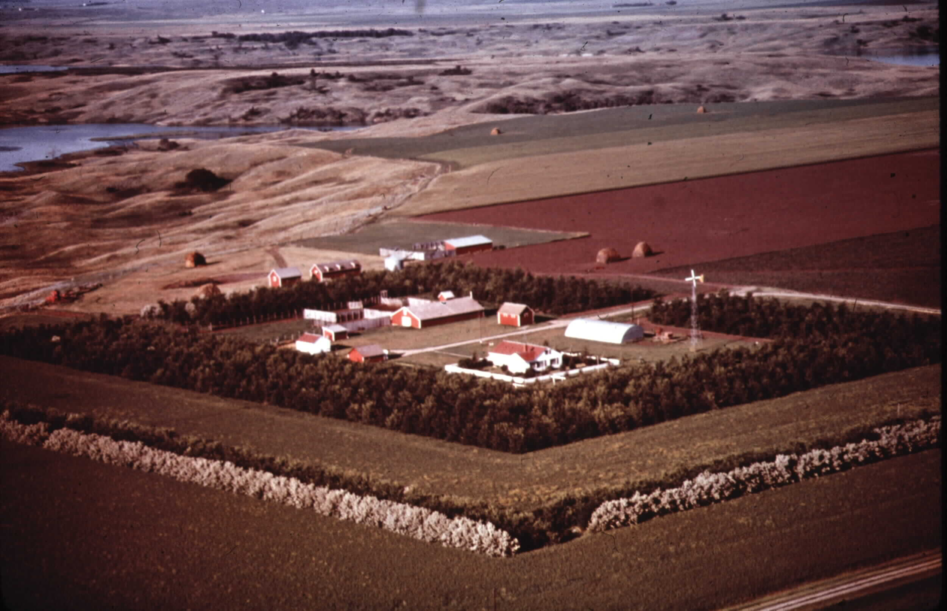
Windbreaks Can Make a Difference
Secondary Windbreak
Primary Windbreak
Snow Trap
Notes:
This is not to teach you how to make the correct answers. It is designed to show you how to ask the right questions. There are few “wrong” windbreak designs as long as the right questions have been asked and the design addresses the answers to those questions.

