Slide 1
Ash Seed Collection and Emerald Ash Borer (EAB)
Prepared by R.P. Karrfalt
Director, USFS National Seed Laboratory
August 2011
rkarrfalt@fs.fed.us
http://www.nsl.fs.fed.us
471-751-3551
404-275-5398

Slide 2
All plants and animals are adapted to their environments through genetic selection over many years of interaction between the organism and the environment. The same is naturally true for ash trees being killed by the emerald ash borer. Therefore, as the trees are lost, so is their adaptation to the many environments in which they grow. It is important to preserve this adaptation for forest restoration once the challenge of the EAB has been solved. One of the easiest and more economical methods of genetic conservation for ash is long term seed storage in deep freeze. Ash seed has successfully stored for almost 40 years. It can be expected to store even longer, but 40 years is the longest measurement made to date.
How many seed lots should be collected and from where should they be collected? Ecoregions are geographic areas in which the environment is similar. Therefore, ash trees growing within one ecoregion could be logically expected to have a similar genetic make up in terms of adaptation to the environment. Genetic tests on many organisms have proven this to be true. One system of defining ecoregions is the Omernik system. http://www.epa.gov/wed/pages/ecoregions/level_iii_iv.htm

Slide 3
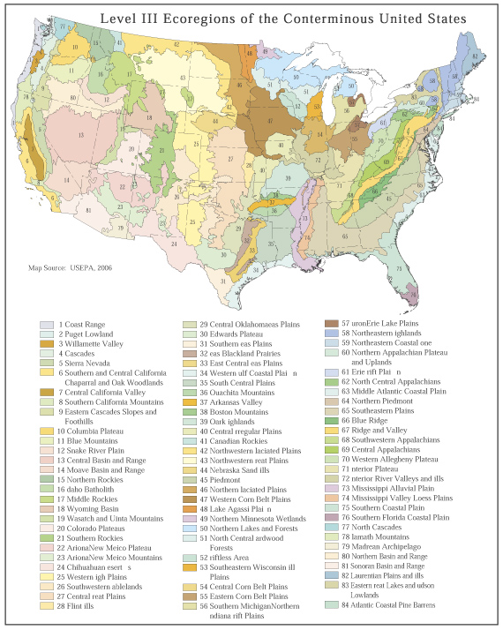
Omernik ecoregions are defined according to precipitation, soil types, temperatures, and similar factors that determine the growing conditions to which plants, e.g. ash trees, must adapt to survive and grow well.
The general target for the Forest Service is to collect seeds from 50 trees within each Omernik level III ecoregion. The trees should be evenly spread across the ecoregion within the range of the ash species.

Slide 4
Seed Collection Locations
The general target for the Forest Service is to collect 50 trees from each Omernik level III ecoregion. The location of the individual trees should be evenly spread across the ecoregion within the range of the ash species. By collecting seeds in this manner it is expected that over 90% of the genes will be collected and saved. Definitely this plan will preserve enough adapted genetic material to reintroduce ash to the ecoregion at the appropriate time.
The managers for a specific National Forest , park, or land holding can select another sampling scheme. Usually the managers opts to collect from more trees.

Slide 5
GIS Maps for Seed Collection
Maps of species range, ecoregion, highways, and political boundaries are combined and then 50 collection locations are marked with a dot within each species range-ecoregion overlap area.
Seeds are then collected from one tree per dot.
Maps are available in GIS, PDF, or Word Doc format from National Seed Laboratory

Slide 6
GIS Maps for Seed Collection
There likely will not be a tree exactly at the dot location. Then find a tree as close as possible to the dot location.
In cases of restricted species range the instructions will be to collect more trees around a specific collection dot location.
Examples of the collection location maps are shown in the next 2 slides.

Slide 7
Ash Seed Collection Sites in Southern Indiana Map 1: White and Green Ash (Counties are outlined)
A blue dot indicates where a collection is needed. One tree per dot is the minimum number of collections. More trees beyond this minimum are welcome if time and resources permit. Individual trees should be no less than 100 feet apart. The dots have been spaced to give collections that are fairly evenly distributed across the whole species range. Their specific location is, however, only approximate. Therefore, the actual collection can be made at another location if that is more practical as long as it is not too close to another collection location. This map is to be used to collect white and green ash seeds.

Slide 8
Blue Ash Seed Collection Sites in Southern Indiana Map 3: Blue Ash Range Shaded in Blue Color (Counties are outlined)
A blue dot indicates where a collection is needed. More trees beyond this minimum are welcome if time and resources permit. Individual trees should be no less than 100 feet apart. The dots have been spaced to give collections that are fairly evenly distributed across the whole species range. Their specific location is, however, only an approximate location for a tree. Therefore, there might not be a fruiting blue ash tree exactly at the dot. Then the actual collection needs to be made at another location but not too close to any of the other dots.

Slide 9
Species Identification
The first step in the collection process is to locate ash trees and identify their species. The next several slides will help with species identification. The species identification is important so that the seed is correctly identified. Leaves, twigs, seeds and the location of the tree are all important to identify it. A voucher specimen (a leaf, a twig, and a picture) will be taken from each mother tree to verify the species identification. Most seed collections will occur after leaf fall or while leaves are dropping and, therefore, a leaf sample will be optional. Contact the NSL if you feel you would like to include leaf samples in your voucher specimen. If you need a camera the NSL can supply a disposable camera to you. Most collectors prefer to use their own digital camera which is much easier for them and the NSL.
The characteristics can vary within a species and look like another species sometimes. Therefore, it is necessary to look at all characteristics to make an accurate identification.

Slide 10
Ash trees have opposite branches.
Maples, ashes, dogwoods, and horse chestnuts (mad horse) have opposite branches but only ash and box elder have a pinnately compound leaf. Do not get confused with box elder. Horse chestnut has a palmately (like a hand) compound leaf.

Slide 11
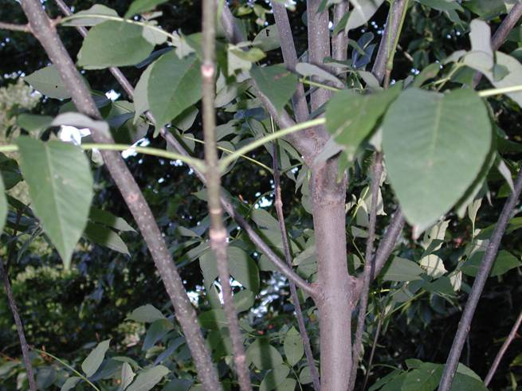
Opposite leaves
Opposite branches
White ash showing opposite arrangement of branches and leaves.

Slide 12
Where species grow can help identify them.
Green ash and black ash are found on wetter sites with black ash sometimes generally growing in swamps.
Green ash might be found near black ash.
White ash is an upland species growing on moist but more well drained sites.
Green ash might grow close to white ash.
White ash and black ash will not normally grow near each other in nature.

Slide 13
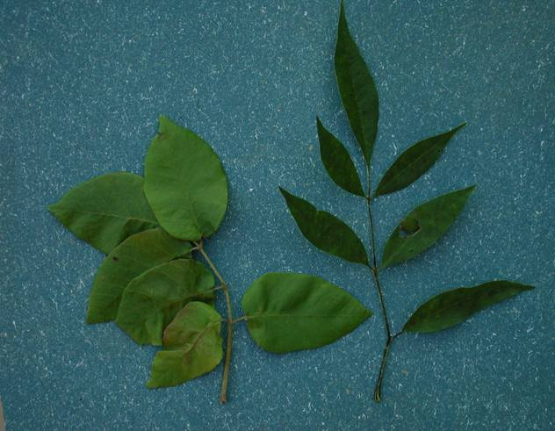
White ash left, green ash right.
Ash leaves are pinnately compound.
Ash leaves have a central stem called the rachis, with leaflets branching off of it somewhat like a feather.
leaflet
leaflet
rachis

Slide 14
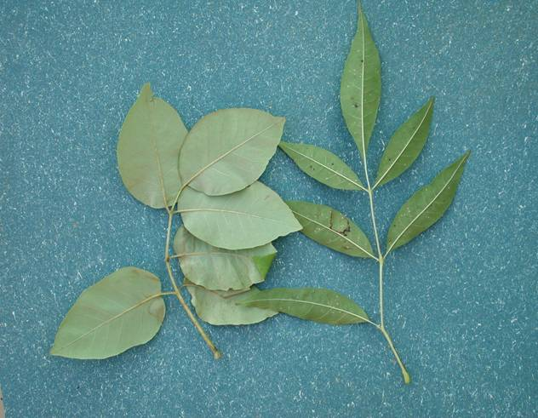
White ash
Green ash
This is the underside of the leaves. White ash is lighter colored beneath than is green ash.

Slide 15
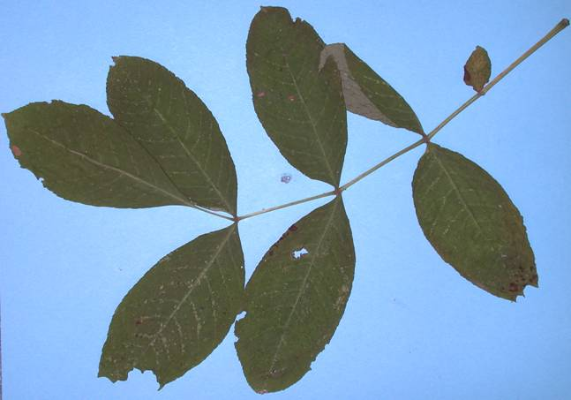
A black ash leaf. The leaflets of black ash are attached very closely
to the rachis. They are sessile on the rachis.

Slide 16
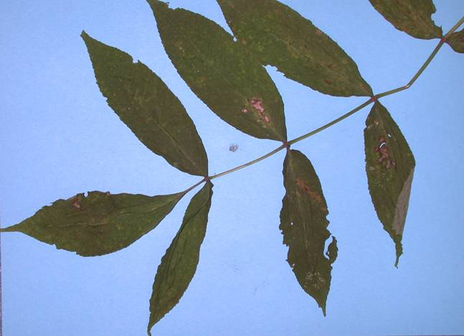
Another black ash showing leaflets that were more pointed (acute) than the leaf in the previous slide. Species characteristics can be variable.

Slide 17
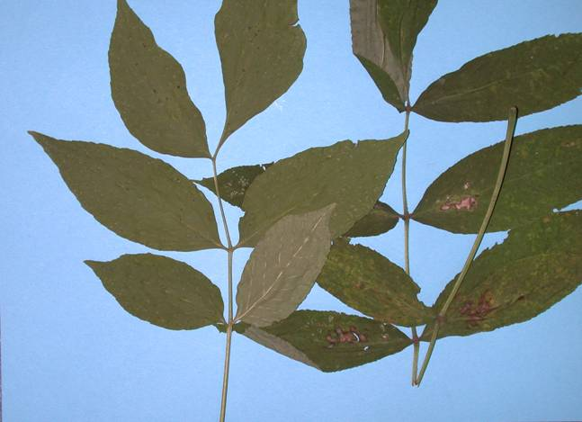
Leaflet is closely attached (sessile) on the rachis.
Leaftlet is not as closely attached to the rachis on green ash.
This rachis is bent to make it fit into an envelope.
A green ash leaf on the left and a black ash leaf on the right. Note the difference in how their leaflets are attached to the rachis.

Slide 18
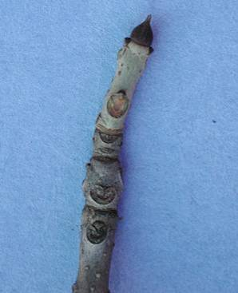
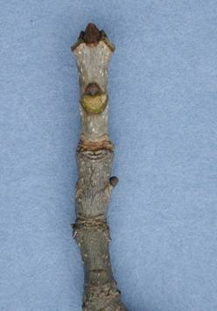
Terminal bud
Lateral bud
leaf scar
Black ash twig
Green ash twig.
The tip of a black ash twig has parallel sides, while a green ash flares at the tip.

Slide 19
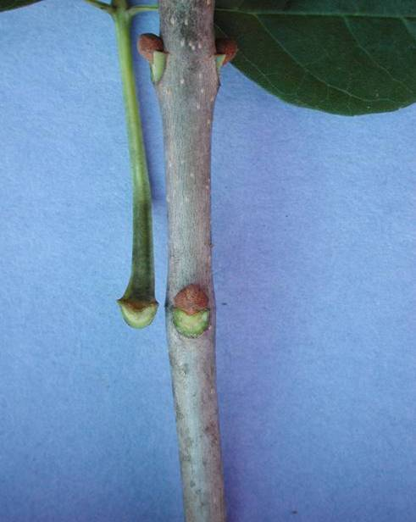
Green ash twig showing the straight top to the scare.
White ash twig showing how the leaf scar comes up on the sides of the bud.
Lateral bud
Leaf scar
Lateral bud
End of leaf rachis pulled off of the scar to the right.
Leaf scar
The upper edge of the leaf scar on green ash is typically straight across the top and does not wrap around the bud.

Slide 20
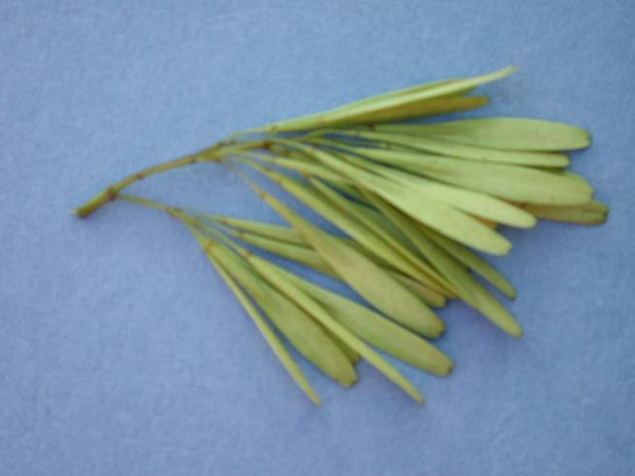
Seeds of green ash are usually born in tighter panicles than white ash. The seeds are also narrower and more pointed.

Slide 21
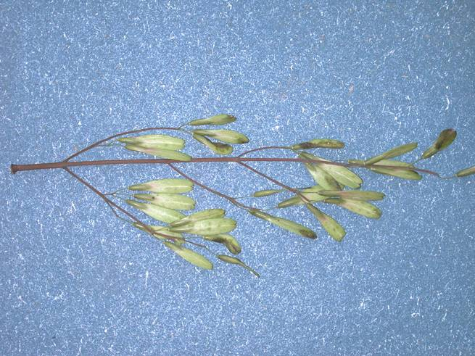
White ash seeds are usually born in looser panicles than are green ash. The seeds generally are not as pointed and sharp as green ash are.

Slide 22
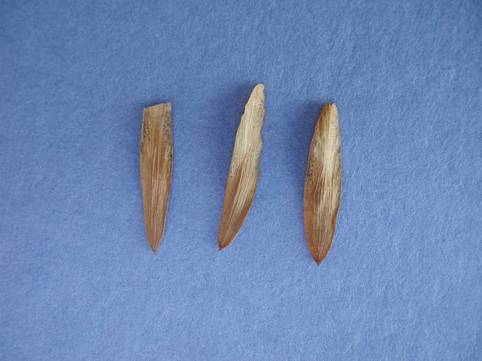
Seed end of the fruit.
Black ash have wings that surround the seed and are easily distinguished from the green and white ash.

Slide 23
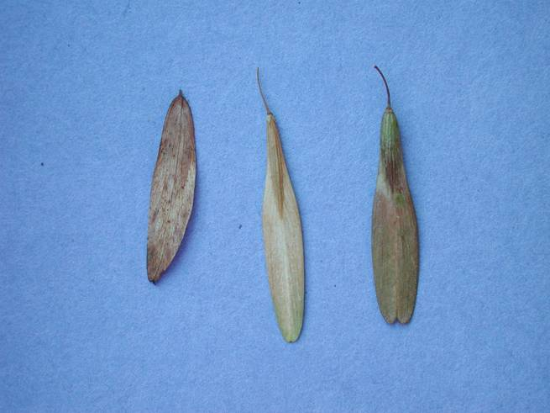
Note that the angle of the wing is much straighter on green ash as the wing goes towards the tip of the seed. The white ash wing is more curved
Black ash
White ash
Green ash
Comparison of black, green and white ash seeds
Blue ash will look like black ash seed but grow in total separate areas and therefore should never be confused.

Slide 24
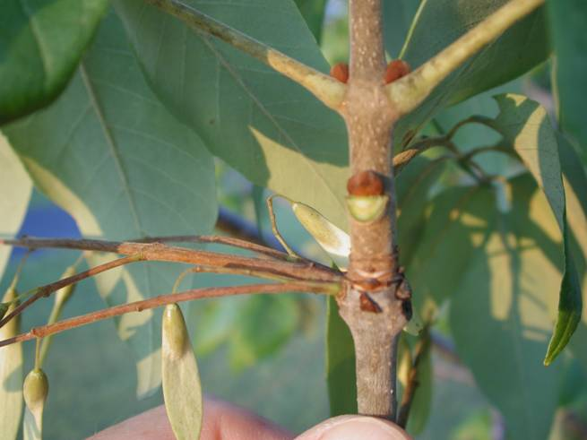
Bud of white ash.
This leaf scar is not typical for white ash but more like the scar on green ash.
Seed of white ash
This tree was called white ash because it was more white than green. This is an example of how traits can vary within a species or on one tree.

Slide 25
Monitoring and Locating Seed Trees
Where will seeds be found?
Predicting if seeds will be found in the fall of the year.
Identifying trees from which to collect.

Slide 26
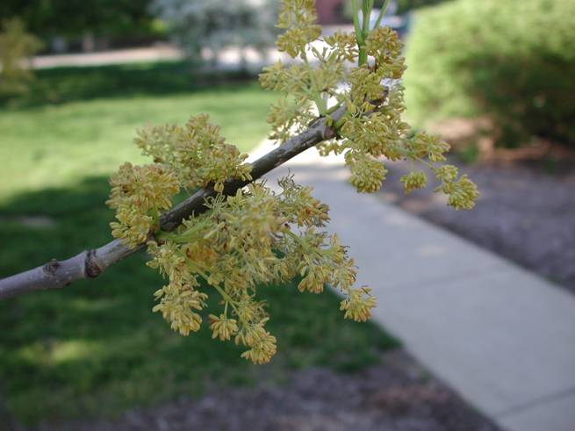
Ash flowers are formed at the base of the new growth each spring. Abundant amounts of seeds will most likely be found from trees that have full crowns with good light exposure. These will be trees growing in open areas.

Slide 27
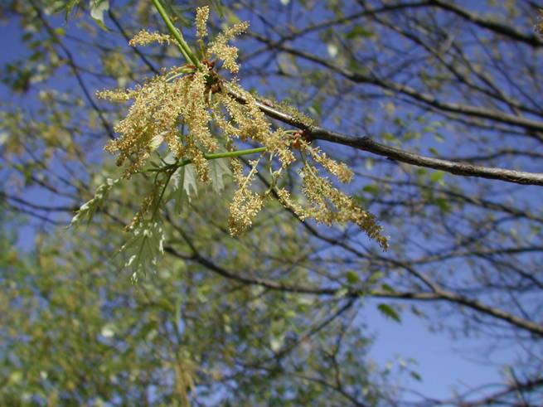
Another view of ash flowers blooming at the base of new shoot growth in the spring of the year. The new growth is bright green in spring.
New growth

Slide 28
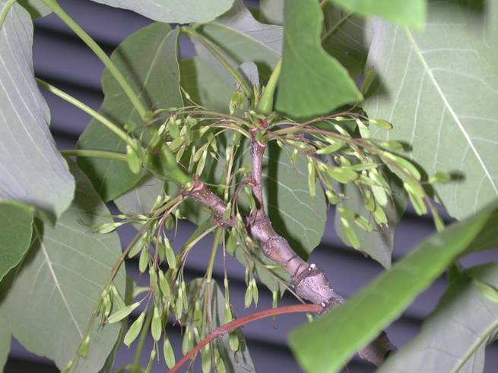
Immature white ash seeds growing from the base of the current year’s growth. The flowers and immature seeds are indicators that seeds will be available in the fall.

Slide 29
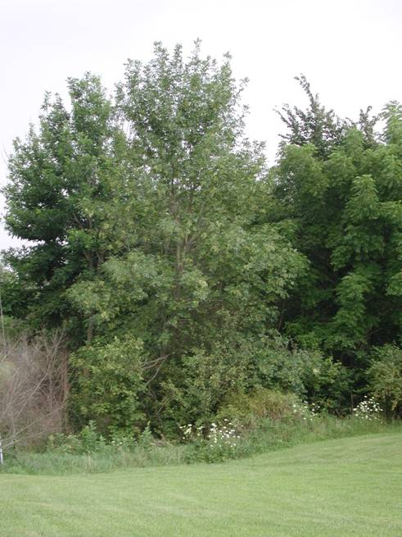
This tree would be good to collect from. It is growing wild next to a residential yard. Unless the tree is positively known to have been a wild tree sprouting up naturally or has been transplanted from the local forest, trees in residential yards are not good trees because their genetic background is unknown. Trees from parks, streets or other public places are not acceptable for the same reason.

Slide 30
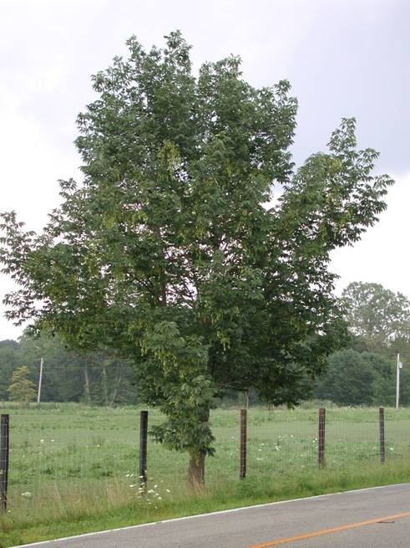
Dioecious: only male or female flowers are produced.
Monoecious: Both male and female flowers are produced.
White and green ash are dioecious.
Black ash is polygomous: maybe male, maybe female, maybe both on the same plant.
Outcross: two trees involved.
Selfed: The tree’s own pollen pollinates the tree.
Trees growing along rural roads are good trees to collect from. White and green ash are either male or female and cannot self pollinate themselves. Although this tree is isolated it has been outcrossed and will have good seeds. Isolated trees of a monoecious tree species might have self pollinated seeds that are inbred and will give poor seedlings.

Slide 31
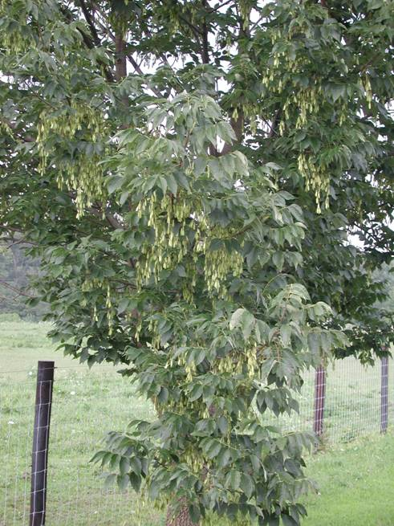
This is the tree from the previous slide. Many seeds can be hand stripped from the tree while simply standing on the ground.
Although this tree has lots of seeds this year it may not have many next year. Trees are cyclical in seed production and may not have seeds every year.
Seed clusters

Slide 32
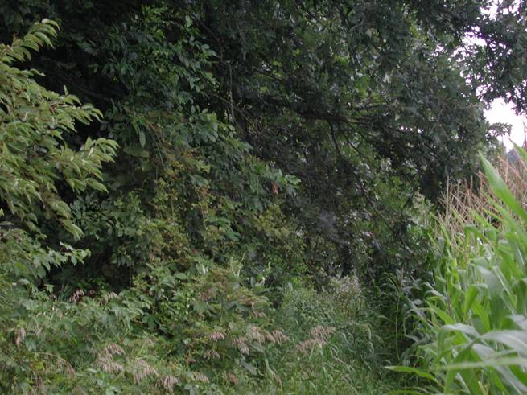
Trees growing along the edge or out in farm fields are good seed producers.
Ash tree

Slide 33
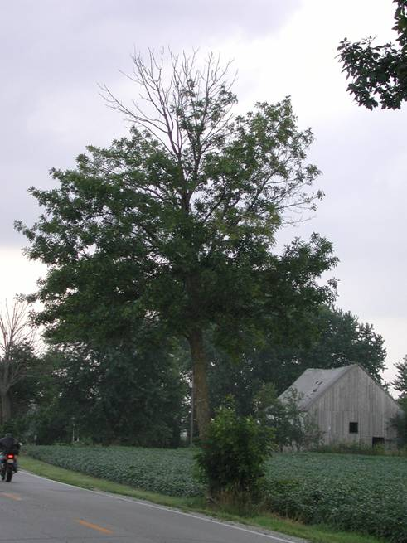
This tree is acceptable for collecting because it was a strong tree at one time. The top has died back most likely because the farmer has struck it several times with farming implements. The bark at the base of the tree has been broken off about half way around the tree.
This tree has an abundant seed crop.

Slide 34
When are seeds ready to collect?
Must first know the seed structures to observe if they are developing and maturing.
The following slide shows the structure of a mature ash seed
Subsequent slides show seeds in different stages of development and the changes they undergo as they mature.

Slide 35
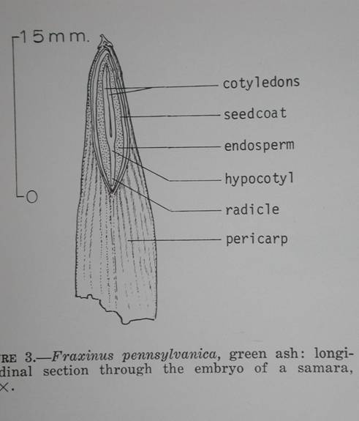
It is important to know the structure of the seed for determining when seeds are mature and good for collecting.
What is called the seed in practice is actually the fruit, samara, of the ash tree. The true seed is inside the fruit.
The pericarp in this drawing is the fruit wall. This fruit type is a samara. A samara is a one-seeded, dry, indehiscent, winged fruit.

Slide 36
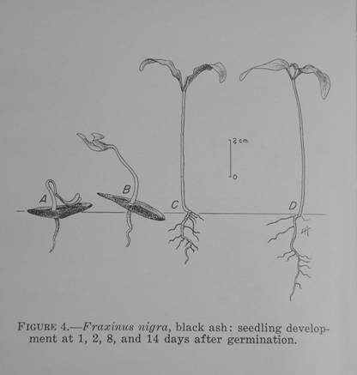
Drawing of black ash seed germinating.

Slide 37
The first seeds to fall are empty or damaged by insect. This is an x-ray of seeds fallen from a tree in late August.

Slide 38
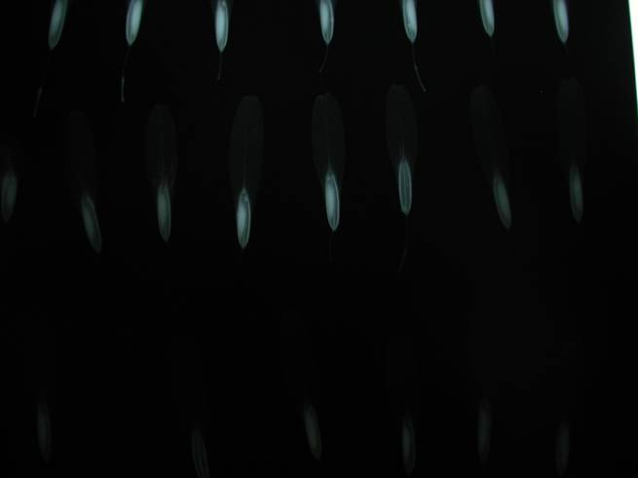
Immature seed
Empty seed
Fruit reaches full size before the seed and embryo. Cut seeds open to make sure embryo is full sized and firm, not soft or milky before collecting. The white image in this x-ray is the developing seed. It is about 1/3 of its mature size.

Slide 39
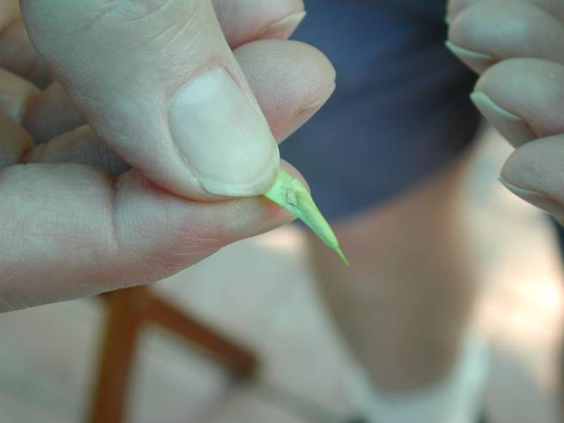
To examine the seed, first grasp it as shown here. The fruit can then be torn open with the thumb nail of the other hand to expose the developing seed.

Slide 40
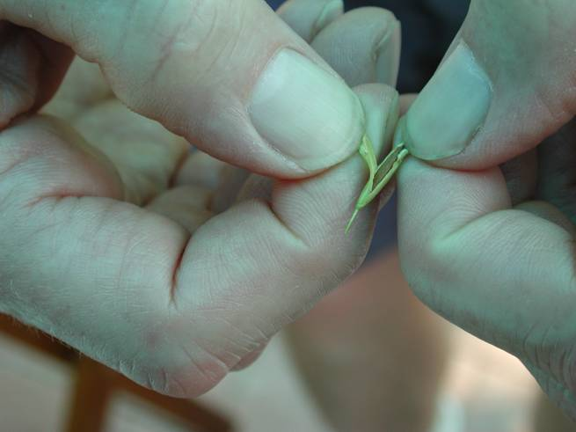
This fruit has been torn open to expose the seed for examination.

Slide 41
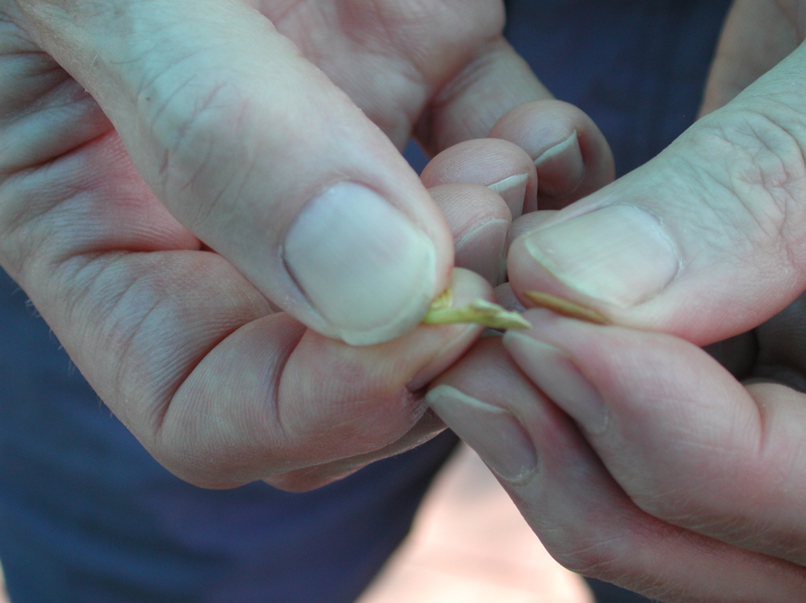
seed
Fruit torn open
This seed has been pulled from the fruit after tearing the fruit open. The brown seed color indicates the fruit is ready for harvest.

Slide 42
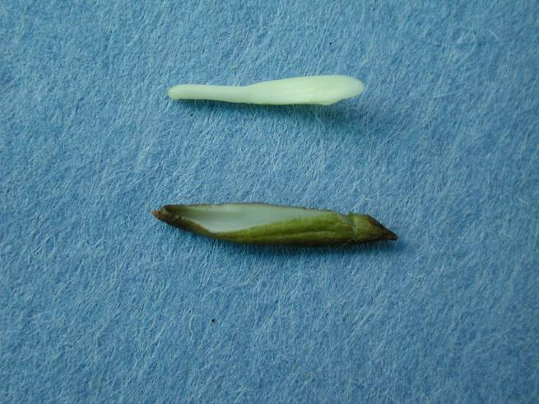
A green immature seed excised from the fruit with the embryo excised from the seed. The embryo is firming up but is still immature.
Radicle (seed root)
Cotyledons (seed leaves)
Embryo
Immature seed (embryo removed)

Slide 43
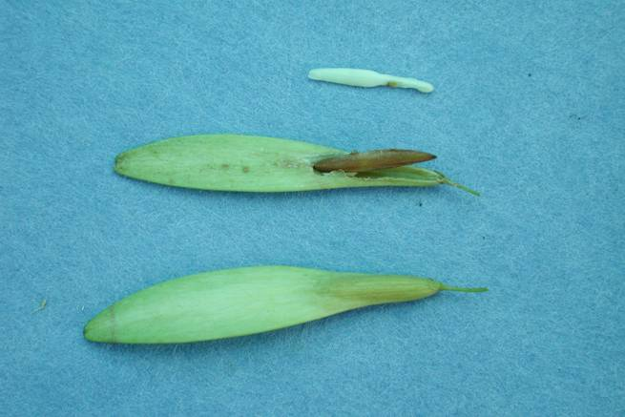
Cotyledons (seed leaves)
Radicle (seed root)
A firm full sized embryo
Fruit torn open exposing seed
Whole fruit
White ash seeds at different stages of examination. These seeds are ready to collect because the seed coat is brown, the seed fills the fruit, and the embryo and endosperm are firm and not soft or milky.

Slide 44
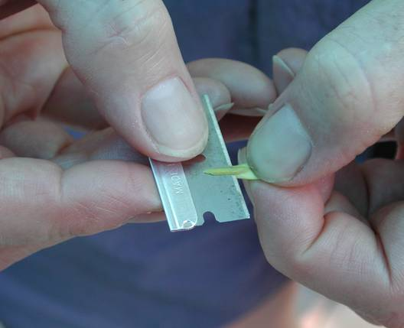
Fruits can also be cut longitudinally with a razor blade to make a clean cut that sometimes makes it easier to see more detail.

Slide 45
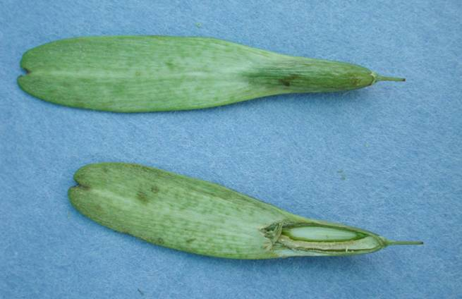
Whole uncut white ash fruit
Immature seed
Fruit cut longitudinally
Placental tissue
Longitudinal cut showing the developing seed. This seed is about half of its mature size. It is important to distinguish between the seed and the placental tissue next to it. Otherwise it could be concluded that the seed fills the fruit when in fact it only about half fills the fruit with the other half filled with placental tissue. This seed is not mature enough to harvest. The seed must develop further.

Slide 46
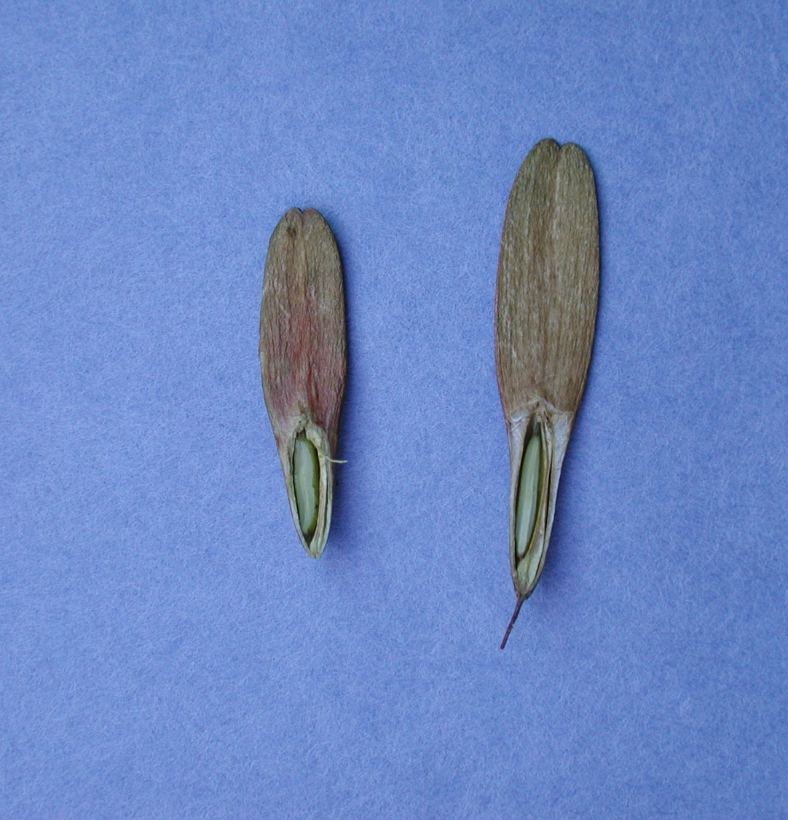
Longitudinal cut showing the developing seed. This seed is almost mature size, but is not mature enough to harvest. The seed coat is still green in color. Seeds from their mother tree must develop further before picking.
Developing seed
Placental tissue

Slide 47
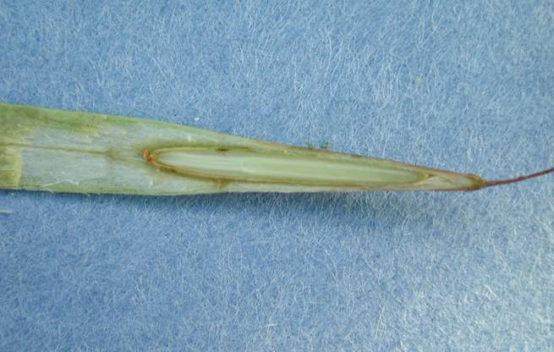
Radicle (seed root)
Cotyledons (seed leaves)
This longitudinal cut of a green ash seed shows that the seed fills the fruit cavity and the embryo has reached full length. It is ready for harvest.

Slide 48
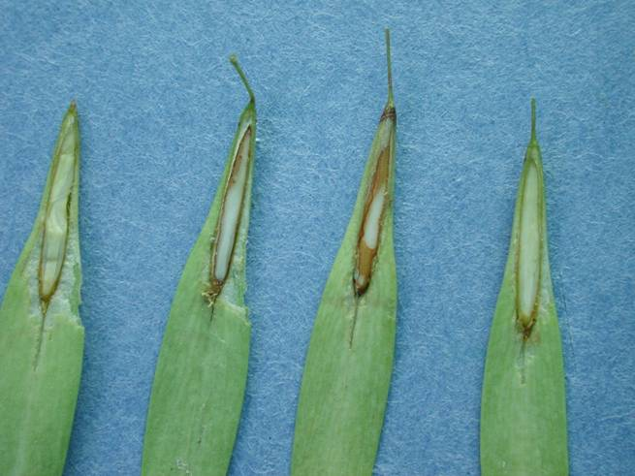
Tan seed coats
Longitudinal cuts on green ash seeds showing that the seed coats have matured and turned tan colored. These seeds are ready for harvest.

Slide 49
Black and Blue Ash
No this is not a bruised tree, I mean two separate species.
Black and blue ash are both shed from the tree with immature embryos.
Therefore you will not see a full sized embryo at collection
But the endosperm will fill the seed. It will be firm and white when full sized and mature.

Slide 50
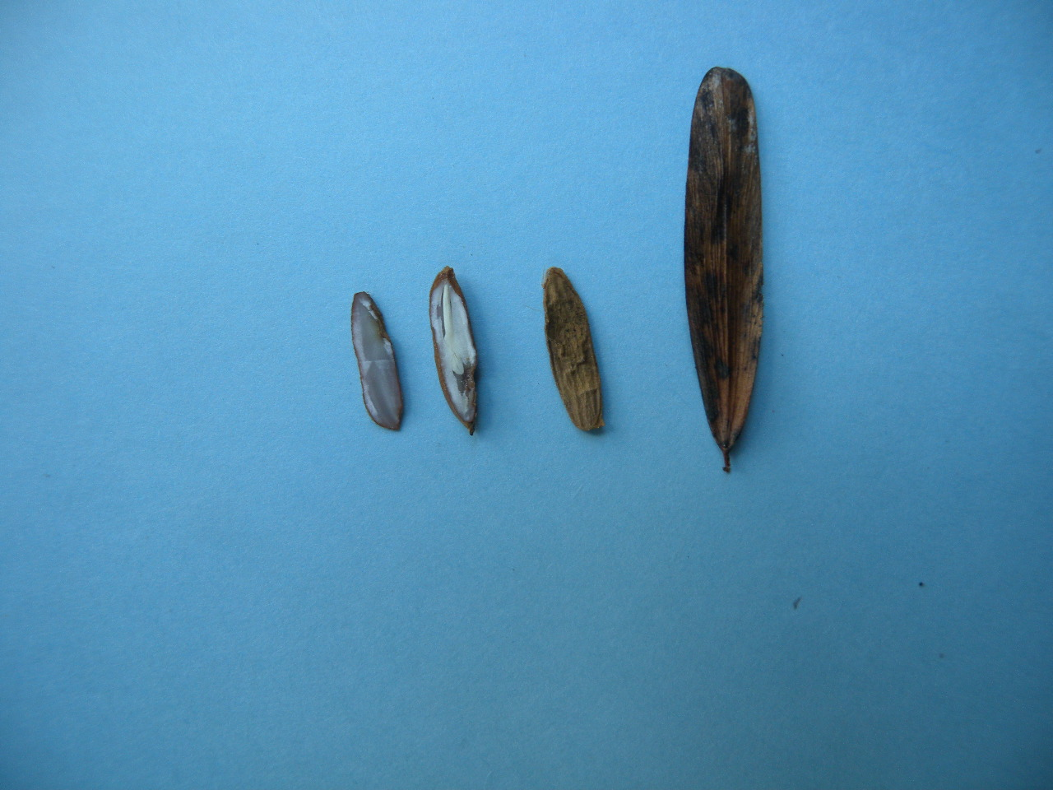
Whole fruit
Whole Seed
Embryo
Endosperm
Seed cut open
Black ash seed cut open to show the embryo.
This embryo is maybe 2/3 the length of the seed.
The embryo can be even smaller.
However the endosperm fills the seed.

Slide 51
Insect damage on seeds
When insects feed on seeds the seeds are often killed.
A longitudinal cut with a razor blade or knife will show if the seed is damaged.
Insect damage can also be seen in an x-ray
Weevils and seed bugs cause damage to ash seeds.

Slide 52
The white oval at the top of this seed is the weevil larva.
An x-ray of green ash seeds. The seed 3rd from the left contains a weevil larva.

Slide 53
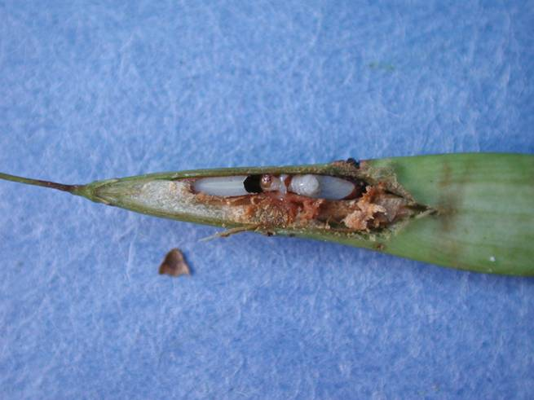
A weevil larva has destroyed this seed.
Larva
Head of larva

Slide 54
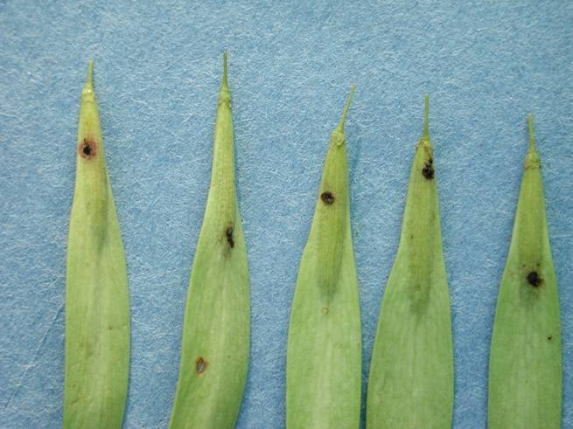
Possible seed bug wounds
These fruits apparently have been attacked by a seed bug.

Slide 55
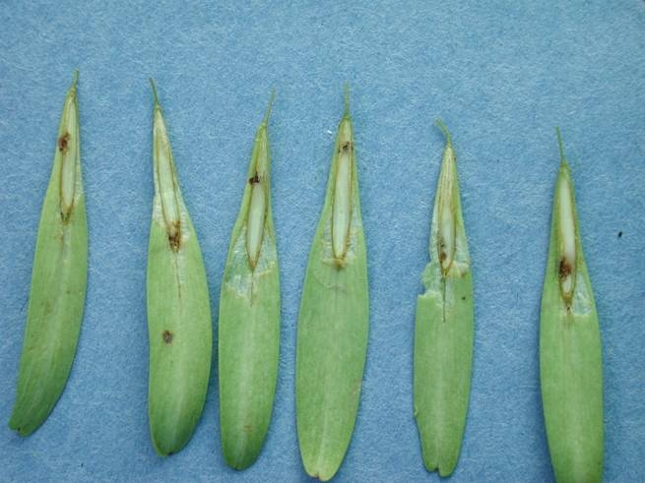
Longitudinal cuts showing the seeds in the previous slide have been damaged at the same point as the fruit was damaged.
Do not collect from trees with heavy amounts of insect damaged seeds. These seeds are of poor quality and not likely to germinate.
Possible seed bug damage

Slide 56
The Actual Seed Collection
Prerequisites
The species of ash has been identified
A tree with an abundant seed crop is located
Examination of the seeds shows they are full, mature, not damaged by insects
Assembled the collection materials

Slide 57
Step by Step Procedures
This section of the presentation covers a line by line completion of the data collection sheet and the picking of the seeds.

Slide 58
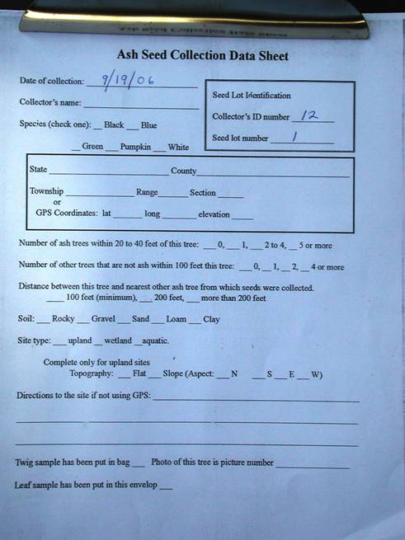
A data collection sheet is needed for each seed lot collected in order to maintain its identity. These sheets are found in the accordion folder.
Filling out the data sheet is the first step in taking the seed from the tree.
“Collector’s ID number” and “Seed lot number” maybe filled in by the seed lab before the data sheets are sent to you.
If the “Collector’s ID” and “Seed lot number” are not filled in, obtain specific instructions from the seed lab on what numbers to use.

Slide 59
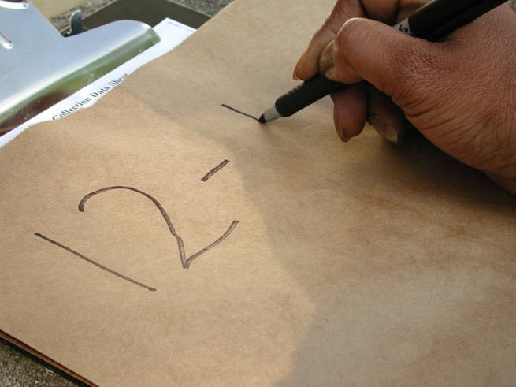
Clearly write the collector identification number and seed lot number on the collection bag for the seeds. Use a dash as shown to separate them. Write the collector’s ID number first followed by the dash and the seed lot number.

Slide 60
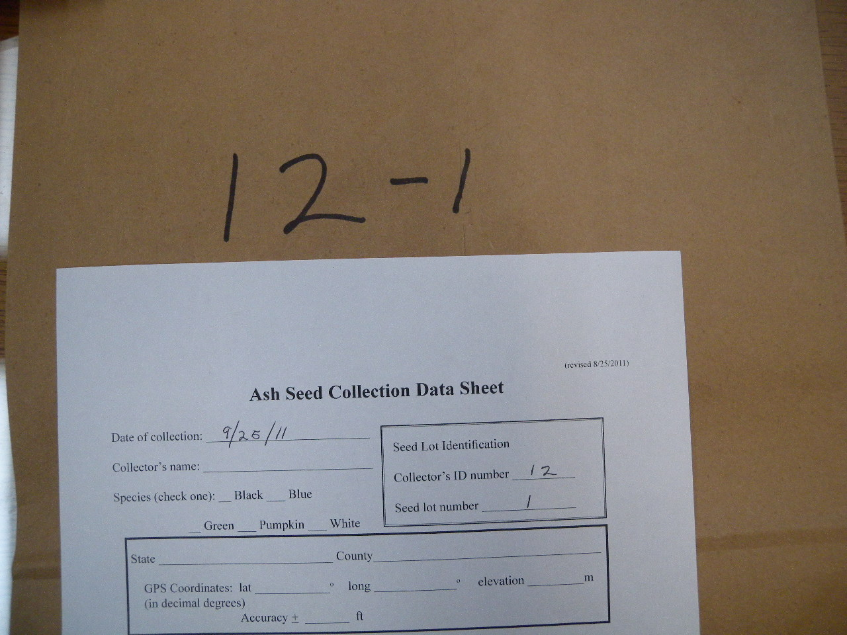
Seed lot number must match
Collector’s number must match
Bag number and data collection sheet numbers must match exactly for the seed to be positively identified and useable in the gene preservation program.

Slide 61
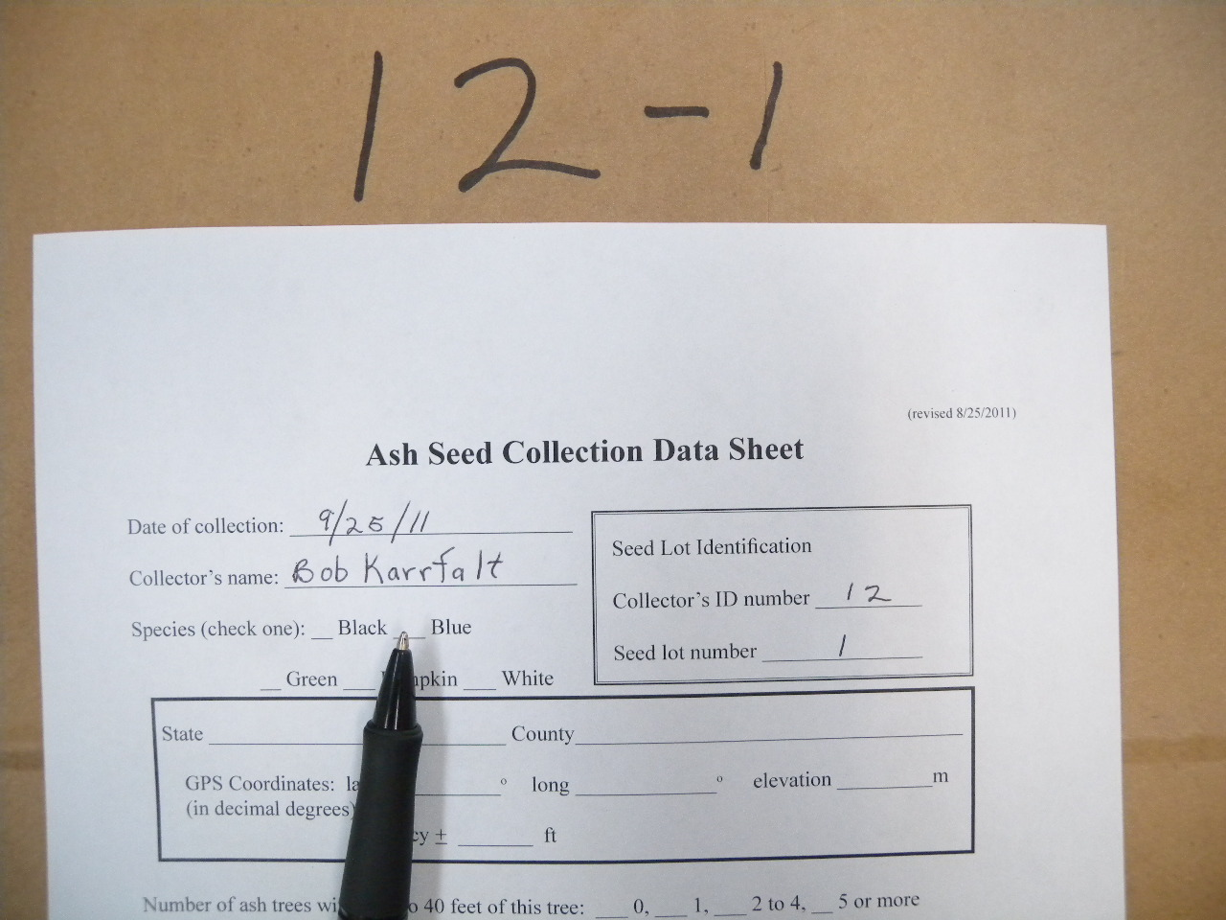
The name of the actual person picking the seeds from the tree is written on the “Collector’s name” line. Just one name is needed if more than one person is picking from the same tree.

Slide 62
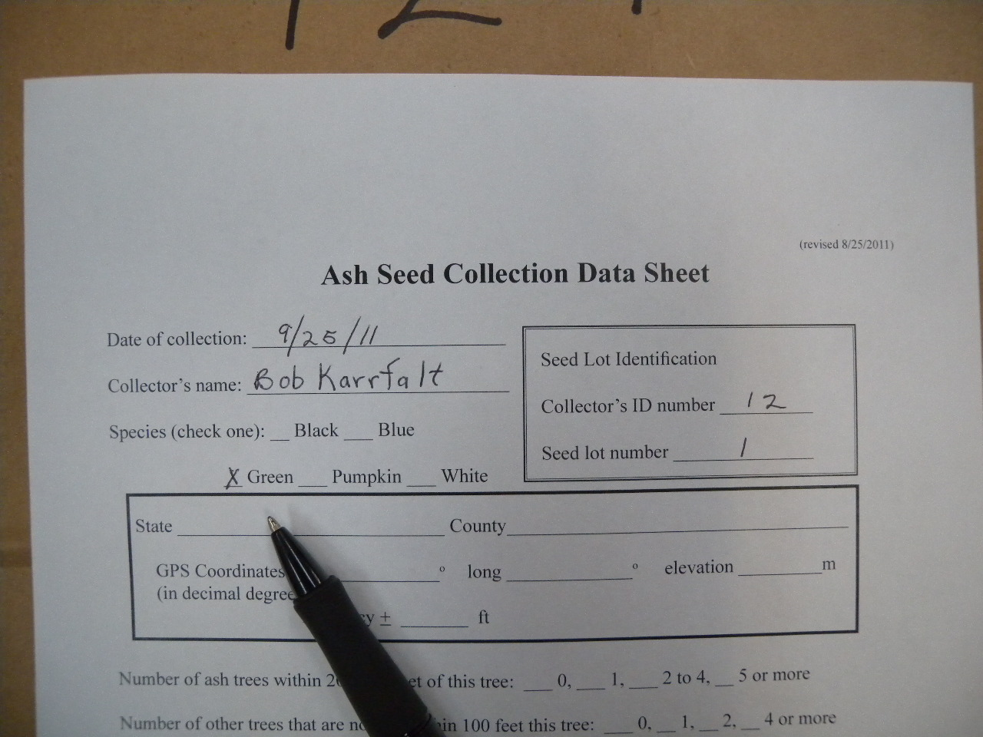
Place an “X” or a check mark indicating what the species of the tree is.

Slide 63
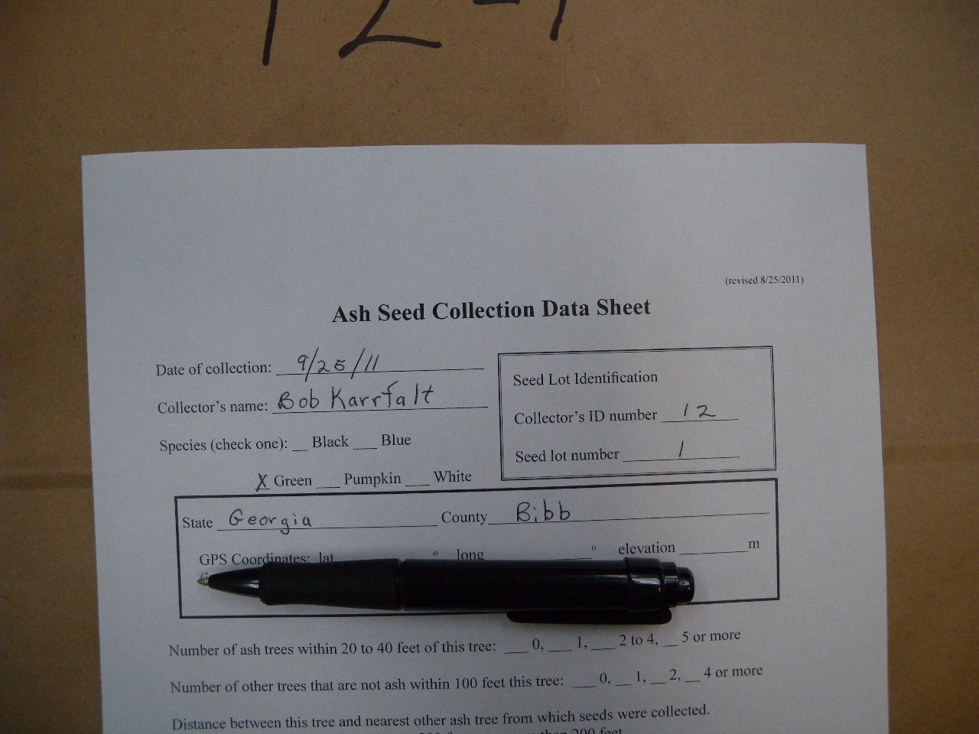
Fill in the state and county where the tree is located. Two letter abbreviations for state can be used (i.e. MI, IN, OH).

Slide 64
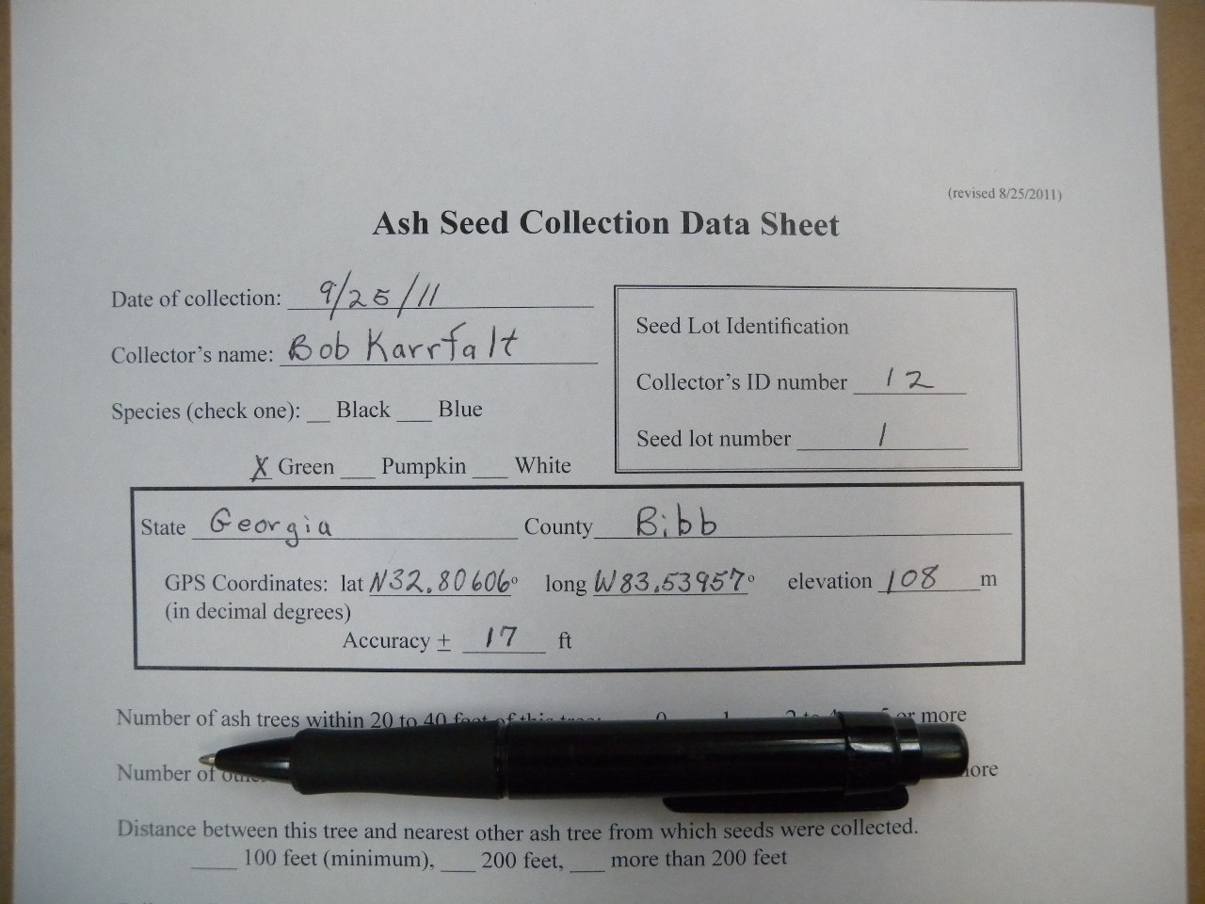
Fill in the GPS line. GPS in decimal degrees is preferred to minutes and seconds. Accuracy of the gps readings should also be recorded if the unit displays it. Both lines can be left blank if the directions to the site are recorded below on the sheet.

Slide 65
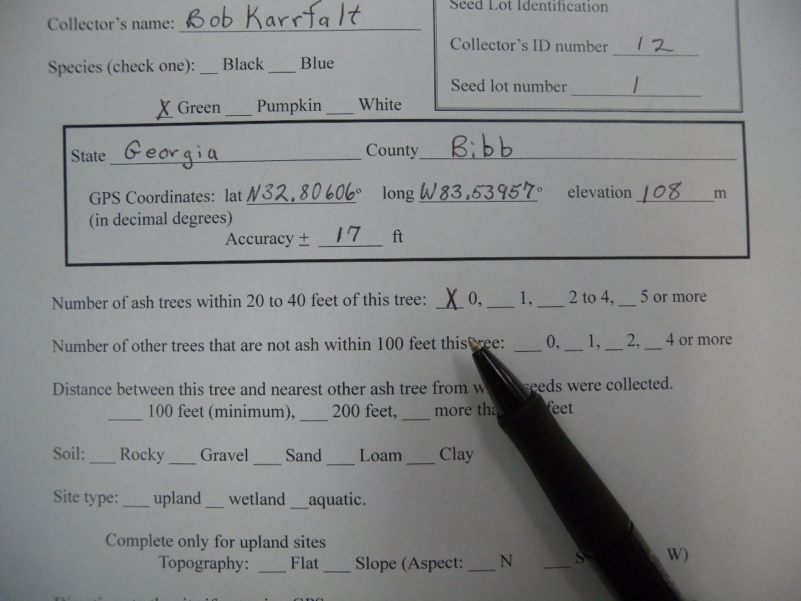
Mark the correct number of ash trees near the collection tree. This information helps us understand the background on the mother tree.

Slide 66
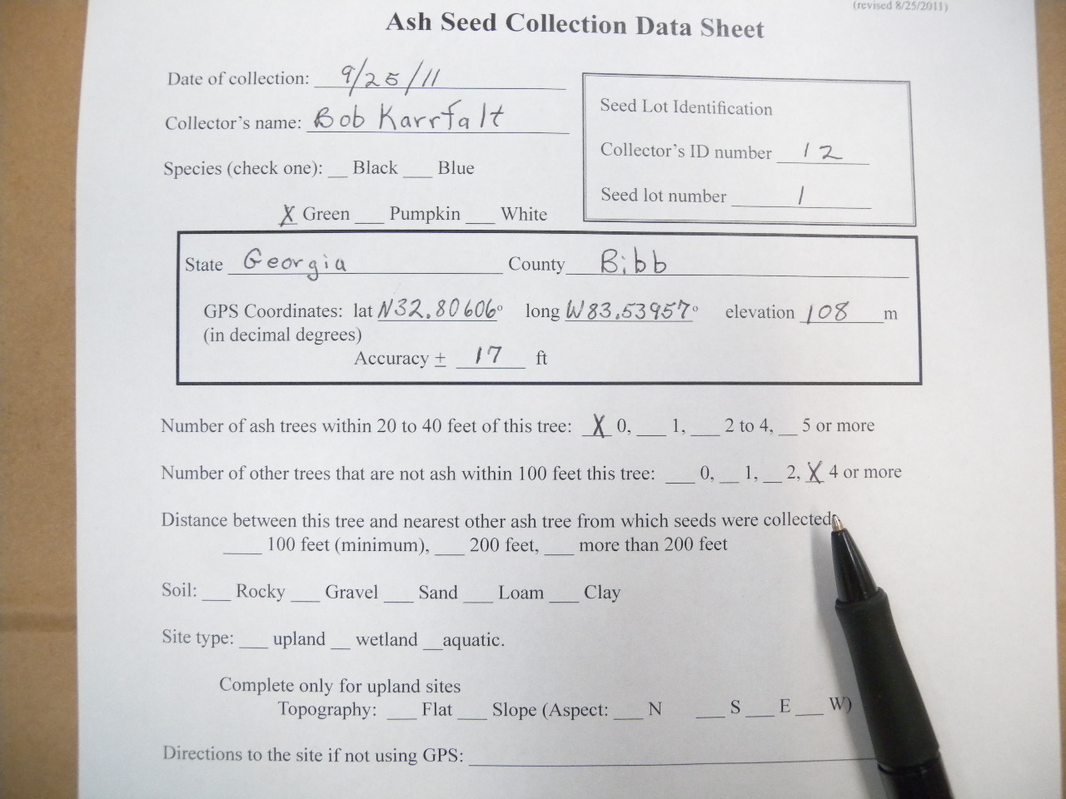
Mark the correct number of other trees near the collection tree. This information helps us understand the background on the mother tree. For example, is it an isolated tree or growing in a stand of trees.

Slide 67
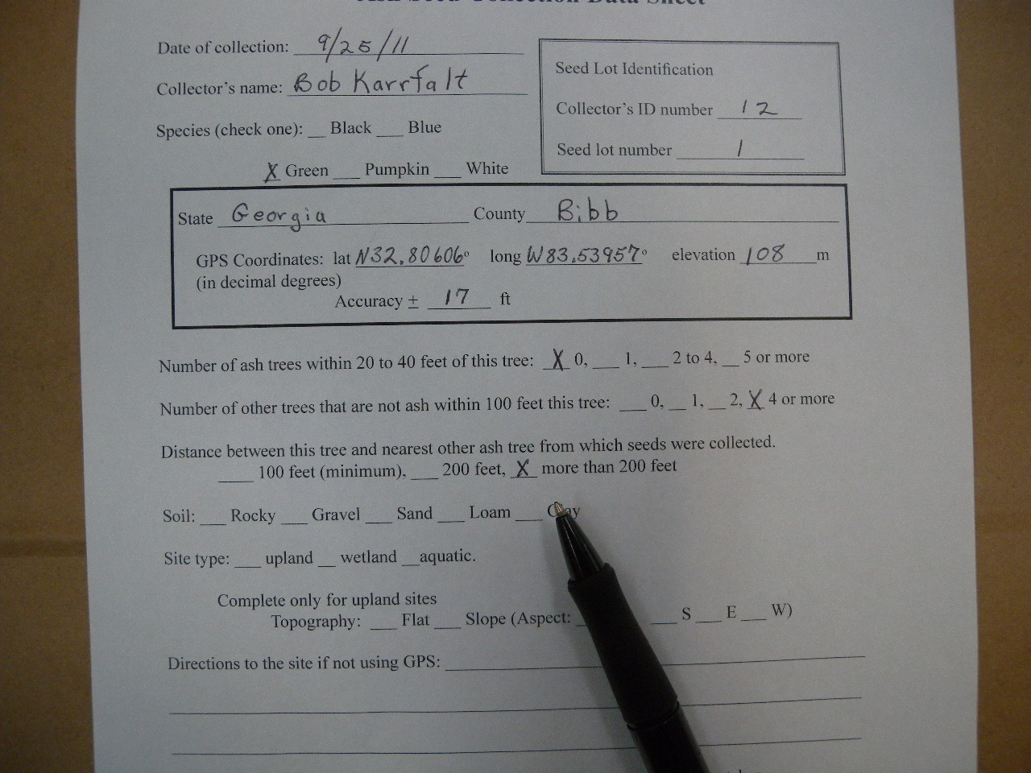
Mark the distance to the nearest other ash from which seeds are collected. A minimum of 100 feet between trees is requested so that related mother trees are not collected. This especially important for black ash which can root sucker, put up sprouts from the roots. Several trees growing close to each other might in fact even be the same tree or clone. Aspen is another tree that propagates itself with root suckers.

Slide 68
Mark the type of soil the tree is growing in. Soil type can be estimated by simply turning over a small amount of soil and estimating what type it is. Soil type shows where this trees progeny might grow well.

Slide 69
Mark the type of site. An aquatic site is a pond or stream. Pumpkin ash actually grows in standing water and therefore lives on an aquatic site. A wetland site is one where the soils are saturated with water for a good portion of the year. These are along streams, near lakes and ponds, and low spots. An upland site is one where water does not stand normally but drains away.

Slide 70
If the site is upland, mark whether it is sloped or flat. White, blue, and sometimes green ash are found on upland sites.

Slide 71
If the site is upland and flat, the aspect is not marked. Aspect in this case does not exist. If the site is upland and sloped it is necessary to mark the aspect. The aspect is the direction the slope faces. With your back to the slope what direction are you facing. (You may have to use a compass.) In our example we face north.

Slide 72
If you recorded a GPS reading, this section can be skipped or filled in at your preference. Distances need not be precise. If for some reason you wish to return to this tree, make the directions as precise as possible to assist your return.

Slide 73
Picking the Seeds
Seed picking can begin once the data sheet is filled out through to the “Directions to the site …”

Slide 74
For seeds that can be reached from the ground, hold the branch in one hand and pull or strip the seeds from the tree with the other hand.

Slide 75
Seeds pulled from the tree.

Slide 76
The seeds are next put into the collection bag that was marked earlier with the Collector’s ID number and Seed lot number

Slide 77
As an interim step it is often helpful to toss the seed into a tote bin. The bin is more stable on uneven ground and in the wind than is a paper bag. Once the seeds are collected they can be transferred from tote to bag. The tote can also serve as a carrier for the collection supplies.

Slide 78
As many seeds as reasonably possible should be taken from each tree. This will maximize the benefit from the effort of finding the tree by making the most research possible.
A good minimum to shot for is to cover the bottom of the paper grocery sack about 3 inches deep with seeds.
It would not be a good use of time and supplies to take more than one full bag from any one tree.
Minimum Fill Line
3 inches

Slide 79
After picking all the seeds that can be reached, a twig sample is taken for identification purposes. To do this grasp the twig with both hands and break off a the end of the twig (about a 6 to 9 inch long piece).

Slide 80
The twig should snap off relatively easily. From a tall tree it may be necessary to use a pole pruner to take the twig sample.

Slide 81
Pull all the leaves off of the twig and drop it in the bag with the seeds you have just collected.

Slide 82
Mark the data collection sheet that you have put a twig sample in the bag. This is done just to make sure the twig sample was taken and not forgotten.

Slide 83
With the twig sample in the bag, fold the top of the bag over once and staple it shut in three or four places to be sure the seeds will not spill out.

Slide 84
“ears”
When using the small stapler, be sure the staples pass beneath the little “ears” shown with the arrows. Otherwise the staples will not feed correctly and the tool will not work.

Slide 85
Bags can be folded down to make them easier to ship and carry.

Slide 86
Take a picture of the tree. The photo provides back-up information about where the tree was growing, its size, condition, and what other trees were growing nearby.

Slide 87
Seed lot number
Two photos are taken of each tree. One photo of the trunk and one of the full tree. Take the photo of the trunk first. In this way the whole tree photo will be associated with the correct trunk photo. Hold the collection bag against the trunk to show the seed lot number when photographing the trunk. This will identify the seed lot to the tree photos.

Slide 88
Mark that the photos were taken

Slide 89
The entire data sheet is now reviewed to be sure all data has been recorded and all samples taken.

Slide 90
Put the completed collection data sheet/envelope back into the accordion folder. Use the cardboard to divide the completed sheets from the unused ones.

Slide 91
Close the folder and secure it with the rubber band before moving on.

Slide 92
The closed folder is now safe to transport without worry of spilling the contents.

Slide 93
If you need to mark the tree for a second visit it can be marked by tying a piece of flagging to a branch and writing the Collector’s ID number and the seed lot number for the tree on the flagging (e.g. 12-1).

Slide 94
Often branches are beyond reach when simply standing on the ground.

Slide 95
When seeds are beyond reach from the ground
A tarp spread beneath the mother tree will catch seeds.
The tree is then shaken by several persons to cause the seeds to fall.
A rope can be thrown over a branch and the branch can be shaken.
A pole pruner can be used to cut the panicles from the tree.
The seeds land on the tarp.
The branch is held on a hook and lowered to the ground
Ladders, or the back of a truck can be used to elevate the pickers up to the seeds. Extra care is always needed when using these methods.
The next few slides also give another idea on reaching seeds from the ground.

Slide 96
A hook, such as this pole pruner, can be used to pull the branch down to within reach of a person on the ground.

Slide 97
The seed bearing branch is hooked with one hand and pulled to within reach of the other free hand.

Slide 98
The branch is held down with one hand while the seeds are stripped from the branch with the other hand.

Slide 99
Ash seeds can be hand stripped from the tree if they are with in reach of the ground.

Slide 100
This modified pole pruner can cut a seed laden branch and lower it gently to the tarp or ground.
Packaging tape or moisture proof tape of your choice
Stick to hook lateral branch
16 to 20 oz drink bottle
2.5 in diameter x 6 in. tall main body

Slide 101
Approximate 2 inch clearance between cutting head and stick.
Stick needs to extend a little past top of cutting head.
Head of pruner hook
Bottle is the spacer to hold stick out from cutting head.
Modified pole pruner

Slide 102
Lateral branch
Cutting head
Place the stick behind a lateral branch
Preparing to cut and lower a branch with seeds.

Slide 103
Cut made here
Cutting head
Seeds
Lateral branch
Main branch
Place the cutting head over the main branch.
Stick behind the lateral branch

Slide 104
Reaching high into the tree to cut a seed laden branch.

Slide 105
Lowering the seed laden branch to the ground. The stick is beneath the lateral branch.

Slide 106
Stick hooked below the lateral branch
The branch is lowered onto a tarp (or other sheet or vessel) so that any loose seed do not fall off onto the ground and become lost.
Lateral branch

Slide 107
Cutting head
Stick
Lateral branch
Close up view showing how the branch is hooked on the modified pole pruner.

Slide 108
Green leaf material should be removed from the seeds because the leaves are too high in moisture and could cause the seed to mold.
Sticks and dry leaves can remain in the seeds. It is more efficient to remove these in the lab.

Slide 109
Post harvest handling
Keep the seed out of the heat (over 90ºF)
Do not leave in the car in the sun
Store them so they do not dry out, but they must remain cool.
Ship the seeds, along with their leaf samples, frequently to the address provided.
You will receive instructions with your supplies on when, to who, and how to ship the seeds.
Upon arrival at the processing location the seed will be given a 2 to 4 week chilling treatment that will cause any weevils to leave the seed.
This is why the seed is kept moist after harvest. Premature drying of the seeds will kill the weevils before they can exit during the chilling treatment.
Once the weevils exit the seeds, the weeviled seed will be more easily separated from the good seeds with a seed cleaner. This makes the seed higher quality for growing seedlings.
The seeds are dried and cleaned after the chilling period.

Slide 110
How the Seeds Will Be Stored Long Term
Dried with air of 30% relative humidity or less until dry.
Sealed in a moisture proof container
4 to 6 mill poly-foil bag, or
Plastic bottle with a tight lid
Frozen at – 8ºC or below
All collections recorded in the GRIN

Slide 111
Finding Forest Service Ash Seed Collections in GRIN
http://www.ars- grin.gov/npgs/acc/acc_queries.html
All Forest Service ash seed collections are found by putting FSNS Fraxinus in the block for Text Search Query and checking the block, “historical and unavailable”
Select “Submit” button

