Slide 1
Sustainable Recreation in Land Management Planning
Module 8: Monitoring
Notes:
Welcome to Module 8 – Monitoring the land management plan

Slide 2
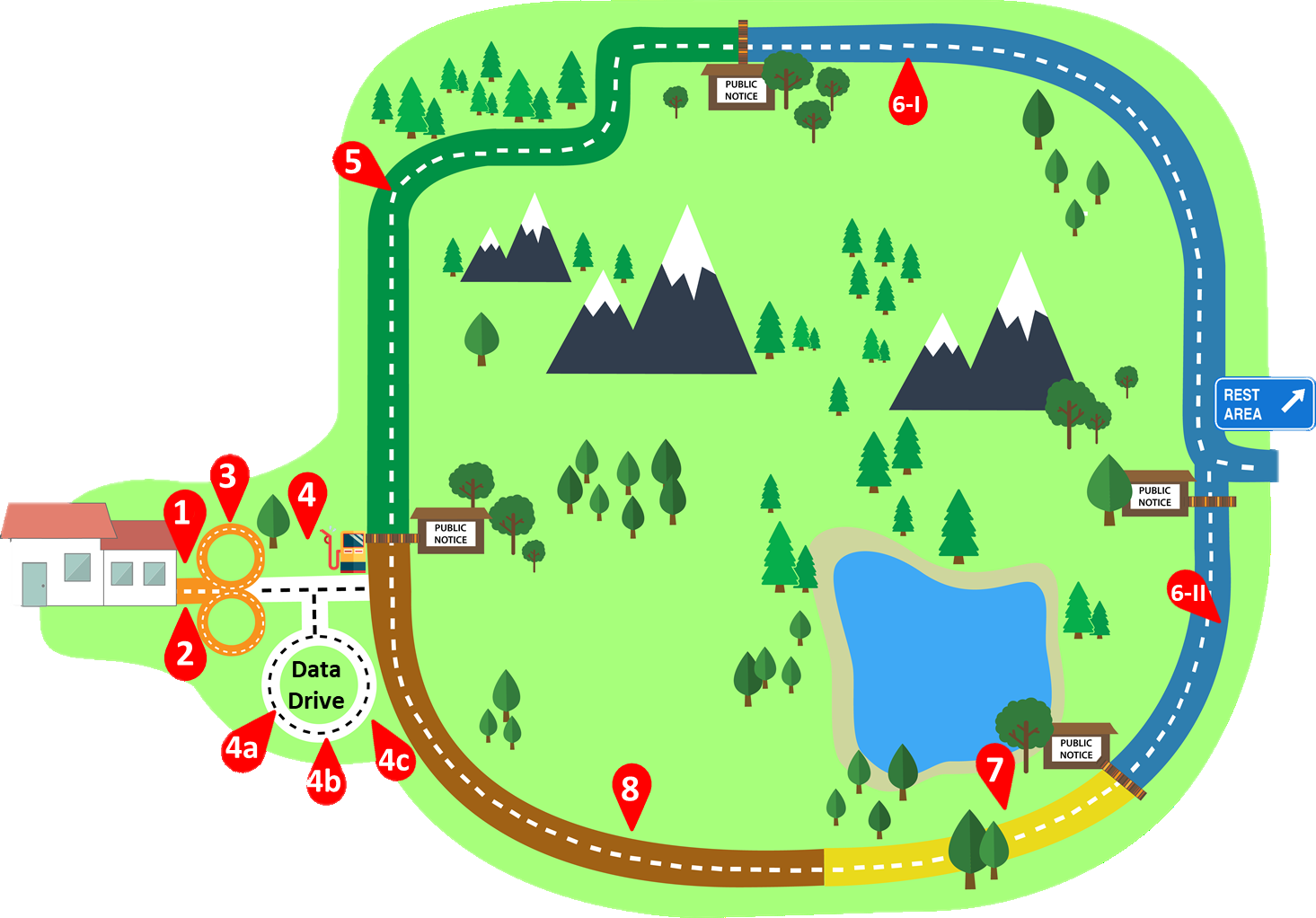

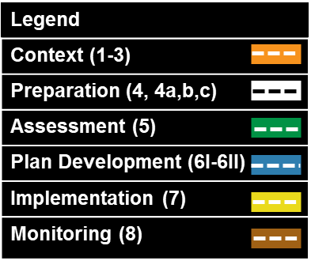
Training Roadmap
You Are Here
Notes:
You’ve now been implementing your Plan and it’s time to see how things are going. This is the last leg of your trip – Monitoring.
The examples in this module will use monitoring questions from the Fictional Forest LMP Monitoring Program (developed in Module 6, part 1).

Slide 3
Learning Outcome
Participants will understand:
The why, what, and where to monitor and what you do with the monitoring results.
Notes:
The Learning Outcome for this module is for
Participants to understand the why, what, and where to monitor; and what you do with the monitoring results.

Slide 4
Outline
Why monitor?
The required monitoring product
Some suggested steps to monitor efficiently
Notes:
We’re going to cover:
Why we monitor;
Required Monitoring Product; and
Some suggested steps

Slide 5
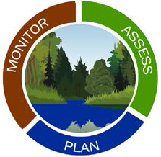
Monitoring vs. the Monitoring Program
Monitoring
(the verb)
Implementation
The Monitoring and Evaluation Program
(the noun)
Defines what will be monitored
Notes:
To quickly clarify - we’re talking about monitoring (the verb). The Monitoring & Evaluation Program (the noun) was developed as part of your LMP – and defines what will be monitored
Monitoring occurs after your plan is finalized and implementation has begun.

Slide 6
Why Monitor?
It’s required…
but more importantly…
It tells us what we need to do or change to achieve LMP desired conditions by:
Tracking whether we did what we said we would do (implementation);
Tracking conditions and results (effectiveness); and
Testing and tracking our assumptions (validation).
This is what adaptive management is all about!
36 CFR 219.5 (a)(3) & 219.12 (d)(2), and FSH 1909.12: sections 30.2 & 31
Notes:
A refresher on WHY we monitor…
“click”
We all know it’s required…but more importantly,
“click”
Monitoring tell us what we need to do or change to achieve LMP desired conditions.
Monitoring:
Tracks whether we did what we said we would do (implementation);
Tracks conditions and results (effectiveness); and
Validates (or not) our assumptions.
“click”
This is what adaptive management is all about!

Slide 7
Product: Biennial Monitoring Evaluation Report
Documents findings and identifies any need:
  To change or amend the land management plan;
  To change management activities;
  To change the monitoring program; or
  To conduct a new assessment.
36 CFR 219.5 (a)(3) & 219.12 (d)(2), and FSH 1909.12: sections 30.2 & 31
Notes:
The end-product is a Monitoring Evaluation Report – generated every two years.
The report documents your findings and identifies any need:
To change the Land Management Plan;
To change management activities;
To change the monitoring program itself; OR where conditions have changed significantly, the need to
Conduct a new assessment.

Slide 8
A Suggested Approach
Know WHAT to monitor.
Determine WHERE to focus monitoring.
Define and map your monitoring plan of attack.
Conduct the monitoring: implementation, effectiveness, and/or validation.
Summarize findings for the biennial monitoring evaluation report.
Notes:
We understand why we monitor, what it should tell us, and the required product,
Let’s talk about How to do it.
Consider approaching monitoring using the following 5 steps:
Determine WHAT to monitor.
Determine WHERE to focus monitoring.
Define and map your monitoring plan of attack.
Conduct the actual monitoring …implementation, effectiveness, and/or validation; and then
Summarize your findings for the Biennial Monitoring and Evaluation Report.
We’ll now go through each of these 5 steps.

Slide 9
Step 1
Know WHAT to monitor
The intent is to make sure you’re focusing on what
you’ve already committed to.
Know what’s in your land management plan’s Monitoring Program:
The 8 Requirements (2 of which are directly related to sustainable recreation)
+
Other monitoring questions and indicators the unit may have related to sustainable recreation
Notes:
The first step is figure out WHAT you’re going to monitor.
Your Monitoring Program (developed as part of your LMP) has already identified LMP Monitoring questions and indicators.
As you’ll recall from Module 6, part 1, the 2012 Planning Rule requires all Monitoring Programs to include monitoring questions for:
Visitor Use and Satisfaction;
Recreation Objectives; and
Desired Conditions (DCs) of Multiples Uses.
Let’s select a monitoring question from the Fictional National Forest’s LMP Monitoring Program…

Slide 10
Step 1 Example
Know WHAT to monitor
The Fictional National Forest land management plan’s
Monitoring and Evaluation Program includes:
Monitoring Question | Measure | Frequency | Methodology
Are existing ROS classes (summer and winter) meeting or trending toward desired ROS classes? | Acres meeting desired ROS classes and subclasses | Post project completion and every 5 years forest-wide | On-the-ground project monitoring and national mapping protocols
+
other monitoring questions related to visitor use and satisfaction, recreation objectives, and desired conditions related to specific recreation programs.
Notes:
The Fictional National Forest’s Monitoring & Evaluation Program incorporated 2012 Planning Rule requirements.
More specifically, A Monitoring Question related to Sustainable Recreation DCs was developed.
As we’ve discussed throughout the training modules, ROS is imbedded in the 2012 Planning Rule’s definition of Sustainable Recreation and is a required framework to allocate the types of recreation settings, opportunities and resulting experiences the Forest will provide.
The Fictional National Forest included a ROS-related Monitoring Question that encompasses both summer and winter ROS settings.
We will use Desired Winter ROS settings as the example we’ll take through remaining steps of the suggested process.

Slide 11
Step 2
Focus WHERE you’re going to monitor
It’s likely you won’t be able to monitor every acre of the unit to determine whether or not desired Recreation Opportunity Spectrum classes are being achieved.
The intent of this step is to focus your on-the ground monitoring.
Considerations…
Notes:
You’ve determined your WHAT to be Desired Winter ROS settings.
It’s likely you won’t be able to monitor every acre of the unit to determine whether the unit is moving toward or achieving Desired Winter ROS classes.
There are some things to consider to help you determine where you should put your focus.

Slide 12
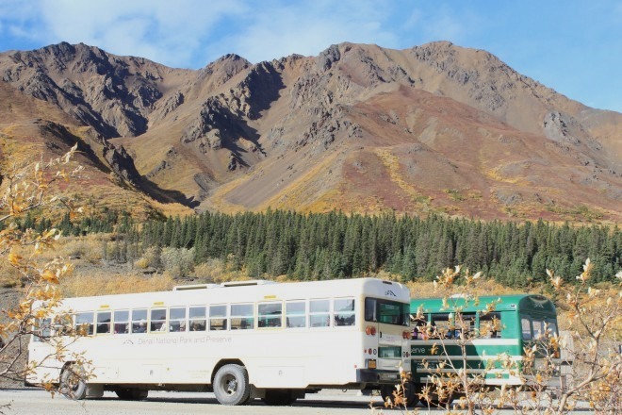
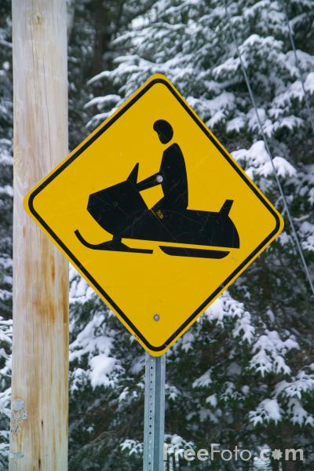

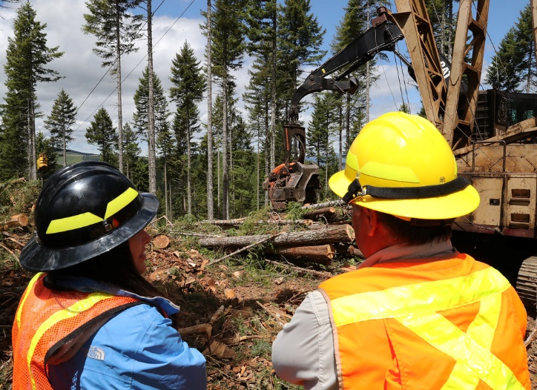
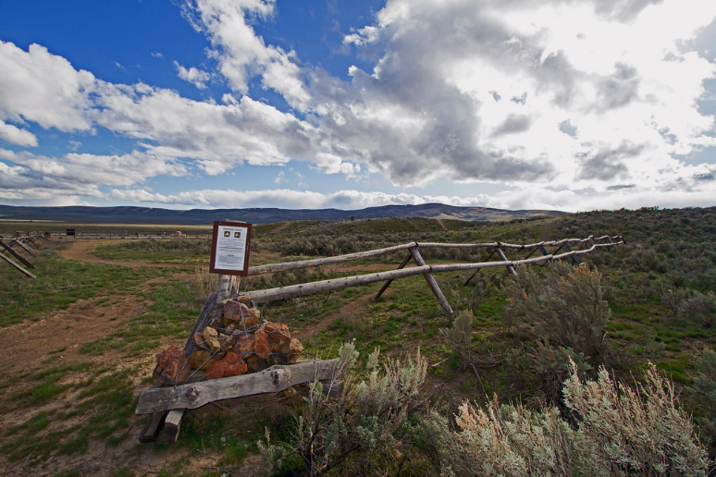
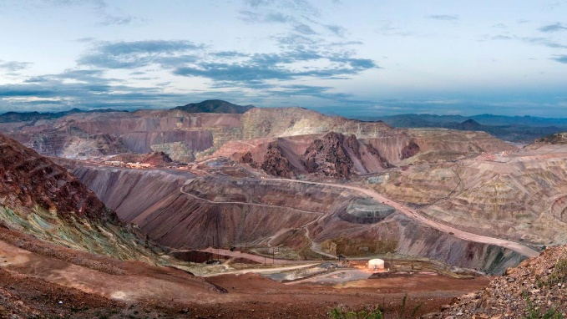
Step 2
Considerations to focus the WHERE, part 1
Where management activities have occurred, in order to:
Meet sustainable recreation objectives and desired conditions
Understand other resource area plan direction that may affect achieving desired conditions for sustainable recreation.
And…
Notes:
One of the things to think about is
Where have management activities occurred?
To meet Sustainable Recreation objectives and DCs; (things like reconstruction or new construction of recreation site(s); new Outfitter & Guides; travel plan decisions and implementation; etc.); and/or
For other reasons, but that may affect achieving LMP direction for Sustainable Recreation. Things like new mining activity, vegetation treatments to move toward Desired vegetation conditions (that is Natural Range of Variation) or new utility corridors.

Slide 13
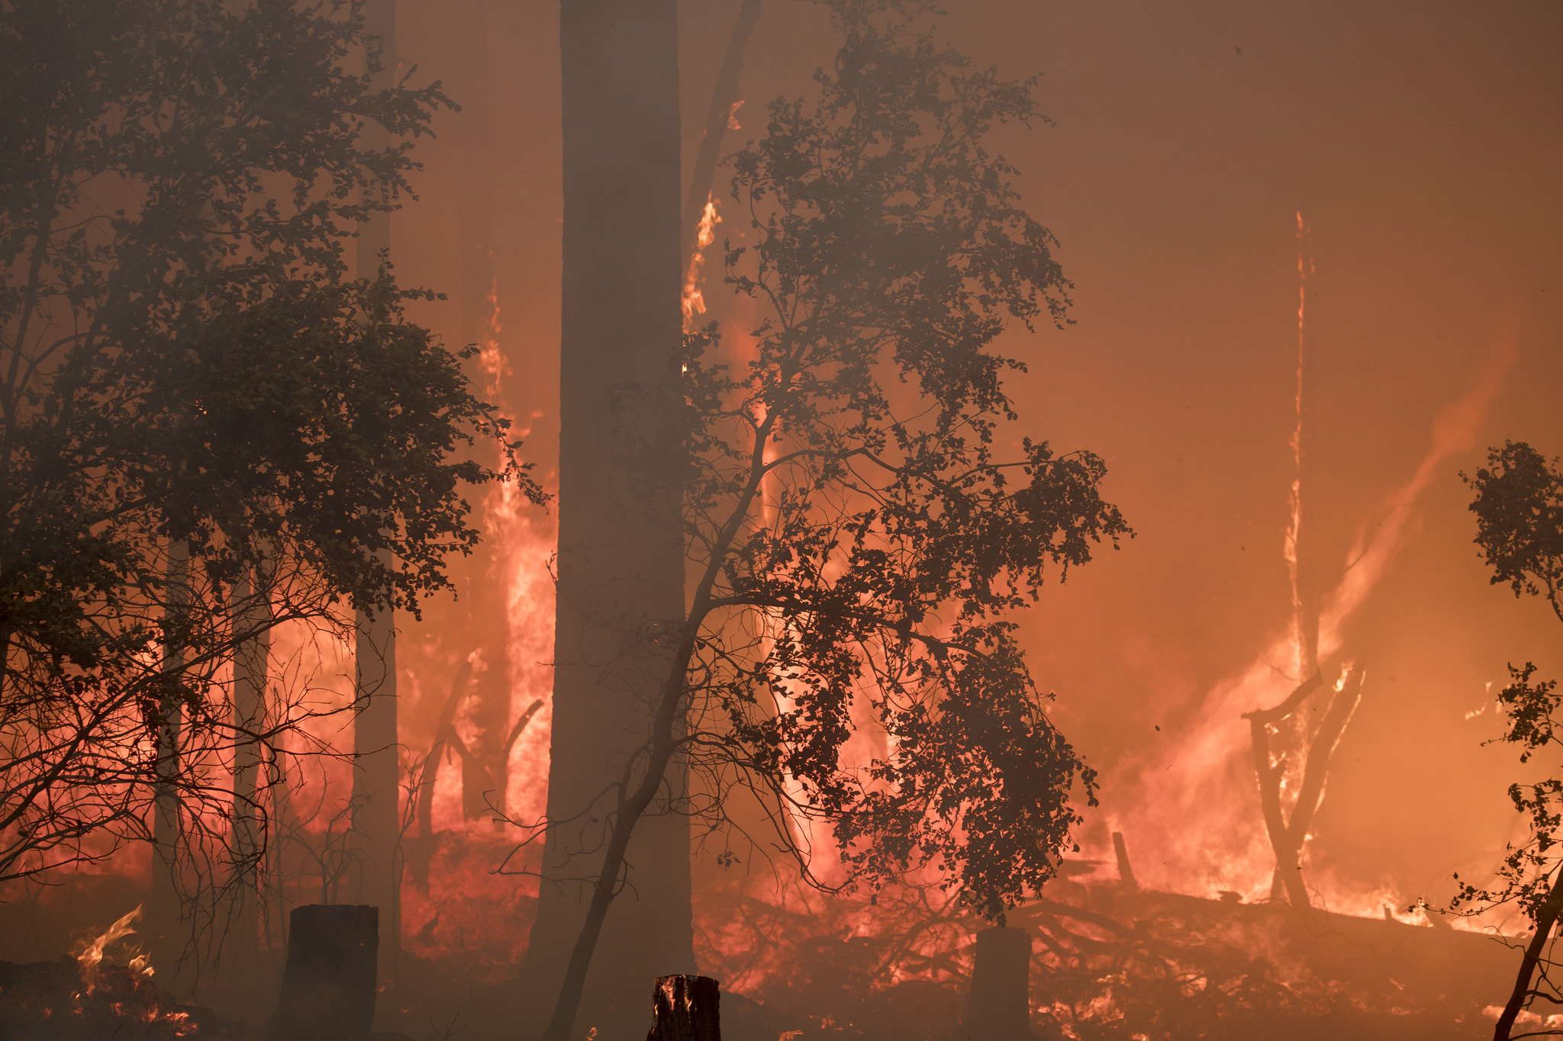
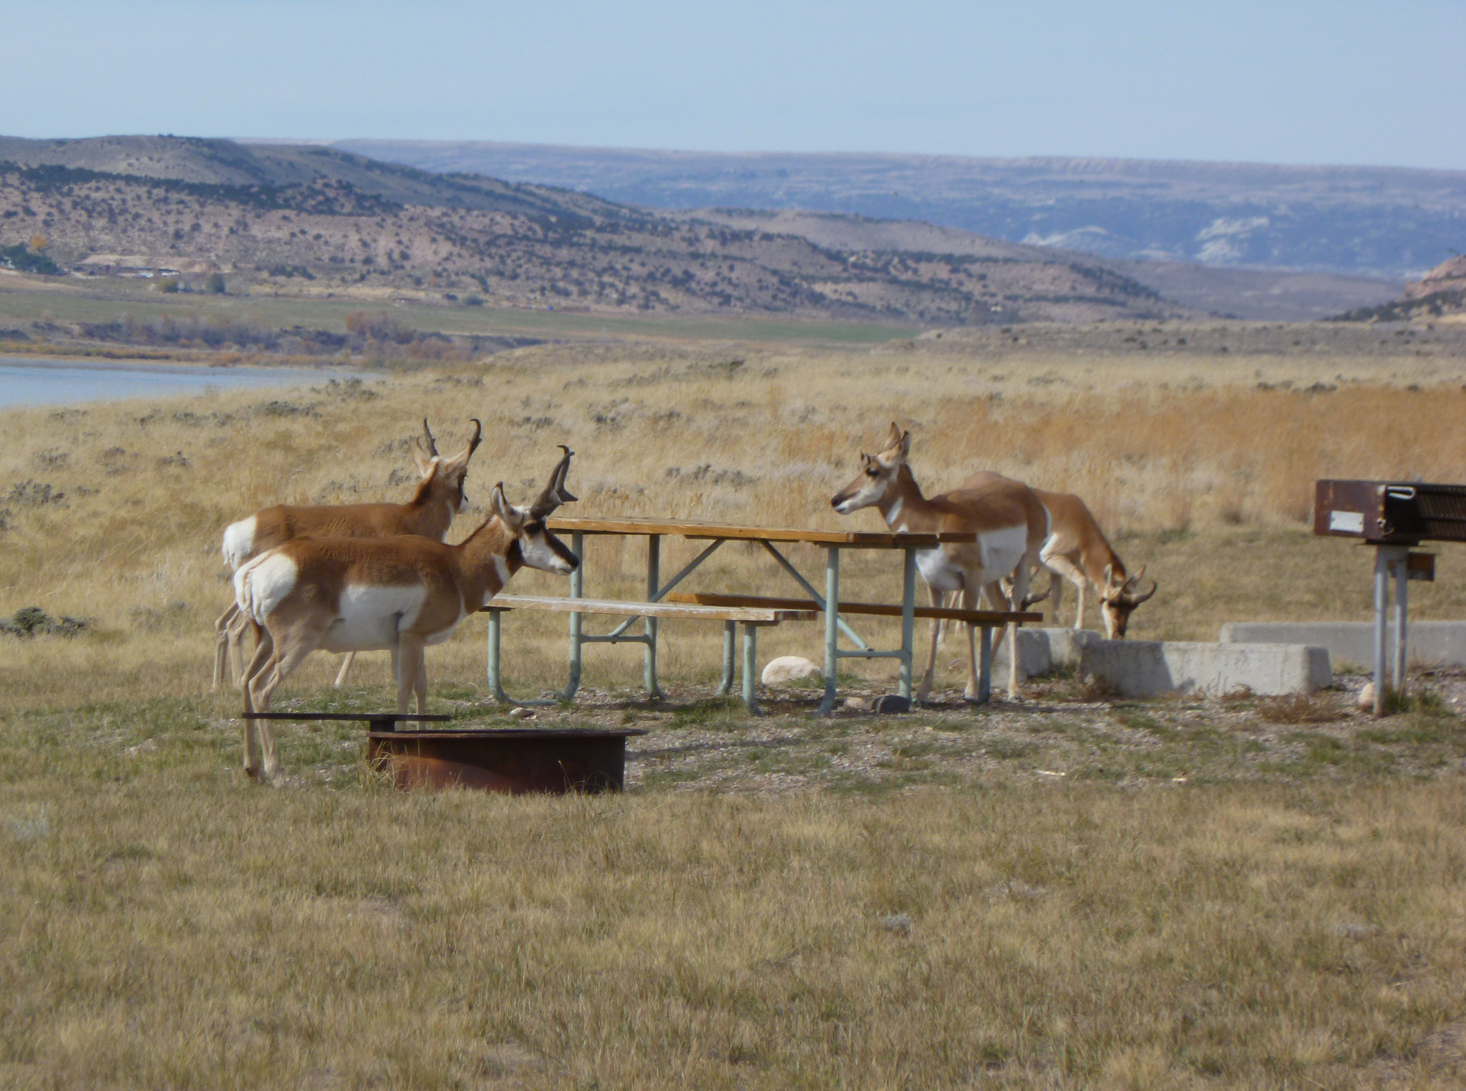
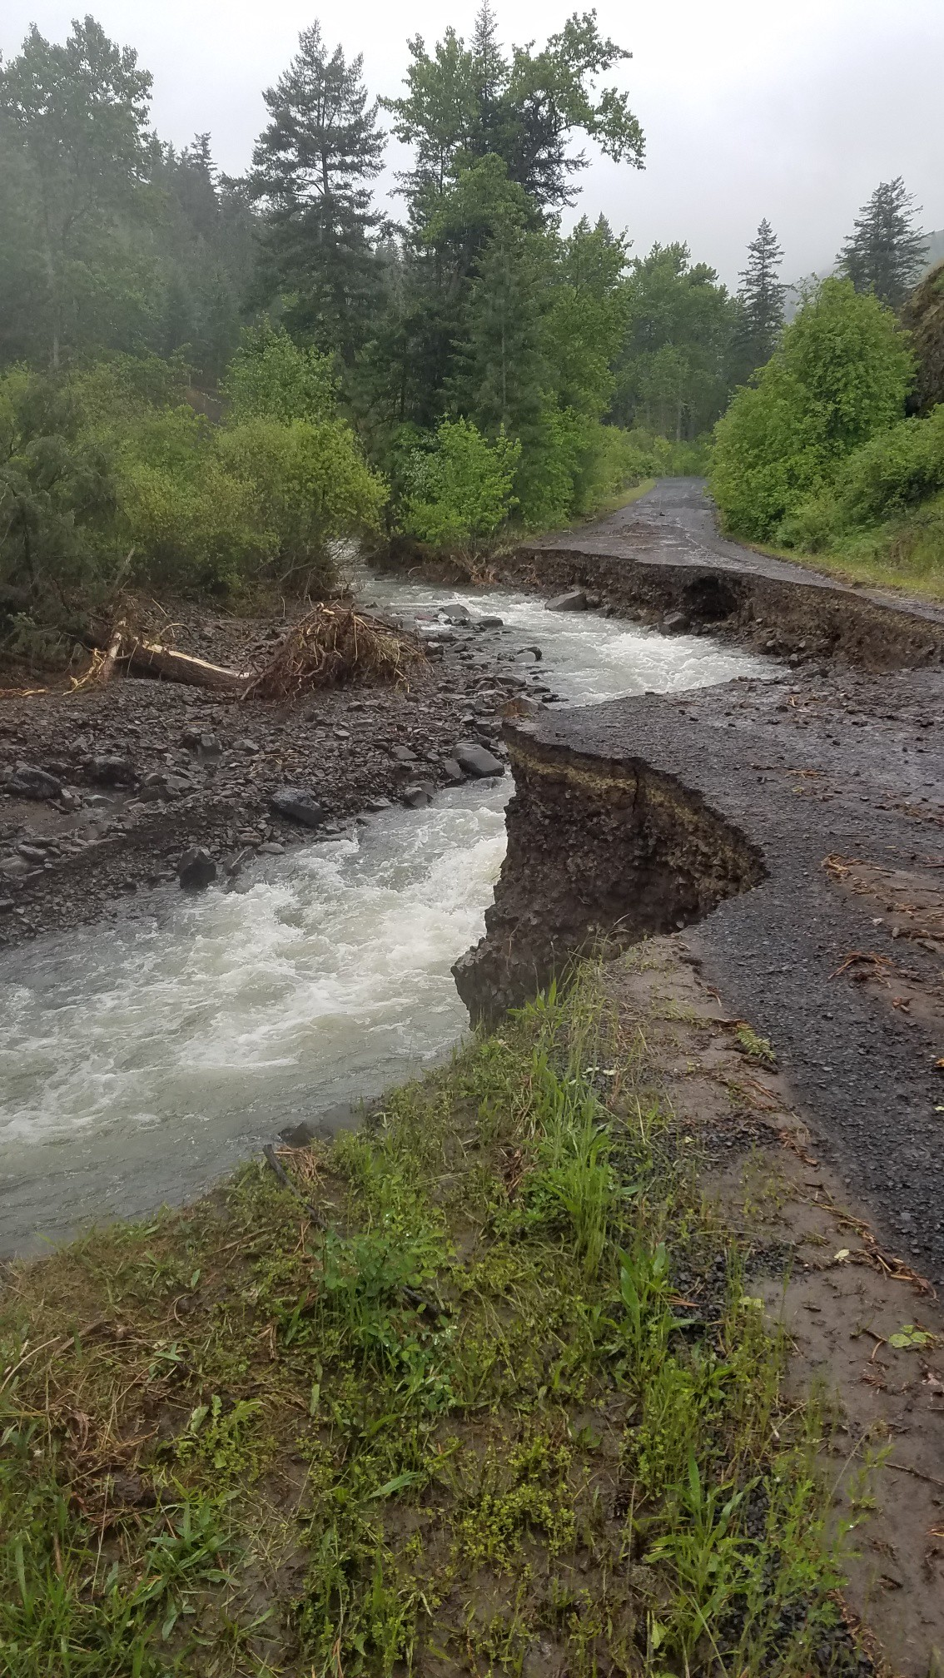
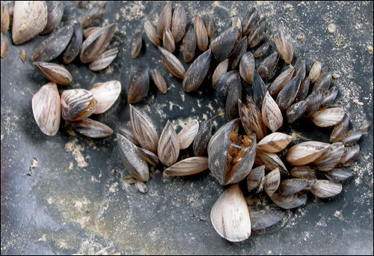
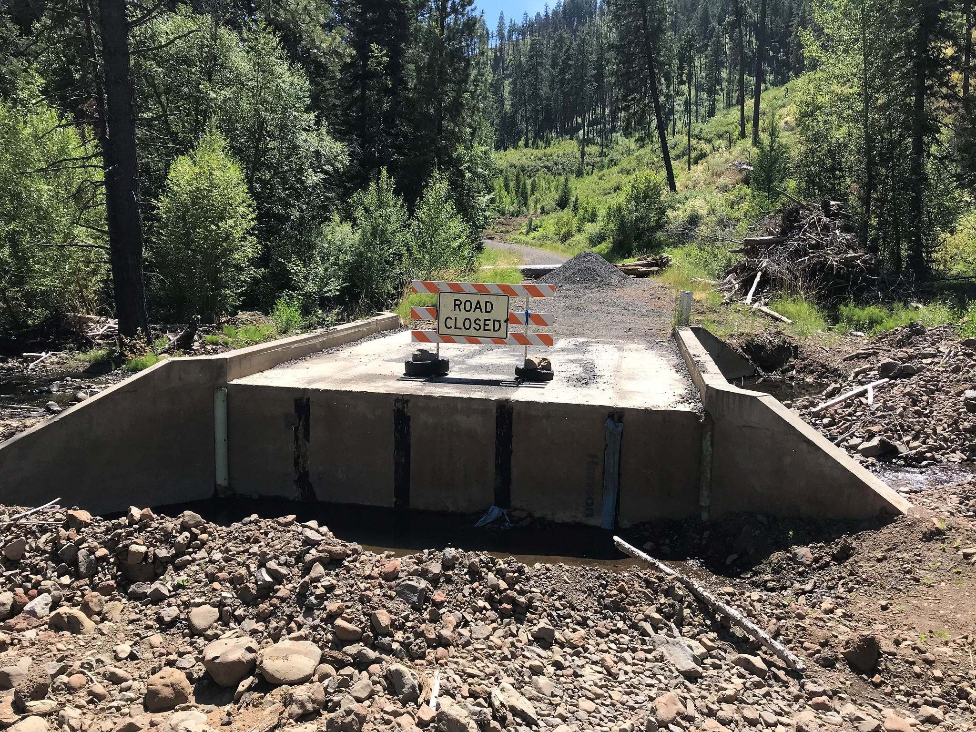
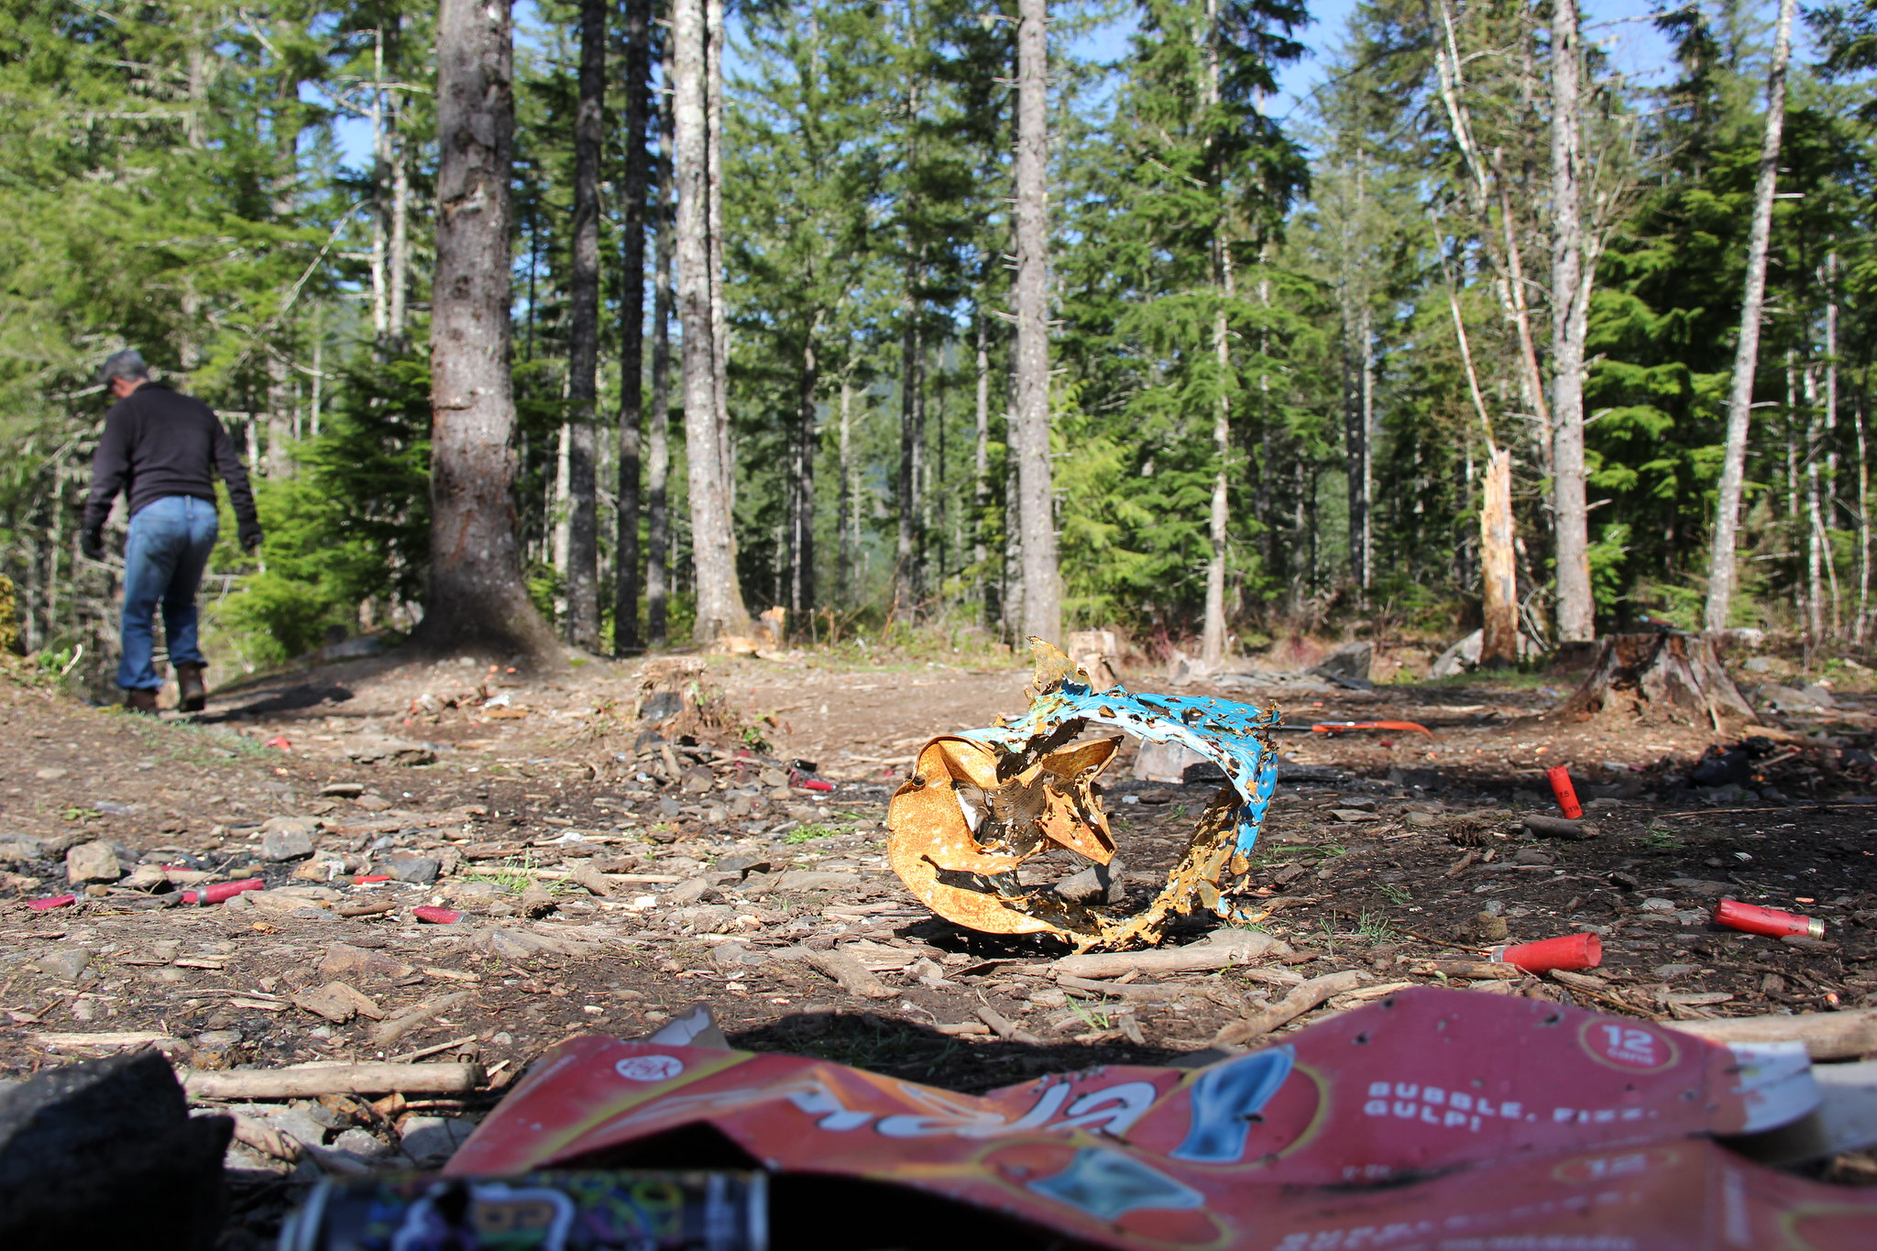
Step 2
Considerations to focus the WHERE, part 2
Where have changes occurred inside the plan area – not related to management actions –that may influence the ability to carry out sustainable recreation plan direction?
Fires
Floods
Insects
Disease
Invasive species
Changes re: wildlife
Changes re: use and/or visitor behavior
And…
Notes:
Also consider where there are changes have occurred inside the plan area that are not related to management activities, but that may influence achieving LMP direction for Sustainable Recreation.
Things like:
Fires
Floods
Insects
disease
Invasive species
Changes in wildlife populations
Changes in use levels and/or activities

Slide 14
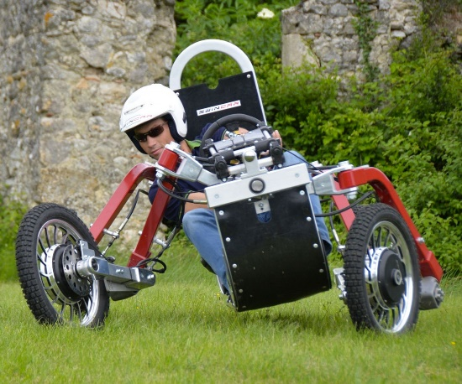
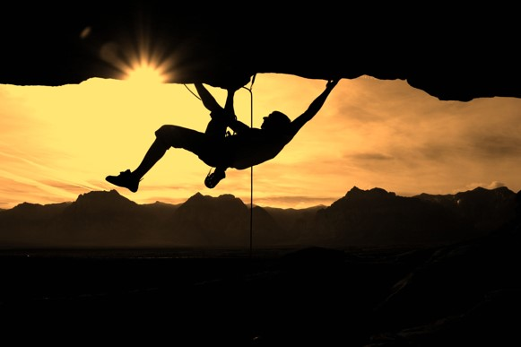
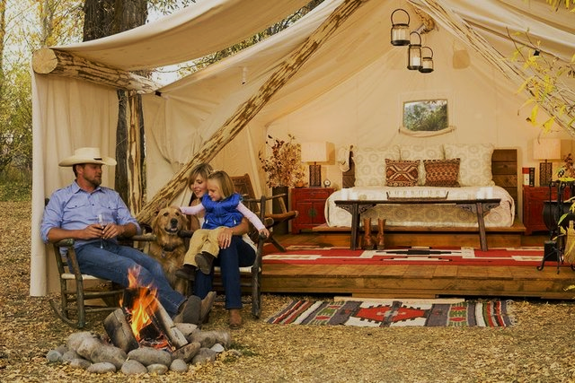
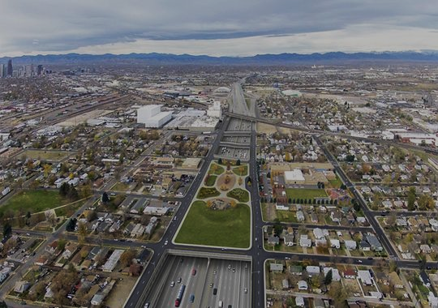

Step 2
Considerations to focus the WHERE, part 3 A
Where have changes occurred outside the plan area that may affect the ability to carry out sustainable recreation inside the plan area?
New or reconstructed access (highways, access from communities, etc.)
New subdivisions/development near the plan area
Housing shortages
State, county, or local marketing
New toys, etc.!!!
Metropolis
A great place to hang out!
Notes:
And lastly,
Consider where changes outside the plan area may have affected sustainable recreation inside the plan area. For example:
New or reconstructed access (highways, access from communities, etc.)
New subdivisions/development near the plan area
Housing shortages
State, county, or local marketing
New toys, ETC!!!
With all these things in mind…let’s get back to where we should focus our Monitoring for Desired Winter ROS settings.

Slide 15
Step 2 Example
Desired Winter Recreation Opportunity Spectrum, part 1
Focusing the WHERE
POST land management plan management decisions and actions:
Winter travel planning decisions and implementation: publication of OSVUM maps, marking and signing open routes and areas, closure orders, etc.
Changed conditions within the plan and affecting sustainable recreation:
Reduced snowpack, especially in low-lying elevations due to climate change.
Changes outside the plan area affecting sustainable recreation inside the plan area:
New winter toys being used to access steep backcountry terrain previously inaccessible.
In addition…
Notes:
In thinking about those considerations for monitoring desired Winter ROS settings on the Fictional National Forest…
Relevant management decisions and actions occurred via Winter Travel Planning and Implementation. These decisions were determined to be “consistent” with the LMPs desired Winter ROS settings and other relevant plan components.
There have been changed conditions due to continued climate change…higher temperatures and a decrease in snowpack – especially in the Southern Grasslands GA.
There have also been some new motorized snow toys that are on the market and are being used to access some of the Forest’s steep backcountry settings that have not been accessible to motorized use in the past.
All these things may influence or will inform where on-the-ground monitoring will occur.
Last, but not least….

Slide 16
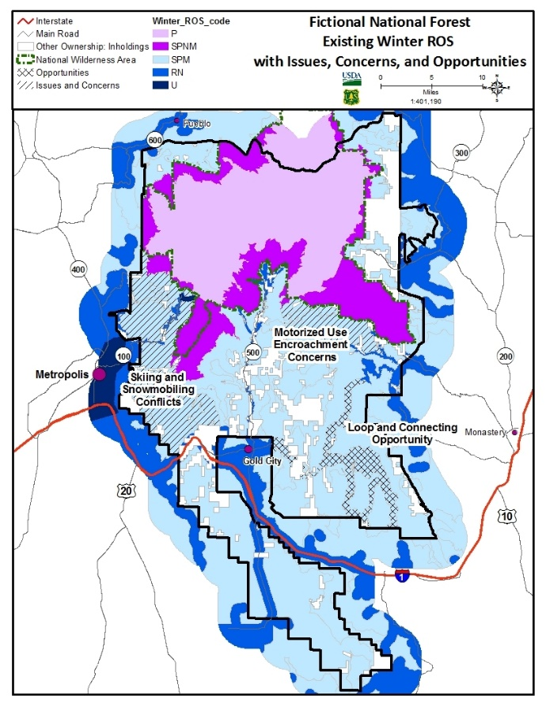
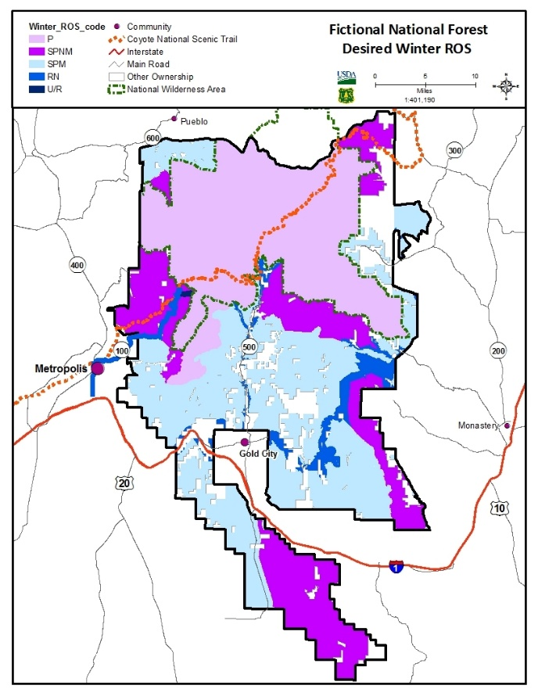
Step 2 Example
Desired Winter Recreation Opportunity Spectrum, part 2
Focusing the WHERE (continued)
Gaps between existing & desired, and relevant ICOs
WINTER ROS | EXISTING ACRES | DESIRED ACRES
P | 130,250 | 208,713
SPNM | 85,646 | 131,151
SPM | 340,620 | 213,610
RN | 21,616 | 24,657
R/U | 610 | 610
Existing Winter ROS & ICOs
Desired Winter ROS
Notes:
Do a quick gap analysis (and reference your LMP FEIS) to determine where changes between existing and desired Winter ROS settings should be occurring.
Winter ROS changes on the Fictional National Forest include:
Desired Primitive areas in all of Wilderness, recommended Wilderness and in some areas along the Wilderness boundary where motorized encroachment has been an issue.
Desired SPNM areas in elk winter range
Desired SPNM north of the Scenic Byway & SPM south of the Scenic Byway to reduce skiing/snowmobiling conflicts and protect the values of the Coyote NST.
The addition of a RN setting to accommodate potential future groomed routes connecting gold city to popular snowmobile staging and access on the east side of the forest.
Go back to the assessment completed prior to LMP development to reference what Issues, Concerns and Opportunities (ICOs) were identified during the LMP development process.

Slide 17
Step 3
Define and map your way forward...
The intent is to combine the what with the where to prioritize your on-the-ground monitoring.
For example…
Notes:
The next step is to take the information you’ve collected and assessed (refining the what and the where) to map your plan of attack for on-the-ground monitoring.

Slide 18
Step 3 Example
Plan of attack for on-the-ground monitoring
Has OSV use along the Coyote NST and in the Snowy Peaks Wilderness been eliminated to achieve desired SPNM and Primitive ROS Settings?
Are we achieving desired winter ROS settings: SPNM to the north and SPM to the south of the Needles Scenic Byway?
Has the implementation of the OSVU map (consistent with LMP Winter ROS allocations) eliminated skier/snowmobiler conflicts adjacent to the Needles Scenic Byway and winter motorized use along the Coyote NST?
Has a groomed OSV route been established between Gold City and existing groomed routes from Monastery?
Has OSV use been eliminated to move existing SPM to desired SPNM?
Notes:
For the Fictional National Forest, there are 4 priority areas to conduct on-the-ground monitoring and determine if the forest is moving toward/achieving Desired Winter ROS settings. Areas include:
The Needle Scenic Byway Area: Are we achieving desired winter settings: SPNM to the north of the Byway (and including the Coyote NST) and SPM to the south of the Needles Scenic Byway? Is the management and implementation of the OSVUM resulting in the elimination of skiing/snowmobiling conflicts?
Along the southern boundary of the Snowy Peaks Wilderness: Has OSV use along the Coyote NST and in the Snowy Peaks Wilderness been eliminated to achieve desire desired SPNM and Primitive ROS Settings?
The desired RN setting between Gold City and existing groomed snowmobile routes emanating from Monastery: Has a groomed route been established to connect the two communities?
The desired SPNM area in the Southern Grasslands GA: Are SPNM characteristics being met?

Slide 19

Step 3 Example
Integrate your plan of attack for on-the-ground monitoring
Look at other monitoring questions in the land management plan Monitoring Program;
Consider other monitoring (not tied to land management plan monitoring); and
Identify intersections to create efficiencies.
For example…
Notes:
As part of your Plan of attack, you may also want to think about other monitoring that’s planned in the areas you’re targeting. These may be part of the LMP Monitoring Program OR separate from LMP monitoring. Find any intersections so that when feasible, you can create some efficiencies by combining and integrating multiple monitoring needs.
For example….

Slide 20
Step 3 Example
Desired Winter Recreation Opportunity Spectrum Monitoring
Integrate your plan of attack for on-the-ground monitoring
Integrate with:
Crucial Elk Winter
Range Monitoring
NVUM efforts to collect more data
NVUM efforts to collect more data
Grazing permit administration
Notes:
The Fictional National Forest is up for NVUM monitoring next year. Consider whether it may be useful to refine your NVUM survey calendar to collect statistically sound winter use data for the Needles Scenic Byway and newly designated winter route between Gold City and Monastery.
The same area along the southern boundary of the Snowy Peaks Wilderness that’s targeted for ROS monitoring is also being targeted by wildlife biologists to monitor the condition of crucial winter range.
The southern grasslands GA is targeted for monitoring winter operations of a grazing permittee. This same area is where winter ROS-monitoring is also being focused.

Slide 21

Step 4
Conduct the on-the-ground monitoring
The intent is to gather the information that will tell us:
Whether we did what we said we would do (implementation);
Whether actions are creating the desired conditions and results we intended (effectiveness); and
Whether our assumptions are correct (validation).
Notes:
It now time to conduct the on-the-ground monitoring. The information collected will serve as a reality check as to whether we’re:
Doing what we said we’d do (implementation monitoring);
Meeting, or moving toward desired conditions and other direction contained in the LMP (effectiveness monitoring); and
Whether our assumptions are correct (validation monitoring).

Slide 22
Step 5
Summarize findings in the biennial report
The intent is to have a record of the monitoring findings that:
Is available to the public;
Indicates whether or not a change is needed to the plan, management activities, or monitoring program and if a new assessment may be warranted; and,
Informs adaptive management of the plan area.
The monitoring evaluation report is NOT a decision document.
36 CFR 219.12 and FSH 1909.12, sec. 34
Notes:
The last step is to document and summarize your findings.
The intent is to have a record of the monitoring findings that:
Is available to the public;
Indicates whether a change is needed to the plan, management activities, or monitoring program and if a new assessment may be warranted; and
Informs adaptive management of the plan area.
The monitoring evaluation report is NOT a decision document.

Slide 23
Step 5 Example
Summary of findings
Produce a map showing desired winter ROS overlaid with OSV Travel Management Plan (TMP) decisions from the OSVUM developed after the LMP Record of Decision.
Include a table comparing acres by winter ROS class using the following:
Existing condition from assessment (existing winter ROS)
LMP decision (desired winter ROS)
Current conditions after the OSV TMP decision to show any progress made moving from existing to desired ROS settings
Provide additional details about areas targeted – linking back to ICOs from the assessment:
Status of use conflicts north and south of the Needles Scenic Byway.
Status of OSV use in crucial elk winter range south of the Snowy Peaks Wilderness.
Notes:
To summarize results of monitoring Desired Winter ROS settings, it may be useful to discuss:
Forest-wide changes based on Winter Travel Plan decisions and implementation. Produce a map with desired winter ROS overlaid with Travel Management Plan (TMP) decisions from the OSVUM developed after the LMP ROD.
Include a table comparing acres by winter ROS class using the following:
Existing condition from assessment (existing winter ROS)
LMP decision (desired winter ROS)
Current conditions after the OSV TMP decision to show any progress made moving acres from existing to desired ROS settings.
If the winter travel management planning resulted in the desired winter ROS map to be adjusted, an updated desired winter ROS map should be produced.
Finer grain monitoring in targeted areas – linking back to the ICOs identified in the assessment. For example:
Status of use conflicts north and south of the Needles Scenic Byway.
Status of OSV use in crucial elk winter range south of the Snowy Peaks Wilderness.

Slide 24
Once you’re done monitoring
Use it to adapt ― and inform ― the next round of planning…starting with the assessment.
Notes:
Once you’re done monitoring, use the information to “adapt”.
Like completing a road trip…once you’ve finished your journey and have had time to reflect with your photos and experiences…you probably learned some things that would cause you to change a couple of things to make your next road trip even better.

Slide 25
To Wrap Things Up: Remember…
  Land management plan monitoring should reveal:
      Whether we did what we said we would do (implementation);
      Whether what we’re doing is working (effectiveness); and
      Whether underlying assumptions are correct (validation).
  There are 5 recommended steps to monitor efficiently:
    Know what’s in the land management plan’s monitoring program – the WHAT
    Determine WHERE to focus on-the-ground monitoring based on what’s changed within and outside the plan area, known gaps between existing and desired conditions, and ICOs identified in your assessment.
    Define and map your monitoring plan of attack.
    Conduct the monitoring: implementation, effectiveness, and/or validation.
    Summarize findings in the biennial monitoring evaluation report.
  Use monitoring results to inform adaptive management actions.
Notes:
To wrap things up – Remember…
LMP monitoring should reveal:
Whether we did what we said we would do (implementation)
Whether what we’re doing is working (effectiveness); and
Whether underlying assumptions are correct (validation).
There are 5 recommended steps to monitor efficiently:
Know what’s in the LMP Monitoring Program – the WHAT
Determine WHERE to focus on-the-ground monitoring based on what’s changed within and outside the plan area; known gaps between existing & desired conditions; and ICOs identified in your assessment.
Define and map your monitoring plan of attack.
Conduct the monitoring …implementation, effectiveness, and/or validation
Summarize findings in the Biennial Monitoring Evaluation Report.
Use monitoring results to inform adaptive management.

Slide 26
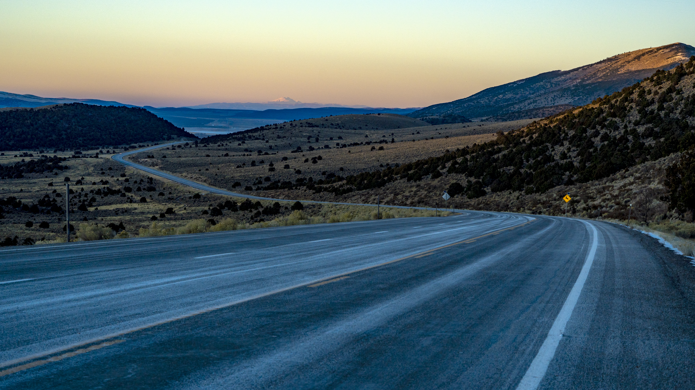

References and Links
The Forest Service 2012 Planning Rule (36 CFR 219)
https://www.fs.usda.gov/detail/planningrule/home/?cid=stelprd3828310
Forest Service Manual 1920
https://www.fs.fed.us/cgi-bin/Directives/get_dirs/fsm?1900
Forest Service Handbook 1909.12, Chapter 30
https://www.fs.fed.us/im/directives/dughtml/fsh1000.html
Technical Information for Planning Land Management Plans:
http://www.fs.fed.us/emc/nfma/TIPS/index.shtml
Tools and Other References
Forest Service Recreation Planning Resources
https://www.fs.usda.gov/managing-land/national-forests-grasslands/recreation/programs/planning
Notes:
Listed are the regulations and implementing directives for land management planning. In addition, the link to other Technical Information for Planning (TIPs) is included at the bottom the list.

Slide 27

CONGRATULATIONS!
Notes:
That’s all folks!

Slide 28

The End!
Notes:
You’ve completed your trip! Unpack, put your feet up, and reflect on your trip.
What were the highlights?…the postcards you sent.
What tools and references did you pick up?...the souvenirs you brought home.

