Slide 1
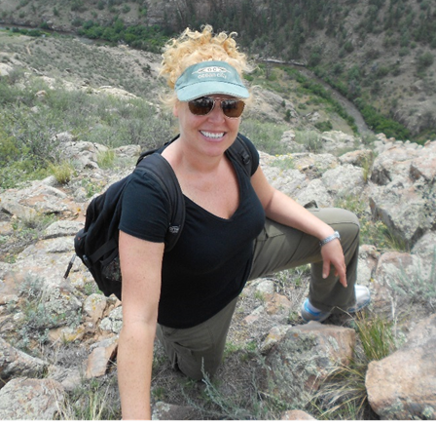
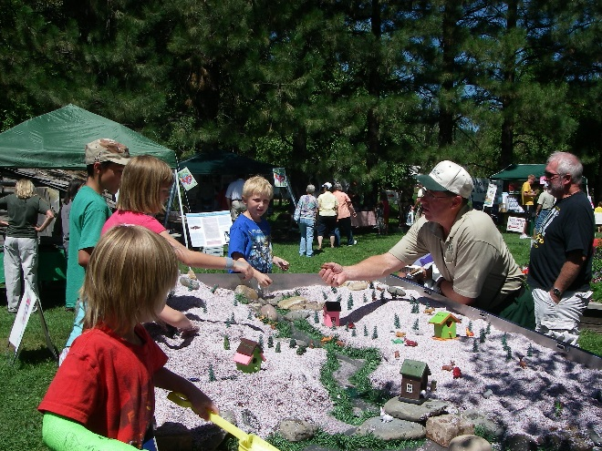
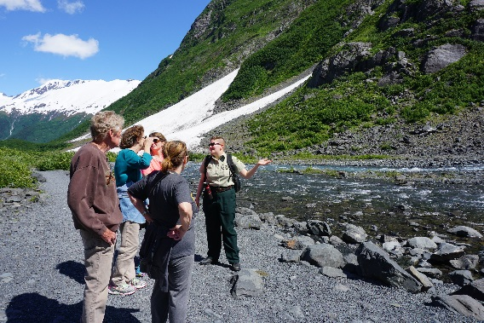
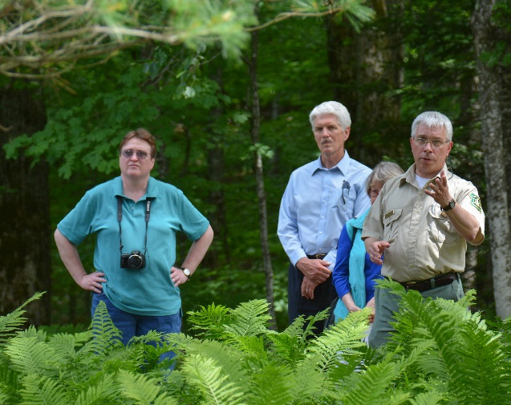
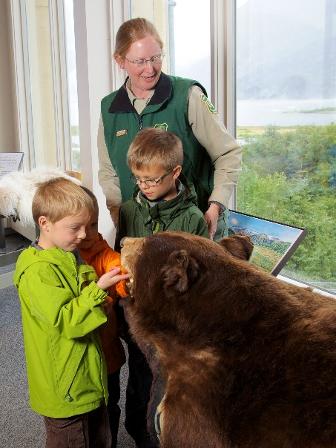
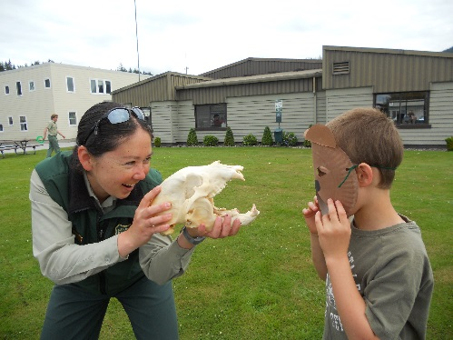
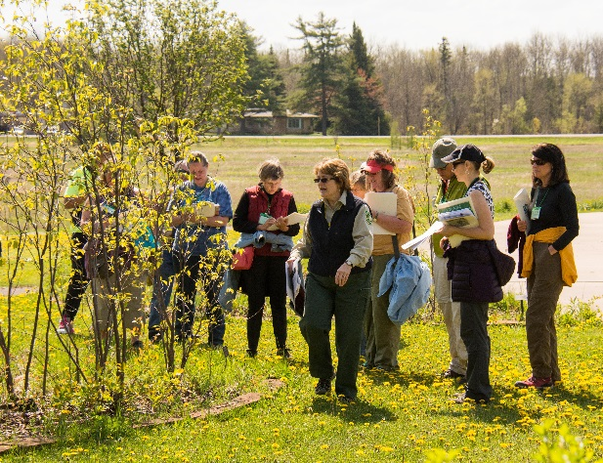
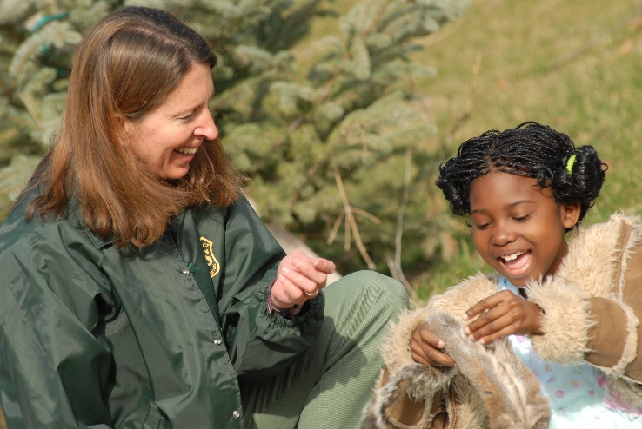
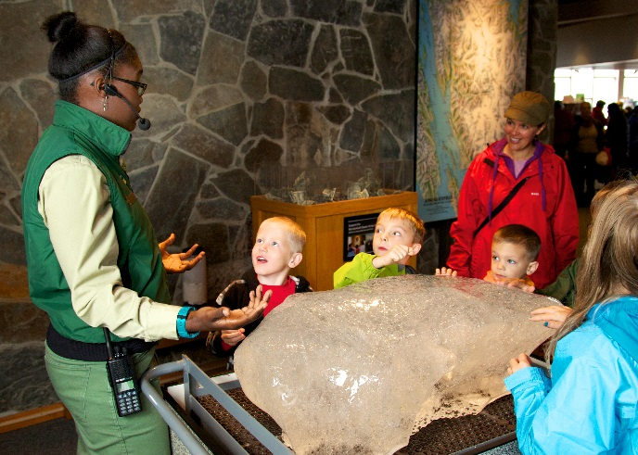
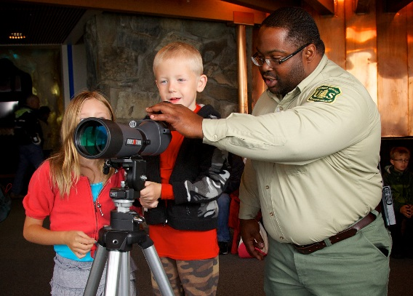
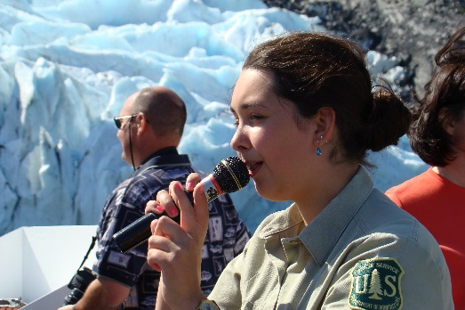
Tourism and Interpretation in the US Forest Service
Toby Bloom National Program Manager Travel, Tourism, and Interpretation tobylbloom@fs.fed.us or (240)330-2260

Slide 2
Federal Land Management Agencies
President
Secretary of Interior
Secretary of Defense
Secretary of Agriculture
Secretary of Commerce
Fish & Wildlife Service
Bureau of Indian Affairs
Army Corps of Engineers
Forest Service
Office of the Chief
NOAA
National Park Service
Bureau of Reclamation
International Programs
Bureau of Land Management
Research & Development
National Forest System
State & Private Forestry

Slide 3
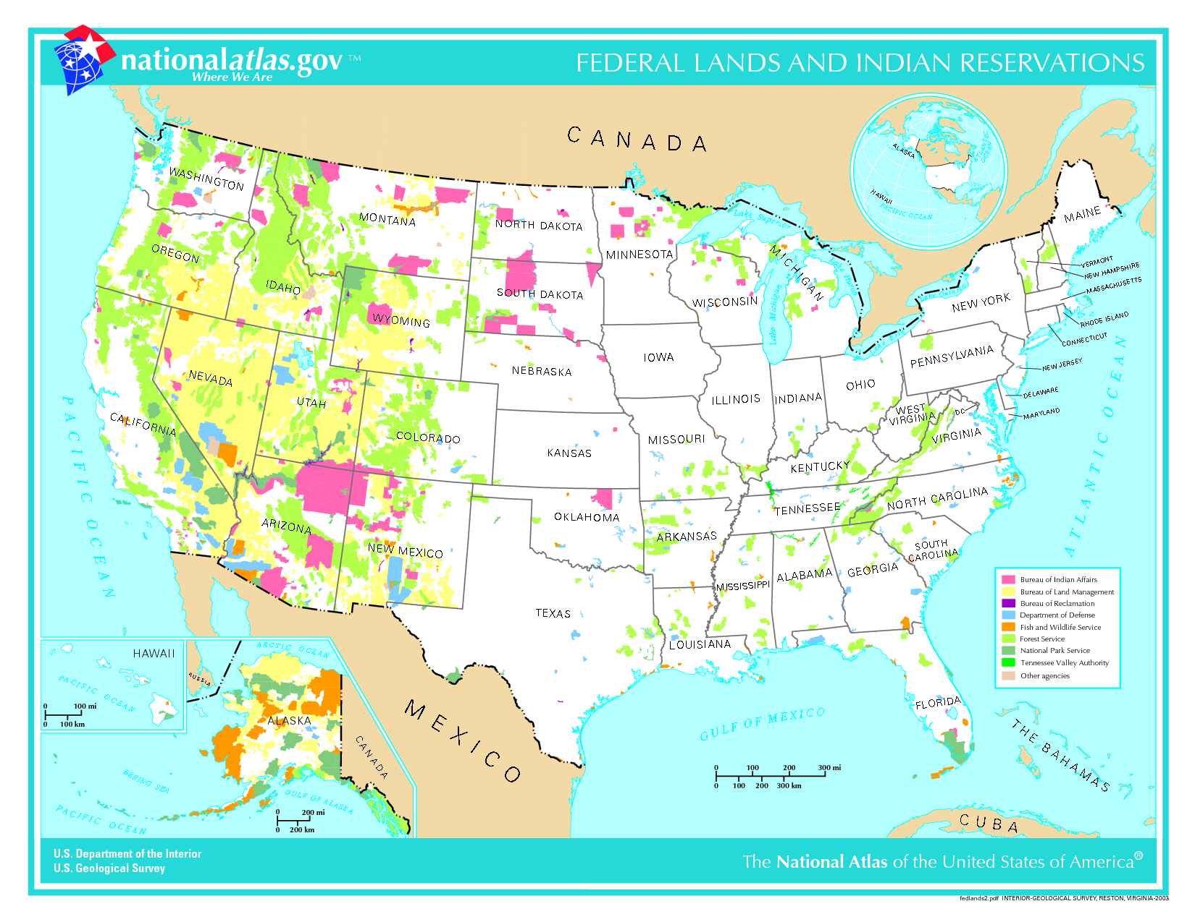
Federal Lands and Indian Reservations

Slide 4
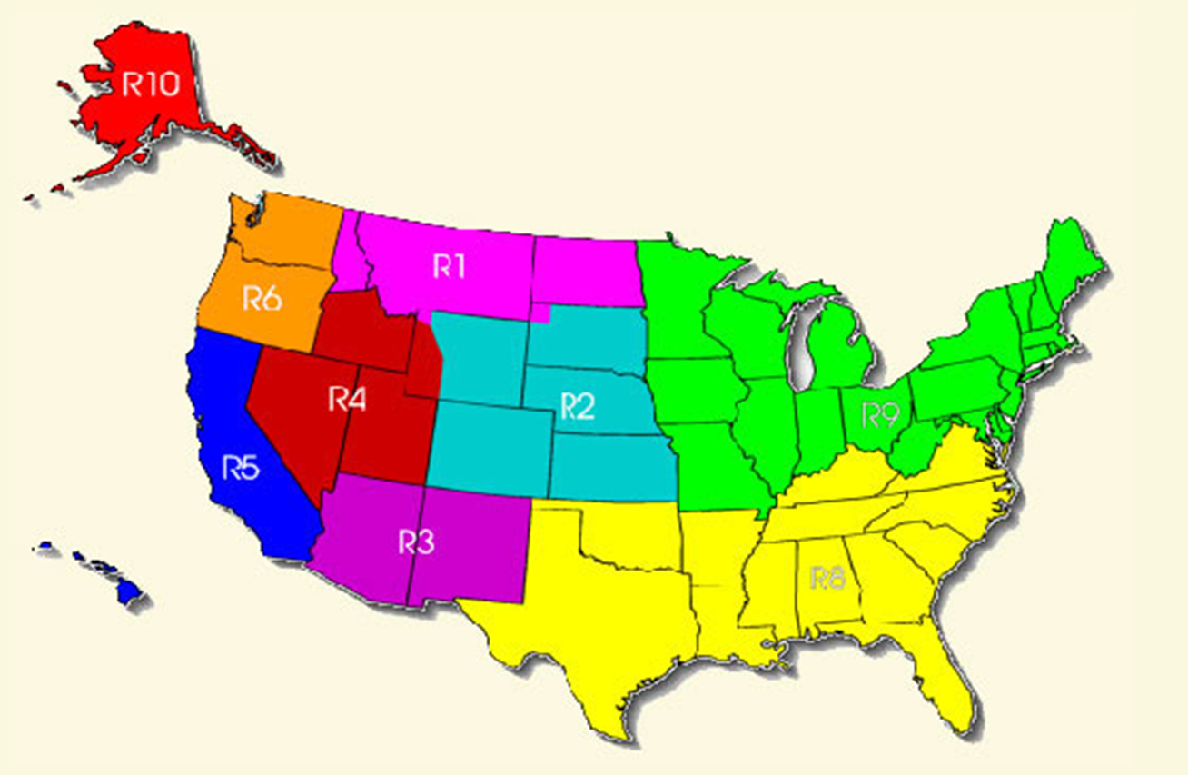
The US Forest Service (USFS)
Mission:
To sustain the health, diversity, and productivity of the Nation’s forests and grasslands to meet the needs of present and future generations.
This includes:
Managing for multiple values and uses (recreation, culture
and history, conservation, production, ecosystem services, etc...)
Collaborating with other agencies, land owners, and private companies for Forest & Grassland Management, including Protected Area Management.
A decentralized organization of ~30,000 employees with a wide range of expertise

Slide 5
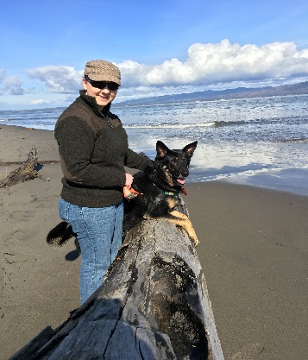
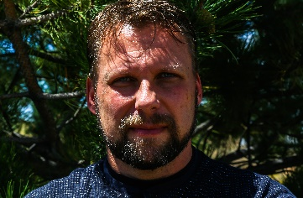
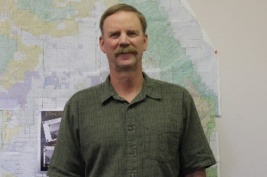
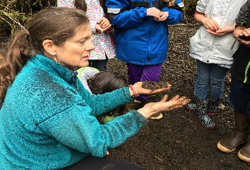
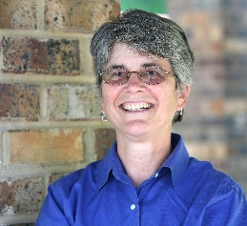
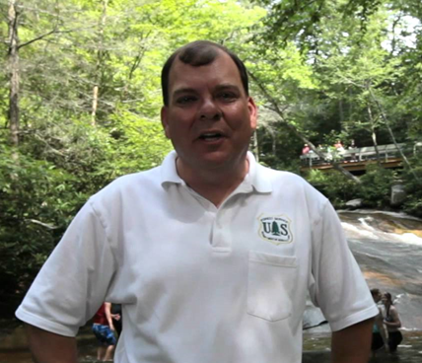
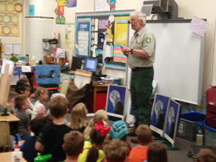
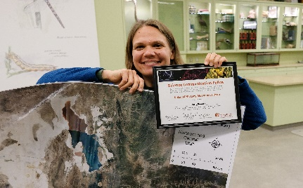
Where does the Tourism/Interpretation program live within the National Forest System?
National Forest System
Logging
Recreation
Volunteer programs
Shooting Sports, Drones, OHVs
Mining
Watershed protection
Wildlife/
habitat management
Trails
Fire
Tourism, Travel and Interpretation
Heritage
Accessibility
Permits/Fee Collection
Youth Activities/
Special Events
Interagency Tourism Policy and Partnerships
Interpretive Association Partnerships
App/
materials development
Backstopping regional tourism/interp leads
Recreation.gov
Brenna White, R6- Pacific Northwest Region- Regional Conservation Education Partnership Specialist
Daryl Ratajczak, R3- Southwestern Region- Wildlife Planner, Santa Fe National Forest
Mike Blakeman, R2- Rocky Mountain Region- Public Affairs Specialist, Rio Grande National Forest
Joanne Rebbeck, R&D- Northern Research Station- Research Plant Physiologist
R9- Eastern Region- Steve Robertsen, Interpretive and Education Specialist, Superior National Forest
Joni Johnson, R10- Alaska Region- Botanist, Petersburg Ranger District, Tongass National Forest
Jeff Owenby, R8- Southern Region- Cradle of Forestry Director, National Forests in North Carolina
Stacie Bender, R4- Intermountain Region- Program Assistant, Geospatial Technology and Applications Center

Slide 6
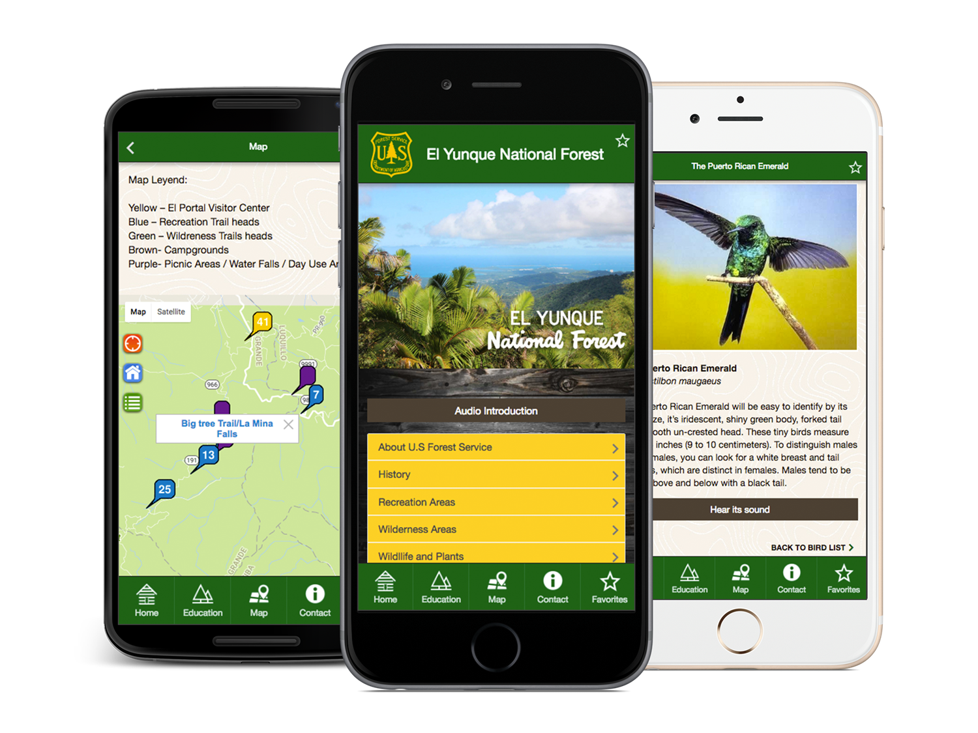
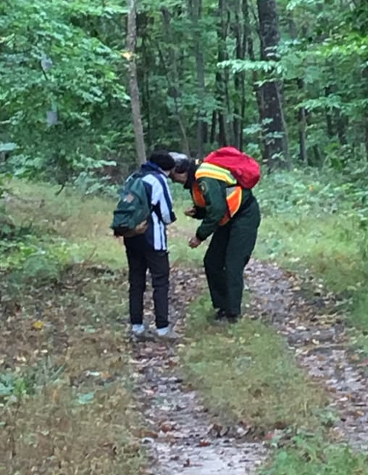
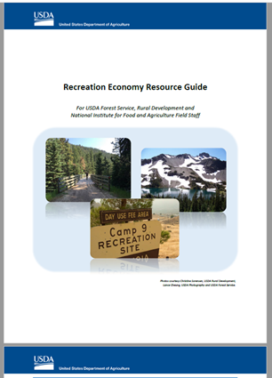
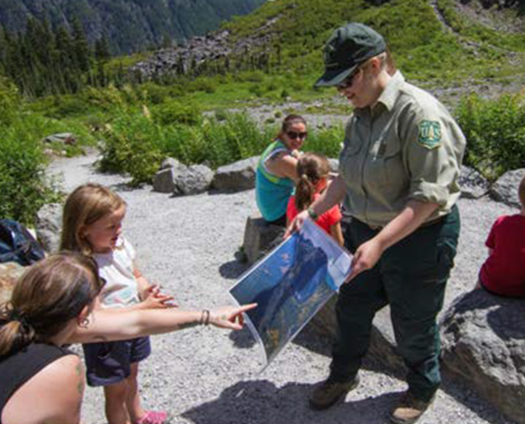
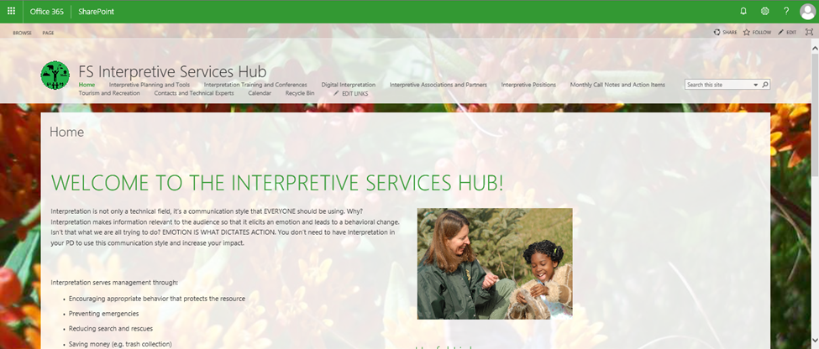
What are we working on right now?
USFS Mobile App
Public Health and Public Lands
Strengthening Recreation Economies in Gateway Communities
Resource Assistants/ Field Rangers Program
FS Interpretive Services Hub

Slide 7
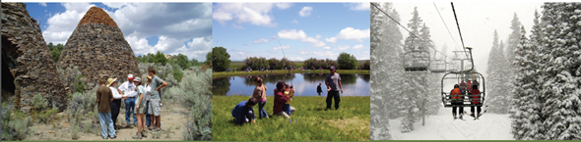
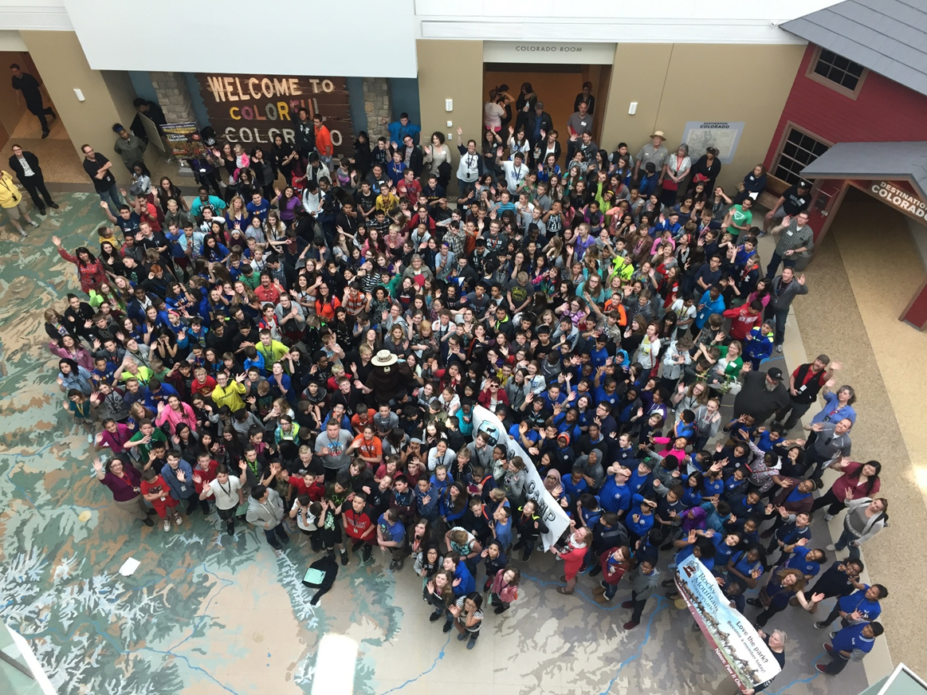
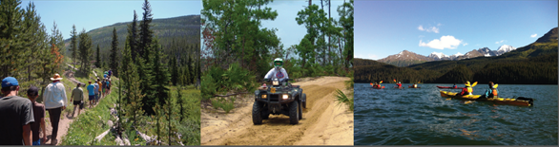
Thank You! Questions?

