Slide 1
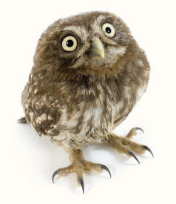
Accessibility for Virtual Meetings: I’m Talon you…it’s important!
US Forest Service
December 19, 2014

Slide 2
Why It Matters
It’s required by law.
Section 508 (§1194.24) requires all training and informational products that “support the agency’s mission” be accessible.
Other accessibility laws apply to blended/hybrid meetings.
Not thinking about accessibility from the outset costs valuable time and resources to be spent on rework.
Inaccessible files must be remediated before they can be posted.
Recorded meetings that are not live captioned must be retrofitted with captions.
Accessibility is directly related to usability.

Slide 3
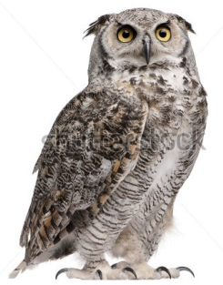
Need Help Getting Started? Owl Tell You How.
Determine your audience.
2. Think about how information will be archived.
3. Decide on an appropriate format for conveying information to participants.
4. Ensure you have chosen accessible tools for the meeting.
5. Build accessibility into the design of presentation materials (e.g., PowerPoint slides, handouts, videos,
documents, etc.)

Slide 4
Some Tips to Remember
Provide a visual description of the on-screen content.
Avoid using vague terms such “do this,” “kind of like that,” “click here” and “over there.” This benefits users with visual impairments as well as those with situational disabilities.
Speak clearly. Be conversational, but try not to ramble or use fillers like “um,” “uh,” “like,” etc.
Use tools that are appropriate for creating materials to share (i.e. PowerPoint is not the end-all, be-all application).
Inviting other participants via Lync or LiveMeeting negates the accessibility features of Adobe Connect.

Slide 5
Accessibility of slides
The world is not in black and white. Your slide deck doesn’t have to be, either.
Choose a design that is visually interesting and branded, but also has an appropriate color contrast.
Reserve dark backgrounds for on-screen presentations only.
Determine whether PowerPoint is the right tool to use.
Avoid layering content in slides, unless you plan to convert them to PDF and manually fix them.
Use built-in chart and table features instead of inserting images of charts and tables.
Use images and charts that are the same size as the surrounding text.

Slide 6
features of Adobe Connect
Caption pod
Keyboard navigation shortcuts
Customizable “look and feel”
Allows participants to interact in a variety of ways
Users can navigate accessible PowerPoint files with their own screen reading software.
Recordings are accessible

Slide 7
Live Captions
Reserve Caption Services at least 12 hr prior from Federal Relay, Caption Colorado
You will be provided an Event Confirmation #
Bring the caption pod into an Adobe Connect Share Pod
Configure with the event # from Caption Colorado
See detailed instructions in section IX of the
USFS Adobe Connect Guide
7

Slide 8
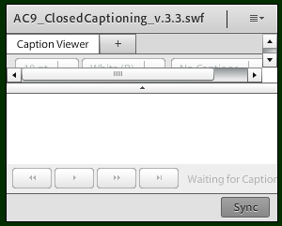
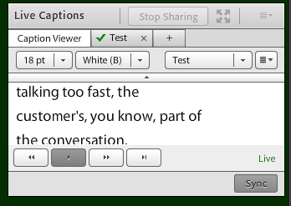
Caption Pod Sizing & Tips
Ensure large enough so menus do not wrap (view from a laptop)
Does not need to be wide
To see ex. captions, configure event # 999999999
Ensure the same caption pod is on EVERY layout
Size the caption pod on one layout and then “Duplicate” that layout for others
Host should have hard-wired connection (to continuous captions)
8

Slide 9
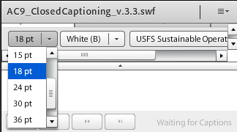
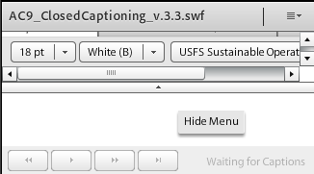
Participants Can Customize
Participants can adjust font size and color
Click the small arrow in the middle to hide menu
Navigate back/forward using buttons at the bottom
9
Notes:
Live captioning from Caption Colorado is streaming in the lower right corner.
You can adjust the font size and color/background in the Caption Pod menu at the top.
Then click the small arrow in the middle to hide the menu and see more of the captioning.

Slide 10
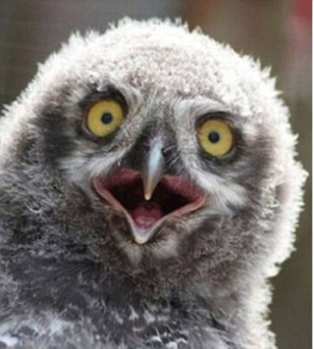
You forgot to reserve a captioner?!
When should I reserve captioning services?
When an employee, contractor or visitor who is Deaf or hard-of-hearing will attend
When the meeting is being recorded and will be posted for later viewing
As soon as possible after the meeting date and time are confirmed
Who do I contact for this?
Federal Relay Conference Captioning located at http://www.fedrcc.us/FedRcc/Order.aspx
Caption Colorado

Slide 11
Keyboard Navigation
Move from pod to pod: CTRL + F6
Navigate within a pod: tab key
Raise Your Hand: CTRL + E
CTRL + ; to type a chat (enter key to submit your chat message)
Use screen reader “read all” command to read ppt in Share Pod
Note: On Macs (Apples), use “Command” instead of “CTRL”
11
Notes:
These are some commonly used keyboard commands.
Note: On Mac computers you will use the command key instead of “Control”
Use Ctrl and the F6 key to bring focus to a pod in the meeting room and then to navigate from pod to pod.
Use the Tab key to navigate to different options within a pod, etc., to read the chat typed into the chat pod or to type your own comments.
Use CTRL and the E key to raise and lower your hand.
Use CTRL and the semicolon key (to the right of the L key) to jump straight to the box where you can type a question or comment into the chat box.
To read a PowerPoint presentation, first navigate to the Share Pod and then use your screen reader “read all” command.
In JAWS the read all command is Insert + down arrow

Slide 12
Inform and orient Participants
BEFORE (event announcement/instructions)
Let participants know if you plan to provide captions
Provide keyboard command tips
AT EVENT START
Provide quick orientation for accessibility features
Monitor chat pod, raised hands, and status feedback
12

Slide 13
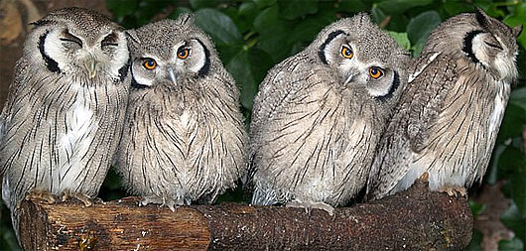
You’re Not owl By Yourself. Resources are available!
USFS Accessibility Program Education & Resources
Adobe Connect Accessibility white paper
USFS Adobe Connect Guide
Twitter hashtag for accessibility: #A11y
Mitch Ringer, USFS Section 508 Coordinator, mringer@fs.fed.us
Sherri Wormstead, USFS NA S&PF, swormstead@fs.fed.us
Meredith Garrard, 508-compliance consultant, mgarrard@fs.fed.us

