Slide 1
The Challenge of Protecting Natural Resources from Invasive Species
Jim Reeves
Deputy Chief, Forest Service Research and Development
22nd USDA Interagency Research Forum on Invasive Species
Annapolis, MD—January 11, 2011
Notes:
Good morning!
I will start by telling you something about the Forest Service, because not all of you might be familiar with our organization.

Slide 2
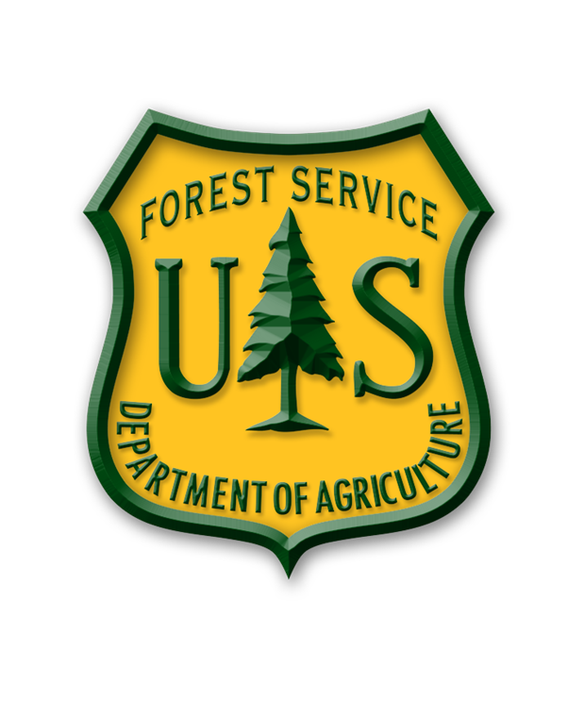
... to sustain the health, diversity, and productivity of the nation’s forests and grasslands to meet the needs of present and future generations.
2
Notes:
The Forest Service is part of USDA, not the Department of the Interior. Our mission is to sustain the health, diversity, and productivity of the nation’s forests and grasslands for the benefit of present and future generations. Our mission extends to all forest land, public and private.

Slide 3
The National Forests and Grasslands 193 million acres
Forest land
748 million acres
National Forest System
20 percent of U.S. forests and many rangelands
3
Notes:
Our best known role is our stewardship of the national forests and grasslands. We manage more than 193 million acres nationwide. That’s an area almost twice the size of California, spread across 42 states and Puerto Rico. We have more than 30,000 employees working with partners across the United States to address conservation issues in all ownerships, public and private.

Slide 4
America’s Forests
748 million acres
Through our State and Private Forestry staff, the Forest Service contributes to sustainable forest management nationwide.
4
Notes:
As you might know, more than half of the forests in the United States are privately owned. We work with state and local governments, the forest products industry, nonindustrial private forest landowners, and other forest users in the management and protection of all forest land nationwide. Our State and Private Forestry activities include cooperation in urban forestry, forest health protection, and wildland fire management.

Slide 5
A Century of Research
research station
experimental area
National Forest System
5
Notes:
We are a science-based organization. We provide the tools and technology to support America’s forest management activities. To that end, we maintain the largest forestry research organization in the world. We manage 81 experimental forests nationwide, representing 85 percent of the forest types in the United States. With our experimental forests, we can conduct and maintain long-term research, and our data goes back a century or more. That is essential as new issues emerge, such as climate change. Our Forest Health Protection specialists and researchers comprise the largest group of forest entomologists and pathologists in the world.

Slide 6
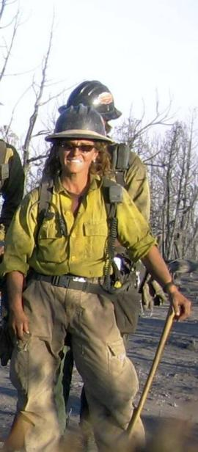
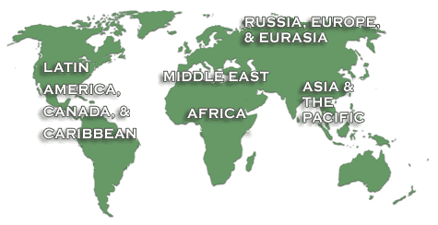

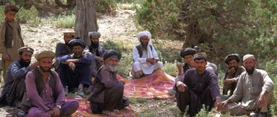
Global Forestry Partnerships
6
Notes:
We also work overseas. The Forest Service plays a key role in formulating policy and coordinating U.S. support for the protection and sound management of the world's forest resources. We work closely with the Agency for International Development and other organizations to protect and manage forests around the world. We work with governments, NGOs, and other partners on a wide range of topics in 88 countries around the world.

Slide 7
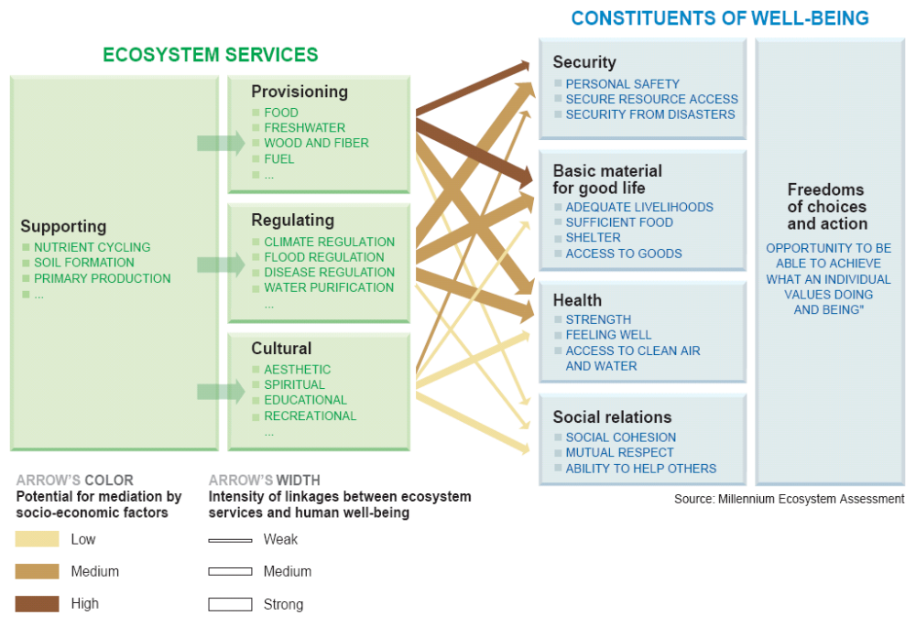
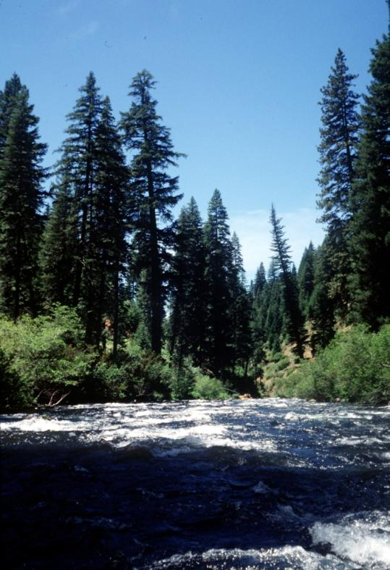
National Forest System:
8.5% of America’s land area
18% of America’s runoff
7
Notes:
In short, we are deeply committed to the sustainable management of the world’s forests and rangelands. Why? Because our citizens benefit so much. These lands purify the air we breathe. They store carbon and regulate climate. They form soils and control runoff and erosion. They protect biodiversity, providing habitat for wildlife. They furnish rich opportunities for collecting wild foods … for hunting and fishing … for outdoor recreation, spiritual renewal, and aesthetic enjoyment.
But maybe the most compelling reason why these lands are so important has to do with that most basic of human needs: water. Forests cover barely a third of America’s land area, yet they deliver more than half of our water supplies. The National Forest System alone, with less than 9 percent America’s total land area, accounts for 18 percent of our water supplies. Watershed protection is a big part of our mission. Watersheds capable of delivering plentiful supplies of pure, clean water can also deliver all the other benefits that Americans want and need from their forests—wood, biodiversity, soil protection, carbon storage, outdoor recreation, and more.

Slide 8
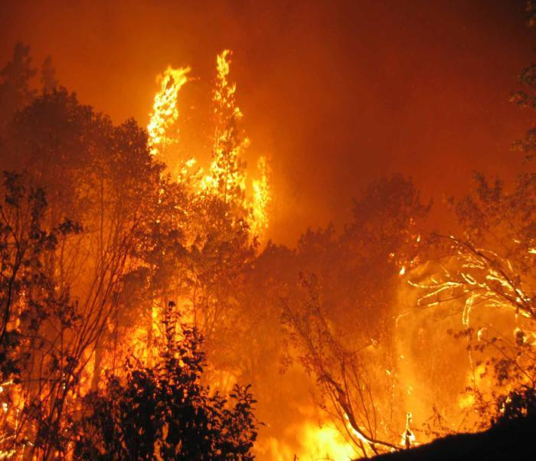
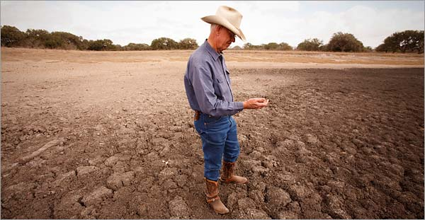
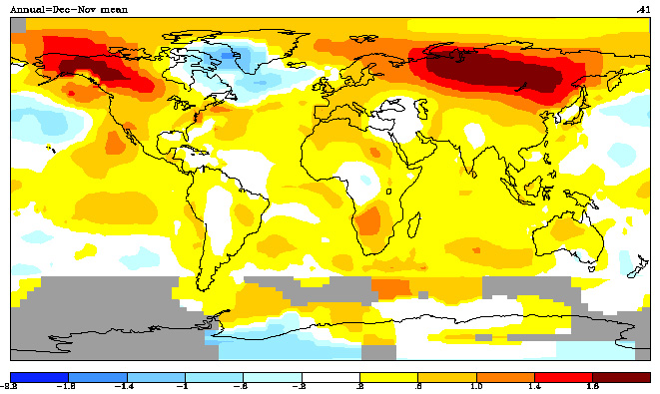
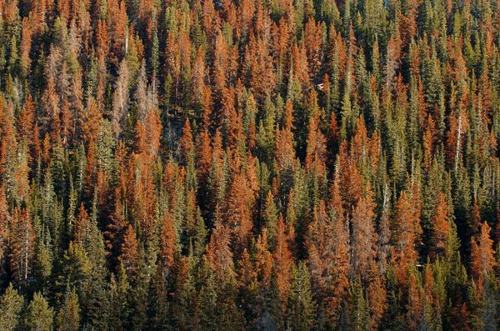
Signs of Stress …
Megafires, severe fire seasons
Regional drought
Mountain pine beetle epidemic
Climate
change
8
Notes:
But America’s watersheds are in trouble. The symptoms are increasingly clear:
Many areas are besieged by drought, especially in the Interior West. Drought-stressed forests are especially vulnerable to wildfire as well as to outbreaks of insects and disease.
In much of the West, a legacy of fire suppression has left forests overstocked and full of hazardous fuels. In terms of fire and fuels, we are in a whole new era. Since 2000, we have seen megafires rarely seen before and fire seasons on a scale rarely not seen for decades.
Overstocked, drought-stressed forests are also susceptible to devastating outbreaks of insects and disease. As you probably know, entire landscapes are dead or dying across the West. That includes the largest mountain pine beetle epidemic ever recorded, affecting about 21 million acres since 1996.
Drought-stressed forests … catastrophic fires … outbreaks of insects and disease … the magnitude of these events increasingly goes beyond what we have seen historically. Partly, these are symptoms of a changing climate. Changes in temperature and precipitation, in the timing and magnitude of weather events, are altering ecosystems and fire regimes. Warmer winter temperatures are letting bark beetles survive in greater numbers and spread to new areas.
As you know, climate change and the associated disturbances can help pave the way for invasive species. All these challenges are linked at a landscape scale. To meet them, we are going to have to work together across landscapes—across ownerships.

Slide 9
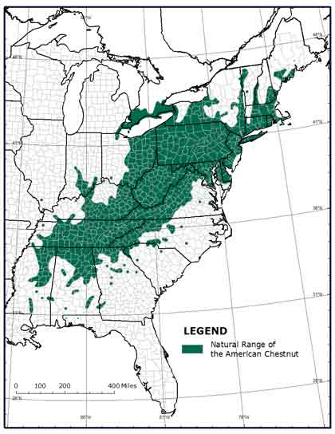
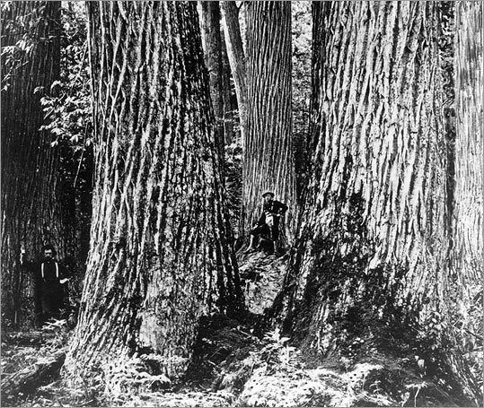
Oak/Chestnut Forest
9
Notes:
I will focus the remainder of my remarks on invasive species. Invasives are threatening forests across the nation. A classic example here in the East is chestnut blight. We will probably never know the scale of the ecosystem services we lost when American chestnut disappeared from our forest canopies 60 to 80 years ago.

Slide 10
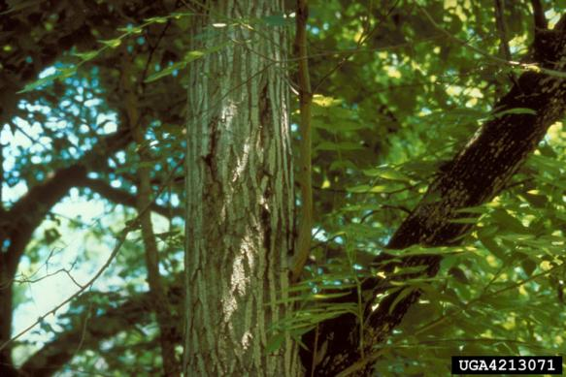
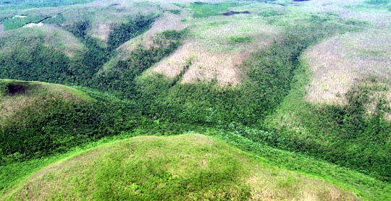
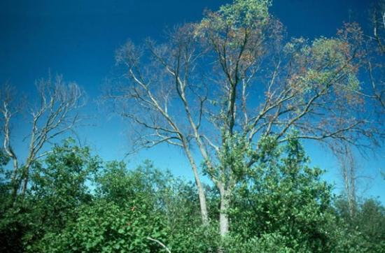
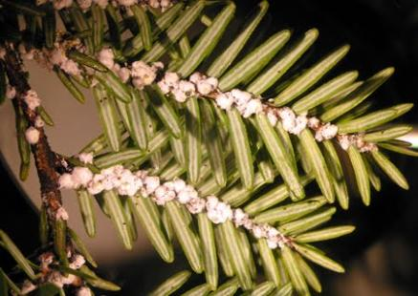
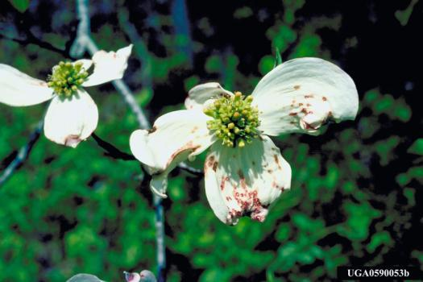
Damage to Eastern Forests
Gypsy moth damage
Butternut canker
Dutch elm disease
Hemlock woolly adelgid
Dogwood anthracnose
10
Notes:
Today, instead of oak/chestnut, we have aging oak/hickory forests threatened by gypsy moth … and possibly by sudden oak death, if it were to escape into the wild here in the East. Butternut canker and Dutch elm disease have virtually eliminated butternut and American elm from our forest canopies. Hemlock woolly adelgid is wiping out eastern hemlock in the Appalachian coves. Dogwood anthracnose is affecting understories in both East and West. Thousand canker disease, our newest problem, is threatening eastern walnut plantations.

Slide 11
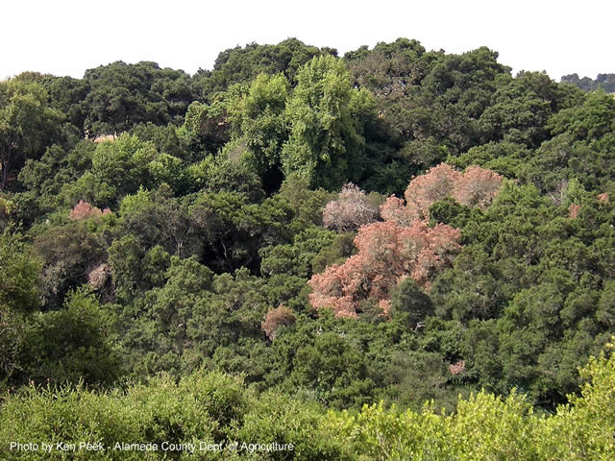
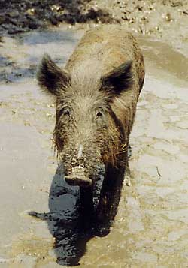
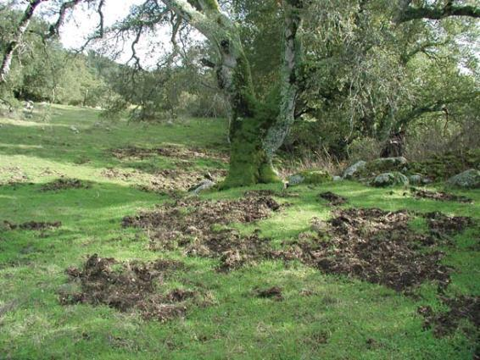
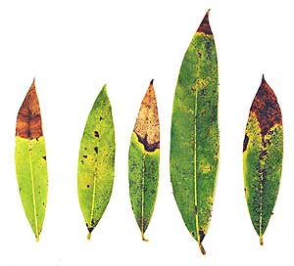
Damage to West Coast Forests
Sudden oak death
Feral pig damage
11
Notes:
On the West Coast, sudden oak death is devastating tanoaks and other trees. In California and across the South, highly prolific feral pigs are invading many areas, damaging oak seedlings, ravaging acorn crops, and destroying habitat for many native birds and mammals, including wild turkeys, voles, and shrews.

Slide 12
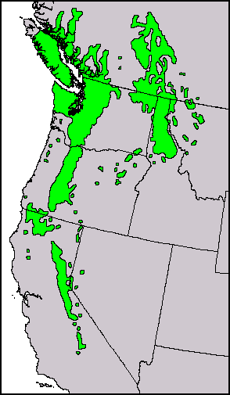
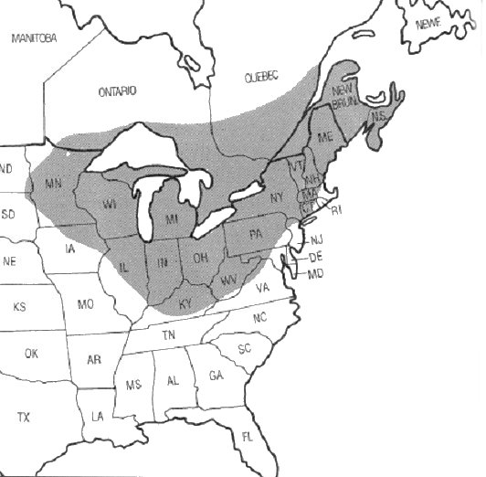
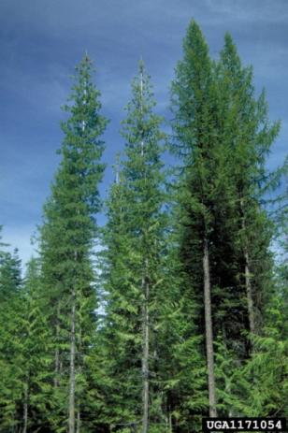
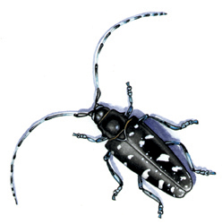
Economic Impacts
?
Western white pine
Sugar maple
12
Notes:
In the West, white pine blister rust has damaged or destroyed thousands of western white pine stands. Western white pine populations are now estimated at less than 5 percent of what they were at the turn of the 20th century. White pine blister rust also affects high-elevation five-needle pines, such as bristlecone pine. Bristlecones are among the world’s oldest living things, reaching an age of almost 5,000 years.
Consider the economic impacts alone. Western white pine was once the most valuable commercial tree in its range. Asian longhorned beetle, along with climate change, is now threatening the maple sugar industry in New England, potentially costing thousands of jobs and tens of millions of dollars each year.

Slide 13
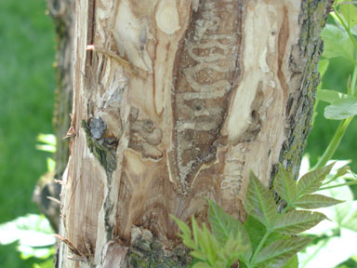
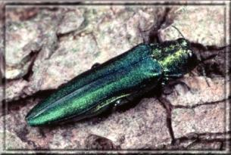
Emerald Ash Borer
Direct costs
  Value of trees
  Management of hazard trees
Indirect costs (hard to quantify)
  Water quality
  Fire hazards
  Lost recreation opportunities
  Wildlife habitat
  Cascading impacts on biodiversity
Estimated combined costs for EAB:
> $1 Billion/yr over next 10 years
13
Notes:
Emerald ash borer is killing ash trees from Michigan to Virginia. Scientists have estimated that emerald ash borer will cost the federal government more than $340 million over the next 10 years. But homeowners will spend almost 10 times that much to remove and replace dead trees; and local governments will spend about 20 times that much, almost $8 billion.

Slide 14
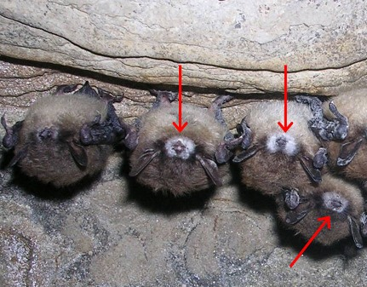
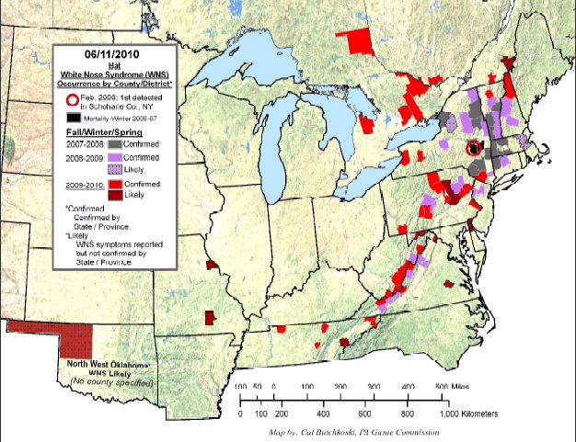
Whitenose Bat Syndrome
14
Notes:
Bats are a major predator of forest and agricultural insect pests. Each night, a single bat will eat its own weight in insects; bats perform an ecosystem service worth billions of dollars to American farmers and foresters each year. That service could be lost due to the spread of whitenose bat syndrome, another invasive.

Slide 15
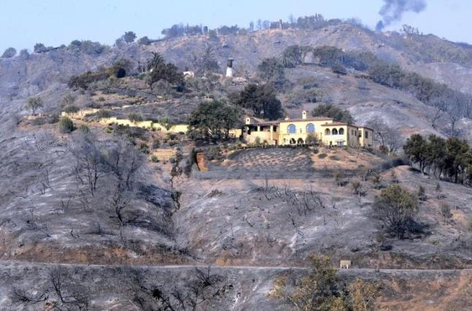
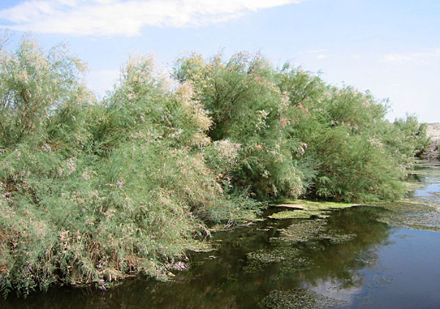
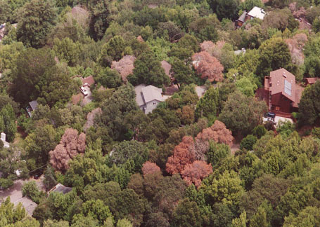
Social Impacts
Fire in the wildland/urban interface
Safety
Water
Amenities
Cultural values
Sudden oak death
Saltcedar-infested waterway
15
Notes:
Consider the social impacts of invasive species, starting with safety concerns. In areas ravaged by sudden oak death, falling snags have severely injured people. Fuel accumulations pose a fire risk, and several fires have been ignited by trees falling on power lines.
The impacts on water are another concern. Cheatgrass has invaded millions of acres in the Intermountain West, increasing fire-related impacts from heavily burned watersheds. The disappearance of hemlocks from the Appalachians can also affect water quality by reducing soil stability on headwaters, thereby increasing erosion and downstream sedimentation. In the West, saltcedar replaces native willows and cottonwoods, altering hydrology. A single large saltcedar can absorb 200 gallons of water per day.
Amenities and cultural values are also affected. For example, sudden oak death in California has killed trees in neighborhoods where more than 6 million people live, work, and play. Many neighborhoods have lost their woodsy character and natural beauty. Recreational opportunities are lost when roads or campgrounds are closed, and scenic views are affected when hillsides are covered with dead trees. Sudden oak death also affects the cultural practices of American Indians, who use acorns, bay leaves, and berries in their rituals.

Slide 16
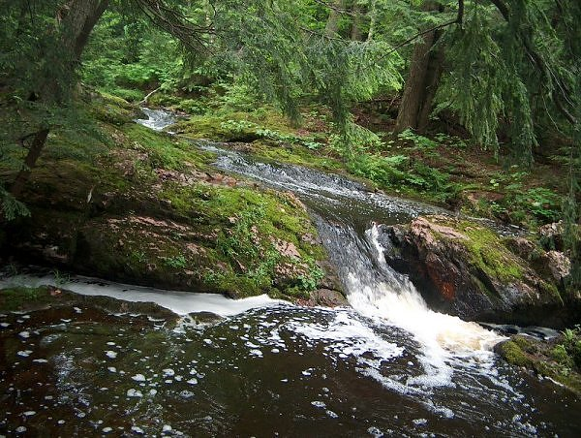
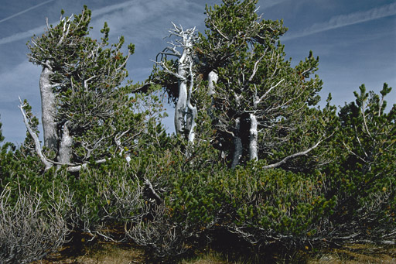
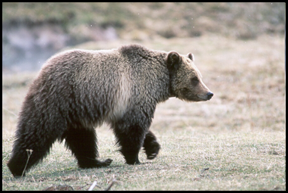
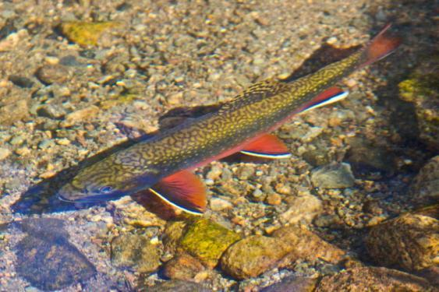
Ecological Impacts
Eastern hemlock
Whitebark pine
16
Notes:
Finally, consider the ecological impacts. Invasive species affect wildlife habitat, with cascading effects on biodiversity. For example, the loss of hemlocks is threatening the survival of native trout, salamanders, and other coldwater species in the Appalachians. In the West, white pine blister rust is affecting high-elevation five-needle pines such as limber, whitebark, and bristlecone. These keystone species are able to grow in harsh climates, stabilizing soils and providing critical wildlife habitat. For example, whitebark pine nuts fatten up grizzlies before winter hibernation.

Slide 17
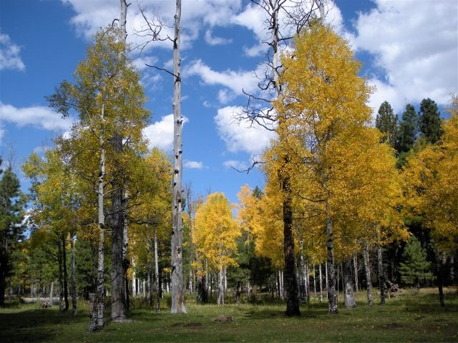
Forest Service Invasive Species Strategy
Prevention of introductions
Early detection and rapid response
Control and management
Rehabilitation and restoration
17
Notes:
I could go on. There are literally hundreds of invasive diseases, plants, and animals in the United States, and their impacts are varied and severe. The question is: What are we doing about it?
Since 2004, the Forest Service has been implementing an invasive species strategy with four components: prevention; early detection and response; control and management; and restoration and rehabilitation.

Slide 18
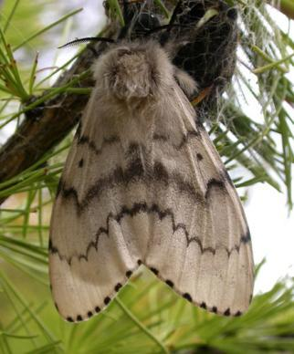

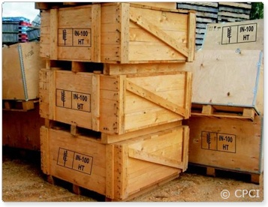
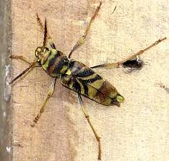
Prevention
Offshore collaboration
Information sharing
Pest studies/risk assessments
Pathway research/mitigation
(ExFor)
18
Notes:
Prevention is key. If we can prevent new species introductions, then we don’t have to throw resources into control and management. The Forest Service works with other countries to identify potential invasive species before they arrive. Together with APHIS, for example, we are monitoring for gypsy moth on ships and in ports in Japan, Korea, and Russia before ships sail to our shores. We maintain a Website called ExFor for sharing information about threats; and, once a pest arrives, we contribute our expertise to pest risk assessments and new pest advisory groups.
The Forest Service has a Technology Enterprise Team that maps potential pest distributions and predicts likely invasion points and produces a National Risk Map for insects and diseases. Our two Threat Assessment Centers are studying the spread of invasive species and how it might be influenced by climate change as well as by fire and other disturbances.
We also research ways of mitigating pathways of forest pests, such as those in wood packaging materials. For example, our scientists proved that small bits of bark on packaging materials pose very little risk. We were able to build this criterion into the international standard for wood packaging materials, saving millions of dollars in unnecessary treatment costs.

Slide 19
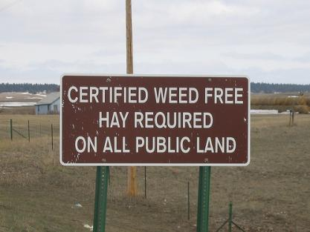
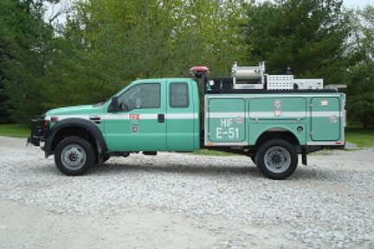
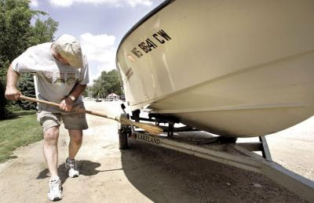
Prevention
On the National Forest System:
  Weed-free materials
  Vehicle-washing stations
  Boat-cleaning facilities
  Water treatment for firefighting
  Special contracting requirements for timber, firewood, etc.
19
Notes:
On the national forests and grasslands, we have taken a number of steps to prevent the spread of invasive species. For example:
We require the use of certified weed-free forage, mulch, and other materials.
We have washing stations for vehicles and equipment to prevent the spread of Port-Orford-cedar root disease and other invasive species.
We have boat inspection and cleaning facilities at boat launches to keep recreational users from spreading aquatic invasive species.
We are treating water used for firefighting to prevent the accidental spread of aquatic invasives to new watersheds.
We also have requirements for preventing the spread of invasives in our contracts and permits for timber sales, firewood cutting, and other activities.

Slide 20

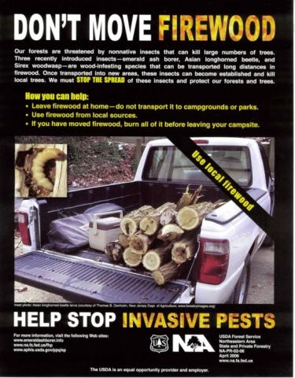
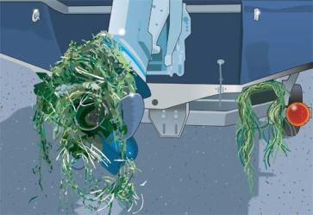
Prevention Challenges
Knowledge barriers
Multiple vectors
  Recreational vehicles
  Firewood
  Nurseries
  Pet shops
  …
Only 7% of the world’s fungi are known to science. We don’t have a good baseline for what is already in the United States.
20
Notes:
We do face major challenges, such as our lack of knowledge about pest biology. For example, only 7 percent of the world’s fungi are known to science, so we don’t really have a good baseline for what is already here in the United States and what we should be trying to keep out. Even for known pests, it is hard to predict their behavior once they become established here.
And then there are all the complexities associated with climate change, not to mention with human behavior. Invasive species move on recreational equipment, through firewood, and through nurseries and pet shops. How do we help manage that?
One way might be through firewood restrictions at campgrounds on the national forests. We are considering a national policy for that. Already, our local land managers are getting out information on the risk of spreading invasive pests like emerald ash borer through firewood.

Slide 21


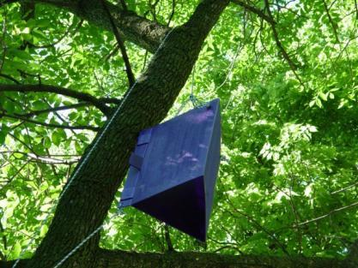
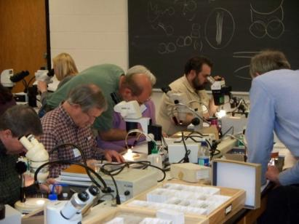
Early Detection/Rapid Response
Installing traps at likely points of entry
Developing control measures
Studying life cycles
National Forest System:
  Surveying for invasives
  Prioritizing management activities
EAB trap to detect spread
Entomologists train managers to recognize invasive insects
21
Notes:
Sometimes, however, prevention doesn’t work. Sometimes, despite our best efforts, a nonnative species reaches our shores or escapes into the wild. The second component of our invasive species strategy is to detect a threat early on and to respond rapidly, while eradication is still possible.
Since 2001, we have been working with APHIS to find new beetles, mainly by installing and monitoring traps where they are likely to first show up. We find about one new species every year. Then we develop trapping technology and control measures, and we learn all we can about the beetle’s biology and ecology so we can pinpoint weaknesses in its life cycle.
We are also working with partners to find new ways of detecting invasives on the national forests and grasslands. We will be making a thorough survey of the National Forest System to detect and inventory all invasive species so we can prioritize management activities and increase program efficiency. Quantifying infestations in these highly complex ecosystems will require close collaboration between our scientists and land managers.

Slide 22
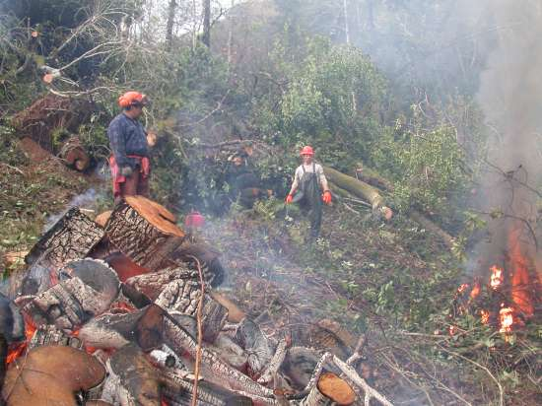
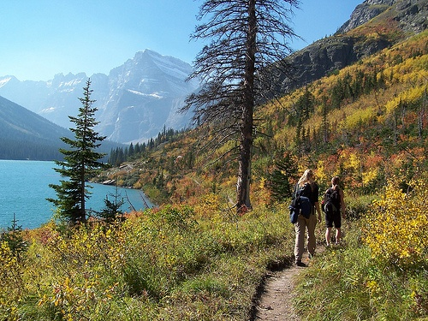
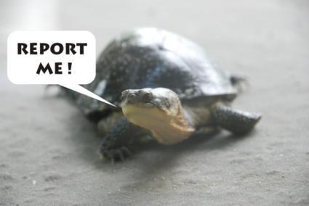
EDRR Challenges
Environmental analysis
Difficulty of detection
Citizen engagement!!
Treatments for sudden oak death in Oregon
22
Notes:
Environmental analysis can prevent rapid response, so we need to be proactive about getting it in place. For example, when sudden oak death was discovered in sensitive habitats in Oregon, the pest specialists had already worked with the wildlife specialists. We were able to quickly respond with burning and vegetation treatments, even in salmon and marbled murrelet habitat.
Another challenge is the time it can take to find new species. It can be 10 years before an infestation is noticed, and by the time effective countermeasures are developed it might be too late for eradication. For example, detecting emerald ash borer and Asian longhorned beetle initially involved a labor-intensive search for exit holes on trees; and it can be extremely difficult to detect the early life stages of invasive mussels in pumps and other aquatic equipment.
Citizen monitoring is key. The public is sometimes the first to notice something new or different in the environment. We get about 173 million visits a year on the National Forest System, and all those visitors can be a valuable resource for early detection. We are working with state and local governments and with other federal agencies to expand our capacity for early detection and rapid response. We need to broaden our communication networks and give our citizens the ability to detect and report invasive species wherever they go.

Slide 23




Control and Management
Gypsy moth:
Slow-the-
Spread
Program
1900
2007
23
Notes:
Where an invasive species has already become established, the Forest Service works with partners for control and management, which can really pay off. For example, we have kept gypsy moth out of the West for 30 years now through our gypsy moth partnership.
Gypsy moth is expanding its range from the Northeast towards the south and west. The slower it moves, the longer we can protect America’s forest resources from gypsy moth attack. Thirty years of research has developed and refined the tools we use. We now treat about 550,000 acres per year, using pheromone traps to detect new colonies, which we then suppress or eradicate. Through the Slow-the-Spread program, the Forest Service and its partners are able to reduce the rate of spread by 50 percent or more.

Slide 24


Control and Management
Emerald ash borer: Biological controls
“Hired assassins: Government agencies draft insects to combat a growing list of invasive species …”
Columbus Dispatch, 8/16/09
24
Notes:
Another example involves biological controls for emerald ash borer. Working with international partners and APHIS, Forest Service scientists identified wasps in China that parasitize emerald ash borer eggs and larvae. After evaluating the wasps, we developed mass rearing techniques for two of these biological controls. The effort is now operational, with rearing by APHIS and release of the wasps in several states. Monitoring is key.

Slide 25


Control and Management
Hemlock
Woolly
Adelgid
Initiative
25
Notes:
The Forest Service is also an active member of the Hemlock Woolly Adelgid Initiative. Under the initiative, a diverse group of scientists, land managers, and others are pooling their expertise and resources to address the hemlock woolly adelgid. The team meets regularly to coordinate its research and its public awareness program; subgroups are addressing various management needs and approaches.

Slide 26




Control and Management
Invasive plants: Biological controls
Yellow starthistle
Cheatgrass
Spotted knapweed
26
Notes:
The Forest Service itself has an active research and management program related to biological controls for invasive plants like yellow starthistle, cheatgrass, and spotted knapweed. We are addressing a broad array of invasive forest and rangeland plants, including invasive weeds in Hawaii. Our researchers are identifying potential biocontrol agents, evaluating their potential impacts on ecosystems, and working with managers to implement new technologies. For example, we recently released a flea beetle complex to control leafy spurge in sensitive riparian habitats in Idaho.

Slide 27

Control/Mgt Challenges
Unintended consequences
Limited resources
Public acceptance of control measures
We need:
  more effective measures
  better public outreach
  science-based protocols to prioritize management actions
  an all-lands approach across multiple ownerships
27
Notes:
Unintended impacts can be a challenge, and we work closely with our partners to identify and minimize them. In Montana, for example, we released gall flies to control spotted knapweed. The fly larvae became food for deer mice, and the mice in turn ate up the seeds of the native plants we were trying to protect. When we discovered this environmental chain reaction, we switched to a more integrated approach that includes grazing and herbicides.
Control and management can be tremendously expensive, and the public might be reluctant to accept the necessary control measures. We need better outreach to our citizens. We also need science-based protocols and strategies to prioritize our actions, and we need to pool our resources across multiple ownerships—to manage invasive species on a landscape scale.

Slide 28



Restoration and Rehabilitation
Collecting and storing seeds, germplasm
Identifying resistant trees
Reforesting with resistant hybrids
Whitebark pine seeds
Planting blight-resistant American chestnut on a national forest
28
28
Notes:
The Forest Service’s fourth strategic approach to invasive species involves restoration and rehabilitation. White pine blister rust is a great example. Our researchers are exploring options for managing blister rust in western white pine, such as planting rust-resistant trees. We are also developing management strategies for high-elevation five-needle pines, including collecting seed and screening for resistance and gene conservation.
The Forest Service is also working to restore other trees at risk, such as ash, hemlock, and butternut. With respect to emerald ash borer, we are identifying trees that are resistant to attack, and we are participating in a national effort to collect and conserve ash germplasm.
In addition, we are working to restore a tree that has already been lost, the American chestnut. We are helping the American Chestnut Foundation test the resistance of hybrids with plantings on the national forests and by utilizing ectomycorrhizal fungi to restore chestnut on reclaimed mine lands.

Slide 29


Restoration and Rehabilitation
Aquatic example: Native trout
29
Notes:
In the Colorado River basin, the Forest Service has been working with partners to replace nonnative brook trout with native cutthroat. As you know, invasive mussels are a huge problem in many watersheds, and we helping to implement the national Quagga–Zebra Mussel Action Plan across the United States, with special emphasis on watersheds west of the 100th meridian and on places like Lake Tahoe. We are also restoring aquatic habitats invaded by exotic amphibians on the national forests in the Southwest.

Slide 30


Restoration Challenges
Costs/scale
Climate change
Public values!!
Focus on restoring degraded landscapes …
El Yunque National Forest
African tulip tree colonizing oldfield
30
30
Notes:
But we can’t restore every native species. Genetic improvement programs are costly and require a long-term commitment, and climate change has created whole new levels of uncertainty and risk. We now focus on restoring degraded landscapes so that they can continue to provide all the benefits that Americans want and need.
For example, the African tulip tree is an invasive species in Puerto Rico, but it can help transition old sugar cane fields back to forest. It isn’t very shade tolerant, so it will eventually die out as native trees take over. But using a nonnative species to restore a degraded landscape is controversial. One of our greatest challenges has to do with the public values that influence how we manage natural resources.

Slide 31


Overarching Challenges
Need for partnerships
and collaboration!!
Flathead basin:
Multiple ownerships
Checkerboard patterns
International boundary
Issues: Aquatic invasive species, blister rust,
bark beetle, wildfire, TES, etc.
Montana
31
31
Notes:
We often face multiple interacting invasive species in complex landscapes under multiple ownerships. The Flathead basin in the Northern Rockies is a great example, with multiple major ownerships on both sides of the border, all with very different missions and goals. The Flathead basin also has very diverse landscapes, plus challenges ranging from aquatic invasive species in the valley to whitebark pine decline up in the wilderness areas.
Like climate change or wildland fire—or like bark beetles in the Rocky Mountains today—invasive species know no borders or boundaries. We have to work together to fight them, taking an all-lands approach. It can be quite challenging to get agreement on priorities and treatments that will be effective at the landscape scale.
But America has untapped resources of knowledge, energy, and ideas to help meet the forestry challenges of the future, including invasive species. If people continue to work in traditional ways—cut off from each other on this piece of private land, that piece of public land—America will never fully tap those resources. But if people come together to collaborate across landscapes, then we can build on our mutual capacities. Synergies are key to the future of conservation.

Slide 32

Forest Service Challenges
Better integration across the landscape
  Region to Region
  Station to Station
Forest Service Regions
(most are served by a different research station)
32
Notes:
Within the Forest Service, we need better integration from Region to Region and Station to Station. This would help us to learn from each other’s successes and mistakes. It would also keep us from duplicating each other’s efforts.

Slide 33




Forest Service Challenges
Stronger partnerships with other agencies and organizations
33
Notes:
We already have strong partnerships with APHIS, the State Foresters, the state departments of agriculture, and many universities. But we need to work even more closely together … and with other agencies and organizations, such as ARS, NIFA, the Department of the Interior, Tribes, and NGOs. By building on our various authorities and funding sources, we can accomplish much more, much faster.

Slide 34



Forest Service Challenges
Better integration across disciplines
  Biologists working with economists and managers to develop new tools
  Social scientists developing better communication tools
34
Notes:
We need better integration across disciplines, especially biologists working with economists, managers, and communication specialists. We need social scientists who can help us find more effective ways to reach target audiences, raise public awareness, and change public behaviors.
Finally, we need more effective communication techniques. We need to use new tools like social media. We need an enhanced Web presence and carefully crafted messages that inspire the public to help us prevent, detect, and control invasive species and restore degraded landscapes.

Slide 35

Stronger partnerships …
… for the benefit of generations to come.
35
Notes:
In closing, I ask you to think about how we can build stronger relationships. For those of you who already work with the Forest Service, thank you for all you do. We cannot succeed without you. The Forest Service is ready to strengthen our partnerships. We are ready to work with everyone, across ownerships, to restore degraded landscapes … for the benefit of generations to come.

